Slide 1

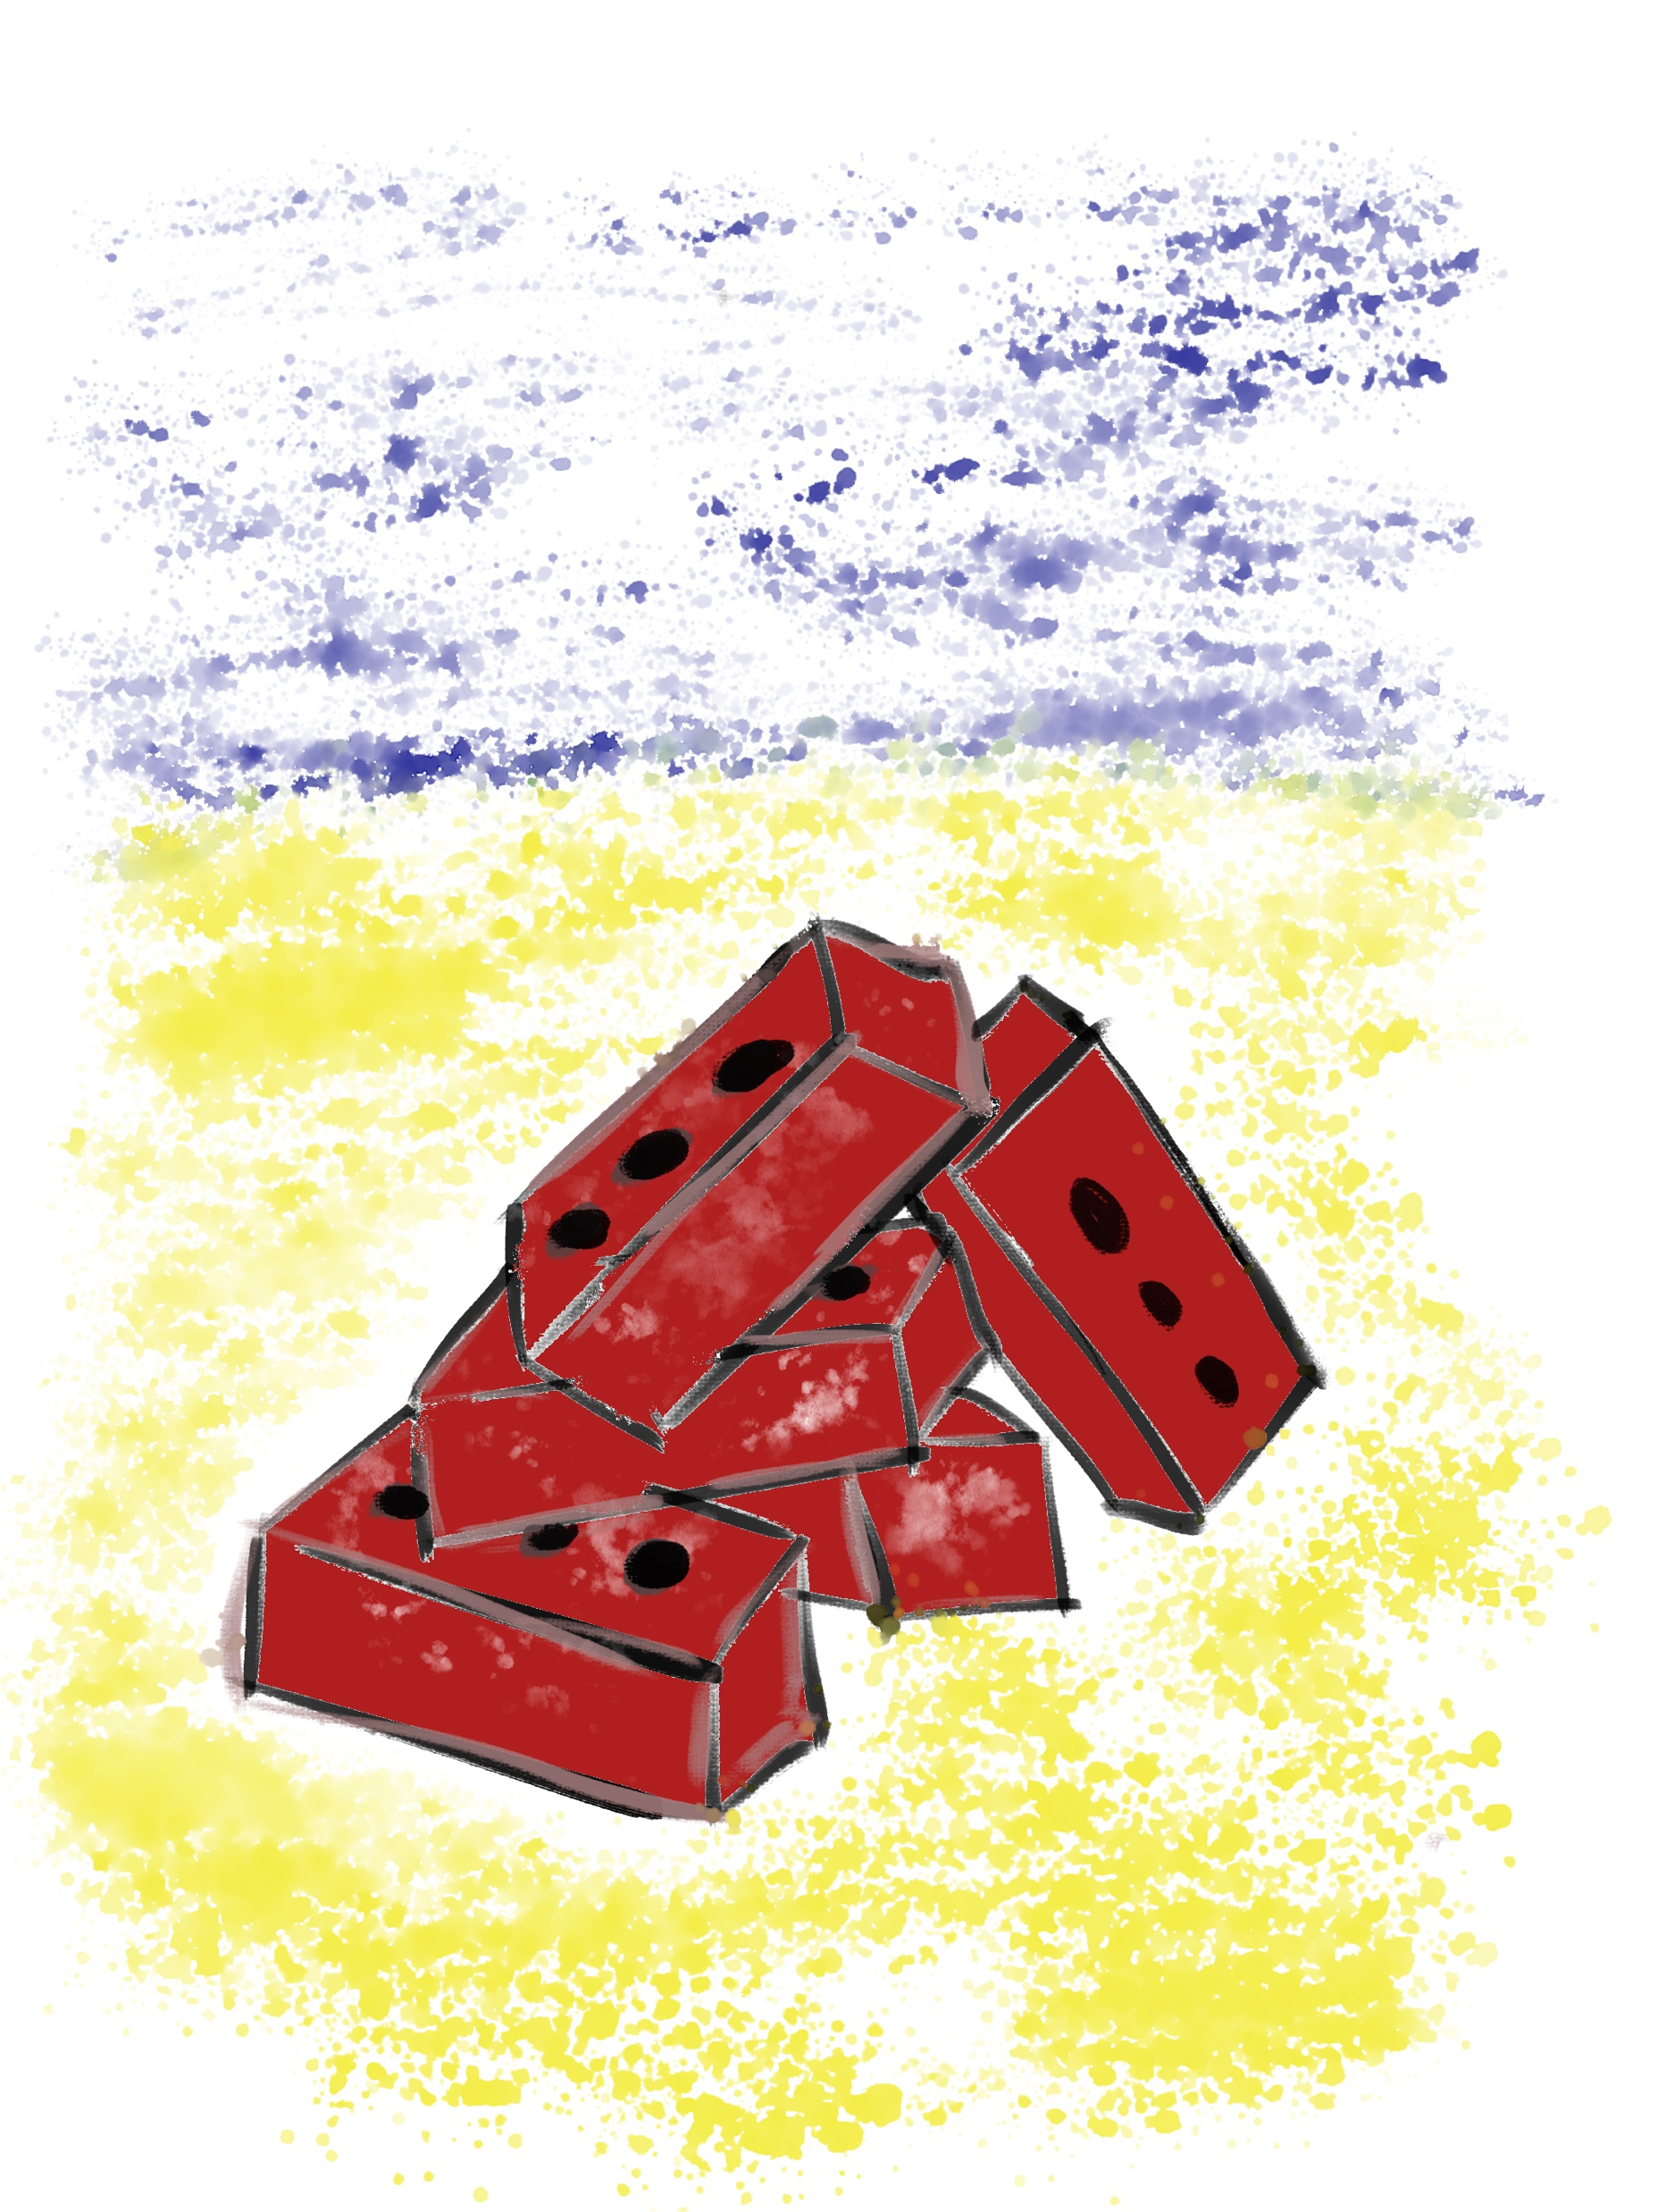

Systems Thinking for Teacher Leaders
Building Teacher Leadership
One Brick at a Time
Dr. Lisa Lande
www.quagliainstitute.org
#HenryATL2023
@Lisa_Lande

Slide 2
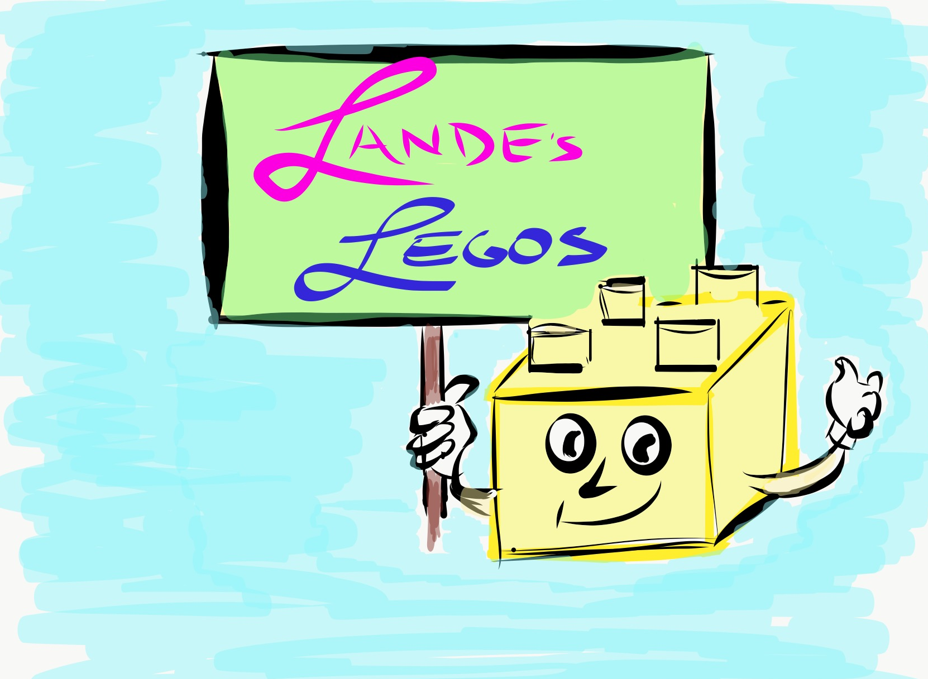
Opening Team Challenge

Slide 3
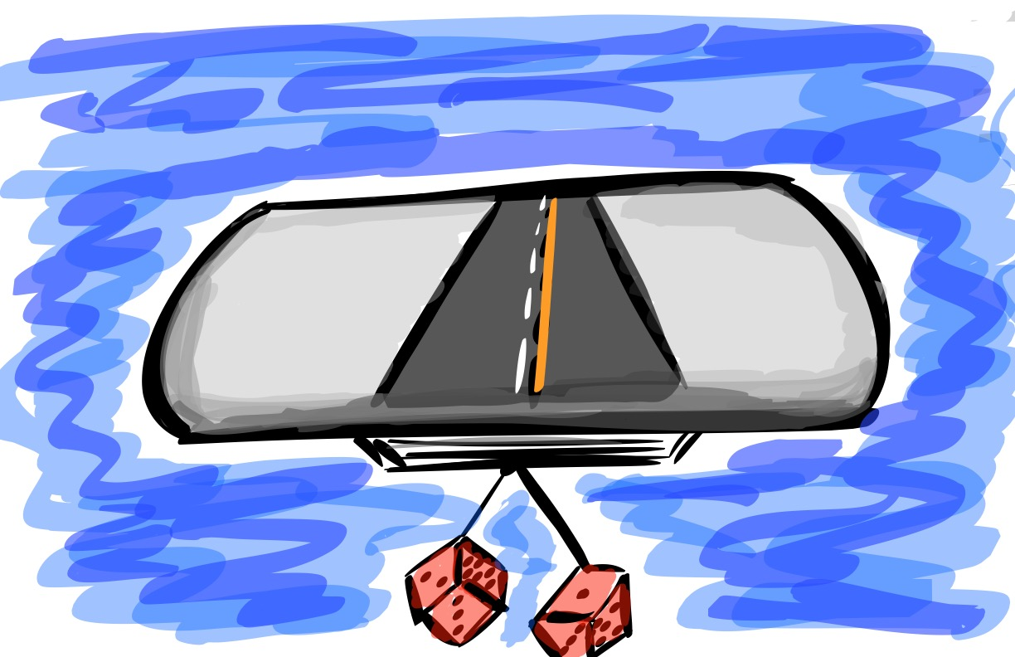
A Quick Review

Slide 4

The 3 Components of Teacher Voice
Sharing thoughts & ideas in an environment underpinned by trust & respect.
Offering realistic suggestions for the
good of the whole.
Accepting responsibility for not only what is said but also what needs to be done.

Slide 5
ASPIRATIONS
The ability to
dream and set goals
for the future,
while being inspired
in the present
to reach those dreams.

Slide 6




high
Imagination
Aspirations
DREAMING
Hibernation
Perspiration
low
DOING
high

Slide 7
LEAD
TAKE ACTION
with others
Share
RESPONSIBILITY
LEARN
UNDERSTAND
& RESPECT
different points
of view
Build
TRUST
LISTEN
SEEK OUT
opinions from
others
School Voice Process

Slide 8








3 Guiding Principles
& 8 Conditions
Self-Worth
Engagement
Purpose

Slide 9
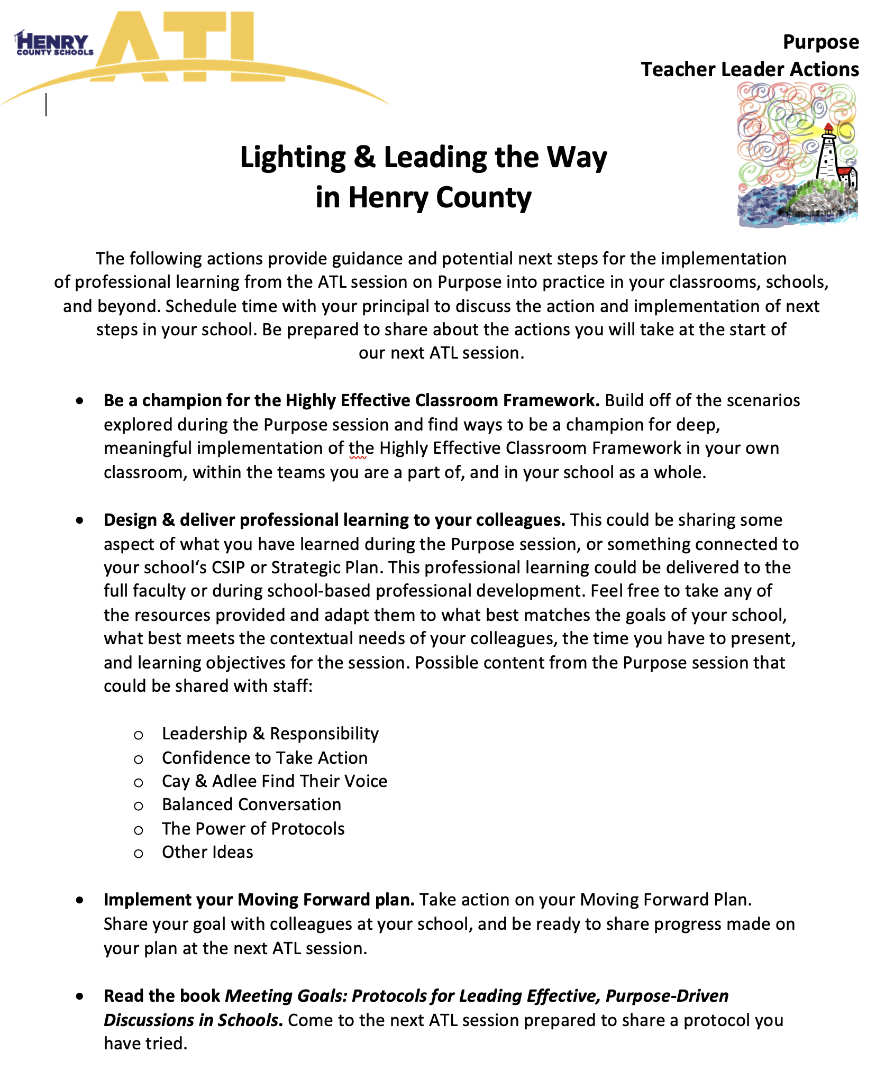
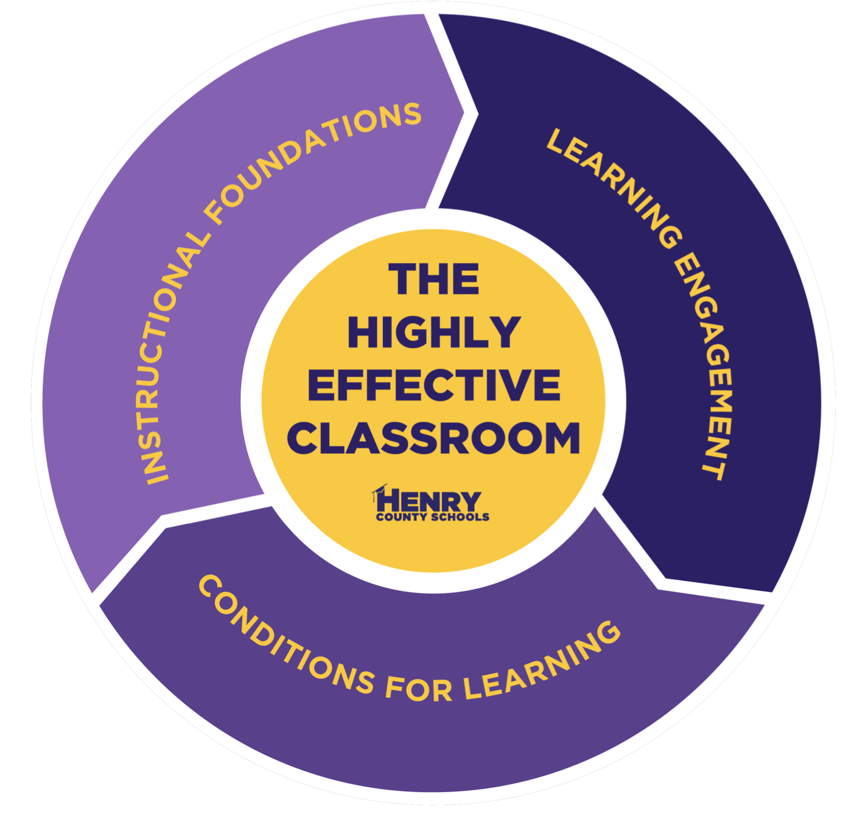

Homework
Check

Slide 10
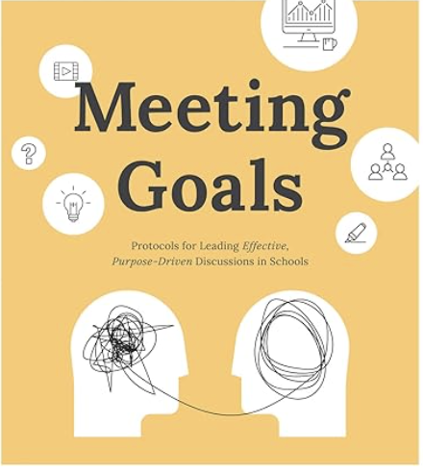
Success Analysis
Meeting Goals p. 56-58
Number off at your table group.
Person 1 shares a Teacher Leader action “story of success” since our last session. Give as
much detail as possible while the other group members take notes.
Group members ask clarifying questions
(quickly asked & quickly answered) to fill in gaps & provide feedback. Person 1 shares
reflections on feedback & ideas for next steps.
Repeat the process for other group members.

Slide 11
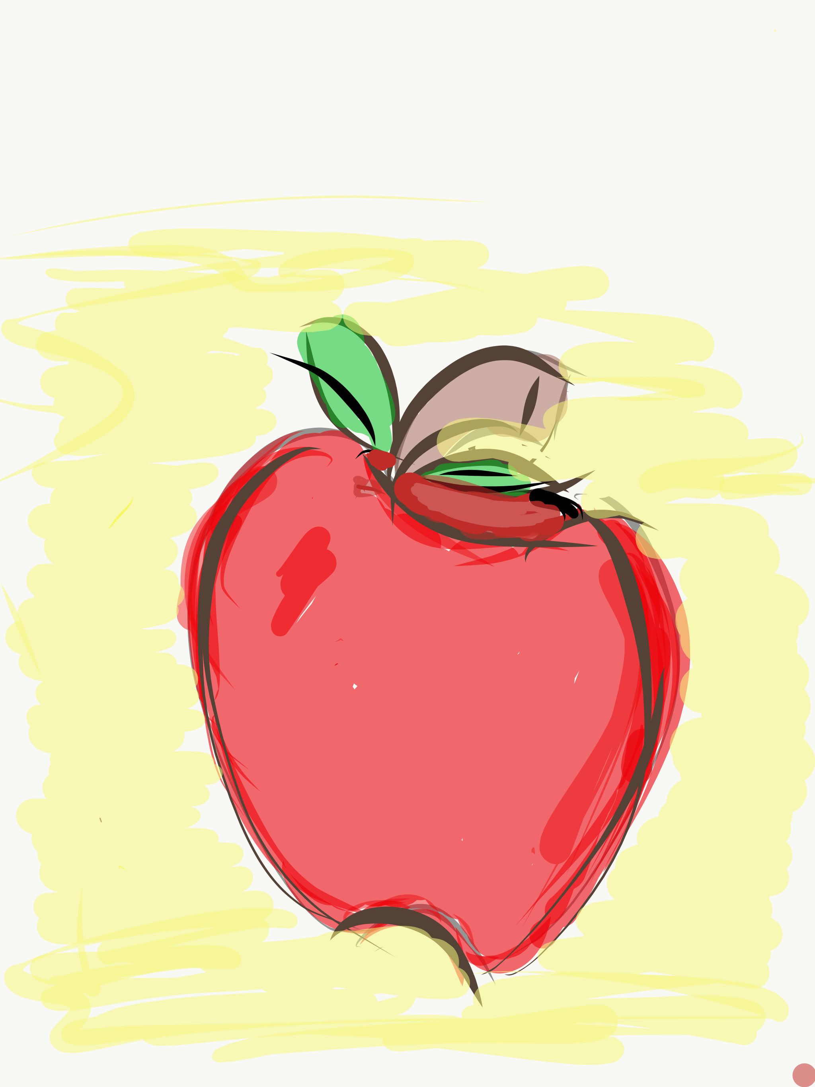
Essential Questions
What is Systems Thinking?
What are key characteristics of Systems Thinkers?
How can Systems Thinking benefit schools?
How does the concept of Unintended Consequences impact Systems Thinking?
How does the Ladder of Inference relate to Systems Thinking?
What Mental Models need to be examined as we move towards Systems Thinking?
How can the Iceberg Model support Teacher Leaders to take action with a Systems Thinking mindset.
How is Systems Thinking connected to the Highly Effective Classroom Framework?

Slide 12
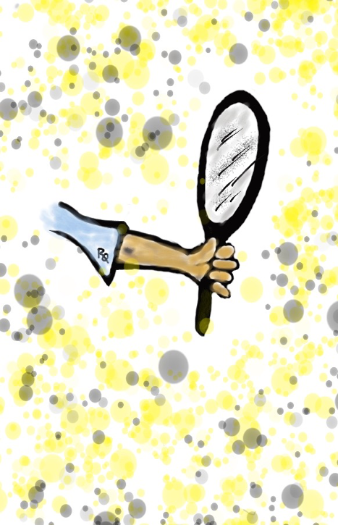
Systems Thinking
Teacher Reflection
Individually, complete the rank order section of the self-assessment.
Discuss the 3 reflection questions.
Resource 1

Slide 13

Challenge Time…

Slide 14
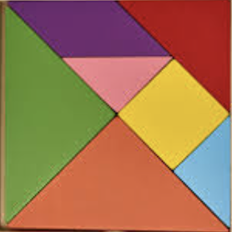
Square Pieces
Goal: Each team member is to form a square (flat on the table or ground) with the pieces of paper.
Process:
-Form a group of 5, make a
circle & distribute 3 pieces
to each person.
-A participant wanting to
exchange a piece can place it in the center of the circle.
-A piece placed in the center
may be take by another
participant in exchange for
one of their pieces.
Rules:
-No Talking
-No folding the pieces
-No overlapping pieces
-All pieces must be used (each square is 3 pieces)
-Exchange 1 piece
at a time

Slide 15

Reflect
What made the task challenging?
What was required to solve the task?
How does this exercise reflect systems thinking in relation to schools?
Notes:
.

Slide 16
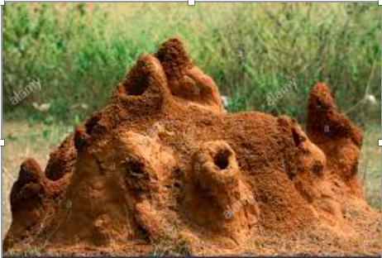



System Examples

Slide 17
Examples of School System Pieces
Teaching & Learning
Assessment
Student Leadership
Professional Development
Special Education
Counseling & Student Services
Administrative Practice & Communication
Food & Transportation Services
Parental Involvement/Community Outreach
Budget & Strategic Planning
Extra Curricular Activities
Teacher Evaluation & Goal Setting
Building Facilities & Maintenance
District Mission, Vision, & Goals

Slide 18

Quick Break!

Slide 19
Challenge Time…

Slide 20
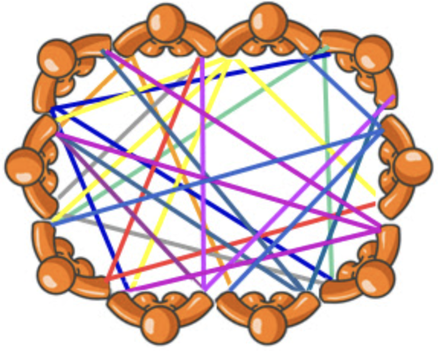
Web of Connection

Slide 21
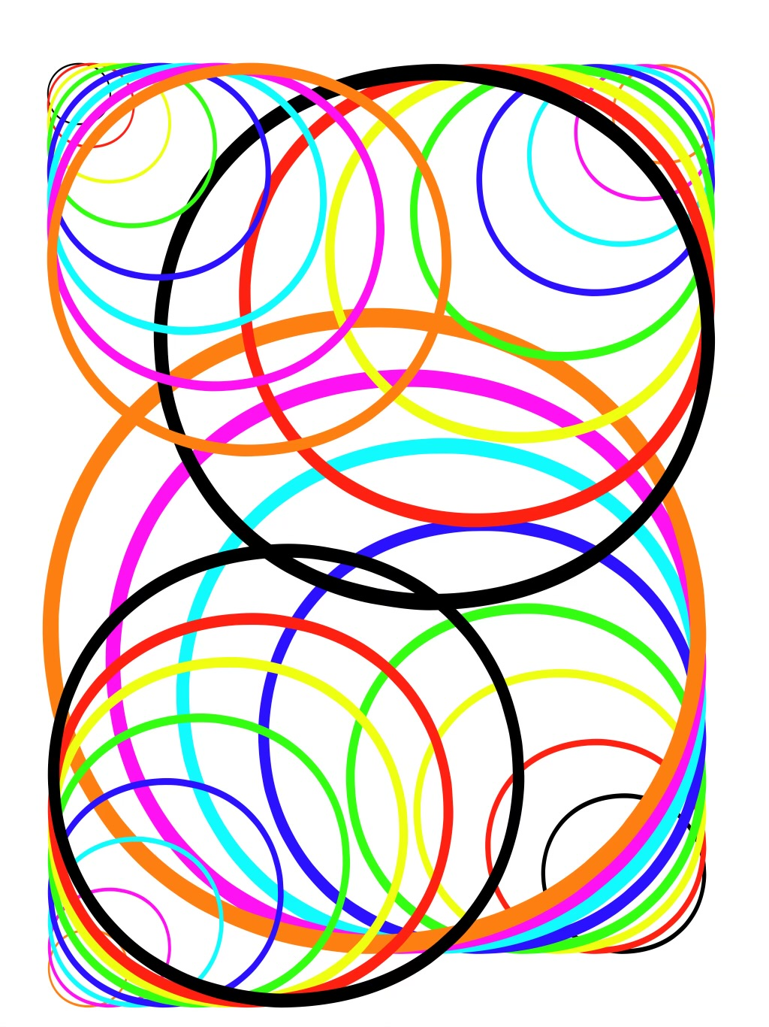
Systems Thinking
Defined
Systems thinking is a way of making sense of the complexity of the world by looking at it in terms of wholes & relationships rather
than by splitting it down into its parts.
It has been used as a way of exploring &
developing effective action in complex
contexts, enabling systems change.

Slide 23
Systems Thinking v. Traditional Thinking
Traditional Thinking focuses on
individual pieces: my classroom,
my students, & my learning.
Systems Thinking focuses on how the
individual pieces interact together:
our school, our students,
& our learning system.

Slide 24
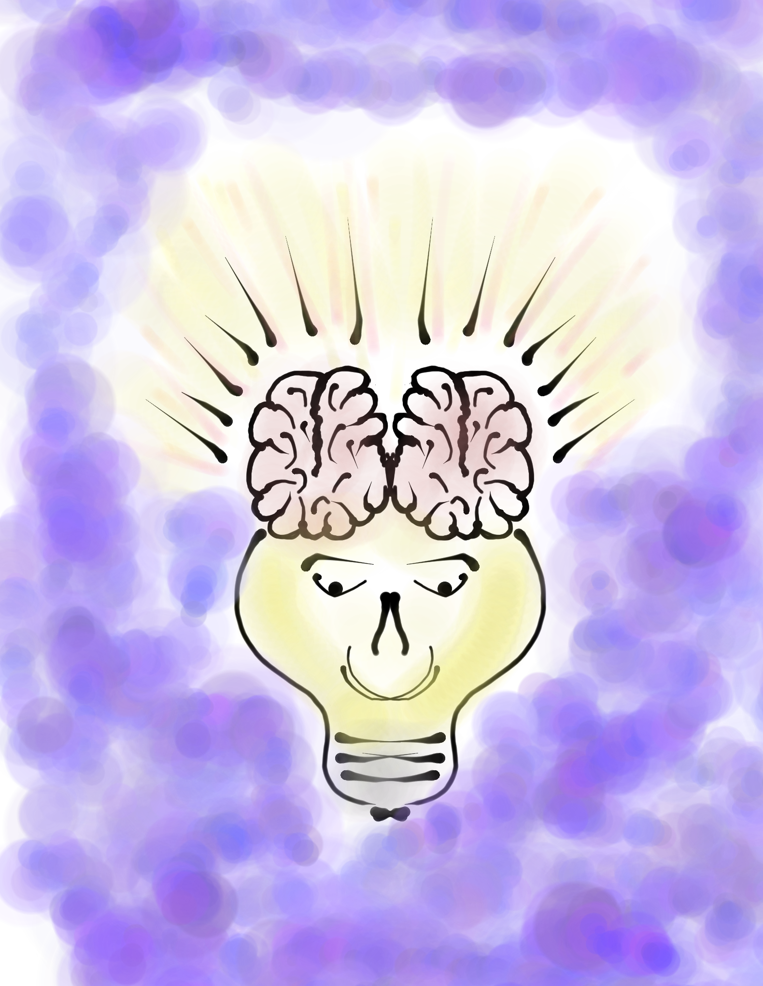
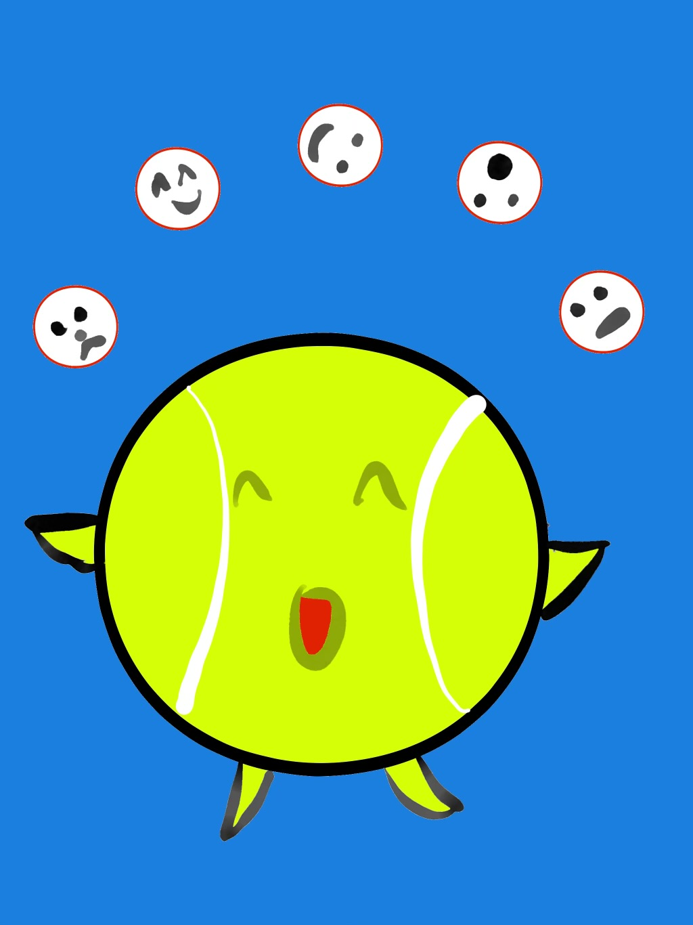
Remember the
Juggling Challenge??
Goal: As a team,
pass 3 balls through
your established order as quickly as you can.
Rules: Maintain the
same passing order &
everyone must touch
all 3 balls.

Slide 25
Juggling Lesson:
Systems Thinking
Traditional Thinking: Less & less, more & more,
faster & faster. Example: If you don’t like
meatloaf, Mom making a bigger meatloaf won’t
make you love it more!
Systems Thinking: Looks different, thinks different.
Example: Instead of less recess to increase reading scores, more movement during reading time to
improve reading scores.

Slide 26

Castro Middle Example
Traditional Thinking: Failing students will attend
Saturday School & receive additional instruction to
build fundamental skills.
Systems Thinking: Failing students will attend
Saturday School & work on missing assignments,
during which time they will build fundamental skills.
Result: Went from one teacher providing Saturday
School to an average of 8 students, to 4 teachers
providing Saturday School to 40-50 students!
Teachers report more meaningful communication &
collaboration in collectively meeting the needs of
students school-wide. Percentage of students failing 1 or more classes significantly decreases.

Slide 27
Reflect
Can you think of an example when
Traditional Thinking has been turned into Systems Thinking at your school? Share these examples & celebrate!
Share opportunities for Traditional
Thinking to be impacted by applying
Systems Thinking.
Notes:
.

Slide 28
Coffee Talk
Meeting Goals p. 37-39
“Talk amongst yourselves!”
Resource 2
Brief introduction of Text Set.
Read whatever you want from the Text Set.
Reflection Questions:
    1. What did you learn about Systems Thinking?
2. What are you wondering about?
3. What do you most want to remember?
Create groups of 3 with people not at your table & “talk amongst yourselves!”

Slide 29
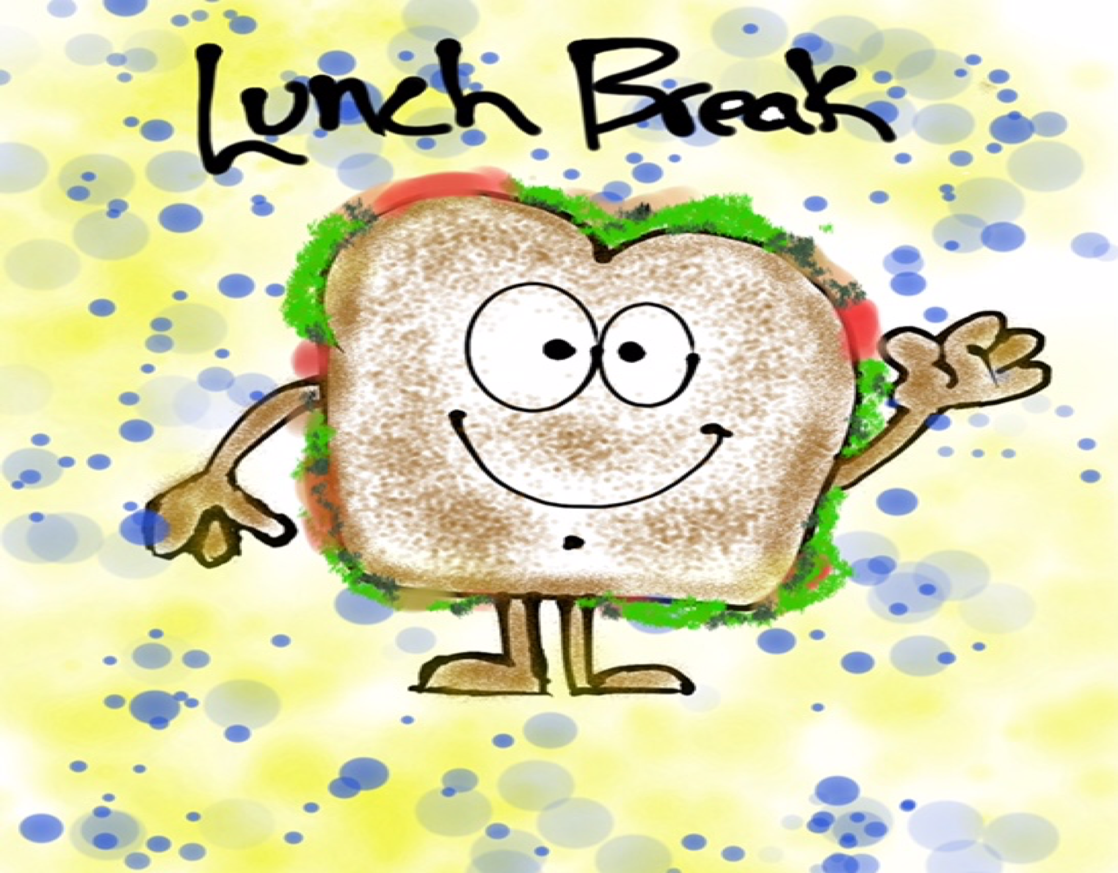
Lunch!

Slide 30
Systems Thinkers…
See the whole picture, not just individual parts. They
look for & value interdependencies.
Value collective intelligence & truly believe we are
smarter together.
Balance short & long term. When necessary, they will
choose the long term over the short term.
Continually challenge their ways of thinking. They are
prepared to be wrong & are always changing & growing.
NEED different points of view. They know that some
things can only be seen by the collective.
Proactively consider unintended consequences.
Focus on structures & solutions, not blame.

Slide 31

OR
Systems thinking is only for the business world.
Systems thinking is evident in all organizations, including schools.
People use systems thinking everyday, they just havenʻt applied a term to it.
Systems thinking is too complex to understand.

Slide 32
Reflect
Were there any of the Myth/Fact
statements that surprised you?
Which Myths do you think are the greatest barriers to Systems Thinking?
Which Facts do you think would be most
powerful in helping to grow systems
thinking in schools?
What would you add to the list?
Notes:
.

Slide 33
Challenge Time…

Slide 34
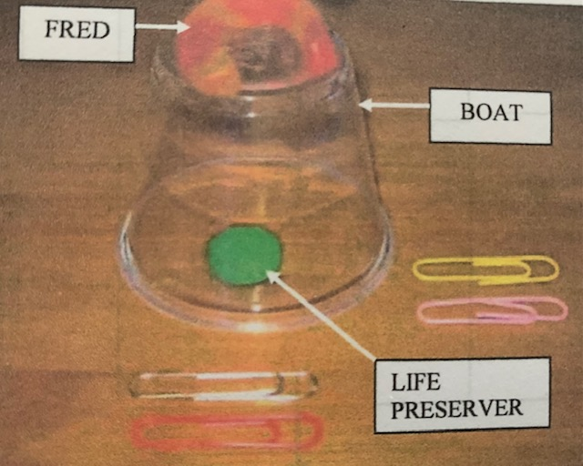
Save Fred!!
Fred, the boat, & the life preserver can be touched only with the paper clips. NO HANDS!
Save Fred & put the life preserver on him without touching the water.

Slide 35
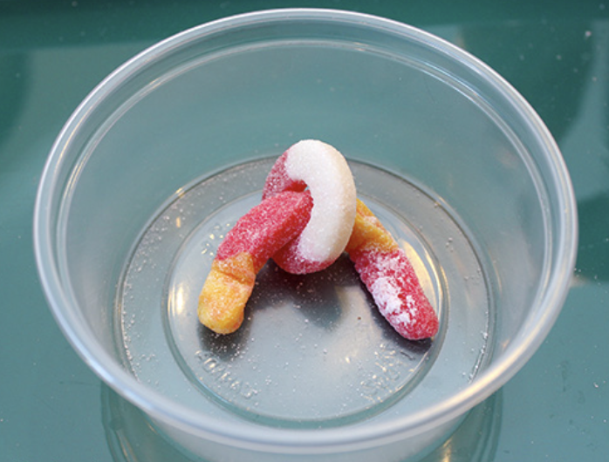
Reflect
What were some of the perceived barriers to the task?
How did you think differently to
overcome the barriers?
In your school system, how might you use resources (including people) differently
to work more efficiently & successfully?
Notes:
.

Slide 36
Cats, Mice & Systems
YouTube:
https://youtu.be/qpkpzsUxfxc
Vimeo:
https://vimeo.com/919731862/fe40b702db
Video

Slide 37
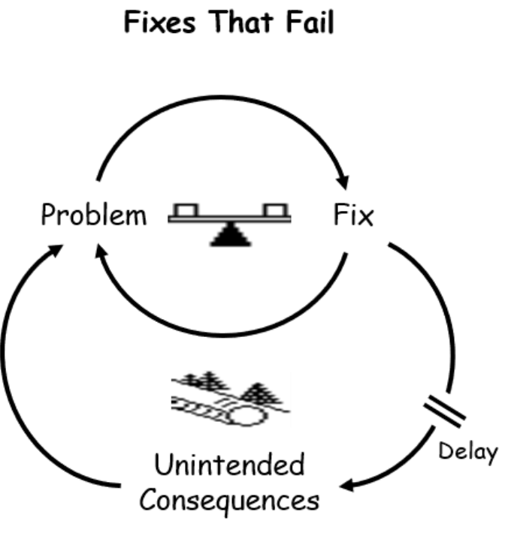

Slide 38
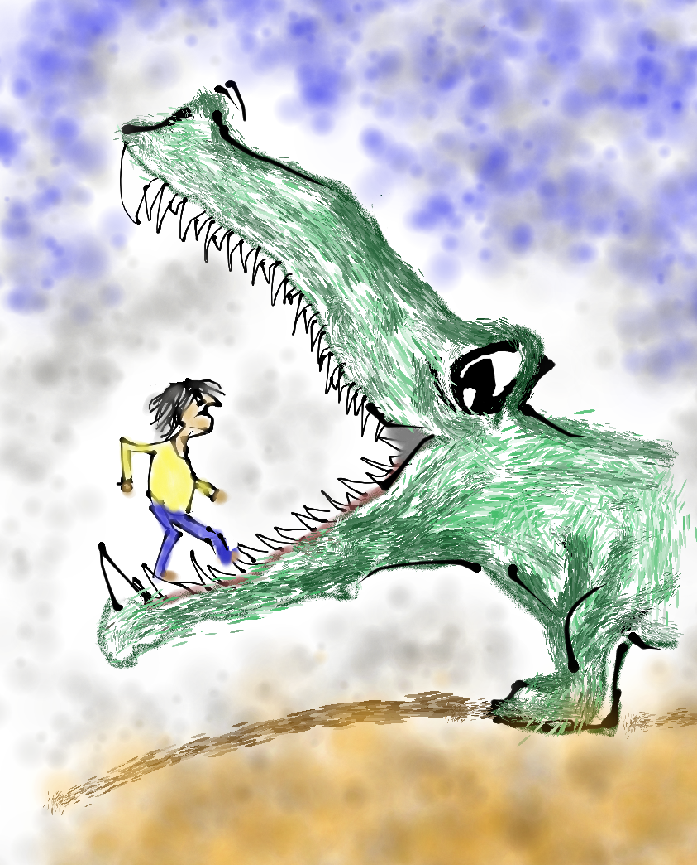
Reflect
Share a time when you experienced
unintended consequences (positive or
negative) from a professional experience?
Think of your current Teacher Leader
efforts & brainstorm possible unintended consequences.
Notes:
.

Slide 39
Challenge Time…

Slide 40
Slumber
Dream
Bed
Quiet
Nap
Pillow
Night
Blanket
Pajamas
Snooze

Slide 41
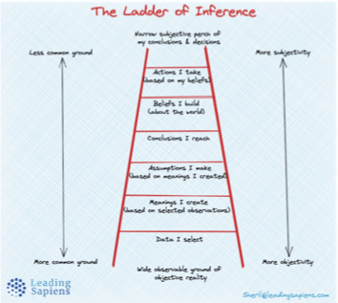
Exploring the Ladder of Inference
Resource 3
Discuss the reflection questions with your table group.

Slide 42
Challenge Time…

Slide 43
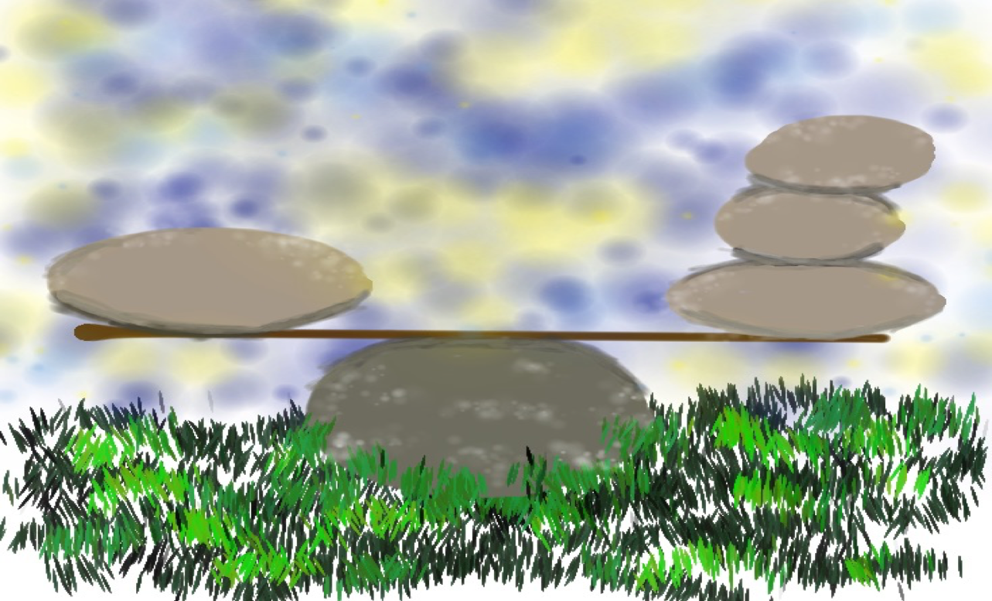
Bones & Balance
Identify 1 person to be the observer.
Use the paint stick & dog bone to make a traditional fulcrum.
Take turns placing items on your end of the paint stick. You may not touch the paint stick.
If the paint stick touches the table, the observer will count the number of items on the stick. Items that fall off do not count.

Slide 44
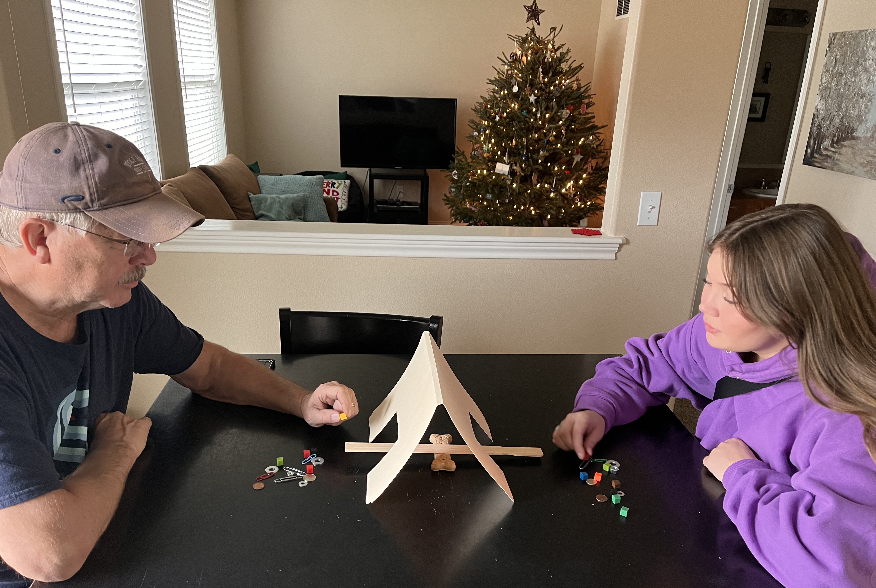
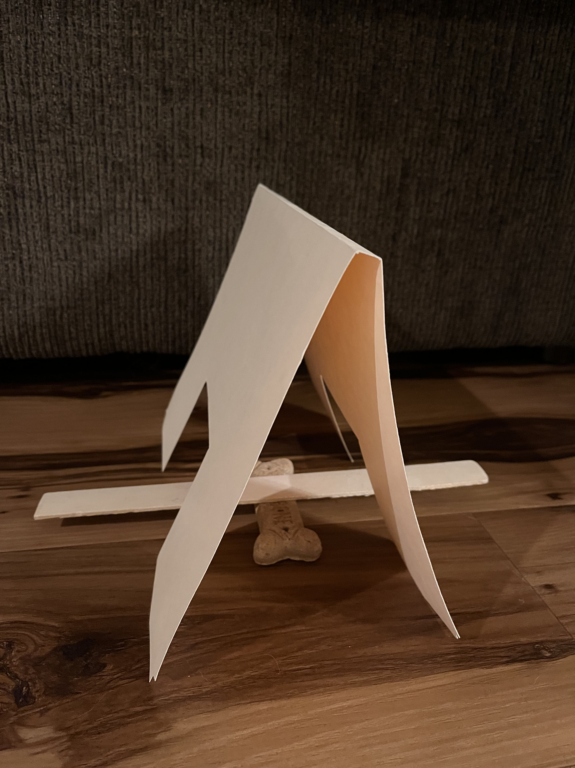
Bones & Balance
Round 2
NO LOOKING
Round 2
NO LOOKING
& NO TALKING

Slide 45
Reflect
What did it feel like to work in this balancing system?
What happened? What did you observe?
How do the workersʻ thoughts differ from the observersʻ?
What was the impact of hiding the workersʻ actions?
What lessons can you apply to your work as a Teacher
Leader in your school system? (ie transparency, shared
responsibility, communication, balance/rhythm, etc.)
Notes:
.

Slide 46
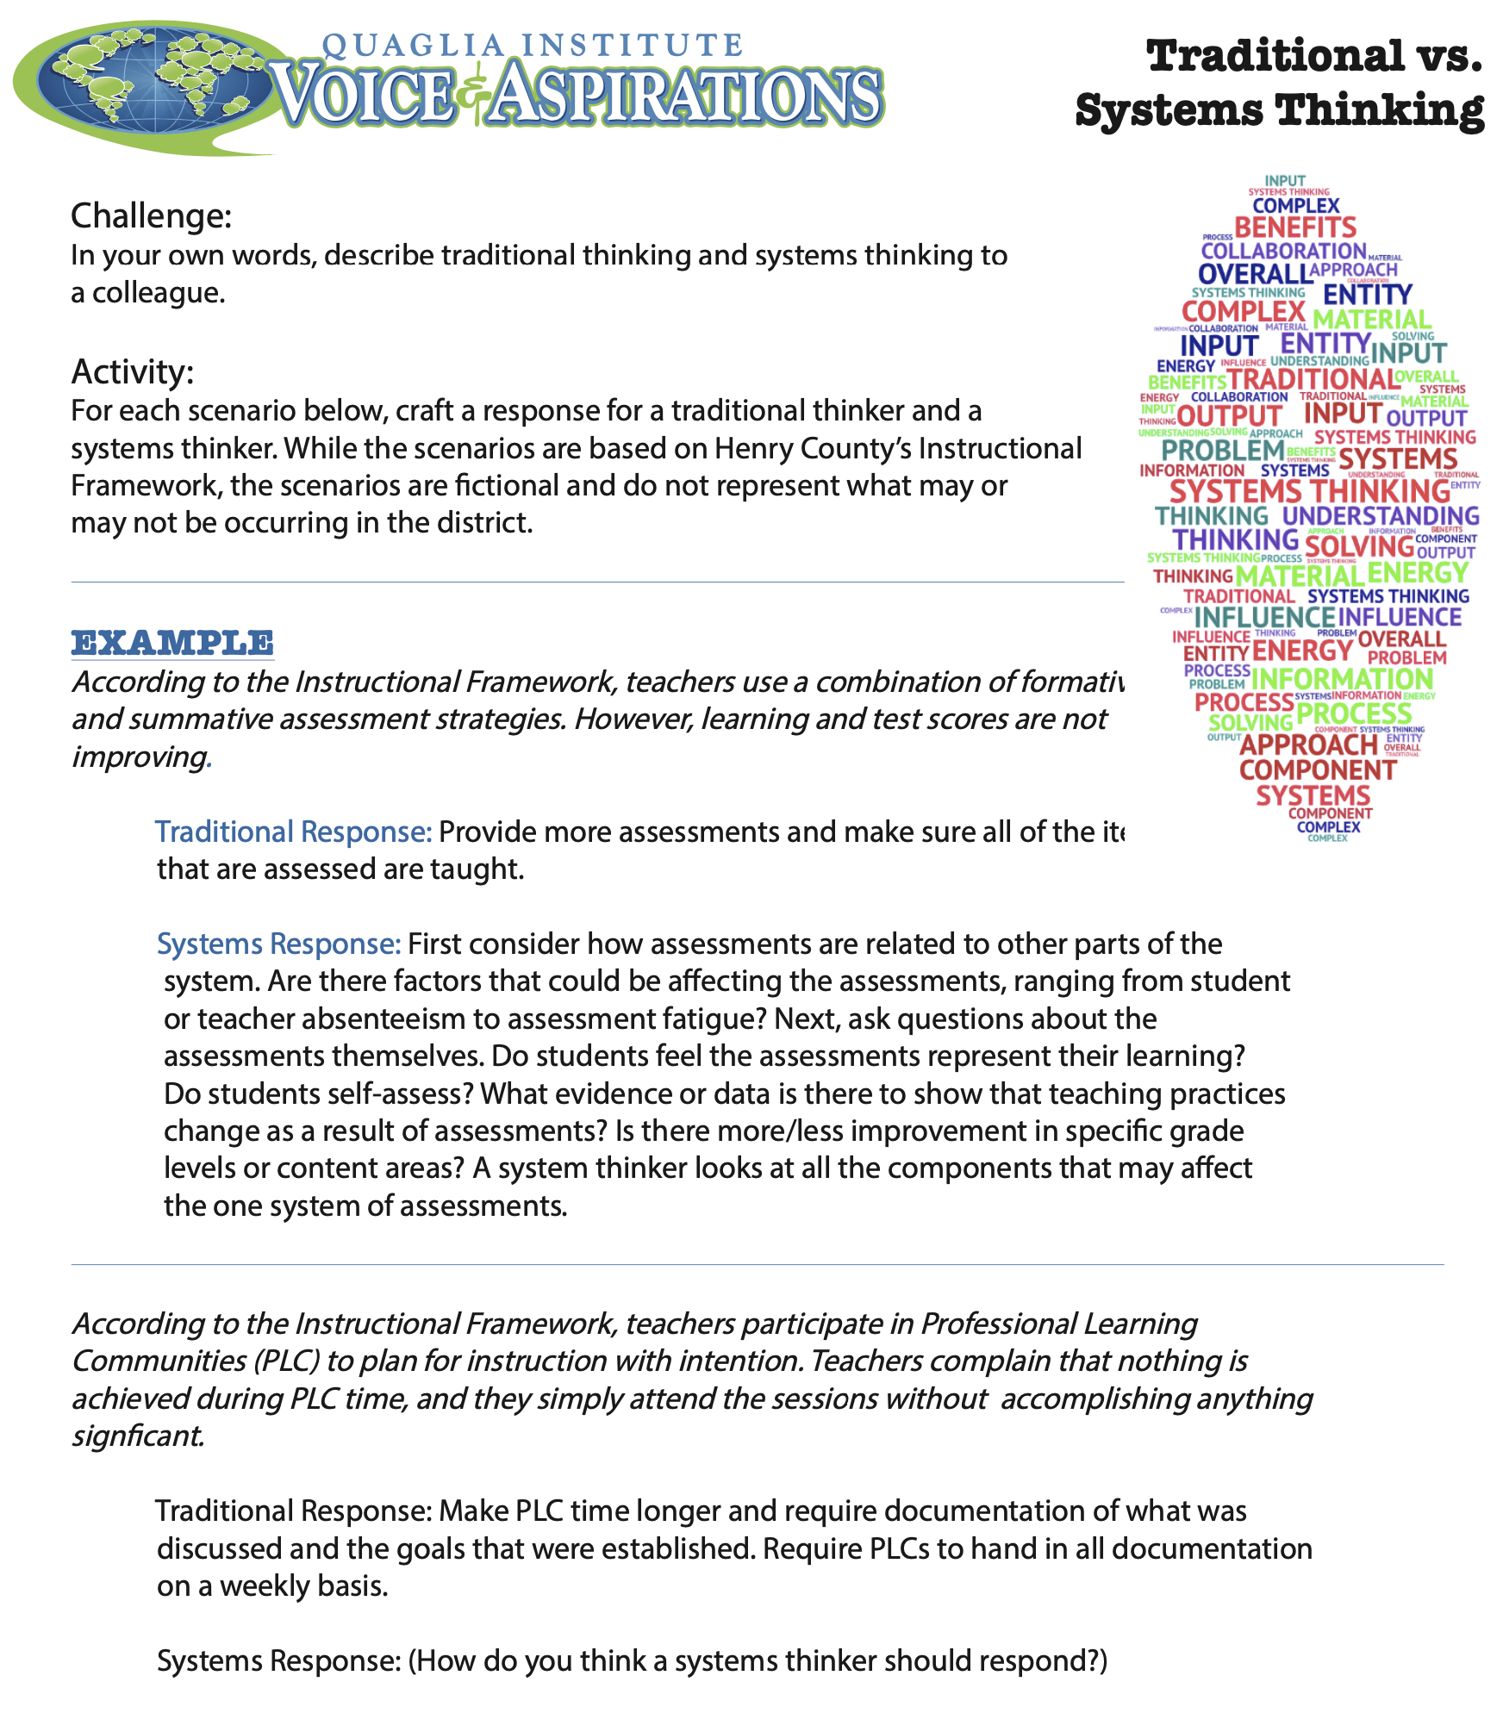
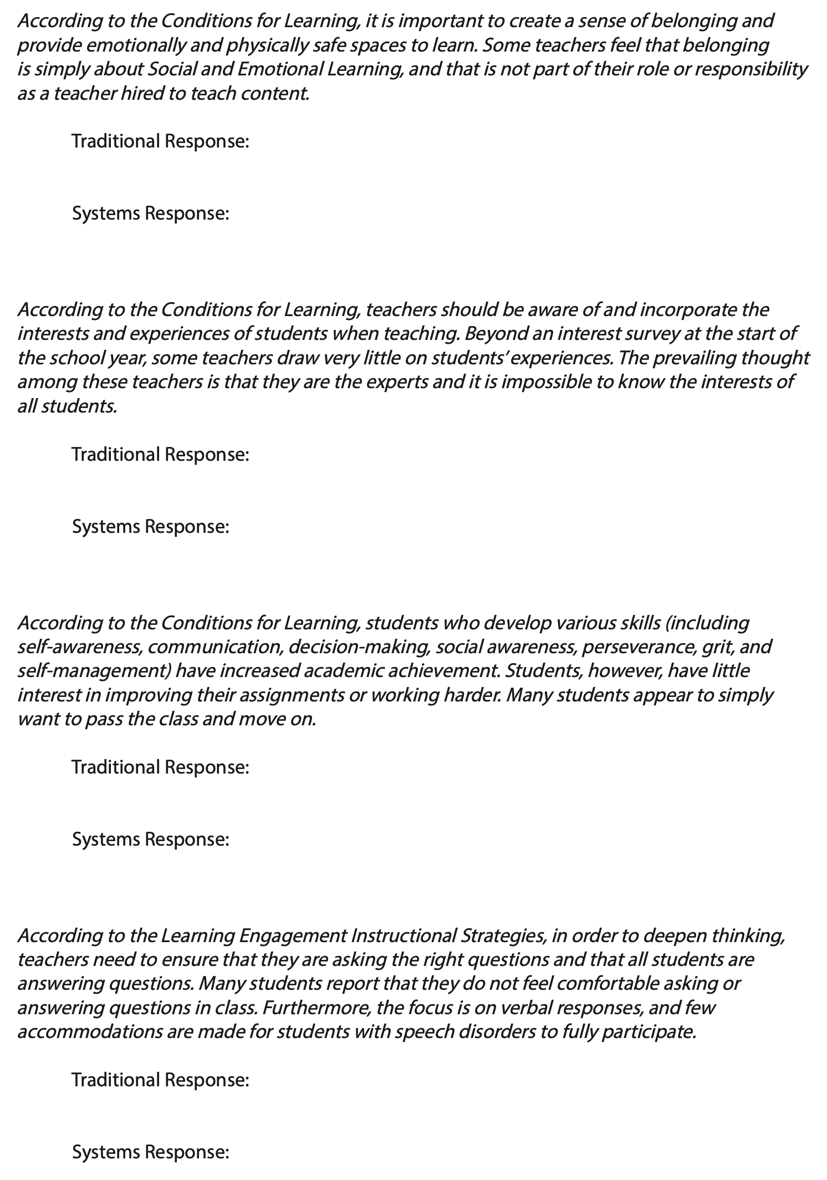
Traditional vs. Systems Thinking
Resource 4

Slide 47
Challenge Time…

Slide 48

Thumb Wrestling
Get as many wins as you can in one minute!

Slide 49
Reflect
What were your mental models about the challenge?
What are the unintended consequences of traditional
thinking about competition?
How could we transform this challenge by embracing
a mental model of interdependency?
To what situations in your school system could you
shift from a mental model of competition to
interdependency?
Notes:
.

Slide 50
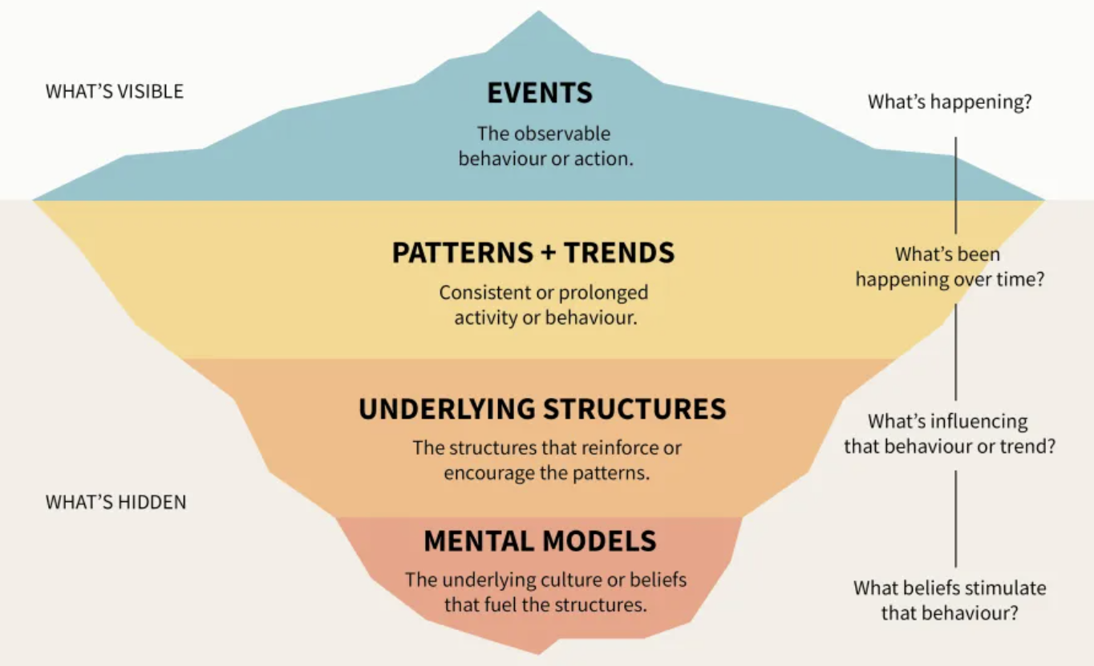
The Iceberg Model of
Systems Thinking

Slide 51
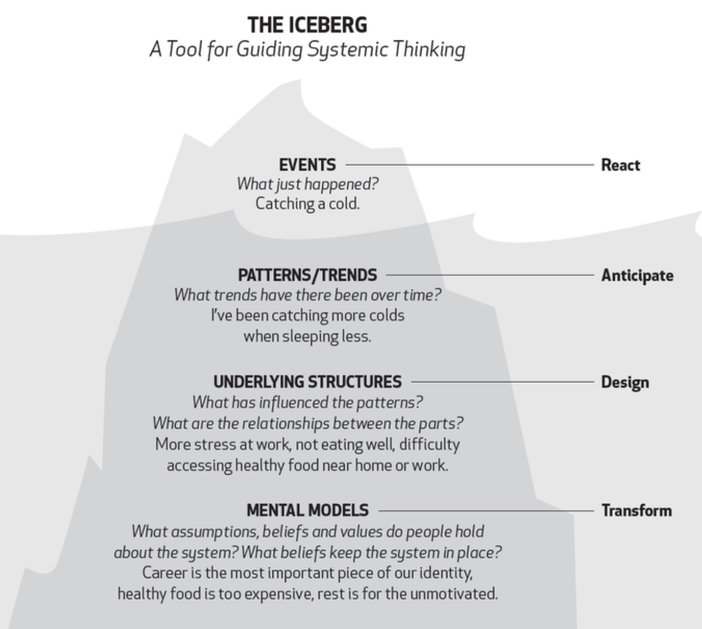

Slide 52
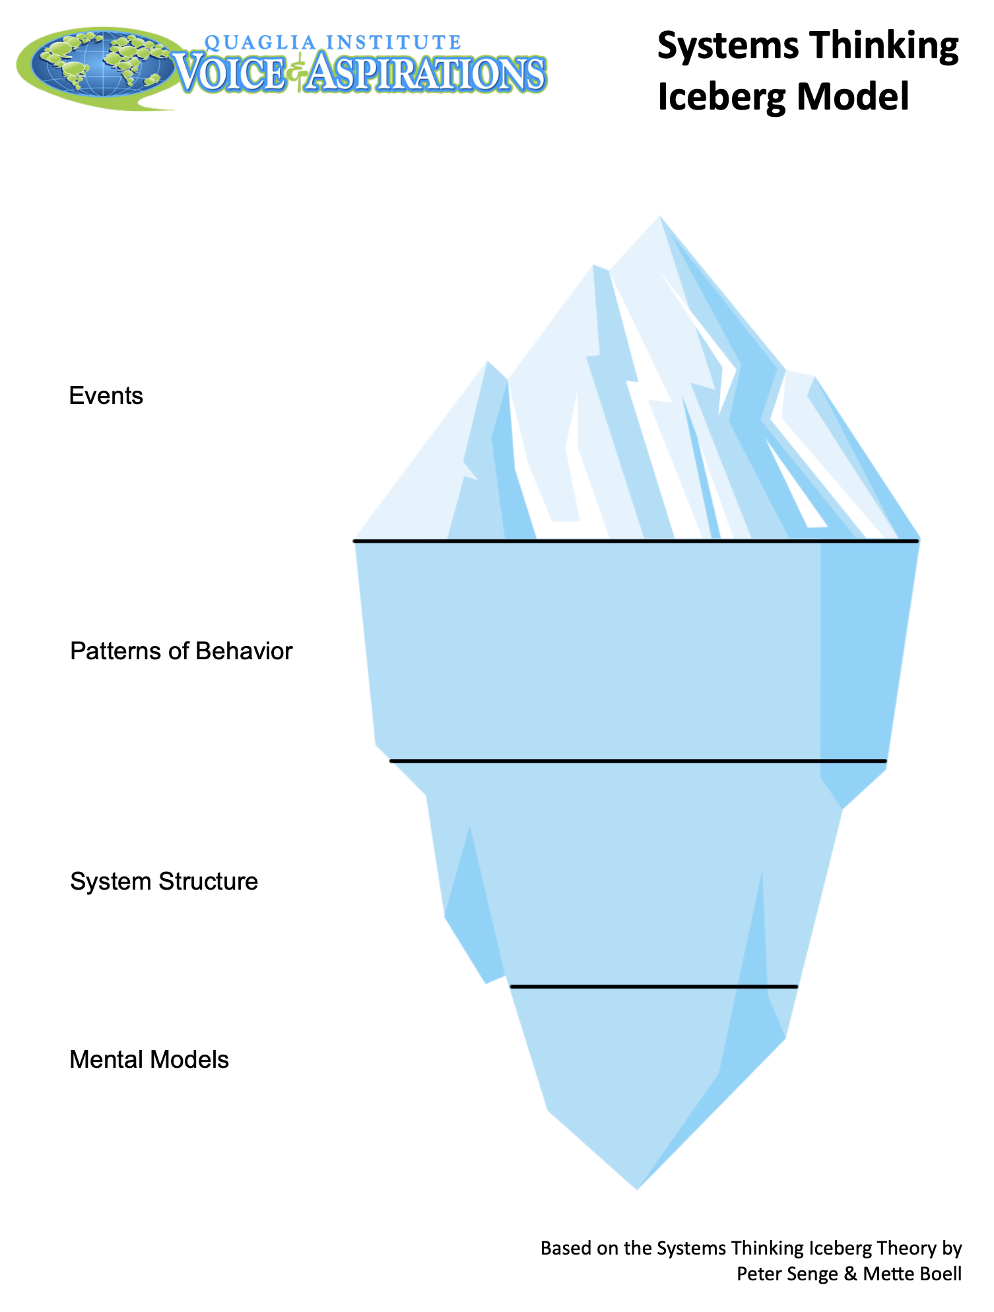
Applying The Iceberg Model
Resource 5
Fill in the Stytems Thinking Iceberg Model template with examples from your school experience.
(Go back to last slide for guiding questions & examples.)

Slide 53
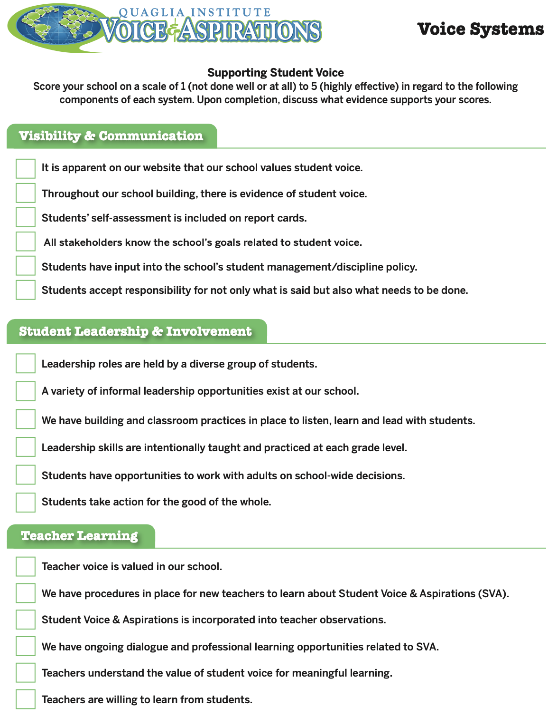
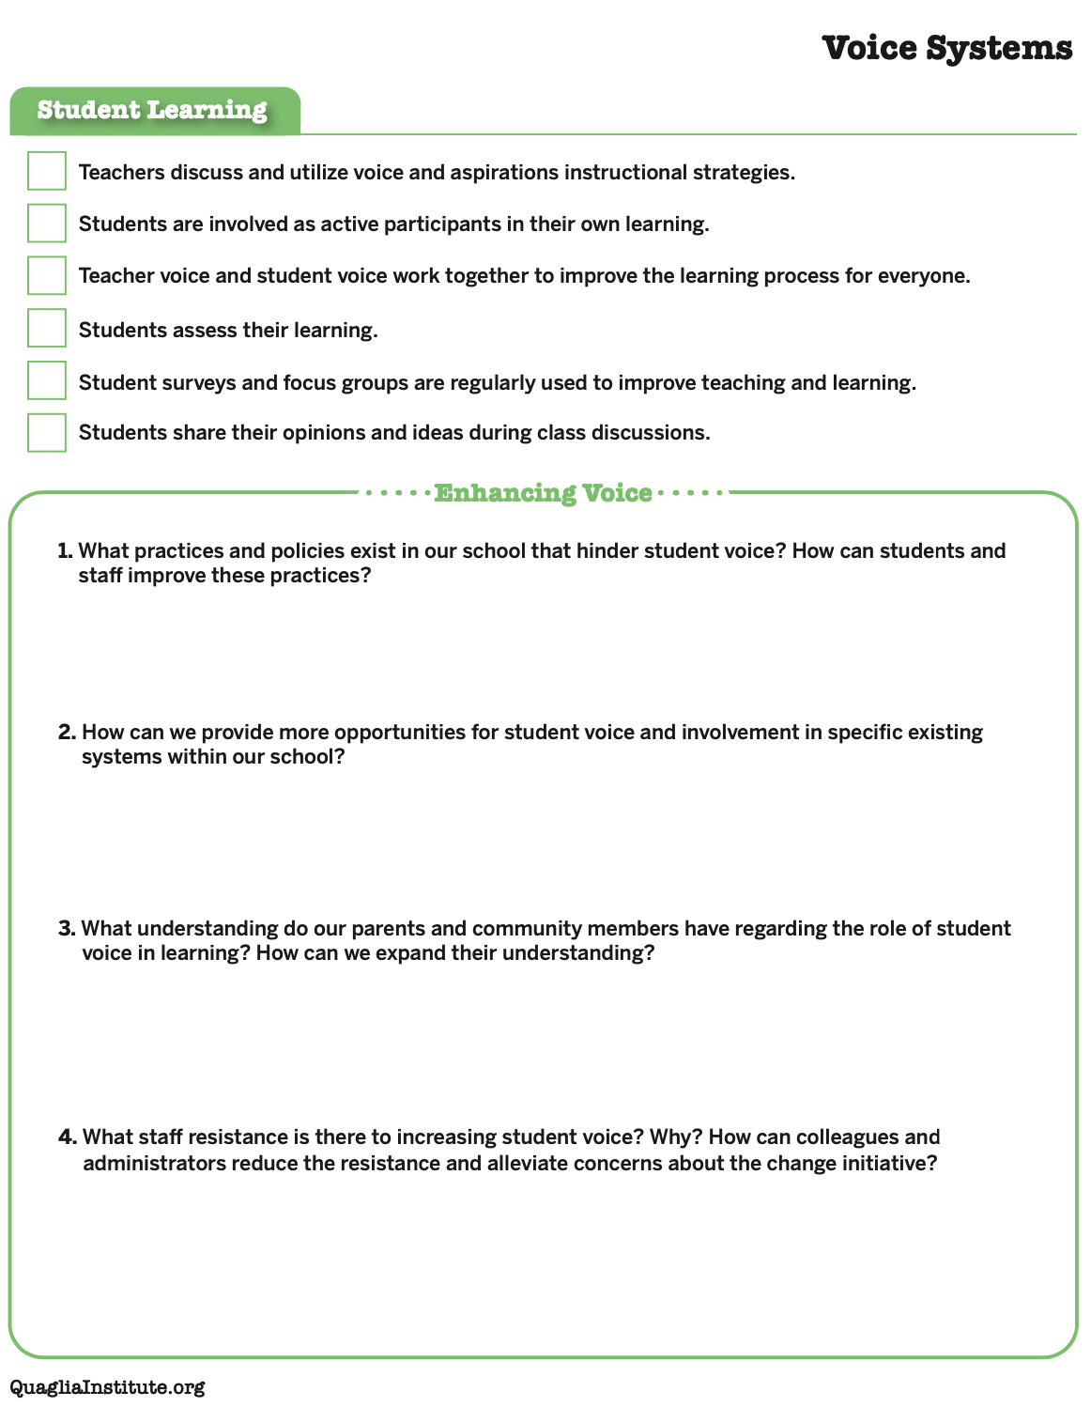
Voice Systems Self-Assessment
Resource 6

Slide 54
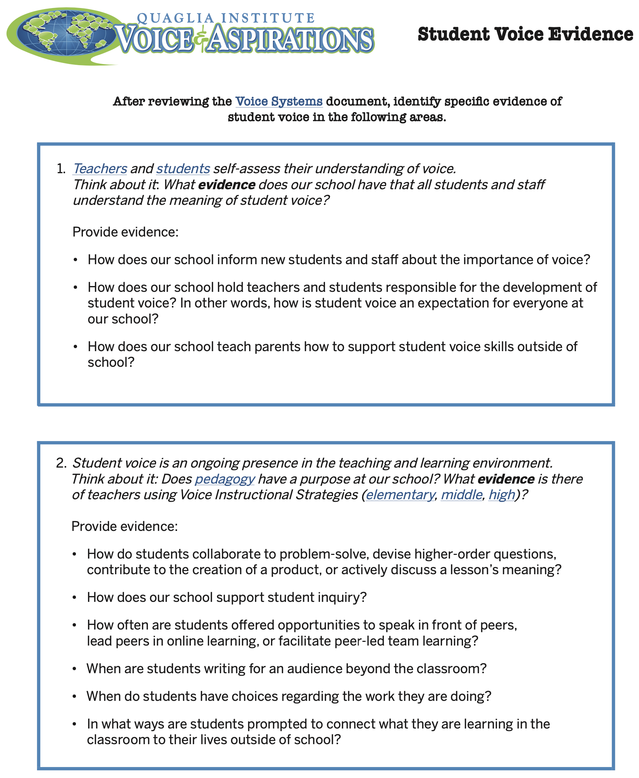
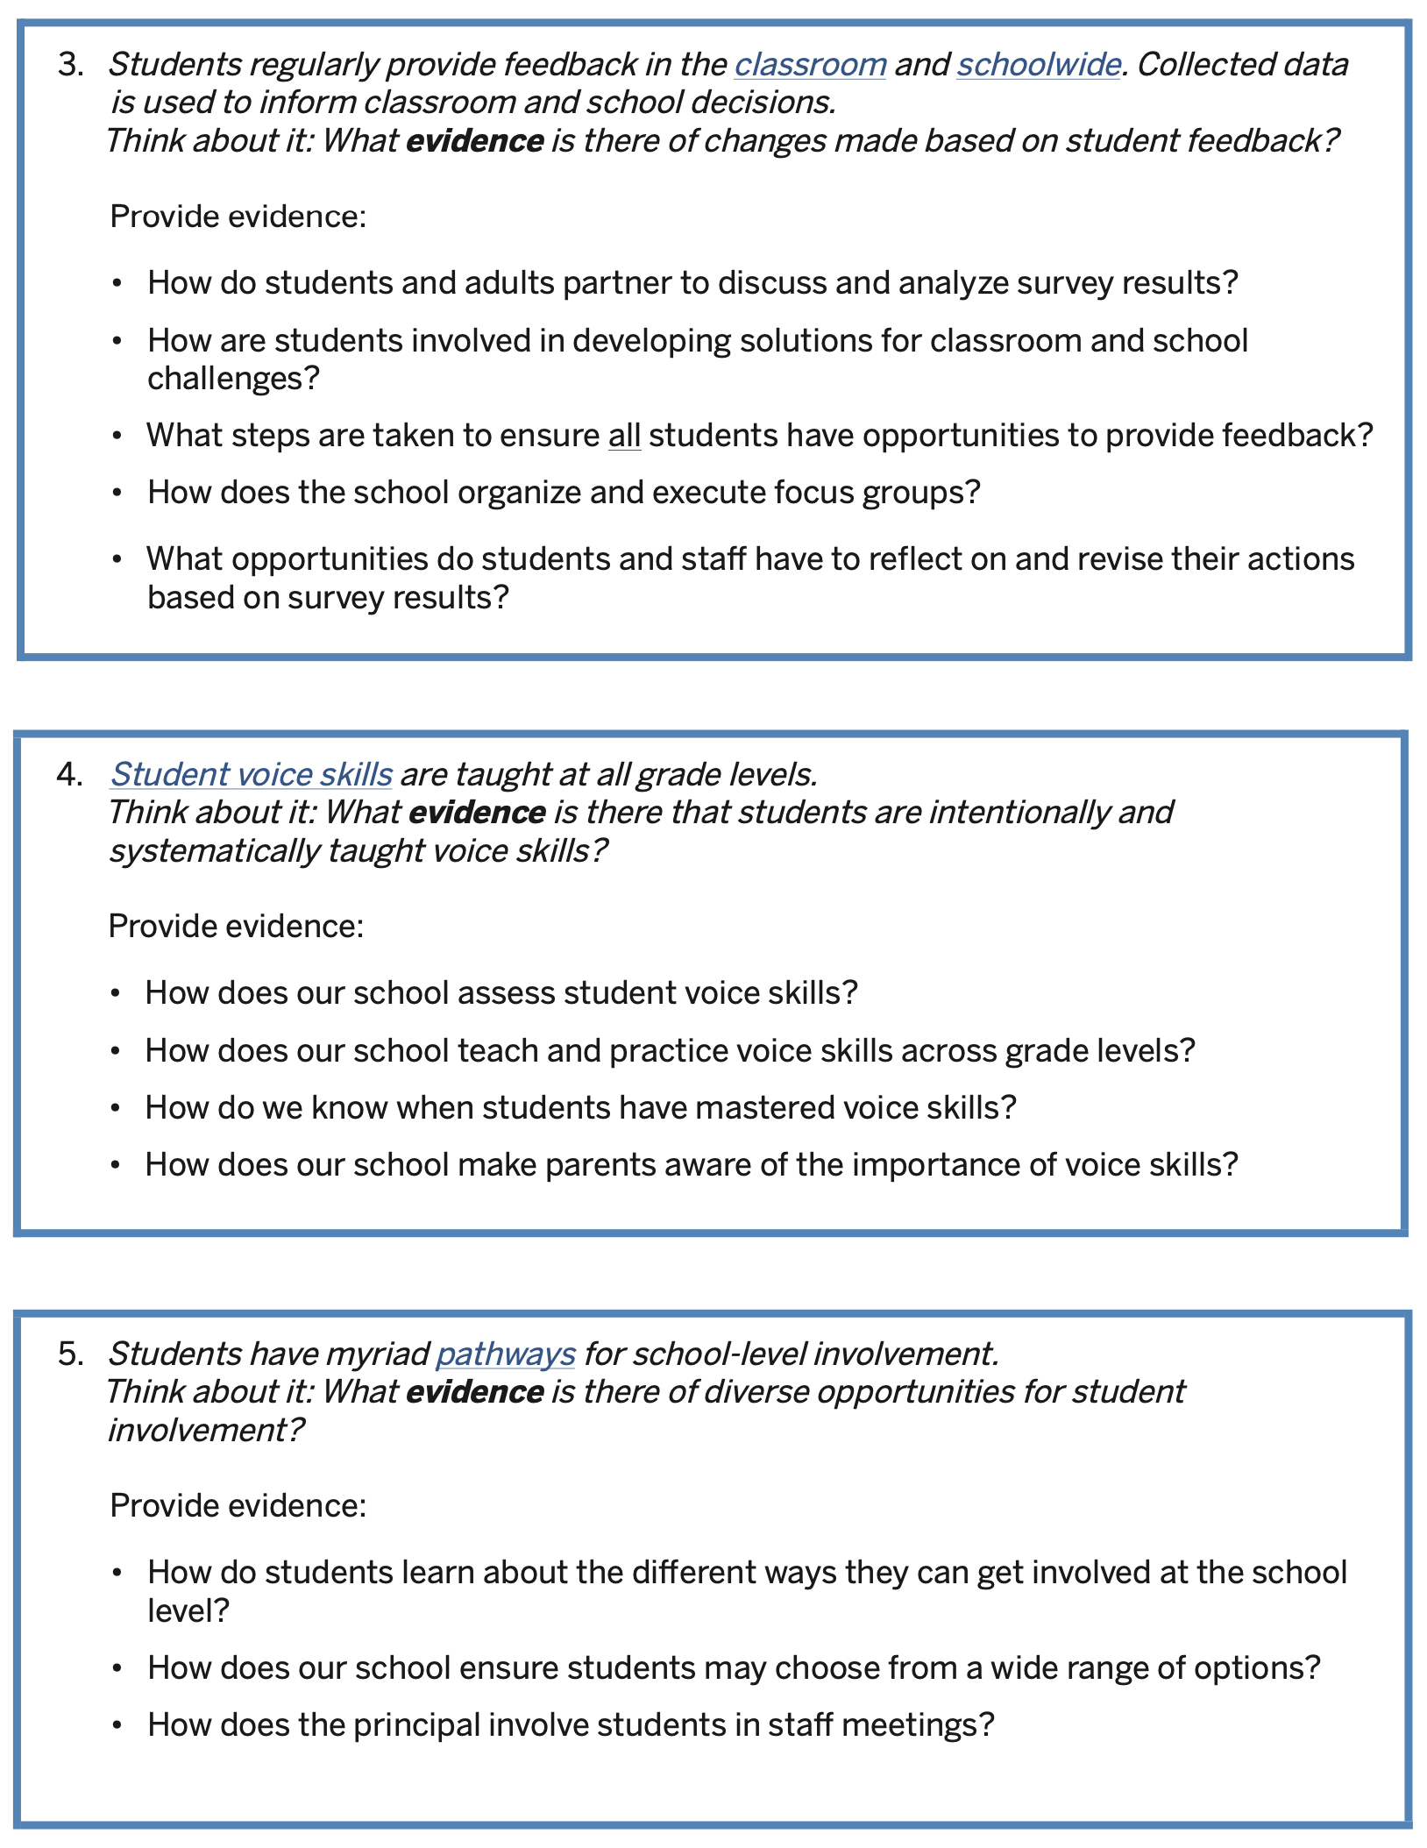
Student Voice Evidence
Resource 7

Slide 55
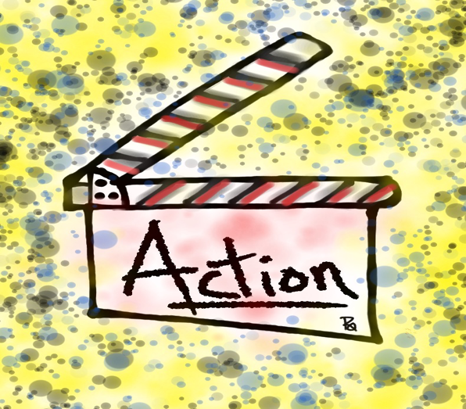
Systems Teacher Leader Actions
Resource 8
Be a champion for the Highly Effective Classroom Framework.
Design & deliver professional learning to your colleagues.
Identify how you can transform ”Traditional Thinking” to “Systems Thinking” in your current Teacher Leadership actions.
Dig into the Unstoppable Learning book & come to the next session prepared to share what you have put into practice.

Slide 56
Brick of Learning
What is a key “brick of learning” from today that has contributed to your growth as a Teacher Leader?

Slide 57
Systems Thinking for Teacher Leaders
Building Teacher Leadership
One Brick at a Time
Dr. Lisa Lande
www.quagliainstitute.org
#HenryATL2023
@Lisa_Lande

