Slide 1



Identifying My Purpose as a Teacher
Lighting & Leading the Way in Henry County
Dr. Lisa Lande
www.quagliainstitute.org
#HenryATL2023
@Lisa_Lande

Slide 2
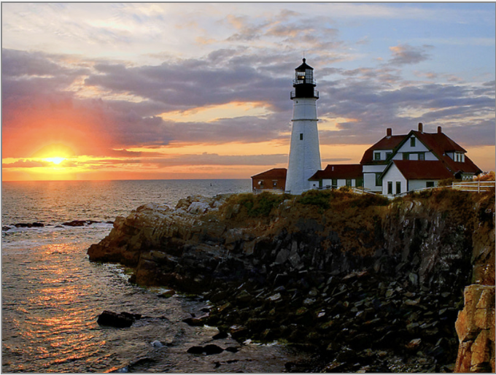
Opening Team Challenge
Lighting & Leading the Way in
Henry County Schools

Slide 3

A Quick Review

Slide 4

The 3 Components of Teacher Voice
Sharing thoughts & ideas in an environment underpinned by trust & respect.
Offering realistic suggestions for the
good of the whole.
Accepting responsibility for not only what is said but also what needs to be done.

Slide 5
ASPIRATIONS
The ability to
dream and set goals
for the future,
while being inspired
in the present
to reach those dreams.

Slide 6




high
Imagination
Aspirations
DREAMING
Hibernation
Perspiration
low
DOING
high

Slide 7
LEAD
TAKE ACTION
with others
Share
RESPONSIBILITY
LEARN
UNDERSTAND
& RESPECT
different points
of view
Build
TRUST
LISTEN
SEEK OUT
opinions from
others
School Voice Process

Slide 8



Self-Worth

Slide 9



Engagement

Slide 10



Homework
Check

Slide 11

Microlabs Protocol
Meeting Goals p. 52-56
Microlab: A short, active experience
Create groups of 3 & letter off A-C.
Read directions on p. 53.
Question #1: Share about your Engagement
Teacher Leader Actions (Framework actions,
delivering PD, Teacher-preneur actions, Total
Participation Techniques, etc.)
Question #2: What challenges have you faced
in your efforts to take action this year as a
Teacher Leader?
Question #3: What Teacher Leader action are
you most proud of from this school year?

Slide 12


Today we journey onward to explore Purpose

Slide 13

Essential Questions
Who are you as an educator?
What drives you to teach?
How do you live out your Purpose as an educator?
How are you embracing Leadership & Responsibility in your current school position?
What do you need to have the Confidence to Take Action?
Why are balanced conversations important?
How does the concept of “bright spots” affect your Purpose as a teacher?
How is Purpose connected to the Highly Effective Classroom Framework?

Slide 14


Encouraging a
Sense of Purpose
Resource 1
Making decisions as the leader
of your own life & taking
responsibility for your choices.
Setting goals & confidently
taking the steps necessary to
reach them.

Slide 15

Purpose
Teacher Reflection
Individually, complete the rank order section of the self-assessment.
Discuss the 3 reflection questions.
Resource 2

Slide 16

Purpose Quote Swap
Meander around the room having brief conversations about your quotes…swapping quote cards after each discussion.
When time is called, return to your table with the quote you are currently holding.

Slide 17
Questions
& Assumptions
Meeting Goals p. 39-41 (modified)
On one sticky note, write a question you have related to your quote. On a second sticky note, write an assumption related to your quote.
Discuss your quotes, questions, & assumptions as a table group.
Identify commonalities & differences in your questions & assumptions.

Slide 18
Questions & Assumptions
Meander around the room having brief conversations about your quotes…swapping quote cards after each discussion.
When time is called, return to your table with the quote you are currently holding.

Slide 19

Quick Break!

Slide 20
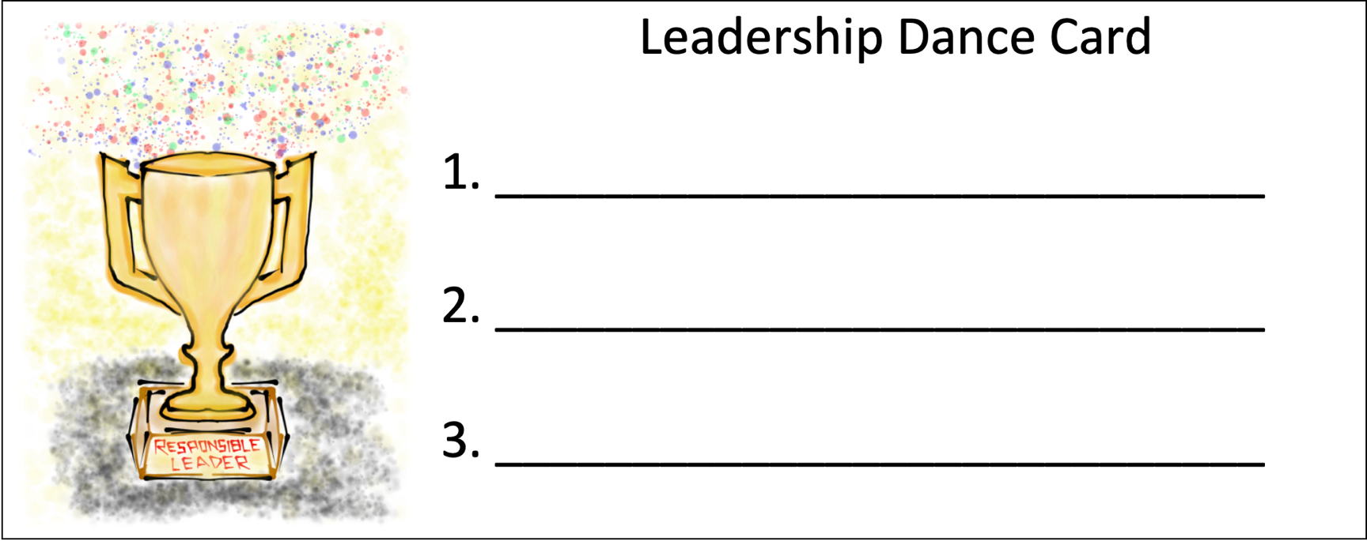
Leadership Dance Card
Find 3 people not at your table & you will both sign each others dance cards for the same number (1, 2, 0r 3).

Slide 21
Leadership & Responsibility

Slide 22
Leadership Lessons From Dancing Guy
YouTube:
https://youtu.be/FVVPi4v2D94
Vimeo:
https://vimeo.com/qisva/dancingguy
Video

Slide 23

Key Points
This condition is fostered when teachers are able to express their ideas, make decisions, & accept responsibility for their choices.
Teachers need genuine opportunities to be
responsible for the school community.

Slide 24

Embracing Leadership
& Responsibility
Broaden the definition of leadership.
Seek out opportunities to lead.
Accept the consequences of your decisions. (fail-fast)
Take time to celebrate accomplishments.
Keep learning, growing, & changing.

Slide 25


Teachers as Leaders of Learning
Resource 3
Complete the I AM A
LEADER Reflection.
Using your Leadership Dance Card, meet with your 3 partners &
share examples of
how you are
currently exercising
leadership at your
school.

Slide 26

School Solutions
Lesson Plan
Resource 4
Supporting staff &
students in forming creative solutions to prevalent school
problems. Making
decisions & taking
responsibility for
choices that impact
the school
community.
Notes:
q

Slide 27

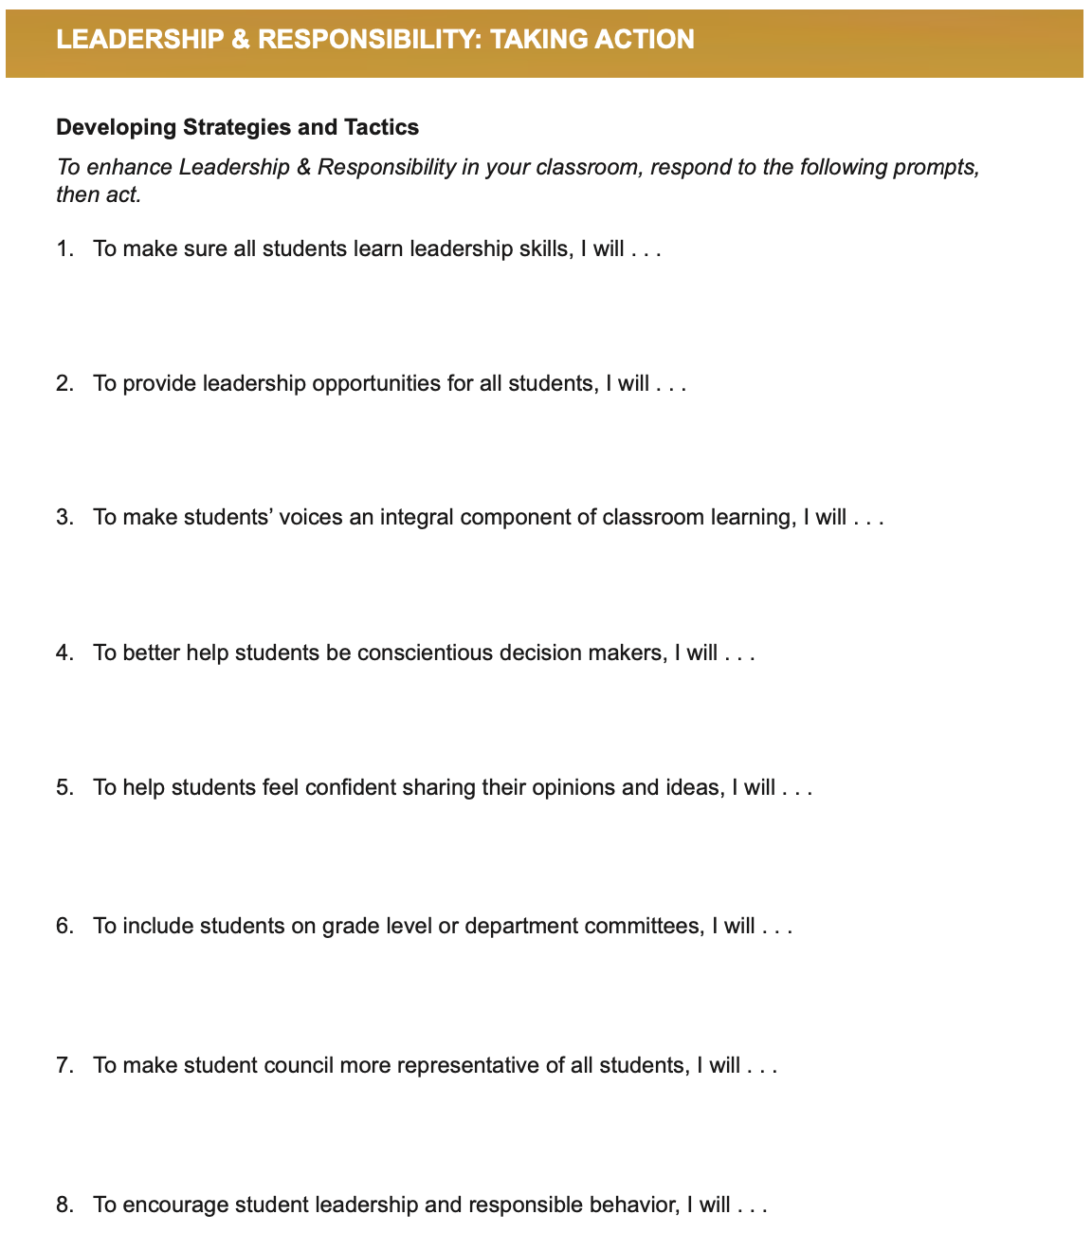
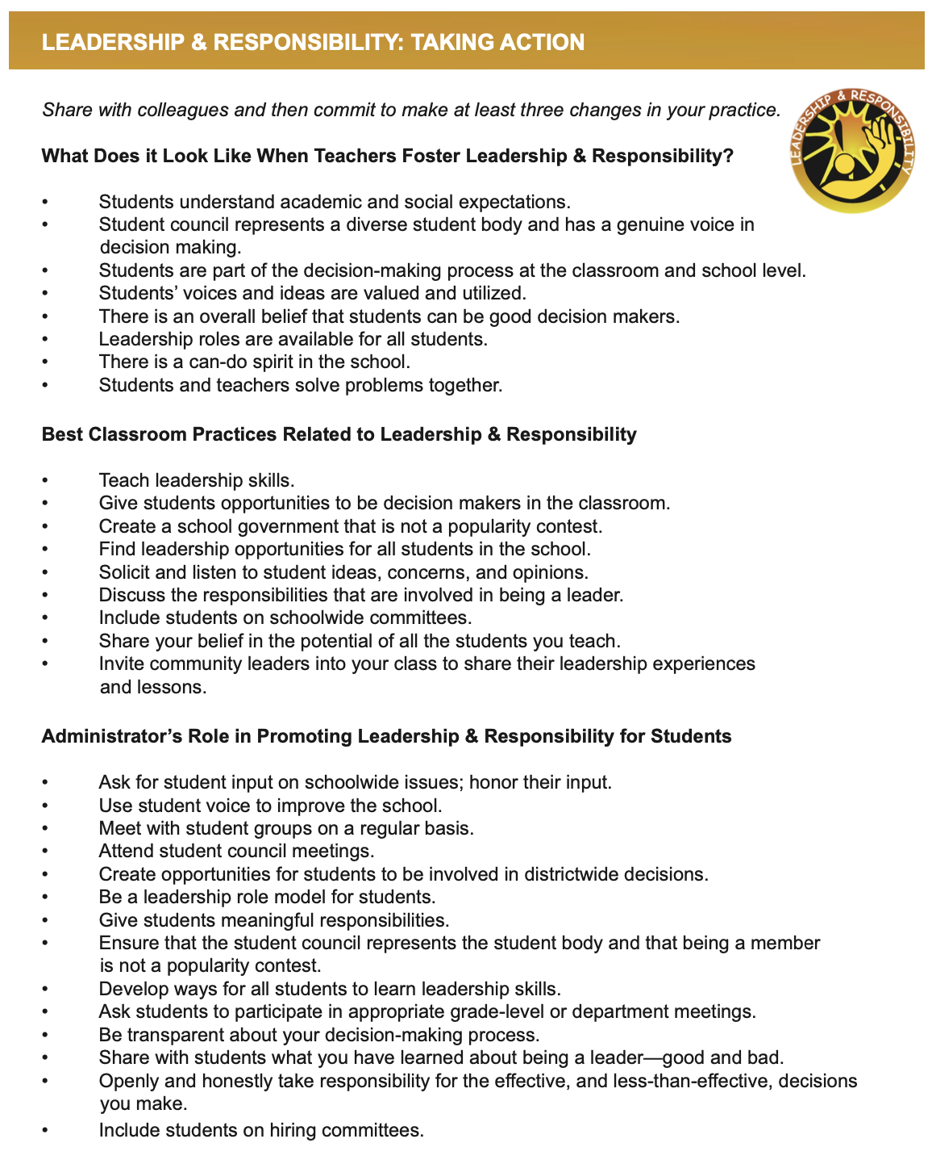
Taking
Action
Resource 5

Slide 28

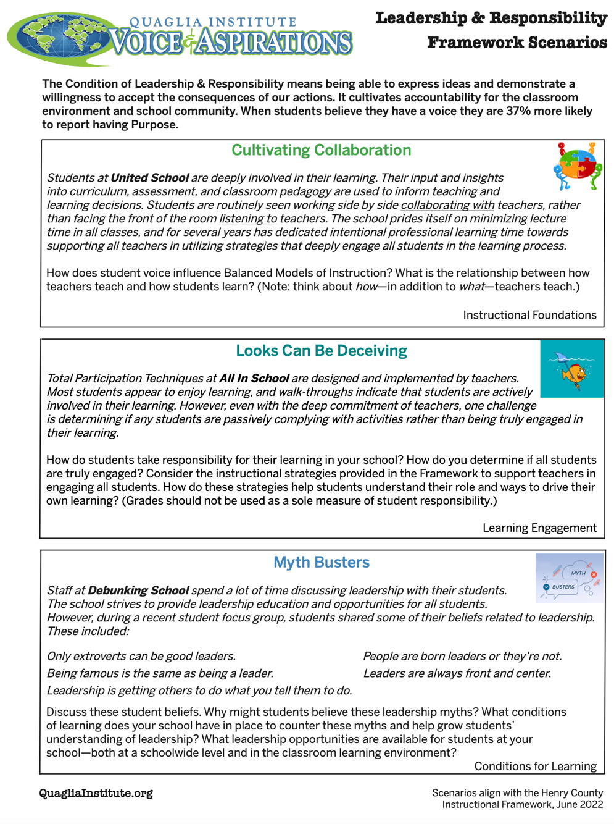
Reflect & Connect
Resource 6

Slide 29

Lunch!

Slide 30

Story Time…

Slide 32
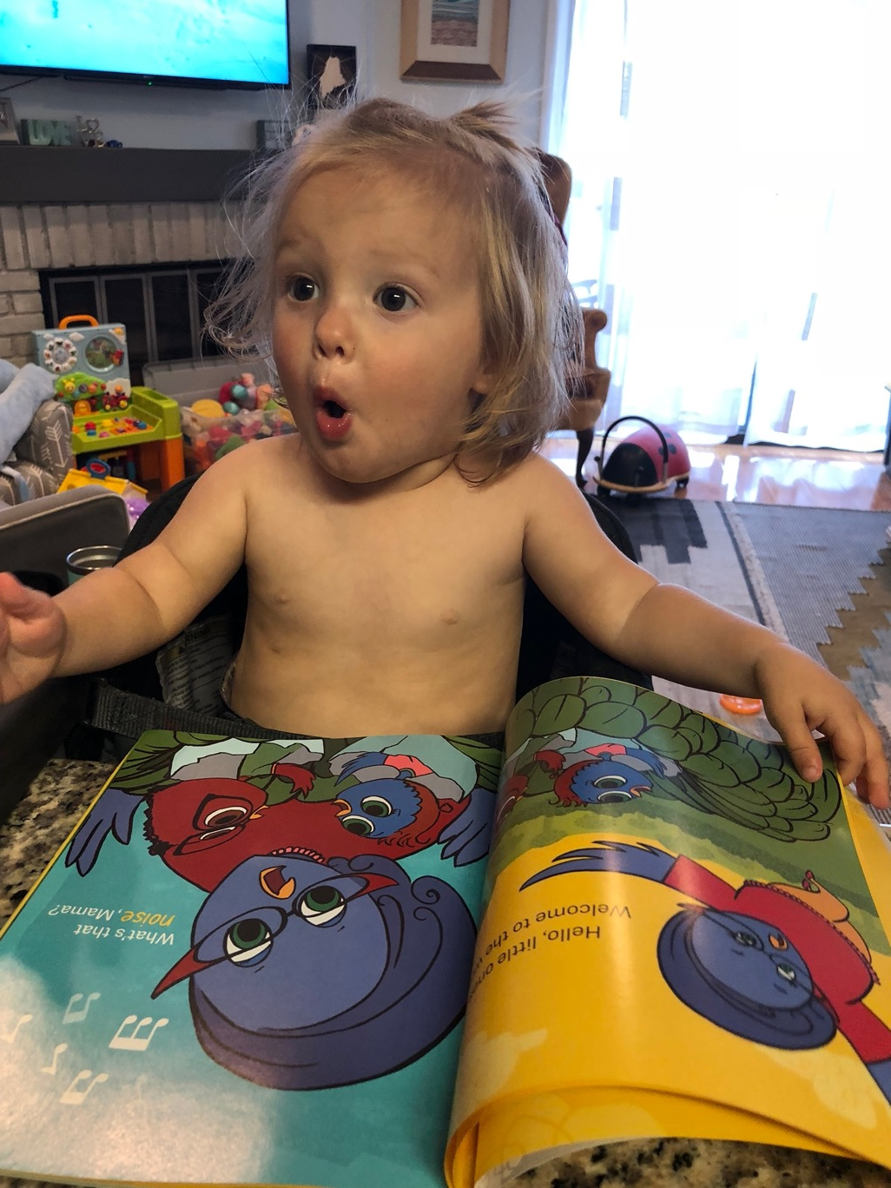
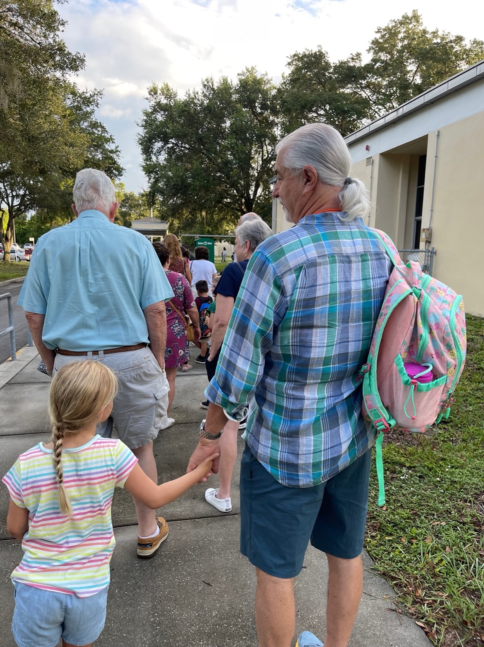

Slide 33

© Quaglia Institute

Slide 34

© Quaglia Institute

Slide 35

© Quaglia Institute

Slide 36

© Quaglia Institute

Slide 37

© Quaglia Institute

Slide 38

© Quaglia Institute

Slide 39

© Quaglia Institute

Slide 40

© Quaglia Institute

Slide 41

© Quaglia Institute

Slide 42

© Quaglia Institute

Slide 43

© Quaglia Institute

Slide 44
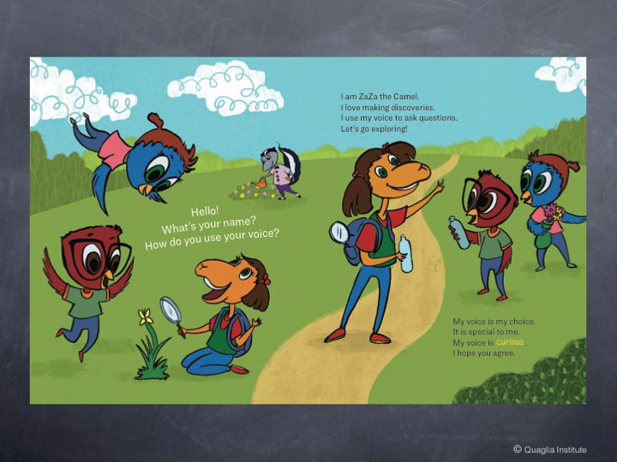
© Quaglia Institute

Slide 45
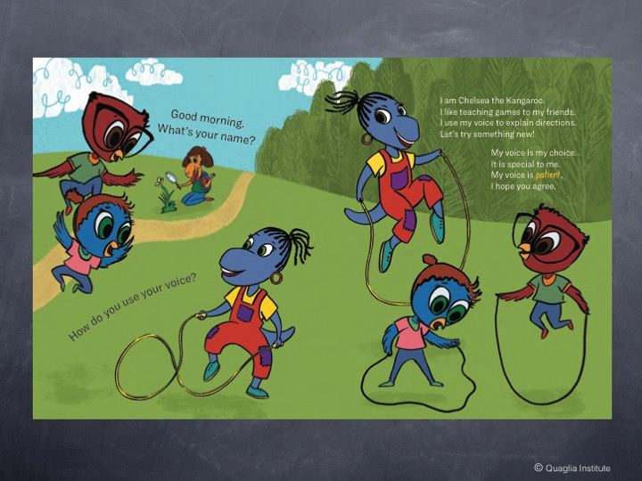
© Quaglia Institute

Slide 46
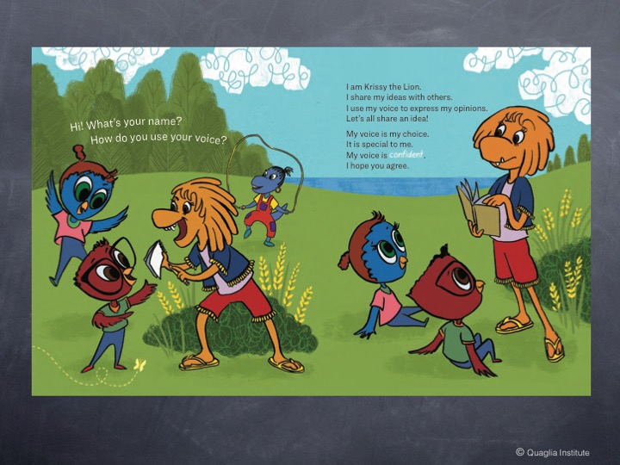
© Quaglia Institute

Slide 47
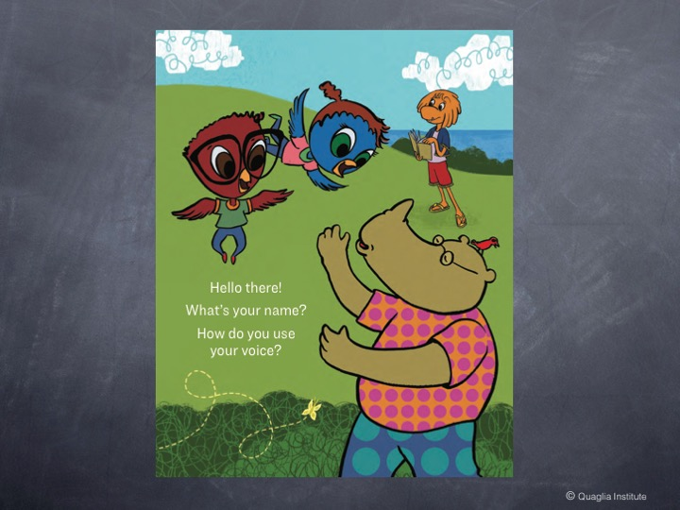
© Quaglia Institute

Slide 48

© Quaglia Institute

Slide 49
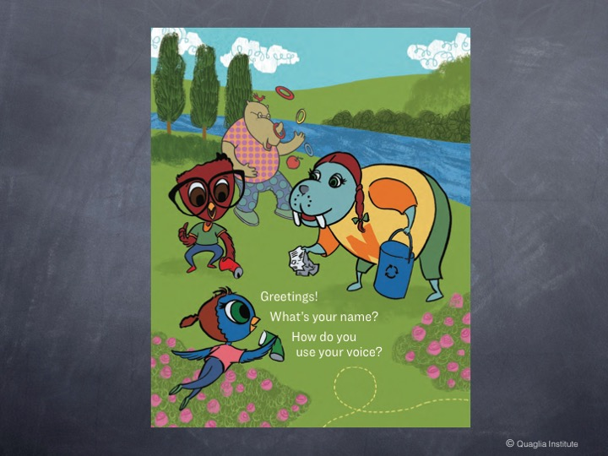
© Quaglia Institute

Slide 50

© Quaglia Institute

Slide 51
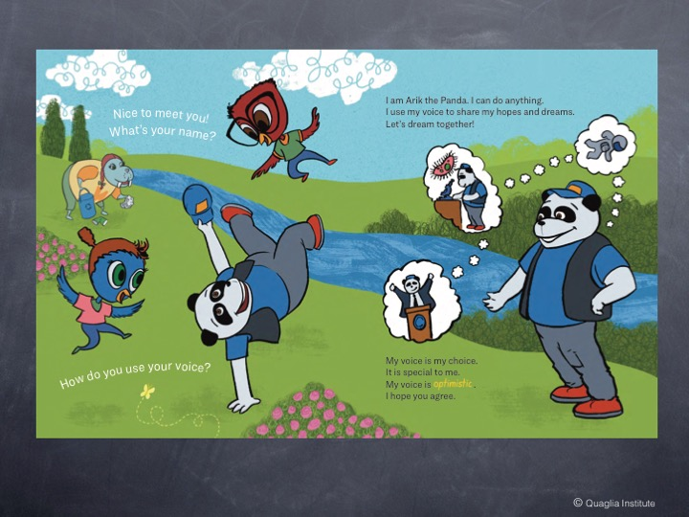
© Quaglia Institute

Slide 52
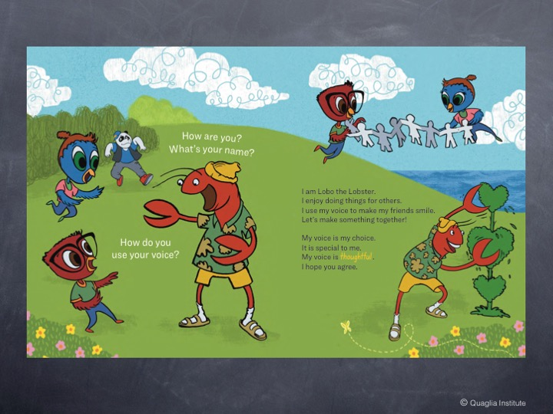
© Quaglia Institute

Slide 53
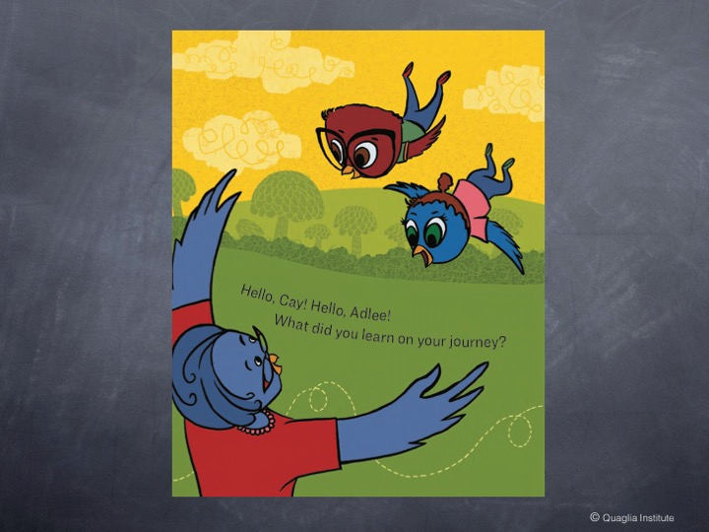
© Quaglia Institute

Slide 54
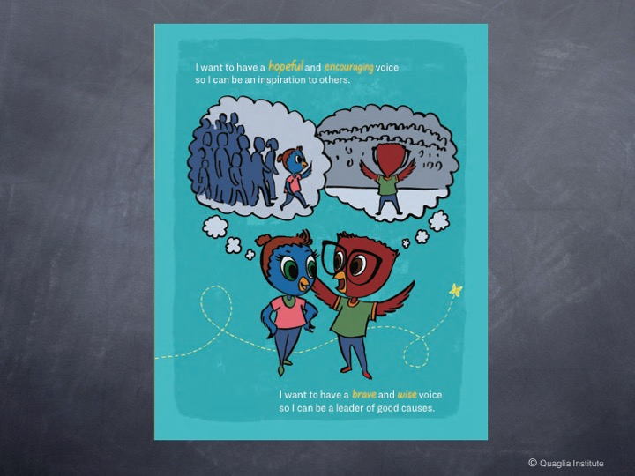
© Quaglia Institute

Slide 55
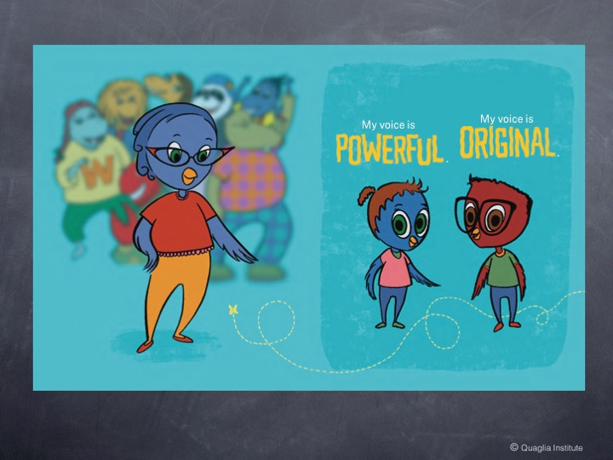
© Quaglia Institute

Slide 56

© Quaglia Institute

Slide 57


My voice is my choice.
It is special to me.
I have a _____ voice.
I hope you agree!

Slide 58
Confidence to Take Action

Slide 59

Key Points
Confidence to Take Action is the cumulative affect of the first seven conditions.
Exhibited by teachers when they have the
desire, willingness, and ability to work
hard towards achieving their goals with
a sense of passion & purpose.

Slide 60

Having Confidence
To Take Action
Find YOUR voice and use it.
Take time to reflect….
remind yourself of your PURPOSE.
Challenge yourself to dream big….
NEVER be satisfied with the status-quo.
Embrace your legacy as a Teacher
Leader, and TAKE ACTION!!

Slide 61







Who Am I?
Resource 7
Is there something or someone that inspires you to teach? How so?
Why do you teach?
As a teacher, what are you most proud of?
When did you decide being a teacher was right for you?
What are your basic beliefs & values as a teacher?
Wild Card! Share anything you want related to who you are as an educator!

Slide 62

Challenge Time…

Slide 63

Donʻt Be a Bore in 2034!

Slide 64

Mock Reunion
Donʻt Be a Bore in 2034!
Welcome to the 10 year reunion since you graduated from the ATL! For the next 15 minutes you will BE yourself 10 years from now & speak only in the present tense as if it were already 2034. Your goals are being achieved & all your dreams are coming true! Share what actions you have taken as a Teacher Leader. Share about things you have done such as best-selling books & articles you have written, magazine covers you have been on,
awards you have won, & important
things you have achieved.

Slide 65
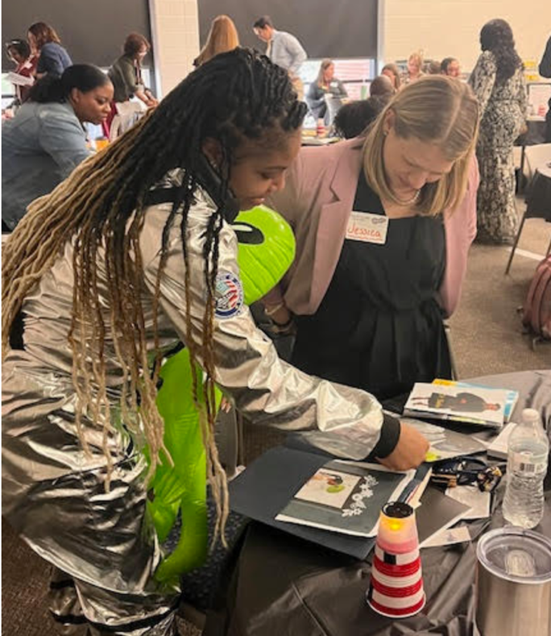
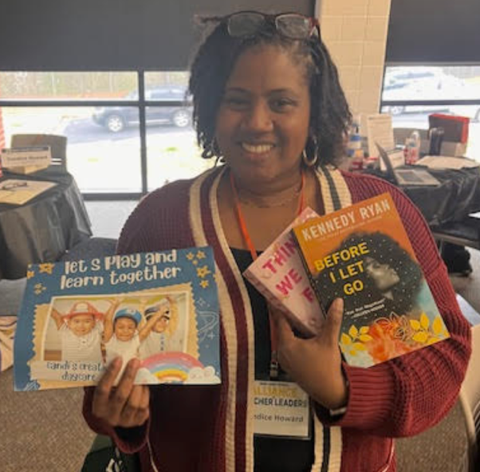
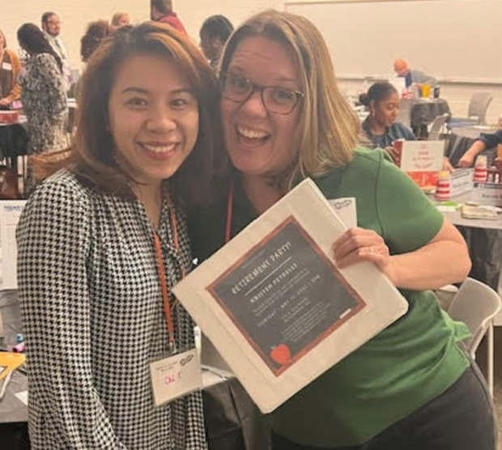
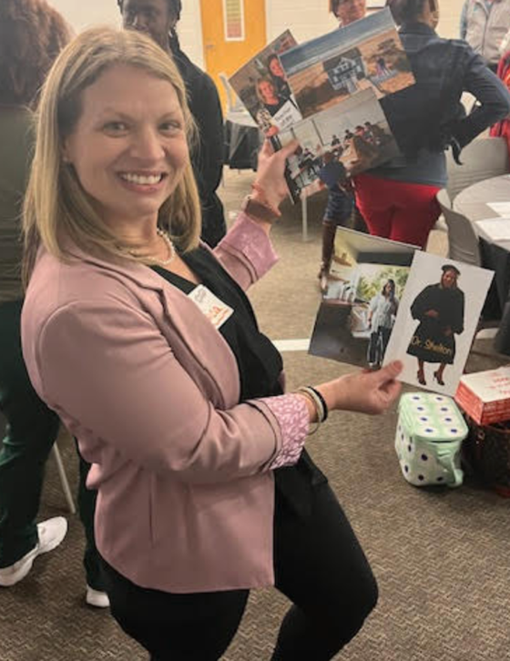
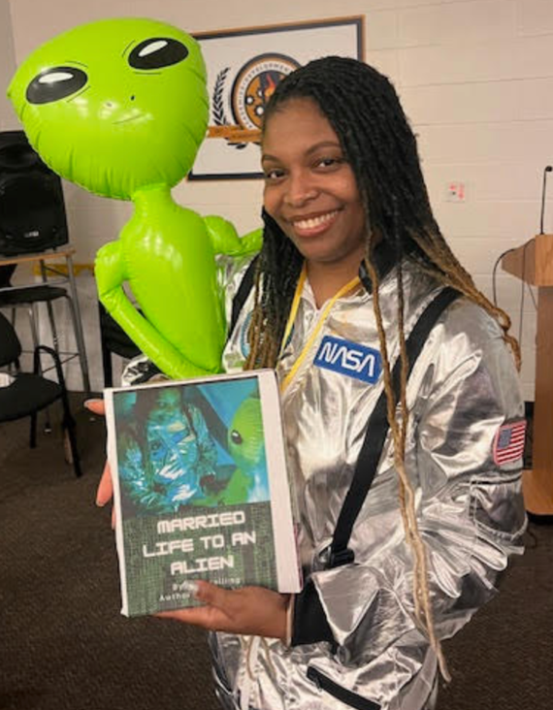
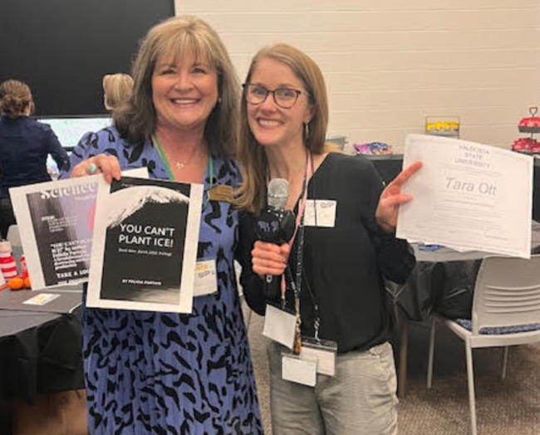
ATL Mock Reunion 2033!

Slide 66
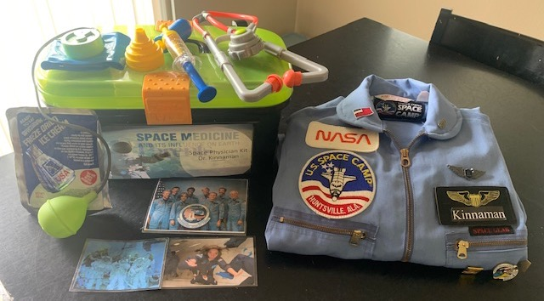
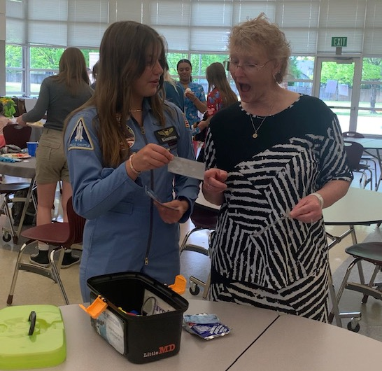
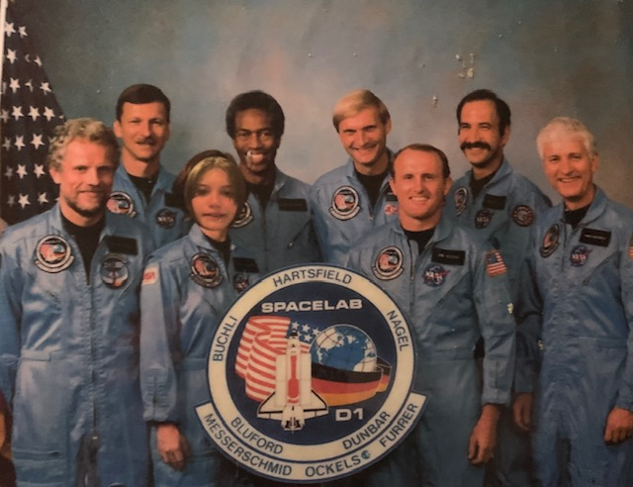

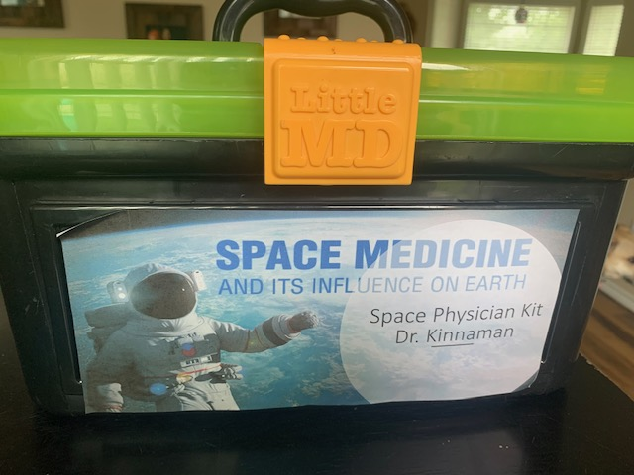
Mock Reunion With Students!

Slide 67
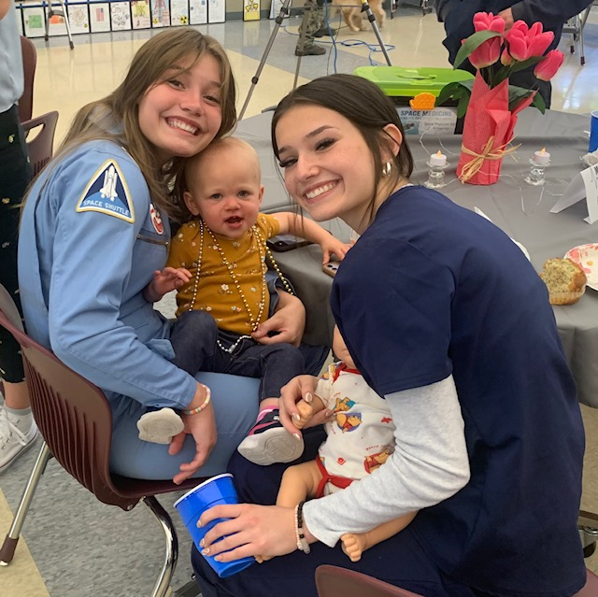
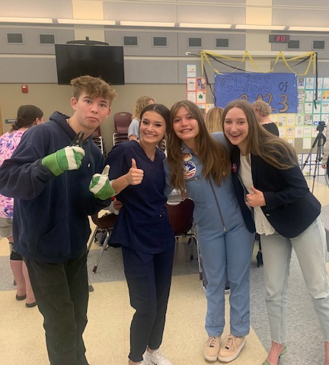
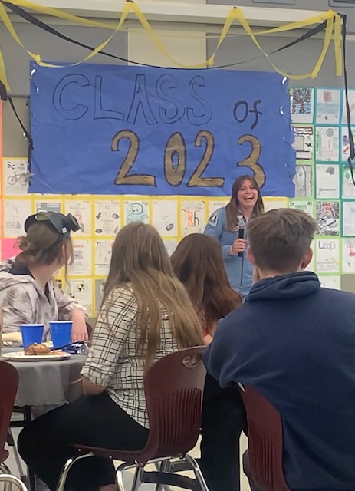
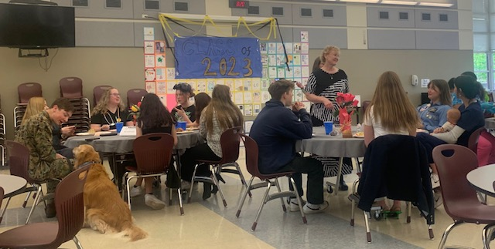
Mock Reunion With Students!

Slide 68

Reflect
What did you hear that inspired you during the Mock Reunion?
What did you learn about yourself from the Mock Reunion?
What will it take for you to achieve your Teacher Leader goals?

Slide 69

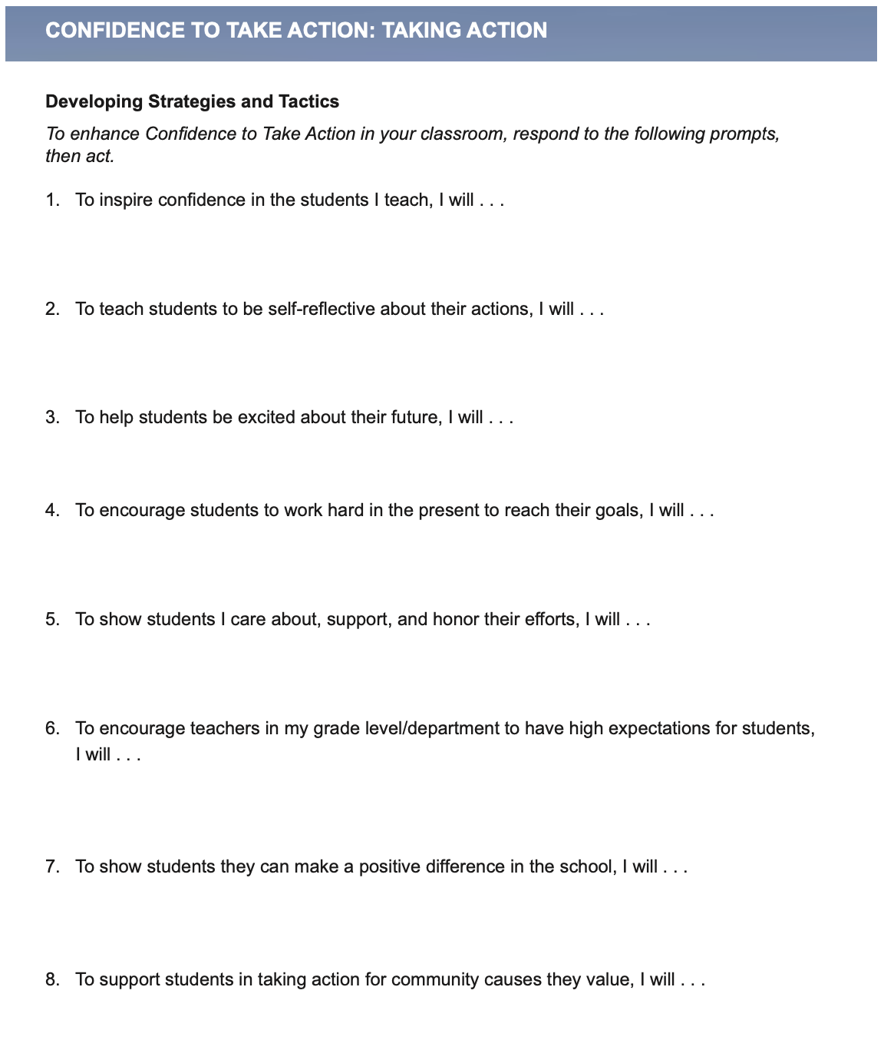
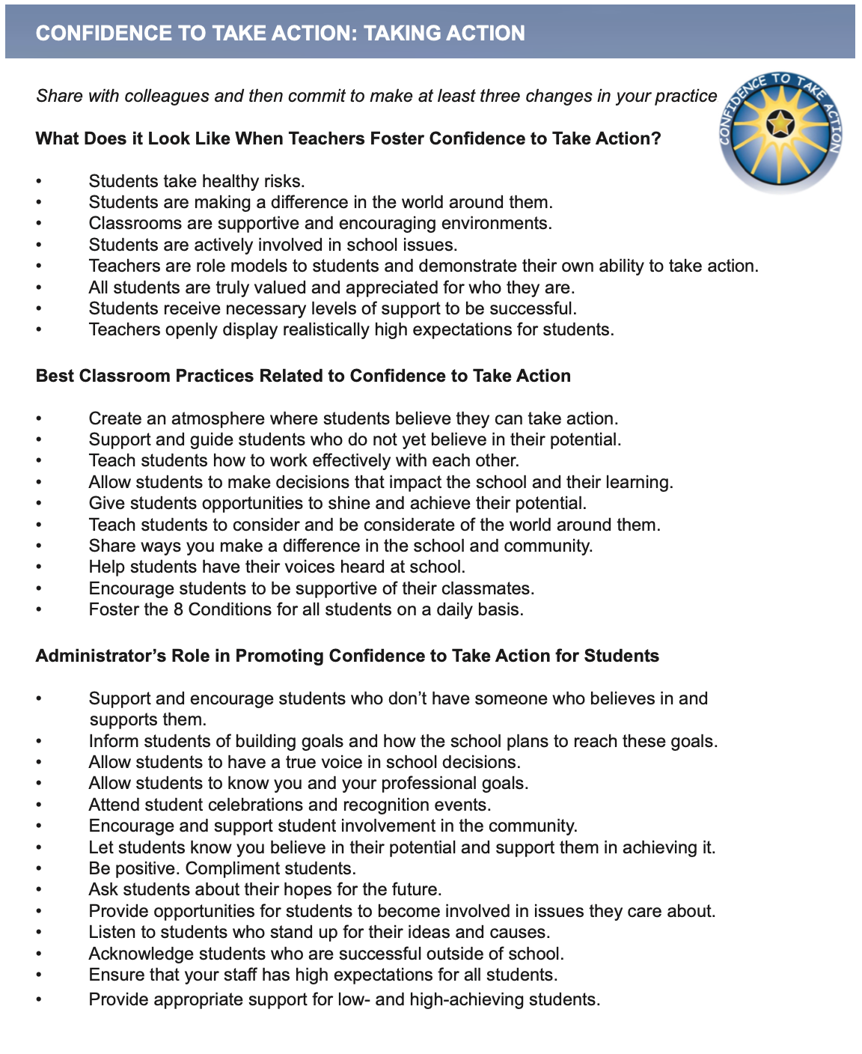
Taking
Action
Resource 8

Slide 70


Reflect & Connect
Resource 9

Slide 71

Teacher Leaders
Embrace….
The Power of Balance

Slide 72

We need to balance...
Teacher
Responsibility
Student
Responsibility

Slide 73
We need to balance...
Listening
Speaking

Slide 74
We need to balance...
Innovation
Compliance

Slide 75
We need to balance...
Needs Fixed
Going Right

Slide 76
We need to balance...
Dreaming
Doing

Slide 77
We need to balance...
Mind
Heart

Slide 78
We need to balance...
Important
Urgent

Slide 79
What would you add?

Slide 80


A Balanced
Conversation
Resource 10
Identify 3 Bright Spots in your district, school, or classroom.
Determine how you will share these Bright Spots with others both within & outside of your
school.

Slide 81
Challenge Time…

Slide 82
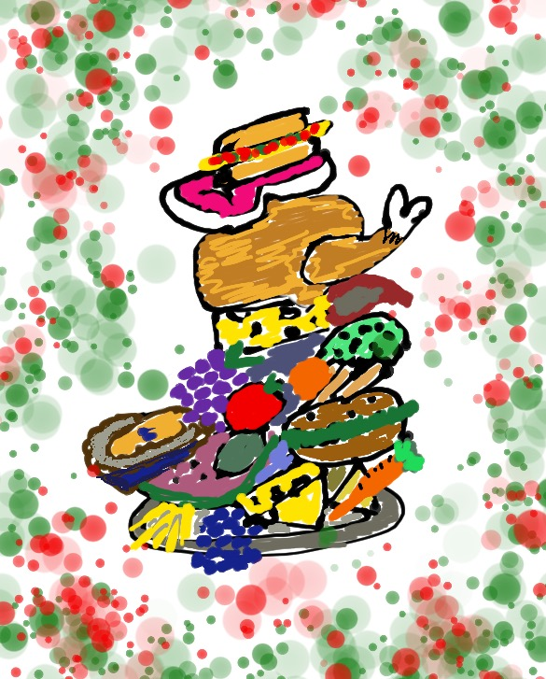
What
Fills
Your Plate?

Slide 83

What
Fills
Your Heart?

Slide 84
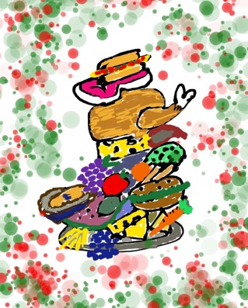

Be sure to balance...

Slide 85
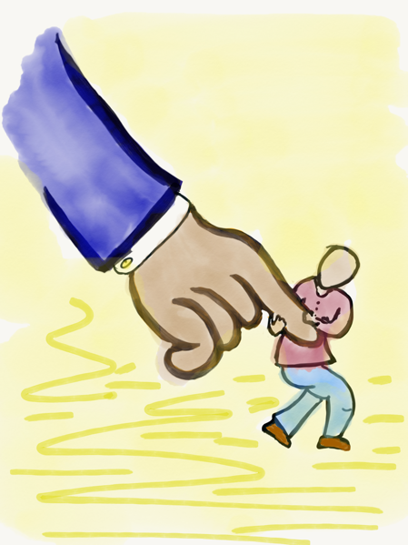
Moving Forward
Resource 11
This is all about YOU and what YOU are
going to differently moving forward!
As you think about what is next for you as a Teacher Leader, use the reflective prompts to guide you in setting a goal & preparing
to achieve that goal!

Slide 86

Peer Consultancy Deep Dive
Match up with a partner from a
different table. Share your Moving Forward Plans & use the following prompts as a guide for a
Peer Consultancy Deep Dive:
Provide positive feedback.
Strengths I observe in your plan…
Ask clarifying questions.
Tell me more about…
Stretch the thinking.
Have you thought about…
Offer support.
How can I support your work
to implement your plan?
Additional
Consultancy
Protocols in
Meeting Goals book
p. 153-168

Slide 87
True Purpose
YouTube:
https://youtu.be/VsEvRY3boEE
Vimeo:
https://vimeo.com/qisva/truepurpose
Video

Slide 88

To further explore topics discussed today, check out the following pages in Teacher Voice: Amplifying Success
pgs. 53-59, 61-77, & 113-118

Slide 89


Purpose Teacher Leader Actions
Resource 12
Be a champion for the Highly Effective Classroom Framework.
Design & deliver professional learning to your colleagues.
Implement your Moving Forward plan.
Dig into the Meeting Goals book & come to the next session prepared to share a protocol you have tried.

Slide 90

Lighting & Leading the Way in Henry County!
Share a key take away of learning from today that reflects how you can light & lead the way in Henry County!

Slide 91
Identifying My Purpose as a Teacher
Lighting & Leading the Way in Henry County
Dr. Lisa Lande
www.quagliainstitute.org
#HenryATL2023
@Lisa_Lande

