Slide 1



Being Meaningfully Engaged as a Teacher
Dr. Lisa Lande
www.quagliainstitute.org
#HenryATL2023
@Lisa_Lande

Slide 2
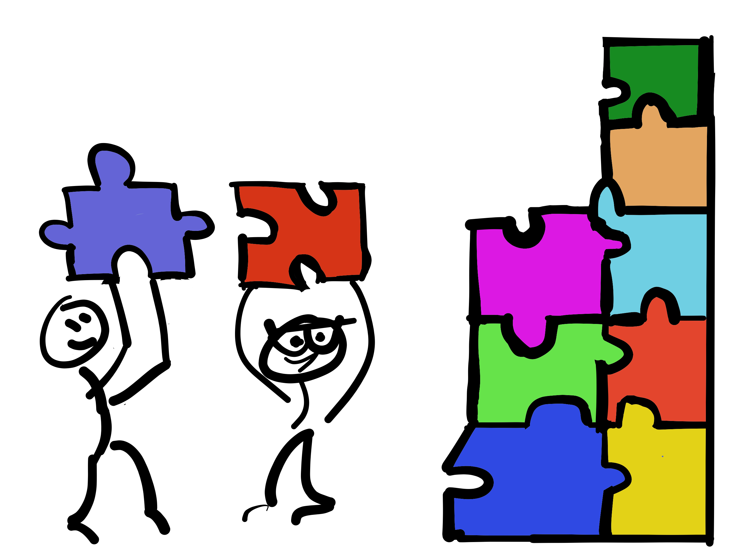
Opening Team
Challenge

Slide 3
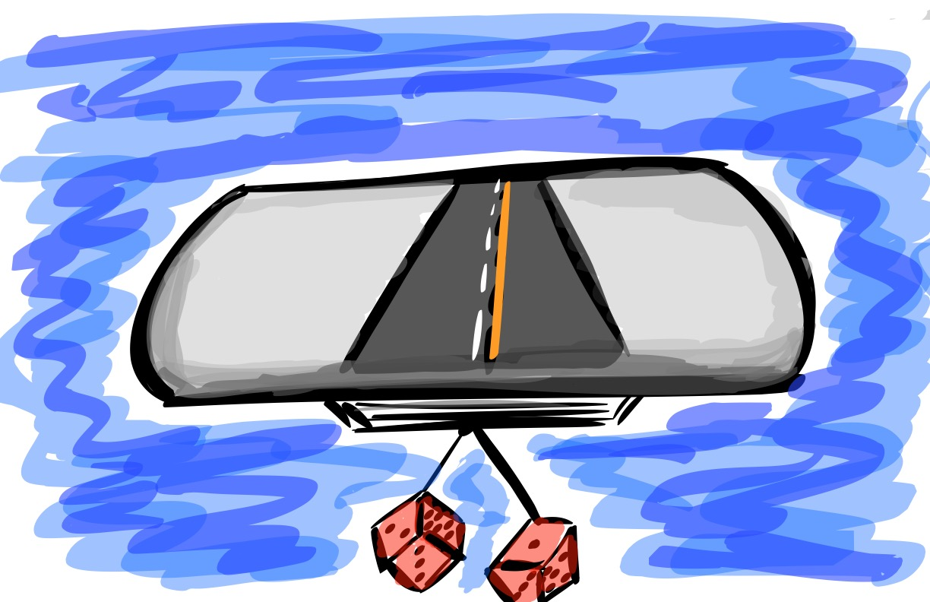
A Quick Review

Slide 4
The 3 Components of Teacher Voice
PART 1:
PART 2:
PART 3:

Slide 5

The 3 Components of Student Voice
Sharing thoughts & ideas in an environment underpinned by trust & respect.
Offering realistic suggestions for the
good of the whole.
Accepting responsibility for not only what is said but also what needs to be done.

Slide 6
ASPIRATIONS
The ability to
dream and set goals
for the future,
while being inspired
in the present
to reach those dreams.

Slide 7




high
Imagination
Aspirations
DREAMING
Hibernation
Perspiration
low
DOING
high

Slide 8
LEAD
TAKE ACTION
with others
Share
RESPONSIBILITY
LEARN
UNDERSTAND
& RESPECT
different points
of view
Build
TRUST
LISTEN
SEEK OUT
opinions from
others
School Voice Process

Slide 9



Self-Worth

Slide 10



Homework
Check

Slide 11
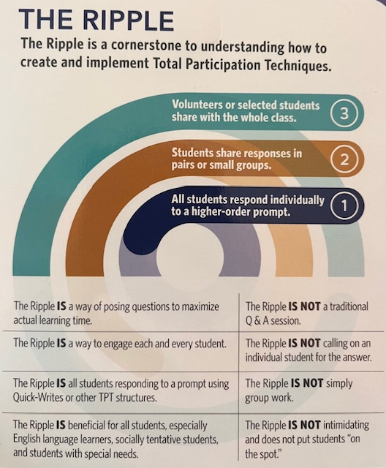

The Ripple Protocol
Adapted from
Total Participation Techniques
Himmele & Himmele

Slide 12

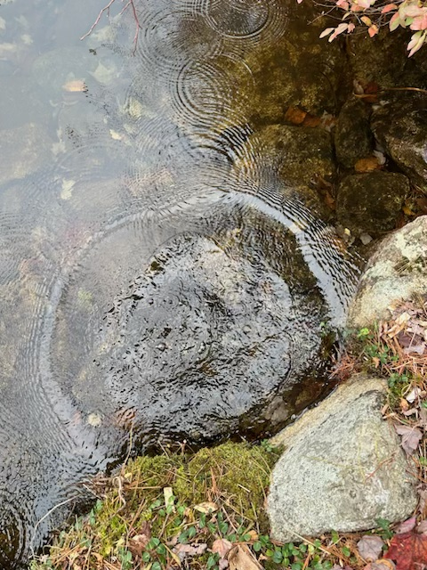
Ripple
Protocol
Individual. Write a reflection on
what actions you have taken from
the Self-Worth session homework:
-Take action on a Self-Worth
scenario linked to the Highly
Effective Classroom Framework.
-Design & deliver professional
learning to your
colleagues.
-Dig into the book Teach Like a
Champion 2.0 & share what strategy
you tried.
2. Pairs. Find a partner from a
different table & share your
reflection on actions taken.
3. Whole Group. Share out brilliant
actions with the whole group!

Slide 13
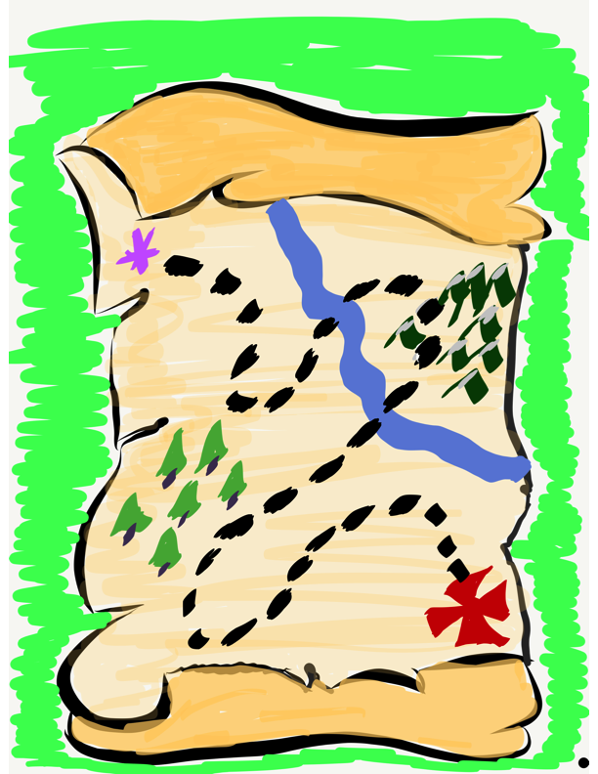
Our Teacher Voice & Aspirations Journey Continues!

Slide 14
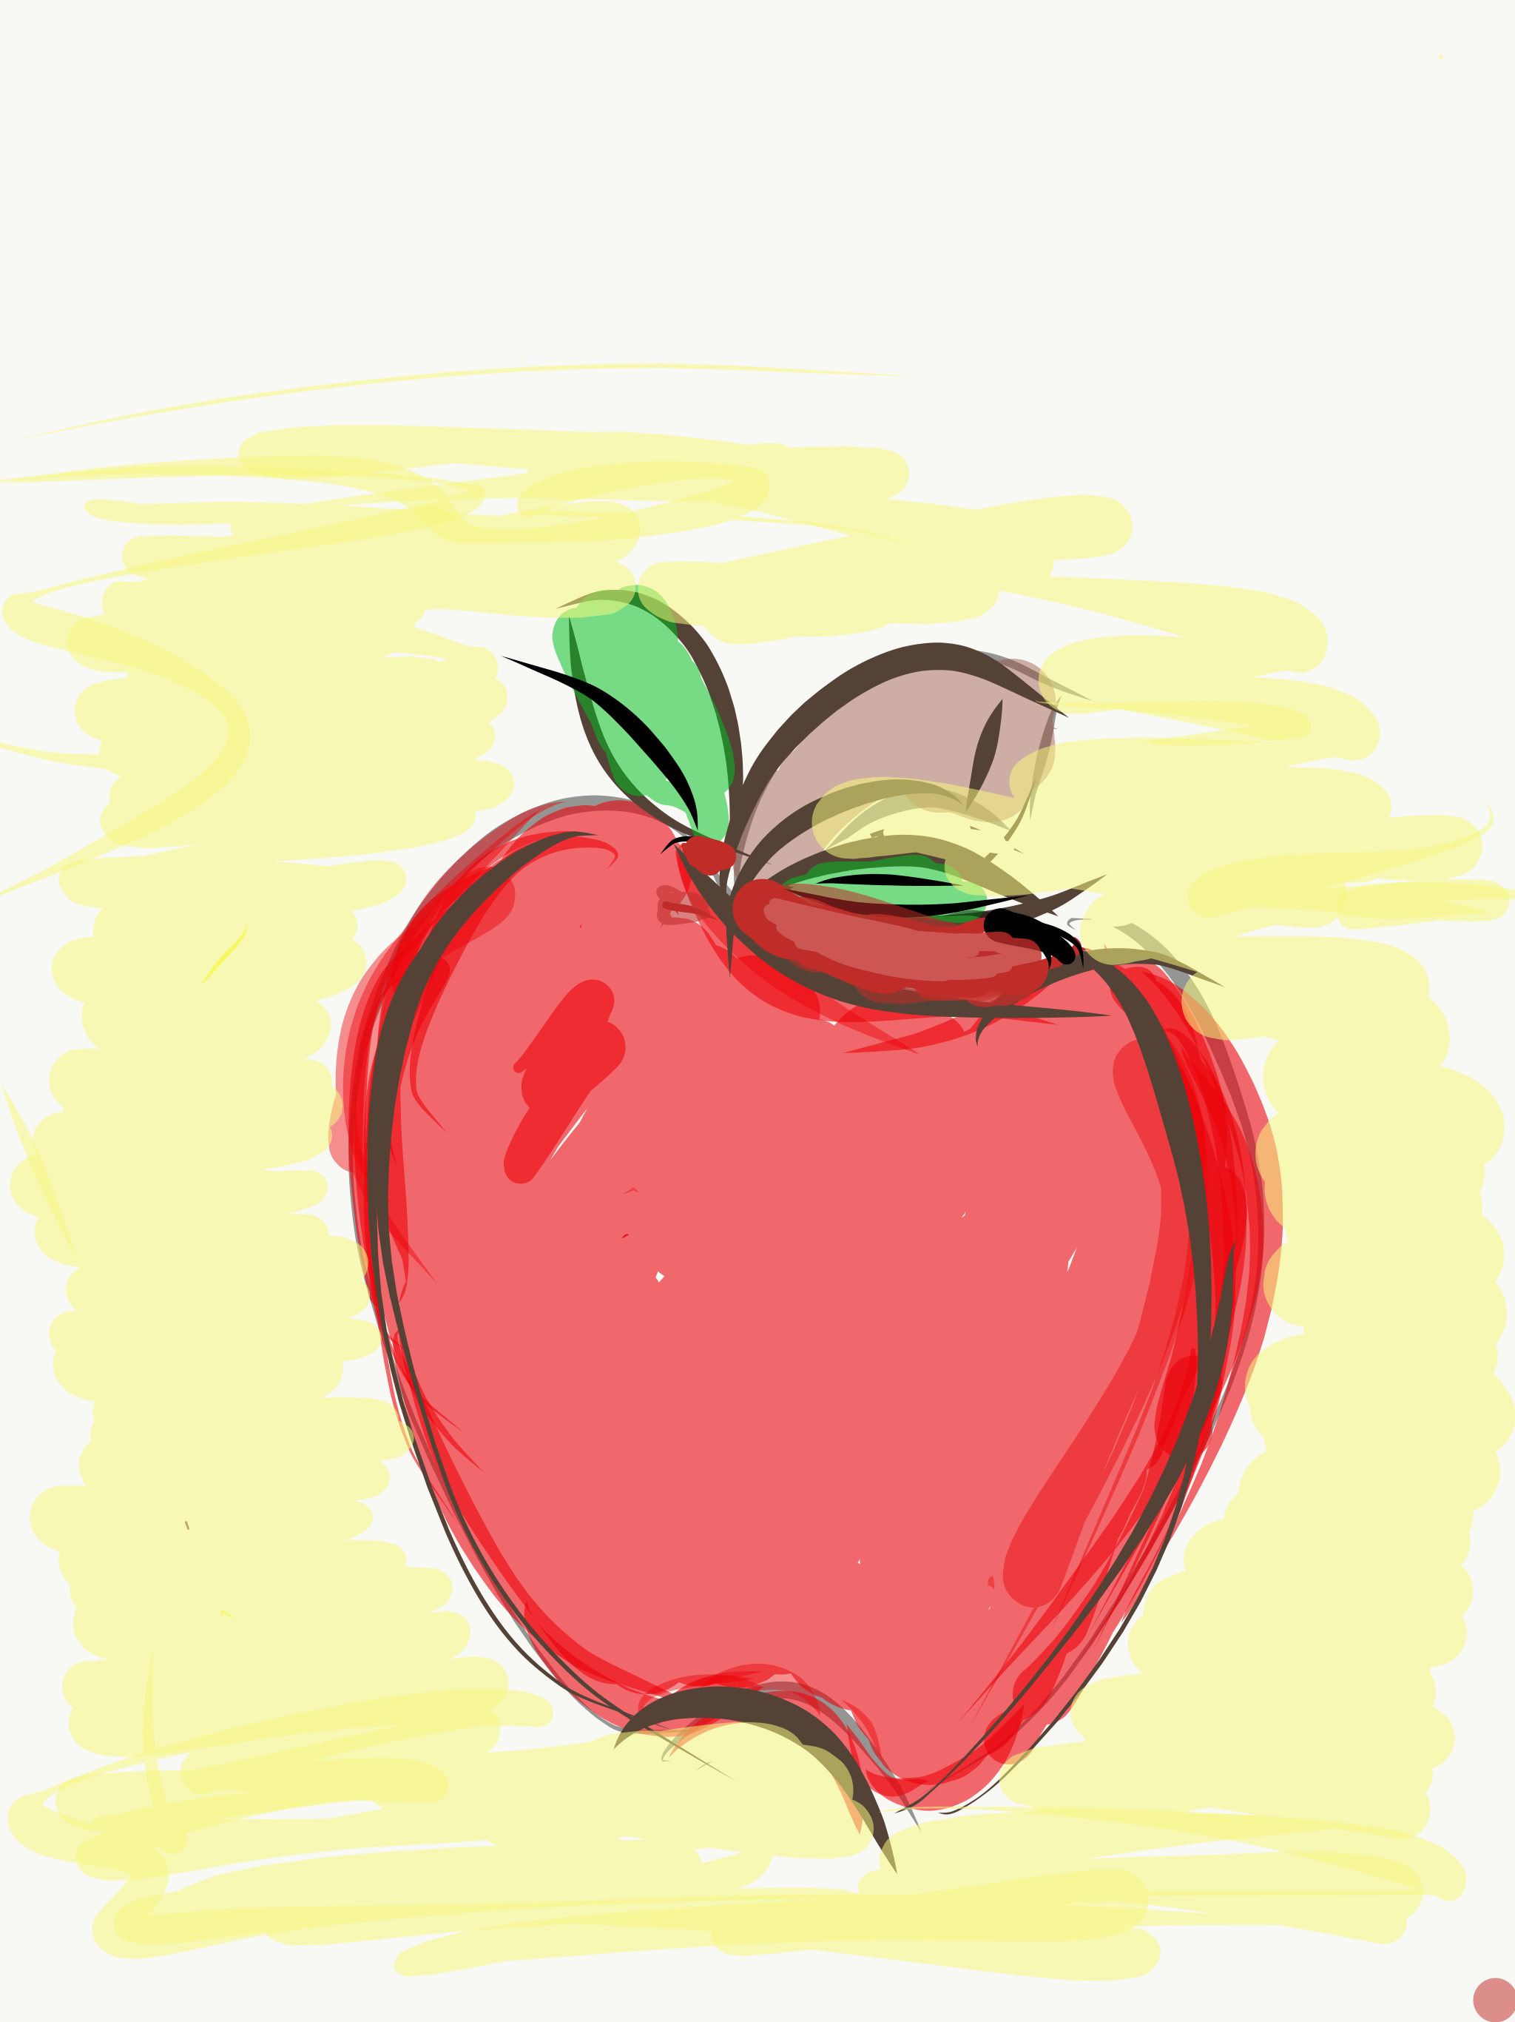
Essential Questions
How are you meaningfully engaged as a professional?
Why is it important to have Fun & Excitement in the classroom?
What are you professionally Curious about?
How do you exercise Creativity?
What does it look like to have a Spirit of Adventure related to learning?
How might the Balanced Model for Engagement impact your practice as a Teacher Leader?
How do the Guiding Principles of Engagement relate to the Highly Effective Classroom Framework?

Slide 15



Today we journey onward to explore Engagement

Slide 16

Engagement
Engagement takes root when schools ensure that students & staff are deeply involved in the learning process, showing enthusiasm & a desire to learn new things, as well as a willingness to take positive, healthy steps toward the future.
Notes:
What key words stand out for you in this definition.

Slide 17

Fostering Teacher’s Engagement
Resource 1
Losing track of time & space
whether at work, school, or play.
Asking “Why?” and “Why not?”
about the world around you.
Being excited to try new things,
even if you don’t know that you
will excel.

Slide 18
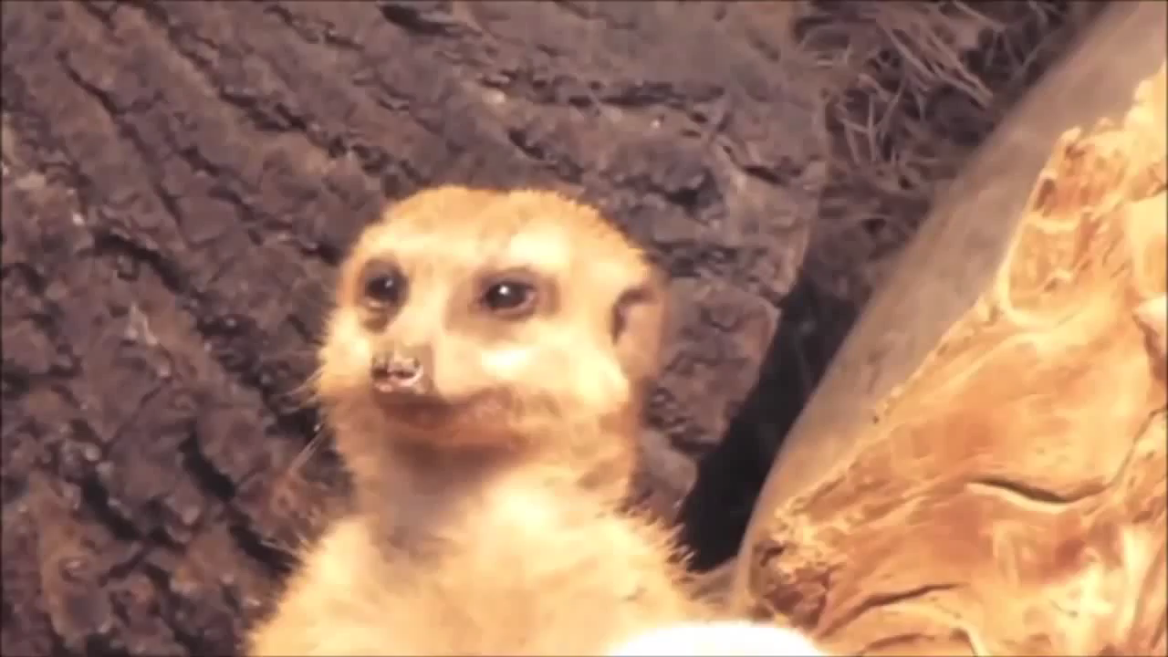
Optimal Engagement?
Video

Slide 19
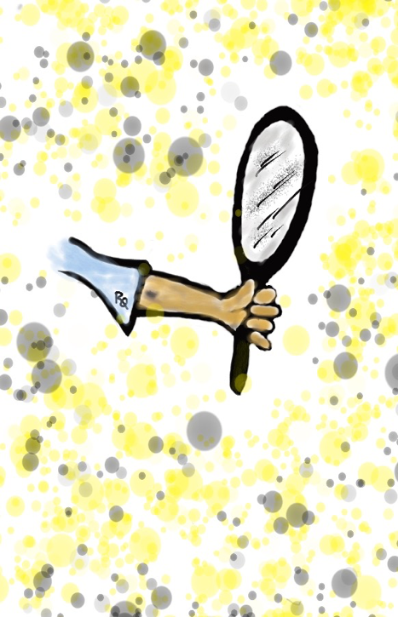
Engagement
Teacher Reflection
Individually, complete the rank order section of the self-assessment.
Discuss the 3 reflection questions.
Resource 2

Slide 20
Fun & Excitement

Slide 21
An Engaging Classroom??
YouTube:
https://youtu.be/5ITa-dKVlxU
Vimeo:
https://vimeo.com/qisva/engagingclassroom
Video

Slide 22
Key Points
Losing track of time & space.
If you are bored, you can bet your
life the students will be as well.
Instilling passion & intellectual
excitement for content being taught.
YOU can make DIRT exciting! ☺

Slide 23
Creating
Fun & Excitement
Let your passion & excitement show!
Do things that “surprise” your colleagues & students…let them know you are alive!
Learn from your students & colleagues, continually adding to your teacher
toolkit of teaching strategies.

Slide 24

Quick Break!

Slide 25

Challenge Time…

Slide 26



Slide 27
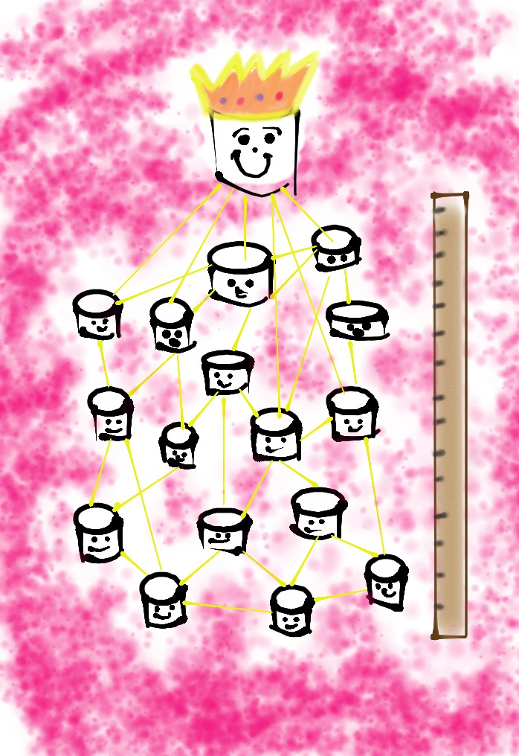
Marshmallow Challenge
*18 minutes
*NO Technology
Devices Allowed
*Build the tallest
free-standing structure
*Use as much or as little of the
supplies (excluding the
paper bag & baggie)
*The entire, whole marshmallow must be on top

Slide 28
Build a tower, build a team
https://www.ted.com/talks/tom_wujec_build_a_tower_build_a_team/transcript
Video

Slide 29
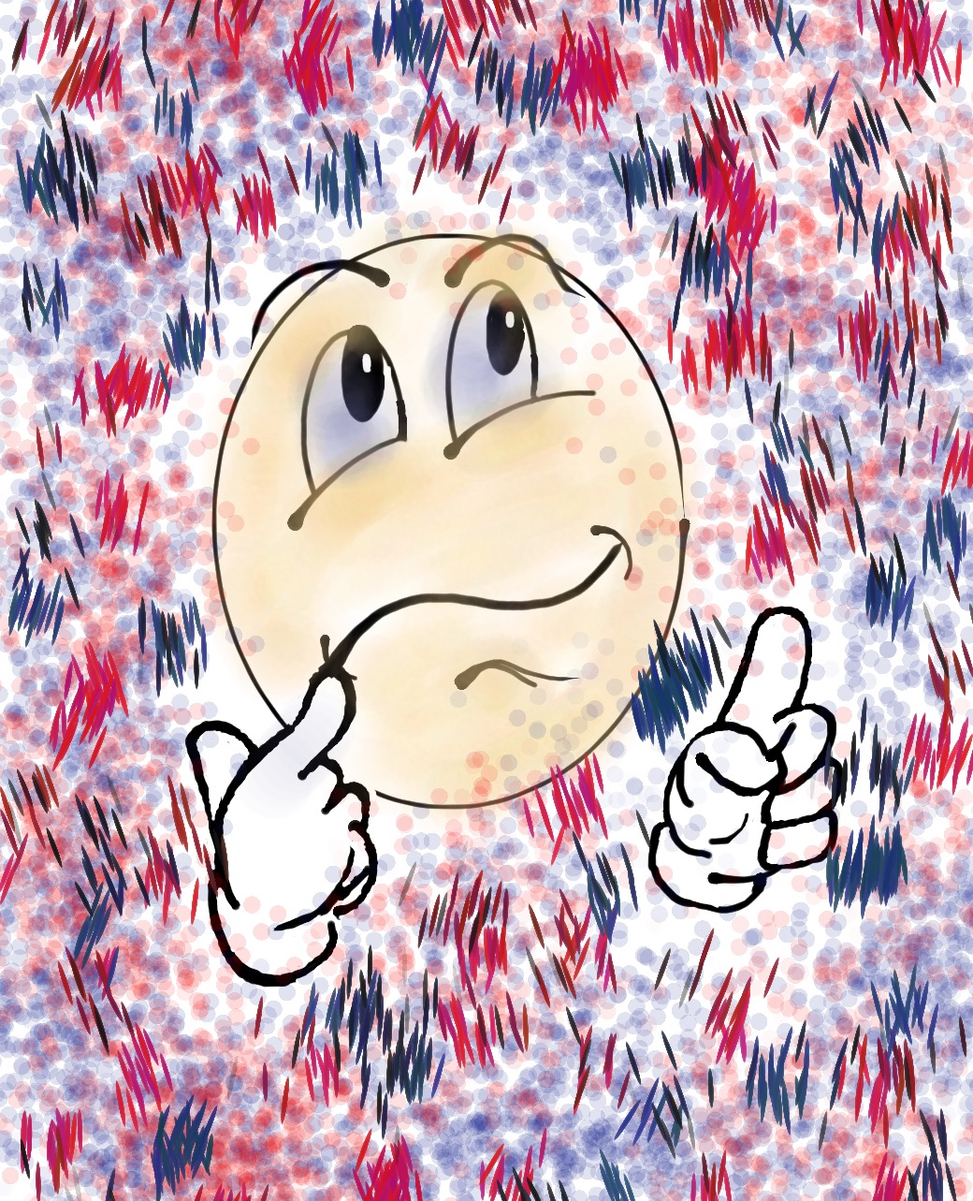
Check Up From the Neck Up
*When were you MOST engaged?
*When were you LEAST engaged?
*What could YOU do in the future to be MORE engaged?

Slide 30

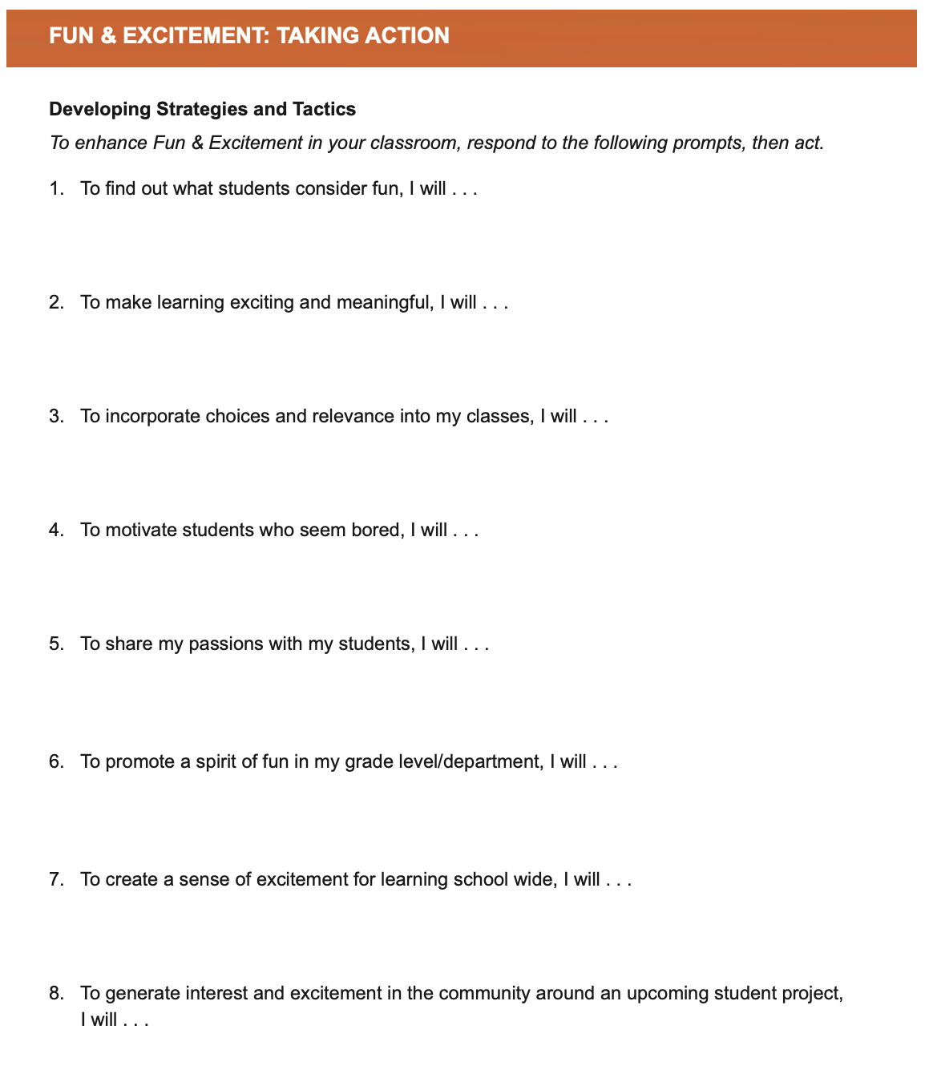
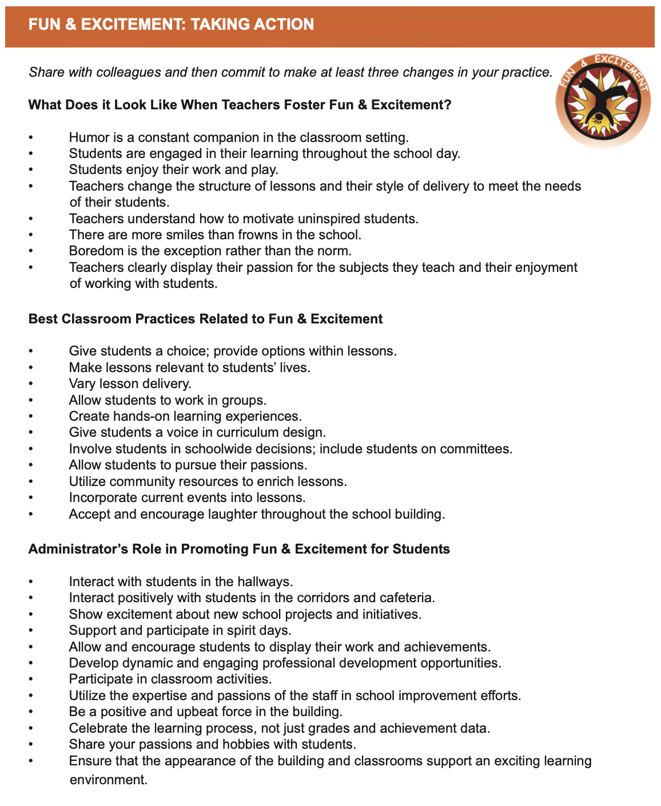
Taking
Action
Resource 3

Slide 31
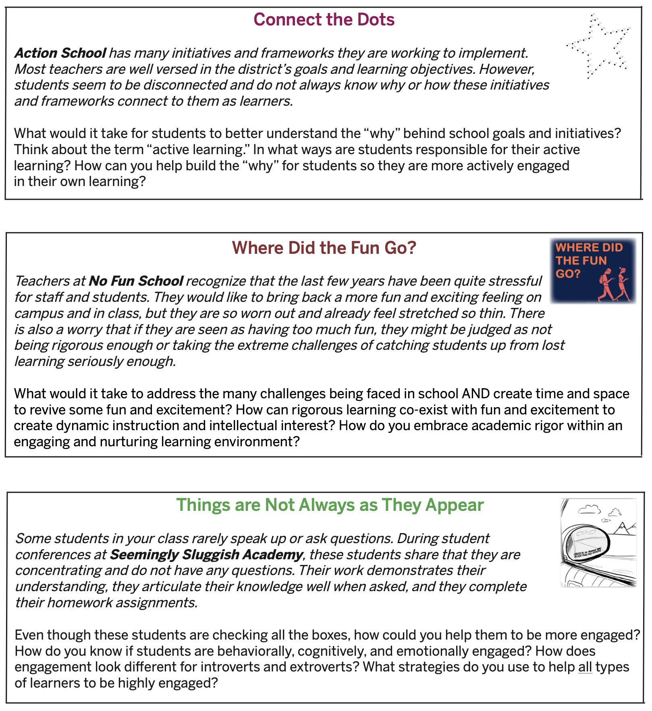
Reflect & Connect
Resource 4

Slide 32
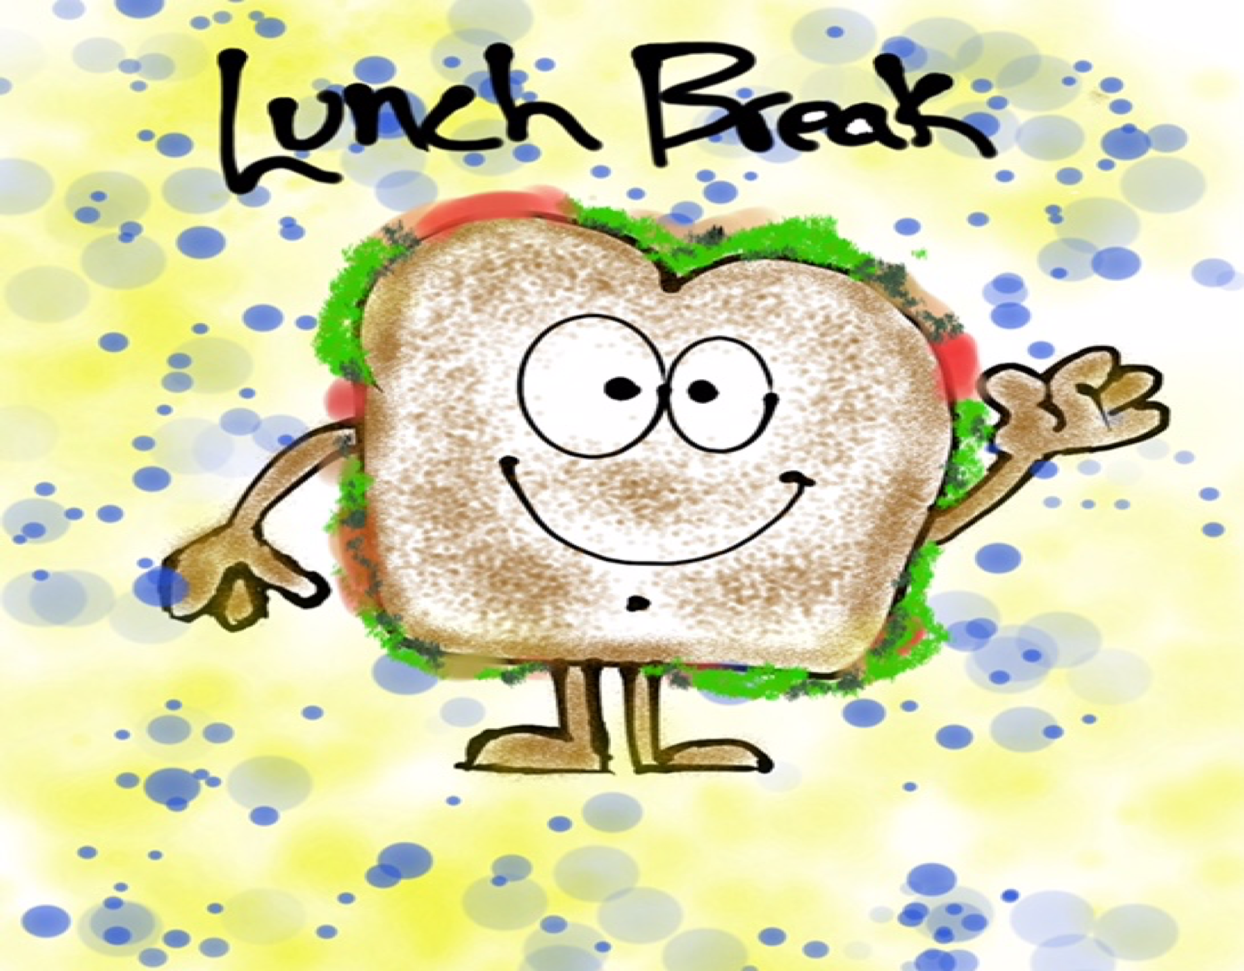
Lunch!

Slide 33
Curiosity & Creativity

Slide 34
Creativity in the Future
YouTube:
https://youtu.be/g1RnveGk8YM
Vimeo:
https://vimeo.com/qisva/creativityfuture
Video

Slide 35
Key Points
Curious teachers/students will ask “Why?”
Creative teachers/students will also ask
“Why not?”

Slide 36
Fostering
Curiosity & Creativity
Know your students hopes, dreams, &
interests.
Share things with your students that you
are curious about.
Let students co-design lessons.
Teach students to pose questions &
encourage critical thinking.

Slide 37
Challenge Time…

Slide 38



CHALLENGE
Cultivating Creativity
Write down the
first word
that comes to mind
for each of the
prompts.

Slide 39

CHALLENGE
Cultivating Creativity
This time, write
down your most
creative thought for
each of the
prompts!

Slide 40

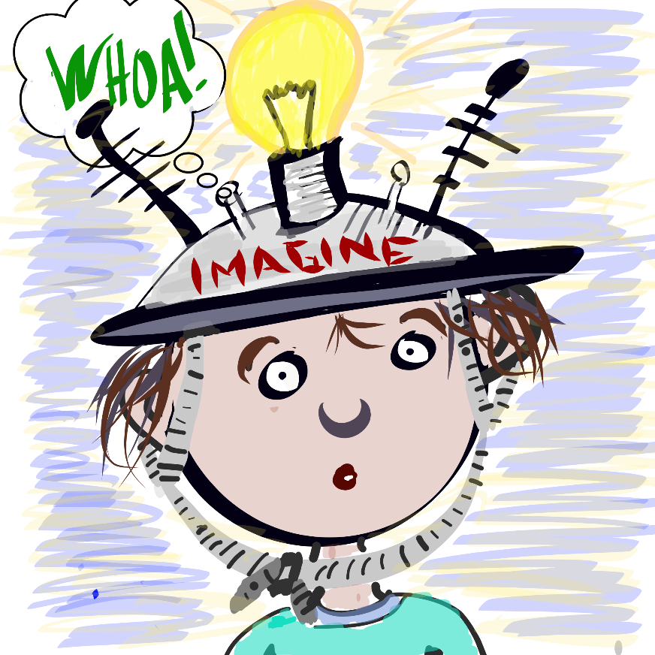
Provide students with an opportunity to explore something they are curious about. See the Genius Hour Lesson Plan for suggestions on how to structure this activity for students.
CHALLENGE
Genius Hour
Resource 5

Slide 41
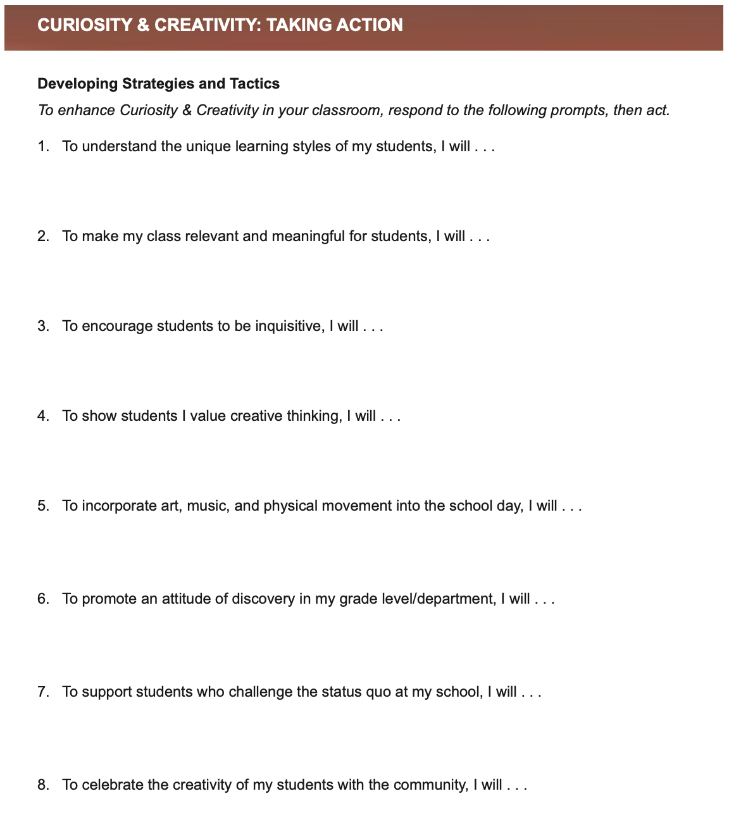
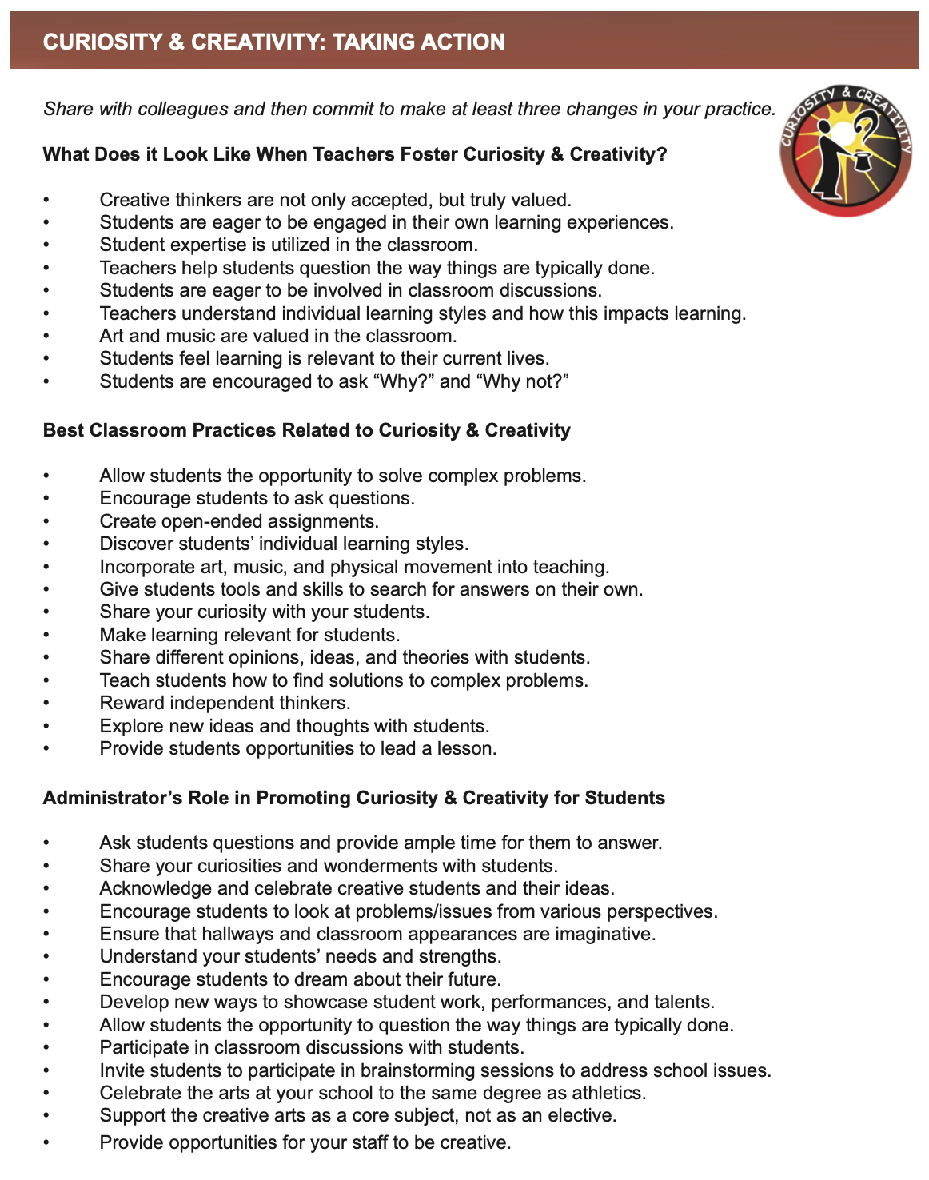
Taking
Action
Resource 6

Slide 42
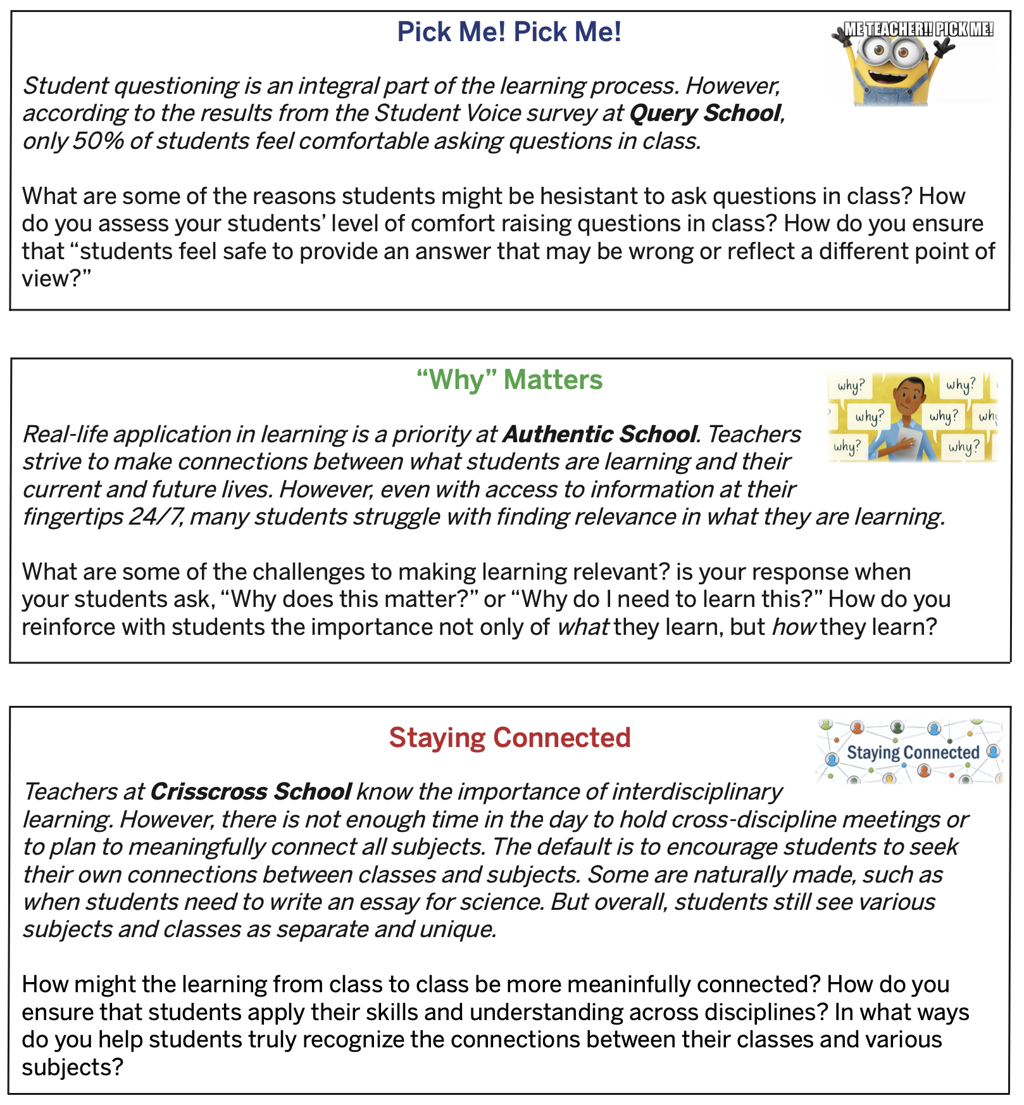
Reflect & Connect
Resource 7

Slide 43
Spirit of Adventure

Slide 44
Explorations:
The Adventure of Learning
YouTube:
https://youtu.be/eCuuoX9UjwI
Vimeo:
https://vimeo.com/qisva/explorations
Video

Slide 45
Key Points
It is more than being willing to try
something new, it is being excited about
the opportunity to experience & learn
new things!
Make it safe for teachers & students to fail & succeed.

Slide 46
Encouraging
Spirit of Adventure
Share with colleagues & students your
accomplishments & disappointments.
Share things you are & are not very
adventurous about.
Have a “Failfest” every now & again.

Slide 47
Challenge Time…

Slide 48
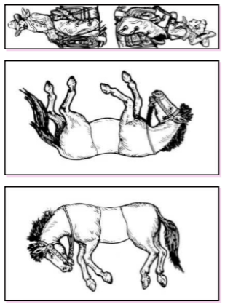
Solve the Puzzle
Arrange the 2 horses & the jockey sheets
so that the 2 jockeys
are mounted on the 2
horses (in the correct
manner that jockeys
ride horses!)
All 3 sheets should
be face up, do not
bend, fold, cut, or
tear the sheets.

Slide 49

Solve the Puzzle

Slide 50

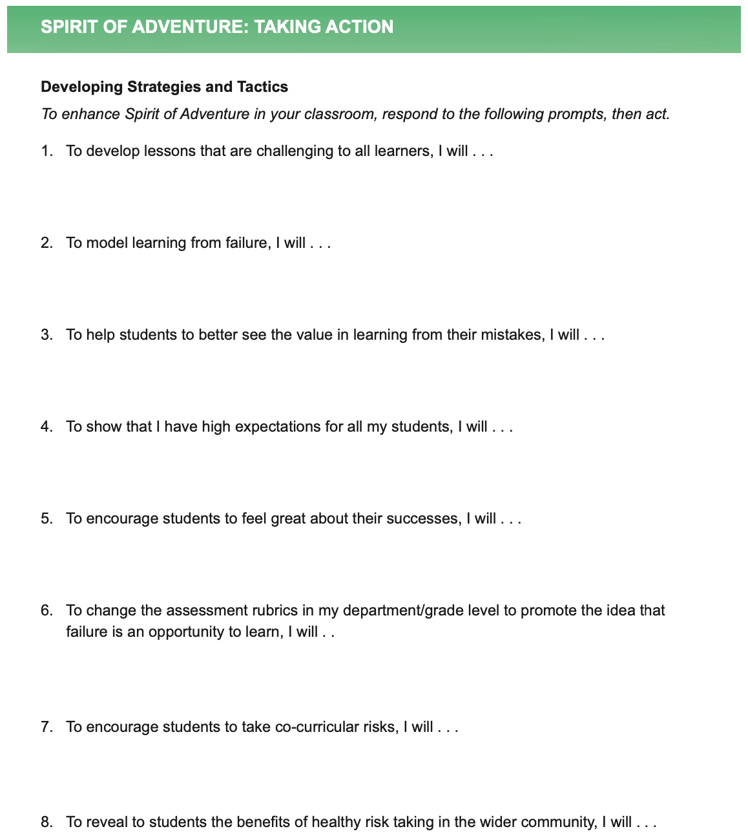
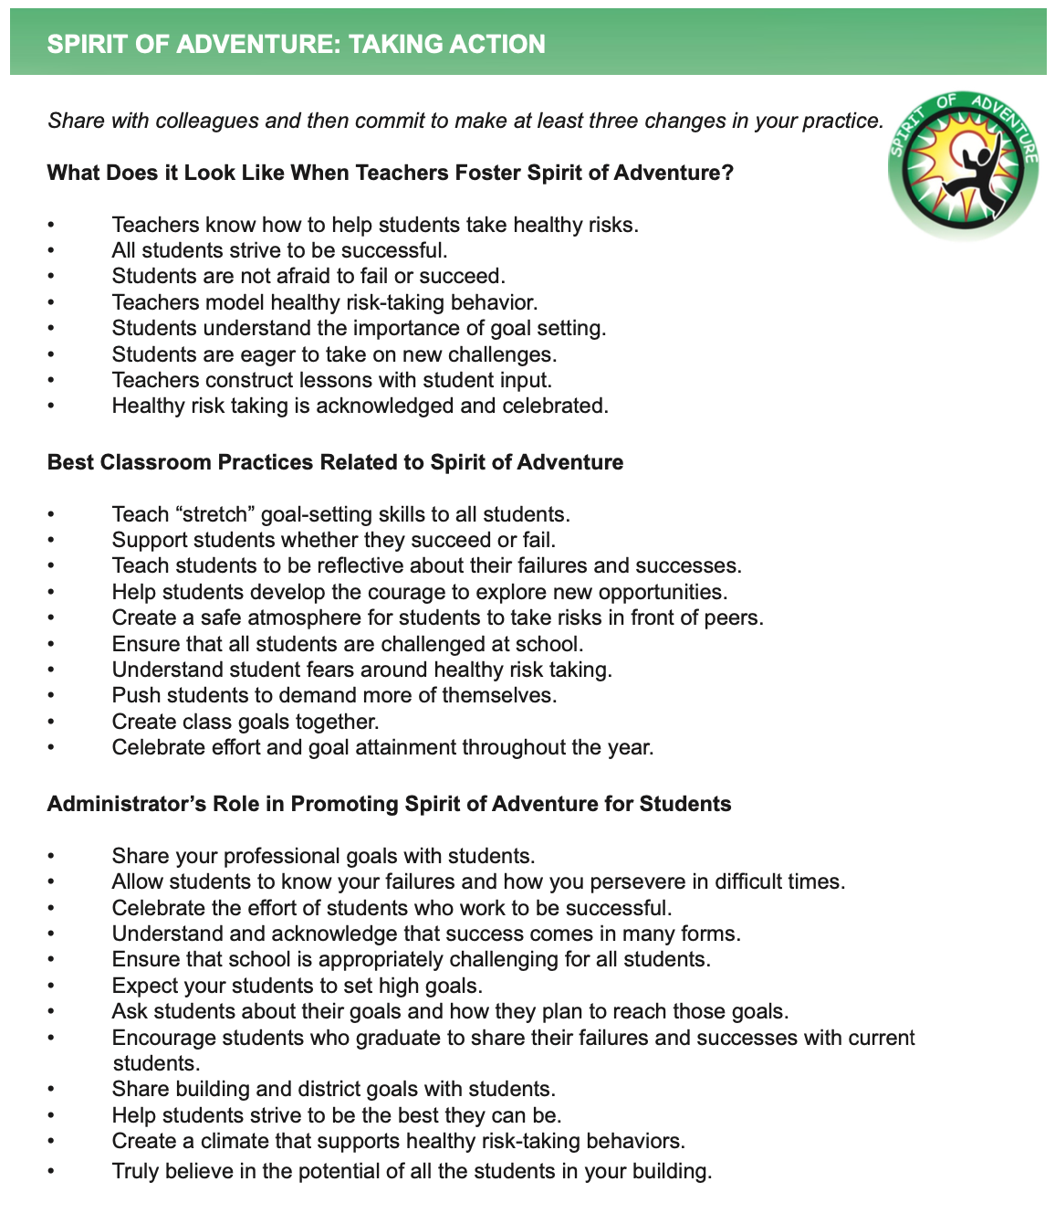
Taking
Action
Resource 8

Slide 51
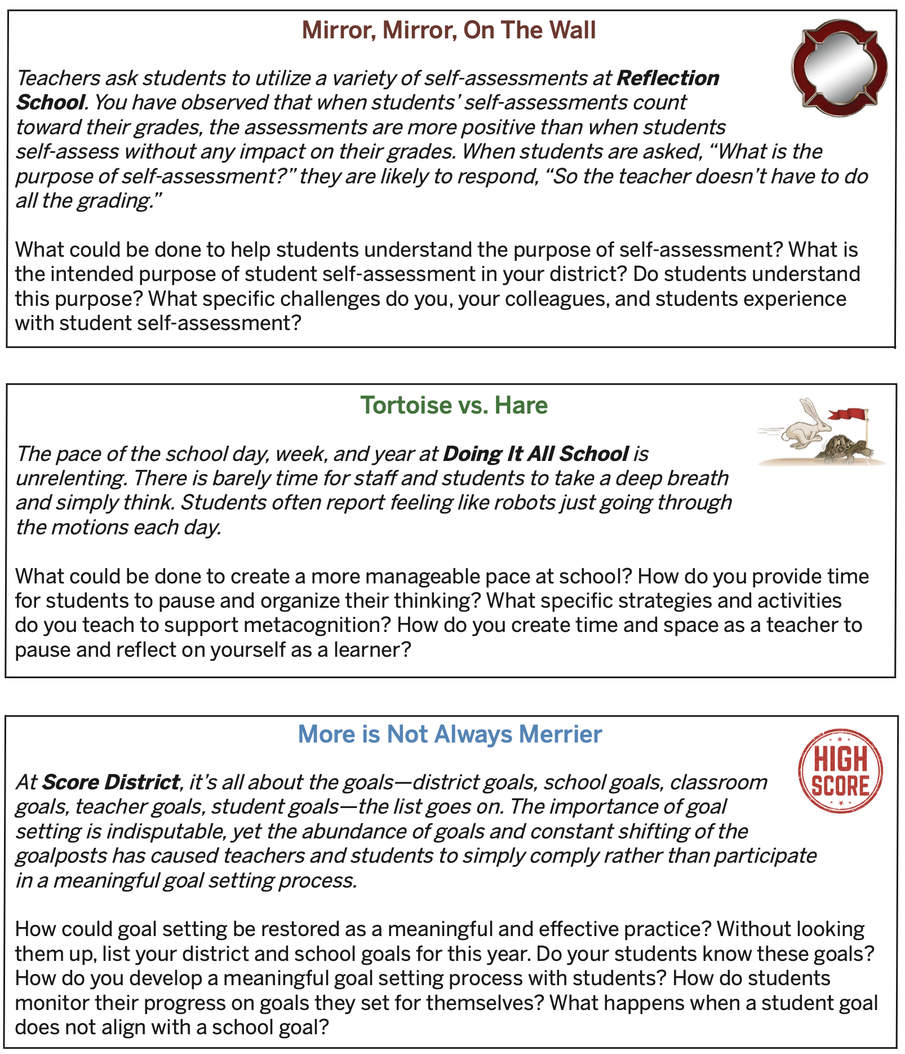
Reflect & Connect
Resource 9

Slide 52

Engagement

Slide 53
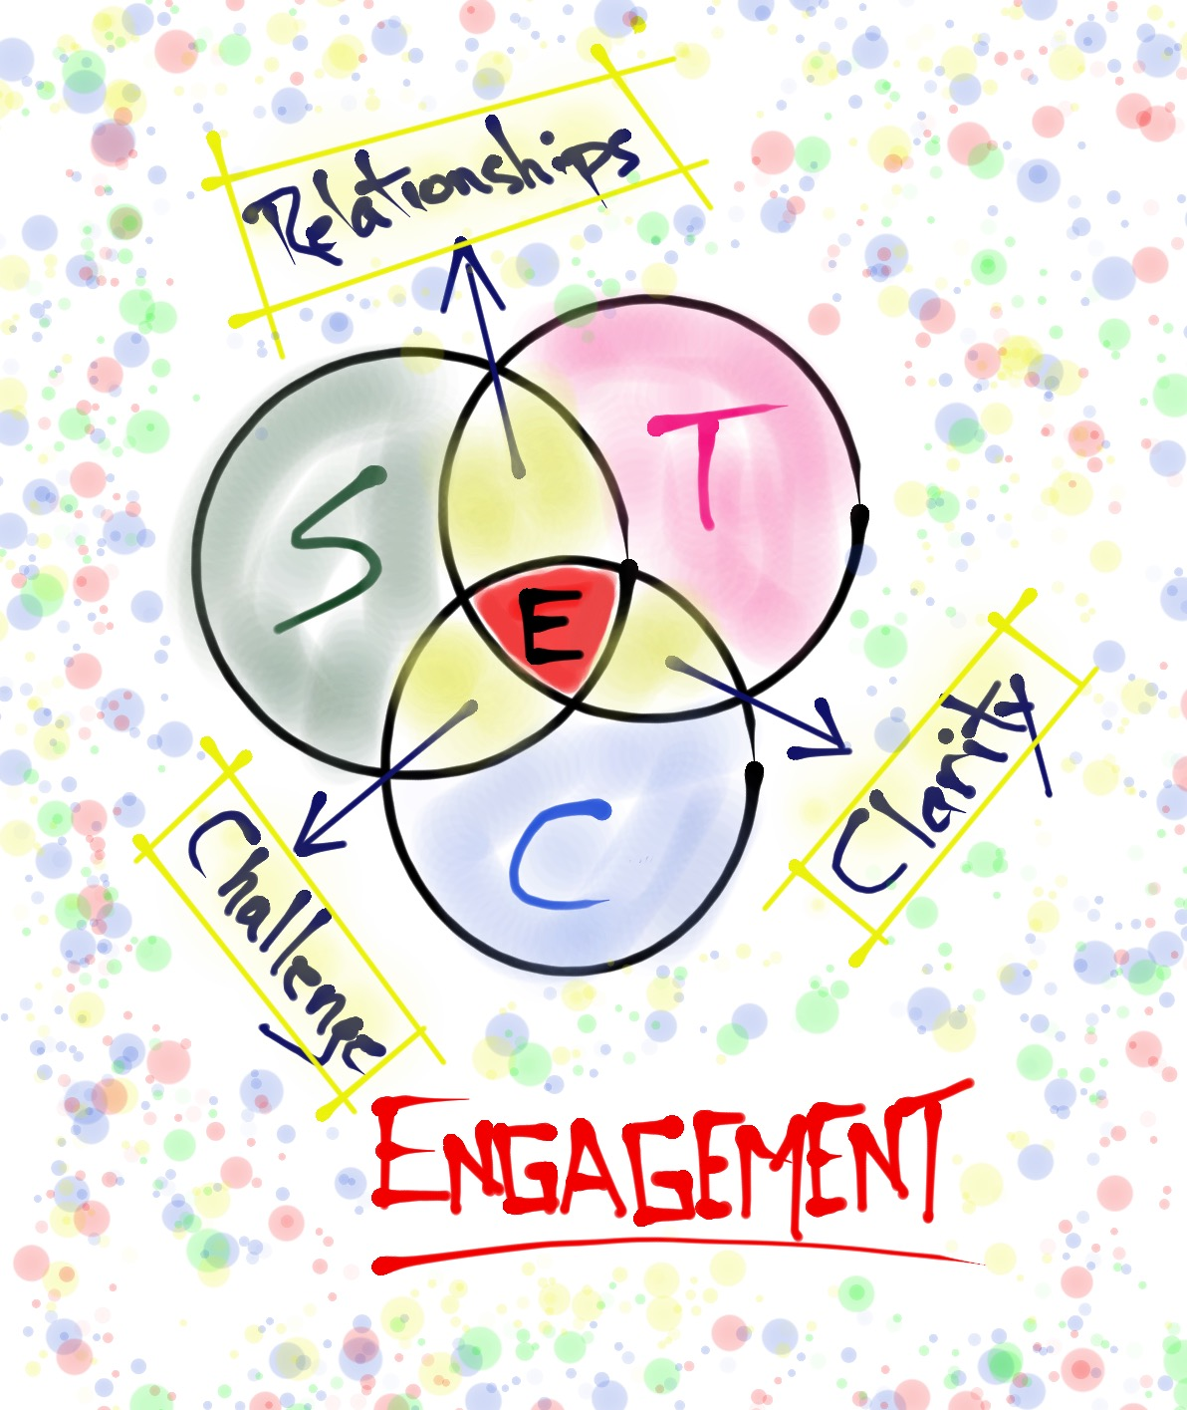
A Balanced Model for Engagement
Resource 10

Slide 54


A Balanced Model for Engagement
Teacher
Student
relationships
clarity
challenge
Content

Slide 55
A Balanced Model for Engagement
Teacher
Student
RELATIONSHIPS
clarity
challenge
Content

Slide 56
50% Teachers care if I am absent from
school.
45% I am a valued member of my school community.
56% Teachers make an effort to get to know me.
46% Teachers have fun at school.
Teacher
Student
RELATIONSHIPS
Content

Slide 57
A Balanced Model for Engagement
Teacher
Student
relationships
CLARITY
challenge
Content

Slide 58
43% My classes help me understand what is happening in my everyday life.
63% I feel comfortable asking questions in class.
42% Students are supportive of each other.
65% Teachers help me learn from my mistakes.
Teacher
Student
CLARITY
Content

Slide 59
A Balanced Model for Engagement
Teacher
Student
relationships
clarity
CHALLENGE
Content

Slide 60
Teacher
Student
44% School is boring.
42% I like challenging assignments.
59% Teachers recognize me when I try my best.
66% At school I am encouraged to be creative.
CHALLENGE
Content

Slide 61
A Balanced Model for Engagement
Teacher
Student
relationships
ENGAGEMENT
clarity
challenge
Content

Slide 62
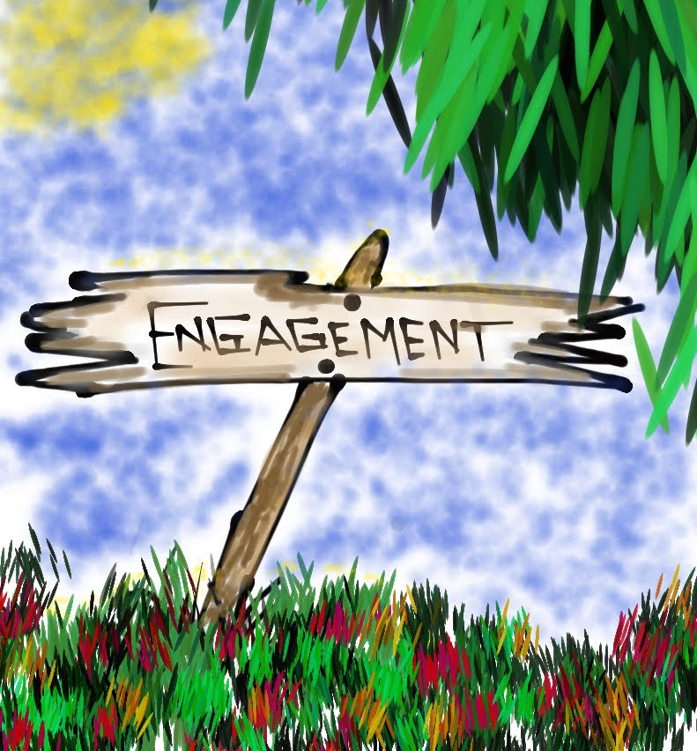
Roads to Engagement
Keeping in mind what you just learned about the Balanced Model
for Engagement,
create a learning
intersection &
share your best
Engagement strategies.
Record insights
from your learning
intersection.
Resource 11

Slide 63
Teacher Voice & Innovation
Read the information about Teacherpreneurs
In the spirit of
Teacherpreneurship,
create a reflection of an innovative idea
from your brain.
Share with your
ATL peeps!
Resource 12

Slide 64

Engagement Teacher Leader Actions
Resource 13
Take Action on an Engagement scenario linked to the Highly Effective Classroom Framework.
Design & deliver professional learning to your colleagues.
Be a Teaher-preneur
Dig into the book Total Participation Techniques book & come to the next session prepared to share one strategy you have tried.
Prepare for “Donʻt Be a Bore in 2034!” mock reunion at our next session.

Slide 65

Mock Reunion
Don’t be a Bore in 2034!
At our next session we will be engaging in an activity in which you will BE yourself 10 years from now & speak only in the present tense as if it were already 2034. Your goals are being achieved & all your dreams are coming true! Share what actions you have taken as a Teacher Leader. Feel free to bring props/artifacts that reflect things you have done such as best-selling books & articles you have written, magazine covers you have been on, awards you have won, & photographs of things you have achieved.

Slide 66

To further explore topics discussed today, check out the following pages in Teacher Voice: Amplifying Success
pgs. 26-30, 50-53
& 74-76

Slide 67
Stay Engaged! Don’t Give Up!
YouTube:
https://youtu.be/_ew45cNmtJM
Video

Slide 68

Leaves of Learning
What is one thing you learned today that can help you ”fall into a winning season”?

Slide 69
Being Meaningfully Engaged as a Teacher
Dr. Lisa Lande
www.quagliainstitute.org
#HenryATL2023
@Lisa_Lande

