Slide 1



Understanding My
Self-Worth as a Teacher
Dr. Lisa Lande
www.quagliainstitute.org
#HenryATL2022
@Lisa_Lande

Slide 2
Opening
Team
Challenge

Slide 3

Rise & Shine Reflection
I most remember
from Summer Camp…
Something that
resonated with me
from reading Big
Potential…
Today I hope to…

Slide 4
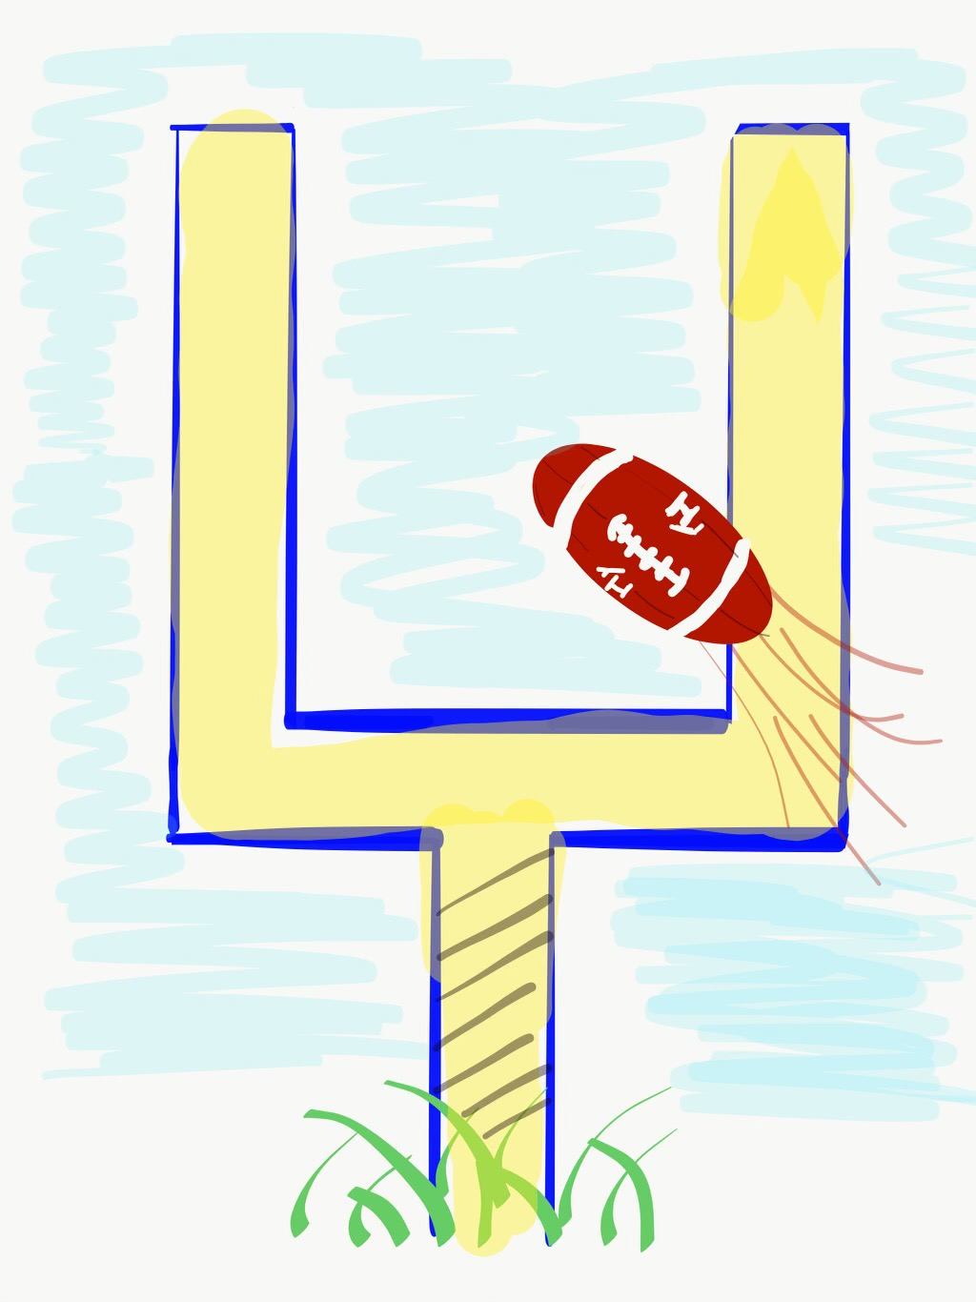

Come
Back!
Come
Back!

Slide 5
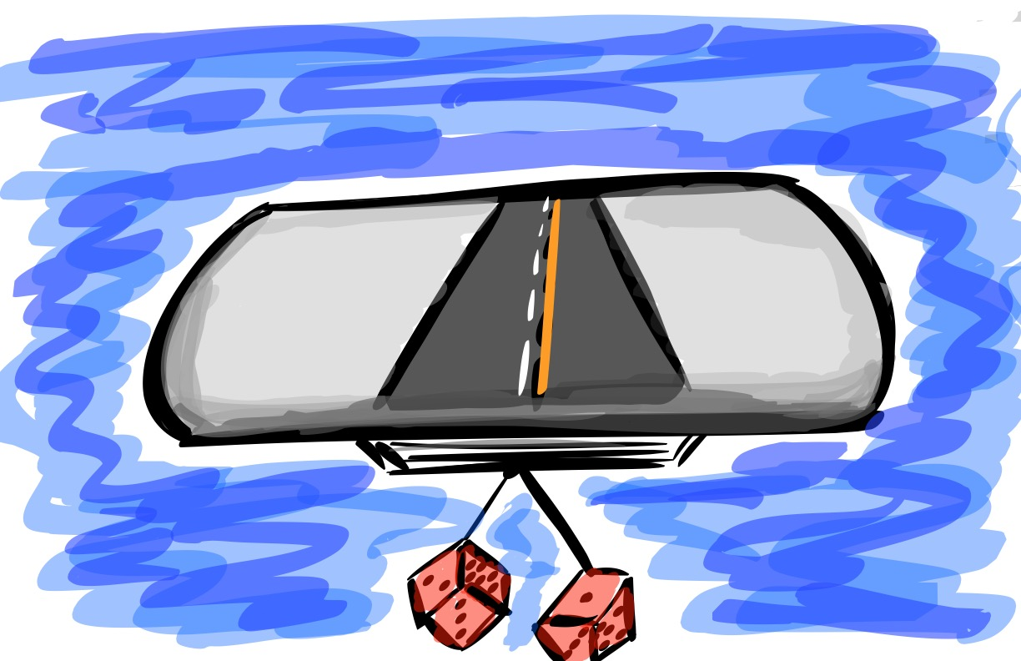
A Quick Review

Slide 6
The 3 Components of Teacher Voice
PART 1:
PART 2:
PART 3:

Slide 7

The 3 Components of Student Voice
Sharing thoughts & ideas in an environment underpinned by trust & respect.
Offering realistic suggestions for the
good of the whole.
Accepting responsibility for not only what is said but also what needs to be done.

Slide 8




high
Imagination
Aspirations
DREAMING
Hibernation
Perspiration
low
DOING
high

Slide 9

LEAD
TAKE ACTION
with others
Share
RESPONSIBILITY
LEARN
UNDERSTAND
& RESPECT
different points
of view
Build
TRUST
LISTEN
SEEK OUT
opinions from
others
School Voice Model
Student
Teacher
Principal

Slide 10



Homework
Check

Slide 11


Tuning Protocol
Adapted from
SRI Resource Guide p. 15-17
To be completed in pairs.
Presentation. Share what Teacher Leader actions
you have taken since Summer Camp. (3 min)
Clarifying Questions. Ask questions to gain
additional clarity on actions taken. (2 min)
Feedback. Celebrate successes & discuss ways to
grow/extend actions moving forward. (3 min)
Reflection. The presenter shares what they
have learned from the conversation. (2 min)

Slide 12
Come
Back!
Come
Back!

Slide 13



Today we journey onward to explore
Self-Worth
Resource 1

Slide 14

Self-Worth
Self-Worth flourishes when students & staff know they are valued members of the school community, have people in their lives they can trust & learn from, believe they have the ability to achieve, & know their efforts & hard work are recognized & celebrated in a variety of ways — academically, personally, & socially.

Slide 15

Essential Questions
What makes a teacher feel valued
as an educator?
How can schools cultivate a culture
of Belonging?
Who are your Heroes, & how are you a Hero?
What makes a teacher feel a Sense of Accomplishment, & why is this important?
How do the Guiding Principles of Self Worth relate to the Highly Effective Classrooms Framework?

Slide 16

Challenge Time…

Slide 17
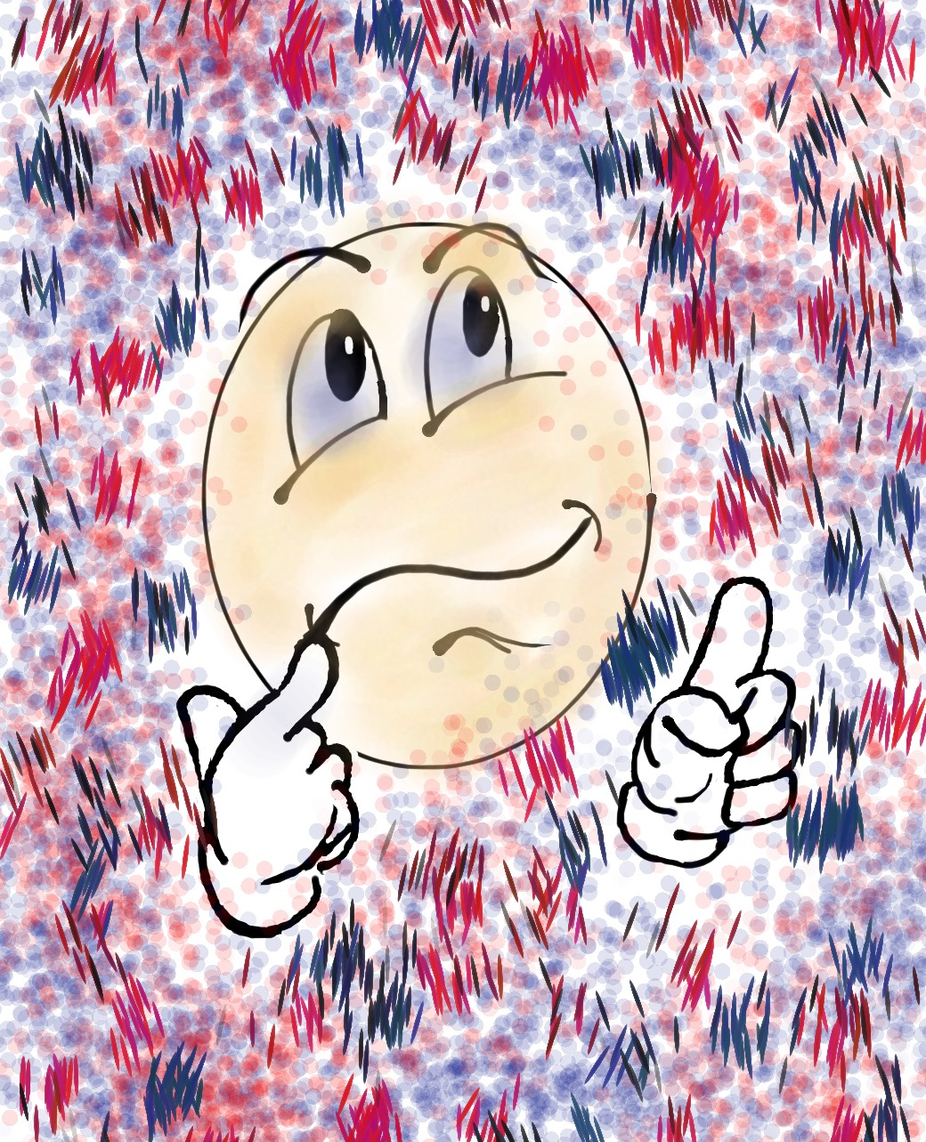

Challenge
Where do I Belong?
NO TALKING!!
NO looking at
your own dot.
Group yourselves according to the dots.

Slide 18
Challenge
Where do I Belong?
How did you FEEL
during the activity?
What did you observe
in others?
What did you learn?
How might you use this type of activity with
your colleagues &
students?
Resource 2

Slide 19

Quick Break!

Slide 20

Self-Worth
Teacher Reflection
Individually, complete the rank order section of the self-assessment.
Discuss the 3 reflection questions.
Resource 3

Slide 21
Come
Back!
Come
Back!

Slide 22
Belonging

Slide 23
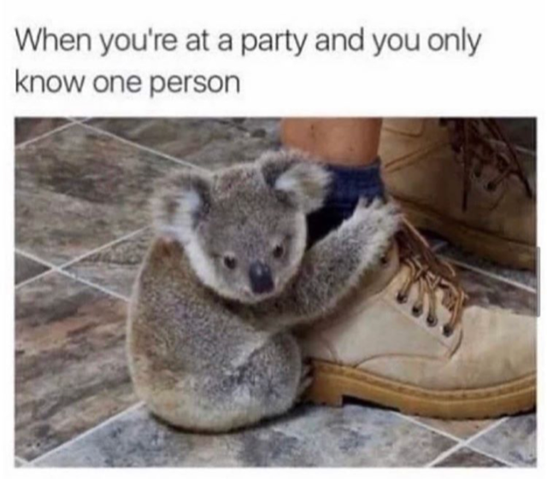

Slide 24
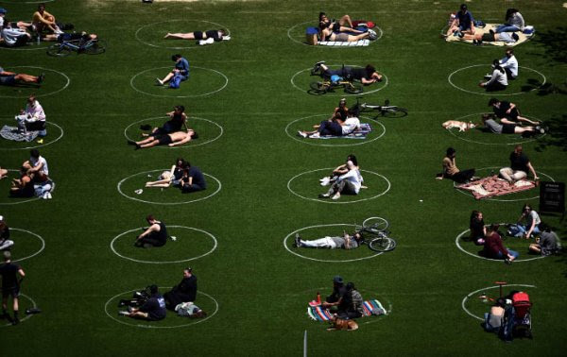

Slide 25
Challenge Time…

Slide 26

Be the first person to solve this riddle!
What is something you own, but everyone
else uses?

Slide 27
Do You Know Me?
Vimeo
https://vimeo.com/854745592
YouTube
https://youtu.be/ZQ0k2iAG1fk
Video

Slide 28
Key Points
Create community without losing the identity of any individual.
Before teachers can feel like they belong
there needs to be trust & respect.
Belonging is about accepting, not judging.

Slide 29
Cultivating
Belonging
Learn & use names (correctly).
Be intentional.
Be human! Get to KNOW your colleagues!
Recognize & celebrate differences.
Expand your posse.

Slide 30
Challenge Time…

Slide 31
What’s in a Name
Adapted from
SRI Resource Guide p. 163-164
“My Name”
From The House on Mango Street
by Sandra Cisneros
Resource 4
Write the story of your name using the
provided resource.
Find a partner you do not yet know well &
share the stories of your name.
Merge with another set of partners & introduce
your last partner via their name story.

Slide 32
Come
Back!
Come
Back!

Slide 33

Reflect
What do you currently do to let others know they Belong at your school?
How can you further cultivate a Sense of Belonging at your school this year?
How does Belonging connect to the Highly Effective
Classrooms Framework?

Slide 34
Take Away Challenge…

Slide 35
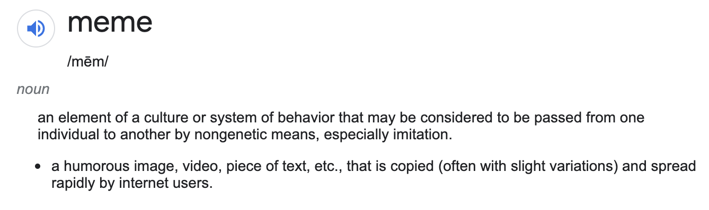
Challenge
Belongmemes

Slide 36


Slide 37
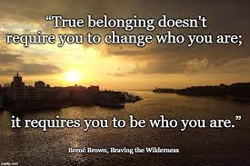

Slide 38


Slide 39
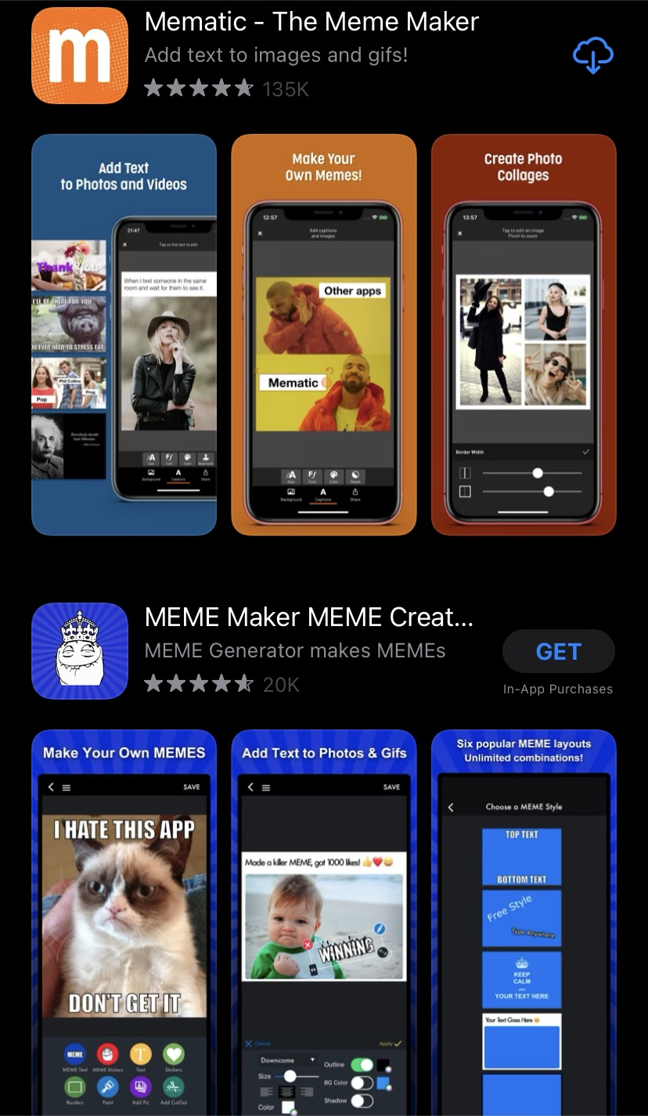
Challenge
Belongmemes
Resource 5
Create a Belong-Meme using a Meme App (or create on an
old school notecard!)
Tweet it out so your colleagues
can see your Meme!
#HenryATL2023

Slide 40

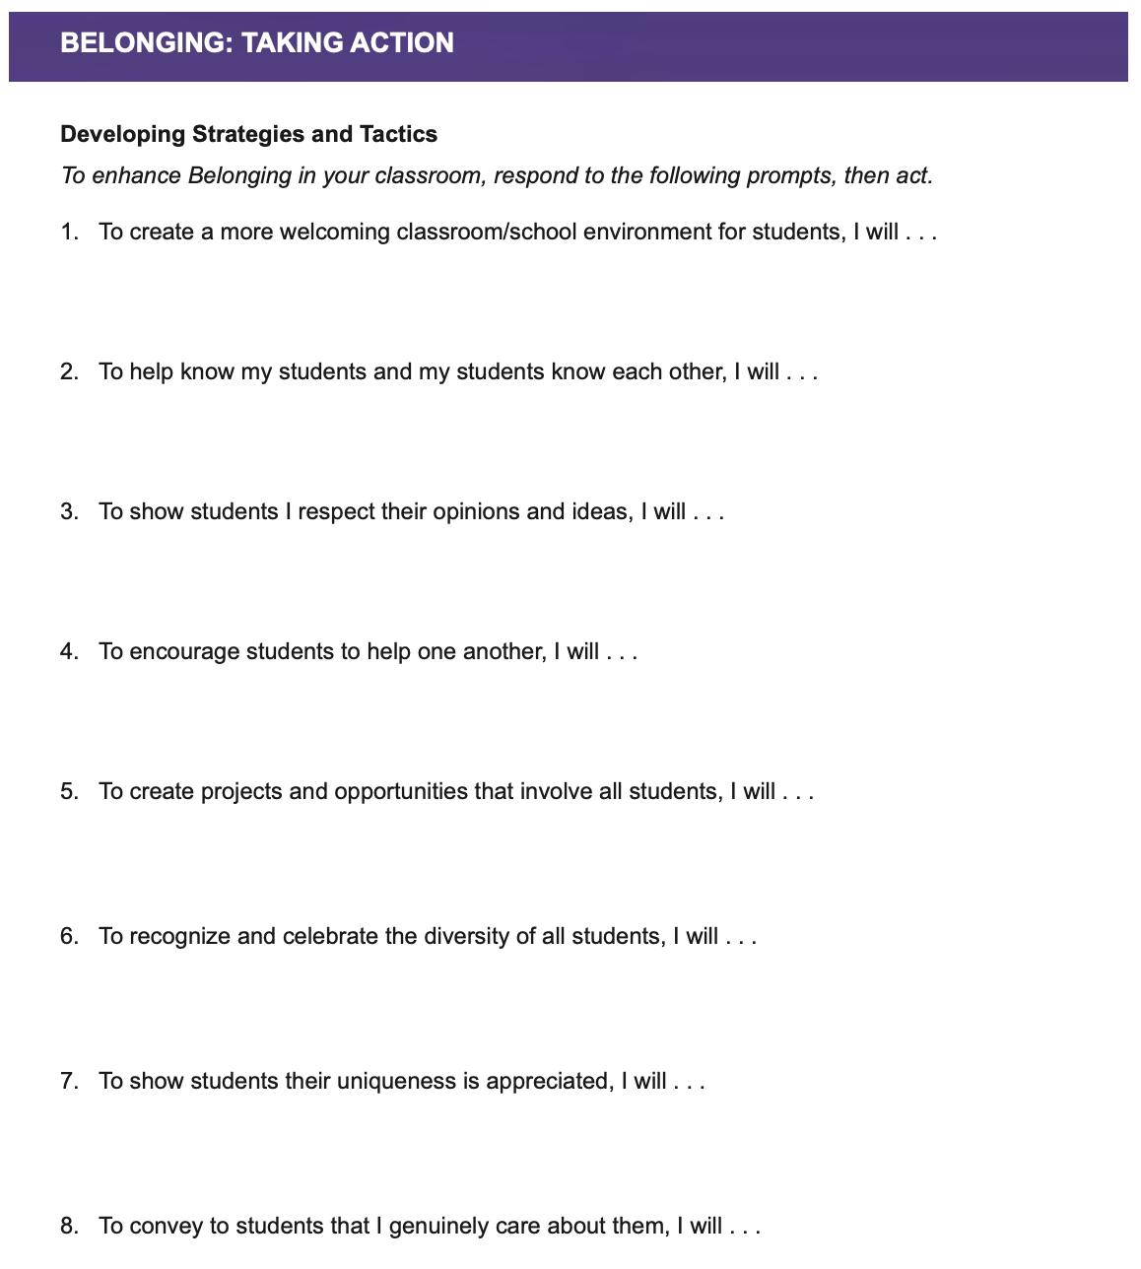
Student
Application
Resource 6

Slide 41

Taking Action
Read through the Belonging Taking Action resource.
Highlight action statements you will intentionally try.
Complete the “I will…” statements.
Resource 6

Slide 42
Heroes

Slide 43
You ARE a Hero!
Vimeo
https://vimeo.com/854746766
YouTube
https://youtu.be/v4aFemrsoMw
Video

Slide 44
Key Points
Be there when things go sideways….
& when things are worth celebrating.
Must be accessible.
Relationships, relationships, relationships.
It takes respect to get respect.
You are a hero whether you know it or not.

Slide 45
Becoming a Hero
Take time to REALLY listen.
Words & smiles are important.
Make sure your colleagues (& students)
know they matter to YOU.
Have high expectations of success.

Slide 46


Slide 47
Challenge Time…

Slide 48

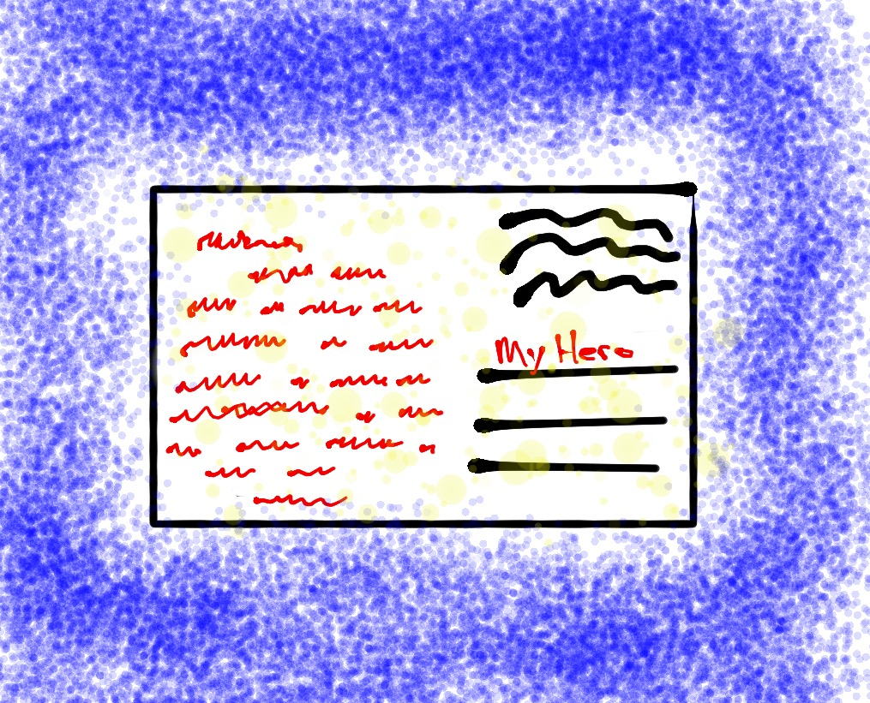
Challenge
Attitude of Gratitude
Write a note of gratitude honoring an act of heroism…
small or big!
(Don’t forget to deliver it!)
Resource 7 & 8

Slide 49
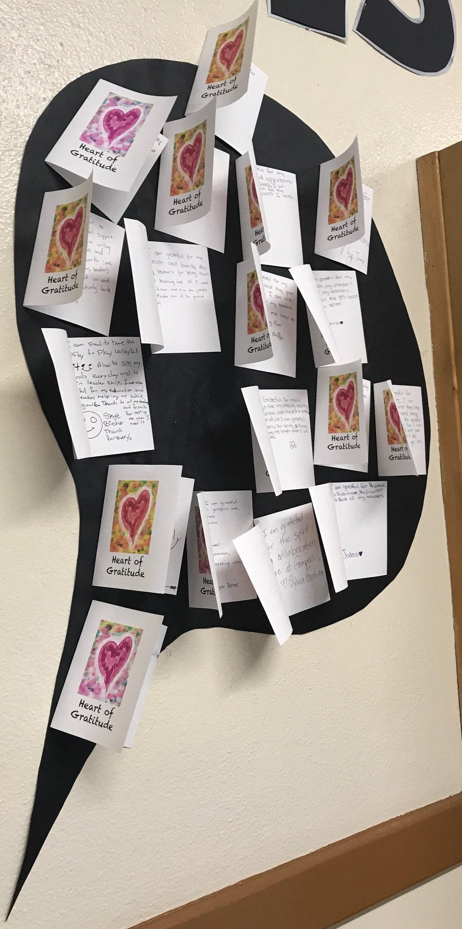
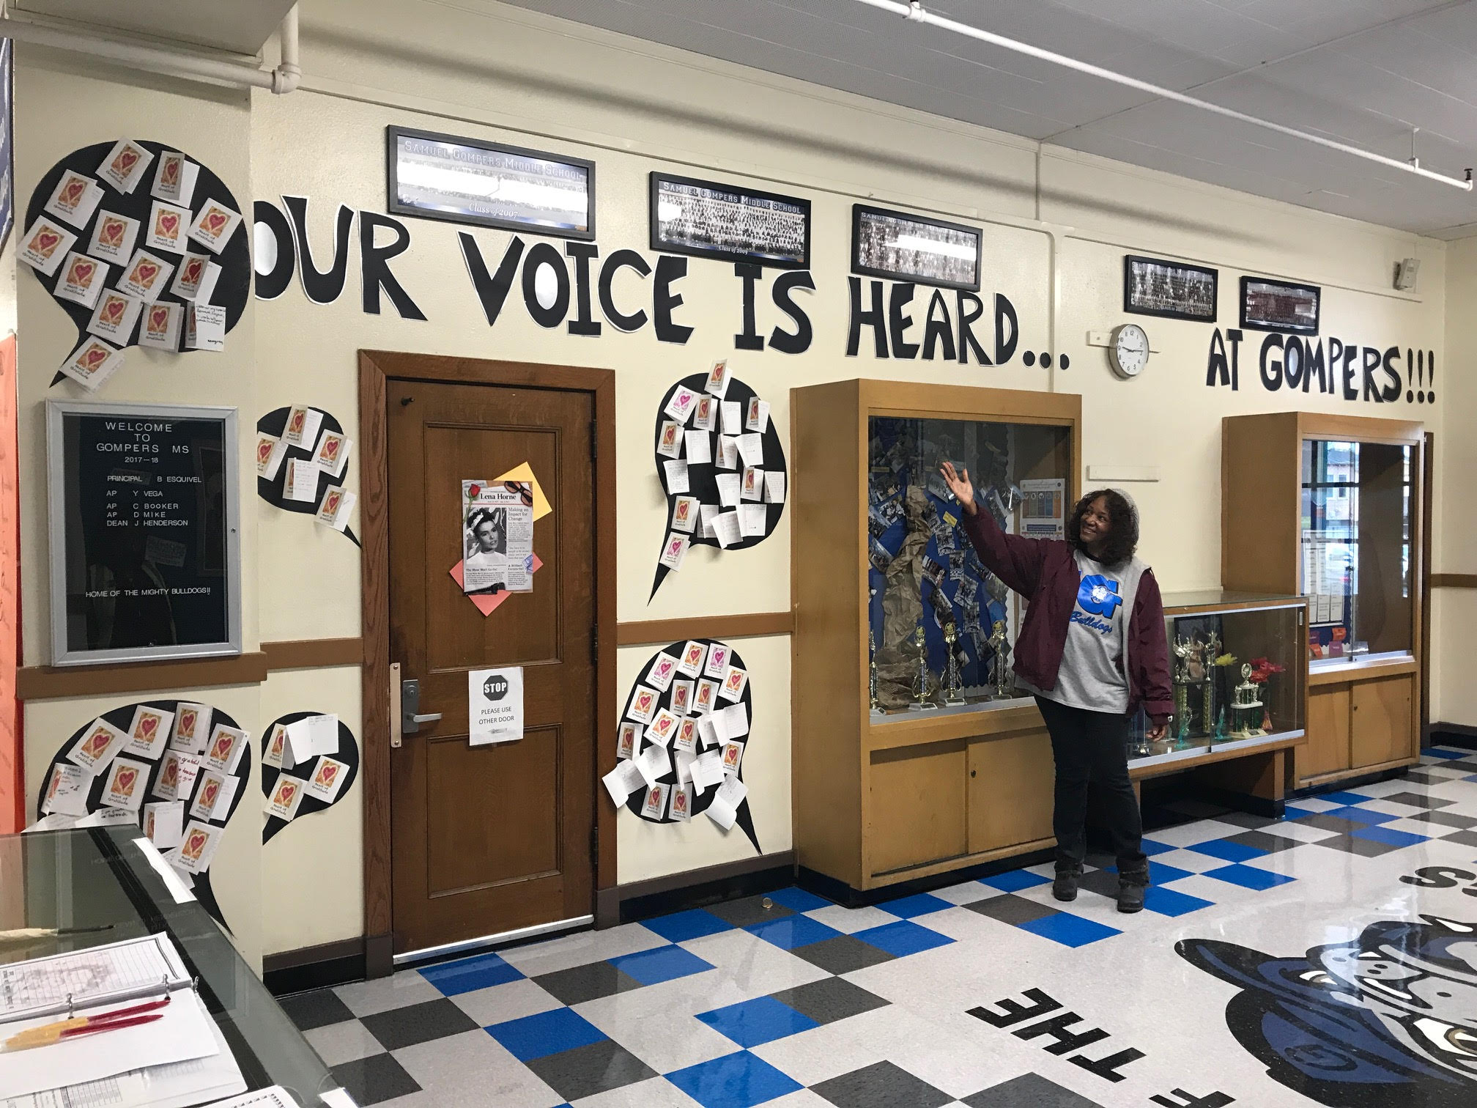
Challenge
Attitude of Gratitude

Slide 50
Reflect
Share a time you were a Hero to a student or colleague.
Share a time when a student or colleague was a Hero for you.
How does the Condition
of Heroes connect to
the Highly Effective
Classrooms Framework?

Slide 51
Come
Back!
Come
Back!

Slide 52
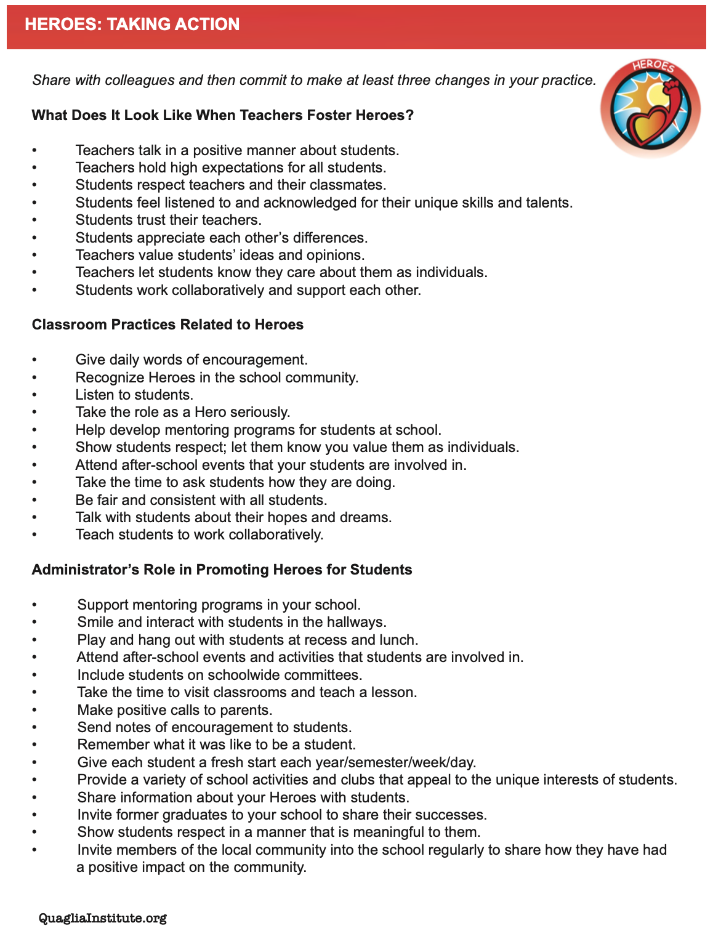
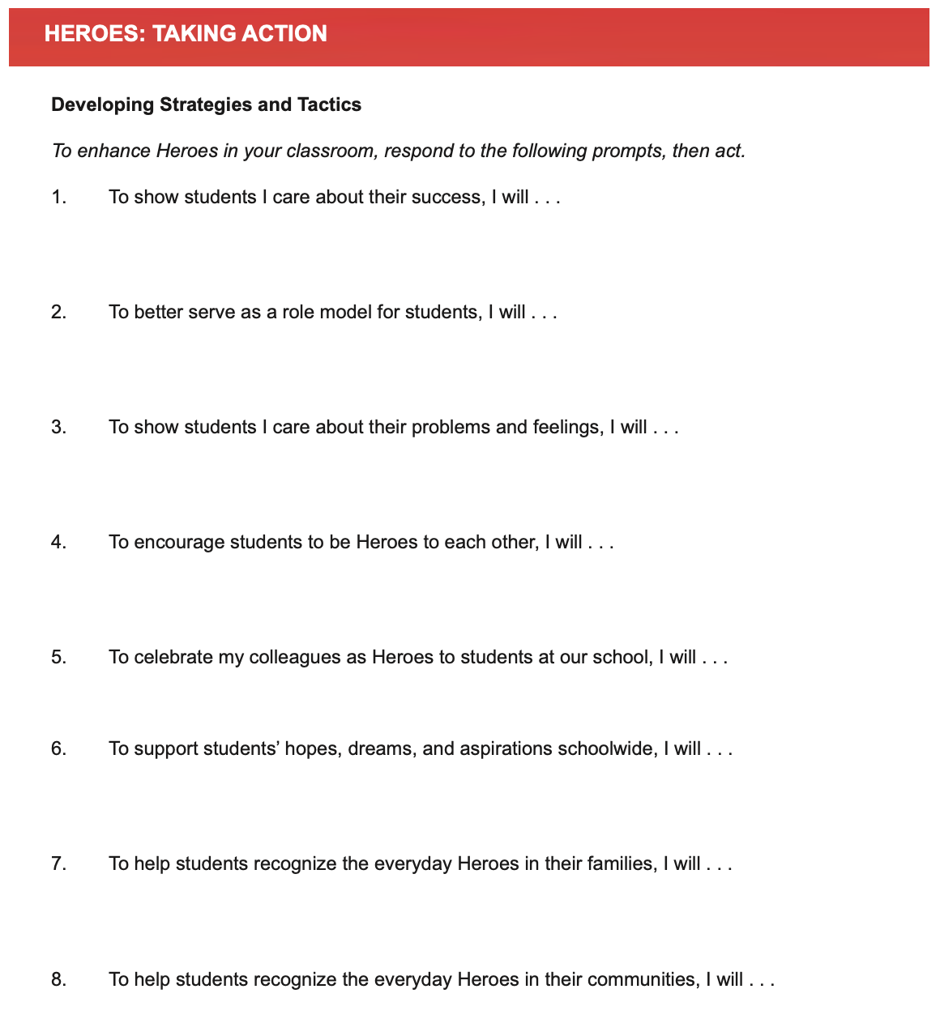
Student
Application
Resource 9

Slide 53
Taking Action
Read through the Heroes Taking Action resource.
Highlight action statements you will intentionally try.
Complete the “I will…” statements.
Resource 9

Slide 54
Sense of Accomplishment

Slide 55
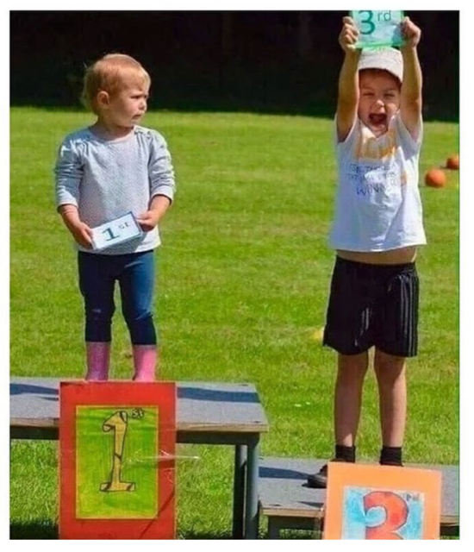

Slide 56
Effort and Perseverance
Vimeo
https://vimeo.com/854748561/53926aaf4e
YouTube
https://youtu.be/w6SgUPwJNNs
Video

Slide 57
Key Points
Move beyond just academic success…
effort, perseverance & citizenship matter.
Value & recognize the learning process,
not just the final product.
Teachers need to establish, recognize &
celebrate their own achievements.

Slide 58
Instill a Sense of Accomplishment
Provide teachers opportunities to reflect
& self assess.
Teachers need clarity & purpose behind
expectations. Help build the “why”!
Provide a wide variety of opportunities for
teachers to grow & succeed.
Revise, revisit, redo!

Slide 59
Challenge Time…

Slide 60
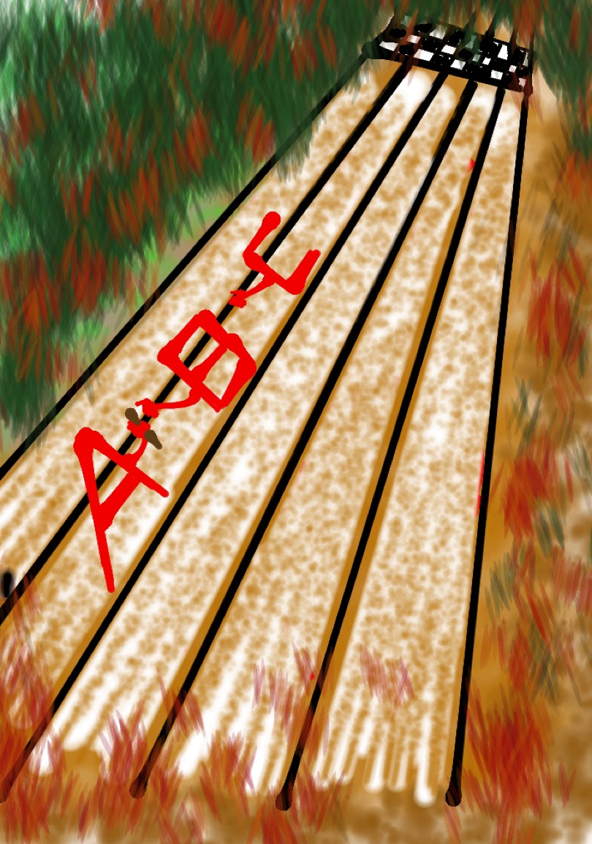
Challenge
A-Z Accomplishments Relay
List examples of different things & ways you celebrate at school starting with each letter of the alphabet.
Once a letter covered, move on to the next letter. You may not skip letters!
Resource 10

Slide 61
Reflect
Create a pie chart & assign percentages
to the major things your school celebrates,
with all percentages totaling to 100%.
What would you like to maintain?
What would you like to change?
How does Sense of Accomplishment
connect to the Highly Effective
Classrooms Framework?

Slide 62
Come
Back!
Come
Back!

Slide 63
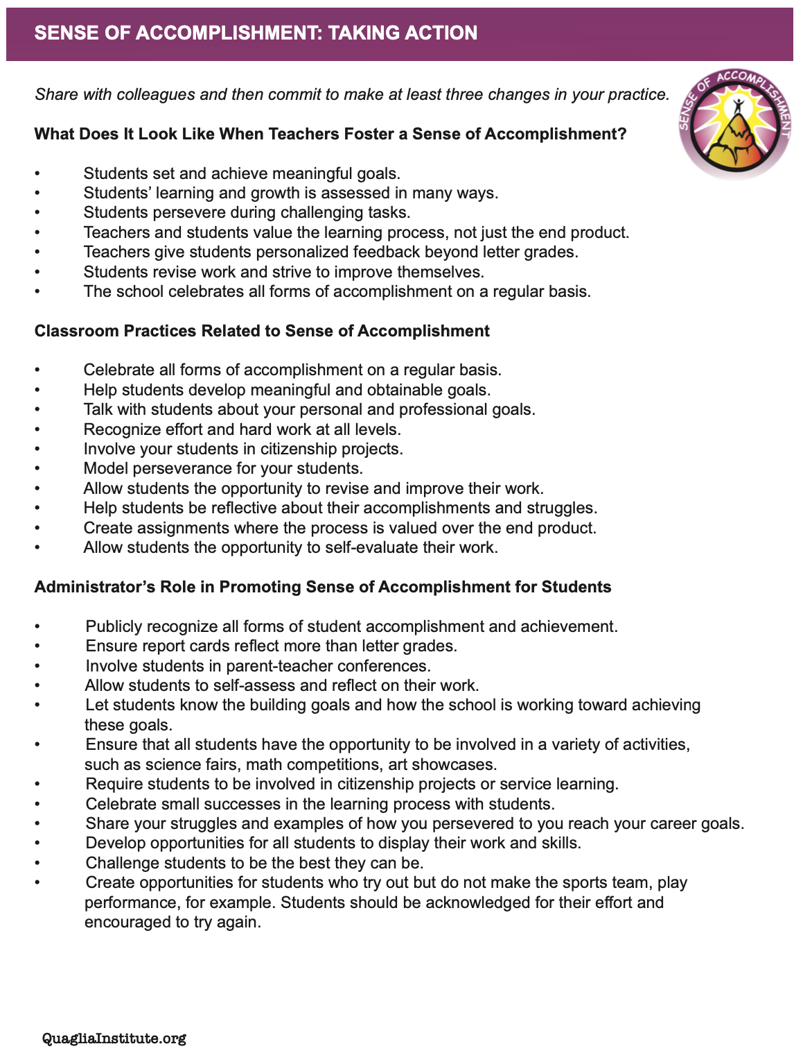
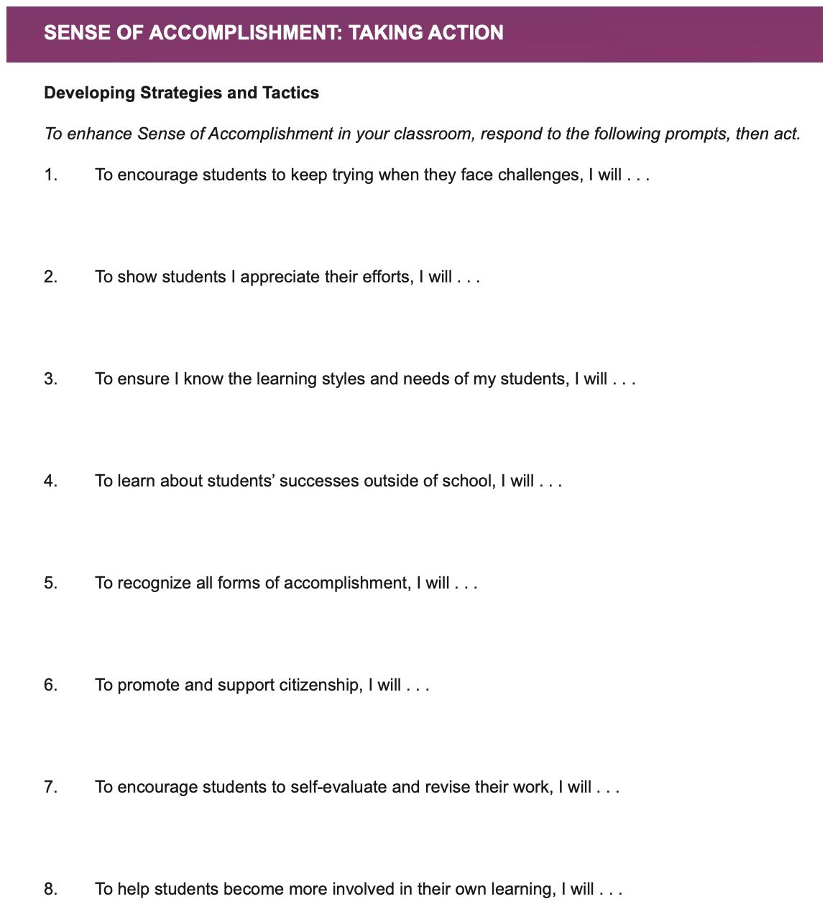
Student
Application
Resource 11

Slide 64
Taking Action
Read through the Sense of Accomplishment Taking Action resource.
Highlight action statements you will intentionally try.
Complete the “I will…” statements.
Resource 11

Slide 65
Self-Worth
Feeling like you are part of a
group, while knowing you are
valued as an individual.
Having someone in your life to
consistently support & encourage you in good times & bad.
Being recognized for different types of successes on a regular basis.
TV Book p. 46-50

Slide 66
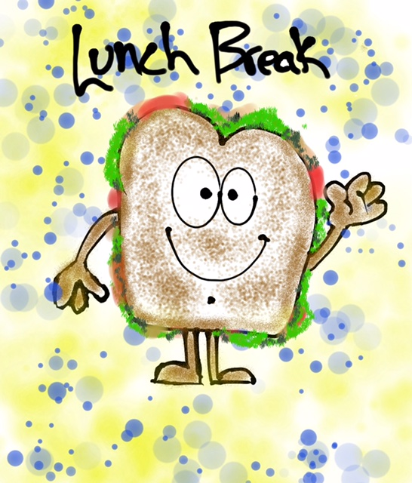

Slide 67
Come
Back!
Come
Back!

Slide 68
Challenge Time…

Slide 69
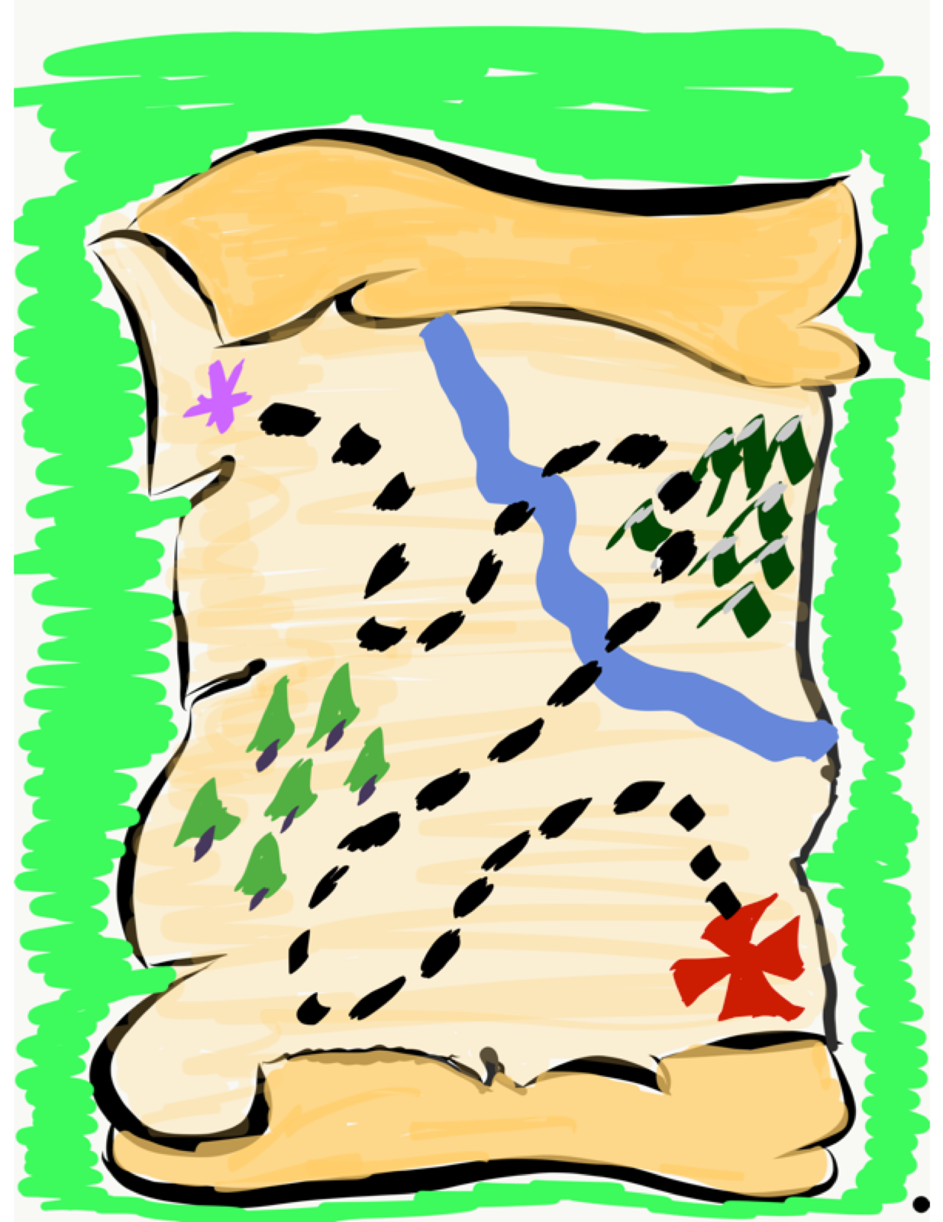
Self Worth Map
Part 1: Create a map that reflects your journey with Self-Worth as a teacher.
-Important Experiences
-Moments of Triumph
-Epic Challenges
-Next Destination
Here are a few examples…

Slide 70
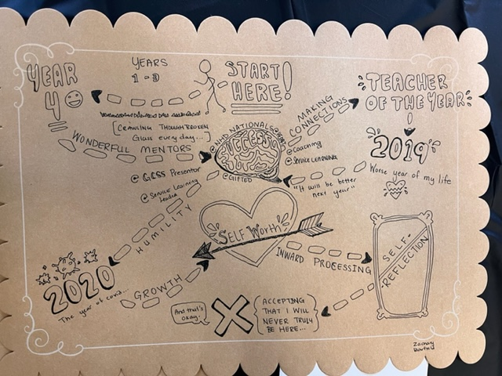
Self Worth Map

Slide 71
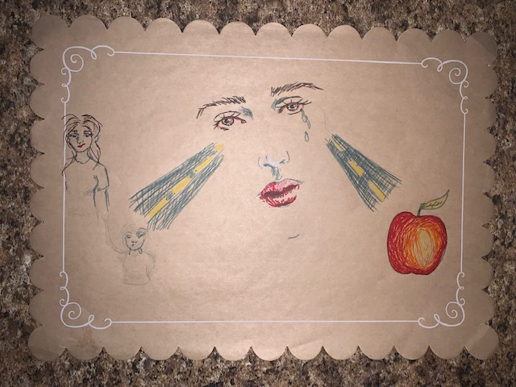
Self Worth Map

Slide 72
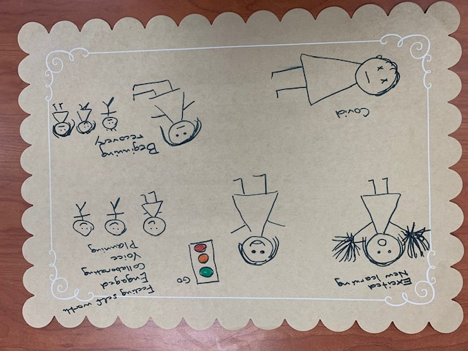
Self Worth Map

Slide 73

Self Worth Map
Part 1: Create a map that reflects your journey with Self-Worth as a teacher.
-Important Experiences
-Moments of Triumph
-Epic Challenges
-Next Destination
Part 2: ”Meet with Your Feet” & share your map with a new “teammate”!

Slide 74
Come
Back!
Come
Back!

Slide 75
Challenge Time…

Slide 76
Festivus…
Vimeo
https://vimeo.com/854750210/cfc61b4844
YouTube
https://youtu.be/EQBJalEtSSc
Video

Slide 77
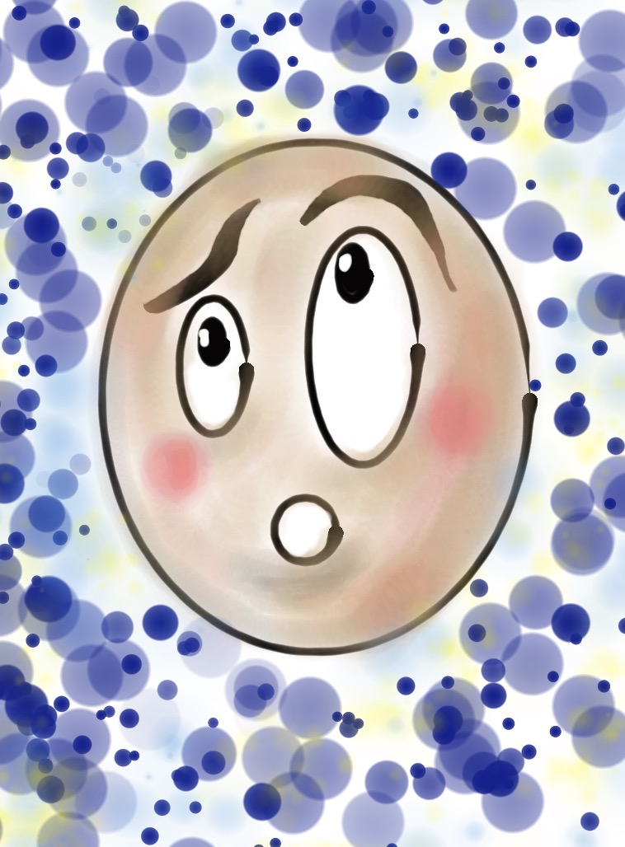
Failfest
Complete the Failfest reflection prompts & discuss with your “teammates”!
Resource 12

Slide 78
Failfest
What did you FEEL during the activity?
What did you observe in others?
What did you learn?
How might you use this type of activity with your colleagues & students?

Slide 79
Come
Back!
Come
Back!

Slide 80
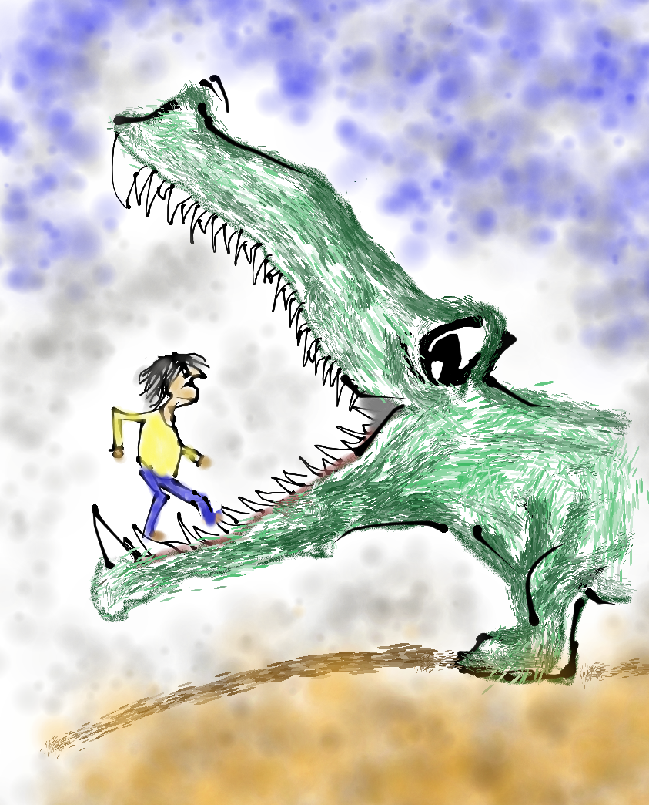
Reflect
Give your
“stress football” a squeeze & share
something that really
stressed you out in your
first few years of teaching.

Slide 81
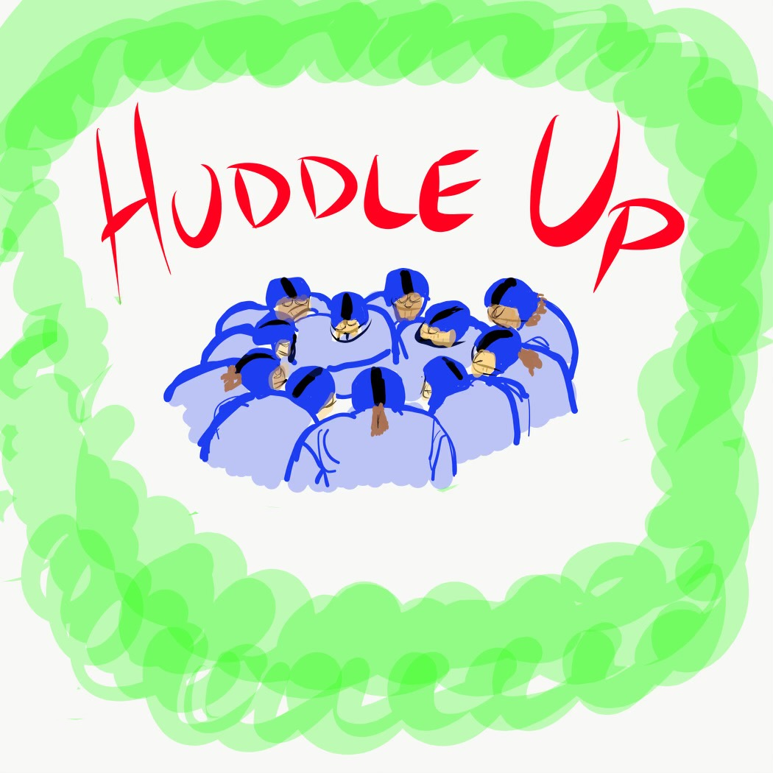
Teacher Voice & Retention
Read aloud to get us thinking.
“Draft” a new teammate & “huddle up” to brainstorm ideas for how teacher leaders can support retaining great teachers.
Share what you learned with your Table Team.
Resource 13
TV Book p. 24-25

Slide 82
Come
Back!
Come
Back!

Slide 83


Citizens & Visitors
As a Table Team, determine your definitions for citizens & visitors.
Individually, respond to the 3 reflection questions.
In pinwheel groups of 6, discuss your responses to the reflection questions.
Resource 14

Slide 84
Self Worth
Scenarios
Identify an aspect of the Highly Effective Classrooms Framework that could be enhanced through an intentional focus on cultivating Self Worth.
Suggest 2 actions that can be taken to address the scenario you create.
Share scenarios with your partner team & add a 3rd action that could be taken to address the new scenario you are considering from the other team.

Slide 85
Come
Back!
Come
Back!

Slide 86
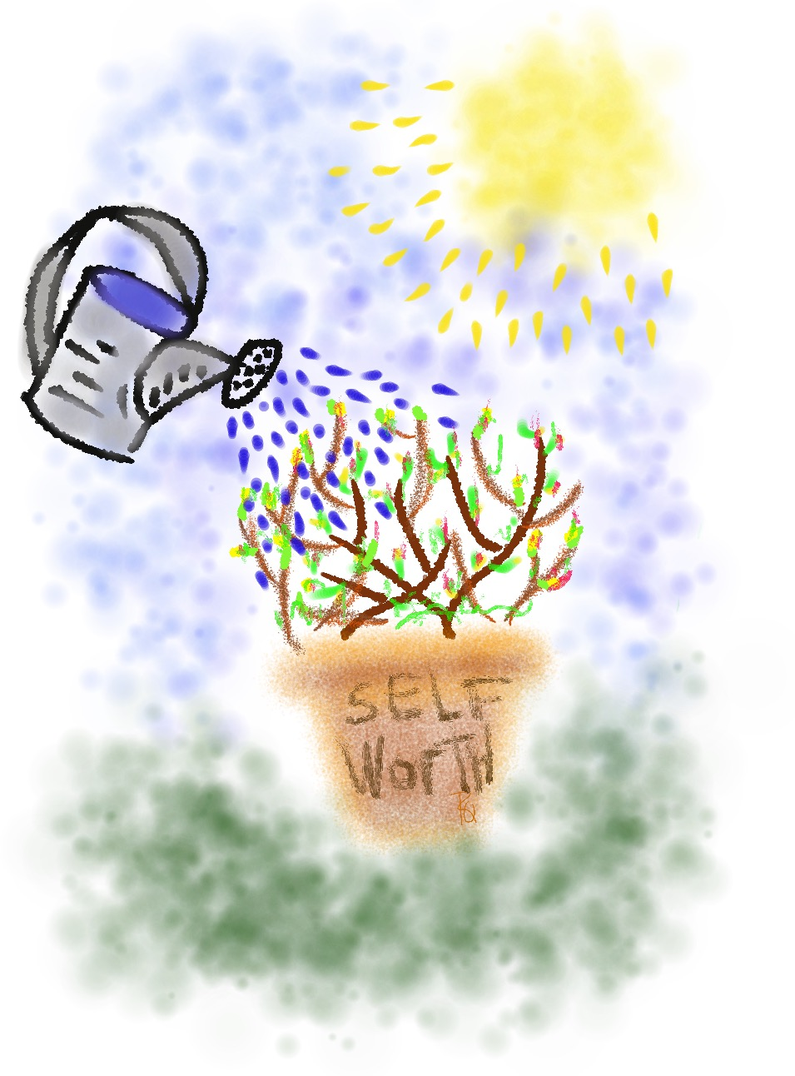
Growing Self-Worth
Individually, respond to the prompts & apply what we have learned about self-worth to your
school context.
Discuss with your Table Team.
Resource 15

Slide 87
Come
Back!
Come
Back!

Slide 88


Kick Off Reading
Enjoy the following reads to help
kick off this season of learning:
Teacher Voice: Amplifying Success
pgs. 24-25, 46-50
& 66-68
Teach Like
a Champion

Slide 89
Self Worth Teacher Leader Actions
Resource 16
Take Action on a Self Worth scenario linked to the Highly Effective Classroom Framework.
Design & deliver professional learning to your colleagues.
Dig into the book Teach Like a Champion & come to the next session prepared to share one strategy you have tried
from the book.

Slide 90
Vimeo
https://vimeo.com/854753125/d1143f7e2c
YouTube
https://youtu.be/tCzM7ZjwT0U
Video

Slide 91

Whistle Worthy Moments!
What is your whistle worthy moment of learning from today?

Slide 92
Understanding My
Self-Worth as a Teacher
Dr. Lisa Lande
www.quagliainstitute.org
#HenryATL2022
@Lisa_Lande

