Slide 1


The Voice Process:
Listen, Learn, Lead
Dr. Lisa Lande
www.QuagliaInstitute.org
June 21, 2023

Slide 2

#HenryATL2023
@Lisa_Lande
@QISAtweets
Tweet Your
Teacher Voice Journey!

Slide 3

Essential Questions
What does it look like in your
current role to effectively listen,
learn, and lead?
What will it take to effectively engage your voice as a teacher leader?
How can you capitalize on the communication and collaboration skills you already have, and continue to develop these skills, to amplify your voice?
How does our learning today reflect The Henry County Highly Effective Classroom Framework?

Slide 4

Quick Review
WITHOUT looking at notes,
write anything you remember from the 3-part Voice
definition from yesterday.

Slide 5

The 3 Components of Student Voice
Sharing thoughts & ideas in an environment underpinned by trust & respect.
Offering realistic suggestions for the
good of the whole.
Accepting responsibility for not only what is said but also what needs to be done.

Slide 6




high
Imagination
Aspiration
DREAMING
Hibernation
Perspiration
low
DOING
high

Slide 7

Time to journey
onward & explore
the Voice Process:
Listen, Learn,
& Lead

Slide 8

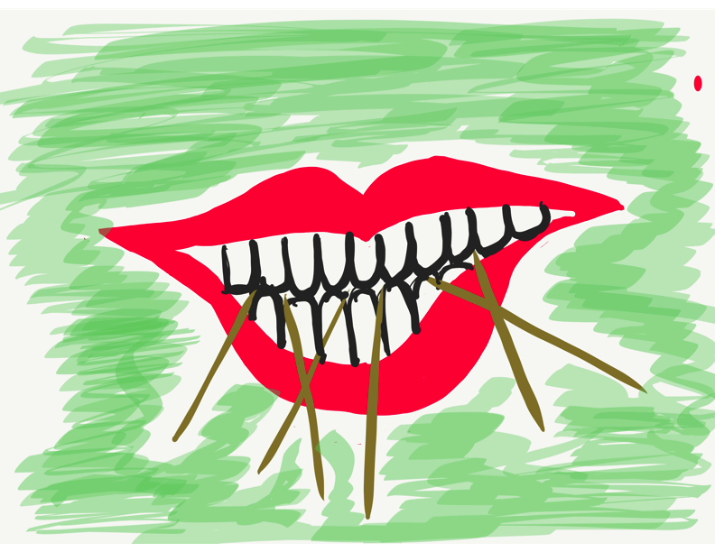
Challenge Time!
Using 6 toothpicks,
make 4 and only 4
equilateral triangles
(all 3 sides the same size).
You may not break the toothpicks.

Slide 9
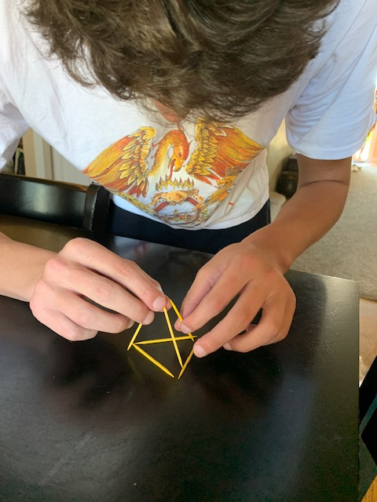
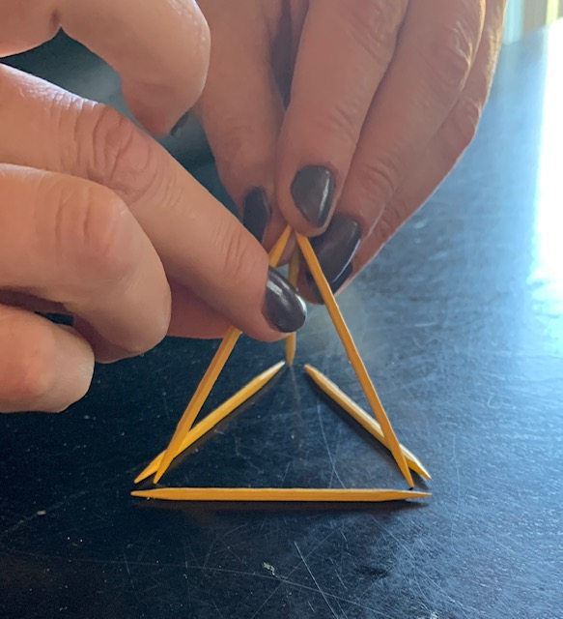
Today we invite you to do
some 3-D thinking!

Slide 10
LEAD
Resource 1
TAKE ACTION
with others
Share
RESPONSIBILITY
LEARN
UNDERSTAND
& RESPECT
different points
of view
Build
TRUST
LISTEN
SEEK OUT
opinions from
others
TV Book
P. 14-20
Voice Process

Slide 11
Teacher Voice…
*Listening
more than speaking
*Learning
more than convincing
*Leading
more with others

Slide 12
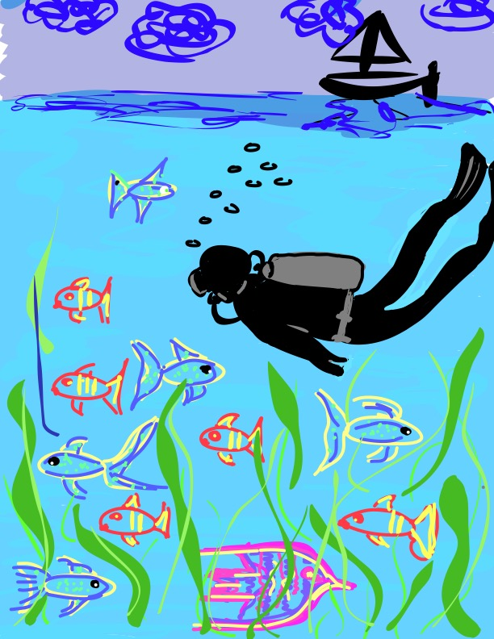
Let’s Dive Deeper…
Listen
Learn
Lead

Slide 13

Listen

Slide 14
The Art of Listening
Vimeo:
vimeo.com/qisva/listening
or
YouTube:
https://youtu.be/ooE9dKobjZU
Video

Slide 15
Listen
Reach out & listen to voices
you typically don’t hear from
Stay focused (put away your phone!)
Be genuine & truly interested
Make sure you are talking less than the
other person
Being open to new ideas is not an option

Slide 16

Challenge Time!
Drawing Dictations
Round 1: Find a partner &
assign one person to be the
Describer, & one person to
be the Artist. Sit back to back. Without looking or asking
questions, describe to your
partner how to replicate
your picture.
Round 2: Switch roles
(Describer & Artist) &
repeat, but this time you
can ask clarifying questions.

Slide 17


Reflect
How does “LISTEN” apply to the
following elements of the Highly
Effective Classroom Framework:
-Monitoring of Student Learning
(Instructional Foundations)
-Effective Questioning
-Dynamic Instruction
(Learning Engagement)
-Relationships
(Conditions for Learning)

Slide 18

Quick Break!

Slide 19

Learn

Slide 20
Taking Time to Learn
Vimeo:
vimeo.com/qisva/time
or
YouTube:
https://youtu.be/tYKcvRfxK0o
Video

Slide 21
Learn
Take notes
Ask questions for clarity
Do not judge, you can learn from anyone
regardless of age, position, or any factor
Follow up & communicate what you
LEARNED from listening
Be prepared to change
Do not fear what you do not know

Slide 22
Challenge Time!
Connections
Find the connection
between the 4 individual pictures.

Slide 23
Connections 1
Vimeo:
vimeo.com/qisva/connection1
or
YouTube:
https://youtu.be/Yl3JrRtyGHc
(all 9 slides)

Slide 24
Connections 2
Vimeo: vimeo.com/qisva/connections2

Slide 25
Connections 3
Vimeo: vimeo.com/qisva/connections3

Slide 26
Connections 4
Vimeo: vimeo.com/qisva/connections4

Slide 27
Connections 5
Vimeo: vimeo.com/qisva/connections5

Slide 28
Connections 6
Vimeo: vimeo.com/qisva/connections6

Slide 29
Connections 7
Vimeo: vimeo.com/qisva/connections7

Slide 30
Connections 8
Vimeo: vimeo.com/qisva/connections8

Slide 31
Connections 9
Vimeo: vimeo.com/qisva/connections9

Slide 32
Challenge Time!
Your Connections
Pick a word that reflects your hopes & dreams for Teacher Leaders & create 4 images.
Can your group guess
your word?

Slide 33
Reflect
How does “LEARN” apply to the
following elements of the Highly
Effective Classroom Framework:
-Clear & Consistent Instructional Program
(Instructional Foundations)
-Visual Representation & Modeling
-Intellectual Interest
-Student Self Worth & Academic Awareness
(Learning Engagement)
-Skills & Mindsets
(Conditions for Learning)

Slide 34
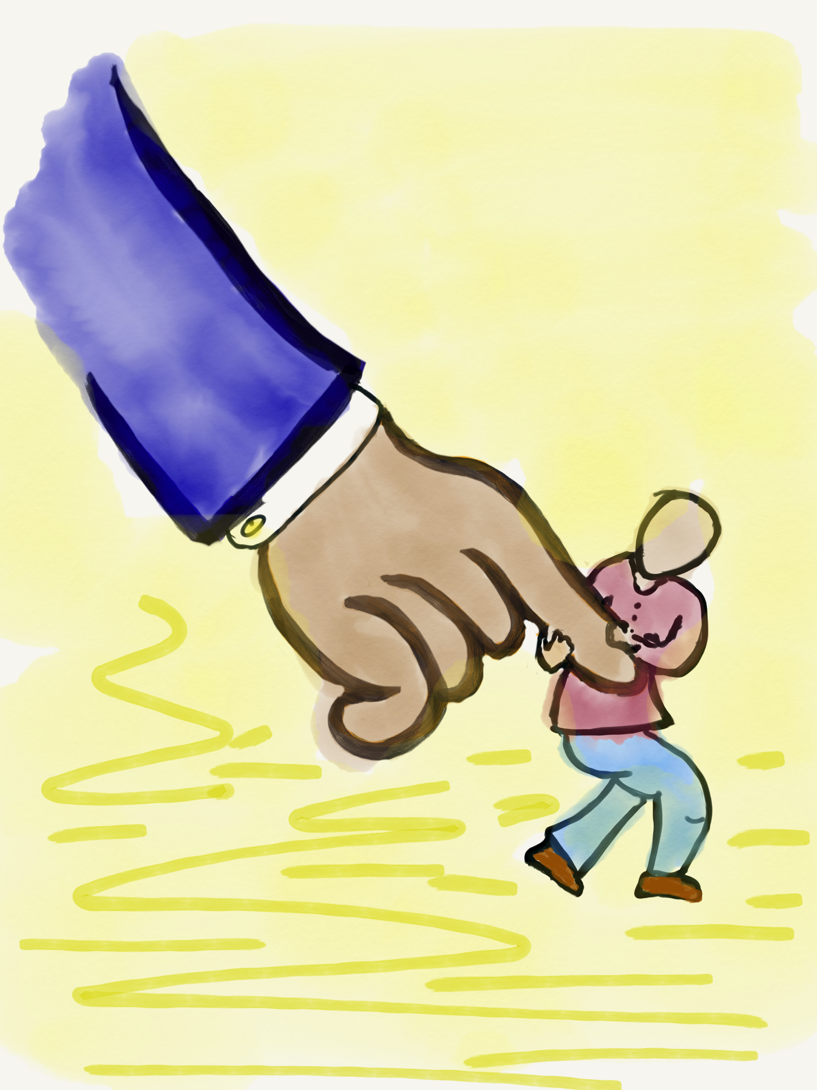
Lead

Slide 35
Leading Together…
Vimeo:
https://vimeo.com/qisva/together
or
YouTube:
https://youtu.be/RTvZCdUP7N4
Video

Slide 36
Reflect
What did you observe related to the term Lead in this video?

Slide 37
Lead
Use what you have heard & learned to drive meaningful change.
Leading is not a solo adventure; take
action with others.
Created a shared sense of purpose.
Voice is not about getting your own way.
You can’t please everyone; but you can
demonstrate value & respect for all voices.

Slide 38

Lead
What do
you value?

Slide 39
Auction Time!!
Your team
gets $2,000!
Determine what items you want to buy at the
auction.
How much are
you willing to
spend on what?

Slide 40
Values Auction
Meaningful Collaboration
Planning Time
Professional Development
Opportunities
Small Class Size
Amazing Administration
Supportive Parents
High Student Achievement
Effective Communication

Slide 41
Reflect
How does “LEAD” apply to the
following elements of the Highly
Effective Classroom Framework:
-Intentional Planning for Instruction
(Instructional Foundations)
-Attend to Precision
-Application of Knowledge
-Collaborative Learning Opportunities
(Learning Engagement)
-Skills & Mindsets
(Conditions for Learning)

Slide 42
LLL in Action!
Vimeo: vimeo.com/qisva/sutter
or
YouTube:
https://youtu.be/_kwkyzH
Video Courtesy of Sutter Middle School, Los Angeles, California

Slide 43
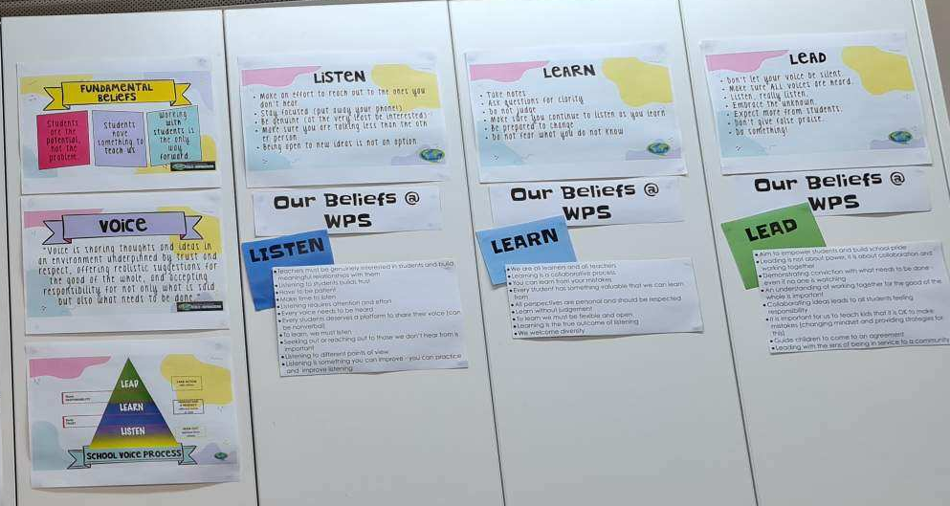
Creating Context for LLL
Picture Courtesy of Winchelsea Primary, Victoria, Australia

Slide 44
LLL Summarized
Vimeo:
https://vimeo.com/qisva/louie
or
YouTube:
https://youtu.be/1Ebg4If1r7A
Video Courtesy of BCE, Brisane, Australia

Slide 45
Less
More
Talking
Listening
Complaints
Solutions
Isolation
Collaboration
Excuses
Action
Frustration
Celebration

Slide 46


Slide 47

Applying the
Voice Process
Jot down some initial thoughts in the template provided on the
Applying the Voice Process handout.
Resource 2

Slide 48

Pinwheel
Discussions
Get into pinwheel groups of 6.
With your first partner, share your
application examples for Listen.
When the wind blows, the outside of the
pinwheel moves one person clockwise. Share your application examples for Learn.
When the wind blows, repeat & share your
application examples for Lead.

Slide 49
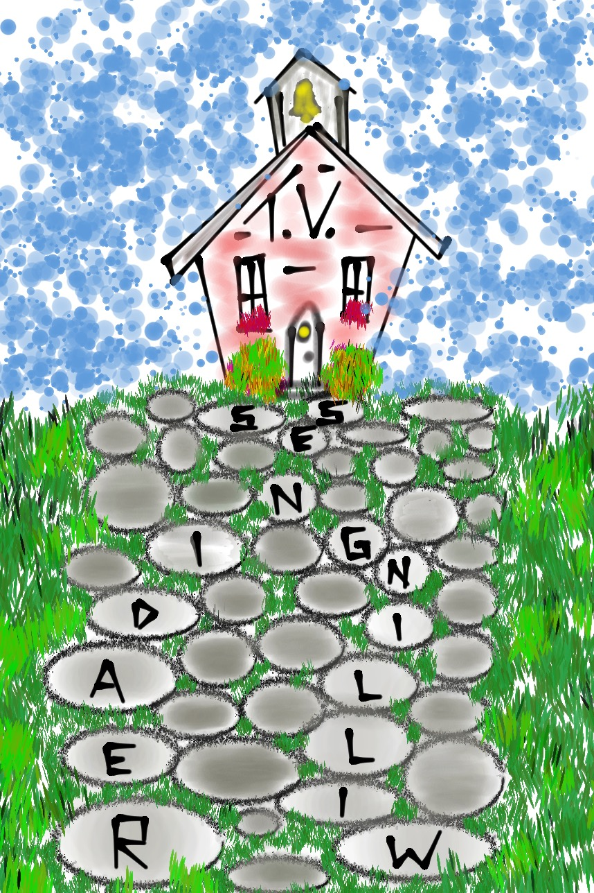
Pathway to
Teacher Voice
Teacher
Willingness
Organizational
Readiness
TV Book P. 37-44

Slide 50
Pathway to
Teacher Voice
As a table group, discuss the
questions in the chart on page 45 of Teacher Voice: Amplifying
Success to personalize the concepts of Teacher Willingness
& Organizational Readiness.

Slide 51

Introduction to the
Aspirations
Framework
Resource 3
TV Book P. 44-45

Slide 52



Aspirations Framework
Self-Worth
TV Book P. 46-50

Slide 53

Challenge Time!
Inside/Outside
My colleagues
would describe
me as…

Slide 54

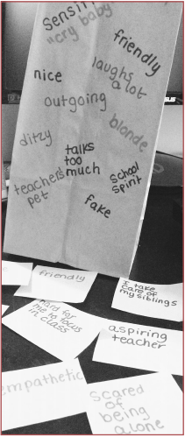
Inside/Outside
If you really knew me as a teacher, you would know…

Slide 55

Reflect
What specific connections can you make between various sub-elements of the Highly Effective Classroom Framework & the concept of Self-Worth? EXPLAIN!
(See page 3 of the Framework to guide your reflective conversation.)

Slide 56



Aspirations Framework
Engagement
TV Book P. 50-53

Slide 57


Challenge Time!
Losing Track of
Time & Space

Slide 58

I lose track of time & space when…
Be sure to include
Your Name!

Slide 59
Reflect
What specific connections can you make between various sub-elements of the Highly Effective Classroom Framework & the concept of Engagement? EXPLAIN!
(See page 3 of the Framework to guide your reflective conversation.)

Slide 60


Aspirations Framework
Purpose
TV Book P. 53-57

Slide 61
Challenge Time…

Slide 62

Ikigai = Life Worth
How to Ikigai: Lessons for Finding Happiness & Living Your Lifeʻs Purpose
By: Tim Tamashiro

Slide 63

Challenge Time!
Embrace Your Ikigai

Slide 64
What is your
passion/mission?
What are your
strengths?
How can you use
your strengths to
help the world?
How can you
connect your
strengths & job?

Slide 65
Reflect
What specific connections can you make between various sub-elements of the Highly Effective Classroom Framework & the concept of Purpose? EXPLAIN!
(See page 3 of the Framework to guide your reflective conversation.)

Slide 66
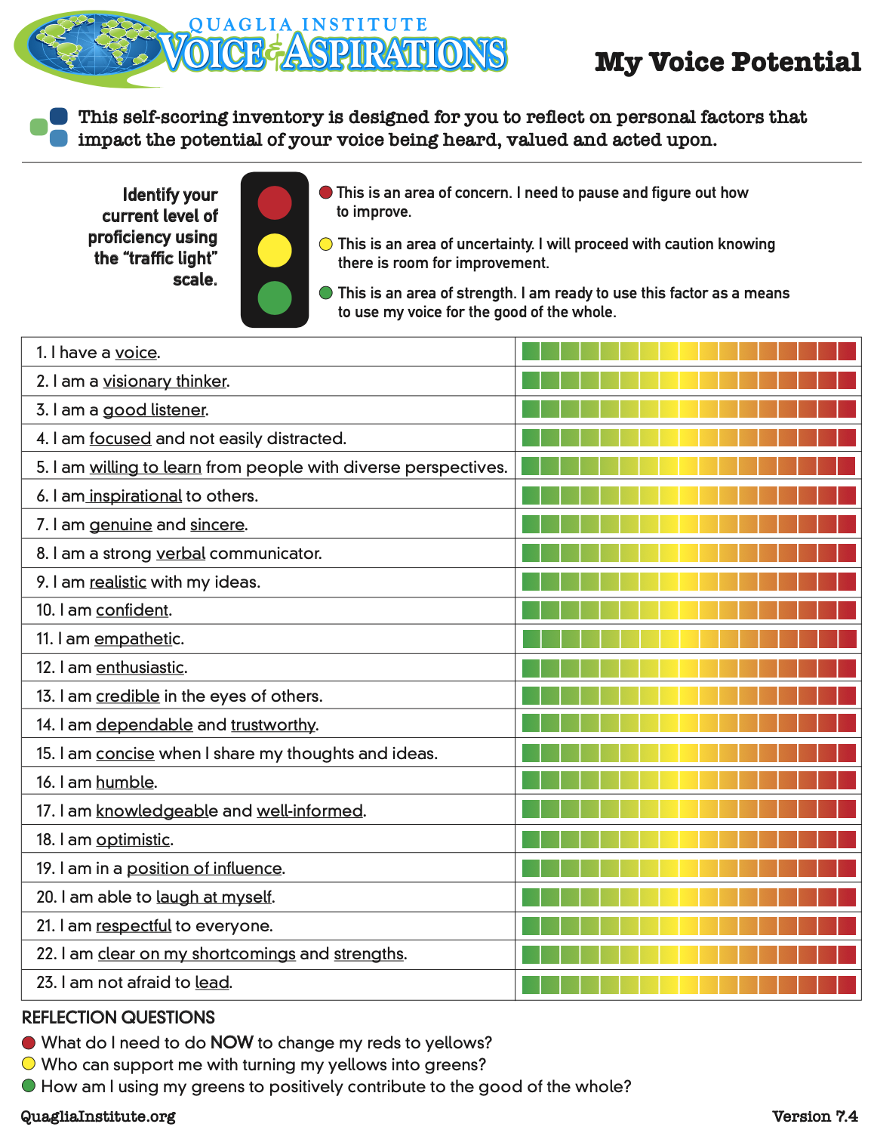
My Voice
Potential
Complete the
Self-Assessment
Find a “Meet with
your Feet” partner & discuss the
reflection questions at the bottom.
Resource 4

Slide 67
The Henry County Highly Effective Classroom Framework

Slide 68
Highly Effective Classroom
Reflect & Connect
Connect your learning experiences thus far in the ATL with the Framework.
Framework Area | Examples | Even Better If
Instructional Foundations
Learning Engagement
Conditions for Learning
-Variety of learning settings (whole group, small group & individual)
-Listening, speaking, discussing, reading, & writing
-Clearly articulated outcomes for the ATL
-Opportunities for modeling
Resource 5

Slide 69
A Quick Recap
Voice Process:
Listen, Learn, Lead
Pathway to Teacher Voice
Aspirations Framework Intro

Slide 70
Where do we
go next?
Future sessions will dig deep into Self-Worth,
Engagement, & Purpose through the lens of
Teacher Leadership.

Slide 71



Camp Fire Reading
Enjoy the following
campfire reads tonight:
Teacher Voice: Amplifying Success
pages 14-20 &
pages 37-45
What Do You Do With An Idea?

Slide 72

What action are you going to take based on what you have learned so far?

Slide 73

I will…

Slide 74
The Voice Process:
Listen, Learn, Lead
Dr. Lisa Lande
lande@quagliainstitute.org
www.QuagliaInstitute.org
June 21, 2023

