Slide 1


Teacher Voice &
Aspirations
Dr. Lisa Lande
www.QuagliaInstitute.org
June 20, 2023
#HenryATL2023

Slide 2
Fundamental Beliefs
We see every individual
in the school community as the potential, not the problem.
We must listen to & learn from one other.
Working together is the only way forward.

Slide 3

#HenryATL2023
@Lisa_Lande
@QISAtweets
Tweet Your
Teacher Voice Journey!

Slide 4

Essential Questions
Why is teacher voice important?
How do we define teacher voice in
the context of the teaching profession?
What is the difference between Noise and Voice?
How does the Aspirations Profile guide and inform efforts to amplify teacher voice?
How can you embrace The Henry County Highly Effective Classroom Framework as Teacher Leader?

Slide 5
Academic Speed Dating

Slide 6
Speed Dating
Vimeo
https://vimeo.com/854655576
YouTube
https://youtu.be/jA9u9zaaJRs
Video

Slide 7


Teacher Voice in Action
On one sticky note, write an example of when you knew your voice as a teacher was valued & heard.
On a second sticky note, write an idea of how to use your Teacher Voice to champion the Henry County Highly Effective Classroom Framework.
Resource 1

Slide 8
Teacher Voice…
Vimeo
https://vimeo.com/854657245
YouTube
https://youtu.be/Z8Z1UmmLq8E
Video

Slide 9

Voice & Aspirations Teacher Reflection
Individually, complete the rank order section of the self-assessment.
As a table group, discuss the 3 reflection questions.
Resource 2

Slide 10
Why Does Teacher Voice Matter?
TV Book P. 7-13

Slide 11

When teachers see themselves as a leader they are
3x more likely to be excited about their future career in education.

Slide 12

60% of teachers believe their colleagues see them as a leader.

Slide 13

55% of teachers report having a voice in decision making at school.

Slide 14

62% of teachers believe building administration is willing to learn from staff.

Slide 15

50% of teachers agree with the statement
“We communicate effectively in our building.”

Slide 16

60% of teachers are confident expressing their honest opinions and concerns.

Slide 17

Teacher Voice
is not YET a
natural way of
being.
Why Not?

Slide 18

The 3 Components of Teacher Voice
Resource 3
Sharing thoughts & ideas in an environment underpinned by trust & respect.
Offering realistic suggestions for the
good of the whole.
Accepting responsibility for not only what is said but also what needs to be done.

Slide 19

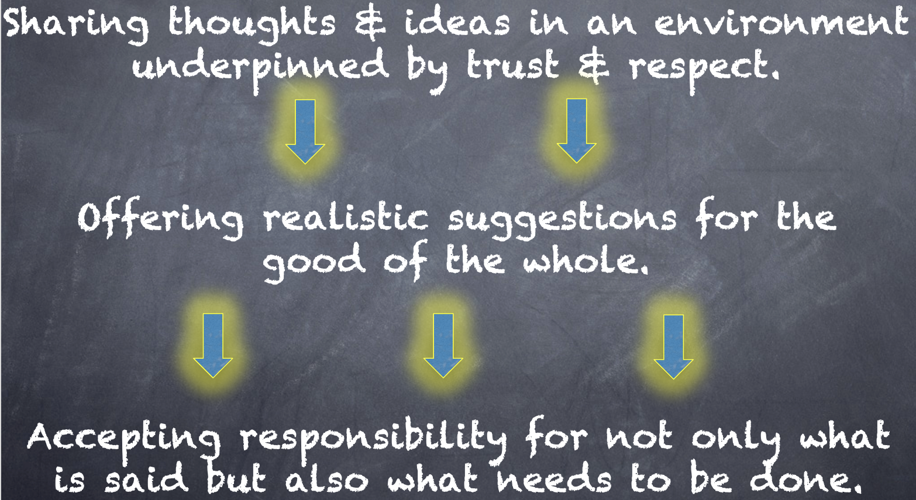
Reflect
How can you put the 3 parts of the Voice Definition into action related to implementation of the Highly Effective Classroom Framework in your school?

Slide 20

Quick Break!

Slide 21

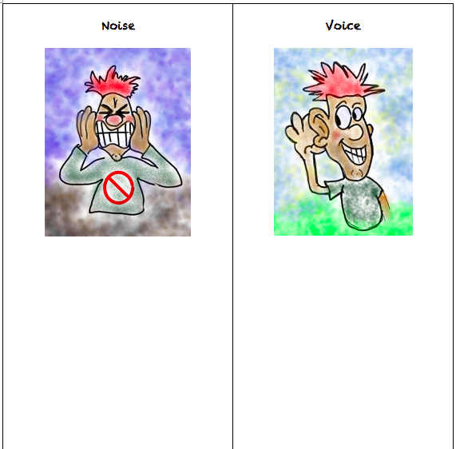
Challenge Time!
Noise vs. Voice
Write down words, phrases, & examples of
Noise vs. Voice.
What does this look like from the lens of a Teacher Leader?
How can you apply Noise vs. Voice to the Highly Effective Classroom Framework?
Resource 4

Slide 22

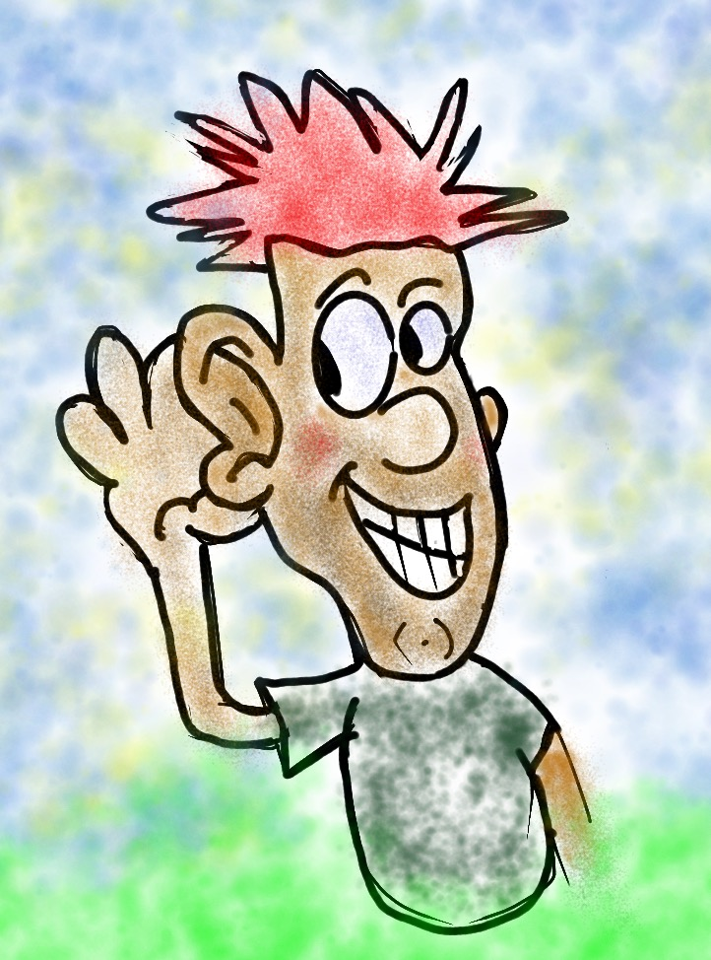
Teachers Control the Volume
Voice Inhibitors
Anger/extreme emotion
Rhetoric
Volume/Tone
Close Mindedness
Self-Serving
Voice Amplifiers
Authenticity/Genuineness
Knowledge
Refocus, Reanalyze, Readjust
Being Relentless

Slide 23
Challenge Time!
Noise vs. Voice
Camp Art
As a table group, create a visual representation that reflects the difference between Noise v. Voice.
When finished, post your art masterpiece on the walls around the room.

Slide 24

Gallery Walk
Welcome to the Silent Gallery!
Take a wander around the room and take in the Noise v. Voice artwork created by the group.

Slide 25
The Henry County Highly Effective Classroom Framework

Slide 26
Reflect & Connect
Dig Deeper into the Highly
Effective Classroom Framework.
-What areas do you consider to be your greatest strengths?
-What areas do you hope to grow in this upcoming school year?
-How can you use your Teacher Leader skills to help turn “Noise” into “Voice” in this area?

Slide 27


Slide 28
ASPIRATIONS
The ability to
dream & set goals
for the future,
while being inspired
in the present
to reach those dreams.
TV Book P. 31-33

Slide 29




high
Imagination
Aspiration
Resource 5
DREAMING
Hibernation
Perspiration
low
DOING
high

Slide 30
Challenge Time!
Aspirations Profile
4-Corners of Reflection

Slide 31
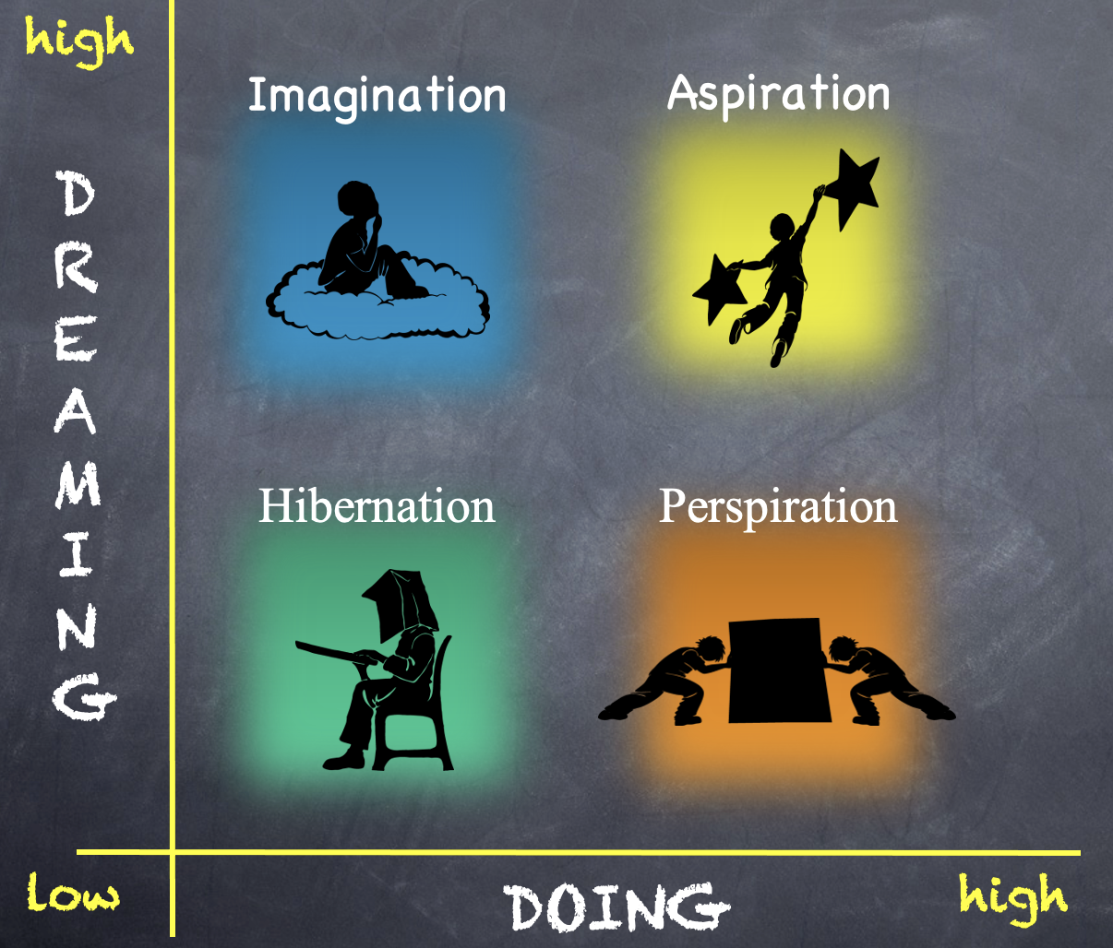
Reflect
Go to the quadrant where you spent most of your time as a student.
Break into groups of 3-4 & share why!
What would have helped you maintain a healthy balance of dreaming & doing?

Slide 32
Reflect
Rotate one corner clockwise.
What types of things do individuals in this quadrant say/do?

Slide 33
Reflect
Rotate one corner clockwise.
What types of actions can you take as a teacher leader to support individuals in this quadrant?

Slide 34
Reflect
Rotate one corner clockwise.
What questions can you ask individuals in this quadrant?

Slide 35
high
Imagination
Aspiration
DREAMING
4-Corners
Debrief
What did you
learn about
the Aspirations
Profile?
Hibernation
Perspiration
low
DOING
high

Slide 36

Time to Dig Deeper!

Slide 37
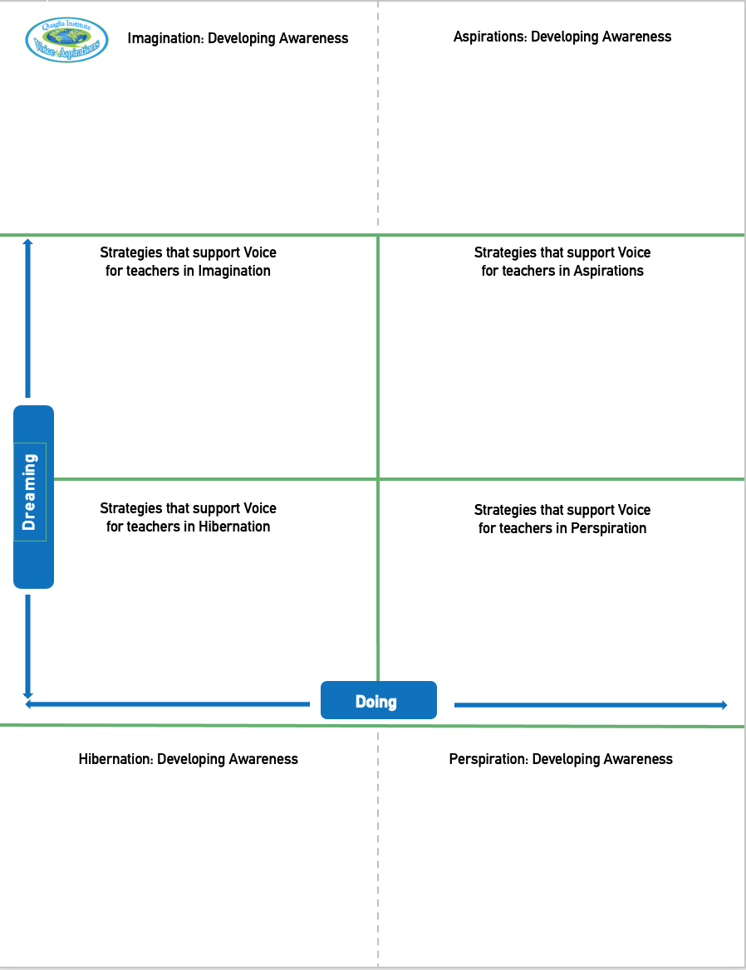
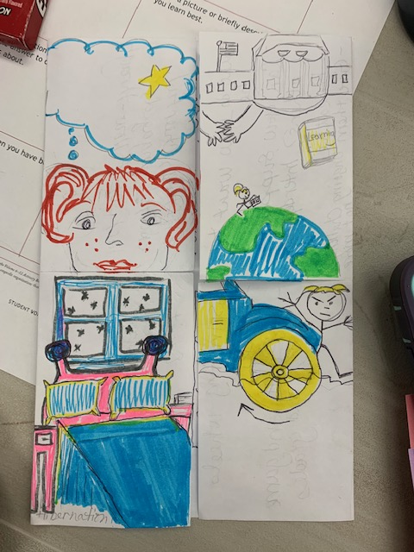
Aspirations Foldable!!
Resource 6
Imagination
Aspiration
Perspiration
Hibernation
Fold
Cut

Slide 38
high
DREAMING
Hibernation
low
DOING
high

Slide 39
high
DREAMING
Vimeo
https://vimeo.com/789017891/1c391b7d0a
YouTube
https://youtu.be/qPYqaBvwhy8
low
DOING
high

Slide 40

On a
Notecard…
Write one word
describing individuals
in Hibernation.

Slide 41

One person holds the deck of cards up to their forehead (do not look at the cards).
Team members will describe what is on the card, without using the actual words on the card.
After a card is correctly guessed, pass the deck to the left. See how quickly you can get through your team deck of cards!
Challenge Time!
Hibernation Heads Up

Slide 42

Teachers in Hibernation
Potential Cons:
Passive & unmotivated
Poor self-esteem &
defeatist attitude
Struggle to take
responsibility for
anything
Potential Pros:
Time to reflect
Space to recharge
They report:
Feeling isolated
Stuck
Misunderstood
Bored
They need to:
Feel valued
Be recognized for success
Have positive role models
Have a sense of purpose

Slide 43
Reflect
Think of the word you wrote on your notecard.
Now think of a word that reflects your hopes & dreams for hibernating individuals?

Slide 44
high
Imagination
DREAMING
low
DOING
high

Slide 45
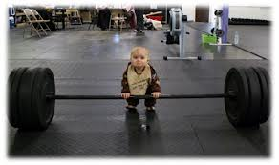
high
DREAMING
low
DOING
high

Slide 46
On a
Notecard…
Write something you
dream about doing
that you have not
yet accomplished.
And keep it
a SECRET!!

Slide 47

Read through the whole deck one time.
Read through the deck a second time and make guesses as to who each card belongs to. How well do you know your colleagues??
Challenge Time!
Imagination Guess Who??
One person takes all the notecards
& mixes them up.

Slide 48

Teachers in Imagination
Potential Pros:
Enthusiastic
Fun to be around
Lots of creative ideas
Potential Cons:
Limited follow-through
Not well connected
to reality
They report:
Having big dreams
Eagerness to explore
Craving creative outlets
They need to:
Develop action plans
Focus
Be realistic

Slide 49
Reflect
Why is it challenging to make your big dream a reality?
What would it REALLY take to make this happen?

Slide 50
high
DREAMING
Perspiration
low
DOING
high

Slide 51
high
DREAMING
Vimeo
https://vimeo.com/789017891/1c391b7d0a
YouTube
https://youtu.be/qPYqaBvwhy8
low
DOING
high

Slide 52
On a
Notecard…
Write a rapid fire list of things that cause you to Perspire at work.

Slide 53

Teachers in Perspiration
Potential Pros:
Determined
Hard Working
Driven to Succeed
Potential Cons:
Overly concerned
about external
accountability
Single-minded,
narrow-focused
They report:
Feeling stressed
Not sure “why” they are working so hard, but
need to achieve
Don’t want to let
anyone down
They need to:
Have a greater purpose for working hard
Balance school work with outside life
Link hard work to
their passions

Slide 54
Challenge Time…
We need 6-8 excited volunteers to come up front!
Warm Up: Establish a passing order with 1 ball.

Slide 55


Challenge
Perspiration Juggling
Goal: As a team,
pass 3 balls through
your established order as quickly as you can.
Rules: Maintain the
same passing order &
everyone must touch
all 3 balls.

Slide 56
Reflect
What can you do differently to perspire a little less?

Slide 57
high
Aspirations
DREAMING
low
DOING
high

Slide 58
high
DREAMING
Vimeo
https://vimeo.com/776344083/affe5a37da
YouTube
https://youtu.be/uLjzbSAEmJI
low
DOING
high

Slide 59
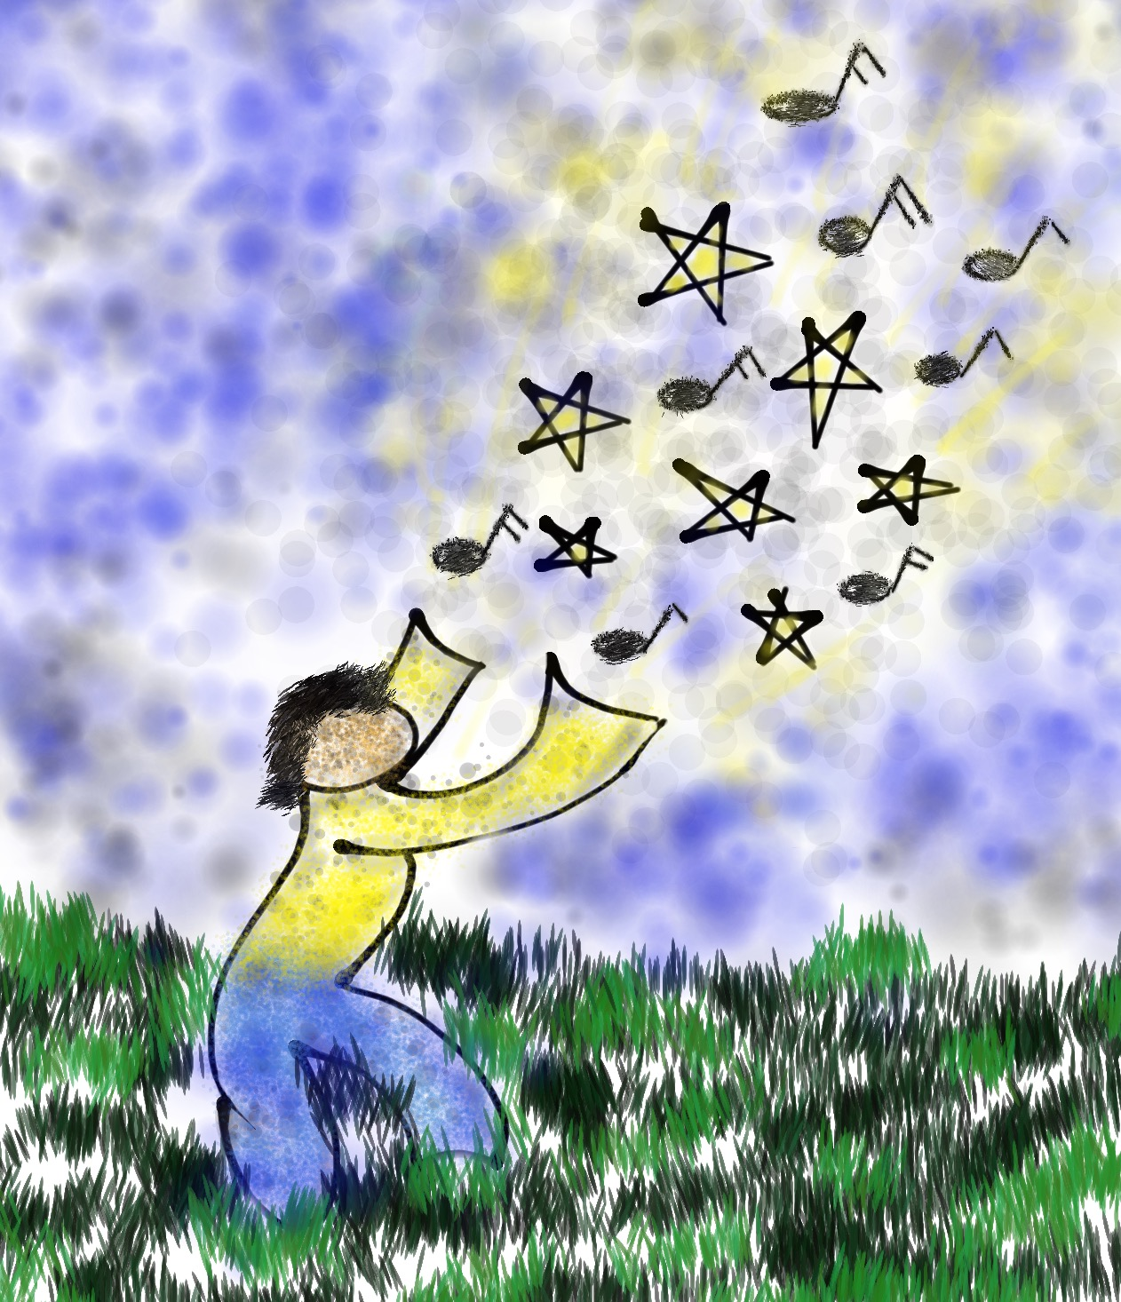
Write something you
have accomplished
that has had a
positive impact
on others.

Slide 60
Proudly use your voice to read your card & collectively celebrate your aspirational moments!
Challenge
Aspirations Accomplishments
Say It Loud…Say It Proud!
Stand in a Circle
as a table team.

Slide 61

Teachers in Aspirations
Potential Pros:
Connects present
actions to future
dreams
Good idea of
potential options
Potential Cons:
Relaxation is Challenging
Under constant pressure
Self-Serving
They report:
Never feeling
satisfied
Driven by being best
Frustration with peers
who don’t work a
hard as they do
They need to:
Validation &
professional respect
Experience meaningful challenges
Breathe!

Slide 62
Reflect
What are your Aspirations for each of the 3 Elements of the Highly Effective Classroom Framework?
Within each area, identify your DREAM & what you will DO to achieve that dream during the 2023-24 school year.
Instructional Foundations
Learning Engagement
Conditions for Learning

Slide 63

Cabin Time

Slide 64

A Quick Recap
3-Part Definition of Voice
Noise v. Voice
Aspirations Profile: Hibernation, Imagination, Perspiration,
& Aspiration

Slide 65
Where do we
go next?
Tomorrow we will
explore the
Voice Process:
Listen, Learn & Lead.

Slide 66

What is your “Mic Drop” moment
of learning from today?

Slide 67

Mic Drop Moments!
What is your mic drop moment of learning from today?

Slide 68



Camp Fire Reading
Enjoy the following
campfire reads tonight:
Teacher Voice: Amplifying Success
pages 31-36
What Do You Do With A Chance?

Slide 69
Teacher Voice &
Aspirations
Dr. Lisa Lande
www.QuagliaInstitute.org
June 20, 2023
#HenryATL2023

