Slide 1




Leadership & Responsibility
Confidence to Take Action

Slide 2
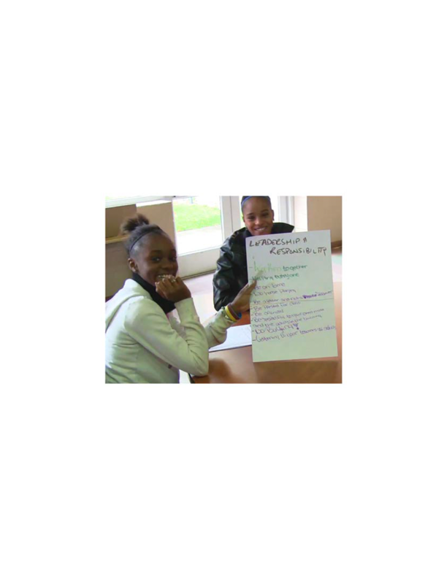
Leadership & Responsibility
Leadership & Responsibility means being able to express ideas, make decisions & understand the impact of your actions for yourself & others.

Slide 3

Leadership & Responsibility

Slide 4

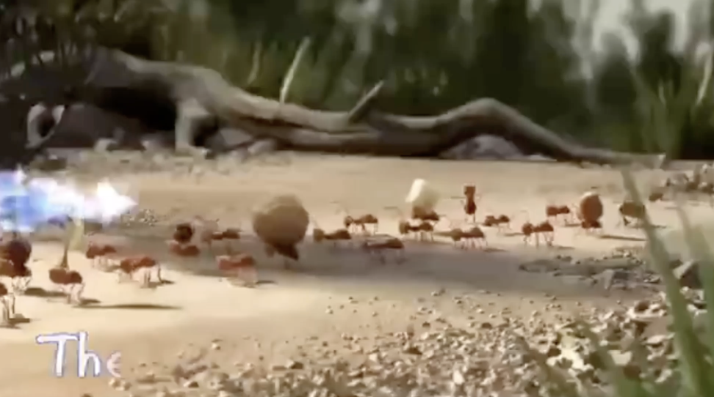
The Power of Teamwork
YouTube:
https://youtu.be/26iabqN8TY4

Slide 5
Leadership & Responsibility
Teamwork
(think beyond sports teams—for example, a group you are working with on a class project)
As a leader, how do you support & facilitate effective teamwork?
What makes the “perfect” team?
Why do you think some teams don’t work so well together?

Slide 6
Leadership & Responsibility
Would you Rather?
Line up across the room. For each scenario that’s read step forward if you choose the first option & backwards if you choose the second options.
After each scenario go back to the starting line up.

Slide 7

Leadership & Responsibility
Leadership
Auction
What leadership traits are most important to you?

Slide 8
Preparing for the
Leadership Auction
Your team gets $2,000!!!
Explore the Leadership Trait Cards & determine your strategy for
the auction. What items do you most want to purchase to create
the ideal leader? How much are you willing to spend on what?
Confidence
Communication
Vision
Adaptability
Respect
Creativity
Integrity
Empathy
Accountability
Resilience
Decision-making
Courage

Slide 9
Auction
Time!!
Confidence
Communication
Vision
Adaptability
Respect
Creativity
Integrity
Empathy
Accountability
Resilience
Decision-making
Courage

Slide 10

Leadership & Responsibility
And just for the fun of it! ☺

Slide 11
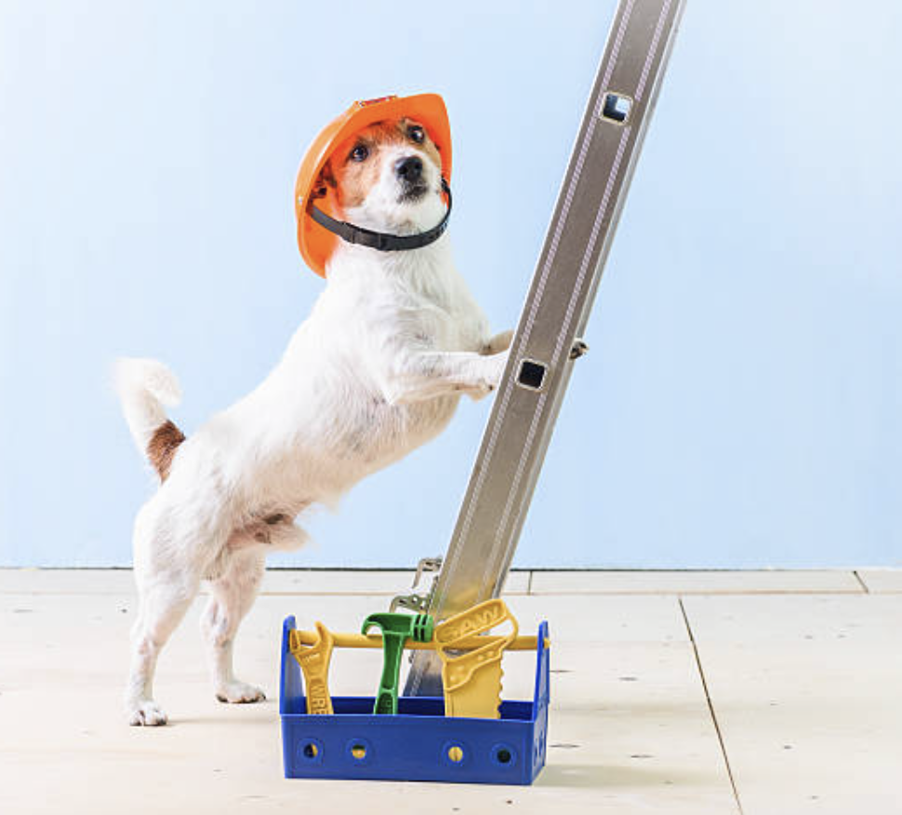


Leadership & Responsibility
Why did the student leader start a bakery?
Why did the pencil run for class president?
Why did the president bring a ladder to the meeting?
Because they knew how to make to make others rise.
To help everyone reach new heights!
It wanted to make a point!

Slide 12
Confidence to Take Action
Confidence to Take Action is characterized by a positive & healthy outlook on life that comes from looking inward rather than outward for approval. It is believing in yourself & knowing you can make a difference for others.

Slide 13

Confidence to Take Action

Slide 14
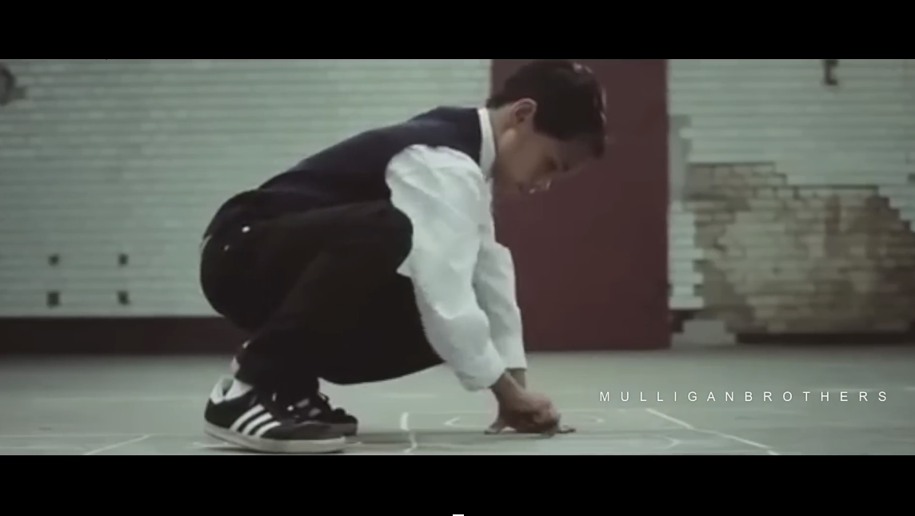
Never give up, Believe in yourself!
YouTube:
https://youtu.be/F1KJDFiLpjM

Slide 15
Confidence to Take Action
What do you confidently believe about yourself?
What can you achieve with confidence, hard work & action? (Yes, you can achieve ANYTHING—but specifically what achievements are you working towards?)

Slide 16
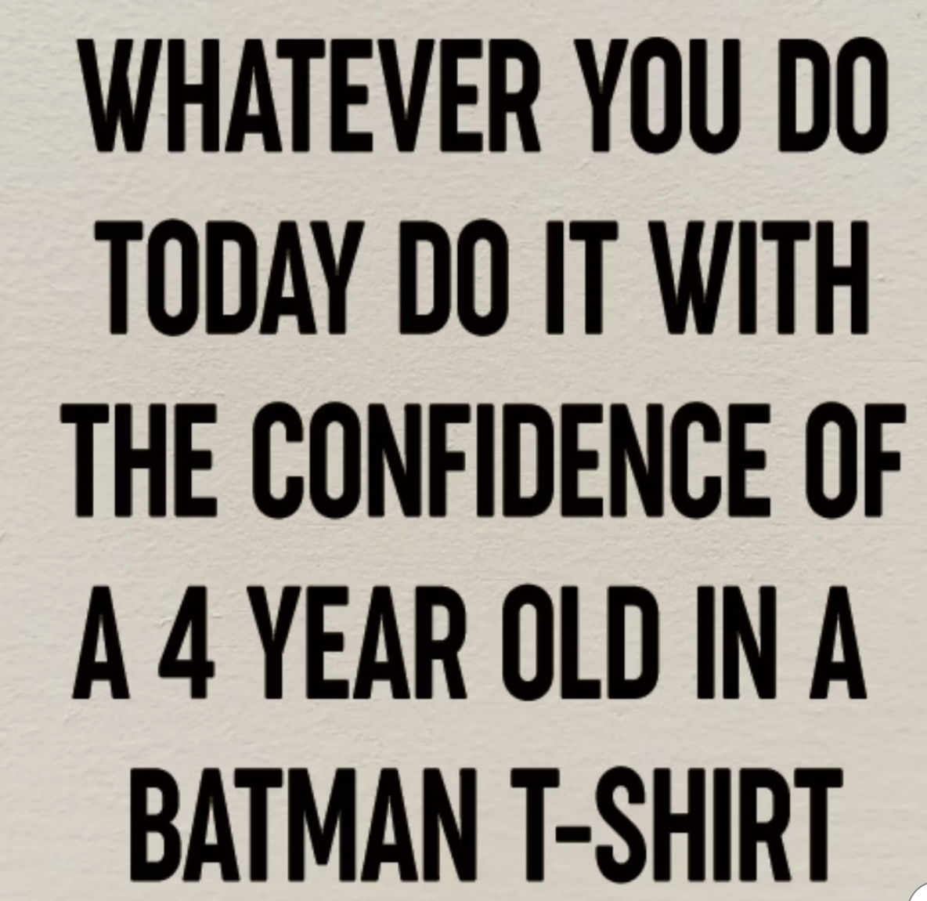
Confidence to Take Action

Slide 17
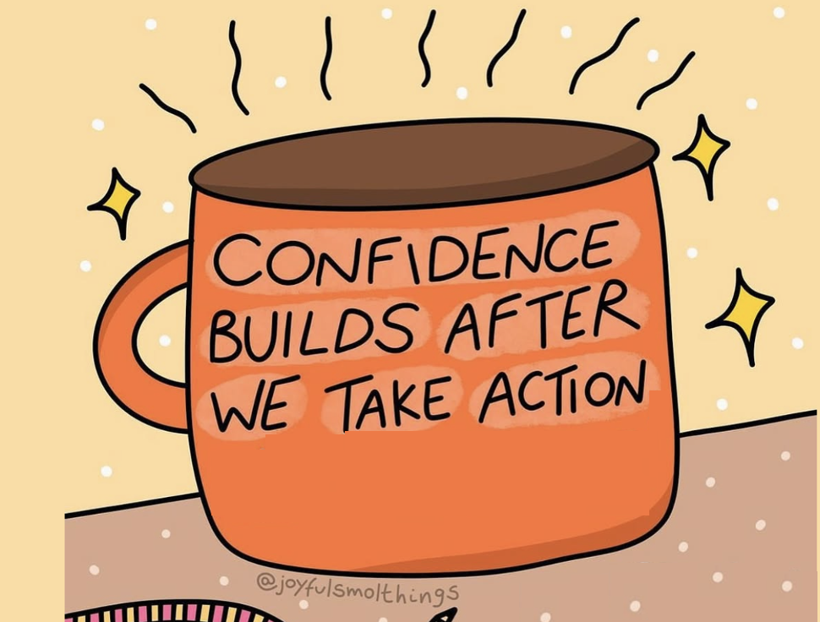
Confidence to Take Action
Confidence = Taking Action
Complete & discuss the
Confidence = Taking Action resource

Slide 18
Leadership & Responsibility
Confidence to Take Action

