Slide 1










Student Voice & Aspirations
Woodside High School
January 8, 2024
Dr. Lisa Lande

Slide 2
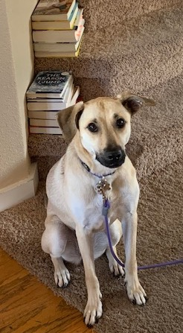
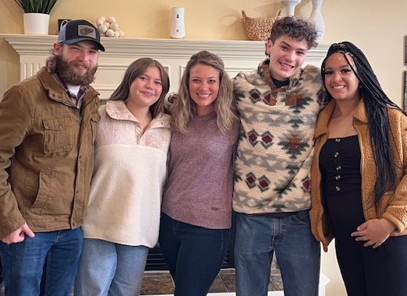
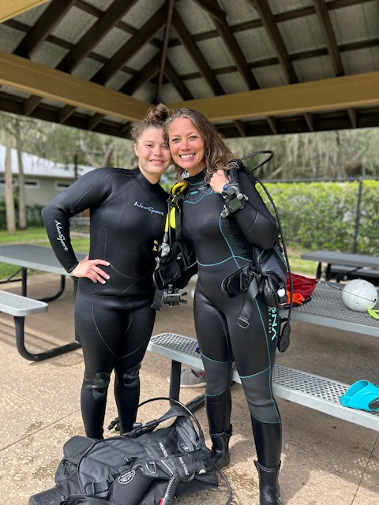
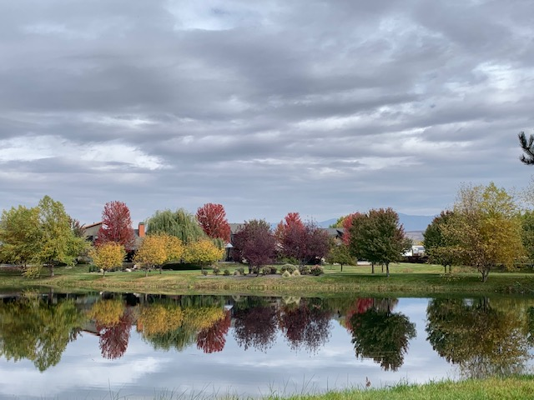
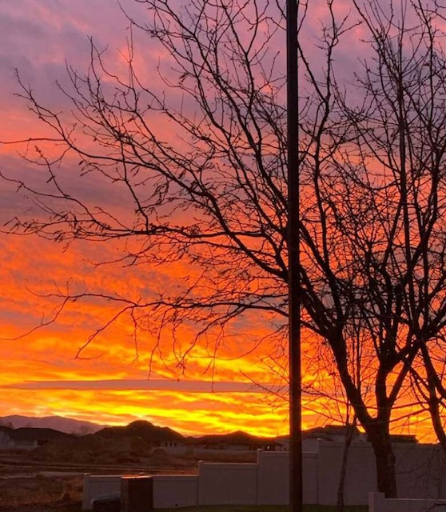
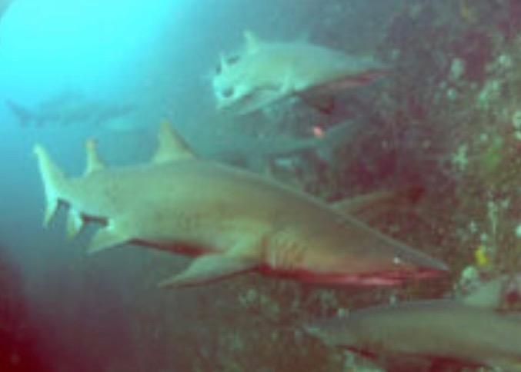


Slide 3
Vimeo:
https://vimeo.com/qisva/drqforwhs
YouTube:
https://youtu.be/0RT0LxBC4Ac
Dr. Russ Quaglia

Slide 4
Vimeo:
https://vimeo.com/qisva/principalwilhelm
YouTube:
https://youtu.be/et90O7n6ezQ
Principal Keoni Wilhelm, Baldwin High School, Maui

Slide 5
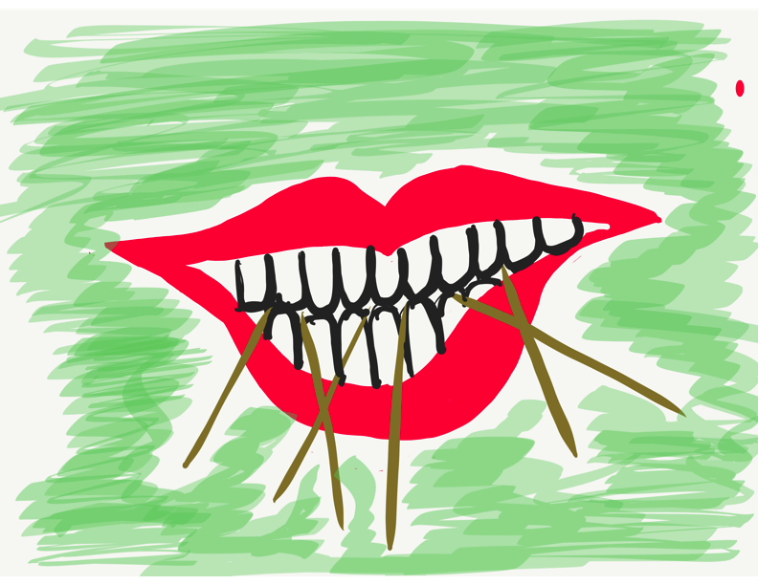
Toothpick Challenge
Using 6 toothpicks,
make 4 and only 4
equilateral triangles
(all 3 sides the same size).
You may not break the toothpicks.

Slide 6
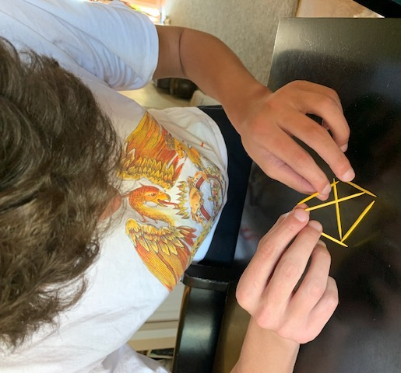
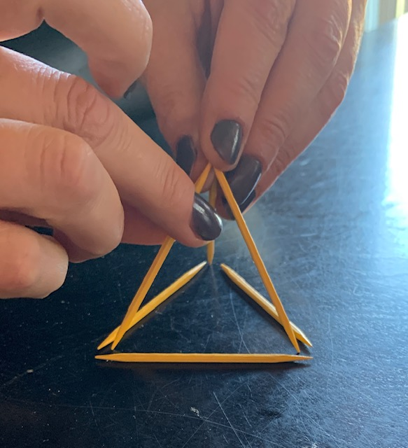
Today we invite you to do
some 3-D thinking!

Slide 7
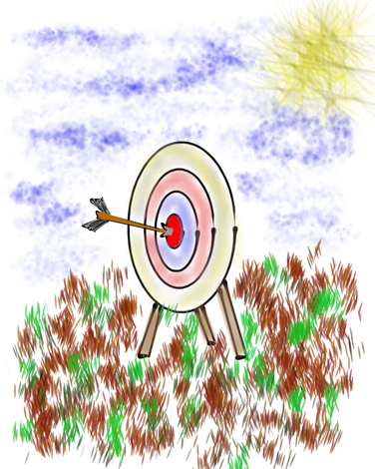
Learning Intention
We are deepening our understanding
of the 8 Conditions as part of
the Woodside Way & WASC goals.
Success Criteria
Review key aspects of the Voice & Aspirations Framework.
Learn how students are experiencing the 8 Conditions at
Woodside by analyzing December survey data.
Consider student & teacher roles & responsibilities for
embedding the 8 Conditions across campus.
Gain inspiration from spotlight sharing of teacher practices related to Self-Worth, Engagement, & Purpose.

Slide 8

Website Just For Woodside
All resources explored today will be electronically provided at this site.
https://www.quagliainstitute.org/woodside-high-school

Slide 9
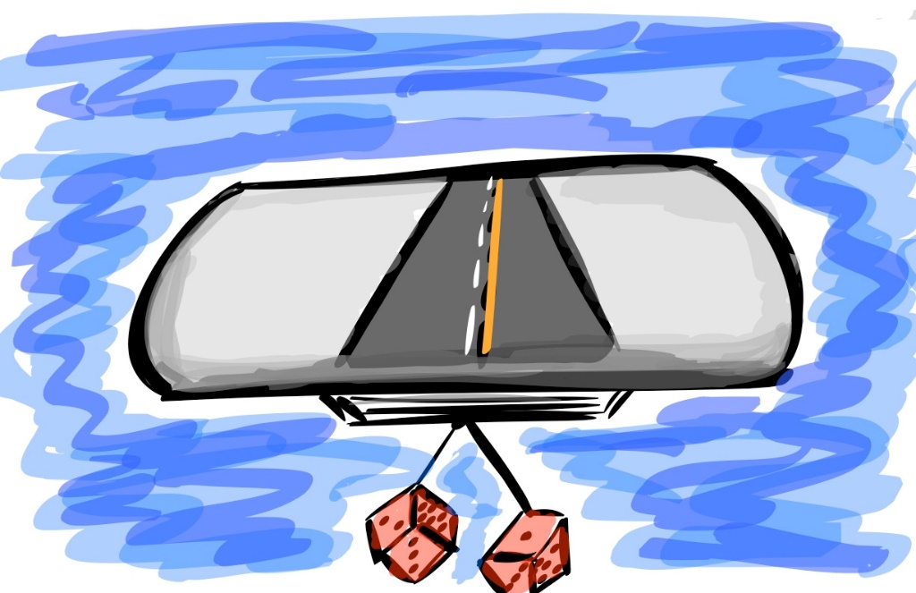
Quick Review

Slide 10
Fundamental Beliefs
Students are the potential, not the problem.
Students have something to teach us.
Working together is the only way forward.

Slide 11

The 3 Components of Student Voice
Sharing thoughts & ideas in an environment underpinned
by trust & respect.
Offering realistic suggestions for the
good of the whole.
Accepting responsibility for not only what is said but also
what needs to be done.

Slide 12

Speedy Gonzales
Come Backs
Cued by Music

Slide 13
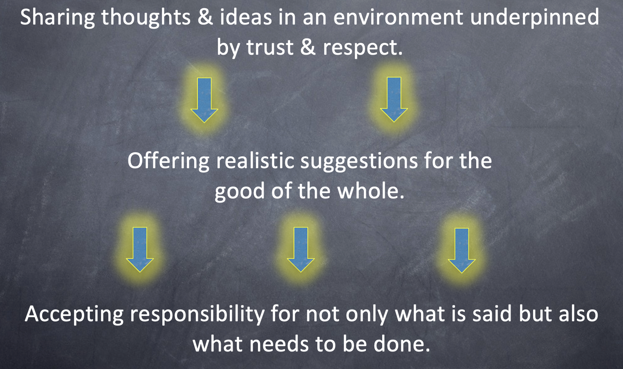
Turn & Talk
What resonates with you from the Voice Definition?

Slide 14
Aspirations
The ability to
dream & set goals
for the future,
while being inspired
in the present
to reach those dreams.

Slide 15




high
Imagination
Aspiration
DREAMING
Hibernation
Perspiration
low
DOING
high

Slide 16
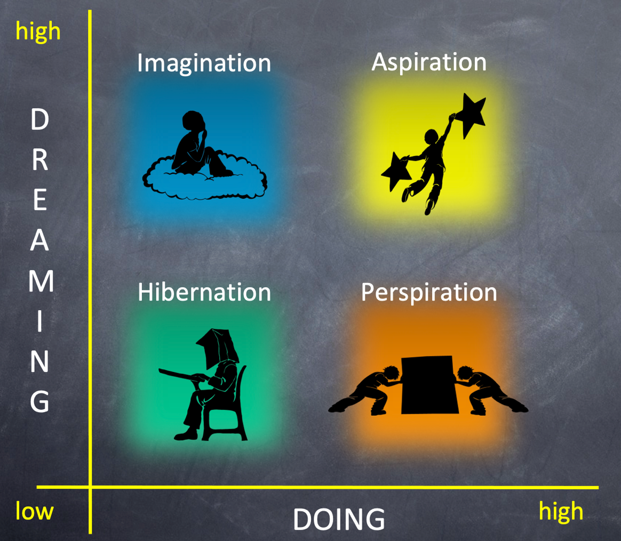
Elbow Partners
How does the Aspirations Profile impact
Teaching & Learning?

Slide 17








3 Guiding Principles & 8 Conditions
Self-Worth
Engagement
Purpose
Badges by
Daniel Minter

Slide 18
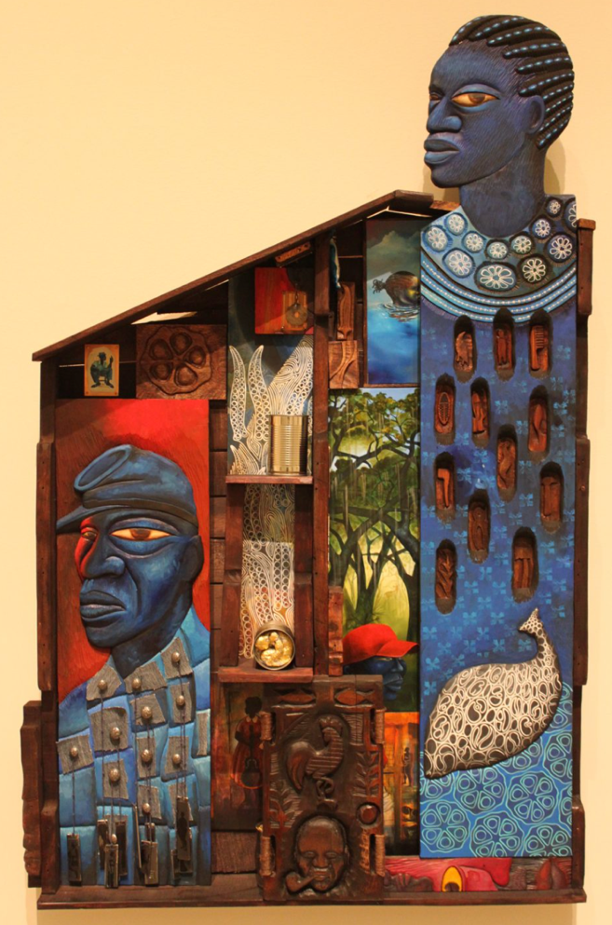
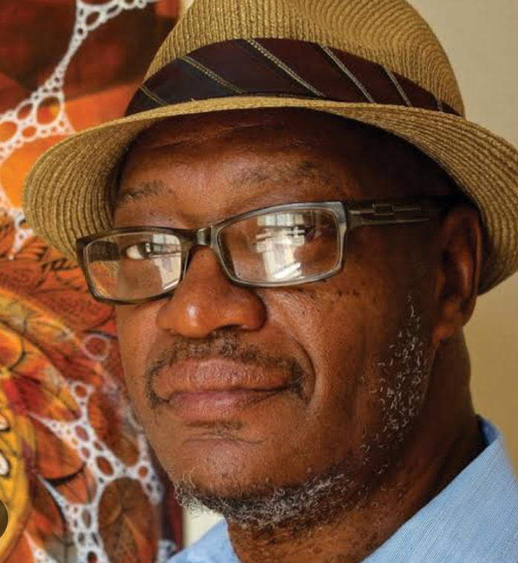
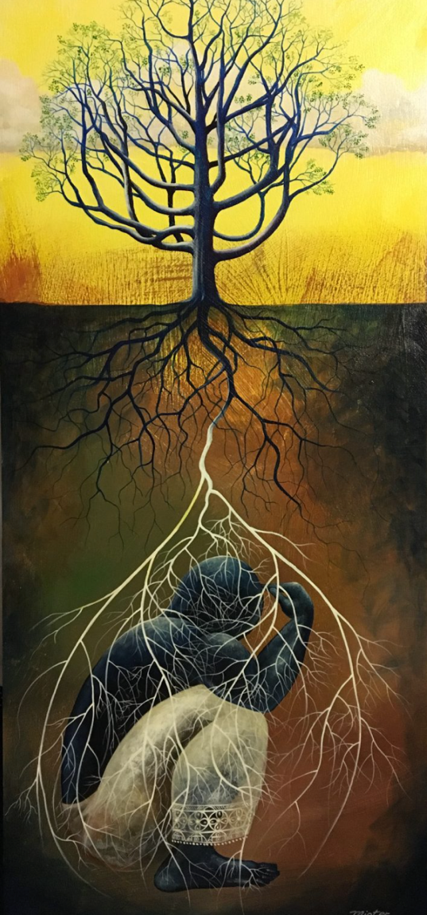


Daniel Minter
Co-founded the Indigo
Arts Alliance
Founding director of the Maine Freedom Trails
danielminter.net

Slide 19

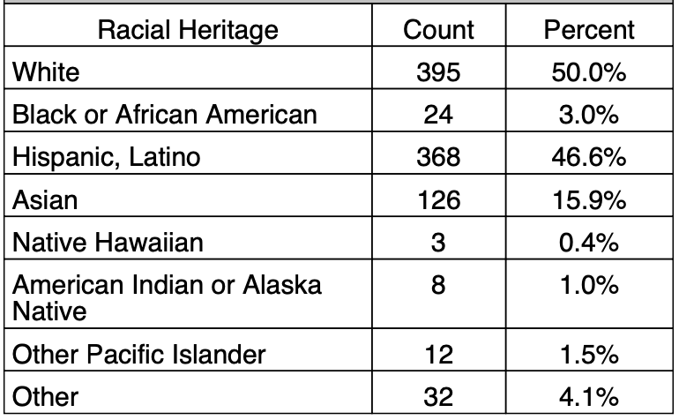
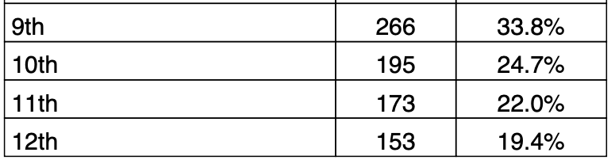
Student Voice Surveys
Woodside has been giving the Student Voice Survey since 2011.
794 students completed the survey in December 2023 (1192 in May 2023).
iKnow My Class
97 Teachers
767 Student Surveys

Slide 20


Woodside Highlights
Between March 2023 & December 2023
Improvement on 27 Statements!
School is boring. -11.5% (reverse statement)
I am proud of my school. +8.8%
Students develop programs that improve the whole school. +8.7%
Adults and students work together to make our school better. +8.6%
I understand the importance of what I am learning in school. +6%
Teachers are willing to learn from students. +6%
Teachers make an effort to get to know me. +6.1%
School is preparing me well for my future. +6.8%
I know the goals my school is working on this year. +5.9%
Students work with adults to find solutions to school problems. +5.8%
I find homework helpful to my overall learning. +5.5%
Students have a voice in decision making at school. +5.3%
If I have a problem, I have a teacher that I can talk to. +5.2%

Slide 21

8 Conditions
Artifact Exploration

Slide 22

Challenge
123 Go!

Slide 23
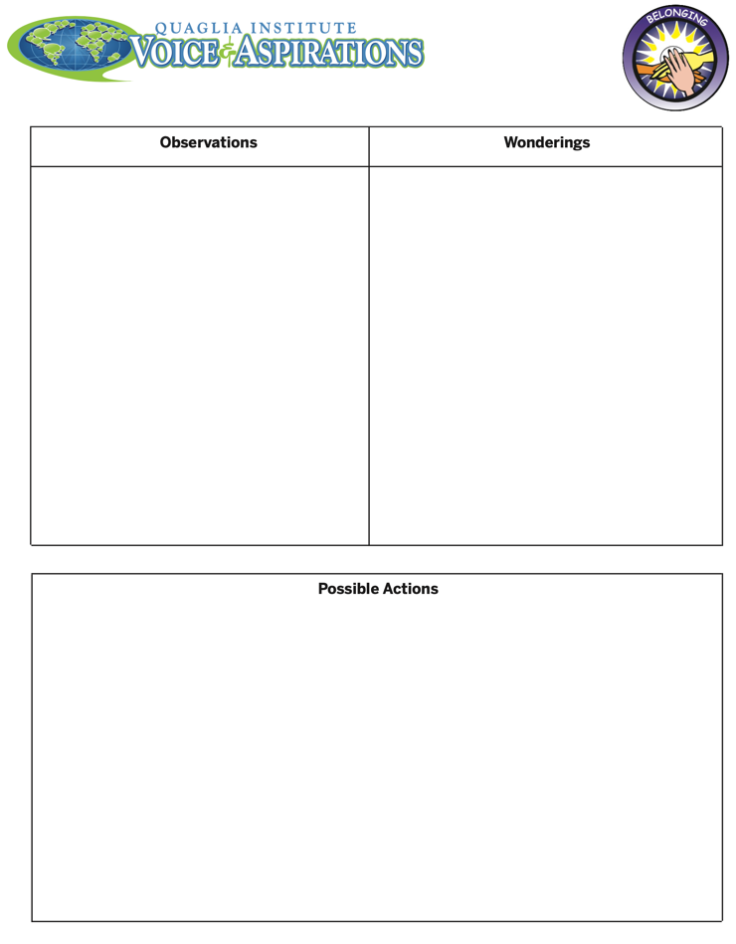
8 Conditions
Artifact Exploration
Wait to open the folders until the cue “GO!”
Learning Pod: 3 tables with the same color folders (different Conditions).
3 Rounds of Exploration: Self Worth, Engagement, & Purpose. At the end of each round, put all papers back in the folder before opening the next folder (keep anything you want except Record Sheet).
Record Observations, Wonderings, & Possible Actions.
Determine what to briefly share about your Condition with your Learning Pod.

Slide 24
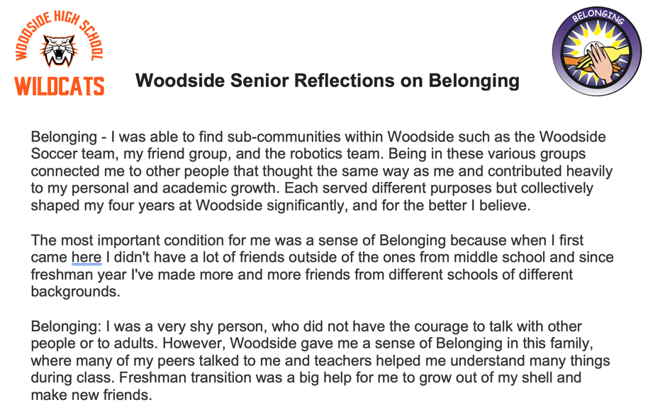

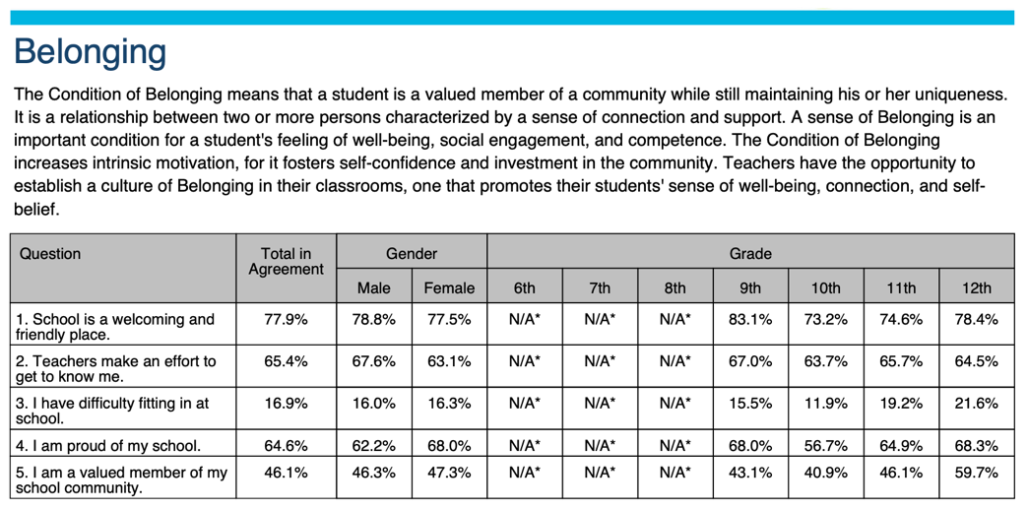

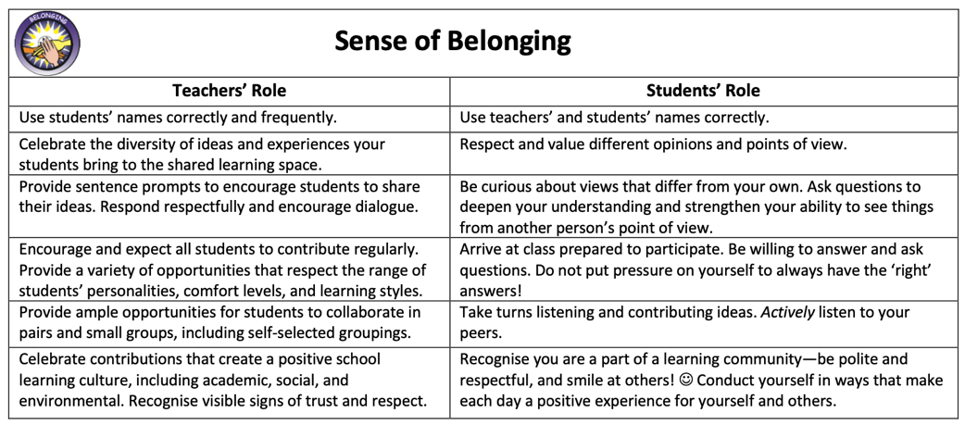
Artifacts to Explore

Slide 25



Round 1 Self-Worth
Take 10 minutes to explore artifacts & determine what
you will briefly share out
Use 12 minutes to share out with your
Learning Pod (4 min per Condition)

Slide 26
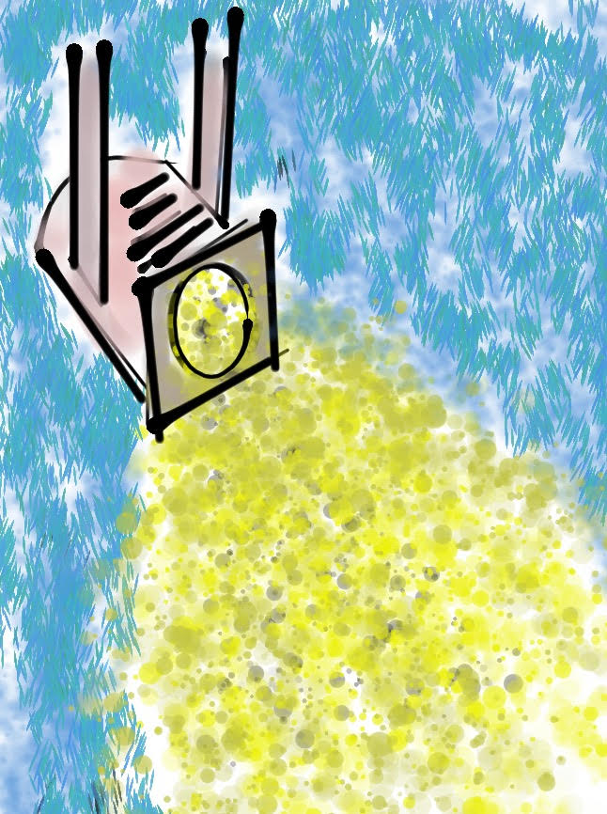
Self-Worth
Spotlight

Slide 27

Challenge
Air Circles

Slide 28



Round 2 Engagement
Take 10 minutes to explore artifacts & determine what
you will briefly share out
Use 12 minutes to share out with your
Learning Pod (4 min per Condition)

Slide 29
Engagement
Spotlight

Slide 30

Challenge
Crossed Arms

Slide 31



Round 3 Purpose
Take 10 minutes to explore artifacts & determine what
you will briefly share out
Use 12 minutes to share out with your
Learning Pod (4 min per Condition)

Slide 32


Purpose
Spotlight

Slide 33

Commitment to Action

Slide 34

“Meet With Your Feet”
& Share Your Commitment
to Action

Slide 35


THANK YOU!!
Dr. Lisa Lande
Lande@QuagliaInstitute.org
208-484-6187
@Lisa_Lande

