Slide 1

Self Worth:
Using Voice to Enhance
School & Classroom Culture
October 6, 2025
Dr. Lisa Lande
lande@quagliainstitute.org
@Lisa_Lande @QISVAtweets
quagliainstitute.org

Slide 2
Fundamental Beliefs
Students are the potential, not the problem.
Students have something to teach us.
Working together is the only way forward.

Slide 3
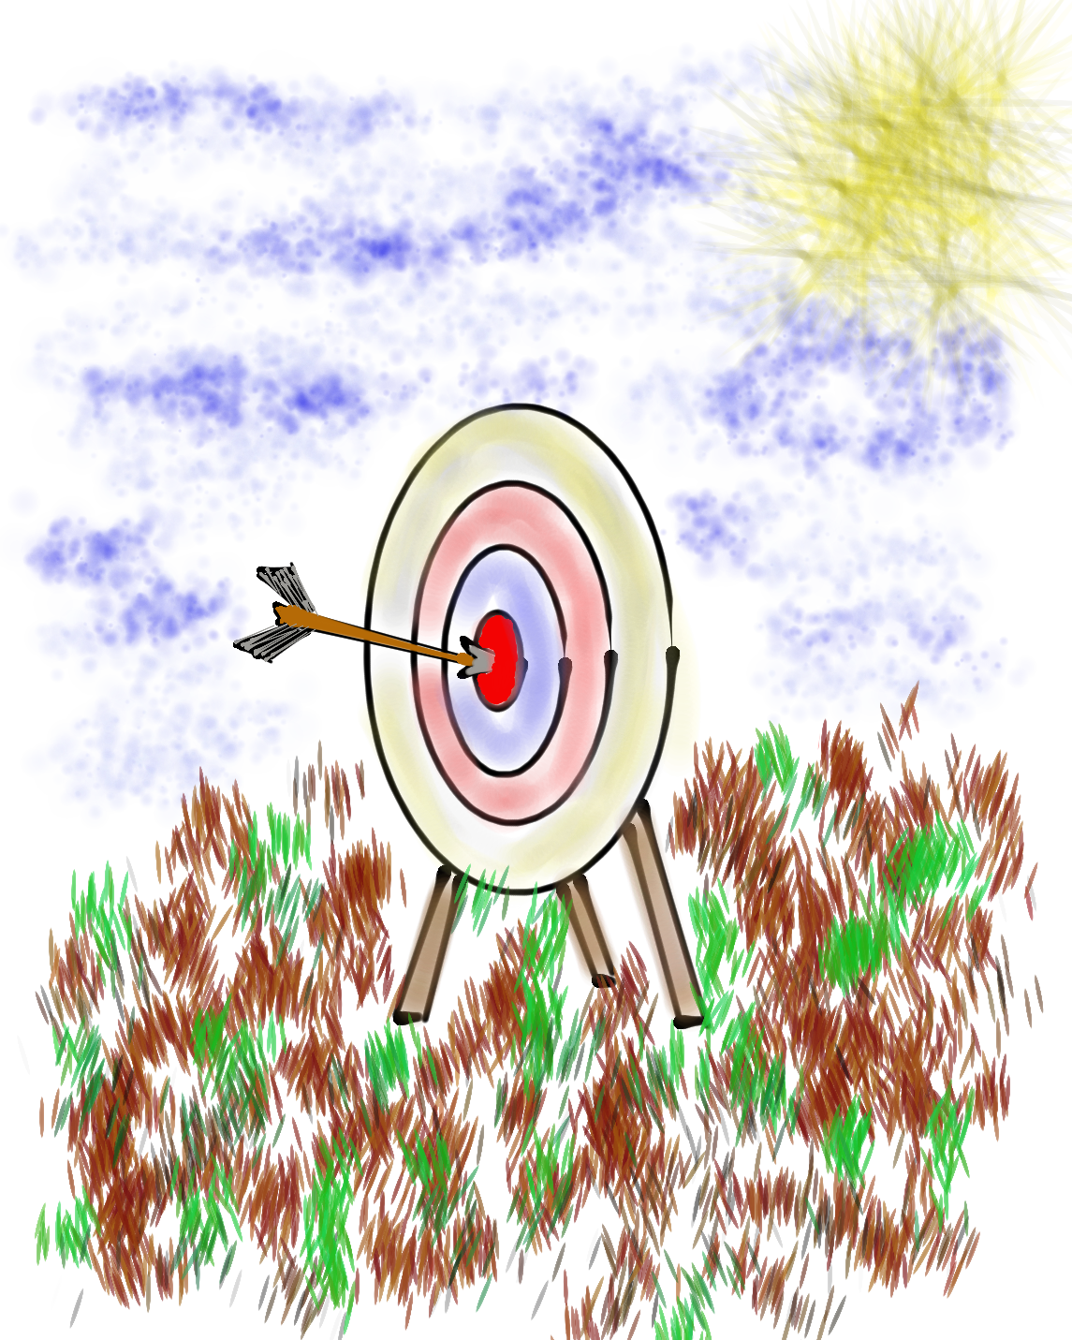
Learning Intention
We are learning about how Self Worth & Voice can positively impact school & classroom culture.
Success Criteria
Explore the interconnectedness between Self Worth
& Voice.
Consider strategies for amplifying Voice & cultivating Self Worth for all students & staff to positively impact school & classroom culture
Apply learning from this session to your role &
coaching/leadership practices at your school.
This session will be a home run for me if…

Slide 4

The 3 Components of Student Voice
Sharing thoughts & ideas in an environment underpinned by trust & respect.
Offering realistic suggestions for the
good of the whole.
Accepting responsibility for not only what is said but also what needs to be done.

Slide 5








Aspirations Framework
Self-Worth
Engagement
Purpose

Slide 6

Self-Worth

Slide 7
Self-Worth
Self-Worth flourishes when students & staff know they are valued members of the school community, have people in their lives they can trust & learn from, believe they have the ability to achieve, & know their efforts & hard work are recognized & celebrated in a variety of ways — academically, personally, & socially.

Slide 8
Why Self-Worth?
When students believe they have a Voice they are 32% more likely to report having Self-Worth.

Slide 9
Belonging

Slide 10
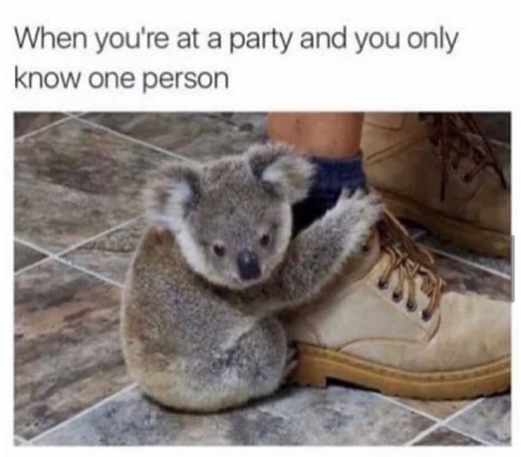

Slide 11
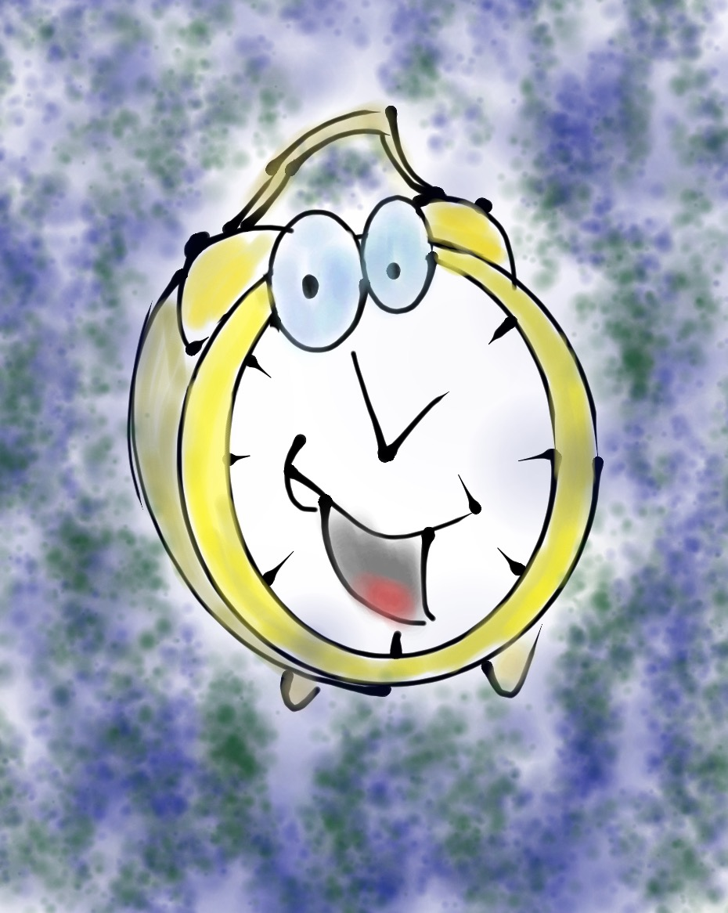
Challenge Time…

Slide 12
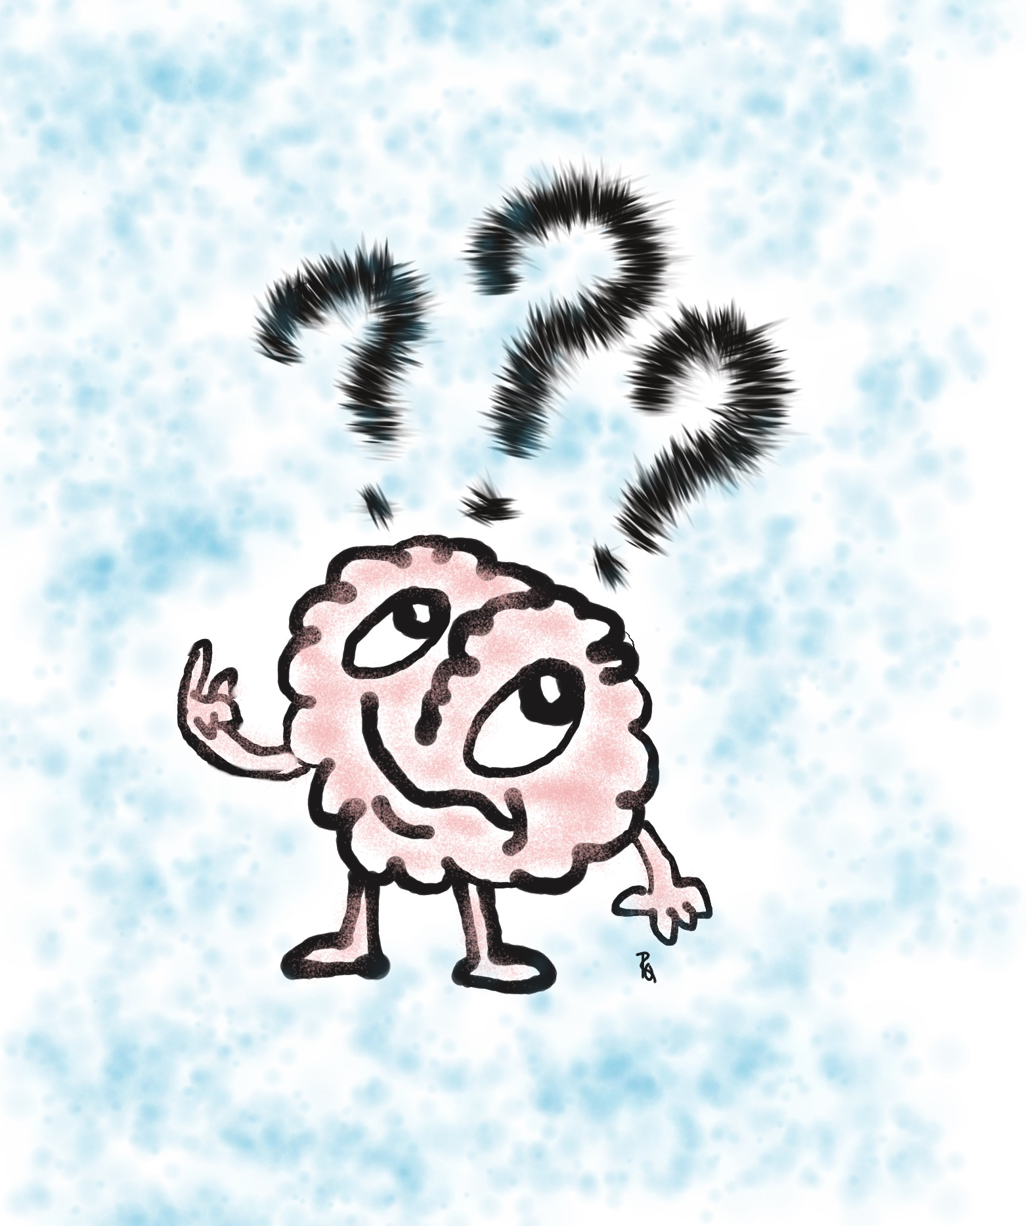
Be the first person to solve this riddle!
What is something you own, but everyone
else uses?

Slide 13
Do You Know Me?
Vimeo
https://vimeo.com/854745592
YouTube
https://youtu.be/ZQ0k2iAG1fk
Video

Slide 14
What’s in a Name
“My Name”
From The House on Mango Street
by Sandra Cisneros
Find a meet with your feet partner & share the
stories of your name.
Merge with another set of partners & introduce
your original partner via their name story.
Adapted from: SRI Resource & Protocol Book p. 163-164

Slide 15
Key Points
Create community without losing the identity of any student.
Knowing you are a part of a group, while
being recognized & celebrated for who
you are as an individual.
Before students can feel like they belong
there needs to be trust & respect.
Belonging is about accepting, not judging.

Slide 16
Cultivating
Belonging
Be aware of the nothing, nowhere, fine rut.
Use the names of students (correctly).
Be culturally & socially sensitive & relevant.
Recognize & celebrate differences.
Getting to KNOW your students is an
on-going process!

Slide 17
Challenge Time…

Slide 18
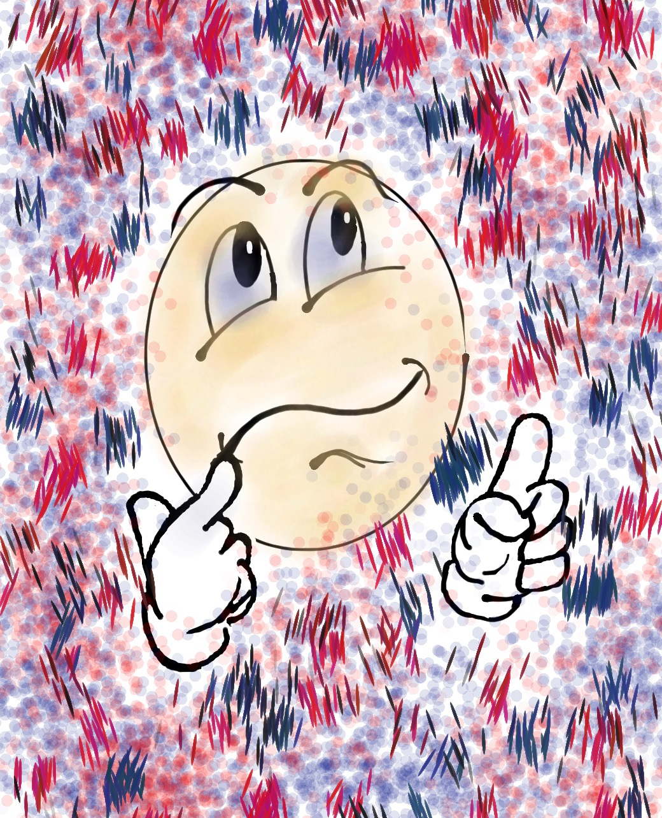

Challenge
Where do I Belong?
NO TALKING!!
NO looking at
your own dot.
Group yourselves according to the dots.

Slide 19
Challenge
Where do I Belong?
How did you FEEL
during the activity?
What did you observe
in others?
What did you learn?
How might you use this type of activity with
your colleagues &
students?

Slide 20
Odd Dot Out
Vimeo
https://vimeo.com/qisva/odddot
YouTube
https://youtu.be/x8r7BDQzaTY
Video
Notes:
This video was taken in my backyard during COVID and used for virtual professional learning sessions with teachers to demonstrate the Odd Dot Out activity and a debrief conversation with students. This group of high school students were in a COVID learning pod together—so don’t worry—I didn’t break any quarantine rules! ☺ Also, sorry for the background noise—my neighbor decided that while I was recording this video would be the perfect time to mow the law! Haha!

Slide 21
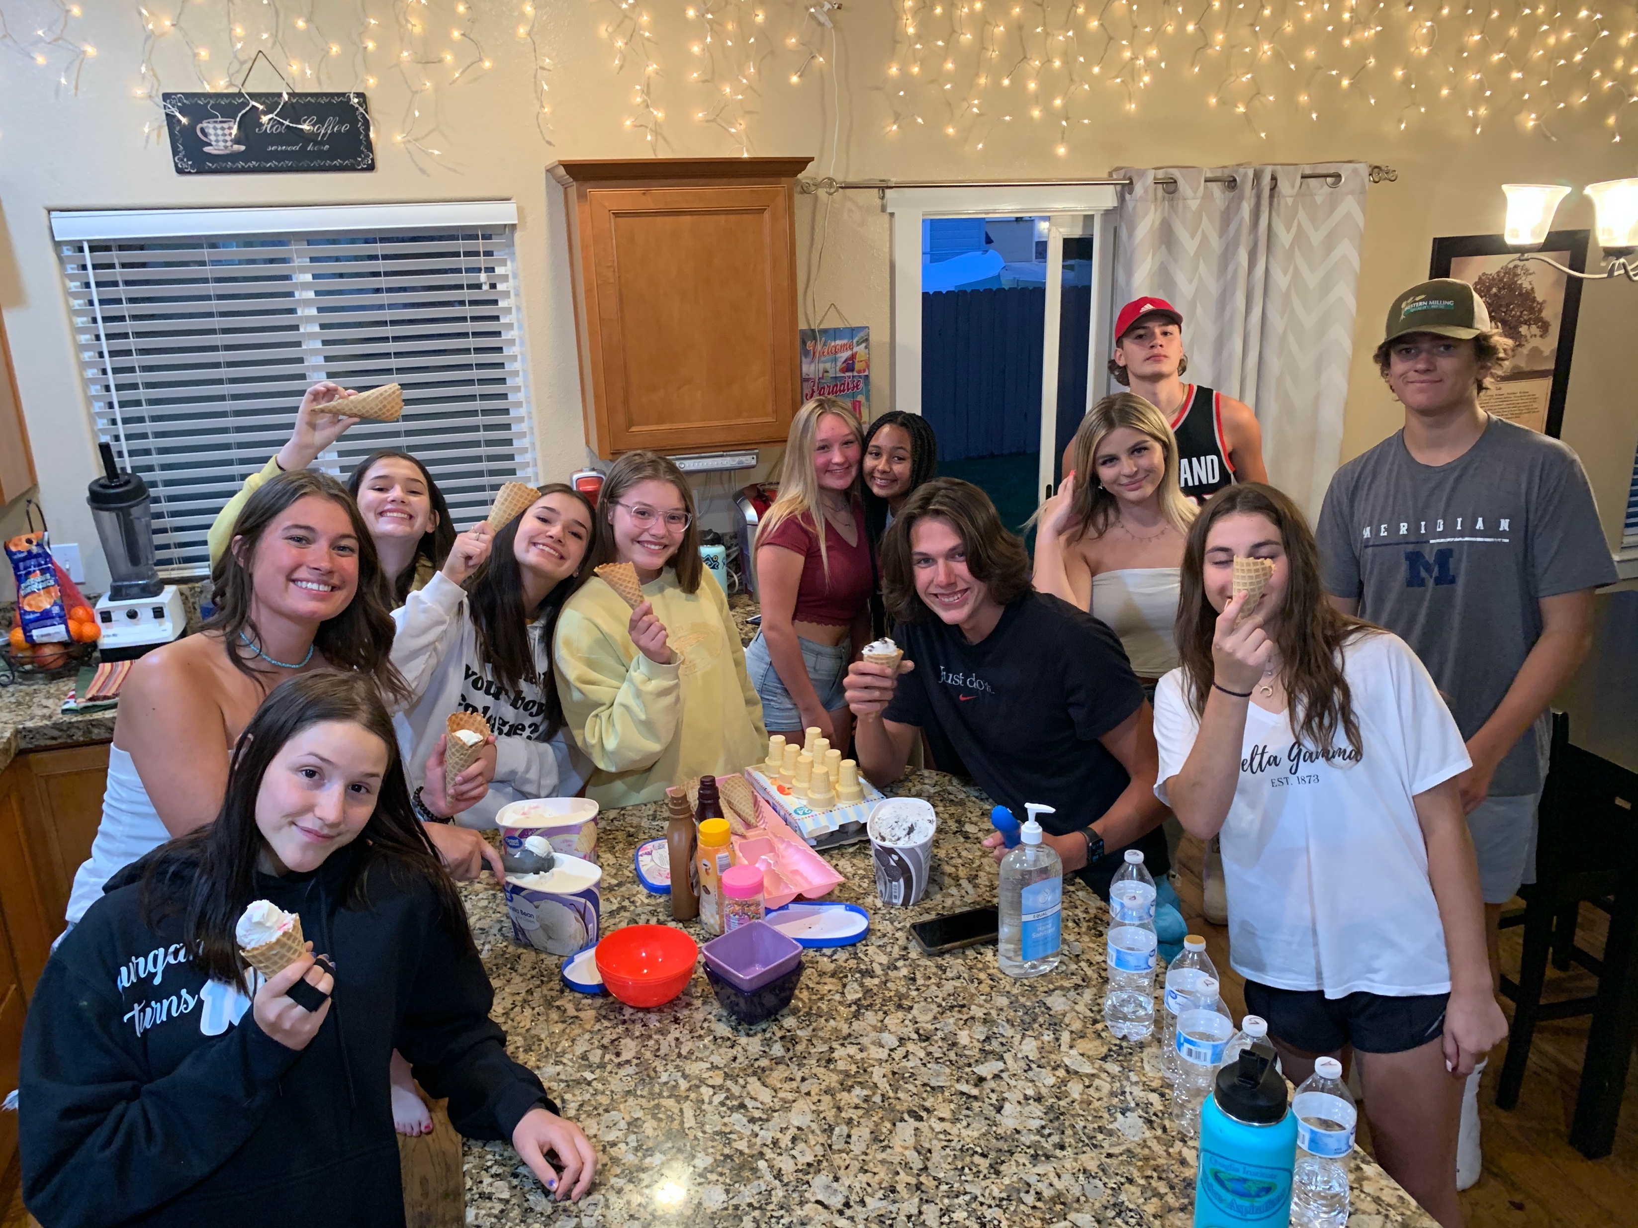
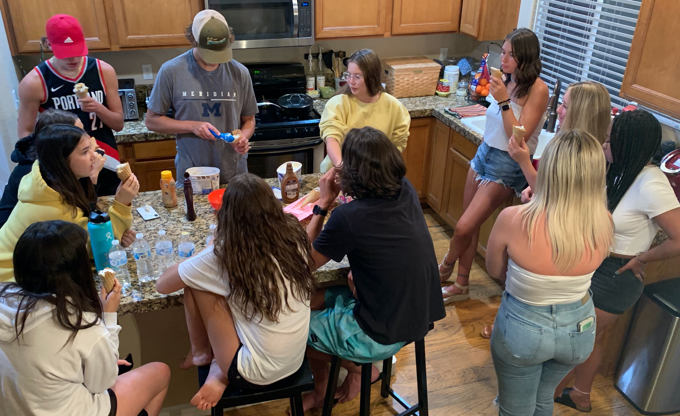
“We are all friends and it was still uncomfortable not knowing where you would fit in.”
“Imagine how it would be different if you got to have an ice cream social BEFORE playing the game!”
“I know it was just a game, but now I actually am thinking about a few people at school we could help feel like they belong.”
Notes:
After the activity I served ice cream to the students and captured a few quotes from their natural conversation (not part of my debrief) in the kitchen. It was really quite amazing to listen in on their observations and the connections they made between the “game” and real life in schools.

Slide 22
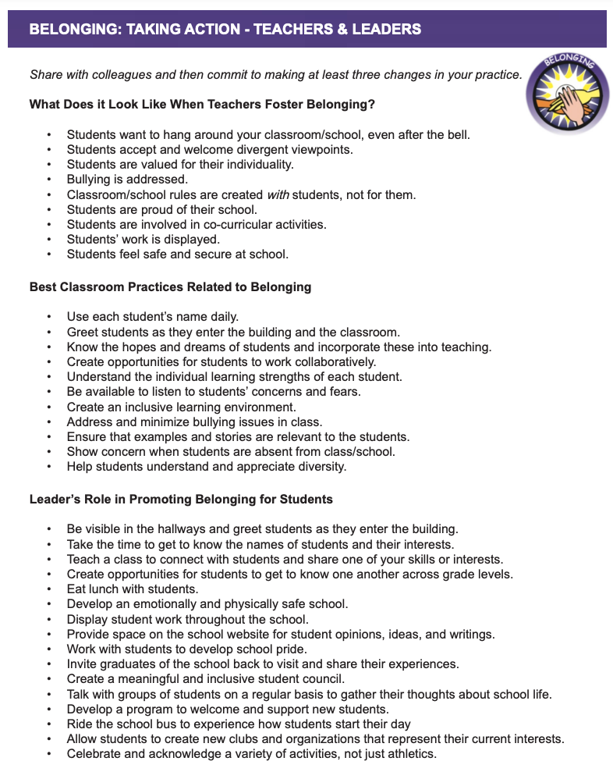
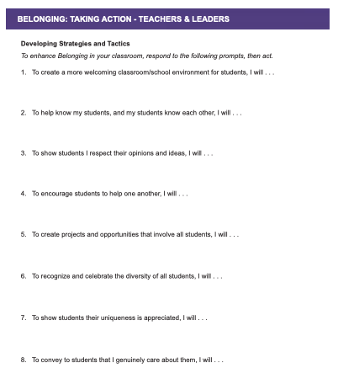

Slide 23
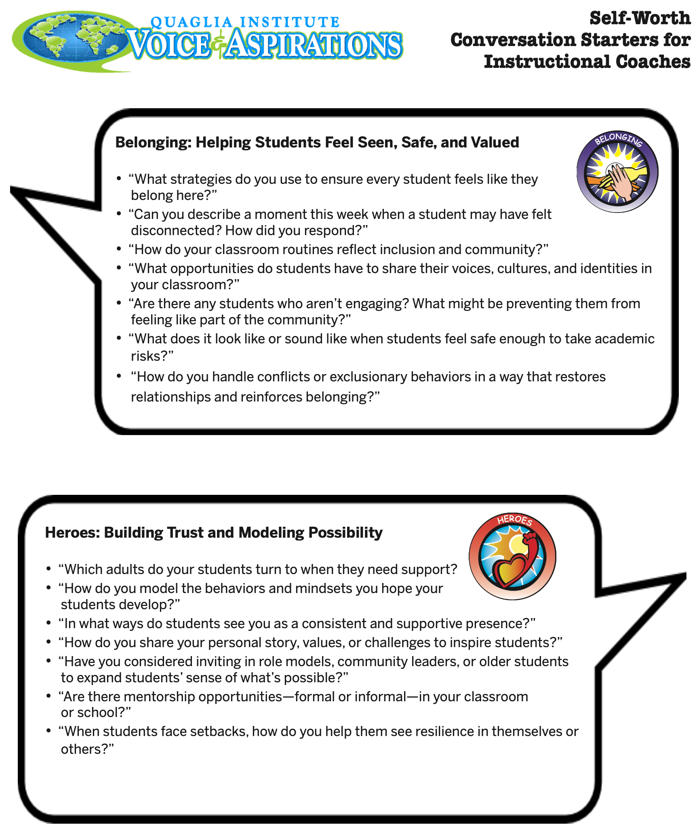

Slide 24
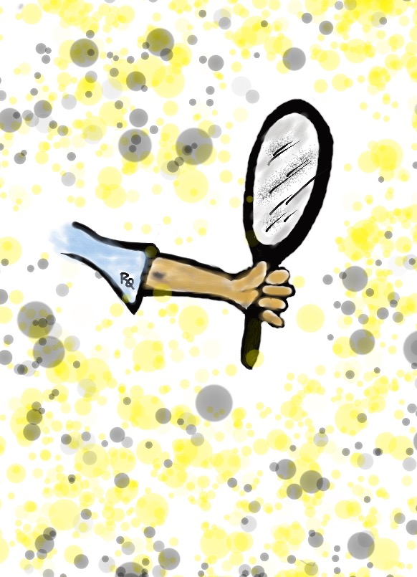
Reflect
What do you wish teachers would have known about you when you were in school? Why would it have
mattered?
How do you know when students feel part of your school community & valued for their uniqueness?

Slide 25
Heroes

Slide 26
You ARE a Hero!
Vimeo
https://vimeo.com/854746766
YouTube
https://youtu.be/v4aFemrsoMw
Video

Slide 27
Key Points
Be there when things go sideways….
& when things are worth celebrating.
Must be accessible.
Relationships, relationships, relationships.
It takes respect to get respect.
You are a hero whether you know it or not.

Slide 28
Becoming a Hero
Take time to REALLY listen to your students.
Kind words & smiles are important.
Make sure students know they matter to YOU.
Have high expectations of success.
Simply show up.

Slide 29


Slide 30
Challenge Time…

Slide 31
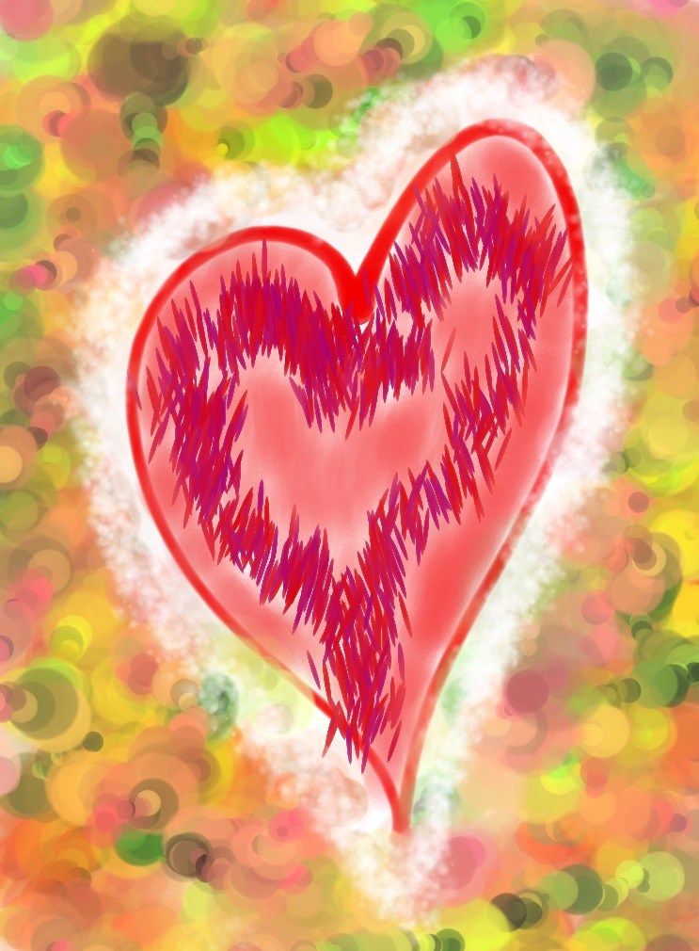
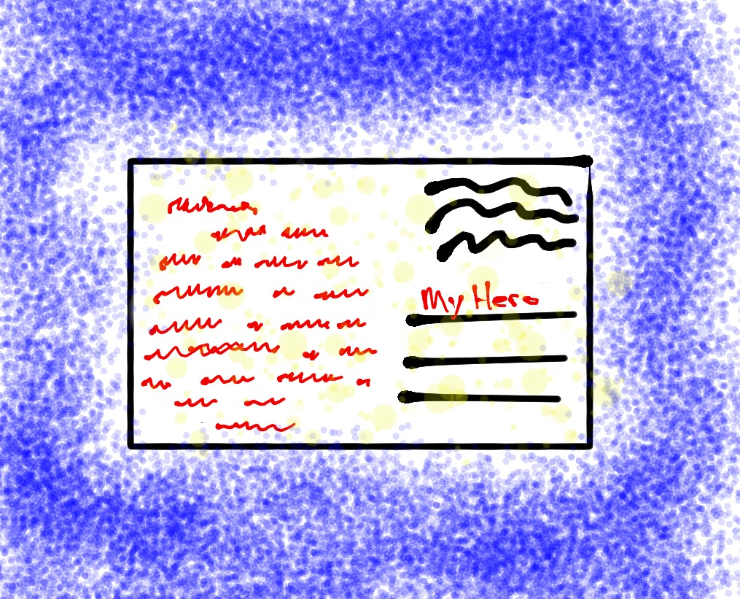
Challenge
Attitude of Gratitude
Write a note of gratitude honoring an act of heroism…
small or big!
(Don’t forget to deliver it!)

Slide 32
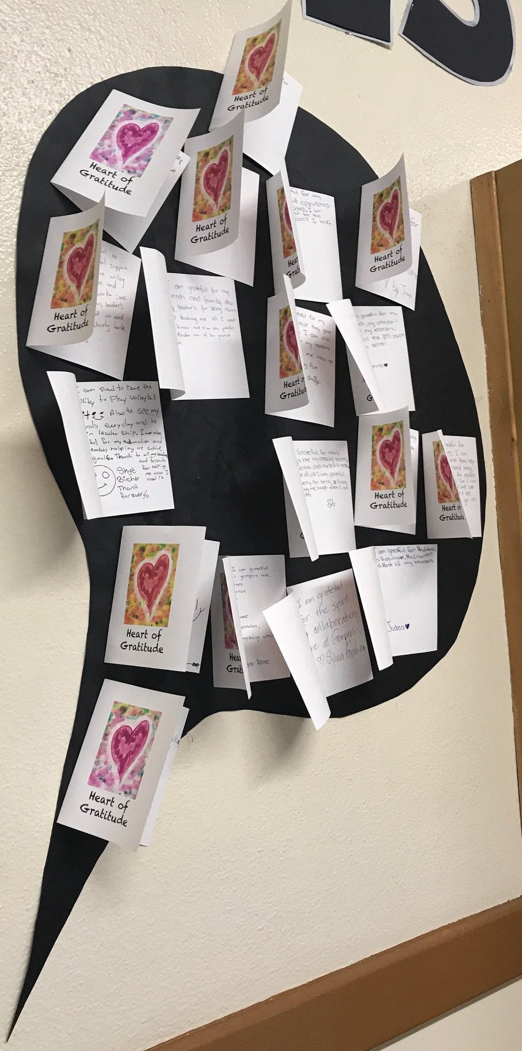
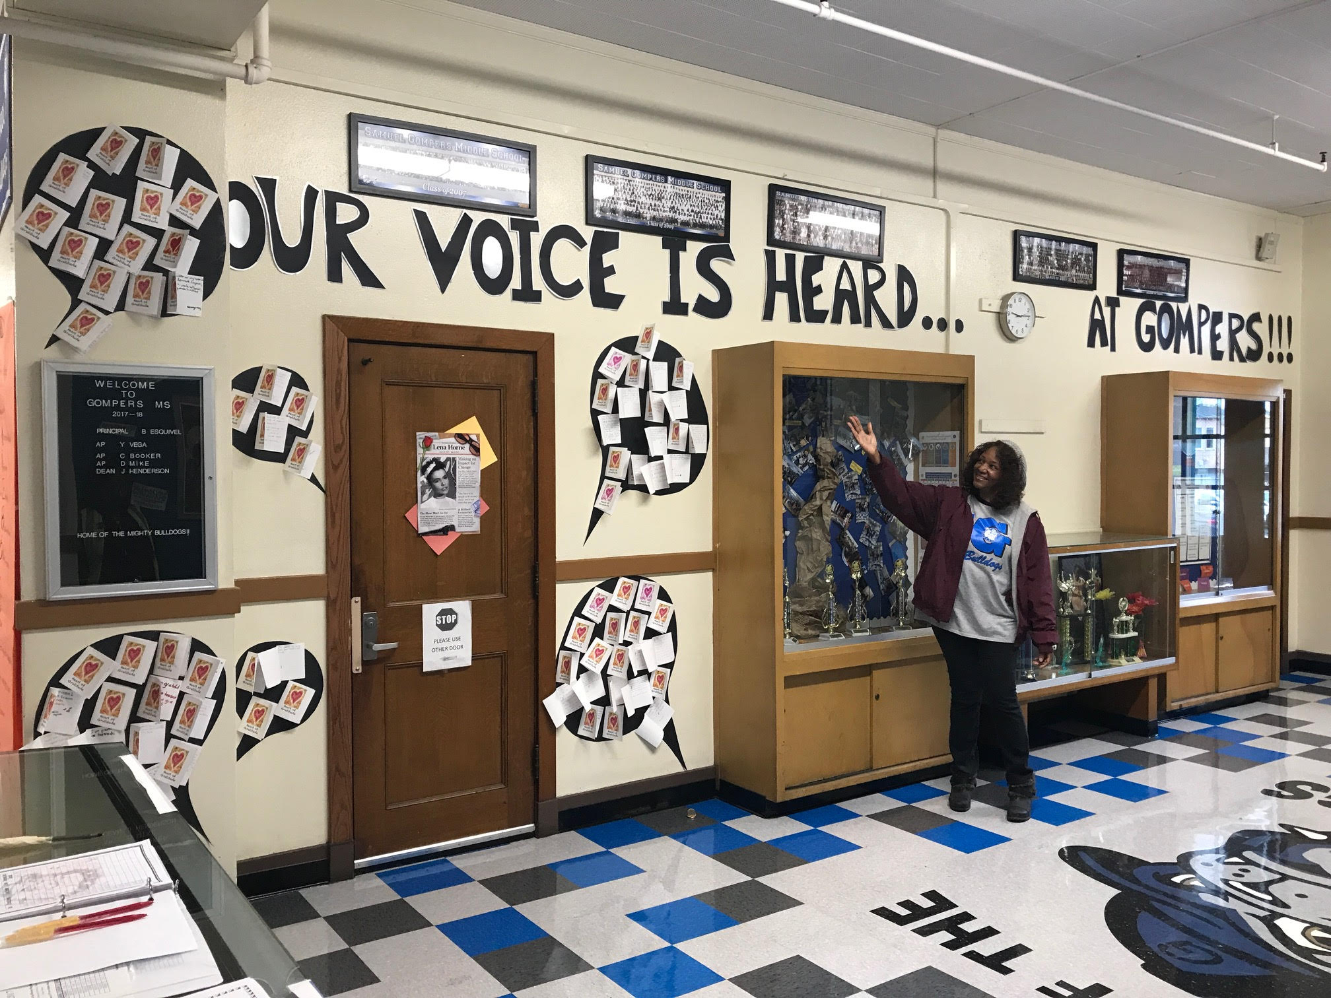
Challenge
Attitude of Gratitude

Slide 34
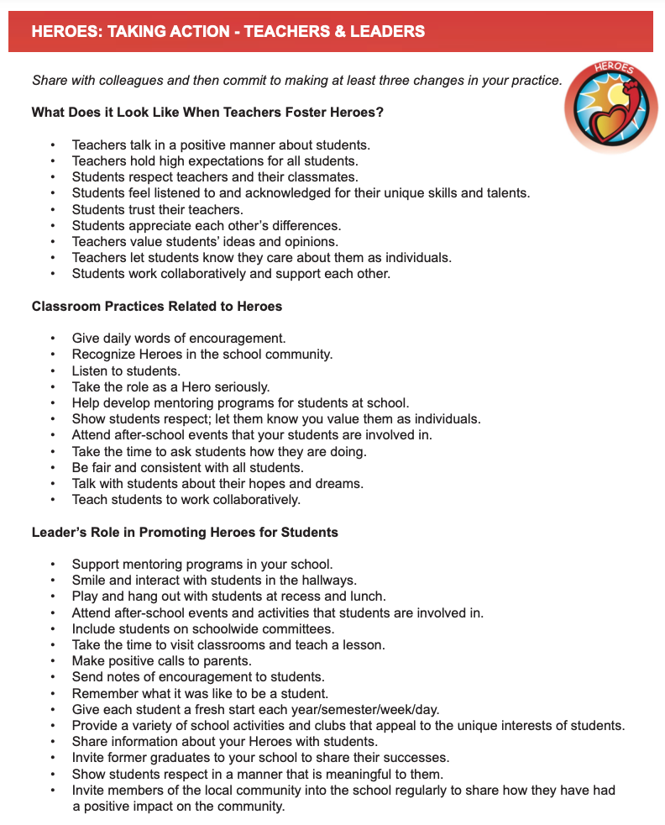
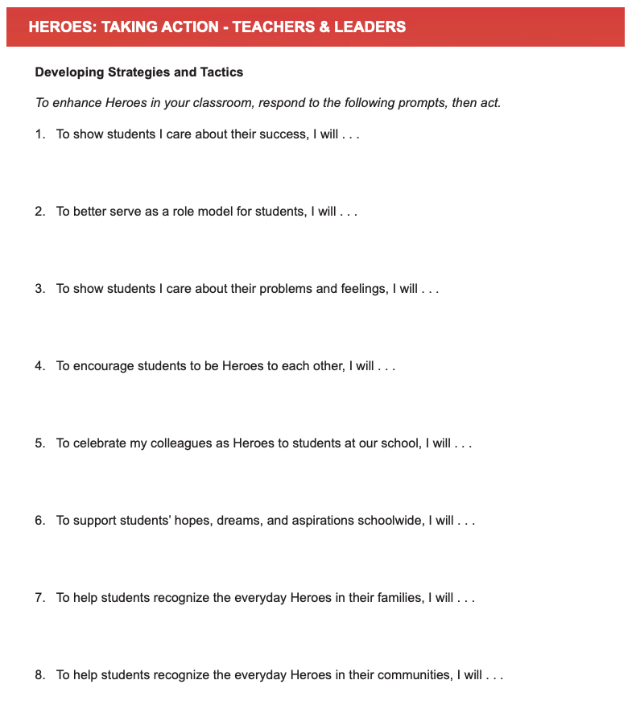

Slide 35
Reflect
Share a time you were a Hero to a student or colleague.
Share a time when a student or colleague was a Hero for you.

Slide 36
Sense of Accomplishment

Slide 37
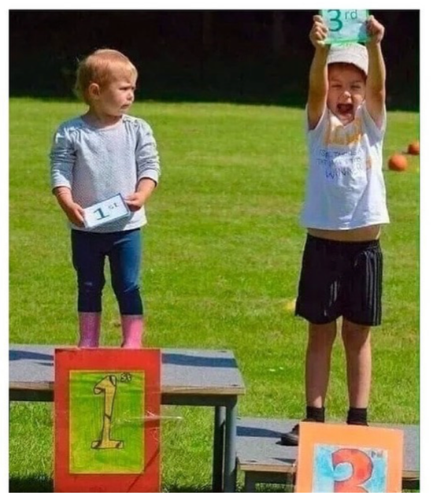

Slide 38
Effort and Perseverance
Vimeo
https://vimeo.com/854748561/53926aaf4e
YouTube
https://youtu.be/w6SgUPwJNNs
Video

Slide 39
Key Points
Move beyond just academic success…
effort, perseverance & citizenship matter.
Value & recognize the learning process,
not just the final product.
Students need to establish, recognize &
celebrate their own achievements.

Slide 40
Instill a Sense of Accomplishment
Provide students opportunities to reflect
& self assess.
Students need clarity & purpose behind
learning & behavior expectations. Help
build the why & shared responsibility.
Provide a wide variety of opportunities for
students to grow & succeed.
Revise, revisit, redo!

Slide 41
Challenge Time…

Slide 42
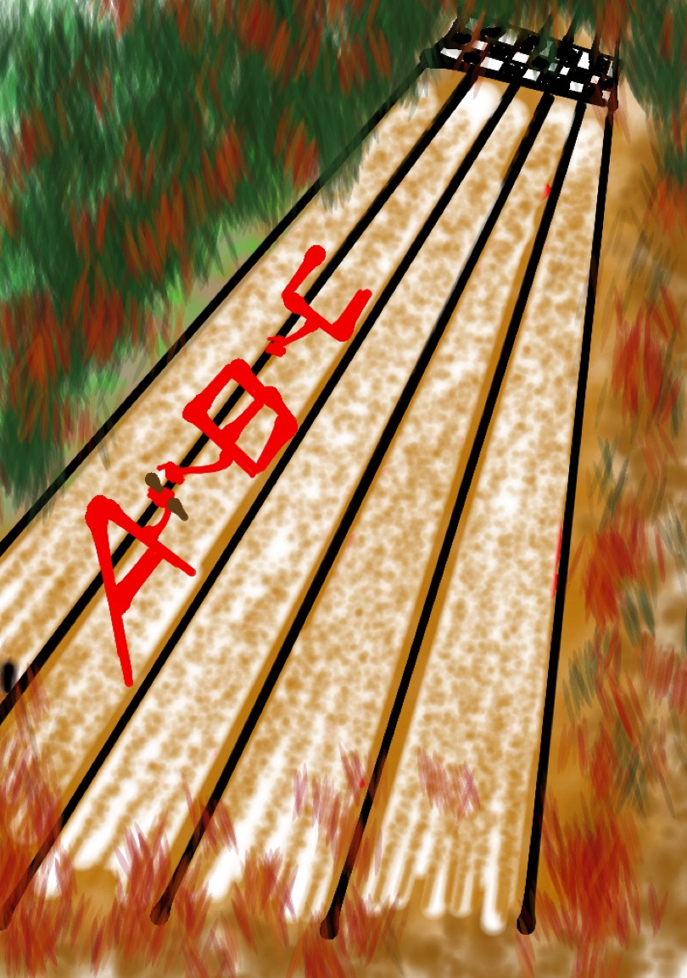
Challenge
A-Z Accomplishments Relay
Take turns listing examples of different things & ways you celebrate at school starting with each letter of the alphabet.
Once a letter covered, pass the baton & the next person moves on to the next letter. You may not skip letters! You CAN help one another if someone gets stuck!

Slide 43
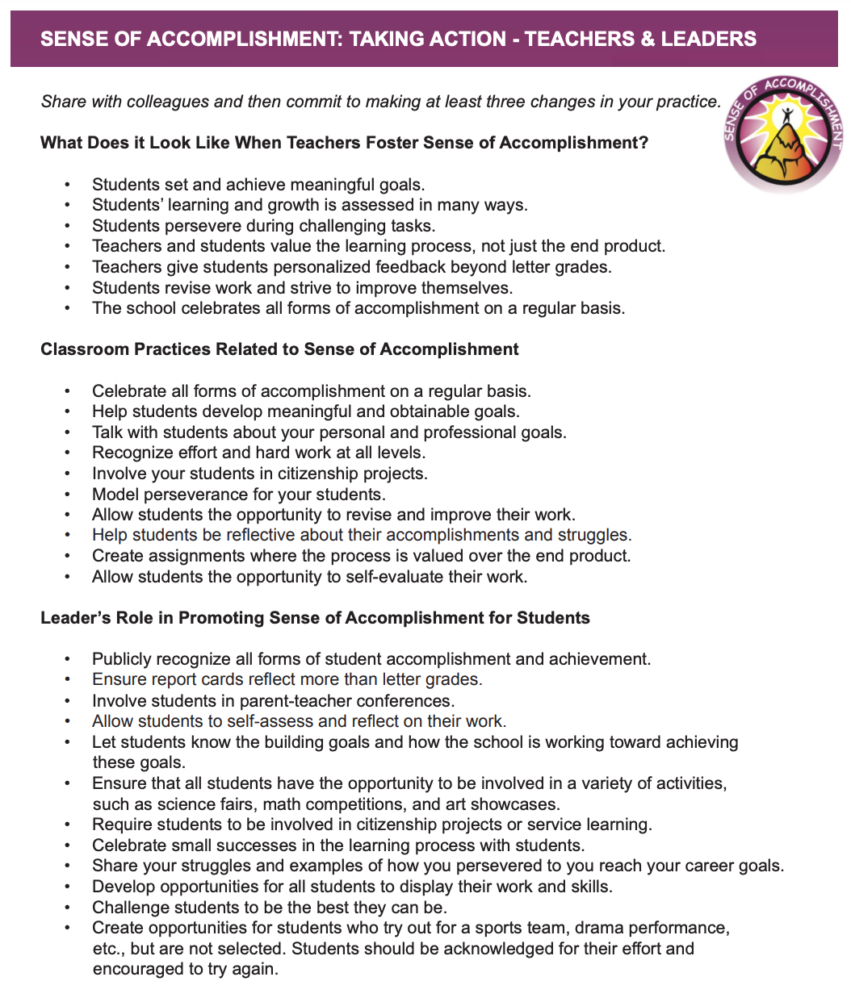
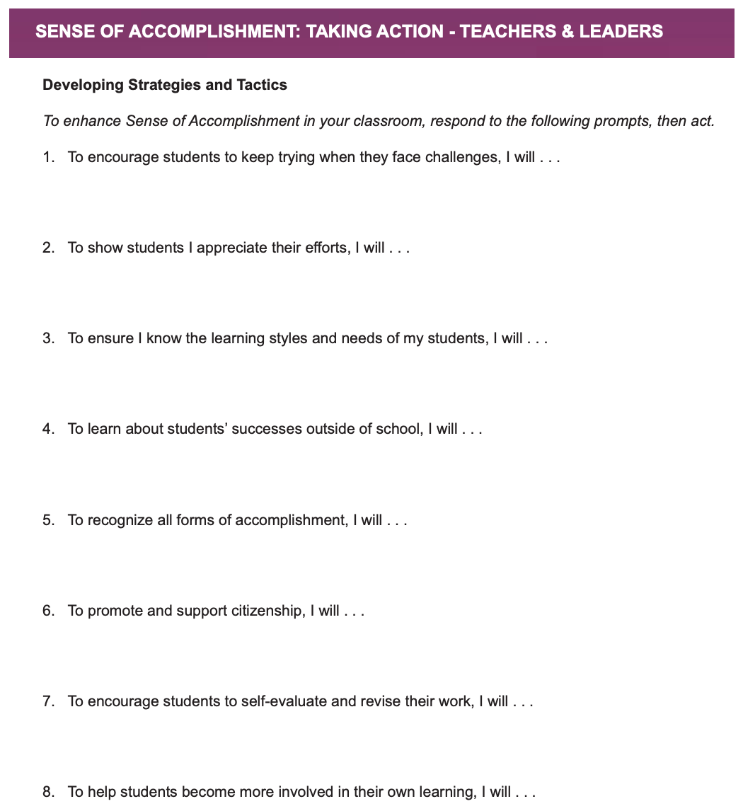

Slide 44
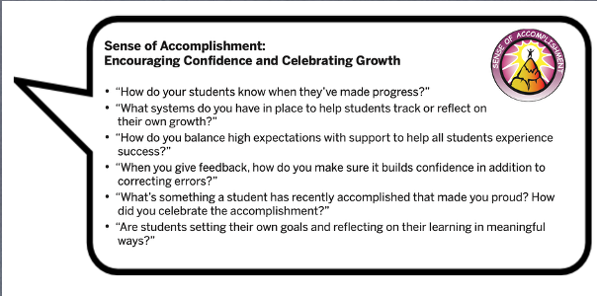

Slide 45

Reflect
Create a pie chart & assign percentages
to the major things your school celebrates,
with all percentages totaling to 100%.
What would you like to maintain?
What would you like to change?

Slide 46
Self-Worth
Feeling like you are part of a
group, while knowing you are
valued as an individual.
Having someone in your life to
consistently support & encourage you in good times & bad.
Being recognized for different types of successes on a regular basis.

Slide 47
RESOURCES

Slide 48
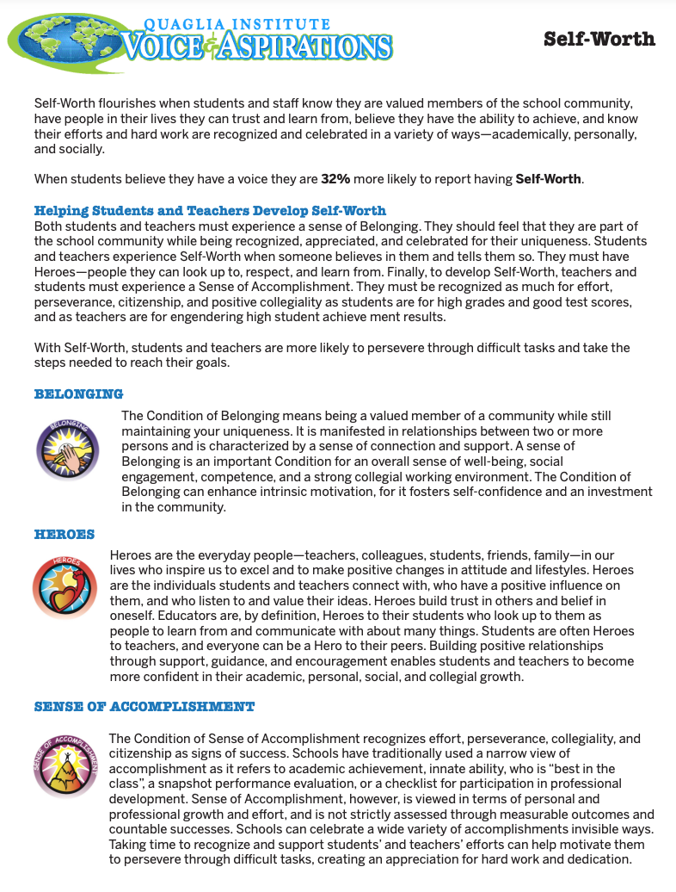
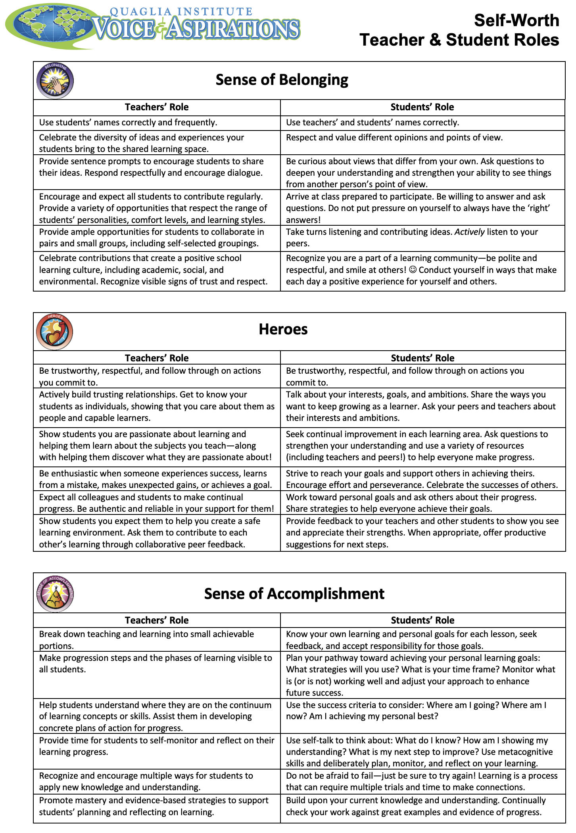
Adding Clarity to Self Worth

Slide 49
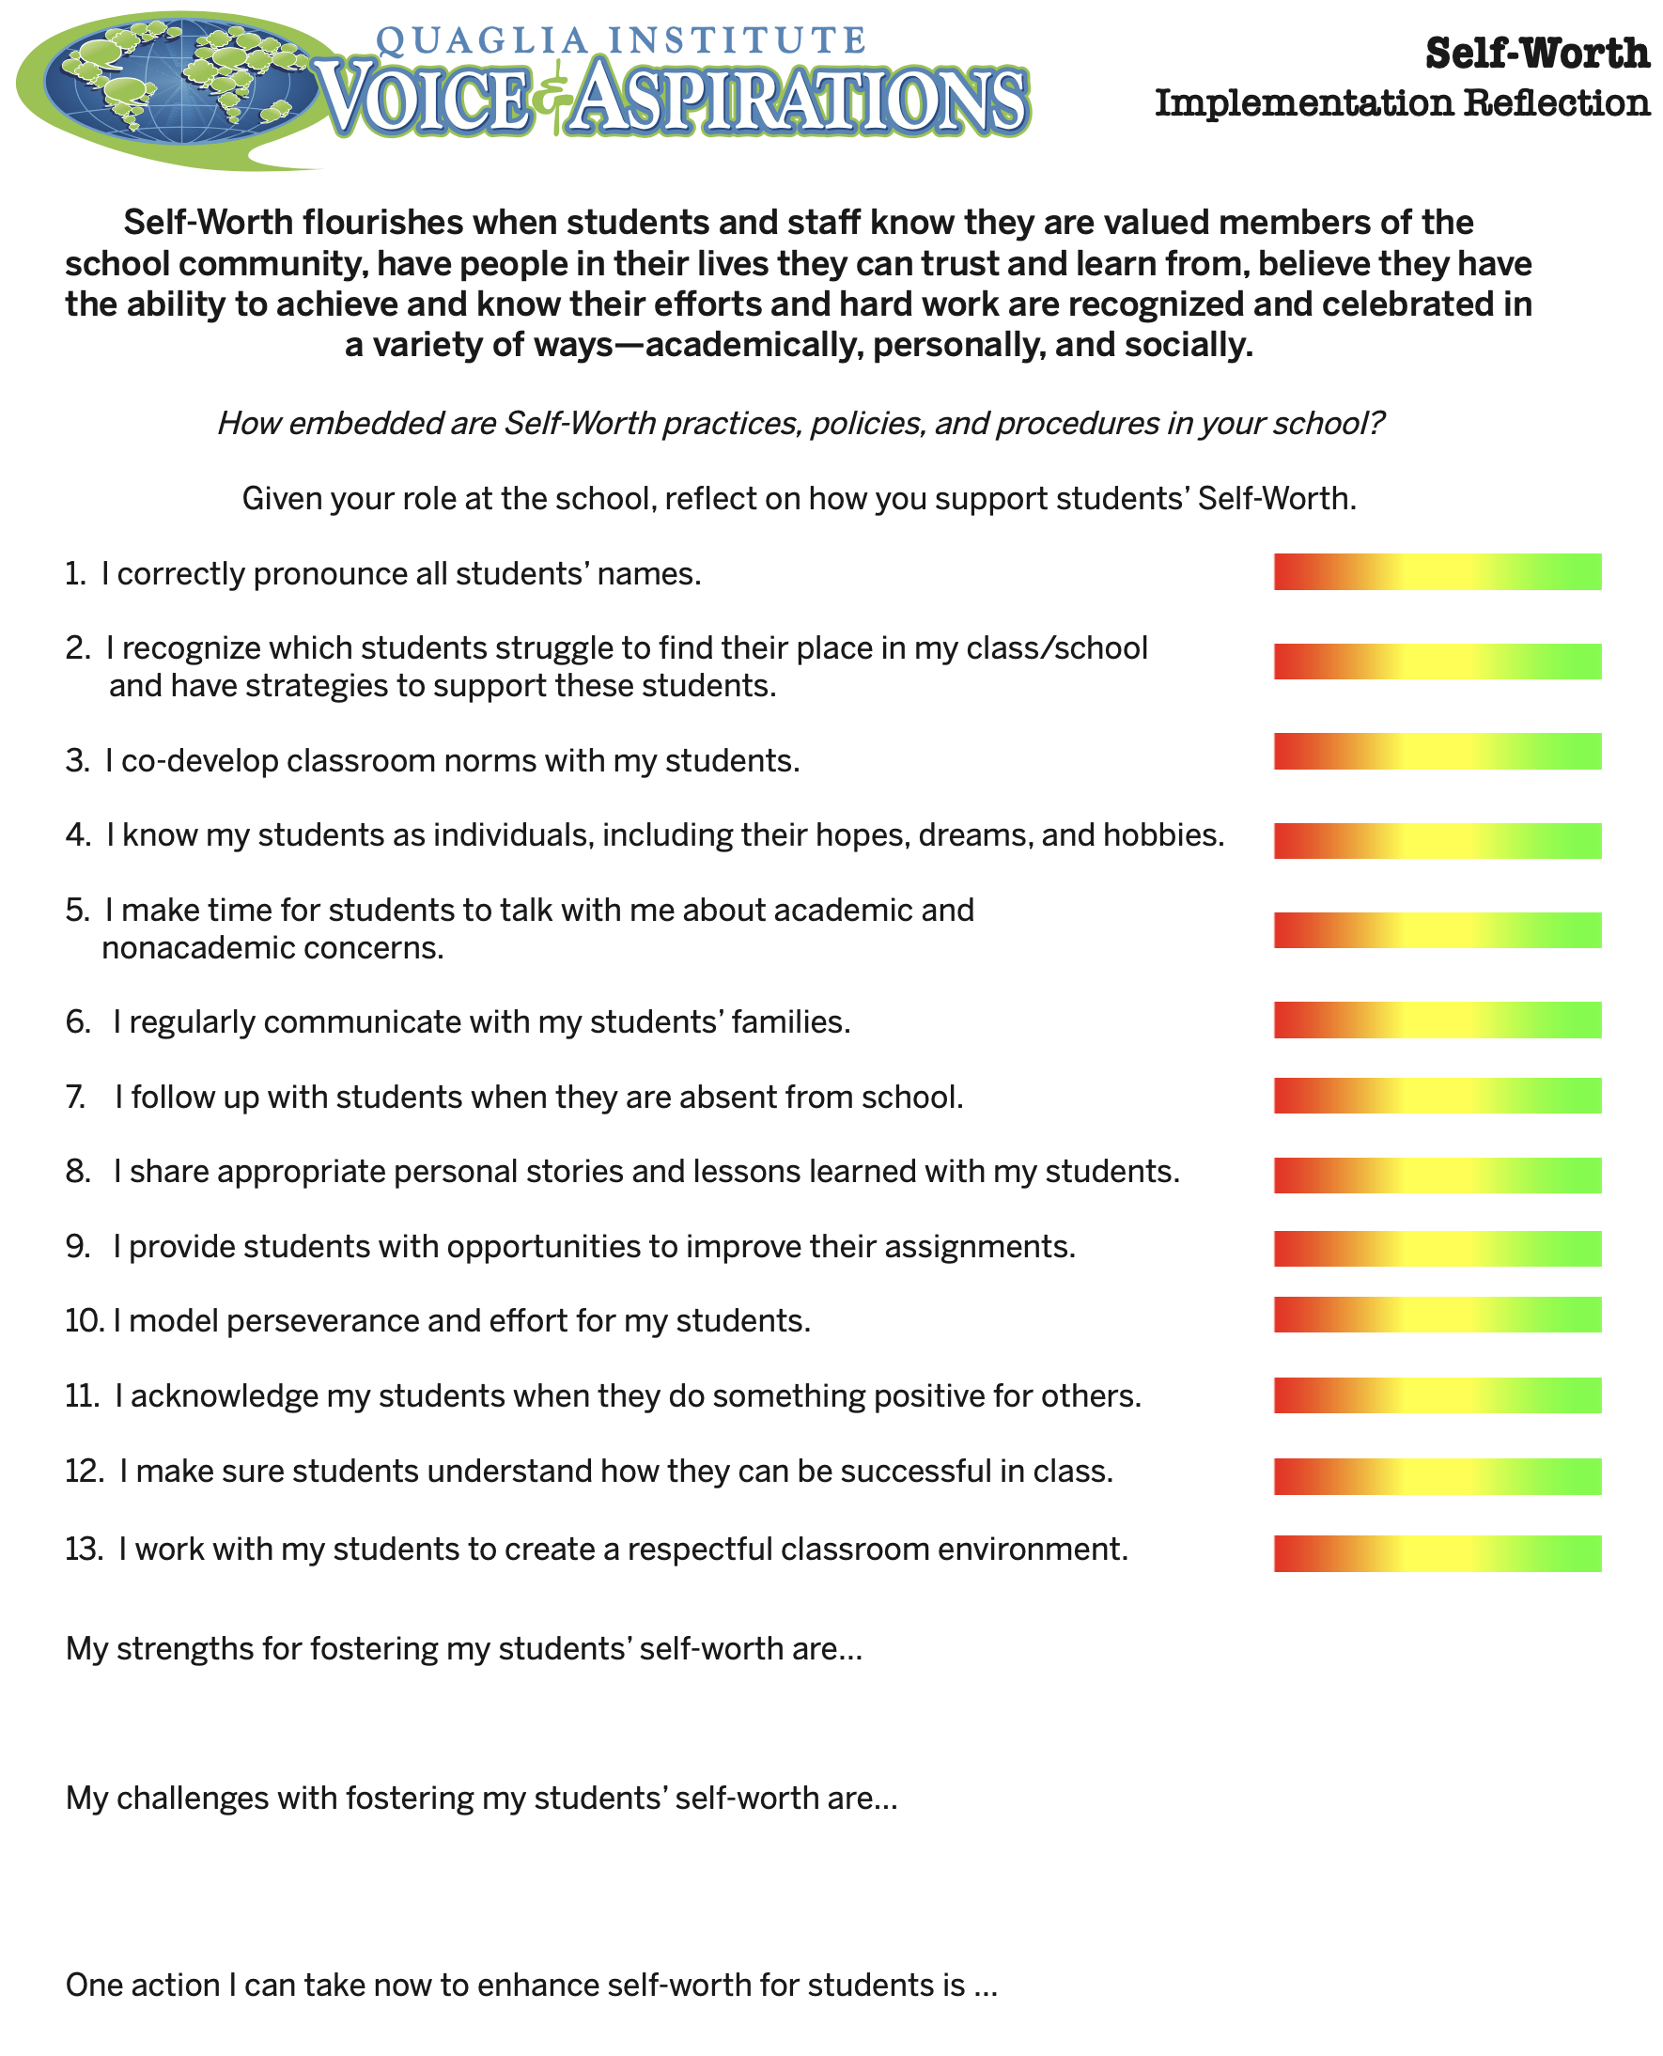
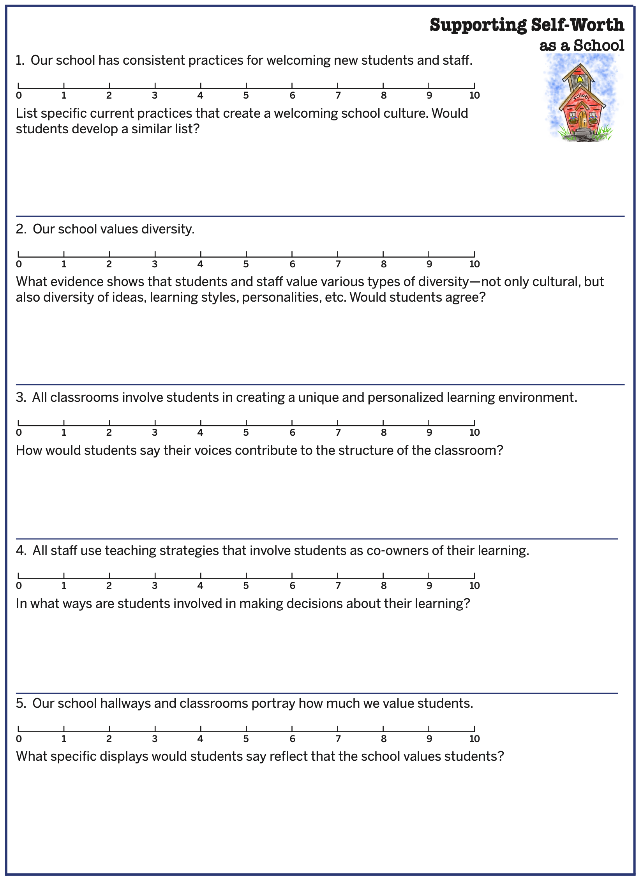
Self-Worth Implementation Self Assessment

Slide 50
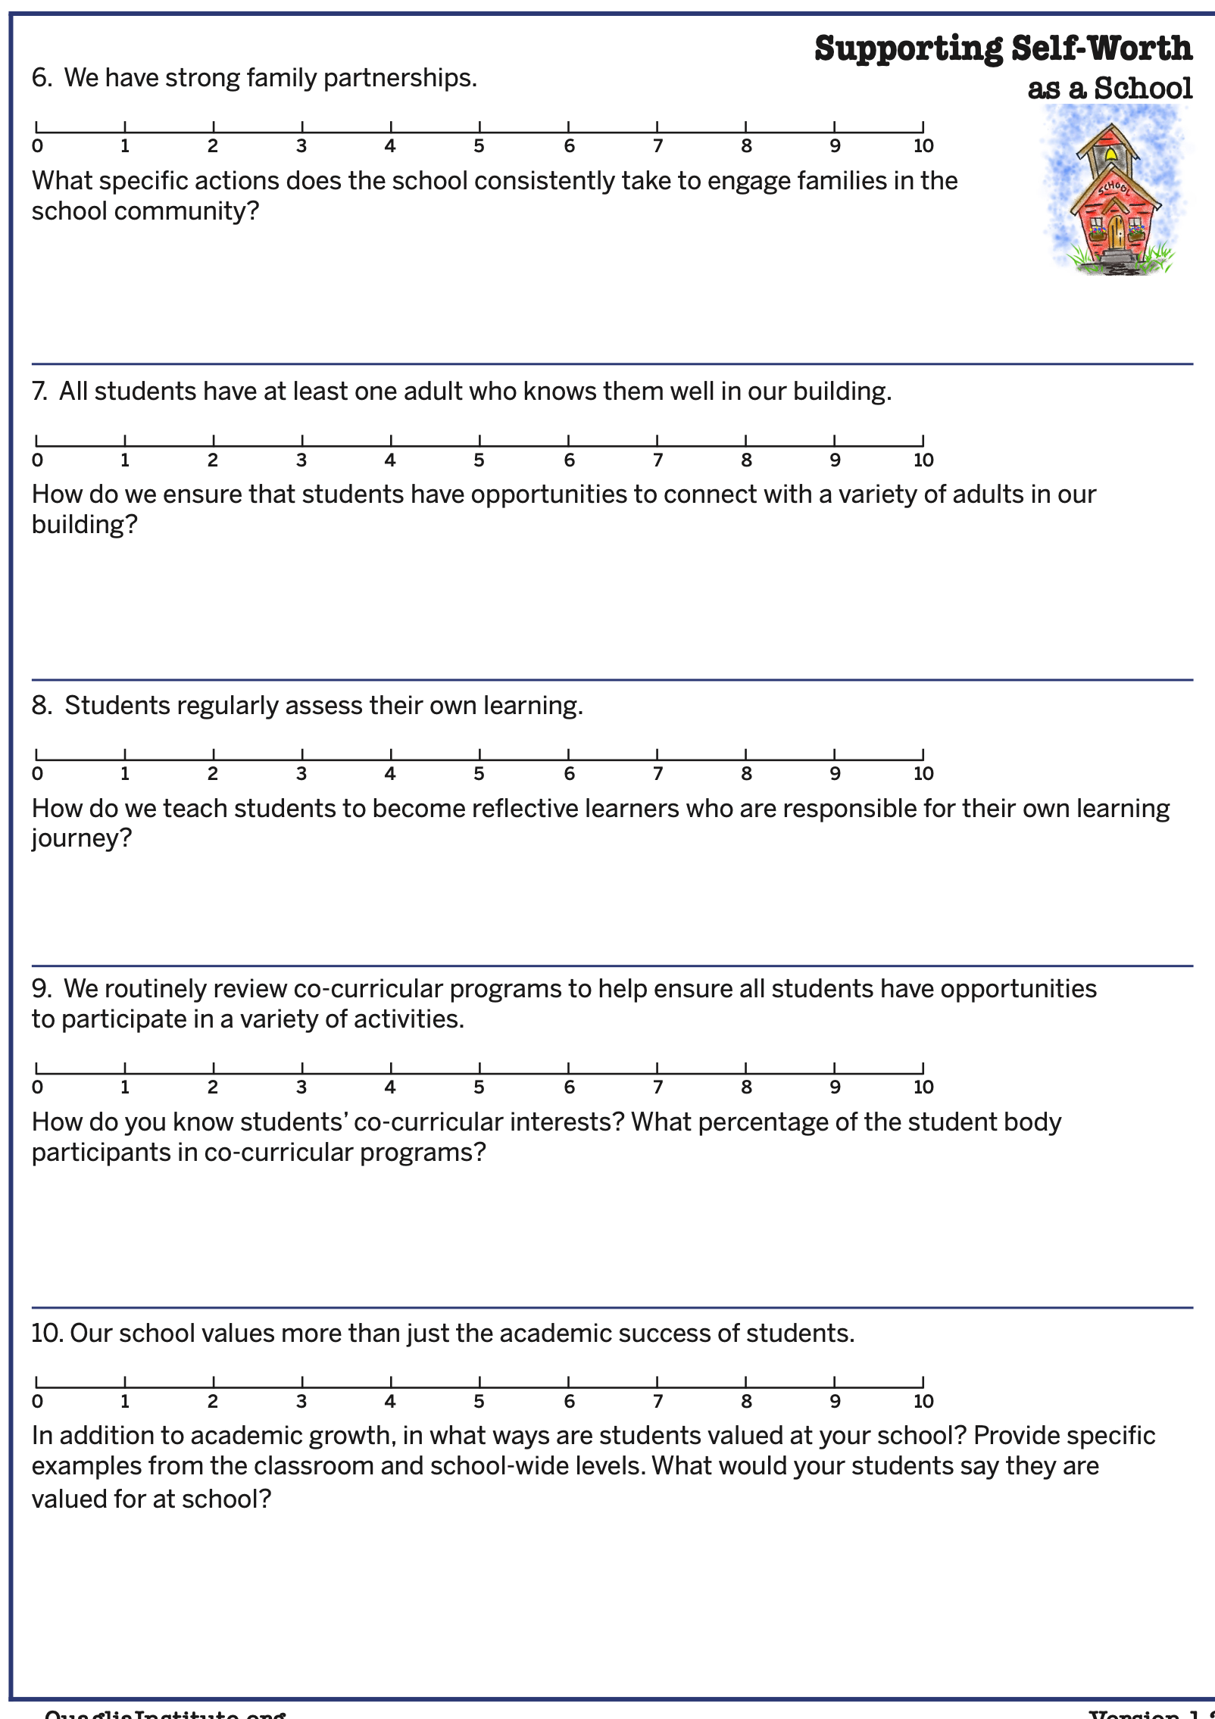
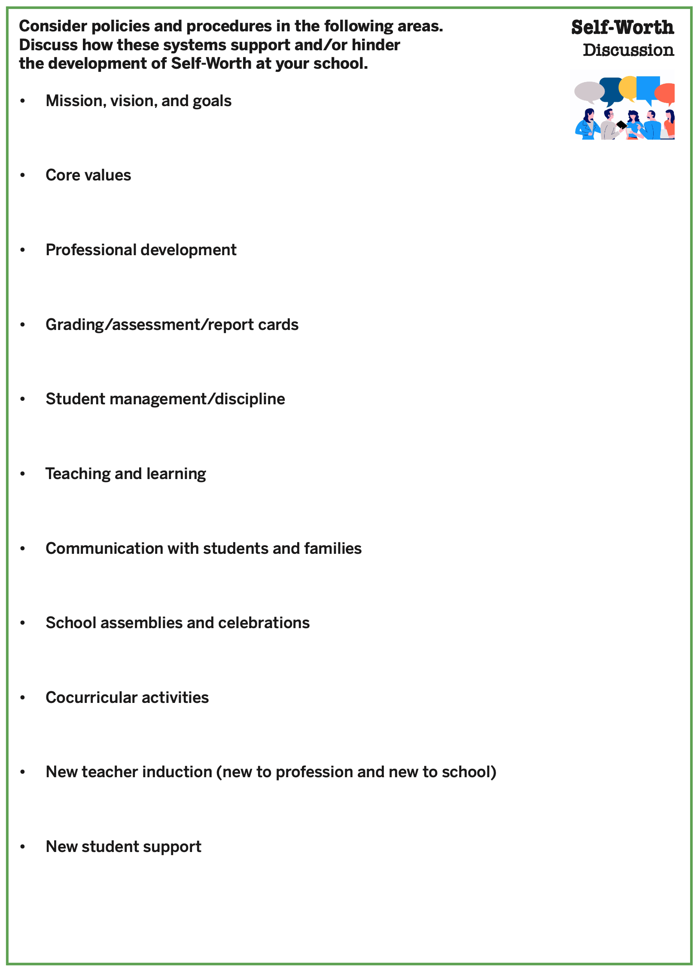
Self-Worth Implementation Self Assessment

Slide 51
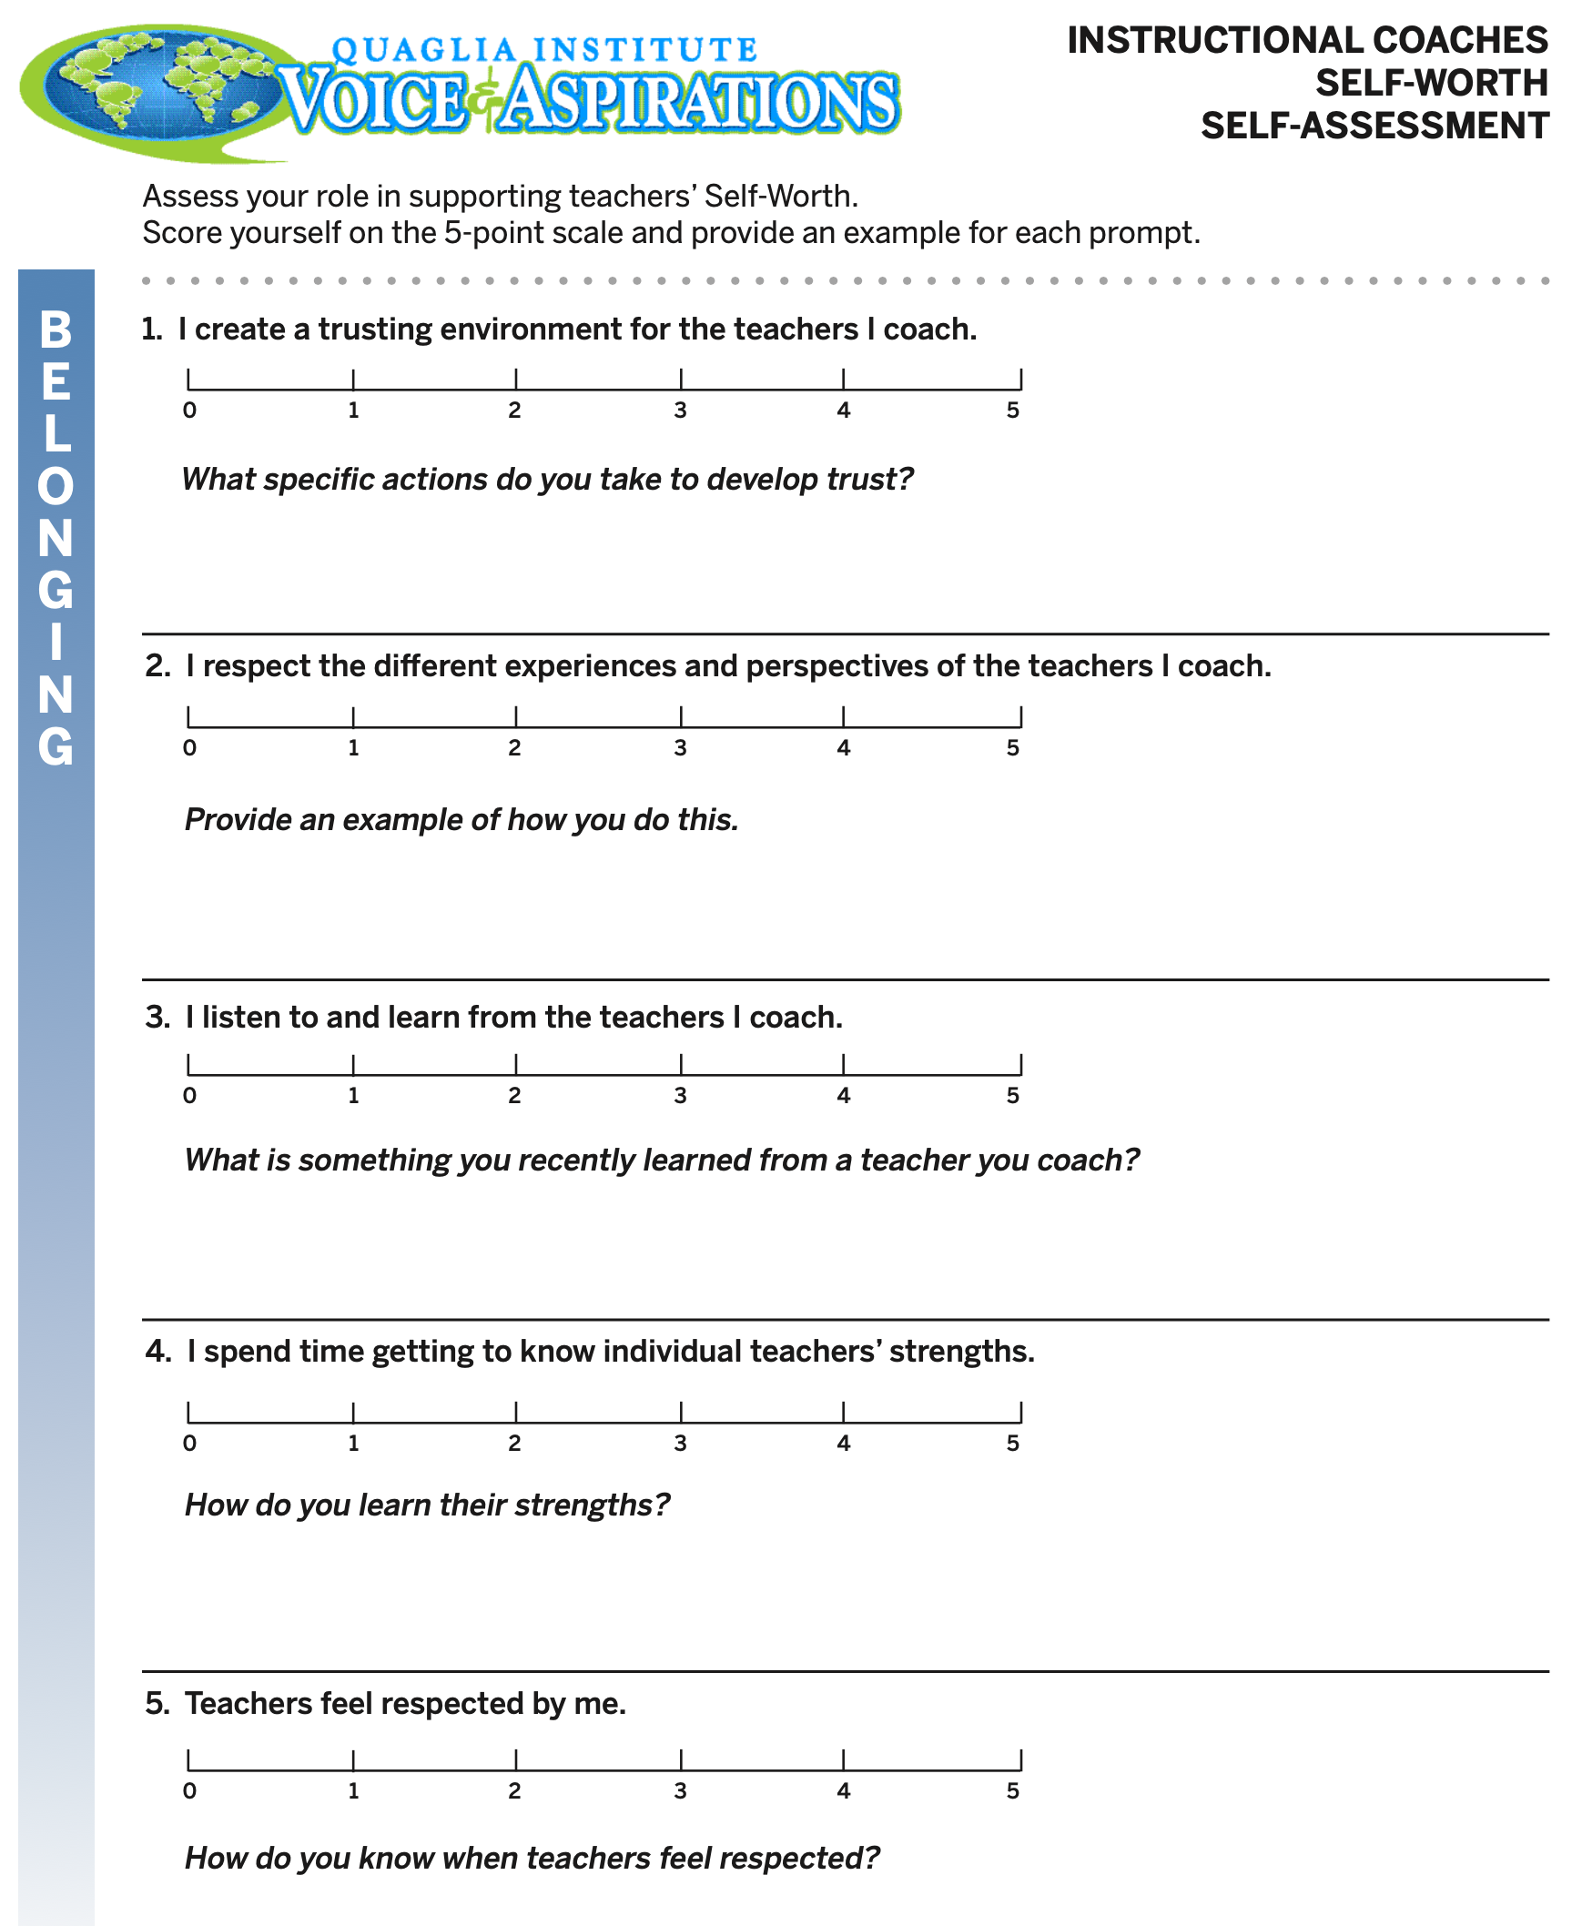
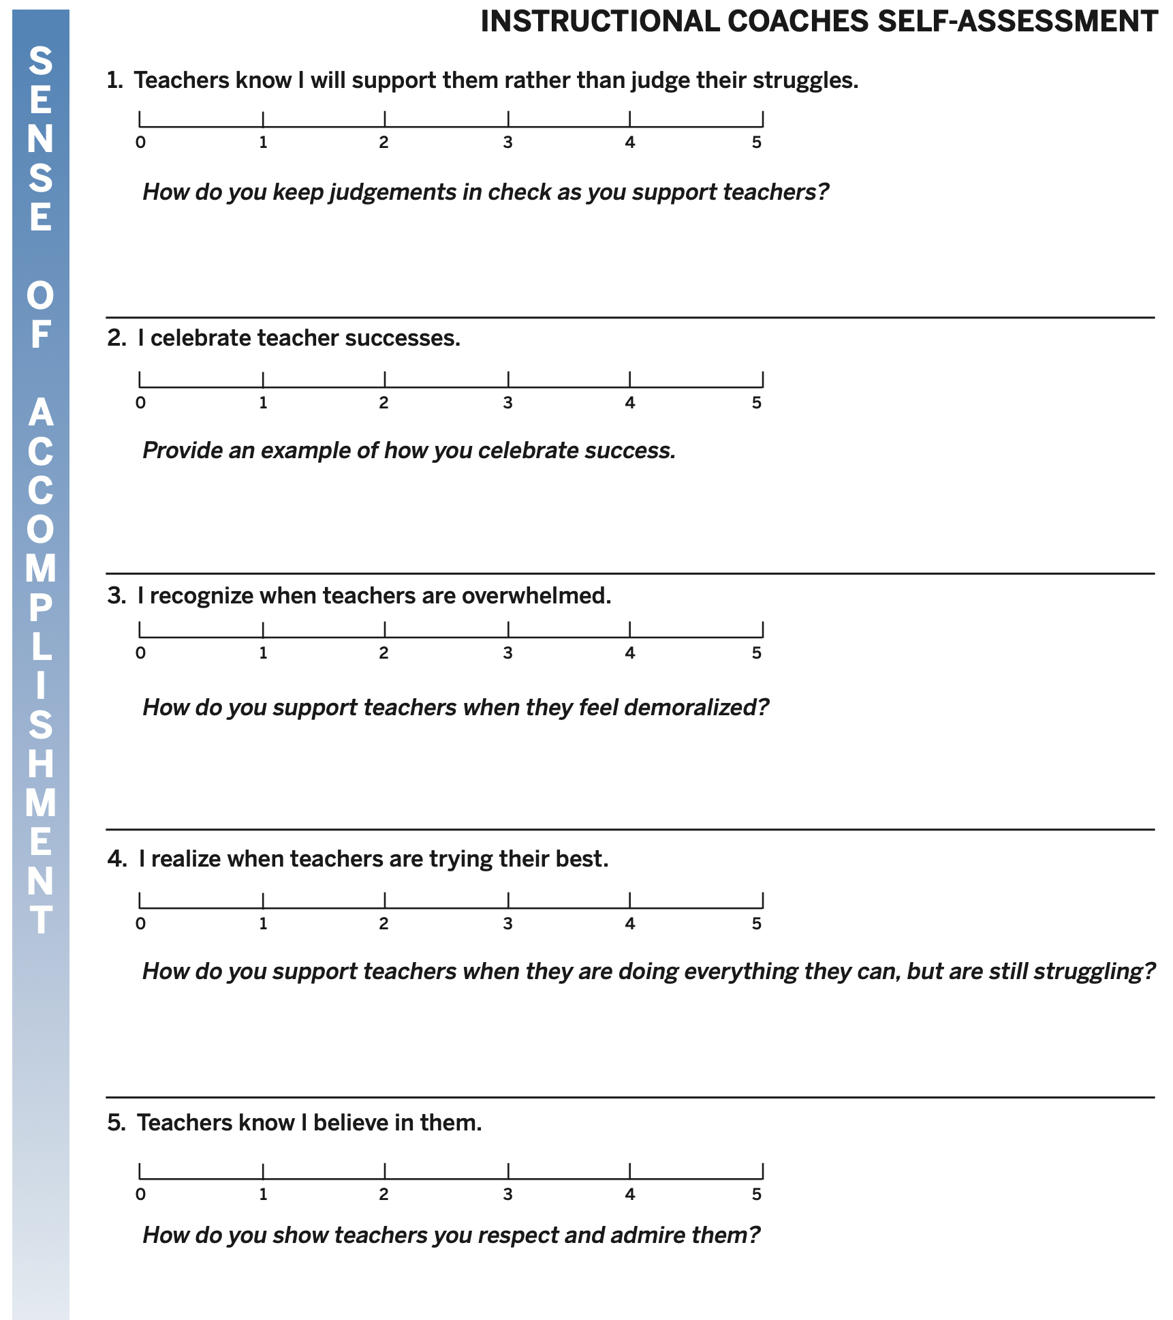
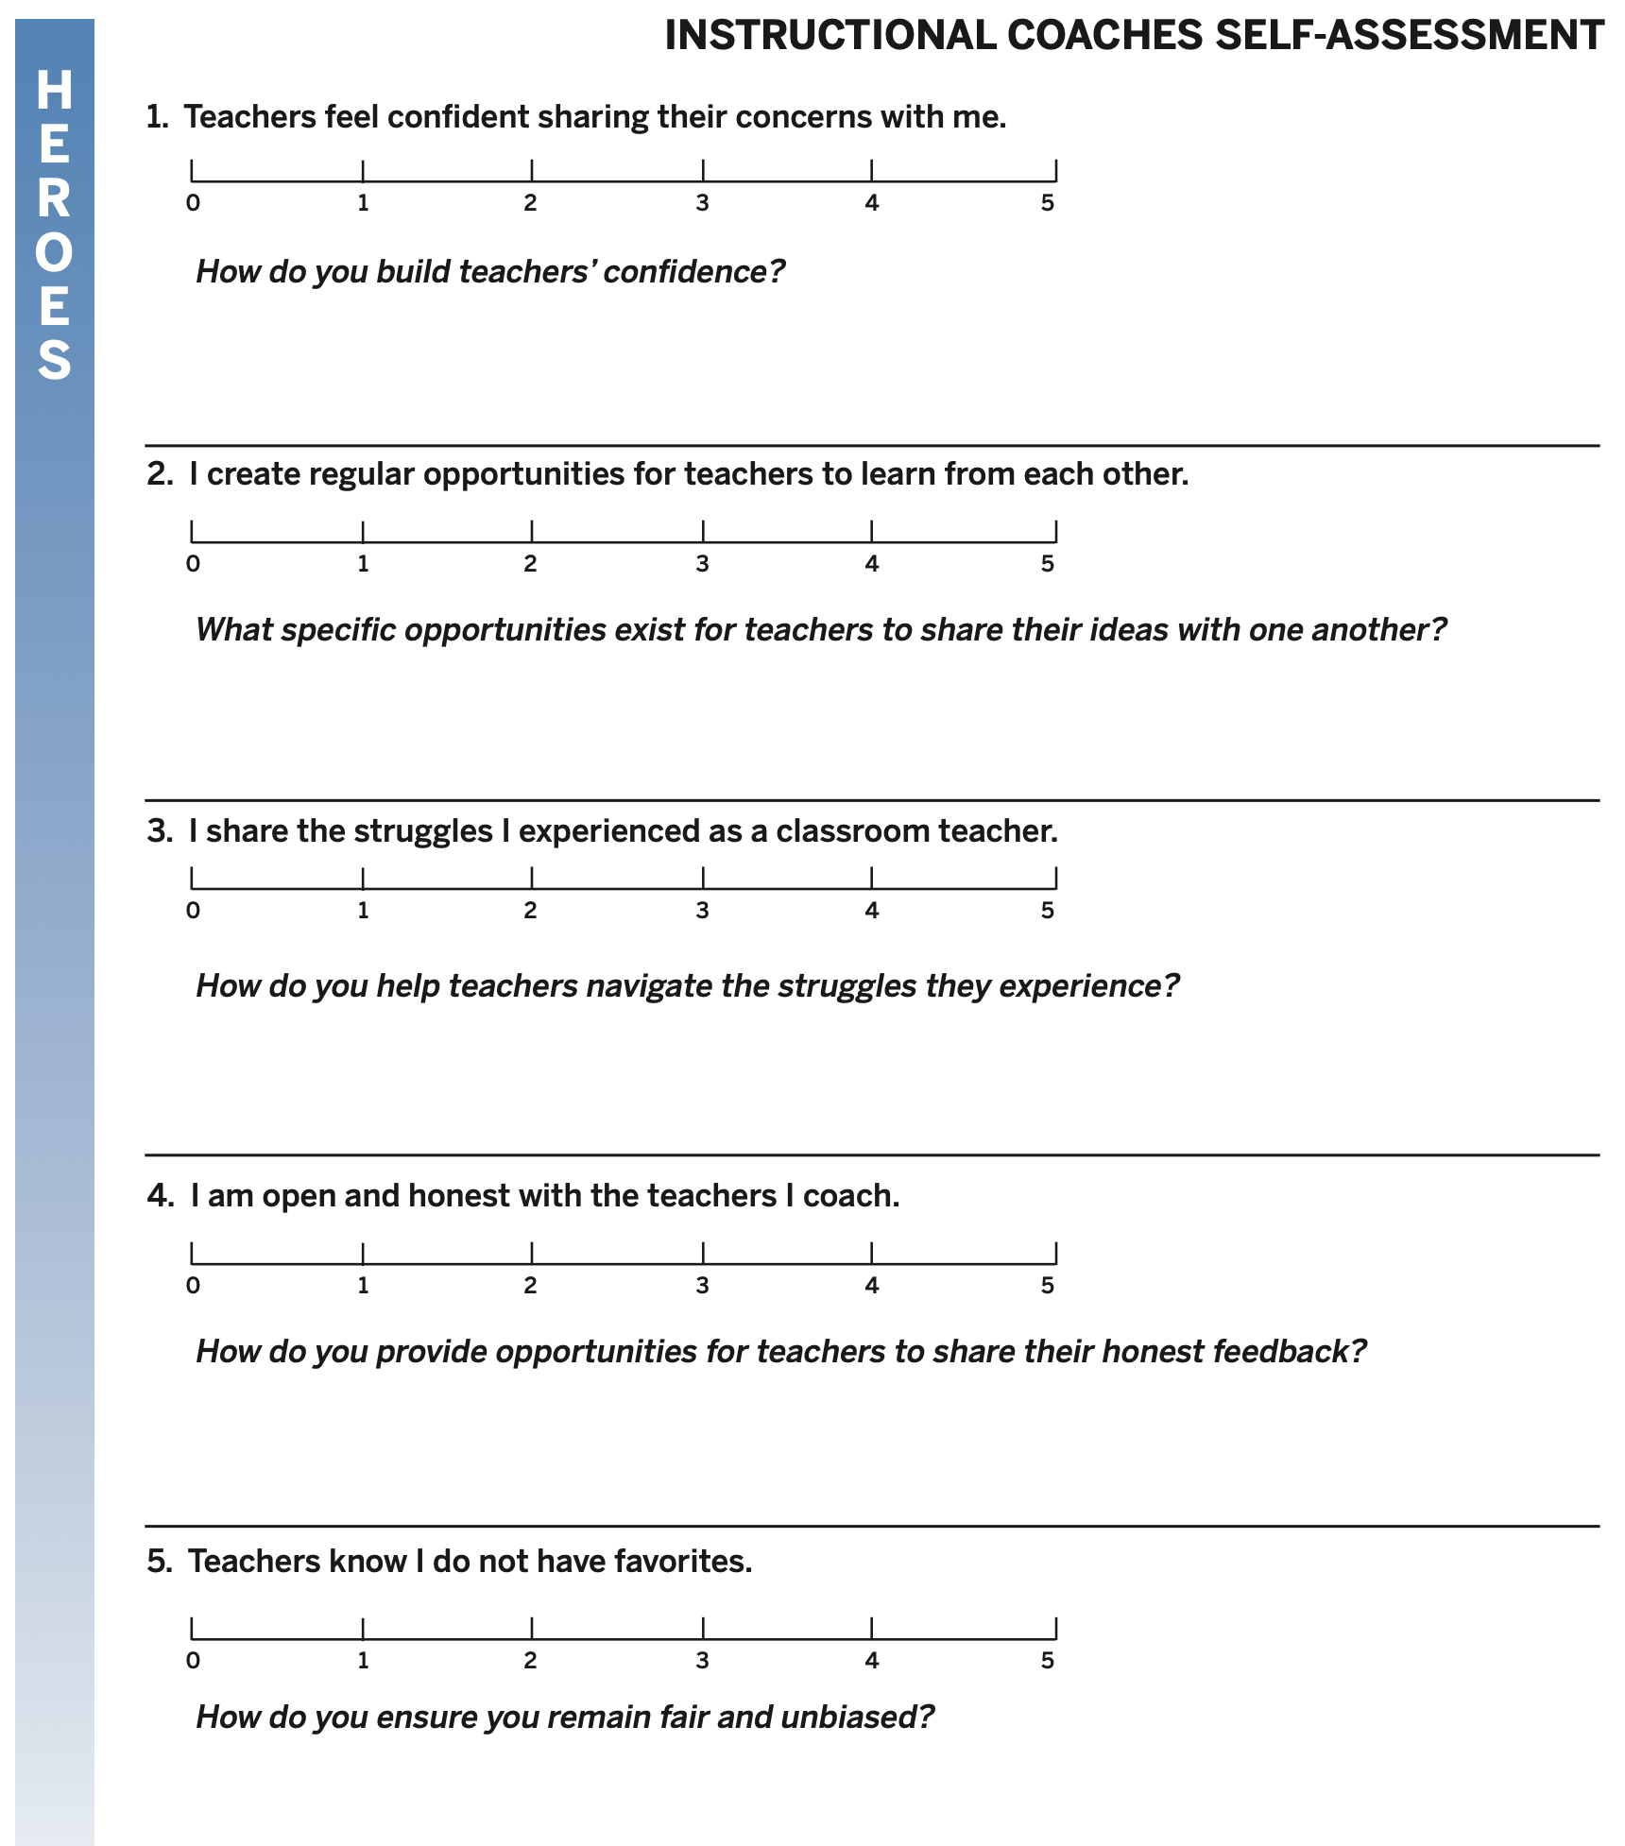
Instructional Coaches Self-Worth Self-Assessment

Slide 52
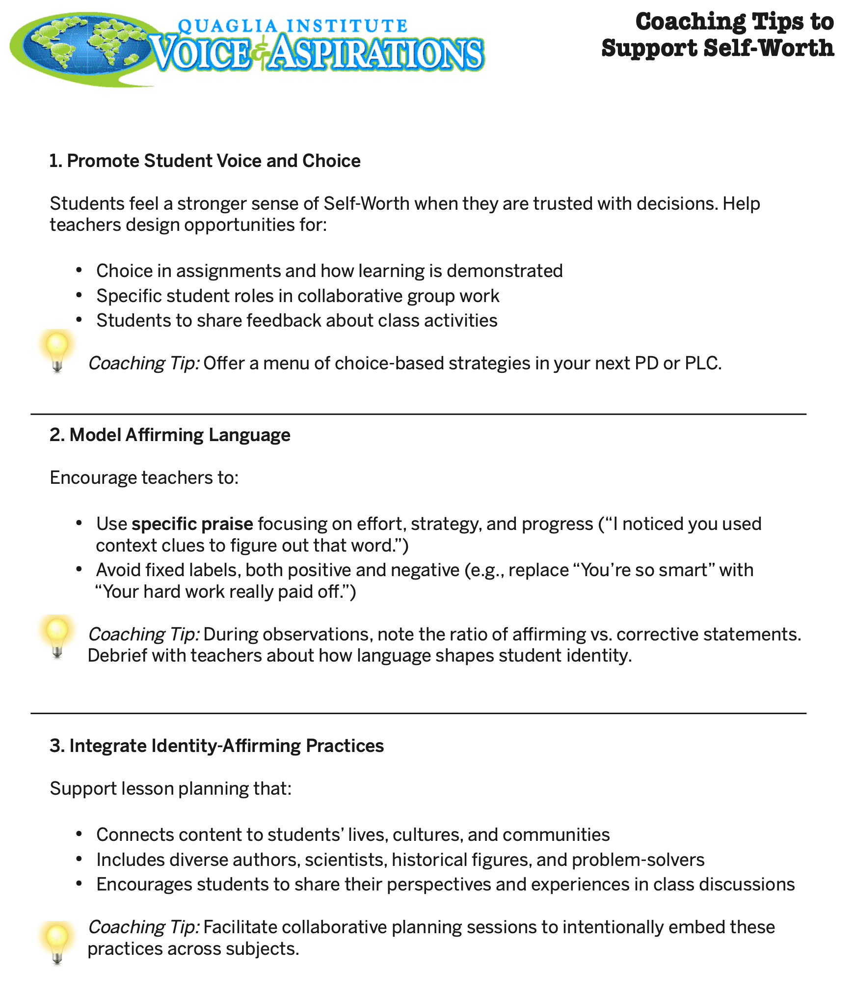
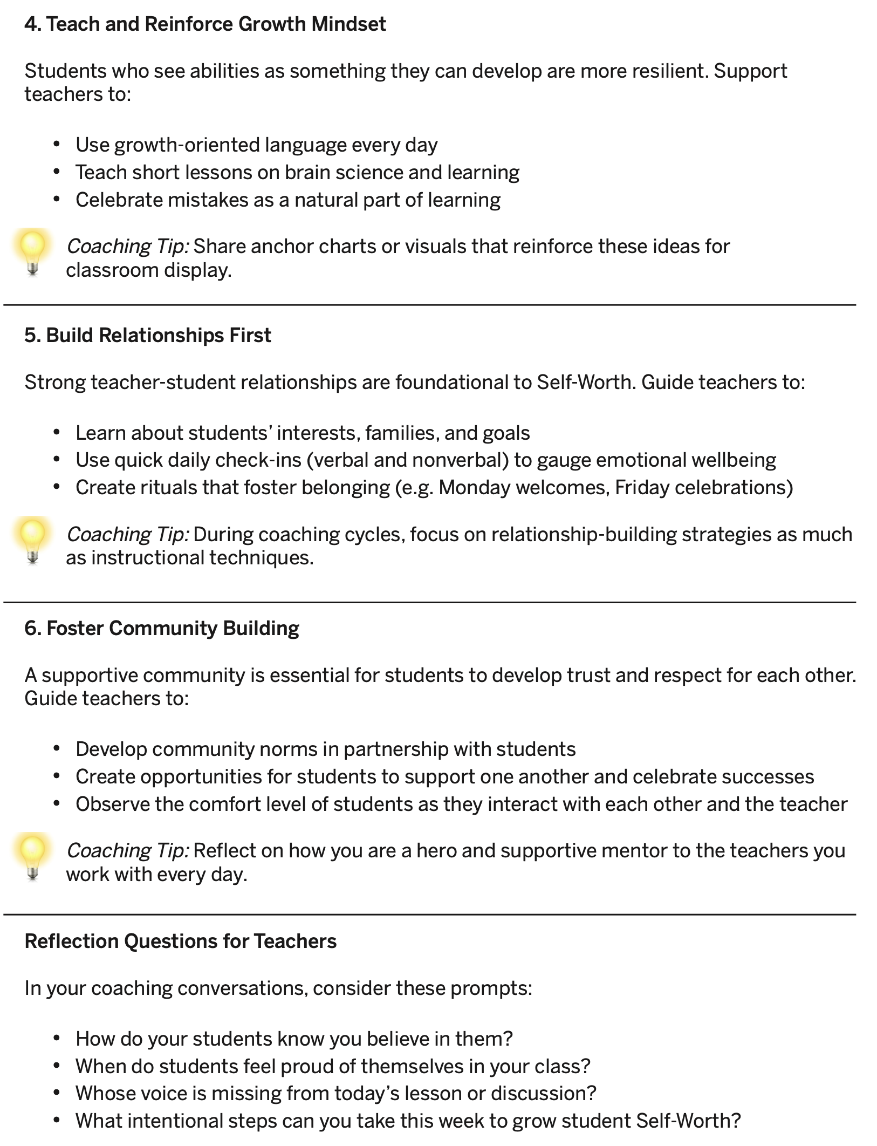
Coaching Tips to Support Self-Worth

Slide 53
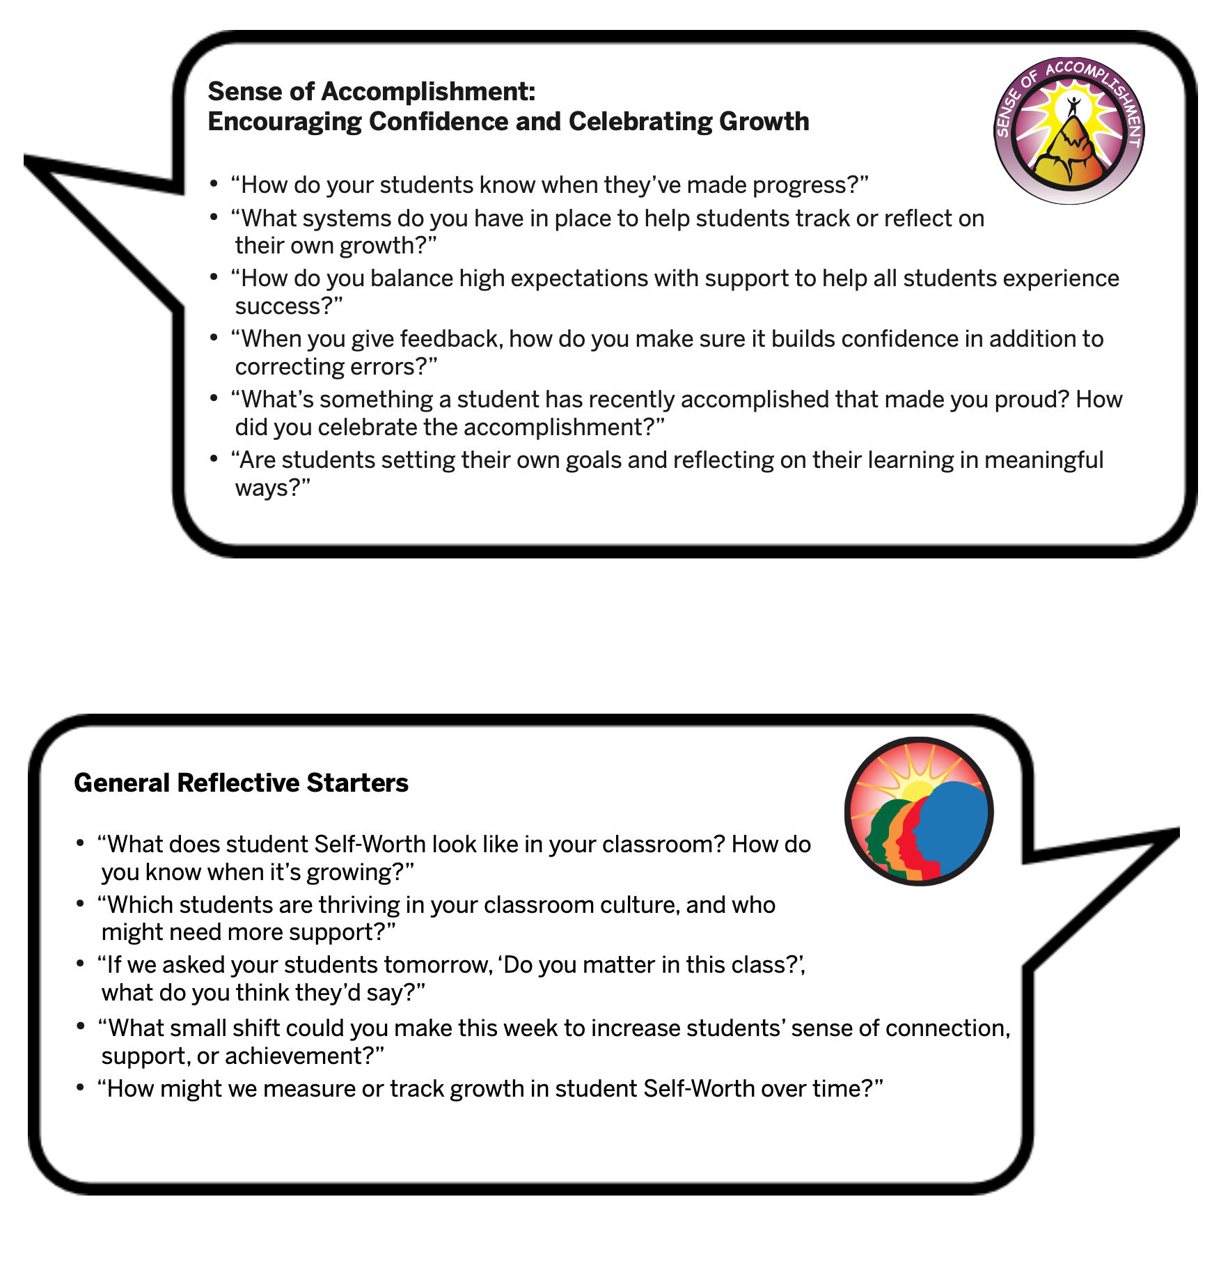
Self-Worth Conversation Starters

Slide 54
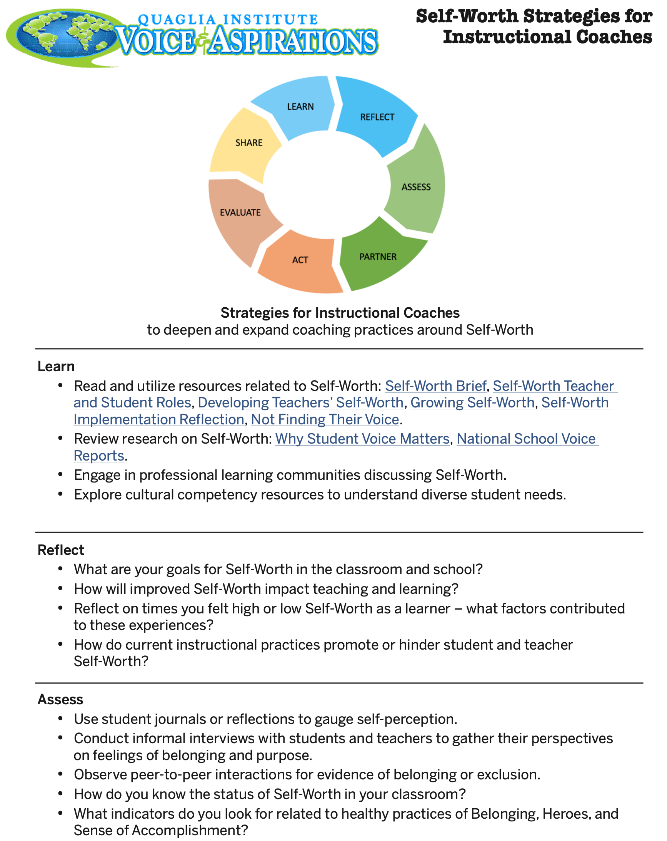
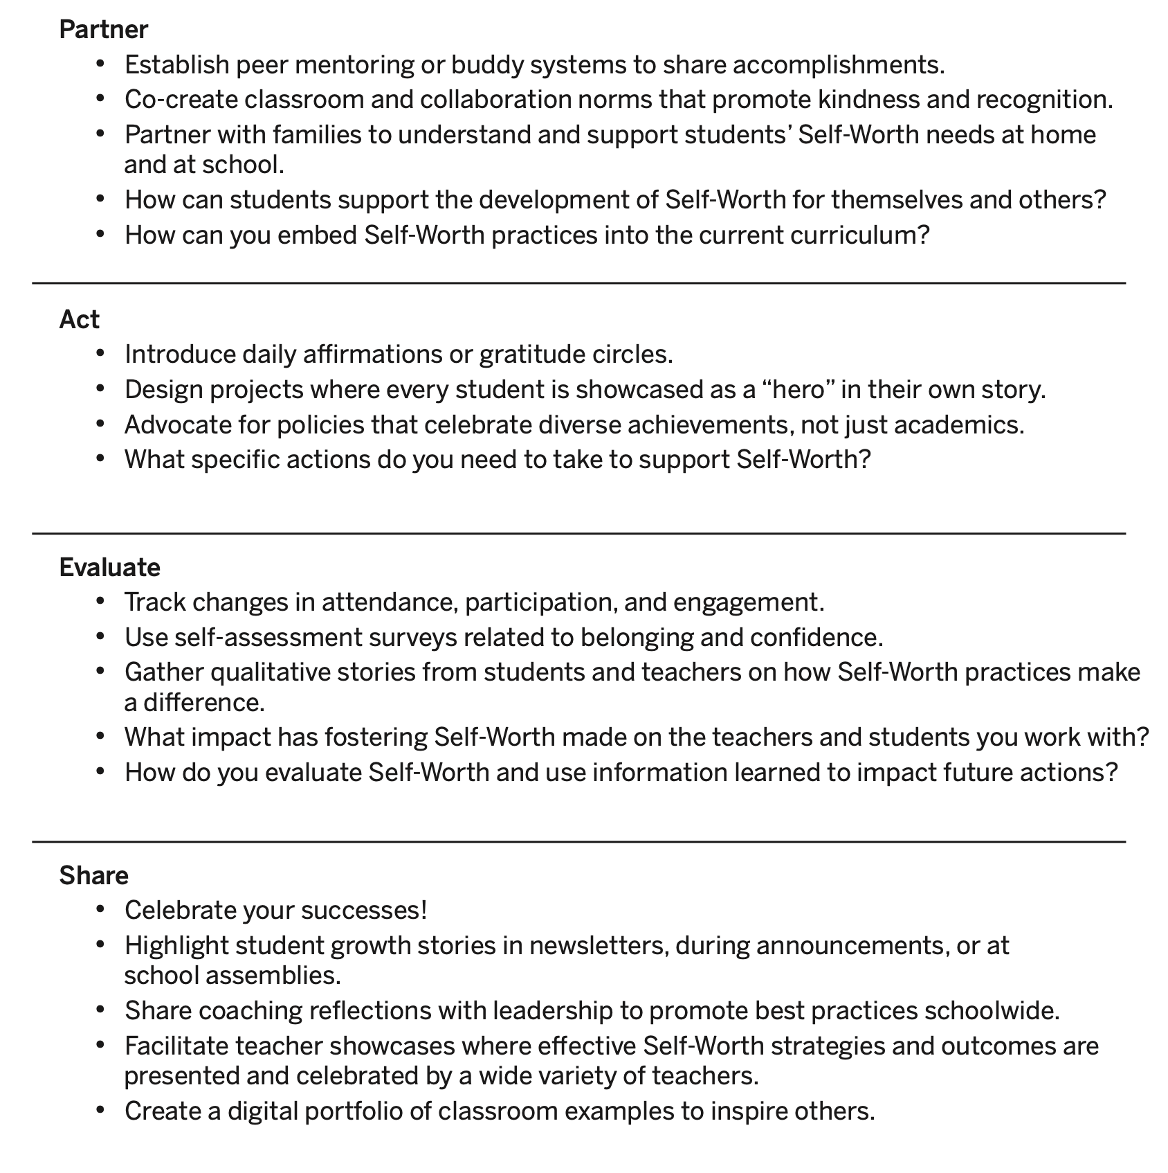
Self-Worth Strategies for Instructional Coaches

Slide 55
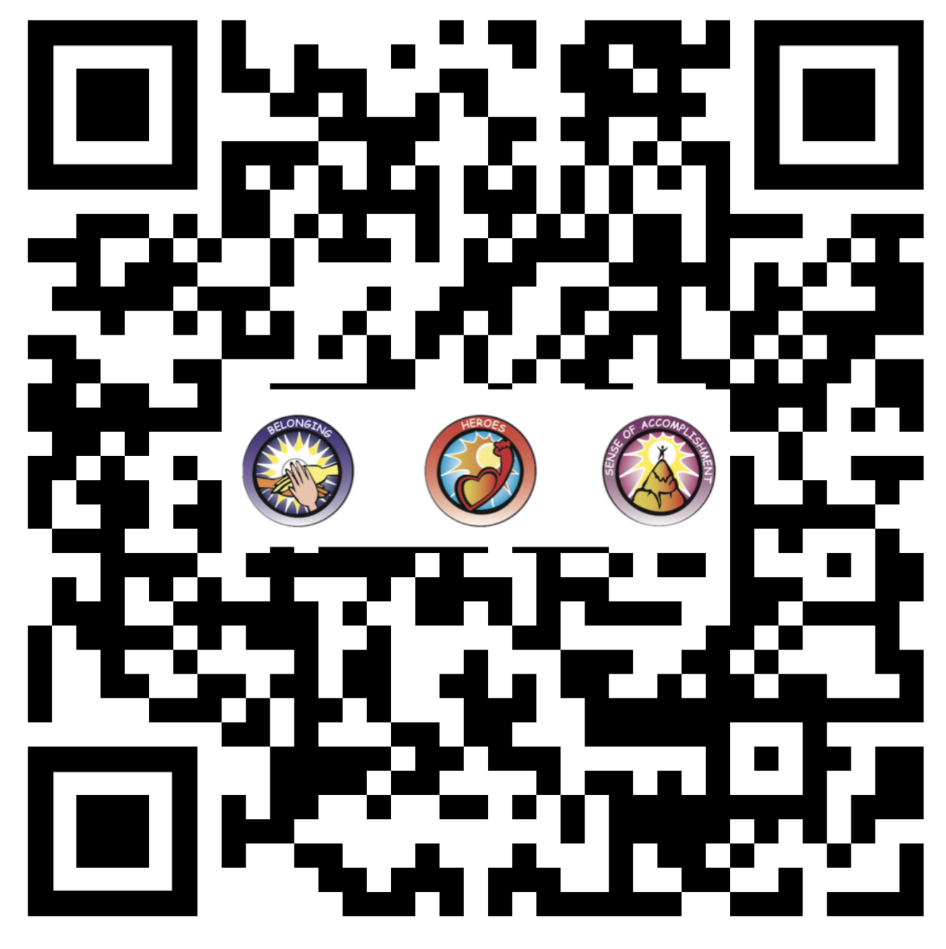
Website Just For YOU!
https://quagliainstitute.org/tlc-self-worth

Slide 56




Taking Action
What actions can you take to amplify Voice & cultivate Self-Worth at your school?
How will you involve staff & students as
partners in cultivating Self-Worth?

Slide 57
Thank you for the opportunity to learn together today.
Dr. Lisa Lande
lande@quagliainstitute.org
@Lisa_Lande @QISVAtweets
quagliainstitute.org

