Slide 1

Coaching to Amplify
Student Voice:
Listen, Learn, Lead
October 17, 2023
Dr. Lisa Lande
@Lisa_Lande @QISVAtweets
quagliainstitute.org

Slide 2

Challenge Time…

Slide 3


Challenge
Perspectives
Point your index finger to the sky & above your head, move your finger in small circles clockwise.
Slowly move your hand down to your waist, continuing to move your hand in small circles.
What direction is your hand moving?

Slide 4
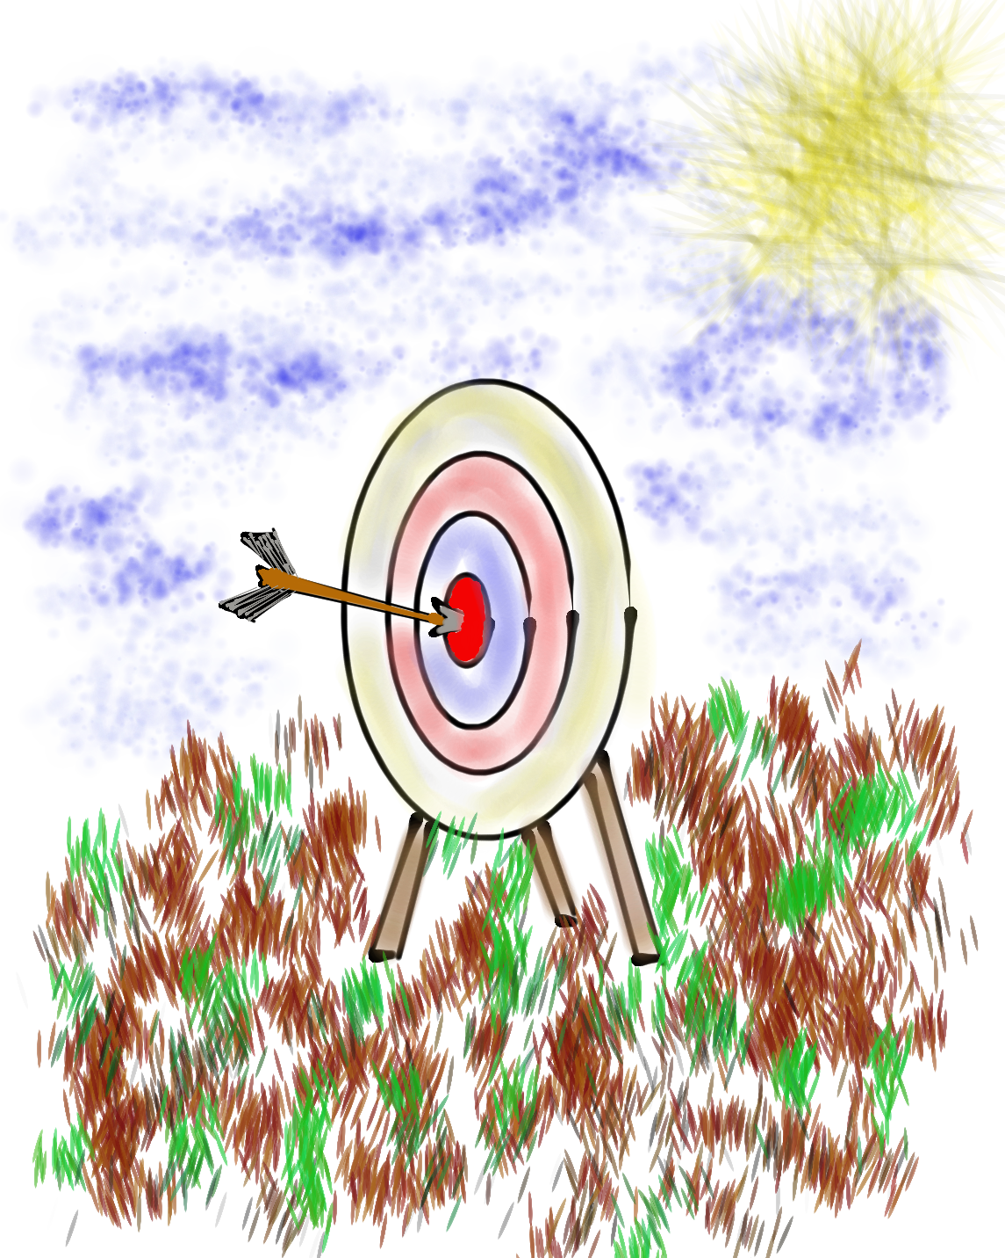
Learning Intention
We are learning to leverage the School Voice Process to support coaches & teachers in amplify the voices of ALL students.
Success Criteria
Discover the components & nuances of the School Voice
Process: Listen, Learn, & Lead.
Explore strategies & resources Instructional Coaches can use to support teachers & students in listening to,
learning from, & leading with one another.
Apply learning to amplify Student Voice in YOUR school.
Today will be a home run for me if…

Slide 5
LEAD
Voice
Process
Brief
TAKE ACTION
with others
Share
RESPONSIBILITY
LEARN
UNDERSTAND
& RESPECT
different points
of view
Build
TRUST
LISTEN
SEEK OUT
opinions from
others
School Voice Process

Slide 6

Listen

Slide 7
The Art of Listening
Vimeo:
vimeo.com/qisva/listening
or
YouTube:
https://youtu.be/ooE9dKobjZU
Video

Slide 8
Listen
Reach out & listen to voices
you typically don’t hear from
Stay focused (put away your phone!)
Be genuine & truly interested
Make sure you are talking less than the
other person
Being open to new ideas is not an option

Slide 9
Challenge Time…

Slide 10


Challenge
Do your best to draw the picture exactly as it is described.
You may not ask any questions.
Notes:
If delivering this activity in a virtual session, the presenter can describe a shape and have the entire virtual audience do their best to replicate the image. Then hold up the image that was described to the camera so participants can see how well they did. Then show the next slide and explain how the activity can be done with two round if delivering to an in-person audience.

Slide 11
Challenge
Drawing Dictations Lesson Plan
Round 1: Find a partner &
assign one person to be the
Describer, & one person to
be the Artist. Sit back to back. Without looking or asking
questions, describe to your
partner how to replicate
your picture.
Round 2: Switch roles (Describer & Artist) & switch cards with someone nearby.
Repeat the activity, but this time you
can ask clarifying questions. Still sit
back to back & no looking! ☺

Slide 12

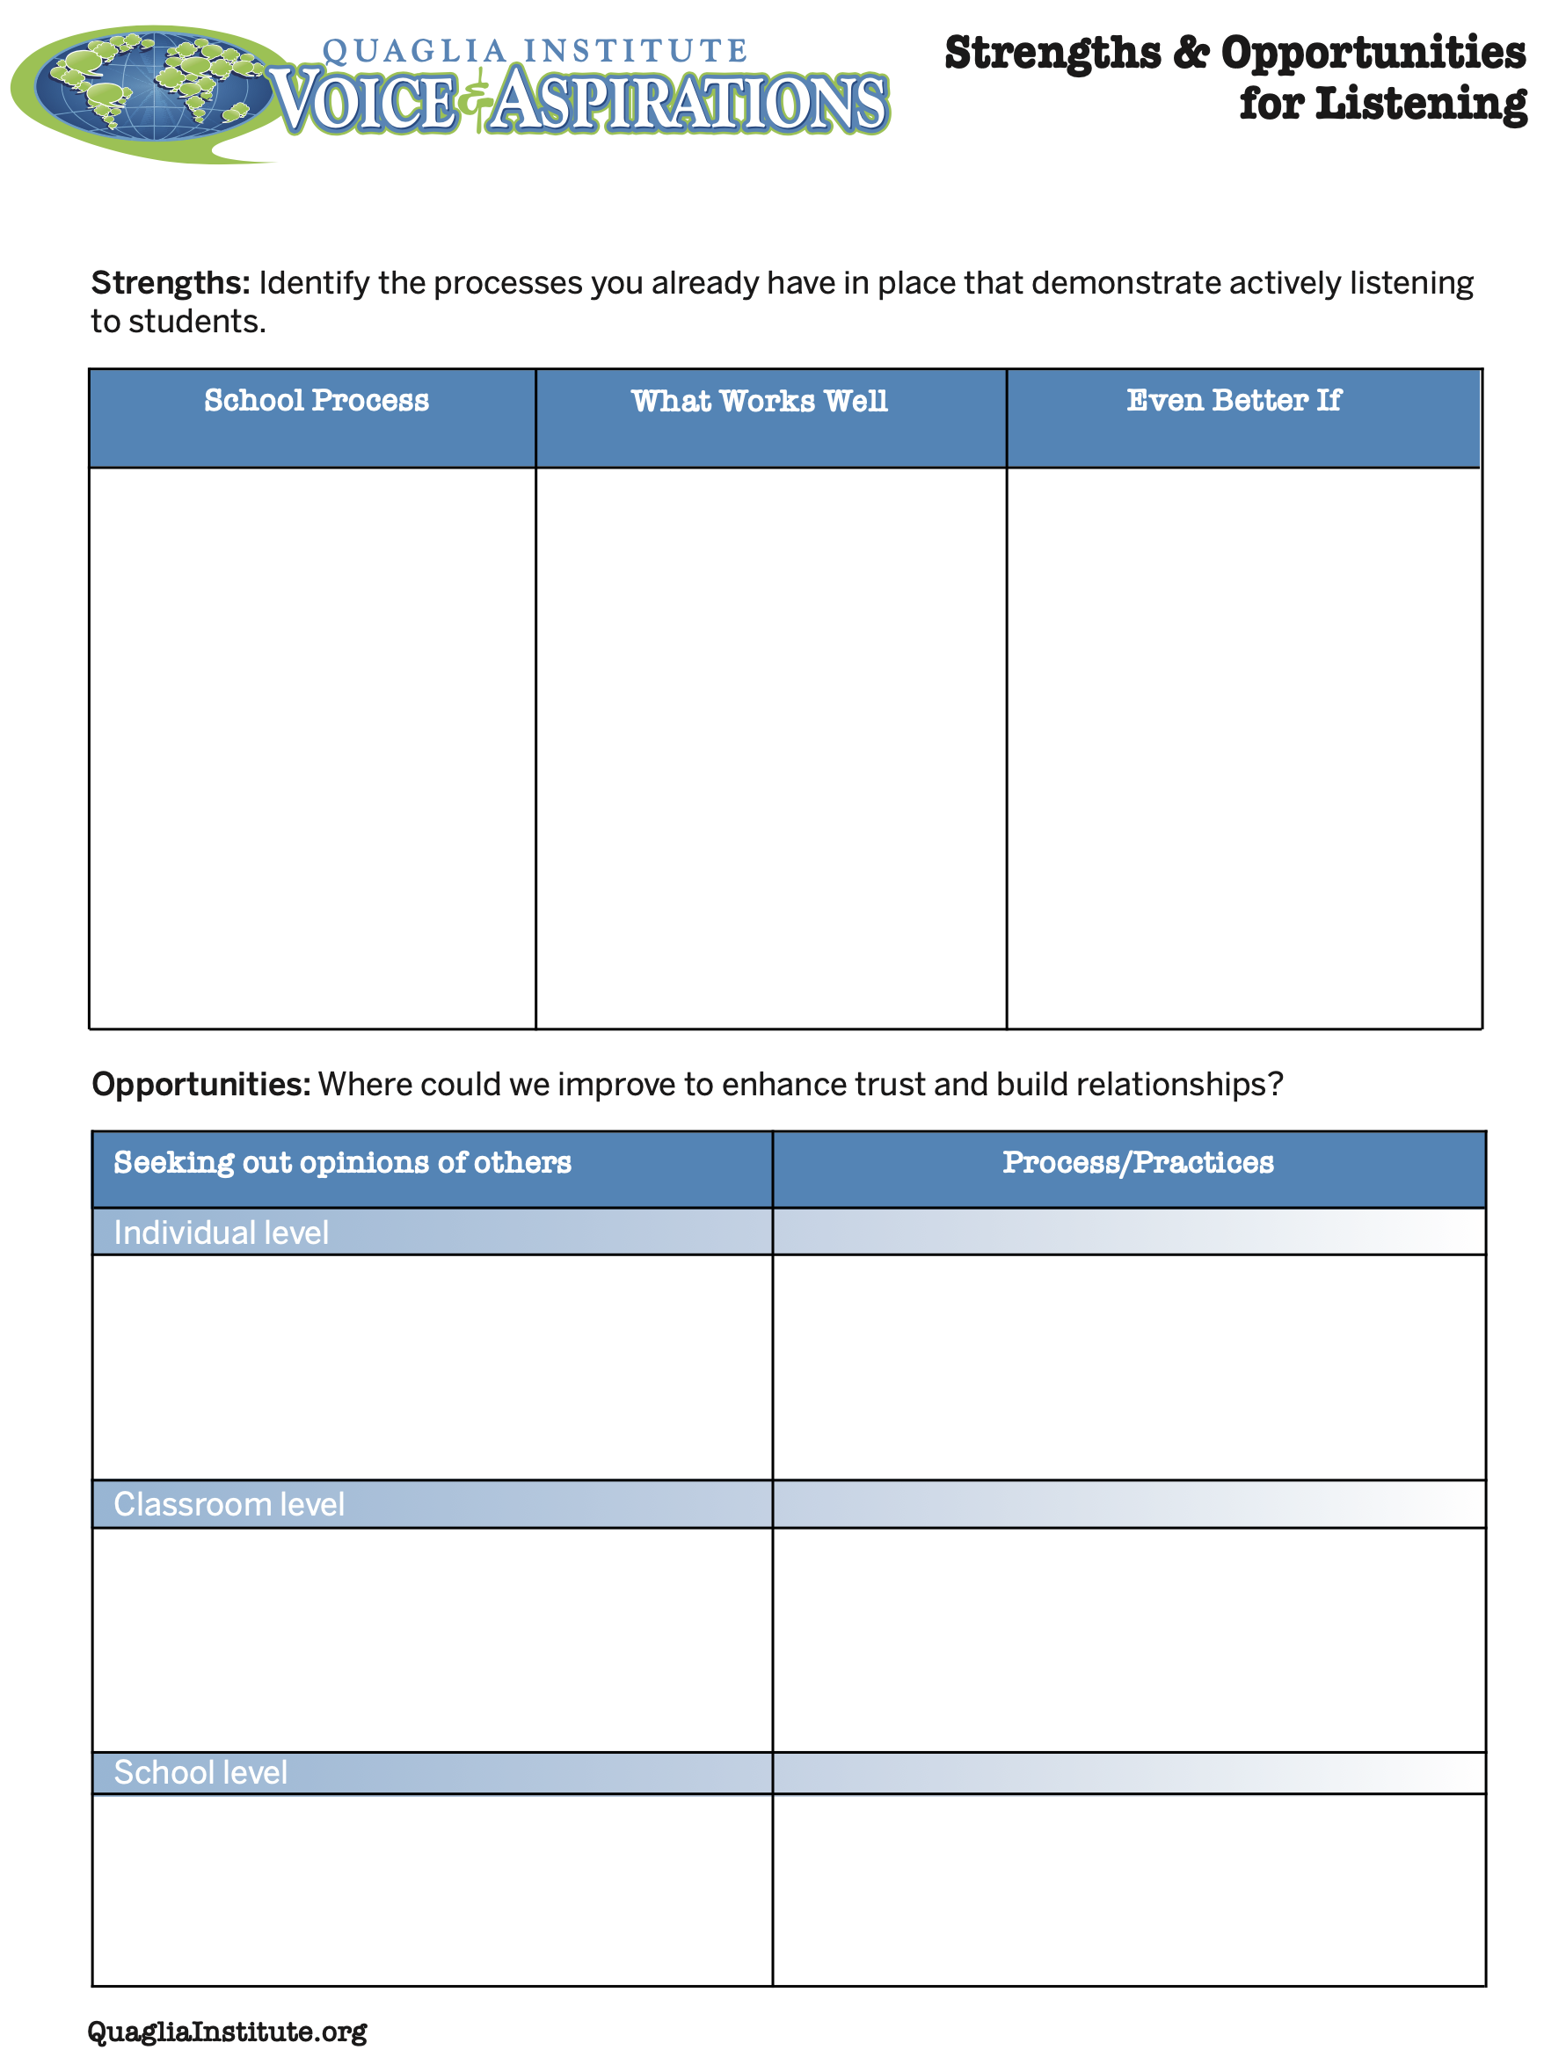
Reflect
As an Instructional
Coach, what strengths &
challenges do you
observe when it comes
to Listening to students?
How do you/can you
coach teachers to really listen to students?
Strengths & Opportunities for Listening

Slide 13

Learn

Slide 14
Taking Time to Learn
Vimeo:
vimeo.com/qisva/time
or
YouTube:
https://youtu.be/tYKcvRfxK0o
Video

Slide 15
Learn
Take notes
Ask questions for clarity
Do not judge, you can learn from anyone
regardless of age, position, or any factor
Follow up & communicate what you
LEARNED from listening
Be prepared to change
Do not fear what you do not know

Slide 16
Challenge Time…

Slide 17
Challenge
Find the connection
between the 4 individual pictures.

Slide 18
Challenge
Find the connection
between the 4 individual pictures.
Be the first person to call out the correct answer!

Slide 19
Connections 1
Vimeo:
vimeo.com/qisva/connection1
or
YouTube:
https://youtu.be/Yl3JrRtyGHc
(all 9 slides)

Slide 20
Connections 2
Vimeo:
vimeo.com/qisva/connections2

Slide 21
Connections 3
Vimeo:
vimeo.com/qisva/connections3

Slide 22
Connections 4
Vimeo:
vimeo.com/qisva/connections4

Slide 23
Connections 5
Vimeo:
vimeo.com/qisva/connections5

Slide 24
Connections 6
Vimeo:
vimeo.com/qisva/connections6

Slide 25
Connections 7
Vimeo:
vimeo.com/qisva/connections7

Slide 26
Connections 8
Vimeo:
vimeo.com/qisva/connections8

Slide 27
Connections 9
Vimeo:
vimeo.com/qisva/connections9

Slide 28
Take Away Challenge
Your Connections
Pick a word that reflects your hopes & dreams for Instructional Coaching & create 4 images.
Share with colleagues & see if
they can guess your word.

Slide 29

Reflect
What is something you have
recently Learned from
students?
As an Instructional Coach,
how can you facilitate Learning from students as a regular
practice at your school?

Slide 30
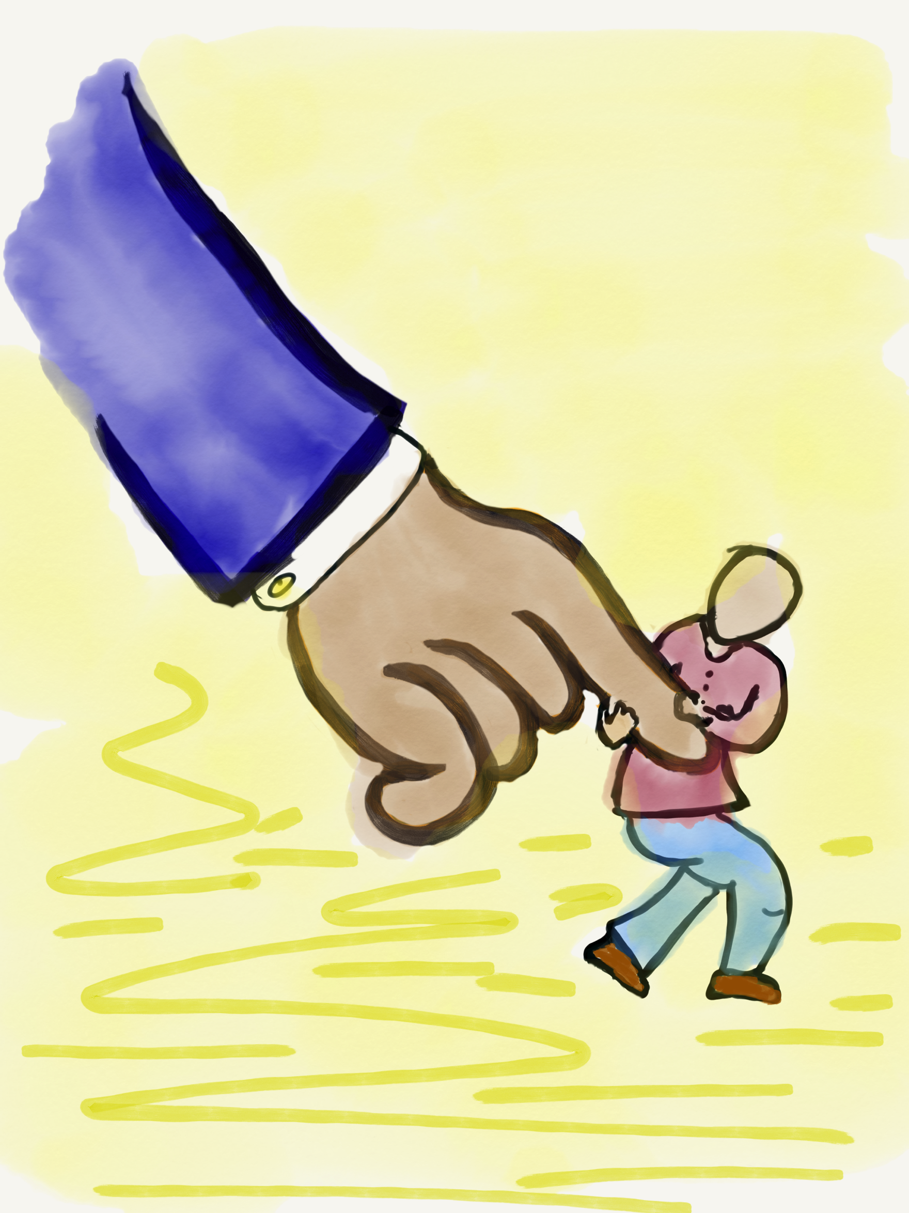
Lead

Slide 31
Leading Together…
Vimeo:
https://vimeo.com/qisva/together
or
YouTube:
https://youtu.be/RTvZCdUP7N4
Video

Slide 32
Reflect
What did you observe related to the term Lead in this video?

Slide 33
Lead
Use what you have heard & learned to drive meaningful change.
Leading is not a solo adventure; take
action with others.
Created a shared sense of purpose.
Voice is not about getting your own way.
You can’t please everyone; but you can
demonstrate value & respect for all voices.

Slide 34
LLL in Action!
Vimeo: vimeo.com/qisva/sutter
YouTube:
https://youtu.be/_kwkyzH
Video
Sutter Middle School, Los Angeles, California

Slide 35
Co-Owning School Data
Vimeo:
https://vimeo.com/qisva/lawrence
YouTube:
https://youtu.be/iZWyKT6Gq4M
Video
Lawrence Middle School, Los Angeles, California

Slide 36
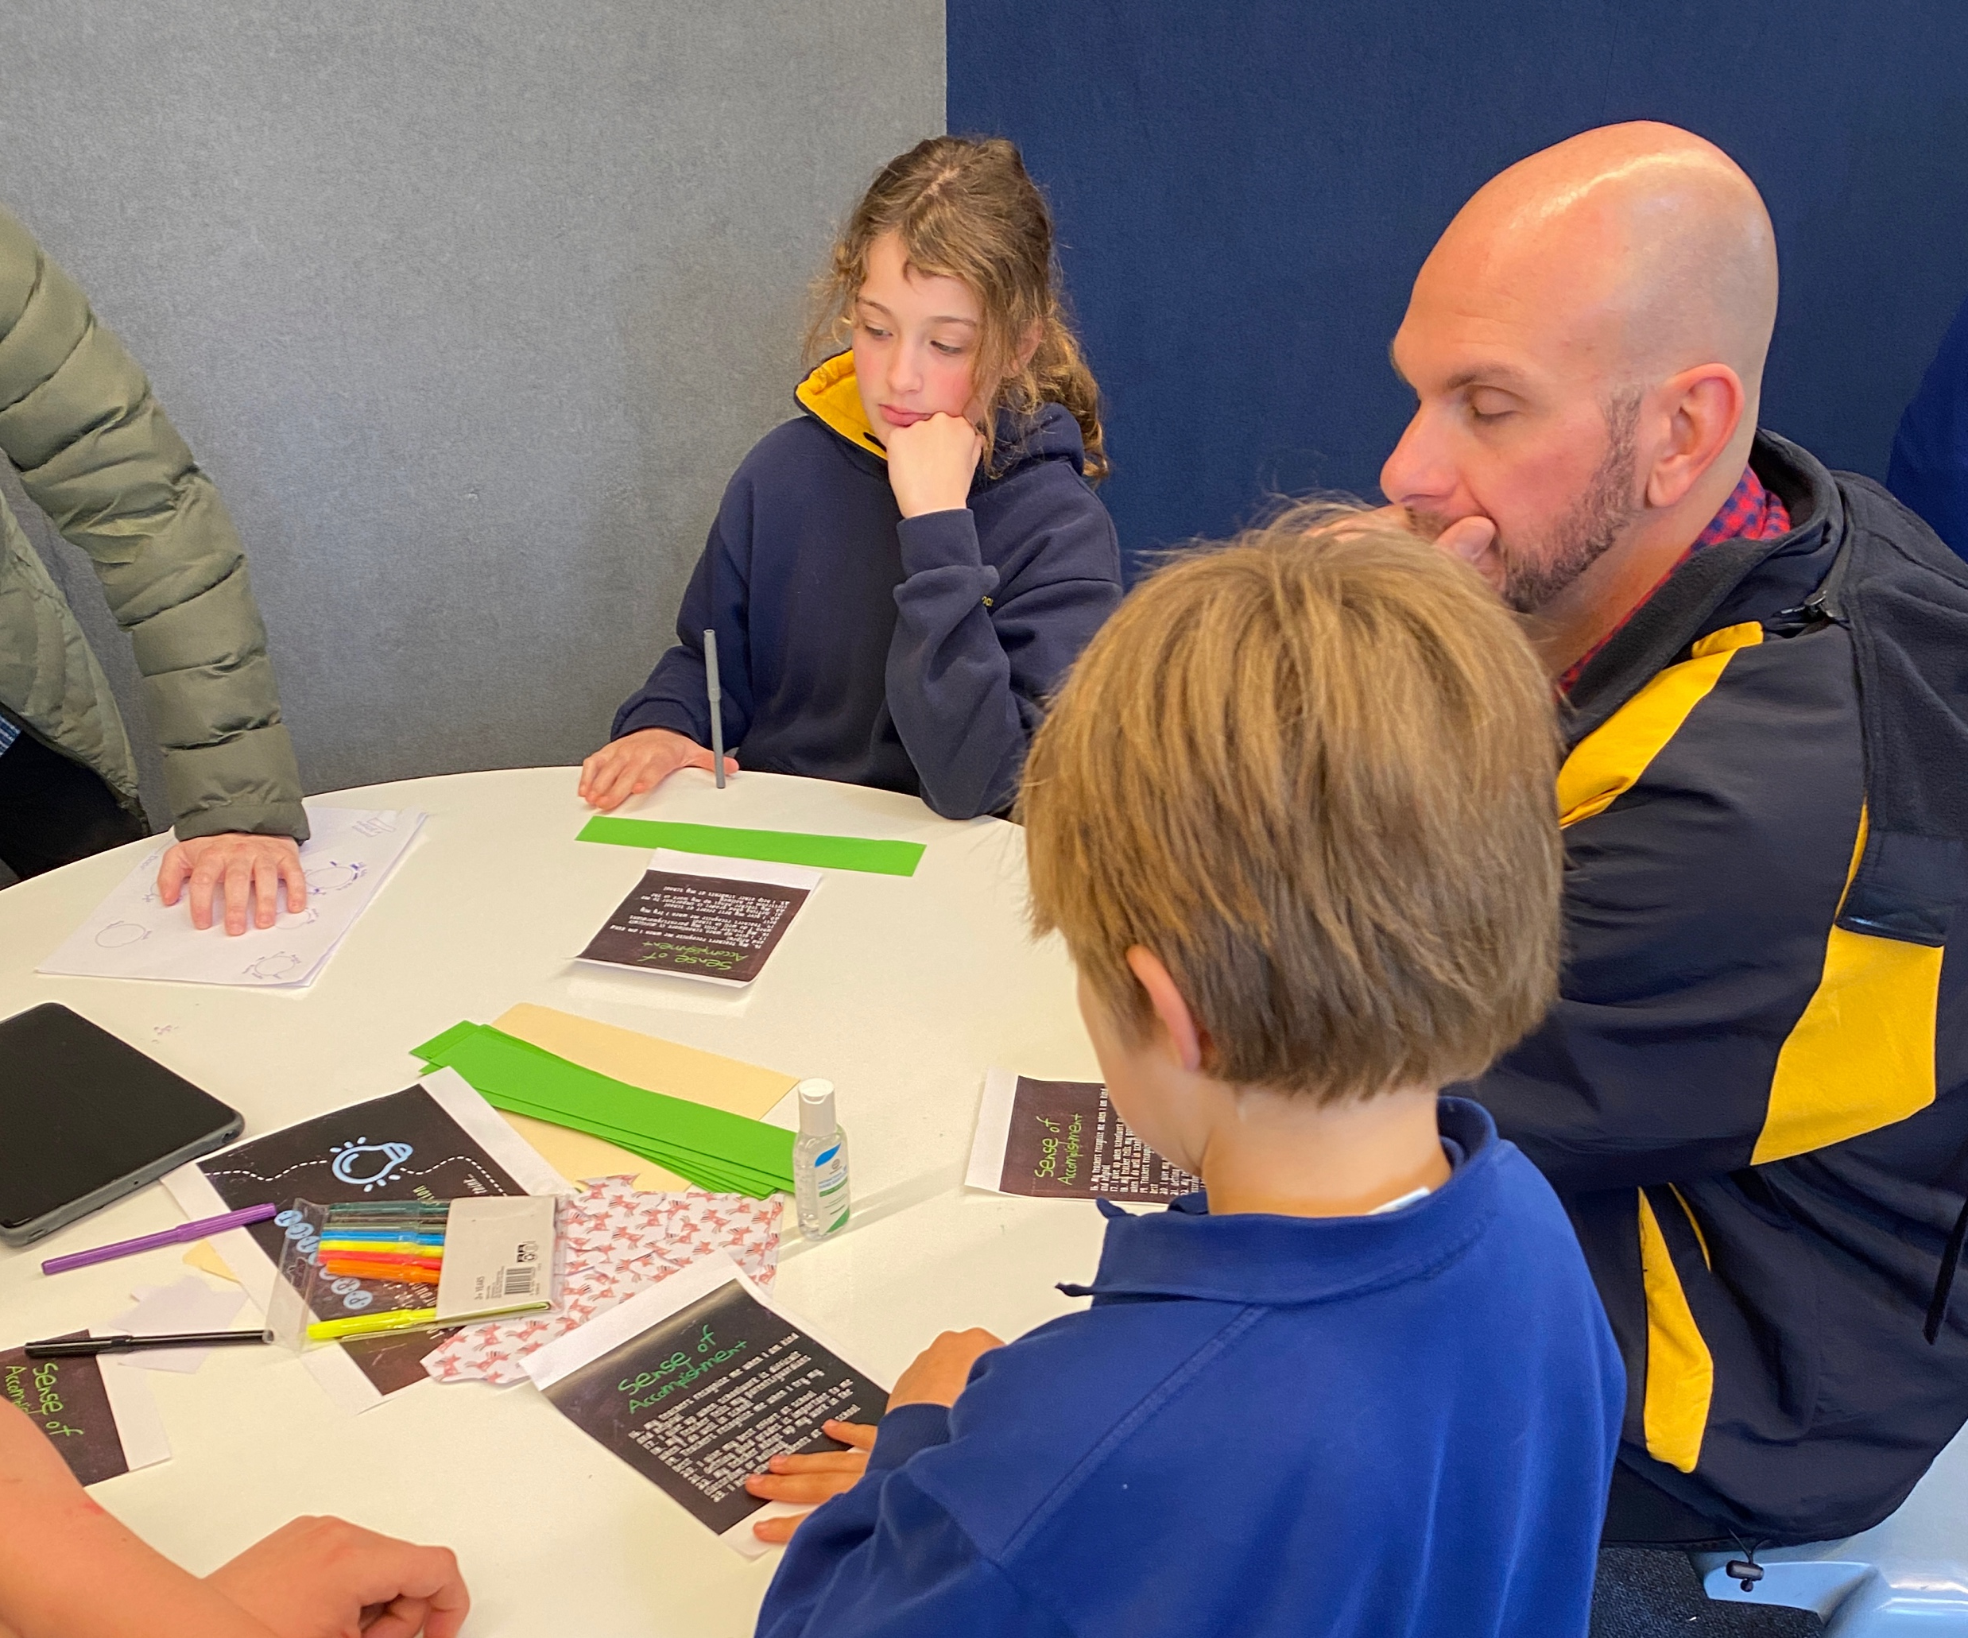
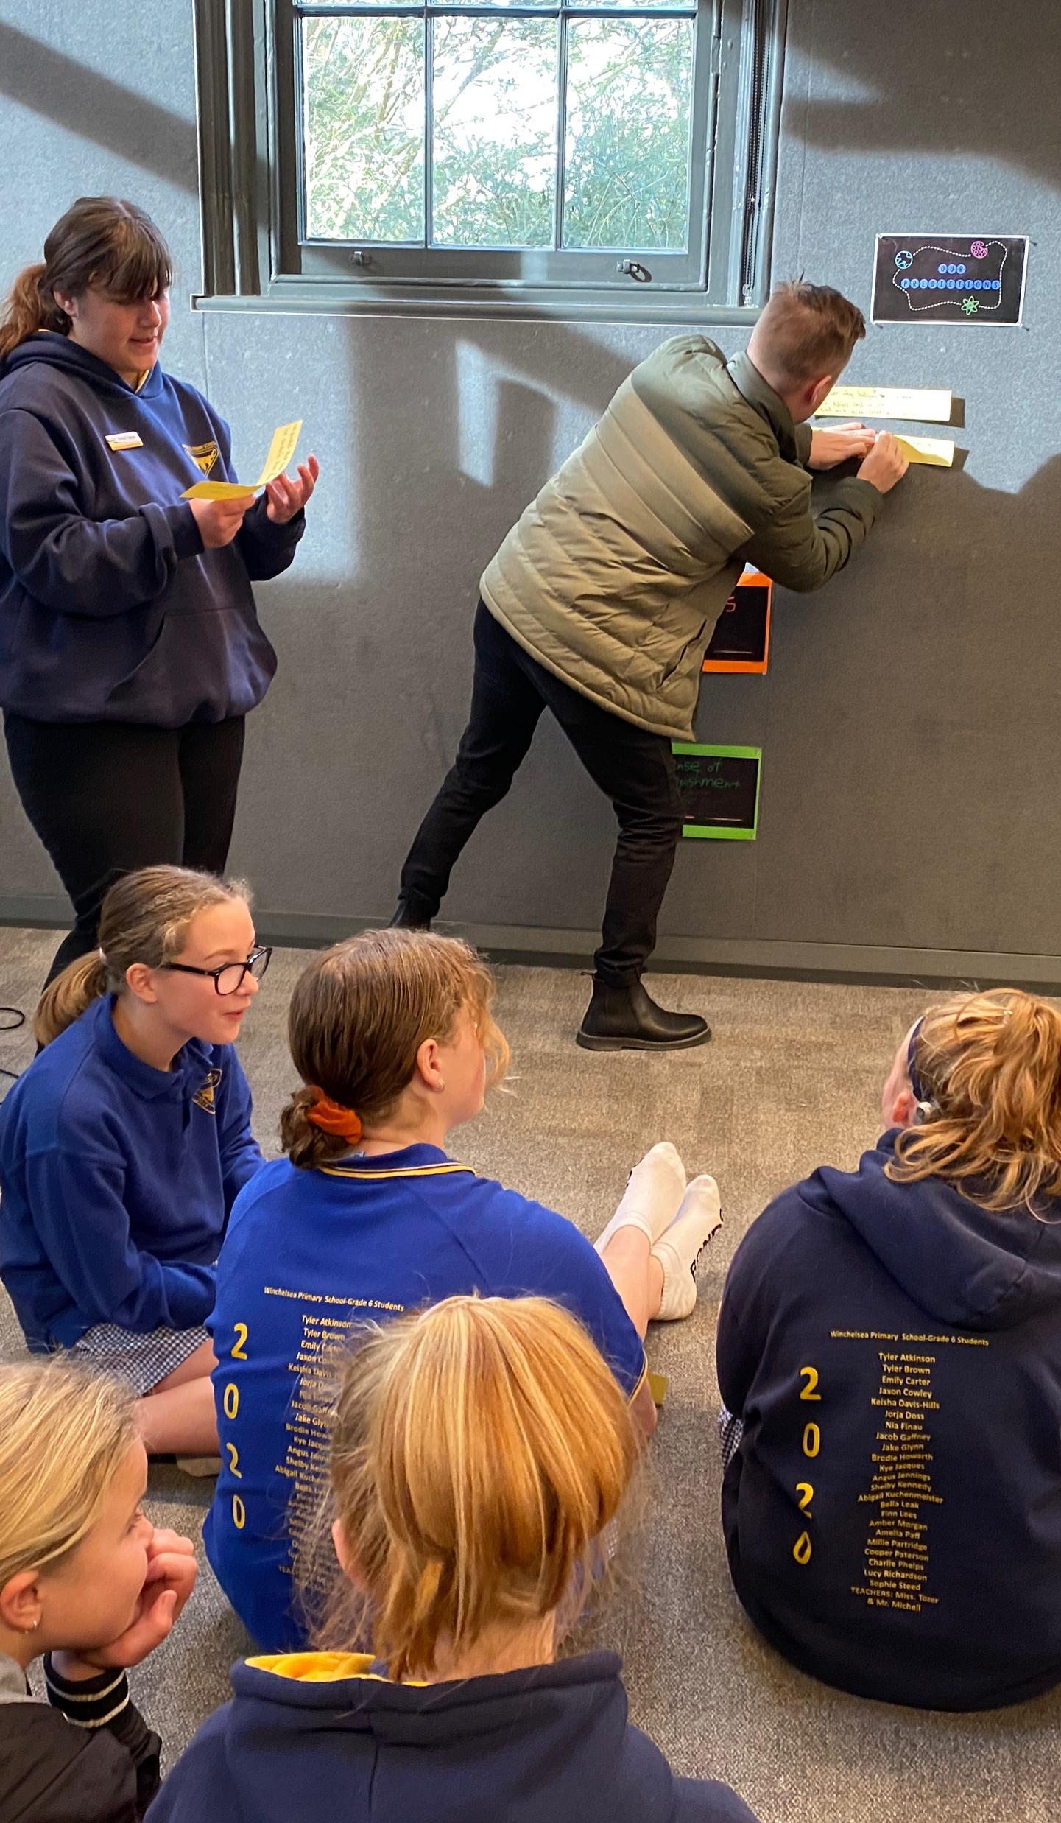
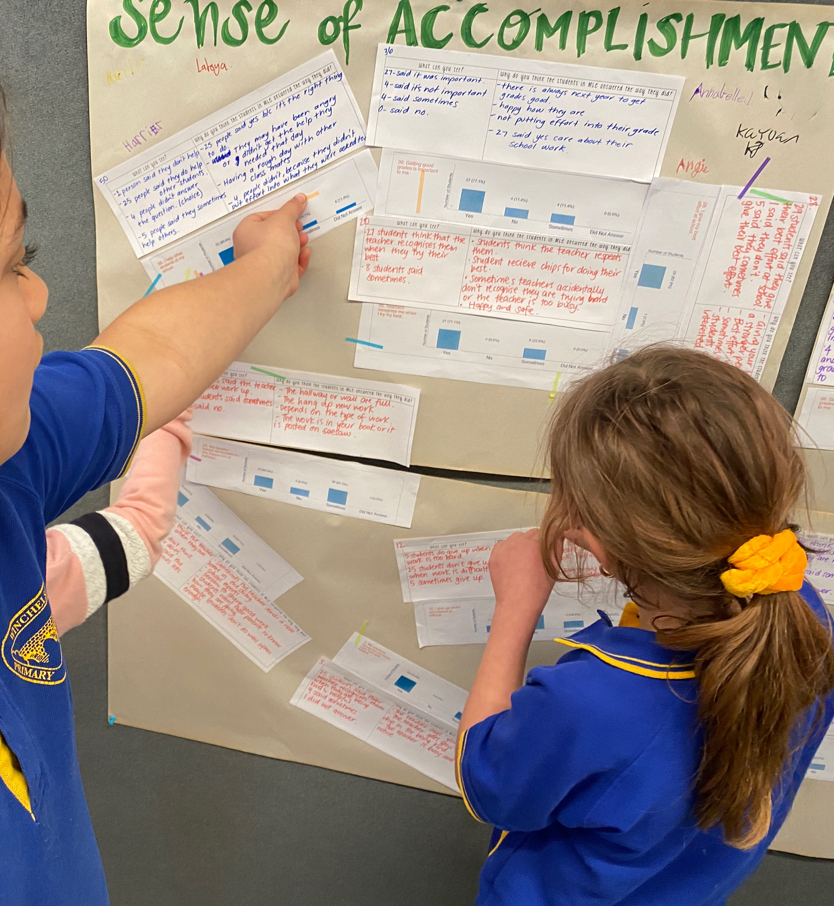
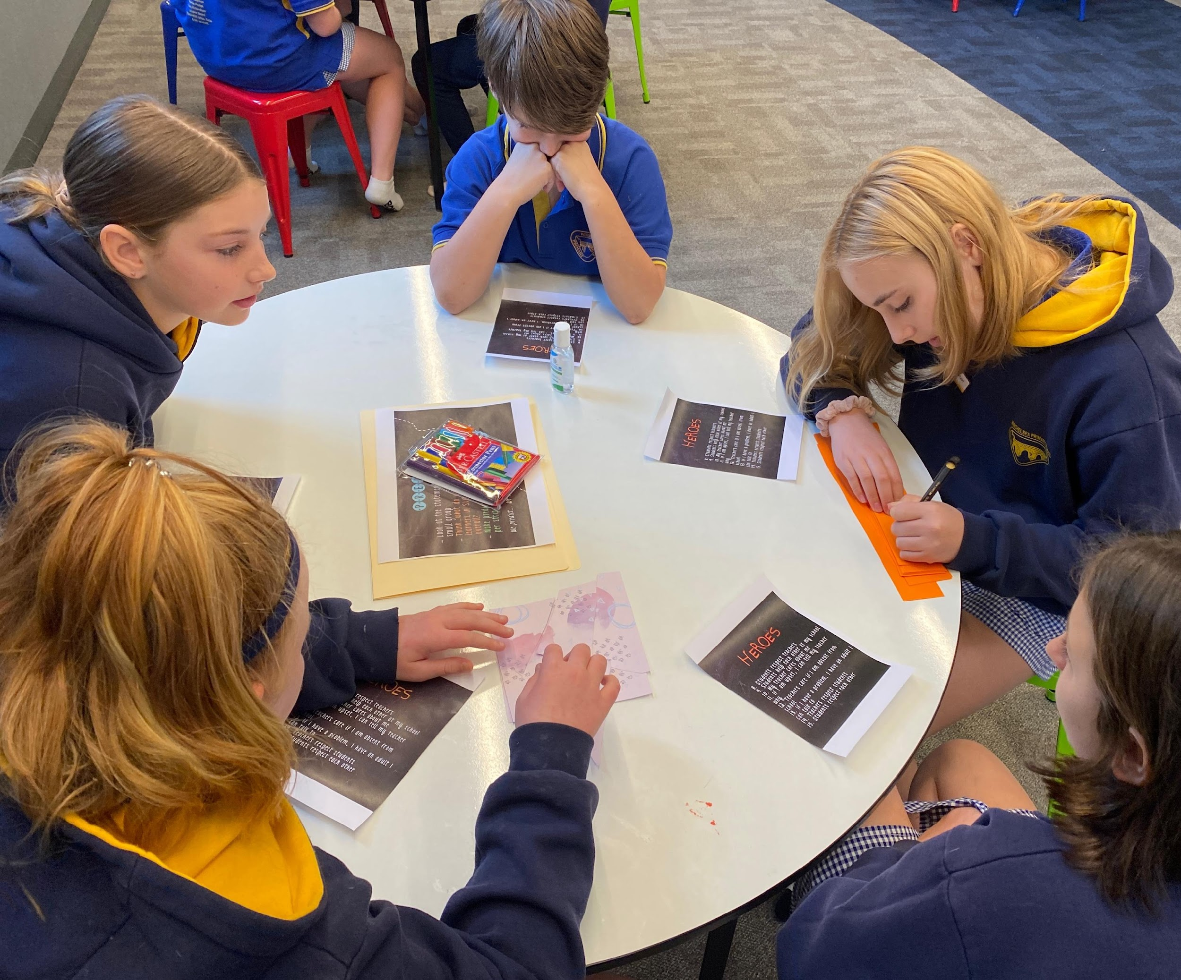
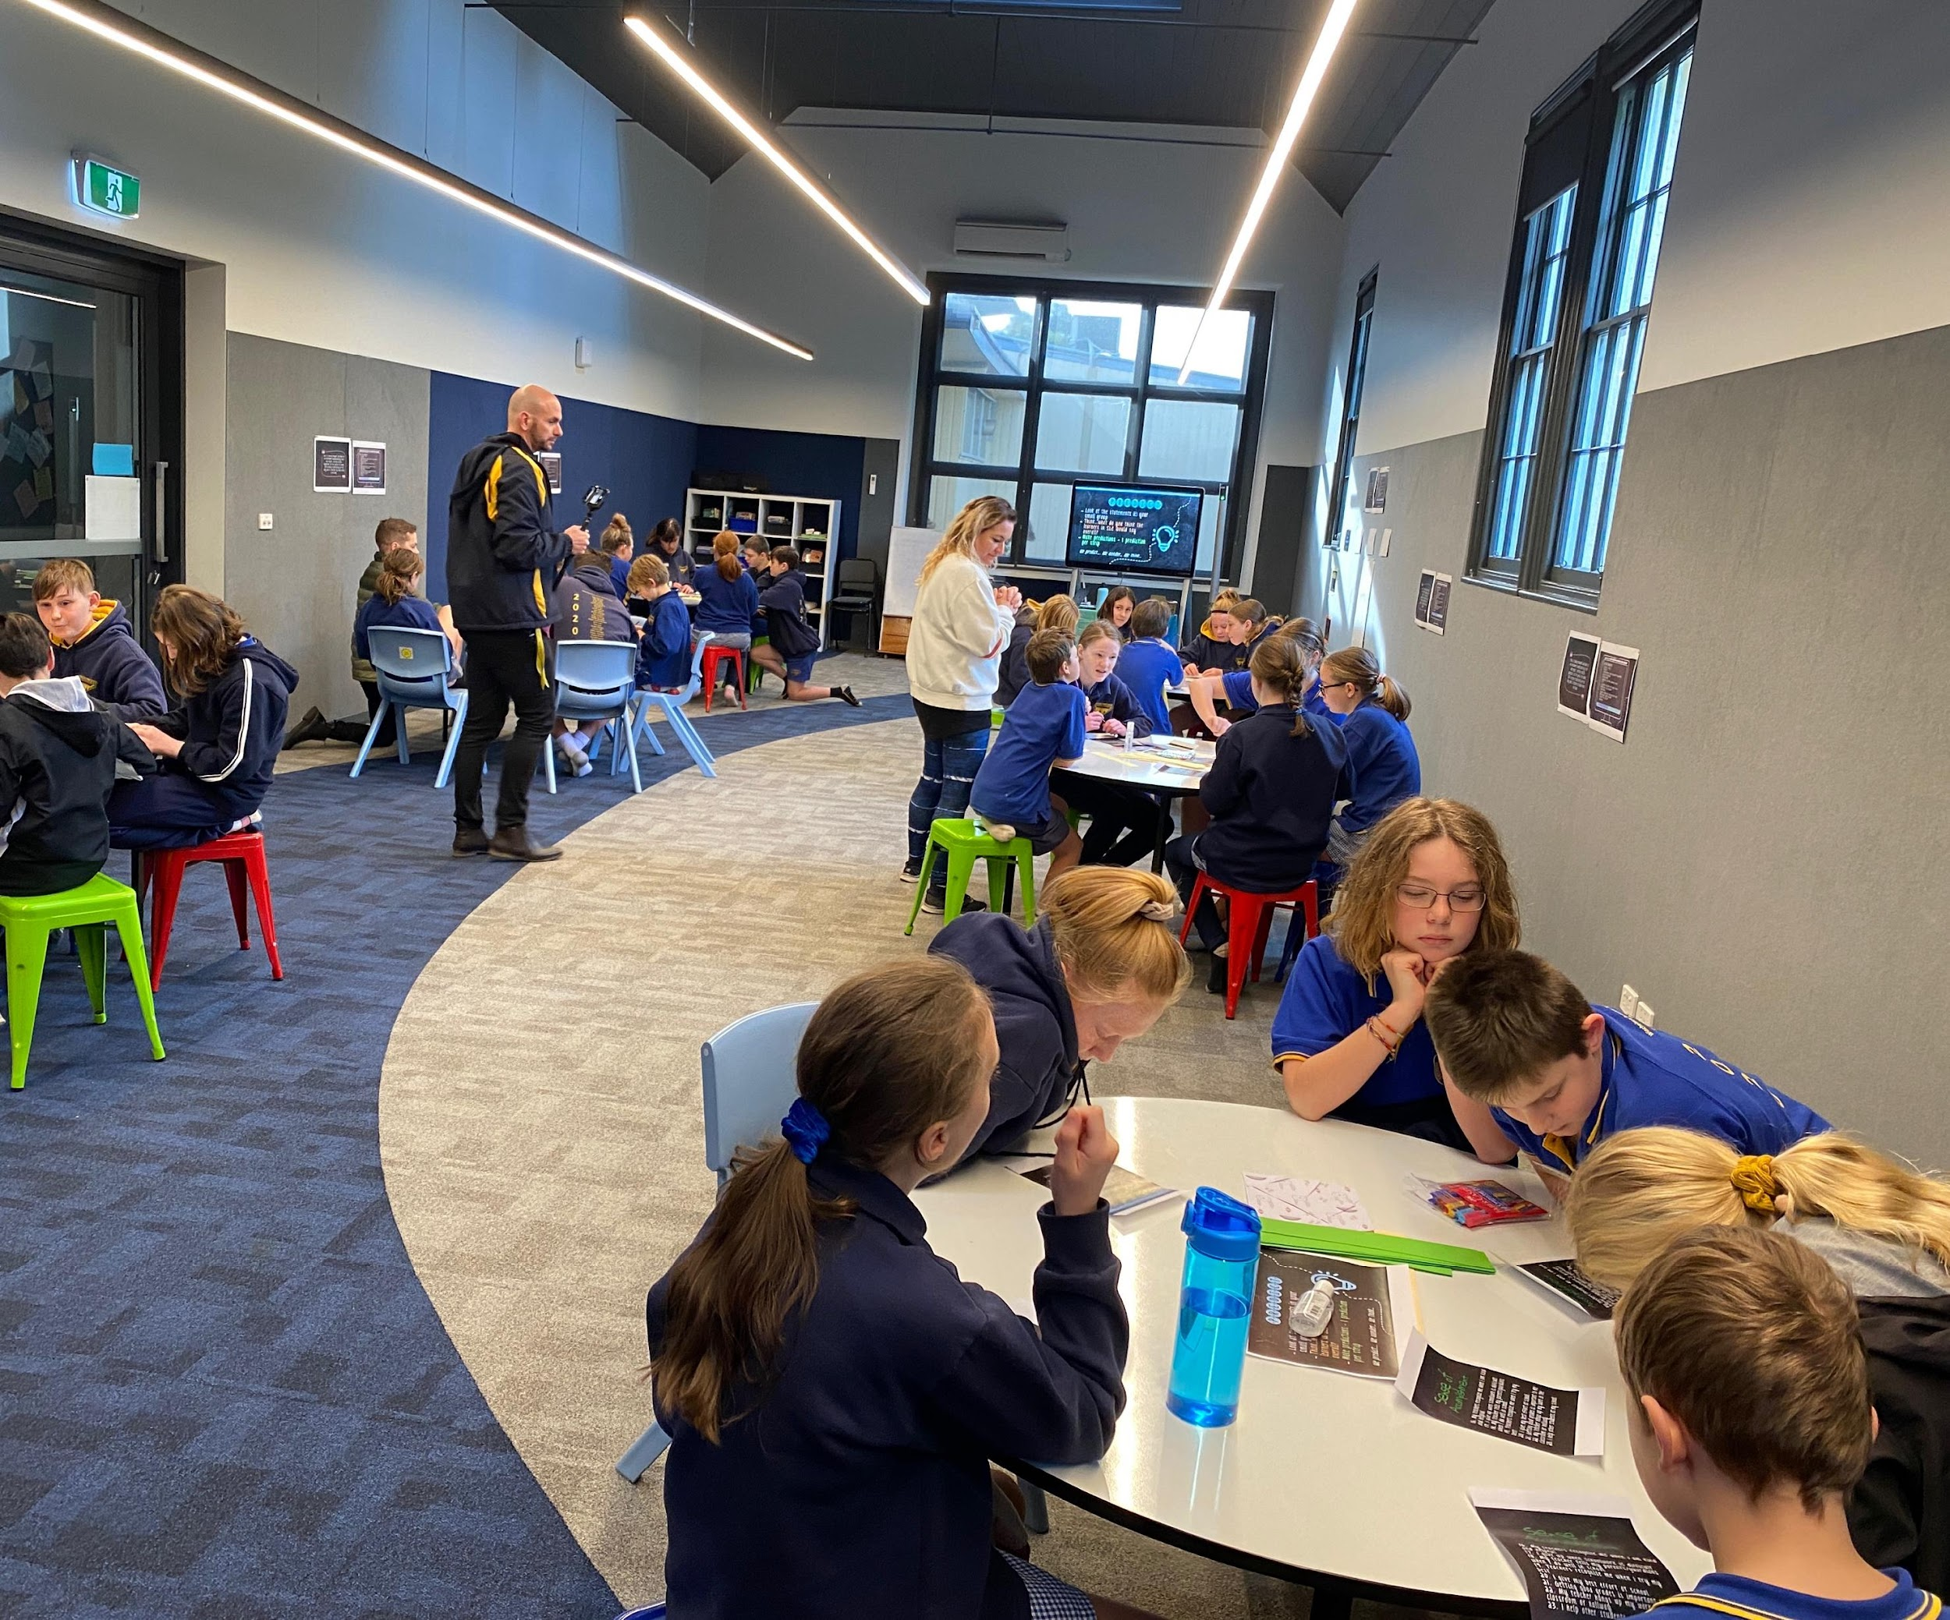
Listening, Learning, & Leading Together
Winchelsea Primary, Victoria, Australia

Slide 37
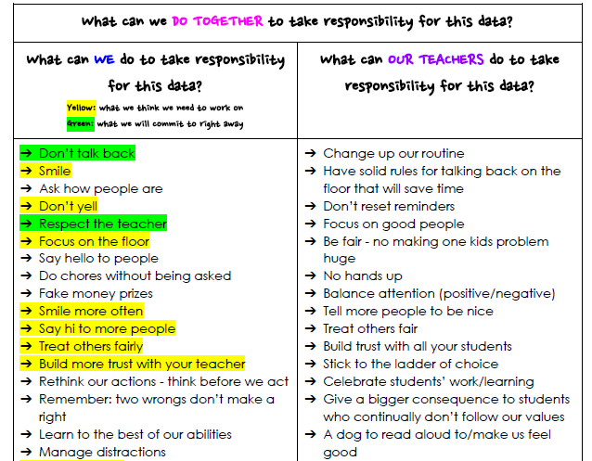
Shared Responsibility
Winchelsea Primary, Victoria, Australia

Slide 38
Reflect
What is one area at your
school in which students can be
invited to Lead with adults?
How can you coach teachers to increase shared responsibility
with their students?

Slide 39
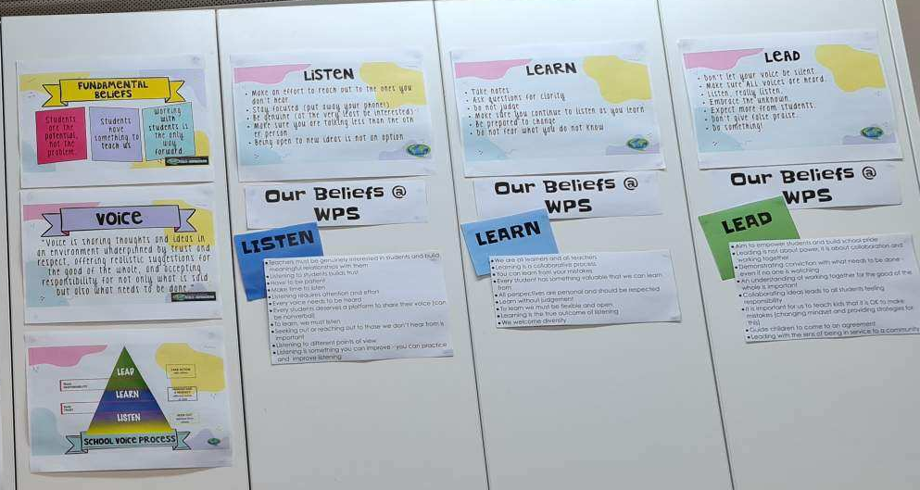
Creating Context for LLL
Winchelsea Primary, Victoria, Australia

Slide 40
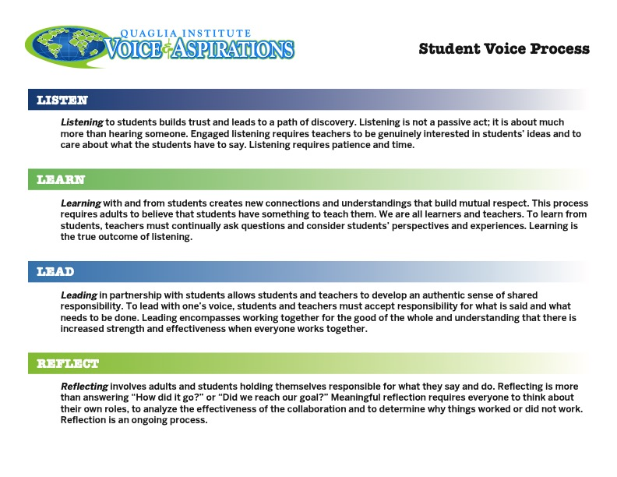
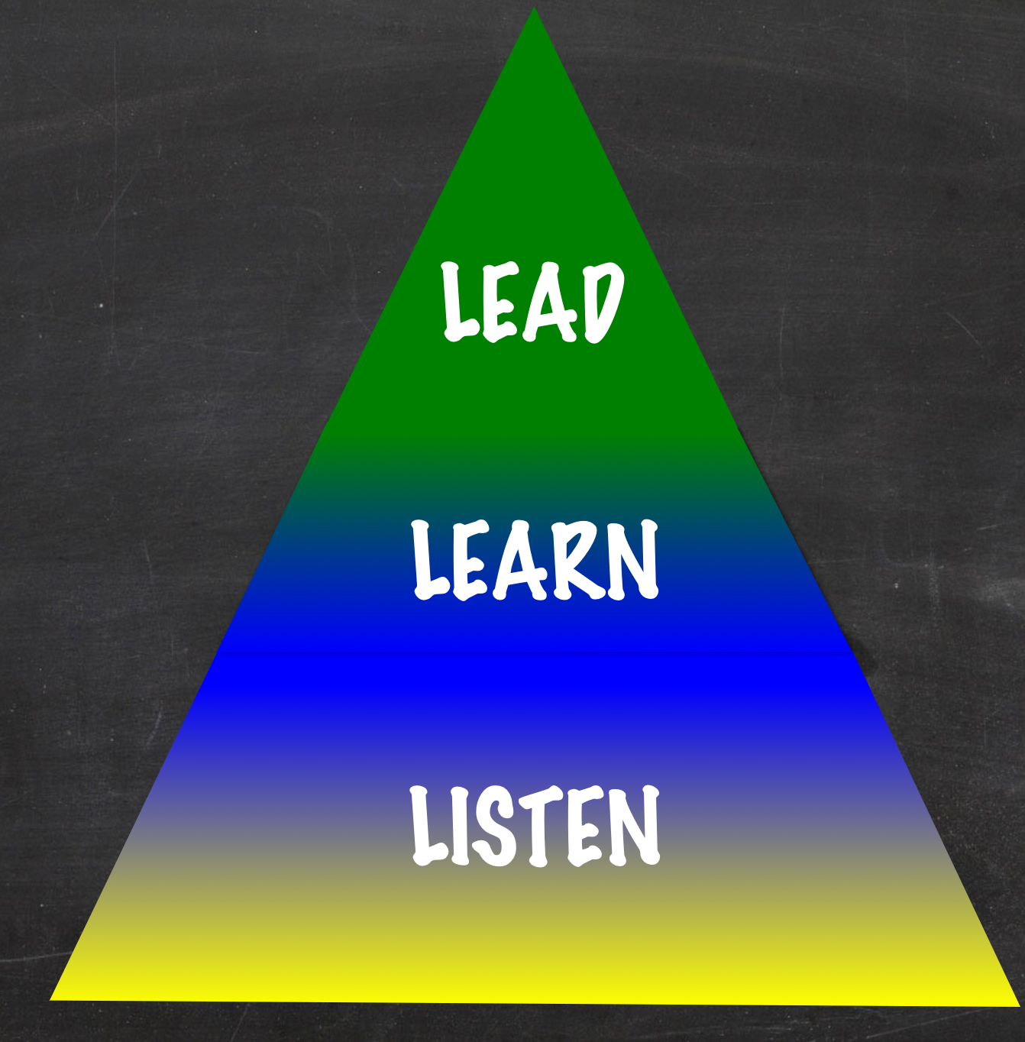
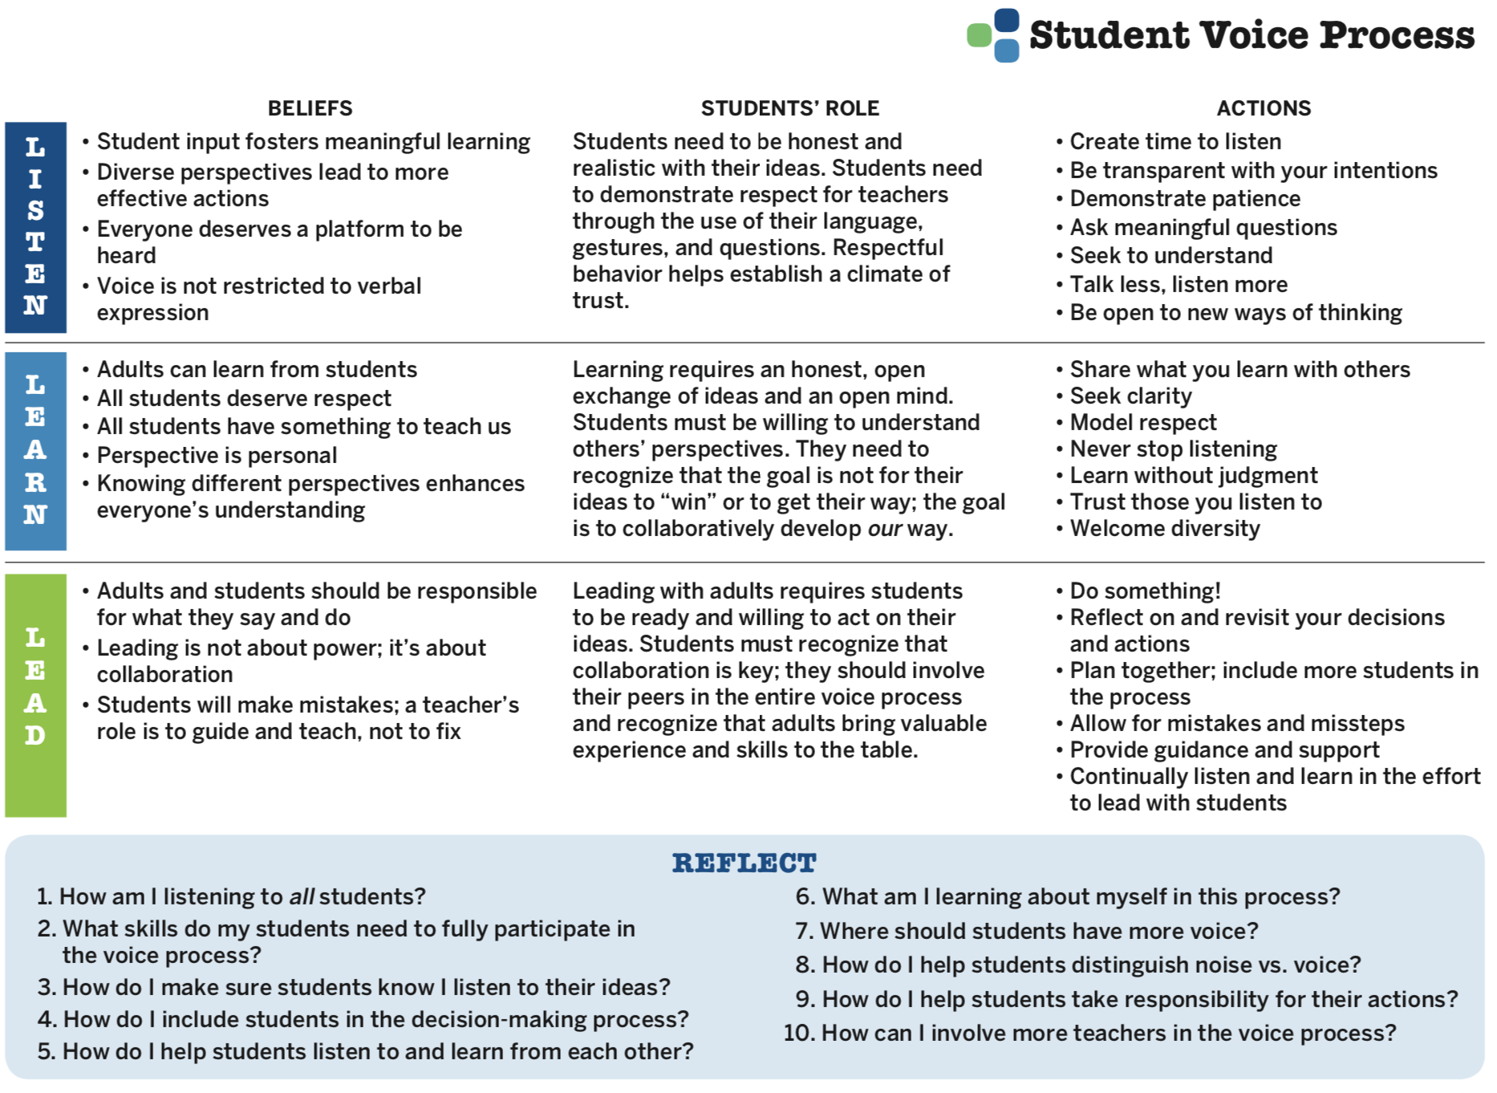

Voice Process Tool
Voice Process Tool

Slide 41
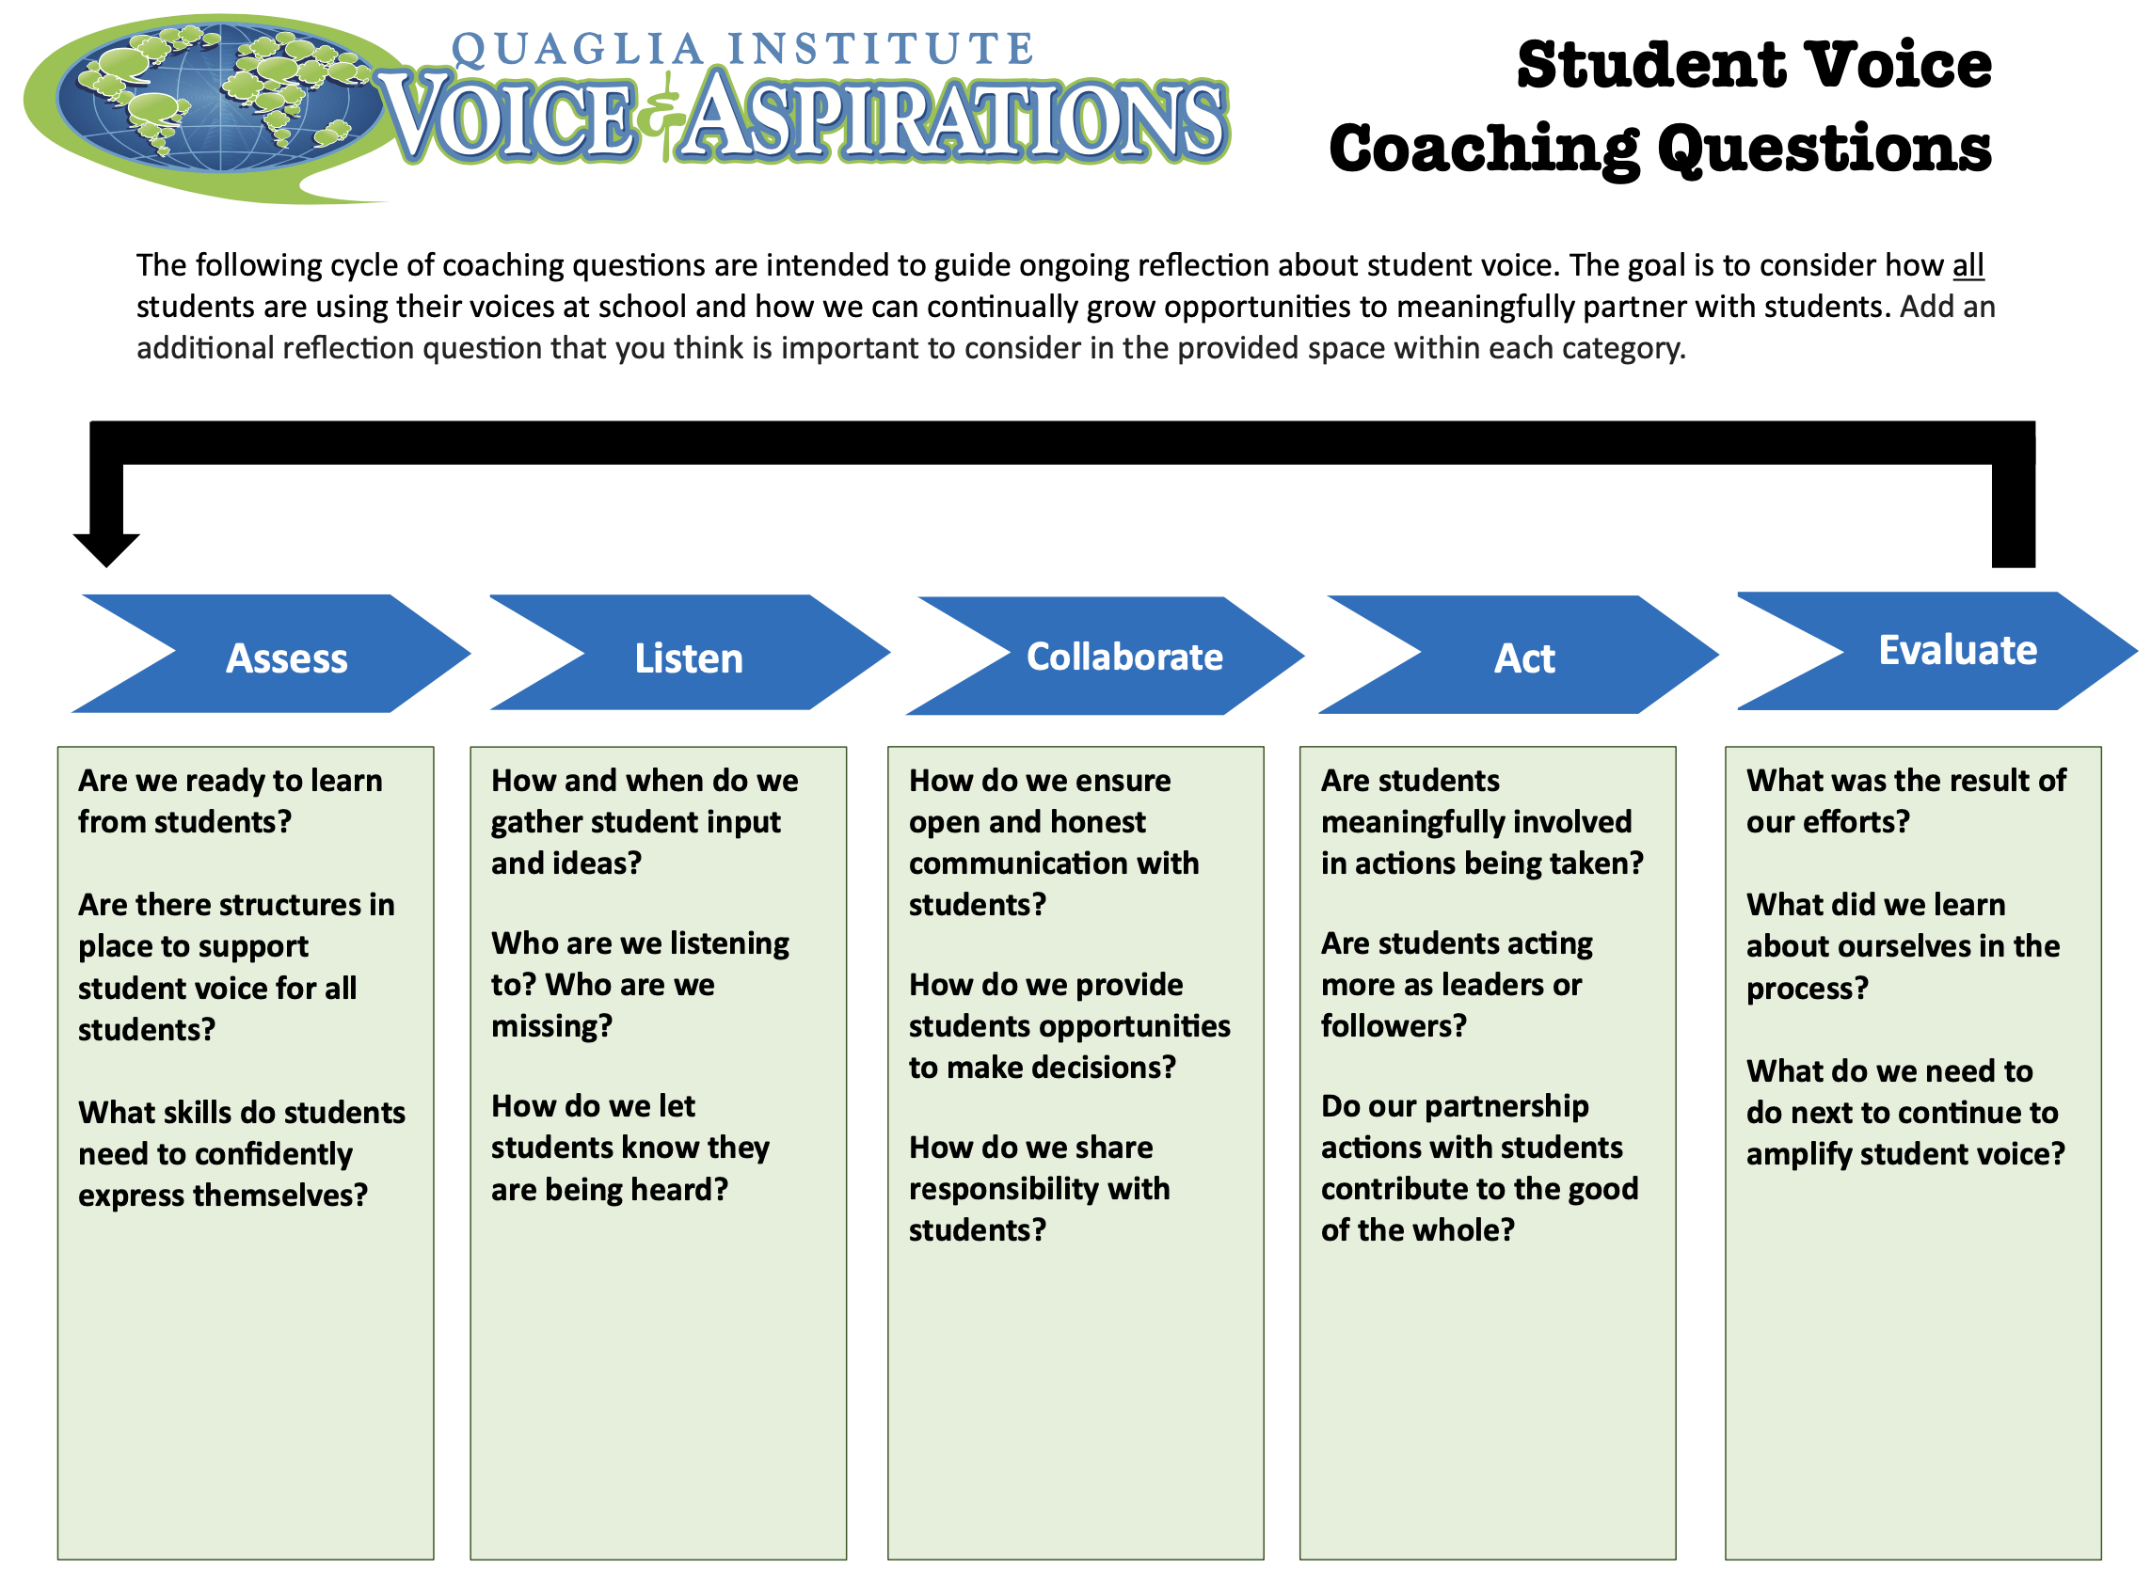
Student Voice
Coaching Questions

Slide 42
LLL Summarized
Vimeo:
https://vimeo.com/qisva/louie
YouTube:
https://youtu.be/1Ebg4If1r7A
BCE, Brisane, Australia
Video

Slide 43


Website Just For YOU!
Website Just For YOU!
https://quagliainstitute.org/coaching-to-amplify-student-voice-listen-learn-lead

Slide 44

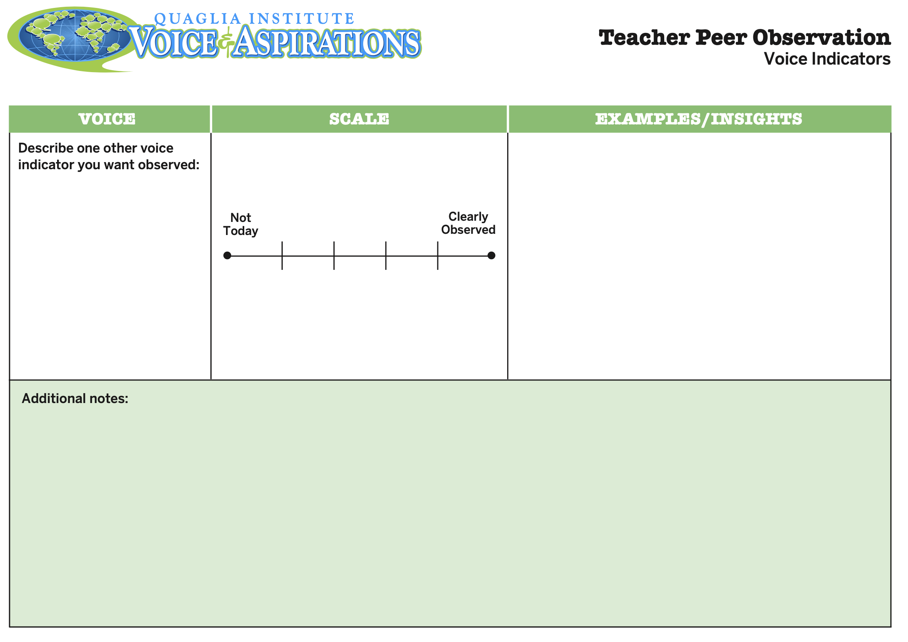
Teacher Peer Observation
Voice

Slide 45
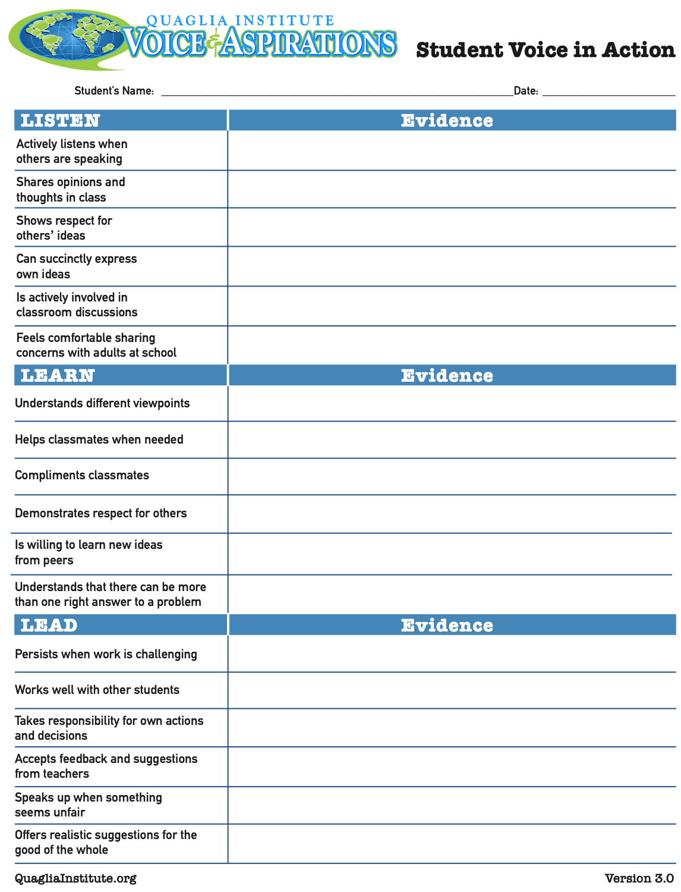
Student Voice
in Action

Slide 46
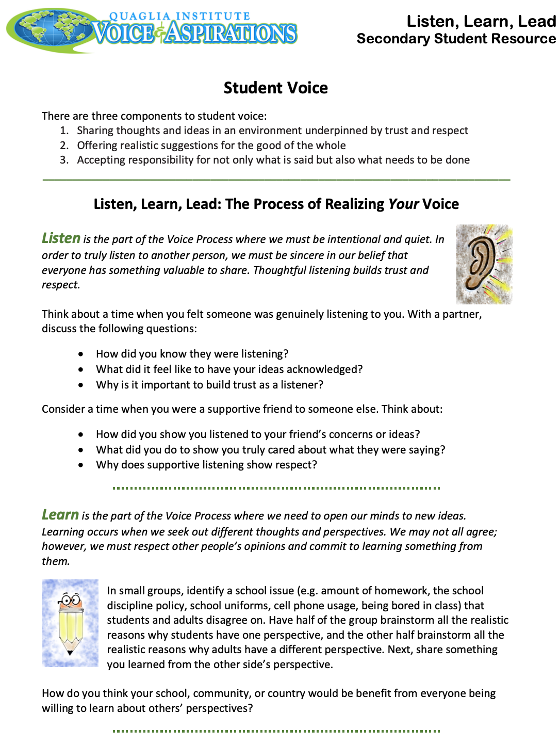

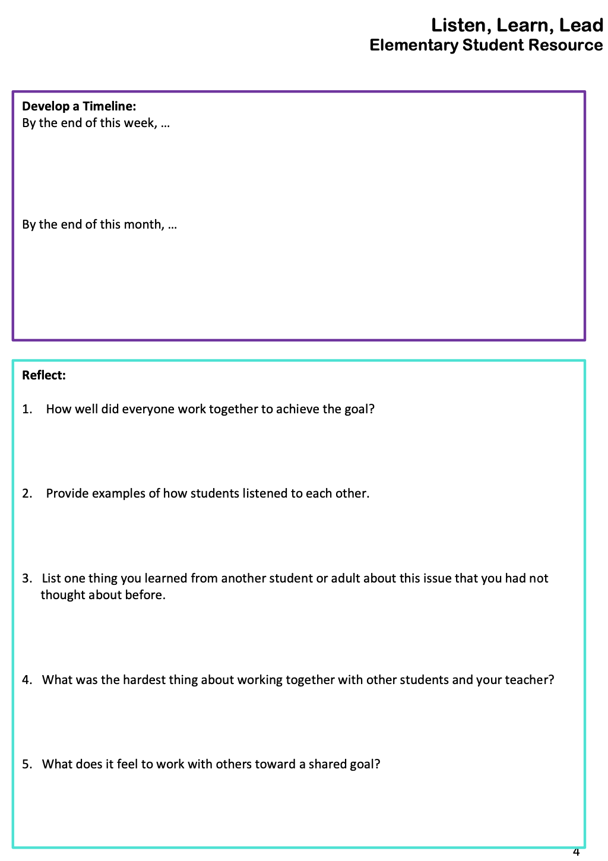
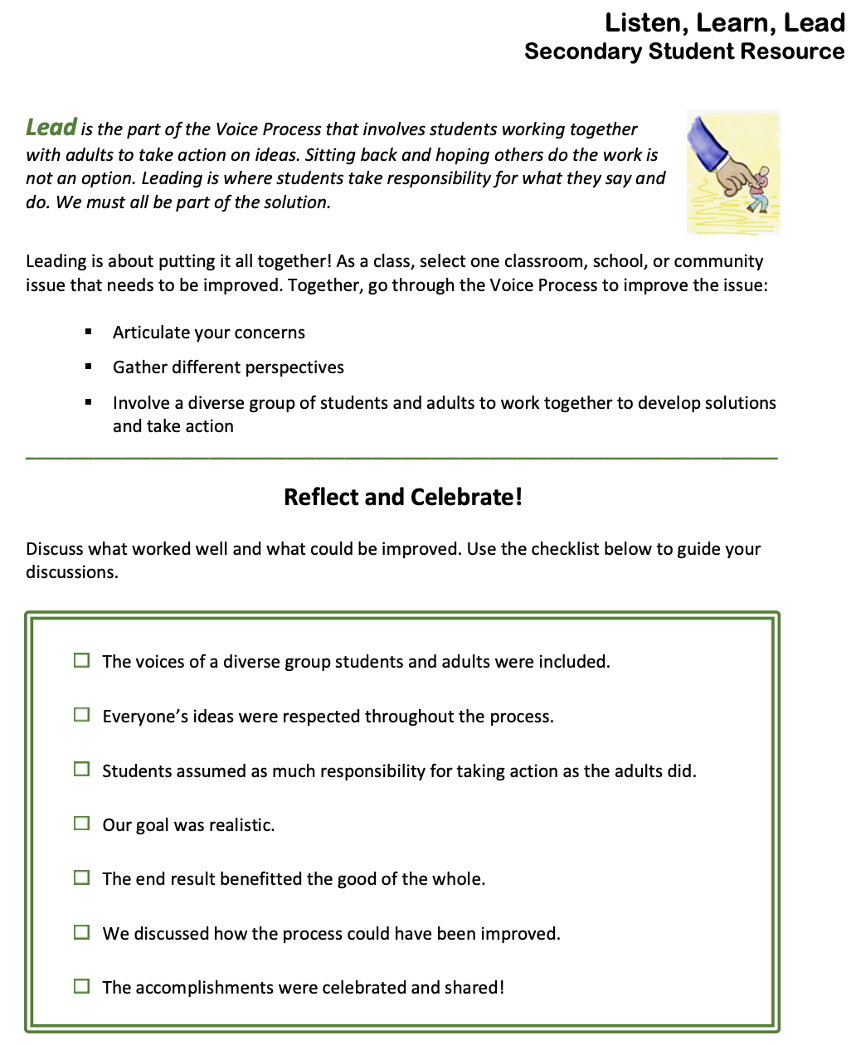
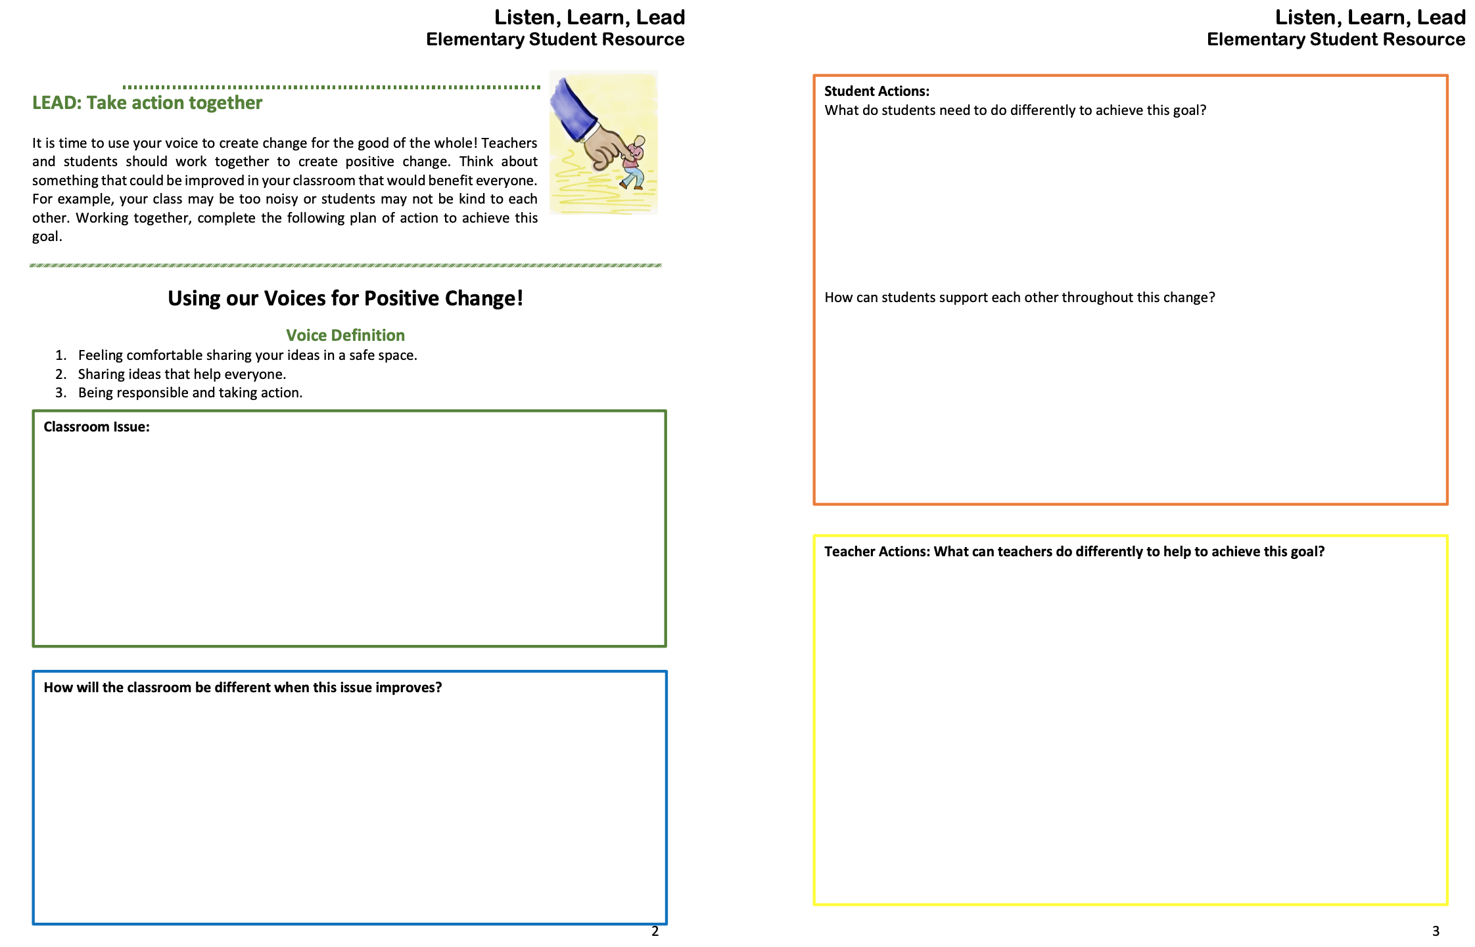
LLL Student Resource
(Elementary & Secondary)

Slide 47
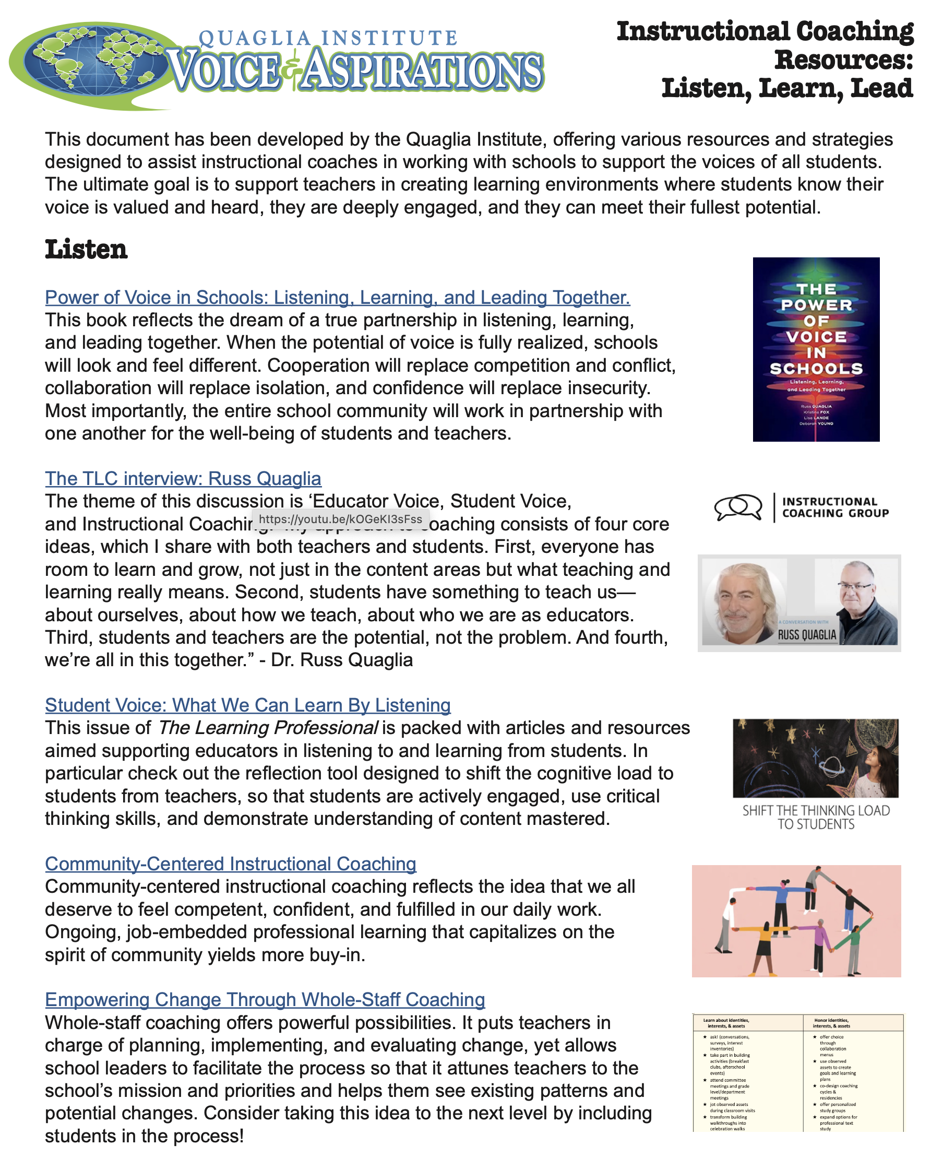
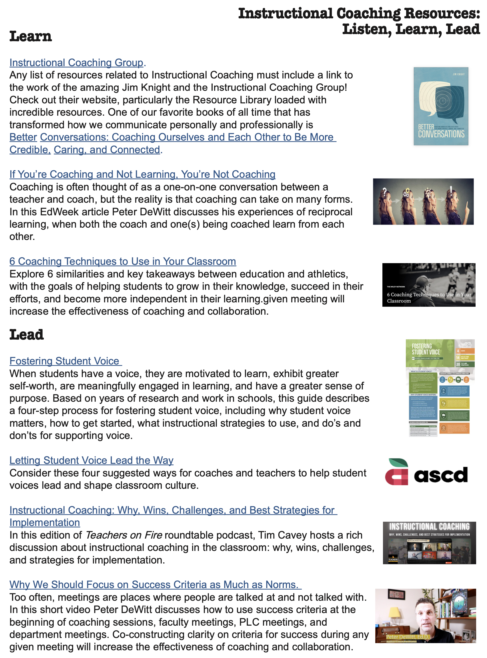
Instructional Coaching Resources: Listen, Learn, Lead

Slide 48

What is your “Mic Drop” moment
of learning from this session today?

Slide 49

What is your
“Mic Drop” moment
of learning from
this session today?

Slide 50
Coaching to Amplify Student
Voice: Listen, Learn, Lead
Dr. Lisa Lande
@Lisa_Lande
QuagliaInstitute.org
lande@quagliainstitute.org
Resources from this session can be downloaded at:
https://quagliainstitute.org/coaching-to-amplify-student-voice-listen-learn-lead

