Slide 1

Voice & Aspirations:
Balancing Dreaming & Doing to Reach Your Fullest Potential
October 29, 2024
Dr. Lisa Lande
lande@quagliainstitute.org
@Lisa_Lande @QISVAtweets
quagliainstitute.org

Slide 2
Fundamental Beliefs
Students are the potential, not the problem.
Students have something to teach us.
Working together is the only way forward.

Slide 3
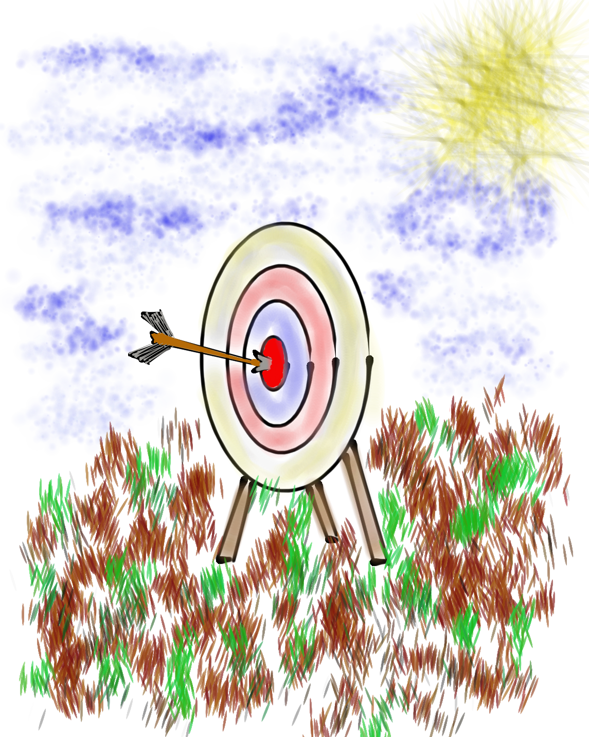
Learning Intention
We are learning about the Aspirations
Profile as a resource for coaches in supporting teachers & students in reaching their fullest potential.
Success Criteria
Explore the 4 quadrants of the Aspirations Profile:
Hibernation, Imagination, Perspiration, & Aspiration.
Consider strategies for supporting all students in
balancing dreaming & doing in their lives.
Apply the Aspirations Profile to instructional
coaching practices at your school.
This session will be a home run for me if…

Slide 4
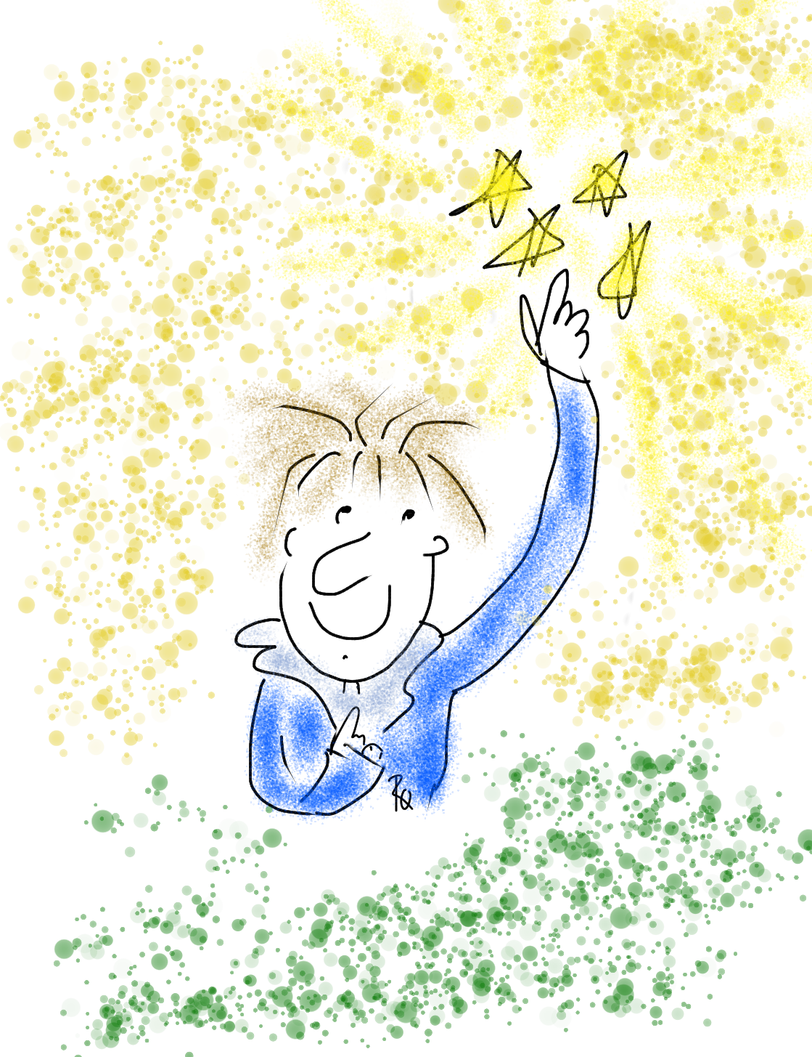
Point your index finger to the sky & above your head, move your finger in small circles clockwise.
Slowly move your hand down to your waist, continuing to move your hand in small circles.
What direction is your hand moving?

Slide 5

Why Student
Voice?

Slide 6
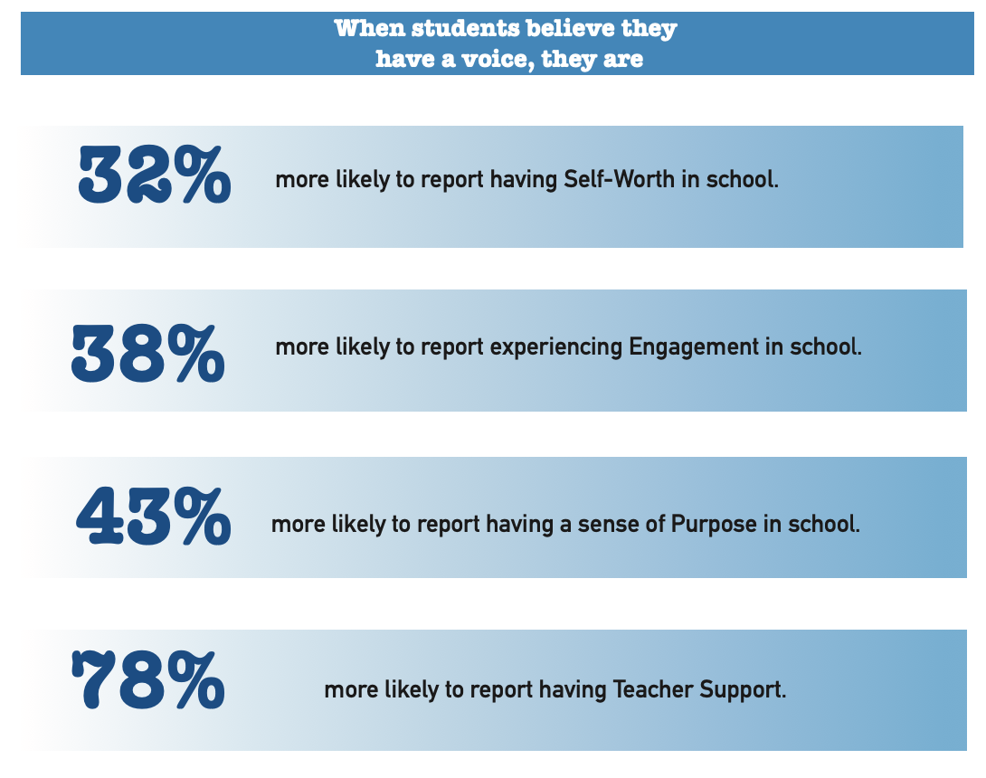

Slide 7

54% of students report that adults listen to student suggestions.

Slide 8

52% of students report using their voice to express their thoughts & ideas.

Slide 9

52% of students report having a voice in decision making at school.

Slide 10

51% of students say they work with adults to make their school better.

Slide 11
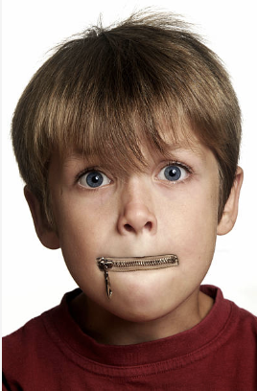
Student Voice
is not YET a
natural way of
being.
Why Not?

Slide 12

The 3 Components of Student Voice
Sharing thoughts & ideas in an environment underpinned by trust & respect.
Offering realistic suggestions for the
good of the whole.
Accepting responsibility for not only what is said but also what needs to be done.

Slide 13
ASPIRATIONS
The ability to
dream & set goals
for the future,
while being inspired
in the present
to reach those dreams.

Slide 14




high
Imagination
Aspiration
DREAMING
Hibernation
Perspiration
low
DOING
high

Slide 15

Challenge Time!
Aspirations Profile
4-Corners of Reflection

Slide 16
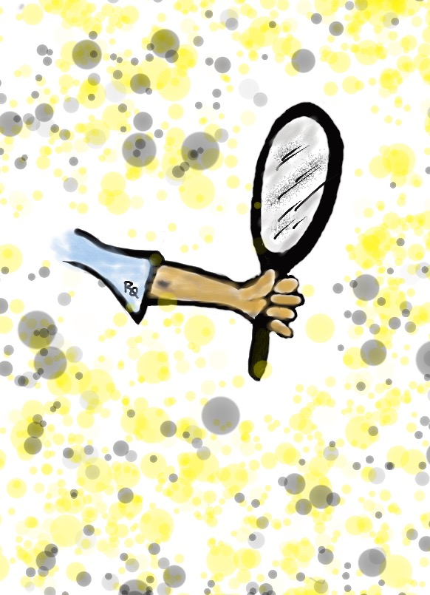
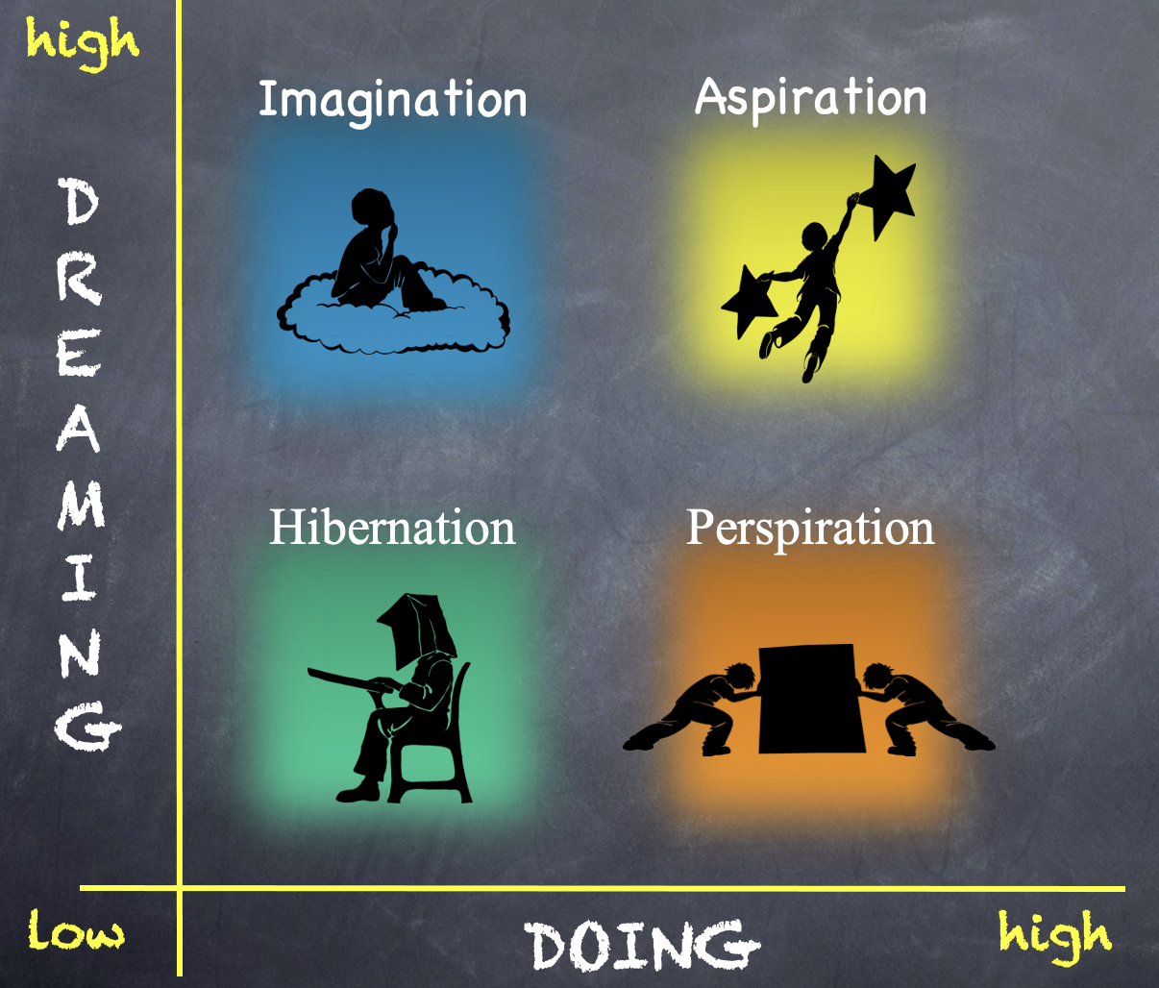
Reflect
Go to the quadrant where you spent most of your time as a student.
Break into groups of 3-4 & share why!
What would have helped you maintain a healthy balance of dreaming & doing?

Slide 17
Reflect
Rotate one corner clockwise.
What types of things do individuals in this quadrant say/do?

Slide 18
Reflect
Rotate one corner clockwise.
What questions can you ask students or teachers who are stuck in this quadrant?

Slide 19
Reflect
Rotate one corner clockwise.
What types of actions can you take to support teachers & students in this quadrant?

Slide 20

Time to Dig Deeper!

Slide 21
high
DREAMING
Hibernation
low
DOING
high

Slide 22
high
DREAMING
Vimeo
https://vimeo.com/789017891/1c391b7d0a
YouTube
https://youtu.be/qPYqaBvwhy8
low
DOING
high

Slide 23

Students in Hibernation
Potential Cons:
Passive & unmotivated
Poor self-esteem &
defeatist attitude
Struggle to take
responsibility for
anything
Potential Pros:
Time to reflect
Space to recharge
They report:
Feeling isolated
Stuck
Misunderstood
Bored
They need to:
Feel valued
Be recognized for success
Have positive role models
Have a sense of purpose

Slide 24
high
Imagination
DREAMING
low
DOING
high

Slide 25
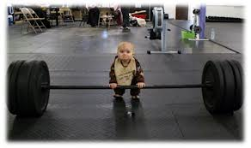
high
DREAMING
low
DOING
high

Slide 26

Students in Imagination
Potential Pros:
Enthusiastic
Fun to be around
Lots of creative ideas
Potential Cons:
Limited follow-through
Not well connected
to reality
Students report:
Having big dreams
Eagerness to explore
Craving creative outlets
They need to:
Develop action plans
Focus
Be realistic

Slide 27
high
DREAMING
Perspiration
low
DOING
high

Slide 28
high
DREAMING
Vimeo
https://vimeo.com/qisva/snowremoval
YouTube
https://youtu.be/m39gWmTaIbY
low
DOING
high

Slide 29

Students in Perspiration
Potential Pros:
Determined
Hard Working
Driven to Succeed
Potential Cons:
Overly concerned
about grades
Single-minded,
narrow-focused
Students report:
Feeling stressed
Not sure “why” they are learning, but need
good grades
Don’t want to let
anyone down
They need to:
Have a greater purpose for learning
Balance school work with outside life
Link learning to
their passions

Slide 30
high
Aspirations
DREAMING
low
DOING
high

Slide 31
high
DREAMING
Vimeo
https://vimeo.com/776344083/affe5a37da
YouTube
https://youtu.be/uLjzbSAEmJI
low
DOING
high

Slide 32

Students in Aspiration
Potential Pros:
Connects present
actions to future
dreams
Good idea of
potential options
Potential Cons:
Relaxation is Challenging
Under constant pressure
Self-Serving
Students report:
Never feeling
satisfied
Driven by being best
Frustration with peers
who don’t try or who
interrupt learning
They need to:
Be assured they
are on a positive track
Experience meaningful academic challenges
Breathe!

Slide 33
high
Imagination
Aspiration
DREAMING
Hibernation
Perspiration
low
DOING
high

Slide 34


Slide 35
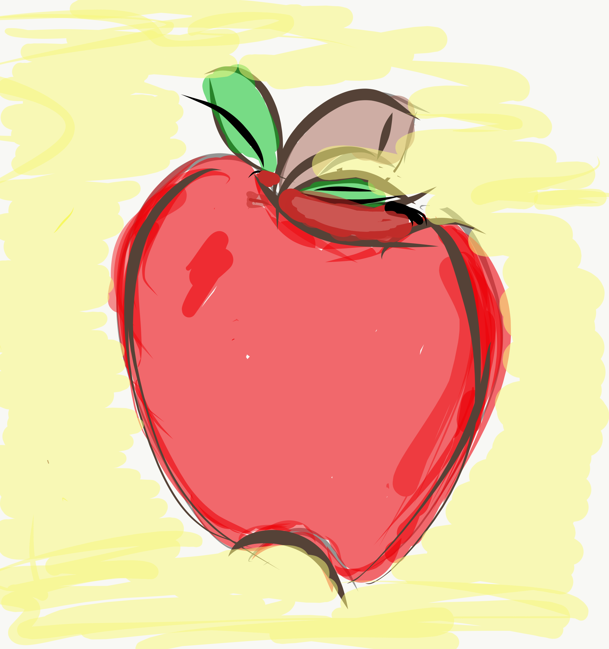
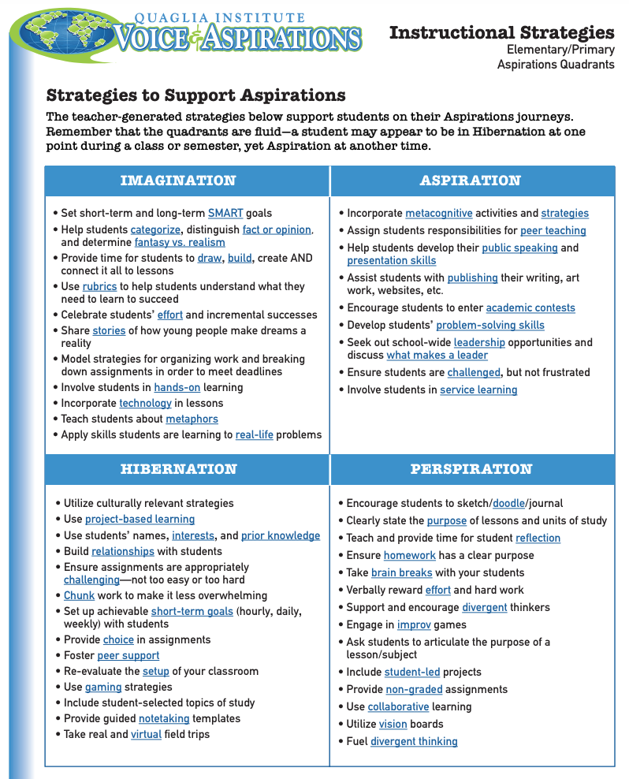
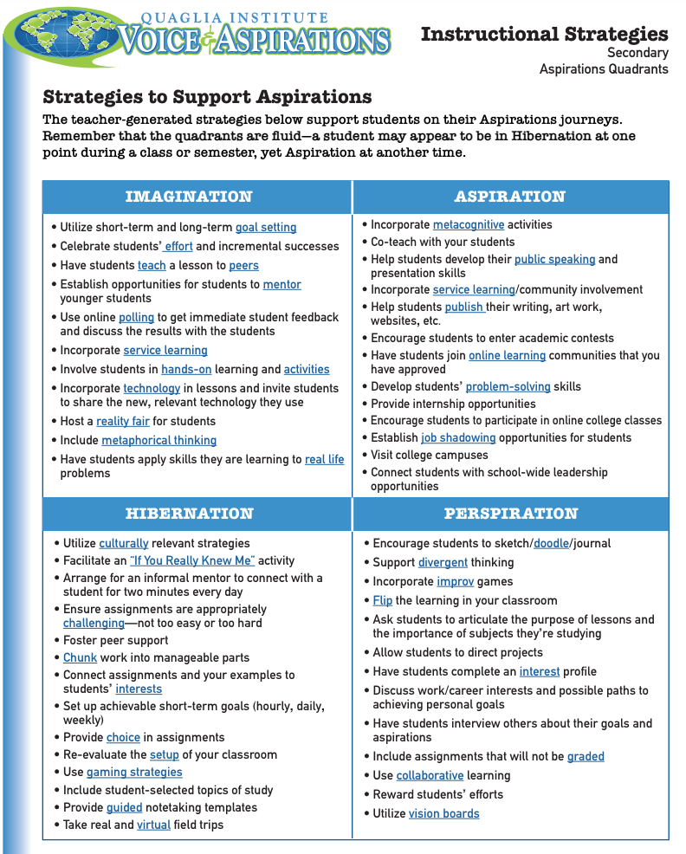
Aspirations Quadrants Instructional Strategies

Slide 36
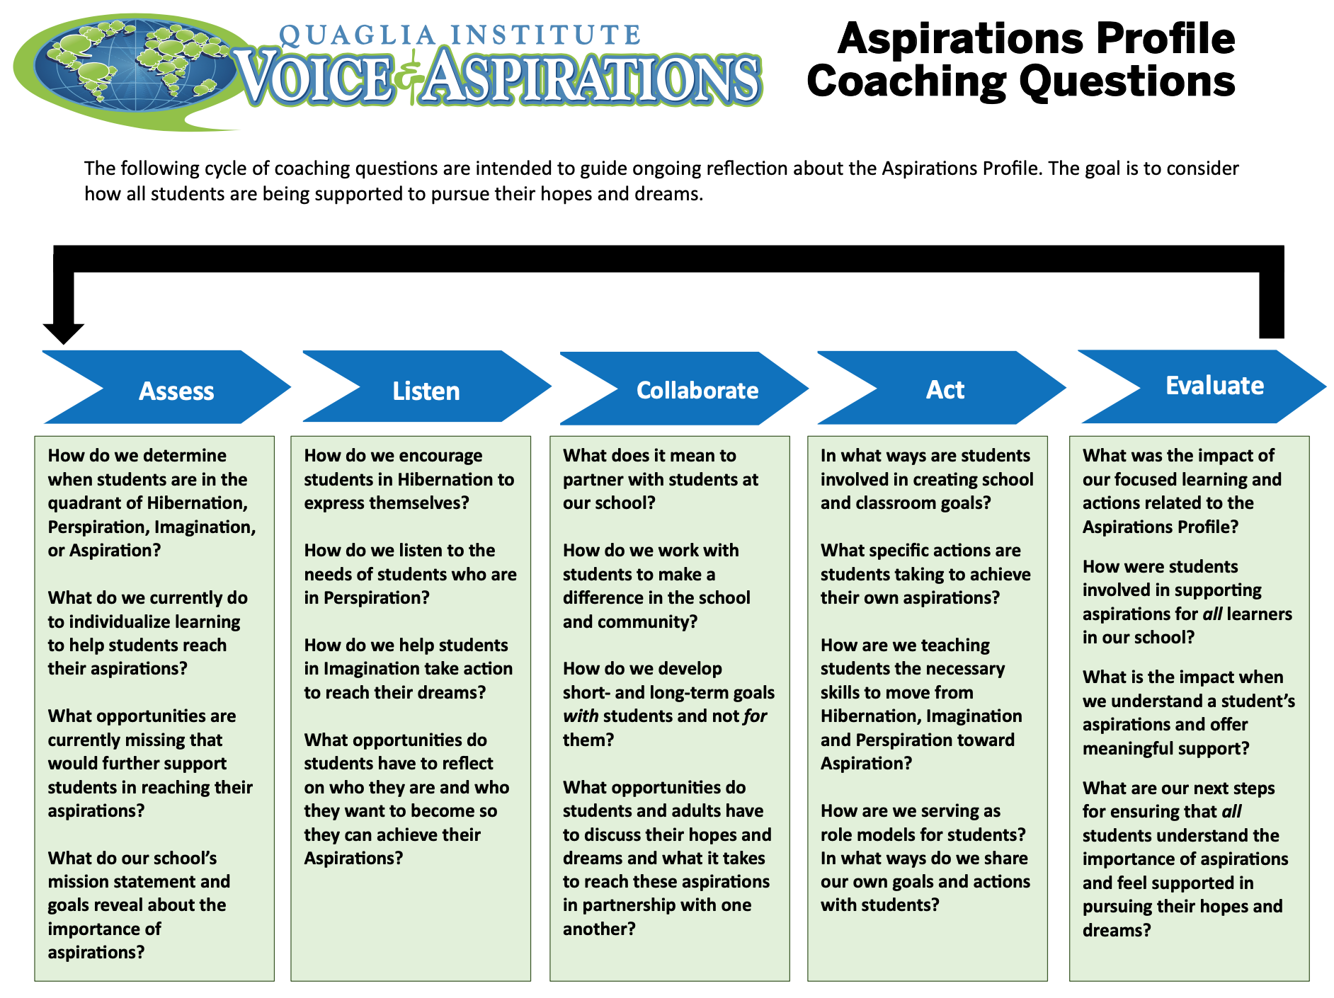
Aspirations Profile
Coaching Questions

Slide 37
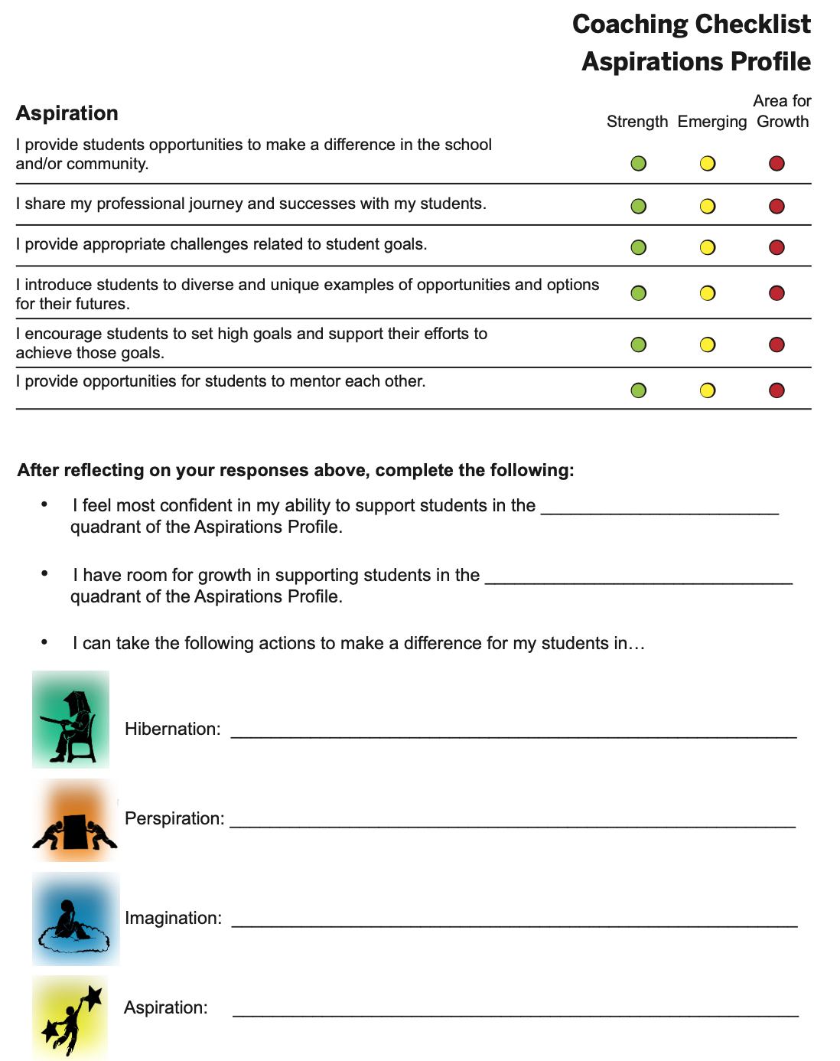
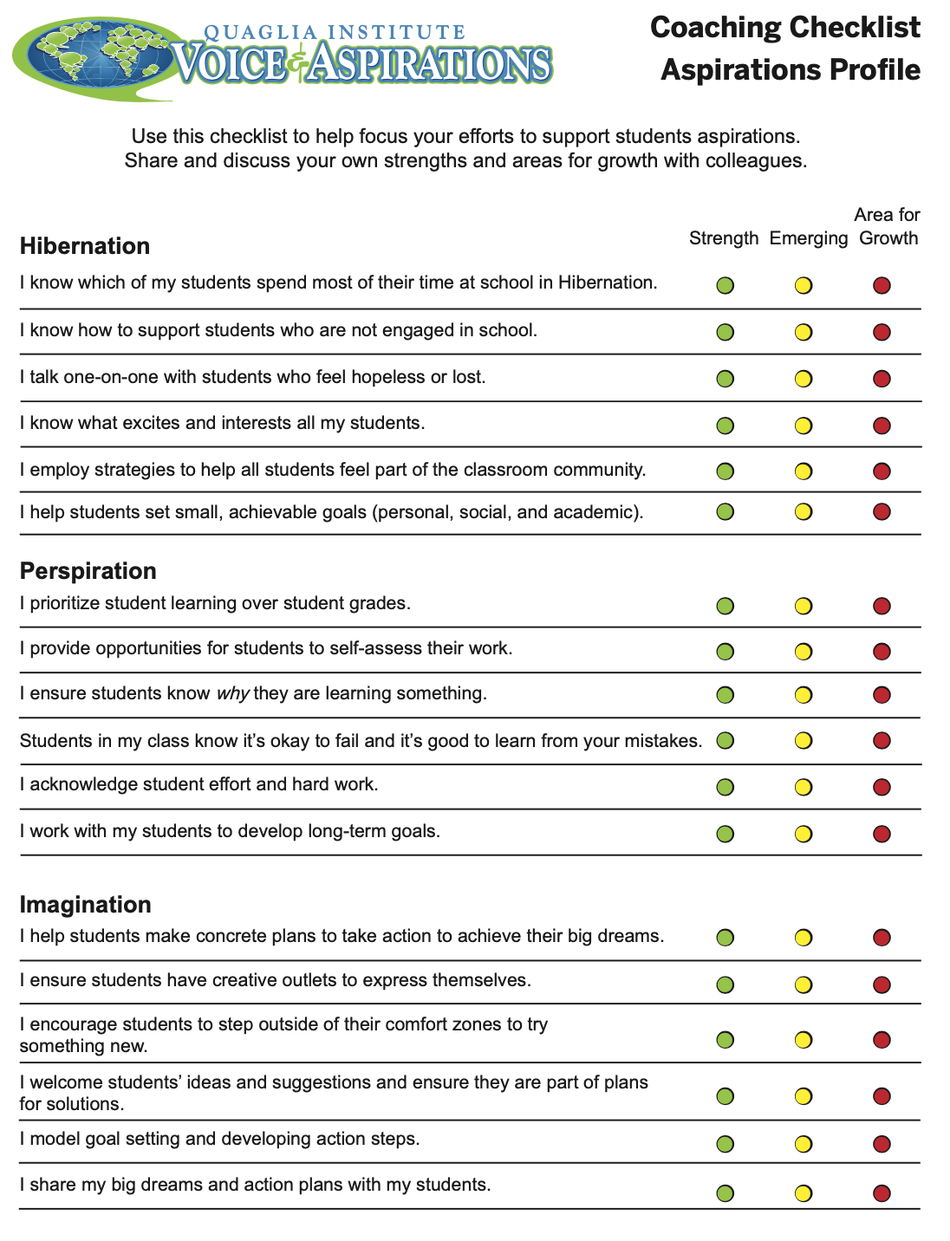
Coaching Checklist
Aspirations Profile

Slide 38
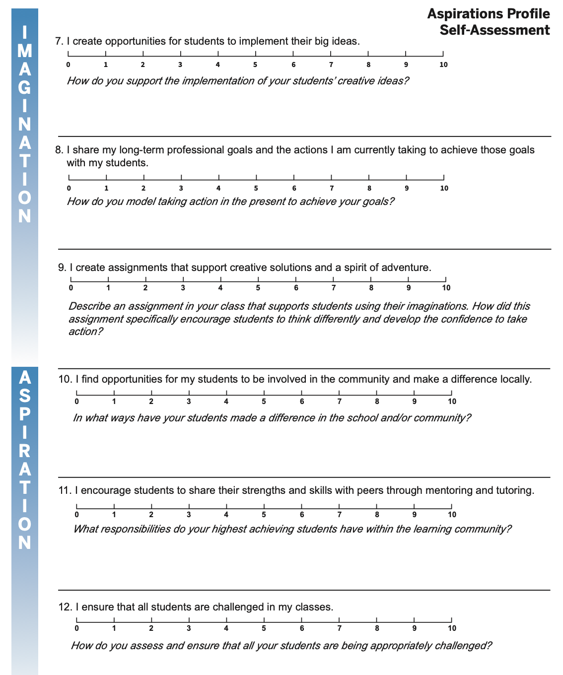
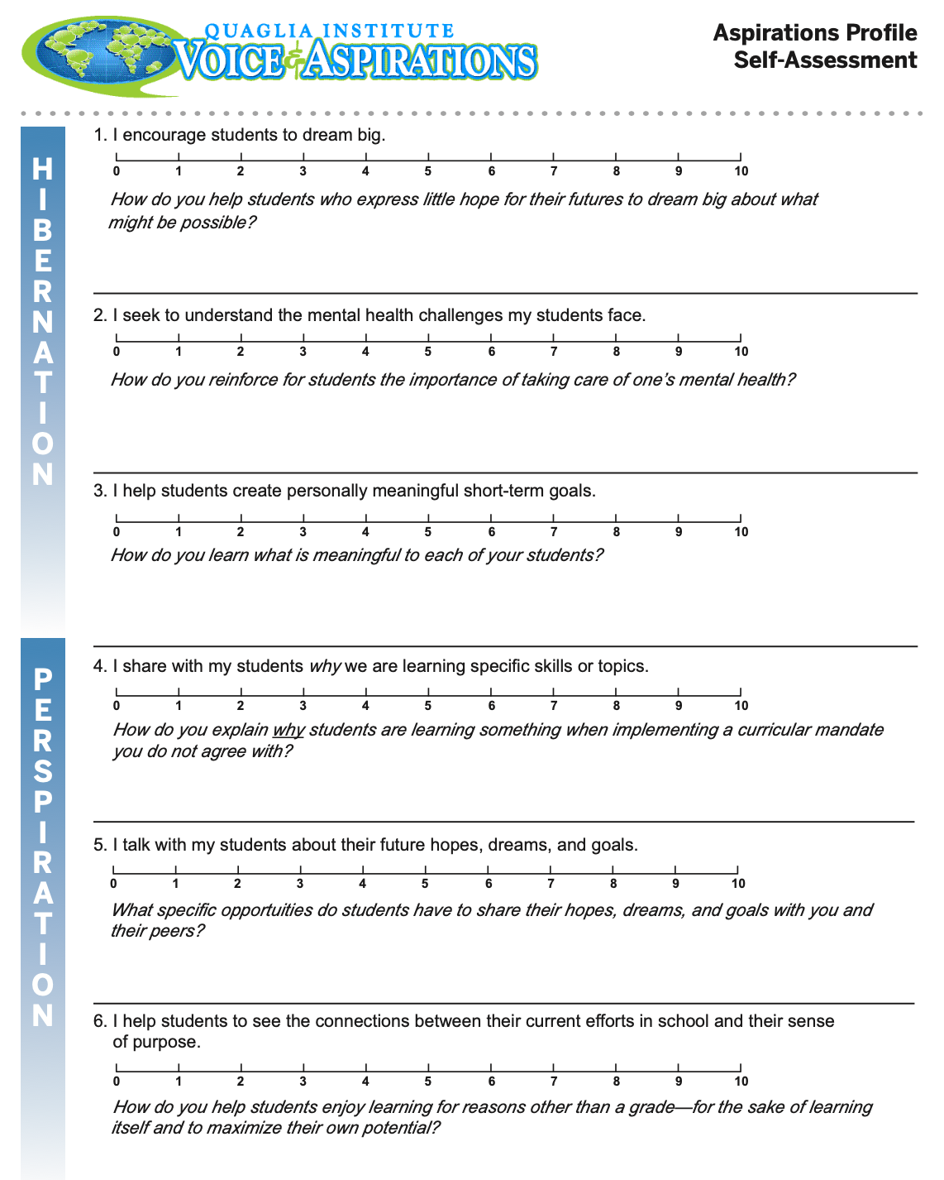
Aspirations Profile
Self-Assessment

Slide 39
Reflect
How can you apply the Aspirations Profile into your work as an Instructional Coach?
(Or your current school role.)

Slide 40
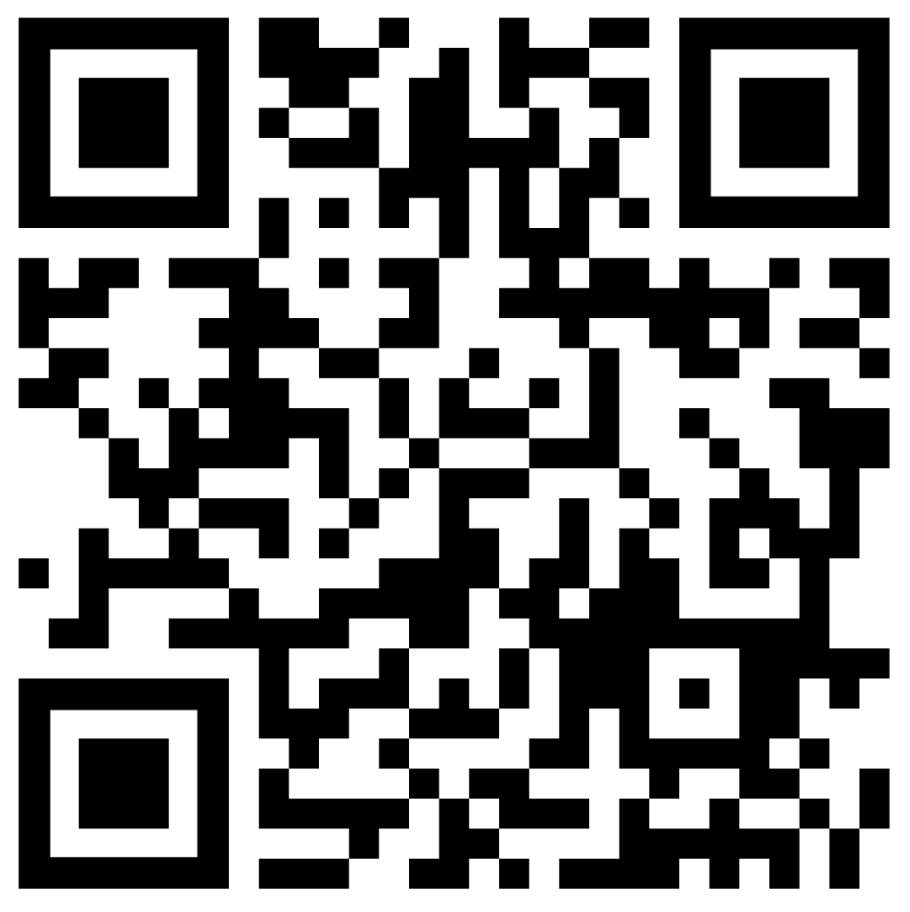
Website Just For YOU!
https://quagliainstitute.org/potential

Slide 41
Voice & Aspirations:
Balancing Dreaming & Doing to Reach Your Fullest Potential
October 29, 2024
Dr. Lisa Lande
lande@quagliainstitute.org
@Lisa_Lande @QISVAtweets
quagliainstitute.org

