Slide 1
STUDENT VOICE CONFERENCE
If you want to go fast, go alone, if you want to go far, go together”
2025

Slide 2
View the conference introduction video here:
Vimeo:
https://vimeo.com/qisva/riversacademy2025
YouTube:
https://youtu.be/hKl68r3l_ts

Slide 3
STUDENT VOICE CONFERENCE 2025 - PURPOSE
“Coming together is a beginning, staying together is progress and working together is success”

Slide 4
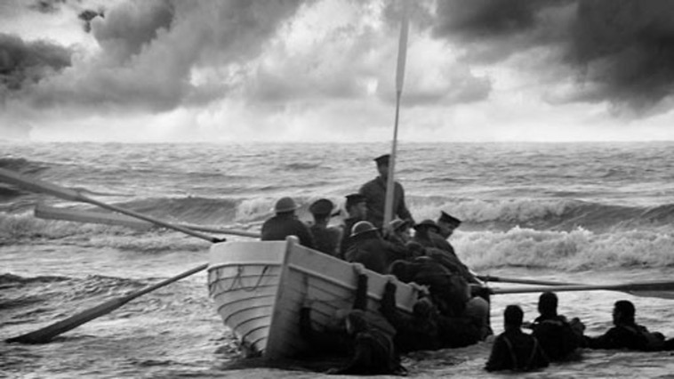
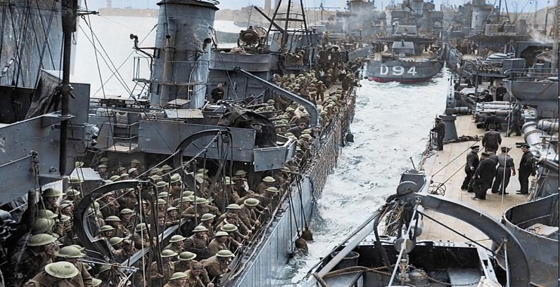
Collaboration - Strength of the Trust and Dunkirk
With purpose, collaboration is a must. It truly ensures that we are connecting our present actions with our future successes
Dunkirk (May 26 – June 4, 1940)
In the same way, within the Aspirations Trust, 16 academies are supporting each other, sharing resources and facing challenges together.
Working in a Trust is about collective strength

Slide 5
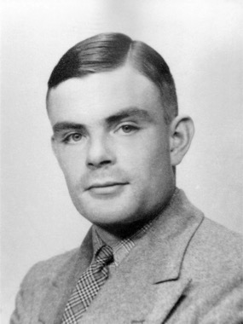
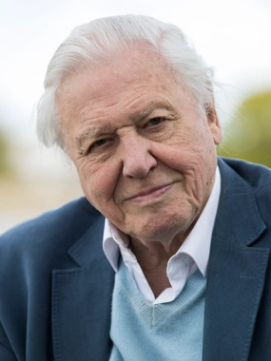
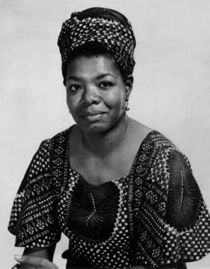
Having Purpose
Embrace your Aspirations
Alan Turing
David Bowie
-Broke the enigma code (WW2)
-Pioneered modern computing
-Famously incriminated for his sexuality
-Challenged music and art norms
-Inspired self-expression
-Redefined identity through his sheer creativity
David Attenborough
Maya Angelou
-Educates* the world about nature
-Advocated for the conservation of the planet
-Compelling activism and poetry
-Empowered marginalised voices

Slide 6
Our aims today
Implement new ideas into our schools
Success isn’t just individual its Collective
Be open minded today
Strengthen our own skills
Give ideas to help each other

Slide 7
Last year’s Student Voice Conference
Successes:
-Every student leader presented their achievements within implementing the value of self-worth within their school
-We listened dearly to every student leader and implemented some innovative ideas, including attendance streaks, which has made significant improvement to our overall school attendance
-Similarly, student leaders implemented the idea of anti bullying ambassadors in their school too

Slide 8
It shouldn’t just end here
Purpose should be a communal goal as well as Student voice
We have the responsibility to empower all students
Create multiple
Opportunities for all pupils regardless of background

Slide 9
TOUR
Look up

Slide 10
PRESENTATIONS
Listen. Learn. Lead

Slide 11
Park Academy

Slide 12
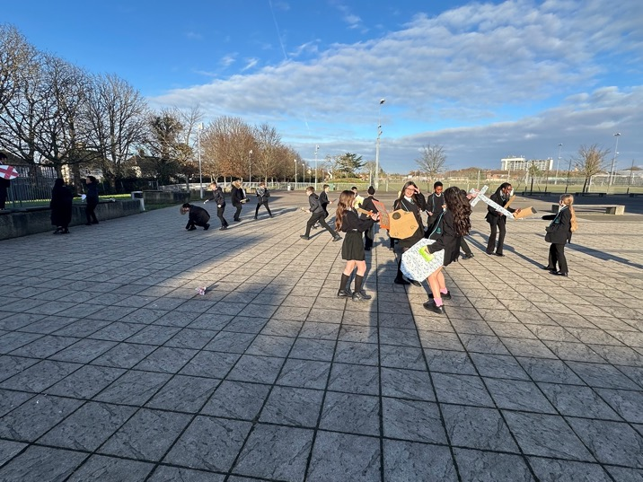
Events and Activities:
Quaglia Survey- “School is boring”:
- House Competitions
- Meetings (Student Council)
-Engaging tasks in lessons
- Sixth Form activities (Enrichment, 6th Form Social)
Notes:
Amber
Attempt to improve by increasing events and activities

Slide 13
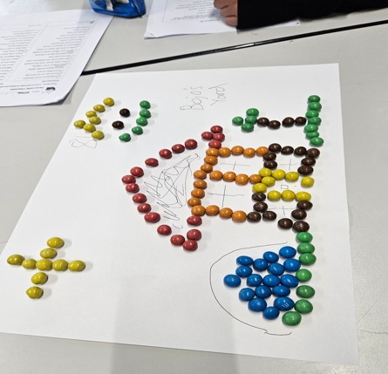
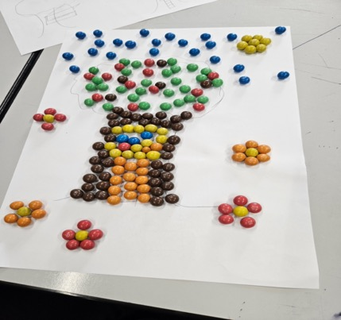
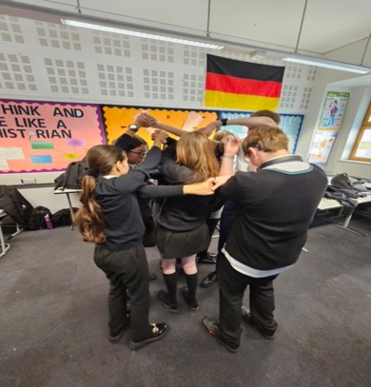
Meetings:
Head Student Meeting with SLT
Student Leadership Conference (Oct 2024)
MBTI test
M&M house building competition
Human knot
Notes:
Amber - First bullet point
Nsma - Student leadership conference - talk about what we did and the impact it had

Slide 14
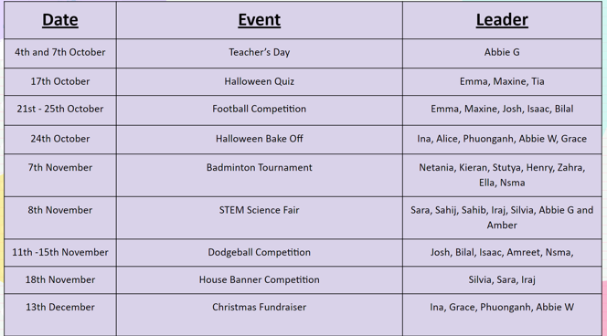
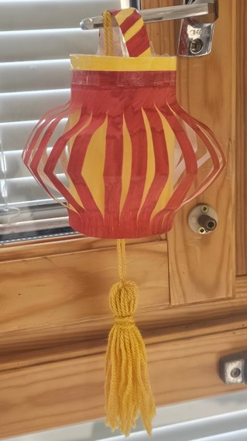
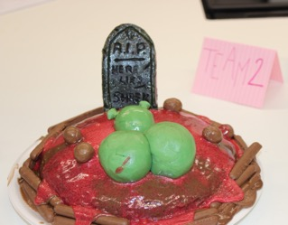
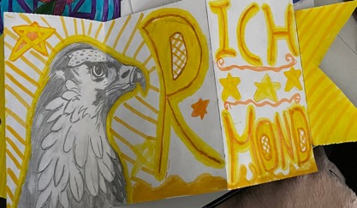
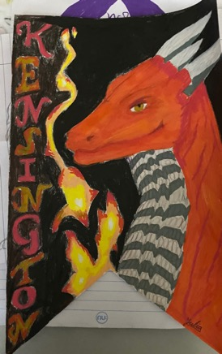
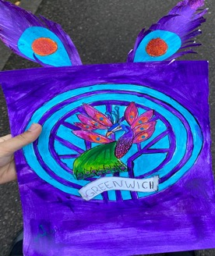
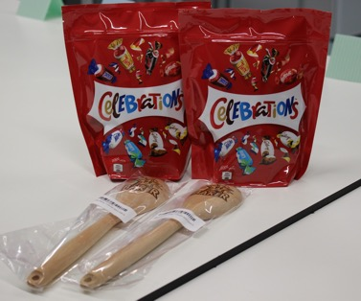
House Competitions:
Banner Competition
Themed Bake Sales/Bake Offs
Sports Tournaments
Charity Events
Cultural Competitions
Notes:
Iraj and Silvia

Slide 15
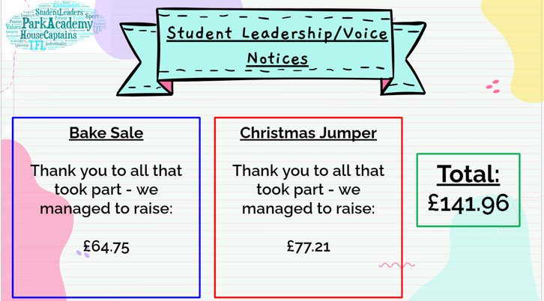
Advertising:
Posters (hung around school)
Promotional slides (shown
during form and assembly)
Daily Announcements during
form
Shown on mini TVs
Notes:
Iraj and silvia

Slide 16
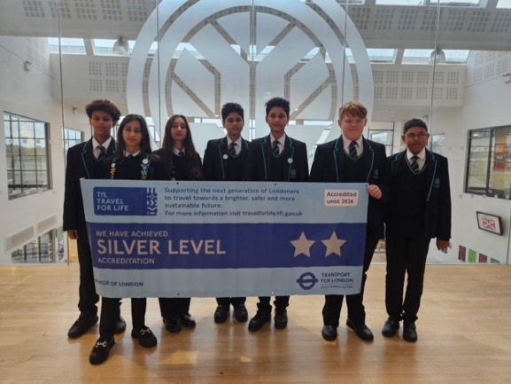
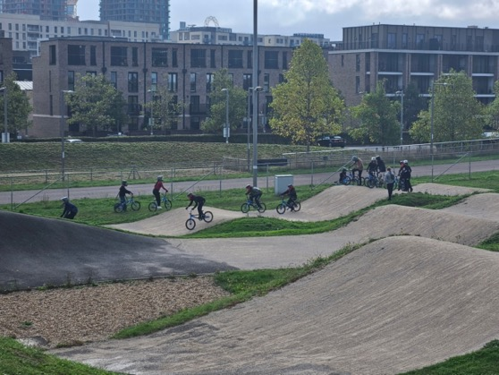
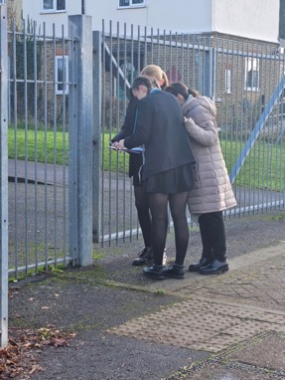
TRIPS:
TFL - BMX (Velodrome)
6th Form Enrichment
Notes:
Sara

Slide 17
Thanks you for listening!

Slide 18
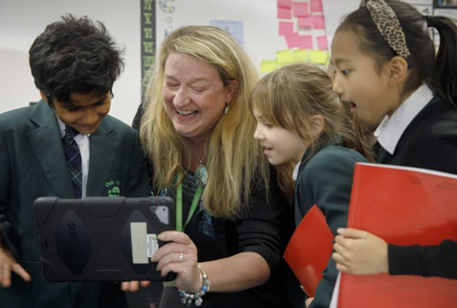
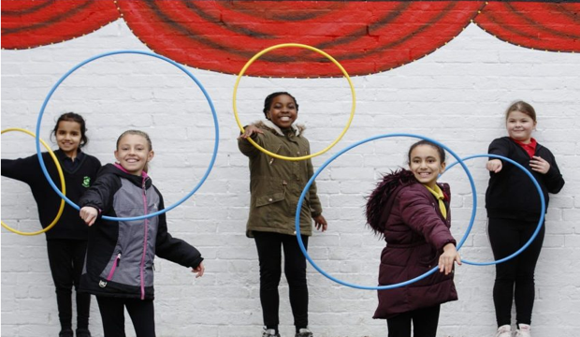
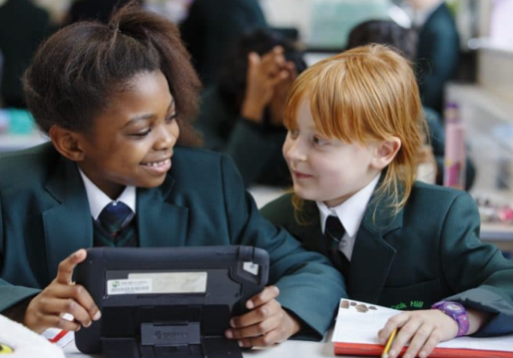
Notes:
Black - Nella
Orange - Gurbej
Blue - Ryan
Purple - Phoebe

Slide 19
All about Oak Hill Academy
Today, we will be telling you about our amazing school ! We will be talking about our school curriculum ,the codes of conduct, our school trips as well as some of the projects that have been keeping us busy…
Made by:Gurbej, Ryan, Phoebe and Nella

Slide 20
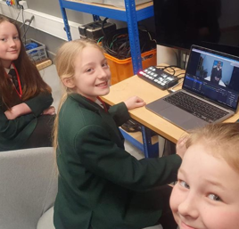
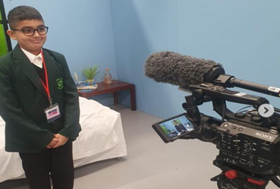
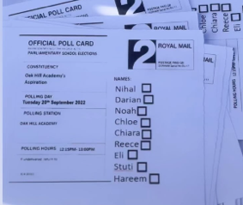
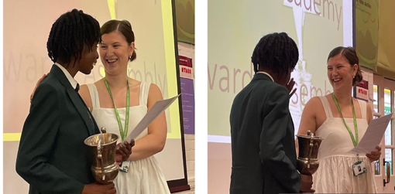
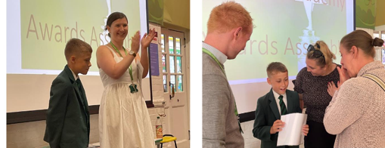
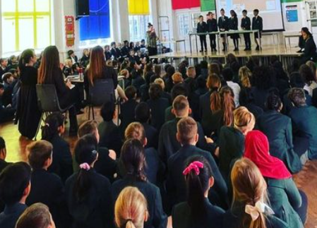
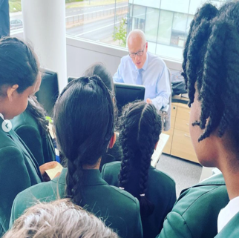
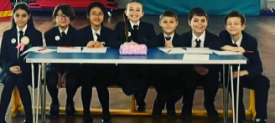
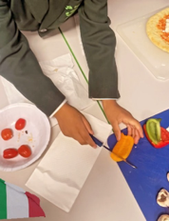
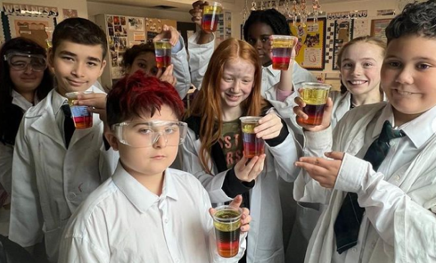
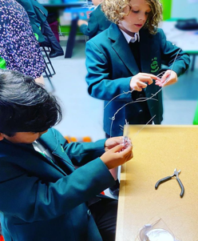
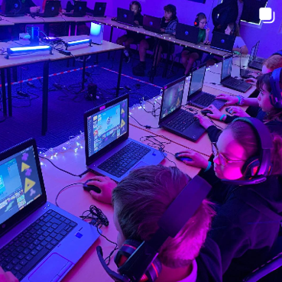
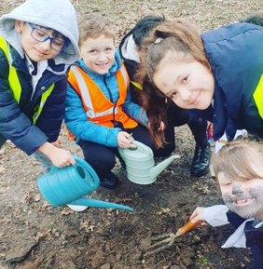
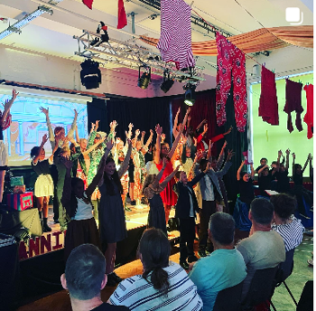
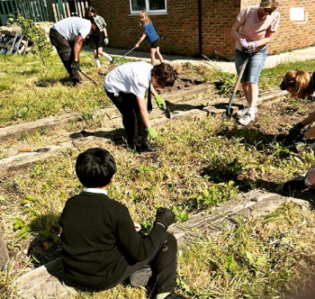
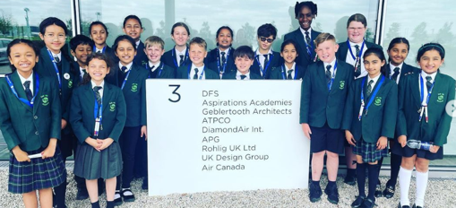
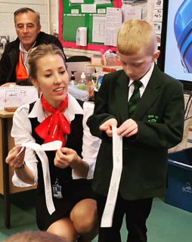
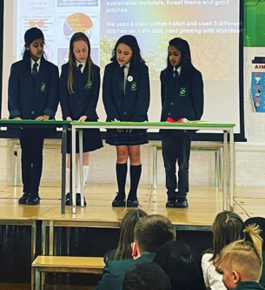
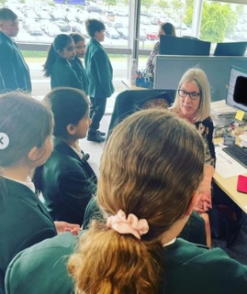
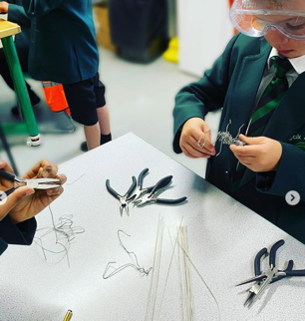
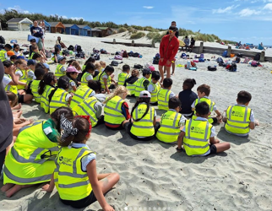
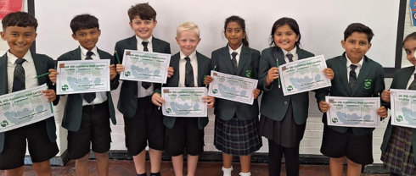
Fantastic
Resilience
Communication
Learning
Family

Slide 21
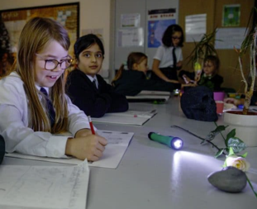
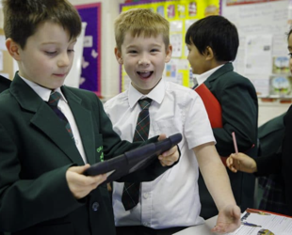
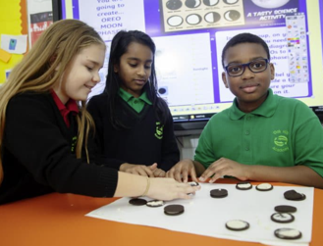
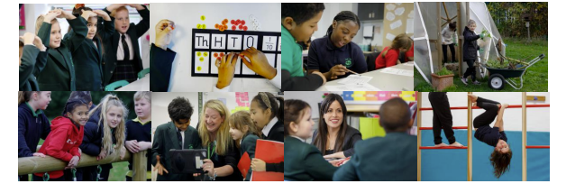
At Oak Hill we become responsible, considerate and resilient members of our society, and become well-equipped for the increasing challenges of life in our 21st century world. All members of our Oak Hill family are valued and respected as individuals and belong to our school community-the Oak Hill family! Our teachers are heroes for us and care about our mental health and wellbeing (as well as our academic progress!). The staff instil in us a sense of purpose, leadership, the ability to problem-solve and to make responsible decisions. Here at school we benefit from a secure and stimulating environment, which promotes independence, self-esteem, health and wellbeing. Fun and excitement and curiosity and creativity are at the heart of all we do! We are nurtured and given opportunities to discover and develop our unique talents, strengths and abilities. We leave Oak Hill with the confidence to embrace new challenges and have a sense of accomplishment and pride in our achievements.

Slide 22
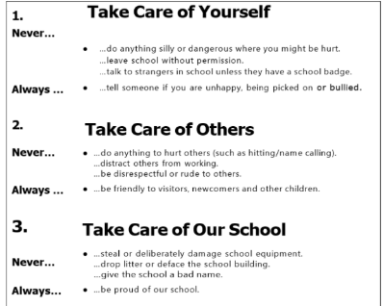
Our Code of Conduct
Take care of yourself.
Always have a positive Attitude.
Take care of others.
Use respective words when
talking.
Take care of the school.
Never give the school a horrible
Reputation and don’t deliberately
Damage school property.

Slide 23
Enrichment
Student Leadership
opportunities
Fun
Aspirations Points
Daily Life at Oak Hill
Wellbeing

Slide 24
Three months ago, we were learning all about space.We wrote a newspaper report about the alien crash-landing.
In our previous term, we were learning about the Vicious Vikings and the Saxon settlers! We learnt about all the conflicts they caused,the weapons they had,what they eat and much more.
This half-term we will be learning about the circle of life(how bugs grow from eggs into their adult forms).Excitingly,we will be growing our own butterflies!
At the start of the year,we were learning about the: Amazon Rainforest, which we learnt about all the species that lived there.

Slide 25
In the Ring of Fire, we learn about volcanoes,how they form and how they explode!
Although we only started The Heart Of It All, we (year sixes) are excited to start learning about the human body!
During the Old Toy Shop,Year 6 students made an amazing narrative based on a magical toy!
While we were in Britain at War,we learnt morse code and made an air raid warning!

Slide 26
Hook Days
We have hook days to engage more in lessons. This is an example: There was an alien crash-landing, which had occurred on one ordinary day while we were doing maths.
.

Slide 27
Our School Trips!
Throughout the year, our pupils have been on a lot of school trips! In Year 3 you go to Butts Farm and they also go to the beach. In Year 4 you go to Harry Potter World. .In Year 5 you go to the Living Rainforest and they go to a Planetarium. Finally in Year 6 you go to the Natural History Museum , Thorpe Park and PGL!

Slide 28
The Power Of Pupils- our first project!
Applying our British Value of ‘Democracy’, in September, Oak Hill Parliament begins! Candidates put themselves forward for roles such as Prime Minister and Deputy, and deliver persuasive speeches in front of the school (outlining their vision for Oak Hill). Then, all members of the Oak Hill Family vote for their favourite! The results are counted and then Prime Minister and Deputies are appointed. For every year group, we also appoint Ambassadors for:
-Curriculum and Learning -Health and Fitness -Community and Events -Technology -Environment
The Parliament members, our Oak Hill Ambassadors, are very important and help with the running of the school. They plan and organise competitions; they help at break and lunch; they share pupil voice with the staff; they give ideas about how to make Oak Hill even better; they support the local community…the list goes on! We also have the platform for all pupils to develop and showcase their leadership skills with regular opportunities to become an ‘Aspirations Volunteer’.

Slide 29
Project 1- The Oak Hill Parliament and Ambassadors
The ambassadors we have are: The extra ambassadors are::
Prime Minister, Personal Best are incharge of the PE equipment.
Deputy Prime Minister, Reading Ambassadors who help around the school with reading.
Curriculum and Learning,
Technology,
Health and Fitness,
Community and Events,
Environment,
Here are some of the badges we have!

Slide 30
The Power Of Pupils- our first project!
-Curriculum and Learning (Pupil Voice- getting our pupils’ to discuss their No Limits Assignment, what they enjoy and what changes they would like to see)
-Health and Fitness (Personal Best children organise activities at lunch time)
-Community and Events (helping to organise event such as charity days)
-Technology (looking after IT equipment around the school, promoting E-Safety- Computing Club)
-Environment (litter picking and Gardening Club)

Slide 31
Enrichment Opportunities @ OHA
Project 2!
The Aspiration Parliament helped to organise the Winter Wonderland Party we organised just before half term
Christmas
Decoration Competition

Slide 32
Enrichment Opportunities @ OHA
Project 2!
What’s coming up this half term?
During World Book Week, we have a ‘500 word’ competition
Easter Egg Decoration Competition
Aspirations Ambassadors trip to Parliament

Slide 33
What’s next for Student Leadership
@ OHA?
Anti-Bullying Ambassadors
From this half term, we will be re-introducing our Anti-bullying Ambassadors and give them further training out on the playground to help support children with their issues at break/lunch and to help children build positive relationships with each other.

Slide 34
Please ask us any questions!

Slide 35
Student weekly
Rivers Academy West London
Founded 2024/2025

Slide 36
What we will discuss today
What is student weekly?
What is in our newsletter?
How do you find out about events happening in your school?
Do you have a school news letter?
What events are happen inside our school?
How do student council implicate their own thoughts and ideas?
What is the importance?
How does a newsletter help students?
Why do you need one?

Slide 37
What is student weekly?
Student weekly is Rivers Academy’s newsletter. It gets sent out each week to all the students in the academy.
It informs students about events, competitions, achievements and other student activities.

Slide 38
Sports aspects
In our weekly newsletter we have
many extra-curricular activities and sports notices for students. This includes any sports fixtures coming up and different clubs during the week.
There are also many inter-house competition notices and the faculty winners.

Slide 39
Student voice/ how we help
Student leaders contribute to student weekly by electing teacher of the week during our meetings.
During these meetings, students come together to discuss what to display on student weekly and other topics regarding our school and its students.

Slide 40
How is the newsletter helpful?
Student weekly is very helpful for all students and even teachers in the academy. It helps students stay informed about extracurricular opportunities, meetings and social events
Additionally, newsletters can highlight student achievements, promote resources, and provide tips for school, which creates a sense of belonging and support among students. .

Slide 41
Why is student weekly important?
A student weekly newsletter is important because it helps keep students informed and organised by providing timely updates on upcoming events, deadlines, and important news
It serves as a reliable source of information that students can refer to regularly, ensuring they don't miss out on opportunities or important announcements.

Slide 42
Thank you

Slide 43
SPACE STUDIO WEST LONDON

Slide 44
Our team
Year 10
Year 12
Maurya
Mihnea
Jasmine
Kayla
Alicia
Year 11
Inayat
Year 13
Zeynah
Enzo

Slide 45
About Space Studio
Space Studio West London offers a unique and innovative way of learning for students aged between 14 to 18.
Studio Schools pioneer a bold new approach to learning, which includes teaching through projects and real work. This approach ensures that students’ learning is rooted in the real world and helps develop the skills they need to succeed in life.
The 8 conditions-
Belonging
Heroes
Sense of accomplishment
Fun & Excitement
Curiosity & Creativity
Spirit of adventure
Leadership & Responsibility
Confidence to take action

Slide 46
Our Events

Slide 47
Halloween

Slide 48
Valentine’s Day

Slide 49
Careers Day

Slide 50
Teacher Cuddle Therapy

Slide 51
School Newsletter

Slide 52
Formative Feedback Form

Slide 53
Thank you for your time

Slide 54
PURPOSE

Slide 55
How are you even here today?

Slide 56
1:400,000,000,000,000

Slide 57
There is something more about you

Slide 58
“What you do for yourself does with you when you leave this world, what you do for others lives on forever.”

Slide 59
Purpose
The object toward which one strives or for which something exists; an aim or goal

Slide 60
Purpose
The object toward which one strives or for which something exists; an aim or goal

Slide 61
Purpose
What drives you to go to school?

Slide 62
Purpose
1 in 5 children regularly miss school
Why do so many children not want to go to school?
Make a list of all the reasons why you think children miss school

Slide 63
Purpose
1 in 5 children regularly miss school
What can we do to reverse this trend?
Next to each of your ideas, suggest at least one thing (there may be a few) that we could do to help

Slide 64
Purpose
1 in 5 children regularly miss school

Slide 65
Purpose
1 in 5 children regularly miss school

Slide 66
TRUST LEADERS
If you want to go fast, go alone, if you want to go far, go together”
2025

Slide 67
Purpose
Where and how can you express ideas?
How are you held accountable for what happens in your classroom and around your school?
Are you ever involved in any decisions?
How is your voice heard?
How are you encouraged to make links with the community?

Slide 68
Purpose
Where are you taught about mental health and wellbeing?
How are achievements celebrated and recognised?
Does your school have high expectations? How do you know?
Where is independent thinking encouraged?
How do you know that your teachers believe in you?
What leadership opportunities do you have?

Slide 69
Where and how can you express ideas?
How are you encouraged to make links with the community?
How are you held accountable for what happens in your classroom and around your school?
Leadership & Responsibility
How is your voice heard?
Are you ever involved in any decisions?

Slide 70
What leadership opportunities do you have?
Where are you taught about mental health and wellbeing?
How do you know that your teachers believe in you?
Confidence to Take Action
How are achievements celebrated and recognised?
Where is independent thinking encouraged?
Does your school have high expectations? How do you know?

Slide 71
Your Survey Results
Identify 3 statements that you think need working on for the next 12 months
Boys/Girls
Year Groups
Trends
issues raised at School Council

Slide 72
Student Voice Survey 25/26
Have a good look at your results
Select three statements that you think you need to work on this year
Arrange a meeting with your Principal/teacher in charge of School Council
Explain why you think you should choose these statements
Decide on two statements for 2025/26

Slide 73
Trust Student Voice Survey 25/26
Primary
Have a good look at the Trust results for Primary and Secondary
Select three statements that you think we need to work on as a Trust this year
Mr David will select the most ‘popular’ statement
The Trust Council will meet online to discuss what we can do to improve the result.

Slide 74
Trust Student Voice Survey 25/26
Secondary
Have a good look at the Trust results for Primary and Secondary
Select three statements that you think we need to work on as a Trust this year
Mr David will select the most ‘popular’ statement
The Trust Council will meet online to discuss what we can do to improve the result.

Slide 75
THANK YOU
If you want to go fast, go alone, if you want to go far, go together”

