Slide 1


The Dynamics of Student
Voice & Aspirations
Voice & Vision:
Using Data to Guide Implementation
of the Aspirations Framework
Session#4 May 5, 2022
Dr. Russ Quaglia & Dr. Lisa Lande

Slide 2
Fundamental Beliefs
Students are the potential, not the problem.
Students have something to teach us.
Working with students is the only way forward.

Slide 3
Goals for Today
Gain a deeper understanding of the
the Aspirations Framework (3 Guiding
Principles & 8 Conditions).
Consider how Student Voice Data
supports implementation of the
Aspirations Framework.
Apply learning to amplify student
voice in YOUR school.

Slide 4

Quick Review

Slide 5

The 3 Components of Student Voice
Sharing thoughts & ideas in an environment underpinned by trust and respect.
Offering realistic suggestions for the
good of the whole.
Accepting responsibility for not only what you say but what needs to be done.

Slide 6
ASPIRATIONS
The ability to
dream and set goals
for the future,
while being inspired
in the present
to reach those dreams.

Slide 7




high
Imagination
Aspirations
DREAMING
Hibernation
Perspiration
low
DOING
high

Slide 8
LEAD
TAKE ACTION
with others
Share
RESPONSIBILITY
LEARN
UNDERSTAND
& RESPECT
different points
of view
Build
TRUST
LISTEN
SEEK OUT
opinions from
others
Student Voice Process

Slide 9


Reflect
What has most stuck with
you from our previous
Voice & Aspirations
learning?

Slide 10

Time to journey
onward & explore the Aspirations
Framework

Slide 11

The Aspirations Framework
Resource #1
Aspirations
Framework
Brief
Aspirations Profile: Dreaming & Doing
3 Guiding Principles
8 Conditions
The Voices of Students, Teachers &
Leadership in deciding
concrete application

Slide 12



3 Guiding Principles
Self-Worth
Resource #2
3 Guiding Principles
Brief
Engagement
Purpose

Slide 13








8 Conditions
Self-Worth
Engagement
Purpose
Resource #3
8 Conditions
Brief

Slide 14

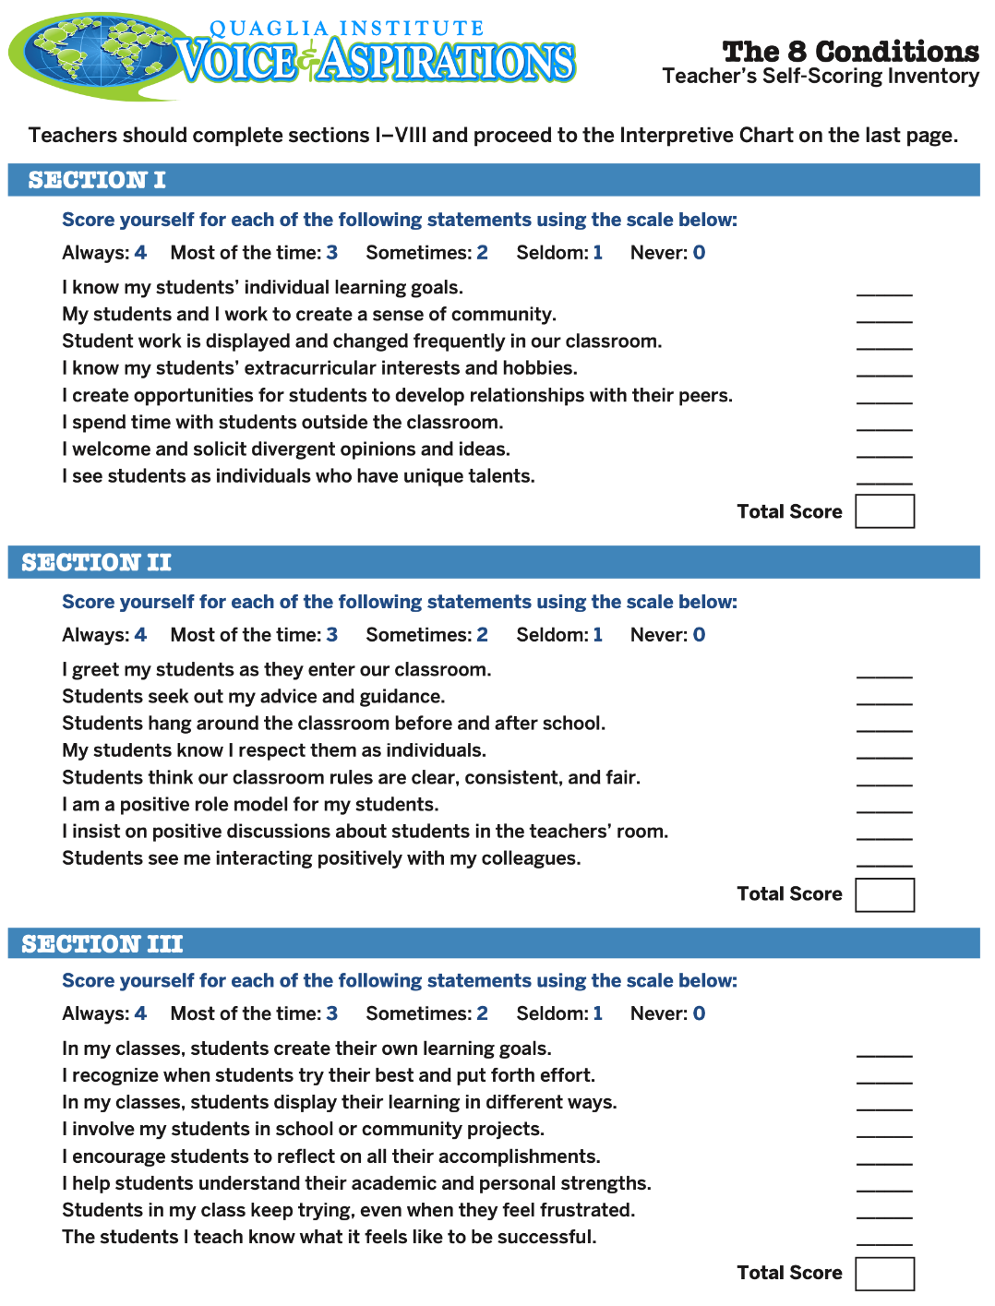
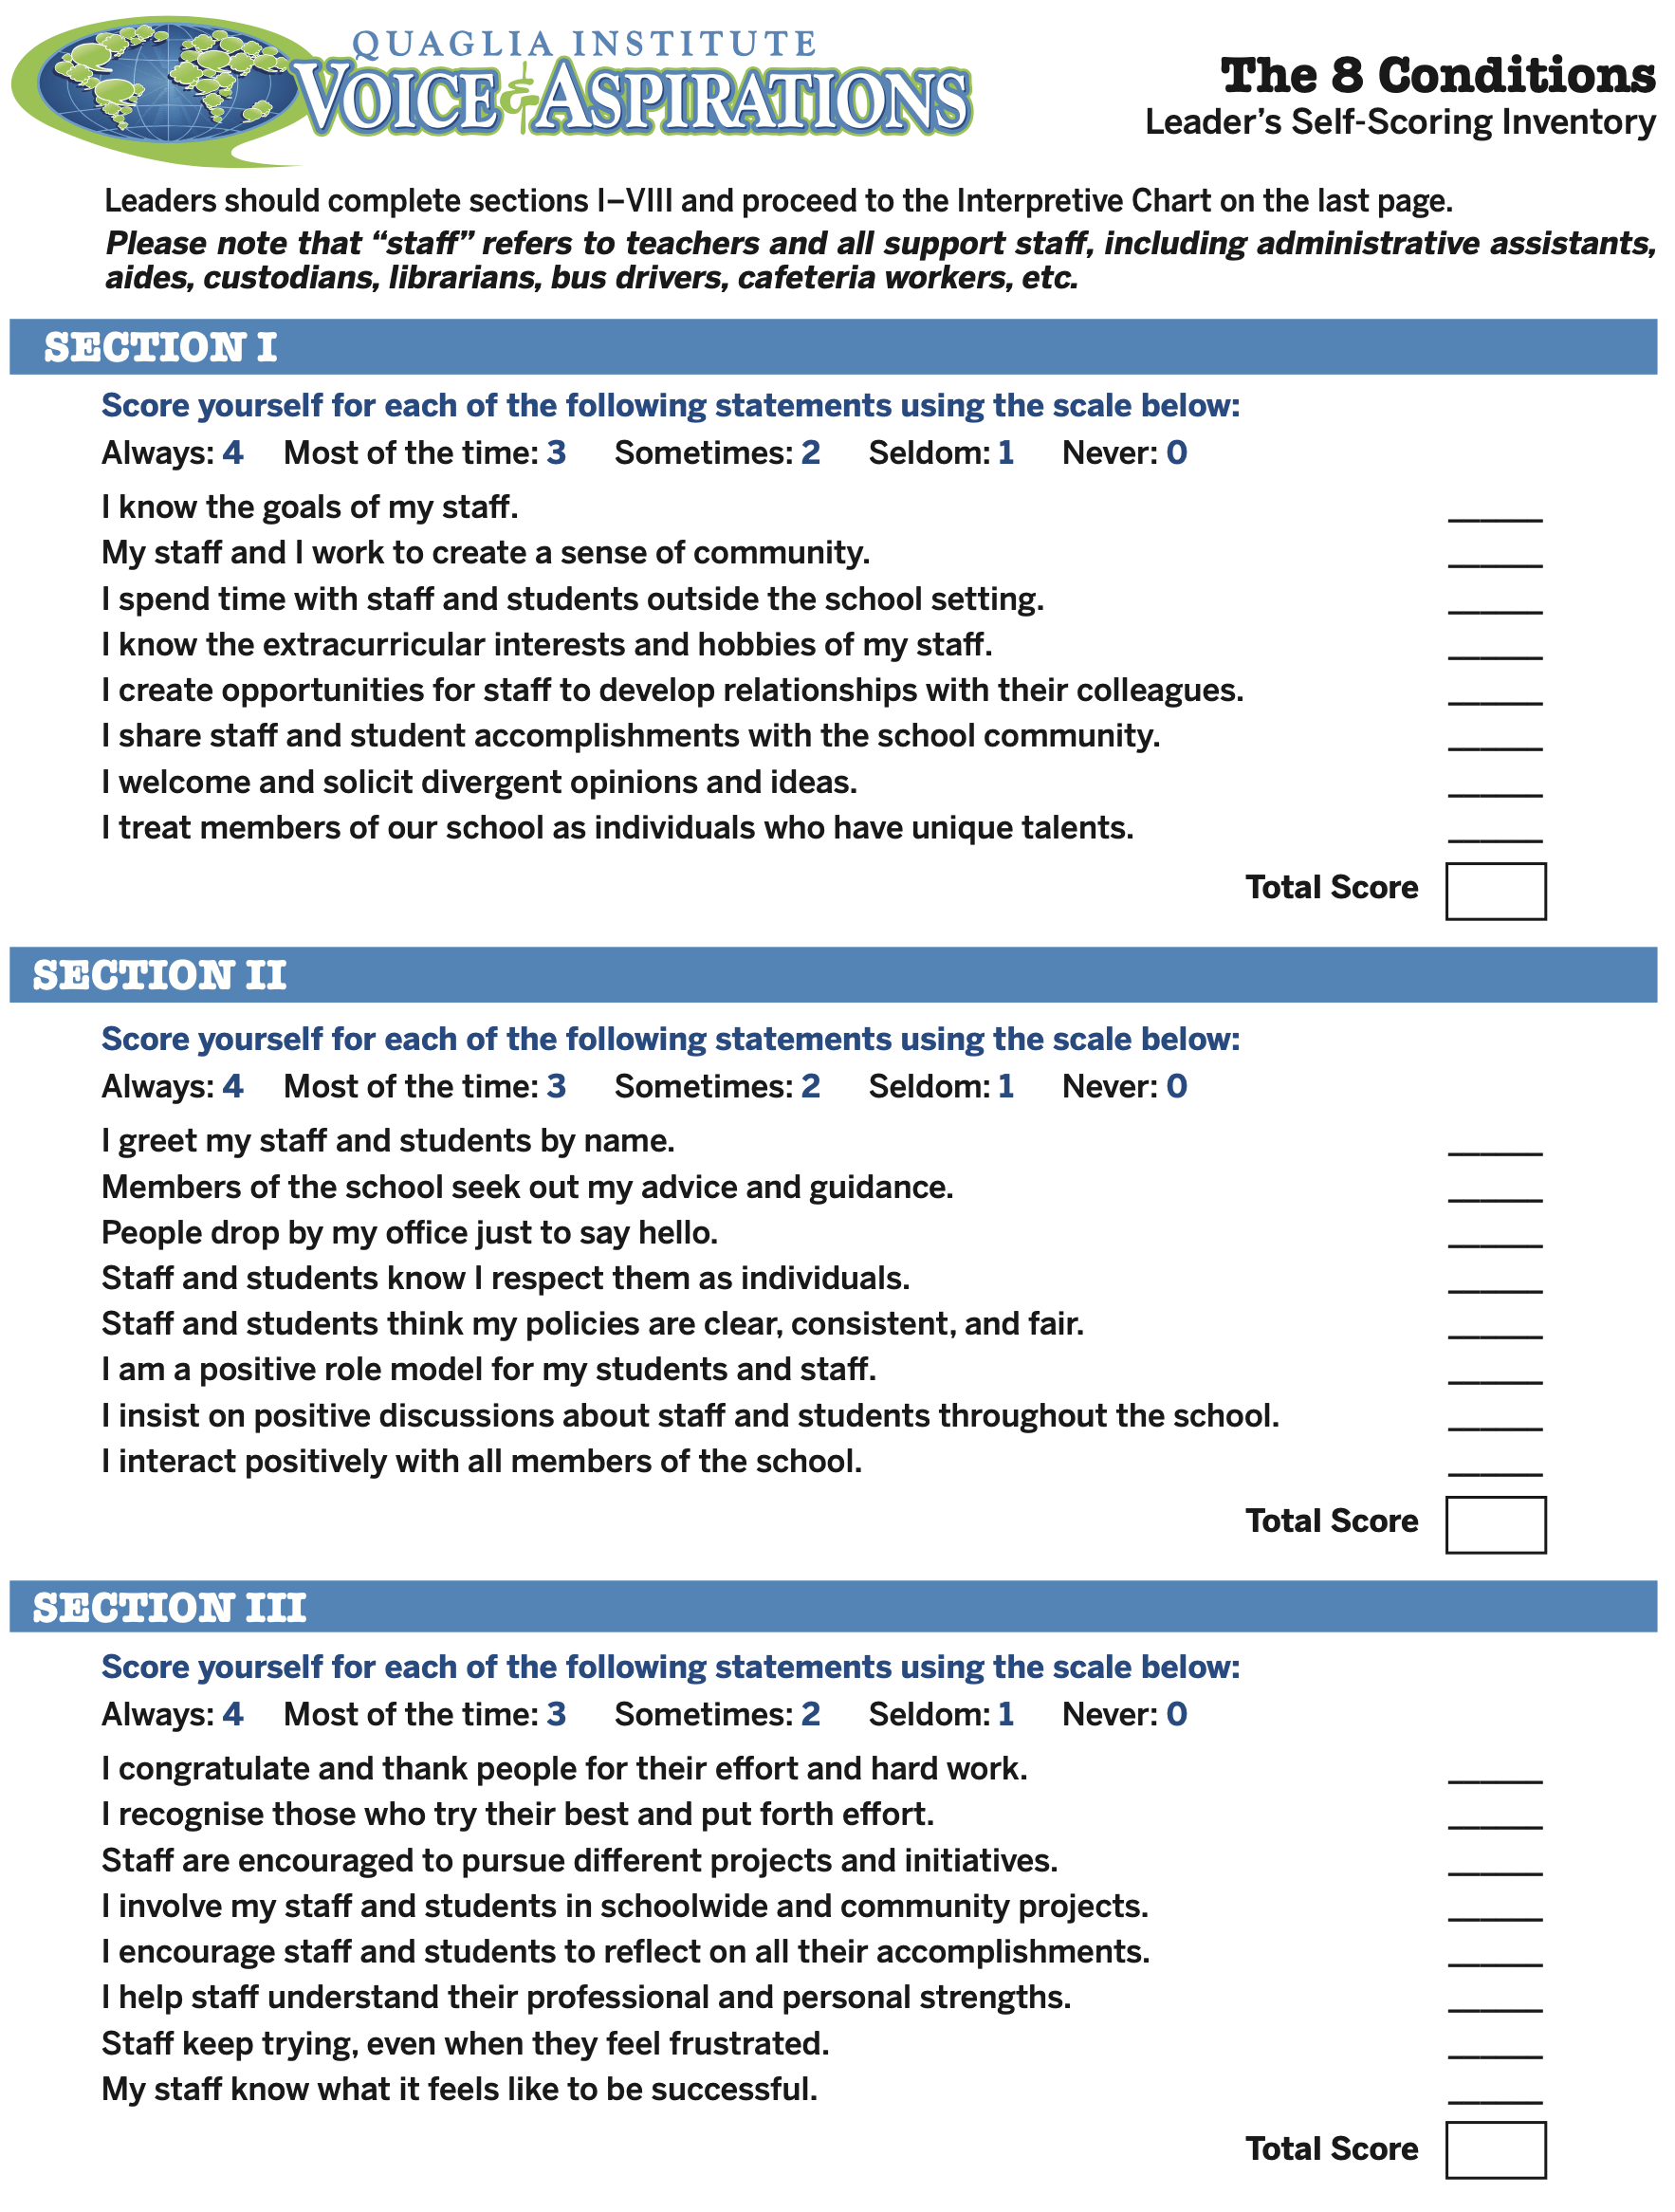
What did you learn from completing the
8 Conditions Inventory?
Resource #4
Teacher
8 Conditions Inventory
Resource #5
Administrator
8 Conditions Inventory

Slide 15

Challenge Time…

Slide 16
8 Conditions
Speed Hiring
Resource #6
8 Conditions
Speed Hiring
Congratulations! You just received funding to open up one of the following
positions at your school.
Select which position you want to add at
your school & write 1 awesome interview
question for potential candidates.

Slide 17
Belonging Facilitator
Assistant Principal of Heroes
Sense of Accomplishment Manager
Leader of Fun & Excitement
Curiosity & Creativity Coordinator
Spirit of Adventure Supervisor
Director of Leadership & Responsibility
Confidence to Take Action Developer

Slide 18
8 Conditions
Speed Hiring
Now…
Conduct 1 minute interviews!
(In your breakout you will be the
interviewer for one round, & then the
candidate for one round.)

Slide 19
Reflect
Why did you select the position you
picked to add to your school?
If YOU were to apply for one of these
positions, which job would you want?
How will you embrace the essence of that position even without the official title?

Slide 20
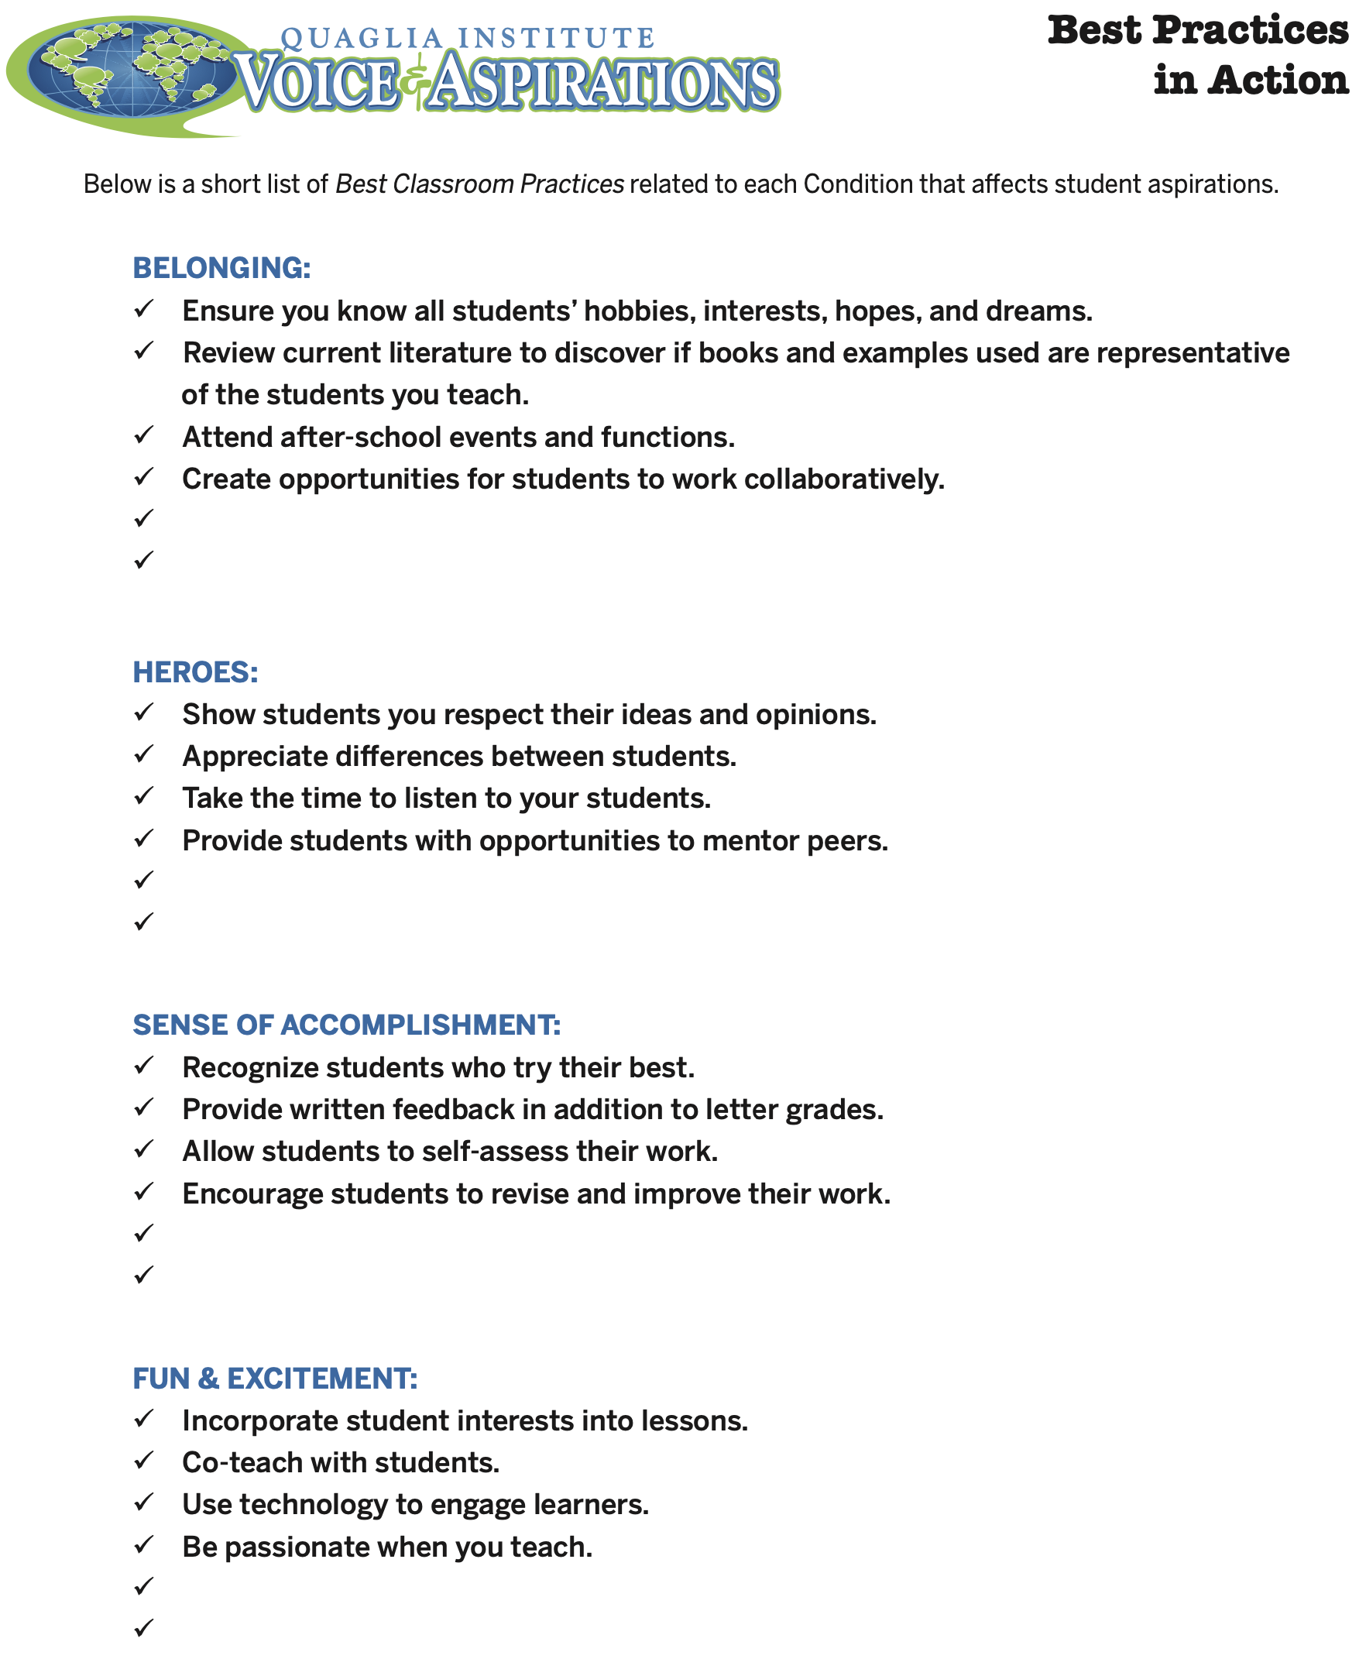
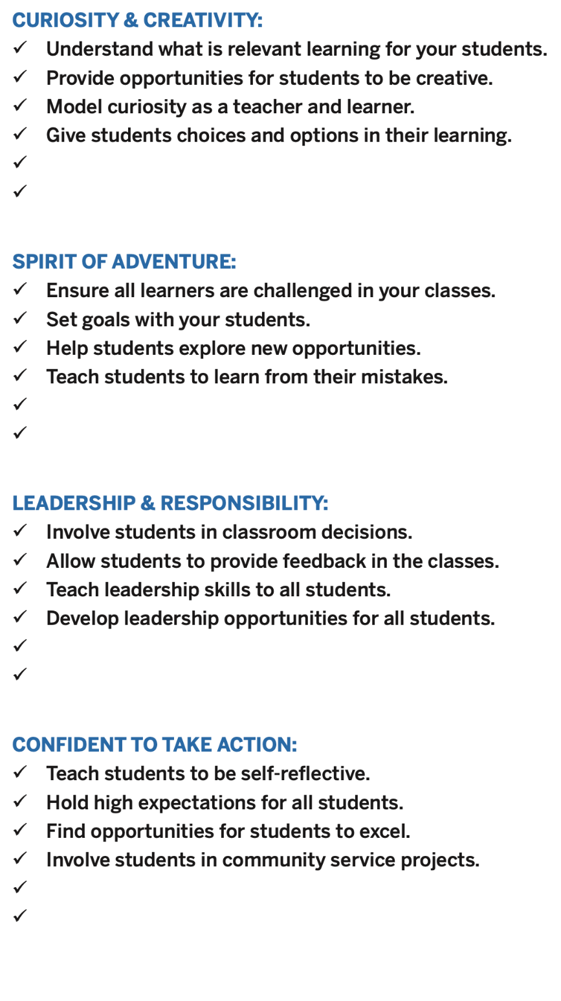
Resource #7
8 Conditions
Best Practices
in Action
What practices are you already doing?
Which practices are you willing to try?
Add a best practice for each of the 8 Conditions

Slide 21

Quick Break!

Slide 22
The Aspirations Framework
Aspirations Profile: Dreaming & Doing
3 Guiding Principles
8 Conditions
The Voices of Students, Teachers
& Leader in deciding
concrete application

Slide 23

Student Voice Data
Love it or Leave it?
Thumbs Up
Thumbs Down
Thumbs Neutral

Slide 24
Viewpoint #1

Slide 25

Viewpoint #2

Slide 26
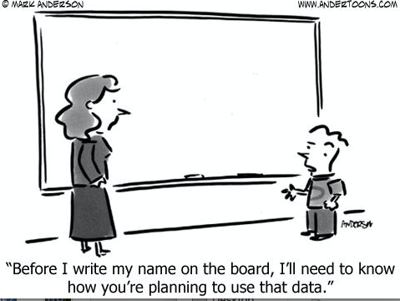
Viewpoint #3

Slide 27
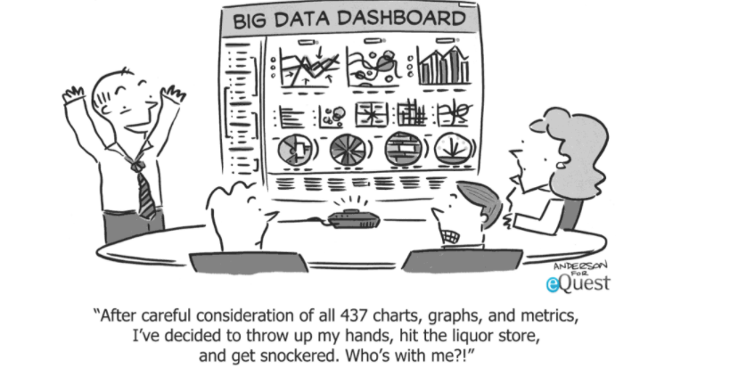
Viewpoint #4

Slide 28
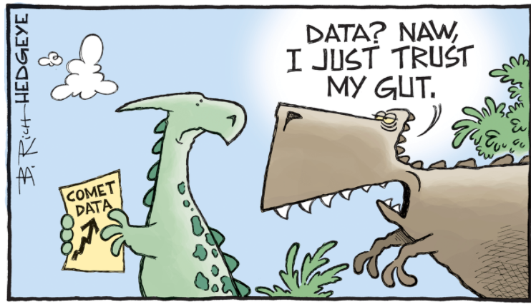
Viewpoint #5

Slide 29
Reflect
What student voice data does your school currently collect, & how is it used?
How are students involved in data
discussions & action planning?

Slide 30

When looking at Student Voice
feedback keep in mind …
Perceptions
Numbers
Comparisons

Slide 31

1. Perceptions

Slide 32
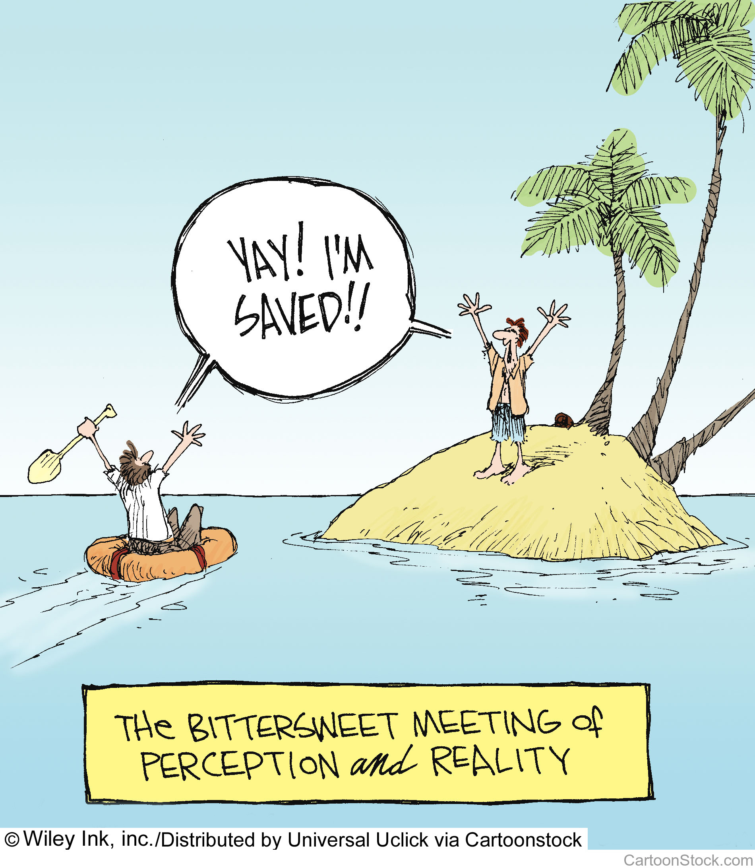

Slide 33

Perceptions
Perception is reality to the beholder
Withhold personal judgement
Don’t jump to solutions
Dialogue is needed to further understand perceptions from multiple perspectives
(Listen, Learn, Lead!)

Slide 34
Reflect
What is the difference between
perception & reality?
How “valid” is student
perception data in your school?

Slide 35
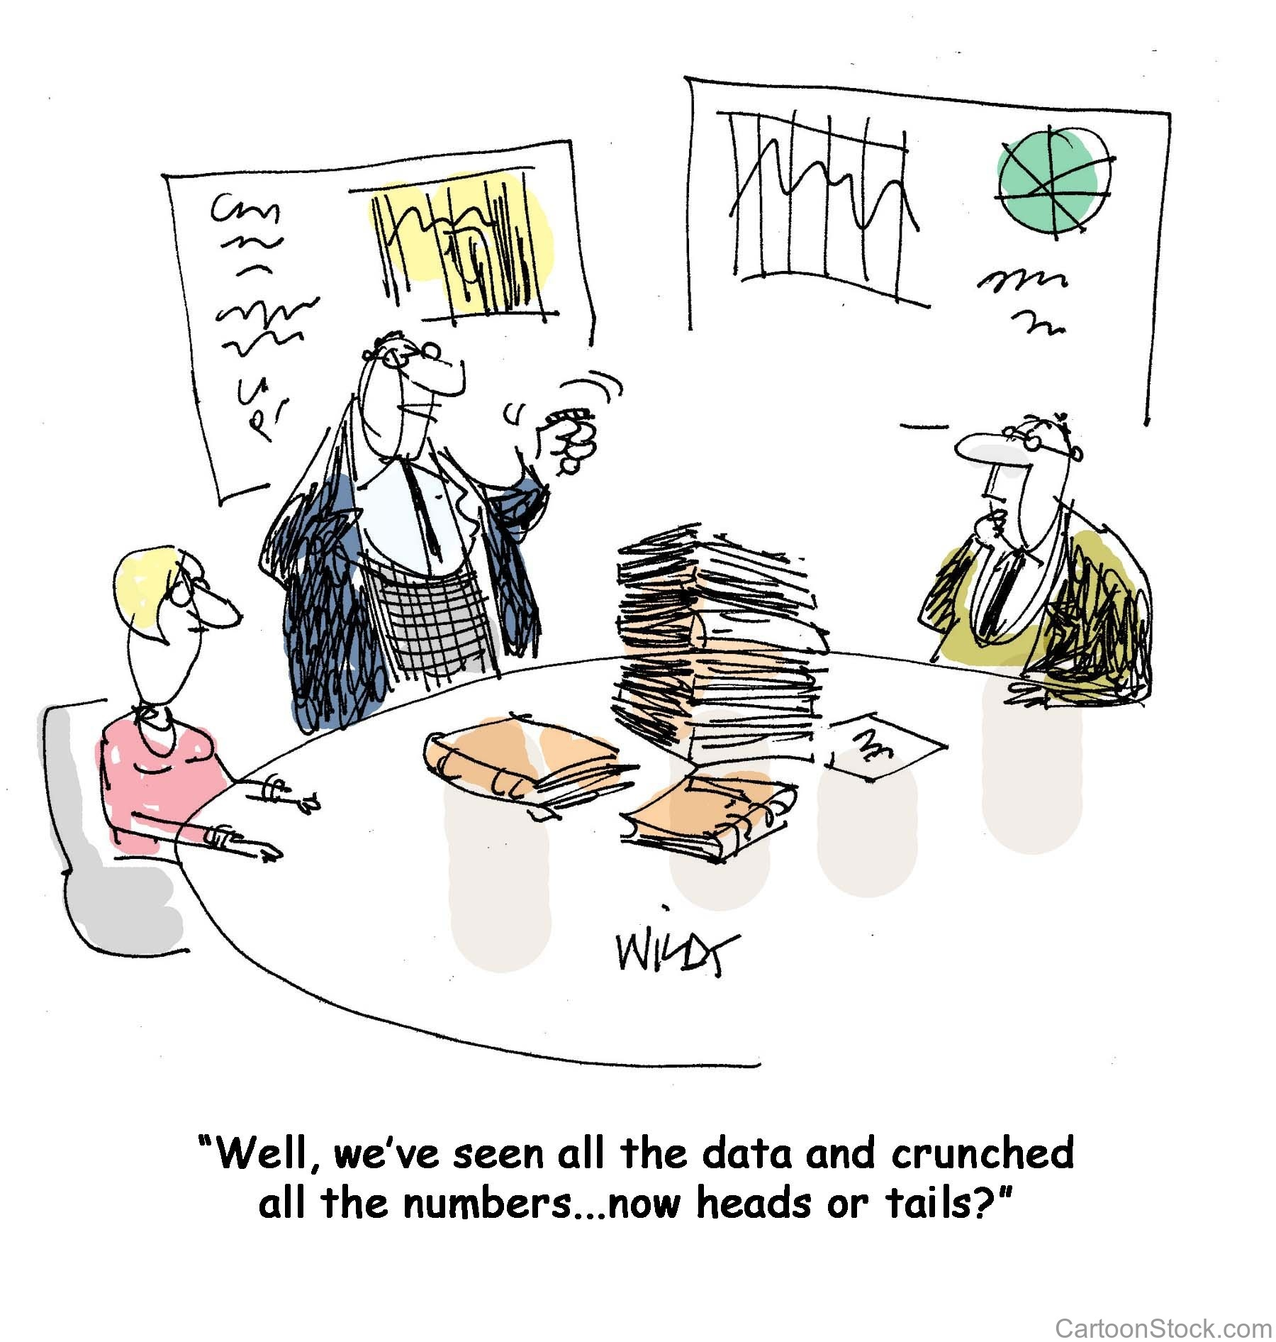
2. Numbers

Slide 36
Challenge Time…

Slide 37

You manage an individual that
FAILS 50% of the time.
What should you do?
1. Fire them.
2. Try to coach them to be better.
3. “Counsel” them out & suggest they try a new career.
4. Pay them whatever they want so they never leave the organization.

Slide 38
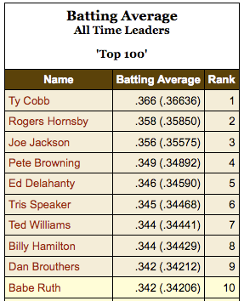
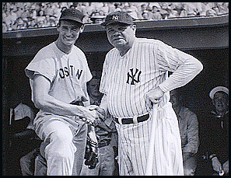

Slide 39
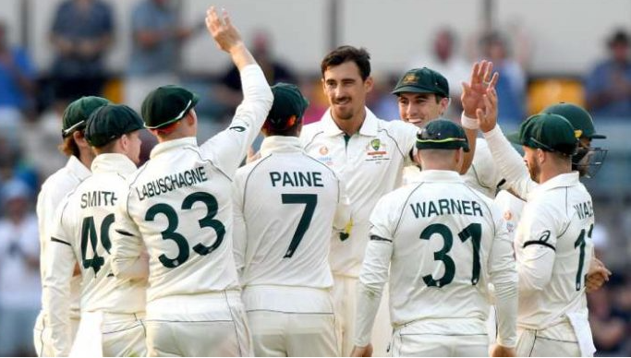
Ground | Matches | RPO
Adelaide Oval | 79 | 3.09
Bellerive Oval | 13 | 3.21
Brisbane Cricket Ground | 63 | 3.15
Melbourne Cricket Ground | 113 | 2.91
Perth Stadium | 2 | 2.80
Sydney Cricket Ground | 109 | 2.88
WACA Ground | 44 | 3.32

Slide 40
Is this
number high
or low? Why?
250,000

Slide 41

Video

Slide 42
Numbers
Avoid “spinning” data
Don’t lie
Reality is not the enemy
An invitation to learn more

Slide 43
Reflect
What is your current culture of giving
& receiving feedback?
-teacher to student
-student to teacher
-peer to peer
What hesitations might teachers have
regarding student voice data?

Slide 44

Gathering Student
Feedback
does not mean…
Students are evaluating teachers
Students know more than the teachers
All student feedback must be acted upon
Teachers are doing something wrong
A once a year survey to “check the box” .

Slide 45

Gathering Student
Feedback
does mean…
We are ready to listen & students are
prepared to share
We believe students have something
to teach us
We are willing to learn from students
We plan to take action in partnership
with students

Slide 46
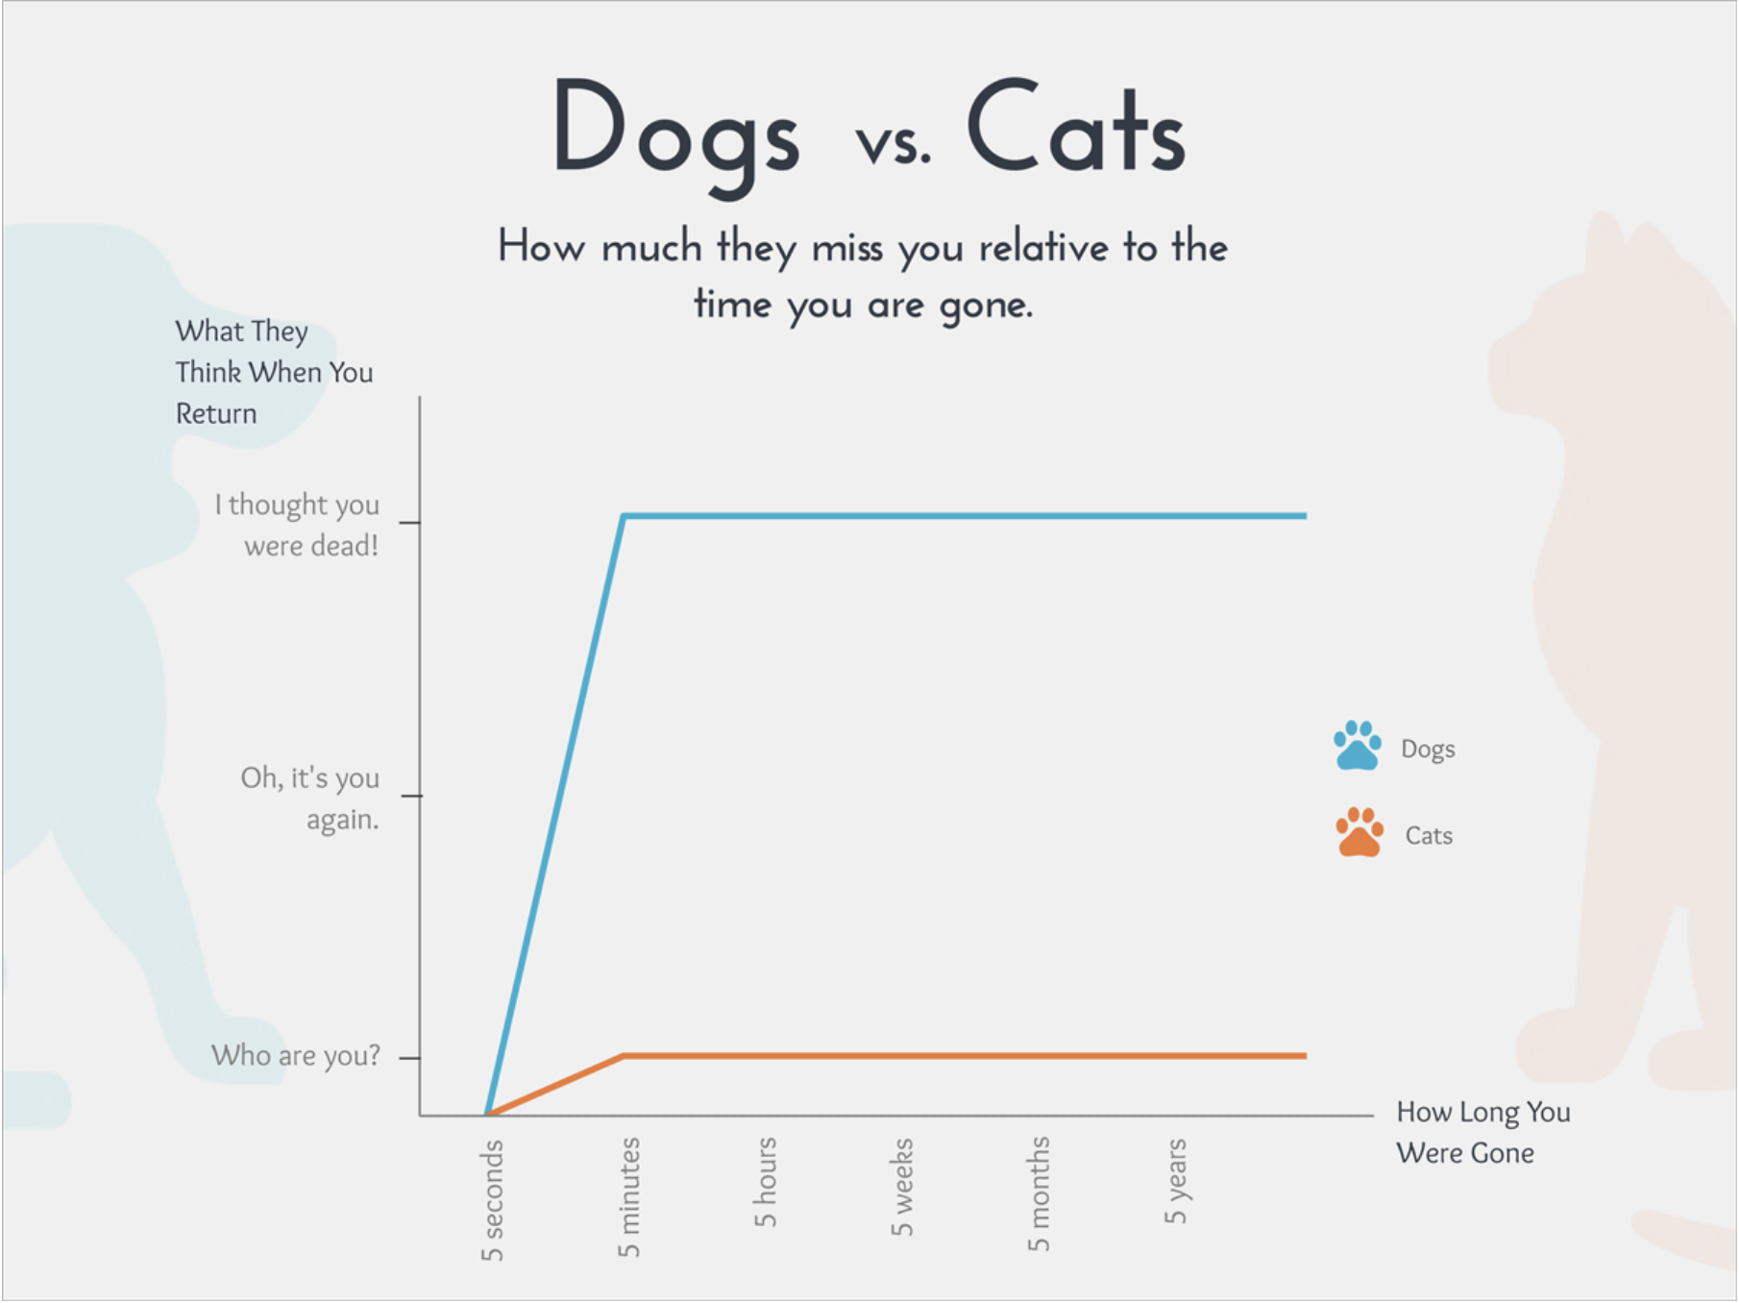
3. Comparison

Slide 47


Slide 48
Comparisons
Compare you to you!
Collect multiple data sources
Focus on growth
Strive for 100%

Slide 49
Quaglia Student Voice Surveys
Focus Groups
Grades PK-2
Voice Instruments
Data Analysis
Activities in
Partnership with
Students
Student Voice Survey
Grades 3-5 & 7-12
iKnow My Class Survey
Grades 3-5 & 7-12

Slide 50
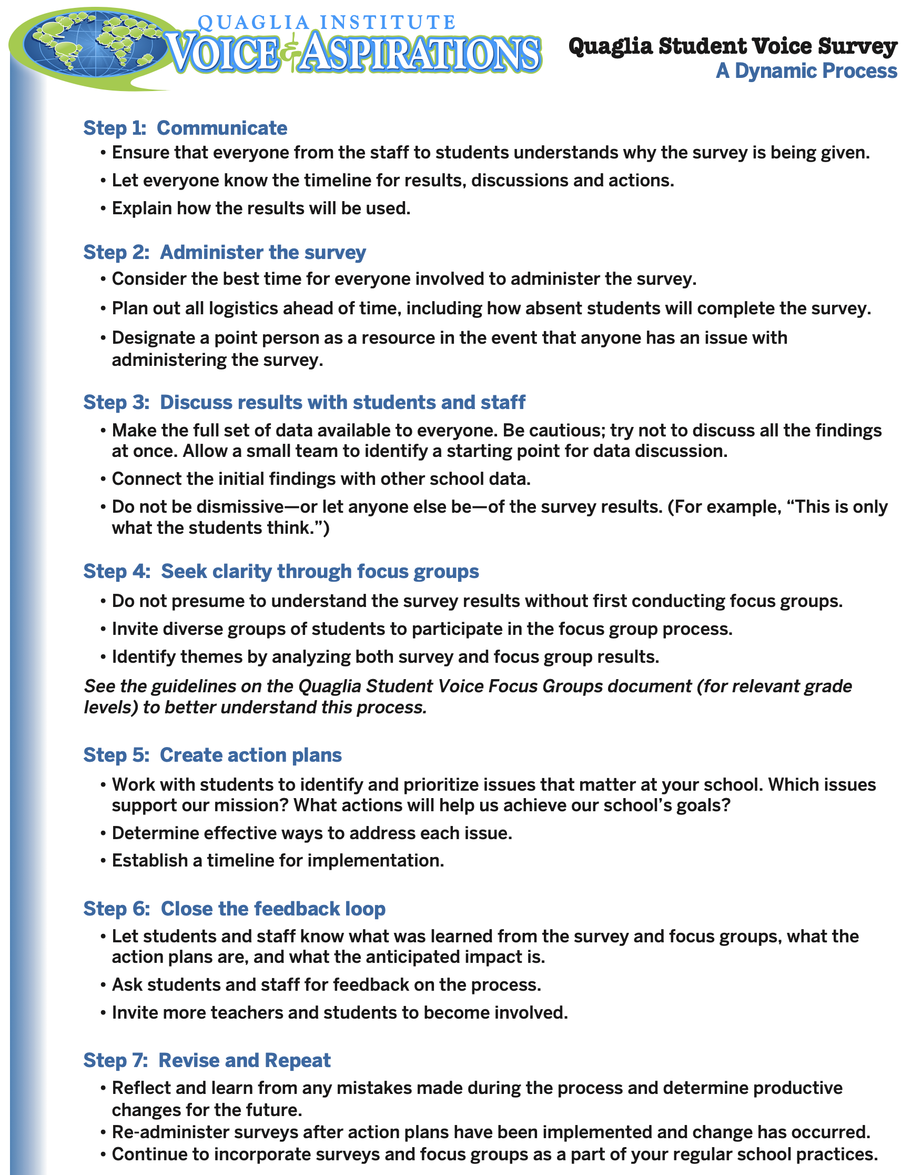
Resource #8
Dynamic Process

Slide 51
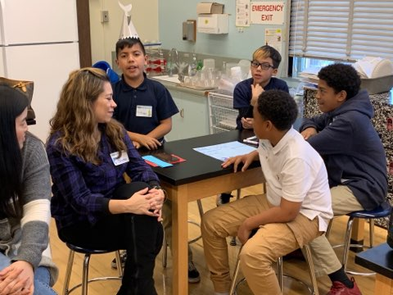
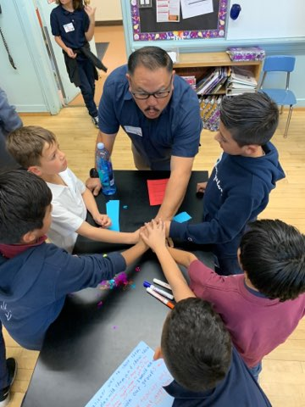
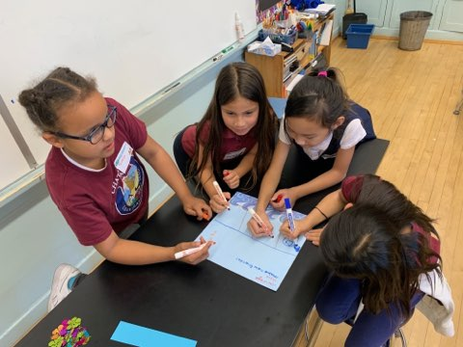
Engage Students in
Analysis & Action
Chatsworth Park Elementary School

Slide 52
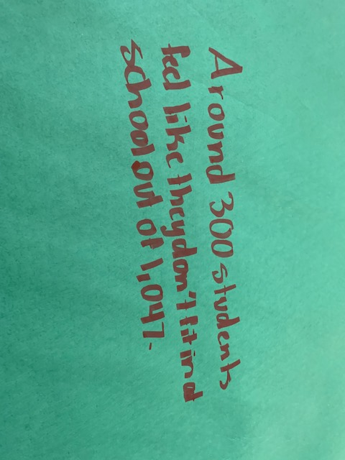
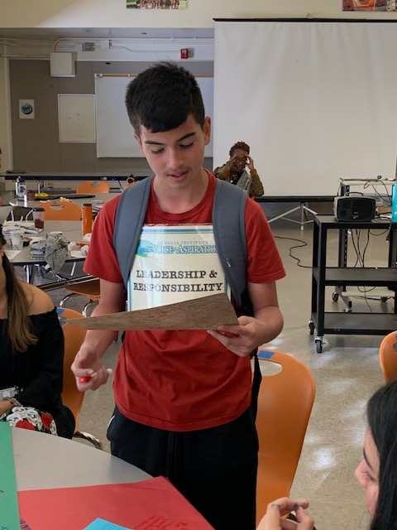
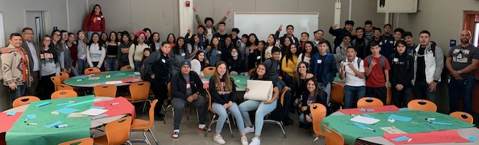
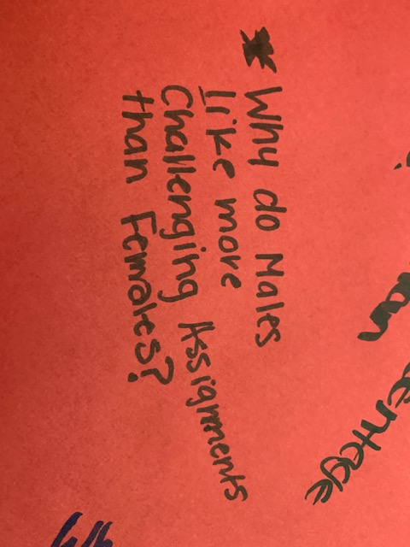
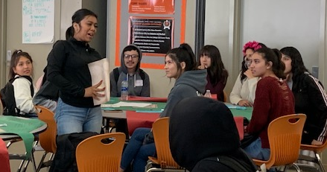
Engage Students in
Analysis & Action
Huntington Park High School

Slide 53

Student Voice Data World Café
Video
Lawrence Middle School

Slide 54
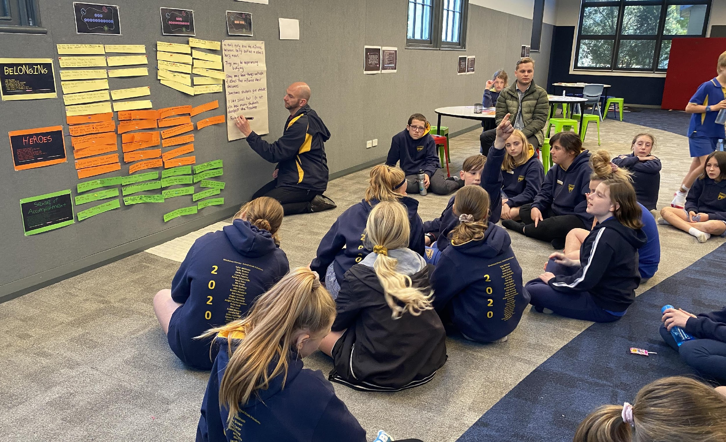
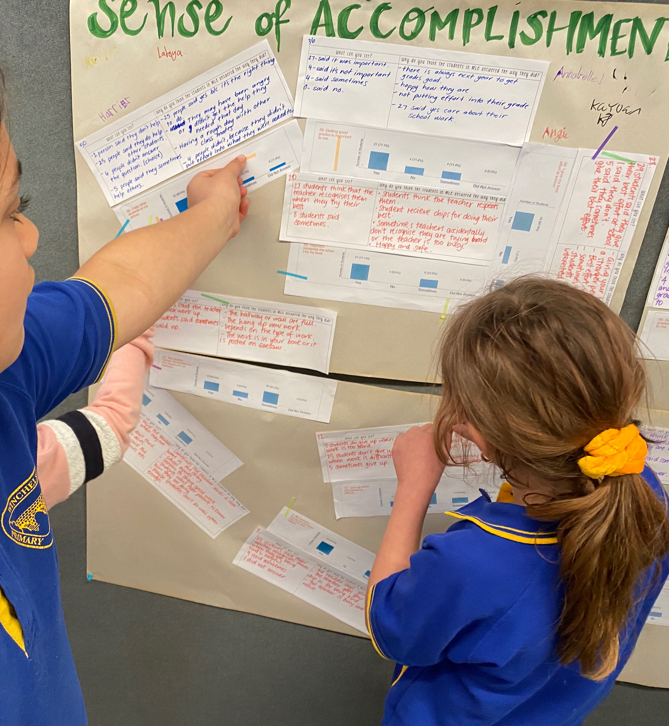
“ This is a starting point – the power in this process is to use what you’ve learned to lead with students and commit to making improvements together.”
Simone, School Leader, VIC

Slide 55

Reflect
How could Student Voice feedback contribute to your school’s
vision & goals?
How will students know they have been heard? How will staff & students USE results in partnership with one another?

Slide 56
The Aspirations Framework
Aspirations Profile: Dreaming & Doing
3 Guiding Principles
8 Conditions
The Voices of Students, Teachers &
Leadership in deciding
concrete application

Slide 57

RESOURCES

Slide 58
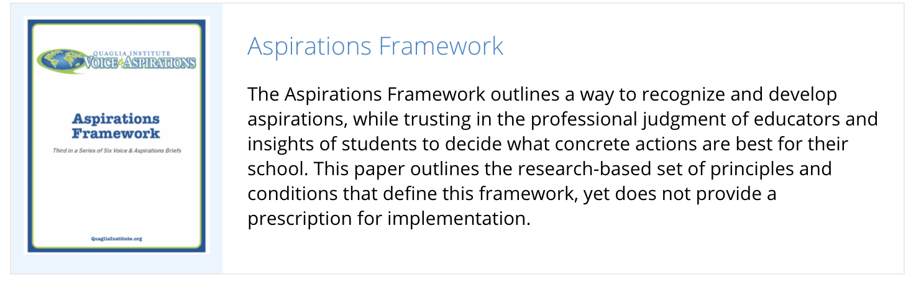
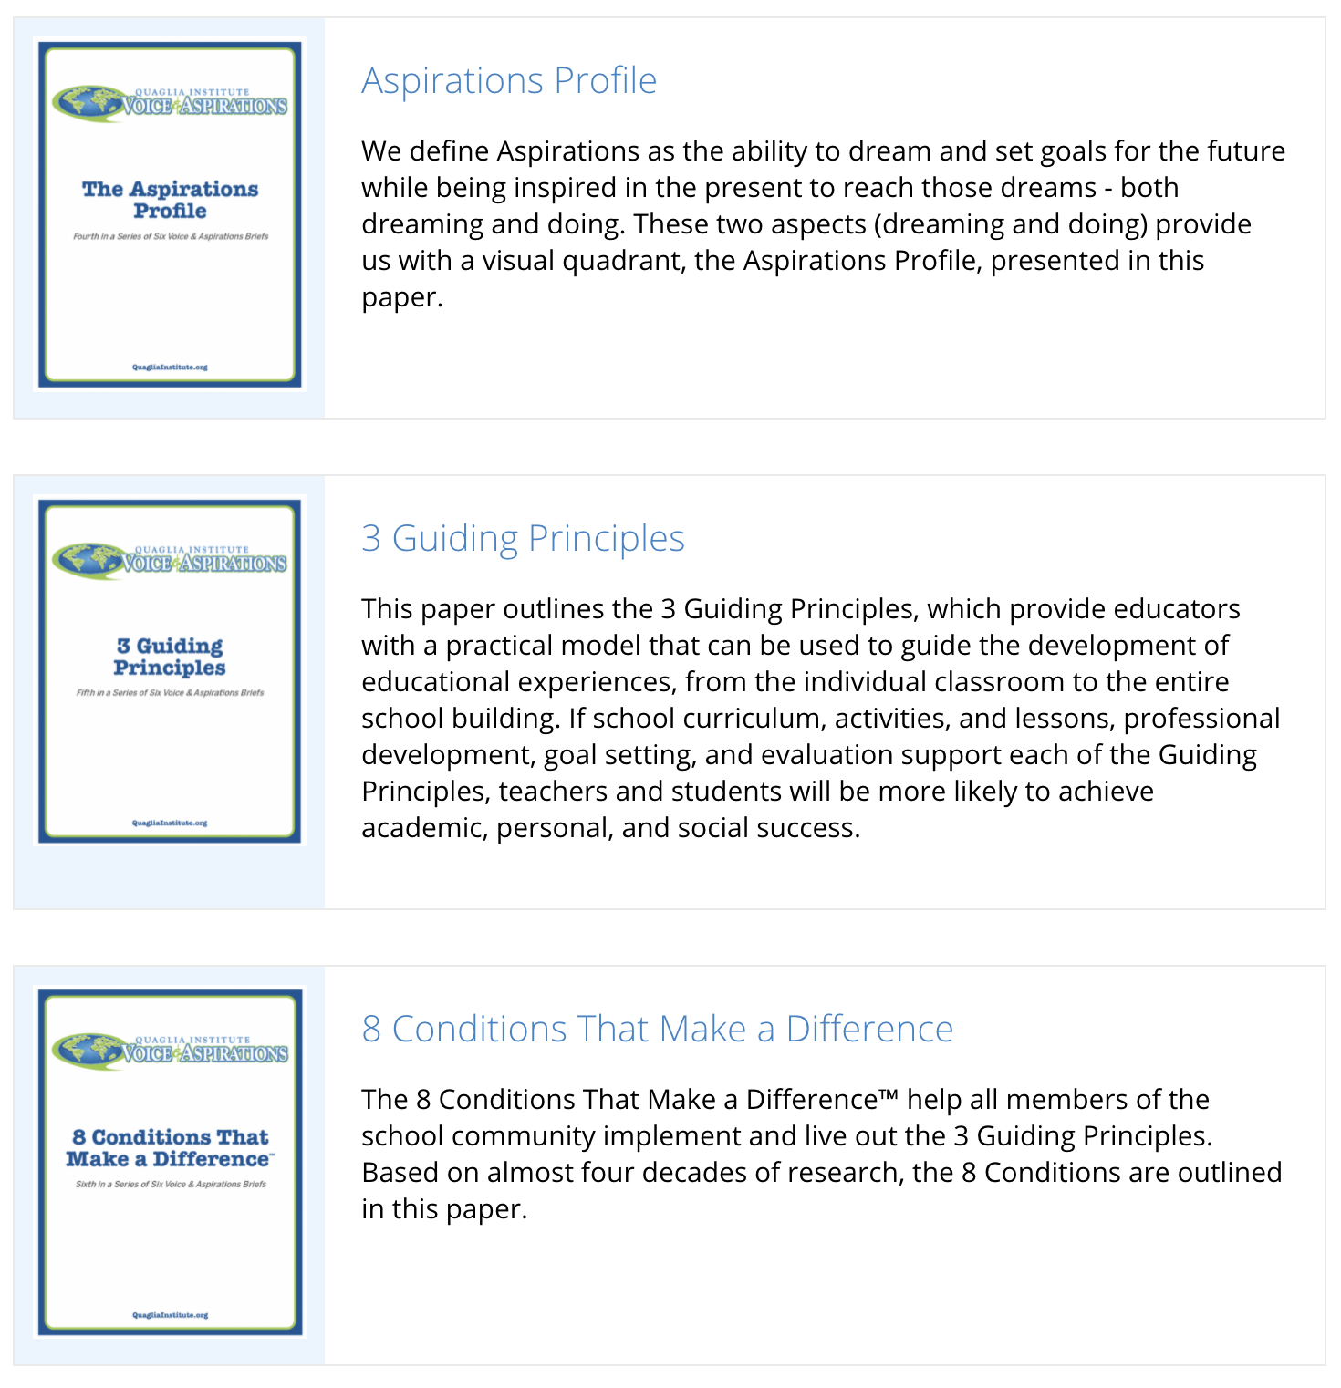
Resource #1
Aspirations
Framework Brief
Resource #2
3 Guiding
Principles Brief
Resource #3
8 Conditions
Brief

Slide 59
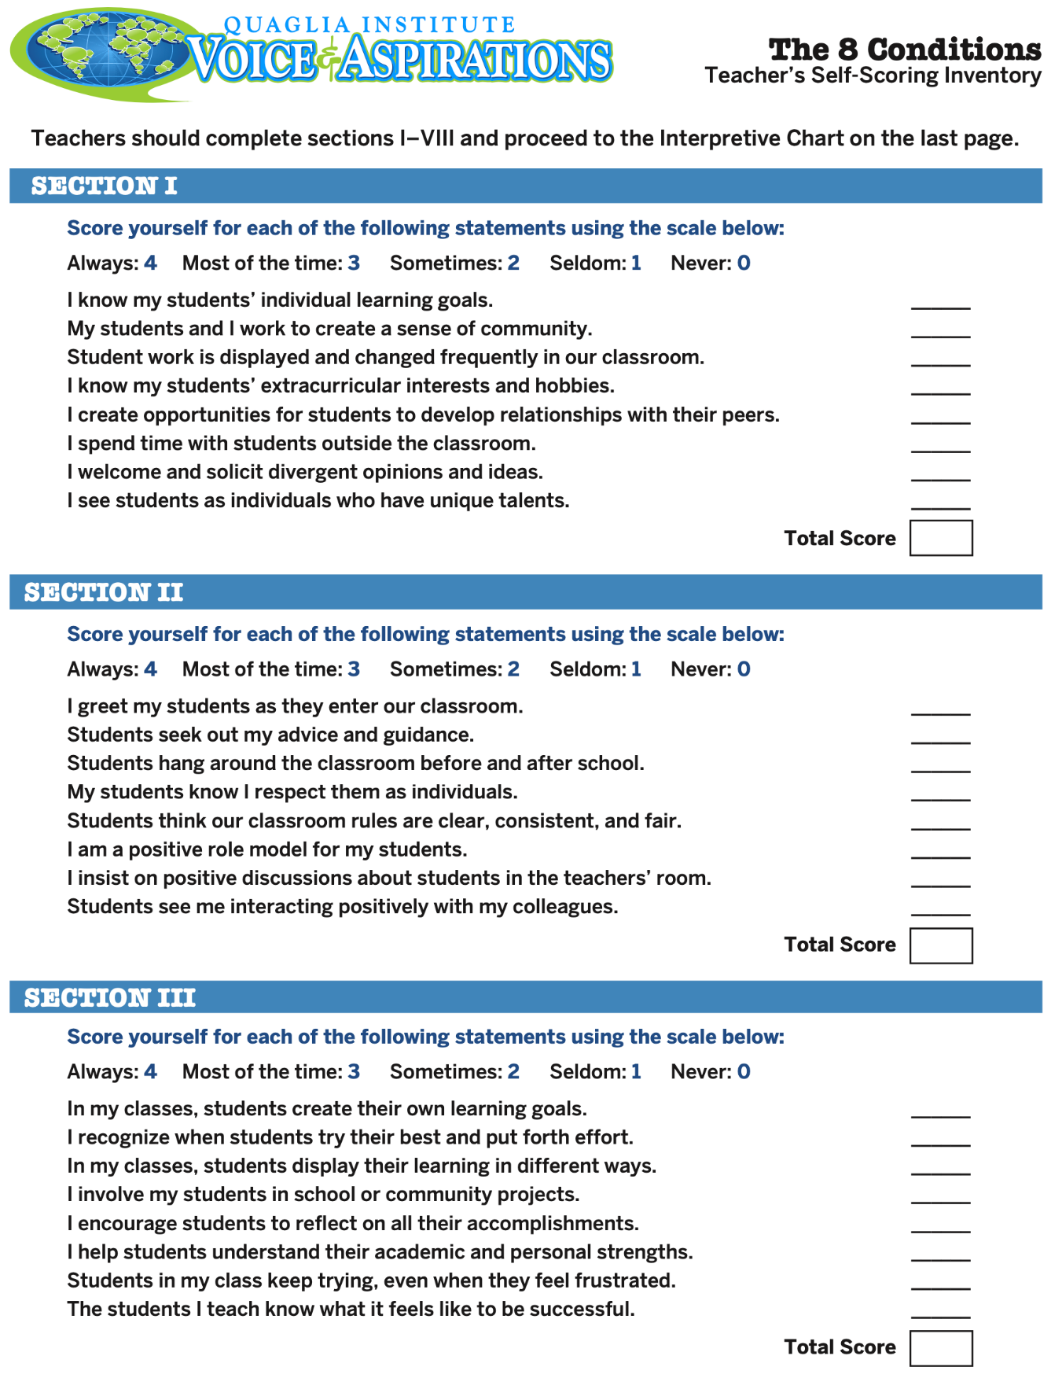
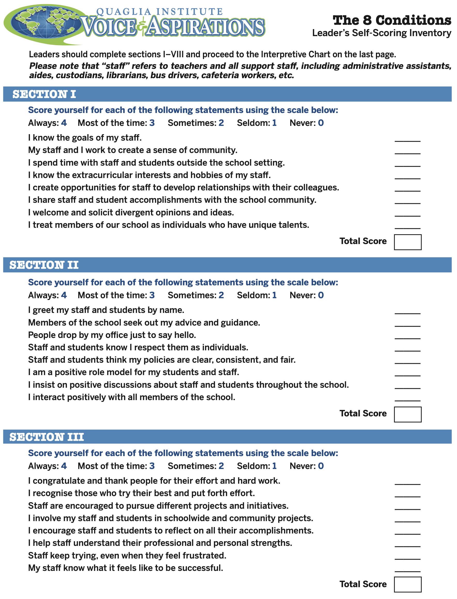
Resource #4
Teacher
8 Conditions Inventory
Resource #5
Leader
8 Conditions Inventory

Slide 60
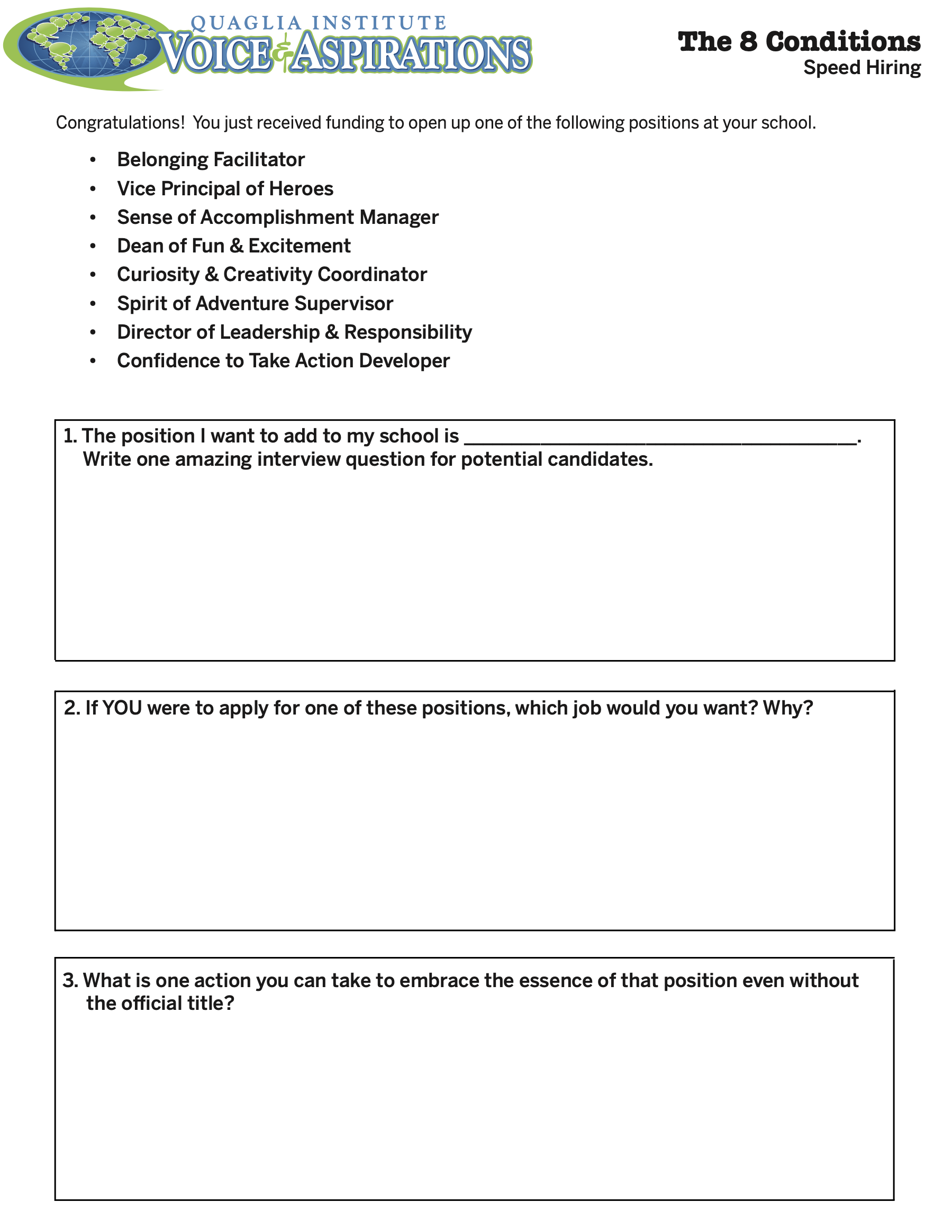
Resource #6
8 Conditions
Speed Hiring

Slide 61

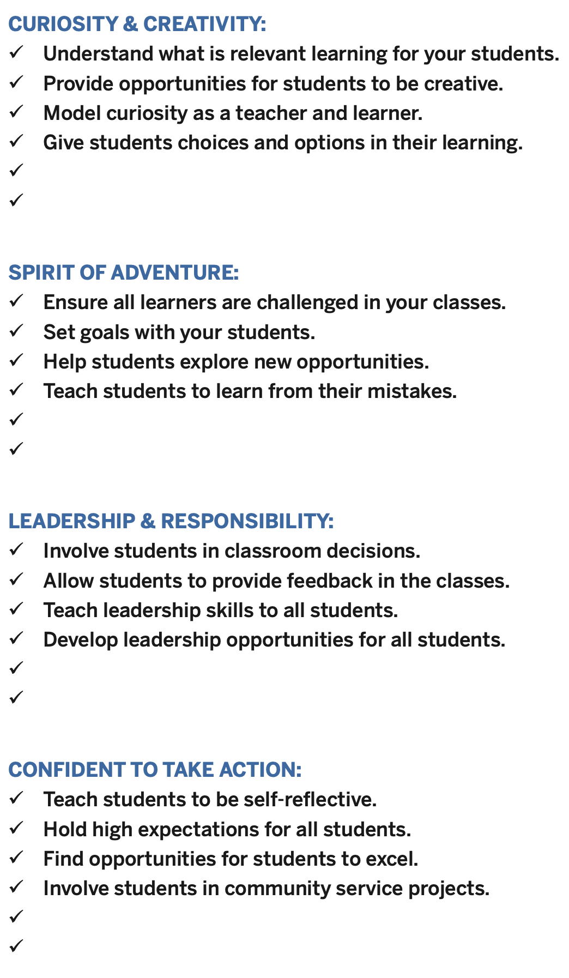
Resource #7
8 Conditions
Best Practices
in Action

Slide 62
Resource #8
Dynamic Process

Slide 63
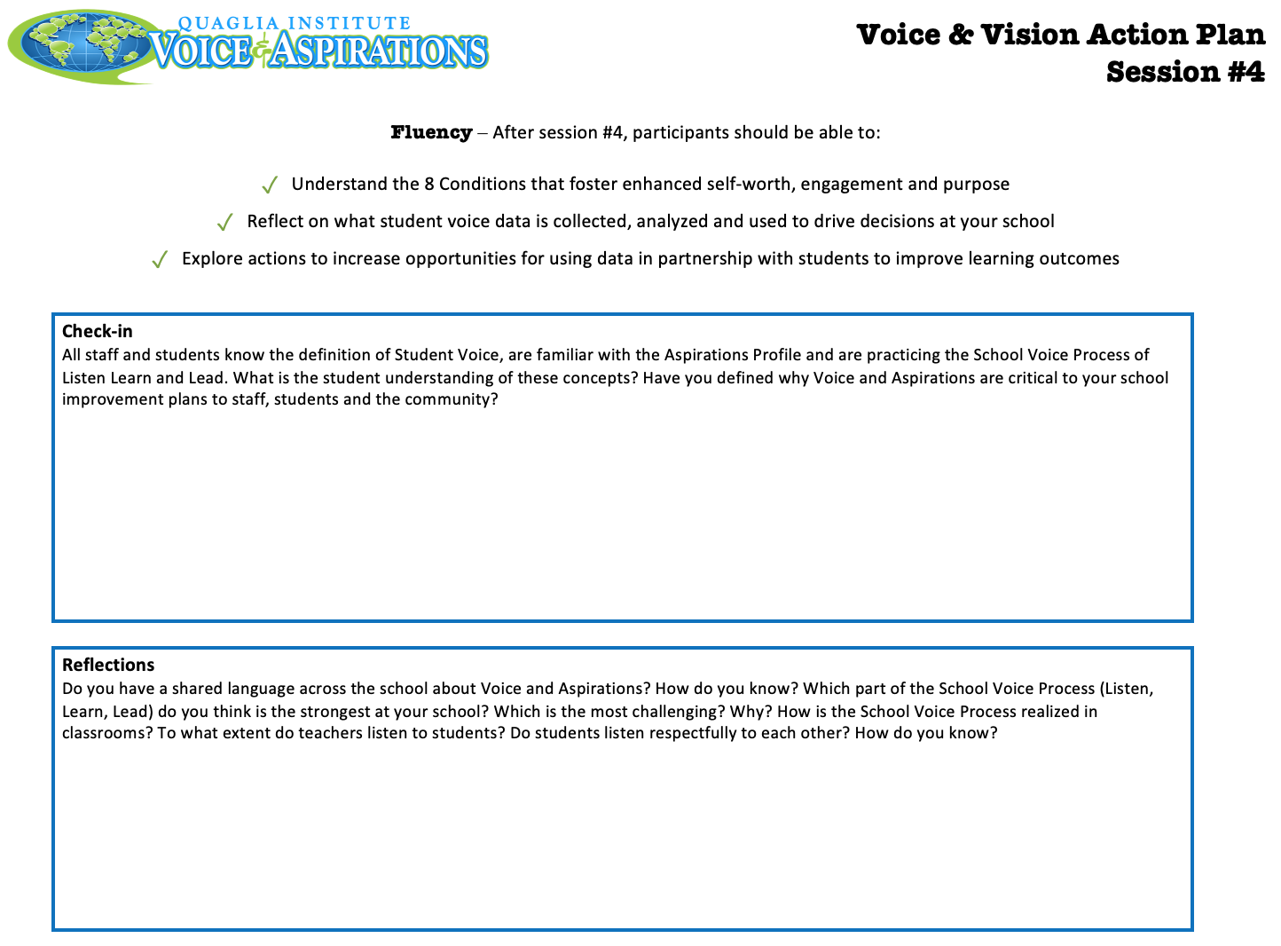
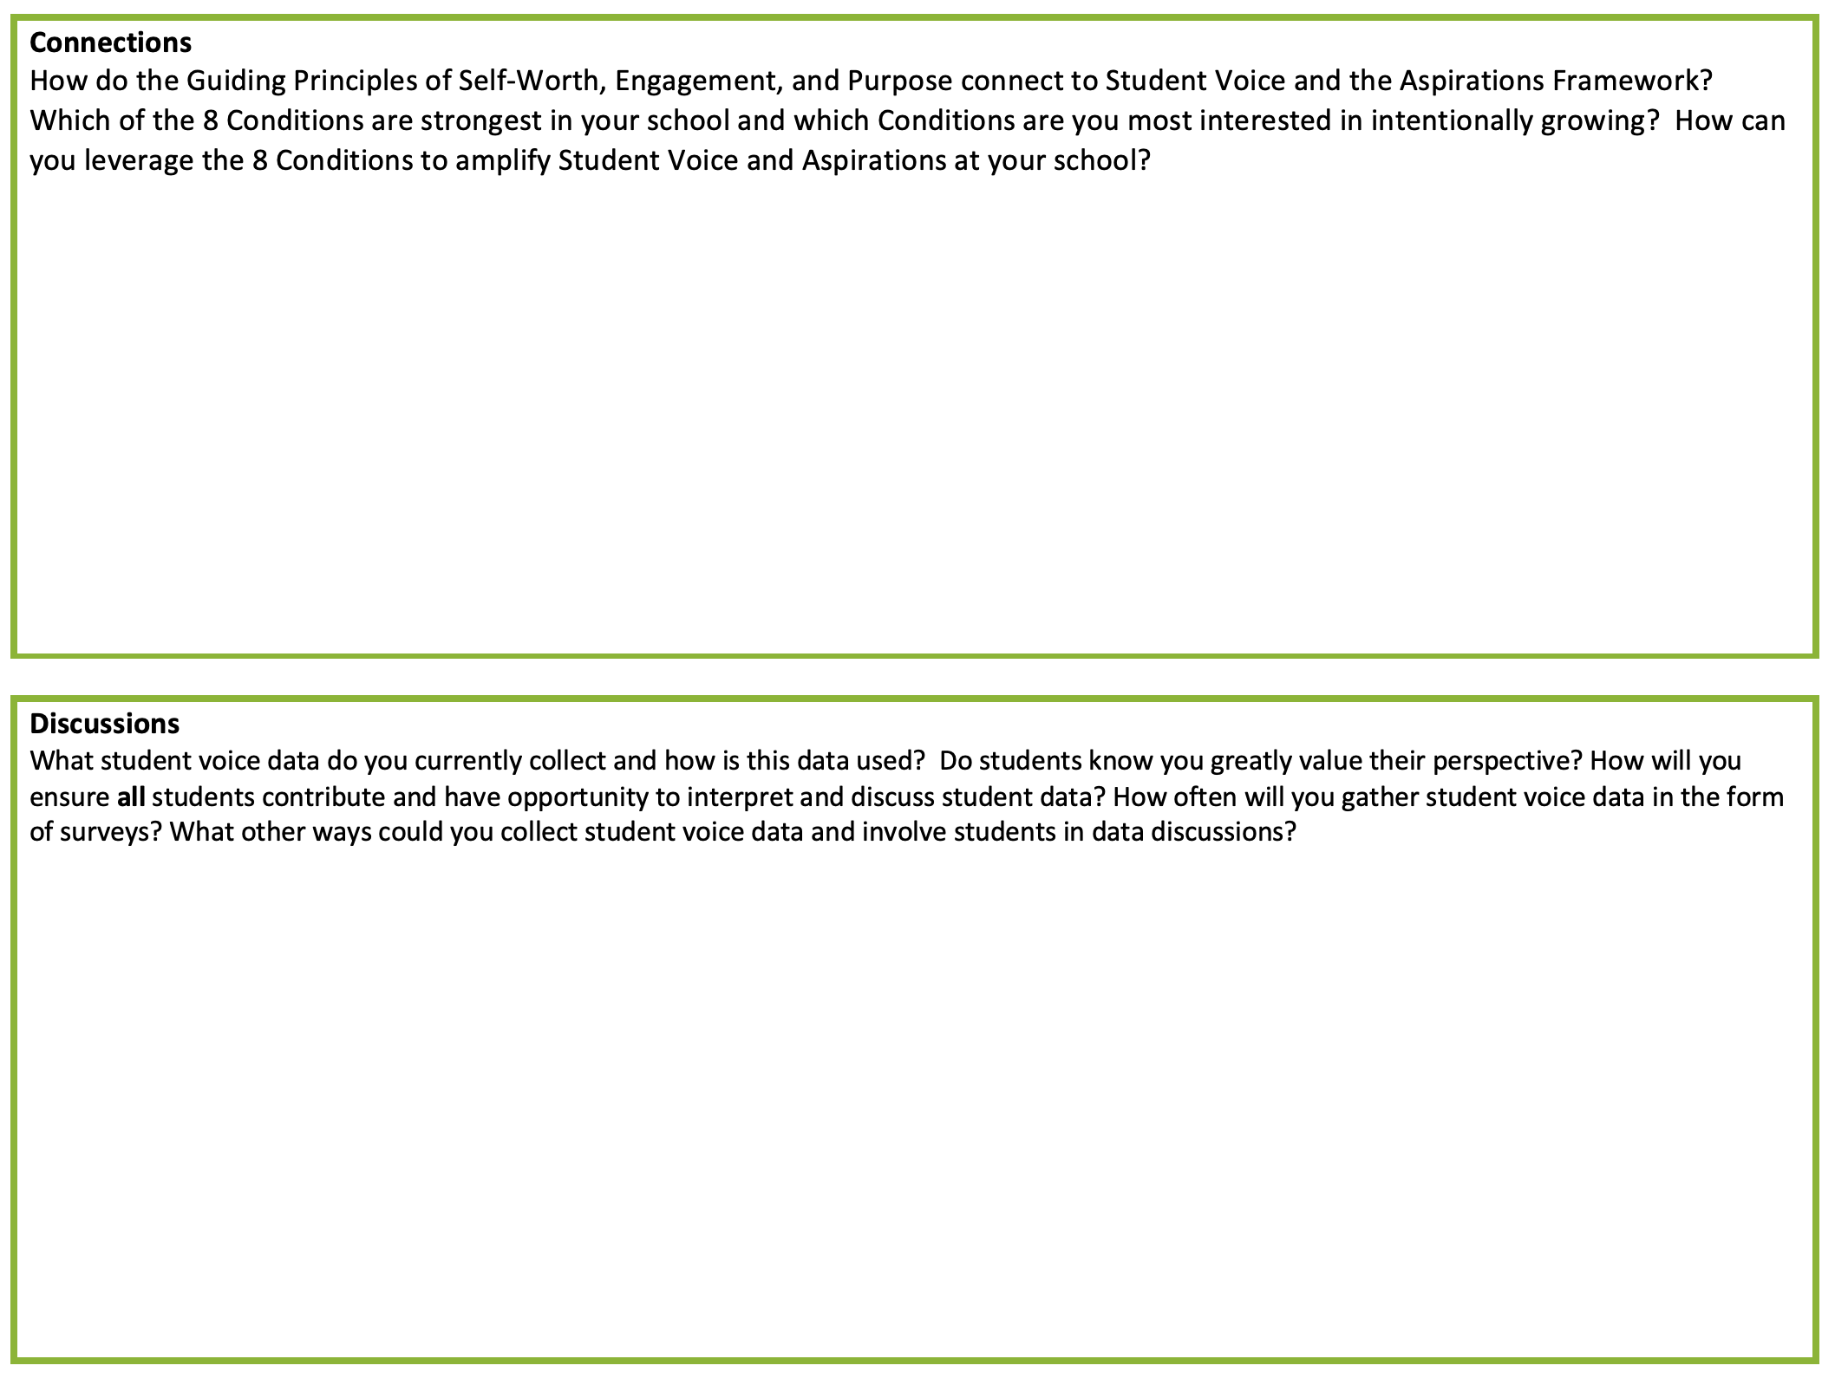
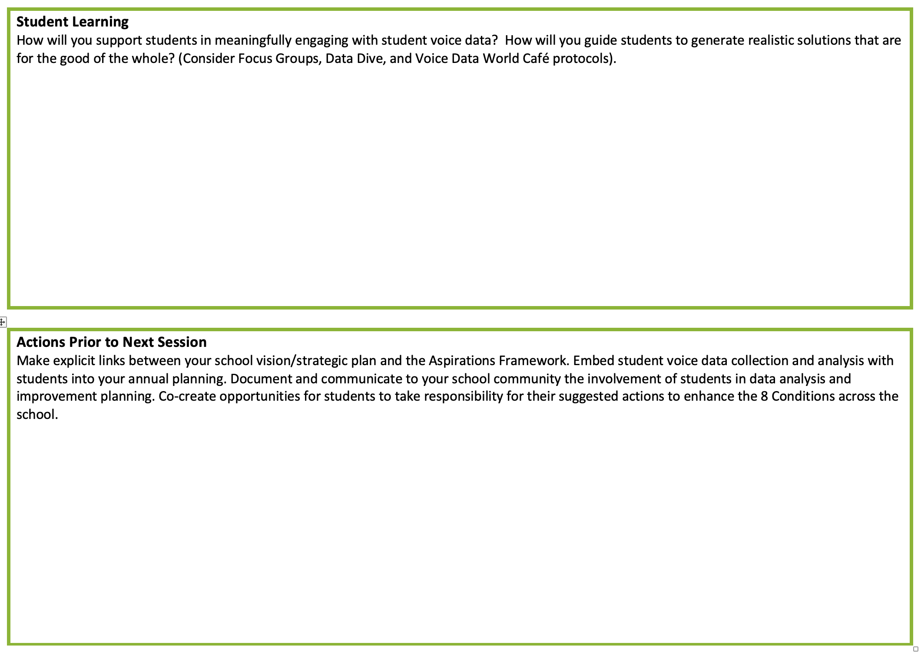
Resource #9
Aspirations
Framework
Action Plan

Slide 64

www.QuagliaInstitute.org
@QISVATweets
Dr. Russ Quaglia
Quaglia@QuagliaInstitute.org
Dr. Lisa Lande
Lande@QuagliaInstitute.org
@Lisa_Lande

Slide 65

What is your
“Mic Drop” moment
from this Student
Voice & Aspirations learning journey?

Slide 66
The Dynamics of Student
Voice & Aspirations
Thank you for joining us
on this learning journey!
Dr. Russ Quaglia & Dr. Lisa Lande

