Slide 1


The Dynamics of Student
Voice & Aspirations
The School Voice Process:
Listen, Learn, Lead
Session#3 May 3, 2022
Dr. Russ Quaglia & Dr. Kristine Fox

Slide 2
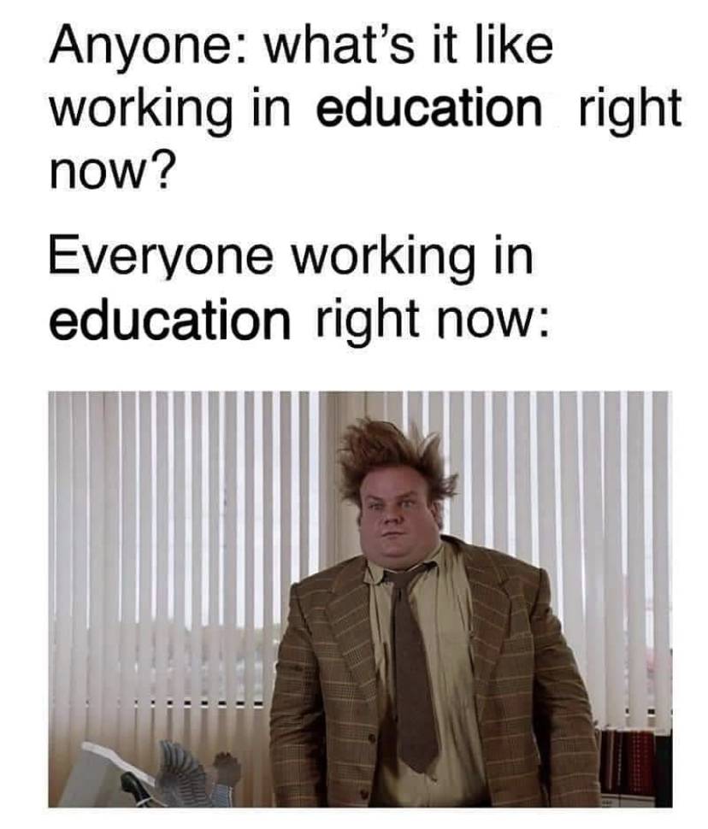

Slide 3
Goals for Today
Gain a deeper understanding of the
the Student Voice Process: Listen, Learn, & Lead.
Consider how the Student Voice Process
can support the implementation of
Student Voice.
Apply learning to amplify student
voice in YOUR school, particularly.

Slide 4

Quick Review

Slide 5
Fundamental Beliefs
Students
_________ are the potential, not the problem.
_________ have something to teach us.
Working with ________ is the only way forward.
Students
students

Slide 6

The 3 Components of Student Voice
Sharing thoughts & ideas in an environment underpinned by trust and respect.
Offering realistic suggestions for the
good of the whole.
Accepting responsibility for not only what you say but what needs to be done.

Slide 7
ASPIRATIONS
The ability to
dream and set goals
for the future,
while being inspired
in the present
to reach those dreams.

Slide 8




high
Imagination
Aspirations
DREAMING
Hibernation
Perspiration
low
DOING
high

Slide 9

Time to journey
onward & explore
the Student Voice Process

Slide 10

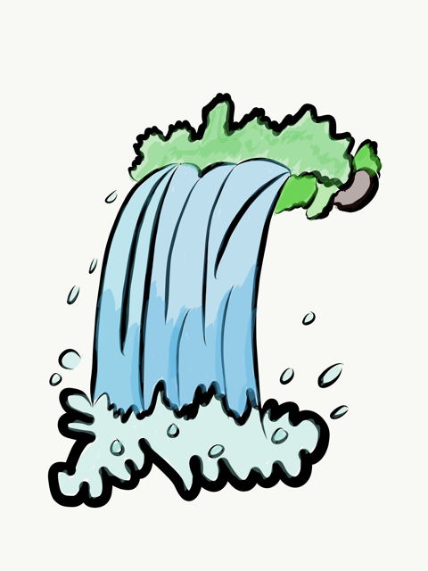
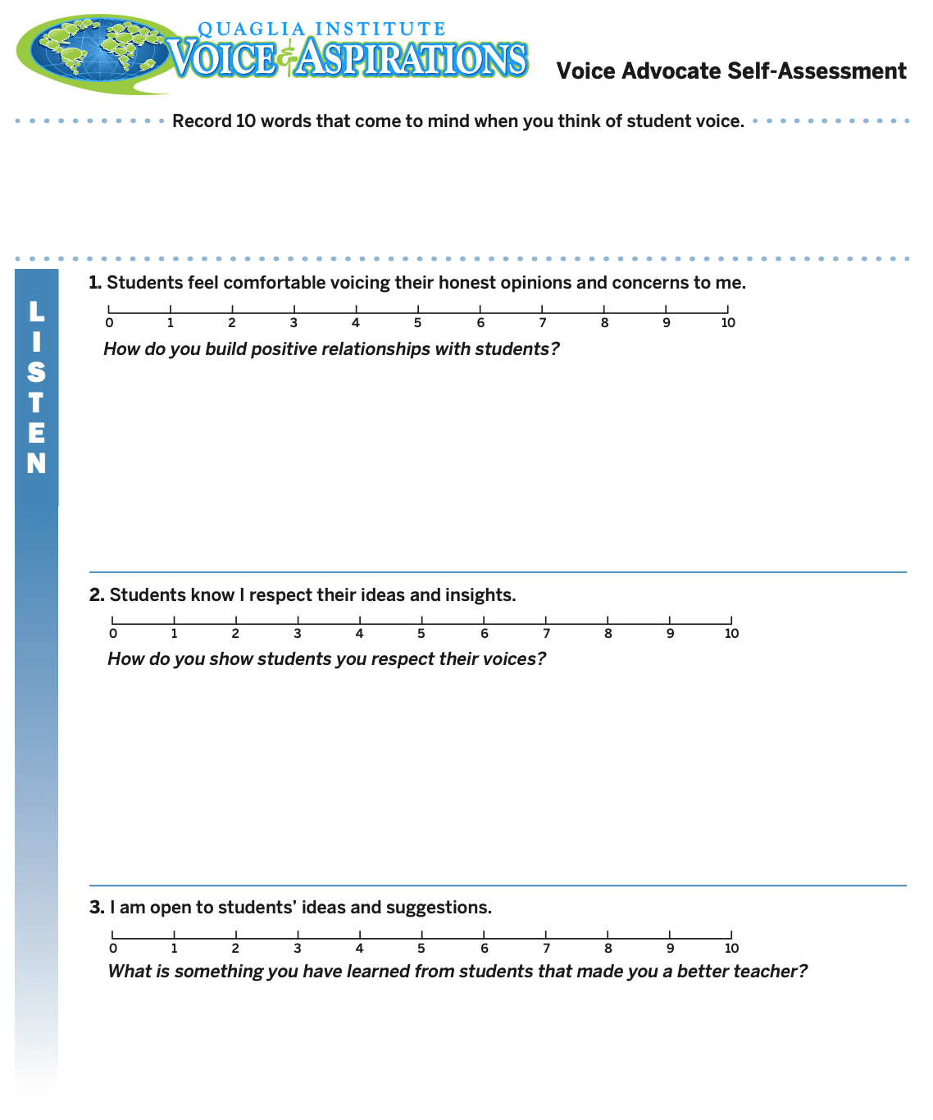
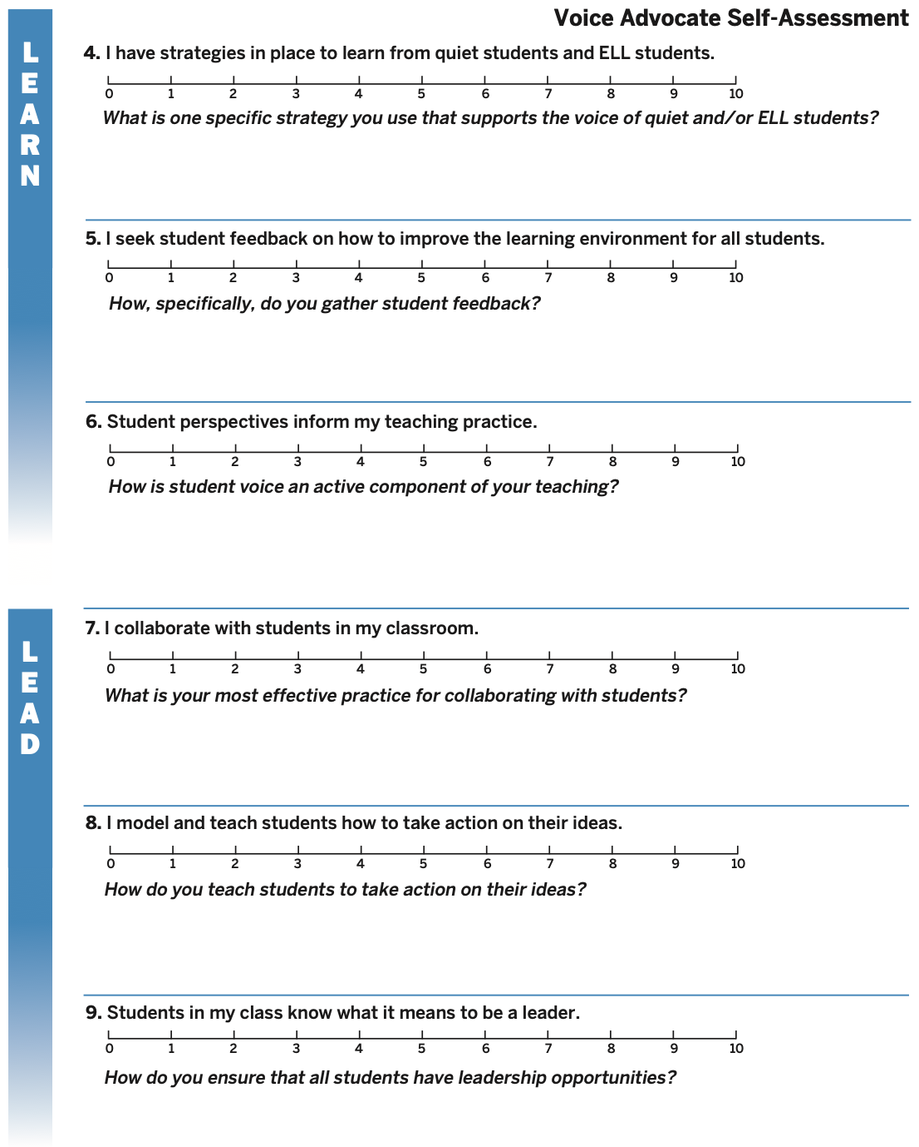
What did you learn from
the Voice Advocate
Self-Assessment?
Resource #1
Voice
Advocate
Self Assessment

Slide 11
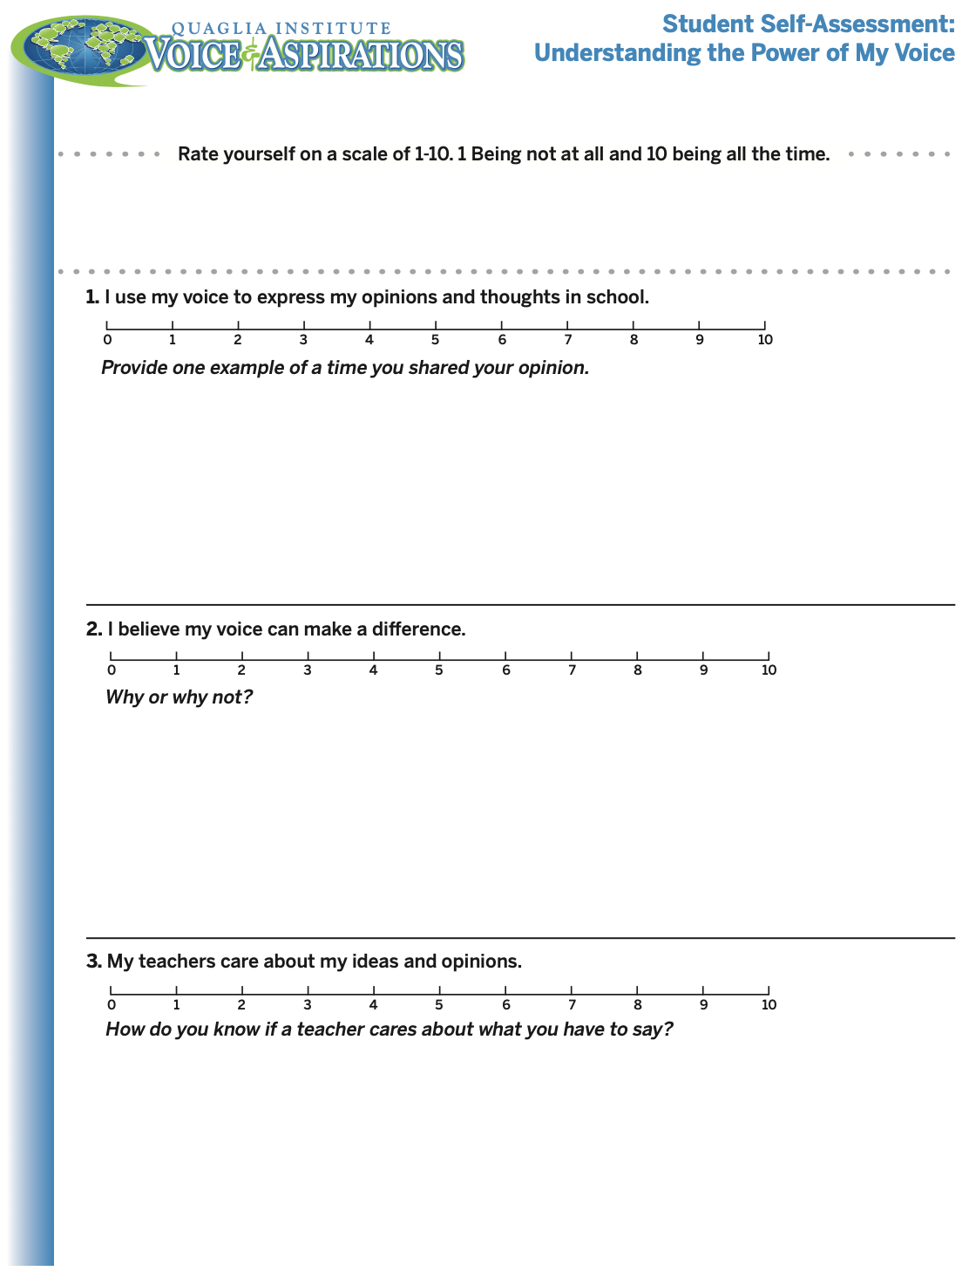
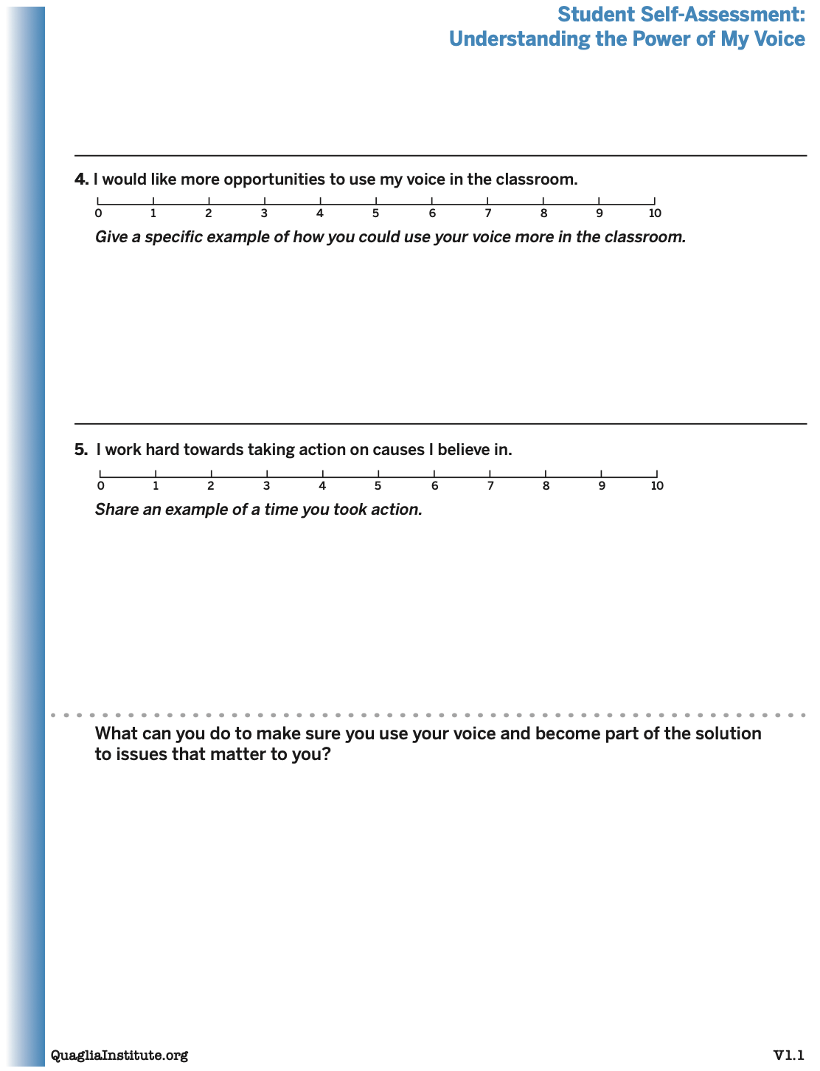
Understanding the Power of My
Voice Student Self Assessment
Resource #2
Student Voice
Self Assessment
Consider having your students
complete this
“Understanding
the Power of
My Voice”
self-assessment.

Slide 12
LEAD
Resource #3
School Voice
Process Brief
TAKE ACTION
with others
Share
RESPONSIBILITY
LEARN
UNDERSTAND
& RESPECT
different points
of view
Build
TRUST
LISTEN
SEEK OUT
opinions from
others
School Voice Process

Slide 13

Listen

Slide 14
The Art of Listening
Vimeo:
vimeo.com/qisva/listening
or
YouTube:
https://youtu.be/ooE9dKobjZU

Slide 15
Listen
Make an effort to reach out to the ones
you don’t hear
Stay focused (put away your phone!)
Be genuine (at the very least be interested)
Make sure you are talking less than the
other person
Being open to new ideas is not an option

Slide 16

Challenge Time…

Slide 17


Challenge
Listen carefully and
try to accurately
draw the design
Dr. Russ will describe.
When finished, hold your picture up for everyone to see and
judge how well you listen! ☺

Slide 18
Challenge (In Person Version)
Round 1: Find a partner &
assign one person to be the
Describer, & one person to
be the Artist. Sit back to back. Without looking or asking
questions, describe to your
partner how to replicate
your picture.
Resource #4
Drawing Dictations Lesson Plan
Round 2: Switch roles
(Describer & Artist) &
repeat, but this time you
can ask clarifying questions.

Slide 19

Reflect
What do you find challenging when it comes to
listening to students?

Slide 20

Quick Break!

Slide 21

Learn

Slide 22
Taking Time to Learn
Vimeo:
vimeo.com/qisva/time
or
YouTube:
https://youtu.be/tYKcvRfxK0o

Slide 23
Learn
Take notes
Ask questions for clarity
Do not judge
Make sure you continue to listen as you learn
Be prepared to change
Do not fear what you do not know

Slide 24
Challenge Time…

Slide 25
Challenge
Find the connection
between the 4 individual pictures.
Who can type the answer
FIRST in the Zoom chat?

Slide 26
Connections 1
Vimeo:
vimeo.com/qisva/connection1
or
YouTube:
https://youtu.be/Yl3JrRtyGHc
(all 9 slides)

Slide 27
Connections 2
Vimeo: vimeo.com/qisva/connections2

Slide 28
Connections 3
Vimeo: vimeo.com/qisva/connections3

Slide 29
Connections 4
Vimeo: vimeo.com/qisva/connections4

Slide 30
Connections 5
Vimeo: vimeo.com/qisva/connections5

Slide 31
Connections 6
Vimeo: vimeo.com/qisva/connections6

Slide 32
Connections 7
Vimeo: vimeo.com/qisva/connections7

Slide 33
Connections 8
Vimeo: vimeo.com/qisva/connections8

Slide 34
REFLECT
Whose perspectives do you need to learn from for
Student Voice & Aspirations to become reality in your school?

Slide 35
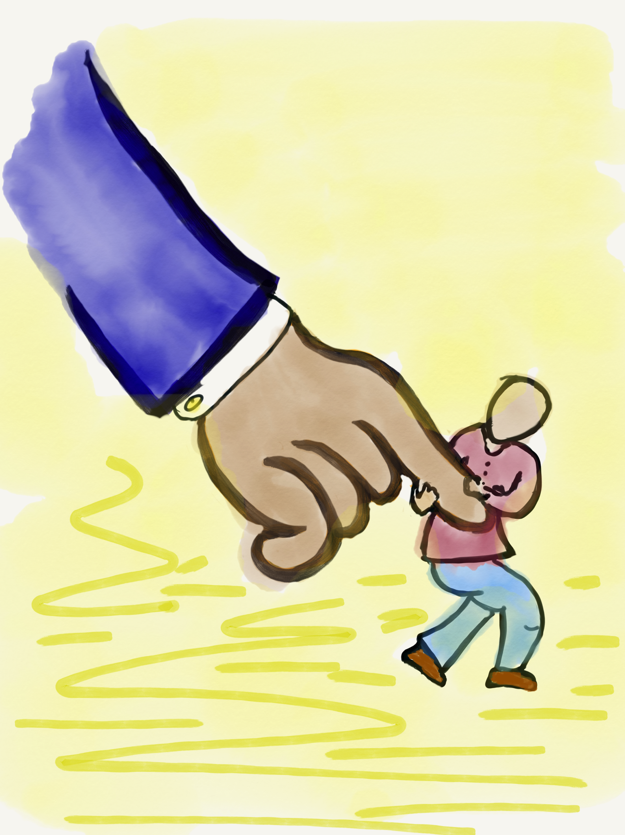
Lead

Slide 36
Leading Together…
Vimeo:
https://vimeo.com/qisva/together
or
YouTube:
https://youtu.be/RTvZCdUP7N4

Slide 37
LEAD
Don’t let your voice be silent.
Make sure ALL voices are heard.
Listen, really listen.
Embrace the unknown.
Expect more from students.
Don’t give false praise.
Do something!

Slide 38
Reflect
What is one area at your
school/in your classroom in
which students can be
invited to lead with you?

Slide 39
Voice Process in Action!
Vimeo: vimeo.com/qisva/sutter
Or
YouTube:
https://youtu.be/_kwkyzH
Sutter Middle School, Los Angeles, California

Slide 40
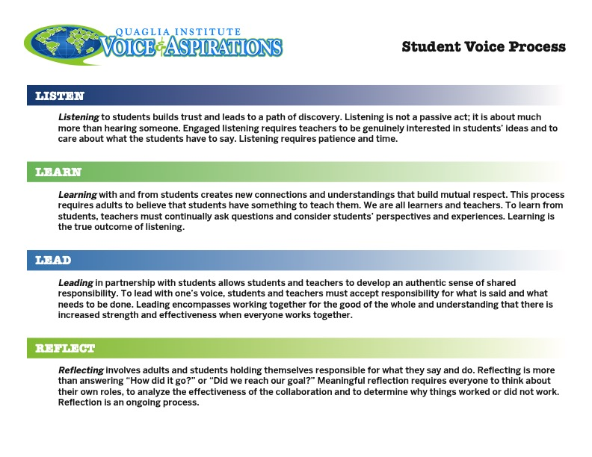
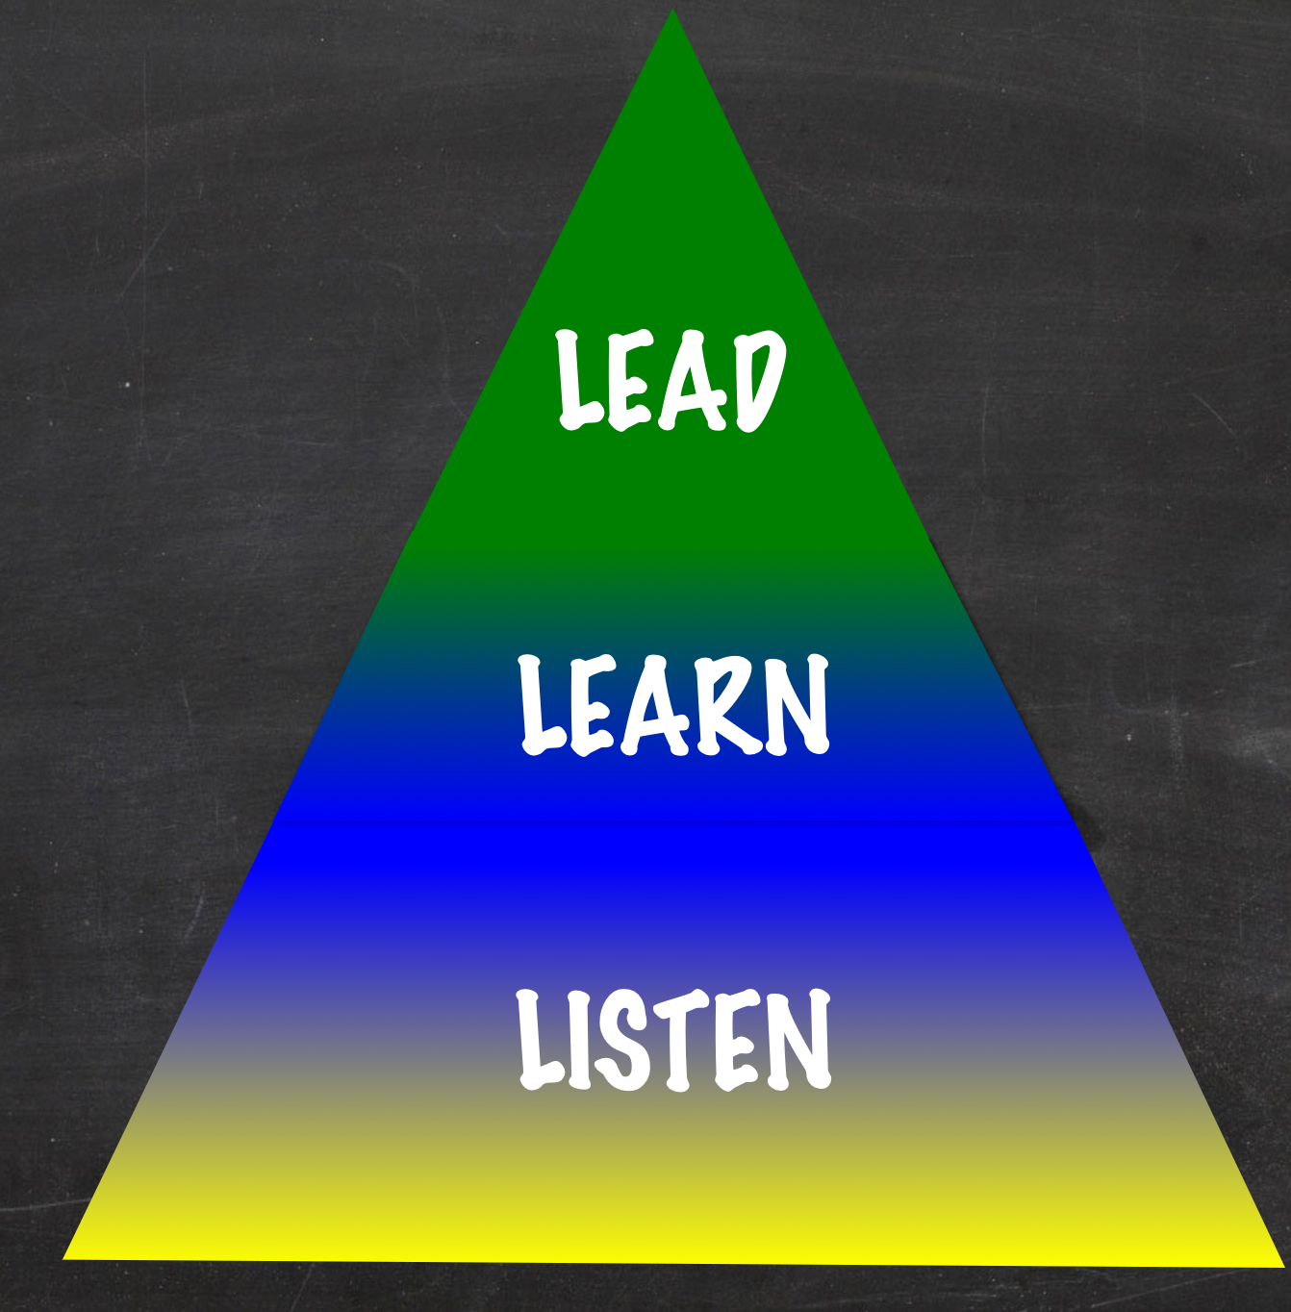
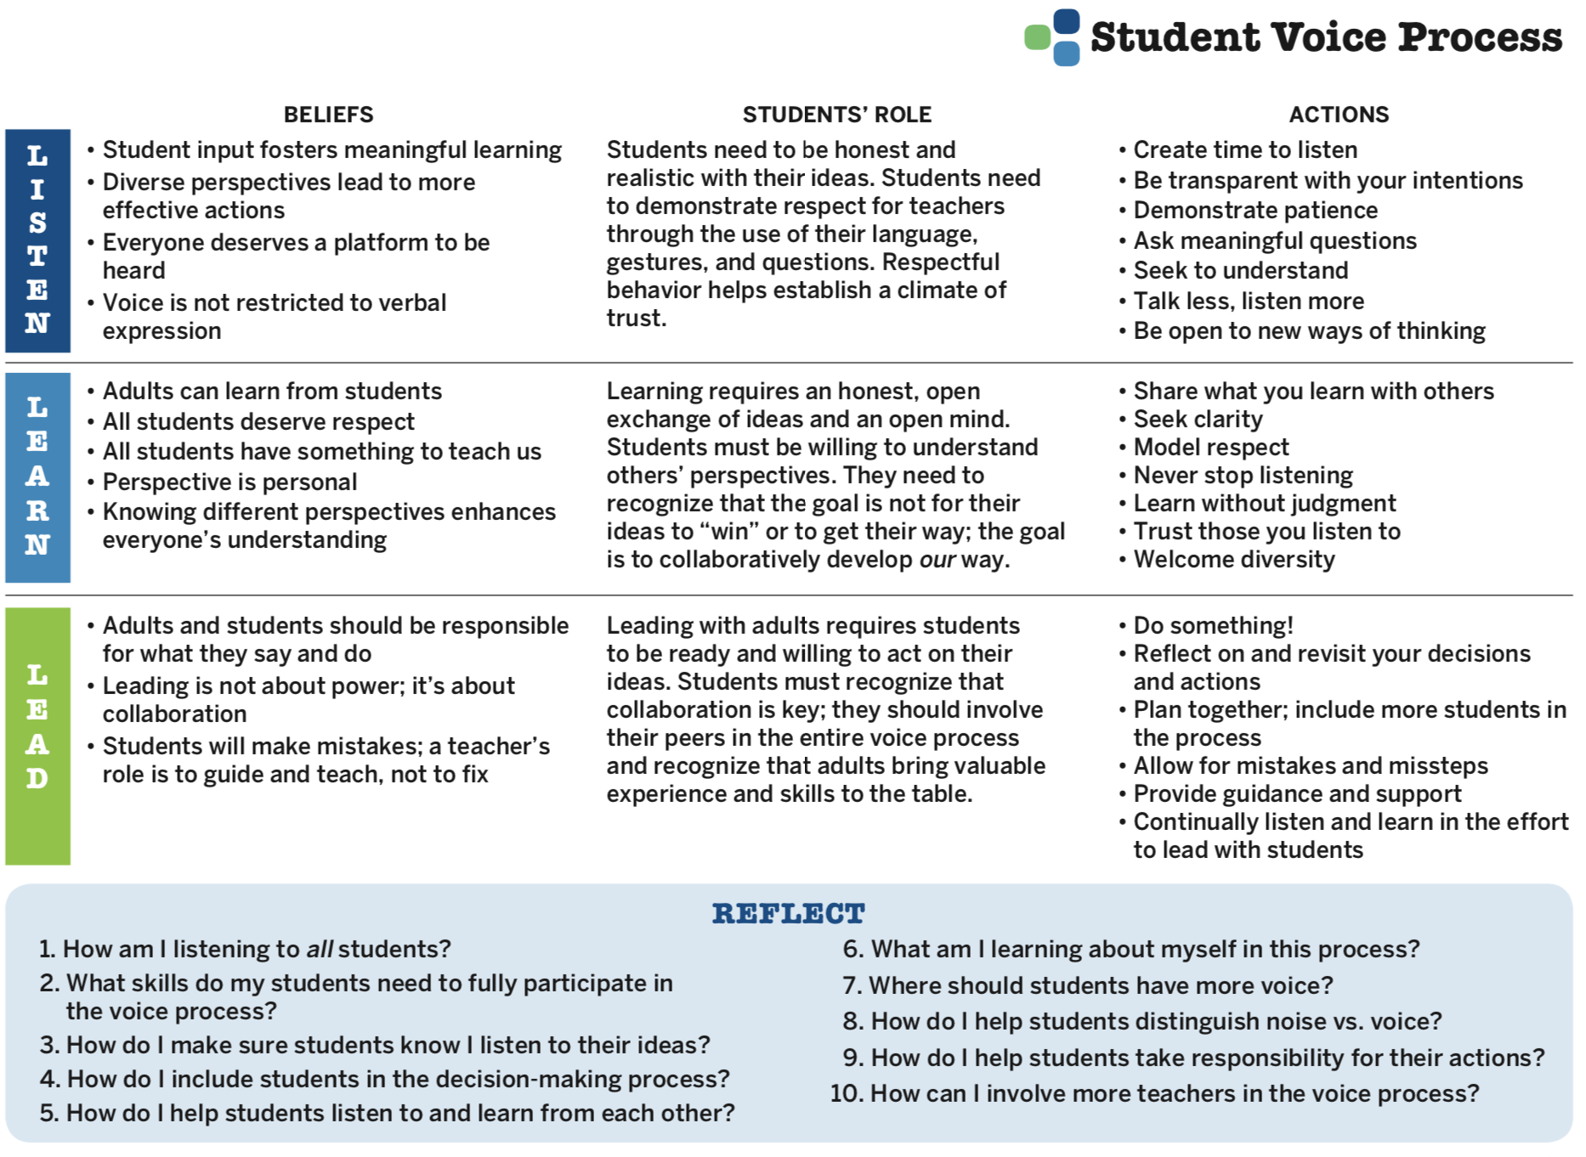

Student Voice Process
Resource #5
Student Voice
Process Tool

Slide 41
Student Voice Process
In your breakout group, begin to
discuss the reflection questions.

Slide 42
Student Voice Process
Consider completing the Student Voice
Process Tool in partnership with
colleagues at your school.

Slide 43
School Voice Model
Vimeo
https://vimeo.com/qisva/louie
YouTube
https://youtu.be/Ff2UVHm9urQ
Louie Galman - BCE

Slide 44
RESOURCES

Slide 45

Deeper Learning
Opportunities
1) Share the Voice Self Assessments with staff & students.
2) Complete the Voice Process Tool.
3) Complete the Session #3 Action Plan (If you haven’t completed the previous Action Plans, complete those first!).

Slide 46
Resource #1
Voice Advocate
Self Assessment
Resource #2
Student Voice
Self Assessment

Slide 47
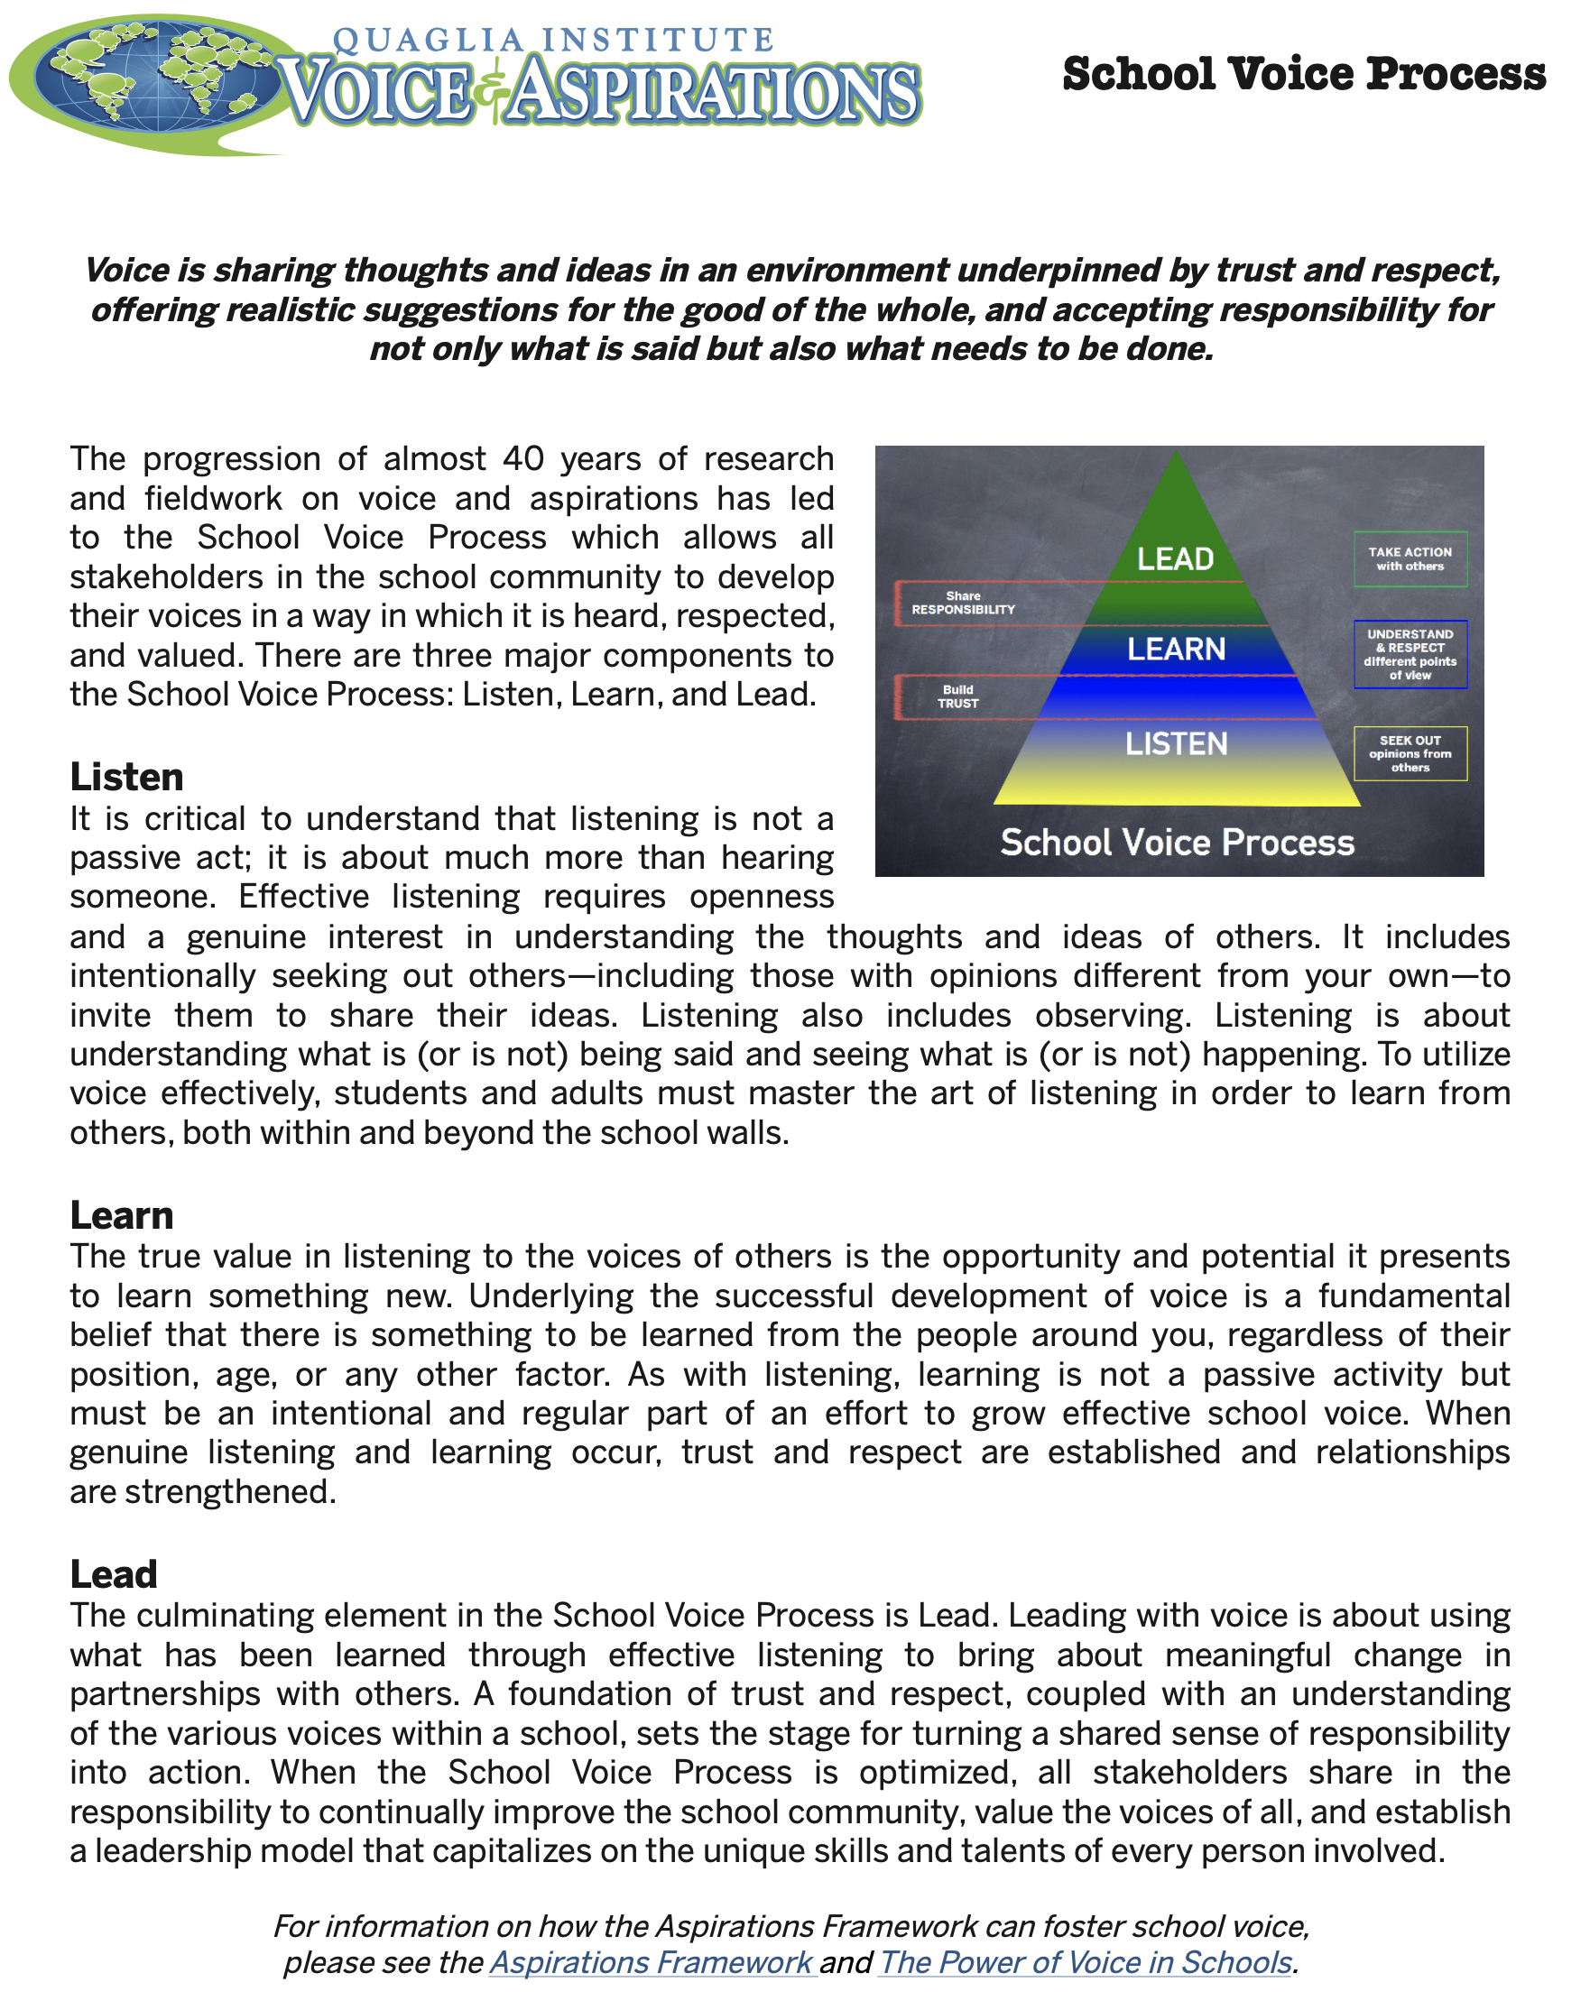
Resource #3
School Voice
Process Brief

Slide 48
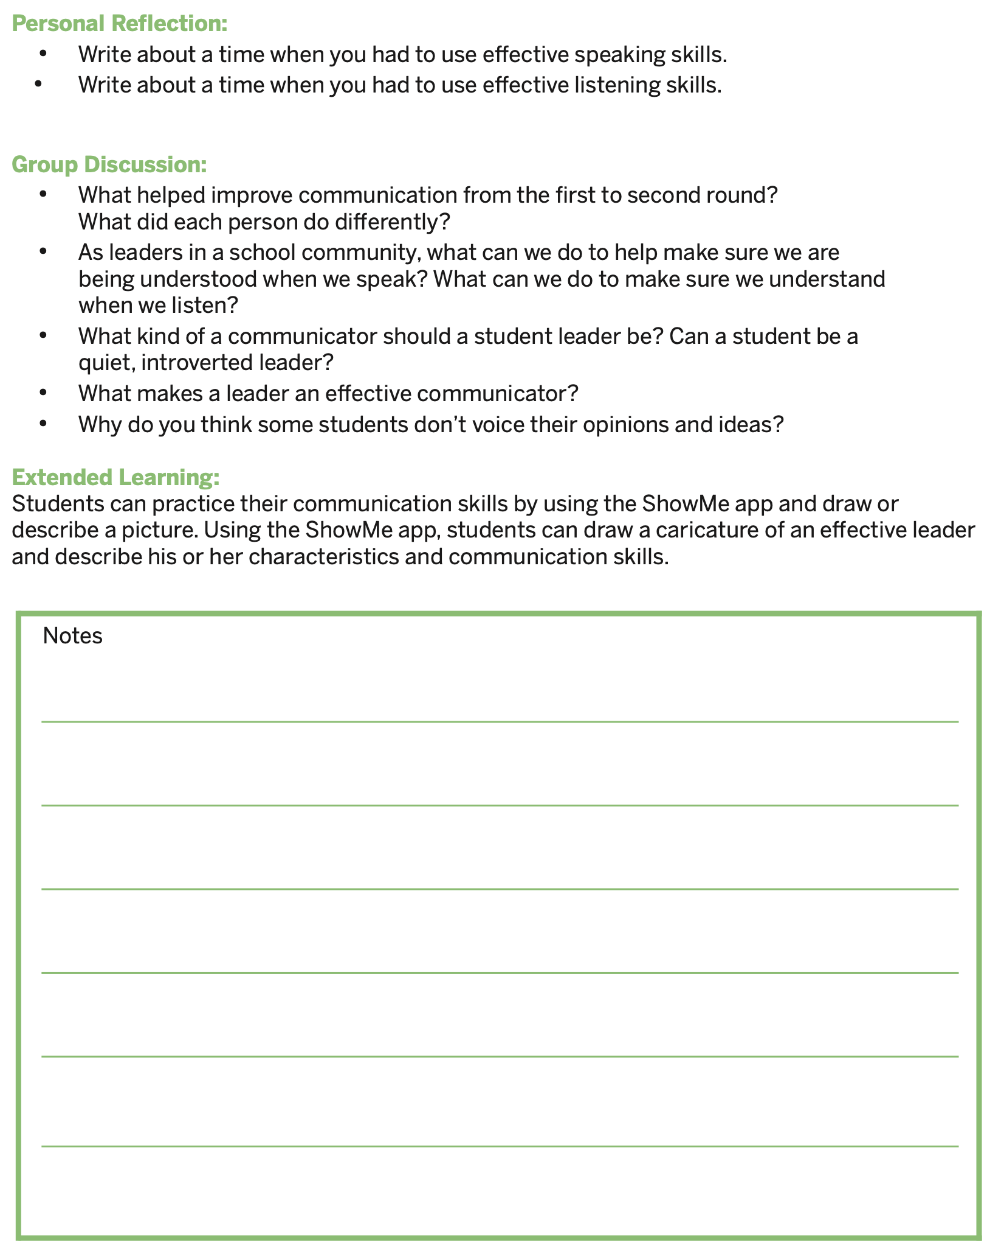
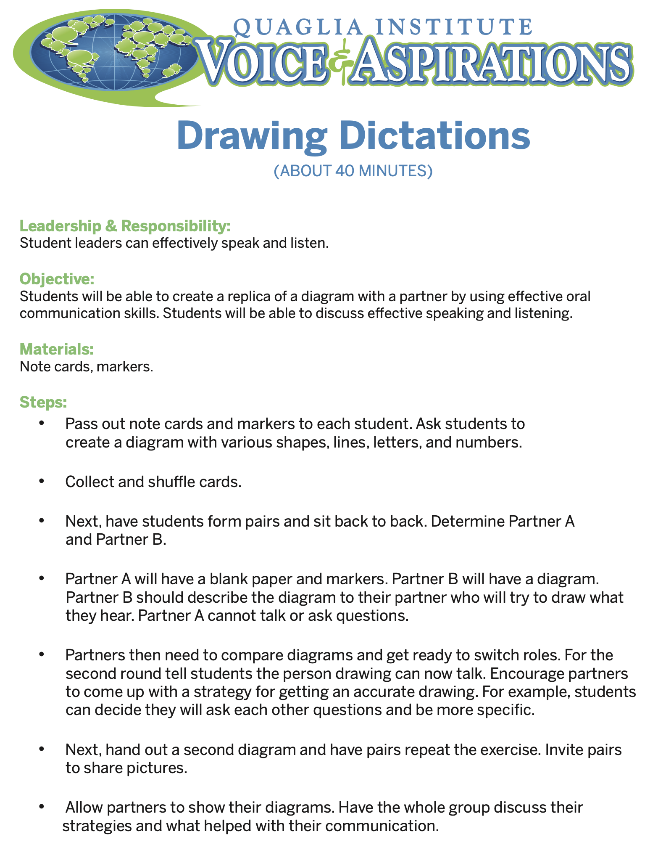
Resource #4
Drawing Dictations Lesson Plan

Slide 49
Resource #5
Student Voice
Process Tool

Slide 50
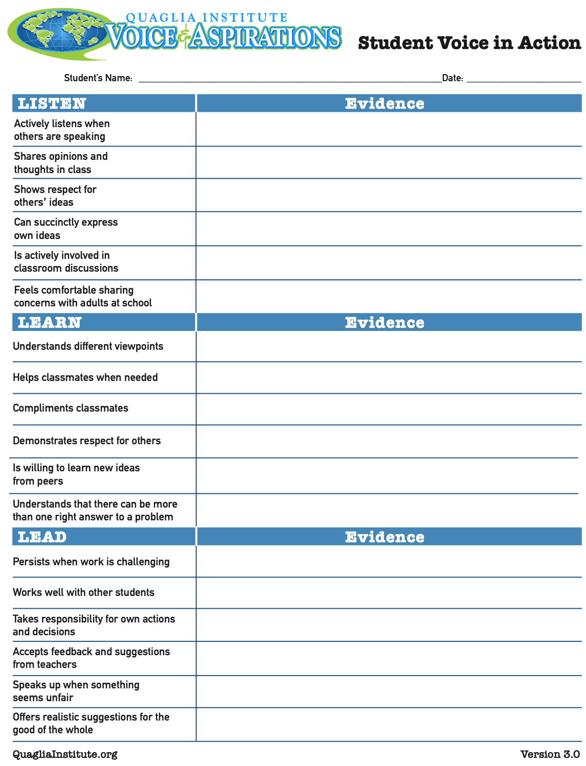
Consider asking
teachers to use this
tool in looking for
evidence of Student
Voice in action.
Resource #6
Student Voice
in Action

Slide 51
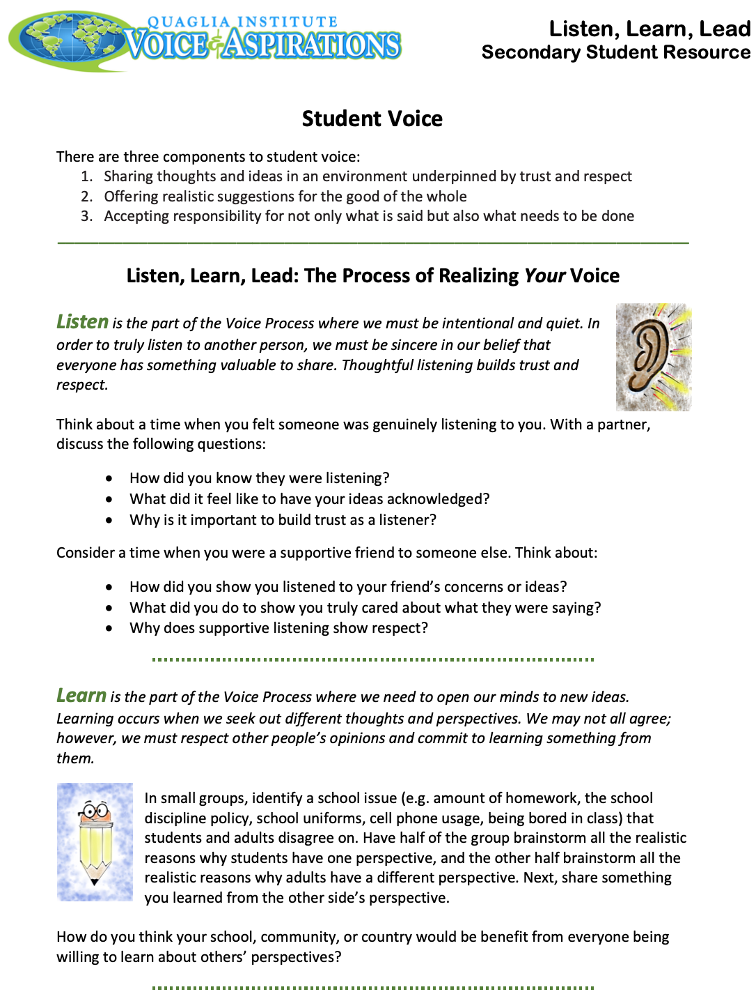
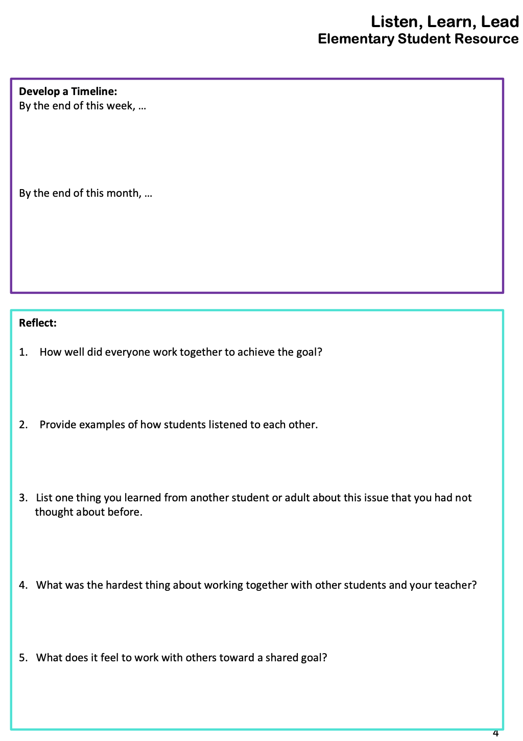

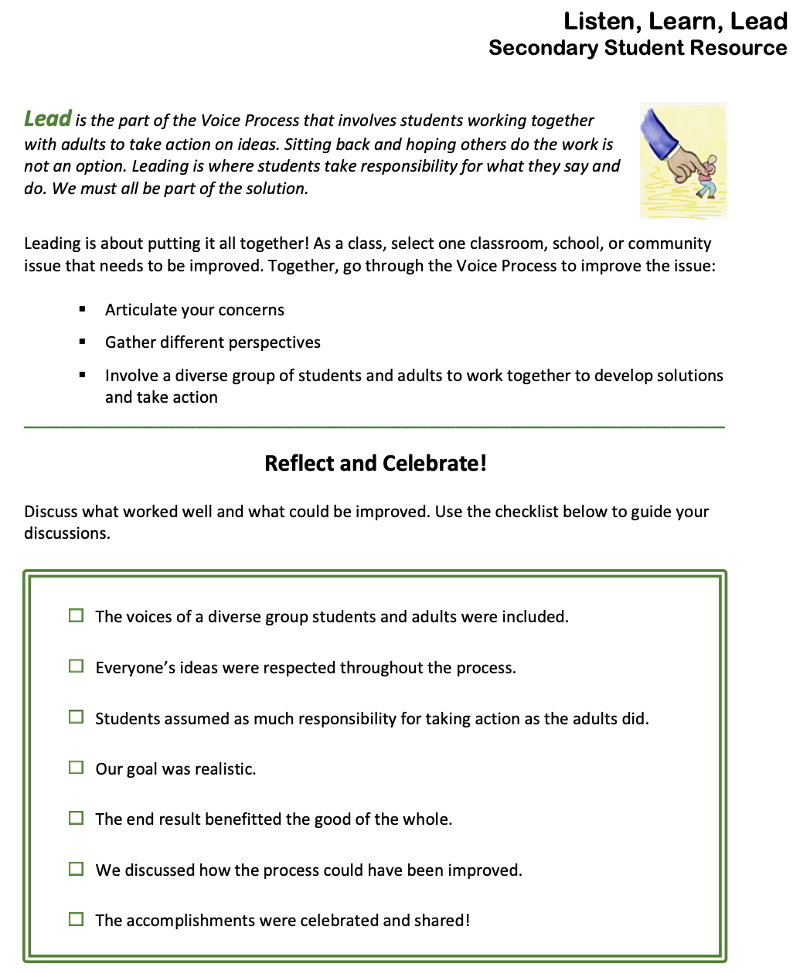
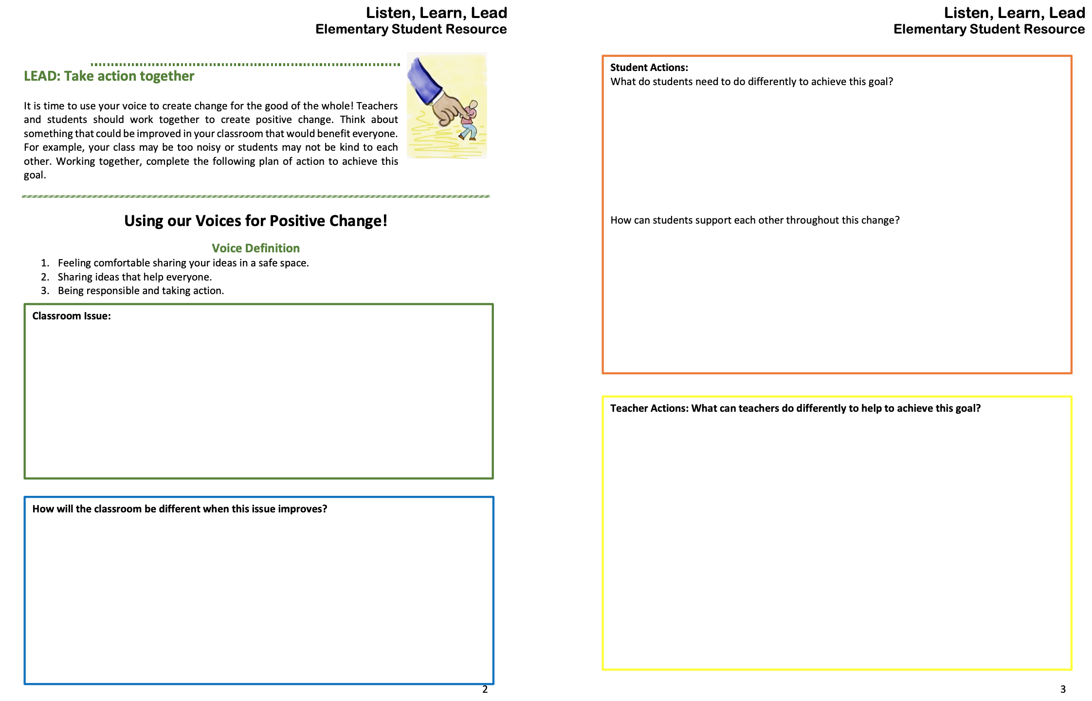
Resource #7a LLL Student Resource Elementary
Resource #7b LLL Student Resource
Secondary

Slide 52
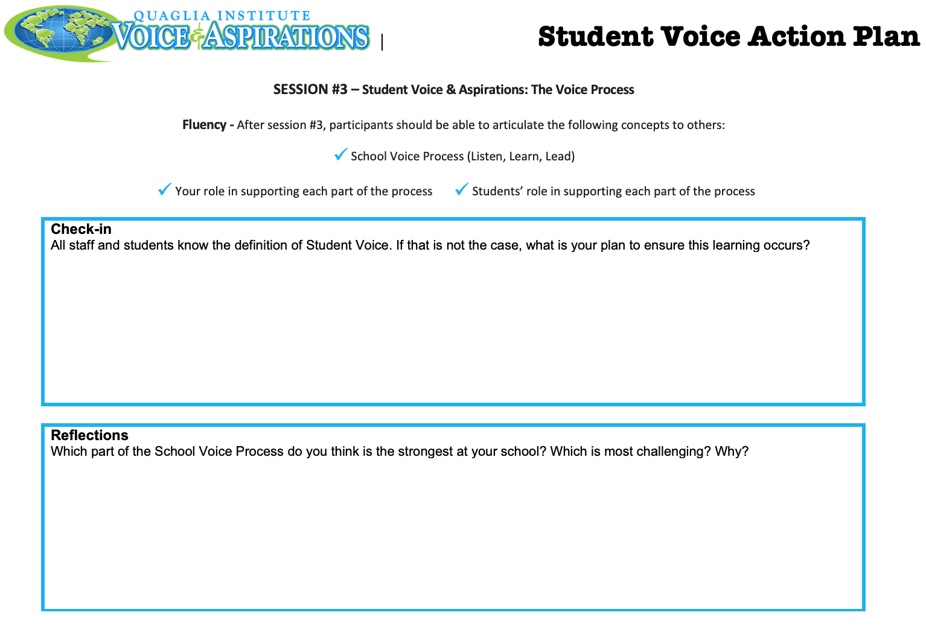
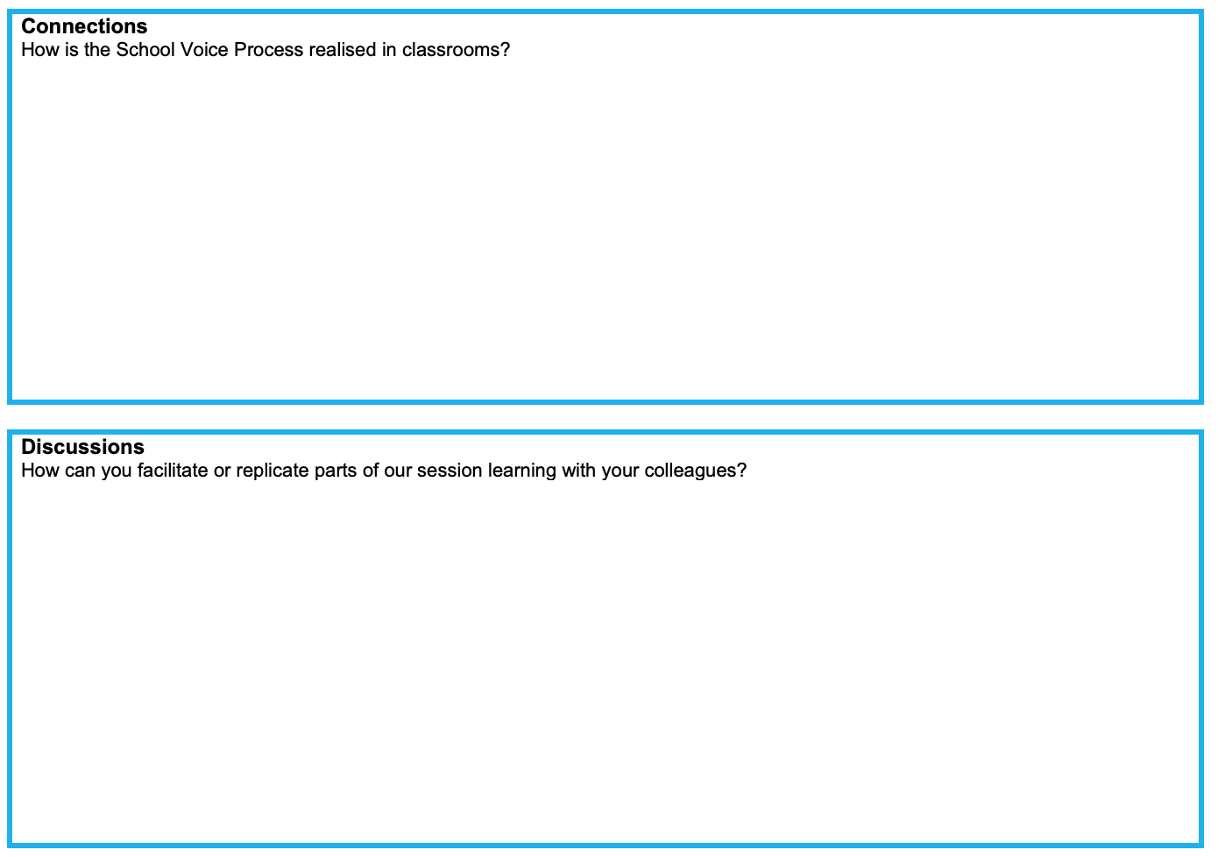
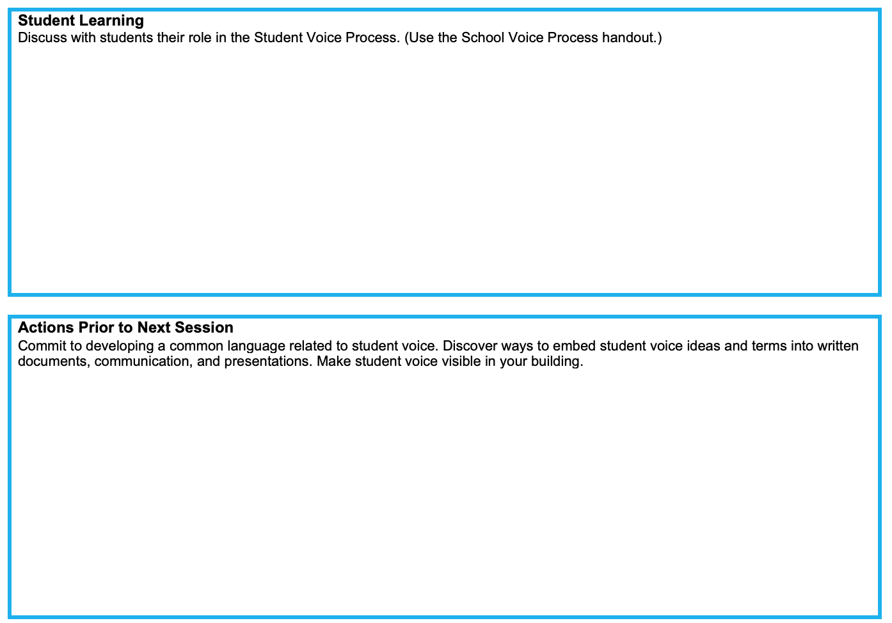
Resource #8
School Voice Process Action Plan

Slide 53

www.QuagliaInstitute.org
@QISVATweets
Dr. Russ Quaglia
Quaglia@QuagliaInstitute.org
Dr. Lisa Lande
Lande@QuagliaInstitute.org
@Lisa_Lande

Slide 54

Fortune Cookie Challenge
In the Zoom chat, share your
fortune cookie message
for others related to the
School Voice Process:
Listen, Learn, Lead.

Slide 55
The Dynamics of Student
Voice & Aspirations
Next Session
Voice & Vision: Using Data to Guide Implementation of the
Aspirations Framework
Session#4 May 5, 2022
Dr. Russ Quaglia & Dr. Lisa Lande

