Slide 1


The Dynamics of Student
Voice & Aspirations
The Aspirations Profile
Session#2 April 28, 2022
Dr. Lisa Lande & Sue Bryen

Slide 2
Fundamental Beliefs
Students are the potential, not the _______.
Students have something to _______ us.
Working with students is the only way _______.
problem
teach
forward

Slide 3
Goals for Today
Explore the Aspirations Profile.
Consider how the Aspirations Profile
can & should affect how we support
student voice.
Apply learning to amplify student
voice in YOUR school.

Slide 4

Challenge Time…

Slide 5
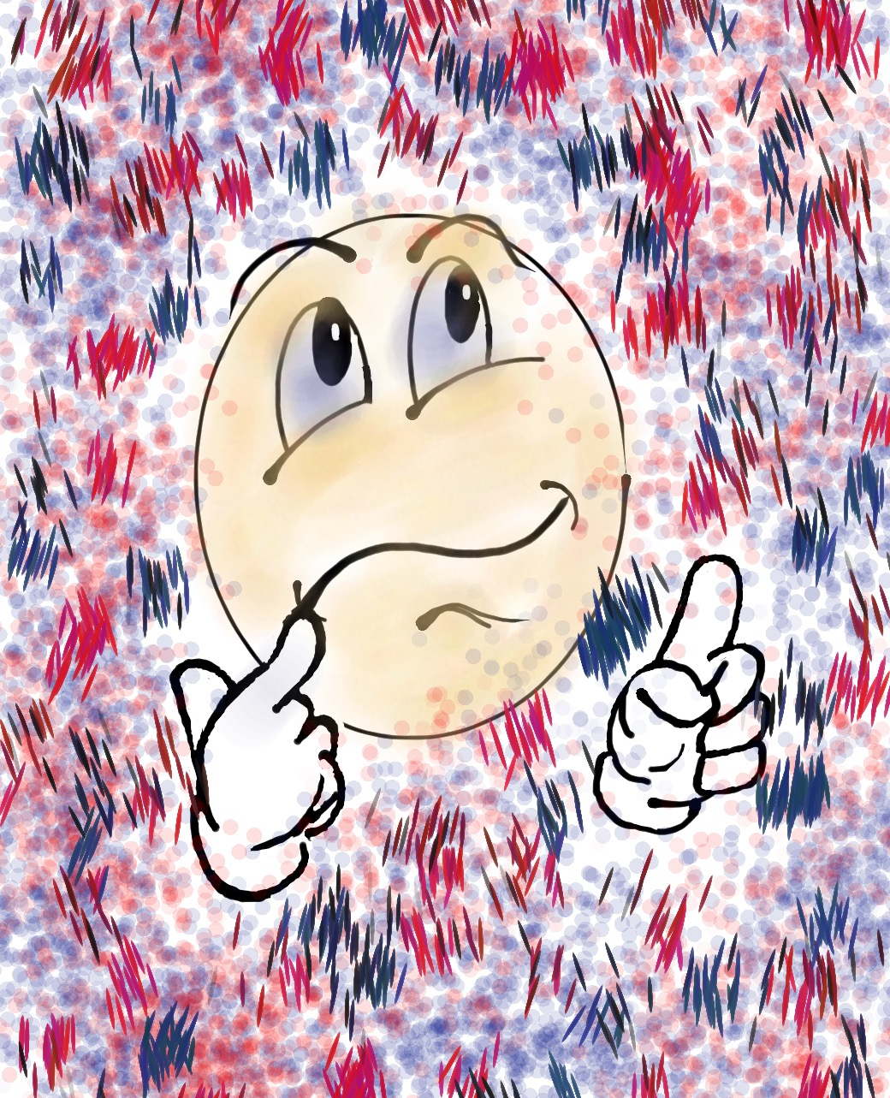
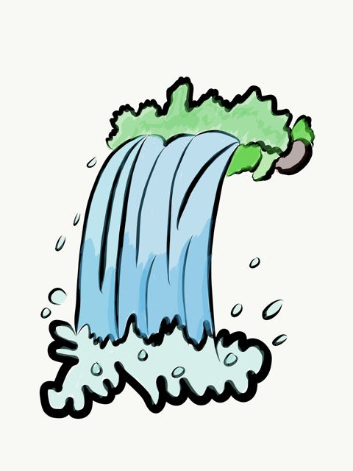
Challenge
Share anything you remember from the 3-part Voice
definition learned during
Session #1 in the chat.

Slide 6

The 3 Components of Student Voice
Sharing thoughts & ideas in an environment underpinned by trust & respect.
Offering realistic suggestions for the
good of the whole.
Accepting responsibility for not only what is said but also what needs to be done.

Slide 7
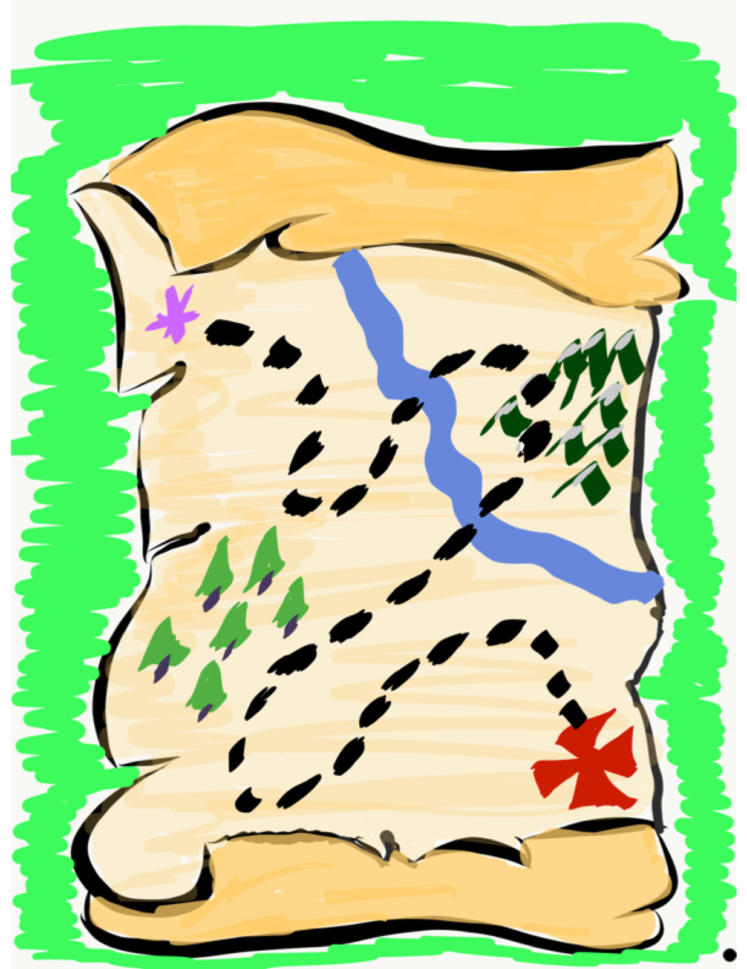
We journey
onward…
Now it is time to explore the Aspirations Profile as we
consider how to support
students in developing their voice & reaching their
fullest potential.

Slide 8
ASPIRATIONS
The ability to
dream & set goals
for the future,
while being inspired
in the present
to reach those dreams.

Slide 9




high
Imagination
Aspiration
Resource #1
Aspirations
Profile Brief
DREAMING
Hibernation
Perspiration
low
DOING
high

Slide 10

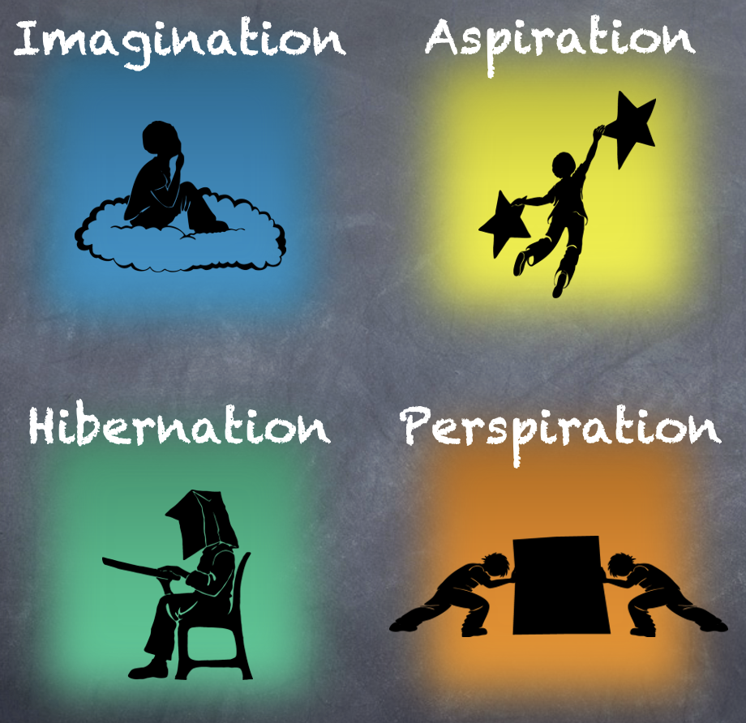
Reflect
In which quadrant did you spend most of your time as a student? Why?

Slide 11
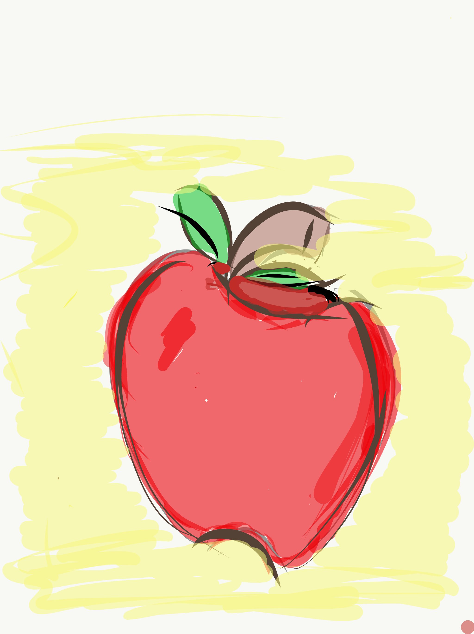
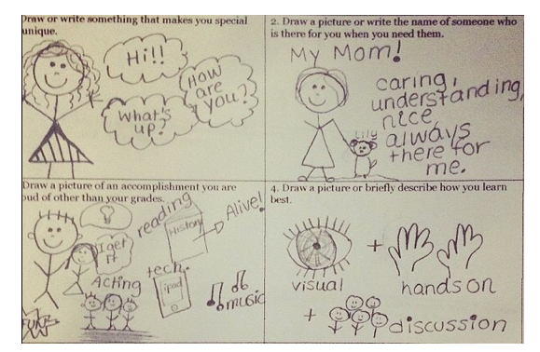
Lesson Plan
Resource #2
Aspirations Story
Squares Lesson Plan
Aspirations Story Squares
Complete the Aspirations Story Squares handout.
Mingle around the room sharing different squares with your peers.

Slide 12

Time to Dig Deeper!

Slide 13
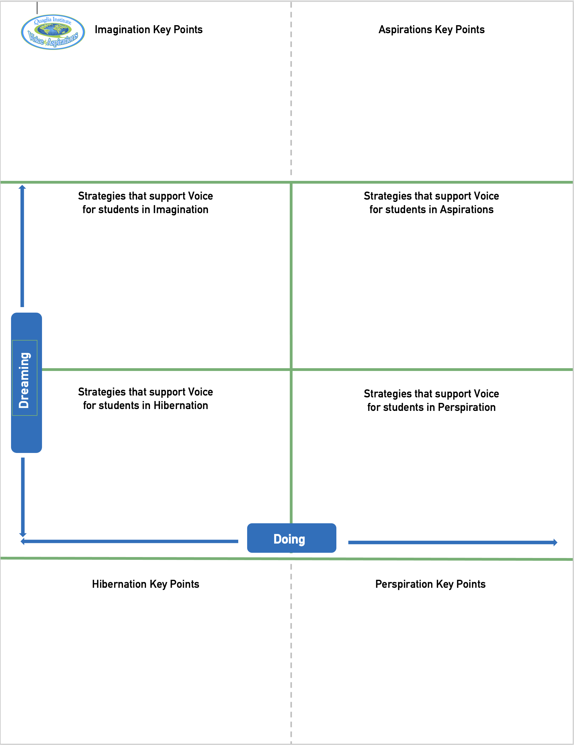
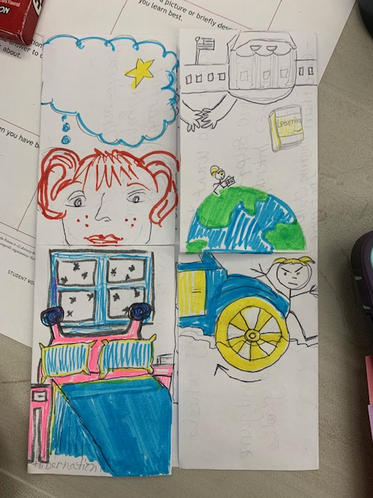
Aspirations Foldable!!
Resource #3
Aspirations
Foldable
Imagination
Aspiration
Perspiration
Fold
Cut
Hibernation

Slide 14
high
DREAMING
Hibernation
low
DOING
high

Slide 15
high
DREAMING
Vimeo
https://vimeo.com/789017891/1c391b7d0a
YouTube
https://youtu.be/qPYqaBvwhy8
low
DOING
high

Slide 16
Reflect
What is one word that might describe students in hibernation?

Slide 17

Students in Hibernation
Potential Cons:
Passive & unmotivated
Poor self-esteem &
defeatist attitude
Struggle to take
responsibility for
anything
Potential Pros:
Time to reflect
Space to recharge
They report:
Feeling isolated
Stuck
Misunderstood
Bored
They need to:
Feel valued
Be recognized for success
Have positive role models
Have a sense of purpose

Slide 18
Reflect
Think of the word you previously shared.
Now share a word that reflects your hopes & dreams for hibernating students.

Slide 19
high
Imagination
DREAMING
low
DOING
high

Slide 20
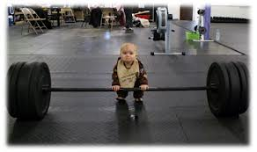
high
DREAMING
low
DOING
high

Slide 21
Reflect
What is something you dream about doing, but have not yet accomplished?

Slide 22

Students in Imagination
Potential Pros:
Enthusiastic
Fun to be around
Lots of creative ideas
Potential Cons:
Limited follow-through
Not well connected
to reality
Students report:
Having big dreams
Eagerness to explore
Craving creative outlets
They need to:
Develop action plans
Focus
Be realistic

Slide 23
Reflect
How could you leverage the
3-part Voice definition to move out of Imagination?

Slide 24

Quick Break!

Slide 25
high
DREAMING
Perspiration
low
DOING
high

Slide 26
high
DREAMING
Vimeo
https://vimeo.com/qisva/snowremoval
YouTube
https://youtu.be/m39gWmTaIbY
low
DOING
high

Slide 27
Reflect
What is the greatest source of your own perspiration right now?

Slide 28

Students in Perspiration
Potential Pros:
Determined
Hard Working
Driven to Succeed
Potential Cons:
Overly concerned
about grades
Single-minded,
narrow-focused
Students report:
Feeling stressed
Not sure “why” they are learning, but need
good grades
Don’t want to let
anyone down
They need to:
Have a greater purpose for learning
Balance school work with outside life
Link learning to
their passions

Slide 29
Reflect
What can you do to perspire a little less & dream a little more?

Slide 30
high
Aspiration
DREAMING
low
DOING
high

Slide 31
high
DREAMING
Vimeo
https://vimeo.com/776344083/affe5a37da
YouTube
https://youtu.be/uLjzbSAEmJI
low
DOING
high

Slide 32
Reflect
What did you learn from the students about Aspirations?

Slide 33

Students in Aspiration
Potential Pros:
Connects present
actions to future
dreams
Good idea of
potential options
Potential Cons:
Relaxation is Challenging
Under constant pressure
Self-Serving
Students report:
Never feeling
satisfied
Driven by being best
Frustration with peers
who don’t try or who
interrupt learning
They need to:
Be assured they
are on a positive track
Experience meaningful academic challenges
Breathe!

Slide 34
Reflect
From your perspective, how does the Aspirations Profile connect to Student Voice.

Slide 35
Quadrants & PLC’s
high
Imagination
Aspiration
Lots of planning
Little follow through
Discuss many ideas
No connection to school vision
Enthusiastic
Purposeful meetings
Changes in practice
Connection to school goals
Shared responsibility & ownership
Commitment
DREAMING
Hibernation
Perspiration
Sporadic attendance
No classroom impact
Compliance driven
No passion
Wait & see if this will last
Hard working
Meets deadlines
Overwhelmed, at risk of burnout
Team player
Dependable
low
DOING
high

Slide 36
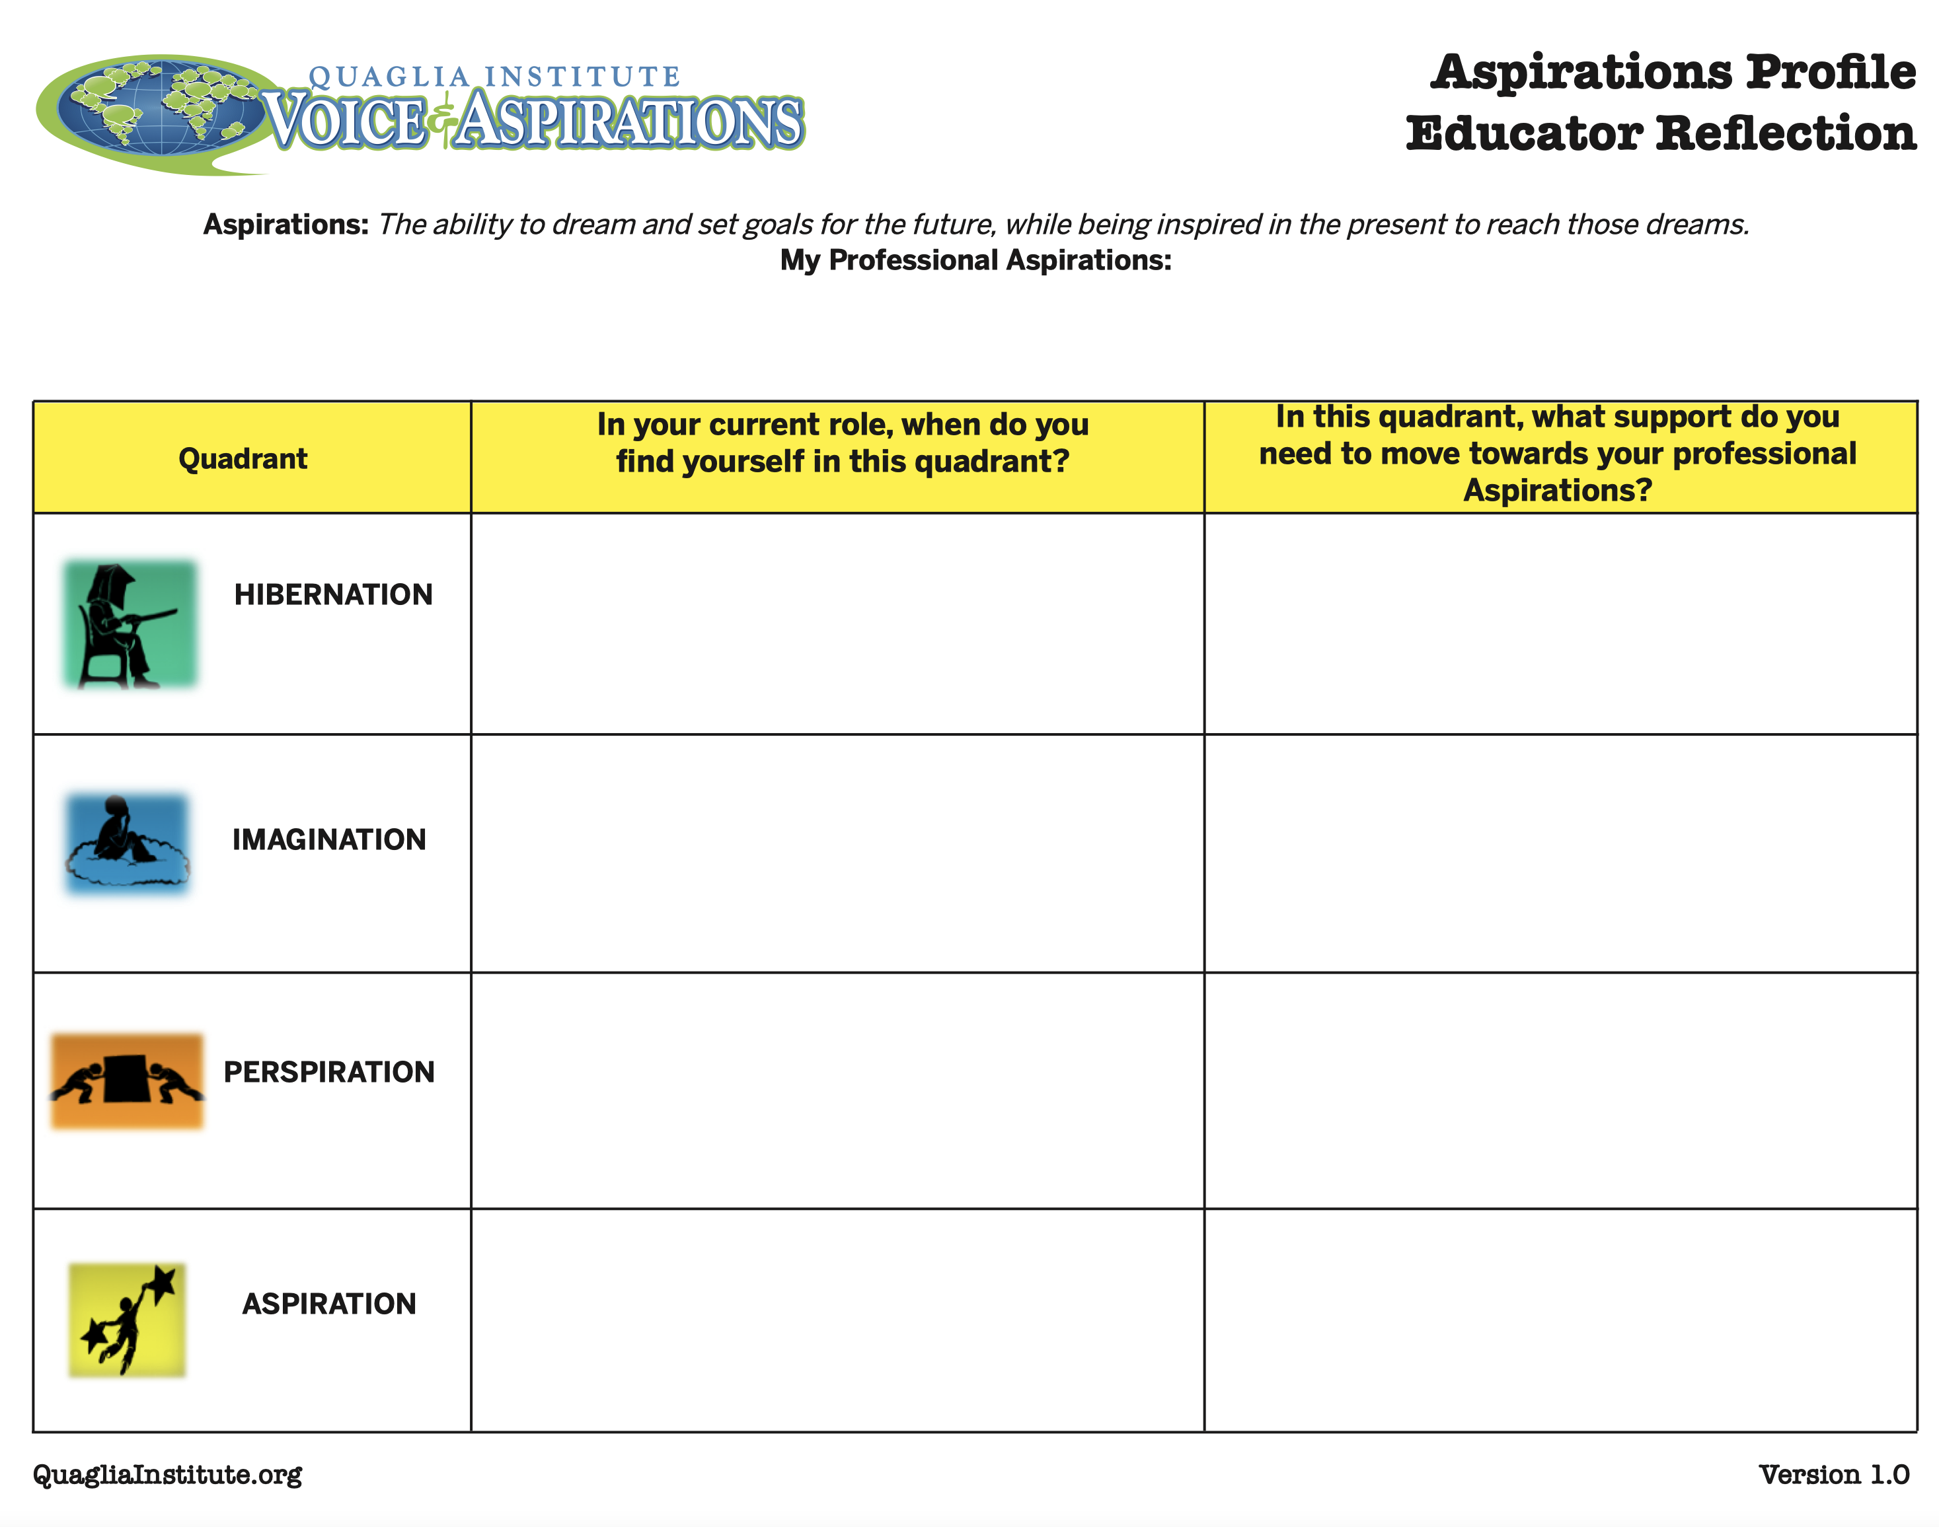
Reflect
Reflect on your professional aspirations in relation to the quadrants.
Resource #4
Aspirations
Profile Educator Reflection

Slide 37
A Quick Recap
3-Part Definition of Student
Voice & Noise v. Voice
Aspirations Profile & how it
relates to Student Voice

Slide 38
Where do we
go next?
In our next session,
we will explore the
Student Voice Process:
Listen, Learn & Lead.

Slide 39
RESOURCES

Slide 40
Deeper Learning
Opportunities
1) Commit to USE Aspirations Instructional Strategies (handout).
2) Learn the Aspirations of as many students (& staff) as you can.
3) Complete the Session #2
Action Plan.

Slide 41
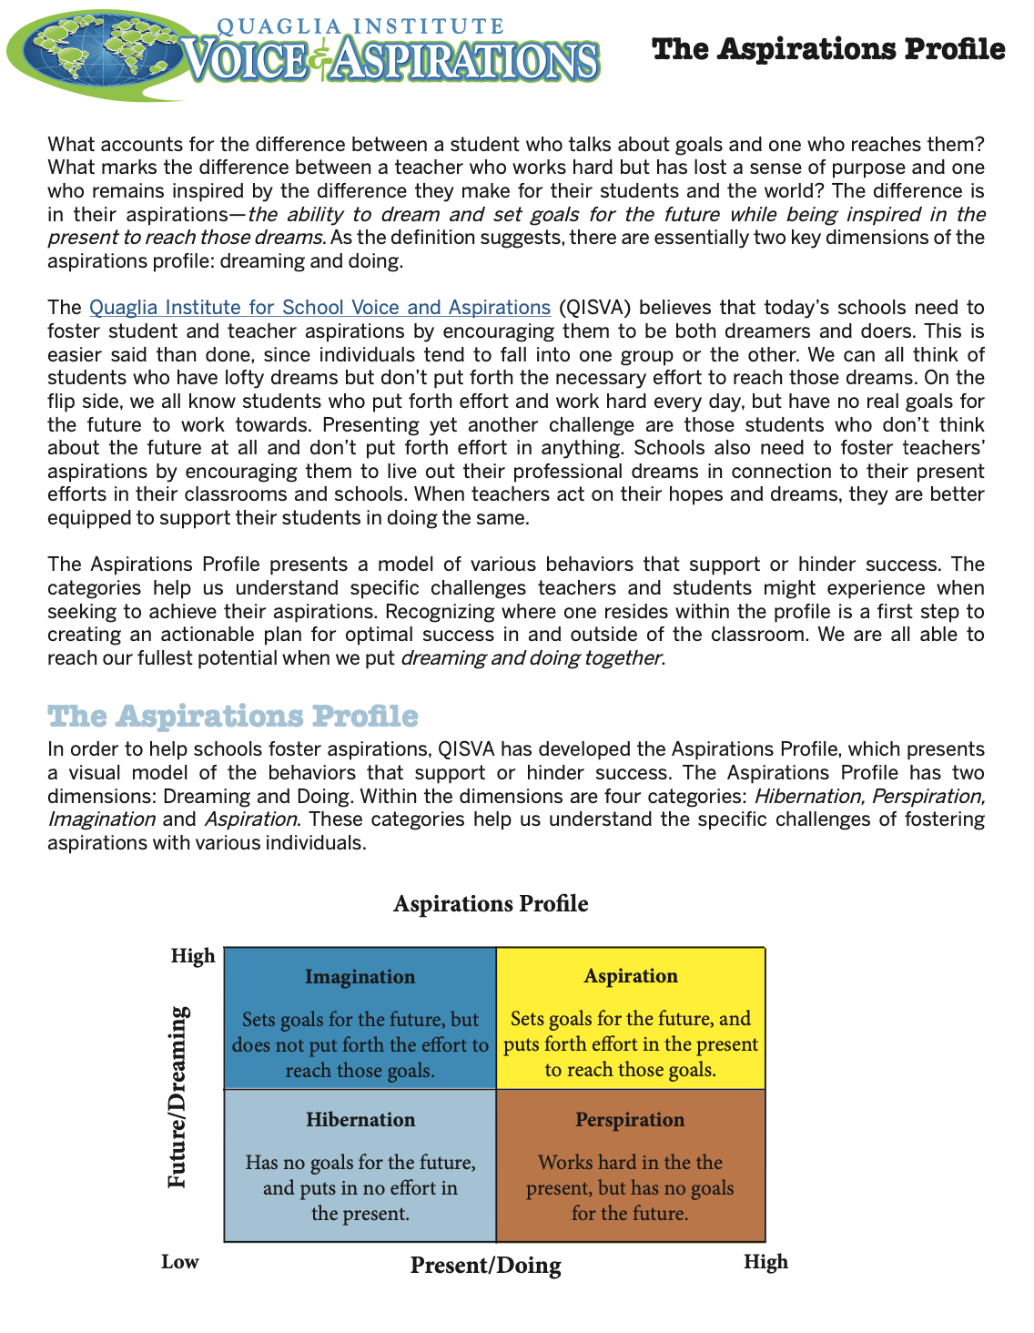
Resource #1
Aspirations
Profile Brief

Slide 42
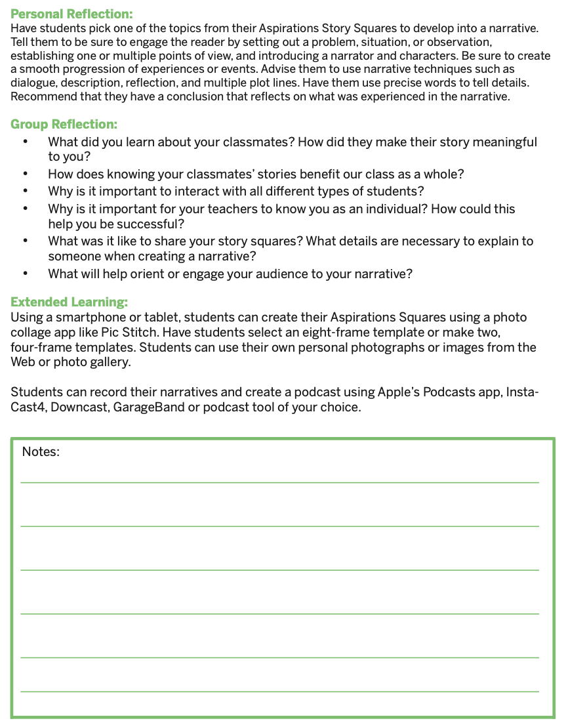
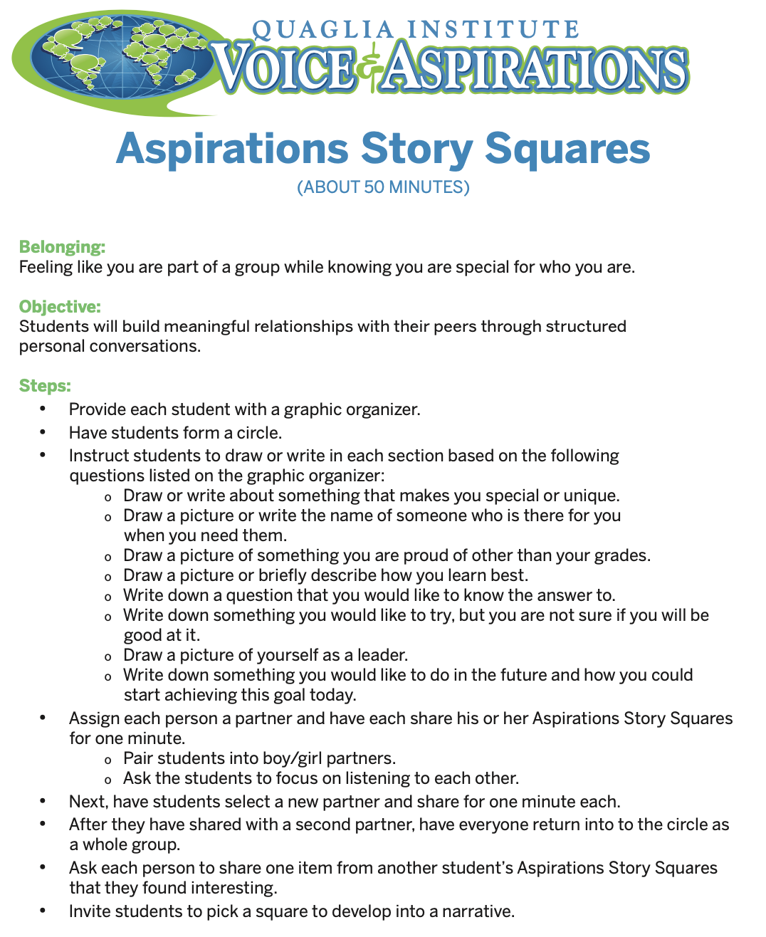
Resource #2
Aspirations
Story Squares
Lesson Plan

Slide 43

Resource #3
Aspirations
Foldable
Template

Slide 44
Resource #4
Aspirations Profile
Educator Reflection

Slide 45
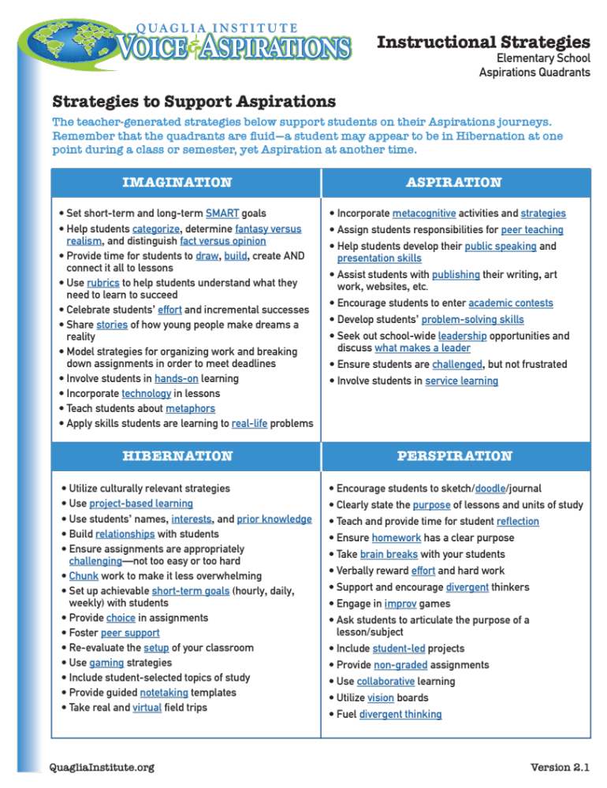
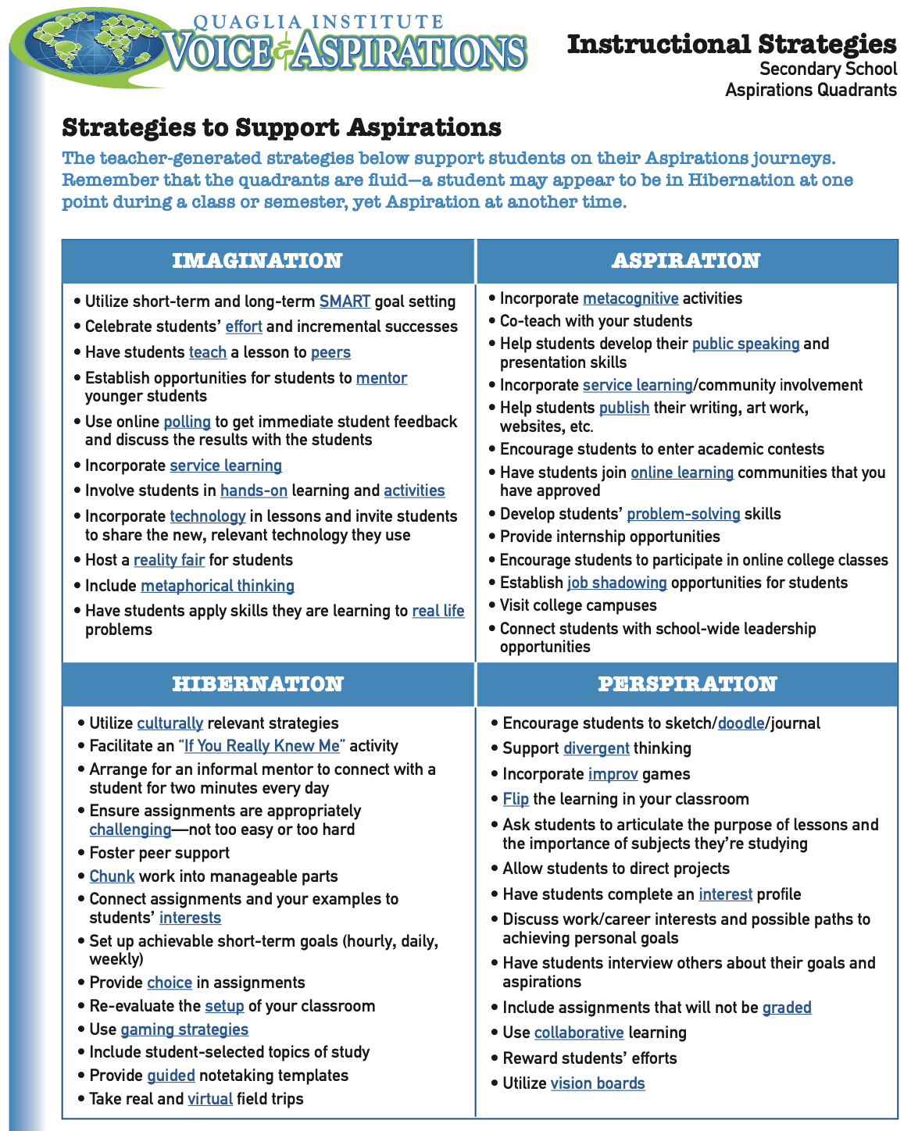
Resource #5a
Aspirations Instructional Strategies Primary
Resource #5b
Aspirations Instructional Strategies Secondary

Slide 46
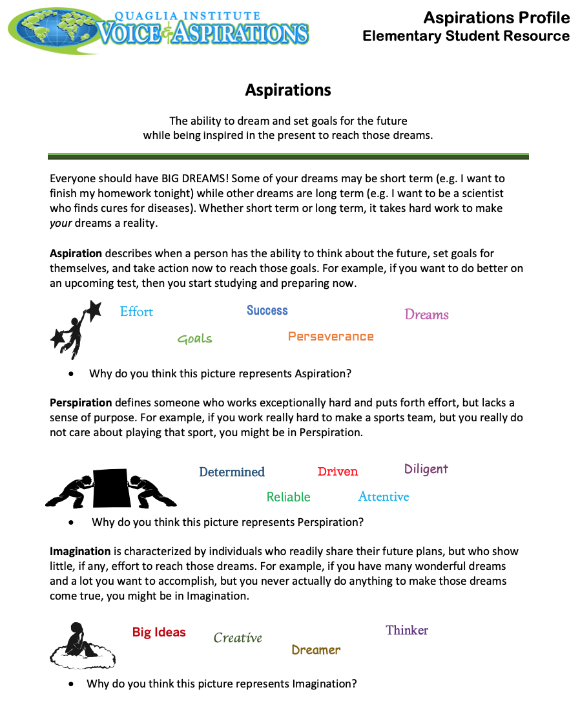
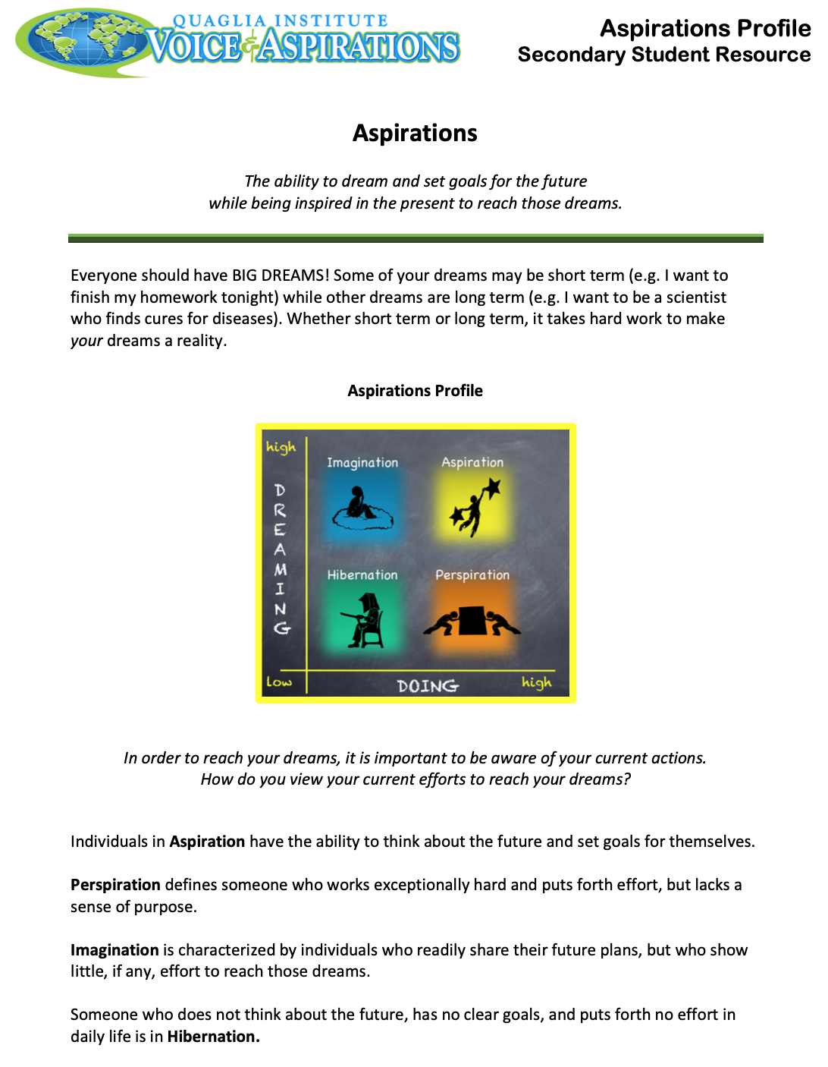
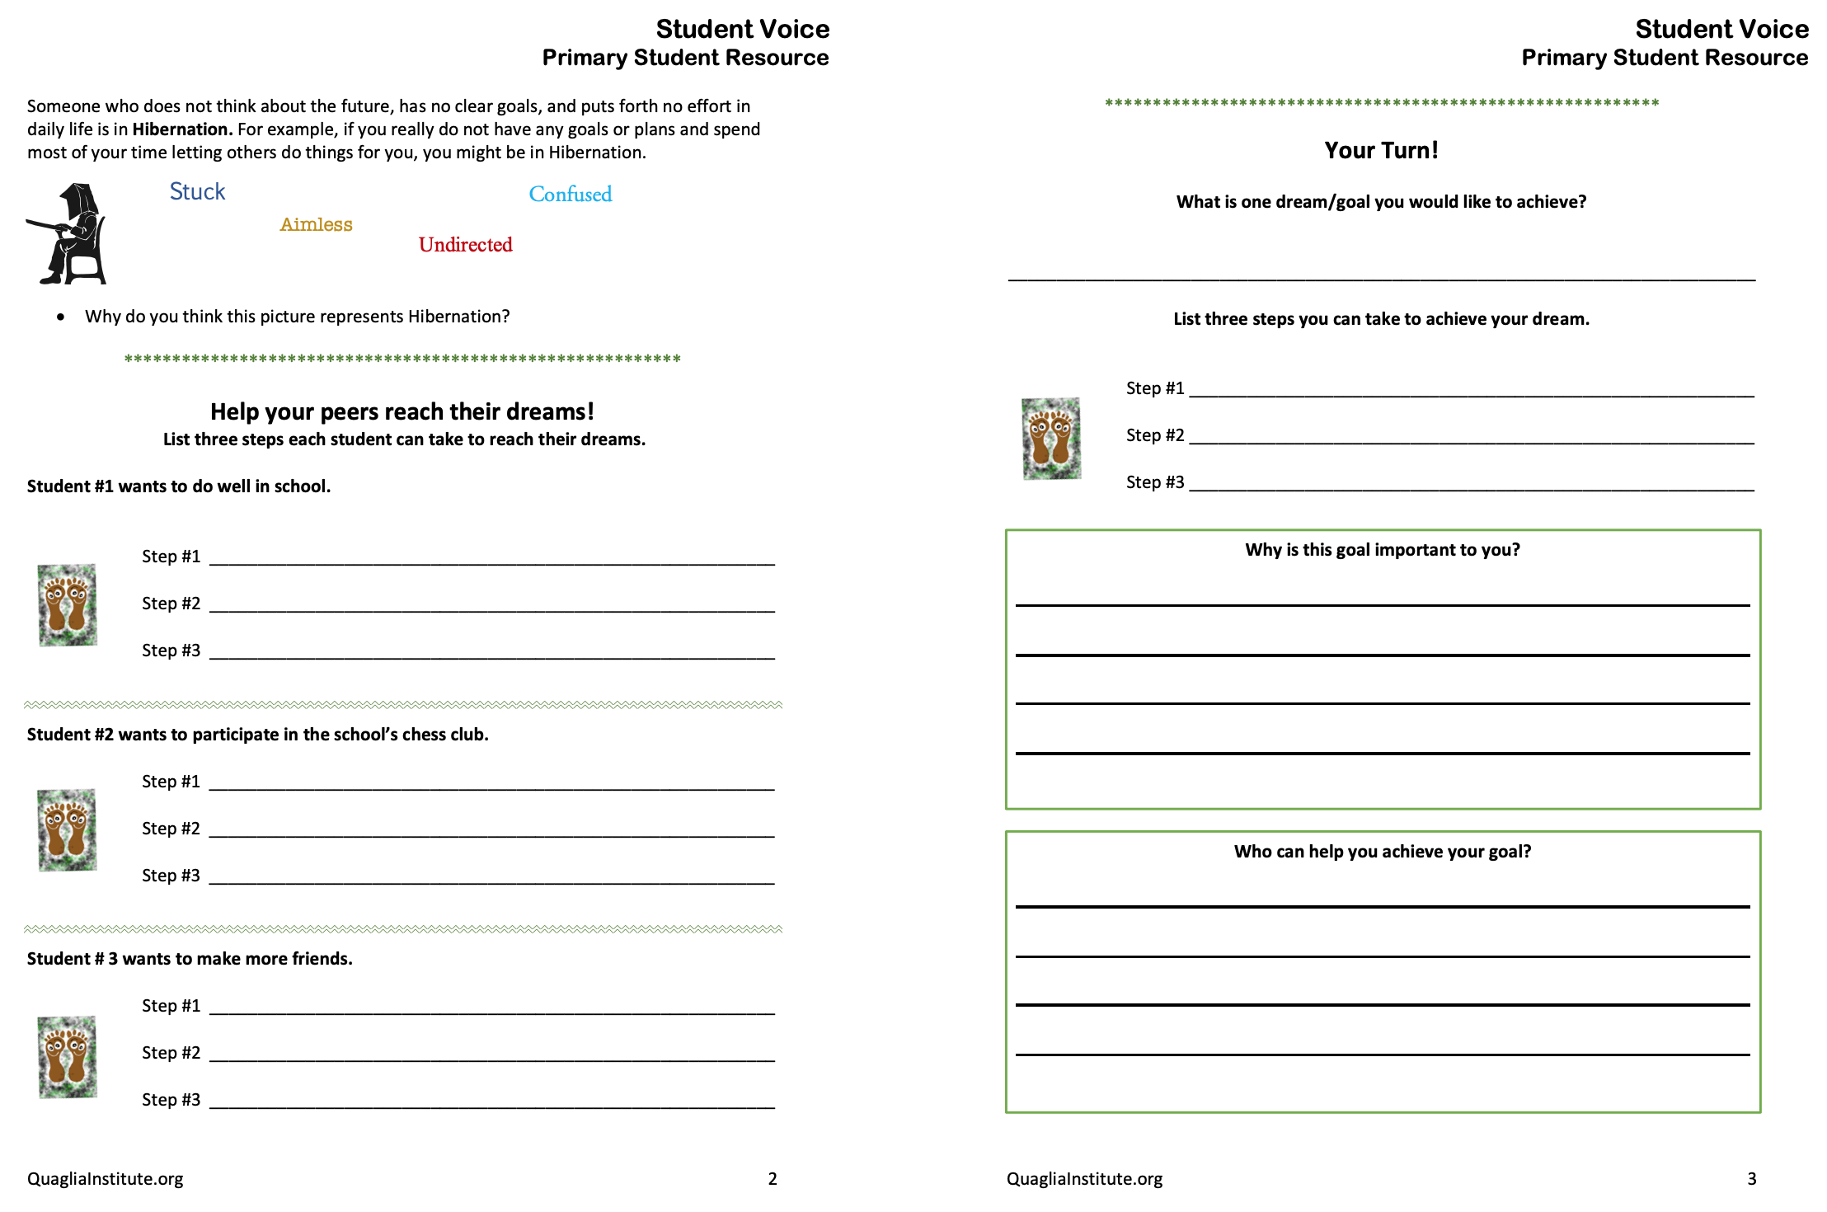
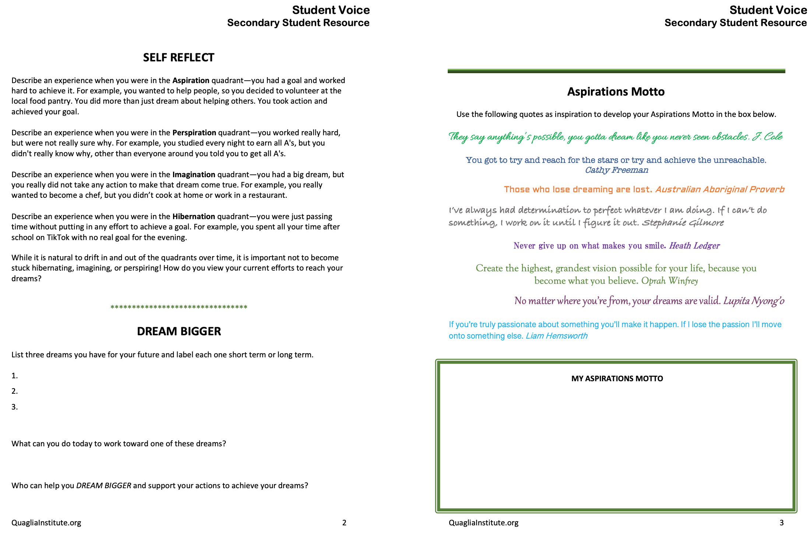
Resource #6a
Aspirations Student Resource Primary
Resource #6b
Aspirations Student
Resource Secondary

Slide 47
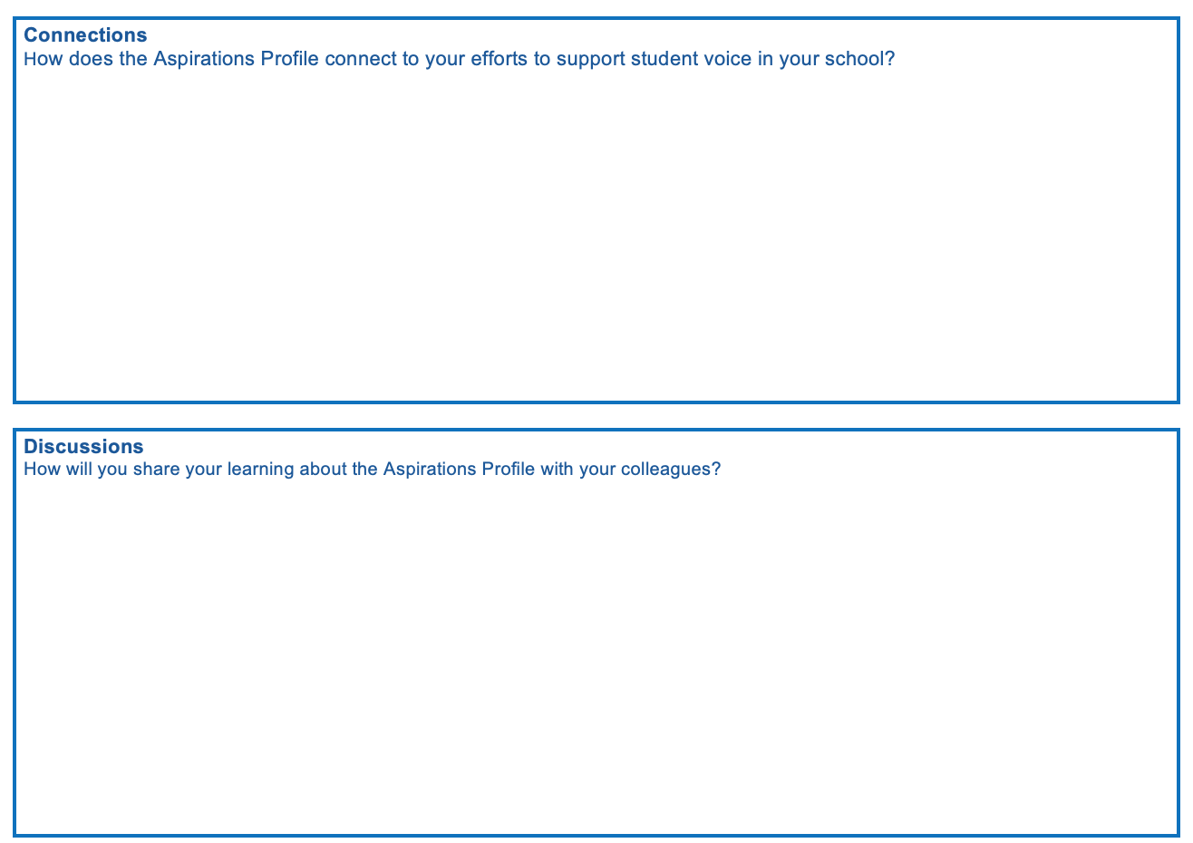
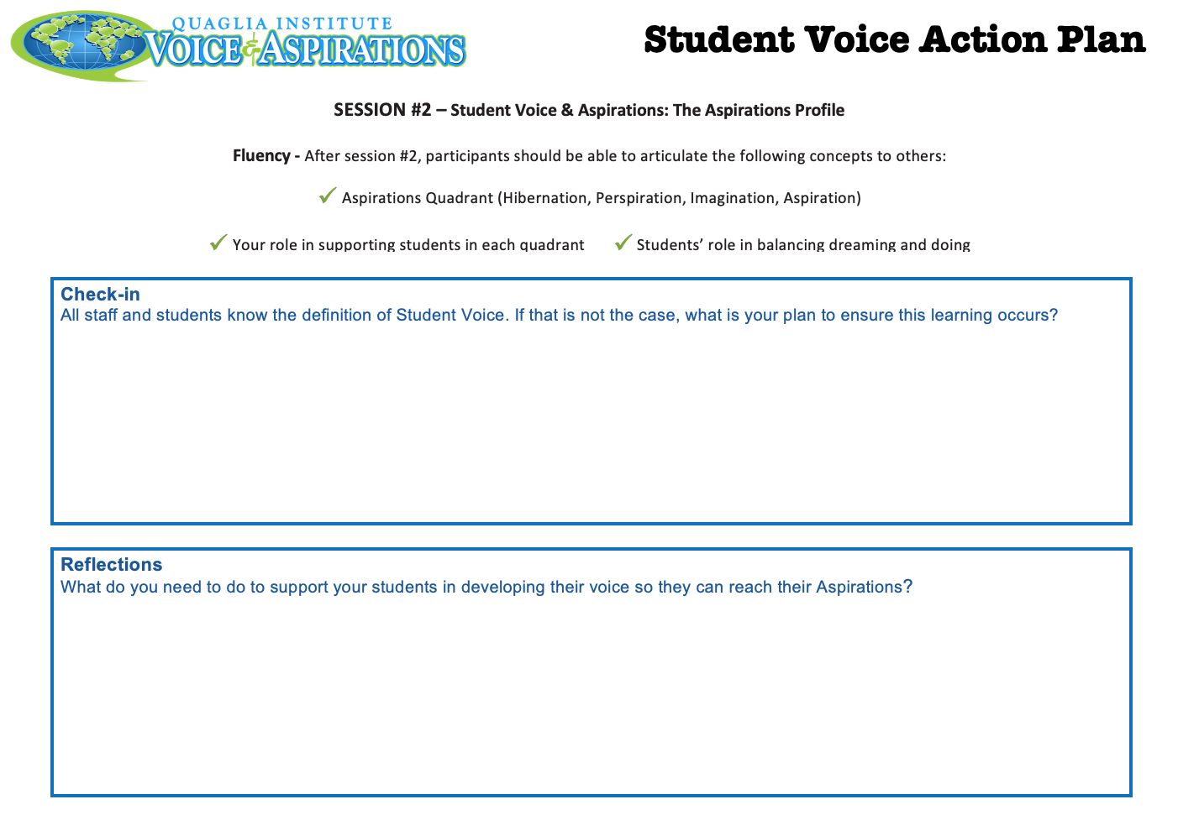
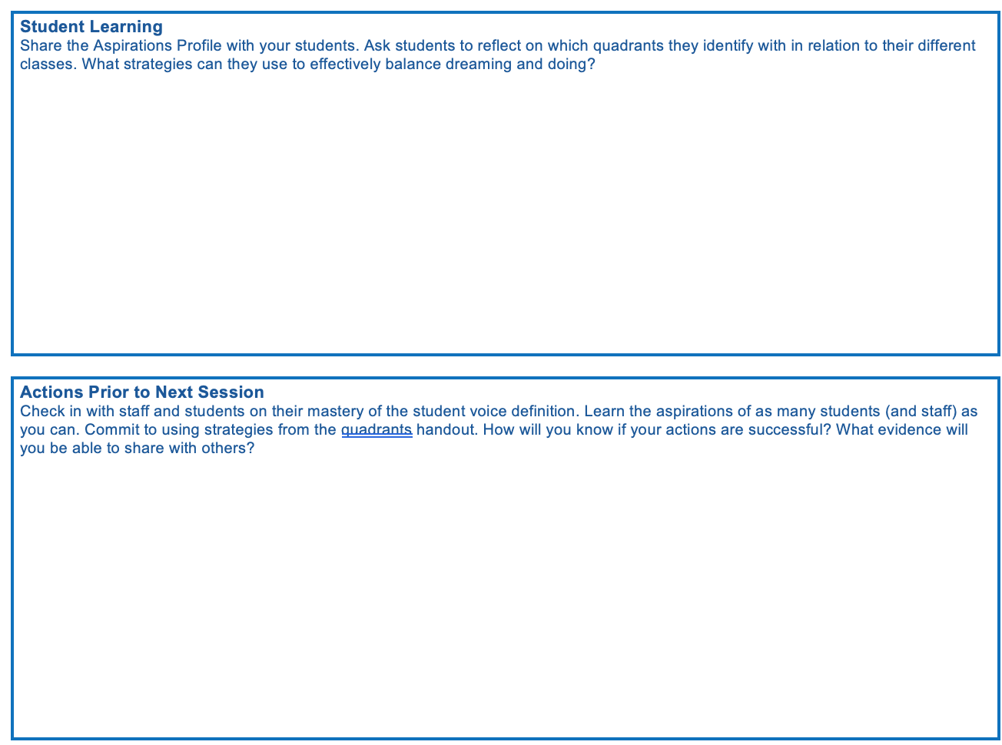
Resource #7
Aspirations
Action Plan

Slide 48

www.QuagliaInstitute.org
@QISVATweets
Dr. Lisa Lande
Lande@QuagliaInstitute.org
@Lisa_Lande
Sue Bryen
Bryen@QuagliaInstitute.org

Slide 49

Reflect
What action are you willing to take to amplify Student Voice at your school?

Slide 50
The Dynamics of Student
Voice & Aspirations
Next Session
The Voice Process: Listen, Learn, Lead
Session#3 May 3, 2022
Dr. Russ Quaglia & Dr. Kristine Fox

