Slide 1


The Dynamics of Student
Voice & Aspirations
Introduction to Student Voice
Session #1 April 26, 2022
Dr. Russ Quaglia & Dr. Lisa Lande

Slide 2
Fundamental Beliefs
Students are the potential, not the problem.
Students have something to teach us.
Working with students is the only way forward.

Slide 3
Goals for Today
Provide an introduction to Student Voice & embrace a common definition for Voice.
Consider how Student Voice applies to
teaching & learning.
Apply learning to amplify student
voice in YOUR school.

Slide 4

Waterfall Chats
Type your response in the chat,
but don’t push send…yet!
Reread your response & see if there is
anything you want to edit or add.
When I say “waterfall”, push send!
Scroll up & read what others have written.
Type a response to what at least one
other person has written.

Slide 5
Waterfall Chats
What comes to mind when you hear the term
Student Voice?

Slide 6

Quaglia Institute Research
17 years of data
43 states
13 countries
980,905 Student Voice Surveys Grades 6-12
142,186 Student Voice Surveys Grades 3-5
628,975 iKnow My Class Surveys
56,353 Teacher Voice Surveys
27,115 Parent Voice Surveys
Notes:
Updated Jan 3, 2022

Slide 7
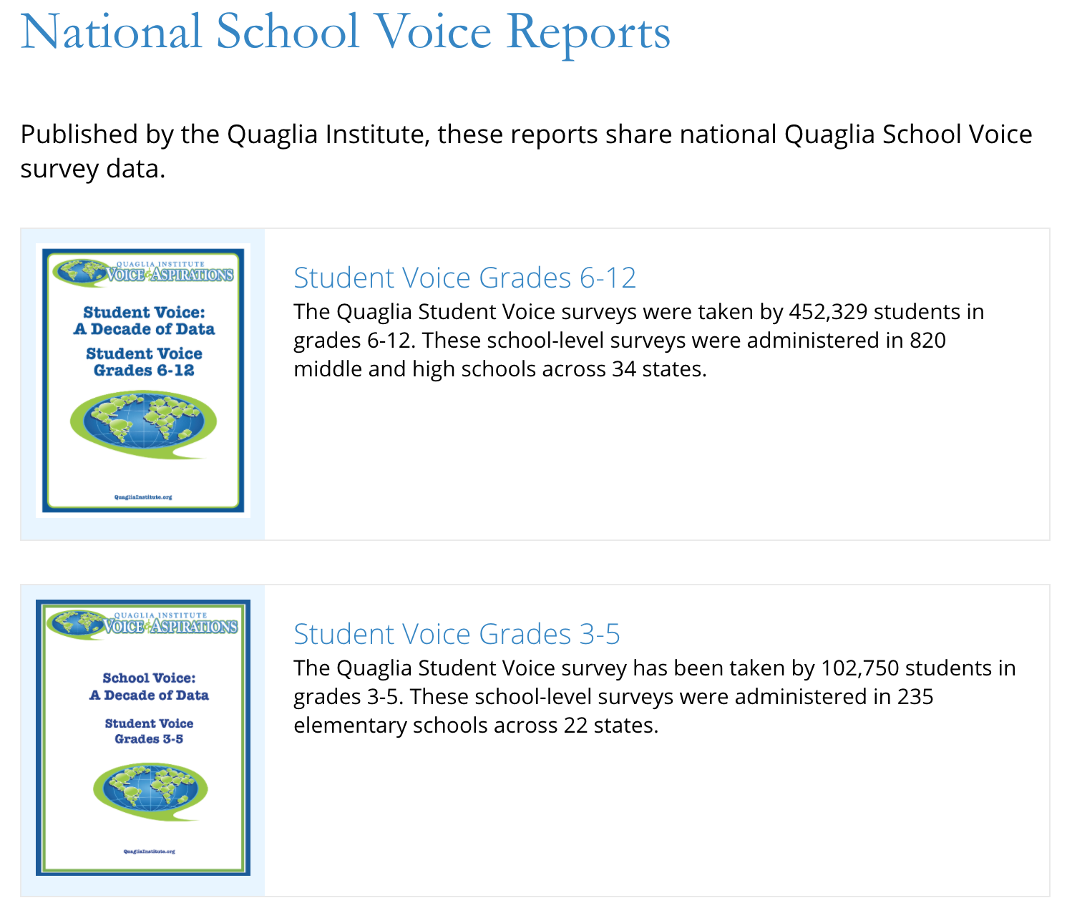
Quaglia Institute Research
QuagliaInstitute.org
National Reports from the last decade of data.

Slide 8
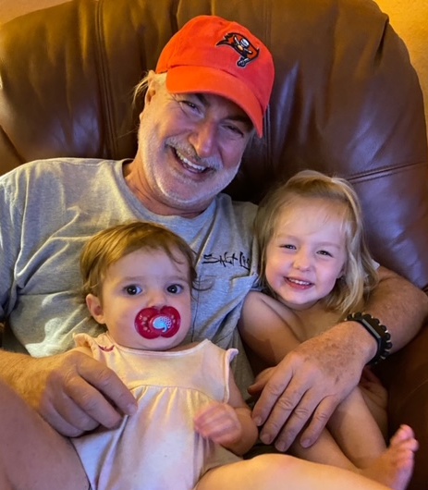
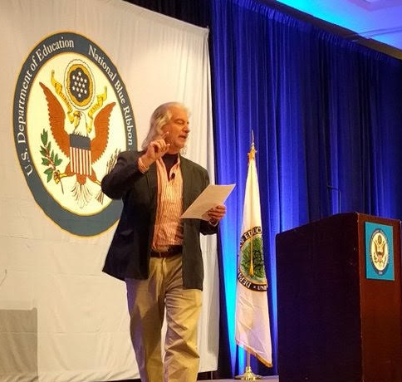

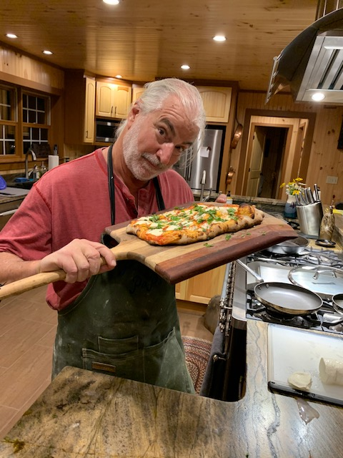
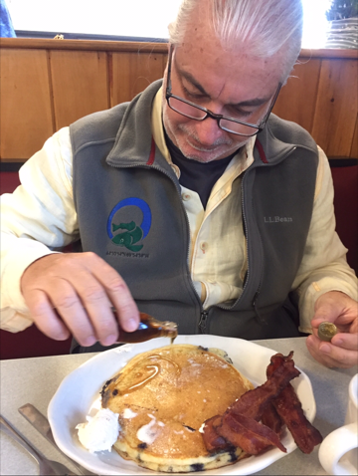


Slide 9

Why Student
Voice &
Aspirations?

Slide 10
TRIUMPHS…
When you Google “Student Voice” you get over
1,010,000,000 results
Search YouTube about “Student Voice” you get over
339,000,000 results
United Nations, Rights of the Child addresses the
importance of Student Voice
Countries, States, and school districts
are making Student Voice a key initiative
Student Voice is not a passing educational whim .

Slide 11
TRIBULATIONS…
46% Students have a voice in decision making at school.
51% Teachers are willing to learn from students.
48% Students develop programs that improve the whole school.
54% Adults and students work together to make our school better.

Slide 12

Students say…
44% School is boring.
42% Teachers make school an exciting place to learn.
43% My classes help me understand what is happening in my everyday life.

Slide 13
Student Voice
Implications….
When students have a voice they are 3X more likely to experience
Self-Worth in school.

Slide 14
Student Voice
Implications….
When students have a voice they are 5X more likely to experience Engagement in school.

Slide 15
Student Voice
Implications….
When students have a voice they are 5X more likely to experience Purpose in school.

Slide 16


REFLECT
What does this data tell us about ourselves?
What is holding us back from Student Voice as a “Way of Being” in schools.

Slide 17

And so the
journey begins!
First, we need a clear
definition of student voice
that we can all
understand, accept, &
put into practice.

Slide 18

The 3 Components of Student Voice
Resource #1
Voice Definition
Brief
Sharing thoughts & ideas in an environment underpinned by trust & respect.
Offering realistic suggestions for the
good of the whole.
Accepting responsibility for not only what is said but also what needs to be done.

Slide 19
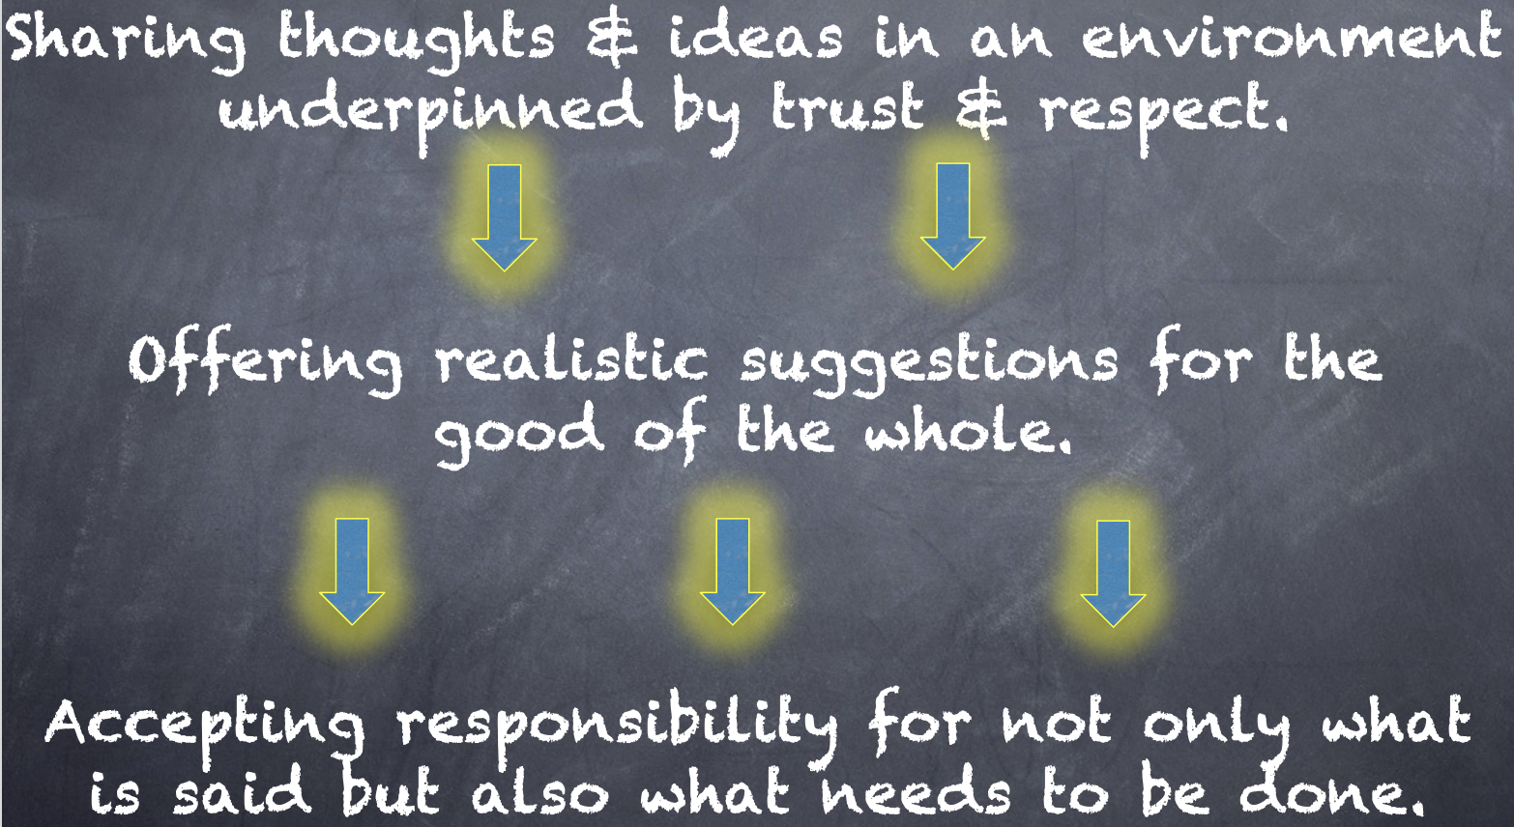
REFLECT
What resonates with you from the Voice definition? What questions do you have as you think about embracing this definition at your school?

Slide 20

Quick Break!

Slide 21

Challenge Time…

Slide 22

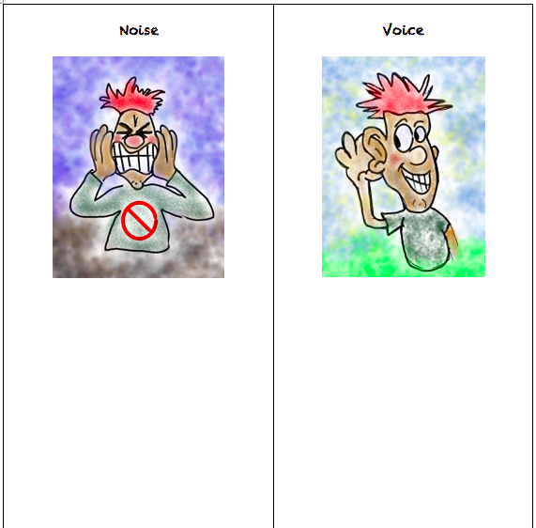


CHALLENGE
Noise vs. Voice
Share words, phrases, &
examples of
Noise.
Resource #2
Noise v Voice
Now share words, phrases, &
examples of
Voice.

Slide 23
Noise vs Voice
Student Noise
Demands/commands/chaotic
Student opinion is most important
All adult voice is negative
Everyone needs to change but me
Complaining/whining
Student Voice
Requests/inquiry/focused
Our ideas are stronger in partnership
Students are open to learn
Personal reflection
Accepting responsibility

Slide 24
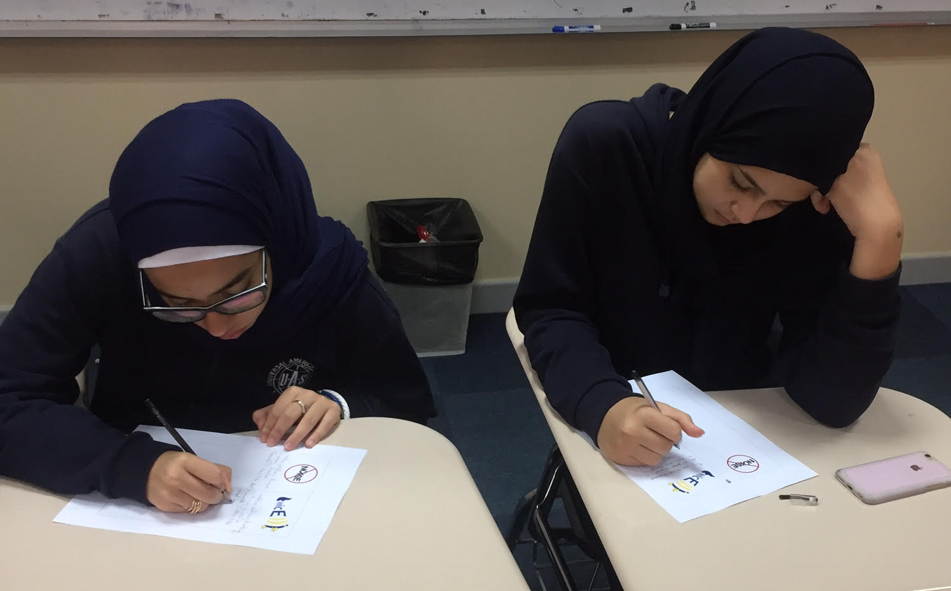
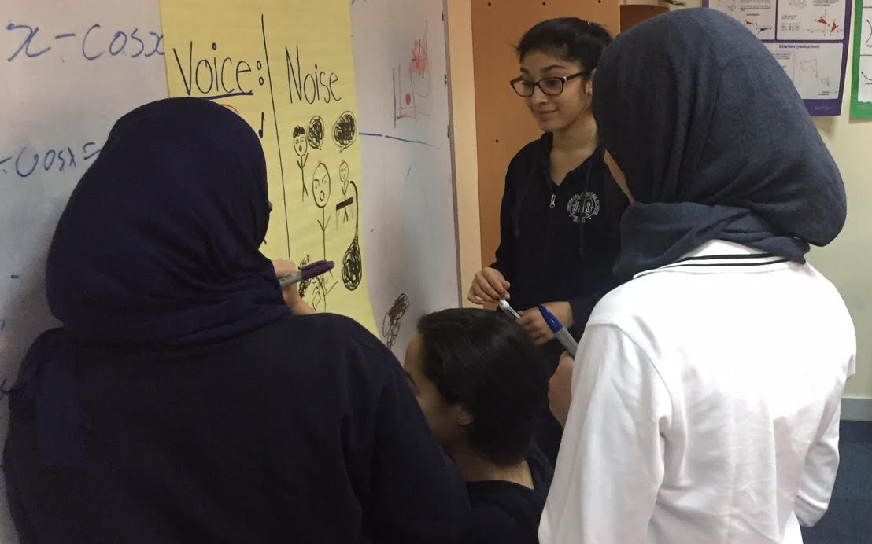
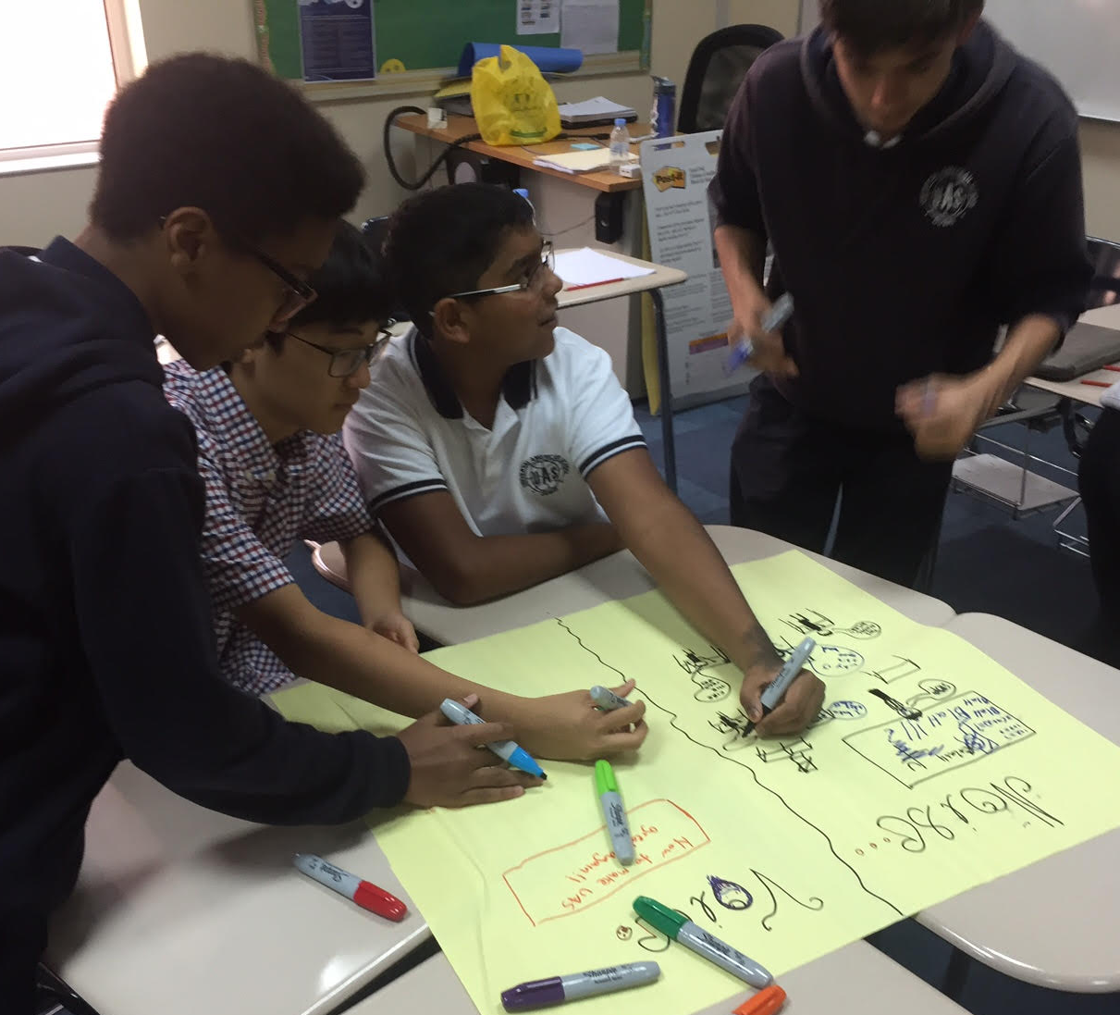
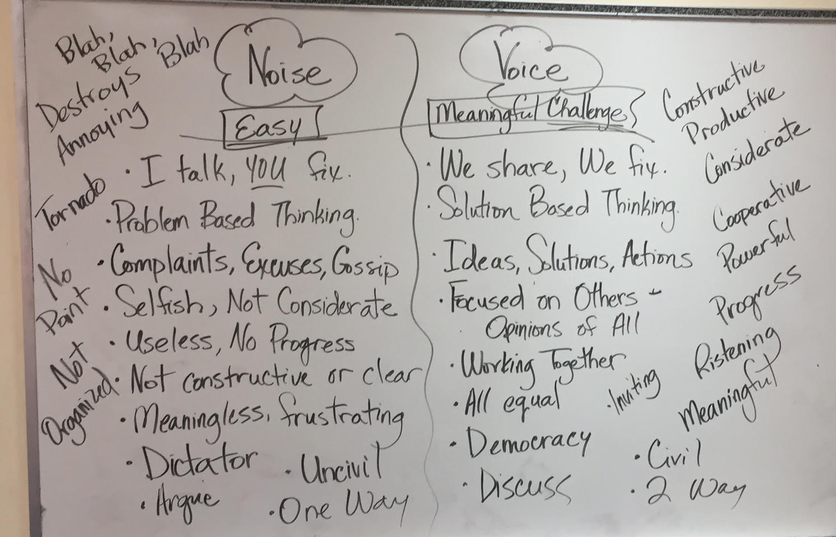

Slide 25
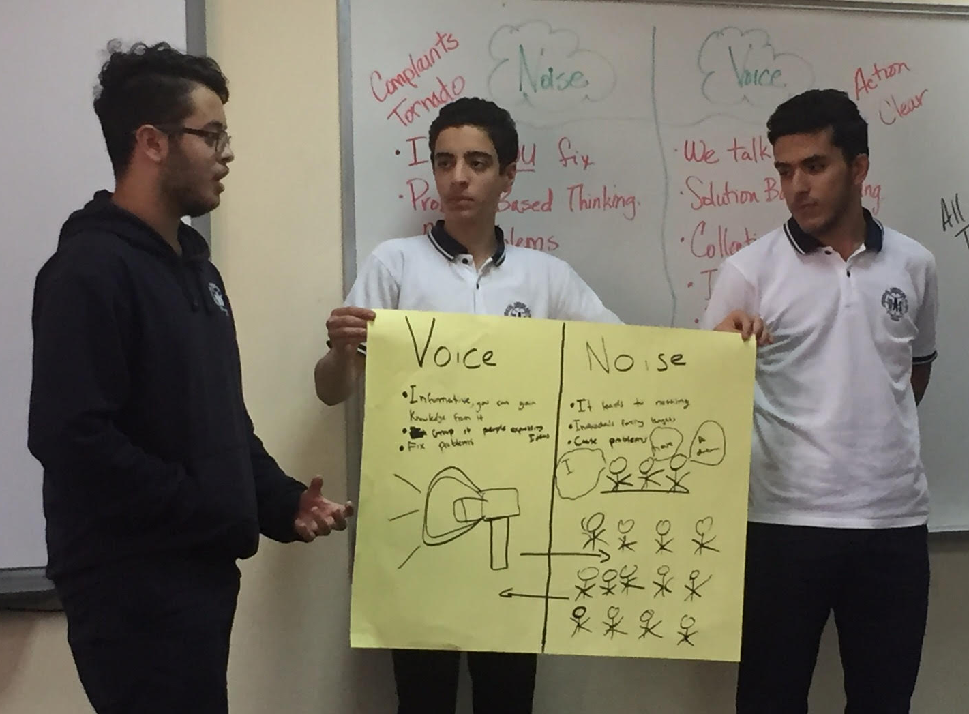
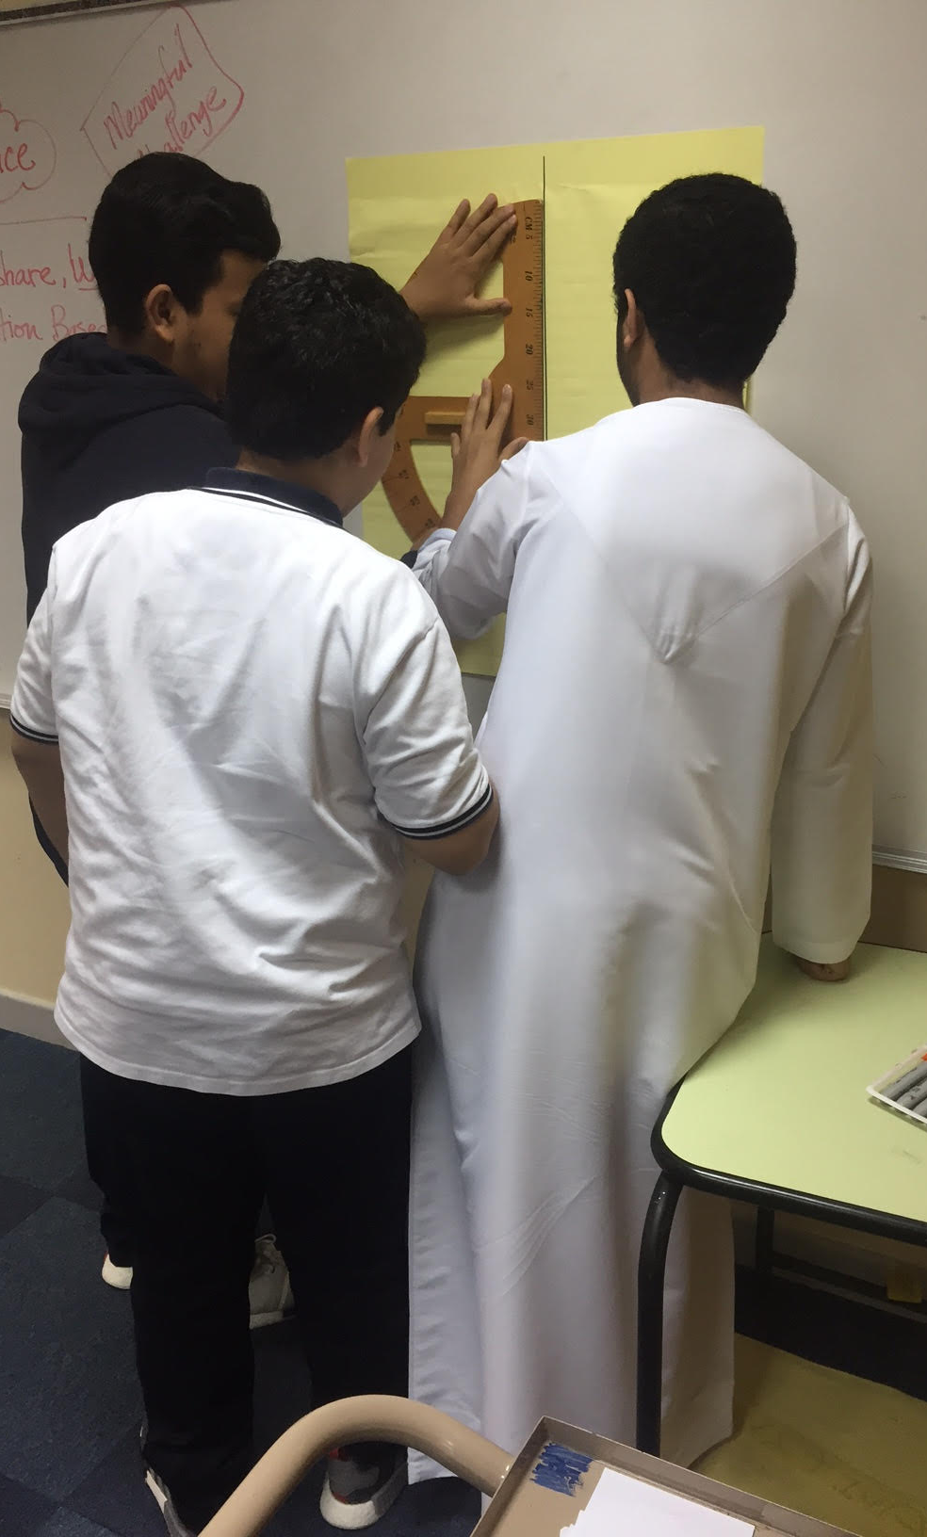
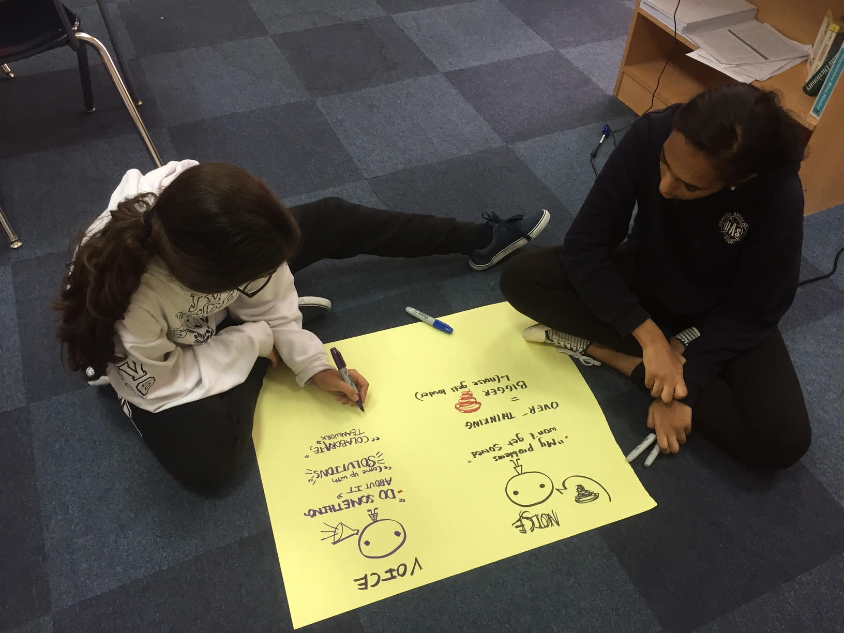

Slide 26
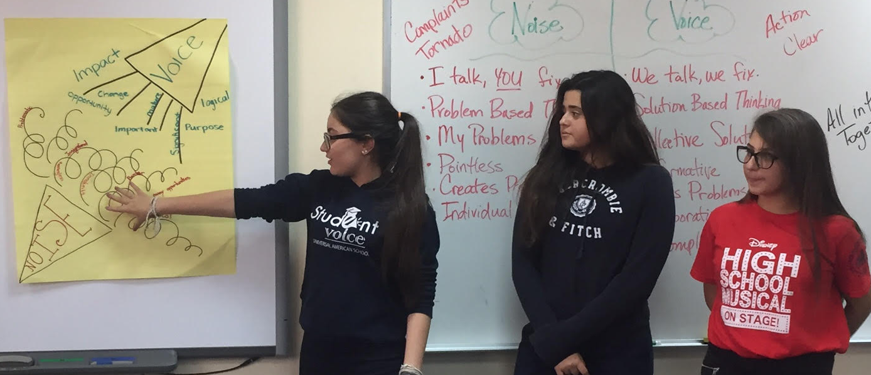
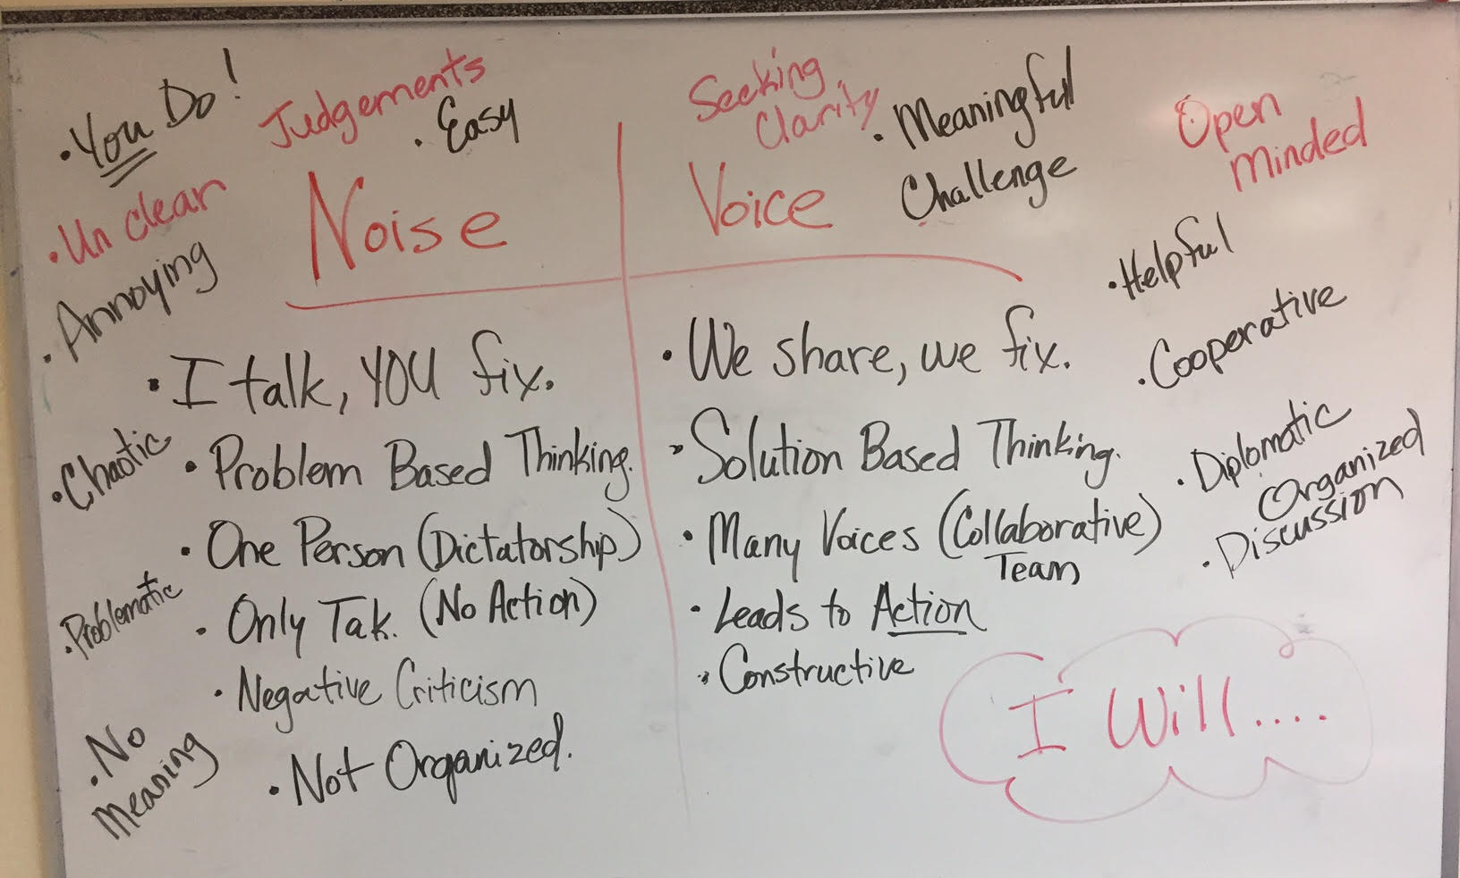
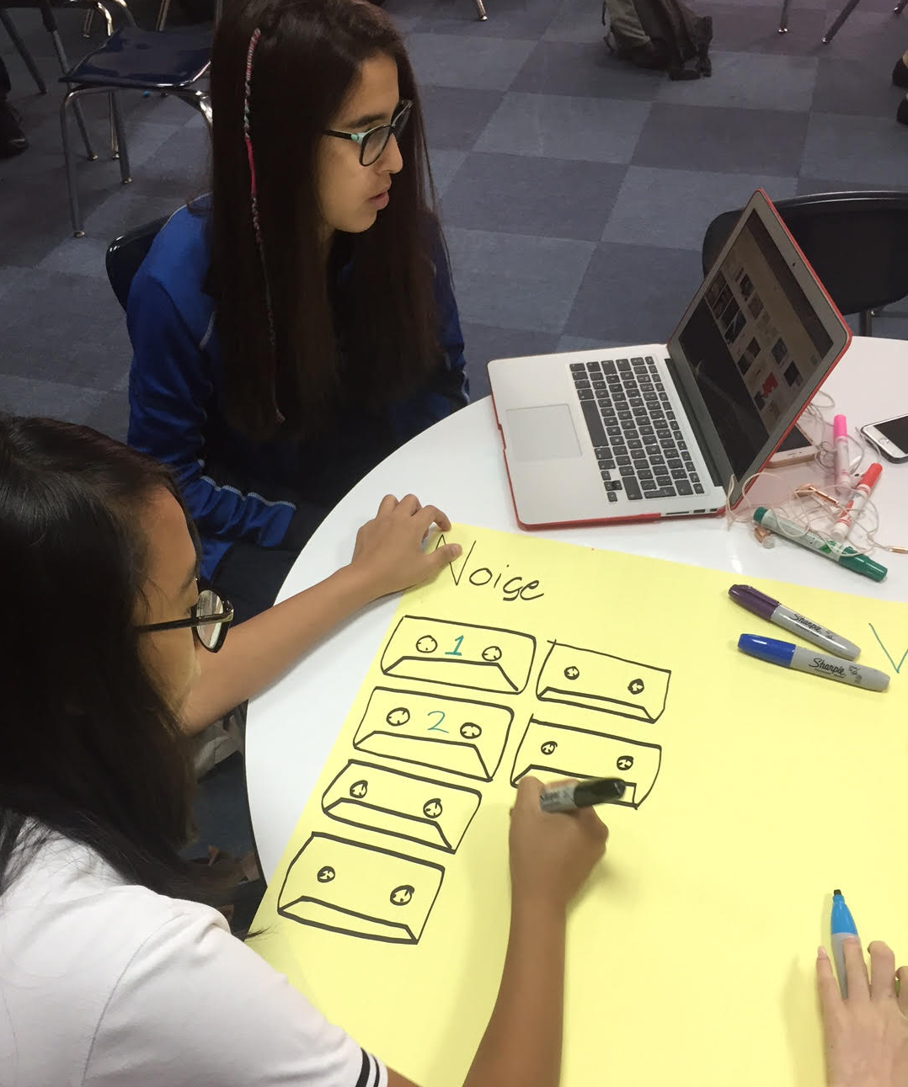

Slide 27
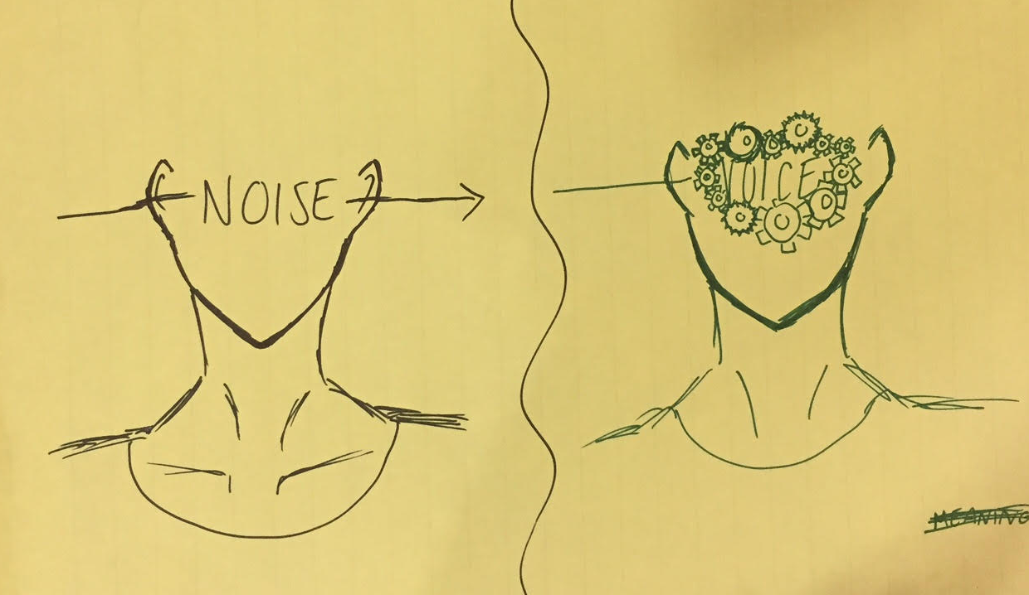
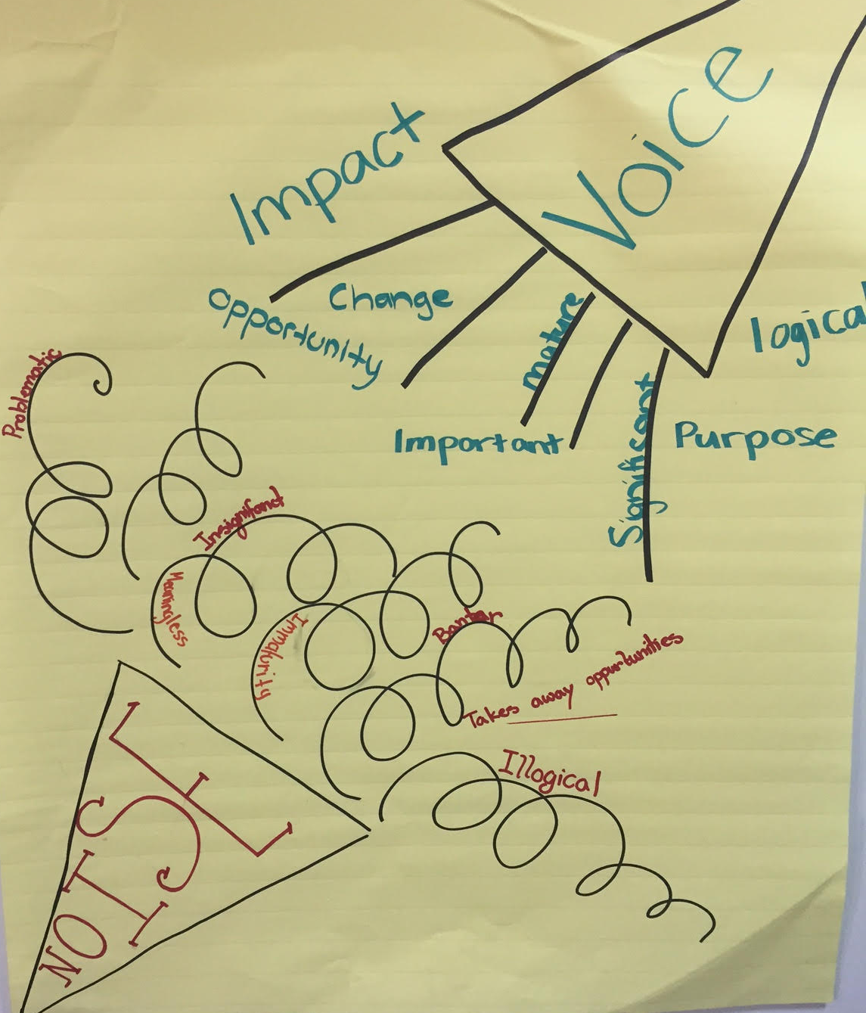

Slide 28
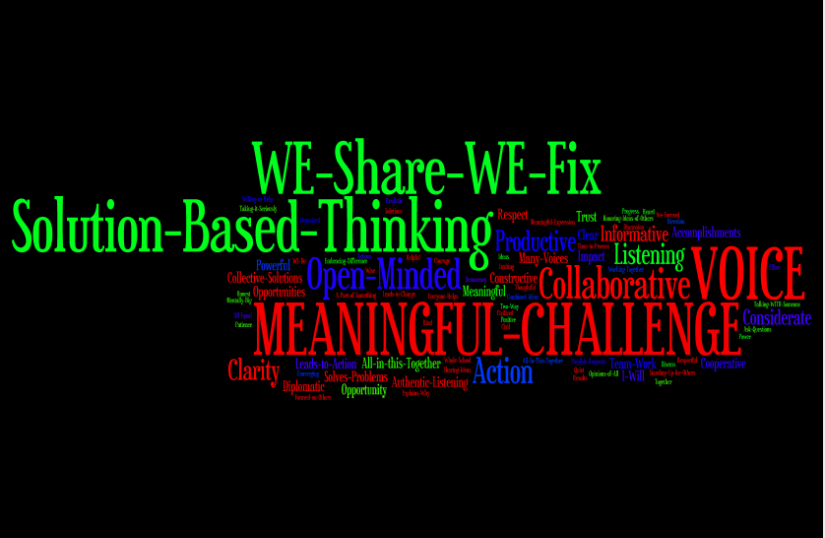

Slide 29
Students Control the Volume
Voice Inhibitors
Anger/extreme emotion
Rhetoric
Volume/Tone
Close Minded
Self-Serving
Voice Amplifiers
Authenticity/Genuineness
Knowledge
Refocus, Reanalyze, Readjust
Relentless
Being a “student”

Slide 30
REFLECT
What skills do your students need for their voices to be heard?

Slide 31
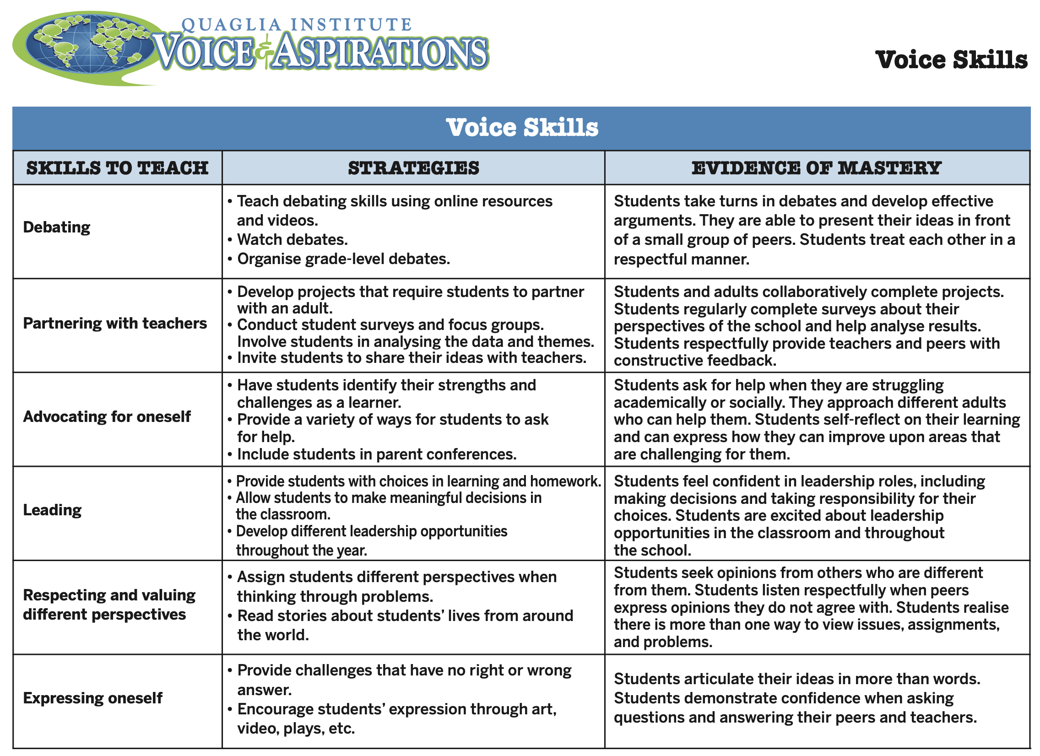
Resource #3
Voice Skills

Slide 32
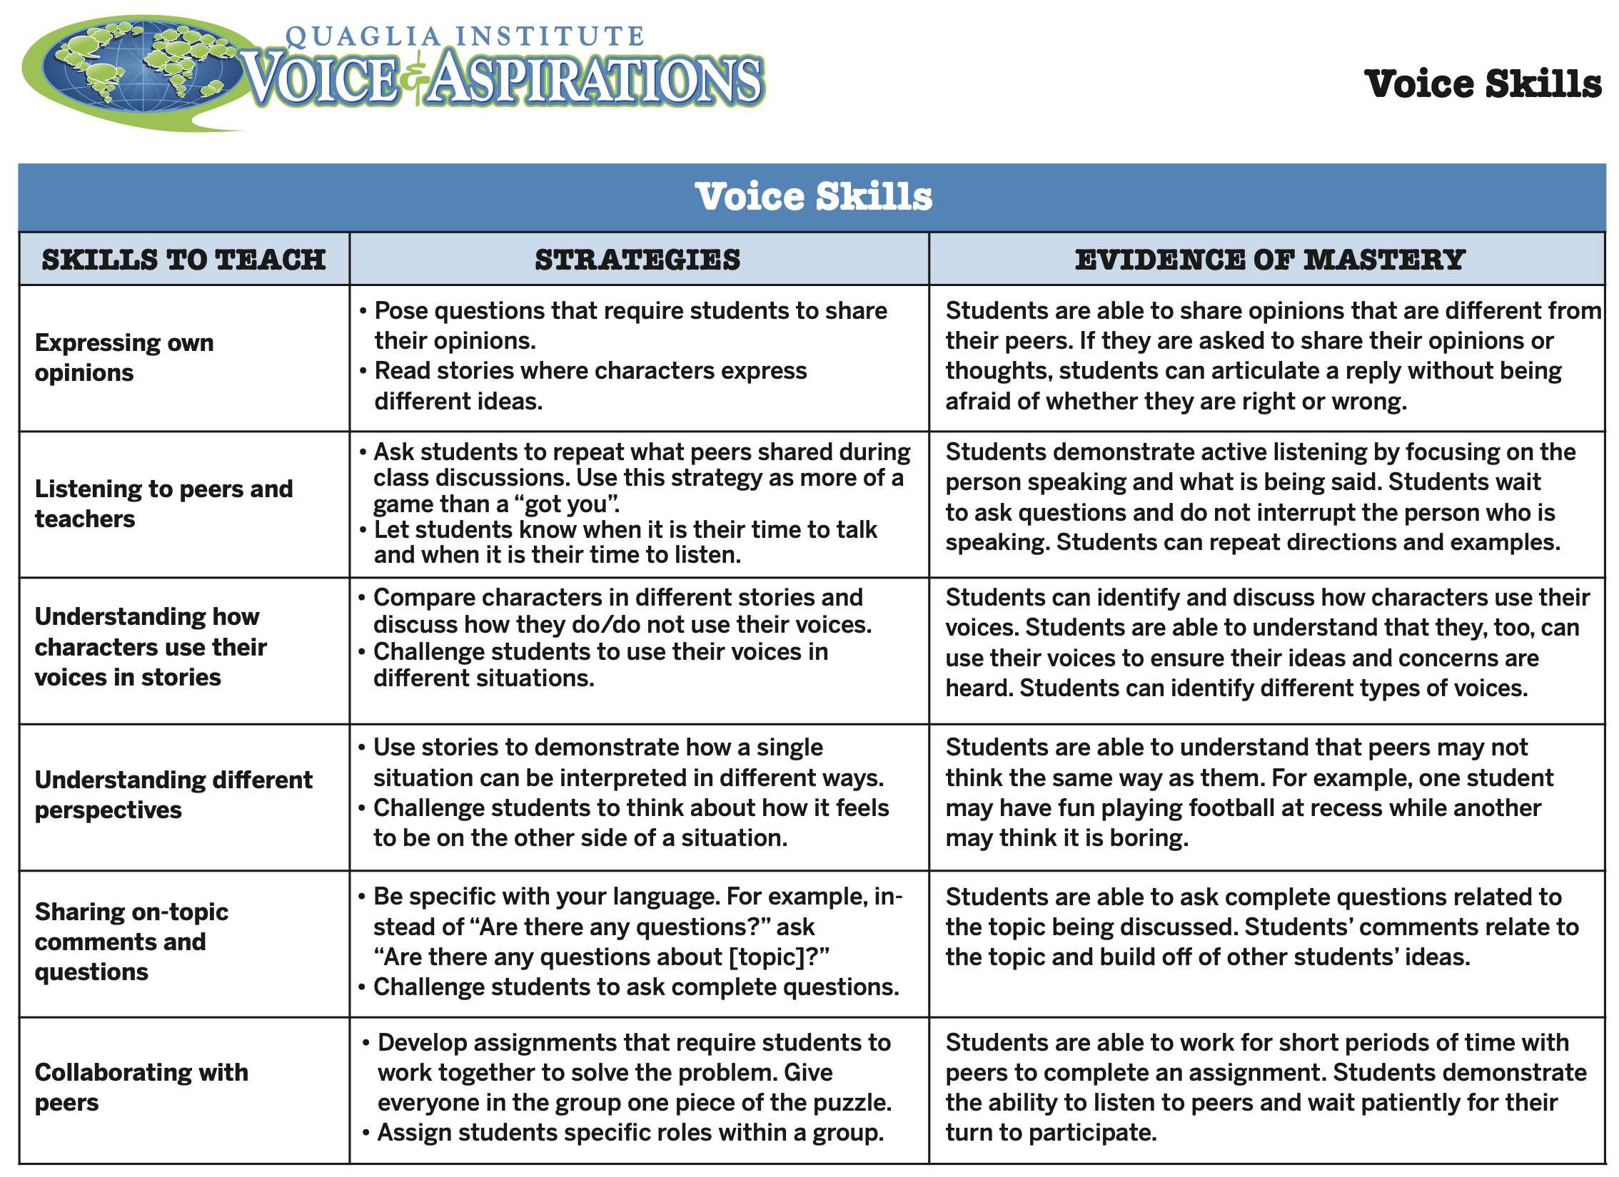

Slide 33
Challenge Time…

Slide 34

Greta Thunberg

Slide 35
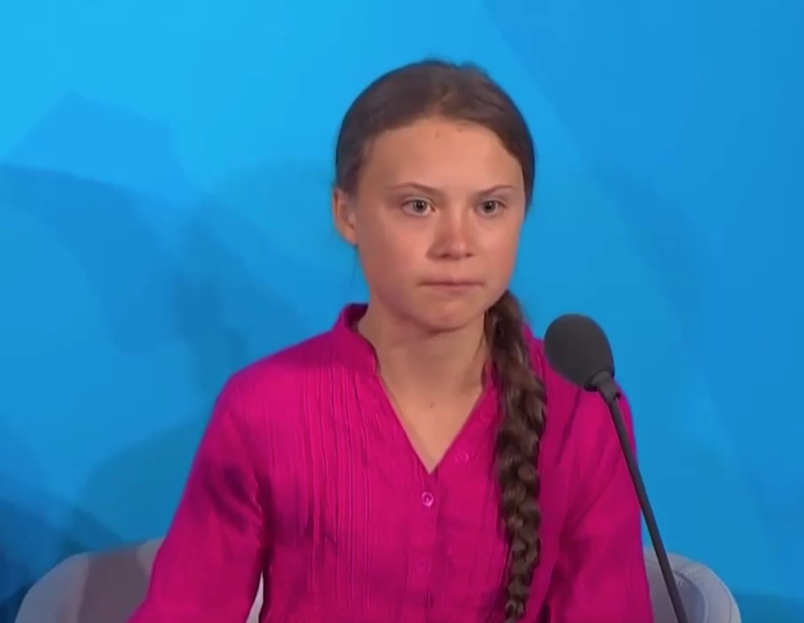
Video

Slide 36





Slide 37

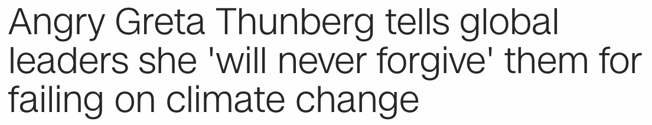
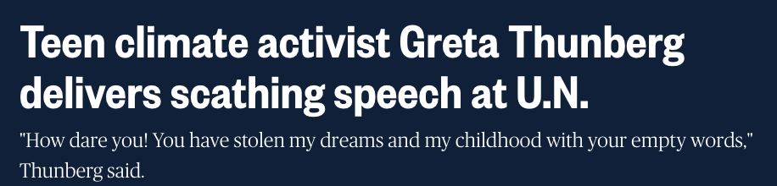
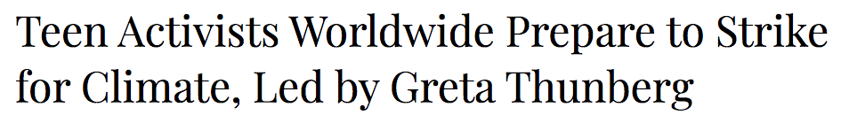
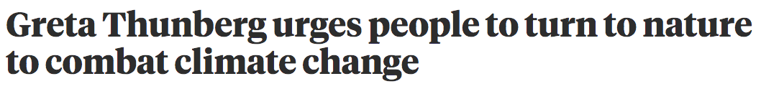

Slide 38
Resource #4
Tag Team Debate
Lesson Plan
Challenge
Tag Team Debate
This is a PERFECT example
of Student Voice.
In the Zoom chat, give a Pro or a
Con response to the above
statement.
Now flip and provide a response for the opposite side of the
argument you just made.

Slide 39
Where do we
go next?
Aspirations Profile: Balancing
Dreaming & Doing
Student Voice Process: Listen,
Learn, Lead
Aspirations Framework:
Self-Worth, Engagement, Purpose

Slide 40
RESOURCES

Slide 41

Deeper Learning
Opportunities
1) Commit to embracing the Student Voice definition across your school.
2) Use & share Voice Instructional Strategies.
3) Complete the Session #1
Action Plan.

Slide 42
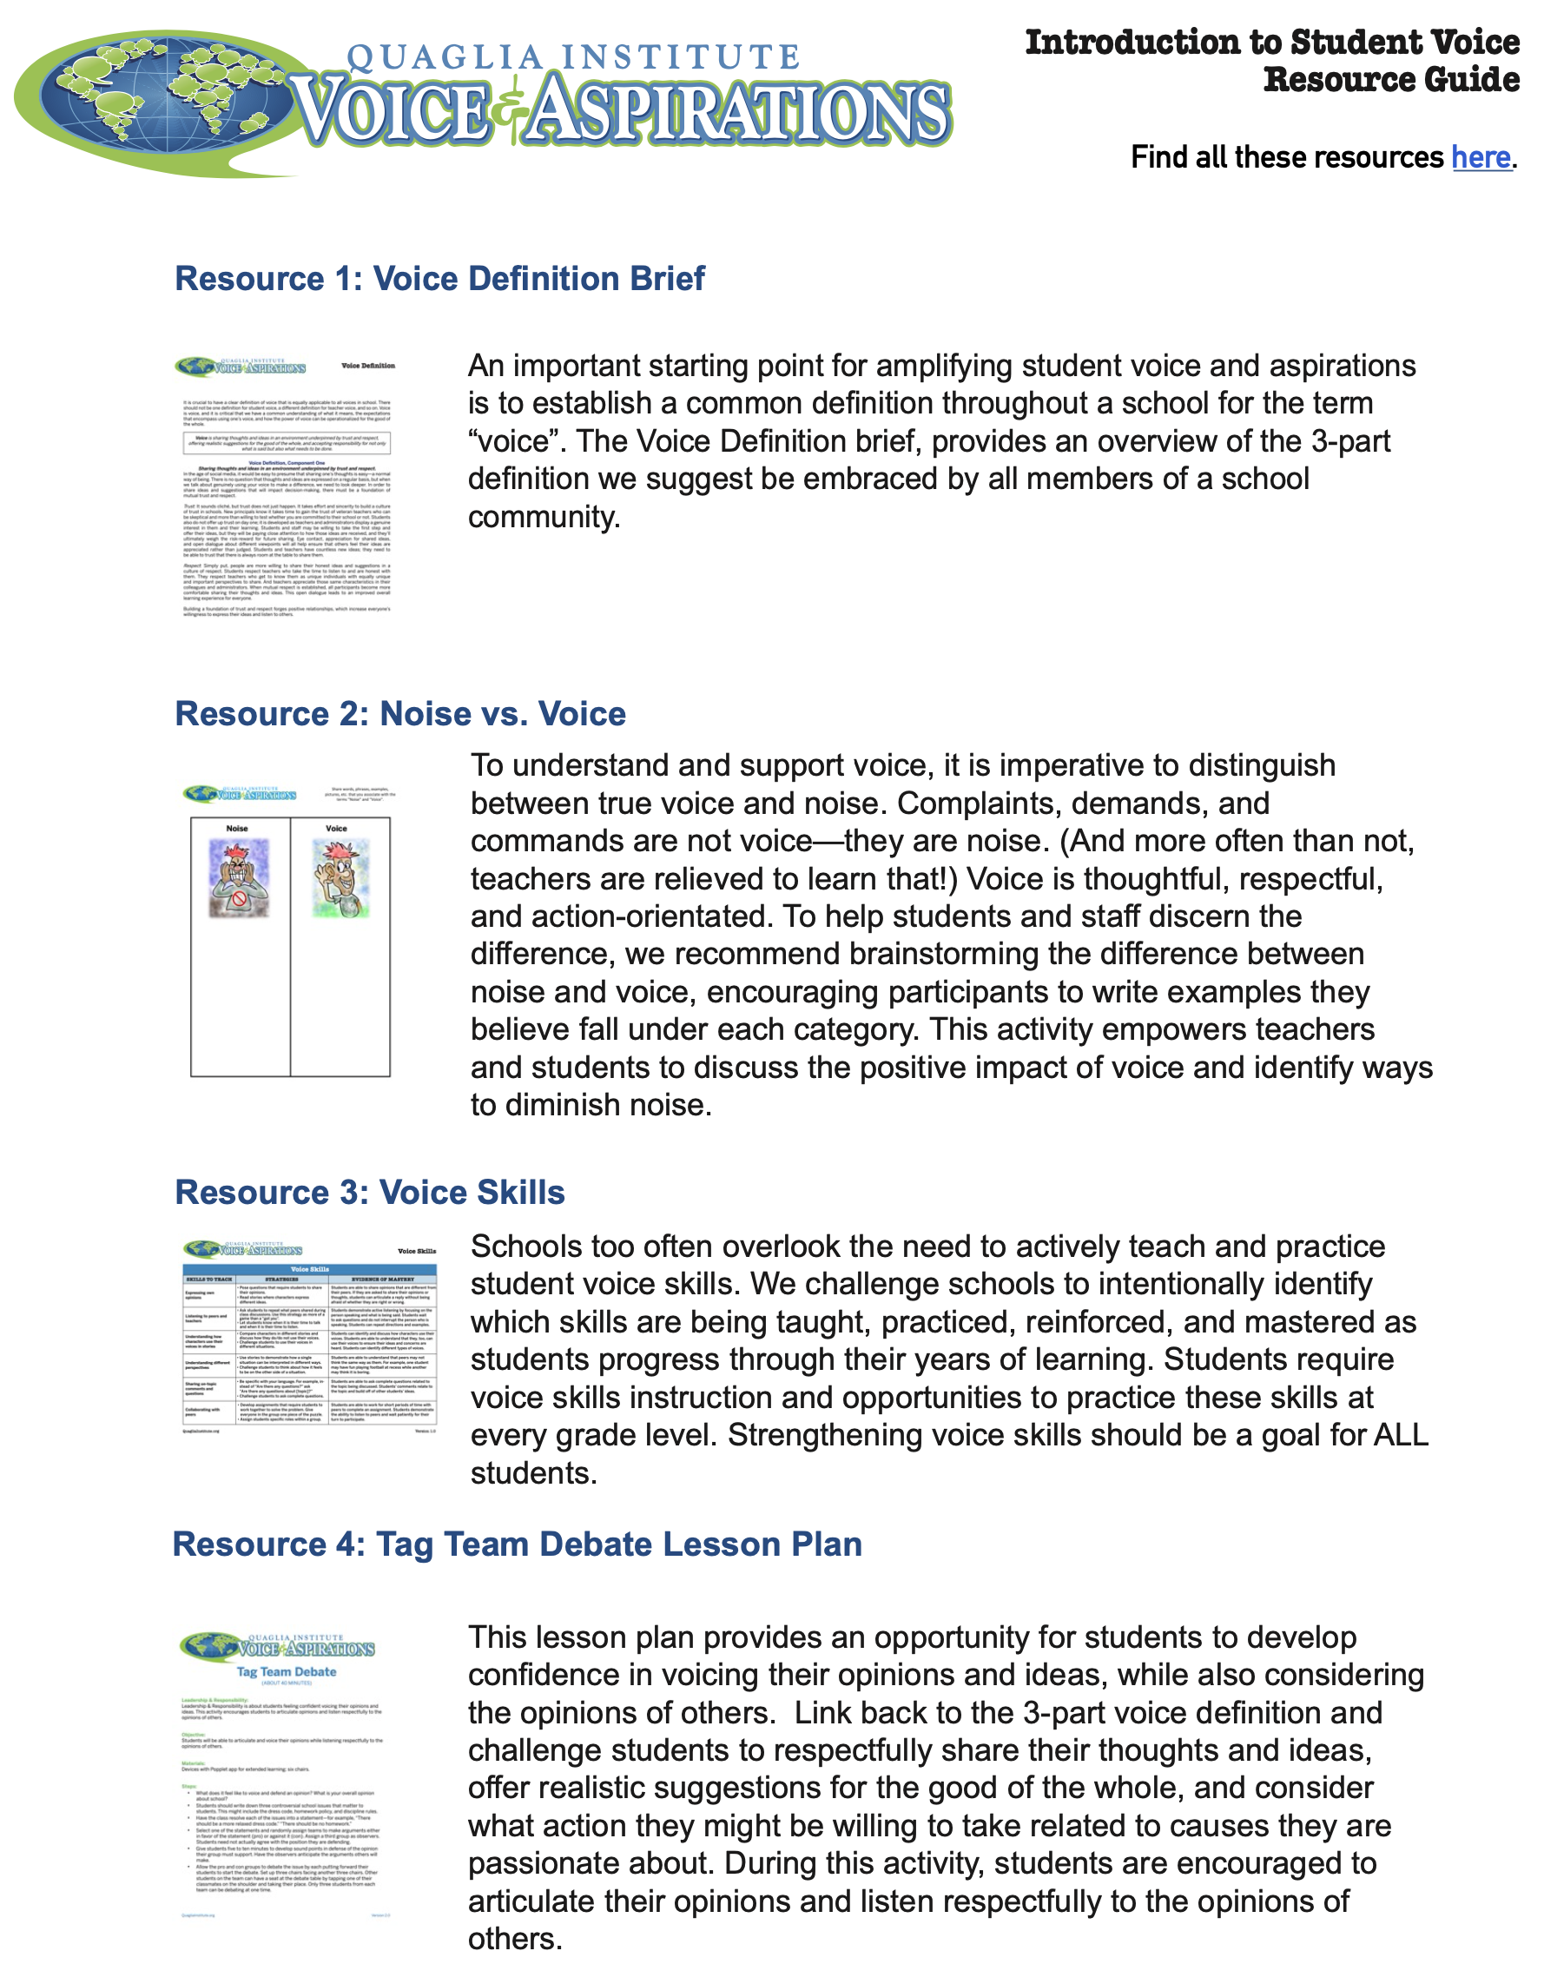
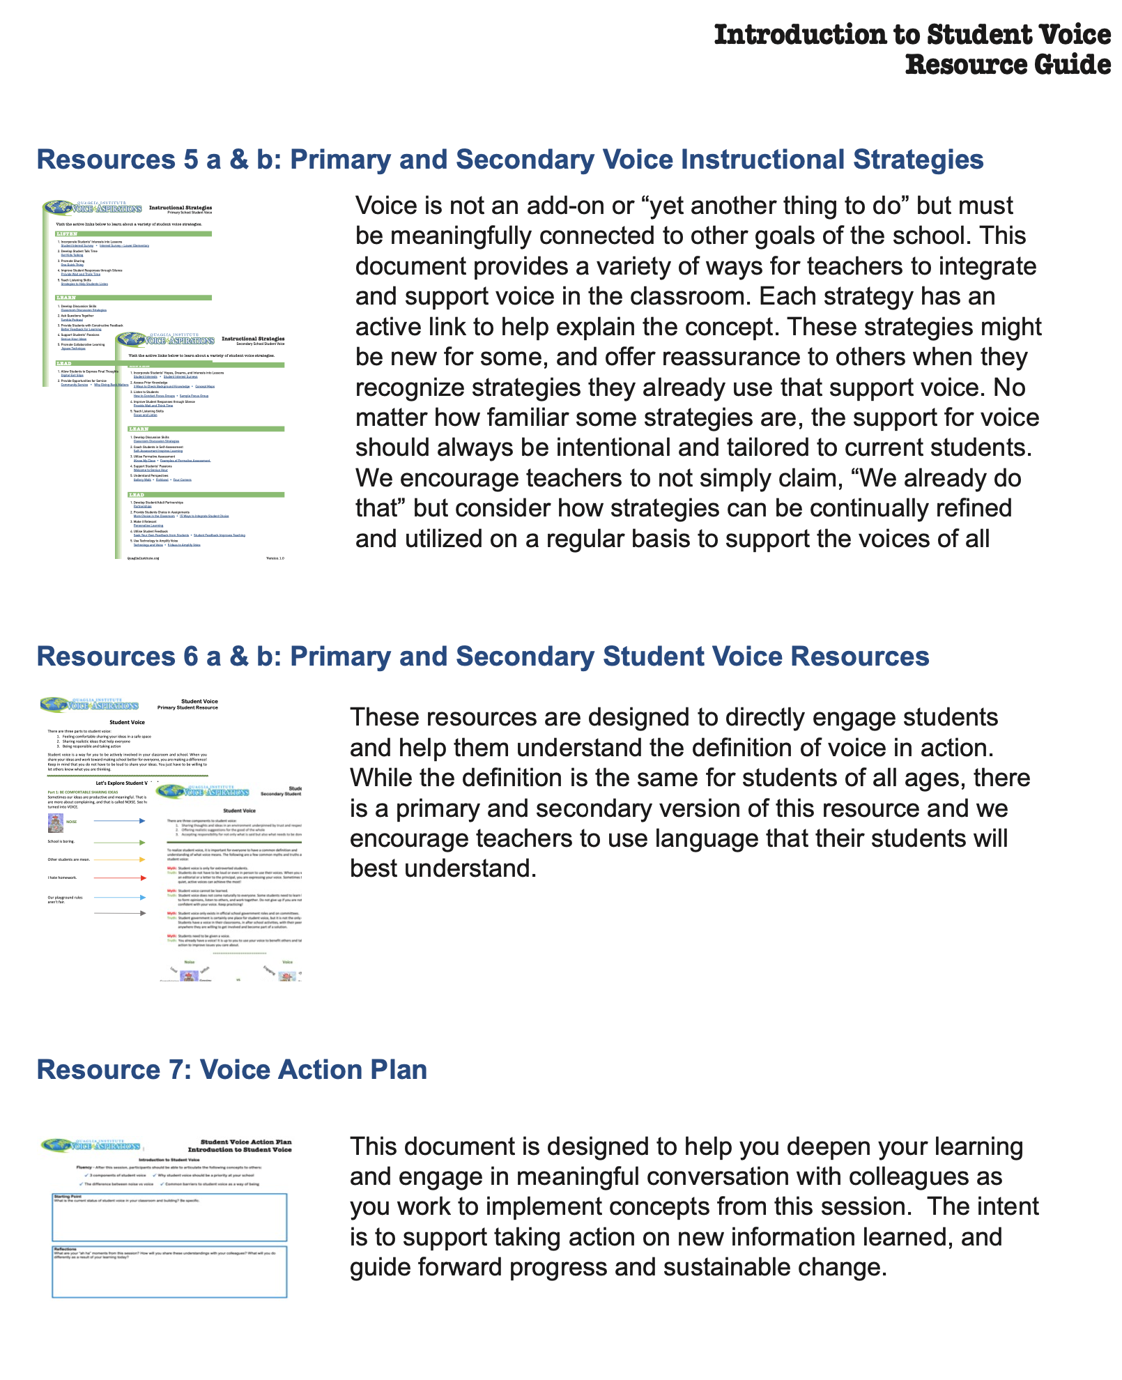
Session #1 Resource Guide

Slide 43
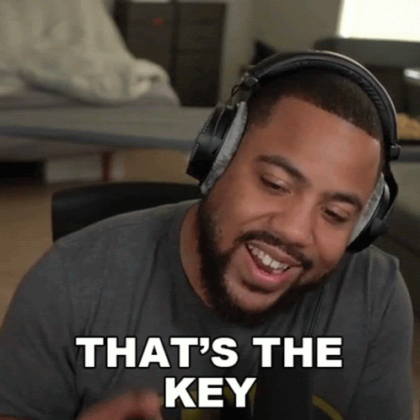



What is your key take away from today’s session?

Slide 44
The Dynamics of Student
Voice & Aspirations
Next Session
The Aspirations Profile
Session#2 April 28, 2022
Dr. Lisa Lande & Sue Bryen

