Slide 1




Sense of Accomplishment
Fun & Excitement

Slide 2
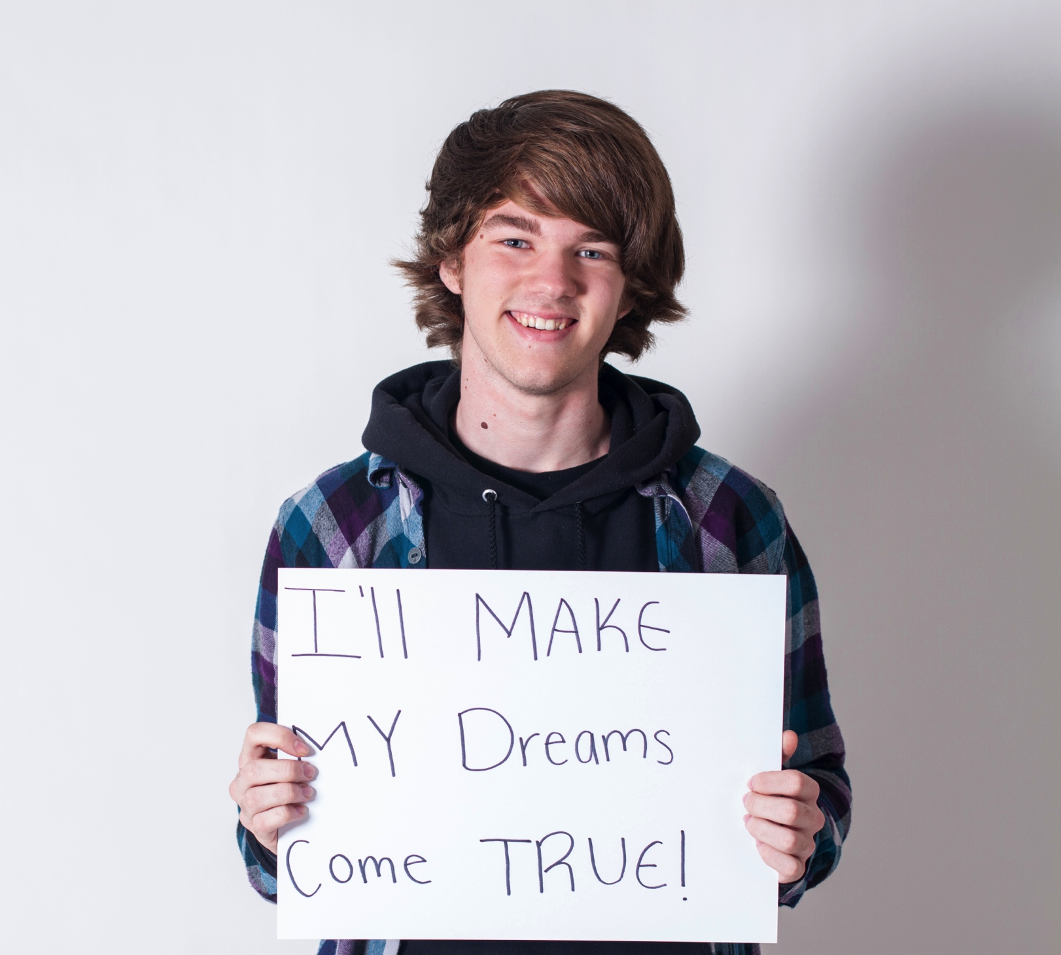

Slide 3
Sense of Accomplishment
Being recognized for many different types of success, including effort, perseverance, & citizenship.

Slide 4
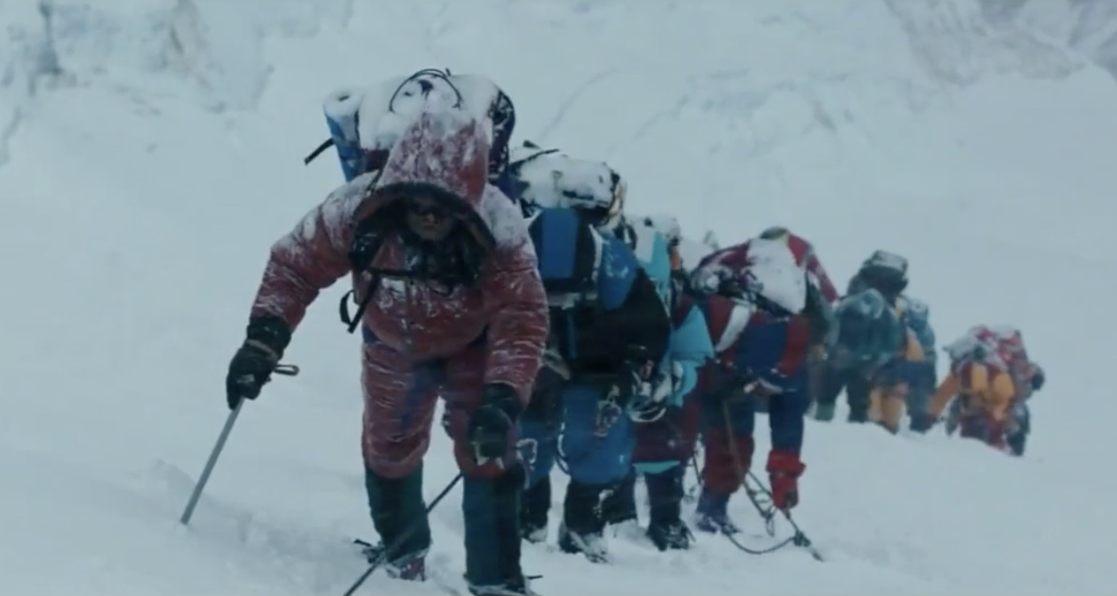
Sense of Accomplishment: Keep Going!
Vimeo:
https://vimeo.com/1179955135/8d98b238d5
YouTube:
https://youtu.be/kXiRcEk-LT0
Video

Slide 5
Sense of Accomplishment
What are you doing now that is hard
& you have a choice to give up or
keep trying?

Slide 6
Perseverance Challenge
Time to test our perseverance by solving some riddles.

Slide 7
Riddle #1
I speak without a mouth & hear without ears.
I have no body, but I come alive with wind.
What am I?
An Echo

Slide 8
Riddle #2
The more of me you take, the more you
leave behind. What am I?
Footsteps

Slide 9
Riddle #3
What has to be broken before you can use it?
An Egg

Slide 10
Riddle #4
What comes once in a minute, twice in a moment, but never in a thousand years?
The letter M

Slide 11
Puzzle Challenge
Try to solve the puzzle by yourself.
Next, find the 2 students doing the same puzzle & work together.
Once your group solves the puzzle, see if it’s correct & then help another group that doesn’t have the solution yet.

Slide 12
Reflect & Discuss
What strategies do you use when you become
frustrated with a task?
Share an experience that required much effort
& perseverance on your part.
3. What does it feel like when you finally succeed?

Slide 13
Sense of Accomplishment
Never give up at Woodside High School!
If you need help, there are many
adults & peers who can help you.
Notes:
** This is an opportunity to teachers and student leaders to share about various supports at Woodside (counseling, mental health, college & career etc.) This could be a place to build in a scavenger hunt or ”field trip” to the counseling center.

Slide 14
Fun & Excitement
Being engaged & interested in learning
& your school experience.

Slide 15
Would you Rather?
Stand if you choose A, Sit for B
A. Have no homework ever again
B. Have shorter school days

Slide 16
Would you Rather?
Stand if you choose A, Sit for B
Sit next to your best friend in every class
B. Meet new people in every class

Slide 17
Would you Rather?
Stand if you choose A, Sit for B
Do hands-on projects
B. Do creative presentations

Slide 18
Would you Rather?
Stand if you choose A, Sit for B
Have teachers who tell amazing stories
B. Have teachers who do interactive
activities

Slide 19
Would you Rather?
Stand if you choose A, Sit for B
Join three clubs
B. Play one sport

Slide 20
Would you Rather?
Stand if you choose A, Sit for B
Try something you’ve never done
before
B. Get really good at something you
already enjoy

Slide 21
Would you Rather?
Stand if you choose A, Sit for B
Learn something that helps you solve real problems
B. Learn something that helps you
discover your passion

Slide 22
Reflect & Discuss
What makes learning fun for you?
Share a learning experience when
you were so immersed in learning that you
lost track of time.
What can you do to make your learning
engaging at school?

Slide 23
Connections Challenge
Guess the word that connects the 4 pictures.
The boxes at the bottom show how
many letters are in the answer.

Slide 24
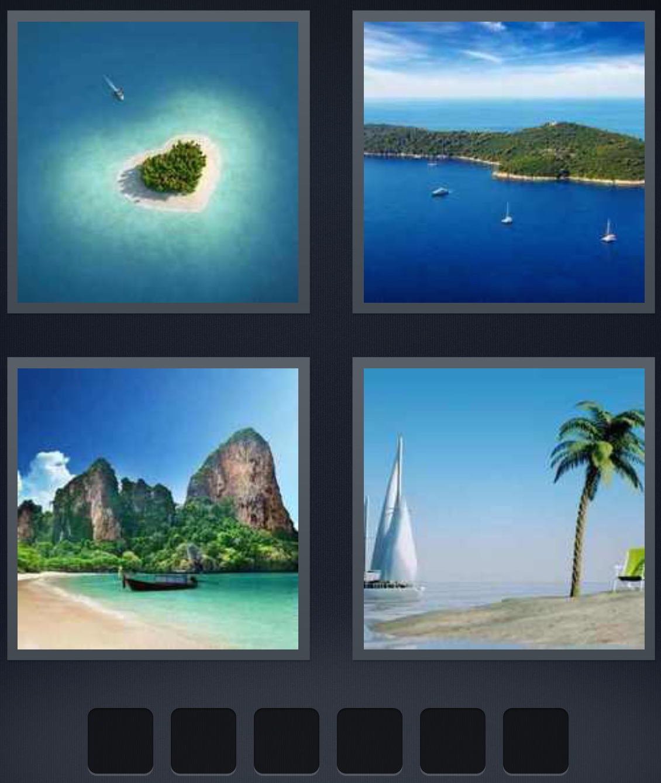
I S L A N D

Slide 25
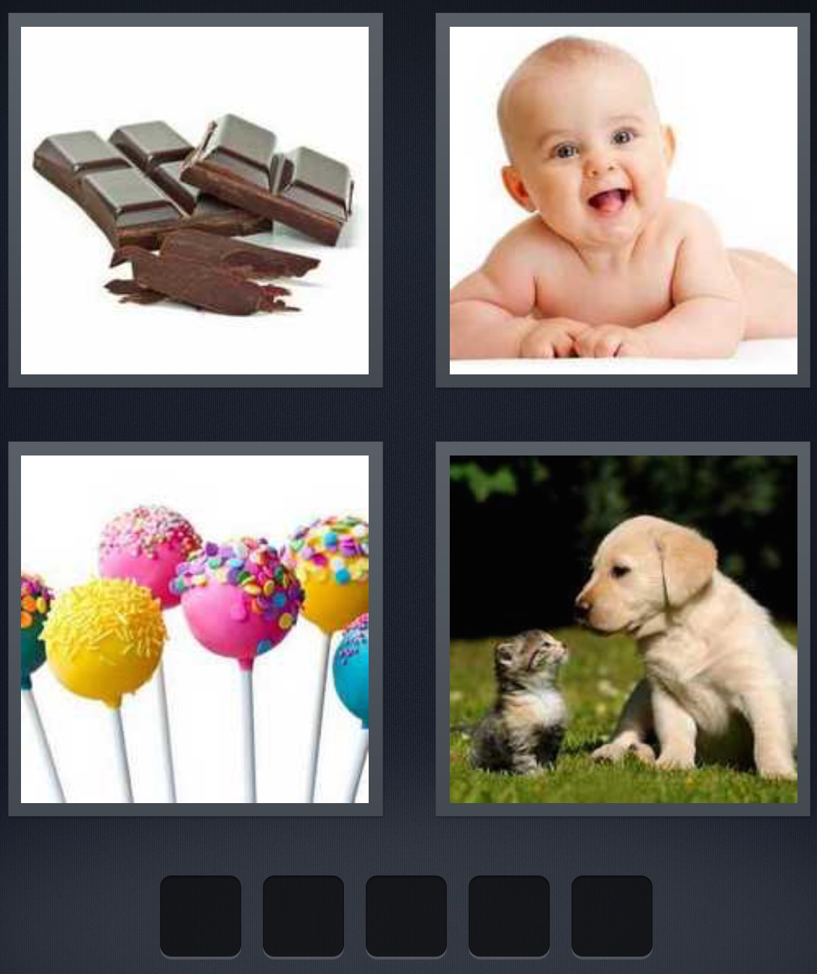

S W E E T

Slide 26
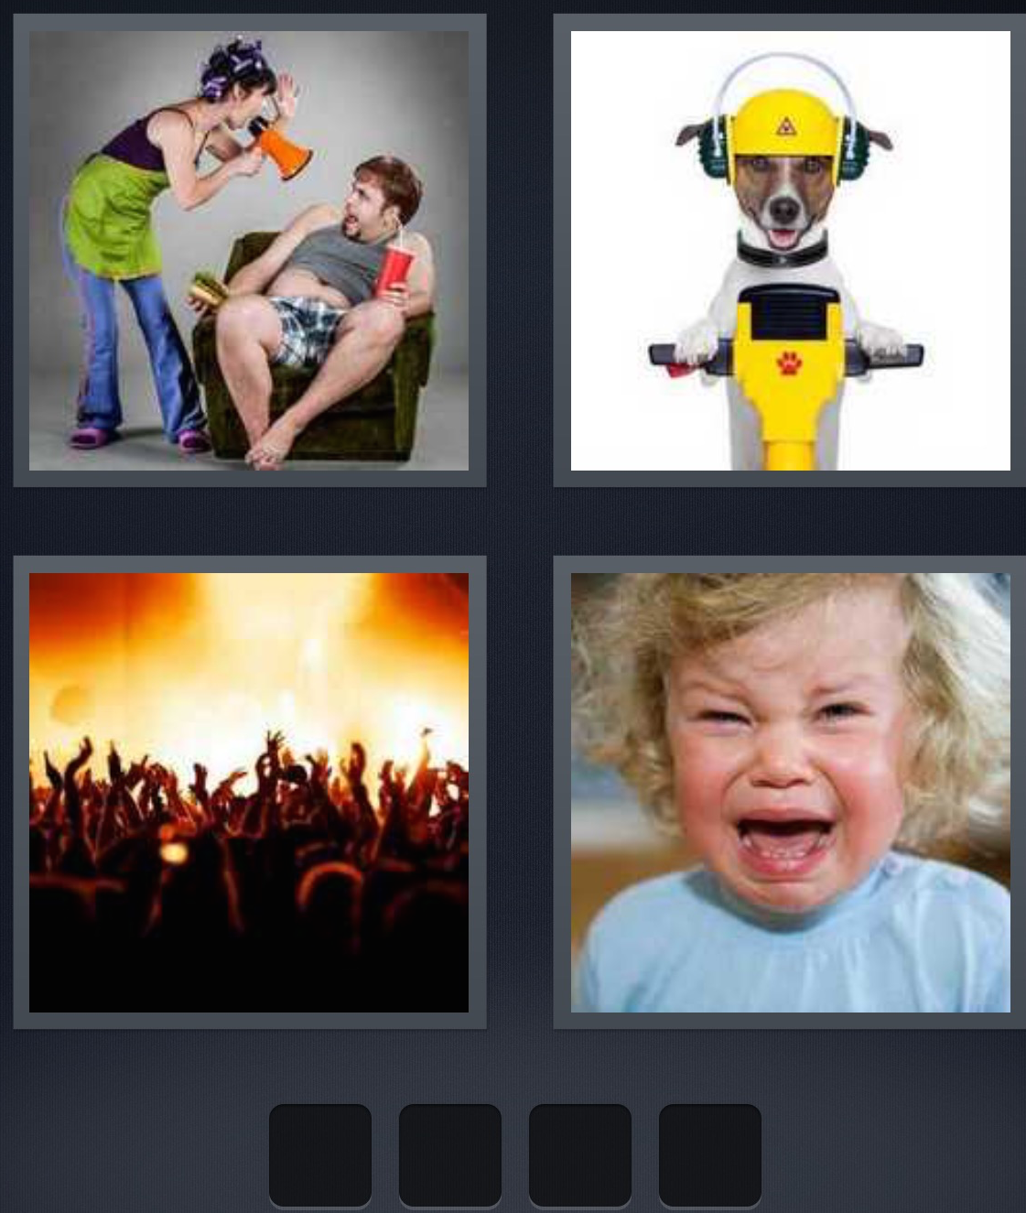


L O U D

Slide 27

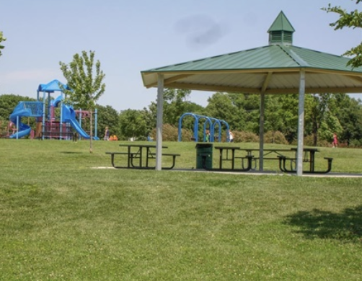
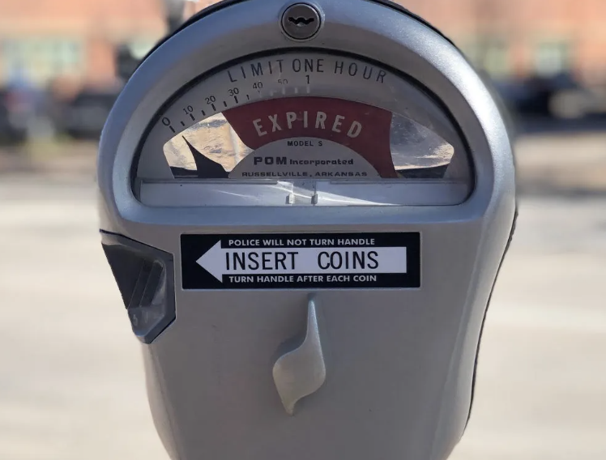

P A R K

Slide 28
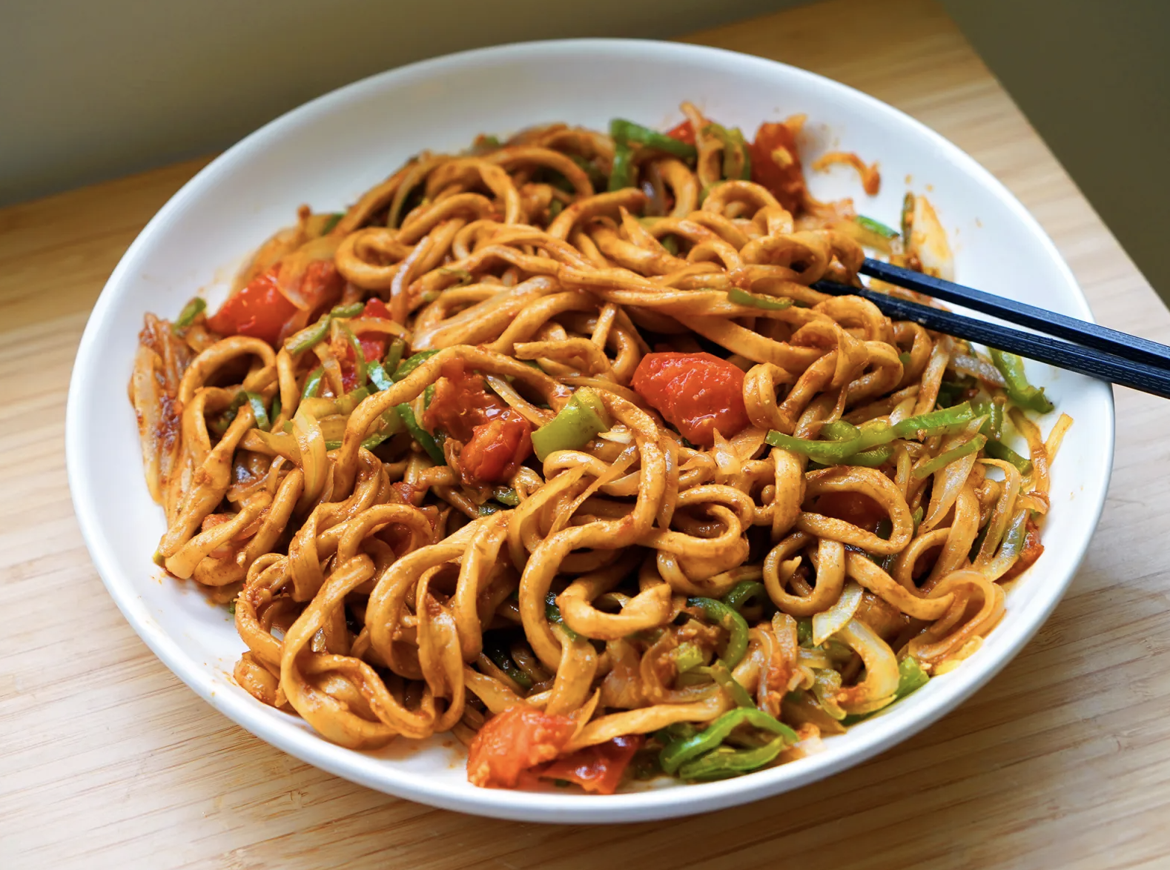
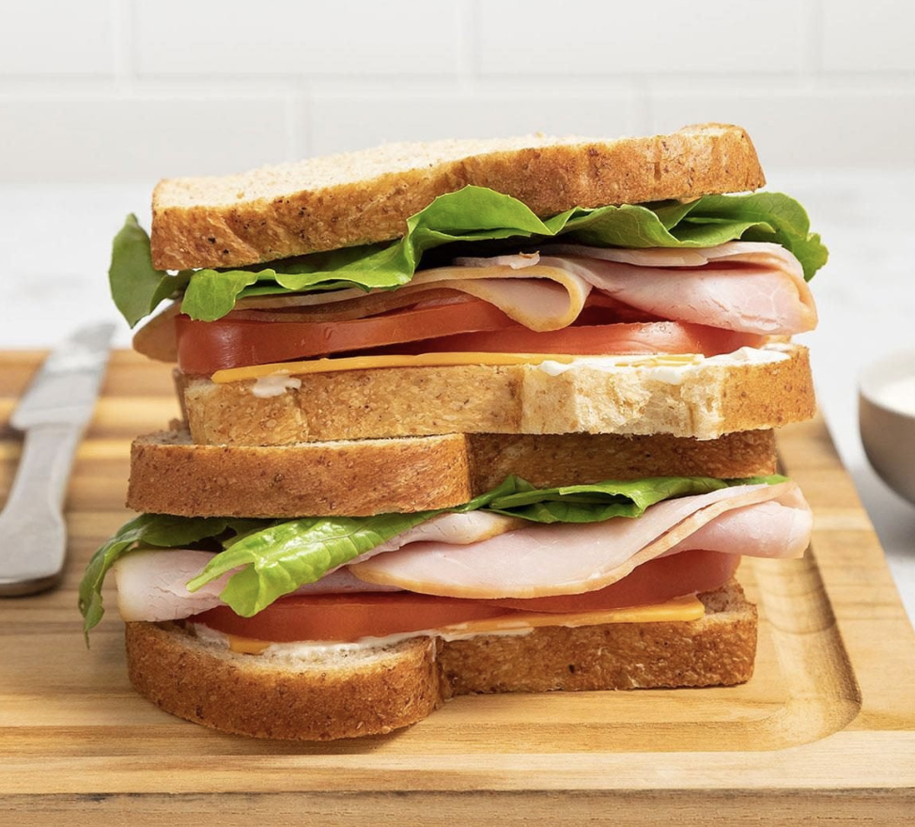

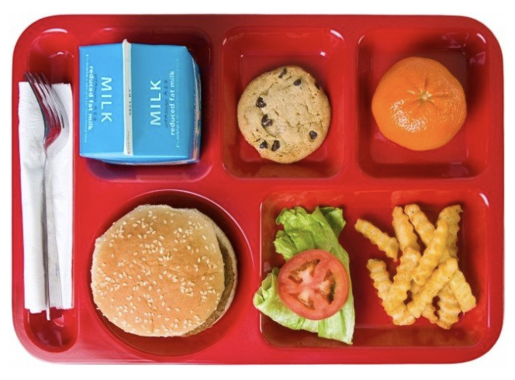
L U N C H

Slide 29
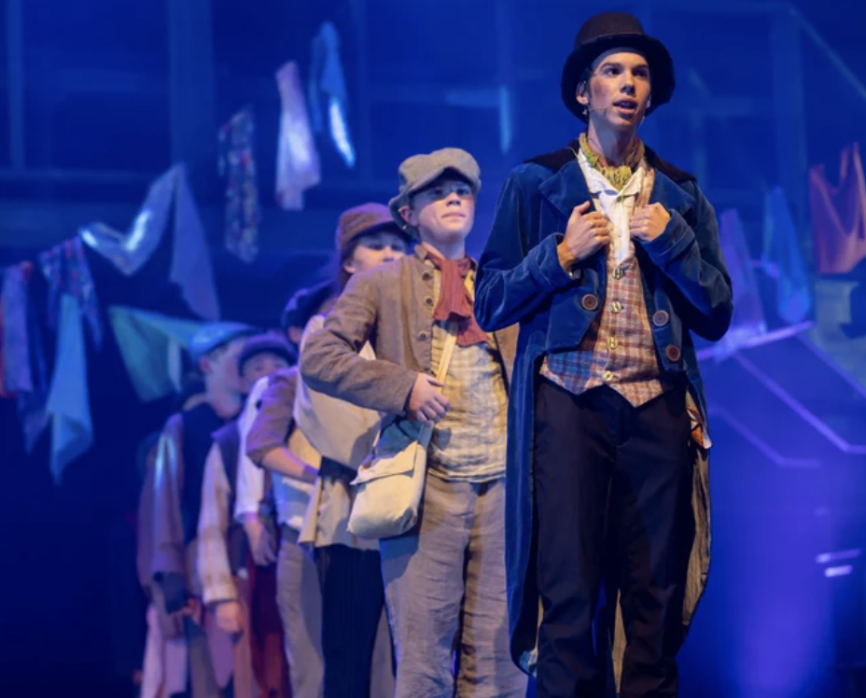

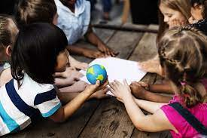



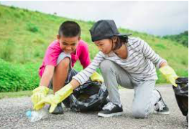
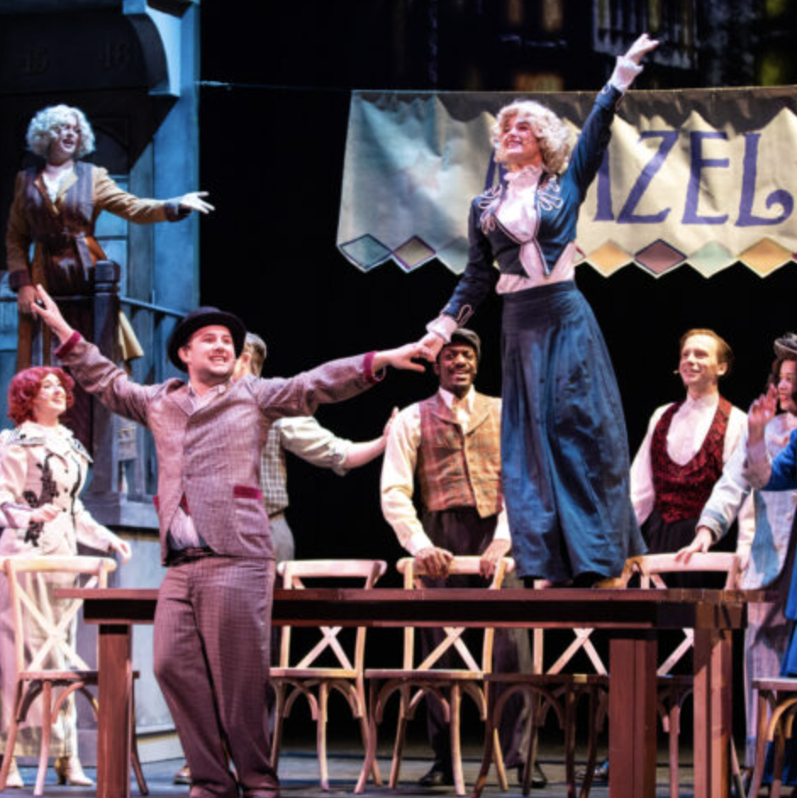
D R A M A

Slide 30


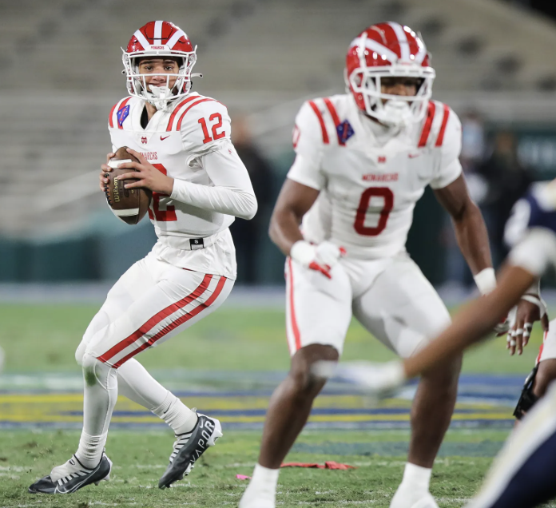
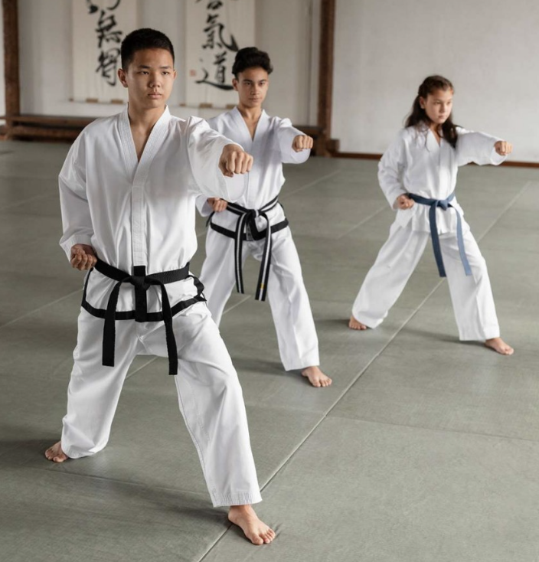
S P O R T S

Slide 31
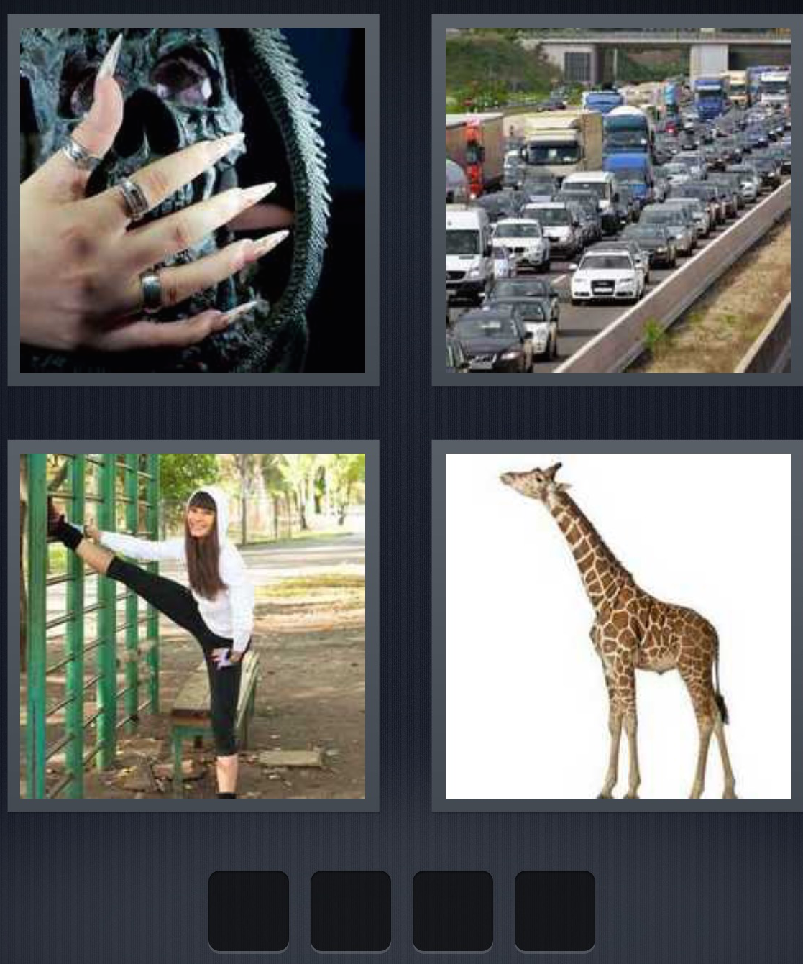
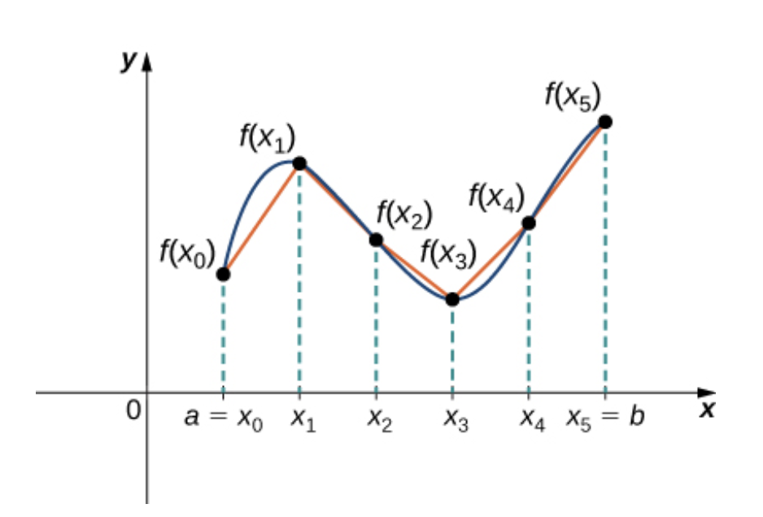
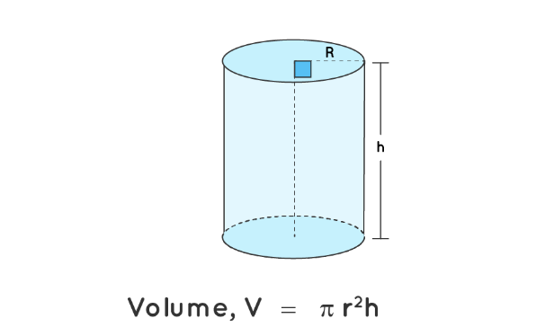
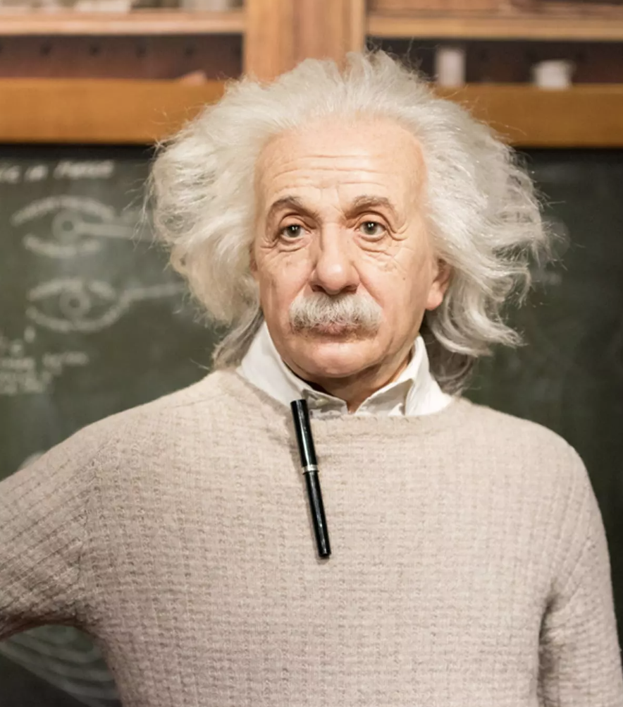

M A T H

Slide 32
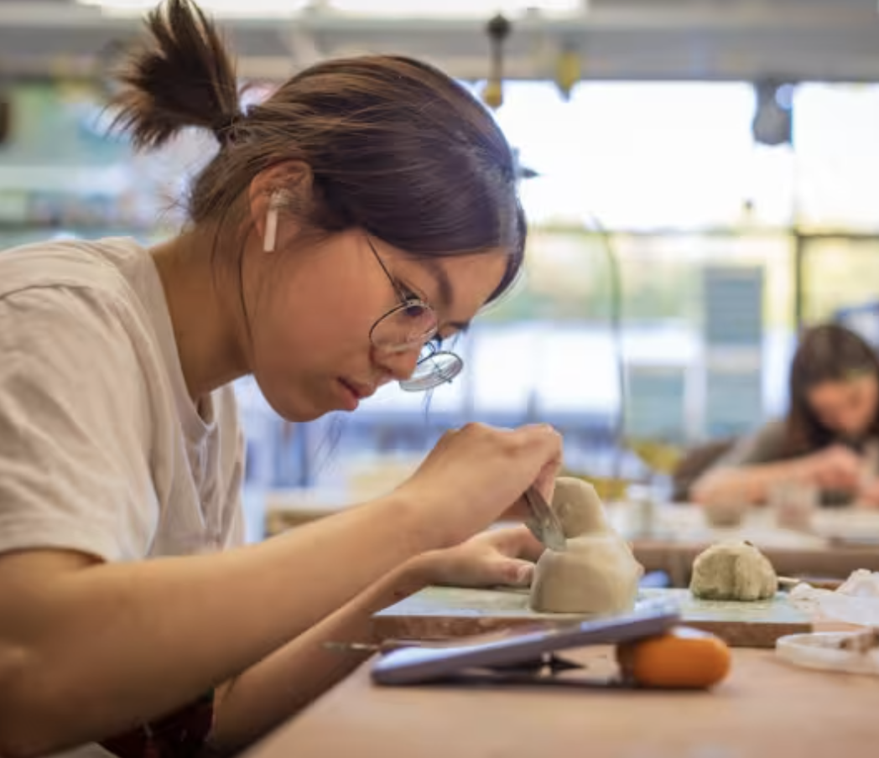
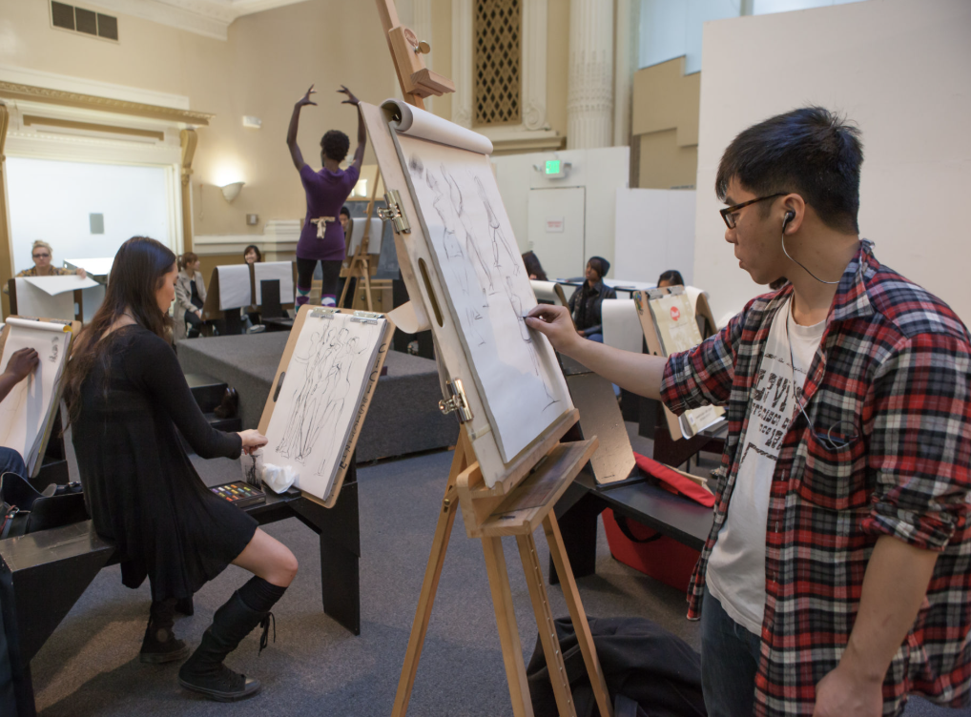
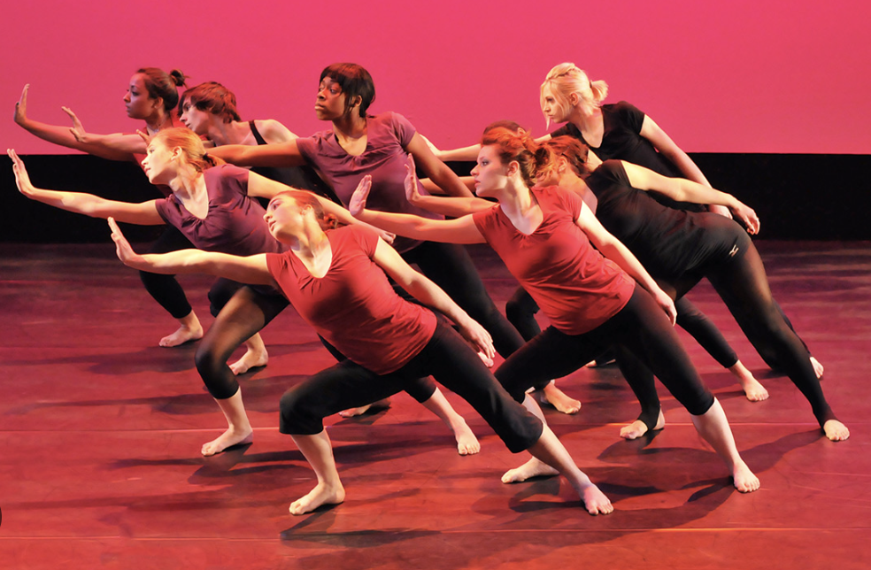

A R T S

Slide 33




F R E N C H

Slide 34
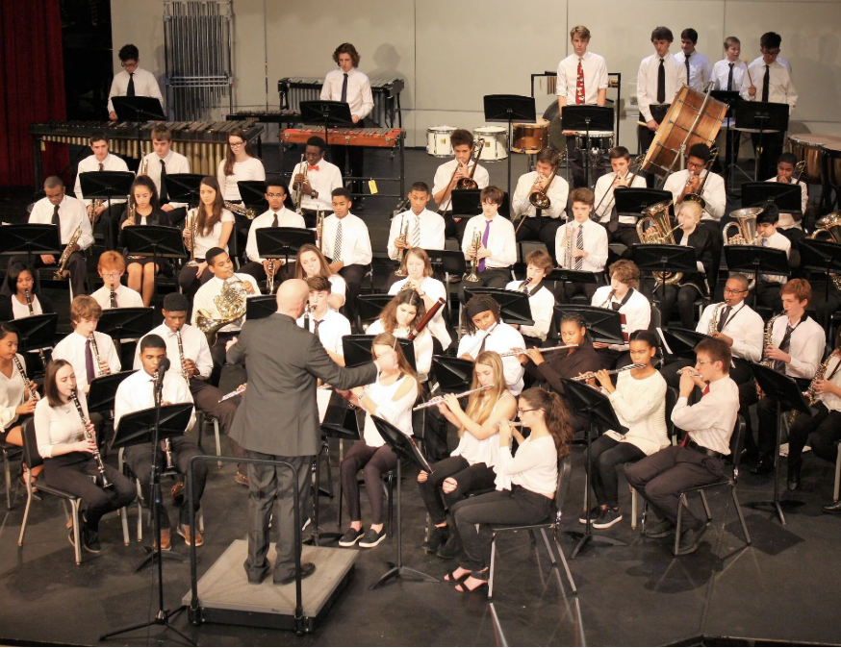


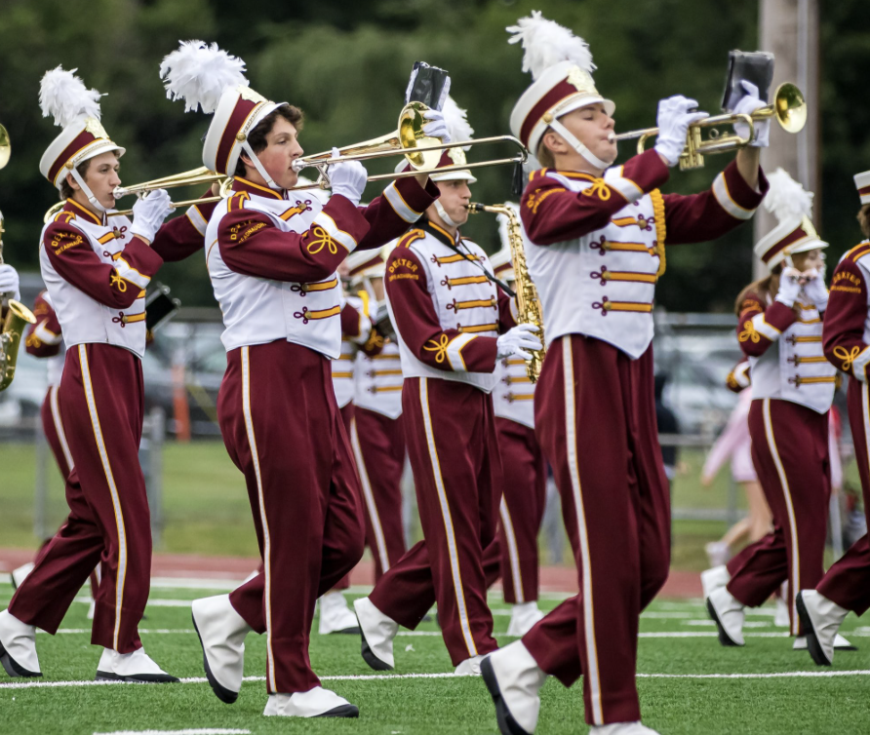
B A N D

Slide 35
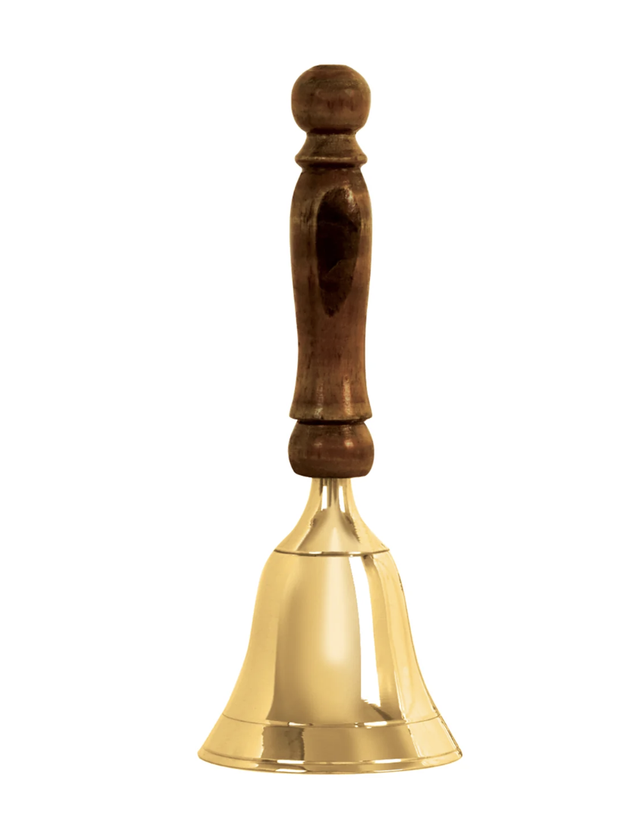
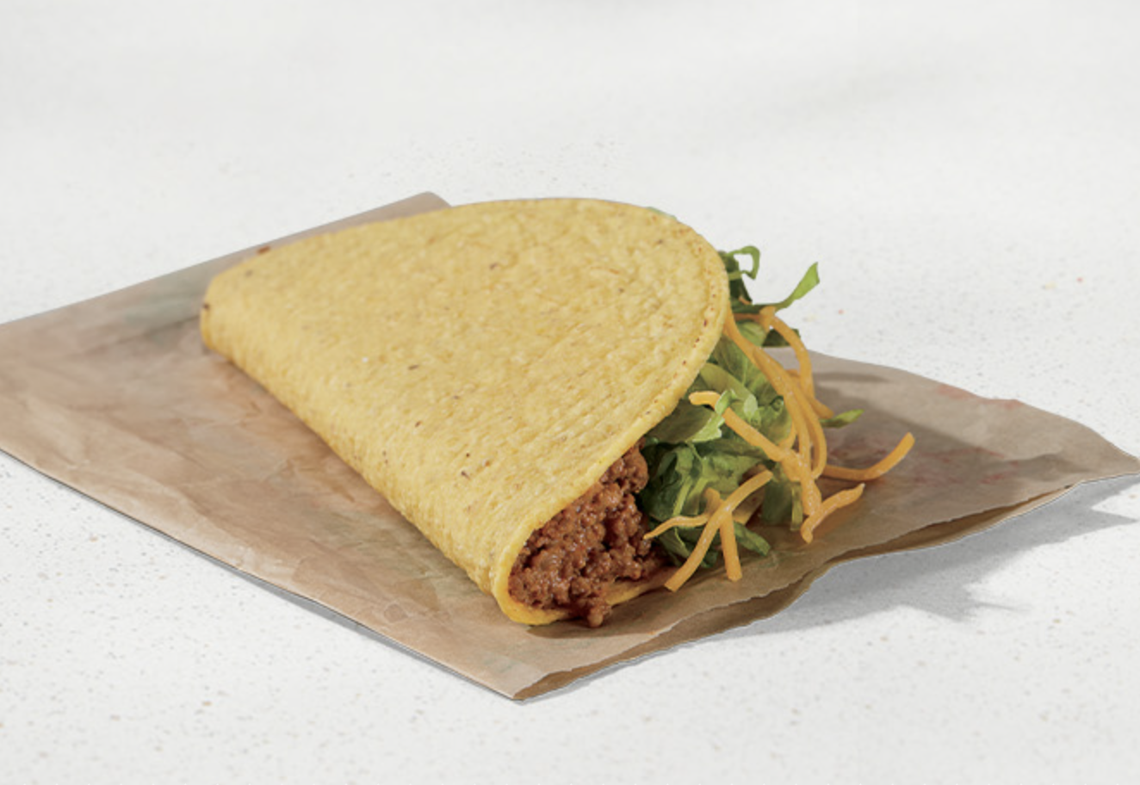
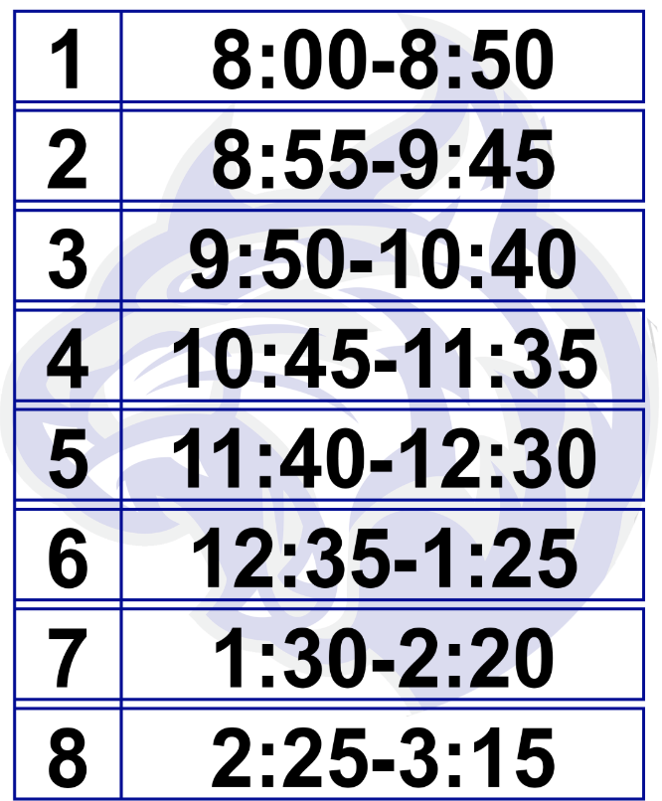
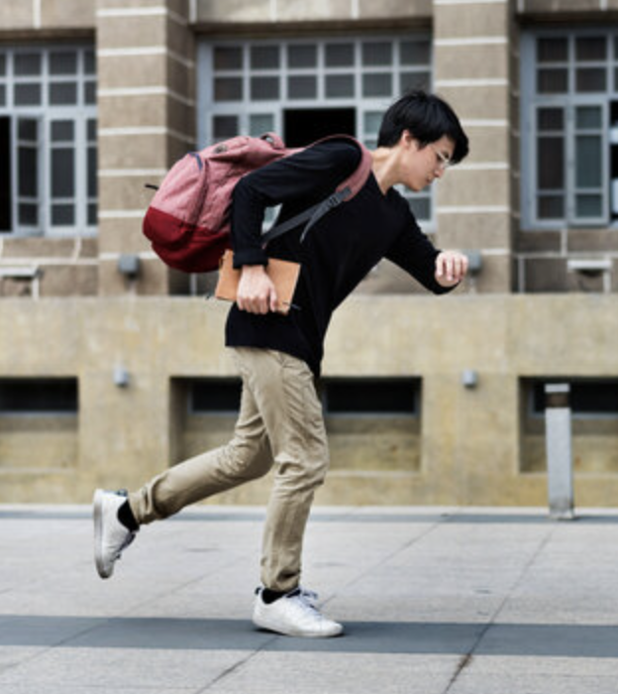
B E L L

Slide 36
Reflect & Discuss
In small groups, discuss how your classes &
experiences at school connect to your
current or future hopes & dreams.

Slide 37
Discuss the following myths &
share your own learning
experiences that have been
Fun & Exciting.
Fun activities are just a break, not real learning
The harder something is, the more valuable
Creative or funny teachers/students aren’t as “academic”
Learning & fun are opposites
The best classrooms are always quiet

Slide 38
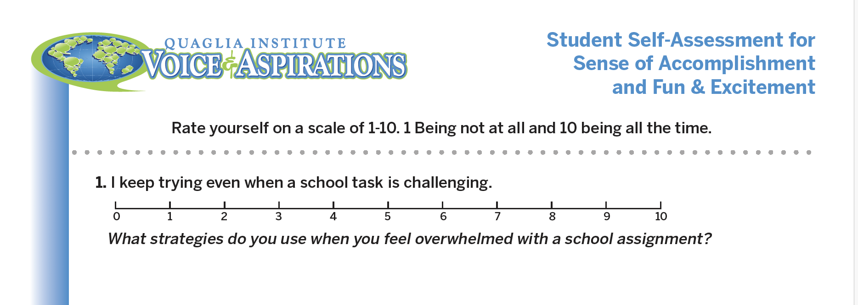
Self-Assessment
Complete the self-assessment
& then discuss in small groups.

Slide 39
Sense of Accomplishment
Fun & Excitement

