Slide 1

The Dynamics
of Student Voice
& Aspirations

Slide 2
Fundamental Beliefs
Students are the potential, not the problem.
Students have something to teach us.
Working with students is the only way forward.

Slide 3

The 3 Components of Student Voice
Sharing thoughts & ideas in an environment underpinned by trust & respect.
Offering realistic suggestions for the
good of the whole.
Accepting responsibility for not only what is said but also what needs to be done.

Slide 4
ASPIRATIONS
The ability to
dream & set goals
for the future,
while being inspired
in the present
to reach those dreams.

Slide 5




high
Imagination
Aspirations
DREAMING
Hibernation
Perspiration
low
DOING
high

Slide 6
LEAD
TAKE ACTION
with others
Share
RESPONSIBILITY
LEARN
UNDERSTAND
& RESPECT
different points
of view
Build
TRUST
LISTEN
SEEK OUT
opinions from
others
Voice Process

Slide 7








8 Conditions
Self-Worth
Engagement
Purpose

Slide 8

Reflect
Celebrating growth in my thinking & practice…
Areas for continued growth…

Slide 9
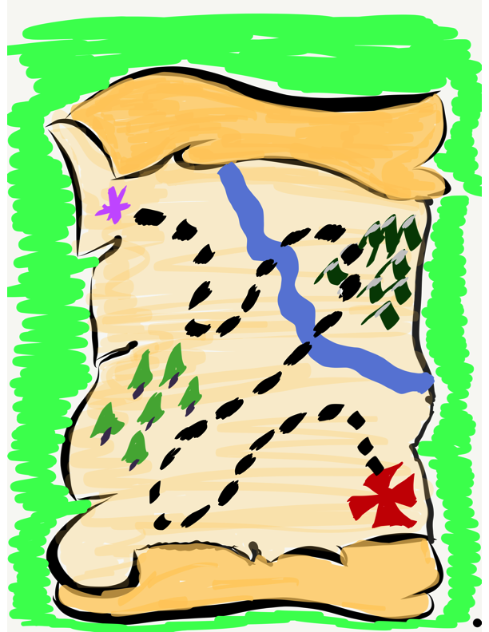
Our Student Voice & Aspirations School of Action Journey Continues!

