Slide 1

Power and Potential of Student Voice
Sue Bryen
Director of Learning Services, Australia
In collaboration with staff and students of Guardian Angels Primary School

Slide 2

I would like to begin by acknowledging the Traditional Custodians of the land on which we meet today and pay my respects to their Elders past and present and emerging.
I extend that respect to Aboriginal and Torres Strait Islander peoples here today.

Slide 3
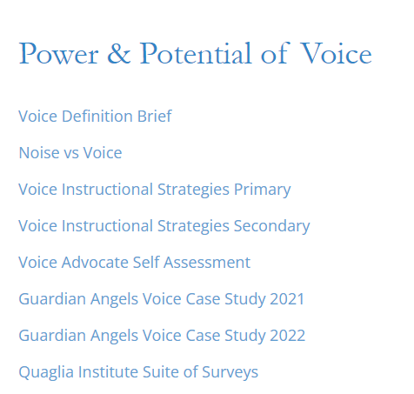
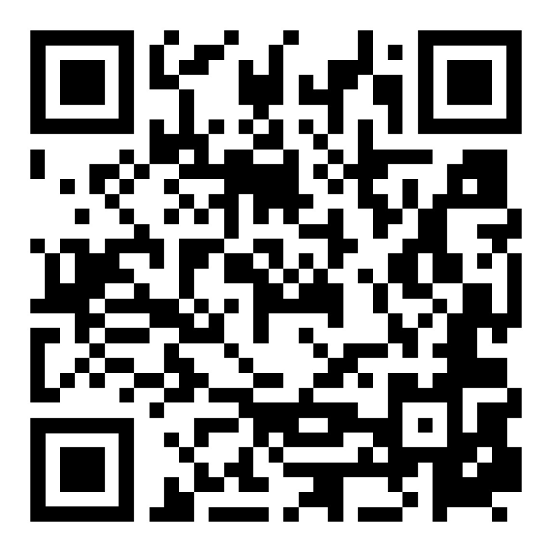
https://quagliainstitute.org/power-potential-of-voice
Just For You
https://quagliainstitute.org/power-potential-of-voice

Slide 4
Fundamental Beliefs
Students are the potential, not the problem.
Students have something to teach us.
Working with students is the only way forward.

Slide 5
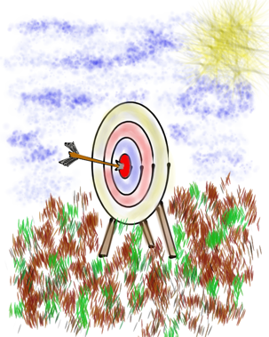
Session Goals
Provide an introduction to Student Voice & embrace a common definition for Voice.
Consider the Power of Voice in the
teaching & learning environment.
Apply learning to amplify Student Voice
in YOUR school.

Slide 6
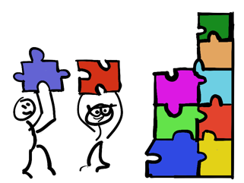
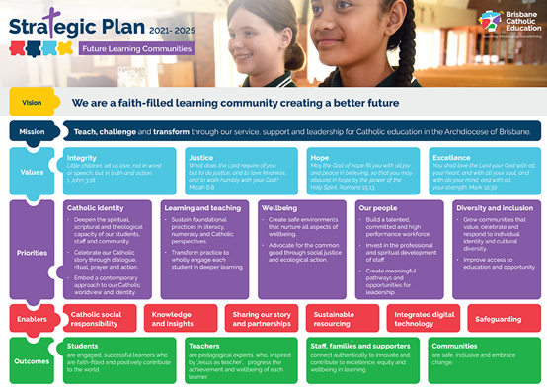


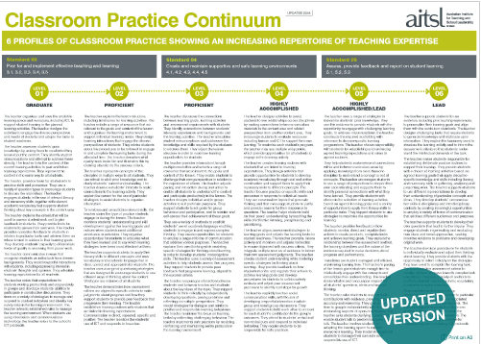
Making Connections
Learning and Wellbeing

Slide 7
30,30,30
All have Think Time
30 seconds
Person 1 speaks
30 seconds
Person 2 listens
Person 2 speaks
30 seconds
Person 1 listens

Slide 8
30, 30, 30
What does “Having a voice” mean?

Slide 9
30, 30, 30
What is student voice?

Slide 10
30, 30, 30
When is student voice most
powerful in schools?

Slide 11


QISVA has over 40 years experience leading research in voice and aspirations schools.
https://www.quagliainstitute.org
Dr Russell Quaglia

Slide 12

Quaglia Institute Research
18 years of data
43 states
13 countries
998,980 Student Voice Surveys Grades 6-12
(2,050 Years 7-12 in Australia)
149,050 Student Voice Surveys Grades 3-5
(3,262 Years 3-6 in Australia)
637,566 iKnow My Class Surveys
59,343 Teacher Voice Surveys
28,667 Parent Voice Surveys
Notes:
Updated September 22, 2023

Slide 13


Quaglia Institute Research
QuagliaInstitute.org
National Reports from the last decade of data.

Slide 14
TRIUMPHS…
When you Google “Student Voice” you get over
1,010,000,000 results
Search YouTube about “Student Voice” you get over
339,000,000 results
United Nations, Rights of the Child addresses the
importance of Student Voice
Countries, States, and school districts
are making Student Voice a key initiative
Student Voice is not a passing educational whim .

Slide 15
TRIBULATIONS…
46% Students have a voice in decision making at school.
51% Teachers are willing to learn from students.
48% Students develop programs that improve the whole school.
54% Adults and students work together to make our school better.

Slide 16

Students say…
44% School is boring.
42% Teachers make school an exciting place to learn.
43% My classes help me understand what is happening in my everyday life.

Slide 17
Student Voice
Implications….
When students have a voice they are 3X more likely to experience
Self-Worth in school.

Slide 18
Student Voice
Implications….
When students have a voice they are 5X more likely to experience Engagement in school.

Slide 19
Student Voice
Implications….
When students have a voice they are 5X more likely to experience Purpose in school.

Slide 20


REFLECT
What does this data tell us about ourselves?
What is holding us back from Student Voice as a “Way of Being” in schools.

Slide 21
Voice in learning
All young Australians become:
successful learners, confident and creative individuals, and active and informed citizens.
What is your school vision/aspiration for all your students?

Slide 22
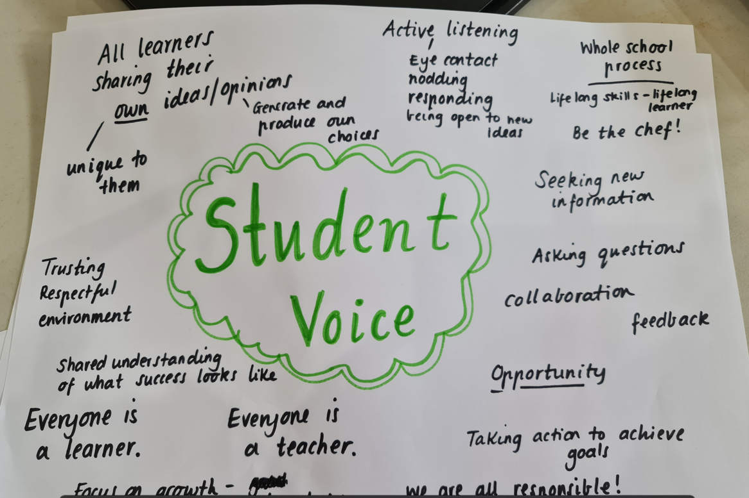
Create your WAGOLL

Slide 23
As you watch this video consider what you see and hear that resonates with the aspirations you have for your students.

Slide 24

Student Voice in Action
Vimeo
https://vimeo.com/qisva/ga
YouTube
https://youtu.be/QhByP9XR1bw
Video
Notes:
We love to ask students to share a time when they knew their voice was valued and heard. One student from a primary school we work with in Australia recently responded, “I remember a time like it was yesterday because I think it was the most important day of my life so far. I had to stand up on stage and talk to everyone about raising money for people in India who needed products to help with Covid. I was really nervous but I knew it was important and I felt like I could be saving thousands of lived doing this.” Voice flourishes when students are given opportunities to shine and make a difference in the world around them. In one day this impressive group of students raised $27,000.

Slide 25
Implementation is a collaborative process
Community defined evidence and cultural adaptations depend on engaging those most affected by interventions from start to finish.
Loper, Woo & Metz, 2021
Notes:
Equity is fundamental to implementation science, Loper, Woo and Metz Stannford Social Innovation Review. We must involve the students to achieve our intended goals.

Slide 26

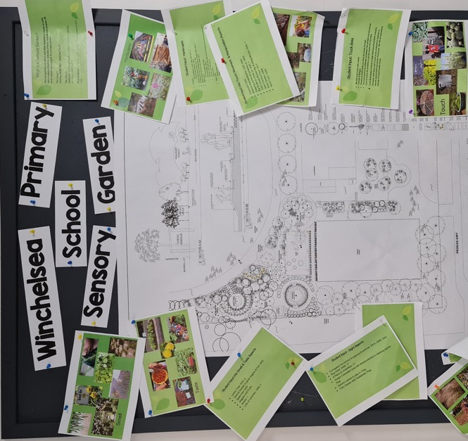
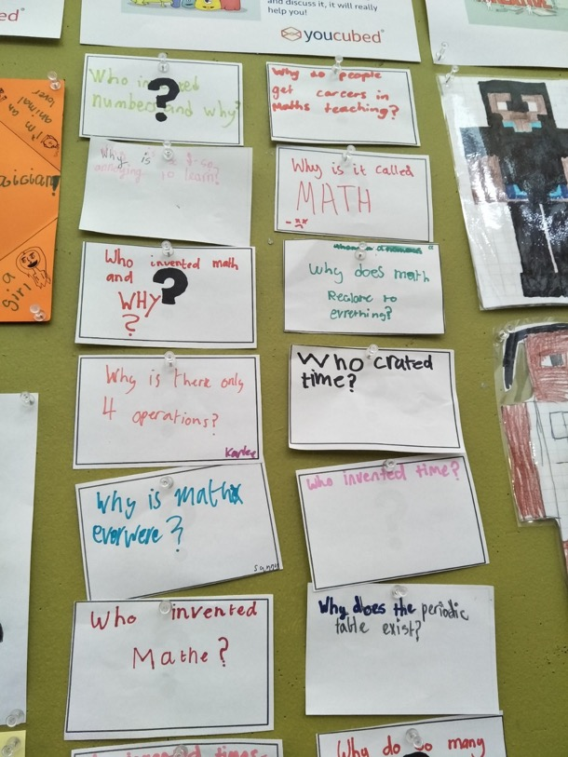
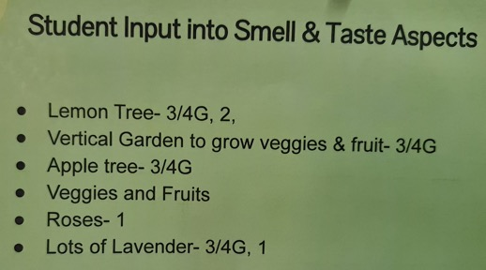
Student Voice in Action
Winchelsea Primary, Victoria, Australia

Slide 27
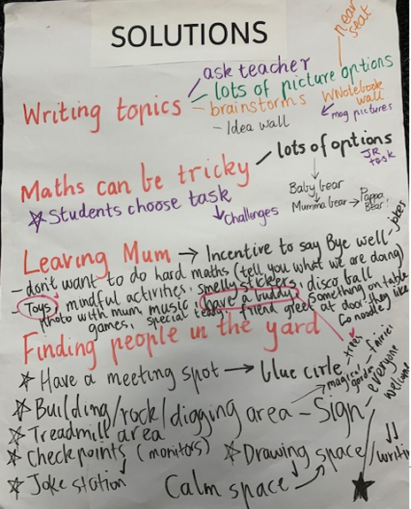
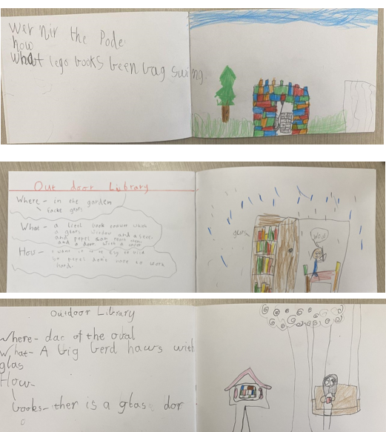
Student Voice in Action
Barwon Heads Primary, Victoria, Australia

Slide 28
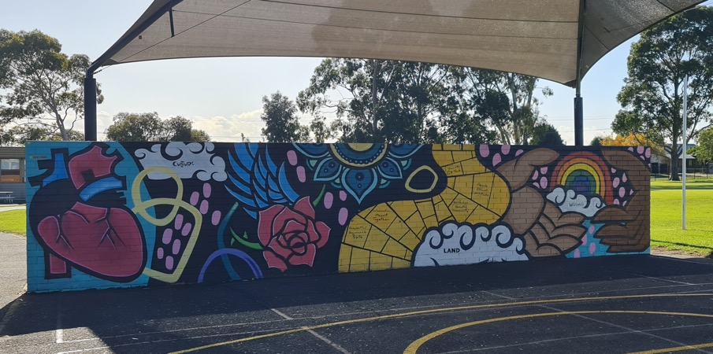
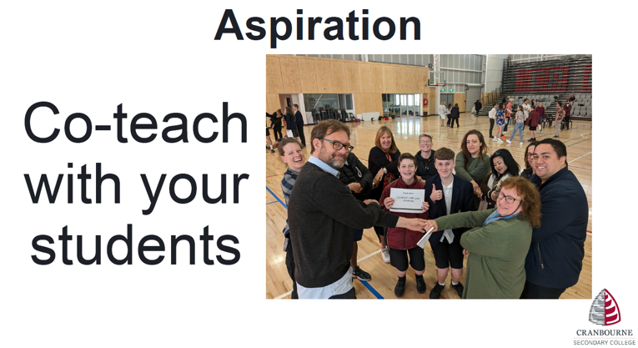
Student Voice in Action
Suggested and designed Multipride Wall
Teach the teachers for PL

Slide 29
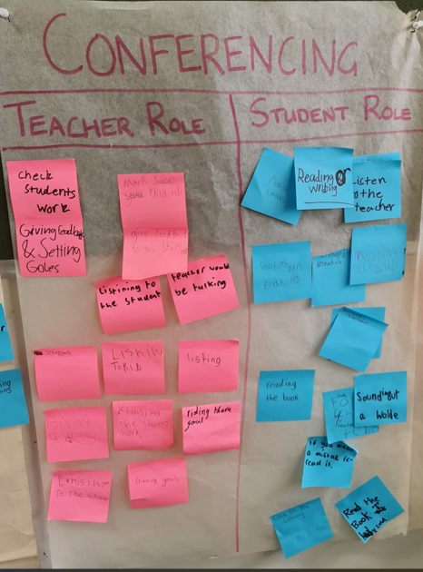
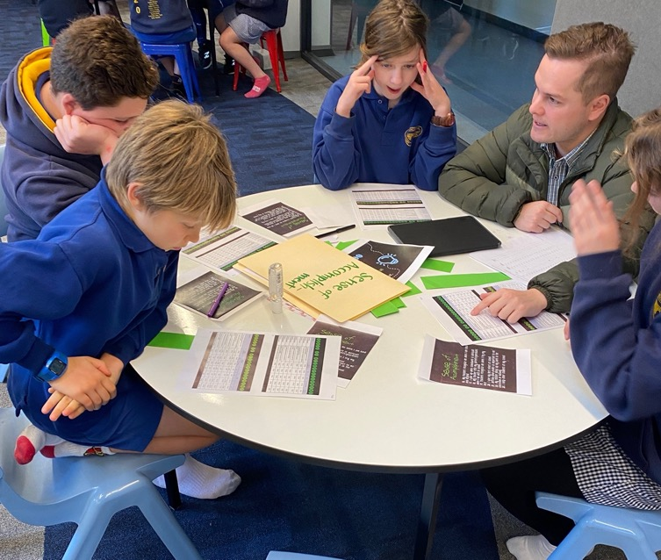
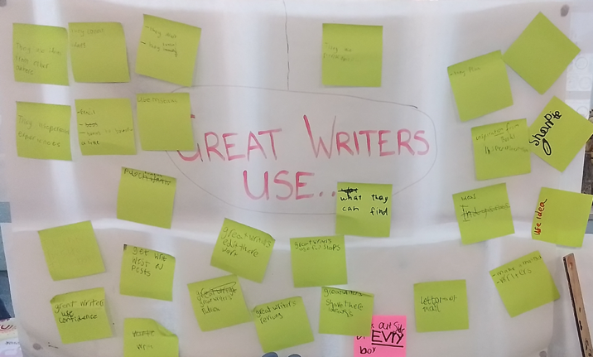
Student Voice in Action
Data analysis
Co-creating expectations

Slide 30
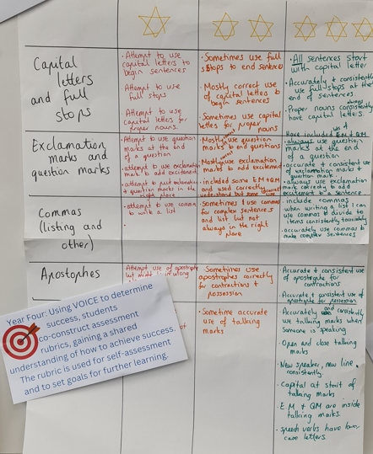
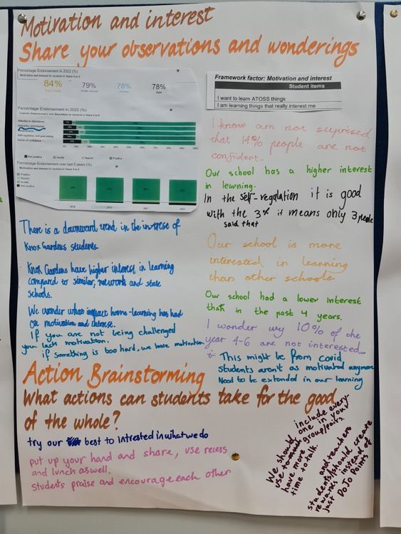
Insights into data
Co-construct SC

Slide 31
Leaders as learners
The true value in listening to the voices of others is the opportunity and potential it presents to learn something new. When genuine listening and learning occur, trust and respect are established and relationships are strengthened.
(Quaglia, 2020)

Slide 32
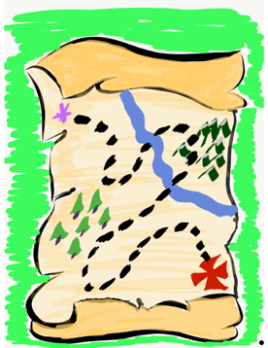
The Student Voice
Journey Begins!
First, we need a clear
definition of Student Voice
that we can all understand, accept, & put into practice.

Slide 33

The 3 Components of Student Voice
Sharing thoughts & ideas in an environment underpinned by trust & respect.
Offering realistic suggestions for the
good of the whole.
Accepting responsibility for not only what is said but also what needs to be done.

Slide 34
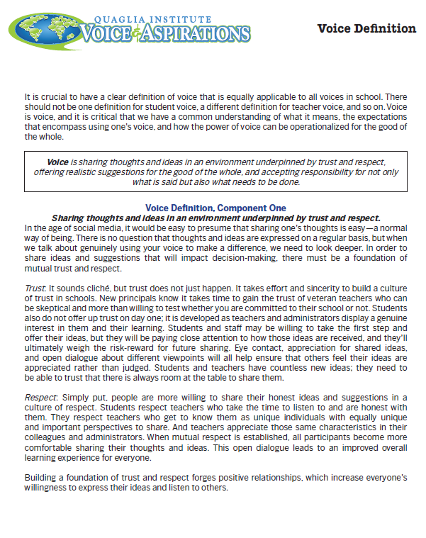
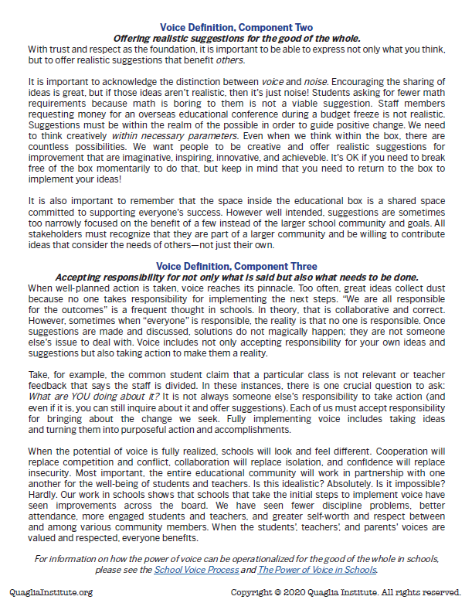
3 parts of Voice Jigsaw activity
Notes:
Groups of 3

Slide 35

Voice and Agency
How will having a shared definition of voice make a difference?
Notes:
What connections do you see between the Quaglia voice definition and student agency?

Slide 36
Shared understanding
showing, discussing, saying
drawing, comments
space, group, classroom,
school, community, playground
my thinking, understanding,
needs, wonderings, questions, feelings
Sharing thoughts & ideas in an environment underpinned by trust and respect.
supported,
built upon, with,
encouraged,
developed,
strengthened,
promoted
honesty, safe, caring,
belief, reliable,
confidence,
shared responsibility
Considerate,
thoughtful,
caring, polite, valued, heard
Notes:
Also give time to read the Voice definition brief.

Slide 37
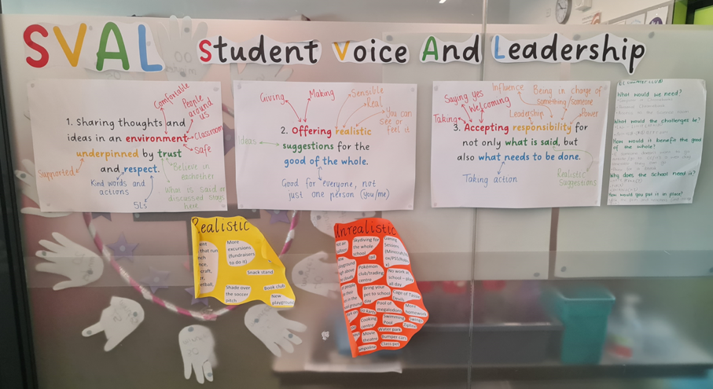
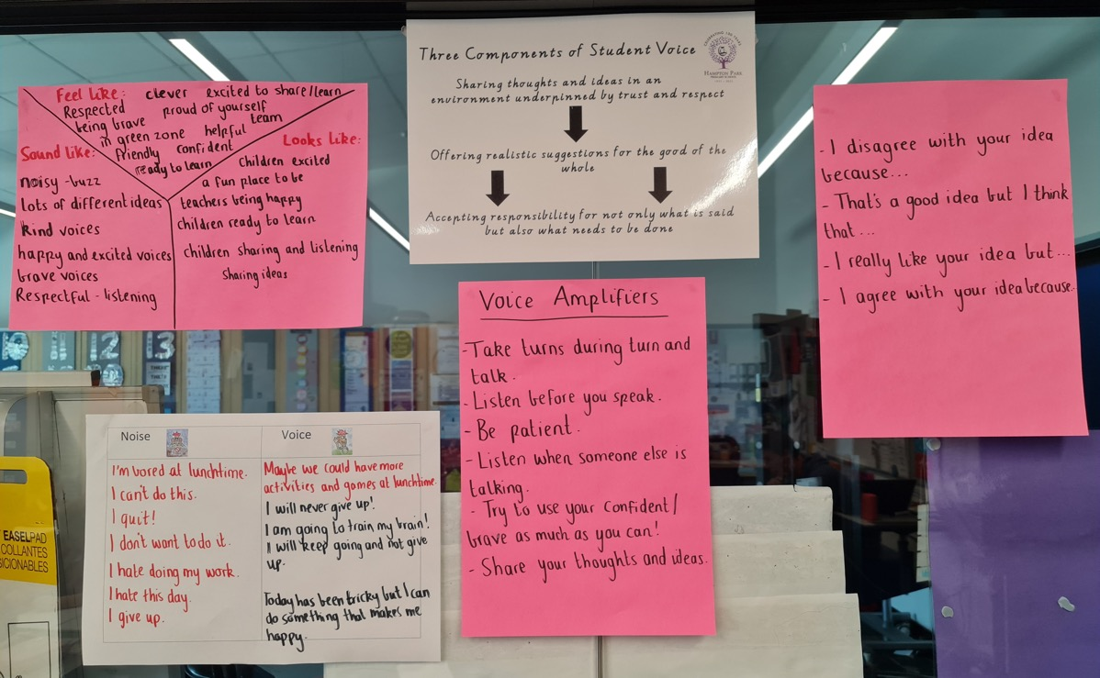
Unpacking Voice

Slide 38

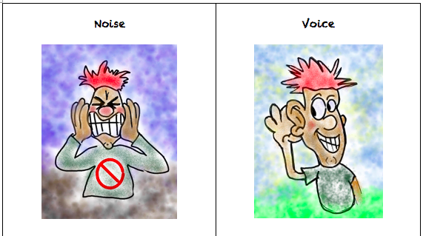
Challenge
Noise vs. Voice Art
As a table group, create a visual representation that reflects the difference between Noise v. Voice.

Slide 39
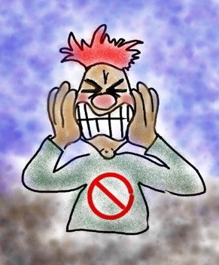
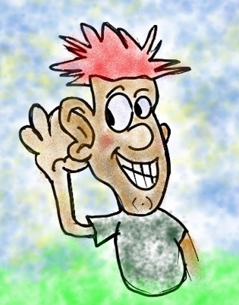
Noise vs Voice
Student Noise
Demands/commands/chaotic
Student opinion is most important
All adult voice is negative
Everyone needs to change but me
Complaining/whining
Student Voice
Requests/inquiry/focused
Our ideas are stronger in partnership
Students are open to learn
Personal reflection
Accepting responsibility

Slide 40

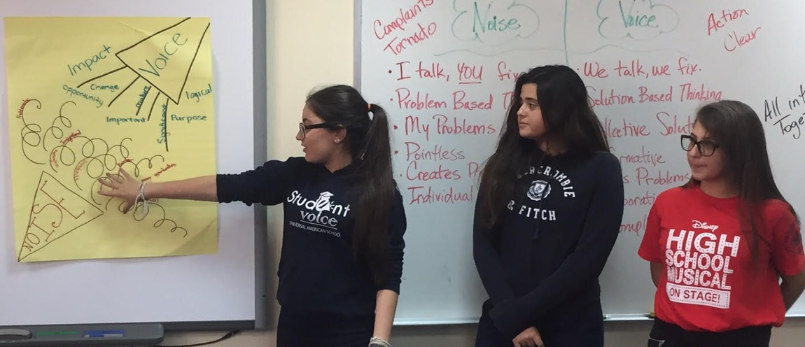
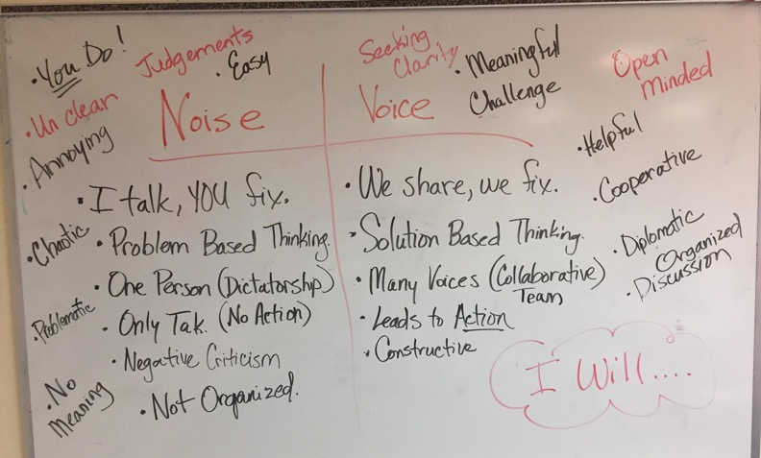
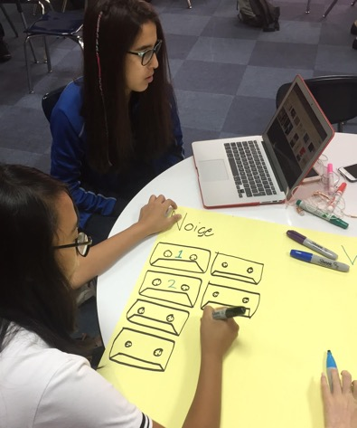
Student Voice in Action
Universal American School,
Dubai, UAE

Slide 41
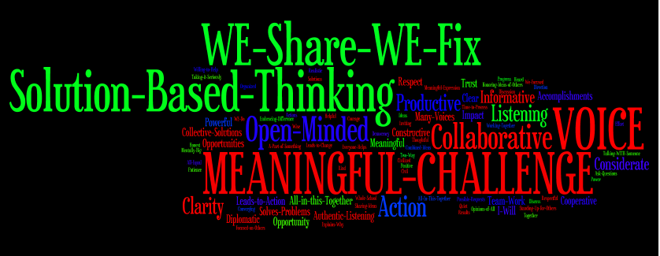
Student Voice in Action
Universal American School, Dubai, UAE

Slide 42
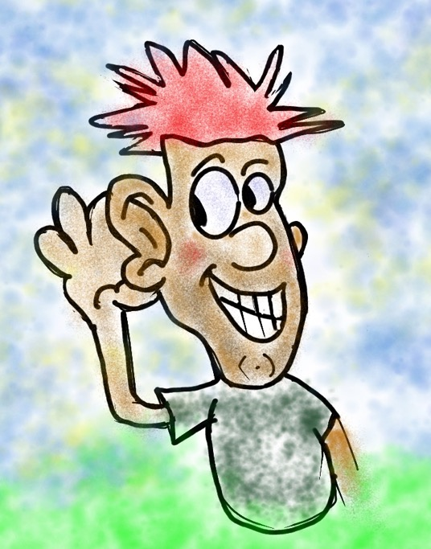
REFLECT
What skills do your students need for their voices to be heard?

Slide 43
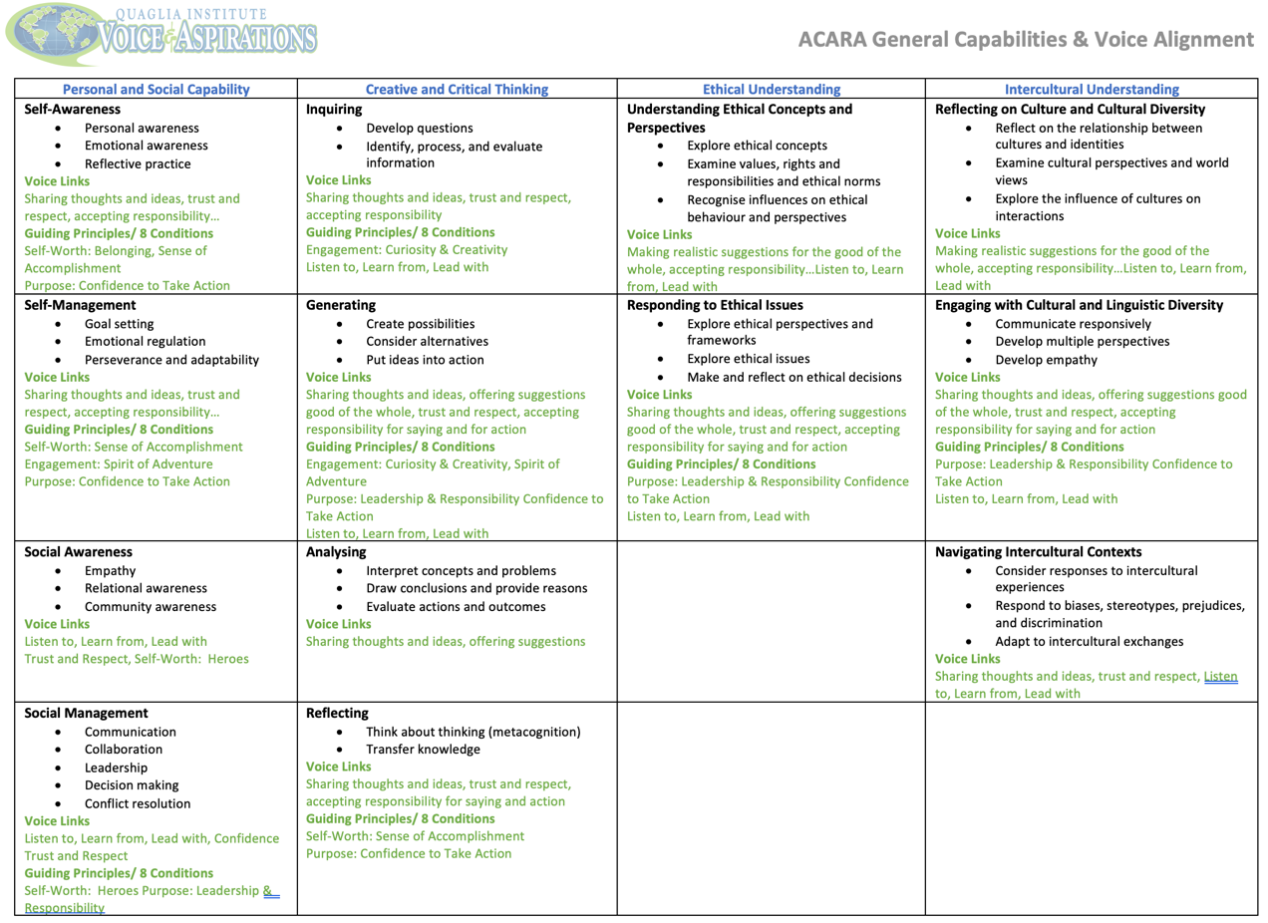
Confident and Competent Citizens
ACARA General Capabilities & Voice Alignment
Notes:
By embedding Voice as a way of being across a school, ALL students have opportunities to develop and demonstrate these competencies and capabilities. As we teach students skills to effectively use their voice, we are also teaching these capabilities.

Slide 44

When students use
their Voice, they…
Recognise their unique identity, feel they belong, & know are valued for their ideas & opinions.
Identify & share their strengths.
Set goals for themselves.
Advocate for themselves & things they care about.
Are more motivated to engage in the challenge of learning & contribute to the learning of others.
Notes:
This links with how DoE defines student agency: “When students are empowered to have an active role in making choices and decisions that shape their learning, wellbeing and experience of school.” This connects back to the 3-part definition of voice with includes offering realistic suggestions for the good of the whole, and taking responsibility for not only what you say but also what needs to be done—taking action.

Slide 45
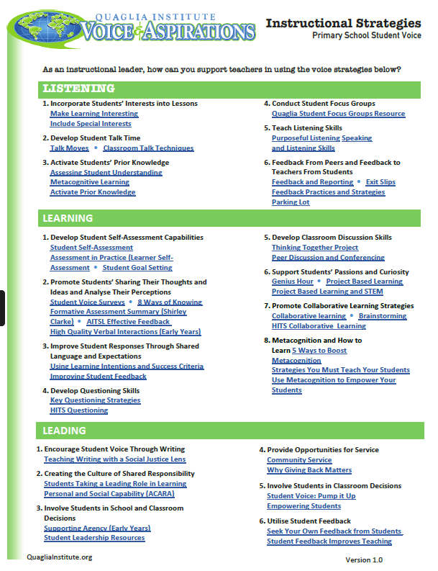
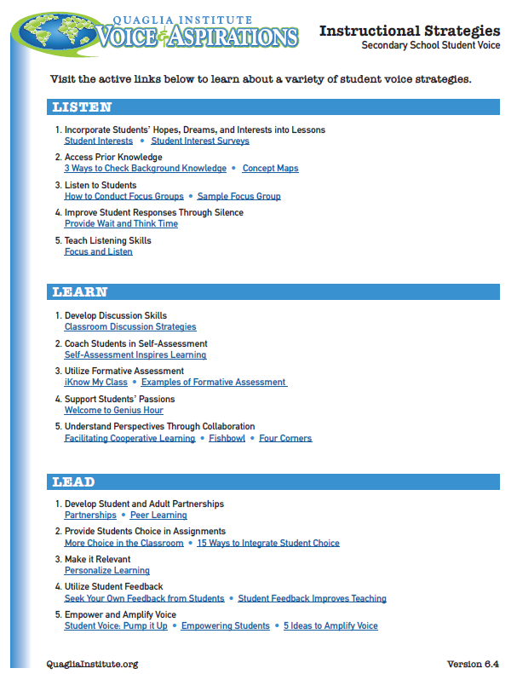
Enhancing Current Practice
Identify which practices are already
expected to be used by all teachers.
How might teachers plan to activate
student voice and responsibility using
these practices?
How will you support staff and students to see the connections?
Notes:
The point is not about new but about enhancing what we already know is effective. We need to be deliberate in involving the students, helping them actively learn and know their role as a learner. It is how the teacher chooses to activate the voices

Slide 46
Return to your WAGOLL.
What would you add to the picture of success for your school?

Slide 47
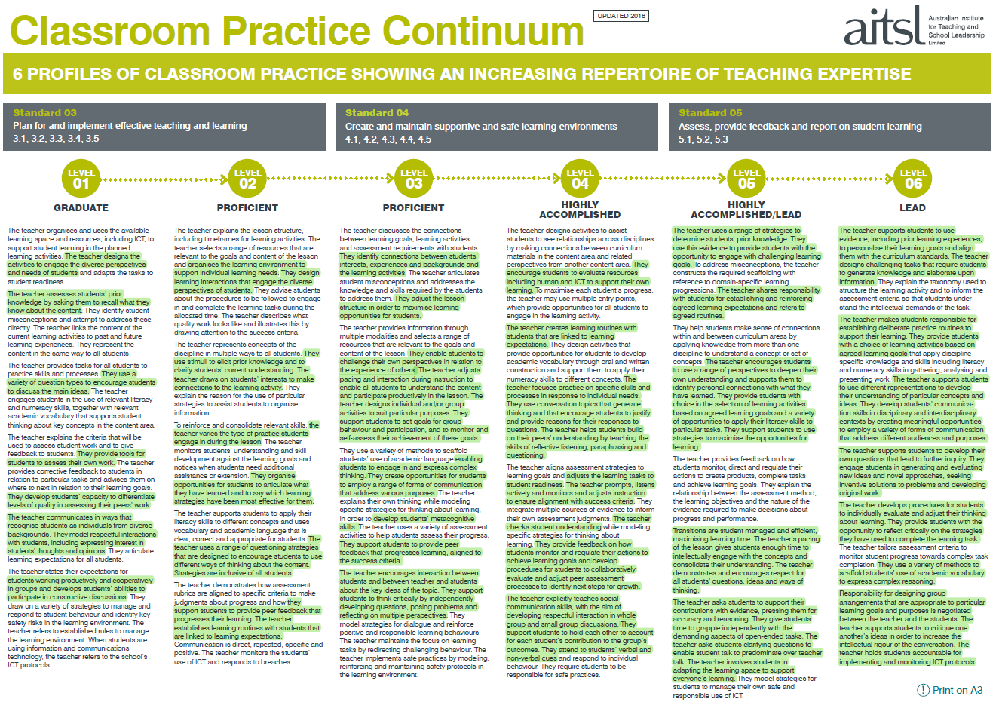

Slide 49
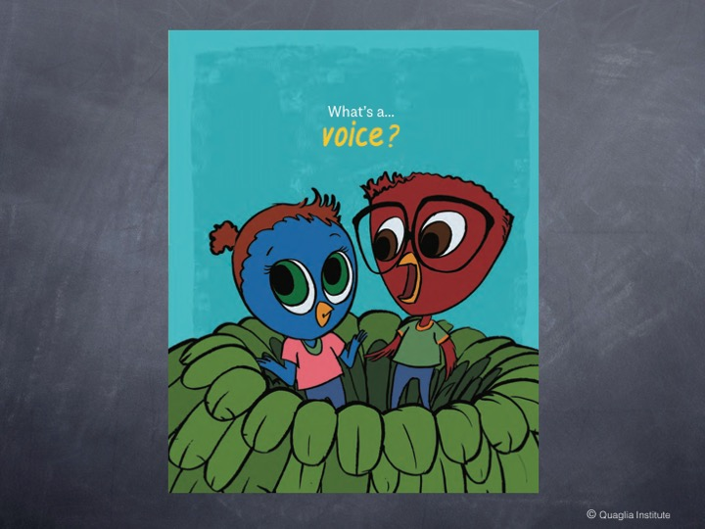
© Quaglia Institute

Slide 50


© Quaglia Institute

Slide 51
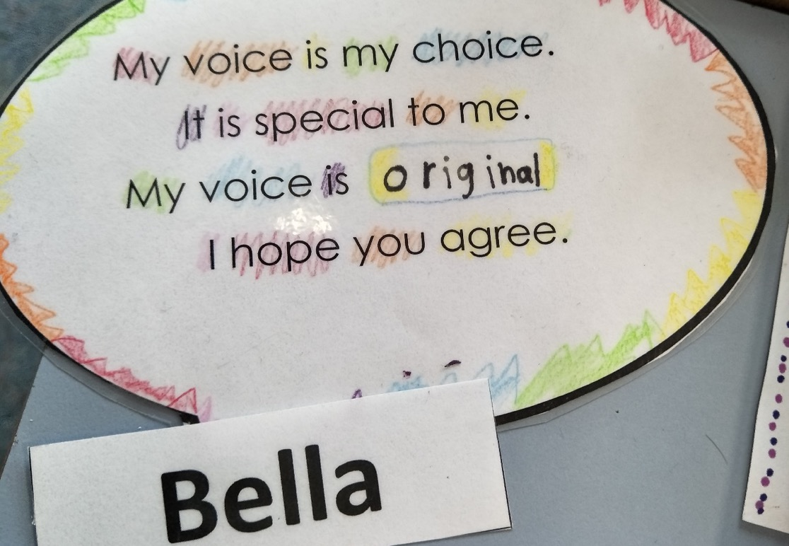
Student Voice in Action
Winchelsea Primary, Victoria, Australia

Slide 52
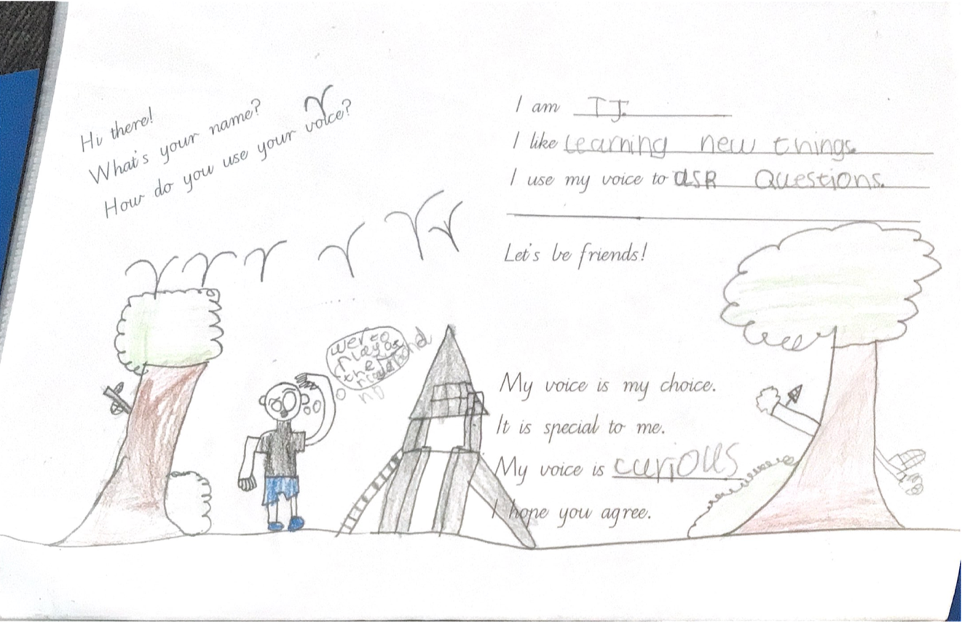
Student Voice in Action
Hampton Park Primary School, Victoria, Australia
Notes:
Year 1/2 class at Hampton Park. The whole school developed pages for their own version of the Cay and Adlee book.

Slide 53
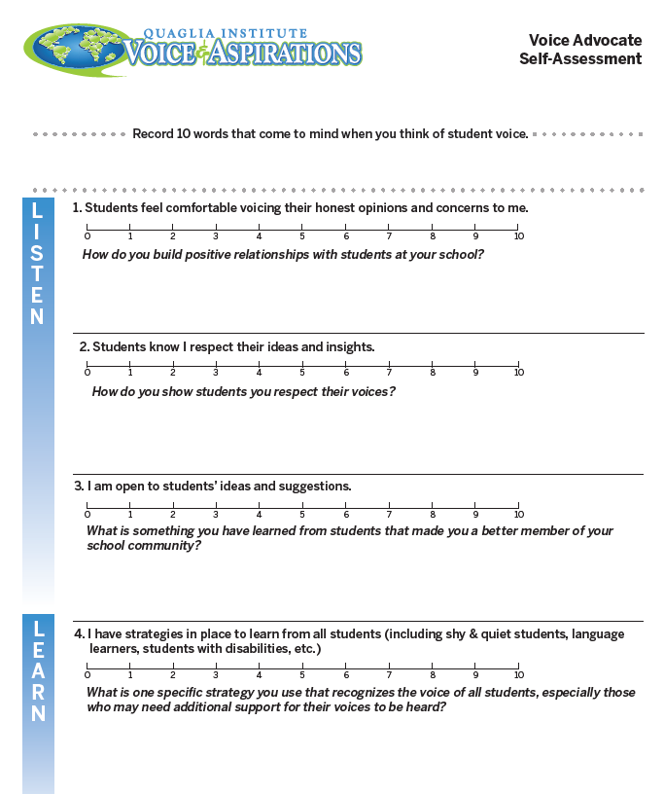
Deliberately Activating Student Voice
“ Voice is in
everything we do!”

Slide 54






Rolling Reflections
What is sticking with you from the Voice definition?
What do you see as the power of student voice?
What voice skills are you going to intentionally develop in students?
What key take away from this session will you share with a colleague?
What connections can you make to your system’s priorities and goals?
Wild Card! Share anything you want related to Student Voice!

Slide 55
The power of voice
When students know how and when to use their voice, they are more willing and able to contribute to their own
wellbeing and learning.

Slide 56
Having a say is not enough
Use voice to:
Influence Question
Be recognised Collaborate
Suggest Partner
Connect Participate
Identity Contribute
Express Advocate
Make a choice Seek help
Staff must show they listen to create a safe space for students to speak up

Slide 57
ASPIRATIONS
The ability to
dream and set goals
for the future,
while being inspired
in the present
to reach those dreams.

Slide 58








Aspirations Framework
Self-Worth
Engagement
Purpose

Slide 59

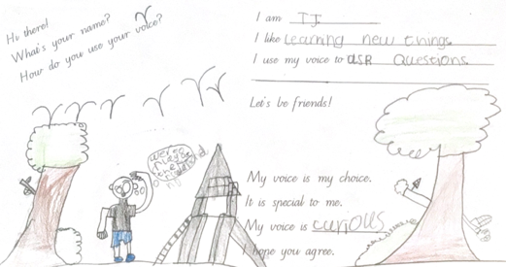



I believe I have the ability to learn
Personal and Social
Creative and critical thinking
Intercultural understanding
Ethical understanding
My
Voice
My
goals and progress
My
Self Worth
My
Capabilities
Notes:
I have a voice and I listen to the voice of others. We share our thoughts and ideas for the good of the whole. I am unique and I belong, we trust and respect each other. Sense of accomplishment is achieved through my own goals

Slide 60


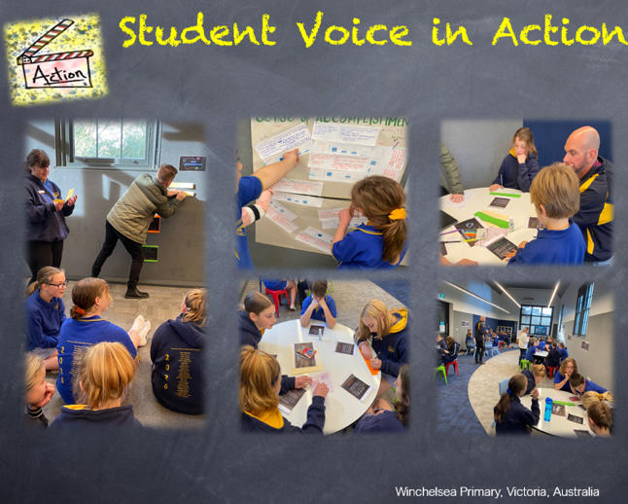



Developing my purpose through engagement
My learning
strategies
My confidence to contribute
My
Engagement

Slide 61
Voice Potential
Current | Intended
Curriculum driven attainment celebration | Student progress and personal growth regularly celebrated
Teacher directed goals | Co-created short-, medium- and long-term goals, personal, academic and social/emotional
Adult analysis of student data | Student analysis of own academic and collective student voice data
Narrow definition of success in school | Broader definition of success in life
Teacher directed learning design | Students and teachers collaborate to design and share pathways to learning and show evidence of learning
All students seen as one largely similar group | Diversity and unique strengths are celebrated, accepted and promoted
Some voices have more ‘power’ and influence than others | All voices are heard, valued and contribute to the good of the whole
Notes:
Where are we going…, where are we now… how will we get there

Slide 62
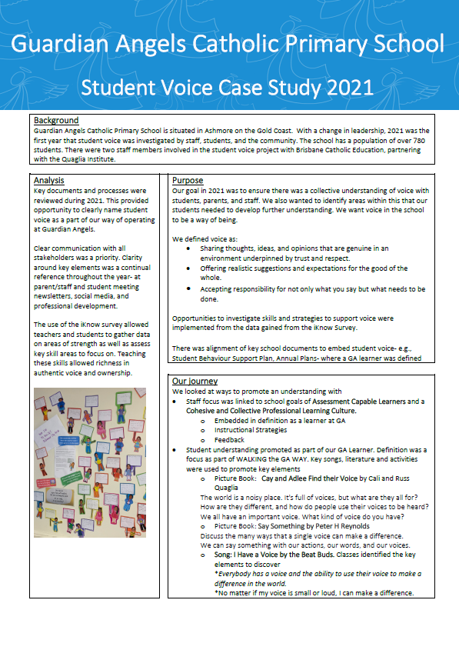
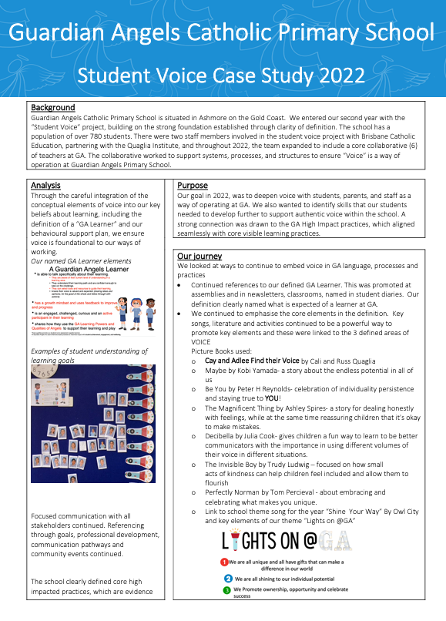
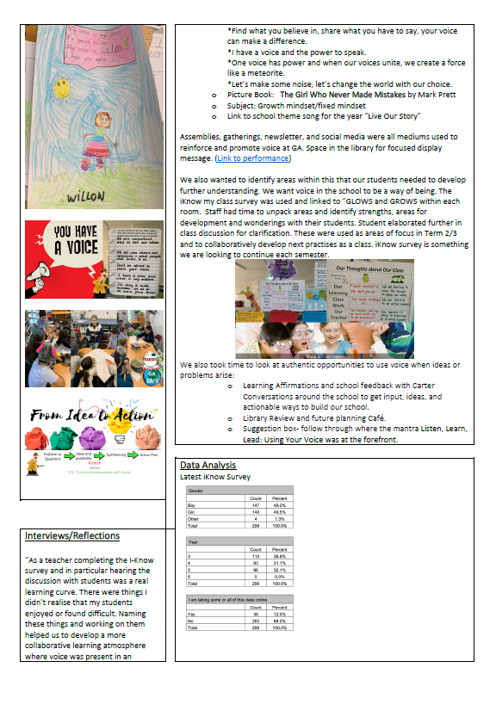
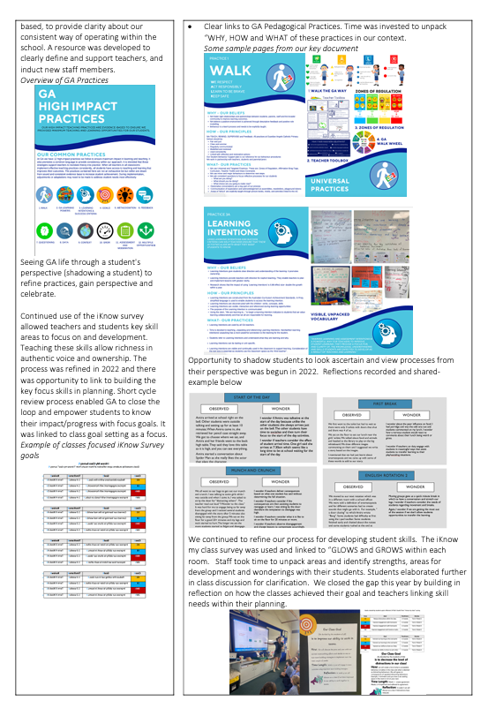
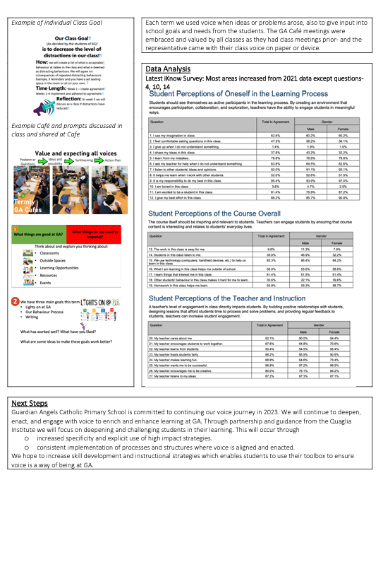
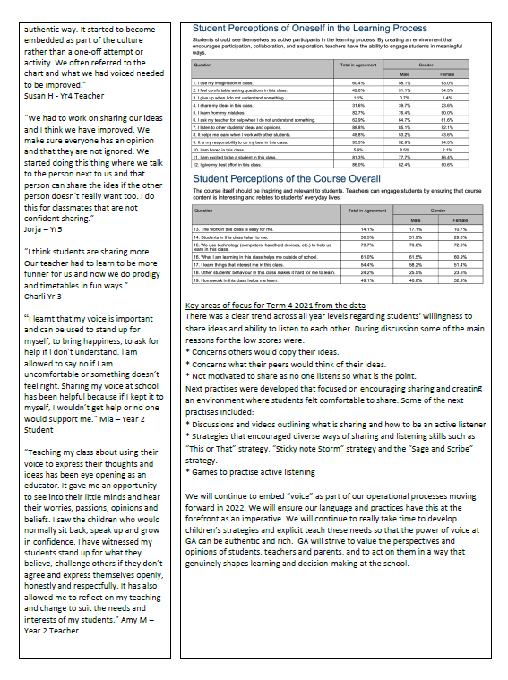
Making Voice a Way of Being. The GA Story

Slide 63

Mic Drop Moments
What is your mic drop moment of learning from this discussion on Student Voice?

Slide 64

Thank you!
Contact me with questions or for further discussion.
Sue Bryen
bryen@quagliainstitute.org

