Slide 1


Empowering Students to Change the World Through the Voice Process: Listen, Learn, Lead
Dr. Russ Quaglia & Dr. Lisa Lande
@QISVAtweets @Lisa_Lande
lande@quagliainstitute.org
www.QuagliaInstitute.org
July 19-20, 2023

Slide 2
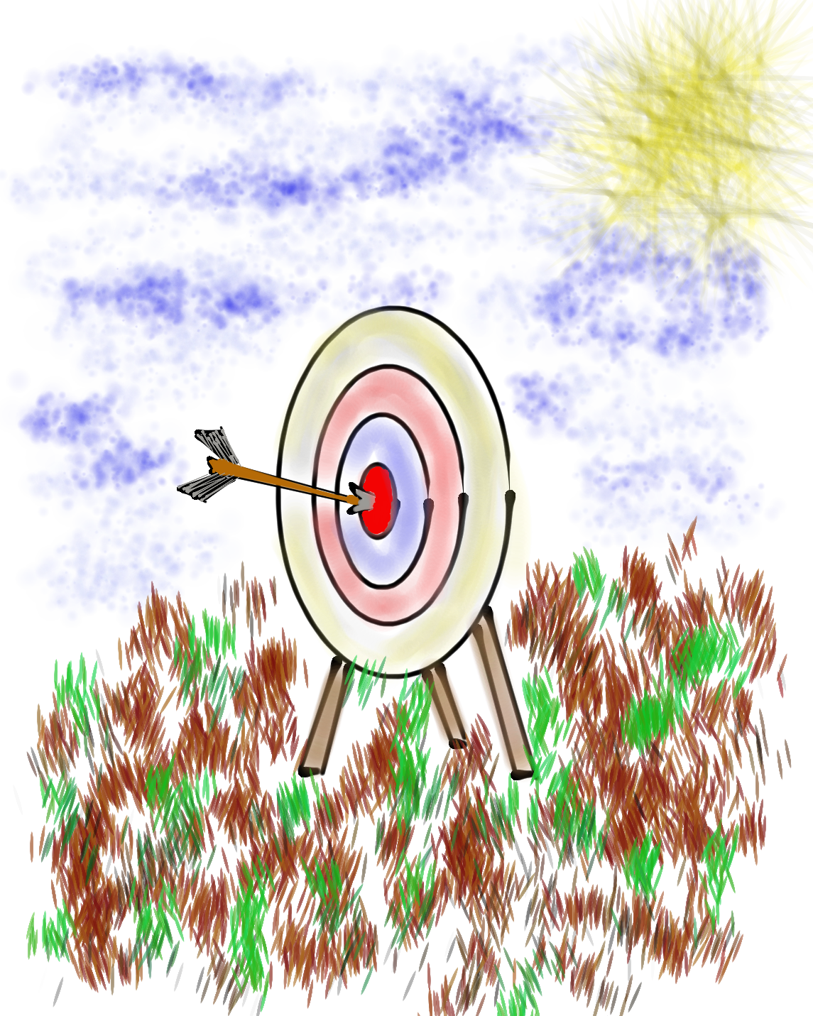
Learning Intention
We are learning to implement the
Voice Process to amplify voice & support all students in reaching their fullest potential.
Success Criteria
Discover the components & nuances of the School Voice Process: Listen, Learn, Lead
Consider how the School Voice Process can help us
  -Reimagine Education
  -Reconnect with the Joy of Teaching
  -Empower Students to Change the World
Apply learning to amplify Student Voice in
YOUR school

Slide 3

Challenge Time…

Slide 4
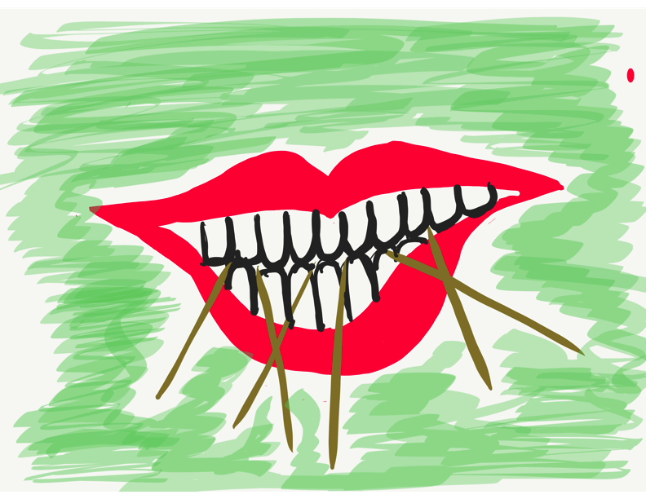
Challenge Time!
Using 6 toothpicks,
make 4 and only 4
equilateral triangles
(all 3 sides the same size).
You may not break the toothpicks.

Slide 5
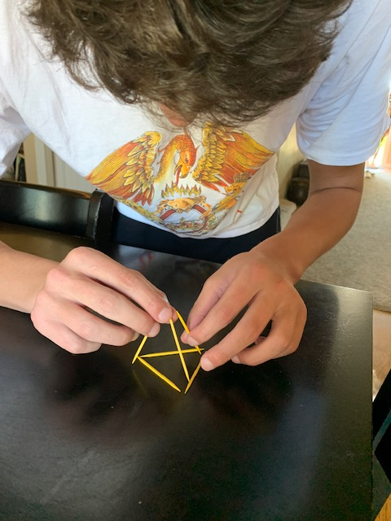
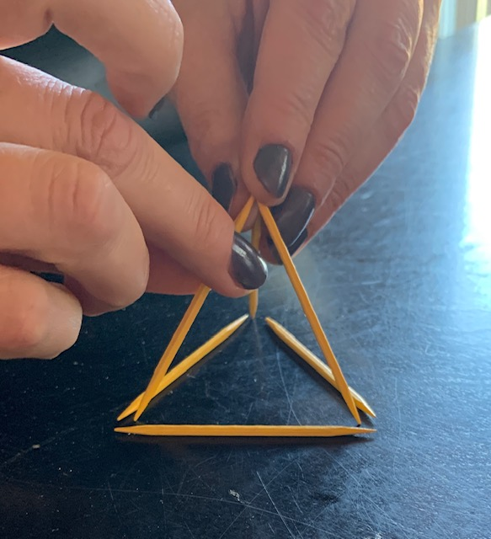
Today we invite you to do
some 3-D thinking!

Slide 6
LEAD
Voice Process Brief
TAKE ACTION
with others
Share
RESPONSIBILITY
LEARN
UNDERSTAND
& RESPECT
different points
of view
Build
TRUST
LISTEN
SEEK OUT
opinions from
others
School Voice Process

Slide 7
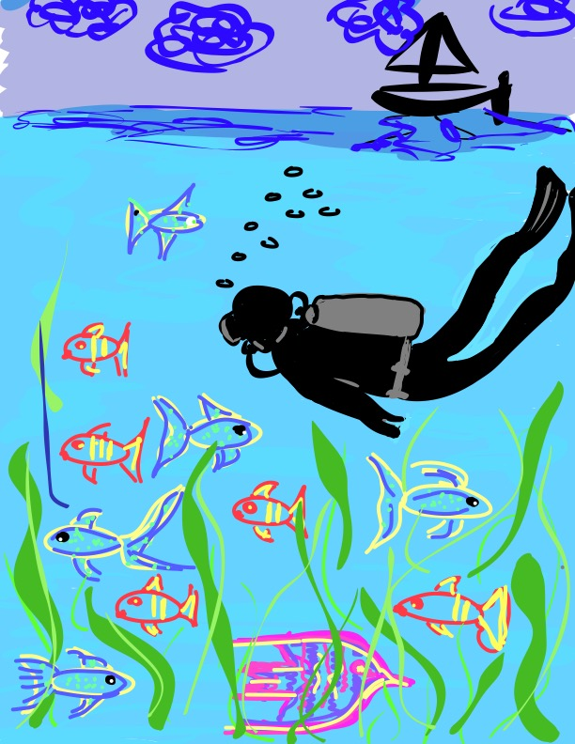
Let’s Dive Deeper…
Listen
Learn
Lead

Slide 8
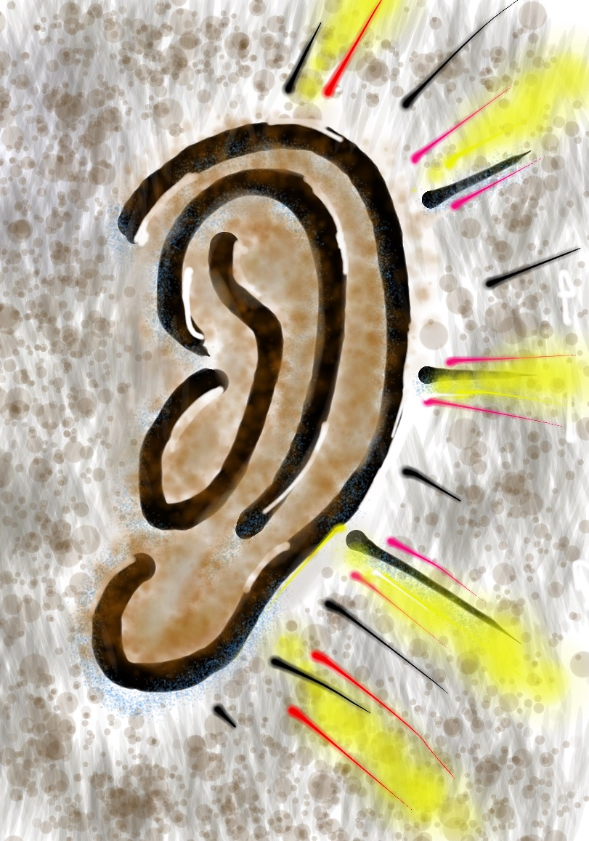
Listen

Slide 9
The Art of Listening
Vimeo: vimeo.com/qisva/listening
or
YouTube: https://youtu.be/ooE9dKobjZU
Video

Slide 10
Challenge Time…

Slide 11

Challenge Time!
Drawing Dictations
Round 1: Find a partner &
assign one person to be the
Describer, & one person to
be the Artist. Sit back to back. Without looking or asking
questions, describe to your
partner how to replicate
your picture.
Round 2: Switch roles
(Describer & Artist) &
repeat, but this time you
can ask clarifying questions.
Drawing Dictations
Lesson Plan

Slide 12
Listen
Reach out & listen to voices
you typically don’t hear from
Stay focused (put away your phone!)
Be genuine & truly interested
Make sure you are talking less than the
other person
Being open to new ideas is not an option

Slide 13

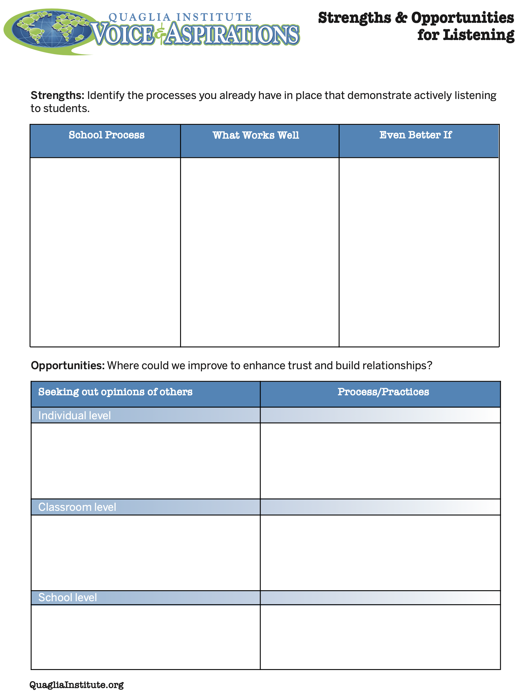
Reflect
What are your
strengths &
challenges when it
comes to
Listening to students?
How do you build trust & positive relationships?
Strengths & Opportunities for Listening

Slide 14

Reflect
How does what we just
explored about “LISTEN”
connect with the “Reimagining
Education” conference theme?

Slide 15

Learn

Slide 16
Taking Time to Learn
Vimeo: vimeo.com/qisva/time
or
YouTube:
https://youtu.be/tYKcvRfxK0o
Video

Slide 17
Challenge Time…

Slide 18
Challenge Time!
Connections
Find the connection
between the 4 individual pictures.

Slide 19
Connections 1
Vimeo: vimeo.com/qisva/connection1
Or
YouTube:
https://youtu.be/Yl3JrRtyGHc
(all 9 slides)

Slide 20
Connections 2
Vimeo: vimeo.com/qisva/connections2

Slide 21
Connections 3
Vimeo: vimeo.com/qisva/connections3

Slide 22
Connections 4
Vimeo: vimeo.com/qisva/connections4

Slide 23
Connections 5
Vimeo: vimeo.com/qisva/connections5

Slide 24
Connections 6
Vimeo: vimeo.com/qisva/connections6

Slide 25
Connections 7
Vimeo: vimeo.com/qisva/connections7

Slide 26
Connections 8
Vimeo: vimeo.com/qisva/connections8

Slide 27
Connections 9
Vimeo: vimeo.com/qisva/connections9

Slide 28
Learn
Learn from a variety of perspectives
Take notes & ask questions for clarity
You can learn from anyone
regardless of age, position, or any factor
Follow up & communicate what you
LEARNED from listening
Be prepared to change
Do not fear what you do not know

Slide 29
Reflect
How does what we just
explored about “LEARN”
connect with the “Reconnecting
with the Joy of Teaching”
conference theme?

Slide 30
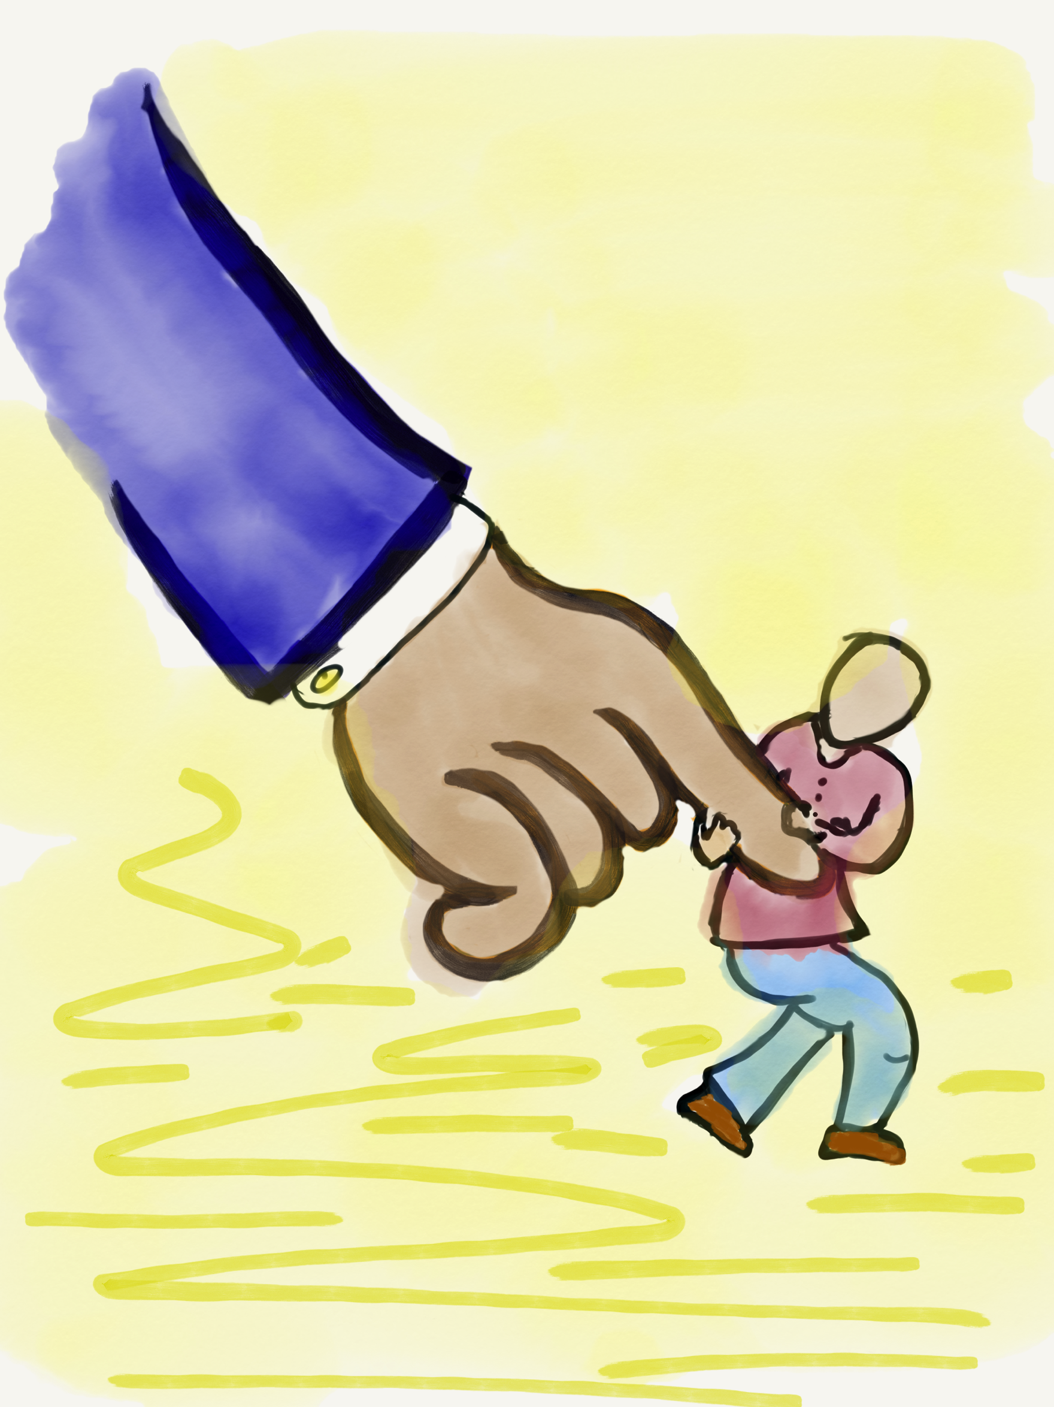
Lead

Slide 31
Leading Together…
Vimeo: https://vimeo.com/qisva/together
Or
YouTube:
https://youtu.be/RTvZCdUP7N4
Video

Slide 32
Reflect
What did you observe
related to the term
Lead in this video?

Slide 33
Lead
Use what you have learned to drive
meaningful change
Leading is not a solo adventure, take
action in partnership with others
Created a shared sense of purpose
Voice is not about getting your own way
You can’t please everyone, but you can
demonstrate value & respect for all voices

Slide 34

Exploring Examples
of the Voice Process
in Action!

Slide 35
Data Analysis & Action Planning
Vimeo: https://vimeo.com/qisva/lawrence
Or
YouTube:
https://youtu.be/iZWyKT6Gq4M
Video
Lawrence Middle School, Los Angeles, California

Slide 36
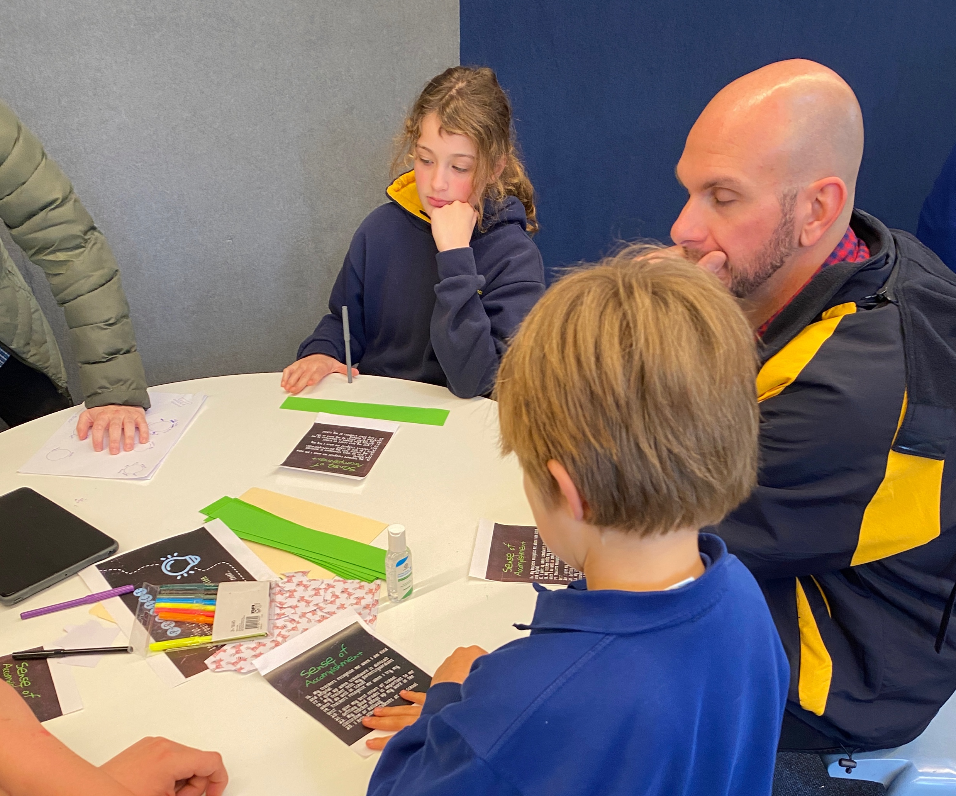
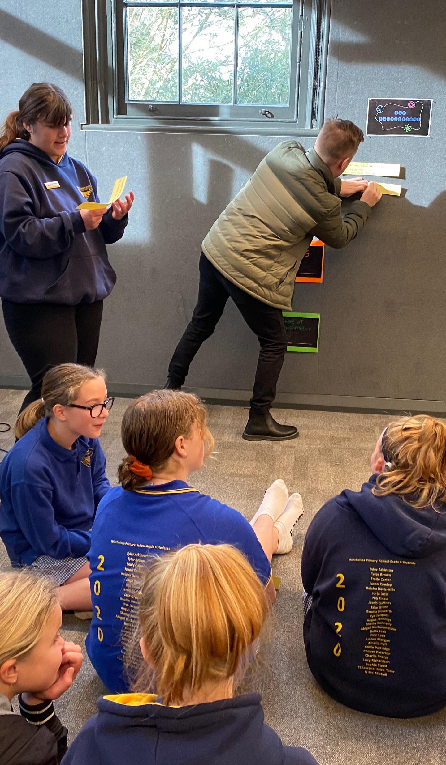
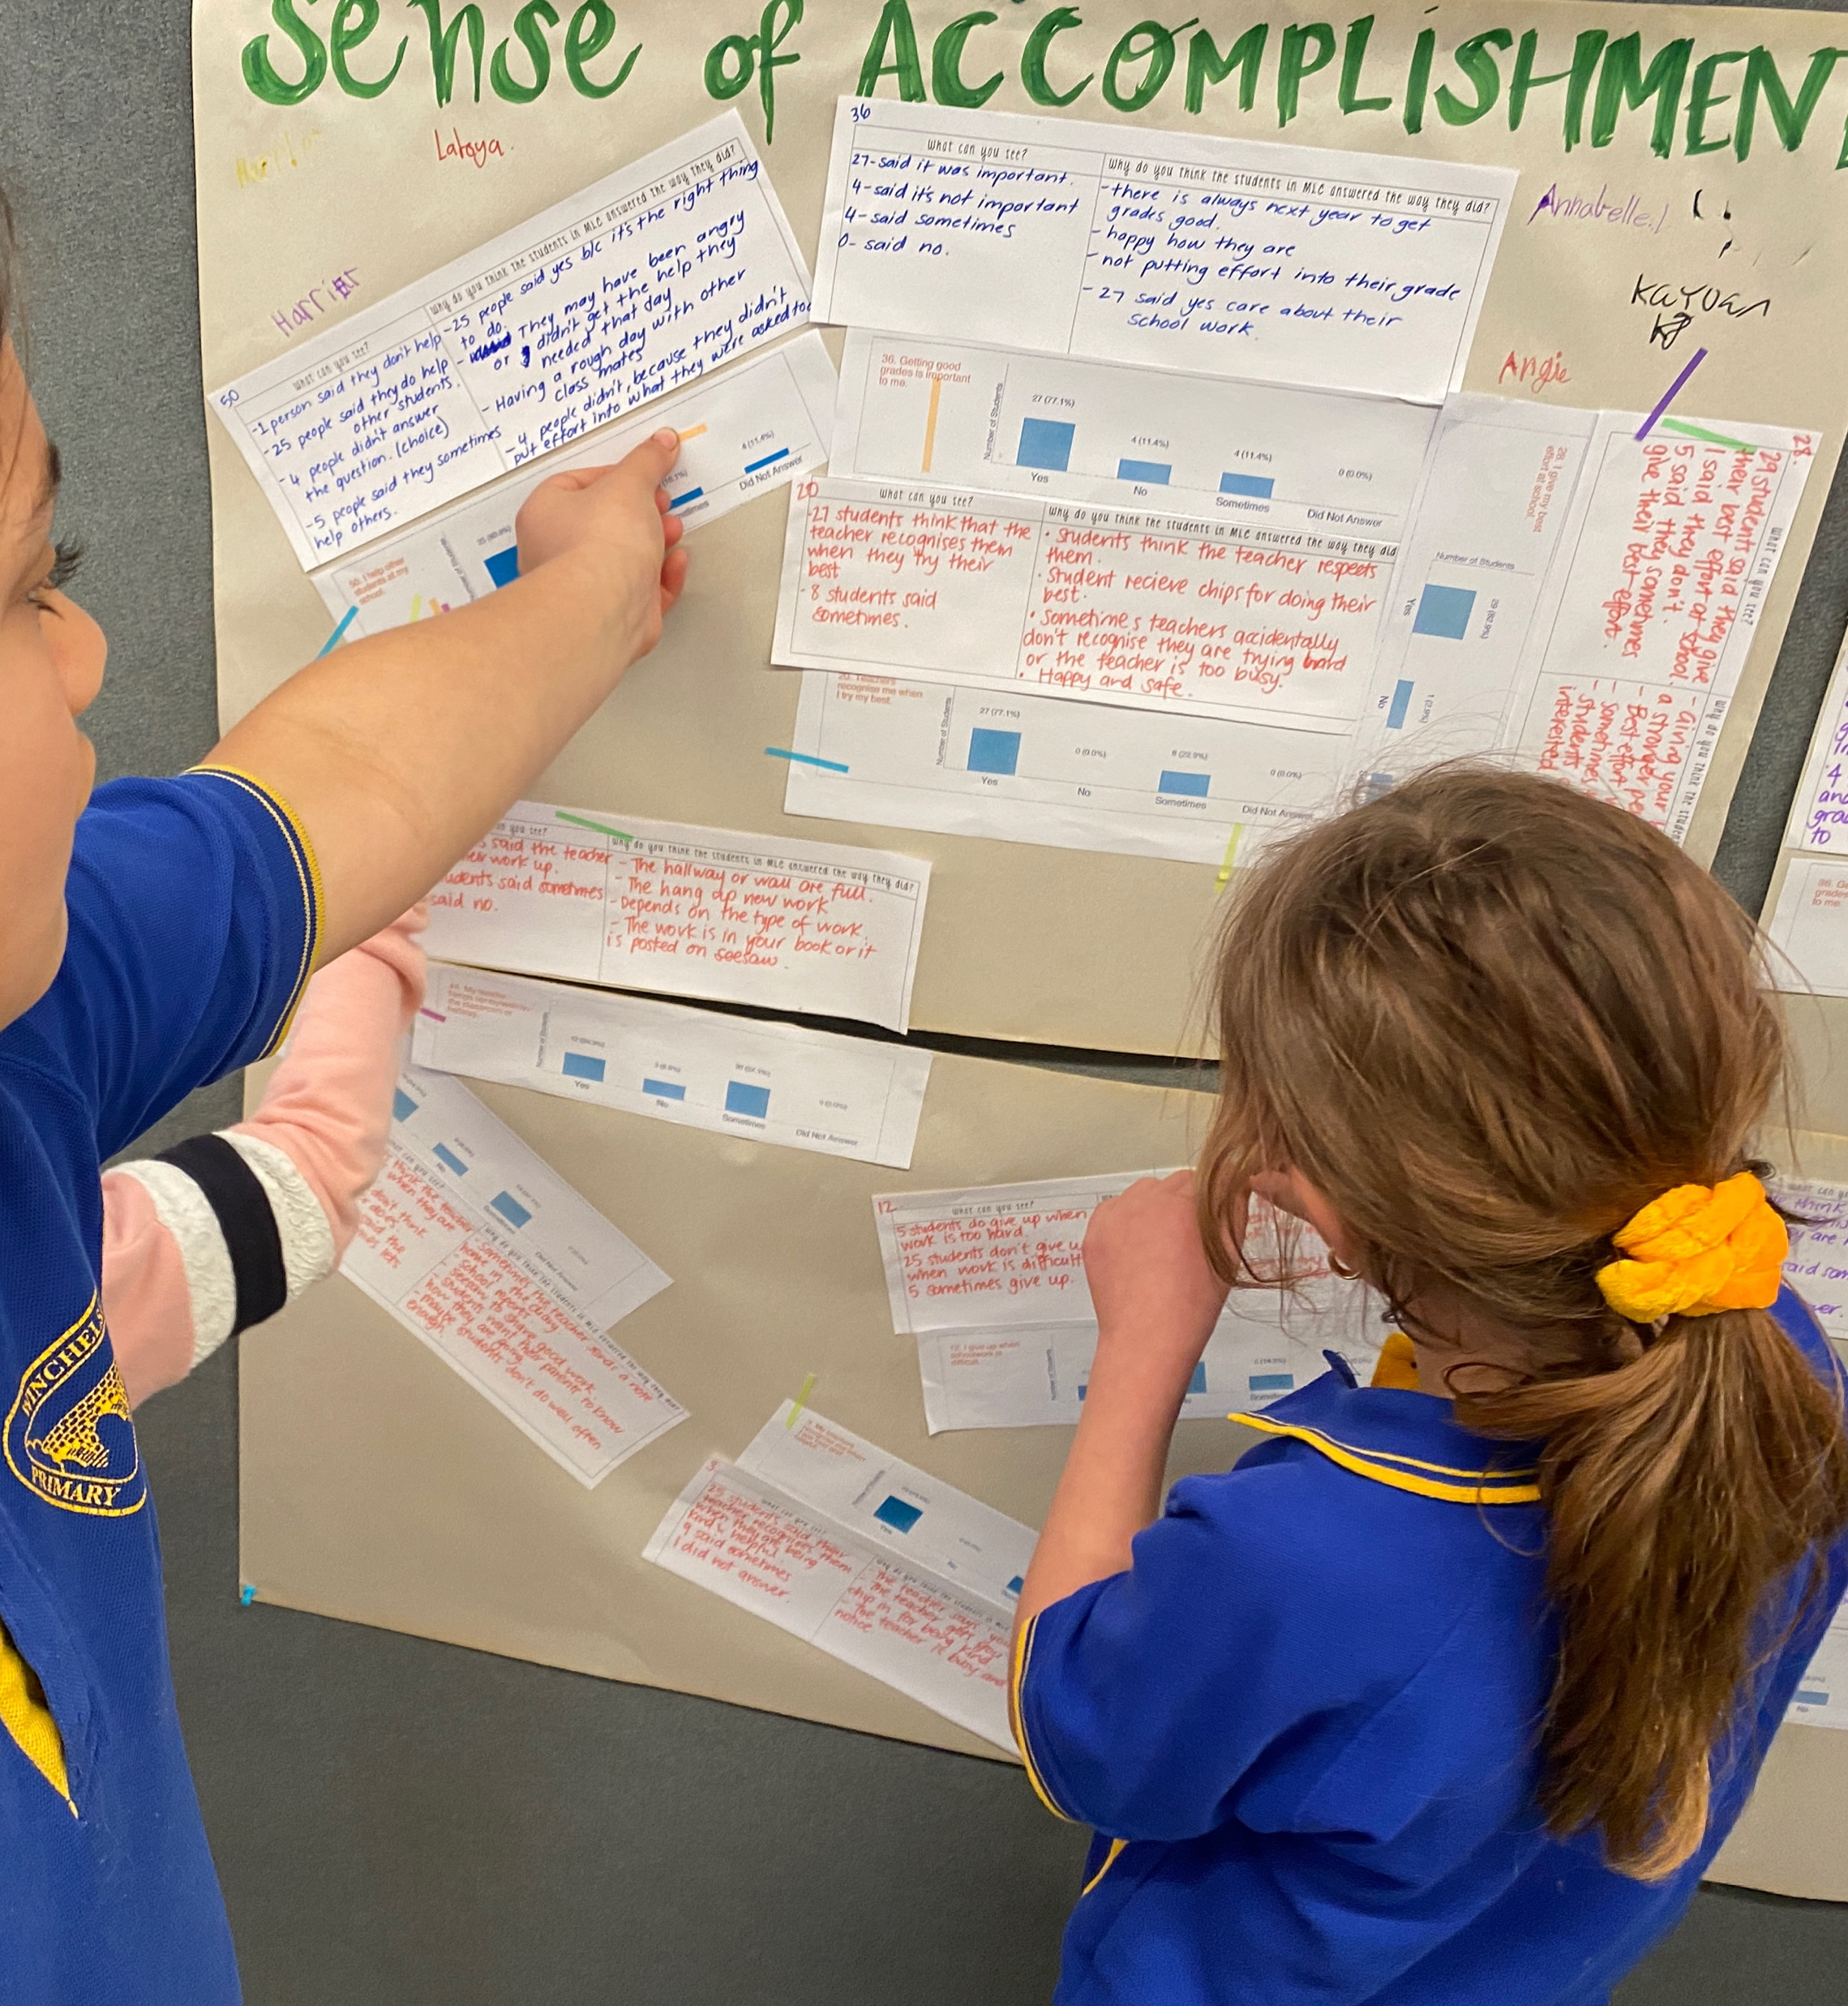
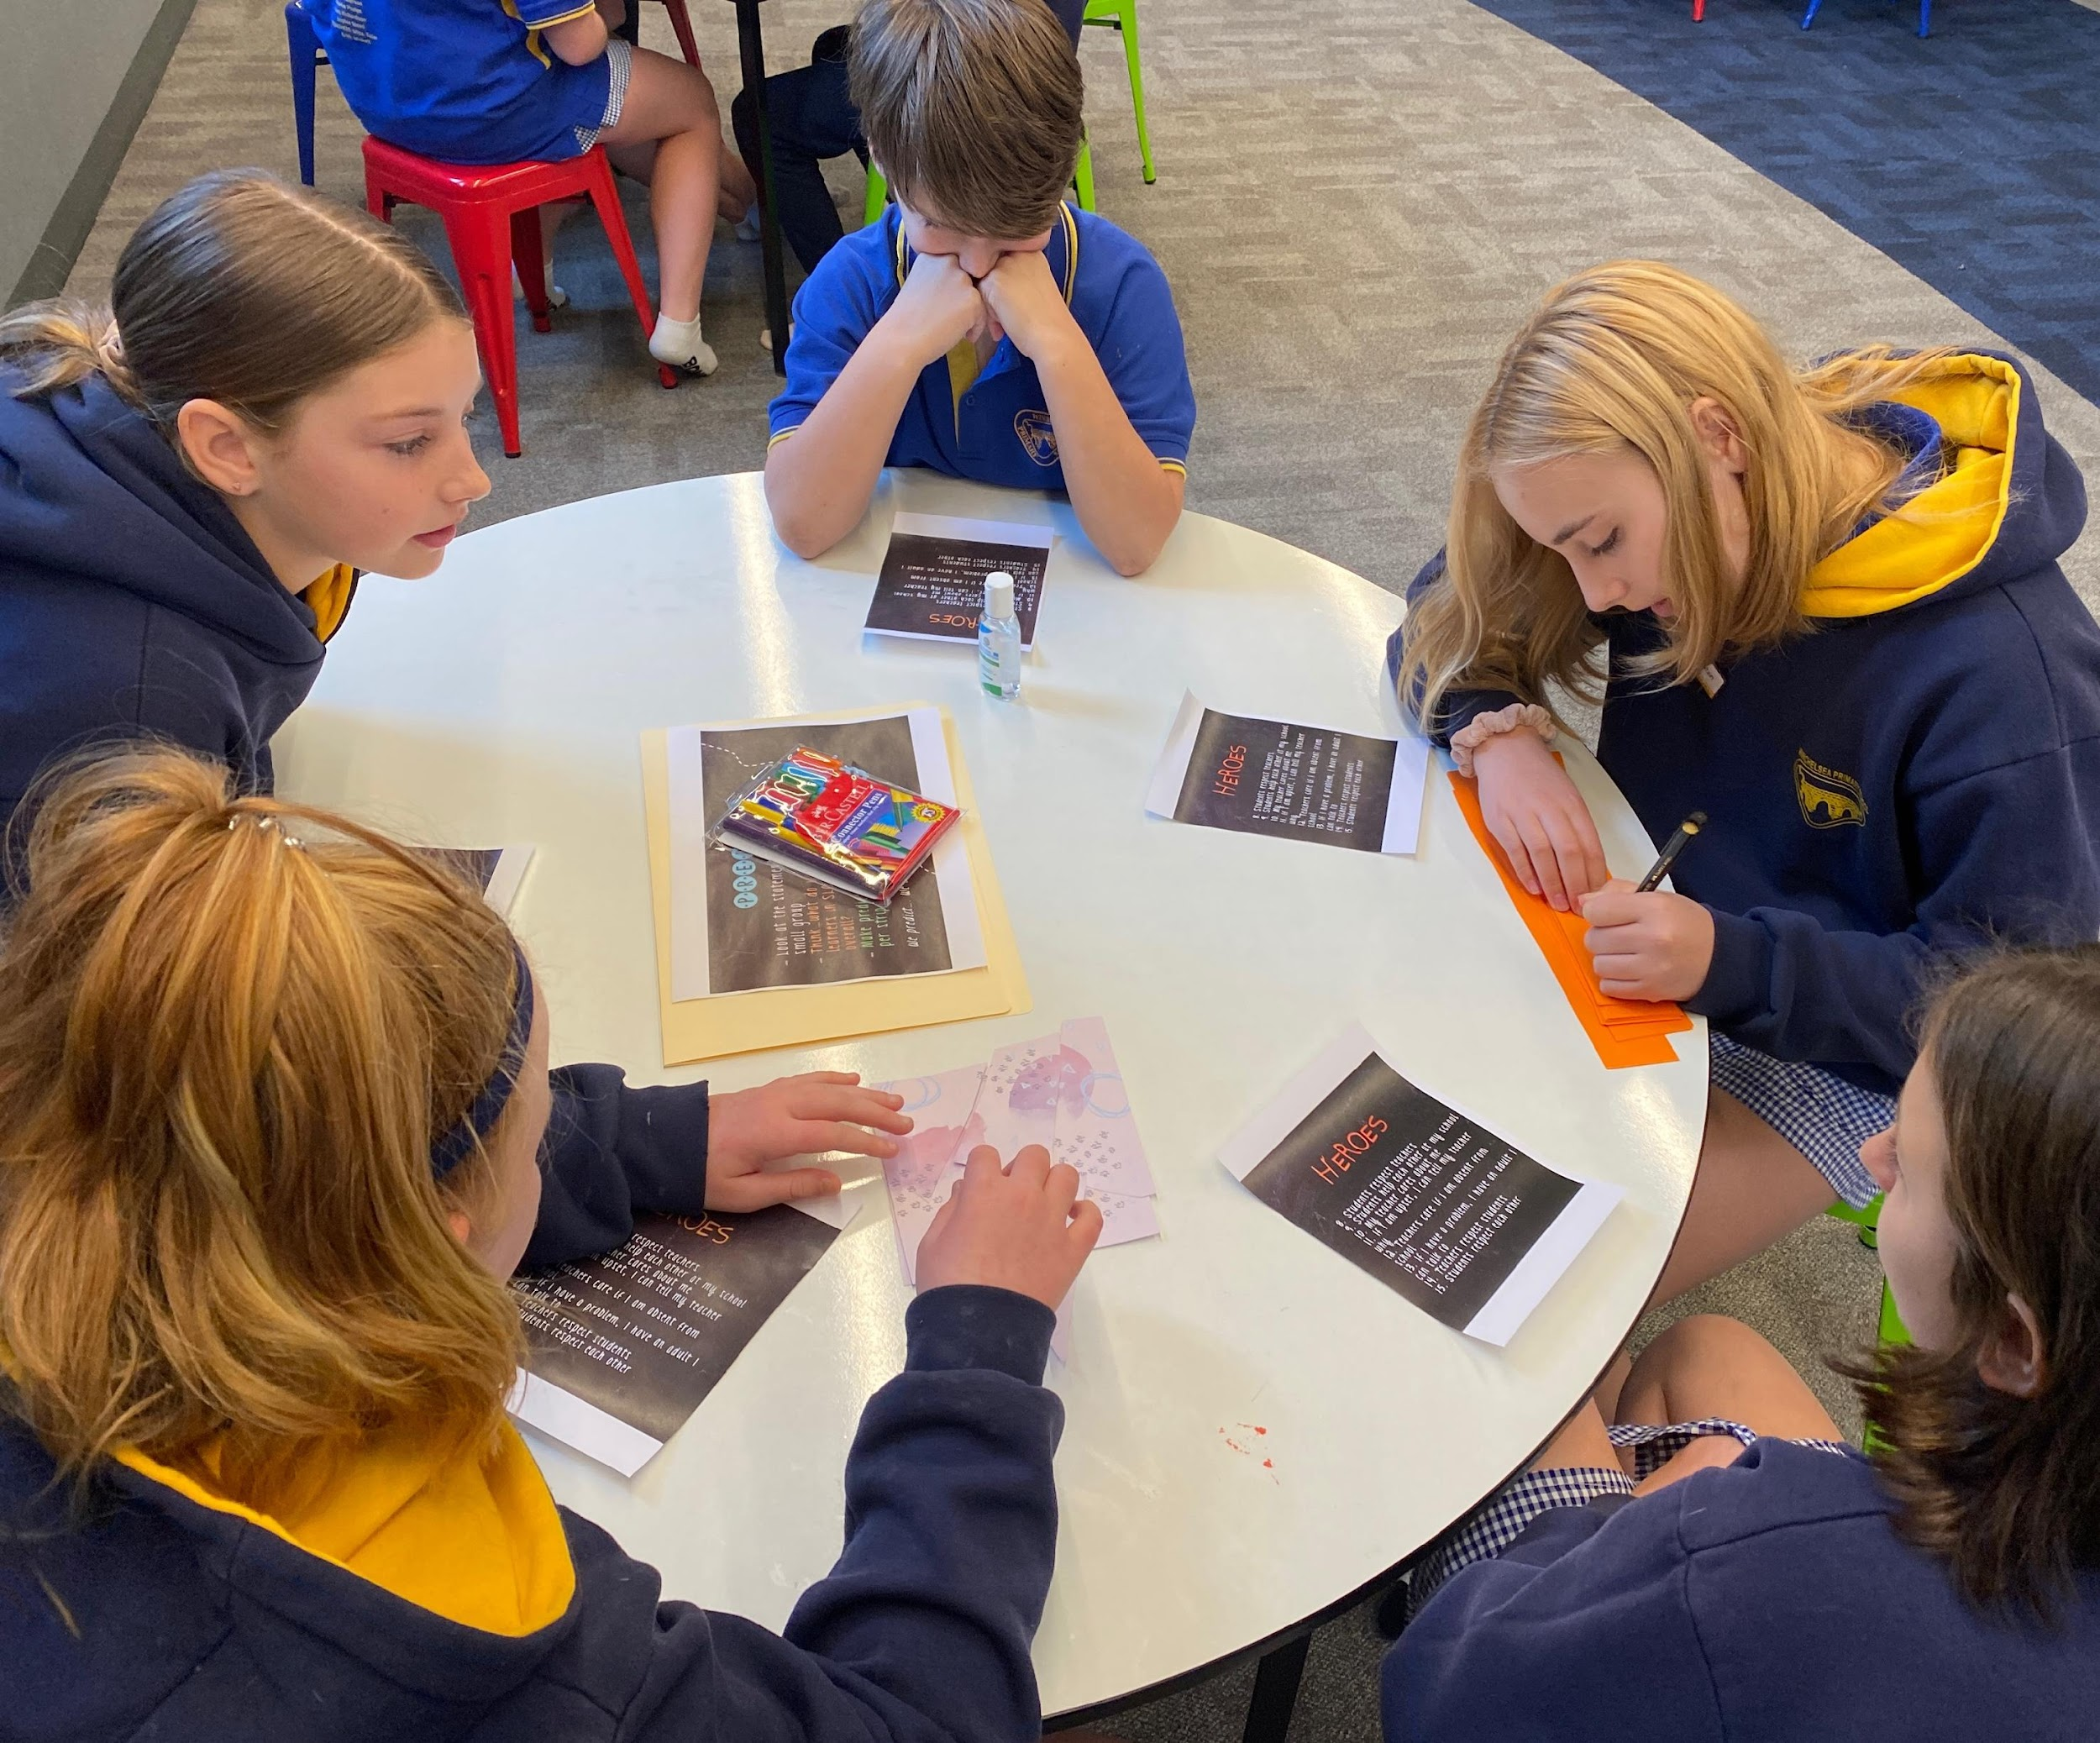
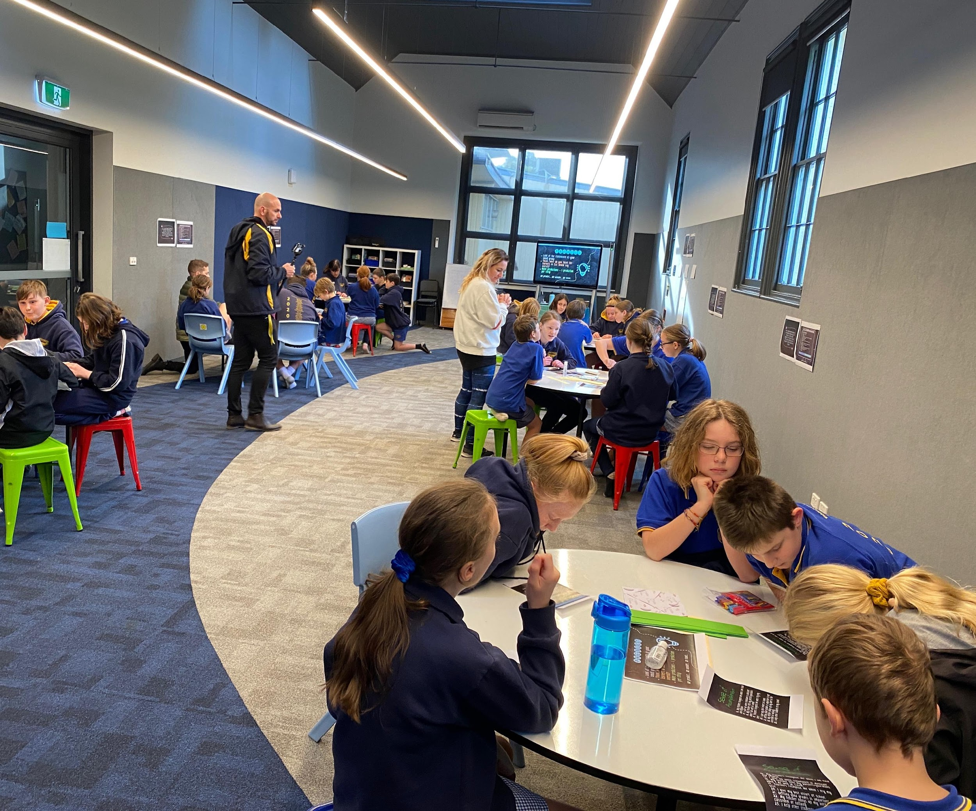
Leading Together
Winchelsea Primary, Victoria, Australia

Slide 37
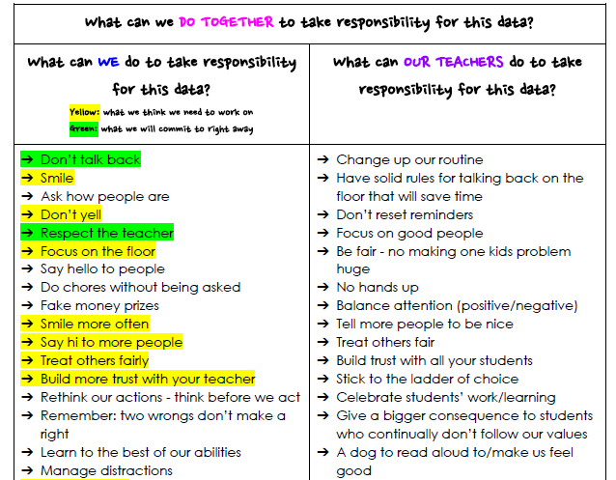
Shared Responsibility
Winchelsea Primary, Victoria, Australia

Slide 38
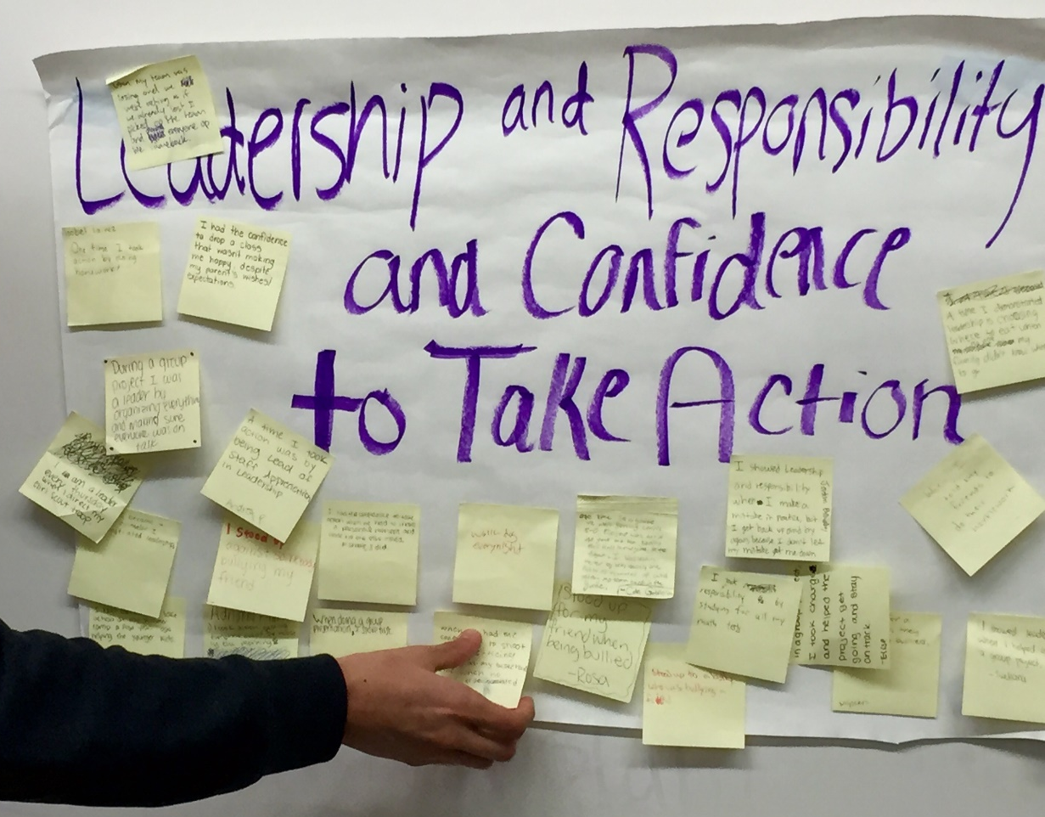
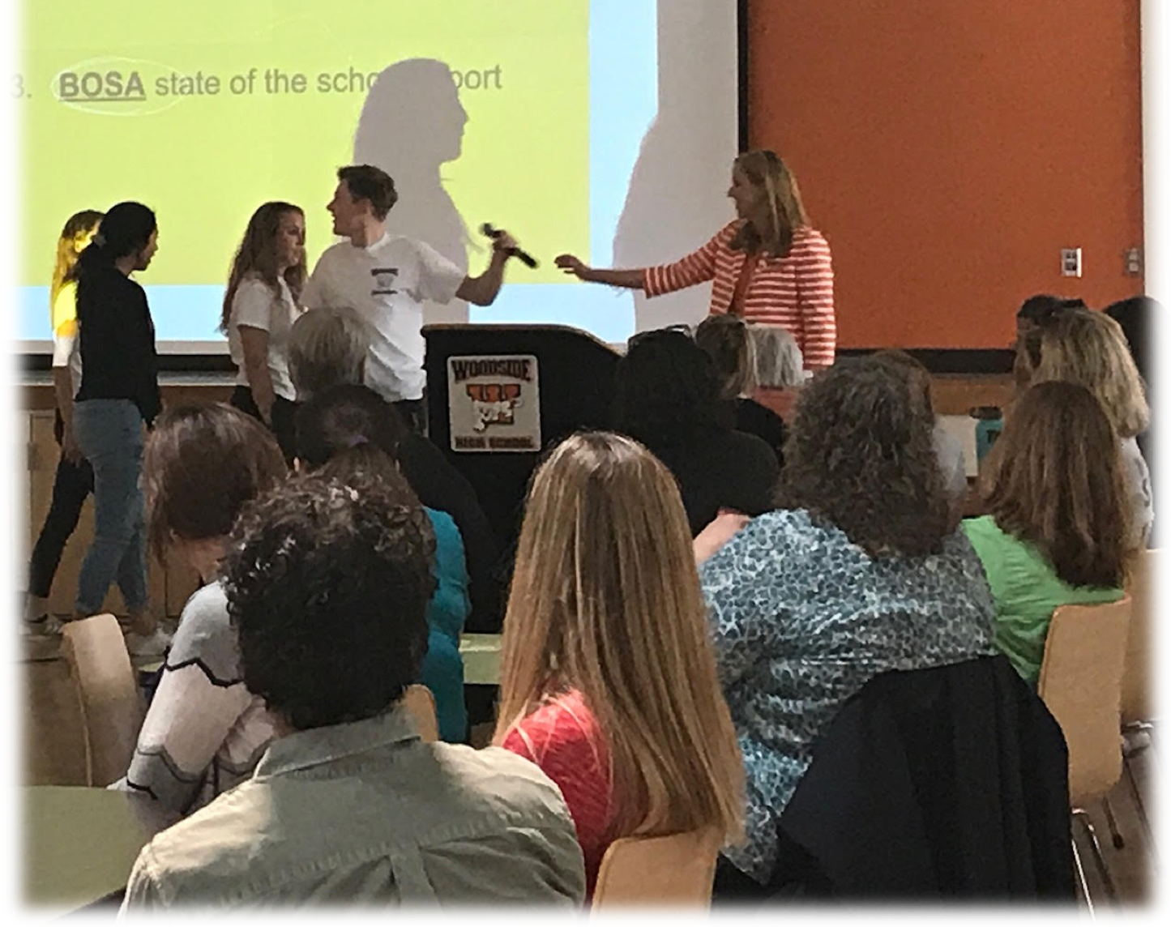
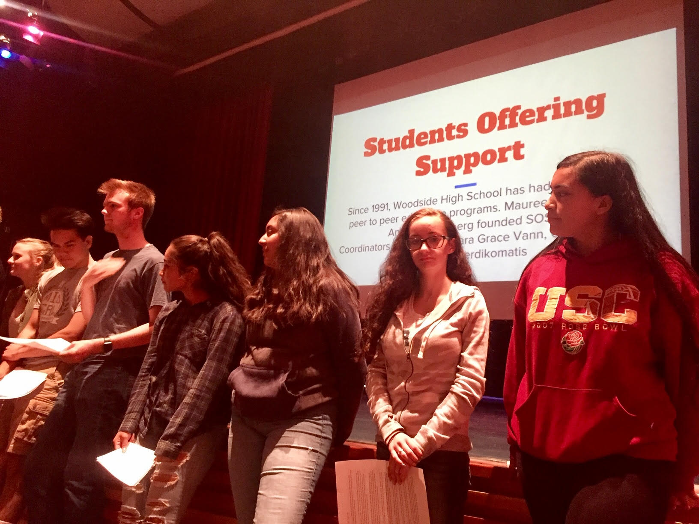
Who Holds the Mic?
Woodside High School, Redwood City, California

Slide 39
Voice Process in Action!
Vimeo: vimeo.com/qisva/sutter
Or
YouTube:
https://youtu.be/_kwkyzH0vWw
Video
Sutter Middle School, Los Angeles, California

Slide 40
Reflect
How does what we just
explored about “LEAD”
connect with the “Empowering
Students to Change the World”
conference theme?

Slide 41
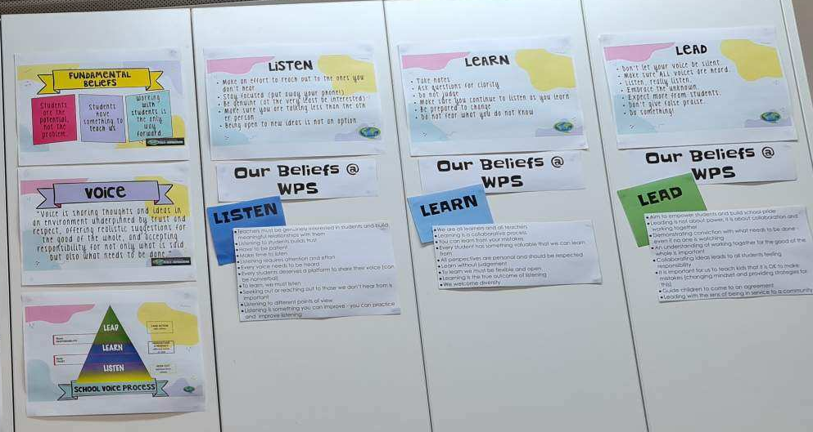
Creating Context for LLL
Winchelsea Primary, Victoria, Australia

Slide 42
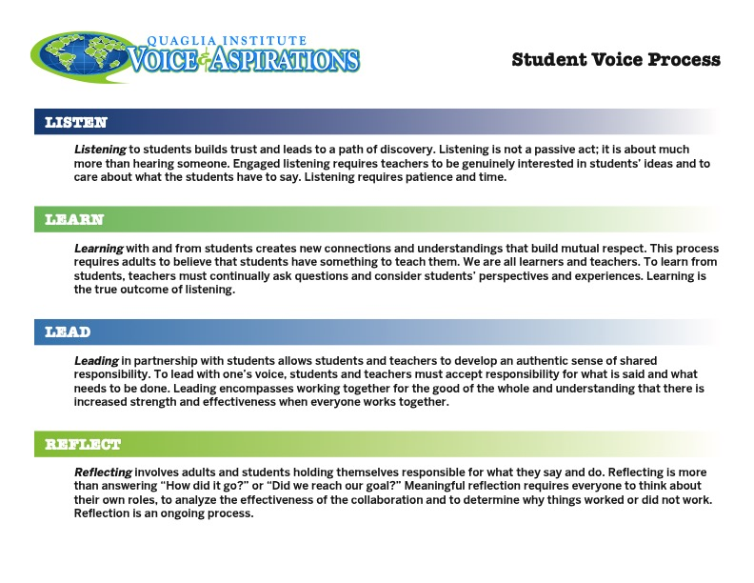
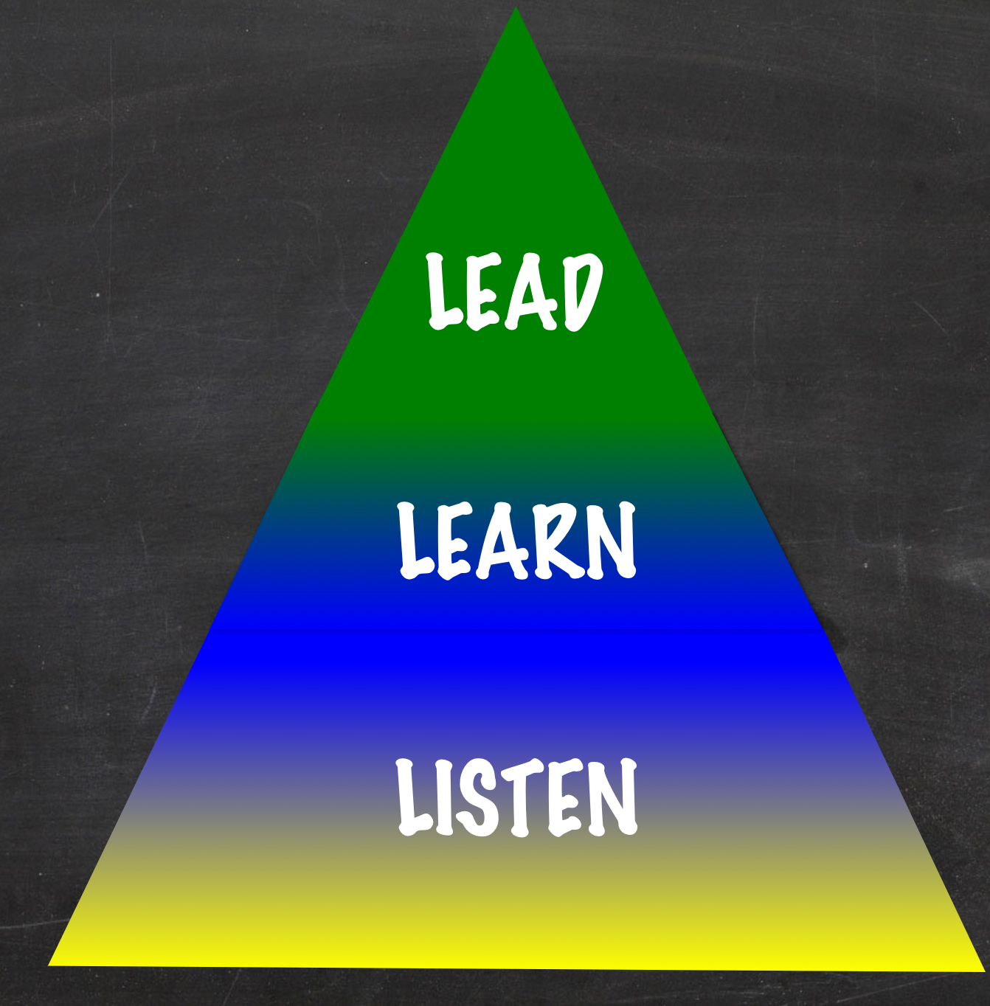
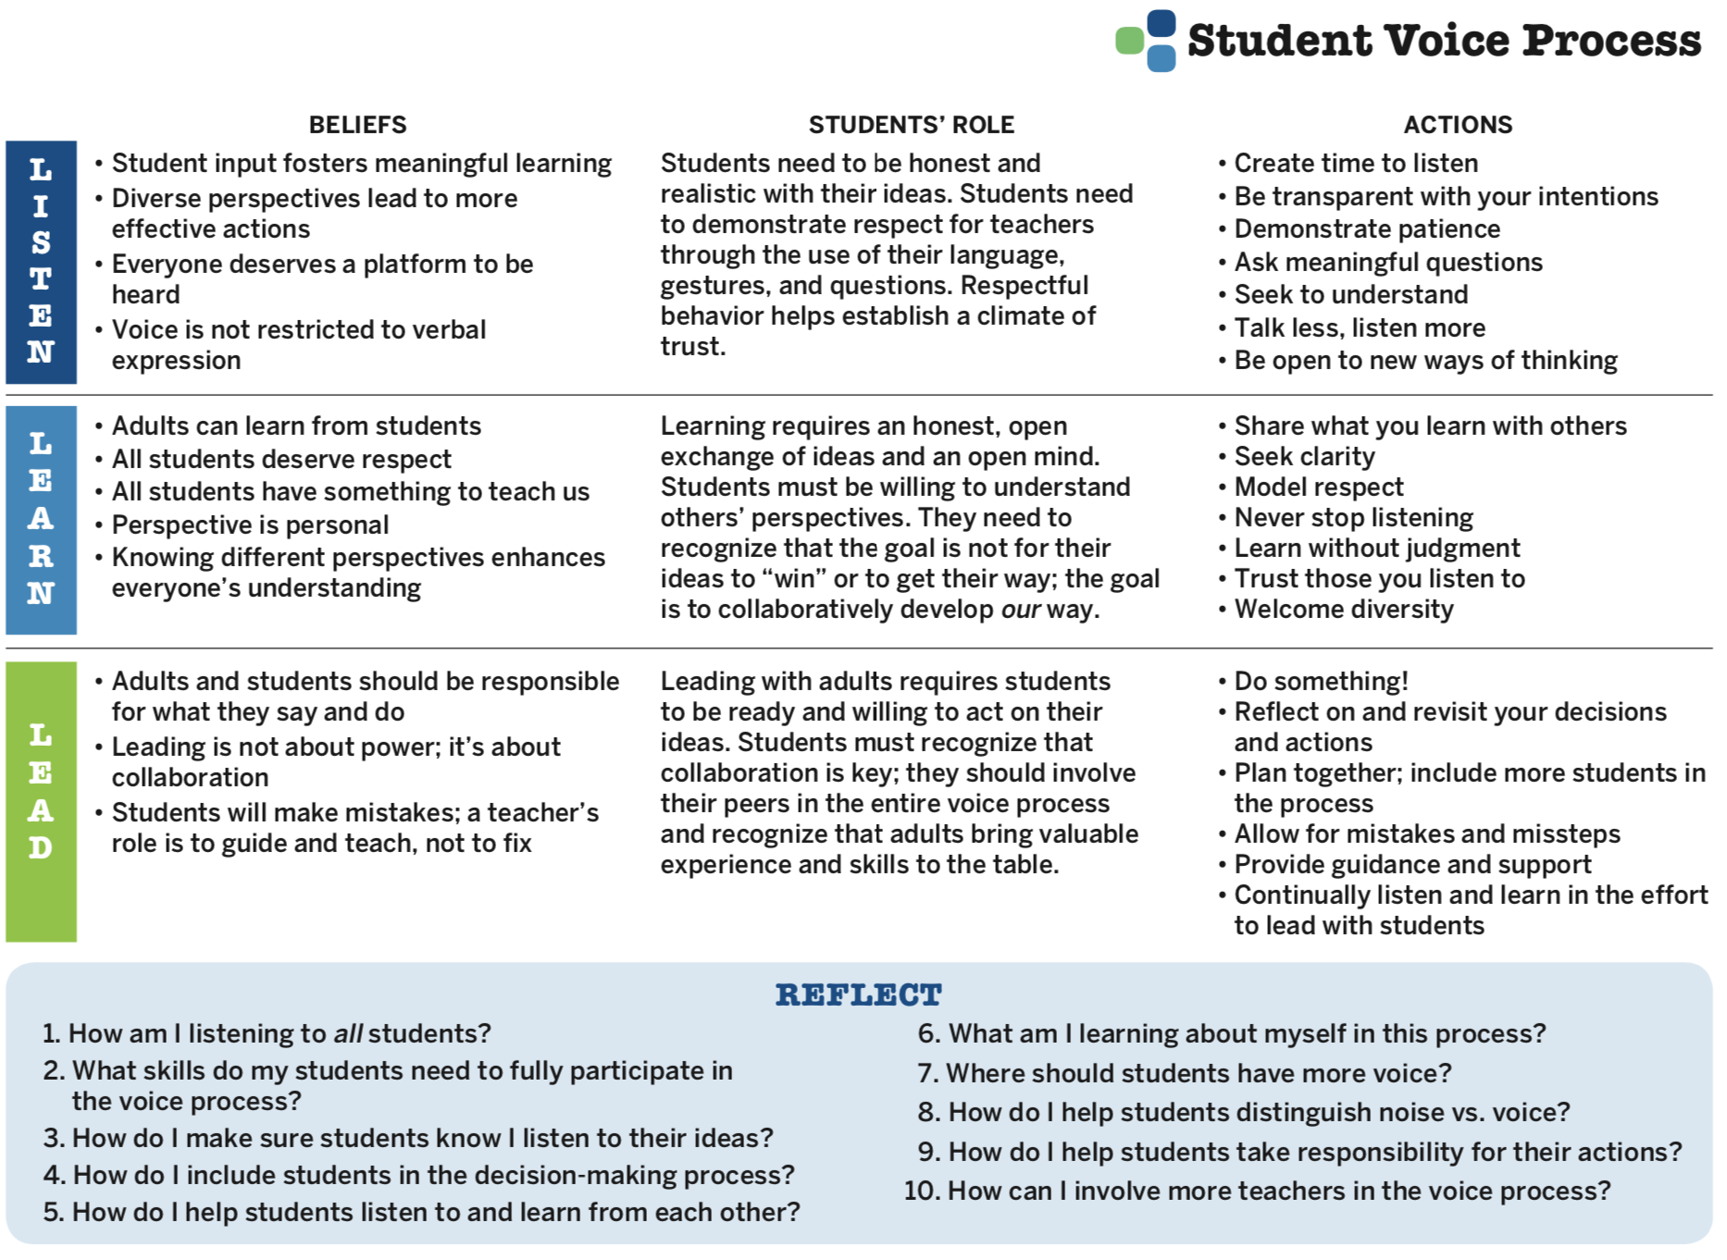

Voice Process Tool
Voice Process Tool

Slide 43
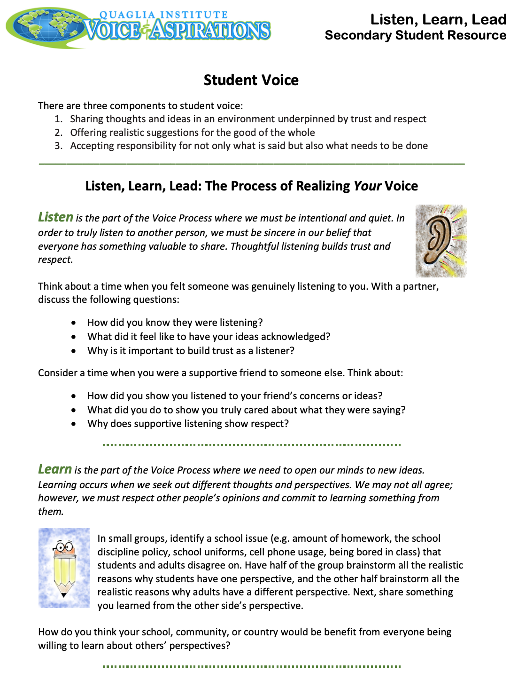
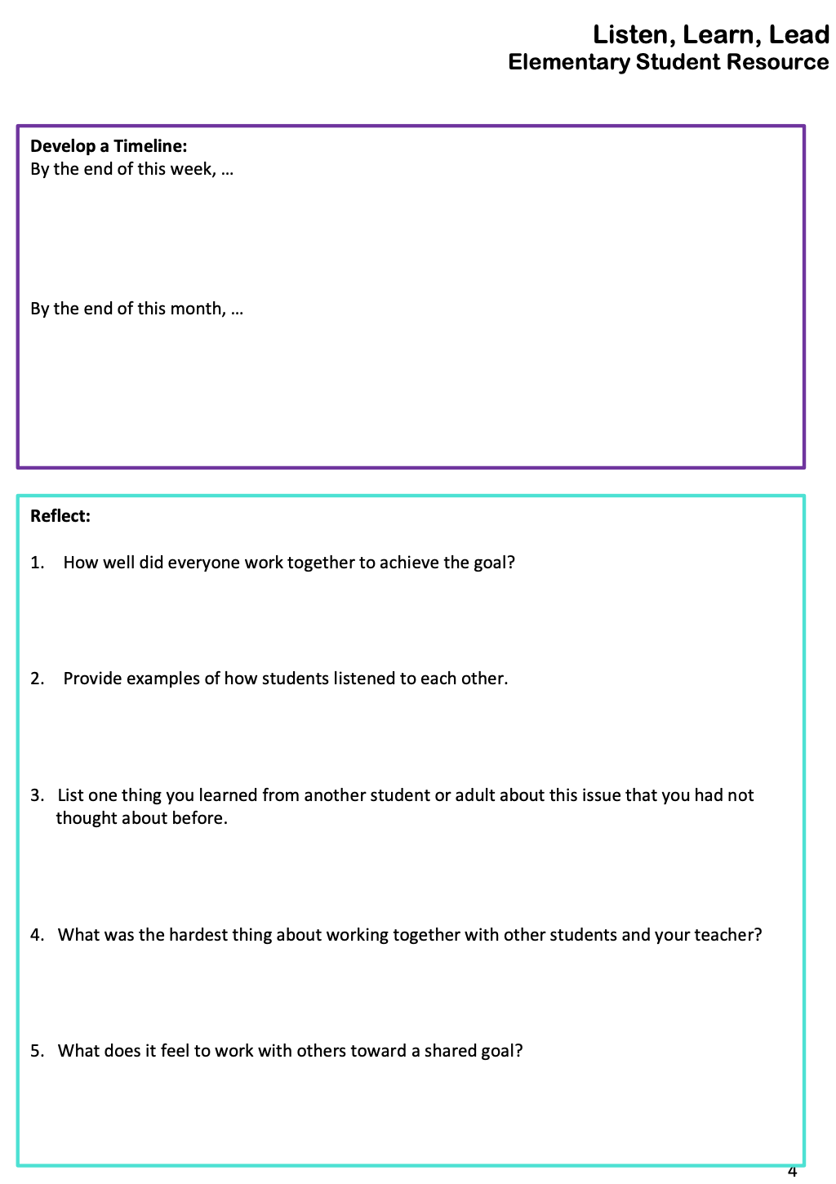

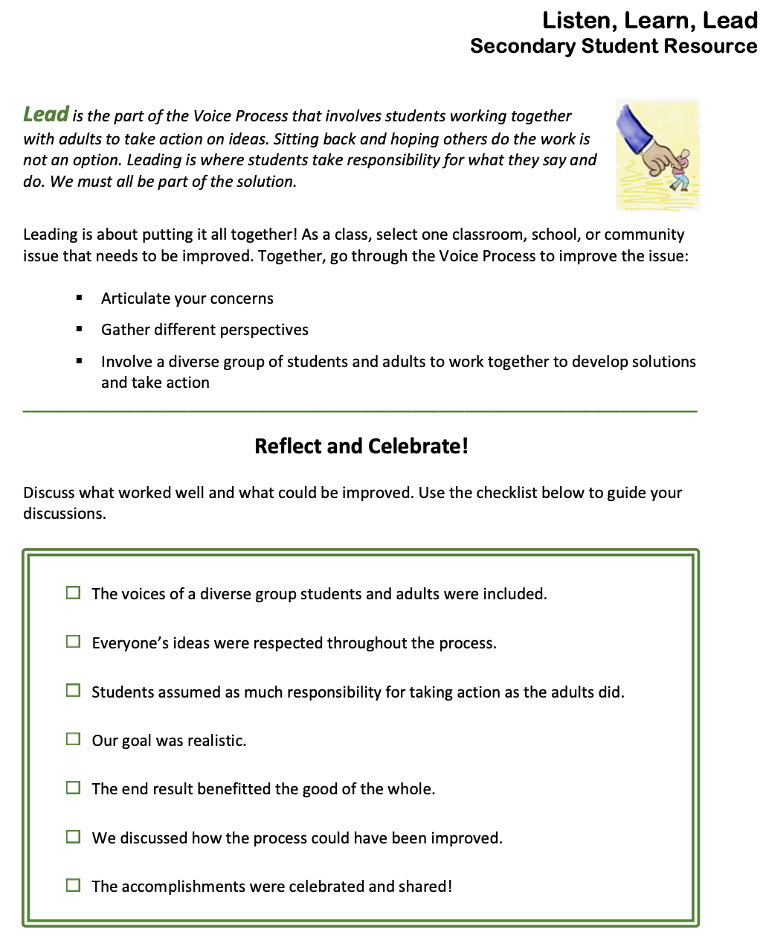
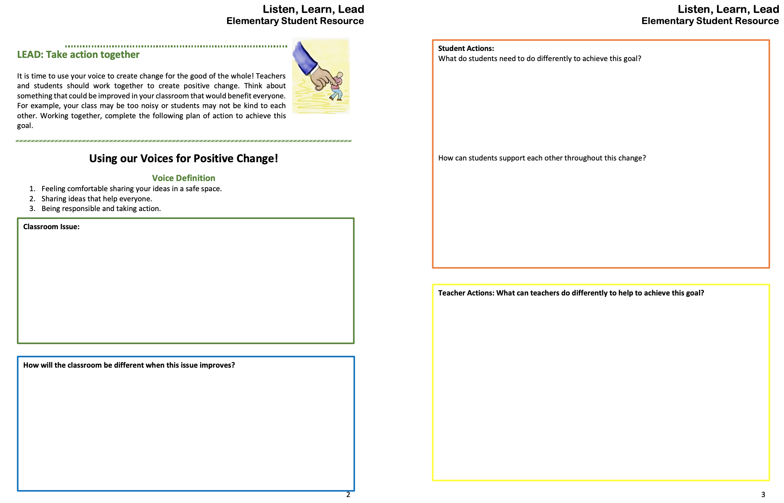
Listen, Learn, Lead Student Resources (Elementary & Secondary)

Slide 44
Voice Process Summarized
Vimeo: https://vimeo.com/qisva/louie
Or
YouTube:
https://youtu.be/1Ebg4If1r7A
BCE, Brisbane, Australia

Slide 45
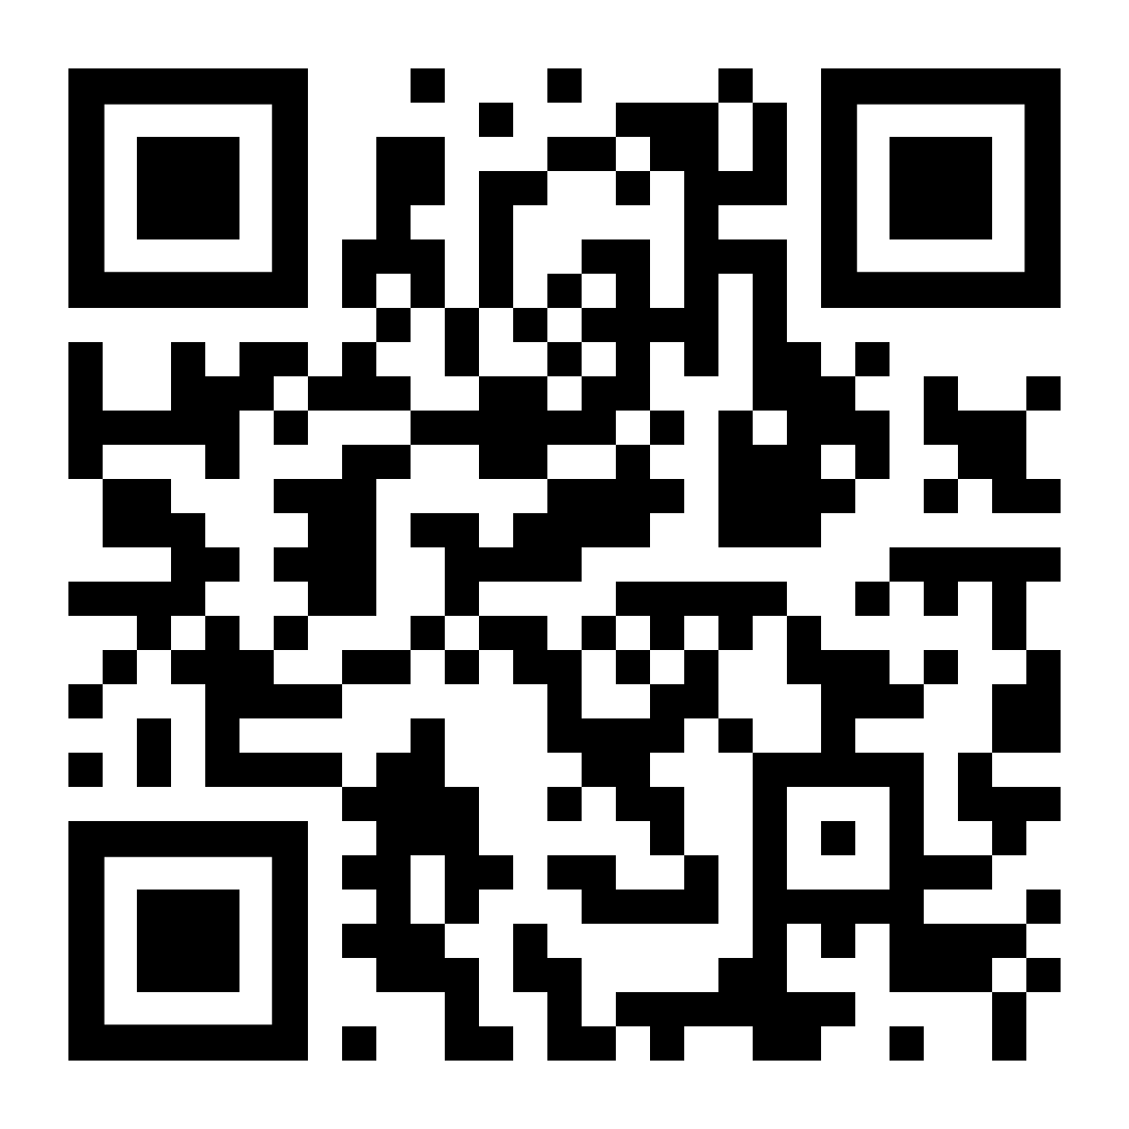
Website Just For YOU!
https://quagliainstitute.org/ohio

Slide 46
Empowering Students to Change the World Through the Voice Process: Listen, Learn, Lead
Dr. Russ Quaglia & Dr. Lisa Lande
@QISVAtweets @Lisa_Lande
lande@quagliainstitute.org
www.QuagliaInstitute.org
July 19-20, 2023

