Slide 1


The Aspirations Profile: Supporting Students in Being Changemakers!
Dr. Lisa Lande
@QISVAtweets @Lisa_Lande
lande@quagliainstitute.org
www.QuagliaInstitute.org
July 23-24, 2024

Slide 2
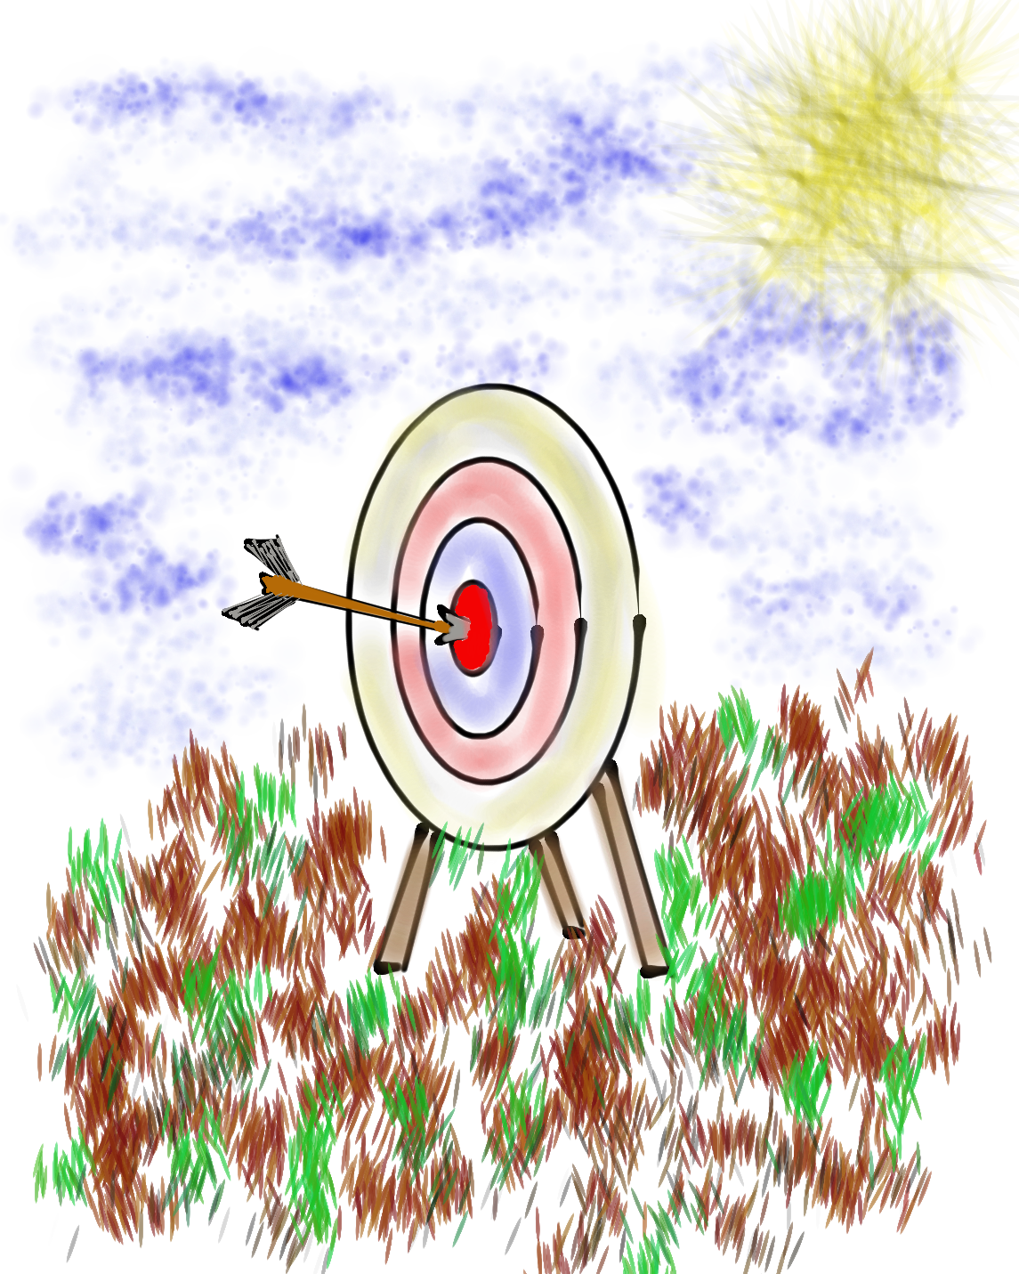
Learning Intention
We are learning about the Aspirations
Profile as a resource for supporting students in becoming changemakers.
Success Criteria
Explore the 4 quadrants of the Aspirations Profile:
Hibernation, Imagination, Perspiration, & Aspiration.
Consider strategies for supporting all students in
balancing dreaming & doing in their lives.
Determine actions for facilitating opportunities for
students to become changemakers.

Slide 3
ASPIRATIONS
The ability to
dream & set goals
for the future,
while being inspired
in the present
to reach those dreams.

Slide 4




high
Imagination
Aspiration
DREAMING
Hibernation
Perspiration
low
DOING
high

Slide 5

Challenge Time!
Aspirations Profile
4-Corners of Reflection

Slide 6

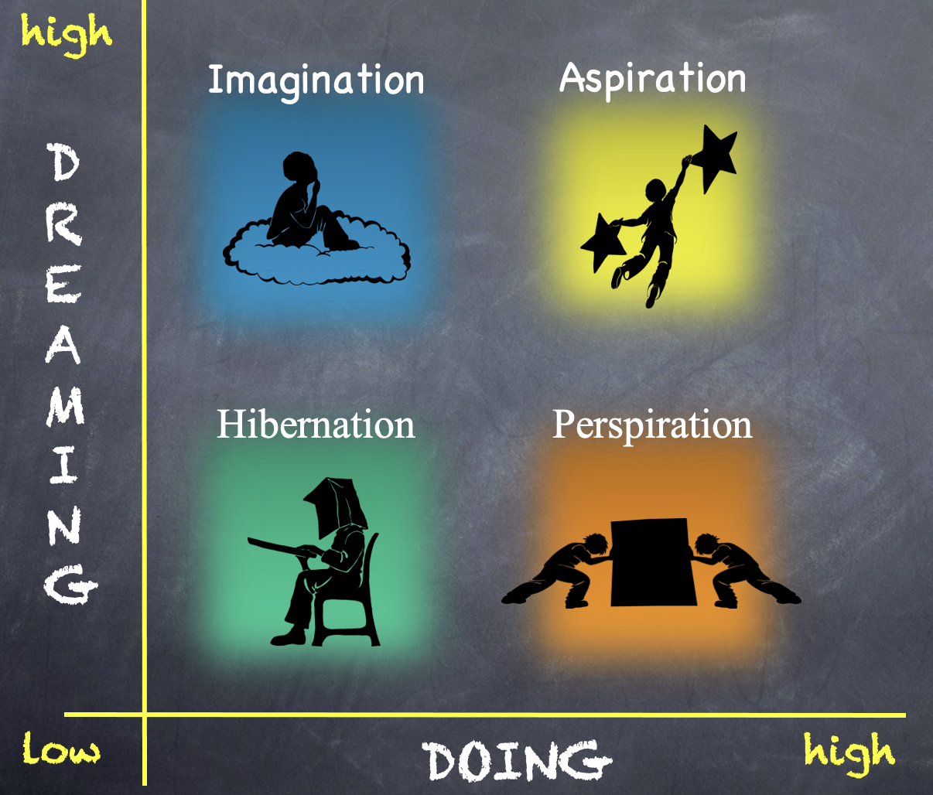
Reflect
Go to the quadrant where you spent most of your time as a student.
Break into groups of 3-4 & share why!
What would have helped you maintain a healthy balance of dreaming & doing?

Slide 7
Reflect
Rotate one corner clockwise.
What types of things do individuals in this quadrant say/do?

Slide 8
Reflect
Rotate one corner clockwise.
What questions can you ask students who are stuck in this quadrant?

Slide 9
Reflect
Rotate one corner clockwise.
What types of actions can you take to support students in this quadrant?

Slide 10

Time to Dig Deeper!

Slide 11
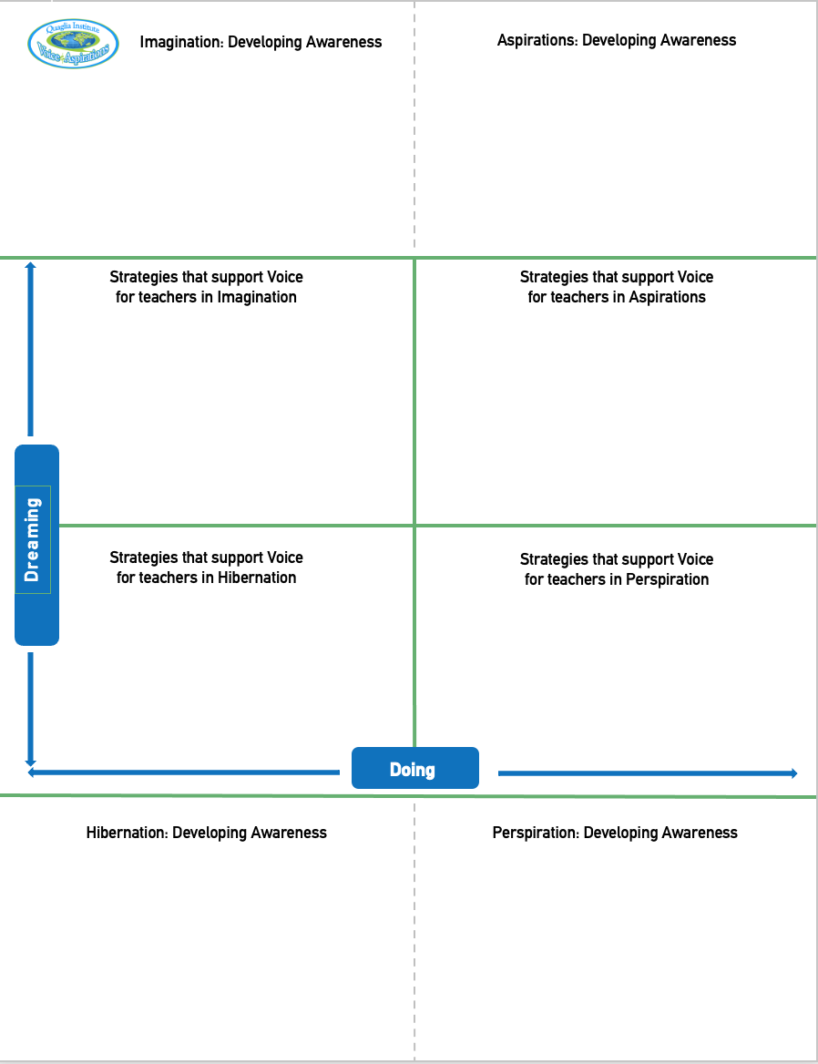
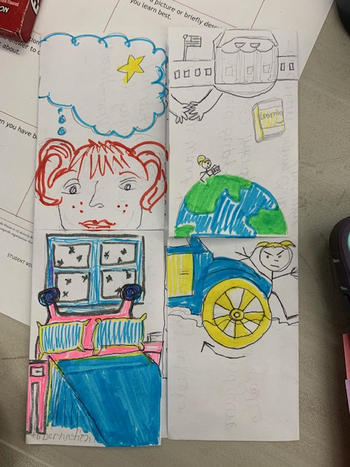
Aspirations Foldable!!
Imagination
Aspiration
Perspiration
Hibernation
Fold
Cut

Slide 12
high
DREAMING
Hibernation
low
DOING
high

Slide 13
high
DREAMING
Vimeo
https://vimeo.com/789017891/1c391b7d0a
YouTube
https://youtu.be/qPYqaBvwhy8
low
DOING
high

Slide 14

On a
Notecard…
Write one word
describing individuals
in Hibernation.

Slide 15

One person holds the deck of cards up to their forehead (do not look at the cards).
Team members will describe what is on the card, without using the actual words on the card.
After a card is correctly guessed, pass the deck to the left. See how quickly you can get through your team deck of cards!
Challenge Time!
Hibernation Heads Up

Slide 16

Students in Hibernation
Potential Cons:
Passive & unmotivated
Poor self-esteem &
defeatist attitude
Struggle to take
responsibility for
anything
Potential Pros:
Time to reflect
Space to recharge
They report:
Feeling isolated
Stuck
Misunderstood
Bored
They need to:
Feel valued
Be recognized for success
Have positive role models
Have a sense of purpose

Slide 17
Reflect
Think of the word you wrote on your notecard.
Now think of a word that reflects your hopes & dreams for hibernating individuals?

Slide 18
high
Imagination
DREAMING
low
DOING
high

Slide 19
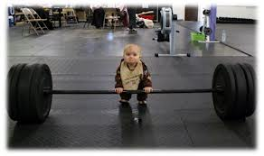
high
DREAMING
low
DOING
high

Slide 20
On a
Notecard…
Write something you
dream about doing
that you have not
yet accomplished.
And keep it
a SECRET!!

Slide 21

Read through the whole deck one time.
Read through the deck a second time and make guesses as to who each card belongs to. How well do you know your colleagues??
Challenge Time!
Imagination Guess Who??
One person takes all the notecards
& mixes them up.

Slide 22

Students in Imagination
Potential Pros:
Enthusiastic
Fun to be around
Lots of creative ideas
Potential Cons:
Limited follow-through
Not well connected
to reality
Students report:
Having big dreams
Eagerness to explore
Craving creative outlets
They need to:
Develop action plans
Focus
Be realistic

Slide 23
Reflect
Why is it challenging to make your big dream a reality?
What would it REALLY take to make this happen?

Slide 24
high
DREAMING
Perspiration
low
DOING
high

Slide 25
high
DREAMING
Vimeo
https://vimeo.com/qisva/snowremoval
YouTube
https://youtu.be/m39gWmTaIbY
low
DOING
high

Slide 26
On a
Notecard…
Write a rapid fire list of things that cause you to Perspire at work.

Slide 27

Students in Perspiration
Potential Pros:
Determined
Hard Working
Driven to Succeed
Potential Cons:
Overly concerned
about grades
Single-minded,
narrow-focused
Students report:
Feeling stressed
Not sure “why” they are learning, but need
good grades
Don’t want to let
anyone down
They need to:
Have a greater purpose for learning
Balance school work with outside life
Link learning to
their passions

Slide 28
Challenge Time…
We need 6-8 excited volunteers to come up front!
Warm Up: Establish a passing order with 1 ball.

Slide 29


Challenge
Perspiration Juggling
Goal: As a team,
pass 3 balls through
your established order as quickly as you can.
Rules: Maintain the
same passing order &
everyone must touch
all 3 balls.

Slide 30
Reflect
What can you do differently to perspire a little less?

Slide 31
high
Aspirations
DREAMING
low
DOING
high

Slide 32
high
DREAMING
Vimeo
https://vimeo.com/776344083/affe5a37da
YouTube
https://youtu.be/uLjzbSAEmJI
low
DOING
high

Slide 33
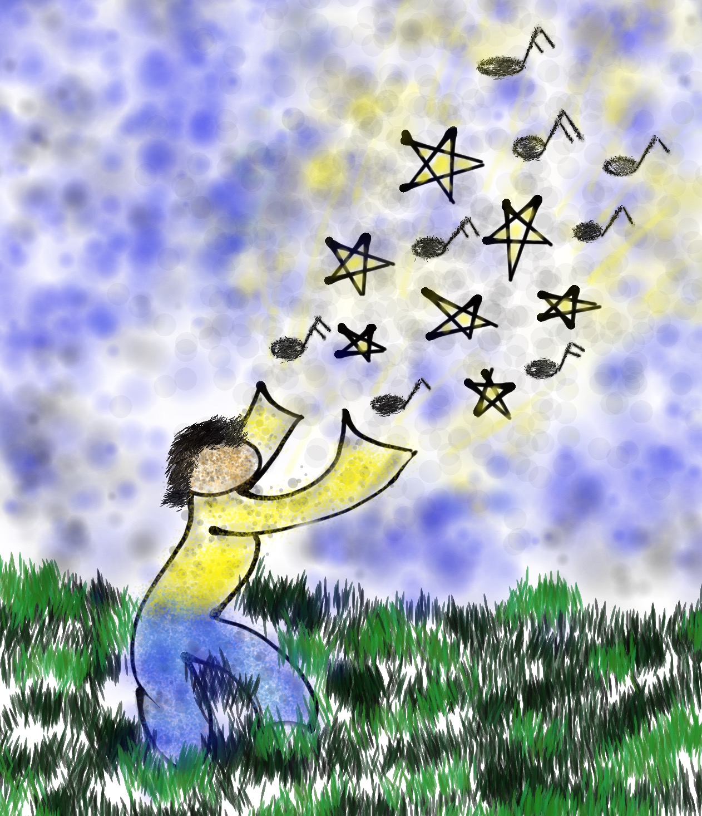
Write an example of a time when you were a changemaker!

Slide 34
Proudly use your voice to read your card & collectively celebrate your change maker moments!
Challenge
Aspirations Accomplishments
Say It Loud…Say It Proud!
Stand in a Circle
as a table team.

Slide 35

Students in Aspiration
Potential Pros:
Connects present
actions to future
dreams
Good idea of
potential options
Potential Cons:
Relaxation is Challenging
Under constant pressure
Self-Serving
Students report:
Never feeling
satisfied
Driven by being best
Frustration with peers
who don’t try or who
interrupt learning
They need to:
Be assured they
are on a positive track
Experience meaningful academic challenges
Breathe!

Slide 36
high
Imagination
Aspiration
DREAMING
Hibernation
Perspiration
low
DOING
high

Slide 37
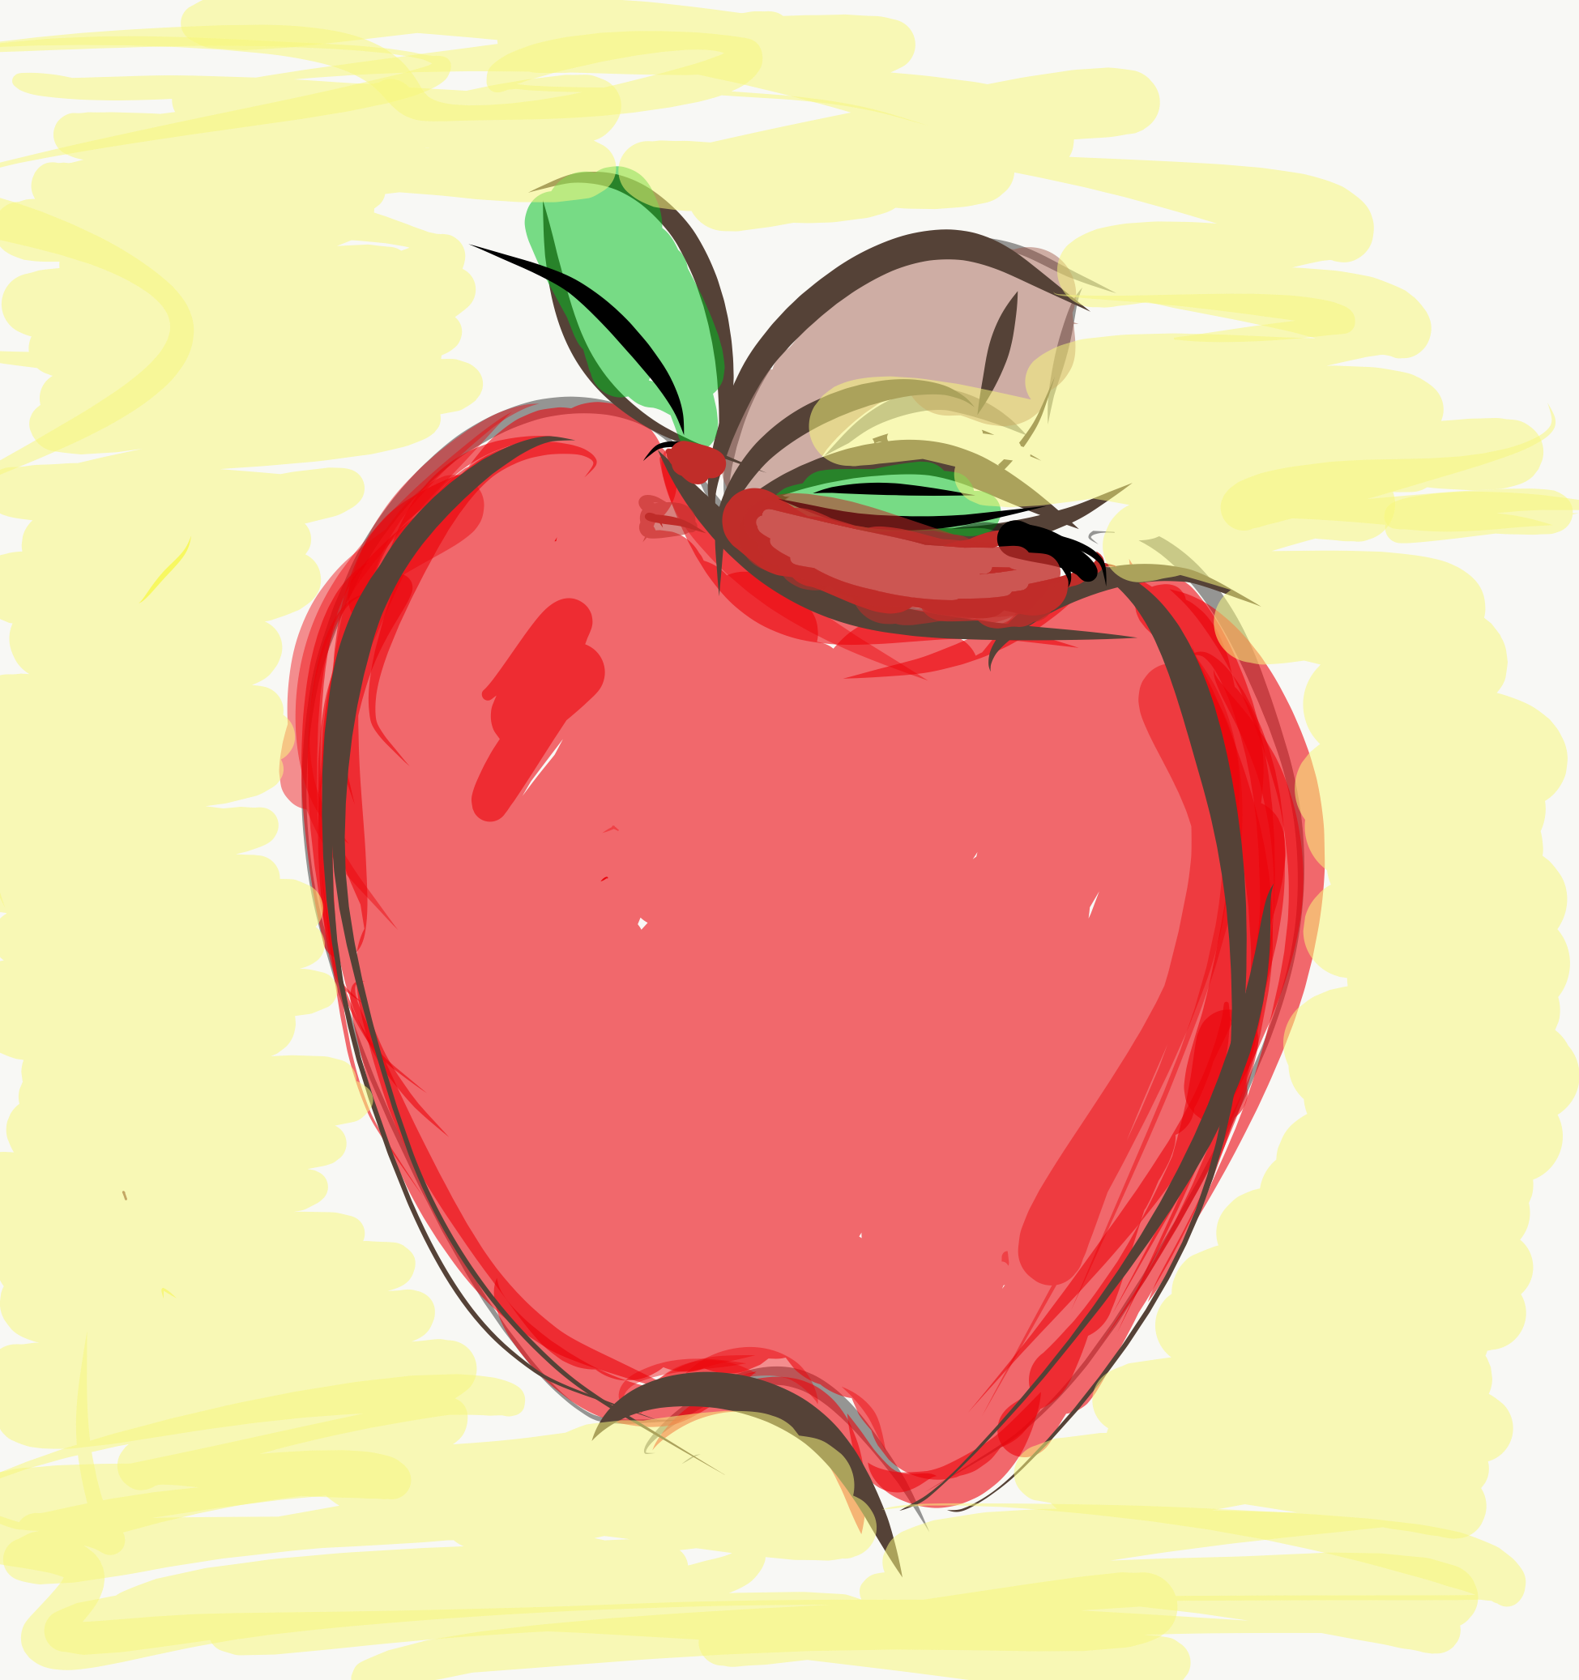
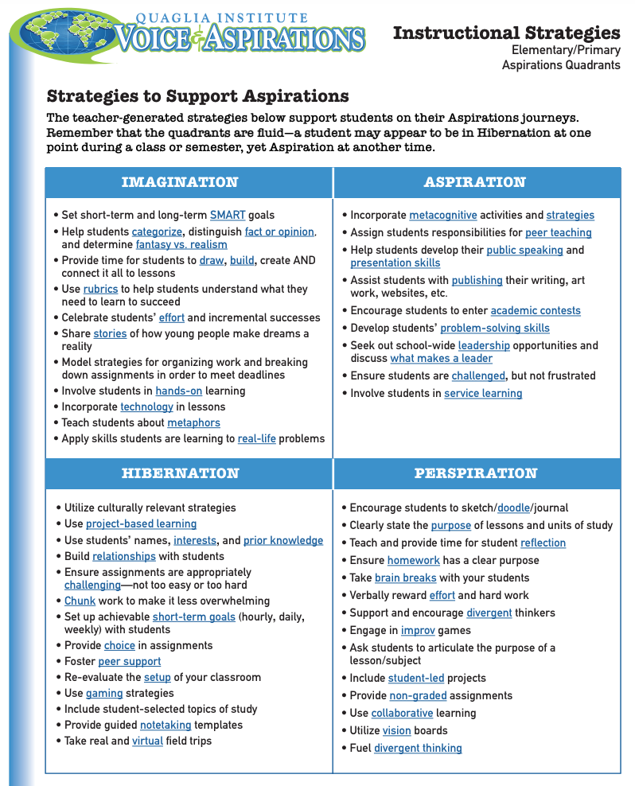
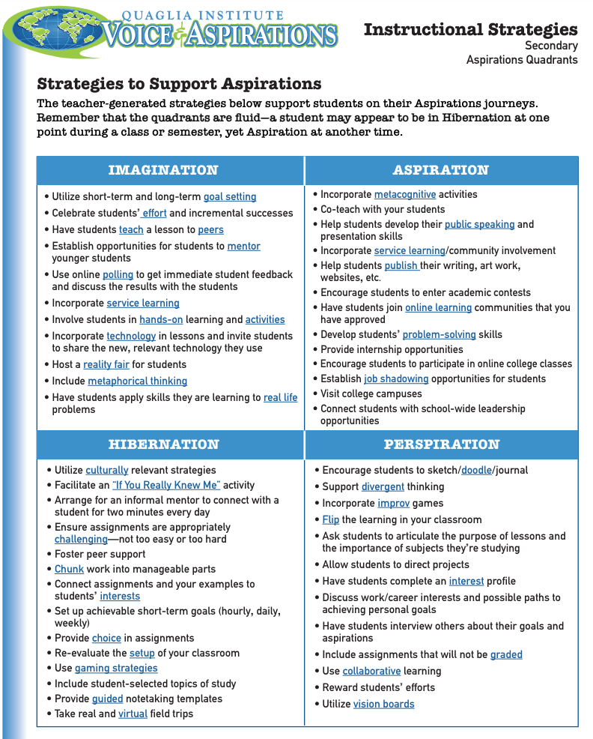
Aspirations Quadrants Instructional Strategies

Slide 38

Changemaking Together!
What is something currently owned only by adults at your school where students could be invited to co-own
with you?

Slide 39

What is your “Mic Drop” moment
of learning from today?

Slide 40

Mic Drop Moments!
What is your mic drop moment of learning from today?

Slide 41

Website Just For YOU!
https://quagliainstitute.org/changemakers

Slide 42
The Aspirations Profile: Supporting Students in Being Changemakers!
Dr. Lisa Lande
@QISVAtweets @Lisa_Lande
lande@quagliainstitute.org
www.QuagliaInstitute.org
July 23-24, 2024

