Slide 1

The Student Voice
Journey Begins!
First, we need a clear
definition of Student Voice
that we can all
understand, accept, &
put into practice.

Slide 2

The 3 Components of Student Voice
Sharing thoughts & ideas in an environment underpinned by trust & respect.
Offering realistic suggestions for the
good of the whole.
Accepting responsibility for not only what is said but also what needs to be done.

Slide 3

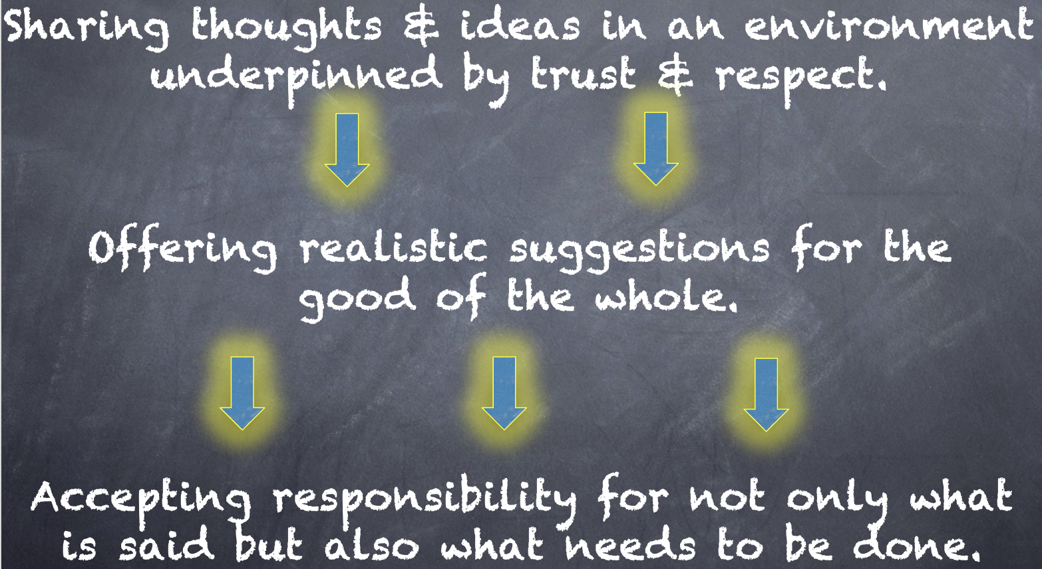
Meet With Your Feet
What resonates with you
from the Voice definition?

Slide 4

Challenge Time…

Slide 5



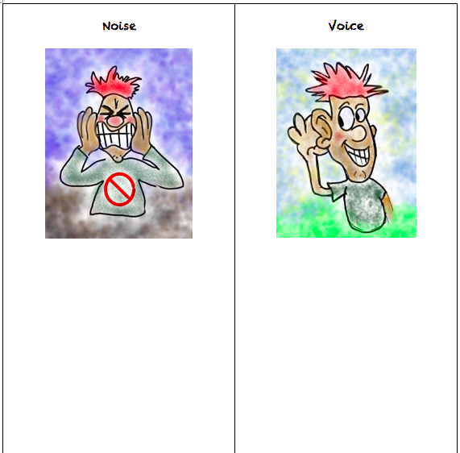
Challenge
Noise vs. Voice
Share words, phrases, &
examples of
Noise.
Now share words, phrases, &
examples of
Voice.

Slide 6
Noise vs Voice
Student Noise
Demands/commands/chaotic
Student opinion is most important
All adult voice is negative
Everyone needs to change but me
Complaining/whining
Student Voice
Requests/inquiry/focused
Our ideas are stronger in partnership
Students are open to learn
Personal reflection
Accepting responsibility

Slide 7
Challenge
Noise vs. Voice Art
As a table group, create a visual representation that reflects the difference between Noise v. Voice.
When finished, post your art masterpiece on the walls around the room.

Slide 8
Gallery Walk
Welcome to the Silent Gallery!
Take a wander around the room and take in the Noise v. Voice artwork created by the group.

Slide 9

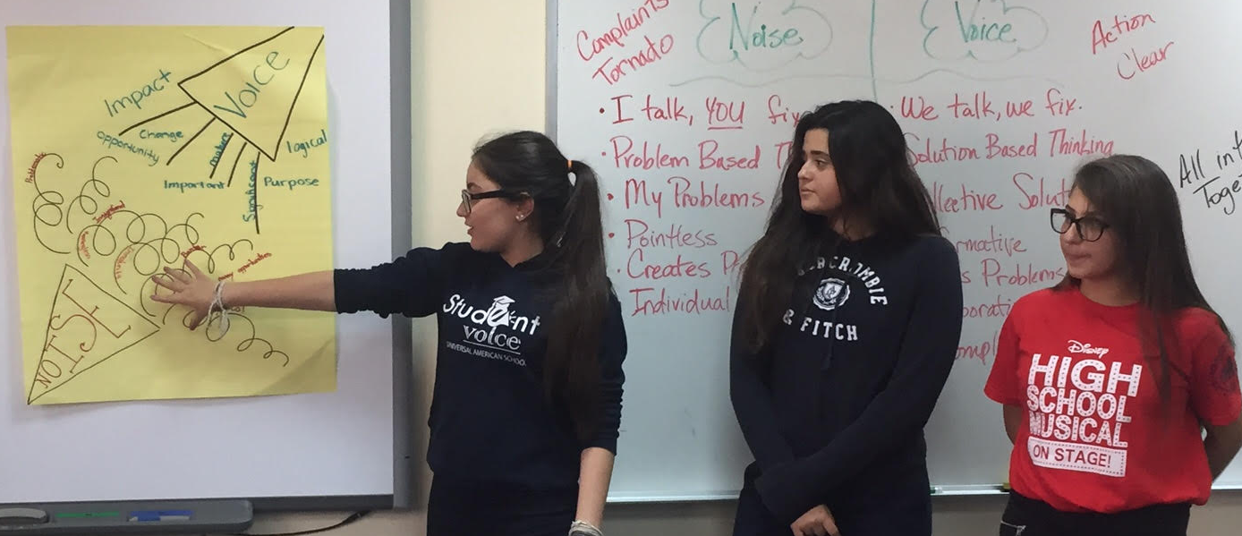
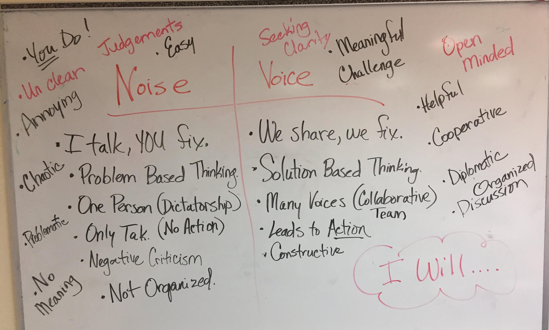
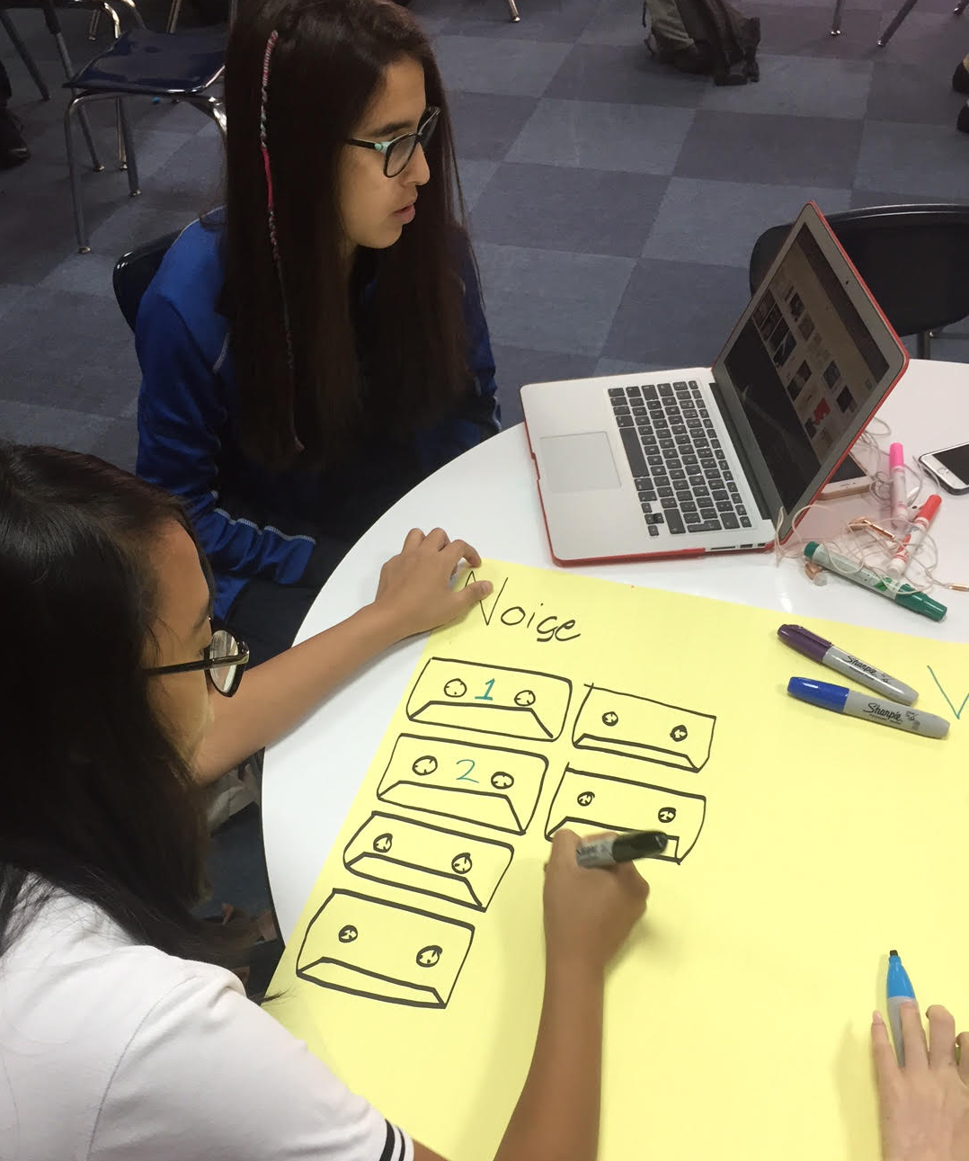
Student Voice in Action
Universal American School,
Dubai, UAE

Slide 10
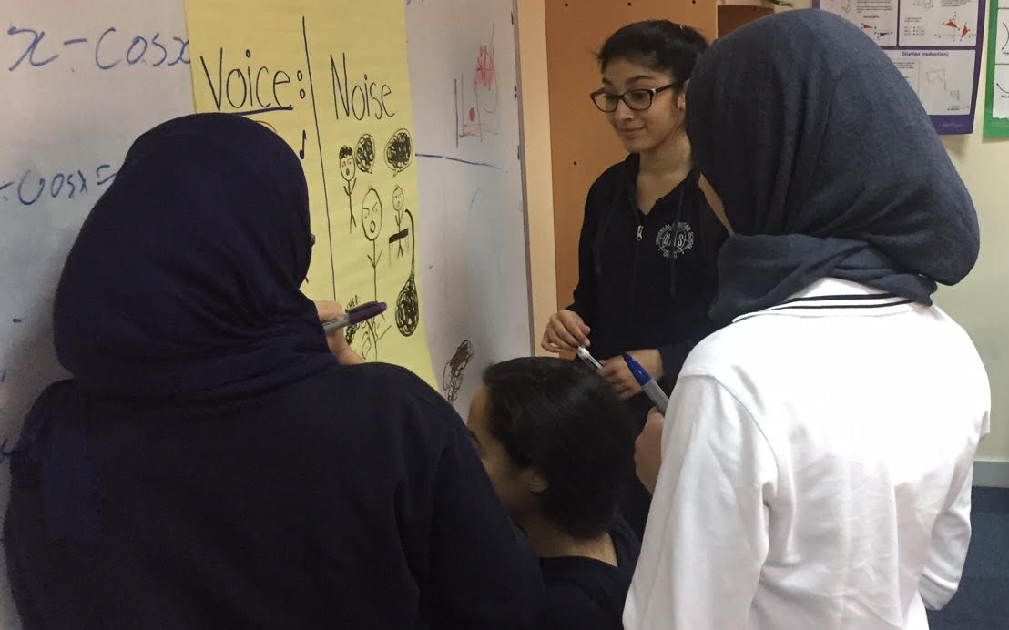
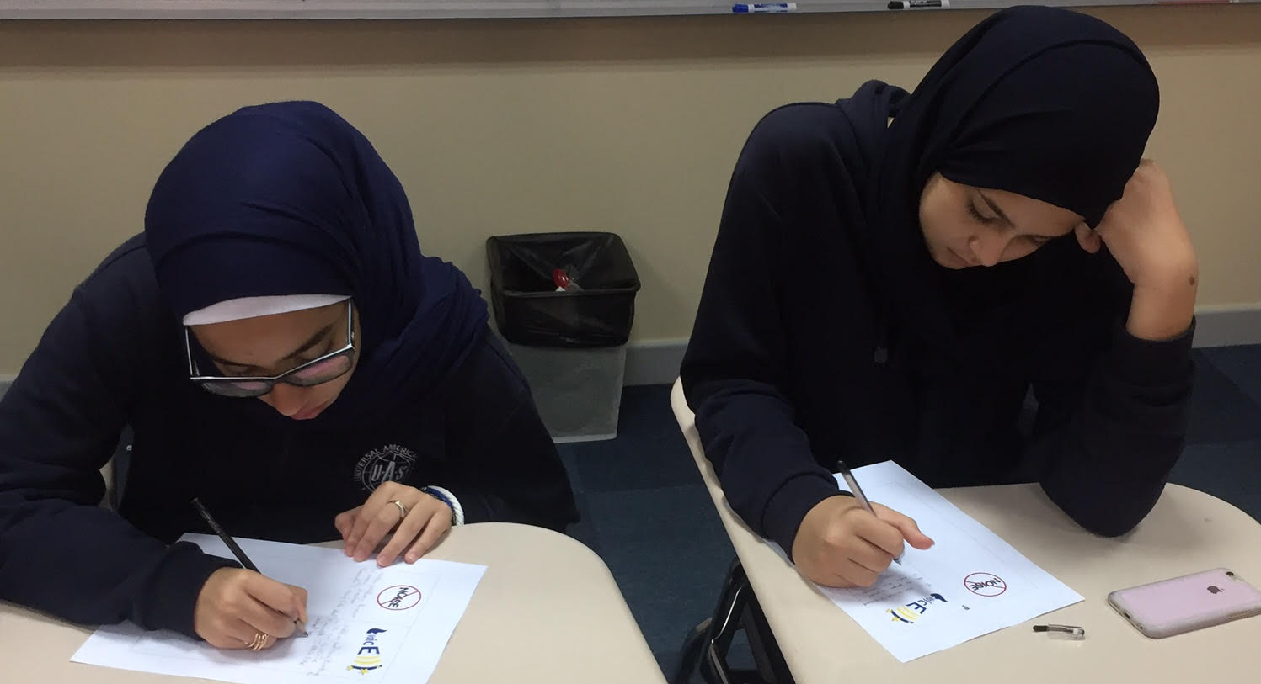
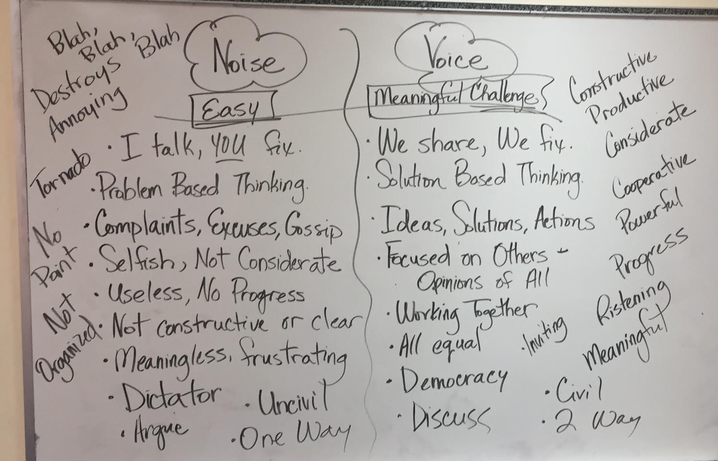
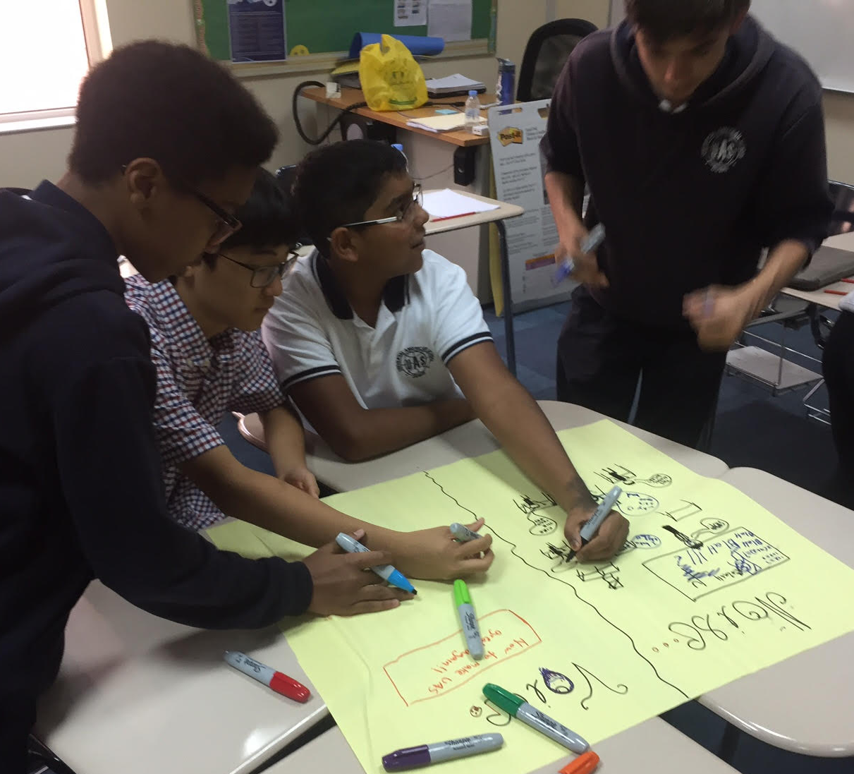
Student Voice in Action
Universal American School, Dubai, UAE

Slide 11
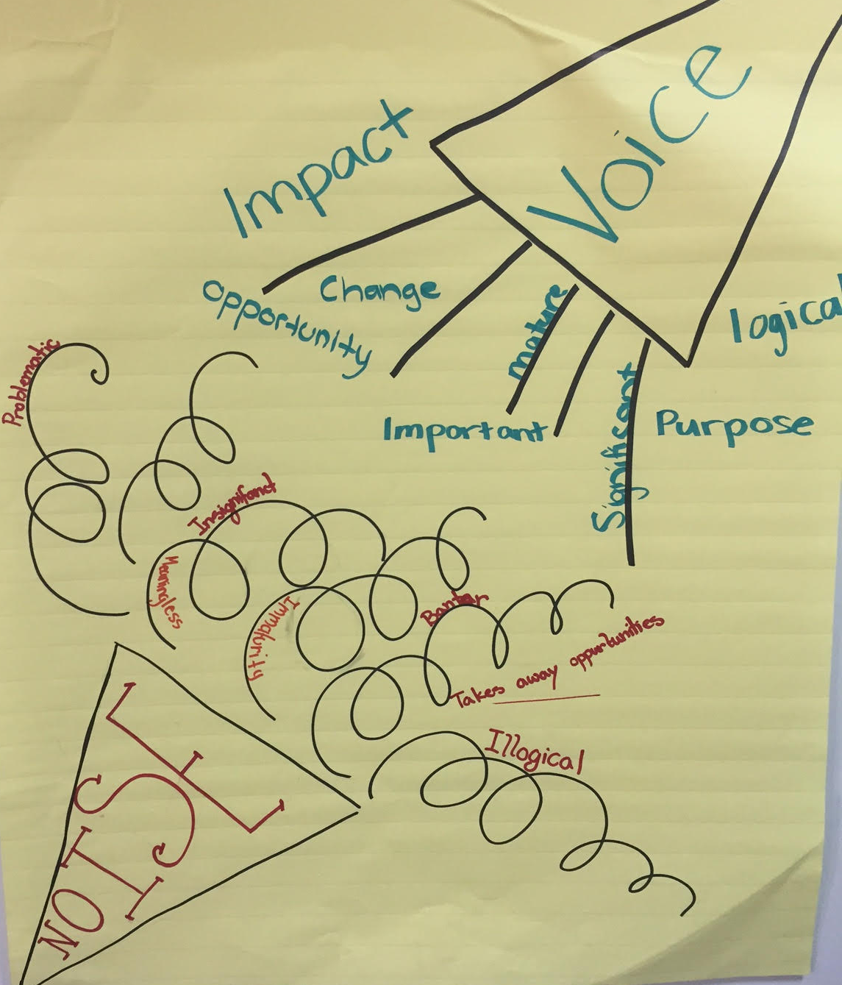
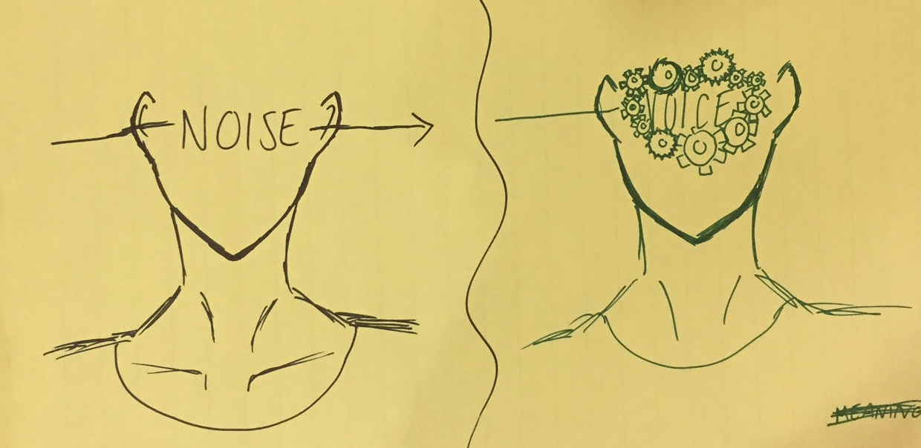
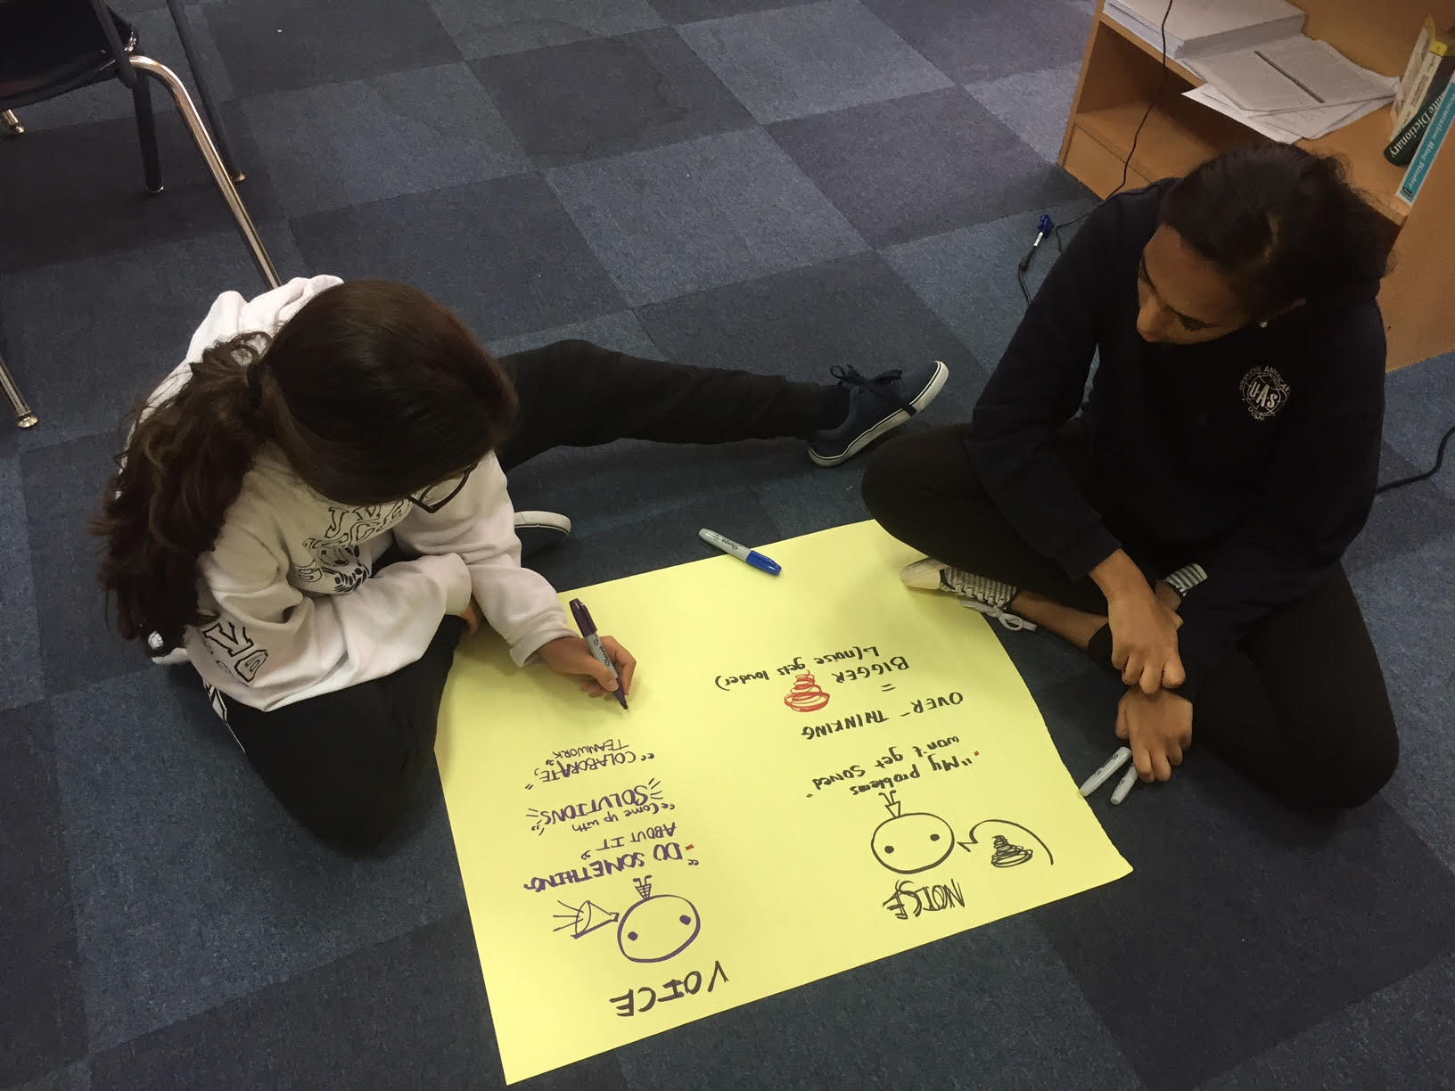
Student Voice in Action
Universal American School, Dubai, UAE

Slide 12
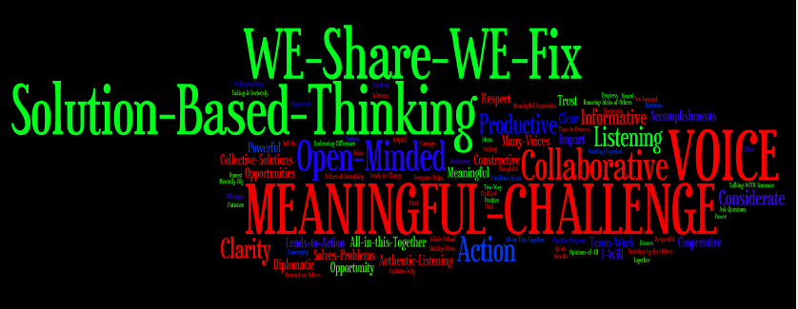
Student Voice in Action
Universal American School, Dubai, UAE

Slide 13

Student Voice in Action
Video
Lawrence Middle School, Los Angeles, California, USA

Slide 14
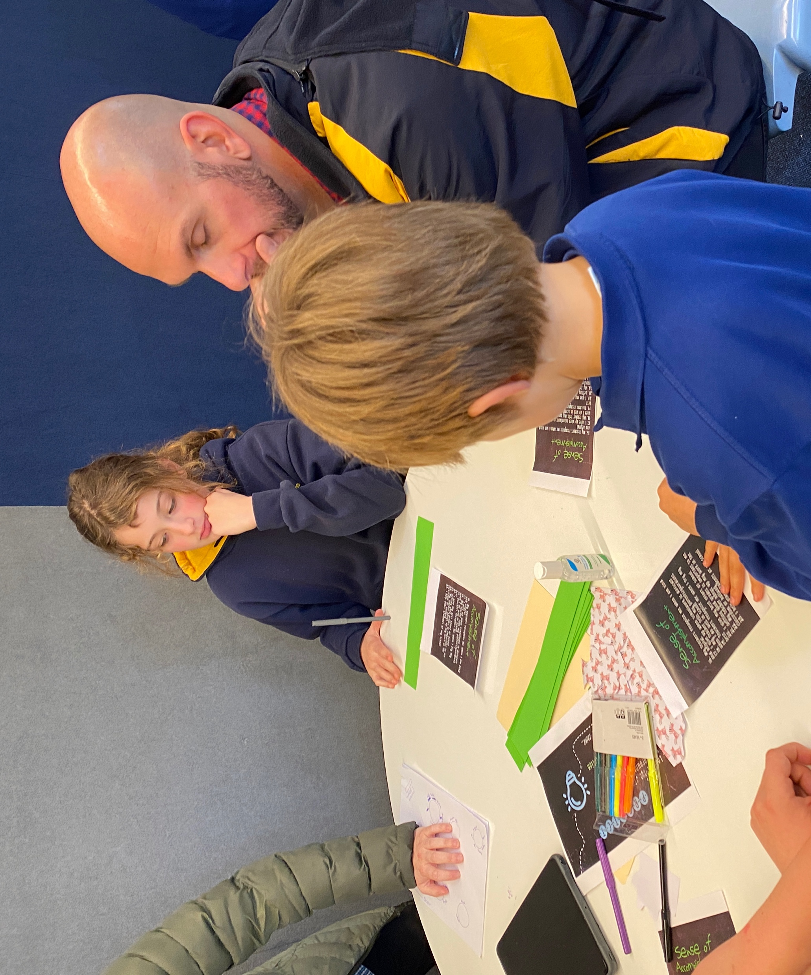
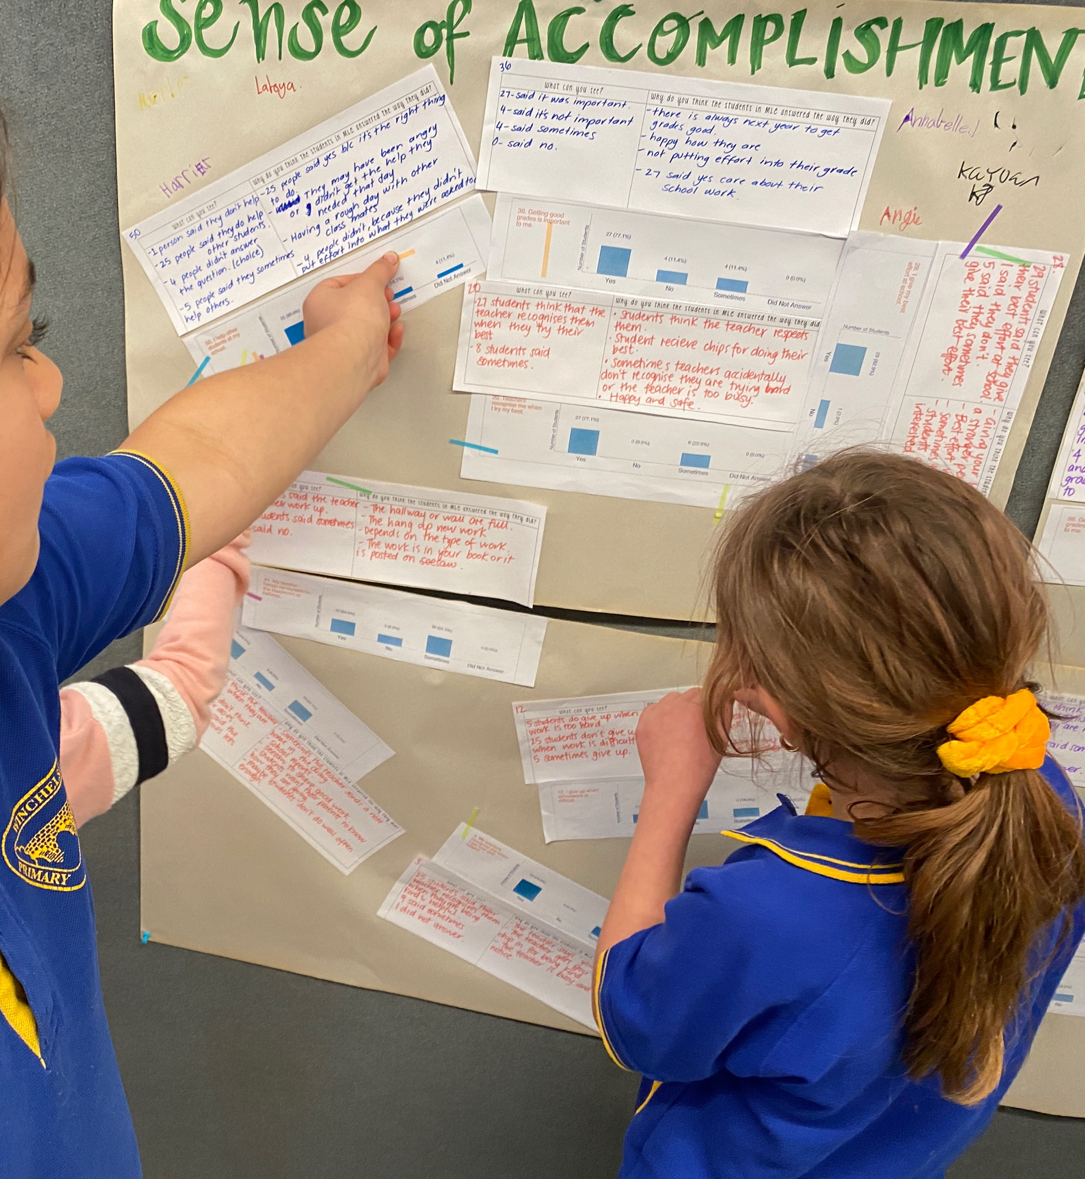
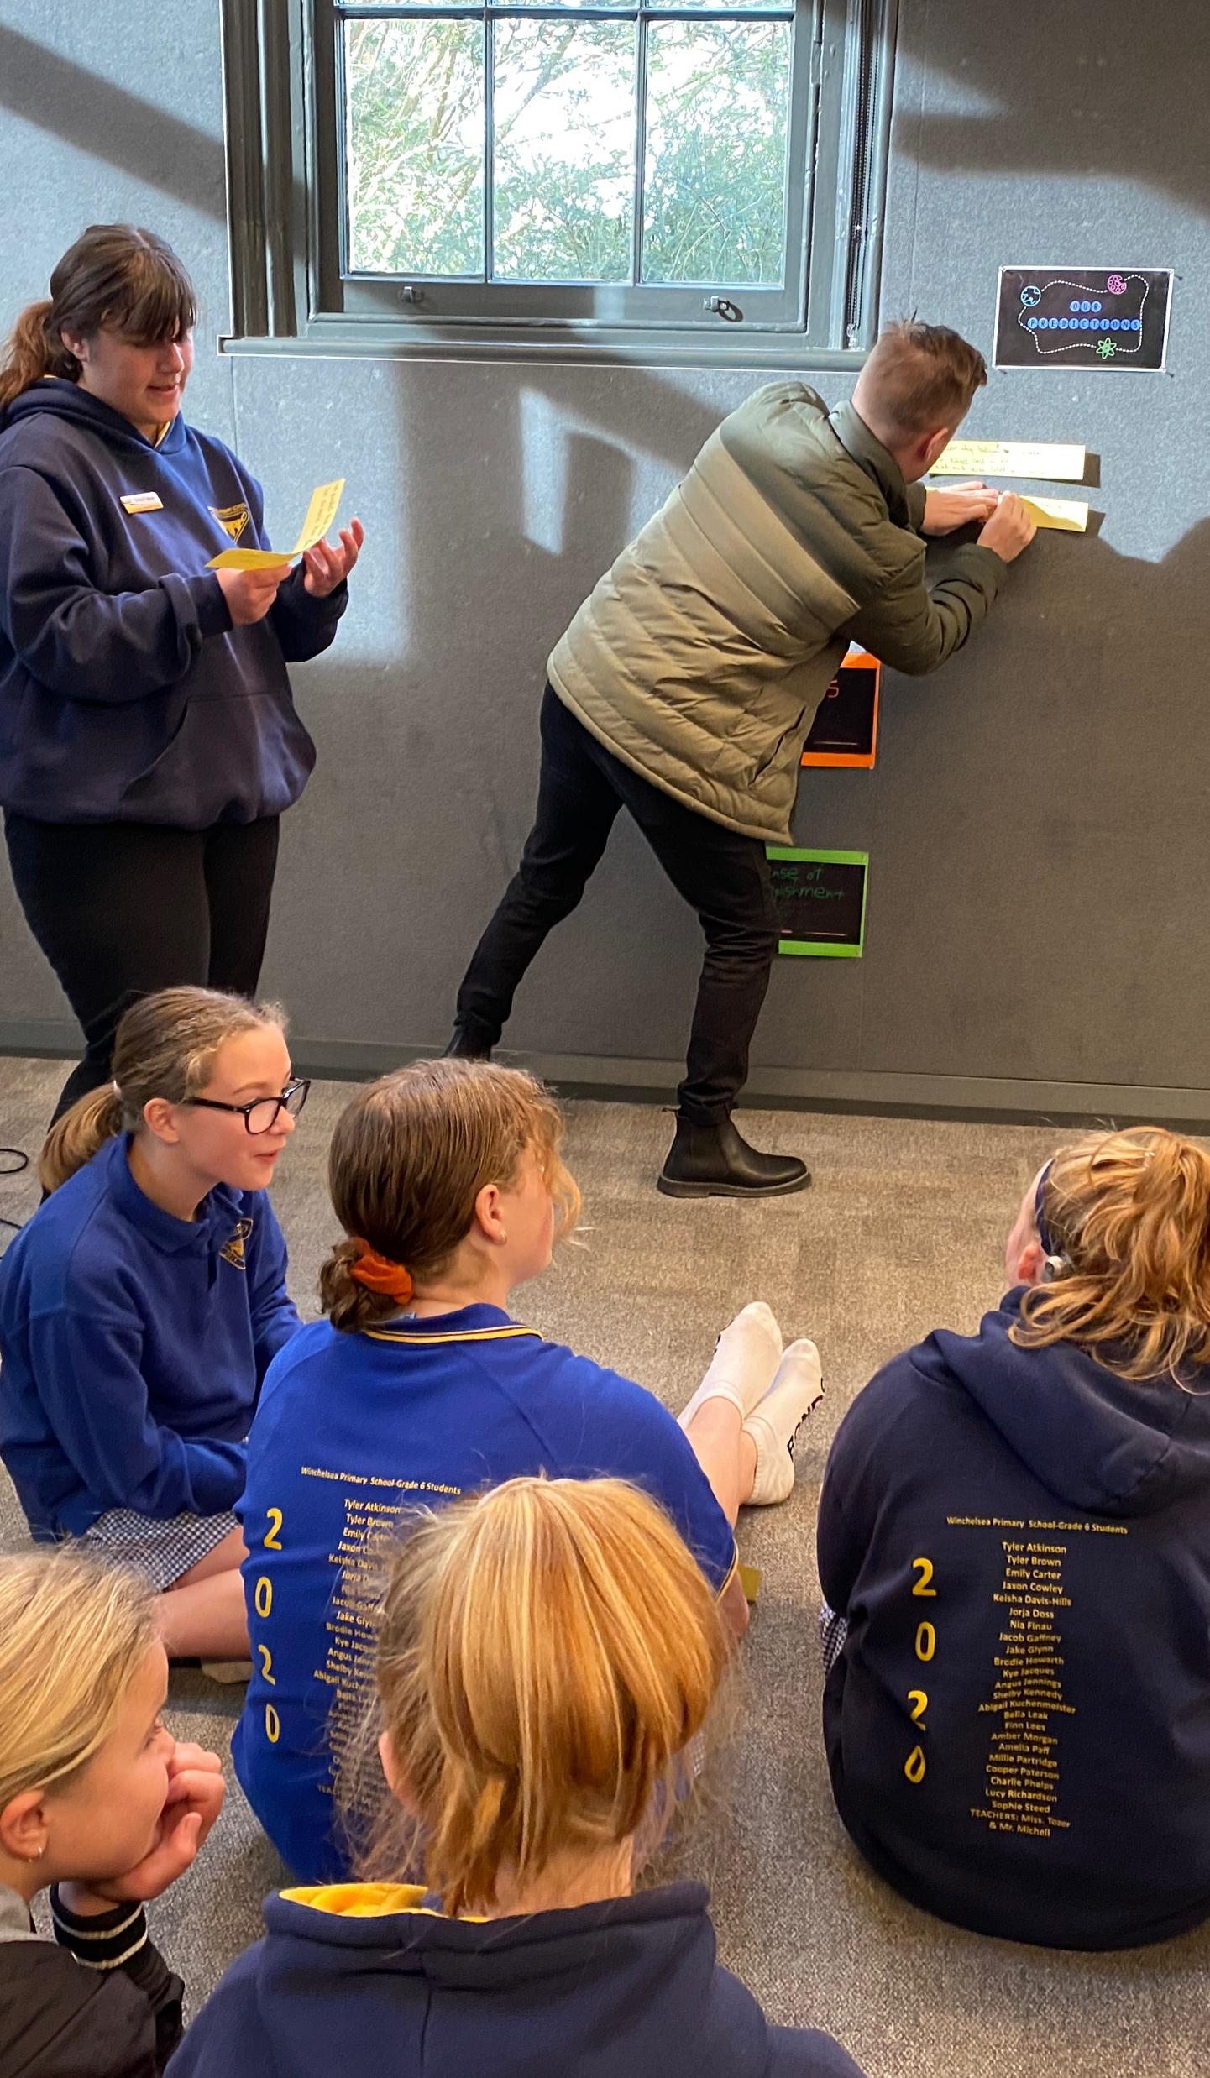
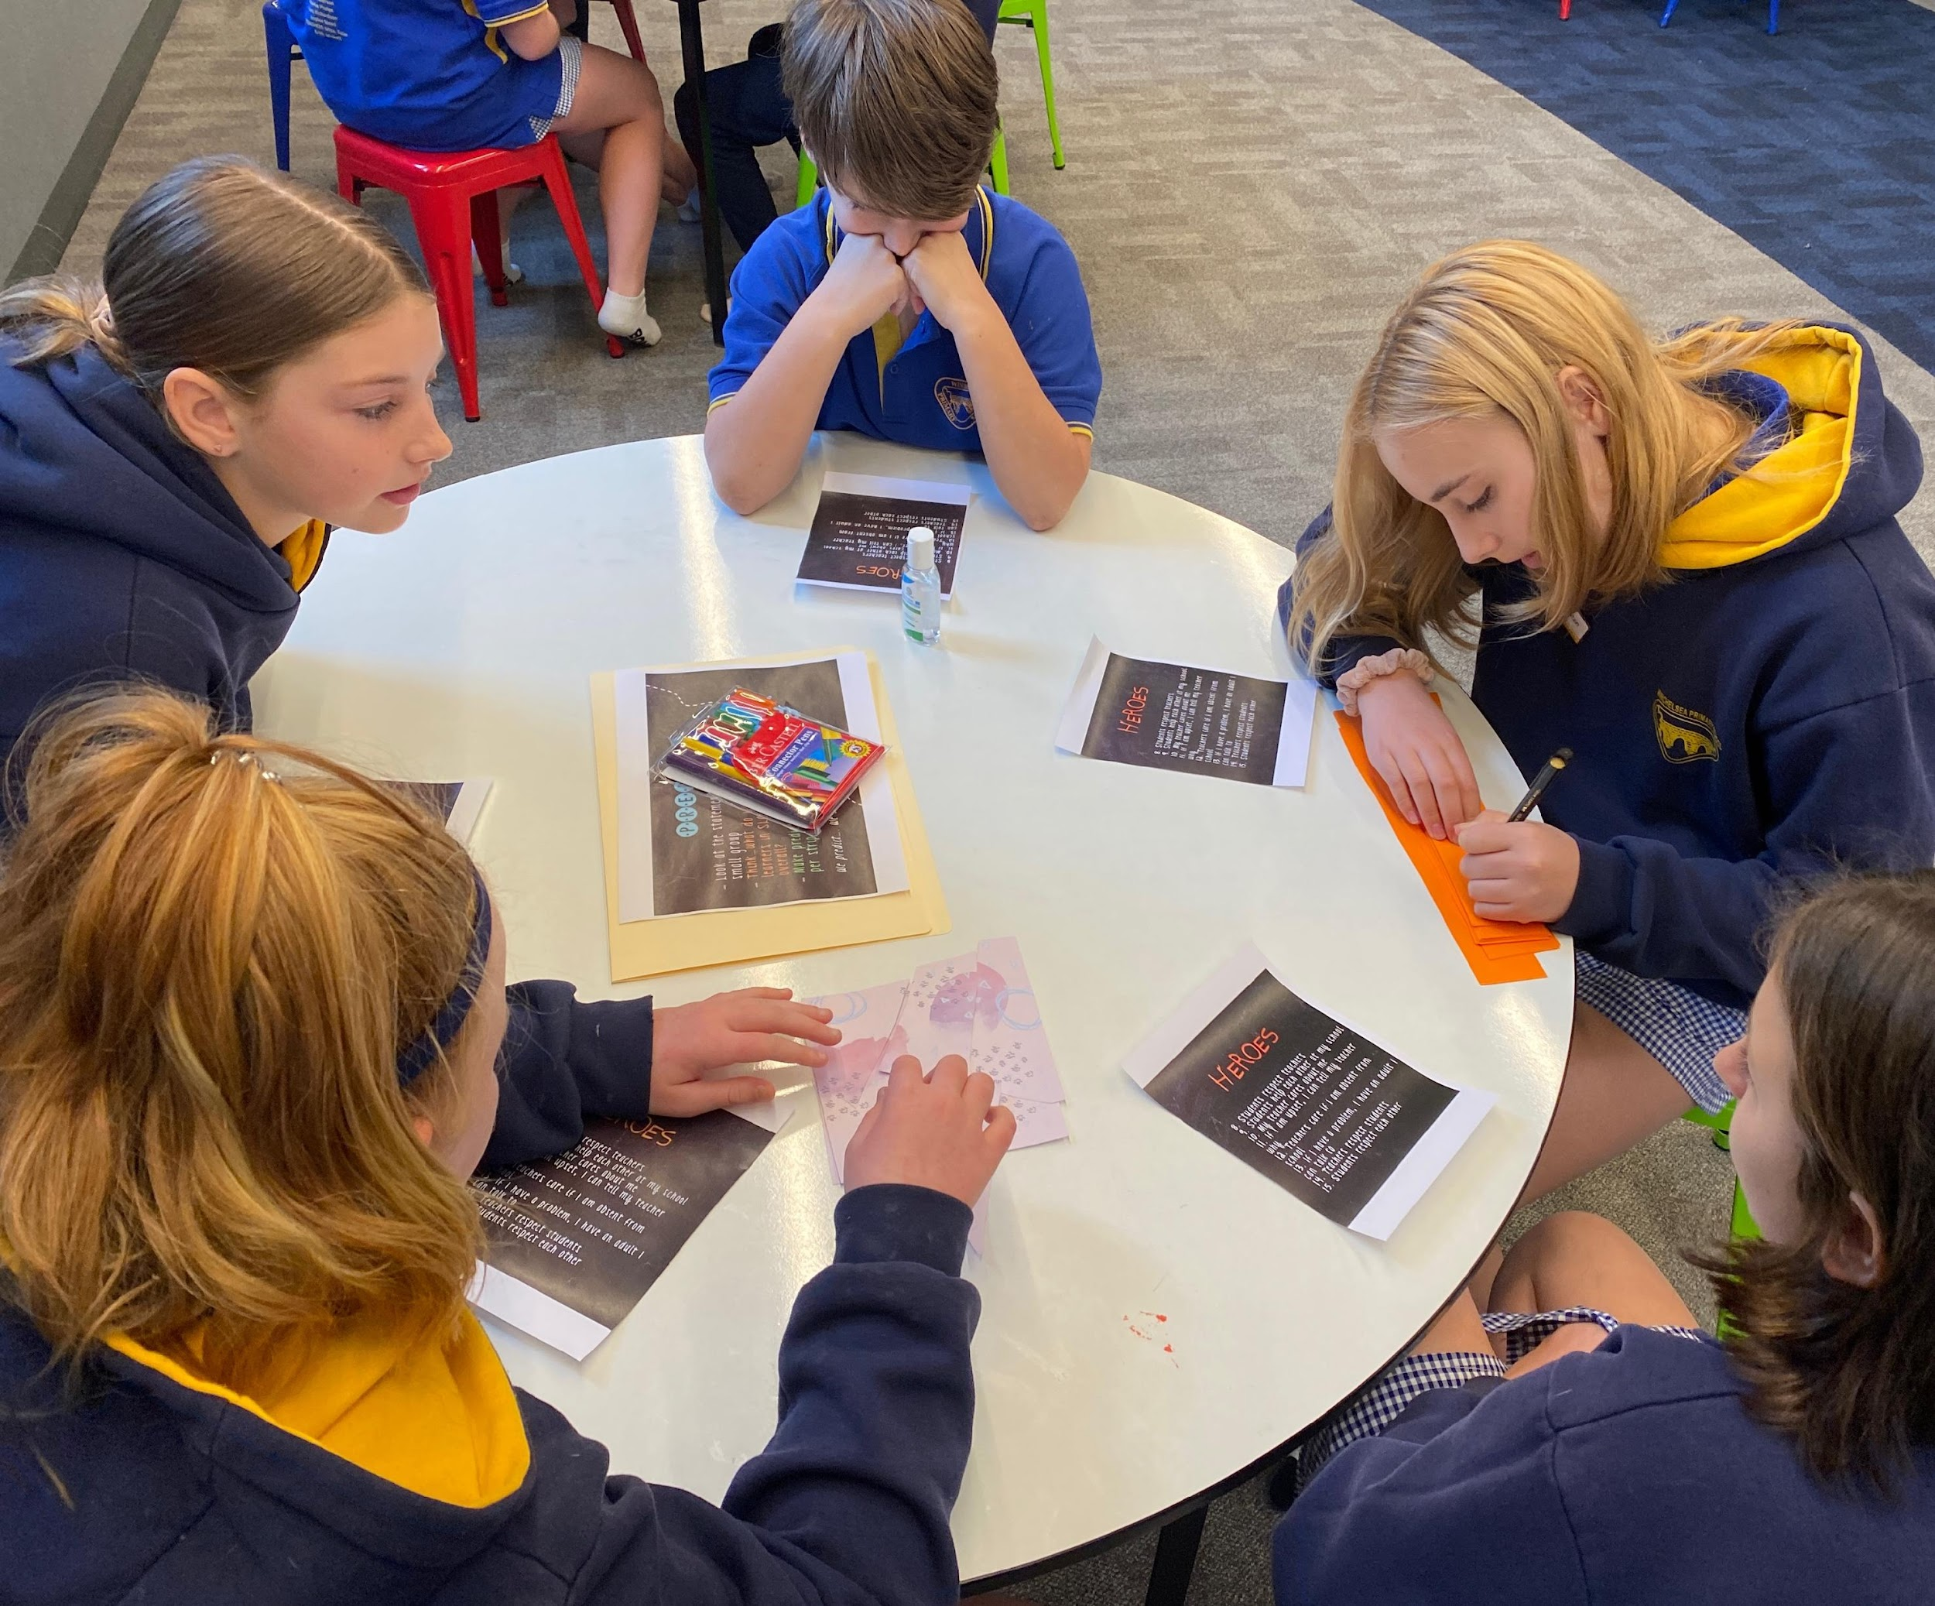
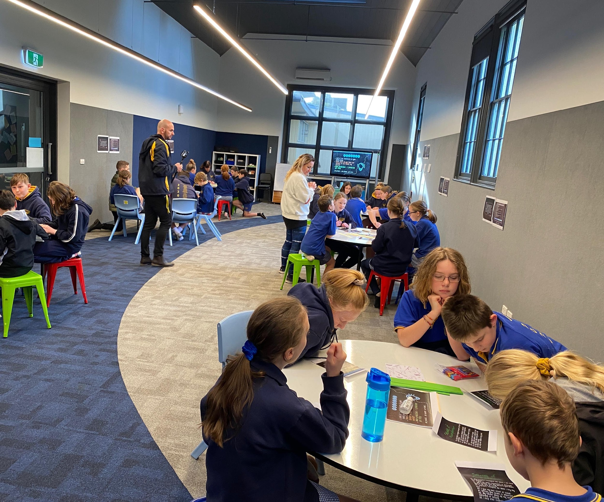
Student Voice in Action
Winchelsea Primary, Victoria, Australia

Slide 15
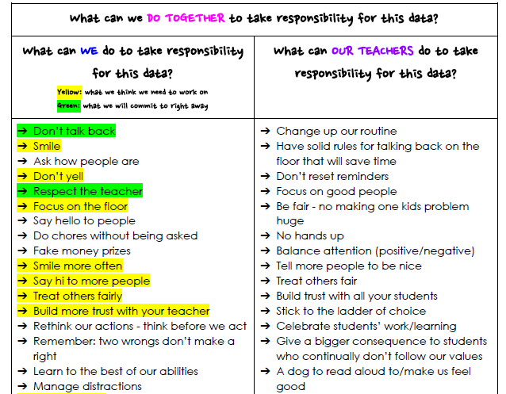
Student Voice in Action
Winchelsea Primary, Victoria, Australia

Slide 16

REFLECT
What skills do your students need for their voices to be heard?

Slide 17
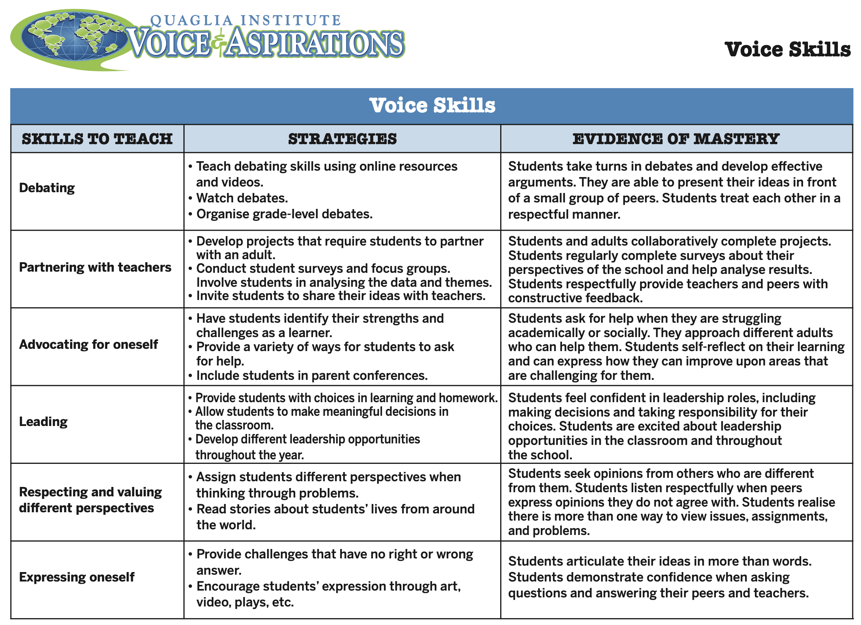
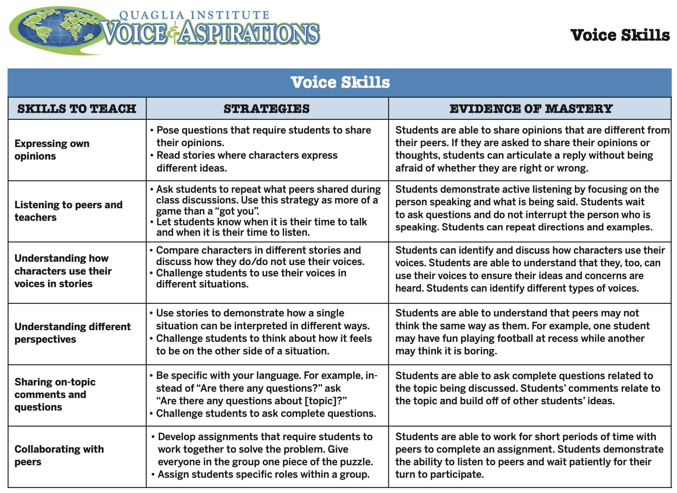

Slide 18
Students Control the Volume
Voice Inhibitors
Anger/extreme emotion
Rhetoric
Volume/Tone
Close Minded
Self-Serving
Voice Amplifiers
Authenticity/Genuineness
Knowledge
Refocus, Reanalyze, Readjust
Relentless
Being a “student”

