Slide 1


The Dynamics of Student
Voice & Aspirations
The Power of Voice
March 18, 2026
Dr. Lisa Lande

Slide 2
Fundamental Beliefs
Students are the potential, not the problem.
Students have something to teach us.
Working together is the only way forward.

Slide 3

Goals for Today
Understand & embrace a common
definition for Student Voice.
Consider how Voice impacts the school
improvement process.
Apply learning to your school goals at
Metropolitan School Frankfurt.

Slide 4

Not Boring
Introduction! ☺
Name & Role at MSF
Something memorable about you
Something you want me to
know about MSF
How your image connects to you!

Slide 5

Challenge Time…

Slide 6

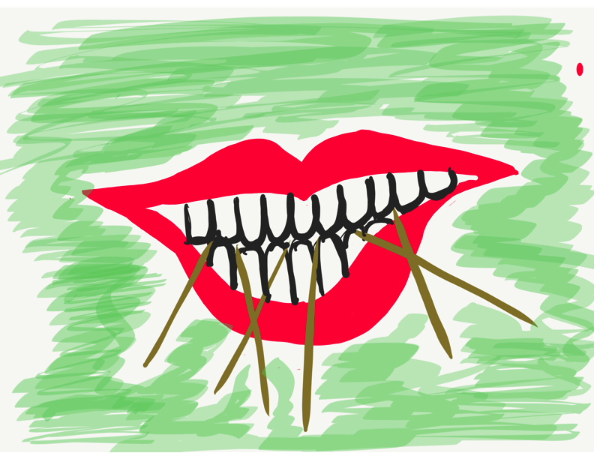
Toothpick Challenge
Using 6 toothpicks,
make 4 and only 4
equilateral triangles
(all 3 sides the same size).
You may not break the toothpicks.

Slide 7
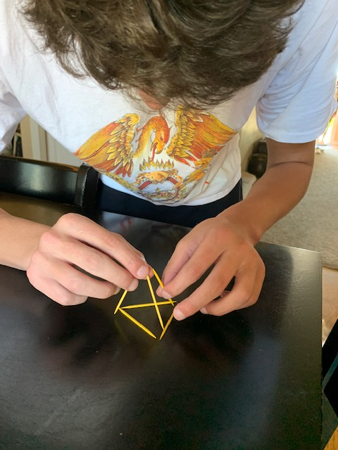
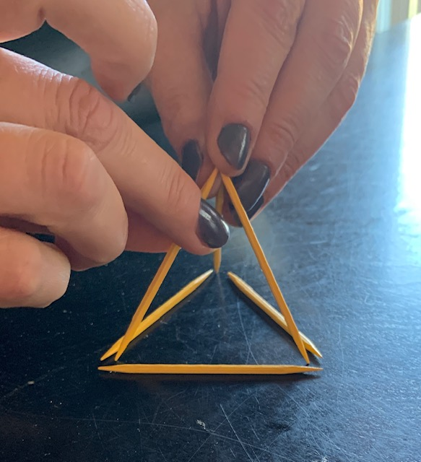
Today we invite you to do
some 3-D thinking!

Slide 8

Quaglia Institute Research
22 years of data
43 states
13 countries
1,016,094 Student Voice Surveys Grades 6-12
153,488 Student Voice Surveys Grades 3-5
649,182 iKnow My Class Surveys
60,466 Teacher Voice Surveys
30,697 Parent Voice Surveys
Notes:
Updated March 2026

Slide 9
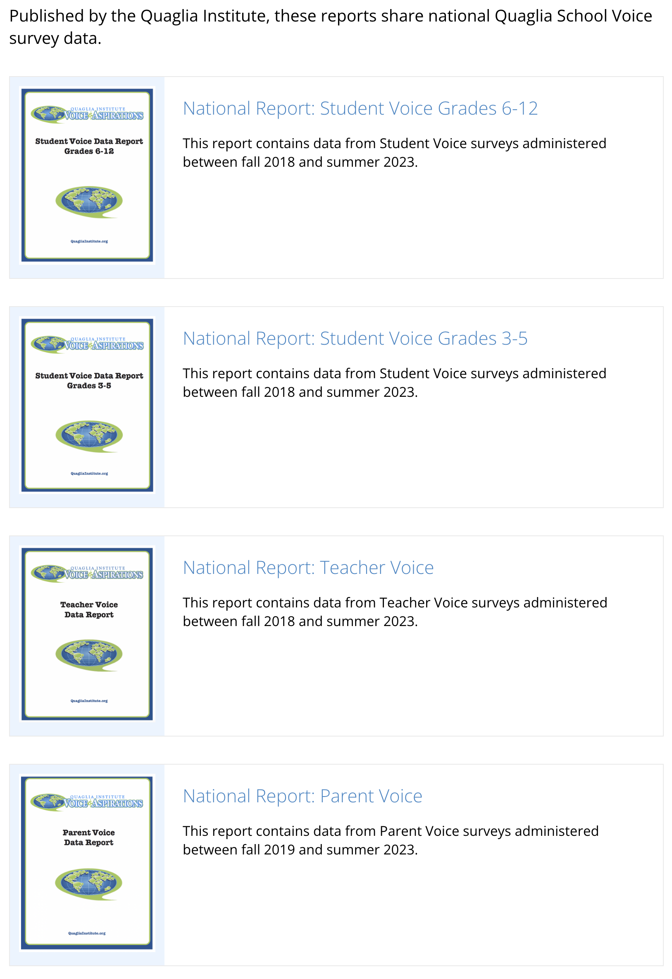
Quaglia Institute Research
QuagliaInstitute.org
Reports:
Student Voice 6-12
Student Voice 3-5
Teacher Voice
Parent Voice

Slide 10

Why Student
Voice &
Aspirations?

Slide 11
TRIUMPHS…
When you Google “Student Voice” you get over
1,620,000,000 results
Search YouTube about “Student Voice” you get over
289,000,000 results
United Nations, Rights of the Child addresses the
importance of Student Voice
Countries, States, & school districts
are making Student Voice a key initiative
Student Voice is not a passing educational whim.

Slide 12
TRIBULATIONS…
52% Adults and students work together to make our school better.
52% Students have a voice in decision making at school.
54% Adults at this school listen to students’ suggestions
57% I use my voice to express my thoughts and ideas.

Slide 13

Students say…
49% Teachers care if I am absent from school.
42% I am a valued member of my school community.
41% My classes help me understand what is happening in my everyday life.
38% Teachers have fun at school.

Slide 14
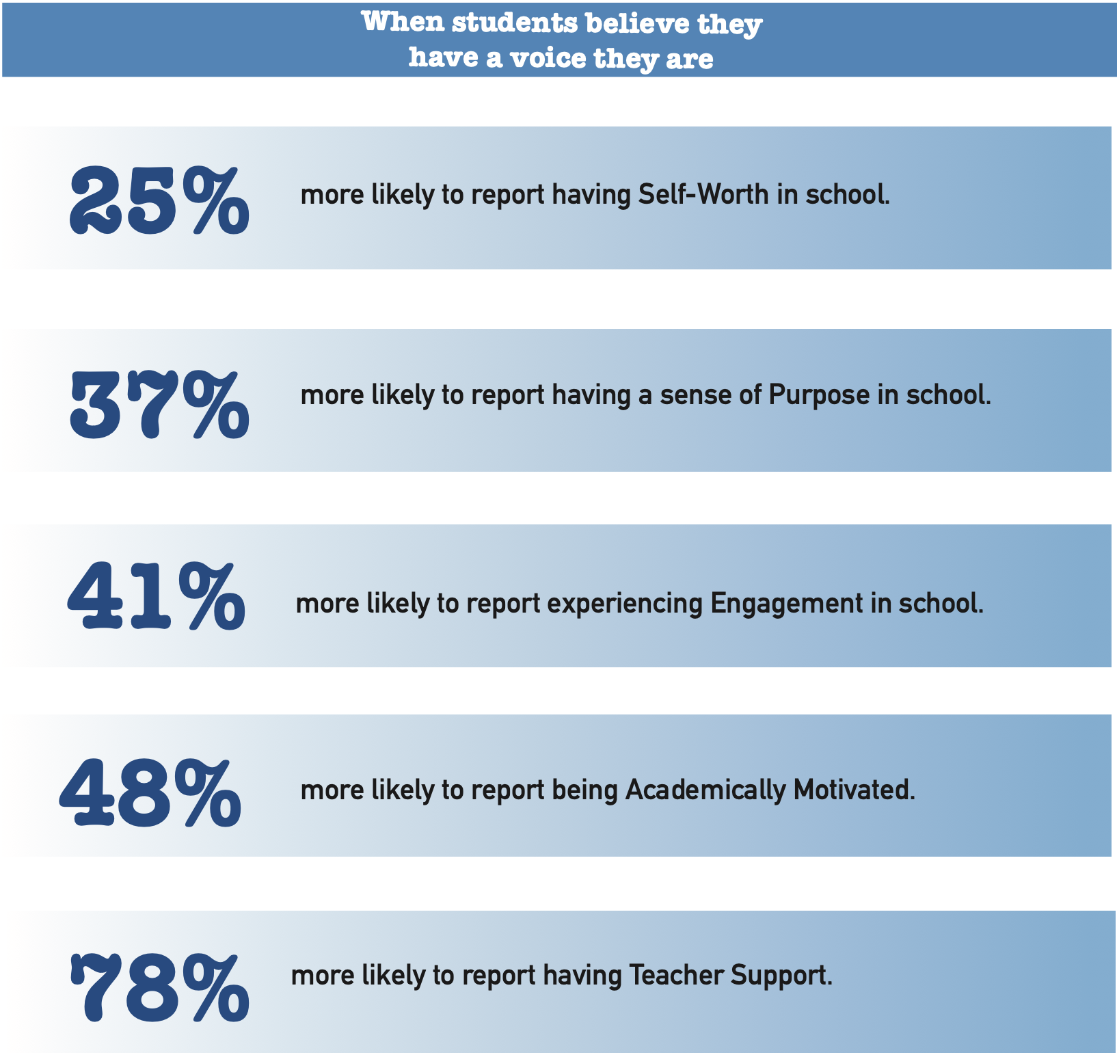

Slide 15
Los Angeles Unified
School District
Video can be viewed here:
https://www.youtube.com/watch?v=O5Tt3H73IR0
Video

Slide 16

And so the
journey begins!
First, we need a clear
definition of student voice
that we can all
understand, accept, &
put into practice.

Slide 17

The 3 Components of Student Voice
Sharing thoughts & ideas in an environment underpinned by trust & respect.
Offering realistic suggestions for the
good of the whole.
Accepting responsibility for not only what is said but also what needs to be done.

Slide 18

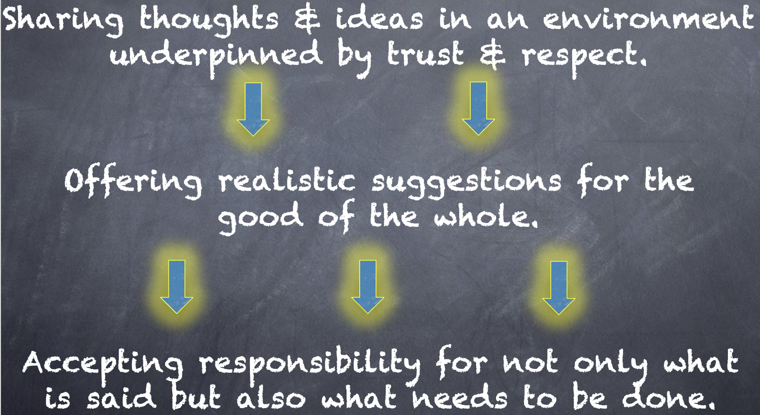
Reflect
What resonates with you from the Voice definition? How does this connect with your beliefs, vision, & goals at MSF?

Slide 19



Slide 20

The Voice Game!

Slide 21

Lunch!

Slide 22

Every voice is unique & represents individual experiences & ideas.
One voice is not better/more important than another.
Equity recognizes that each person
has different circumstances & allocates the exact resources & opportunities needed to reach an equal outcome. Every
voice matters!
Voice & Equity

Slide 23
Challenge Time…

Slide 24
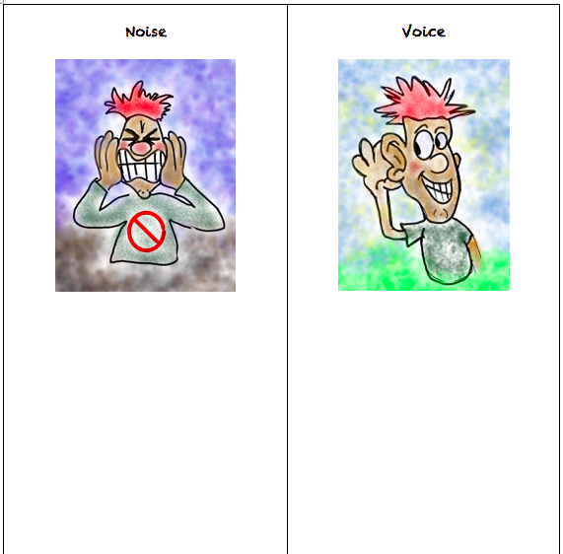


CHALLENGE
Noise vs. Voice
Share words, phrases, &
examples of
Noise.
Now share words, phrases, &
examples of
Voice.

Slide 25
Noise vs Voice
Student Noise
Demands/commands/chaotic
Student opinion is most important
Everyone needs to change but me
Complaining/whining
Blame Game
Student Voice
Requests/inquiry/focused
Our ideas are stronger in partnership
Being open to learn
Personal reflection
Accepting responsibility

Slide 26
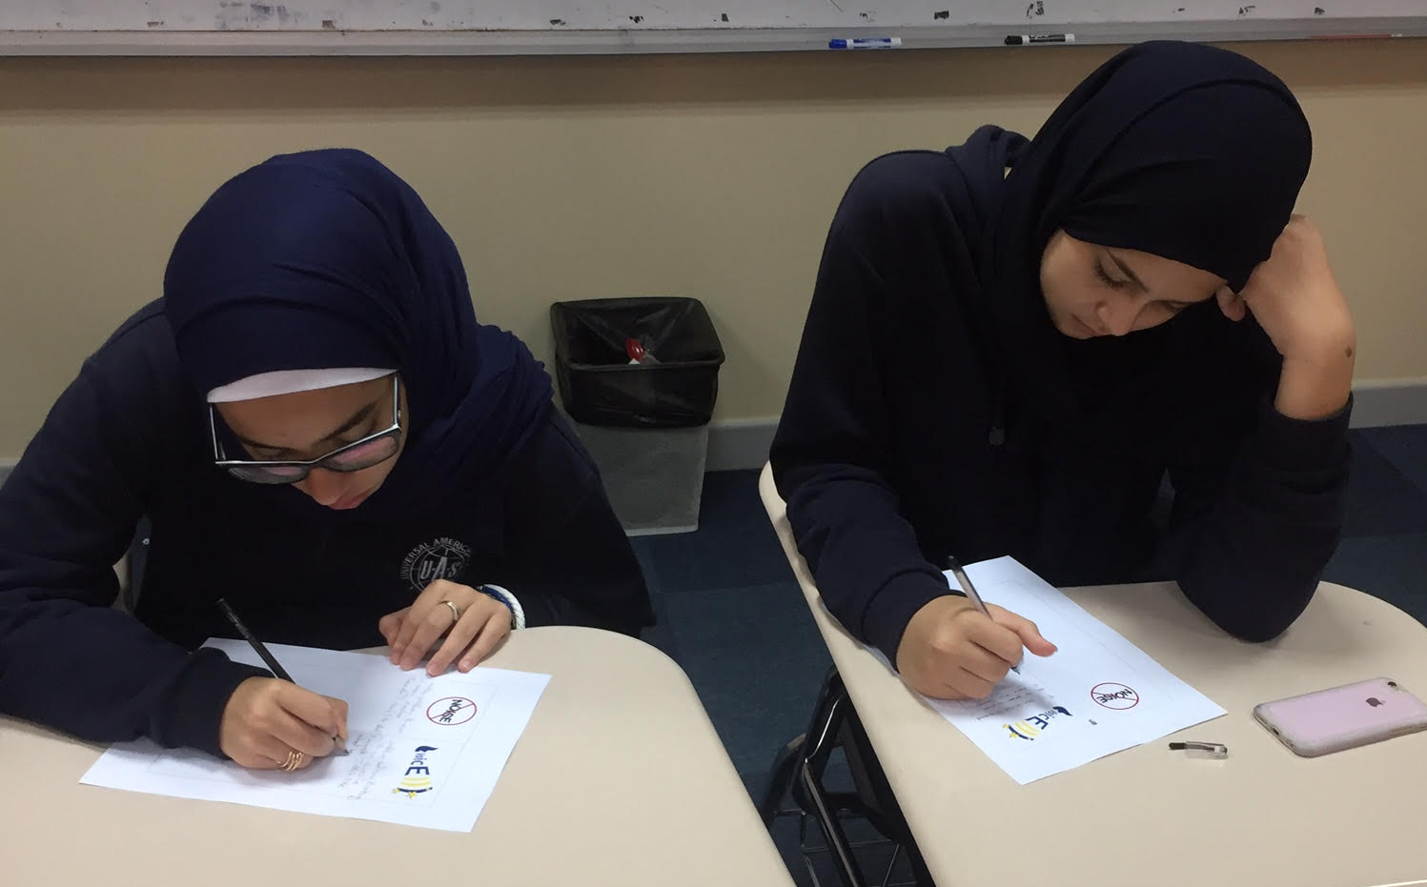
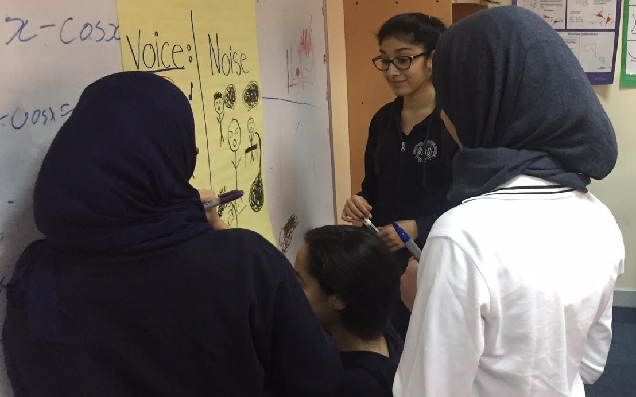
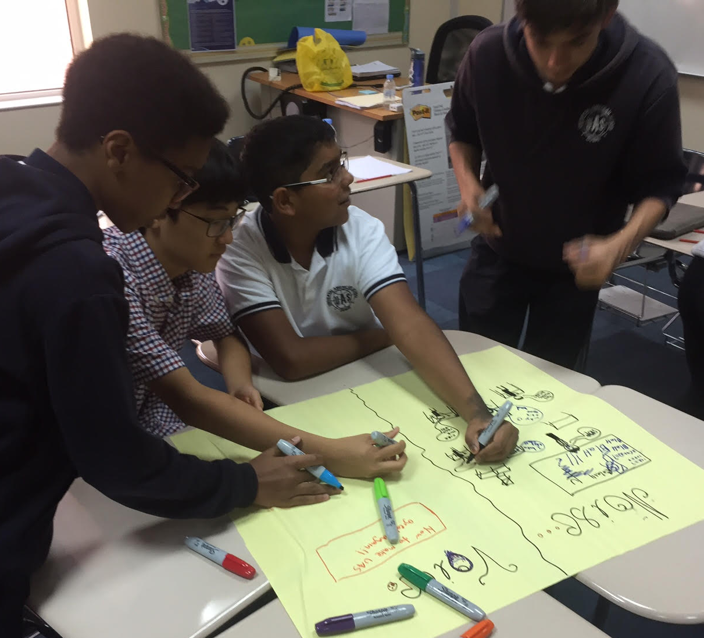
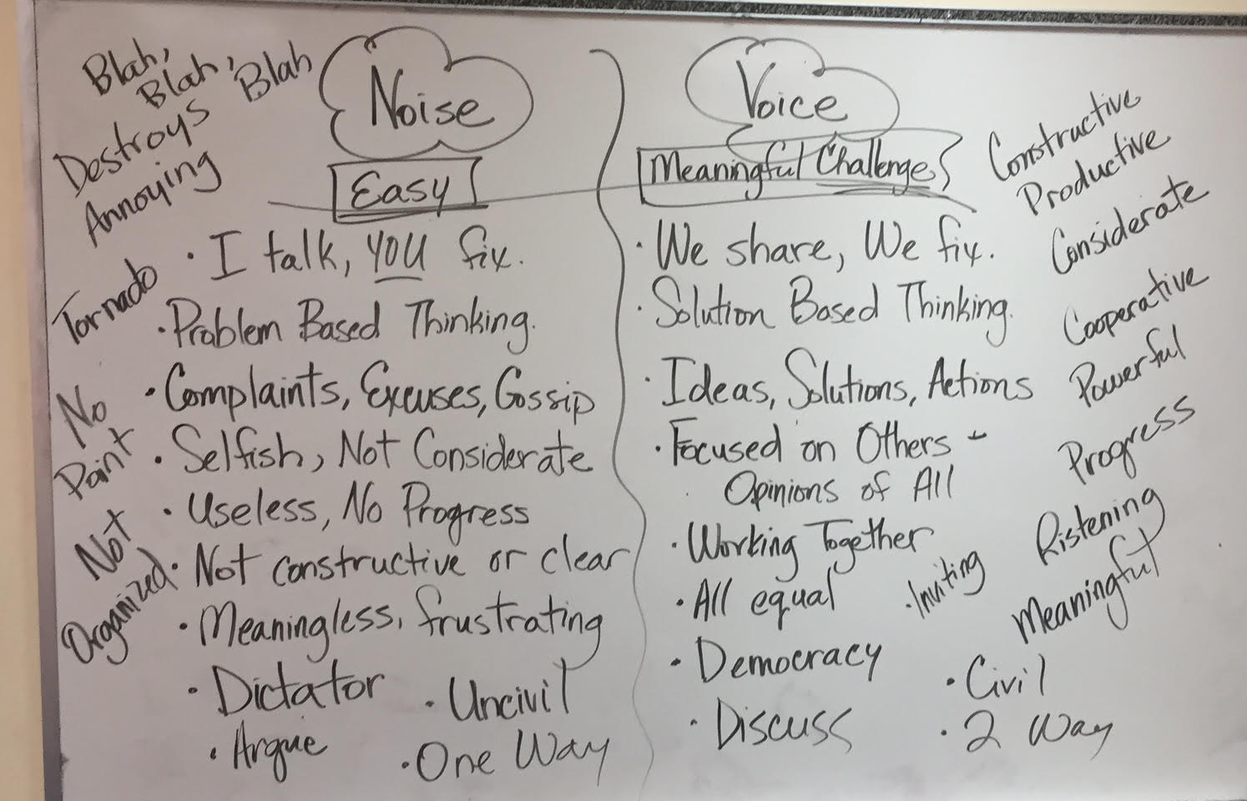

Slide 27
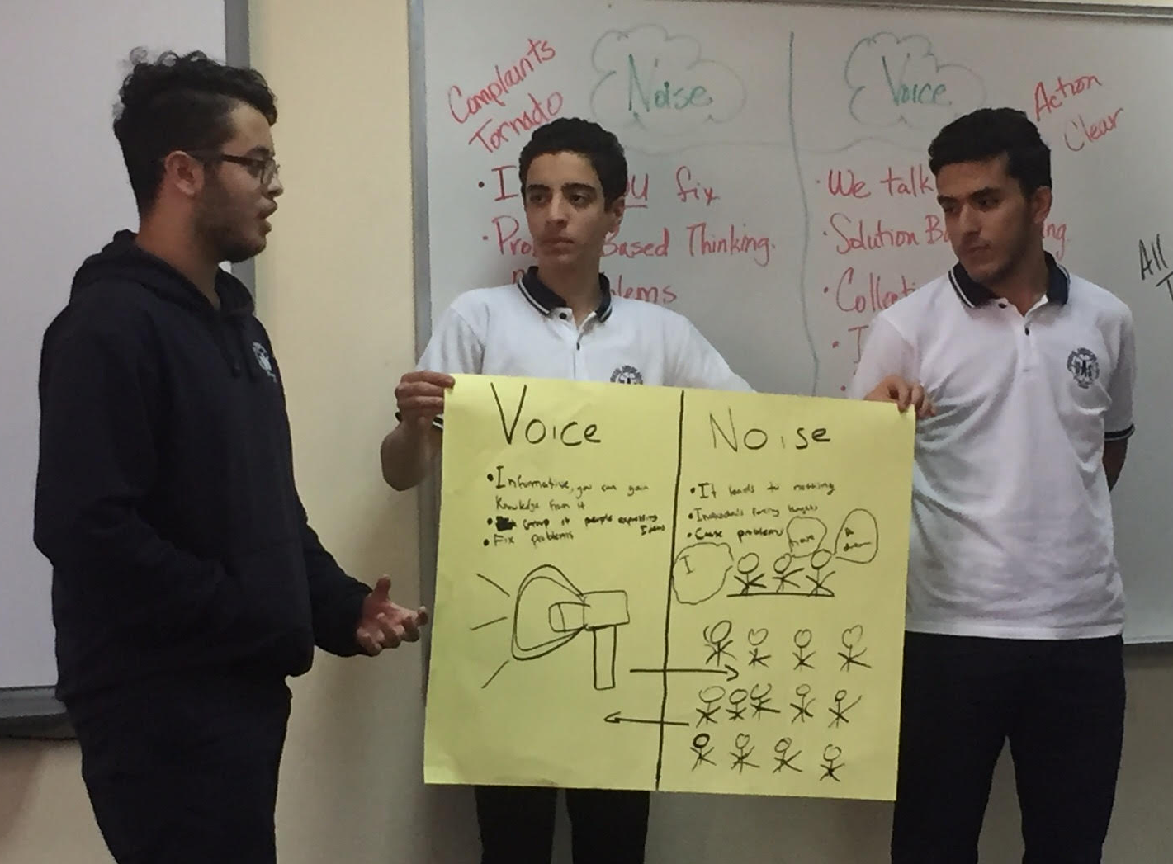
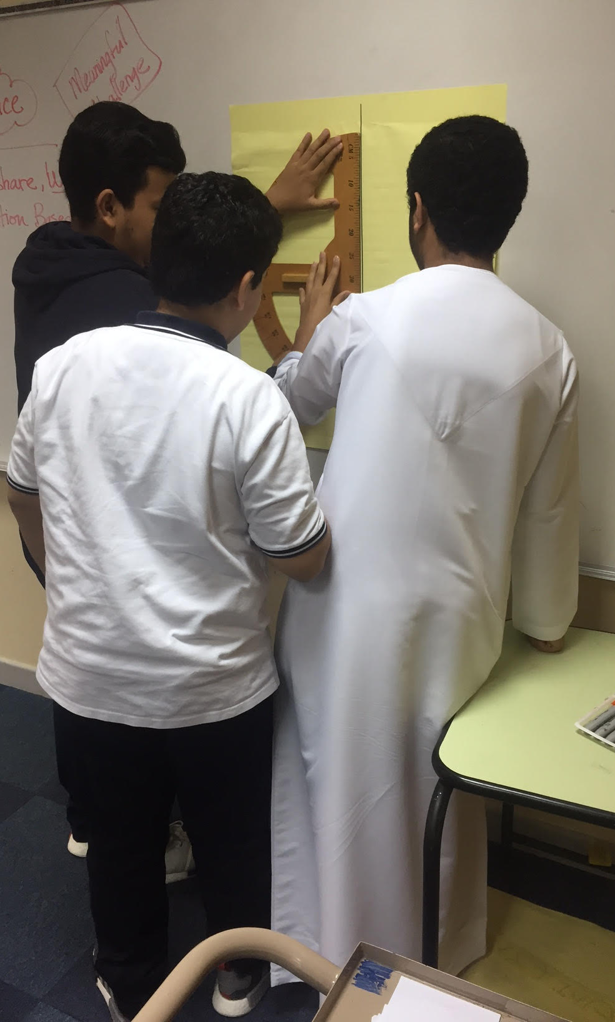
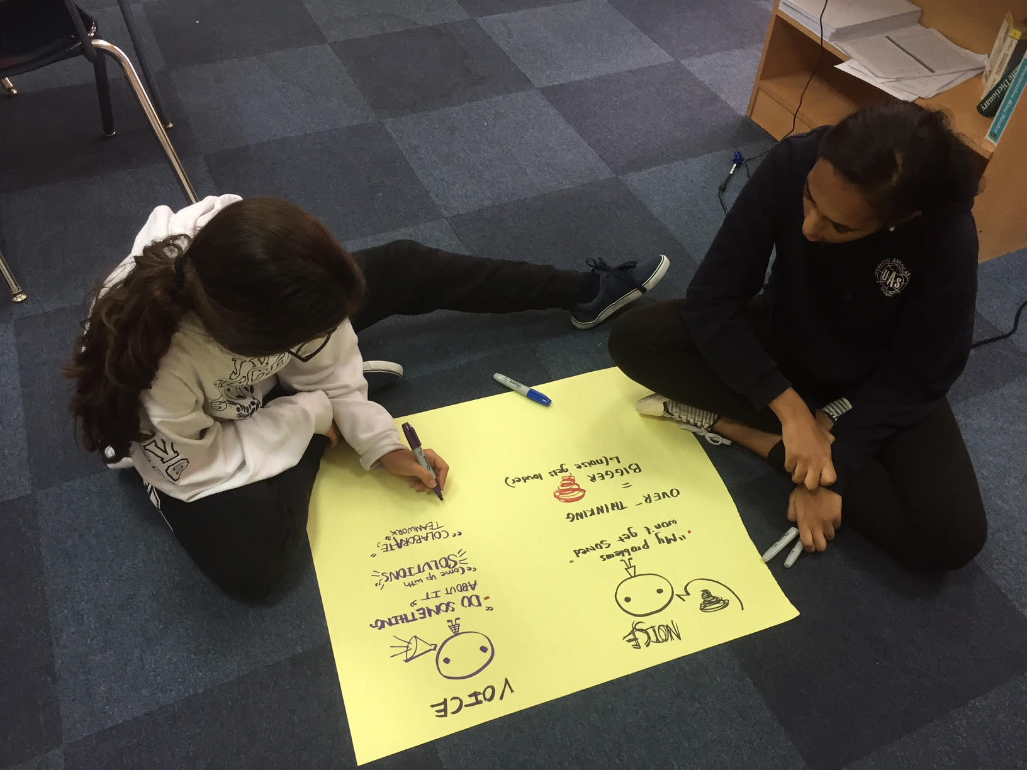

Slide 28
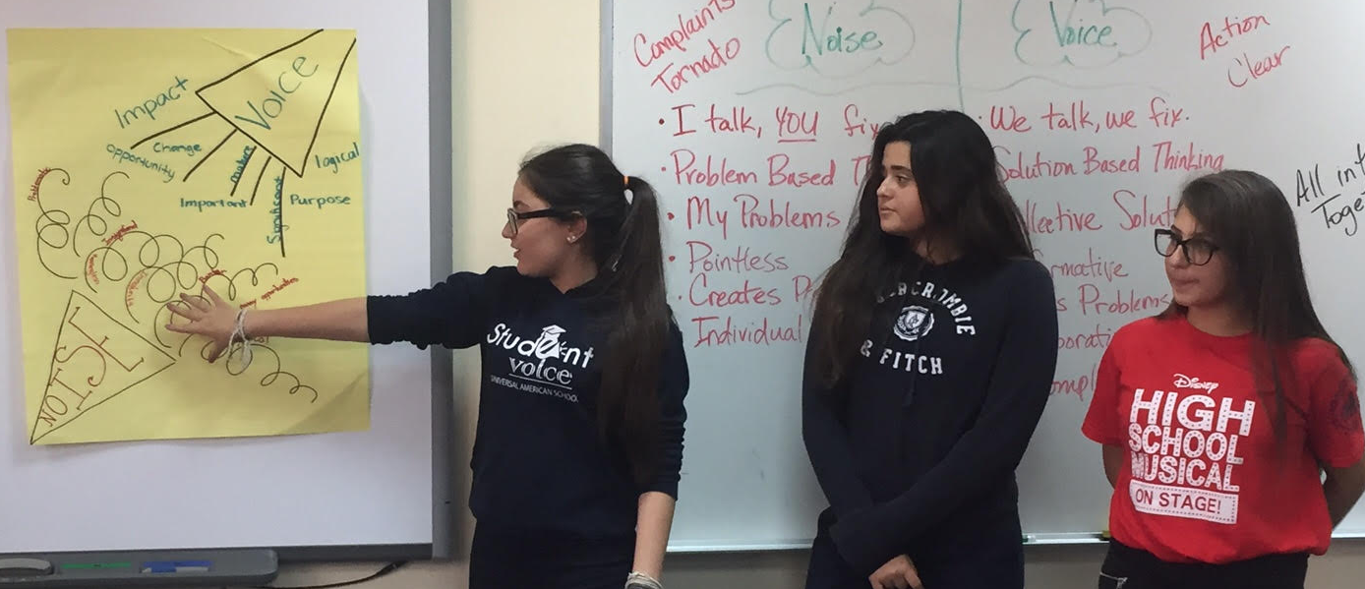
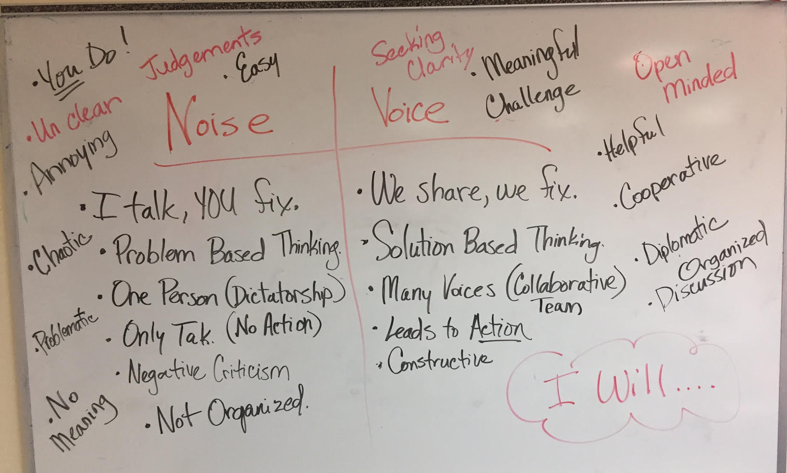
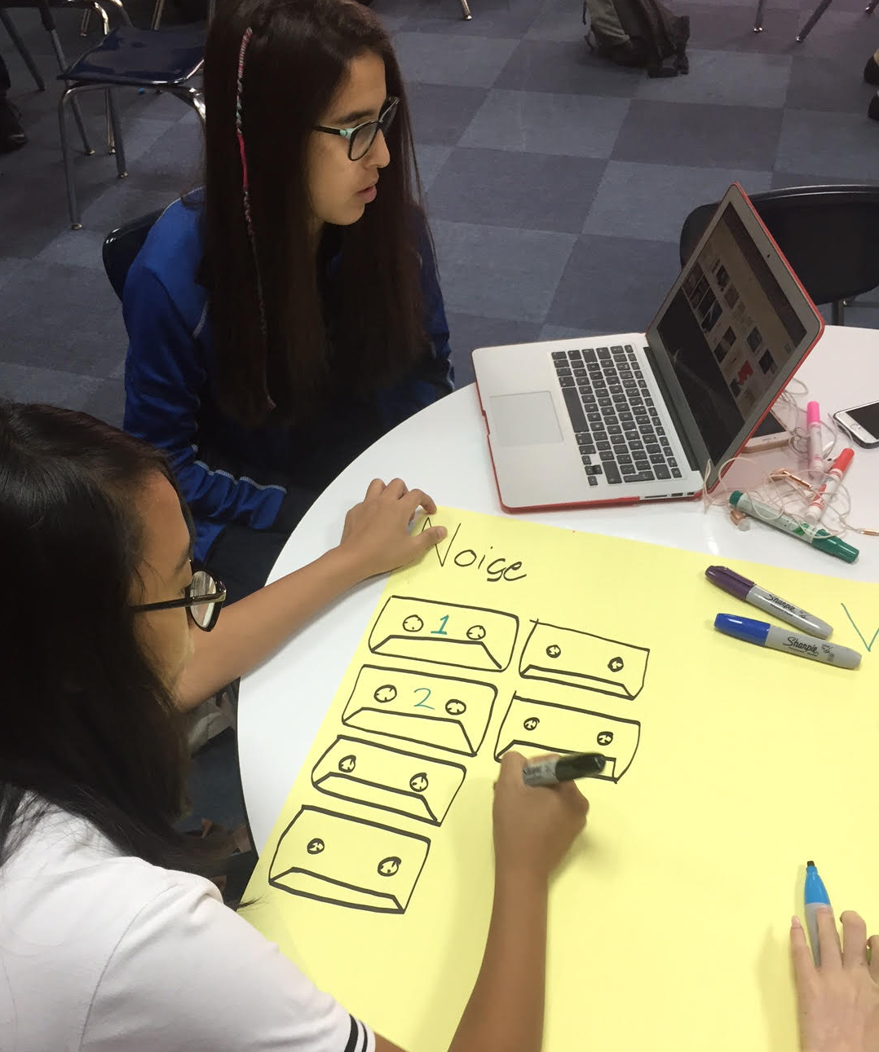

Slide 29
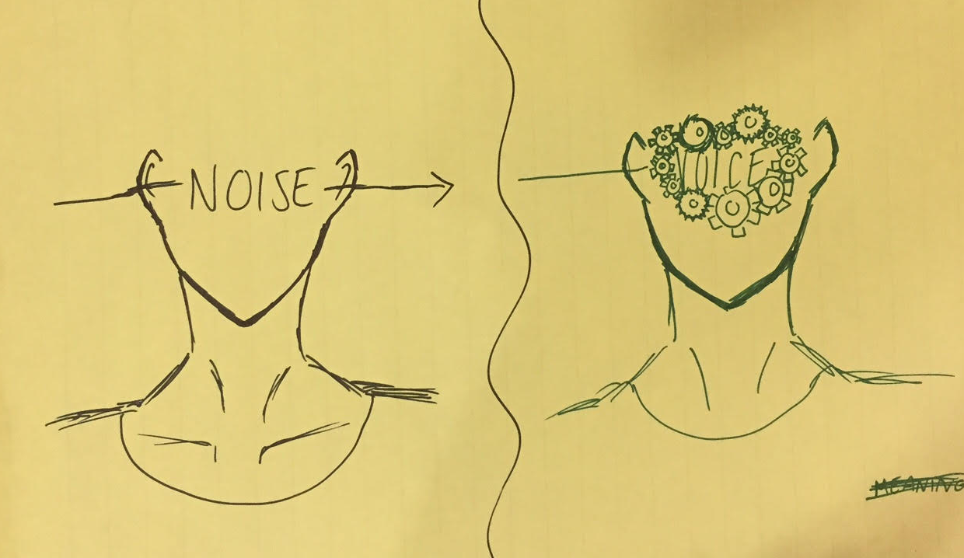
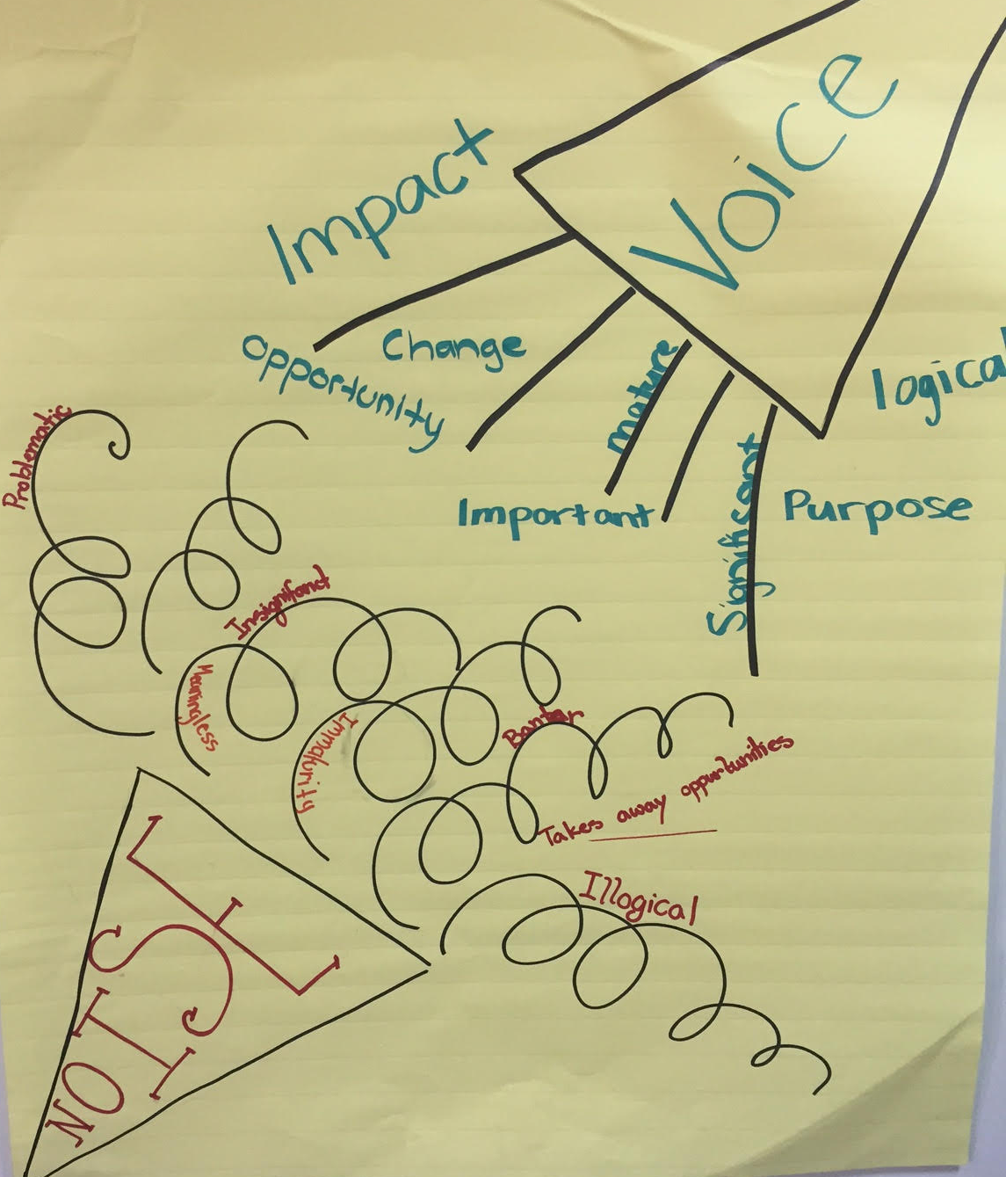

Slide 30
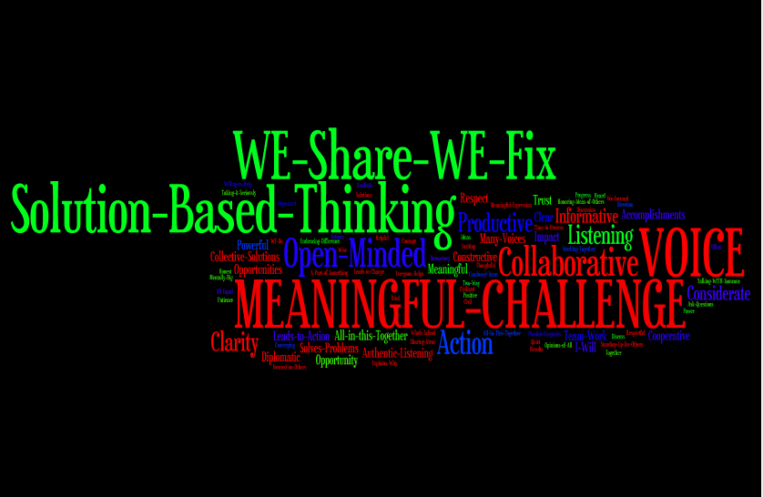

Slide 31
Students Control the Volume
Voice Inhibitors
Anger/extreme emotion
Volume/Tone
Close Minded
Self-Serving
Voice Amplifiers
Authenticity/Genuineness
Build Knowledge
Refocus, Reanalyze, Readjust
Respectfully Relentless
Being a “student”

Slide 32
Reflect
What skills do your students need for their voices to be heard?

Slide 33
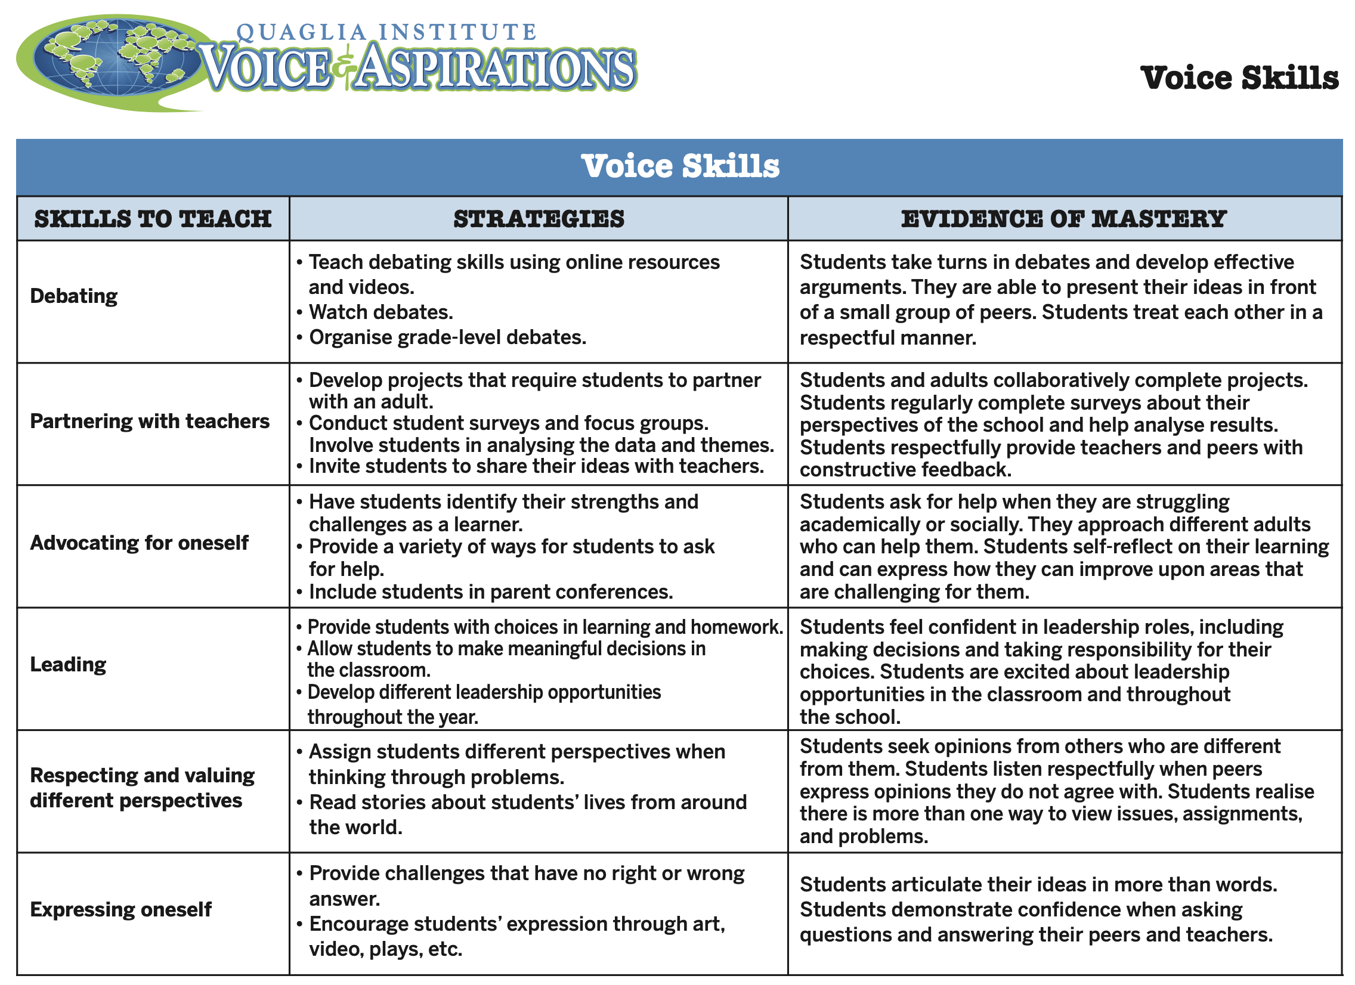

Slide 34
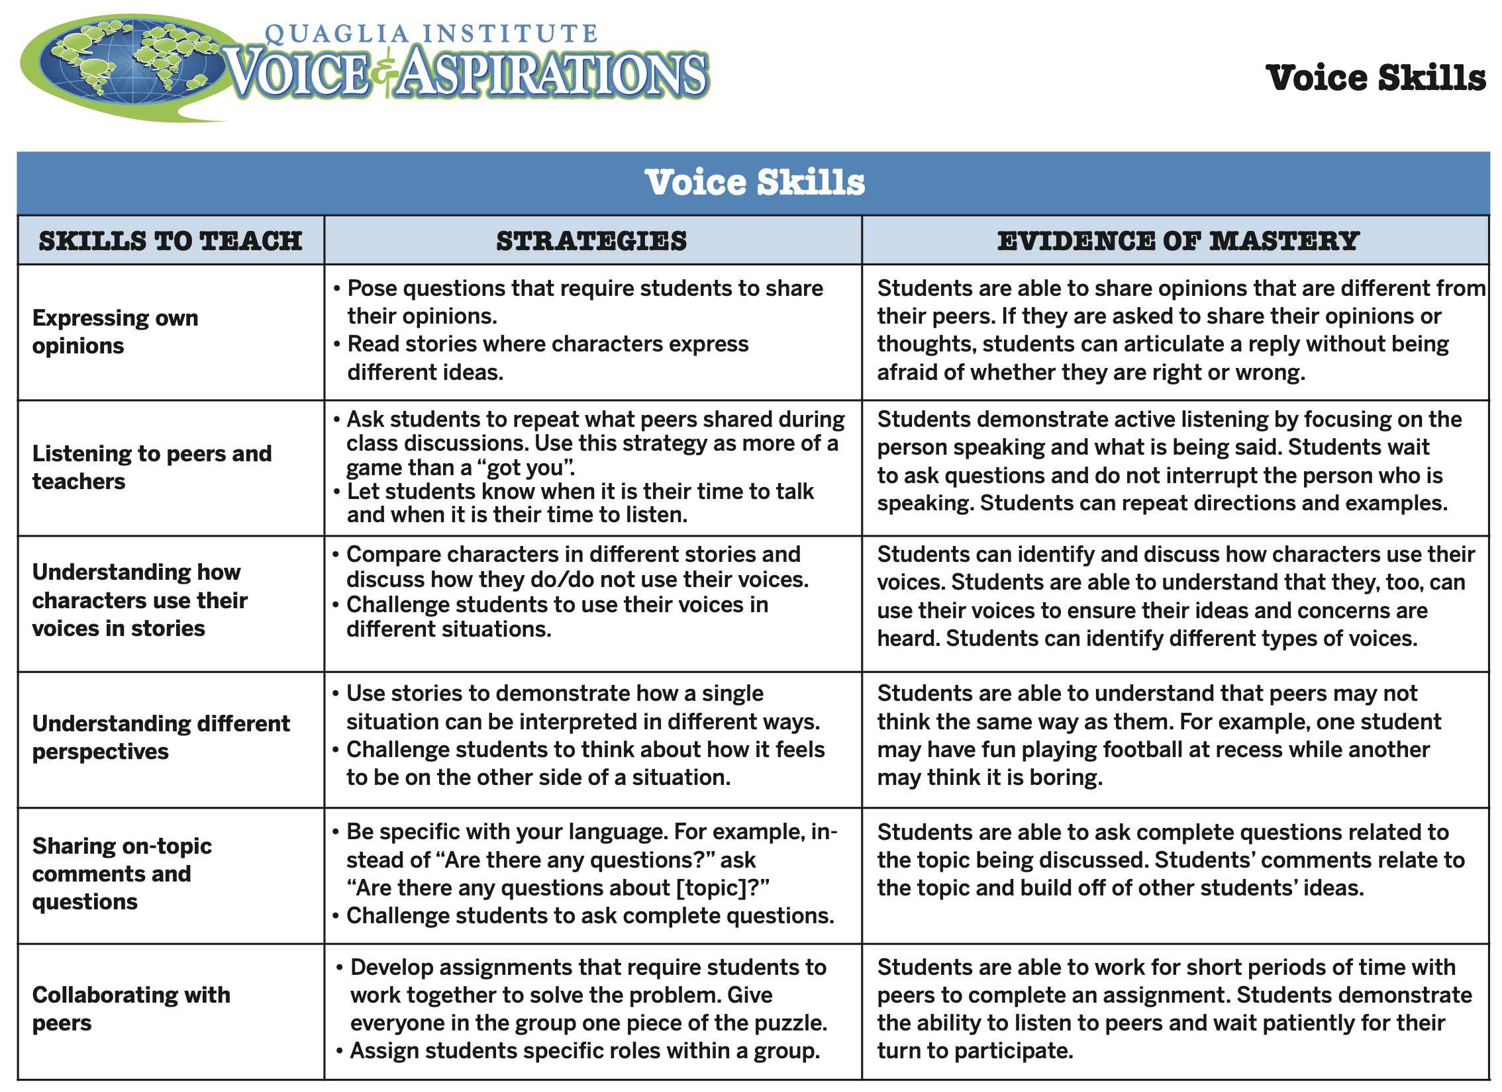

Slide 35
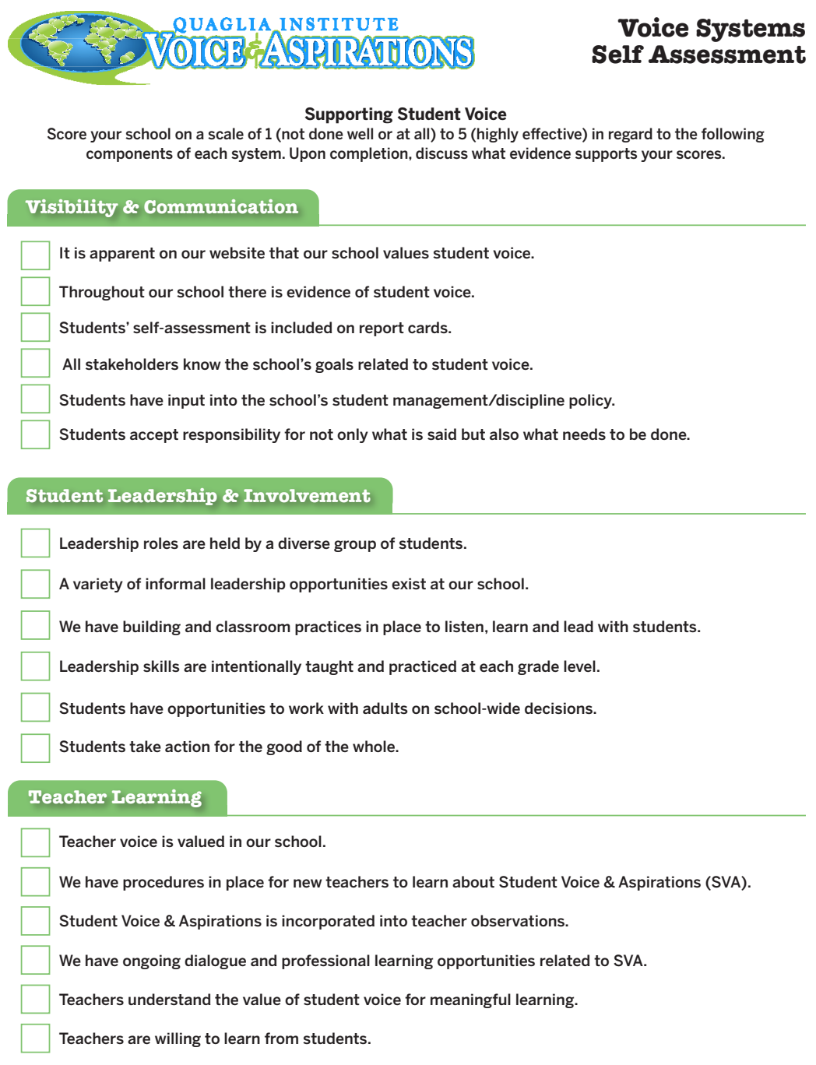
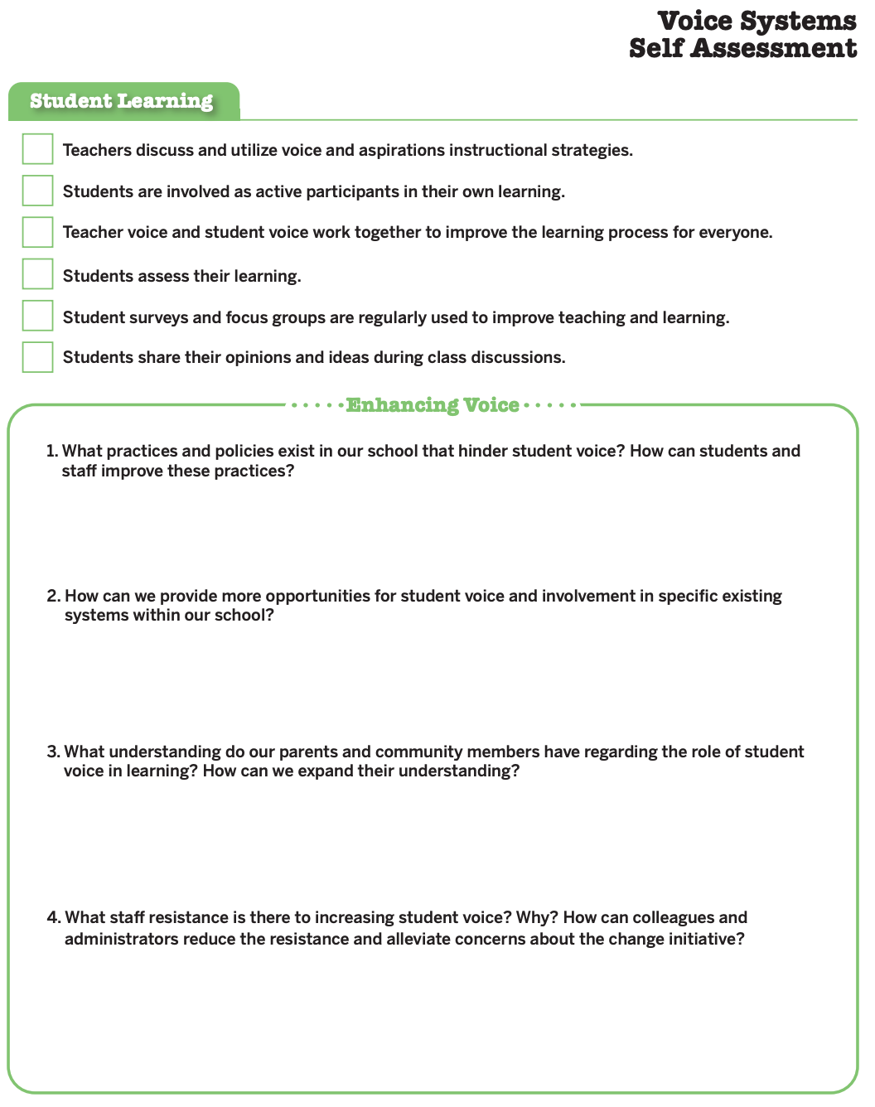

Slide 36
RESOURCES

Slide 37
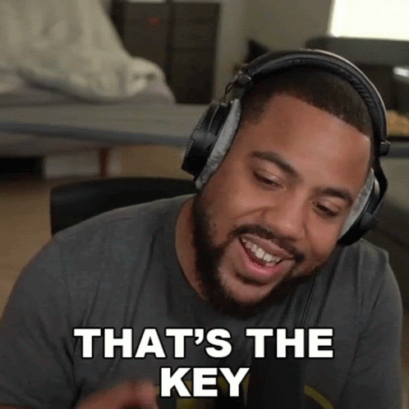
What is your key take away from today’s session you can share with colleagues &/or students?

Slide 38

What is your key take away from today’s session you can share with colleagues &/or students?

Slide 39
Thank you for the opportunity to learn together today!
Dr. Lisa Lande
lande@quagliainstitute.org
@Lisa_Lande

