Slide 1


The Dynamics of Student
Voice & Aspirations
School Voice Process: Listen, Learn, Lead
March 19, 2026
Dr. Lisa Lande

Slide 2

Challenge Time…

Slide 3
Vimeo: https://vimeo.com/1099356131/fe873ec26f
or
YouTube: https://youtu.be/aut4gPpBkXo
The Life of an Emoji

Slide 4
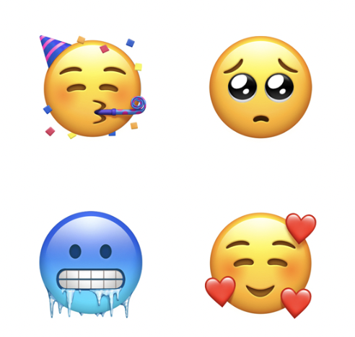
Emoji Challenge
Crate an Emoji that represents Student Voice at MSF.

Slide 5
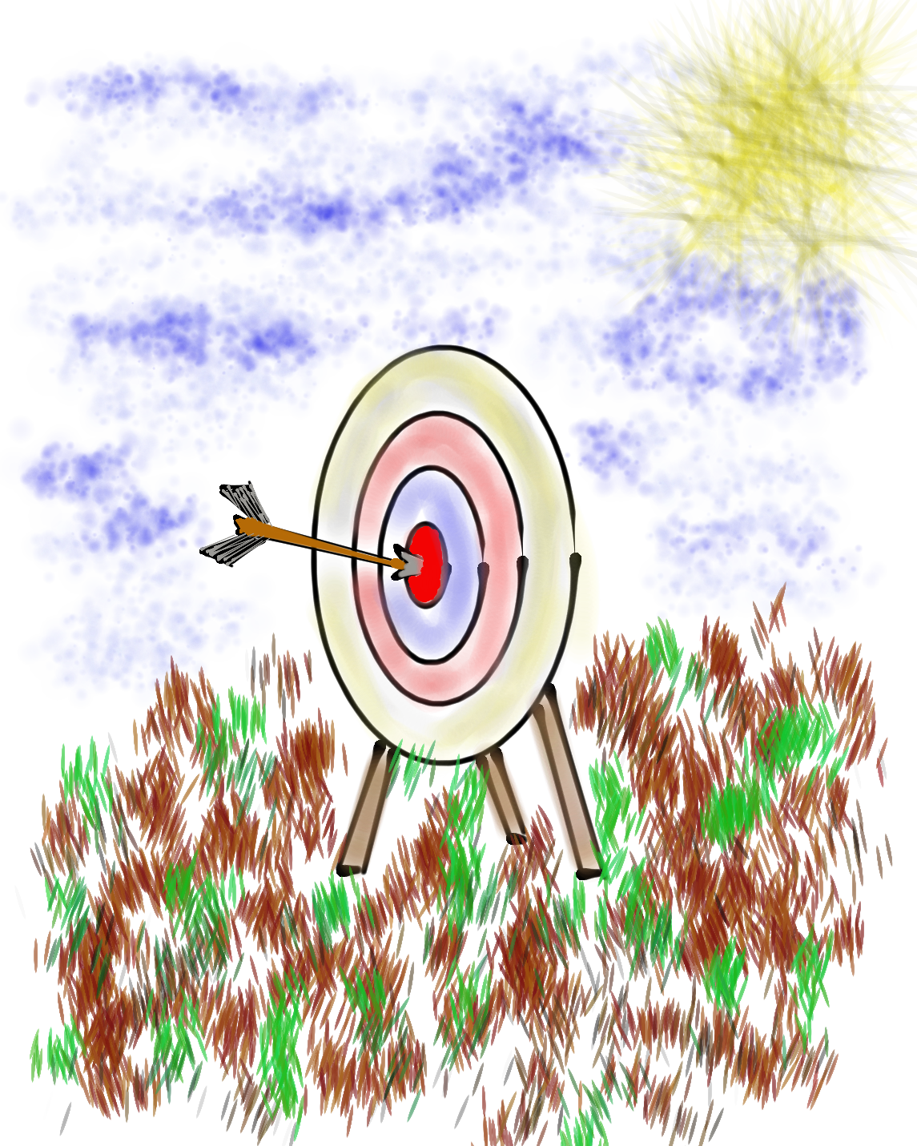
Goals for Today
Continue our journey to amplify student
voice & grow a Community Schools culture of partnership.
Explore the Voice Process & consider how
this impacts our efforts in Listening to,
Learning from, & Leading with one another (including students!).
Apply learning to your school goals at
Metropolitan School Frankfurt.

Slide 6
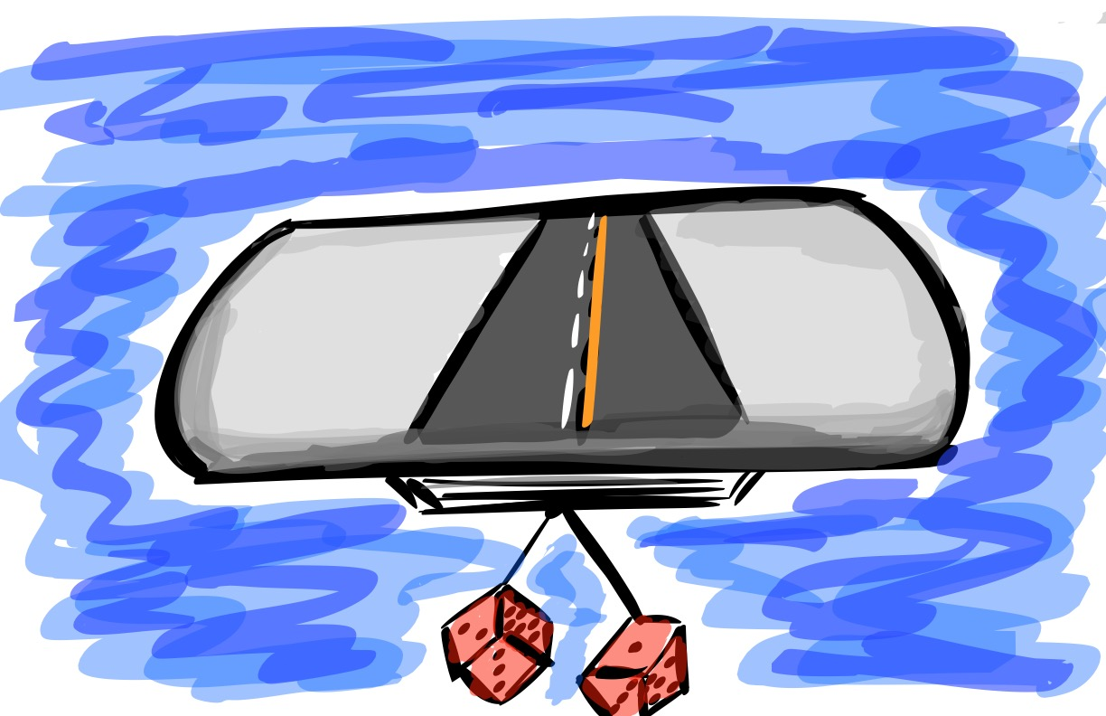
Quick Review
What most stuck with you
from our learning together
yesterday?

Slide 7

The 3 Components of Student Voice
Sharing thoughts & ideas in an environment underpinned by trust & respect.
Offering realistic suggestions for the
good of the whole.
Accepting responsibility for not only what is said but also what needs to be done.

Slide 8
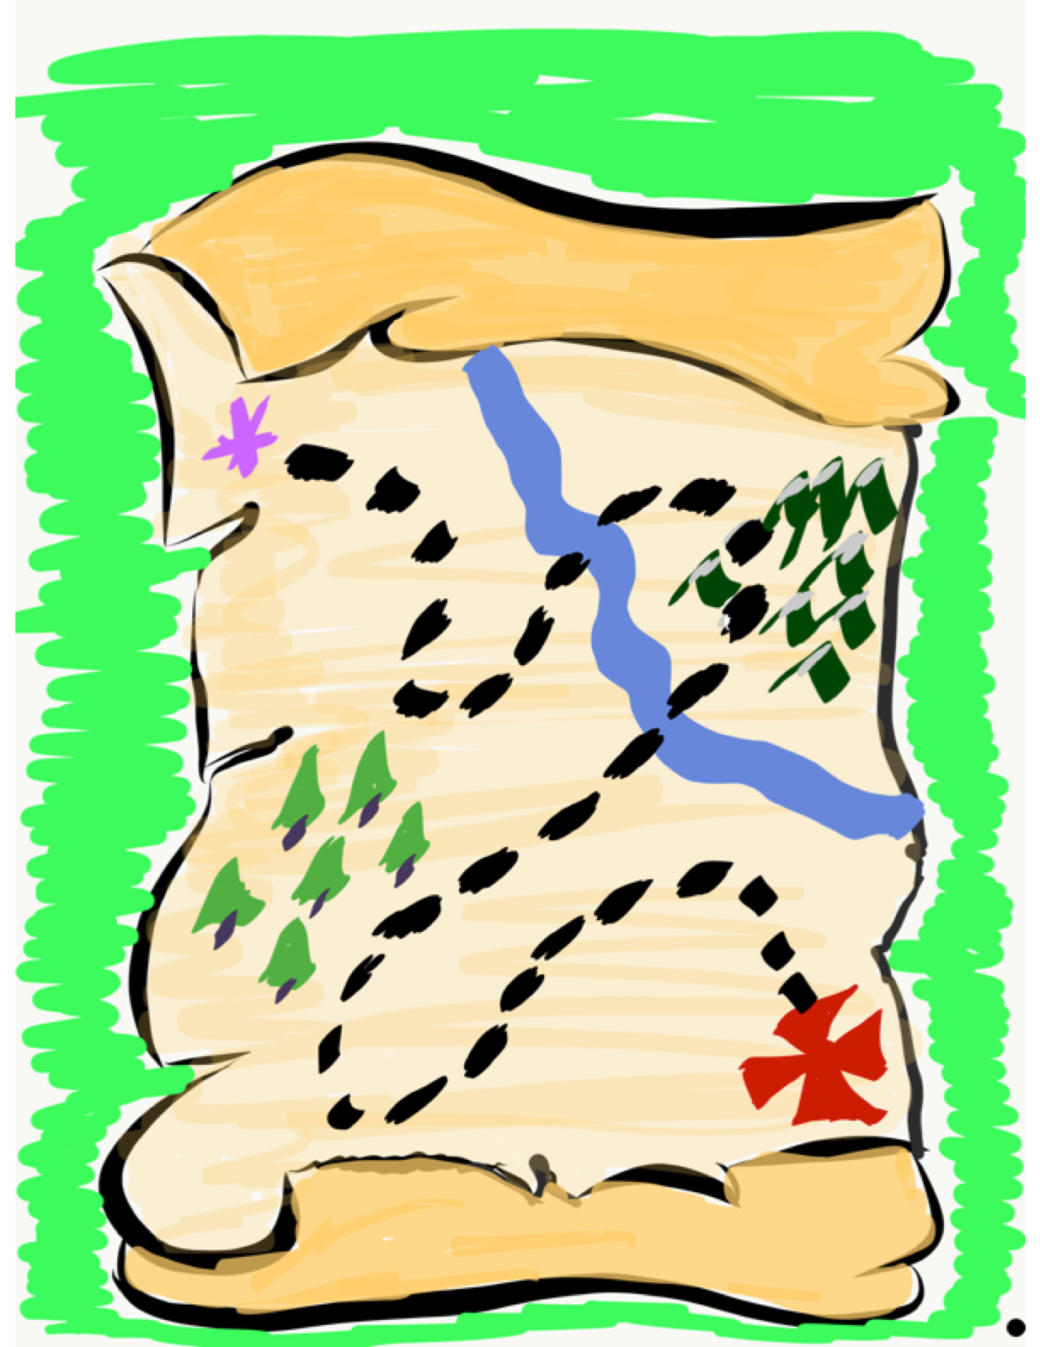
Student Voice Map
Create a map that reflects your journey with Student Voice.
-Key Understandings
-Important Experiences
-Moments of Triumph
-Epic Challenges
-Next Destination

Slide 9
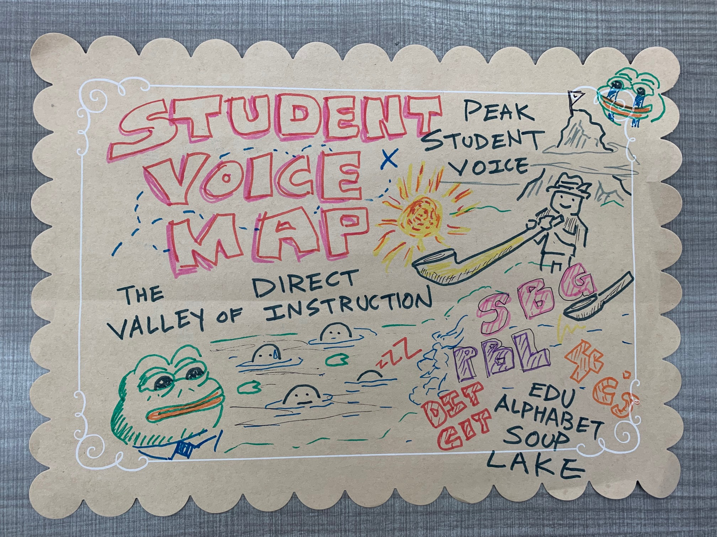
Student Voice Map

Slide 10
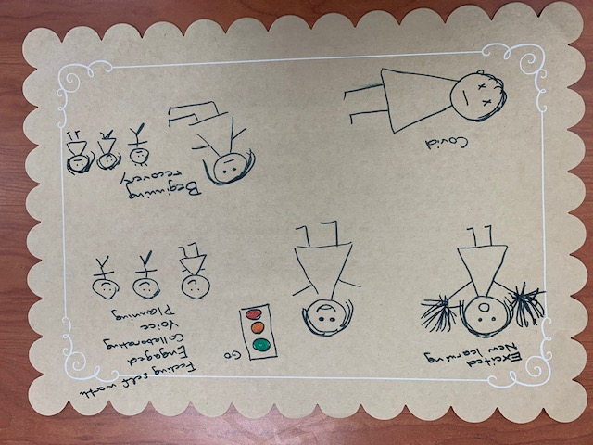
Student Voice Map

Slide 11
Time to journey
onward & explore
the Voice Process:
Listen, Learn,
& Lead

Slide 12
LEAD
TAKE ACTION
with others
Share
RESPONSIBILITY
LEARN
UNDERSTAND
& RESPECT
different points
of view
Build
TRUST
LISTEN
SEEK OUT
opinions from
others
Voice Process

Slide 13
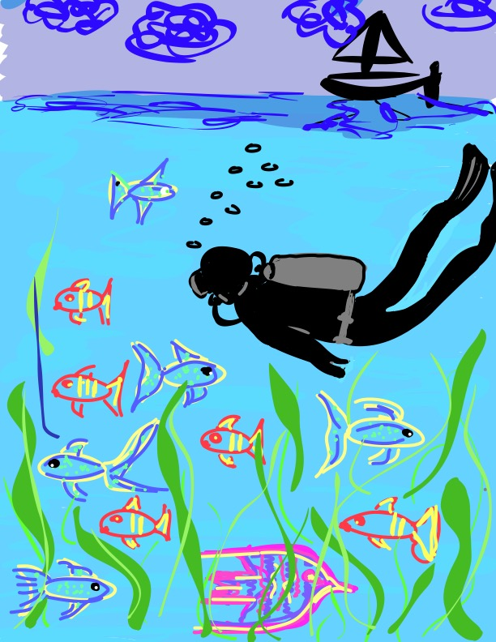
Let’s Dive Deeper…
Listen
Learn
Lead

Slide 14

Listen

Slide 15
The Art of Listening
Vimeo:
http://vimeo.com/qisva/listening
or
YouTube:
https://youtu.be/ooE9dKobjZU

Slide 16
Listen
Reach out & listen to voices
you typically don’t hear from
Stay focused (put away your phone!)
Be genuine & truly interested
Engage in 2-way conversations that are
life-giving
Be perpetually open to new ideas

Slide 17

Challenge Time!
Drawing Dictations
Round 1: Find a partner &
assign one person to be the
Describer, & one person to
be the Artist. Sit back to back. Without looking or asking
questions, describe to your
partner how to replicate
your picture.
Round 2: Switch roles
(Describer & Artist) &
repeat, but this time you
can ask clarifying questions.

Slide 18
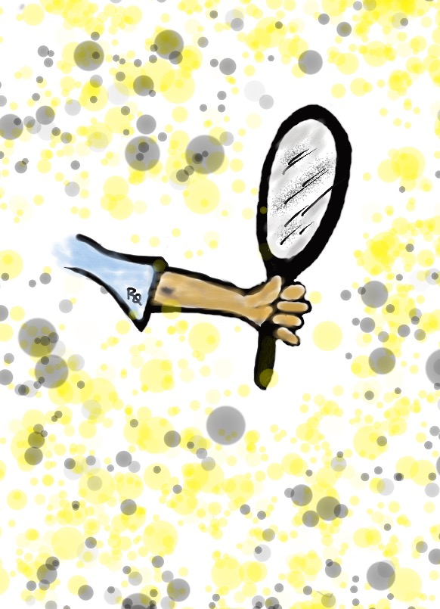
Reflect
What are the biggest challenges/barriers to effectively “listening”
to students?

Slide 19

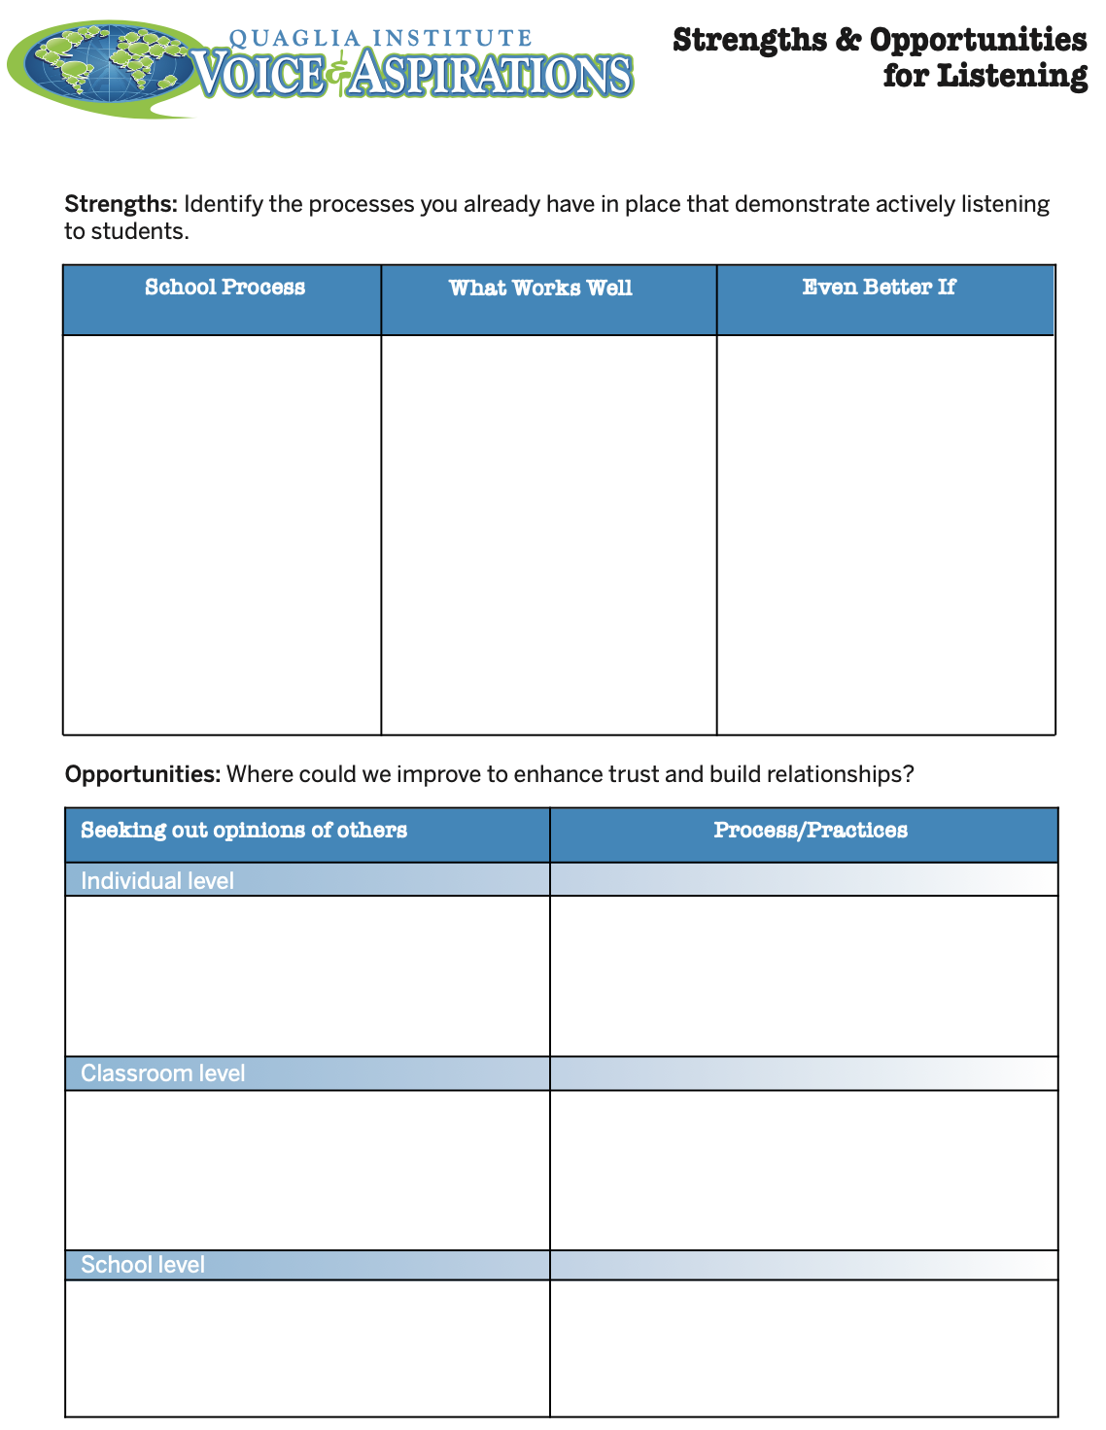
Reflect
What are your
strengths &
opportunities when it
comes to listening
to students?
How are you building
trust & positive
relationships with
ALL students?

Slide 20

Learn

Slide 21
Taking Time to Learn
Vimeo:
vimeo.com/qisva/time
or
YouTube:
https://youtu.be/tYKcvRfxK0o
Video

Slide 22
Learn
Ask questions for clarity & take notes
Move from a place of judgement to wonder
You can learn from anyone
regardless of age, position, or any factor
Follow up & communicate what you
LEARNED from listening
Be prepared to change
Do not fear what you do not know

Slide 23
Challenge Time!
Why Why Why?
With a partner, consider the
provided scenario.
Write a list of possible reasons WHY behind your scenario.
Try to get 30 reasons or MORE!

Slide 24
Reflect
Why do we jump to conclusions & solutions
so quickly?
How might the component of “learn” impact your school improvement efforts?

Slide 25
Challenge Time!
Connections
Find the connection
between the 4 individual pictures.

Slide 26
Connections 1
Vimeo:
vimeo.com/qisva/connection1
or
YouTube:
https://youtu.be/Yl3JrRtyGHc
(all 9 slides)

Slide 27
Connections 2
Vimeo:
vimeo.com/qisva/connections2

Slide 28
Connections 3
Vimeo:
vimeo.com/qisva/connections3

Slide 29
Connections 4
Vimeo:
vimeo.com/qisva/connections4

Slide 30
Connections 5
Vimeo:
vimeo.com/qisva/connections5

Slide 31
Connections 6
Vimeo:
vimeo.com/qisva/connections6

Slide 32
Connections 7
Vimeo:
vimeo.com/qisva/connections7

Slide 33
Connections 8
Vimeo:
vimeo.com/qisva/connections8

Slide 34
Connections 9
Vimeo:
vimeo.com/qisva/connections9

Slide 35
Challenge Time!
Your Connections
Pick a word that reflects your hopes & dreams for this
Community of Schools effort at Jefferson & create
4 images.
Can the group guess
your word?

Slide 36
Reflect
What voices might you still need to learn from?
What is something you have recently learned from a student?

Slide 37
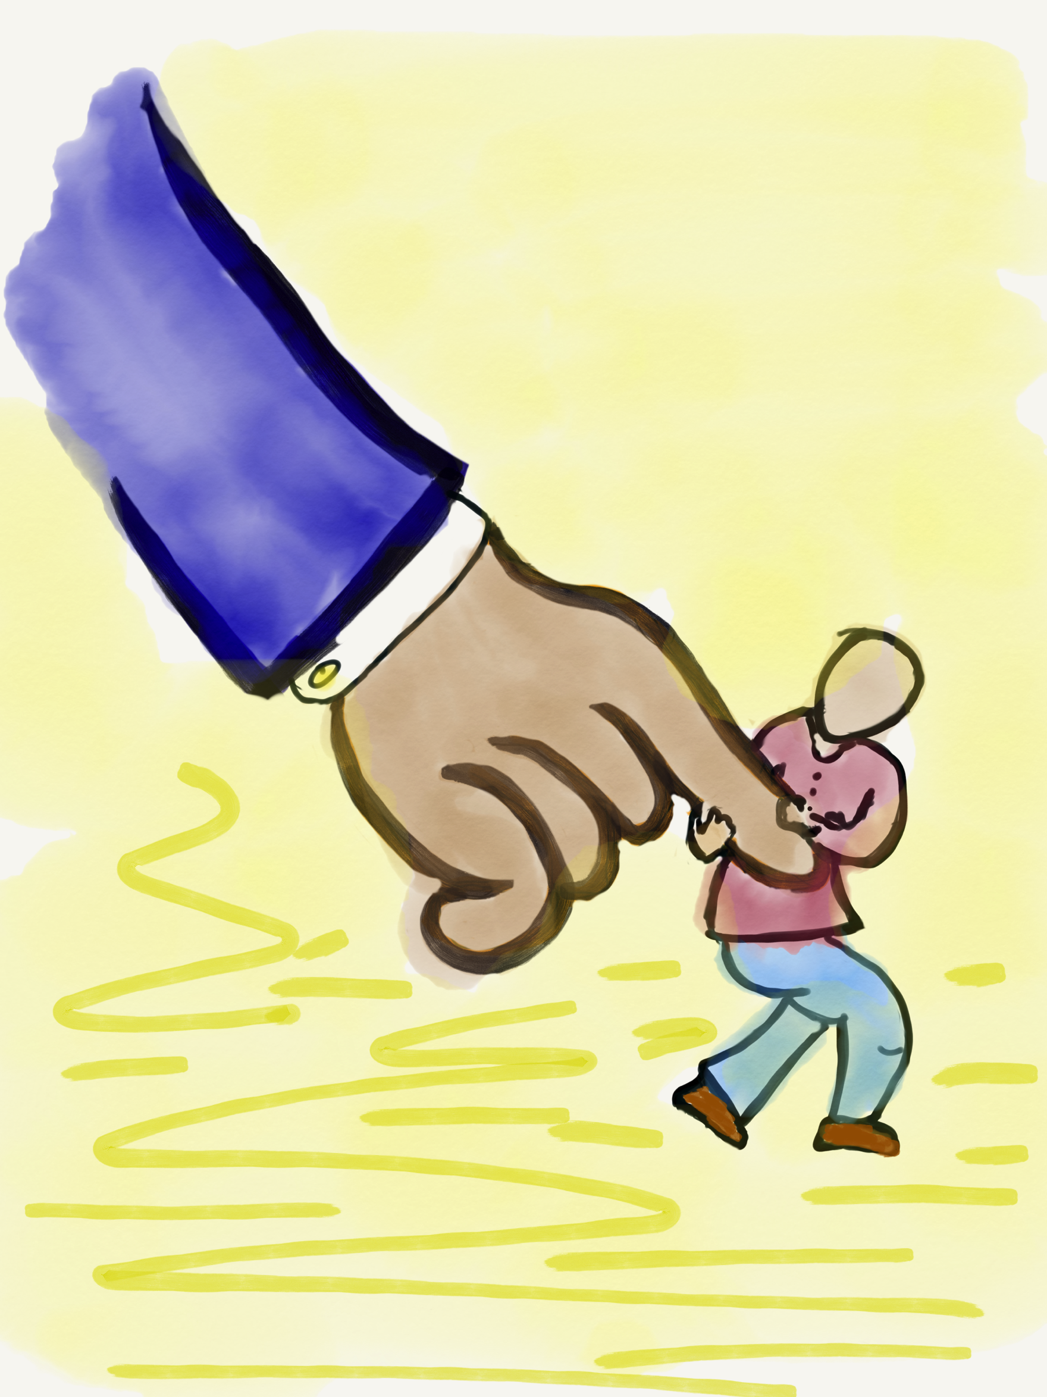
Lead

Slide 38
Leading Together…
Vimeo:
https://vimeo.com/qisva/together
or
YouTube:
https://youtu.be/RTvZCdUP7N4
Video

Slide 39

Reflect
What did you observe related to the term Lead in this video?

Slide 40
Lead
Use what you have heard & learned to drive meaningful change.
Leading is not a solo endeavor; take action in true partnership with others.
Created a shared sense of purpose.
Voice is not about getting your own way.
You can’t please everyone; but you can
demonstrate value & respect for all voices.

Slide 41


Slide 42

Values Auction
What do
you value?

Slide 43
Preparing for the
Values Auction
Your team gets $2,000!!!
Explore the Values Cards & determine your
strategy for the auction. What items do you
most want to purchase for your
school/students? How much are you
willing to spend on what?
Courage
Creativity
Empathy
Equality
Freedom
Generosity
Gratitude
Honesty
Love
Security
Trust
Wisdom

Slide 44
Auction
Time!!
Courage
Creativity
Empathy
Equality
Freedom
Generosity
Gratitude
Honesty
Love
Security
Trust
Wisdom

Slide 45
Reflect
Why are values important to
consider when leading?
How do you go about leading when differing values
& ideas exist?
(in your professional context)

Slide 46
Reflect
What values are most important to you as a team?
How will those values guide
you in leading at MSF?

Slide 47
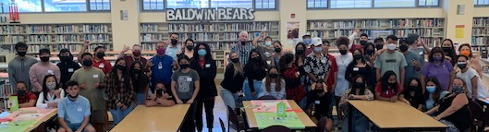
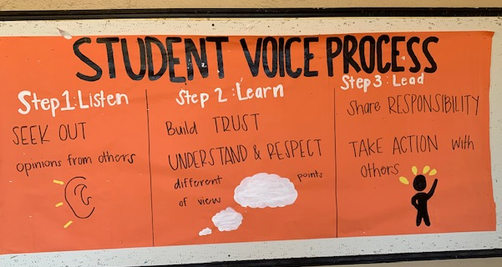
Shared Ownership with Students
Baldwin High School
Maui, Hawaii
Notes:
The top picture is a bulletin board created by students at the entrance of Baldwin High School in Maui, Hawaii that serves as a visual reminder to all students of their schoolwide commitment to live out the 3 parts of the Voice Process as part of their “way of being” at Baldwin. The bottom picture is just one example of that commitment jumping off of the bulleting board into action as randomly selected groups of students come together each year to analyze data side by side adults at the school so they listen to and learn from one another, and then create action plans for continually improving the school in partnership with one another.

Slide 48
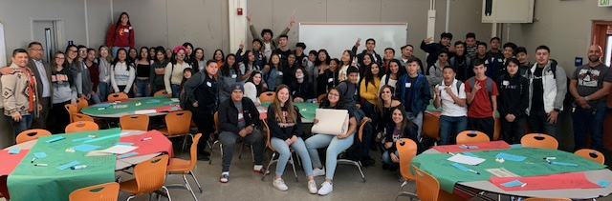
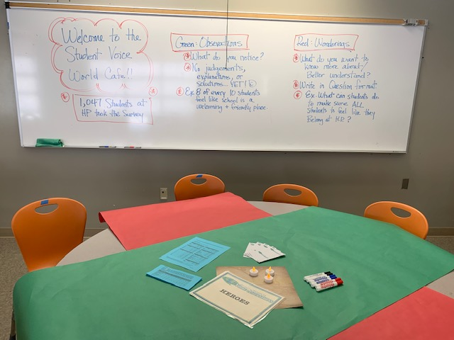
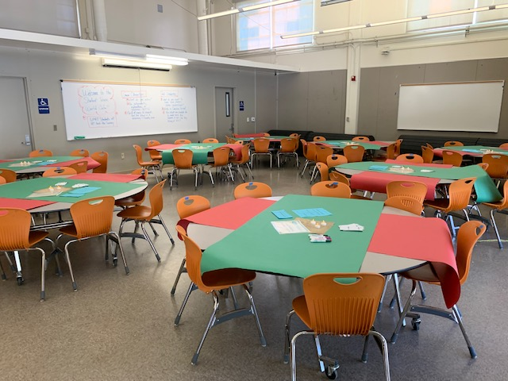
Data Analysis WITH Students
Huntington Park High School, LAUSD
Notes:
World Cafe

Slide 49
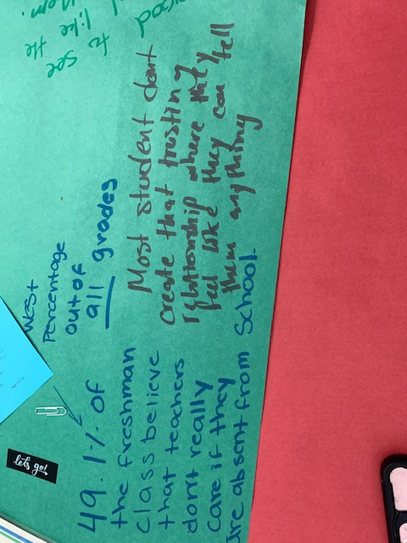
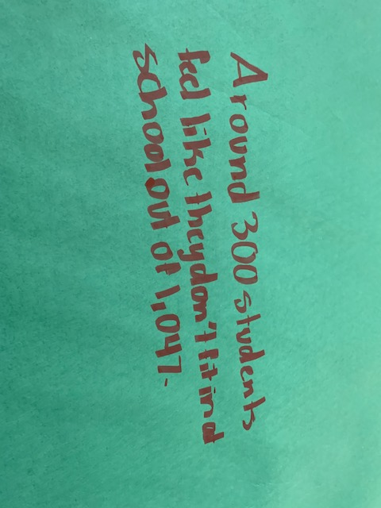
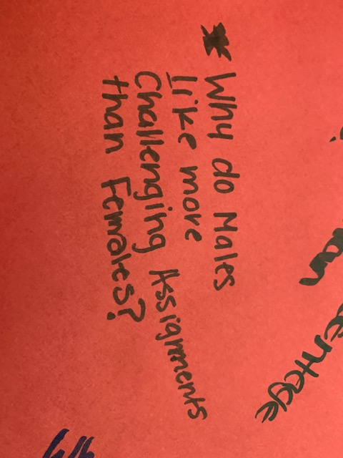
Huntington Park High School, LAUSD

Slide 50
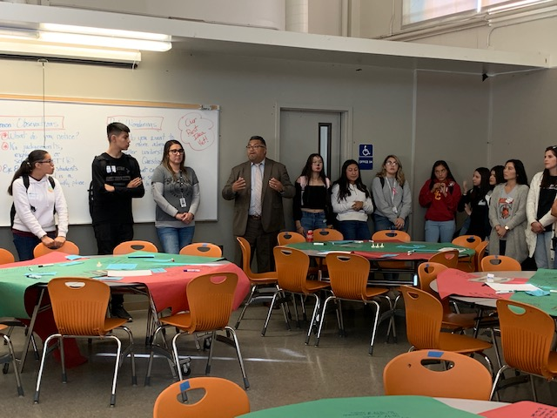
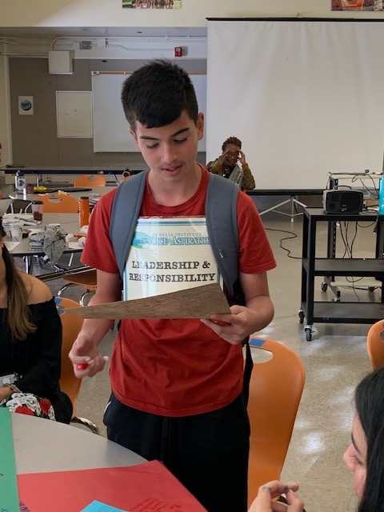
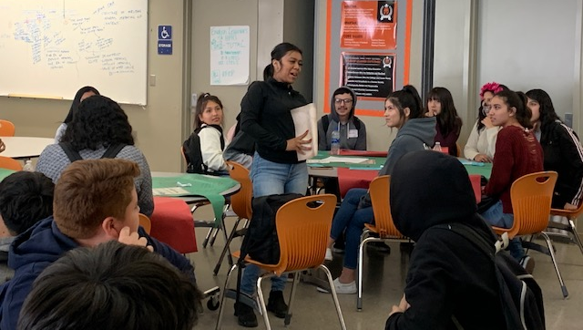
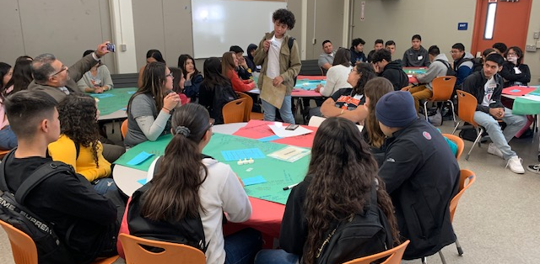
Huntington Park High School, LAUSD

Slide 51
LLL in Action!
Vimeo: vimeo.com/qisva/sutter
YouTube:
https://youtu.be/_kwkyzH
Sutter Middle School, LAUSD

Slide 52
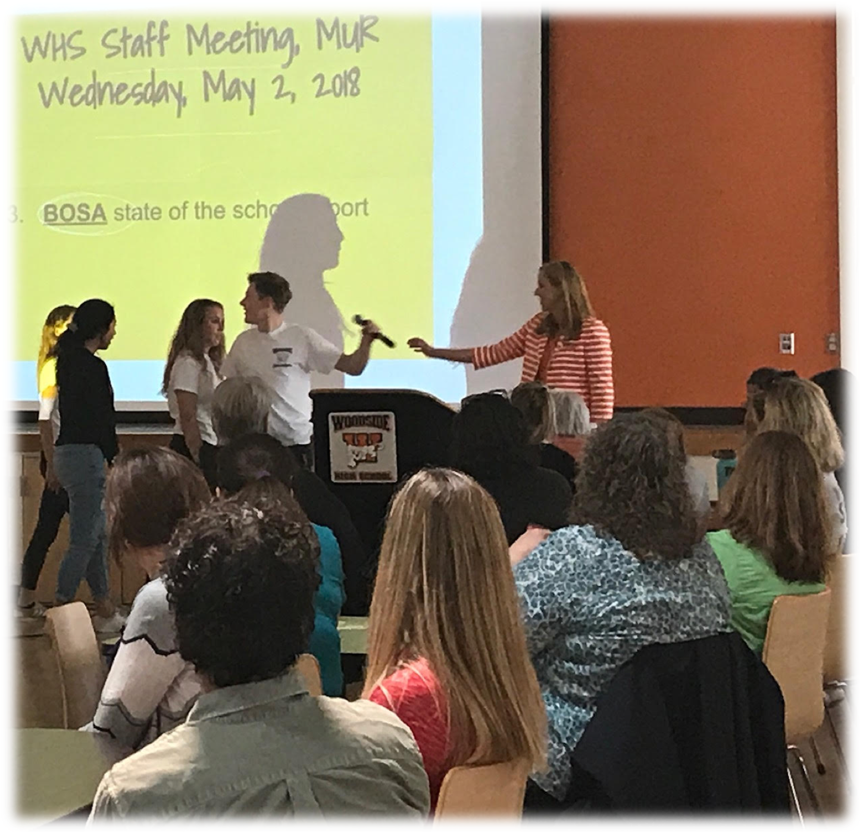
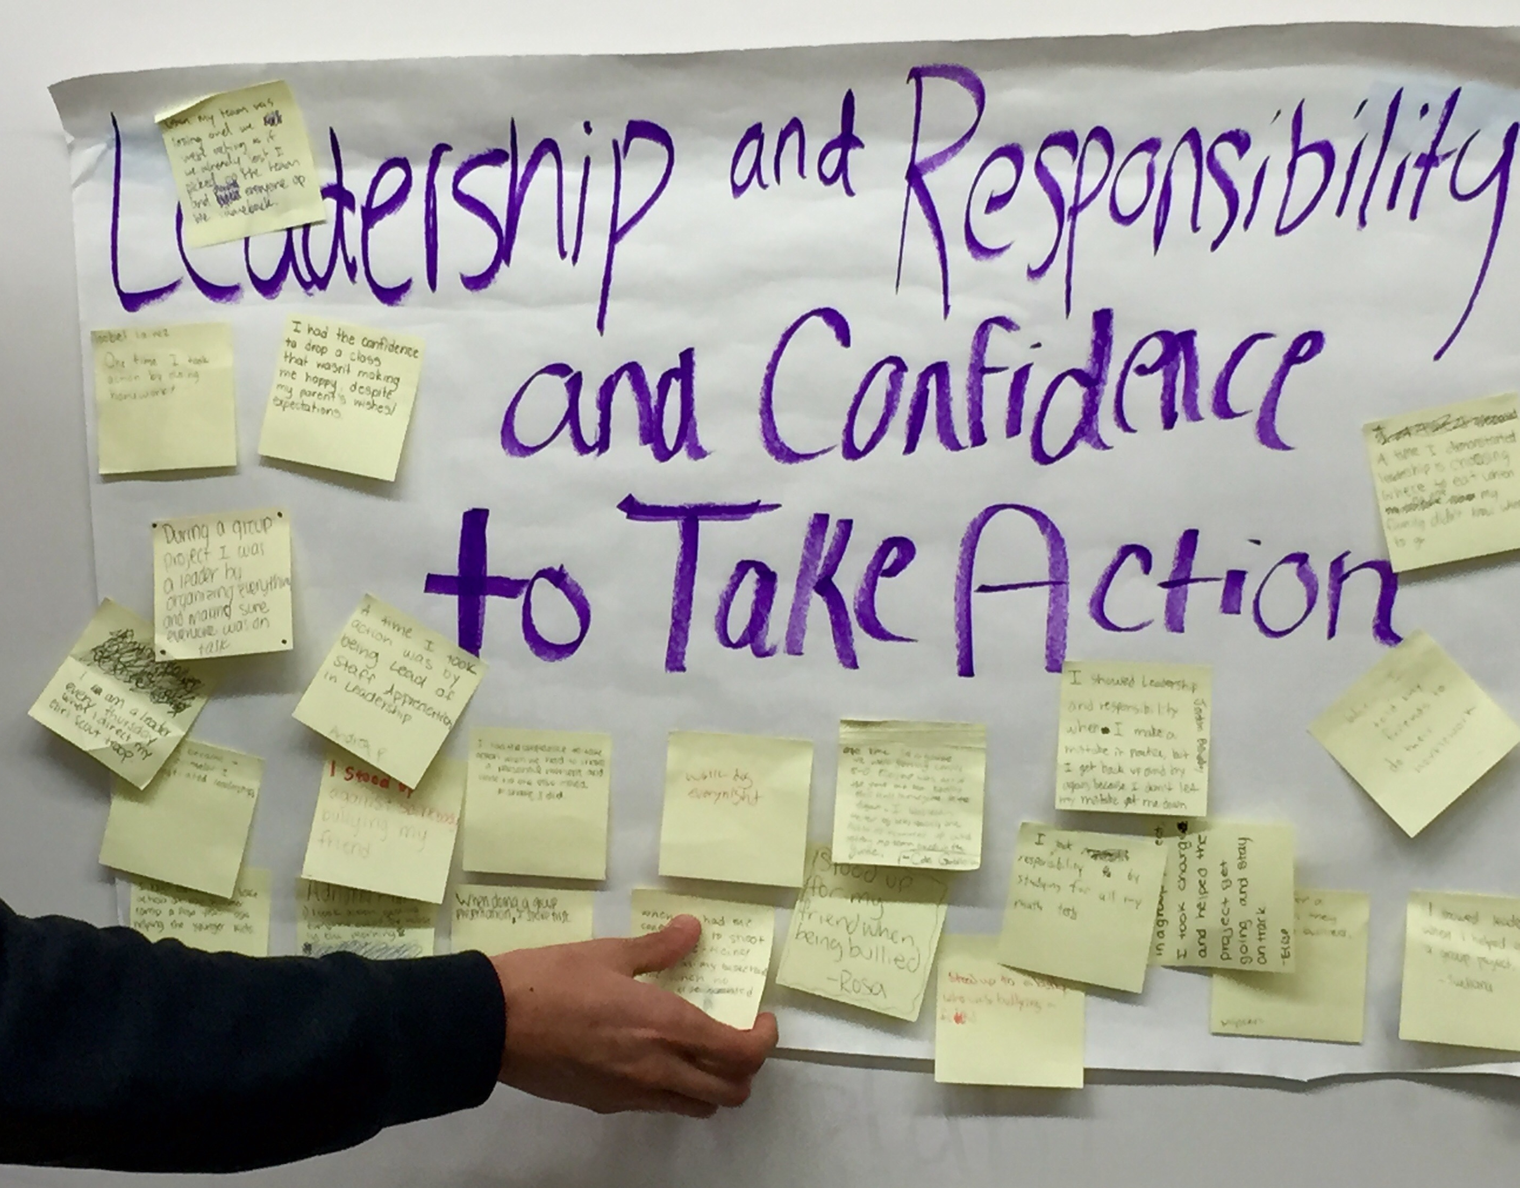
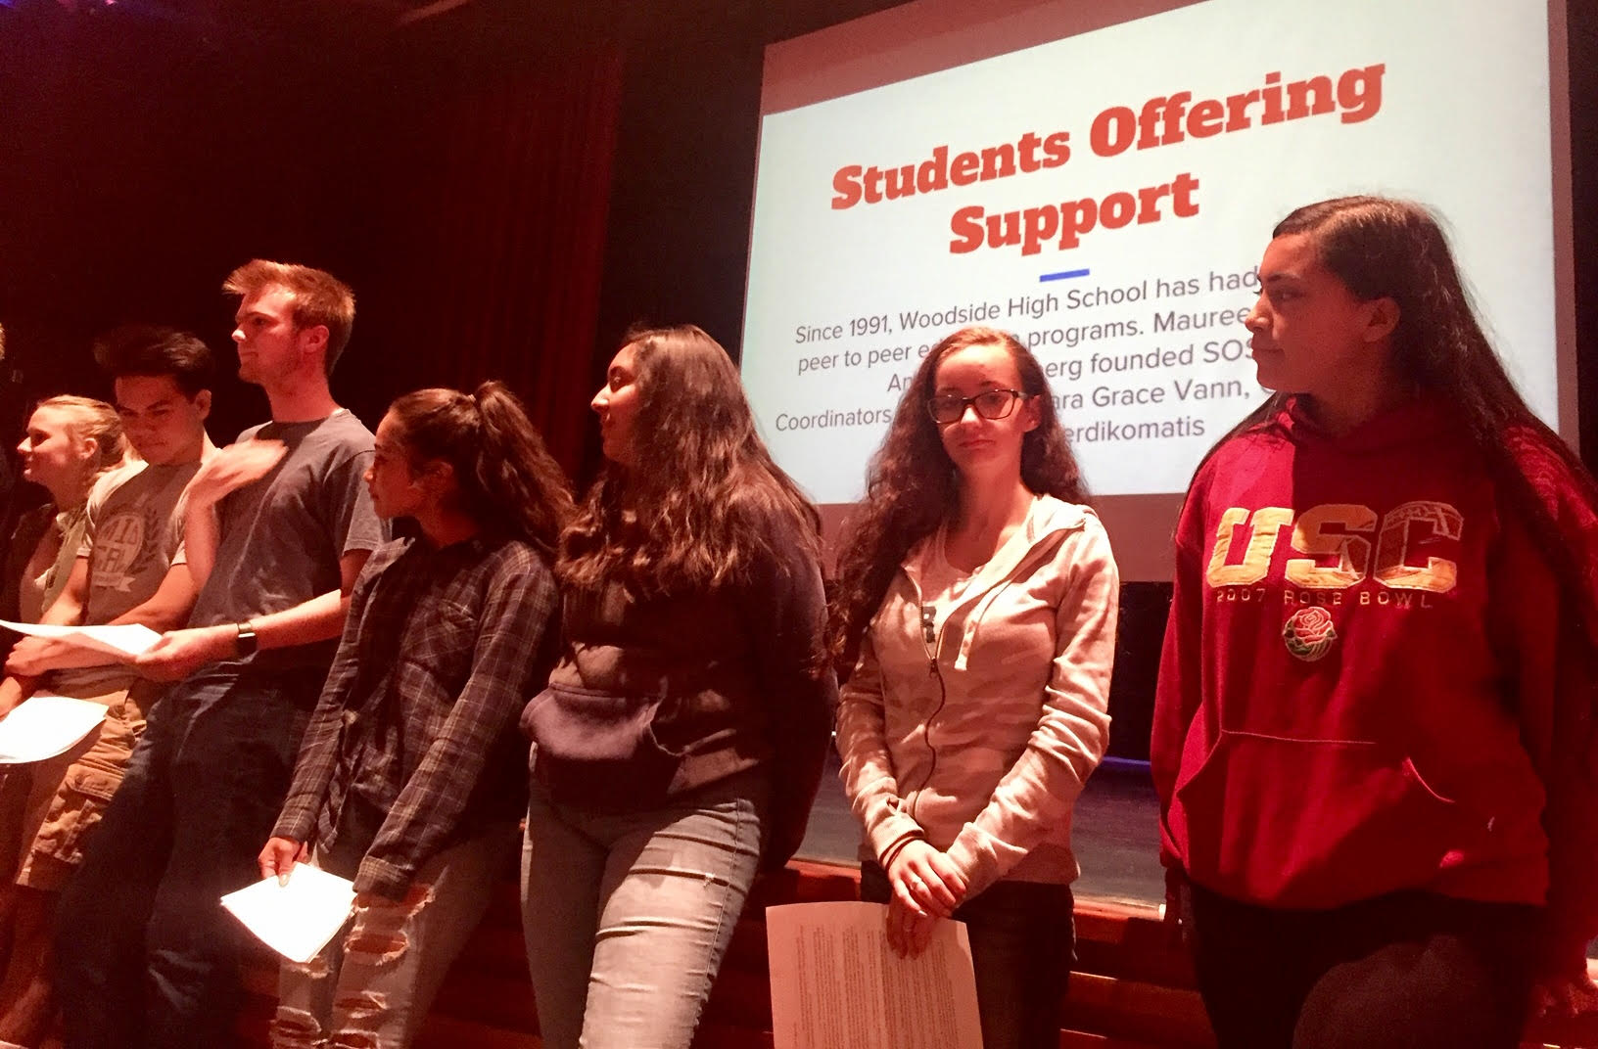
Students as Partners in Professional Learning
Woodside High School, Redwood City USD

Slide 53
Reflect
What things are currently
owned only by adults in your
school that students could be
invited to co-own with you?

Slide 54
LLL Summarized
Vimeo:
https://vimeo.com/qisva/louie
YouTube:
https://youtu.be/1Ebg4If1r7A
BCE, Brisane, Australia

Slide 55
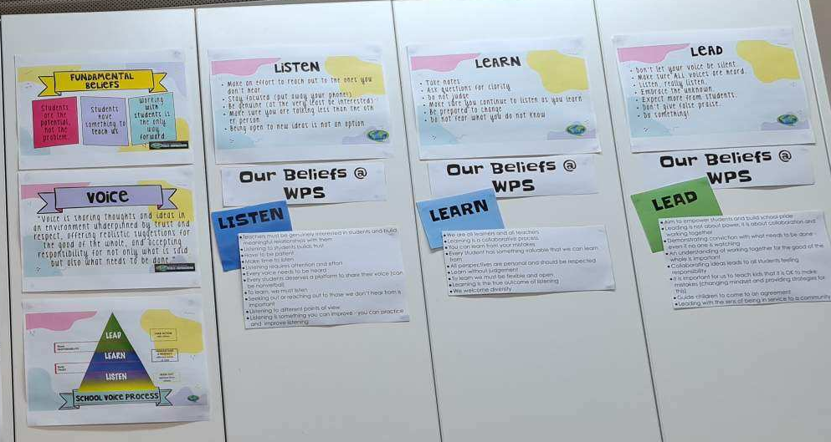
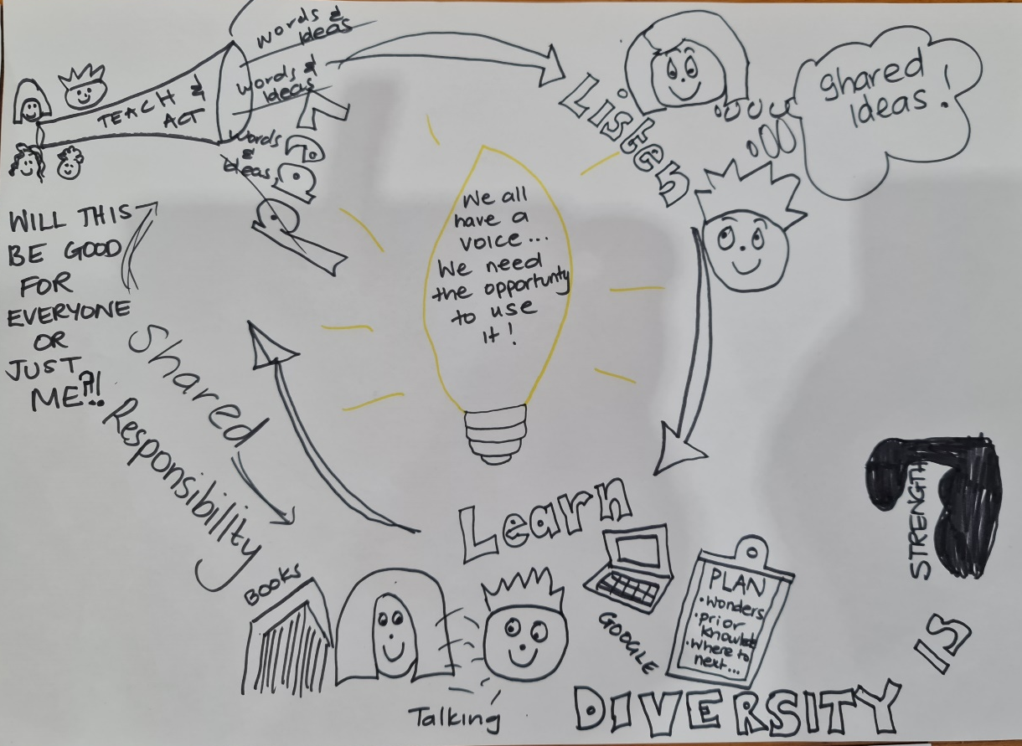
Creating Context for LLL
Winchelsea School, Victoria, Australia

Slide 56
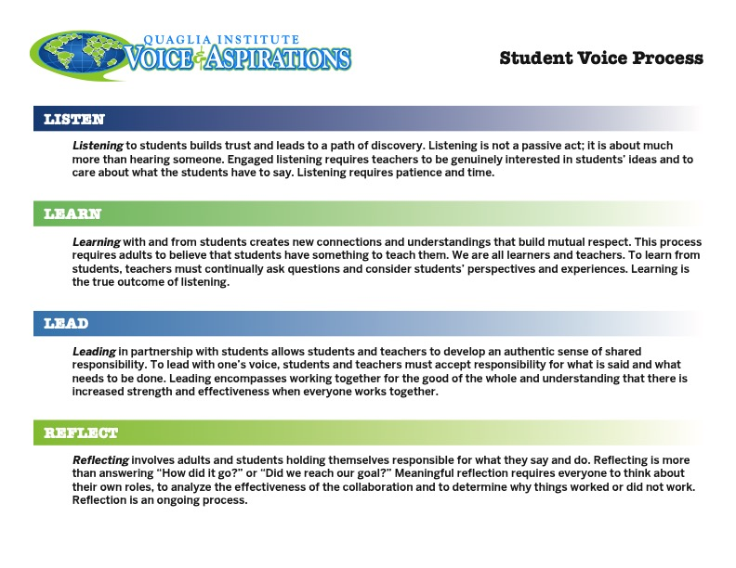
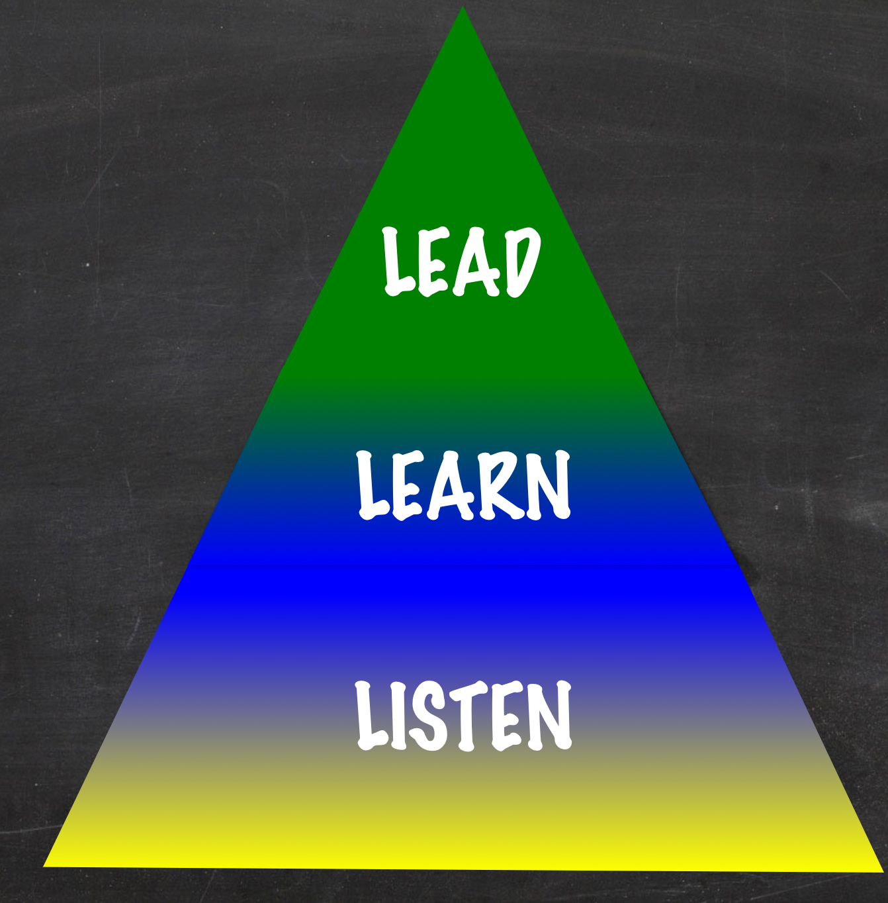
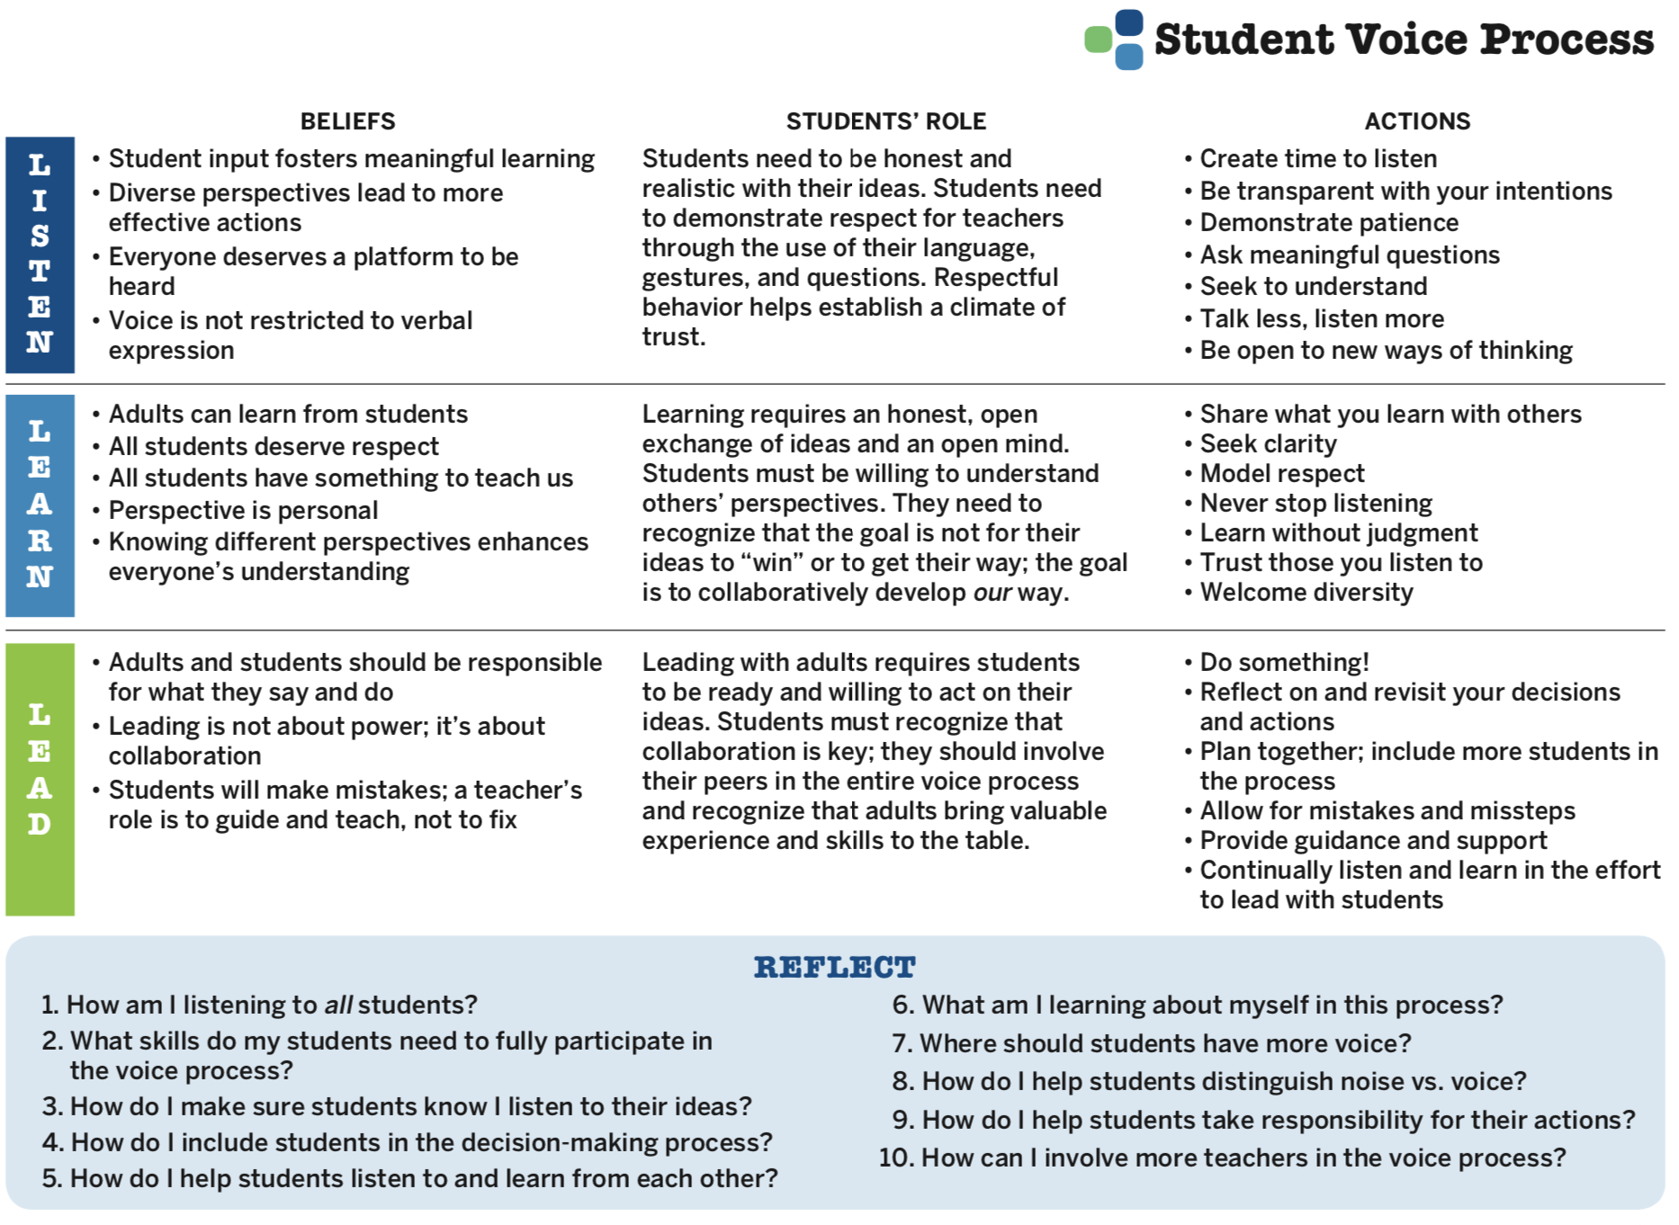

Voice Process Tool
Notes:
Given as a take away

Slide 57






Rolling Reflections
What is sticking with you from the Voice definition?
What is one action you can take based on what you learned today?
What was most interesting to you from the Listen, Learn, Lead model?
What key take away from this session will you share with a colleague?
What connections can you make to other goals & initiatives at MSF?
Wild Card! Share anything you want related to Student Voice!
Notes:
Did not have time to do this.

Slide 58

Website Just For YOU!
https://quagliainstitute.org/msf

Slide 59
Thank you for the opportunity to learn together today!
Dr. Lisa Lande
lande@quagliainstitute.org
@Lisa_Lande

