Slide 1


The Power of My Voice as an Assistant Principal
July 11, 2024
Dr. Russ Quaglia & Dr. Lisa Lande

Slide 2

Non-Icebreaker Icebreaker

Slide 3
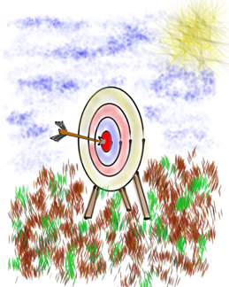
Goals for Session
Explore the concepts of Voice & Aspirations through the Vice Principal perspective.
Consider how to use your voice as a
Vice Principal to foster an environment
of trust & respect
Apply learning to support & amplify your
own voice AND the voices of in YOUR school.

Slide 4
Fundamental Beliefs
Students are the potential, not the problem.
Students have something to teach us.
Working together is the only way forward.

Slide 5

Challenge Time…

Slide 6

Challenge
Voice Art
Part 1: As a table group, create a play-doh masterpiece that reflects Voice.
Part 2: Travel & Talk Field Trip to each table for a quick share about each masterpiece.

Slide 7

Why Student
Voice?

Slide 8
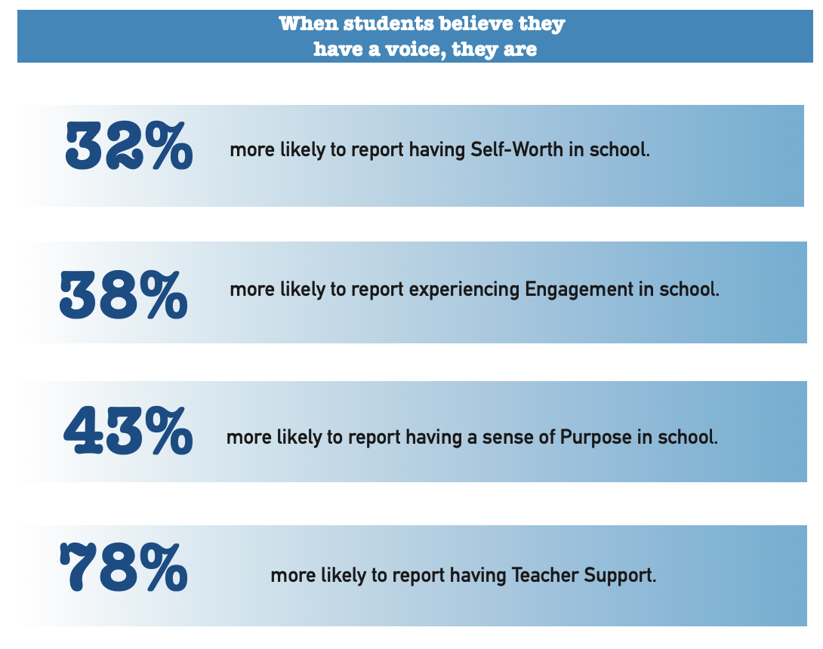

Slide 9

The 3 Components of Voice
Sharing thoughts & ideas in an environment underpinned by trust & respect.
Offering realistic suggestions for the
good of the whole.
Accepting responsibility for not only what is said but also what needs to be done.

Slide 10

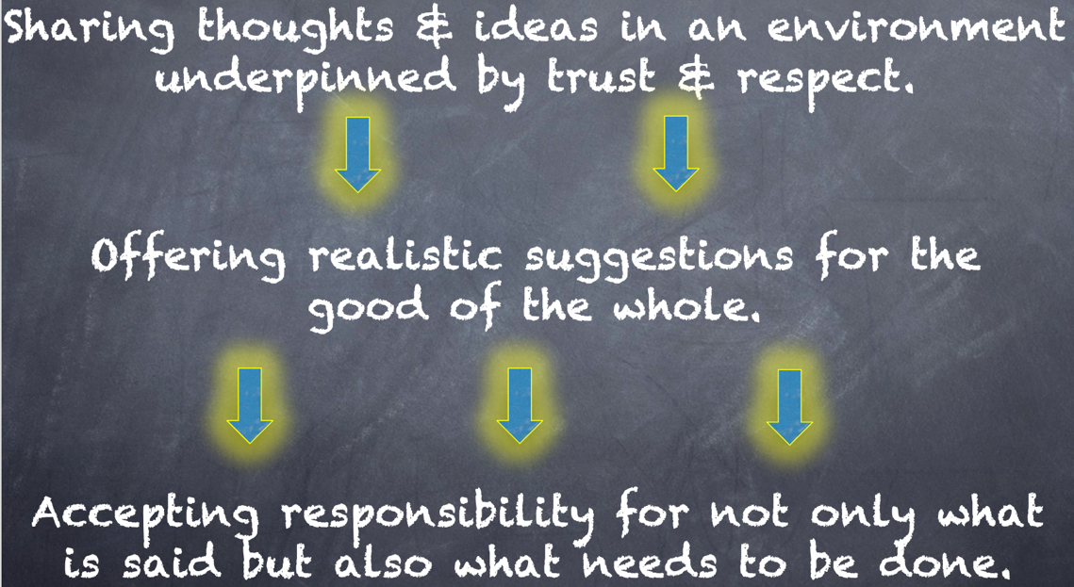
Meet With Your Feet
What resonates with you
from the Voice definition?

Slide 11

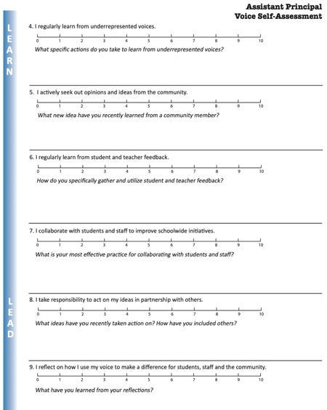
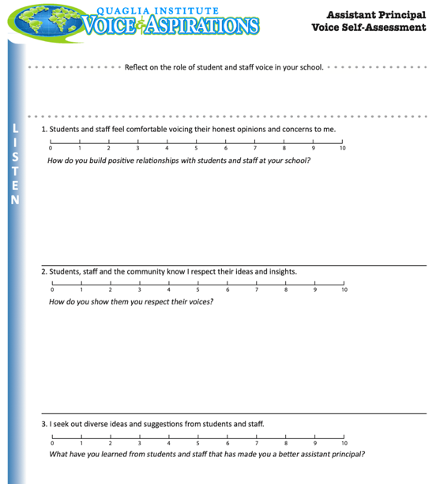
Assistant Principal
Voice Self-Assessment
What did you learn
about yourself?

Slide 12
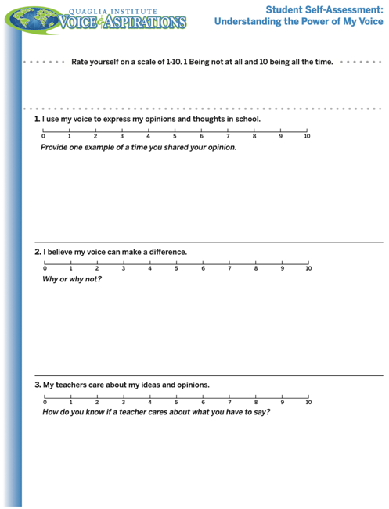
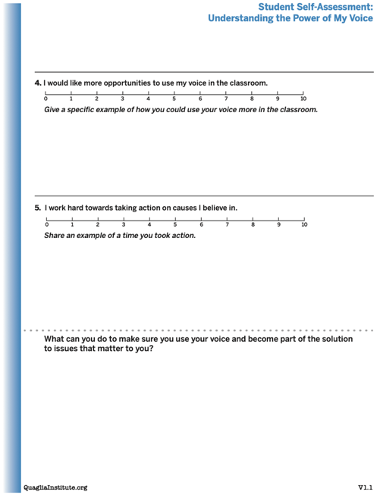
Understanding the Power of My
Voice Student Self Assessment
Consider having your students
complete this
“Understanding
the Power of
My Voice”
self-assessment.

Slide 13
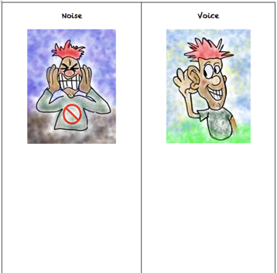
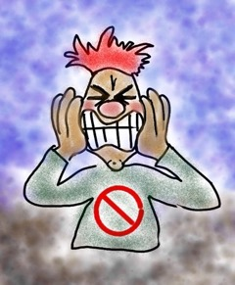
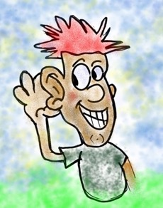
Noise vs. Voice
Share words, phrases, &
examples of
Noise.
Now share words, phrases, &
examples of
Voice.

Slide 14

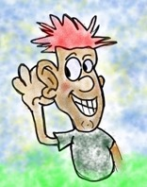
Noise vs Voice
Noise
Demanding/commanding/complaining
Believing your opinion is most important
Being closed to diverse ideas
Changing everyone but me
Listening to only my “go to” voices
Voice
Requesting/inquiring/empathizing
Believing ideas are stronger in partnership
Being open to multiple perspectives
Accepting responsibility
Actively seeking feedback from all

Slide 15
Challenge Time…

Slide 16

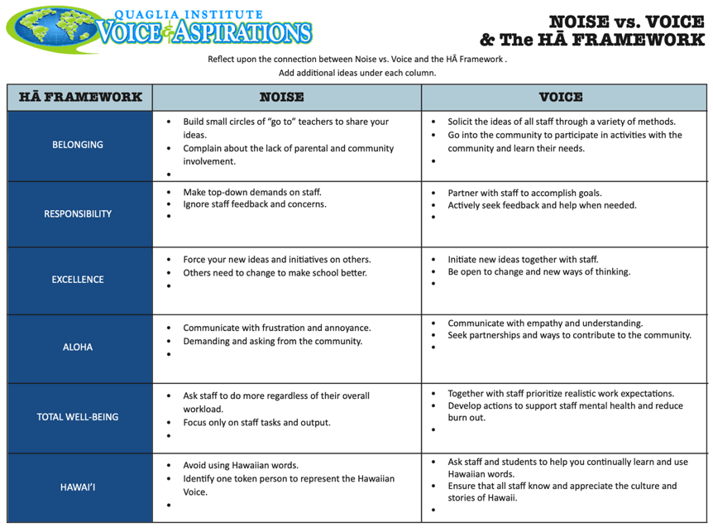
Challenge
Making Connections
As a table group, work through the resource connecting
Noise vs. Voice to the
HA Framework

Slide 17
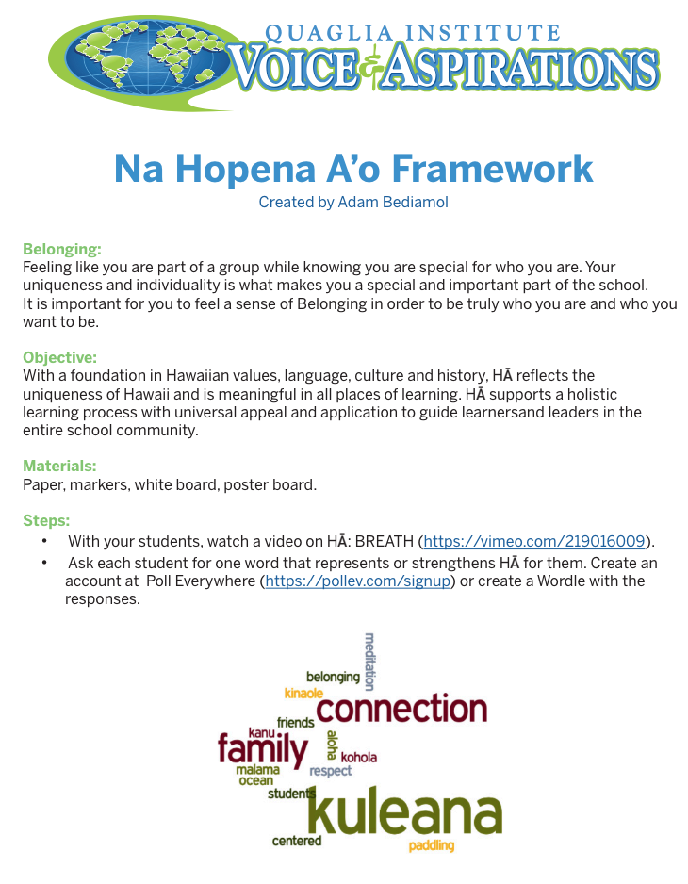
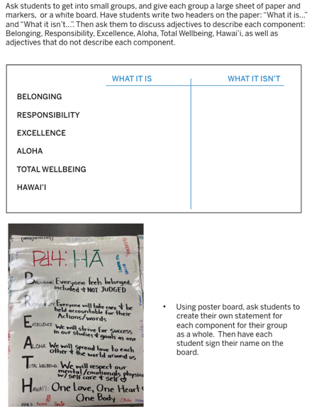
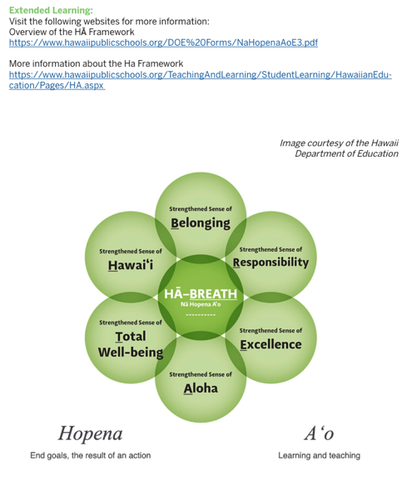
HA & Voice
Lesson Plan

Slide 18
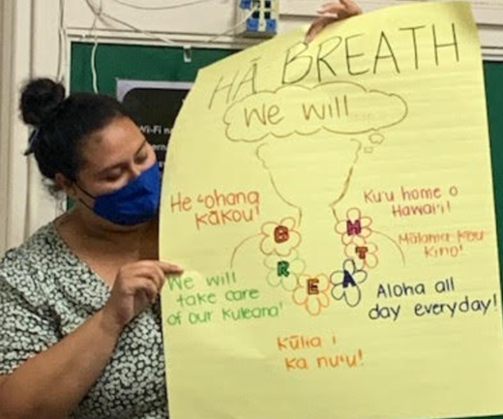
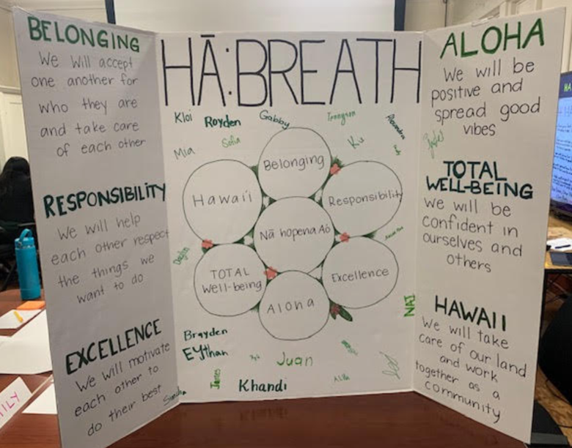
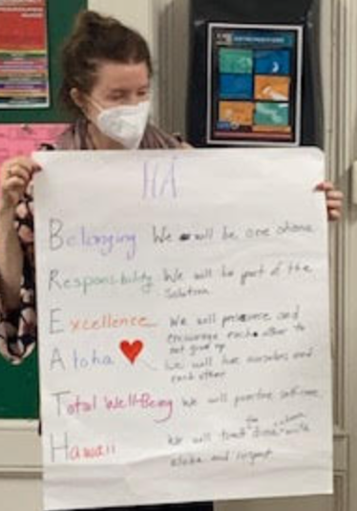
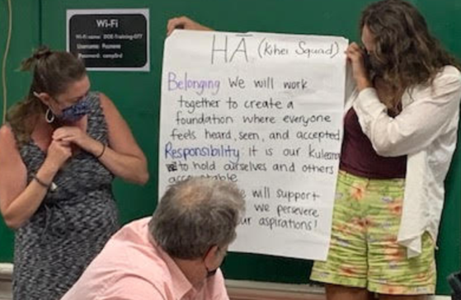

Slide 19
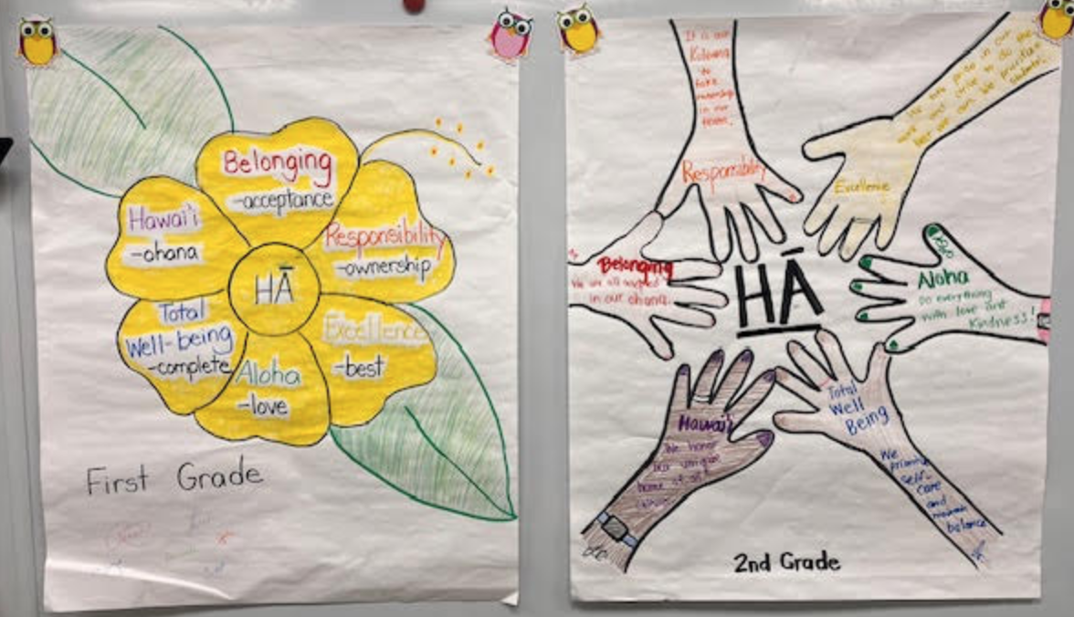

Slide 20
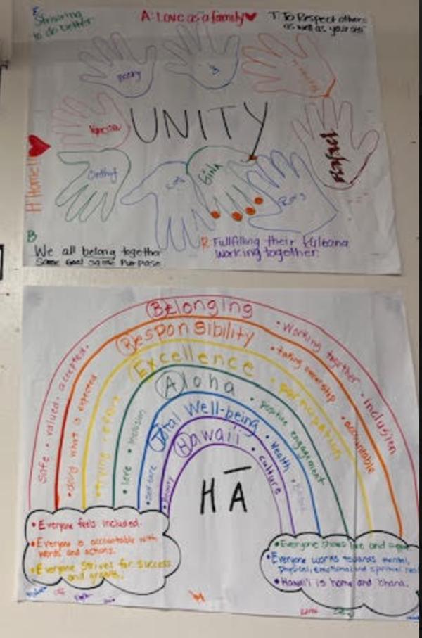
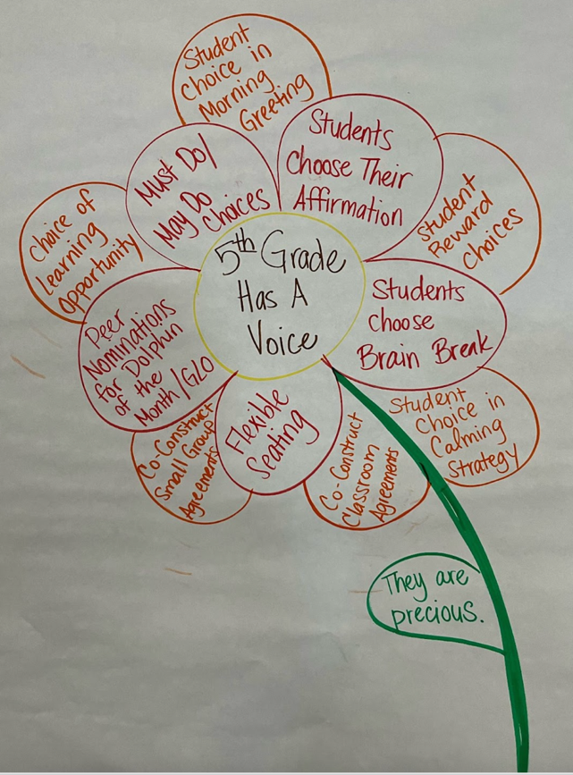

Slide 21
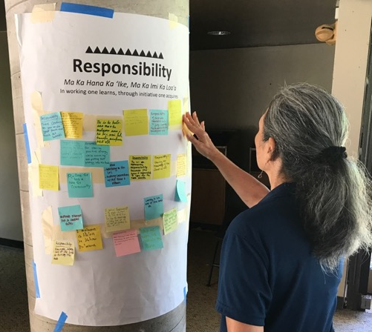
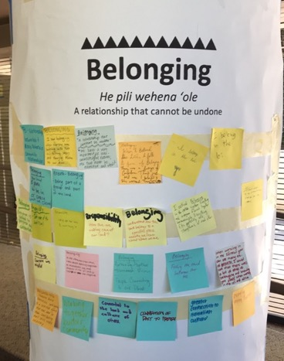
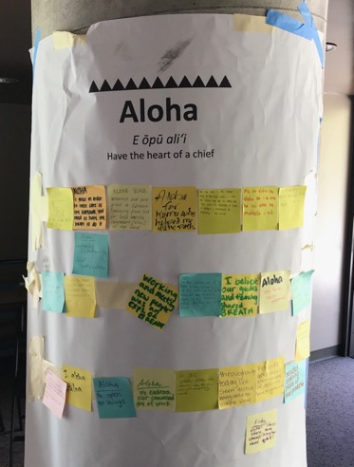
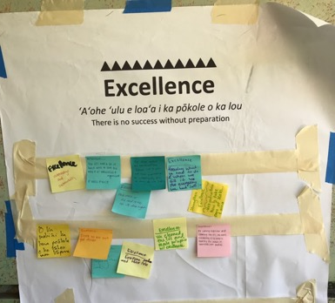
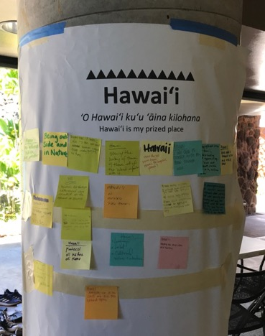
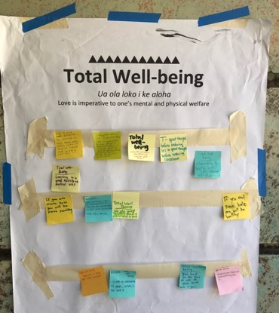

Slide 22

Voice in Action
YouTube:
https://youtu.be/Samh7f1Jlk0
Vimeo:
https://vimeo.com/985907591
Kula Elementary

Slide 23
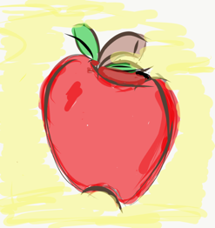
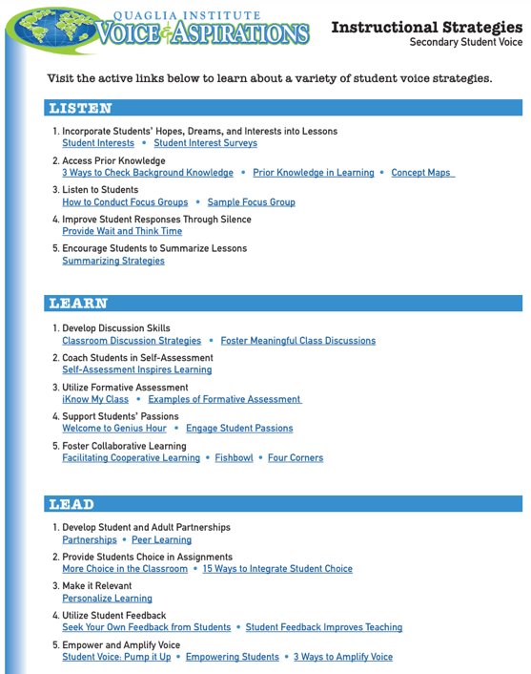
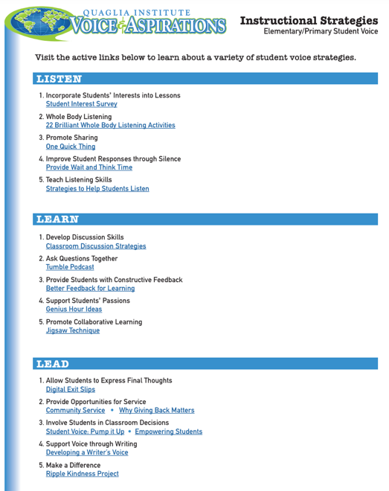
Voice Instructional Strategies

Slide 24
ASPIRATIONS
The ability to
dream & set goals
for the future,
while being inspired
in the present
to reach those dreams.

Slide 25




high
Imagination
Aspirations
DREAMING
Hibernation
Perspiration
low
DOING
high

Slide 26

Challenge Time!
Aspirations Profile
4-Corners of Reflection

Slide 27

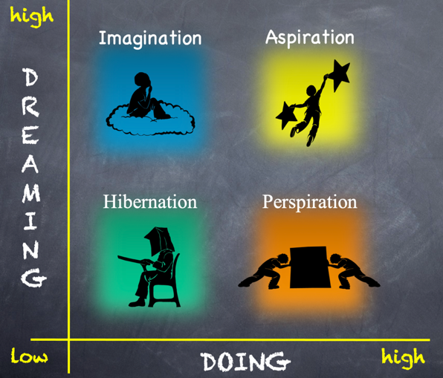
Reflect
Go to the quadrant where you spent most of your time as a student.
Break into groups of 2-3 & share why!
What would have helped you maintain a healthy balance of dreaming & doing?

Slide 28
Reflect
Rotate one corner clockwise.
What types of things do individuals in this quadrant say/do?

Slide 29
Reflect
Rotate one corner clockwise.
What questions can you ask individuals in this quadrant to learn from their perspective?

Slide 30
Reflect
Rotate one corner clockwise.
What types of actions can you take as an Assistant Principal to support individuals in this quadrant?

Slide 31
high
Imagination
Aspiration
DREAMING
4-Corners
Debrief
What did you
learn about
the Aspirations
Profile?
Hibernation
Perspiration
low
DOING
high

Slide 32


Slide 33

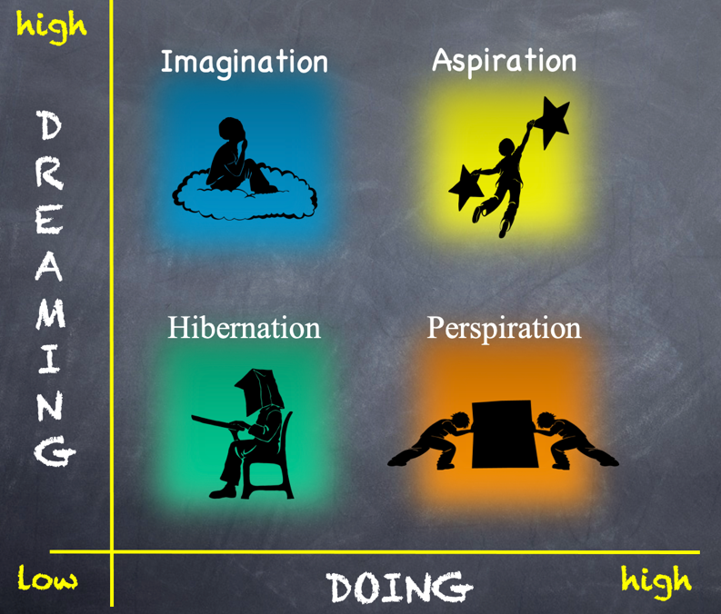
Time to Dig Deeper!

Slide 34
high
DREAMING
Hibernation
low
DOING
high

Slide 35

Students in Hibernation
Potential Cons:
Passive & unmotivated
Poor self-esteem &
defeatist attitude
Struggle to take
responsibility for
anything
Potential Pros:
Time to reflect
Space to recharge
They report:
Feeling isolated
Stuck
Misunderstood
Bored
They need to:
Feel valued
Be recognized for success
Have positive role models
Have a sense of purpose

Slide 36
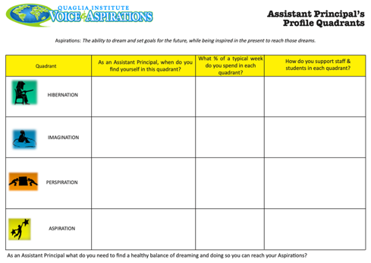
Reflect
Aspirations Quadrants
for Assistant Principals
As a table group, work through the Hibernation section of this reflection resource, applying the Aspirations Quadrants to your role as an Assistant Principal.

Slide 37
high
Imagination
DREAMING
low
DOING
high

Slide 38

Students in Imagination
Potential Pros:
Enthusiastic
Fun to be around
Lots of creative ideas
Potential Cons:
Limited follow-through
Not well connected
to reality
Students report:
Having big dreams
Eagerness to explore
Craving creative outlets
They need to:
Develop action plans
Focus
Be realistic

Slide 39
Reflect
Aspirations Quadrants
for Assistant Principals
As a table group, work through the Imagination section of this reflection resource, applying the Aspirations Quadrants to your role as an Assistant Principal.

Slide 40
Challenge Time…

Slide 41
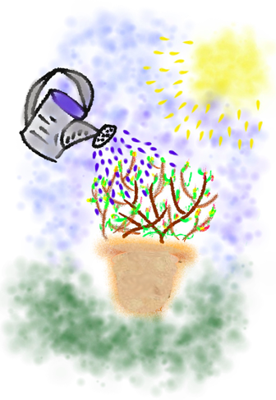
Challenge
Growing Voice
Paint & plant while discussing the following:
How are you going to continue cultivating your own voice as an Assistant Principal?
How are you going to support amplifying the voices of others at your school (staff & students)?

Slide 42
high
DREAMING
Perspiration
low
DOING
high

Slide 43

Students in Perspiration
Potential Pros:
Determined
Hard Working
Driven to Succeed
Potential Cons:
Overly concerned
about grades
Single-minded,
narrow-focused
Students report:
Feeling stressed
Not sure “why” they are learning, but need
good grades
Don’t want to let
anyone down
They need to:
Have a greater purpose for learning
Balance school work with outside life
Link learning to
their passions

Slide 44
Reflect
Aspirations Quadrants
for Assistant Principals
As a table group, work through the Perspiration section of this reflection resource, applying the Aspirations Quadrants to your role as an Assistant Principal.

Slide 45
high
Aspirations
DREAMING
low
DOING
high

Slide 46

Students in Aspiration
Potential Pros:
Connects present
actions to future
dreams
Good idea of
potential options
Potential Cons:
Relaxation is Challenging
Under constant pressure
Self-Serving
Students report:
Never feeling
satisfied
Driven by being best
Frustration with peers
who don’t try or who
interrupt learning
They need to:
Be assured they
are on a positive track
Experience meaningful academic challenges
Breathe!

Slide 47
Reflect
Aspirations Quadrants
for Assistant Principals
As a table group, work through the Aspiration section of this reflection resource, applying the Aspirations Quadrants to your role as an Assistant Principal.

Slide 48

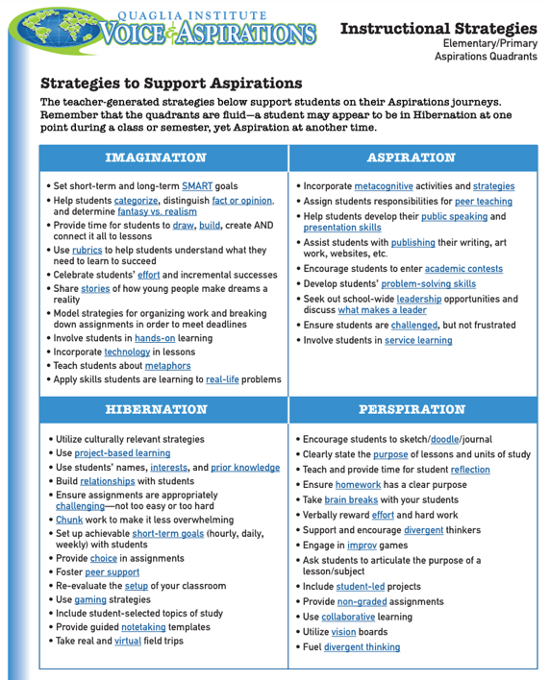
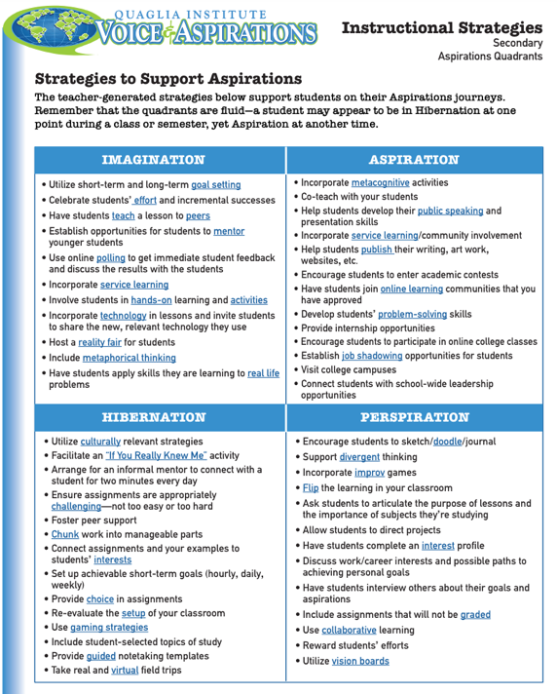
Aspirations Quadrants Instructional Strategies

Slide 49






Rolling Reflections
What is sticking with you from the Voice definition?
What is one action you can take based on what you learned today?
What was most interesting to you about the Aspirations Profile?
What key take away from this session will you share with a colleague?
What connections can you make to other goals & initiatives at your school?
Wild Card! Share anything you want related to Student Voice & Aspirations!
Notes:
Did not have time to do this.

Slide 50

Closing Thoughts
from Dr. Russ!

Slide 51
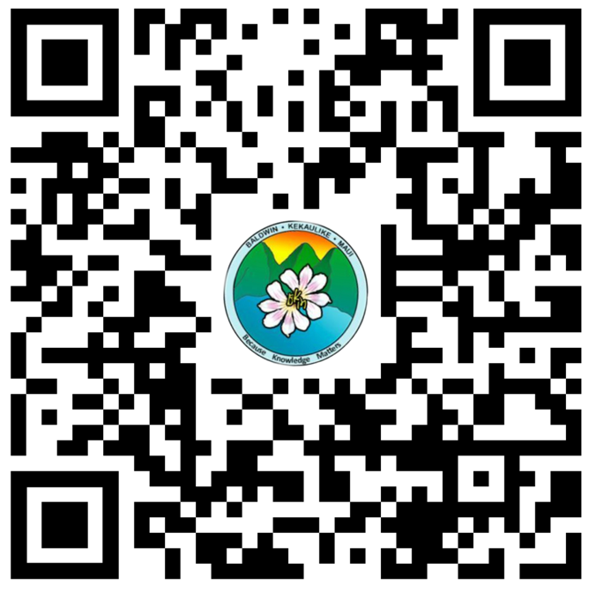
Website Just For YOU!
https://quagliainstitute.org/voice-ap

Slide 52

Thank you for learning with us! Reach out with any questions or to continue
the conversation!
Dr. Russ Quaglia
Quaglia@QuagliaInstitute.org
Dr. Lisa Lande
Lande@QuagliaInstitute.org
www.quagliainstitute.org
@QISVAtweets

