Slide 1


Student Voice & Aspirations
Maui Complex Vice Principals
June 26, 2025
The School Voice Process:
Listen, Learn, Lead
Dr. Russ Quaglia
& Dr. Lisa Lande
@QISVAtweets @Lisa_Lande
quagliainstitute.org

Slide 2


Slide 3
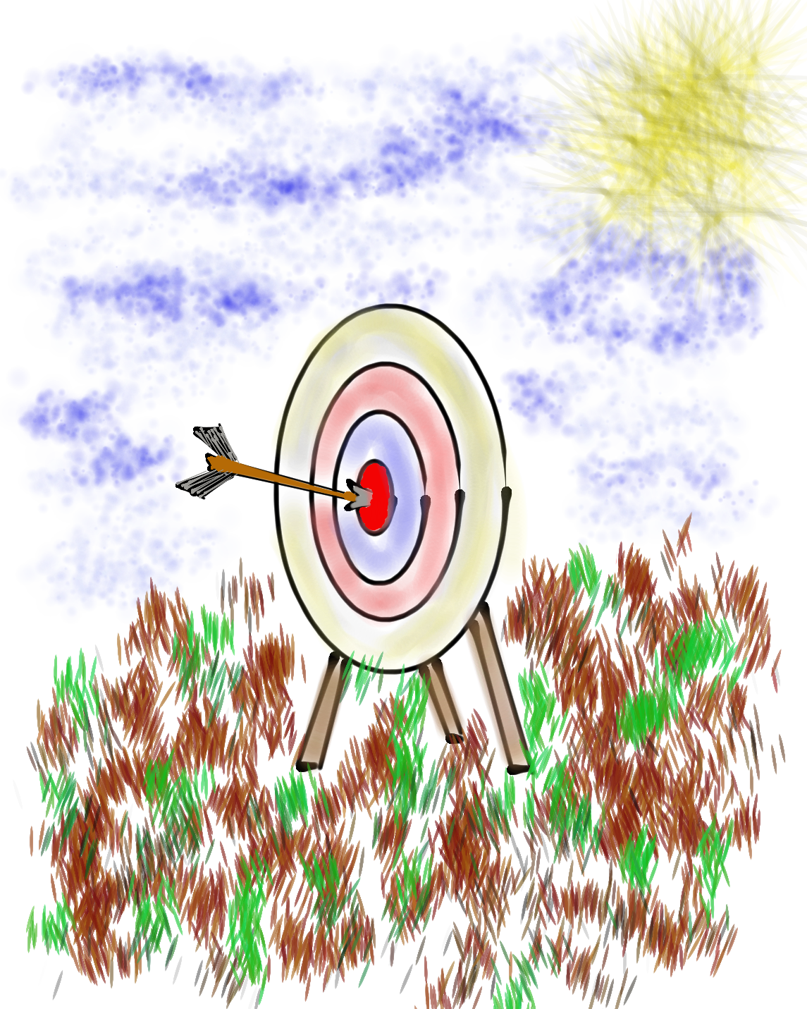
Learning Intention
We are learning about the the School Voice Process & how it can support our efforts to amplify Student Voice & Aspirations.
Success Criteria
Discover the components & nuances of the School Voice Process: Listen, Learn, Lead.
Consider how the School Voice Process can contribute
to fostering a positive school culture & an effective
learning environment.
Apply what has been learned about the School Voice
Process to efforts at your school to amplify Student
Voice & support all students in reaching their
fullest potential.

Slide 4
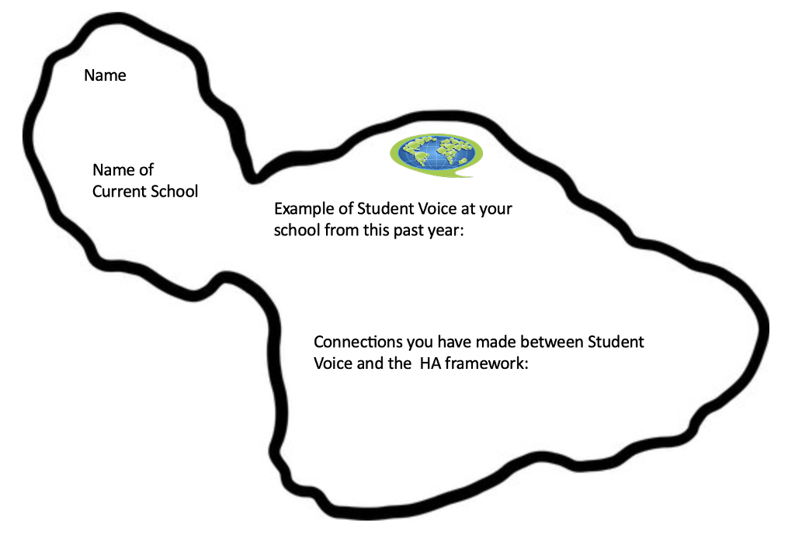
Non-Icebreaker Icebreaker

Slide 5
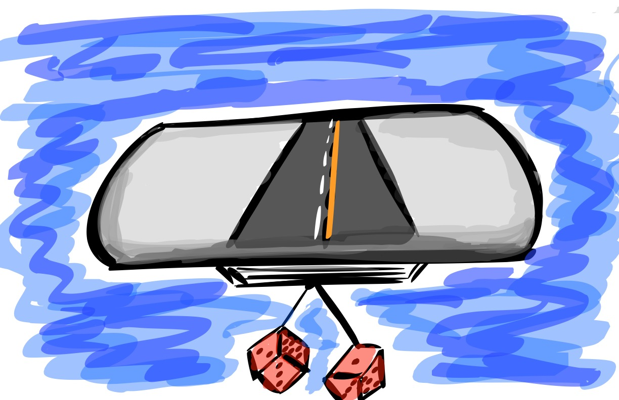
Quick Review

Slide 6

The 3 Components of Student Voice
Sharing thoughts & ideas in an environment underpinned by trust & respect.
Offering realistic suggestions for the
good of the whole.
Accepting responsibility for not only what is said but also what needs to be done.

Slide 7
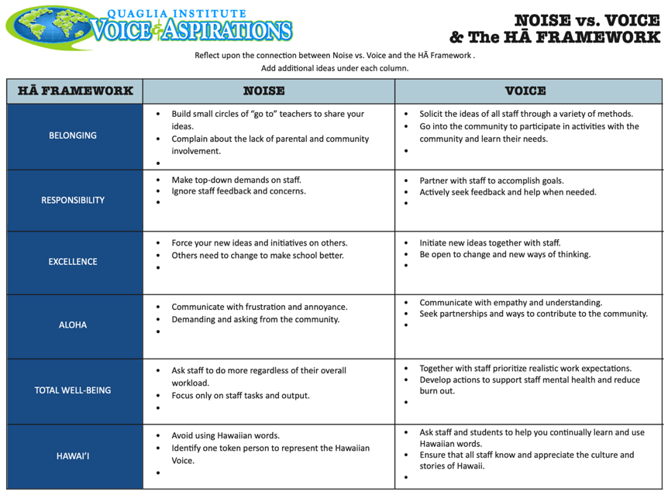

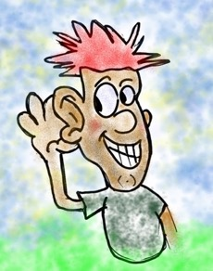
Noise vs. Voice

Slide 8
ASPIRATIONS
The ability to
dream & set goals
for the future,
while being inspired
in the present
to reach those dreams.

Slide 9




high
Imagination
Aspiration
DREAMING
Hibernation
Perspiration
low
DOING
high

Slide 10
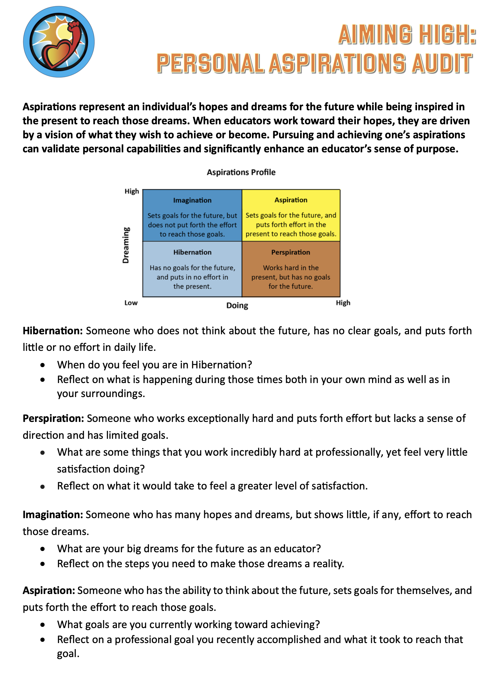

Time to further explore & reflect on Aspirations in connection with your Purpose as a Vice Principal.

Slide 11
Pinwheel Discussions
Get into pinwheel groups of 8.
With your first partner, discuss the
reflection questions for Hibernation.
When the wind blows, the outside of the
pinwheel moves one person clockwise.
Discuss the reflection questions
for Perspiration.
When the wind blows, repeat & discuss
the reflection questions for Imagination
& Aspirations.

Slide 12

Quick Break!

Slide 13

Time to journey
onward & explore
the Student Voice Process

Slide 14
LEAD
TAKE ACTION
with others
Share
RESPONSIBILITY
LEARN
UNDERSTAND
& RESPECT
different points
of view
Build
TRUST
LISTEN
SEEK OUT
opinions from
others
School Voice Process

Slide 15
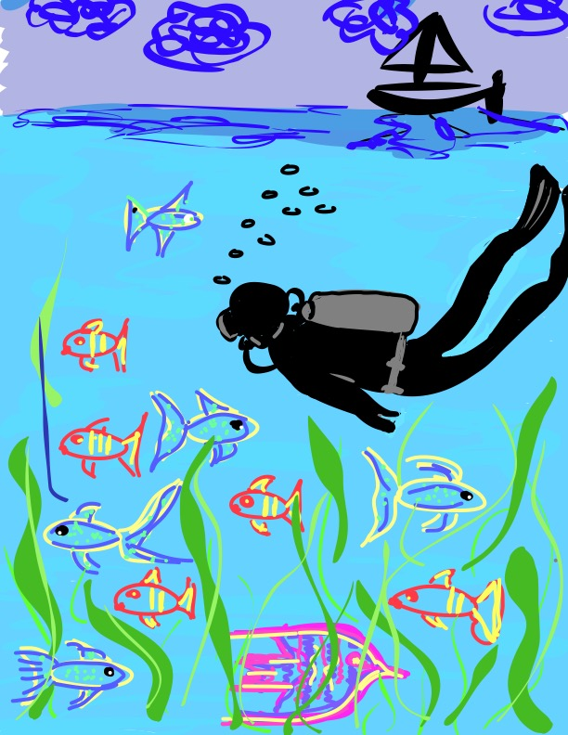
Let’s Dive Deeper…
Listen
Learn
Lead

Slide 16

Listen

Slide 17
The Art of Listening
Vimeo:
http://vimeo.com/qisva/listening
or
YouTube:
https://youtu.be/ooE9dKobjZU
Video

Slide 18

Challenge Time…

Slide 19


Challenge
Round 1: Find a partner &
assign one person to be the
Describer, & one person to
be the Artist. Sit back to back. Without looking or asking
questions, describe to your
partner how to replicate
your picture.
Round 2: Switch roles (Describer & Artist) & switch cards with someone nearby.
Repeat the activity, but this time you
can ask clarifying questions. Still sit
back to back & no looking! ☺

Slide 20
Listen
Reach out & listen to voices
you typically don’t hear from.
Stay focused. (put away your phone!)
Be genuine & truly interested.
Make sure you are talking less than
the other person.
Being open to new ideas is not an
option…it is a MUST!

Slide 21

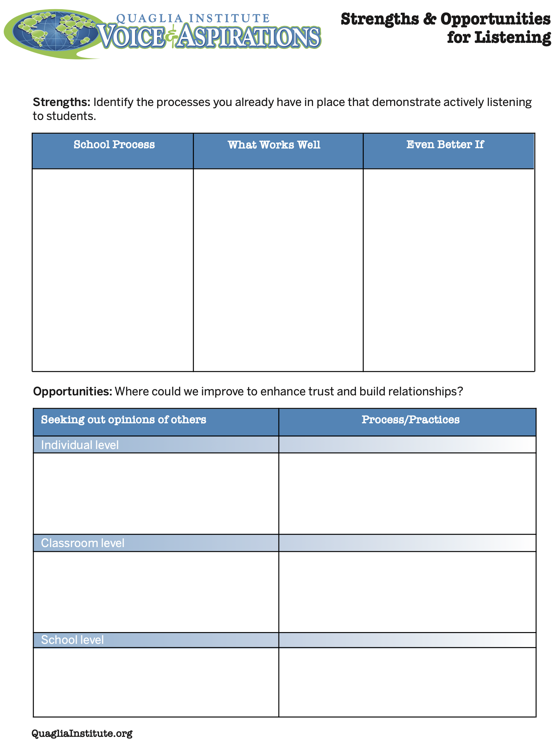
Reflect
What are your
strengths &
challenges when it
comes to
Listening to
students & staff?
How do you build trust & positive relationships?

Slide 22

Learn

Slide 23
Taking Time to Learn
Vimeo:
vimeo.com/qisva/time
or
YouTube:
https://youtu.be/tYKcvRfxK0o
Video

Slide 24
Challenge Time…

Slide 25
Challenge
Find the connection
between the 4
individual pictures.

Slide 26
Connections 1
Vimeo:
vimeo.com/qisva/connection1
or
YouTube:
https://youtu.be/Yl3JrRtyGHc
(all 9 slides)

Slide 27
Connections 2
Vimeo:
vimeo.com/qisva/connections2

Slide 28
Connections 3
Vimeo:
vimeo.com/qisva/connections3

Slide 29
Connections 4
Vimeo:
vimeo.com/qisva/connections4

Slide 30
Connections 5
Vimeo:
vimeo.com/qisva/connections5

Slide 31
Connections 6
Vimeo:
vimeo.com/qisva/connections6

Slide 32
Connections 7
Vimeo:
vimeo.com/qisva/connections7

Slide 33
Connections 8
Vimeo:
vimeo.com/qisva/connections8

Slide 34
Connections 9
Vimeo:
vimeo.com/qisva/connections9

Slide 35
Learn
Take notes.
Ask questions for clarity.
Do not judge, you can learn from anyone
regardless of age, position, or any factor.
Follow up & communicate what you
LEARNED from listening.
Be prepared to change.
Do not fear what you do not know.

Slide 36
Challenge Time…

Slide 37

Challenge Time!
Why Why Why?
Consider the scenario
provided to your table.
Write a list of possible reasons WHY behind your scenario.
Try to list as MANY reasons as you can in the provided time!

Slide 38

Reflect
Why do we jump to conclusions
& solutions so quickly?
How might the component of “learn” impact your school improvement efforts?

Slide 39


Slide 40


Resin-ate Your Voice:
Art Time with Dr. Russ!

Slide 41
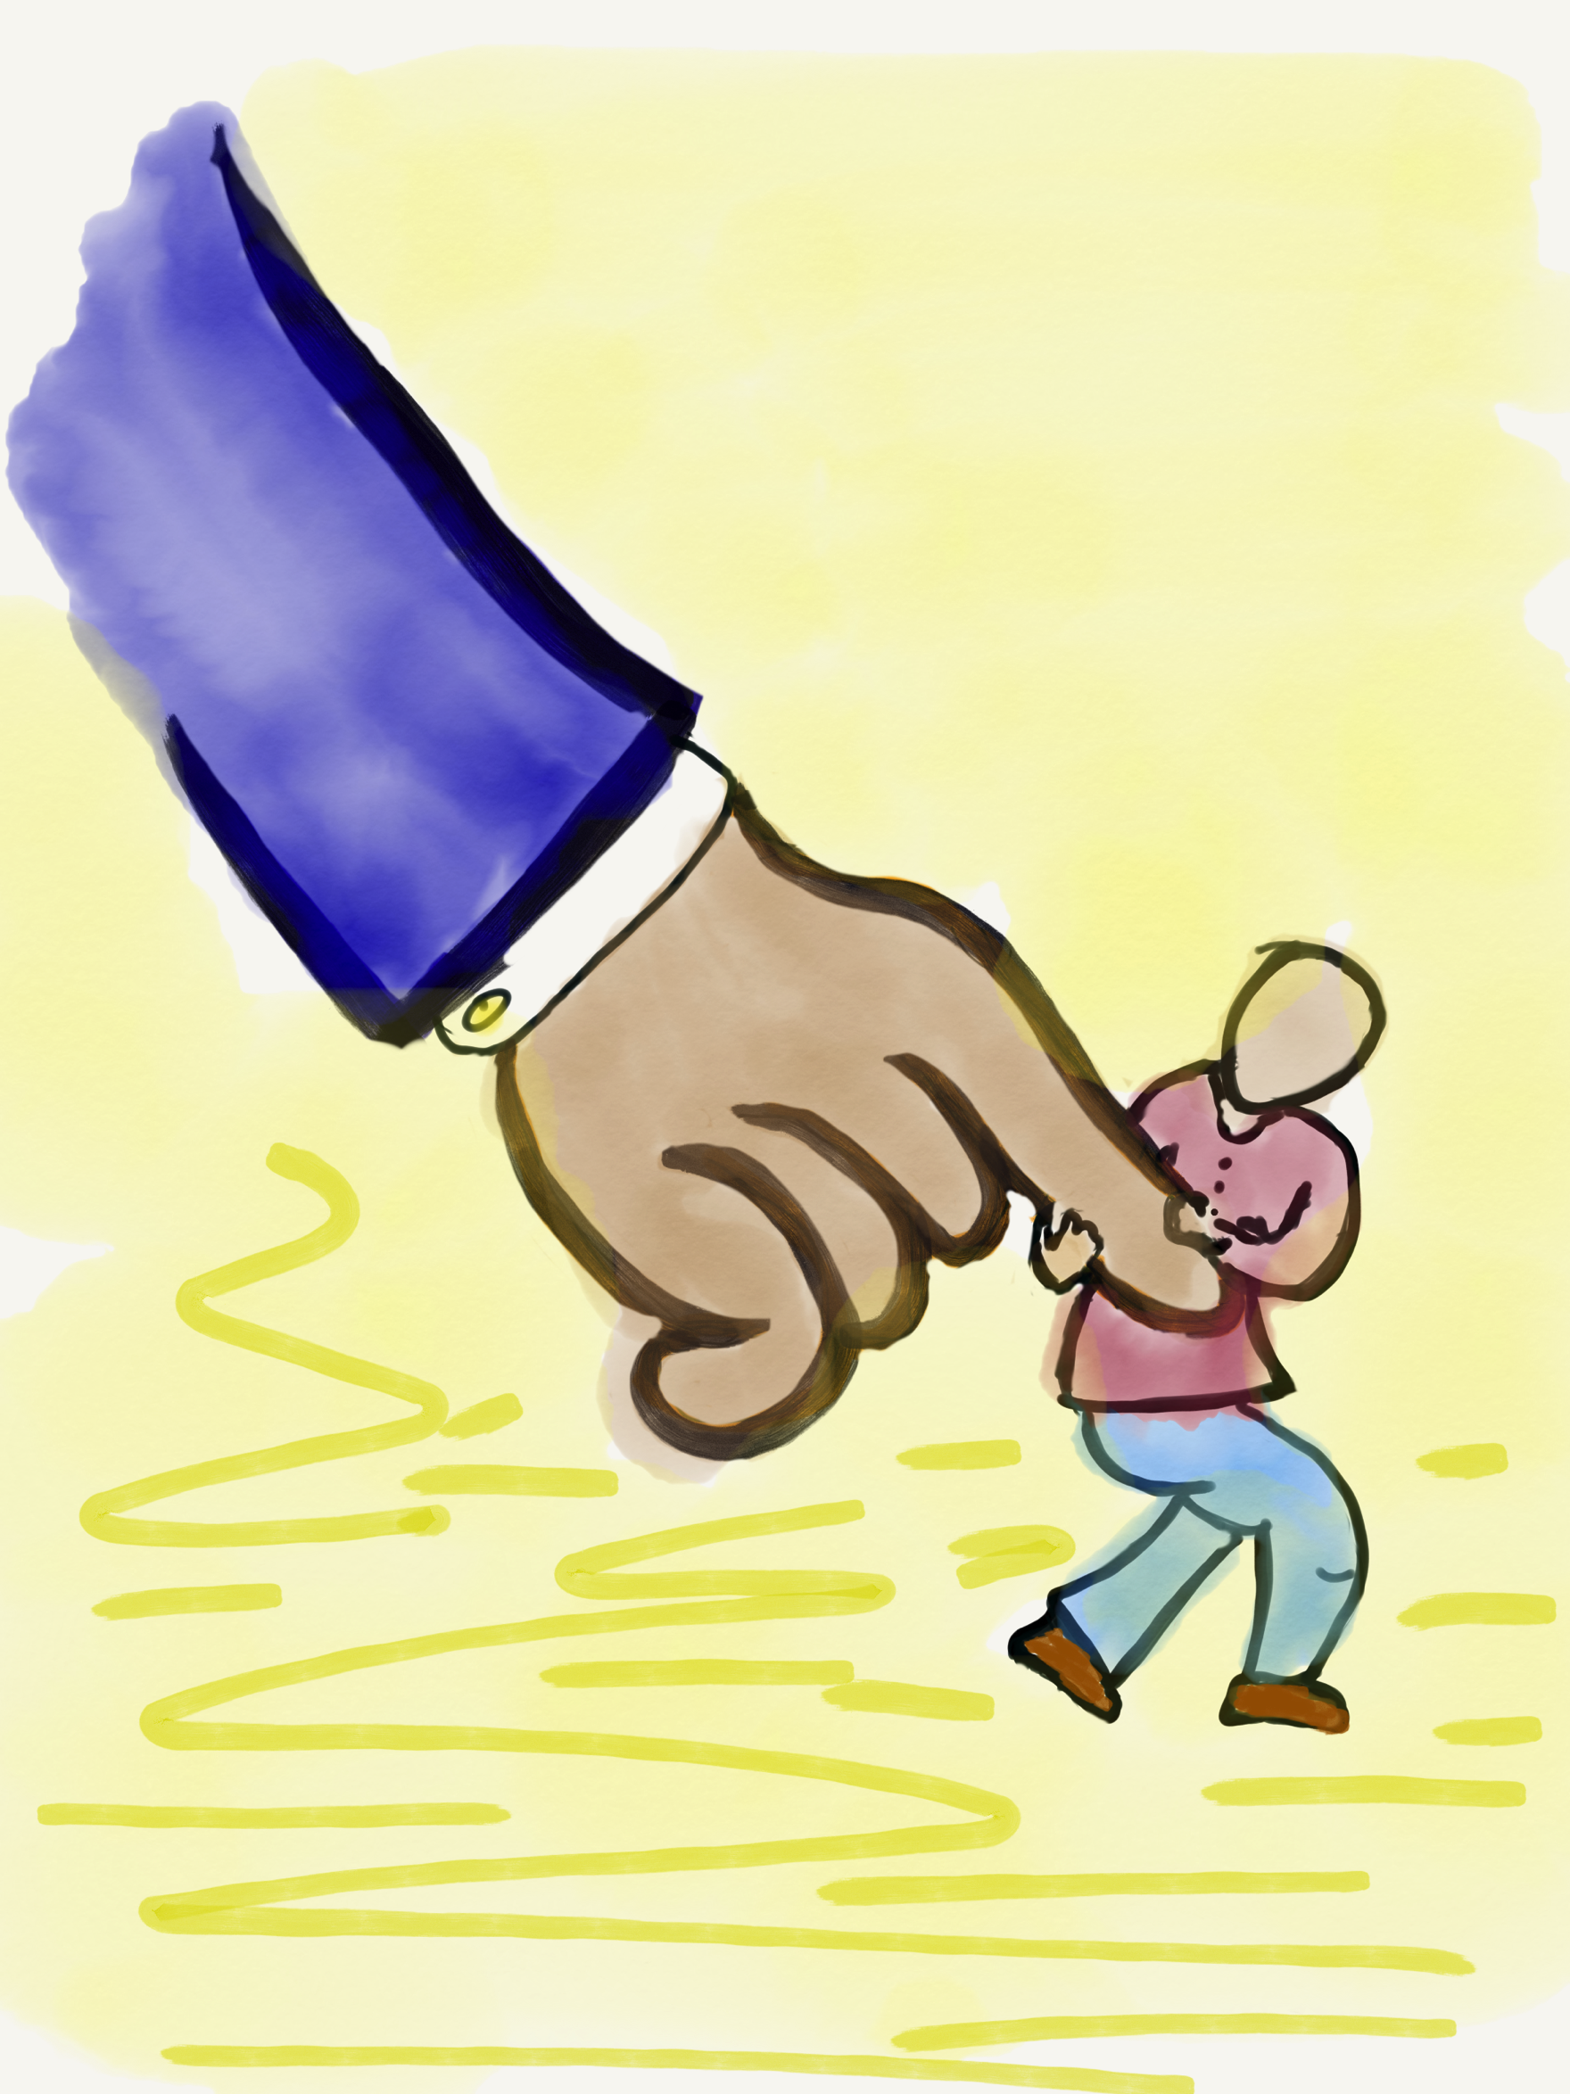
Lead

Slide 42
Leading Together…
Vimeo:
https://vimeo.com/qisva/together
or
YouTube:
https://youtu.be/RTvZCdUP7N4
Video

Slide 43

Reflect
What did you observe
related to the term Lead
in this video?

Slide 44
Lead
Use what you have heard & learned to
drive meaningful change.
Leading is not a solo adventure; take
action with others.
Create a shared sense of purpose.
You can’t please everyone; but you can
demonstrate value & respect for all voices.

Slide 45
World Cafe
Vimeo
https://vimeo.com/1076039128
or
YouTube
https://youtu.be/Kx3_osIWy_A
Video courtesy of Baldwin High School, Maui District Complex

Slide 46
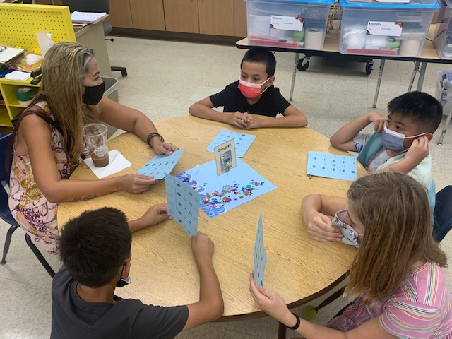
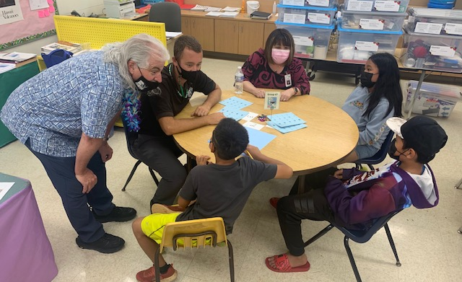
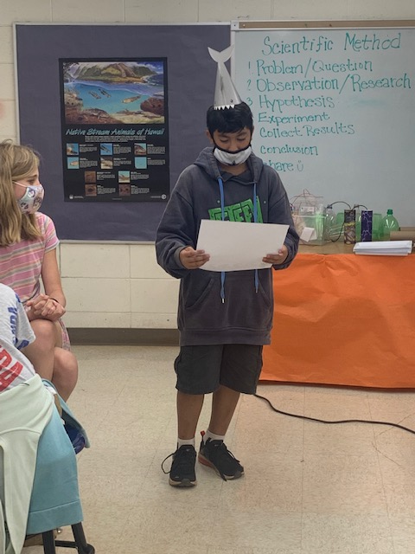
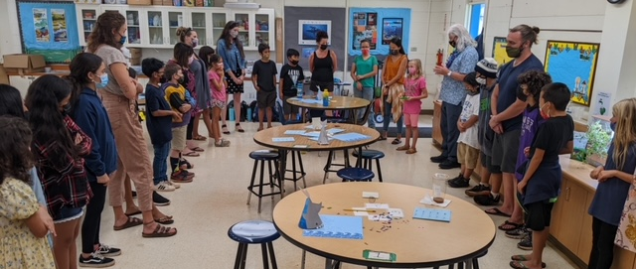
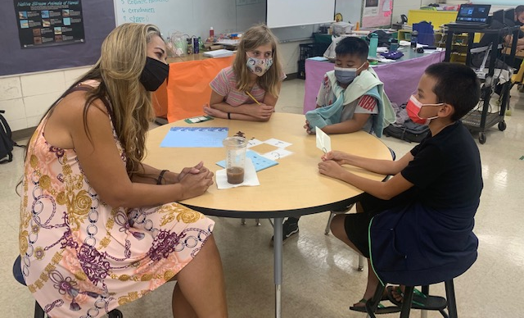
Pictures courtesy of Kihei Elementary School, Maui District Complex

Slide 47
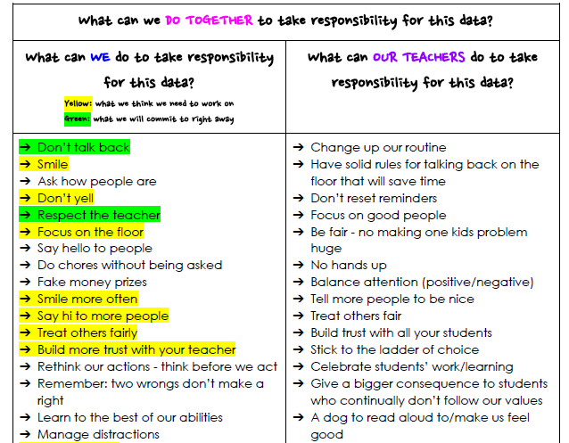
Taking Responsibility for LEAD
Document courtesy of Winchelsea Primary, Victoria, Australia

Slide 48
Voice Process in Action!
Vimeo: vimeo.com/qisva/sutter
YouTube:
https://youtu.be/_kwkyzH
Video courtesy of Sutter Middle School, Los Angeles Unified School District

Slide 49
Reflect
What is one area at your
school/in your classroom in
which students can be
invited to Lead with you?

Slide 50
Challenge Time…

Slide 51

Values Auction
What do
you value?

Slide 52
Preparing for the
Values Auction
Your team gets $2,000!!!
Explore the Values Cards & determine your
strategy for the auction. What items do you
most want to purchase for your
school/students? How much are you
willing to spend on what?
Courage
Creativity
Empathy
Equality
Freedom
Generosity
Gratitude
Honesty
Love
Security
Trust
Wisdom

Slide 53
Auction
Time!!
Courage
Creativity
Empathy
Equality
Freedom
Generosity
Gratitude
Honesty
Love
Security
Trust
Wisdom

Slide 54
Reflect
Why are values important to
consider when leading?
How do you go about leading when differing values
& ideas exist?
(in your professional context)

Slide 55
School Voice Model
Vimeo
https://vimeo.com/qisva/louie
YouTube
https://youtu.be/Ff2UVHm9urQ
Video Courtesy of BCE, Brisbane, Australia

Slide 56
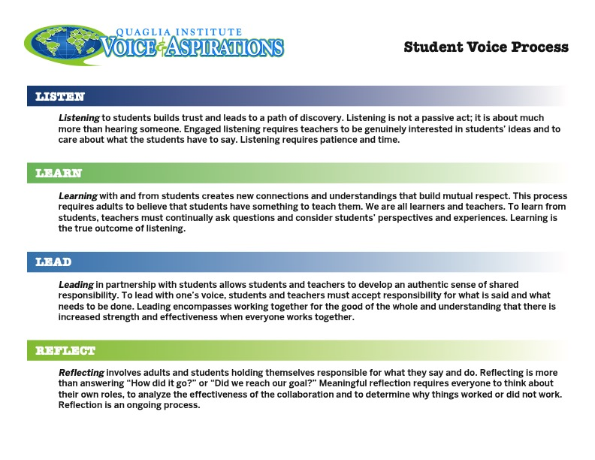
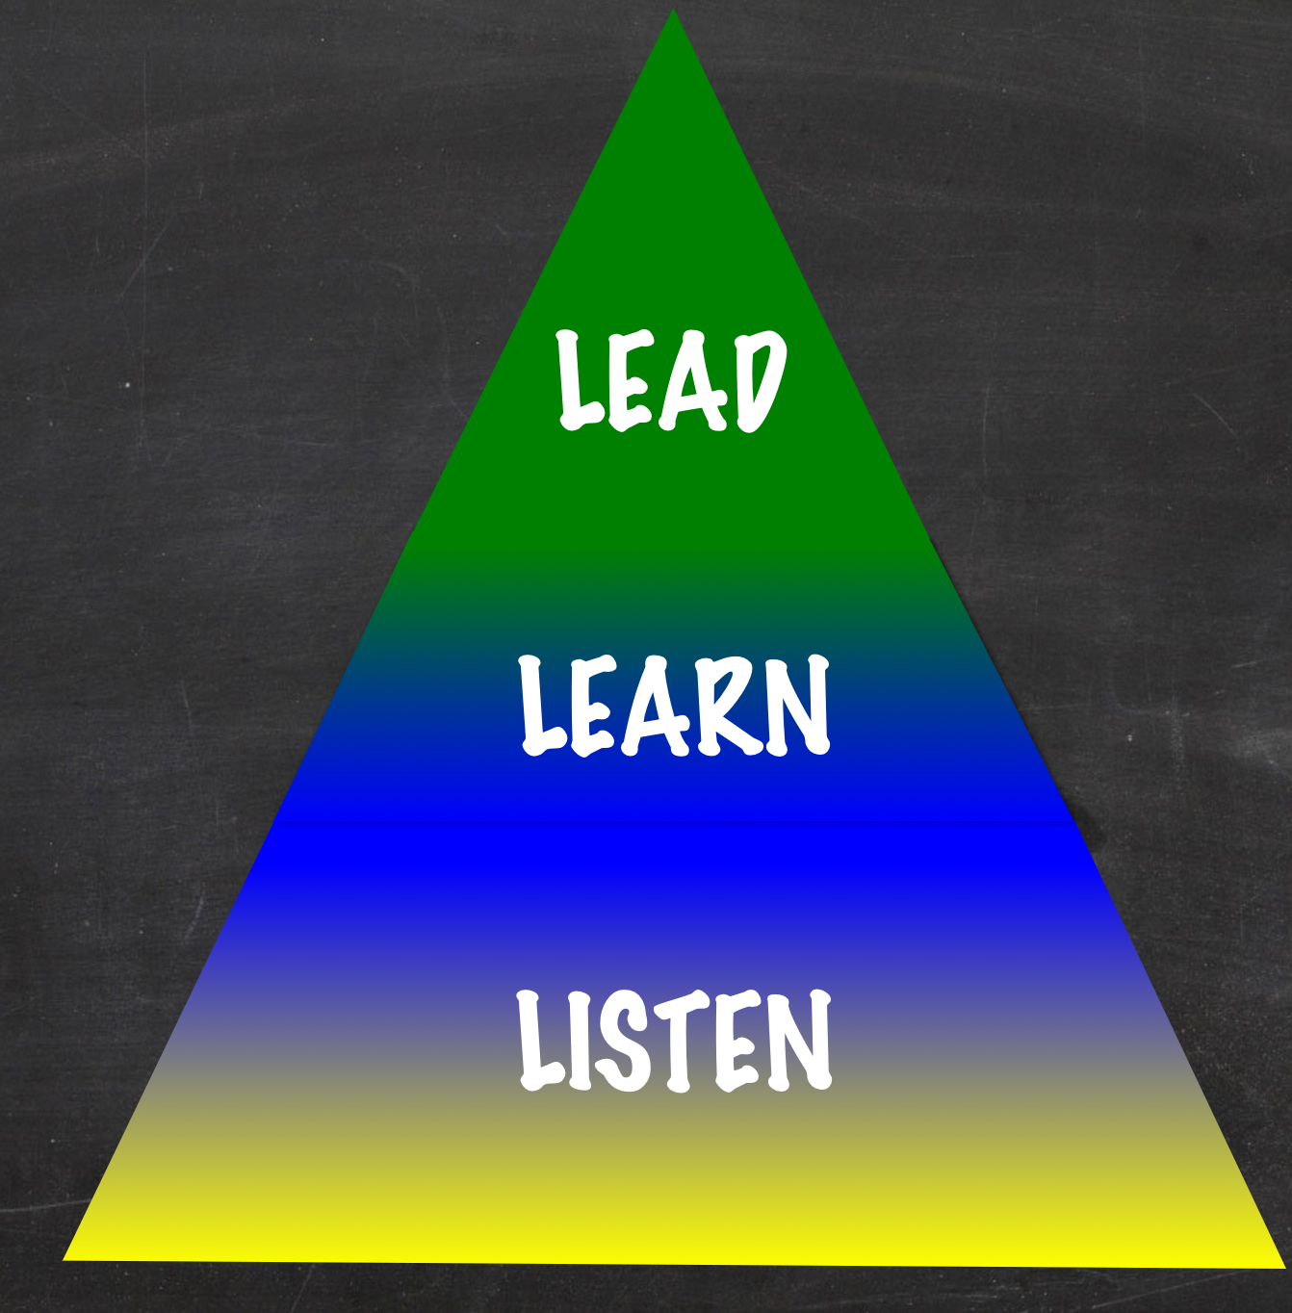
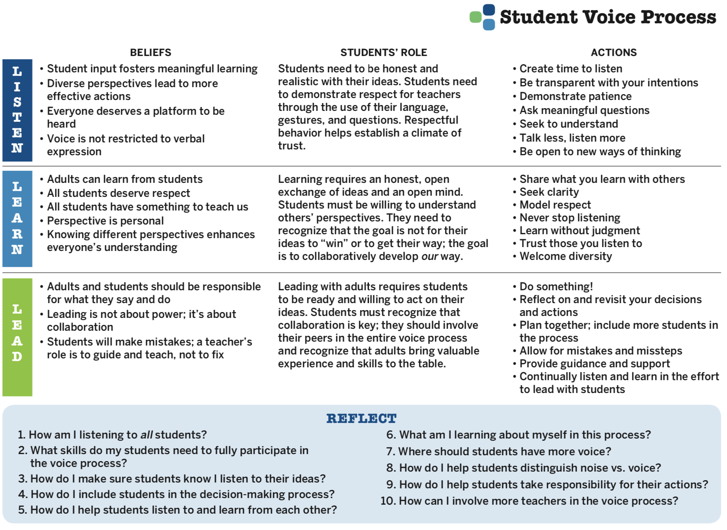

Student Voice Process Tool

Slide 57
Student Voice Process
Explore beliefs, students’ role, & actions related to Listen, Learn, & Lead.
Discuss the reflection questions.

Slide 58
Student Voice Process
Co-construct shared meaning &
expectations for Listen, Learn, Lead
specific to your school.

Slide 59
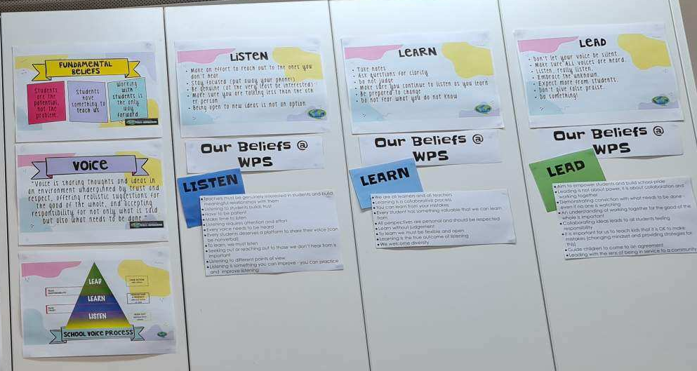
Picture Courtesy of Winchelsea Primary, Victoria, Australia

Slide 60

Website Just For YOU!
https://quagliainstitute.org/voice-ap

Slide 61
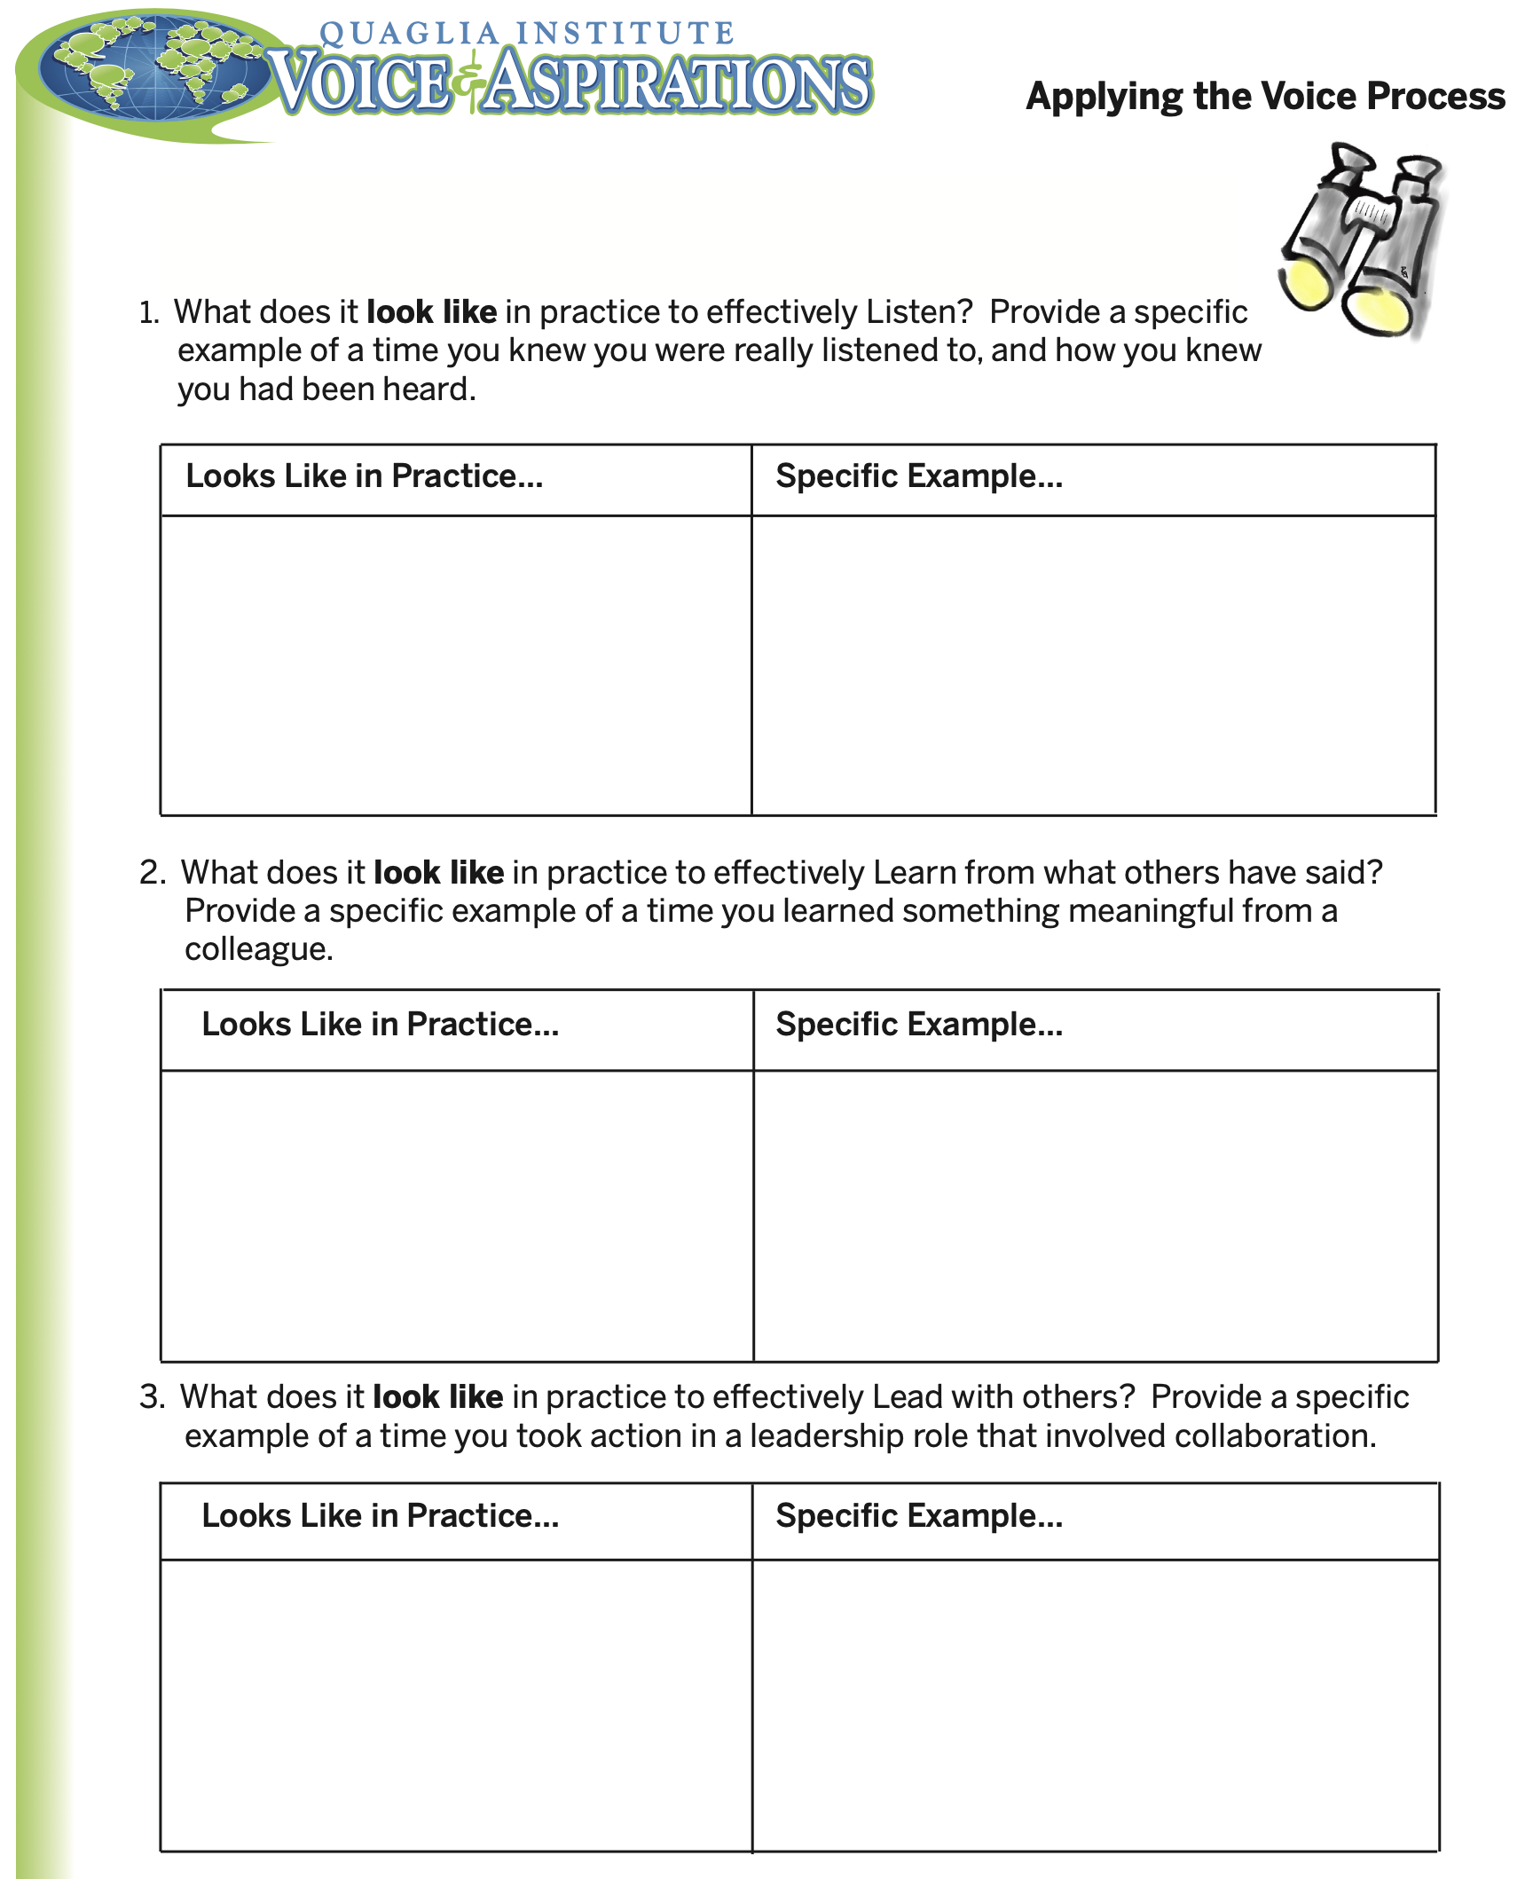

Slide 62
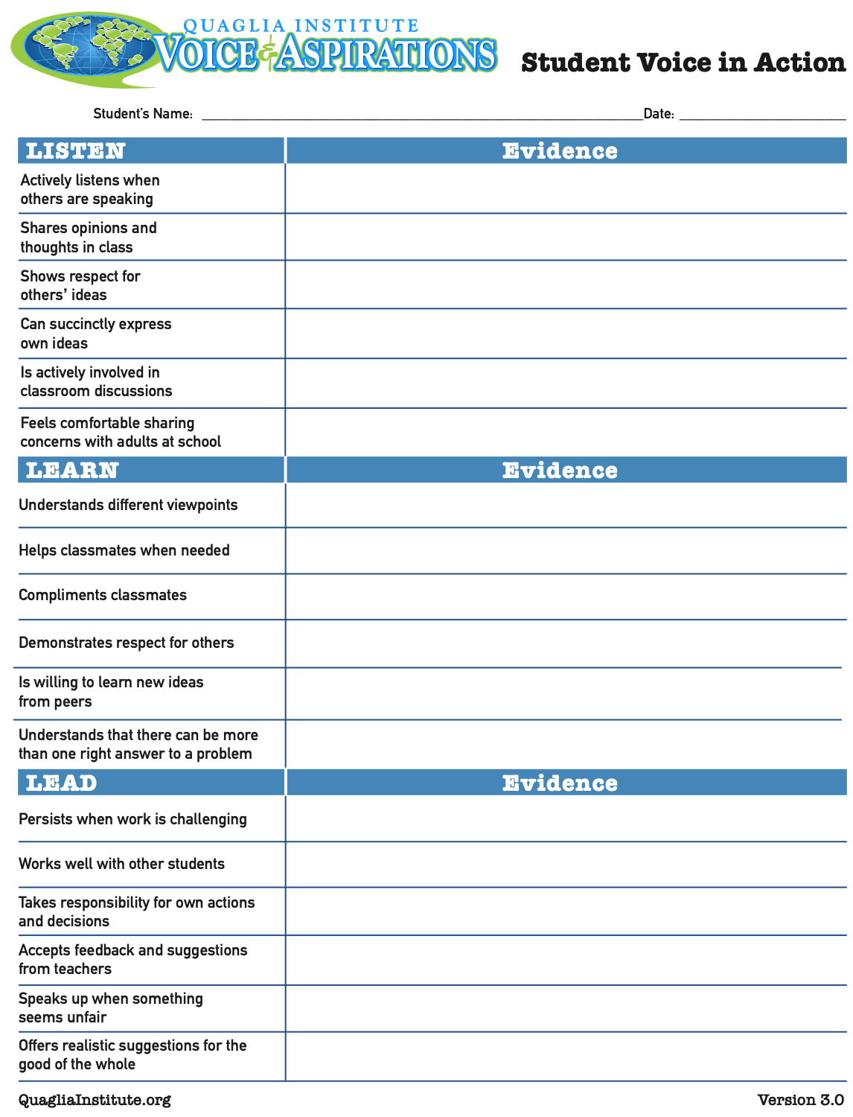

Slide 63


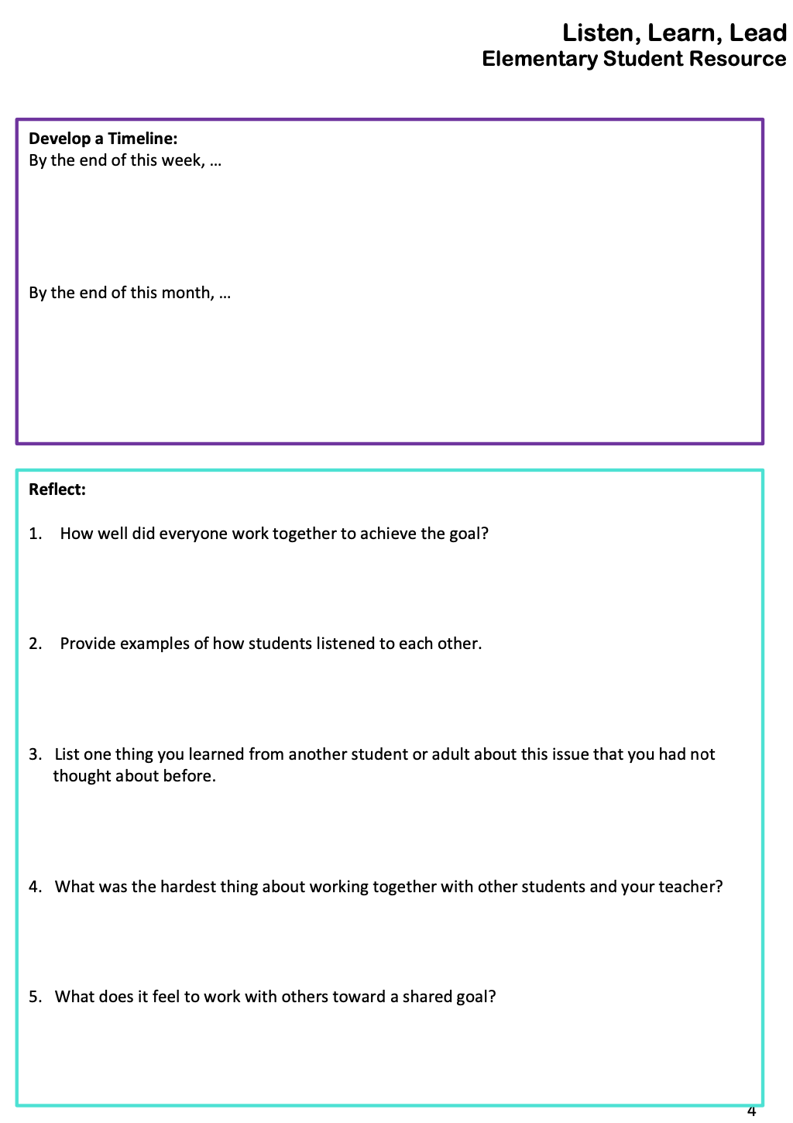
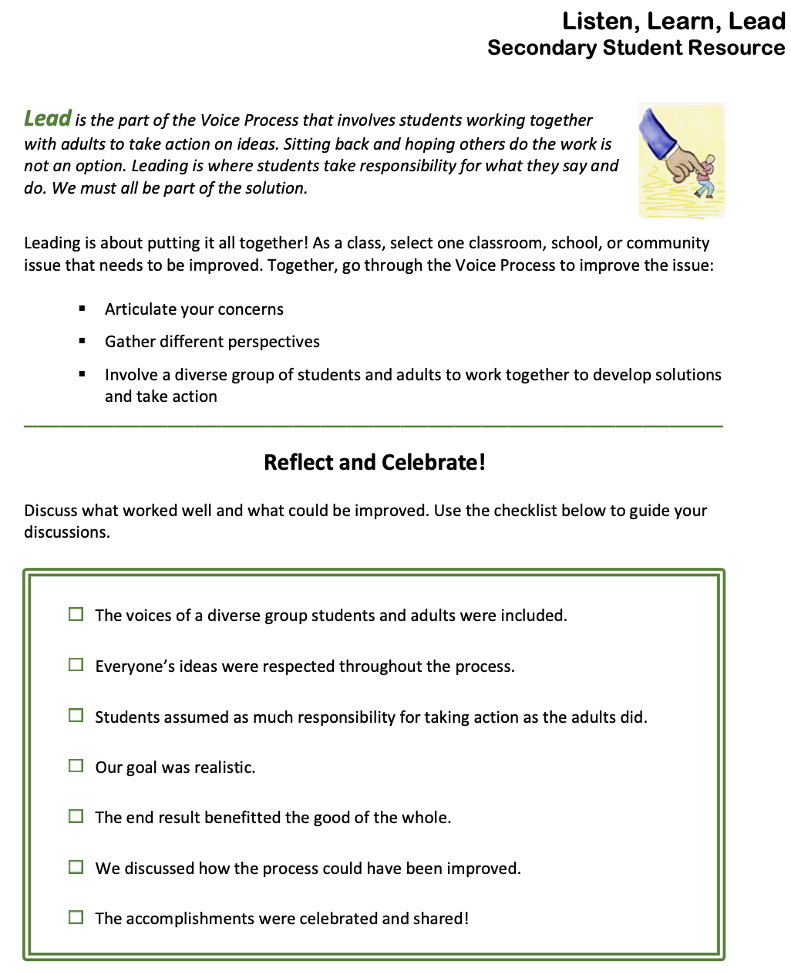
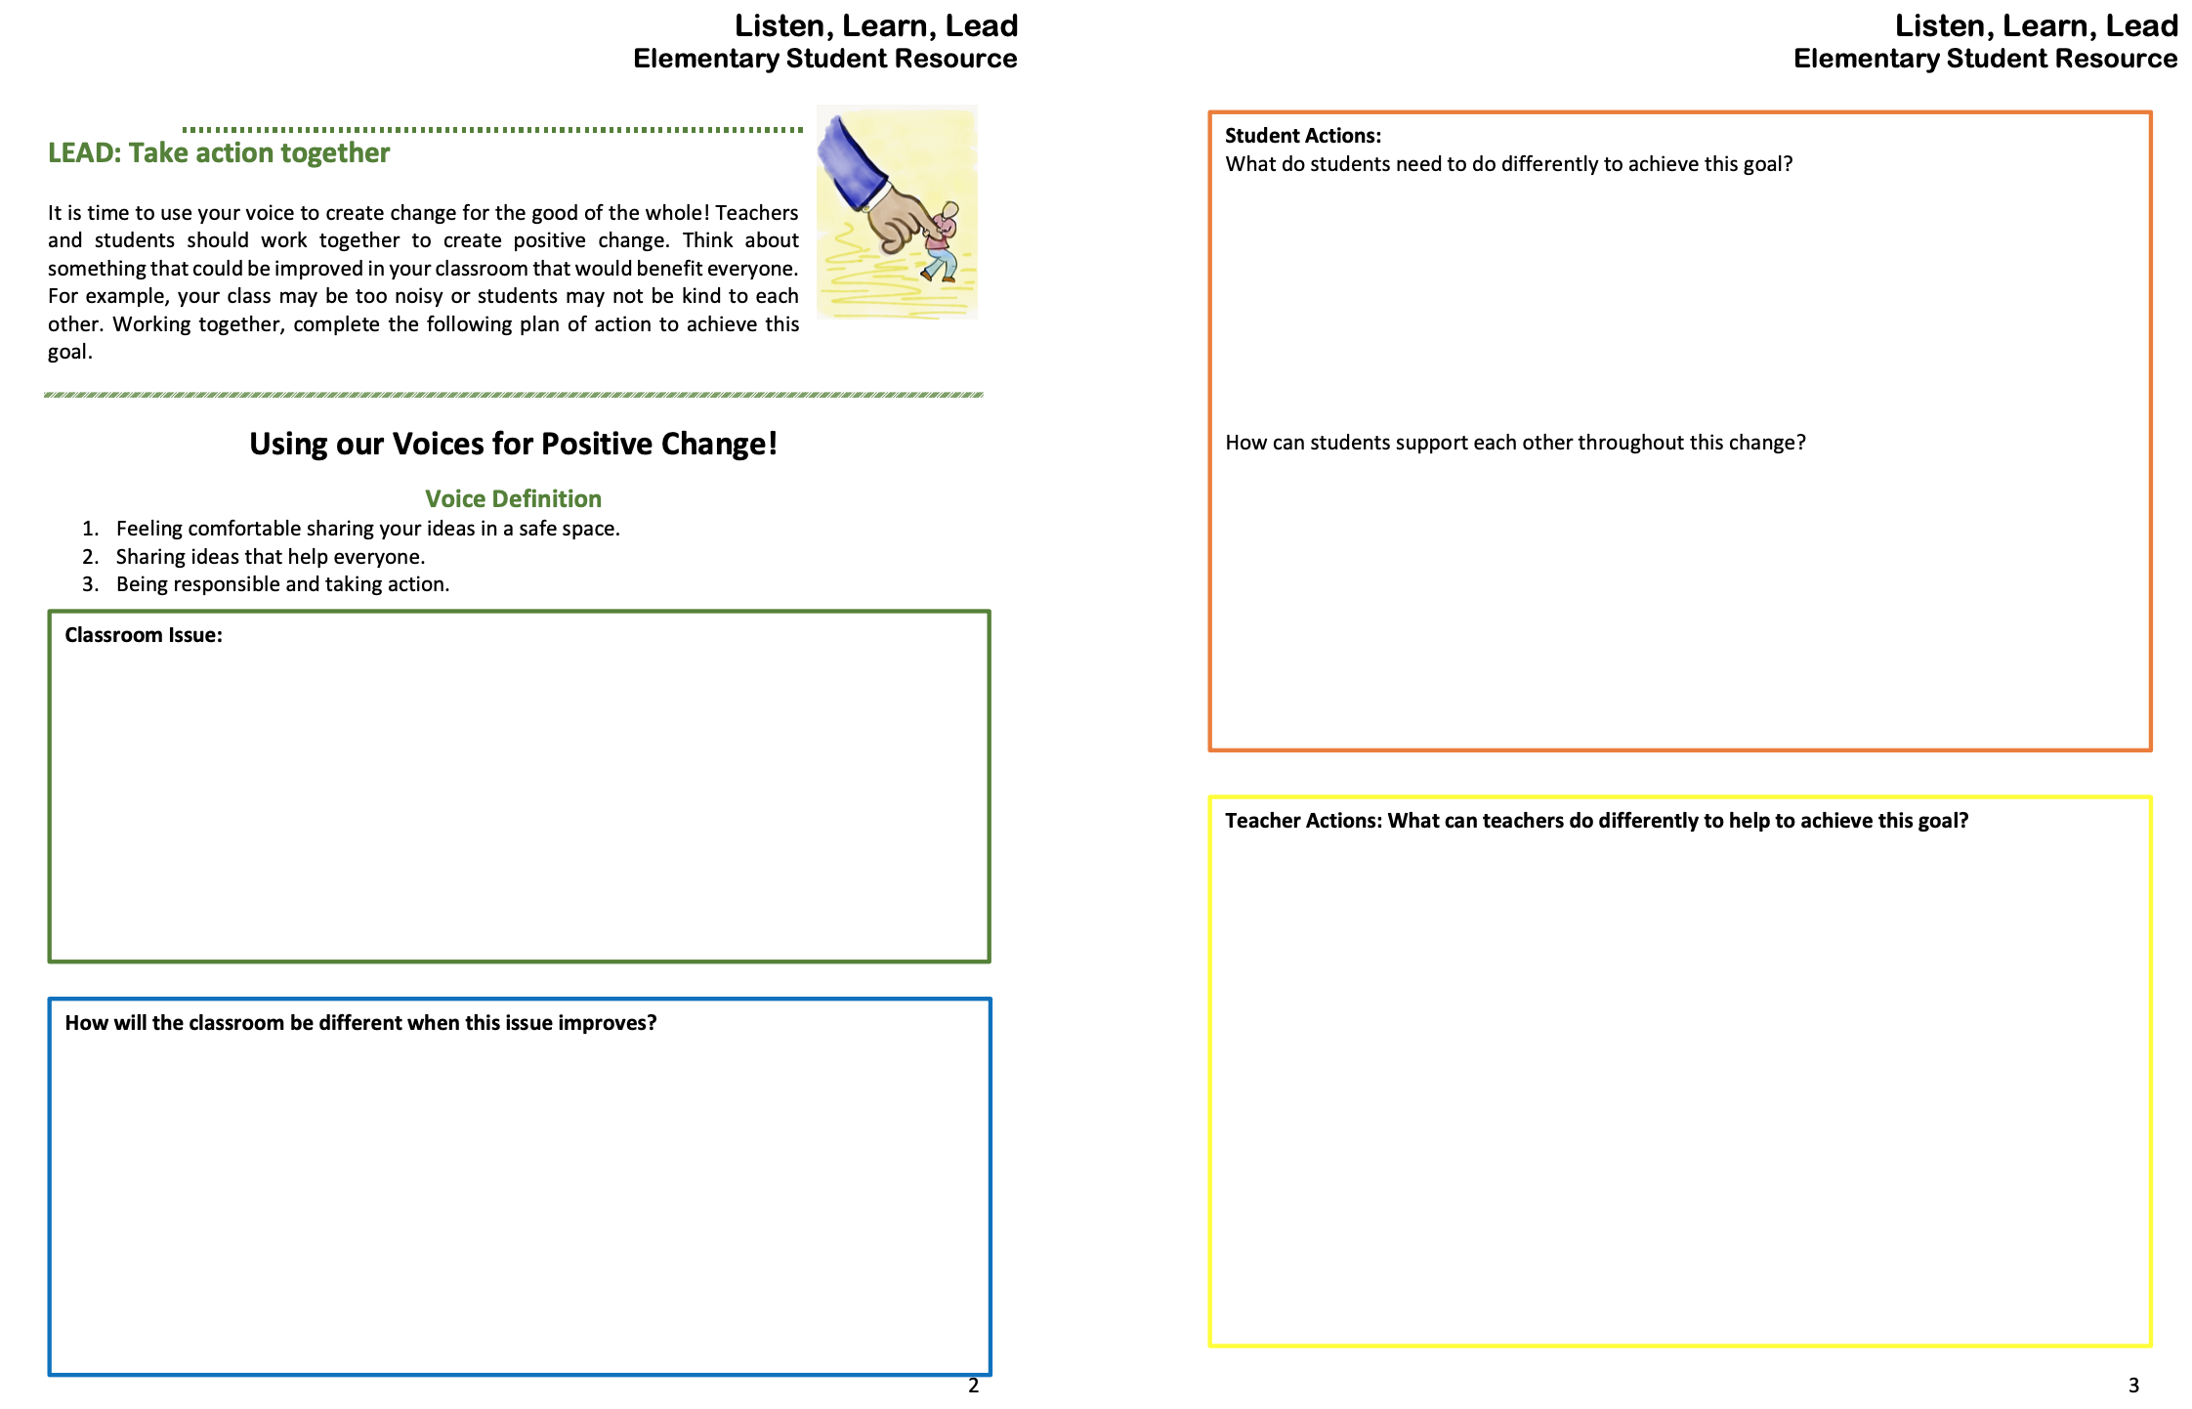

Slide 64


Slide 65

Fortune Cookie Challenge!

Slide 66

Share your
fortune cookie message
related to what you
learned today.

Slide 67

Thank you
for the opportunity to learn together!
Dr. Russ Quaglia & Dr. Lisa Lande
@QISVAtweets @Lisa_Lande
quagliainstitute.org

