Slide 1


C3 Summit: Communicate Collaborate Celebrate
Dr. Russ Quaglia & Dr. Lisa Lande www.quagliainstitute.org
@QISVAtweets
June 25, 2025

Slide 2
Web of Connection
Introduce the team member
to your left.
Share one thing you appreciate
about this colleague, or something they contribute to your
Student Voice Team.

Slide 3
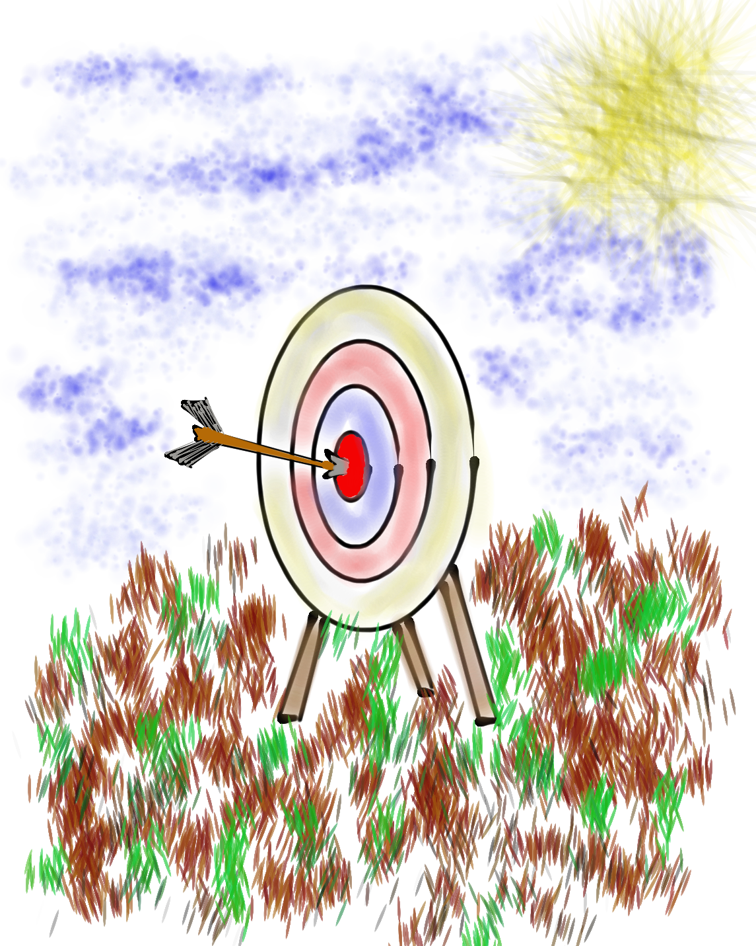
Learning Intention
We are learning to amplify our skills of collaboration, communication, & celebration as a Schools of Action Community.
Success Criteria
Engage in meaningful collaboration across Schools
of Action teams.
Explore communication styles and how our style can
be used to communicate more effectively.
Identify & celebrate your unique talents & how
to best use those talents to elevate the work of your
Student Voice team.

Slide 4
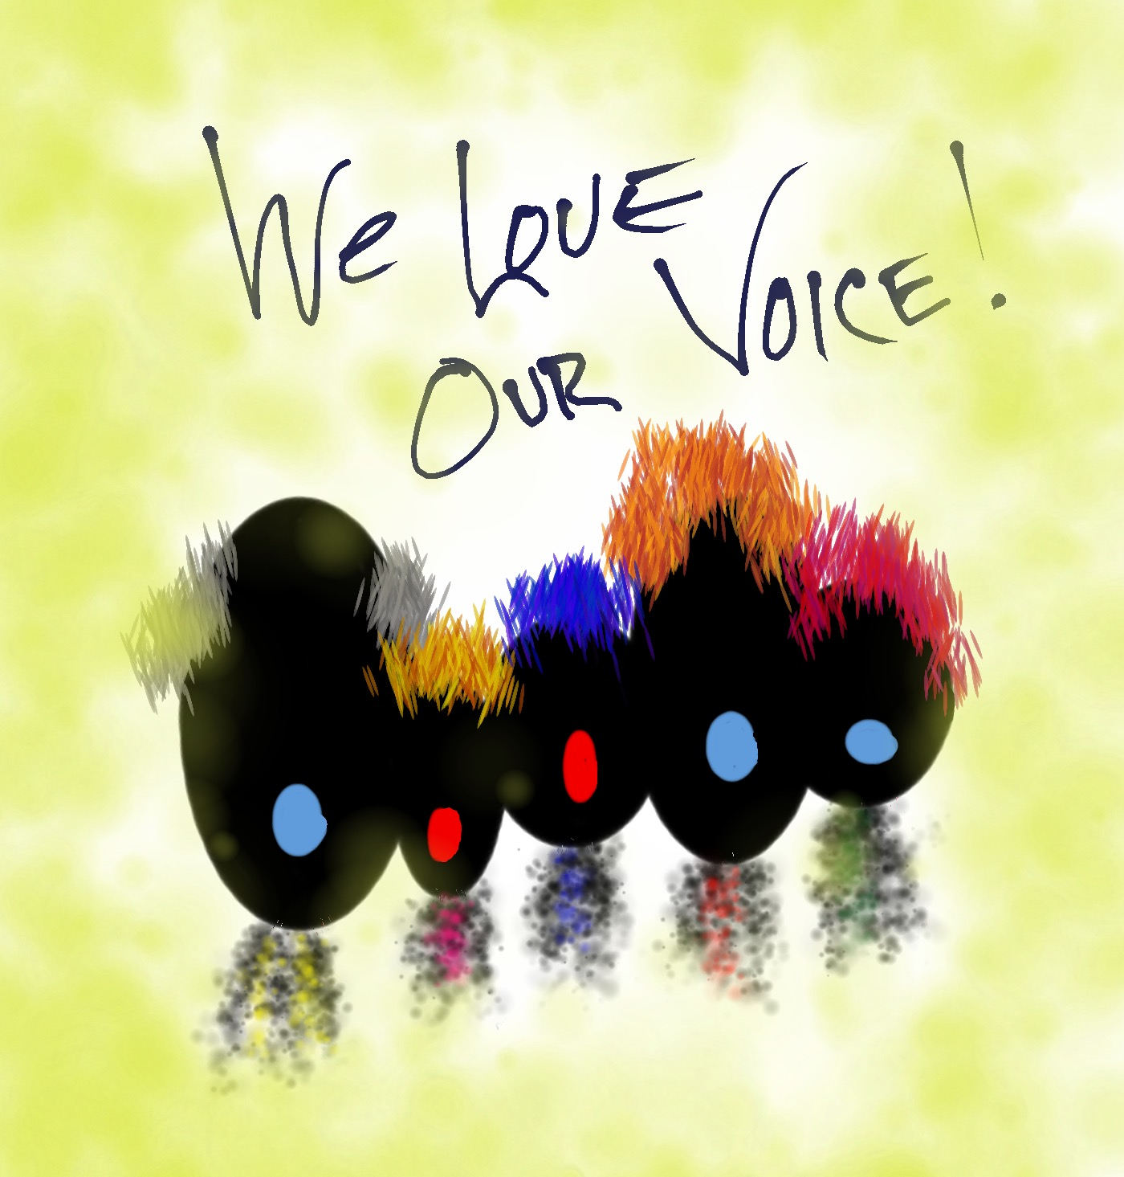
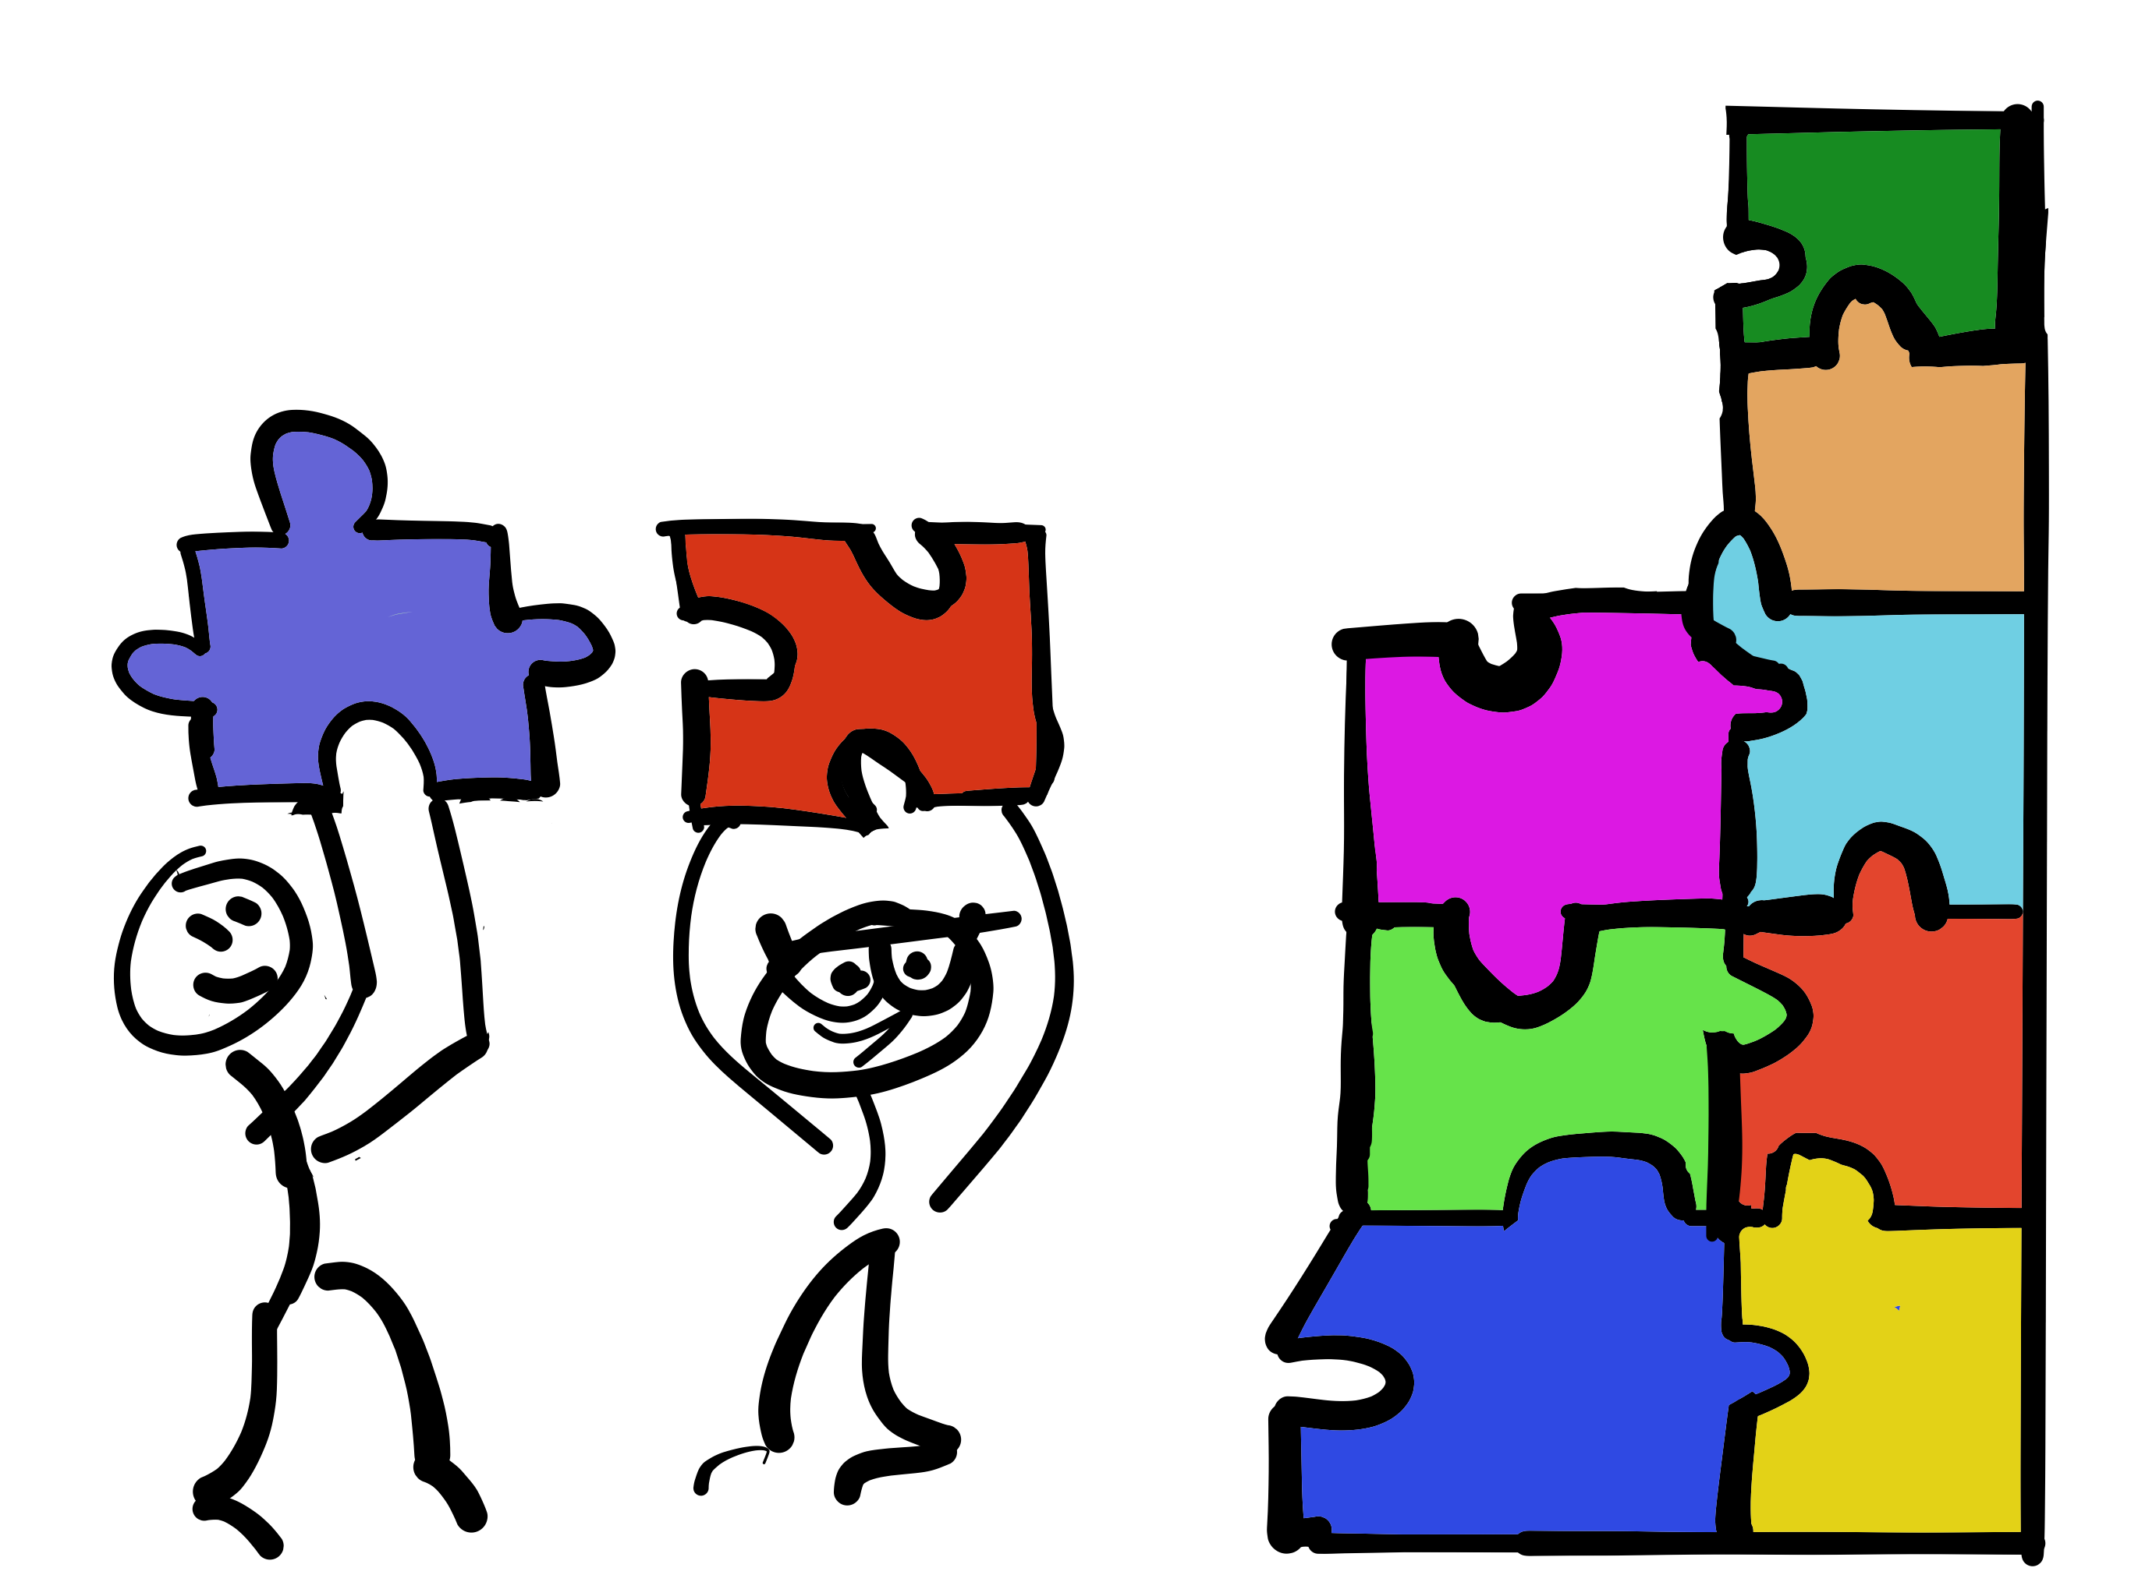

C3 Summit
Communicate
Collaborate
Celebrate

Slide 5
Communicate

Slide 6
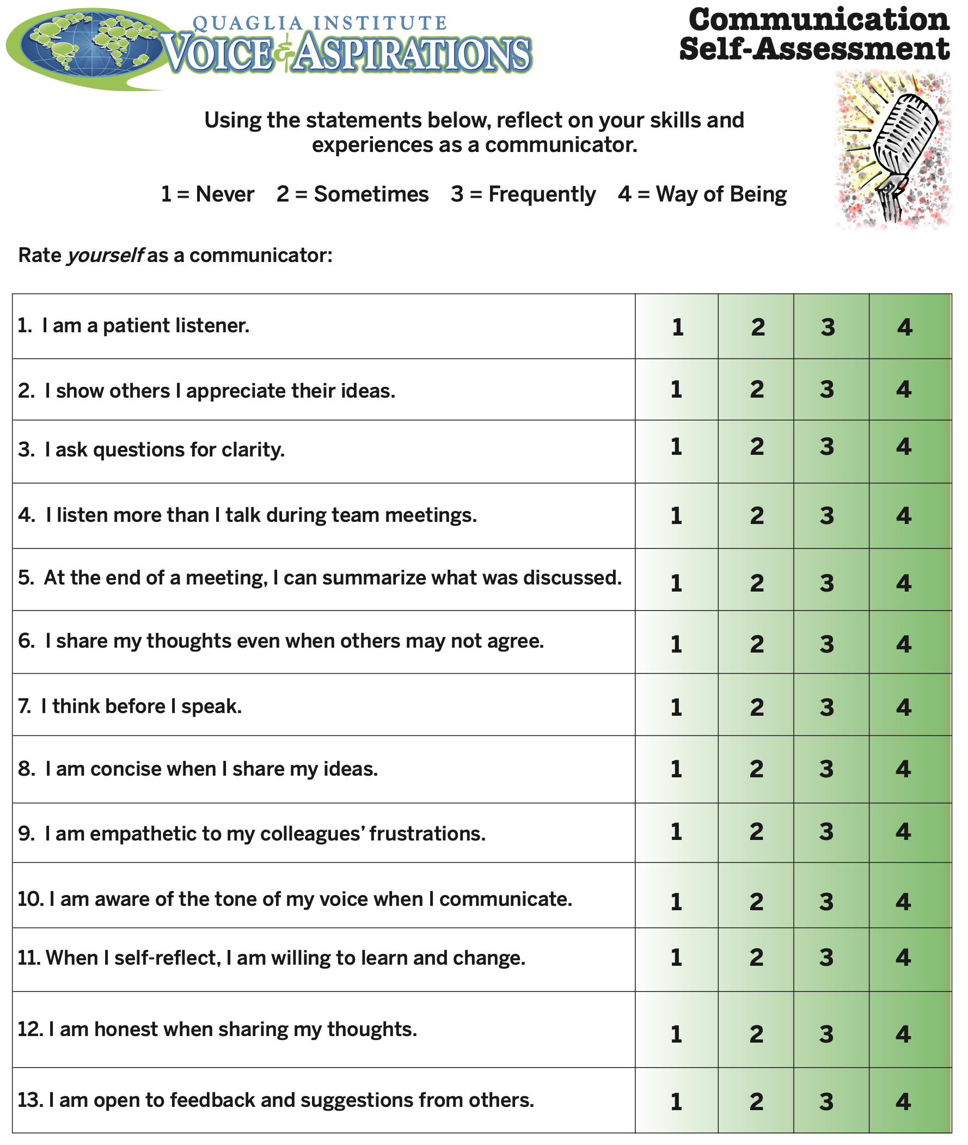
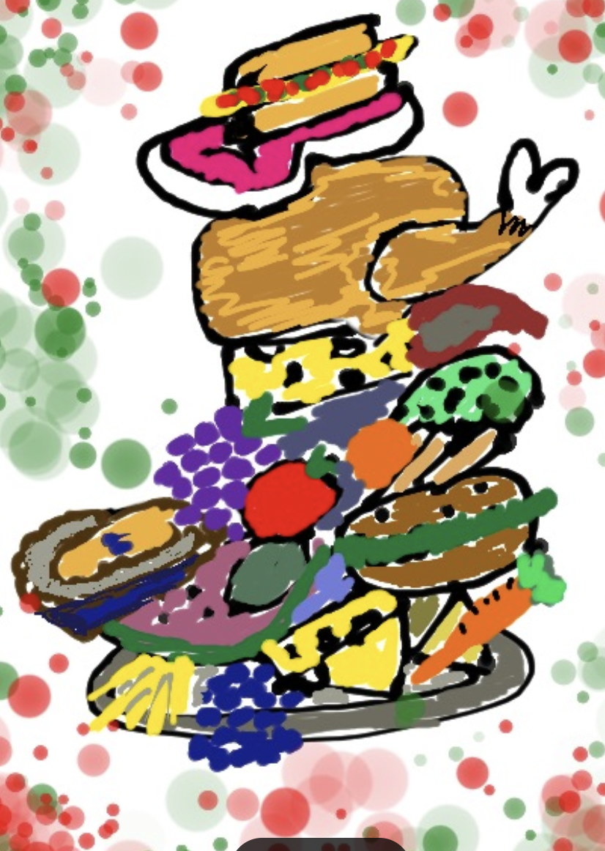
Communication
Self-Assessment
Part 1:
Revisit the assessment
& choose 2 statements
you feel improved since last summer.
Part 2:
Find your food
partner & discuss
what actions you took to improve your
communication.

Slide 7

Communication
Styles

Slide 8
Vimeo: https://vimeo.com/1099356131/fe873ec26f
or
YouTube: https://youtu.be/aut4gPpBkXo
The Life of an Emoji
Video

Slide 9
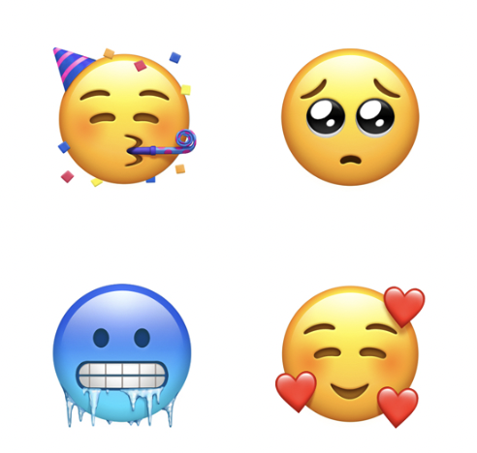
Communication Challenge
As a team, create an Emoji that represents the status of Student Voice implementation at
your school.

Slide 10




Communication Styles

Slide 11
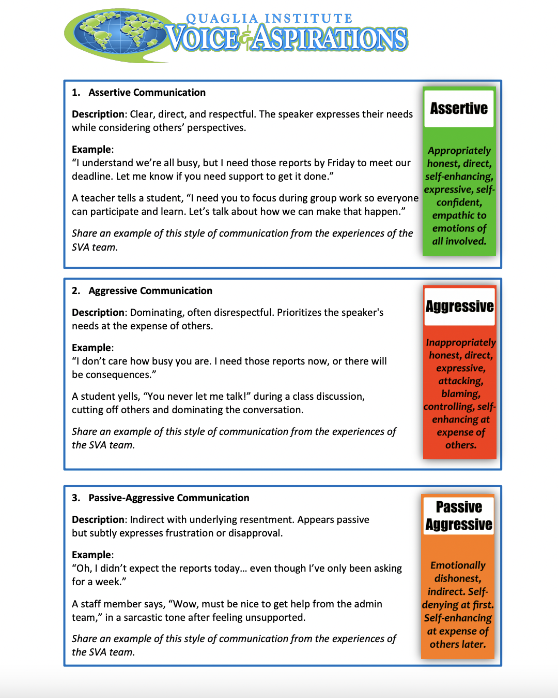
Communication Styles
Part 1:
Create a group of 3, representing 3
different schools.
Part 2:
Discuss the communication styles & the examples.
Part 3:
In your Student Voice
team discuss the
questions on page 2.

Slide 12
Communication
Commitment
2025-26
What improvements related to communication will your Student Voice team commit to for the upcoming year?
Why does this matter for the advancement of the work you are doing as a team?

Slide 13
Collaborate

Slide 14
Collaboration Habits
Ask questions before giving feedback.
“Clarify for me…” or “Help me
understand…” are a powerful phrases.
Share the why behind your ideas.
Use “Yes, and…” to build on contributions.
Be mindful of airtime—make space for
quieter voices.
Assume positive intent & stay
solutions-focused.

Slide 15
Collaboration
Challenge!
Part 1:
Create groups of 4.
Part 2:
For each prompt, come up with a “Yes, and…” statement & a “Yes, but…” statement.

Slide 16
The Student Voice team wants the entire
staff to commit to student voice practices & common lessons.
The Student Voice team wants to add a few students to be part of the team.
The Student Voice team believes everyone teacher should participate in student focus groups.
Yes, And…
Yes, But…

Slide 17
Collaboration
Challenge!
Part 3:
Discuss the difference between
the “Yes, and…” & ”Yes, but”
statements & the impact this might
have on collaboration.

Slide 18
Collaboration
Scenarios
Number group off 1-8.
Consider cartoon & scenario.
Work through the discussion questions.

Slide 19
Collaboration Commitments
2025-2026
What can your team do to collaborate
(related to Student Voice & Aspirations work)
this next school year with:
Students?
Your Colleagues?
Schools of Action?
Other Complex Schools?

Slide 20
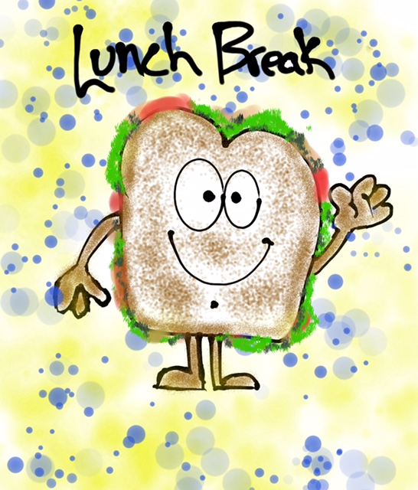

Slide 21
Celebration

Slide 22
Teacher Talents?
Vimeo:
https://vimeo.com/1099356557/71c41e575c
or
YouTube:
https://youtu.be/UD5sKRmPu6Y
Video

Slide 23
Real Teacher Talents
Vimeo:
https://vimeo.com/1099354875
or
YouTube:
https://youtu.be/MYN0OuIrYMw
Video

Slide 24

Coffee Talk
Meeting Goals
“Talk amongst yourselves!”
Brief introduction of Text Set.
Read whatever you want from the Text Set! Freedom to choose!
Reflection Questions:
    1. What did you learn about Talents?
2. What are you wondering about?
3. What do you most want to remember?
Create groups of 3 with people not at your table & “talk amongst yourselves!”

Slide 25
Celebrating Talents
Team benefits of recognizing & utilizing individual talents:
1. Maximizes time.
2. Supports individual accountability.
3. Builds a stronger sense of team.
4. Celebrates each person’s unique abilities, skills & experiences.

Slide 26
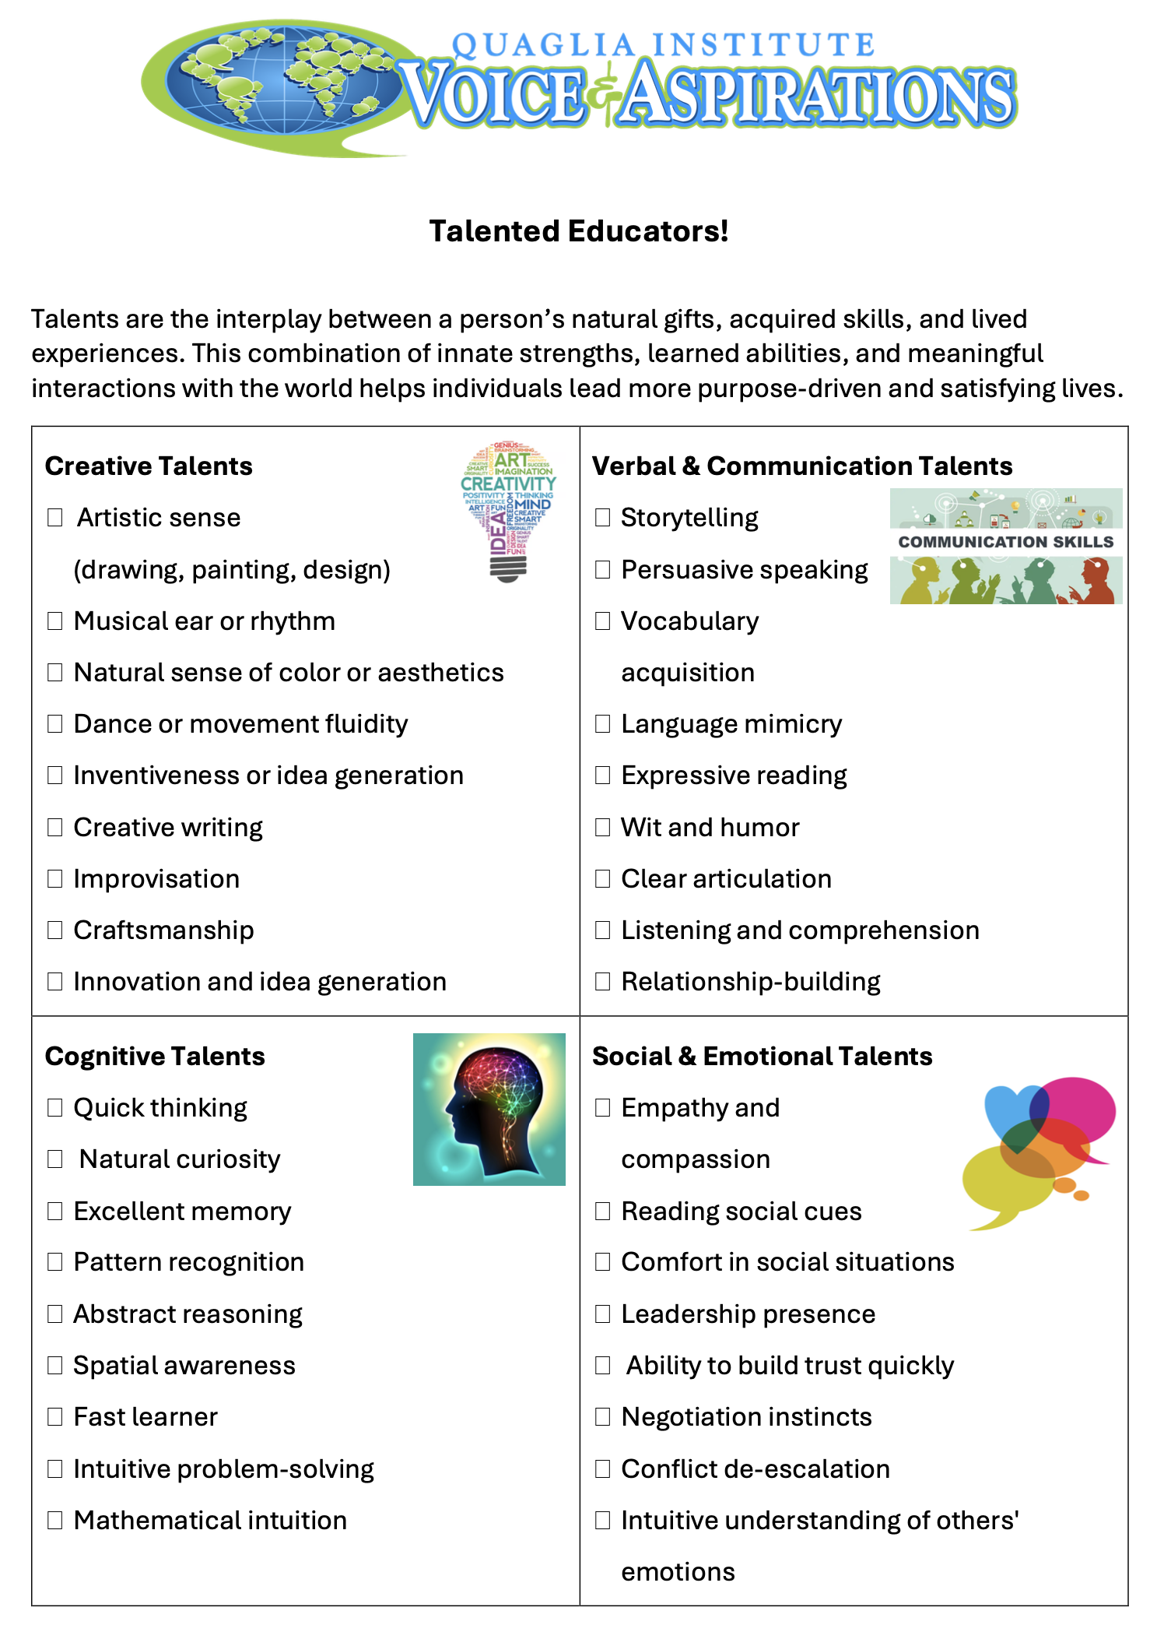
Our Talented
Student Voice Team
Part 1:
Using the Talented Educators
resource as a guide, choose 1
talent you see in EACH of
your team members. Write a
post card to each team member highlighting the specific talent you see in them.
Part 2:
After receiving your Talent Cards, first
celebrate, & then consider how you can use
your talents as a member of the
Student Voice Team.

Slide 27
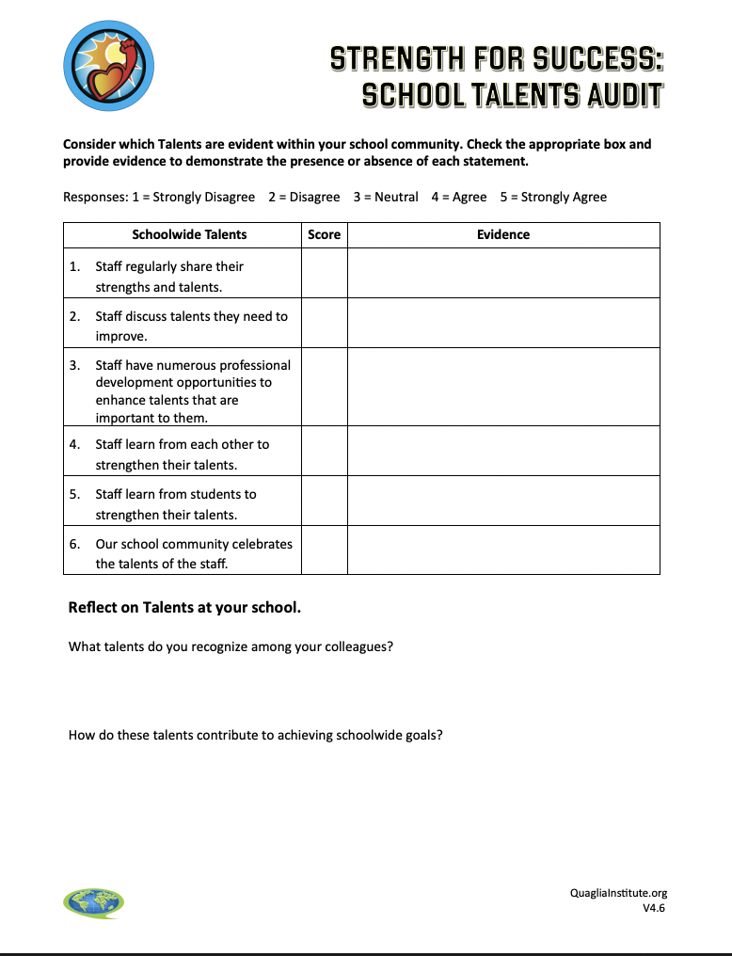
Celebrating the Talent
at our School
Work through the
School Talents Audit
to further explore how talents are recognized & utilized to amplify
Student Voice at your
school.

Slide 28
Celebration
Commitment
2025-26
How can each team member use their
talents to grow, share & celebrate the work
being done by the Student Voice team?
How can you regularly celebrate &
share successes as a Schools of Action
community?

Slide 29
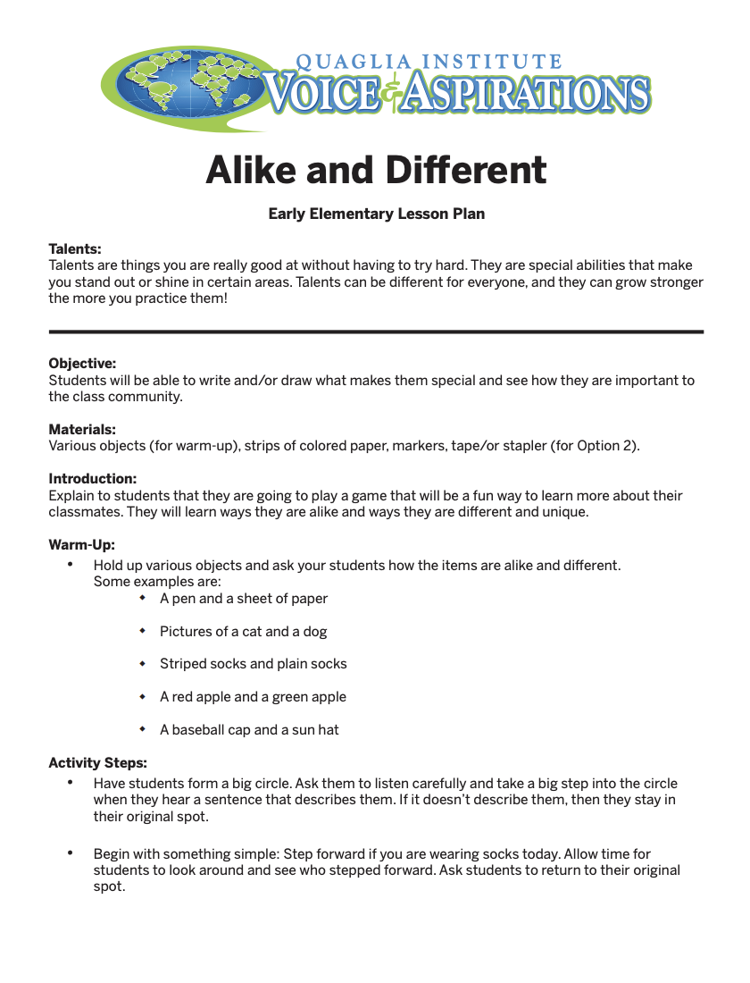
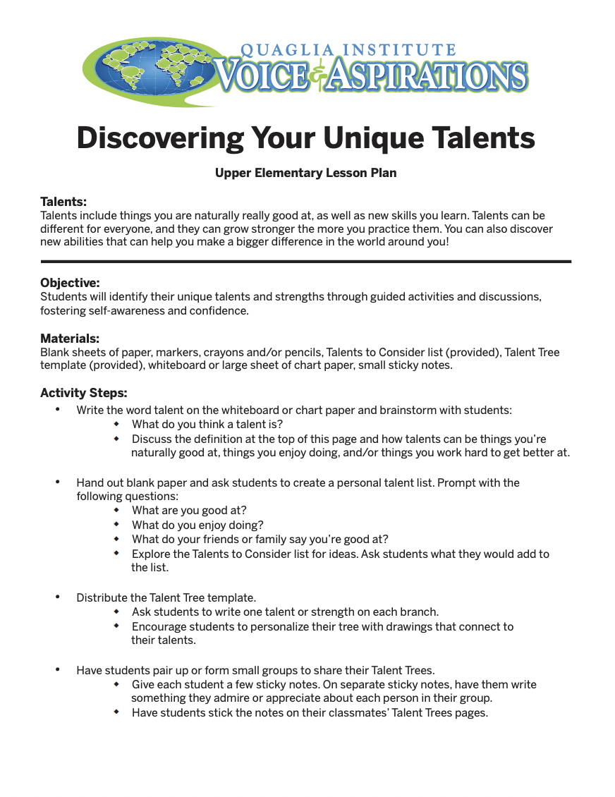
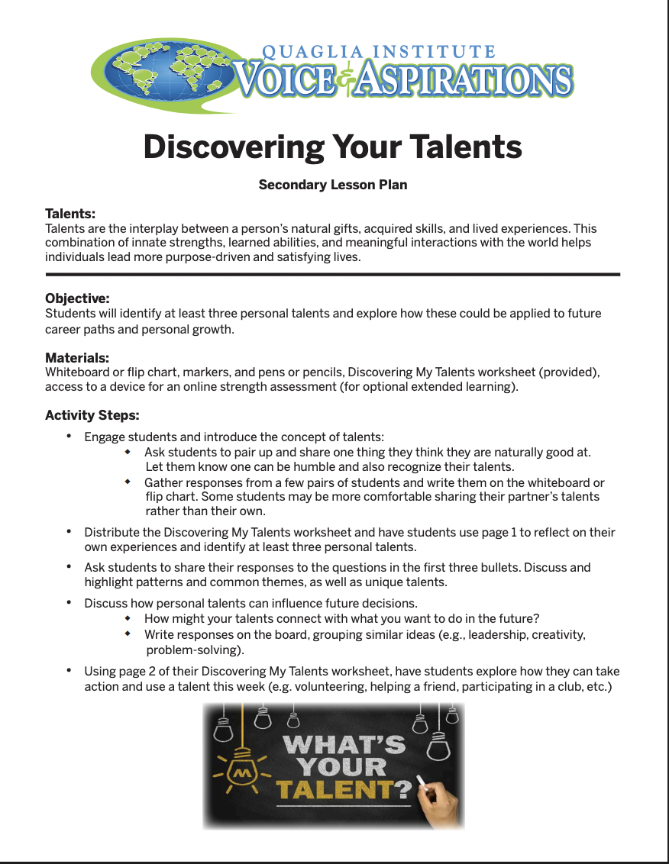
Celebrating Students’
Talents
Notes:
Hand outs…

Slide 30
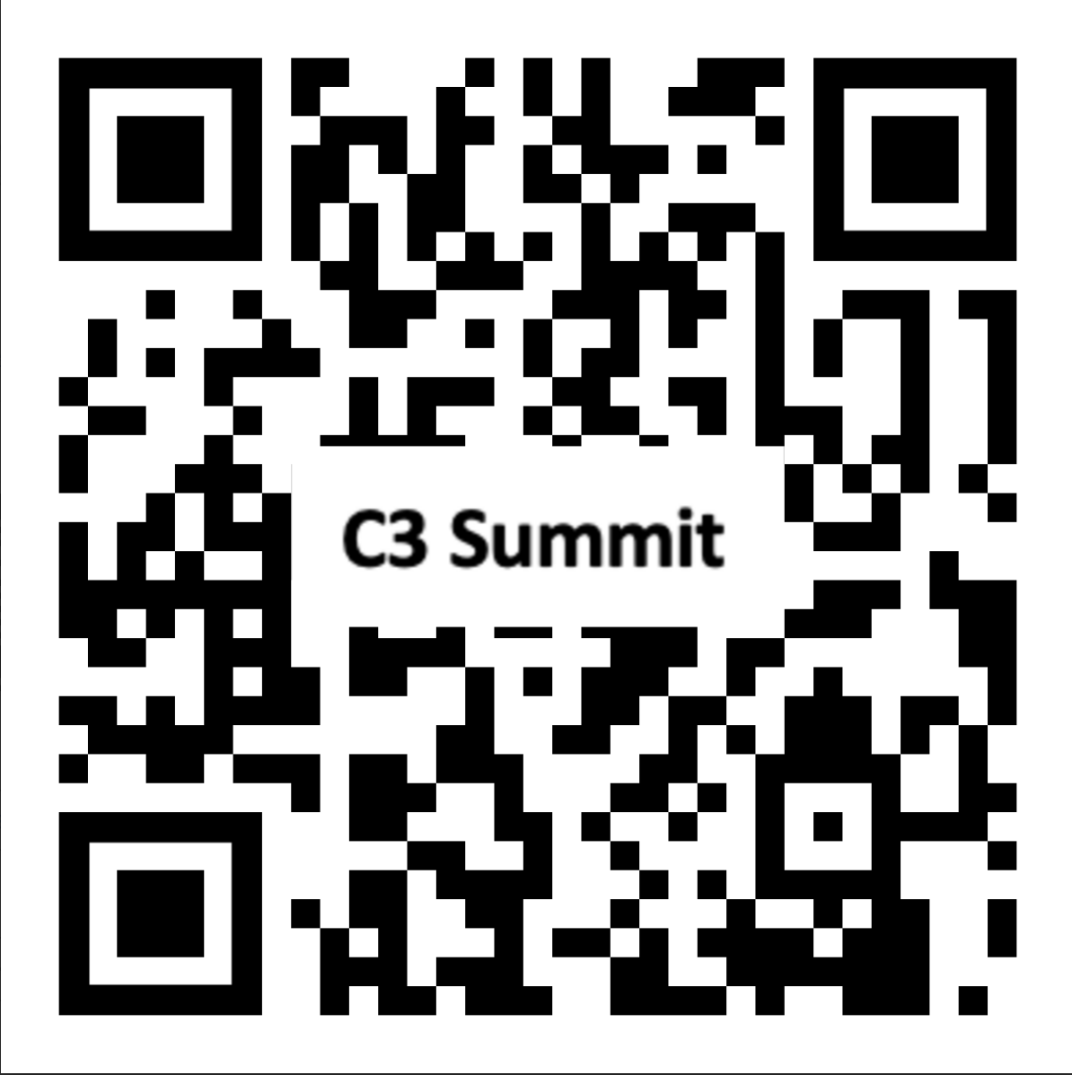
Website Just for You!
https://quagliainstitute.org/c3

Slide 31



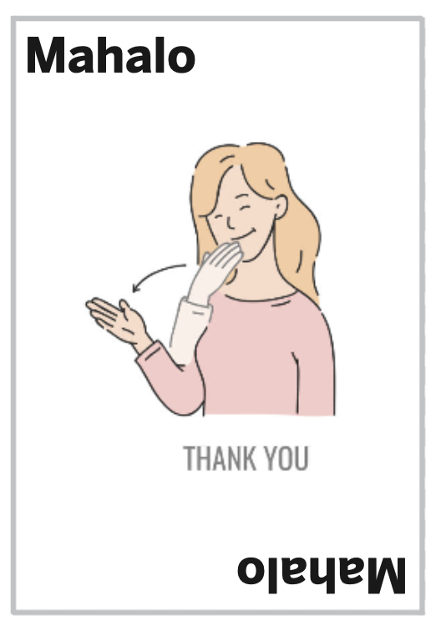
Dr. Russ Requested
to End the Day
with a Game! ☺
Crazy, random motions & saying blah blah doesNOT count! Must do correct motion & word! ☺

Slide 32
C3 Card Game Directions
12 cards per person in a face down pile, one hand length from the middle.
One hand flat next to your pile.
Take turns saying any word on the front of the card. Flip the top card away from yourself. If the card is
the one you called, slap the pile. If you are the last to slap, you take the pile & call out any word on
the front of the card to start the next round.
If a wild card is flipped you must say the word & do the motion before slapping the pile. Crazy, random
motions & saying blah blah does NOT count! Must do correct motion & word before slapping the pile or
you pick it up! ☺
First person out of cards wins!

Slide 33

Closing Thoughts
from Dr. Russ!

Slide 34
Thank you for Communicating, Collaborating, & Celebrating with us today!
See you in September!
Dr. Russ Quaglia
Quaglia@QuagliaInstitute.org
Dr. Lisa Lande
Lande@QuagliaInstitute.org
www.quagliainstitute.org
@QISVAtweets

