Slide 1


C3 Summit: Communicate, Collaborate, Celebrate!
Dr. Russ Quaglia & Dr. Lisa Lande www.quagliainstitute.org
@QISVAtweets
July 15, 2024

Slide 2
Web of Connection
A “Non-Icebreaker”
Icebreaker
Name
Current School & Years There
Something Interesting About You.
Each person who shares has to
somehow connect their interesting
thing to the last person's
interesting thing.
Notes:
United in order to progress.

Slide 3
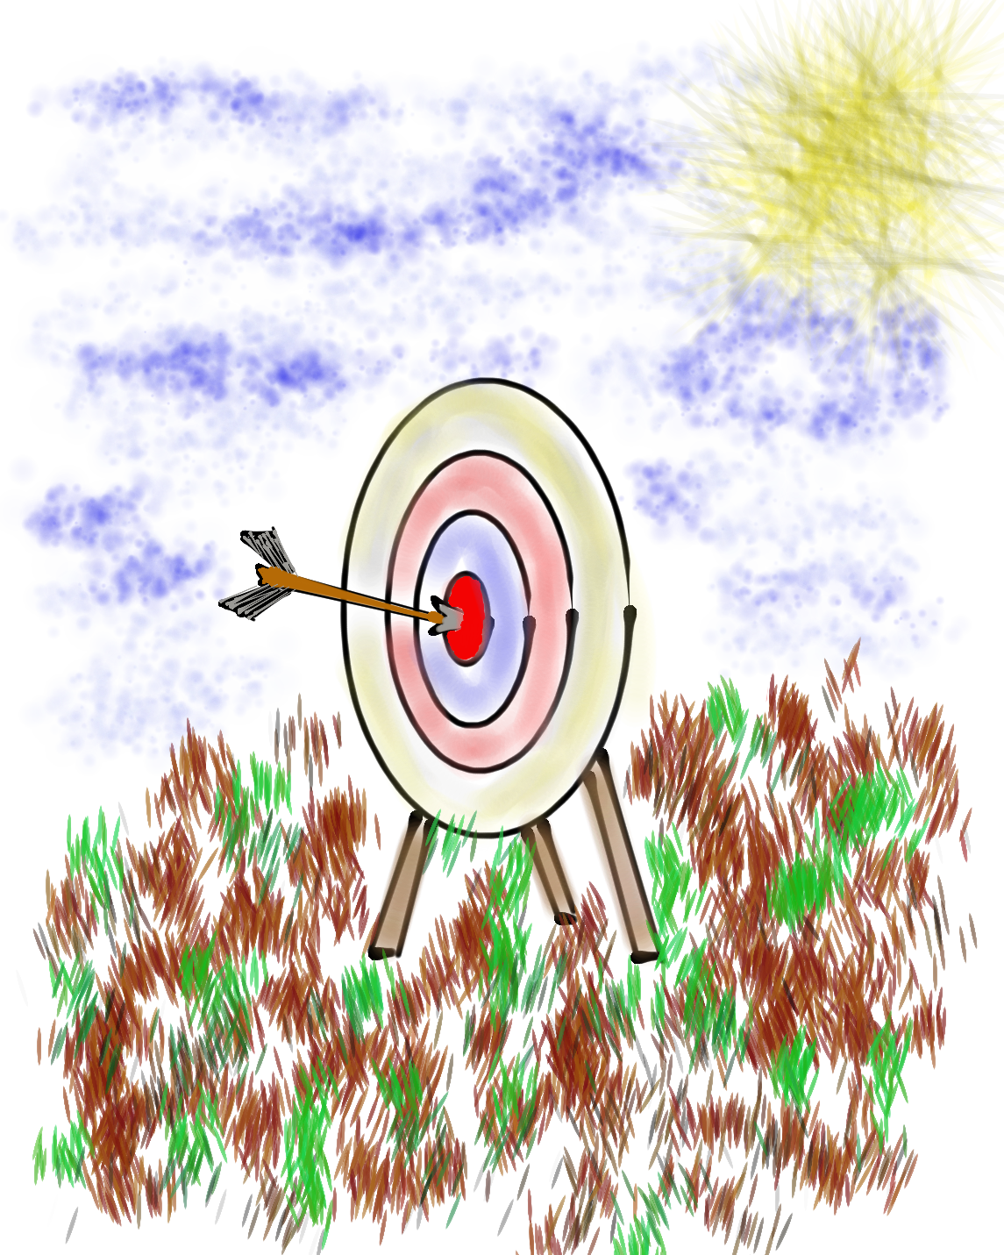
Learning Intention
We are learning to amplify our skills of collaboration, communication, & celebration as a Schools of Action Community.
Success Criteria
Engage in meaningful collaboration across Schools
of Action teams.
Consider the current status of communication at your
school & possibilities for improving communication.
CELEBRATE the incredible progress being made &
get excited for continuing forward progress.

Slide 4
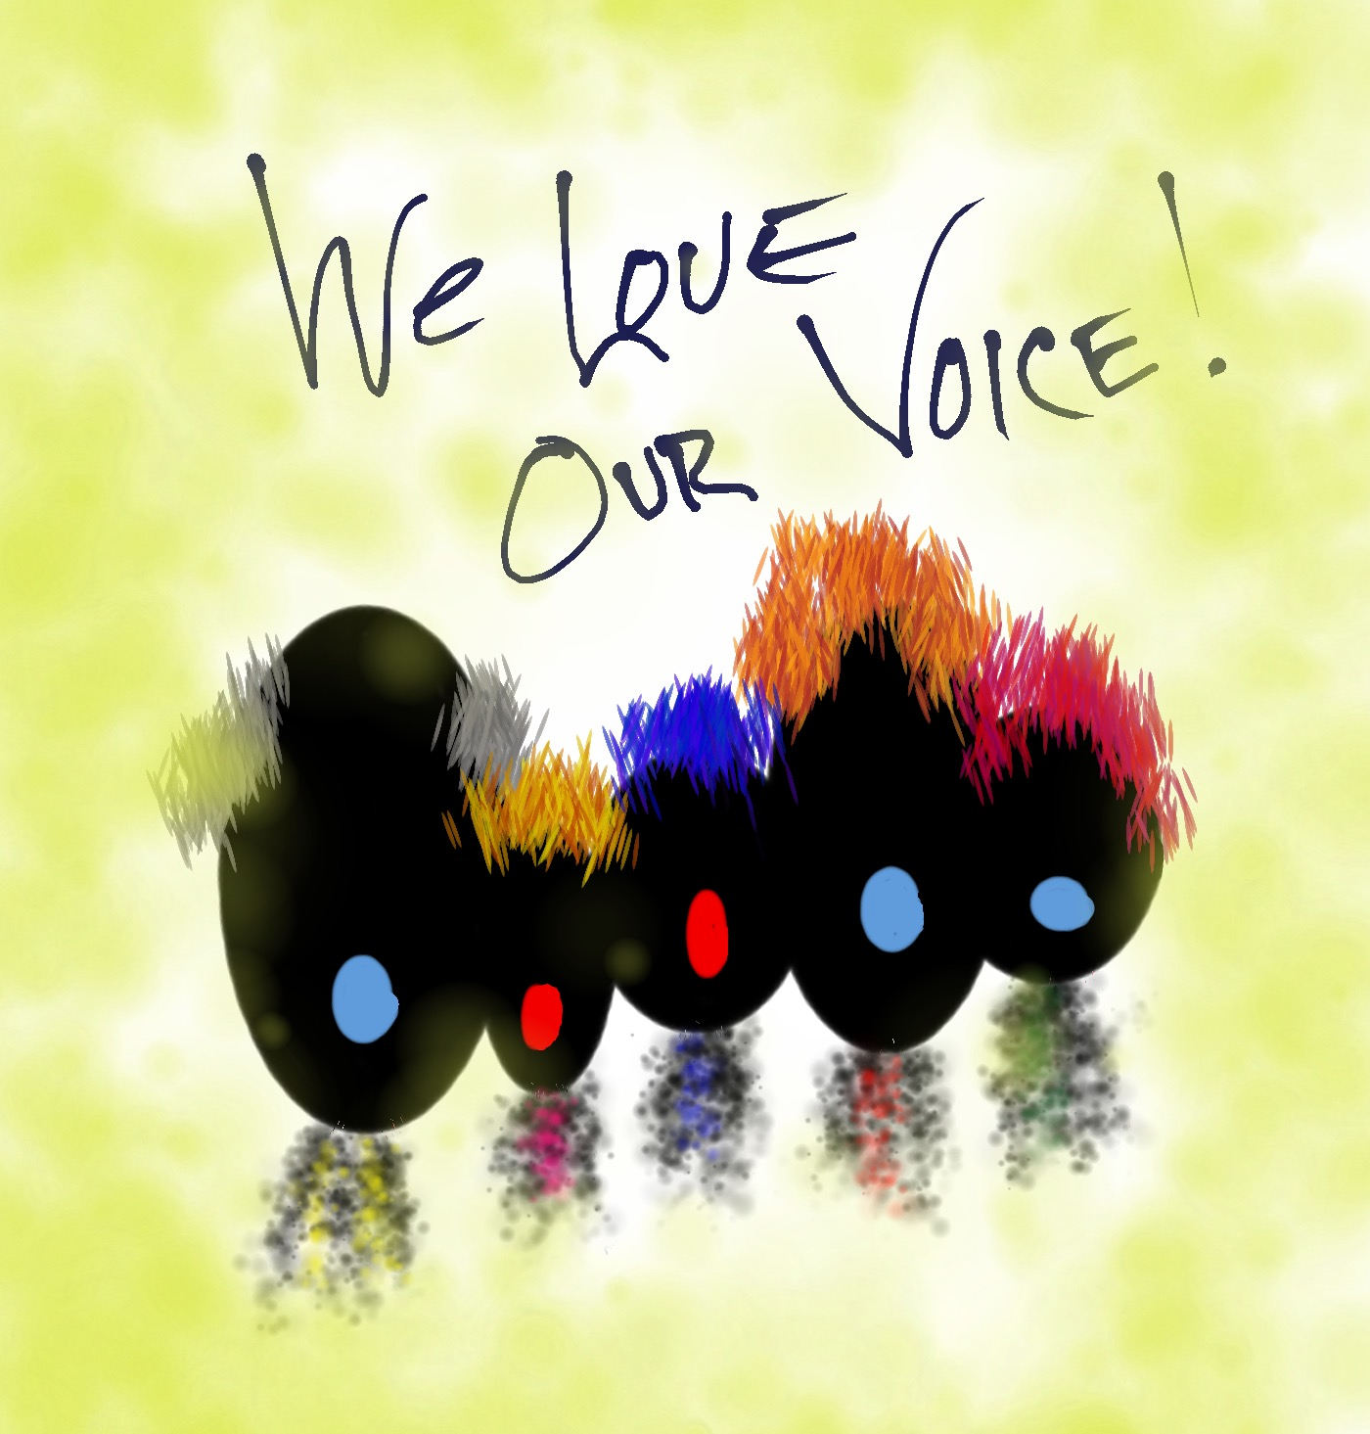
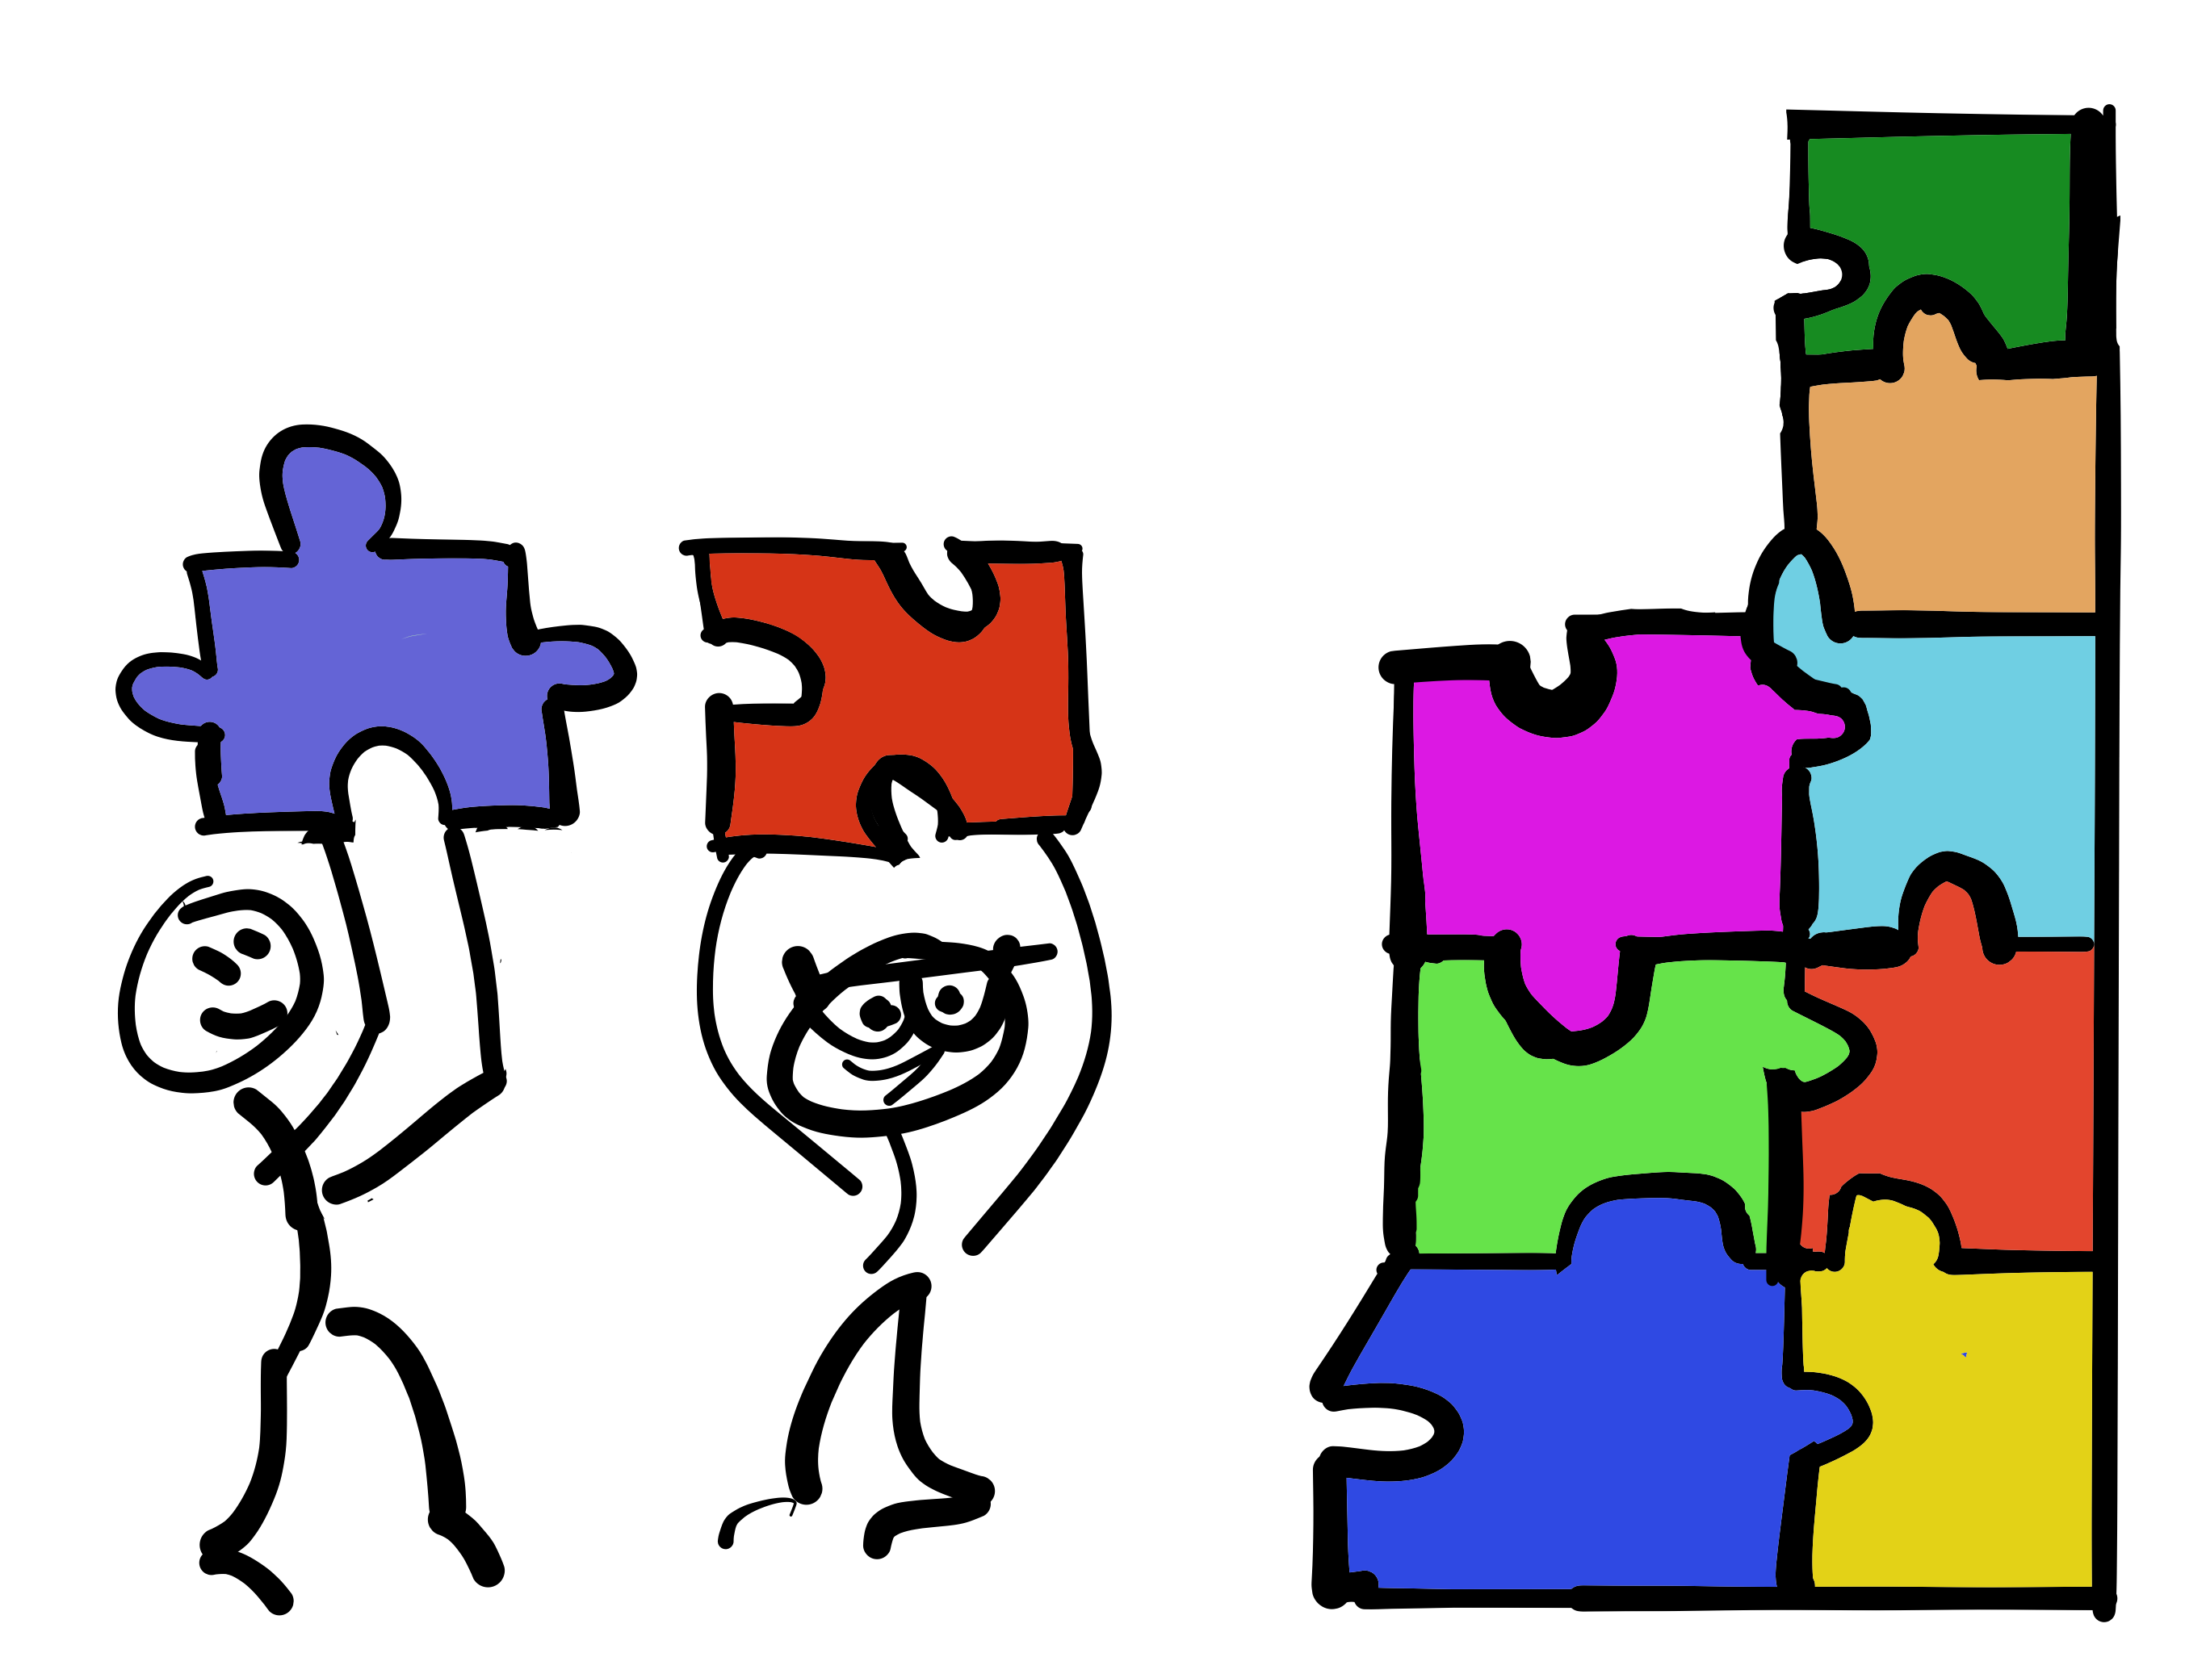

C3 Summit
Communicate
Collaborate
Celebrate

Slide 5
Communicate

Slide 6
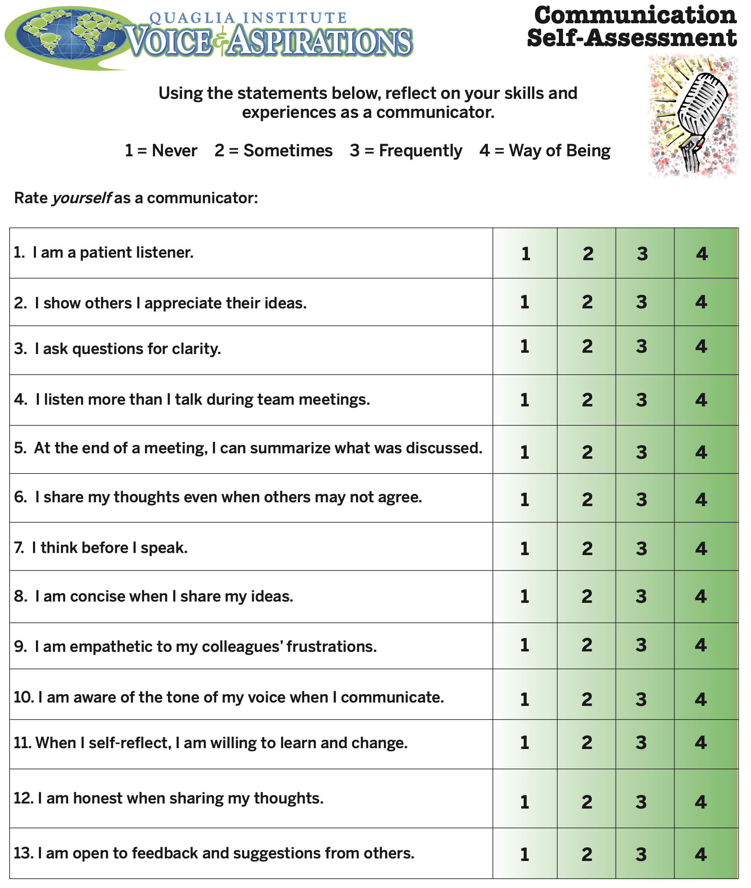

Communication Self Assessment Part 1
Part 1:
Complete the Personal Communication
Self Assessment.
Part 2:
Discuss what you
learned about yourself with a “Meet With Your Feet” partner.

Slide 7
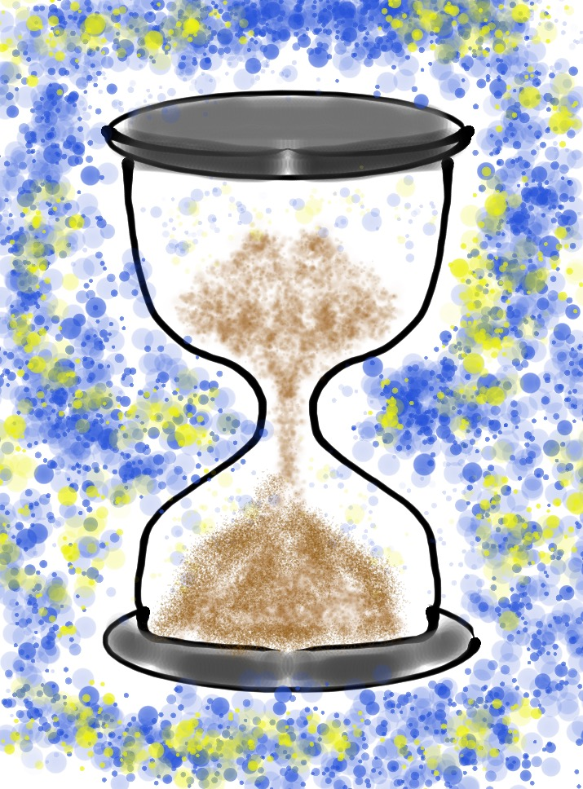
Quick Break!

Slide 8
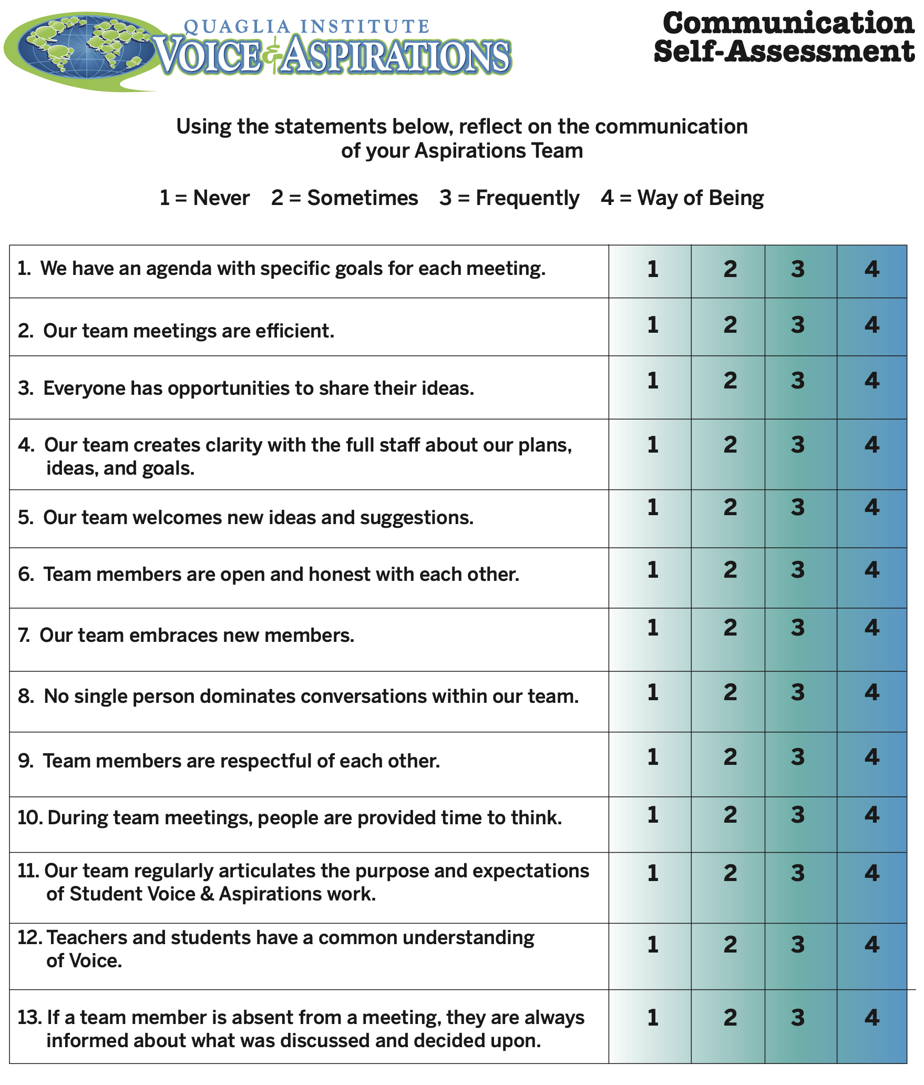
Communication Self Assessment: Part 2
Part 1:
As a school team,
reflect on your collective communication.
Part 2:
Pair up with another
school group & share
your communication
strengths.

Slide 9
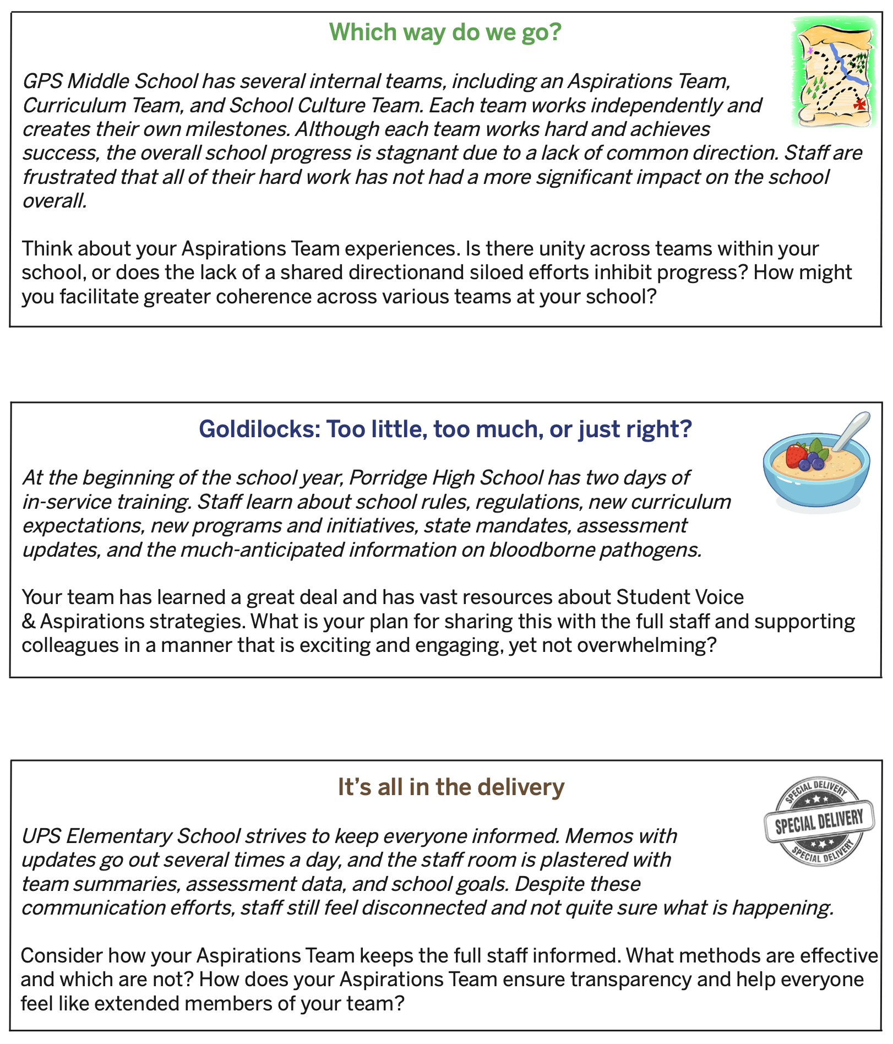
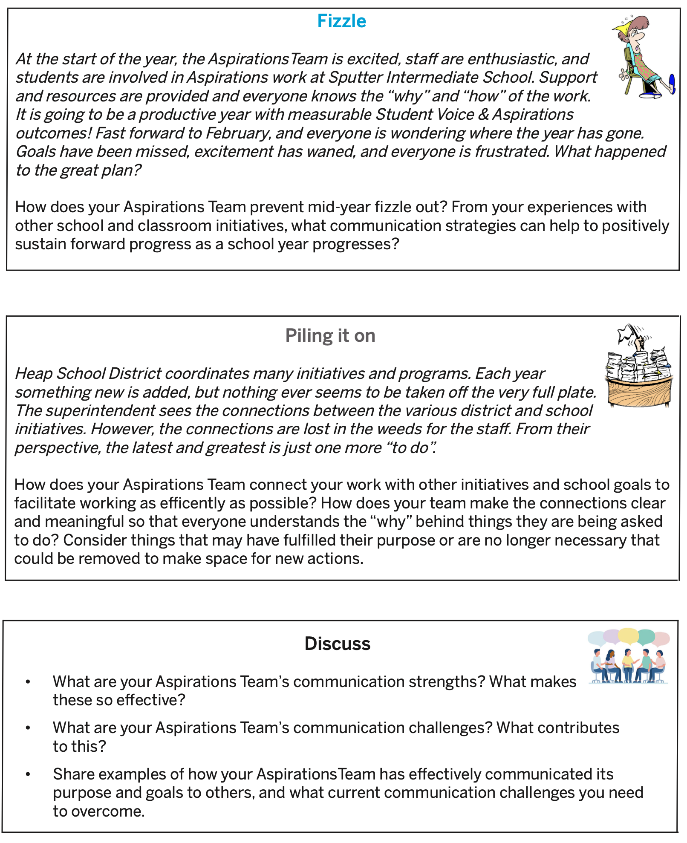
Communication Challenges
Part 1:
Number off 1-5 & work through the scenario assigned to your group.
Part 2:
Share highlights from group discussions.
Part 3:
Work the Discuss
questions with your school team.

Slide 10
Collaborate

Slide 11
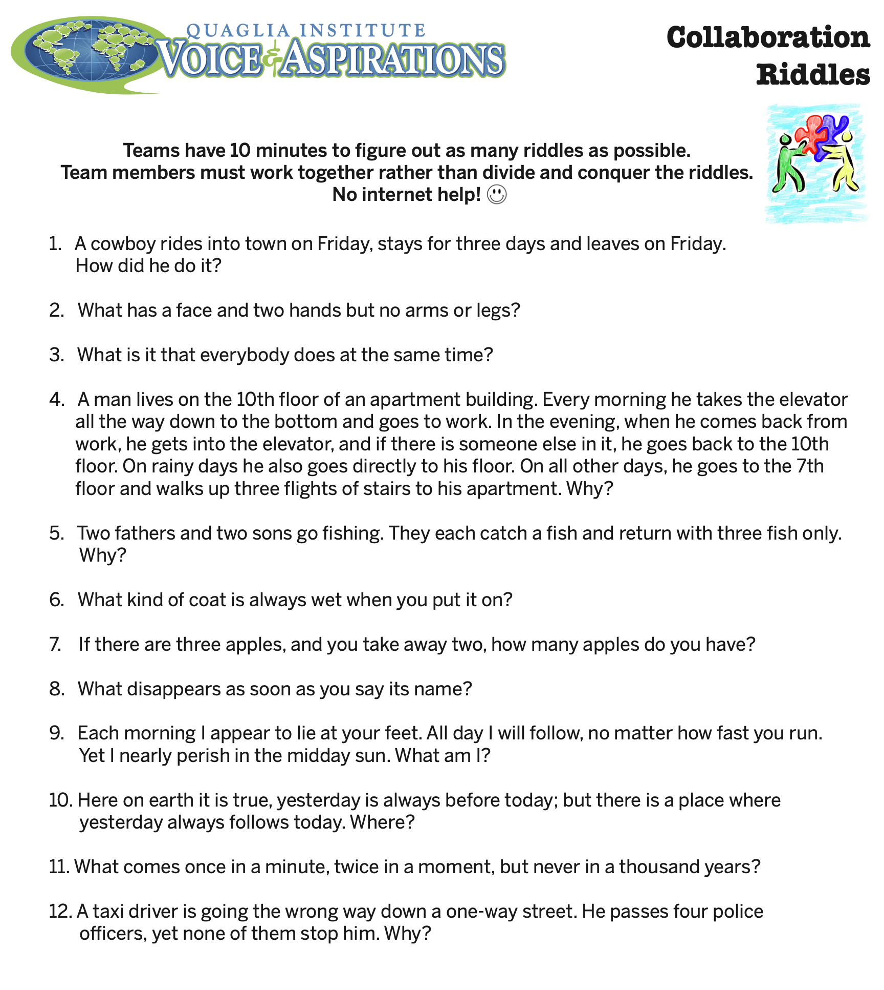
Collaboration Riddles

Slide 12
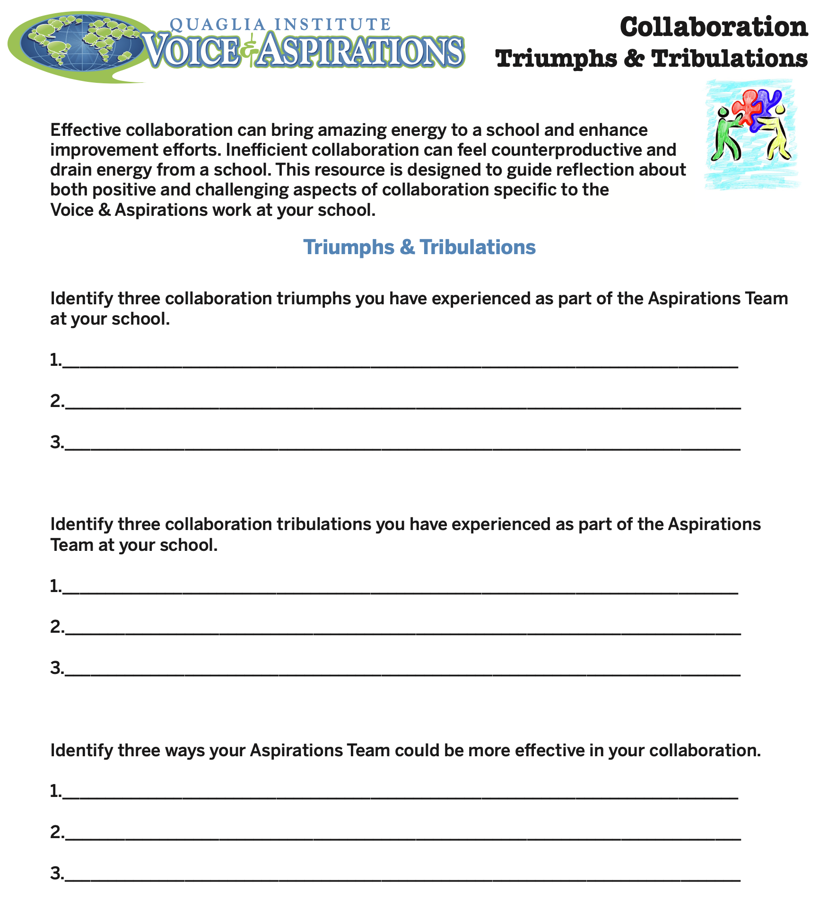
Collaboration Triumphs
& Tribulations
Part 1:
Complete page 1 with your school team.
Make sure everyone
on the team is ready to share with others!

Slide 13
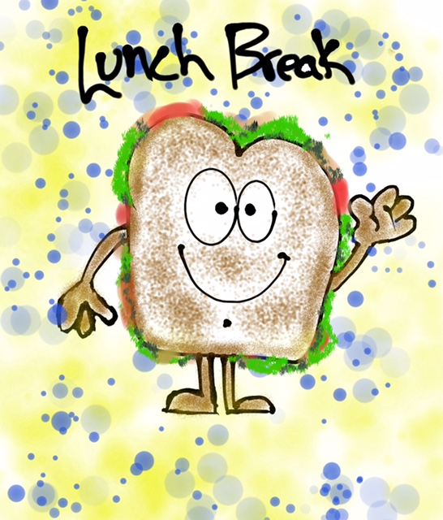

Slide 14
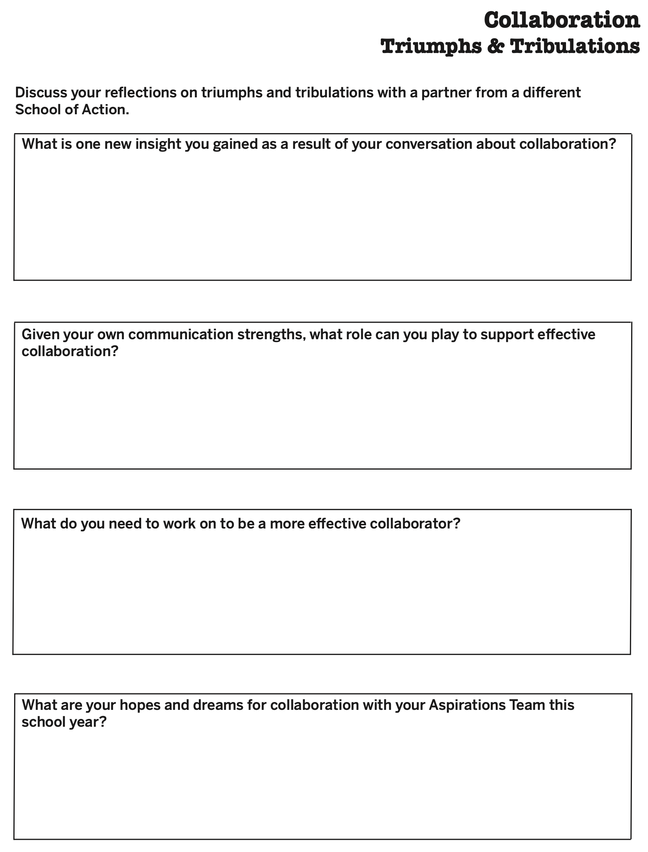
Collaboration Triumphs
& Tribulations
Part 1:
Complete page 1 with your school team.
Part 2:
Complete page 2 with a partner from a
different school.
Part 3:
Return to your school team & share what
you learned.

Slide 15
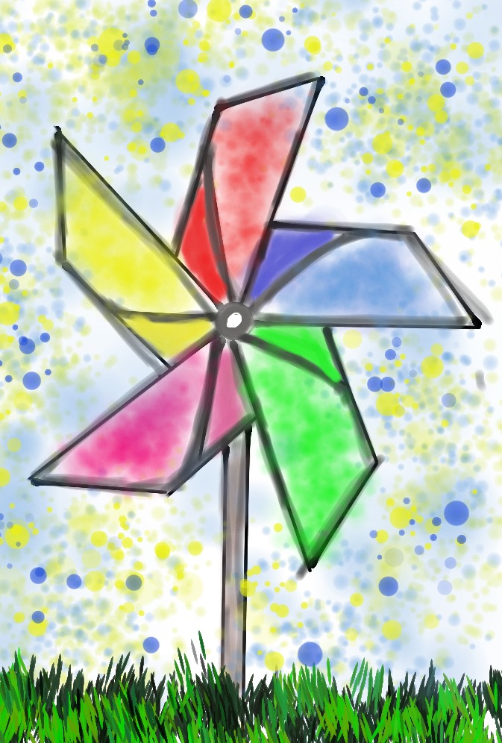
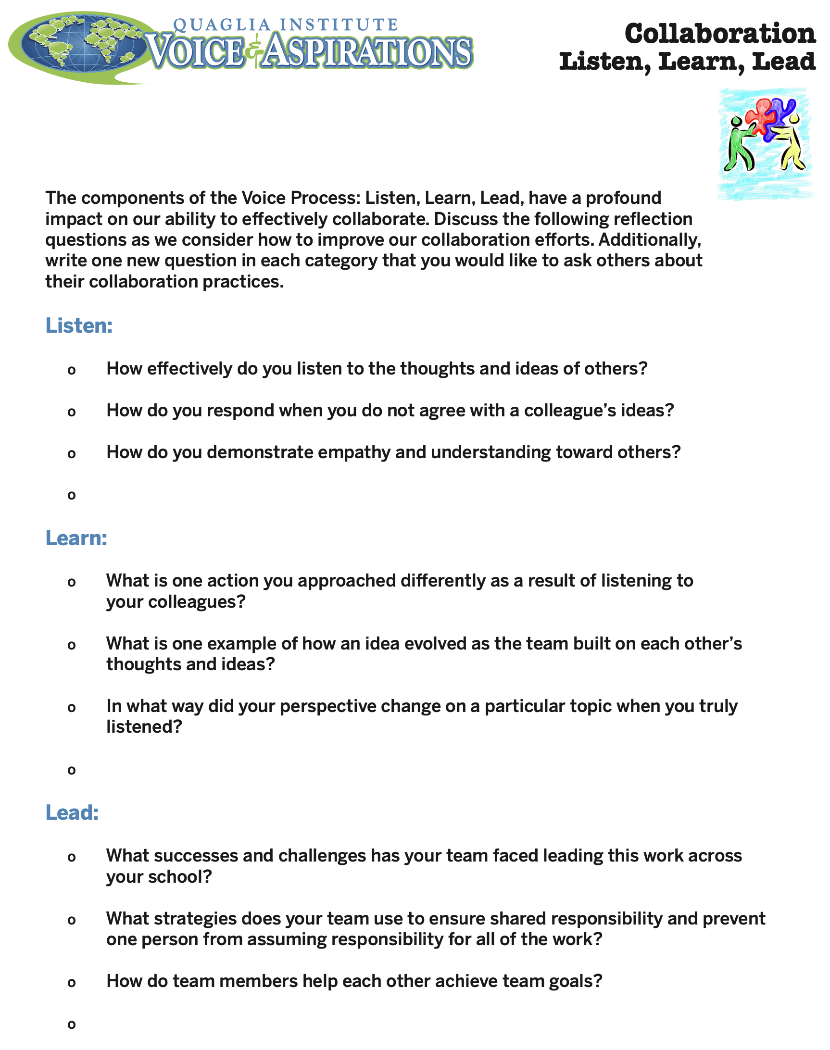
Collaboration
Listen, Learn, Lead
Pinwheel groups of 6.
3 Rounds of Listen.
Outside 3 in the pinwheel
moves to a different group.
3 Rounds of Learn.
Outside 3 move to a
different group.
3 Rounds of Lead.

Slide 16
Celebrate

Slide 17
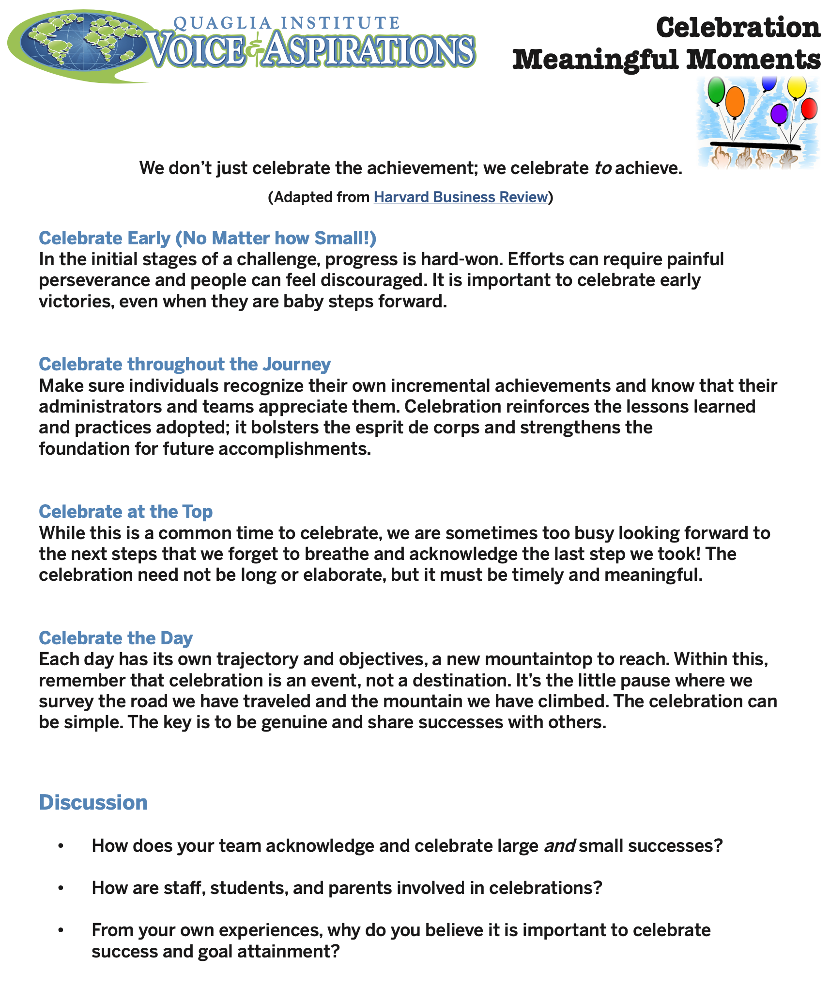
Celebration
Meaningful Moments
Celebration Tips Read Aloud.
Groups of 3 representing
different schools.
Work through the Discussion questions.
Return to school team &
share one thing you learned.

Slide 18
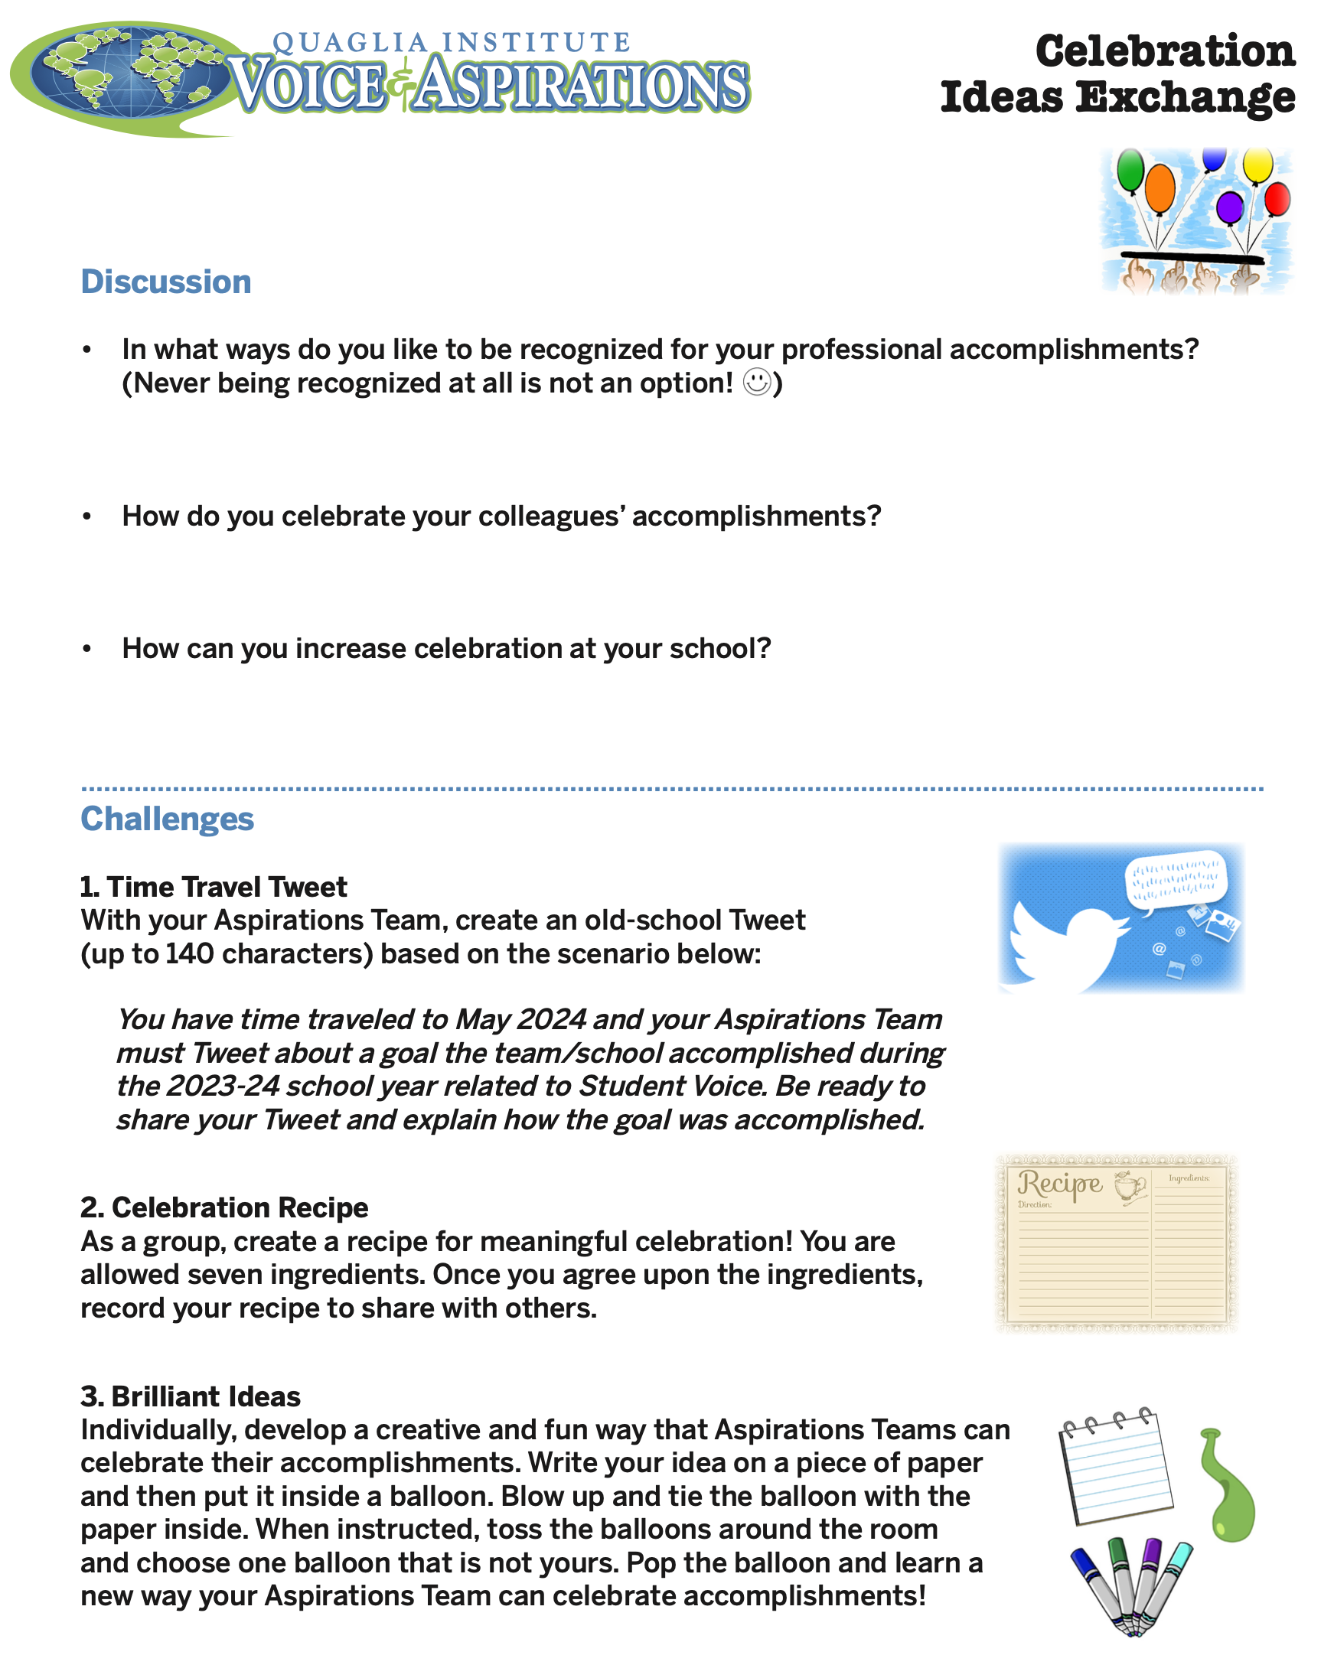
Celebration Ideas Exchange
Work through the
discussion questions.
(somewhat quickly! ☺)
Complete Challenge 1 OR 2.
Everyone complete
Challenge 3 (1 balloon
per school team).

Slide 19

Closing Thoughts
from Dr. Russ!

Slide 20
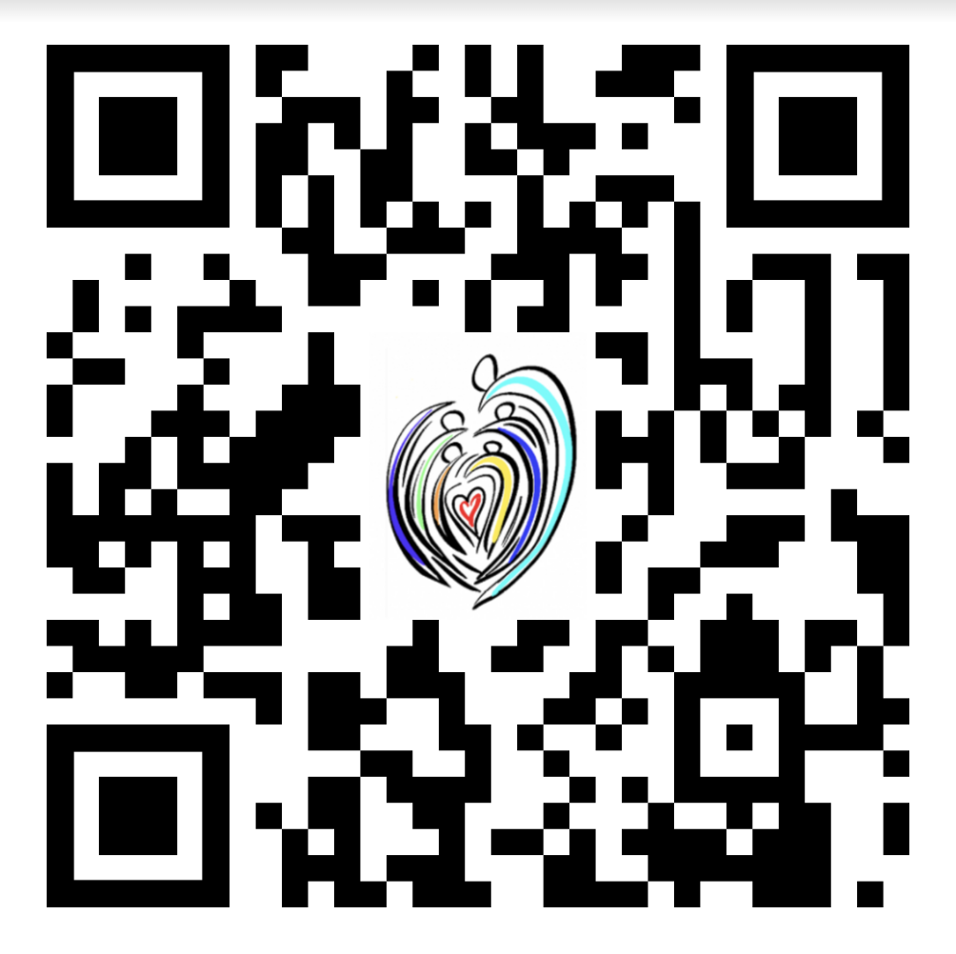
Website Just for You!
https://quagliainstitute.org/c3

Slide 21
Thank you for Communicating, Collaborating, & Celebrating with us today!
See you in September!
Dr. Russ Quaglia
Quaglia@QuagliaInstitute.org
Dr. Lisa Lande
Lande@QuagliaInstitute.org
www.quagliainstitute.org
@QISVAtweets

