Slide 1



The Power of Purpose
Dr. Russ Quaglia & Dr. Lisa Lande www.quagliainstitute.org
@QISVAtweets
June 27, 2025

Slide 2

Introductions &
Opening Reflection
Name & School
What is something about your job as a Principal that you
are passionate about?

Slide 3

Learning Intention
We are learning about Purpose as a renewable energy source to fuel & guide educators.
Success Criteria
Consider how Purpose is the driving force that gives
meaning to educators’ actions.
Reflect on previous learning about the importance of
Values & further explore the element of Passion in
relation to your Purpose as an educator.
Leverage your Purpose as energy to guide your career,
shape decisions, & motivate you towards personal
fulfilment & contributions to the greater good.

Slide 4



Last Summer…
All Year
Long…
Get Ready
for Today!!!

Slide 5
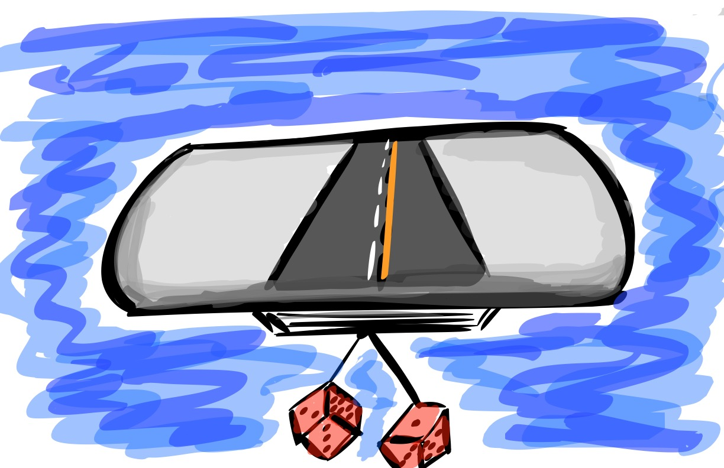
Quick Review

Slide 6
Purpose: The Renewable Energy in Education

Slide 7
Purpose Matters
Directs Energy Toward Meaningful Goals
Fosters Social Connection & Contribution
Promotes Productivity & Achievement
Helps Navigate Uncertainty & Change
Enhances Personal Well-Being

Slide 8
Four Key Elements
to Purpose
Values
Passions
Aspirations
Talents

Slide 9


ELEMENTS OF PURPOSE
Aspirations
Talents
Values
Passions

Slide 10
Values

Slide 11
Values
The moral compass guiding our
choices & actions.
Guides Decisions
Shapes Goals
Influences Behavior

Slide 12
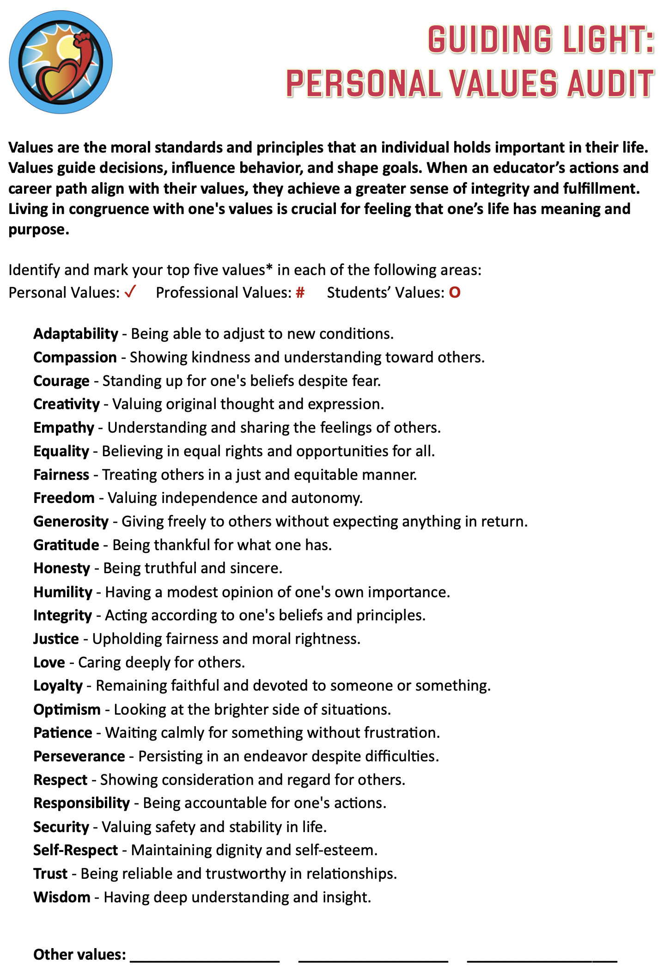

Slide 13
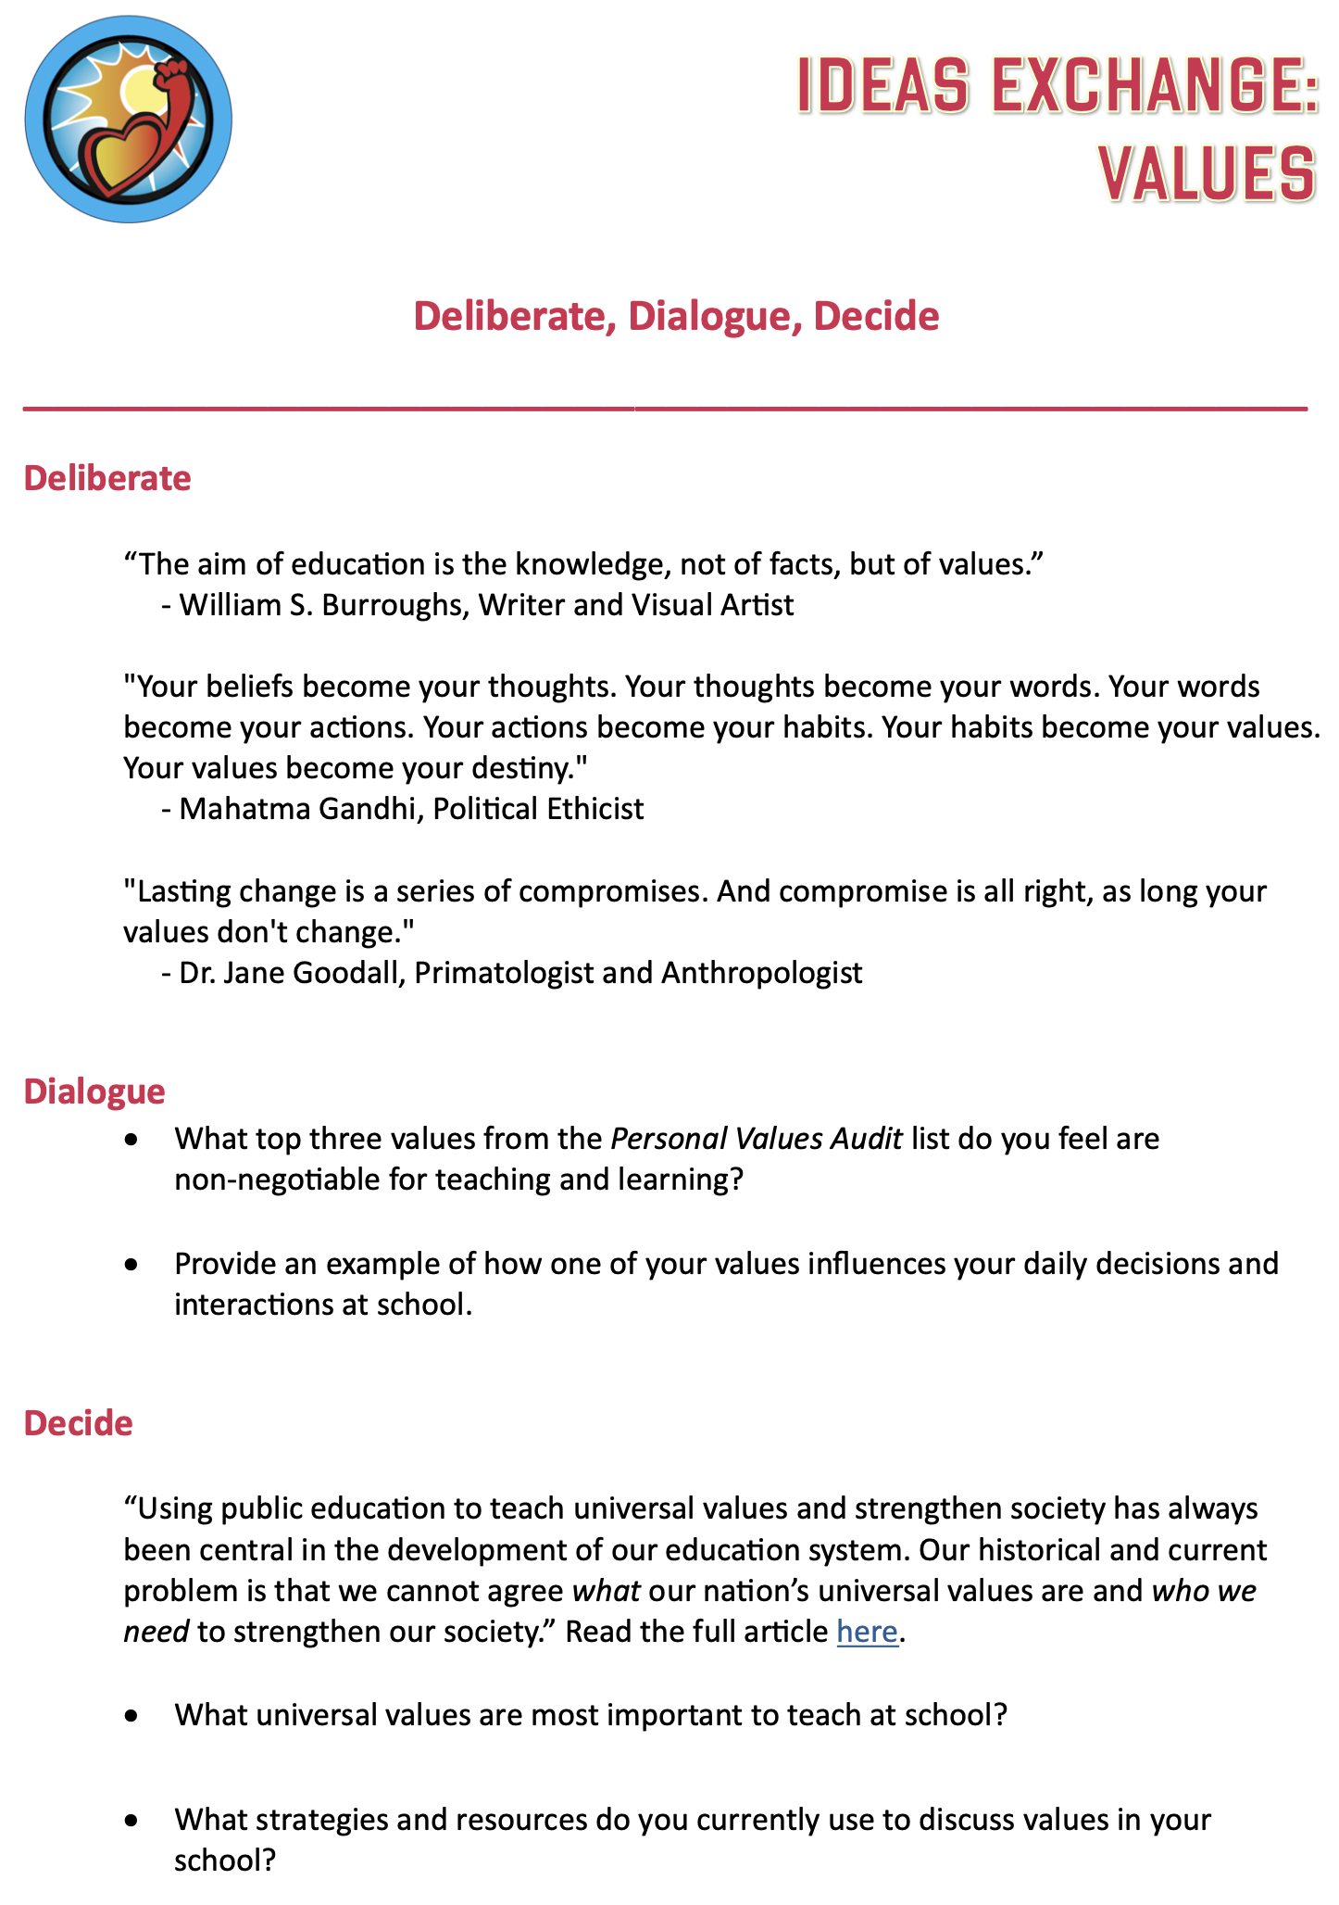
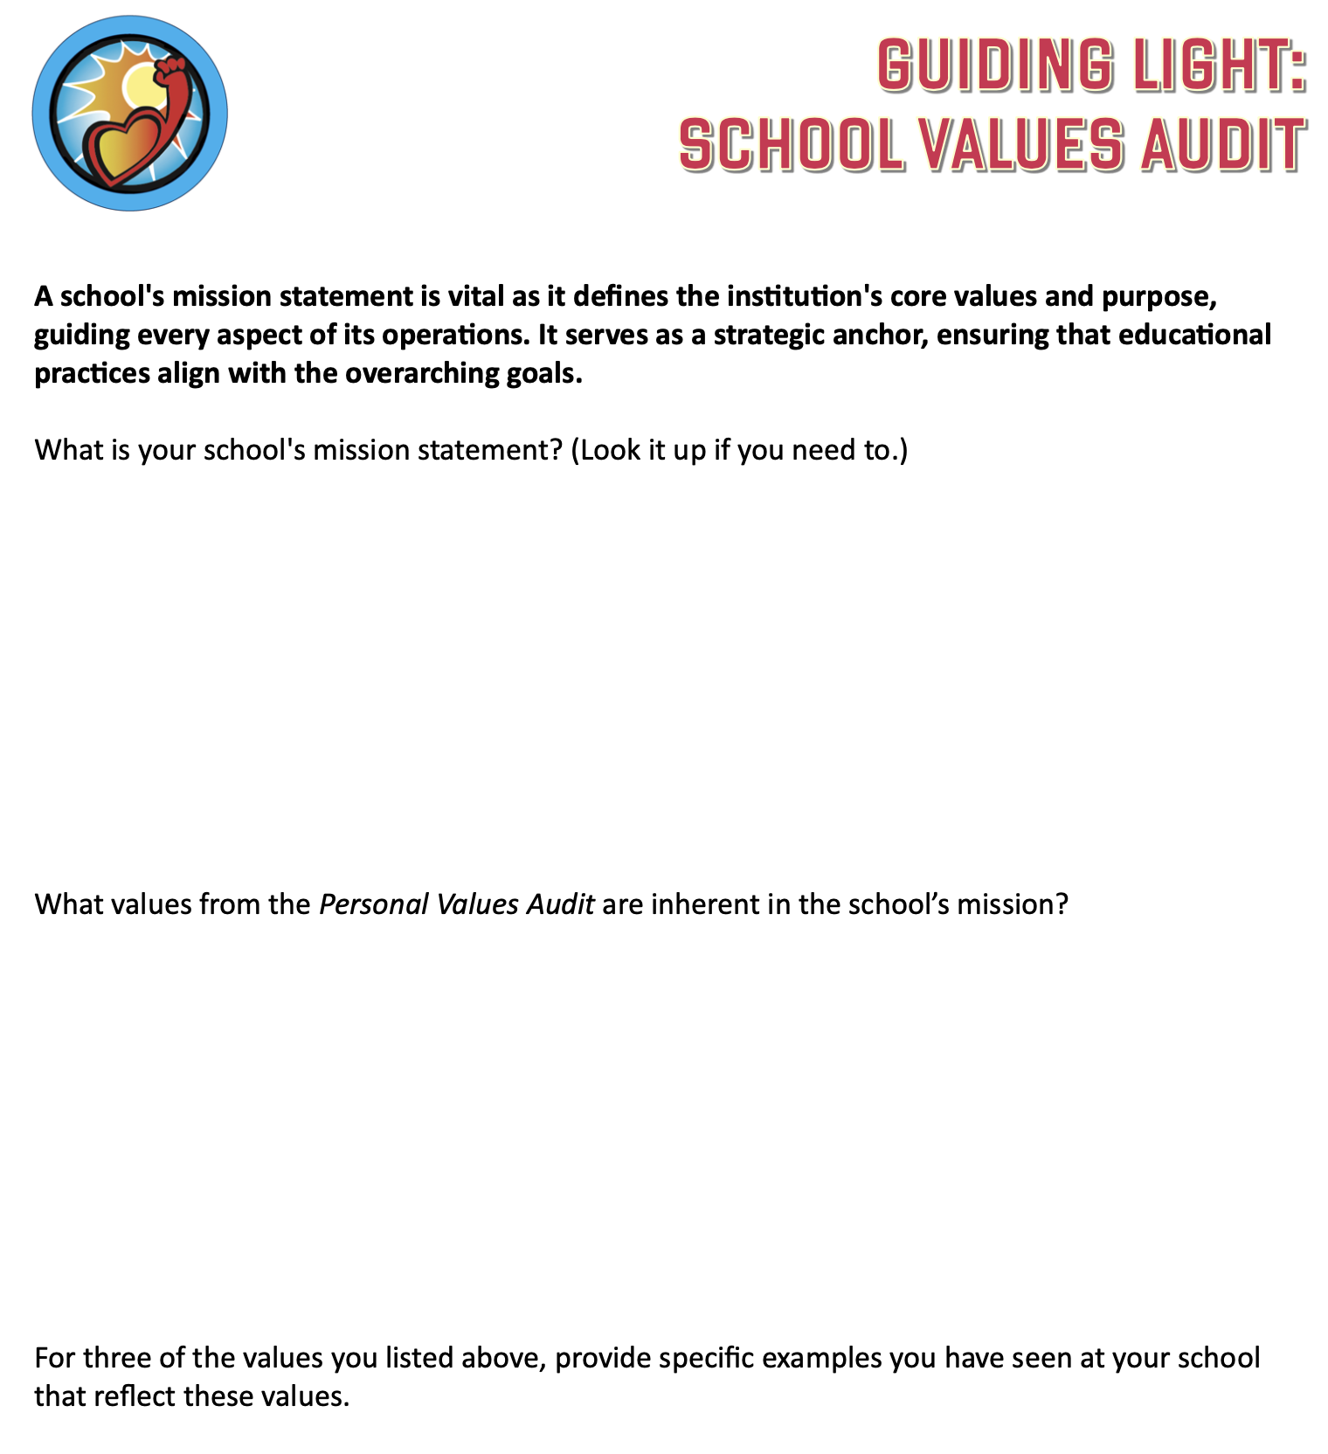

Slide 14
Reflect
What additional thinking did you do this
past year about Values?
Did Values play a role in the work you did
to lead your school this past year?

Slide 15

Challenge Time…

Slide 16

Values Auction
What do
you value?

Slide 17
Preparing for the
Values Auction
Your team gets $2,000!!!
Explore the Values Cards & determine your
strategy for the auction. What items do you
most want to purchase for the Maui Complex? How much are you willing to spend on what?
Courage
Creativity
Empathy
Equality
Freedom
Generosity
Gratitude
Honesty
Love
Security
Trust
Wisdom

Slide 18
Auction
Time!!
Courage
Creativity
Empathy
Equality
Freedom
Generosity
Gratitude
Honesty
Love
Security
Trust
Wisdom

Slide 19
Reflect
Why are values important to
consider as a Principal?
How do you go about leading when differing values
& ideas exist in your school
community?

Slide 20

Quick Break!

Slide 21
Passions

Slide 22
Passions
The driving forces that ignite our
enthusiasm & dedication.
Fuels Motivation & Persistence
Inspires Others
Drives Innovation & Creativity

Slide 23
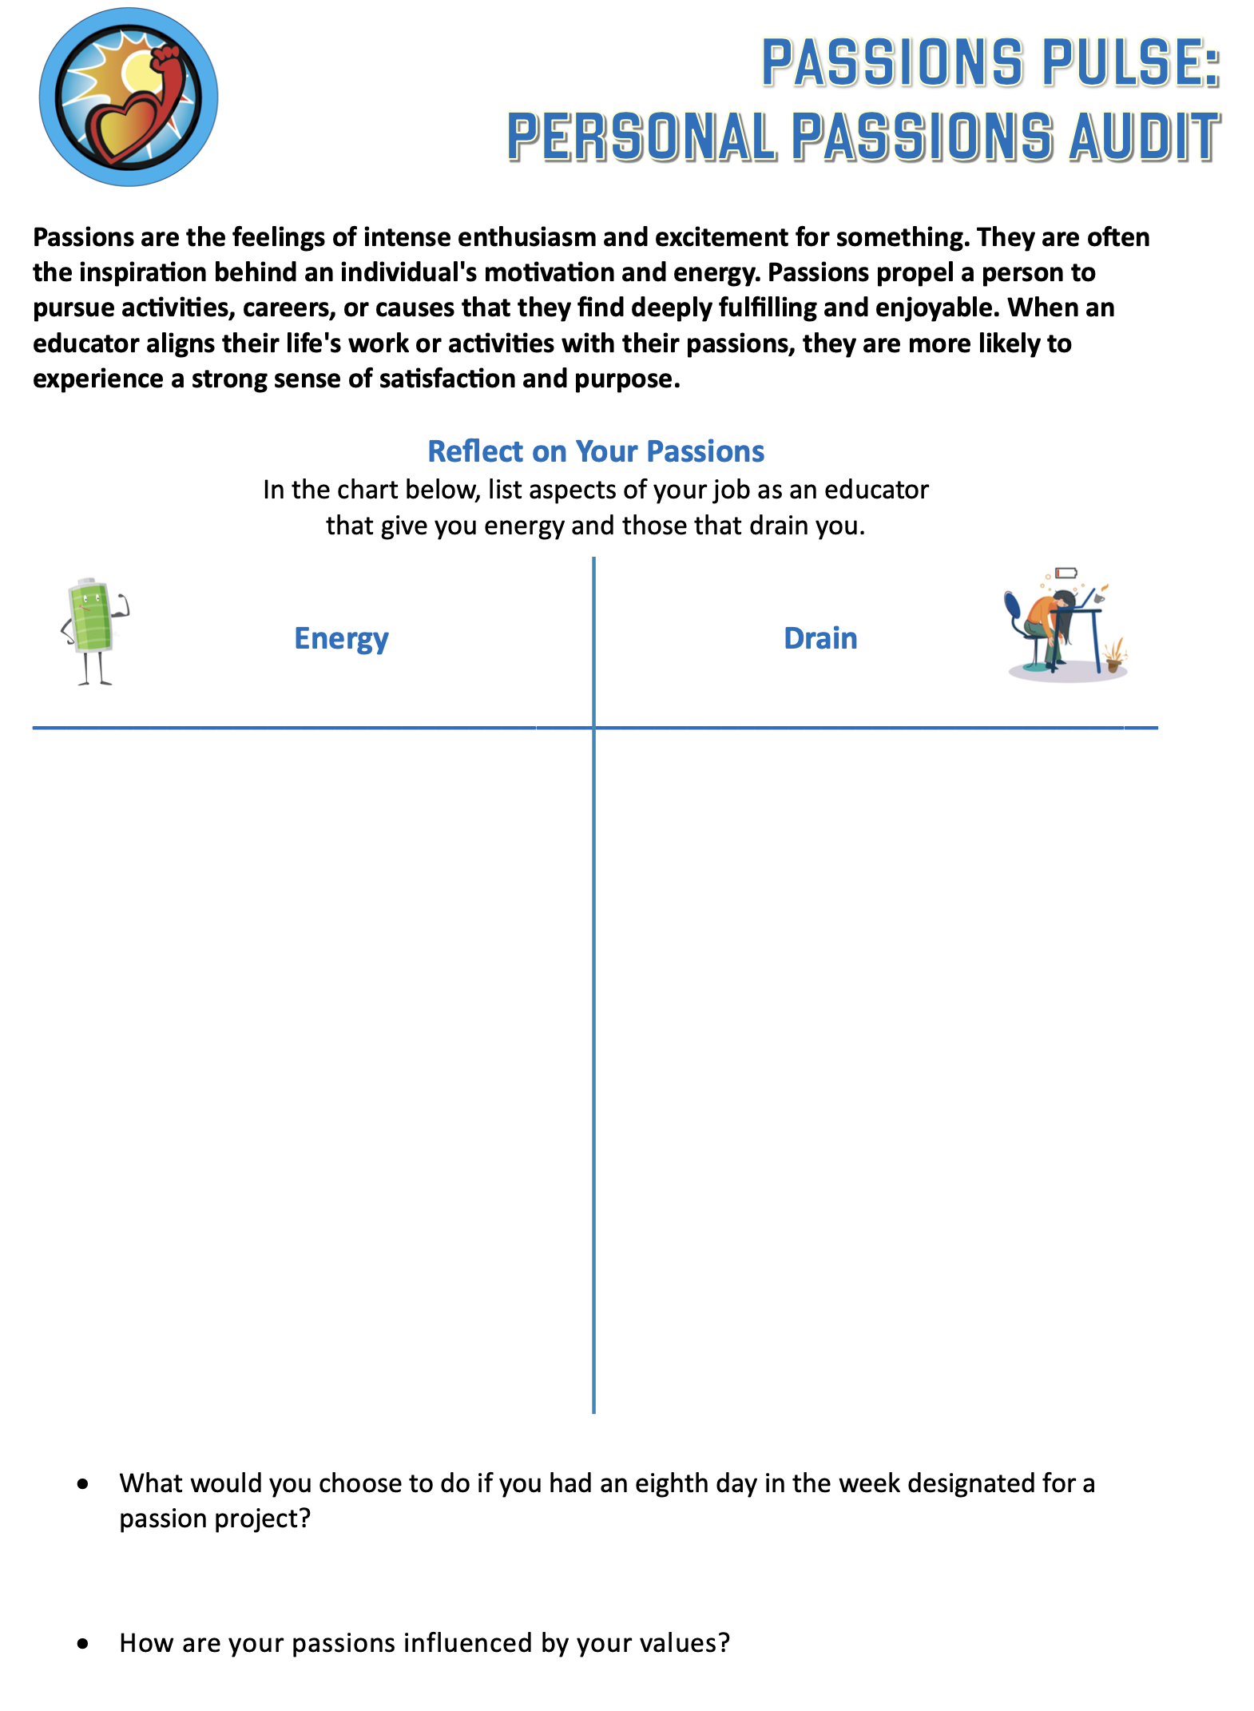
Passions Pulse:
Personal Passions Audit
Find a partner
not sitting at your
table. Interview one
another to complete the Audit. You will
fill out the questions about your partner & give to them at the
completion of the
activity.

Slide 24
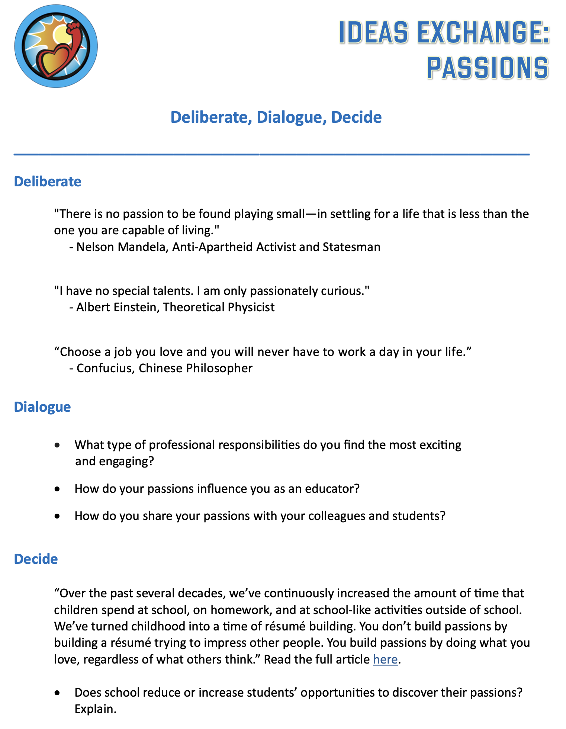
Ideas Exchange:
Passions
Part 1:
Deliberate with
your table group.
Part 2:
Dialogue with your
assigned partner.
Part 3:
Decide is an opportunity
to extend your learning
& continue your
reflection post-session.

Slide 25


Slide 26


Resin-ate Your Passion: Art Time with Dr. Russ!

Slide 27
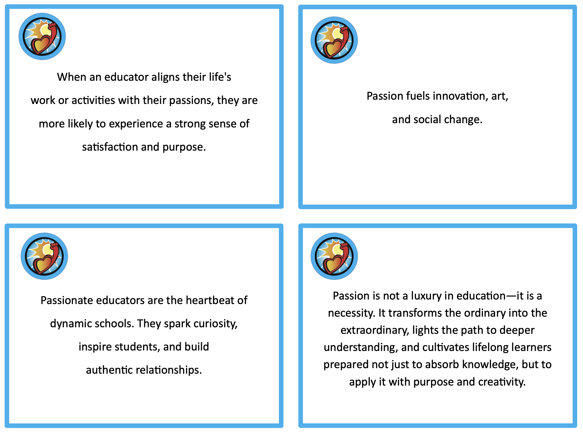
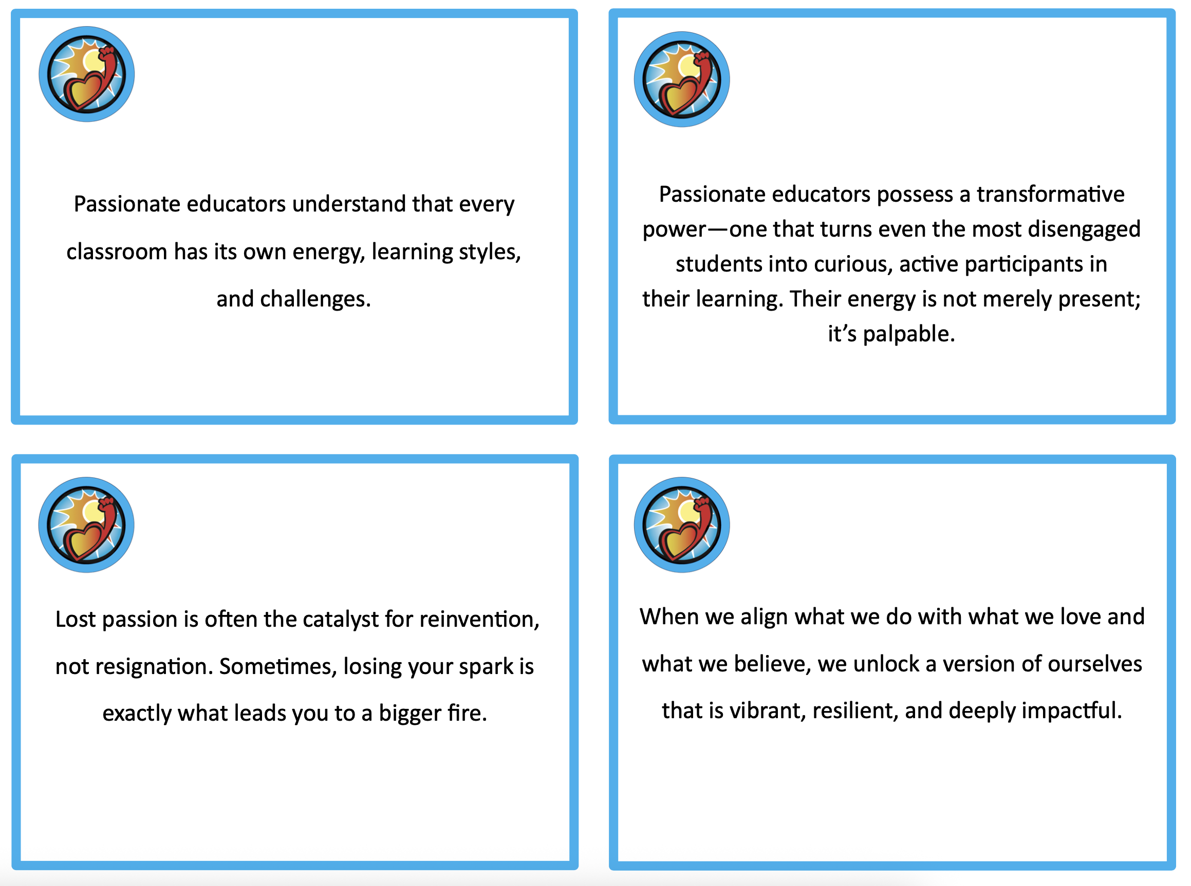
Quotes & Questions
Part 1:
Write 10 questions
related to your
Passions Quote.
Part 2:
Discuss 2-3 questions from your list with a partner who has the
same color boarder around their quote
(blue, red, orange).

Slide 28
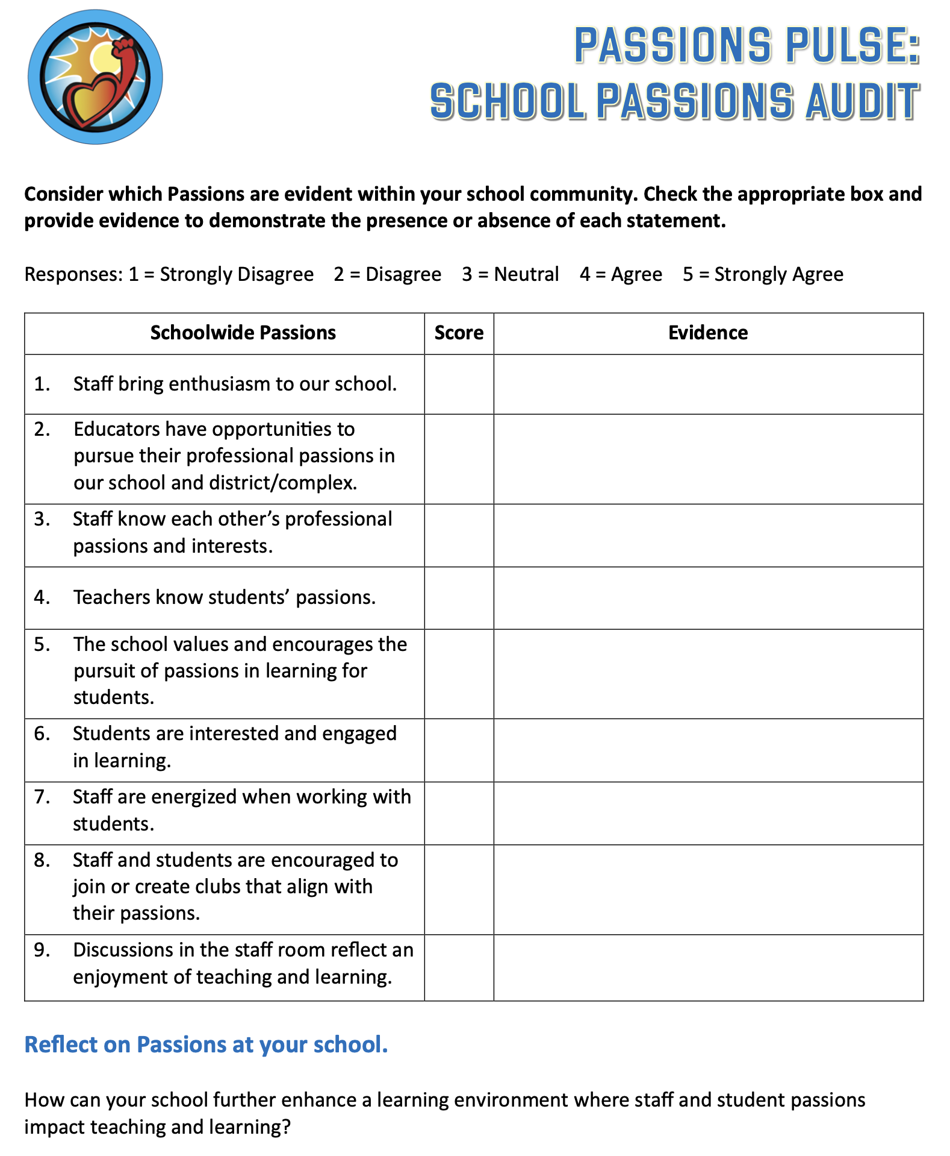
Passions Pulse:
School Passions Audit
Part 1:
Work through the
School Audit
individually.
Part 2:
Discuss with a partner of your choice.

Slide 29
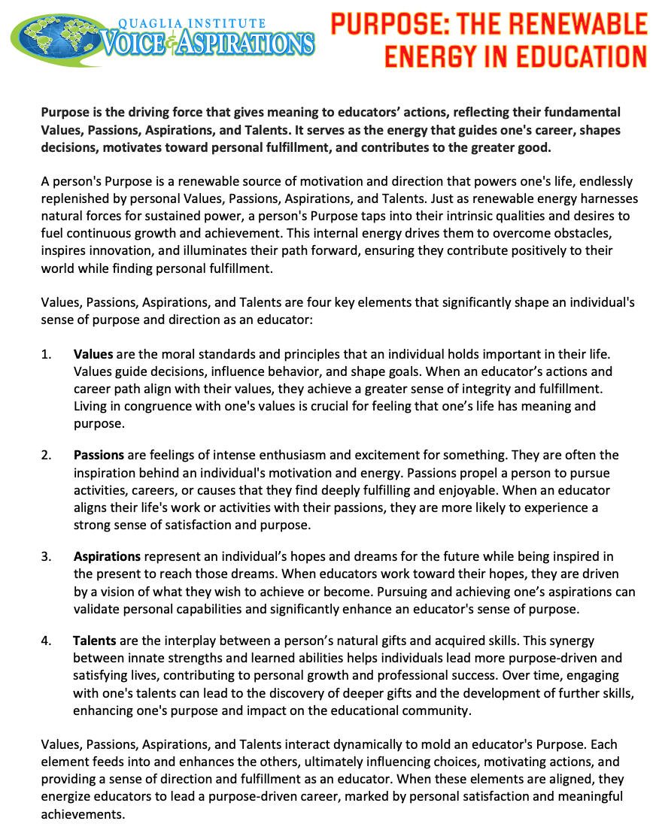

Slide 30
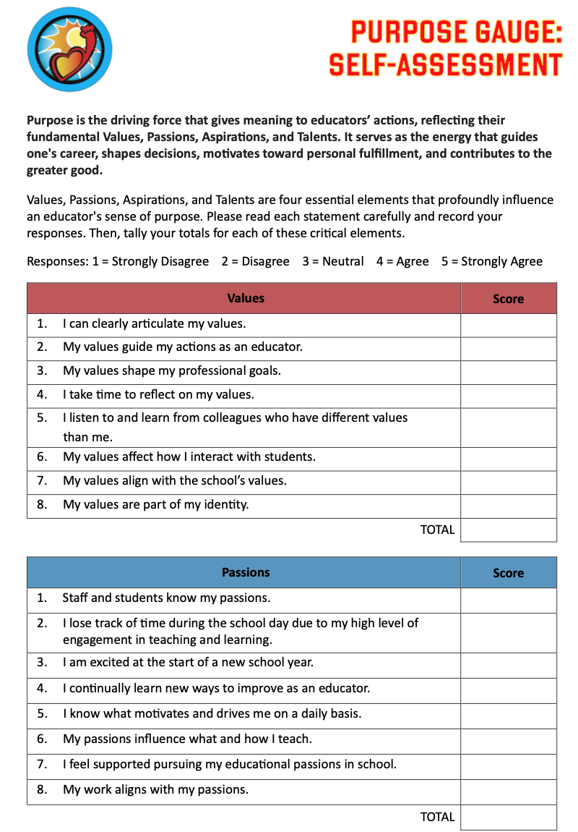
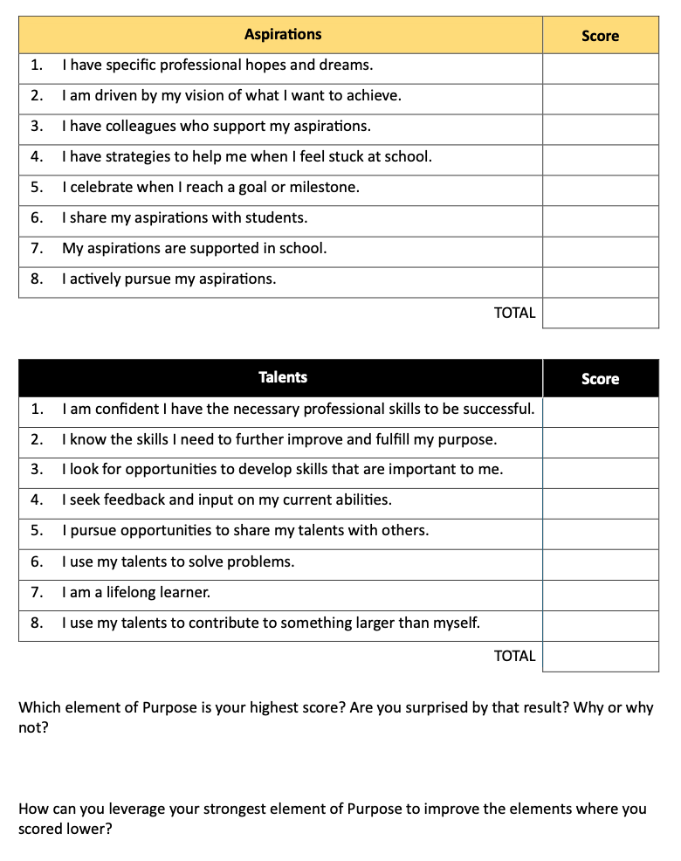

Slide 31
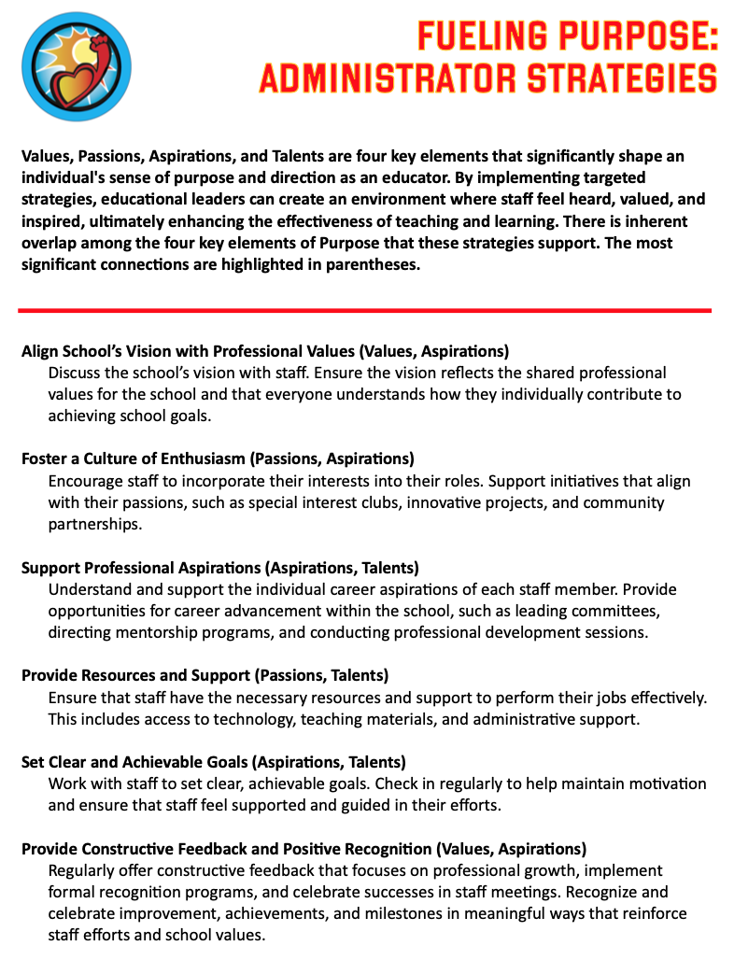
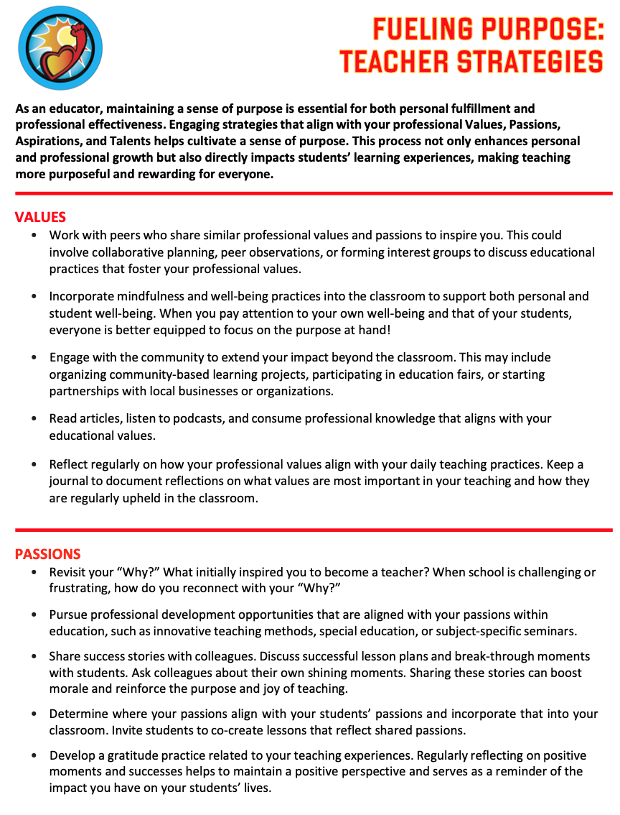
Fueling Purpose
Admin & Teacher Strategies
Take Away
Strategies to
support fueling
Purpose for
Administrators & Teachers

Slide 32

Website Just for You!
https://quagliainstitute.org/the-renewable-energy-in-education

Slide 33
Closing Thoughts
from Dr. Russ!

Slide 34

Thank you for learning with us! Reach out with any questions or to continue
the conversation!
Dr. Russ Quaglia
Quaglia@QuagliaInstitute.org
Dr. Lisa Lande
Lande@QuagliaInstitute.org
www.quagliainstitute.org
@QISVAtweets

