Slide 1


Voice & Vision:
Using Data to Guide Implementation
Dr. Kristine Fox & Sue Bryen with special guest Dr. Russ Quaglia

Slide 2
Fundamental Beliefs
Students are the potential, not the problem.
Students have something to teach us.
Working together is the only way forward.
Notes:
How do we enact these beliefs in our day to day work. Does our practice reflect these beliefs?

Slide 3
Goals for Today
Dig deeper into student voice pathways
and skills and use of student perspectives
Consider how Student Voice Data
informs progress towards school vision
Apply learning to amplify student
voice in YOUR school.

Slide 4
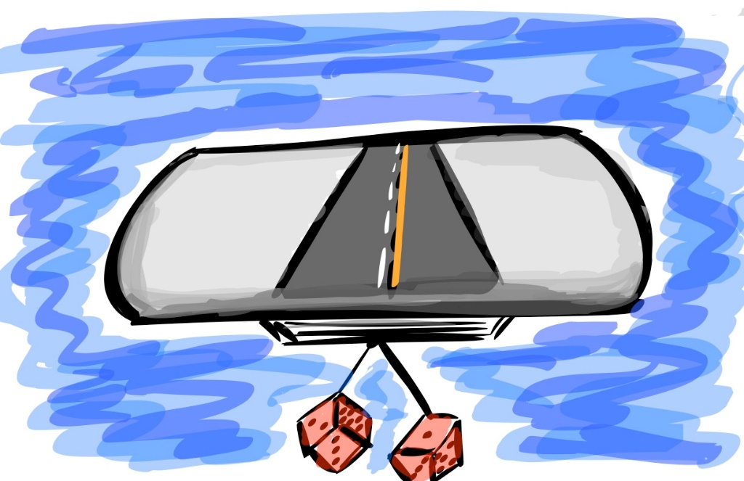
Quick Review

Slide 5

The 3 Components of Student Voice
Sharing thoughts & ideas in an environment underpinned by trust and respect.
Offering realistic suggestions for the
good of the whole.
Accepting responsibility for not only what you say but what needs to be done.

Slide 6
ASPIRATIONS
The ability to
dream and set goals
for the future,
while being inspired
in the present
to reach those dreams.

Slide 7




high
Imagination
Aspirations
DREAMING
Hibernation
Perspiration
low
DOING
high

Slide 8
LEAD
TAKE ACTION
with others
Share
RESPONSIBILITY
LEARN
UNDERSTAND
& RESPECT
different points
of view
Build
TRUST
LISTEN
SEEK OUT
opinions from
others
Student Voice Process

Slide 9
Trust Fall
YouTube video - https://youtu.be/aTY2WwNj8lc
Vimeo video - https://vimeo.com/qisva/trustfall

Slide 10


Reflect
What has most stuck with
you from our previous
Voice & Aspirations
learning?

Slide 11

Time to journey
onward & explore voice more in-depth in your context

Slide 12
How are students
genuinely contributing
to enacting your school
vision?
Notes:
The vision is our point of reference. Not just words, but the actions and conditions that create the vision. Do our words and actions align? If we want students to be able to… then we need to build their skills and capabilities and we can only know this through hearing and using their voice. Through all voices, we can create the conditions where every day, students are partnering with each other and teachers to listen, learn and lead together. They need to know what is current reality and what they can do to improve (learn) toward the shared vision/aspiration and goals and lead with action and shared responsibility. Moving towards engagement in learning with teachers how to improve and reach our aspirations

Slide 13
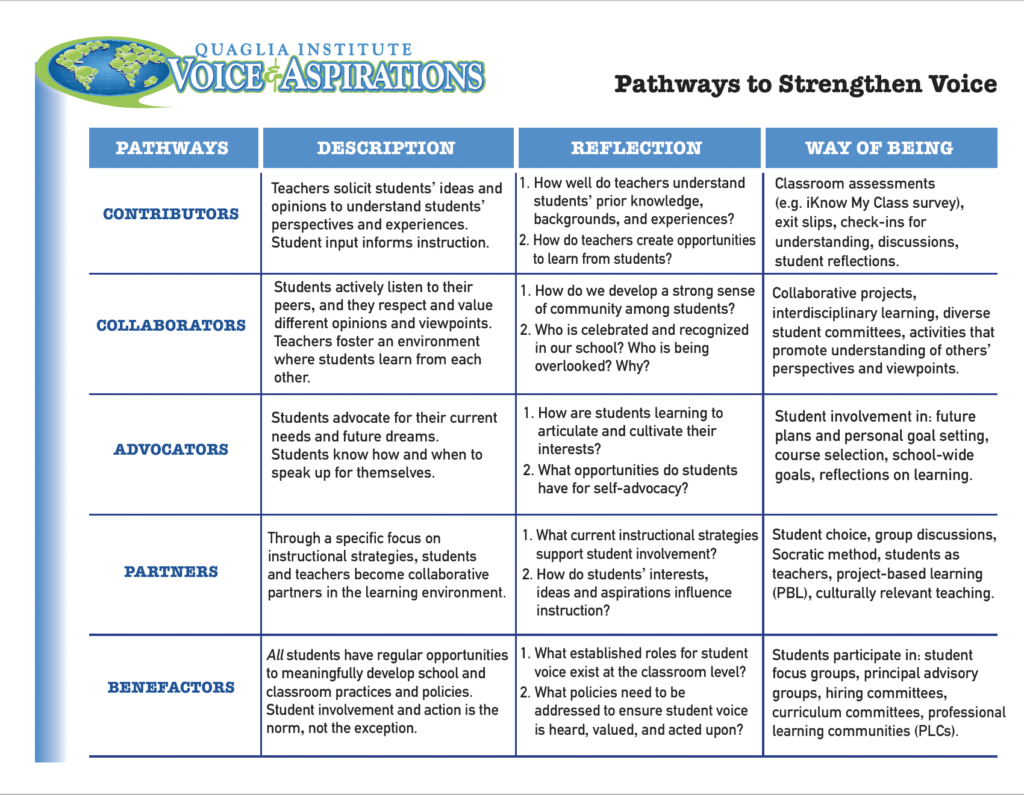
Voice Pathways
Resource #1

Slide 14
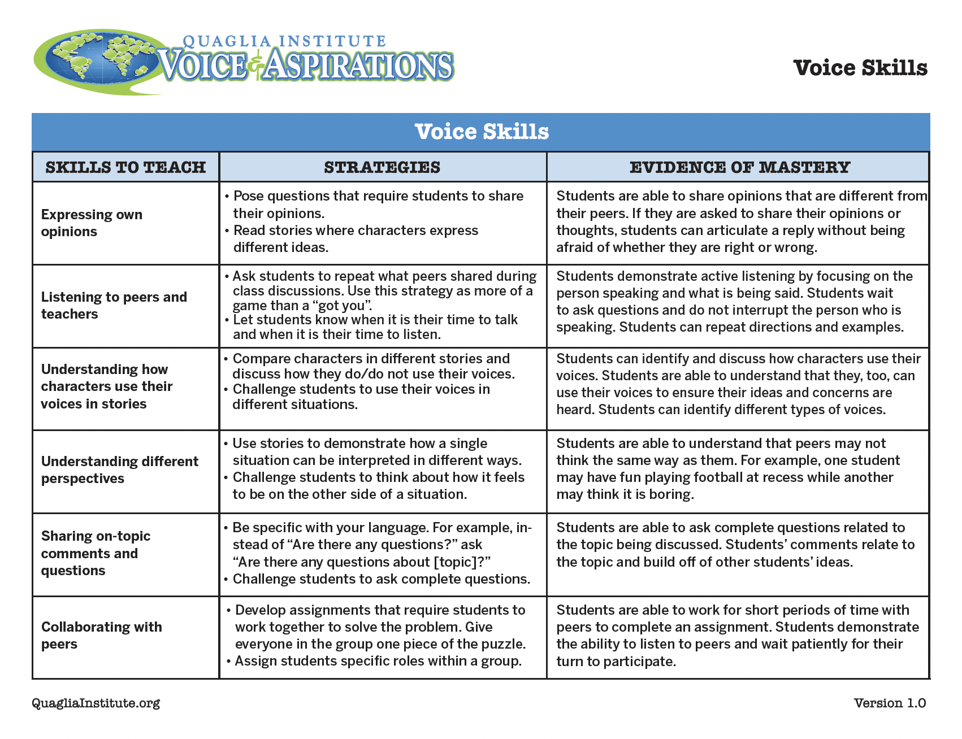
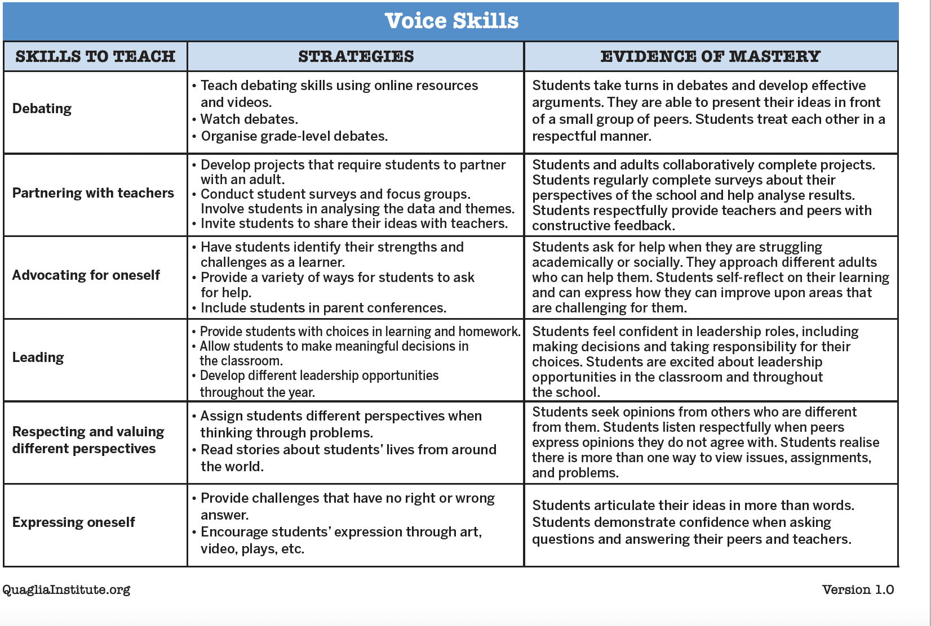
Voice Skills
Resource #2
Notes:
We did look at VIC voice skills in session 1. I think here we would emphasise that students can’t follow those pathways without the skills, capabilities and motivation to use their voice. Thus implementation and deliberate integrating these skills in multiple aspects of school work. Leads on to developing students as partners

Slide 15

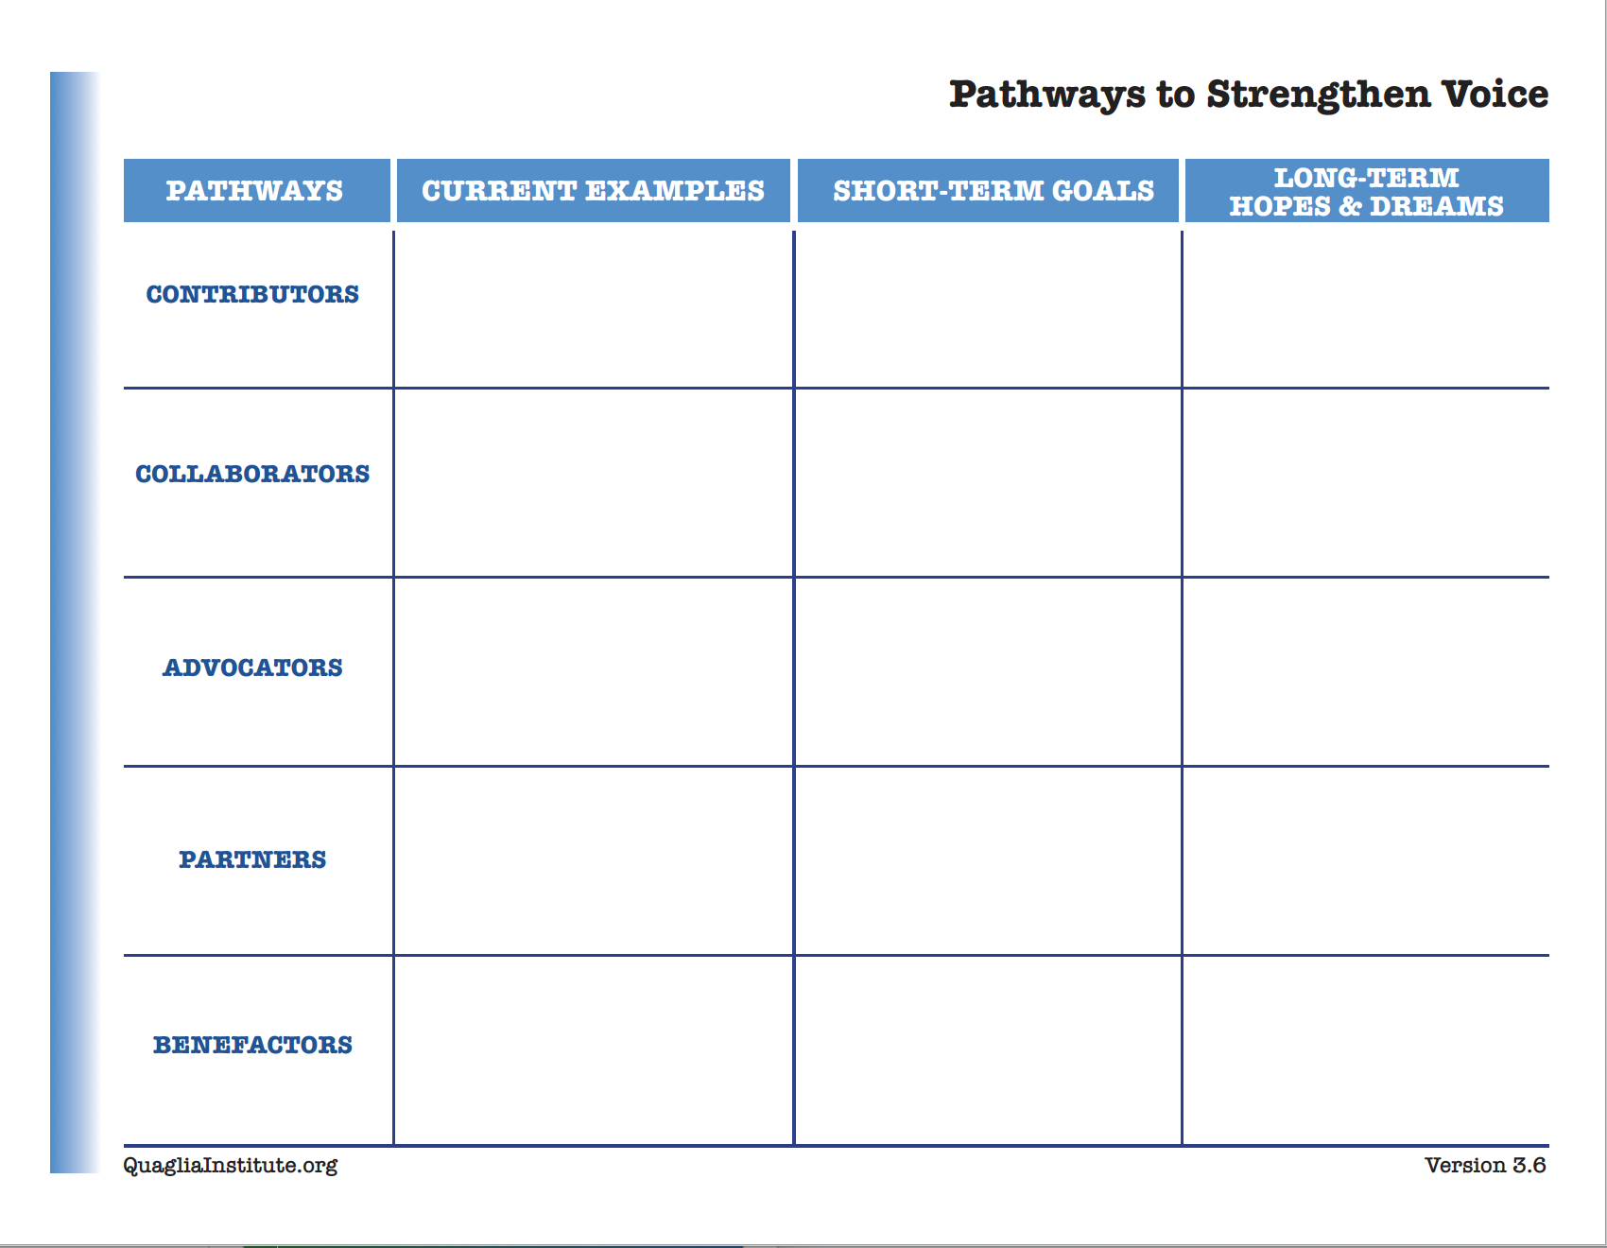
Check in
In your breakout group, check in with colleagues and discuss examples in your school of each pathway.

Slide 16

Students as partners in creating the vision
Collaborators
Co-creators
School Vision
and
Purpose
Contributors
Partners
Benefactors
Advocates
Problem solvers
Notes:
Students as active participants in learning how to achieve the school vision. School vision requires all to listen and learn together to then lead, and interpret, is this working, is this creating the school we all aspire to have? Voices of all to actively create and decide, what are we doing well, what can we do next to ensure all are thriving, learning, being well etc? Are we making explicit the conditions that will create the school vsio

Slide 17
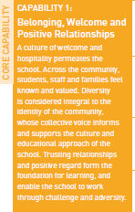
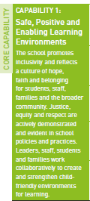
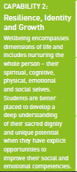
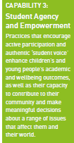

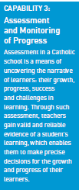
Are we deliberately creating the conditions that support school community, wellbeing and learning?
How do we know our student perceptions of these conditions in our school?
Notes:
Link to their SIF rubric here. I can talk through this. Are we ensuring all students feel they belong, have people to support them and they can be their unique self, recognising their individual strengths and sense of identity? Are we creating a fun learning environment, that supports creativity and activates curiosity. Do we develop resilience and encourage a sense of adventure, where mistakes are seen as part of learning. How do we monitor our progress together? See our collective responsibility for creating these conditions, to work deliberately towards our shared purpose, our own goals and aspirations? Are we developing the confidence to see that it is by using our voice and taking responsibility to act on those suggestions, that we will create the vision.

Slide 18

Quick Break!

Slide 19
Reflect
What student voice data does your school currently collect, & how is it used?
How are students involved in data
discussions & action planning?
Notes:
Chat opportunity

Slide 20

Student Voice Data
Love it or Leave it?
Thumbs Up
Thumbs Down
Thumbs Neutral

Slide 21
Viewpoint #1

Slide 22

Viewpoint #2

Slide 23
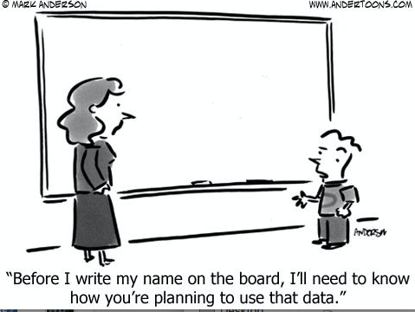
Viewpoint #3

Slide 24
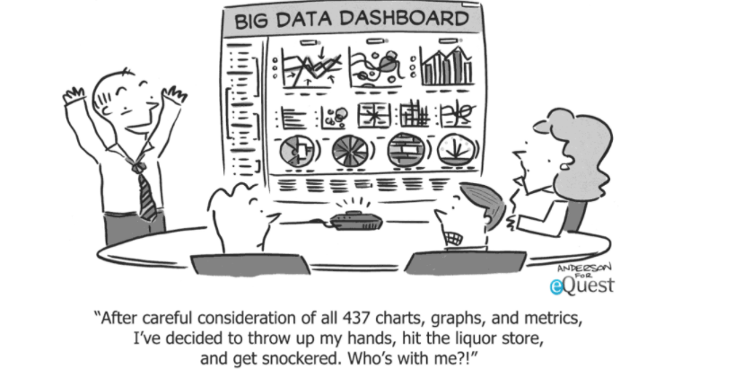
Viewpoint #4

Slide 25
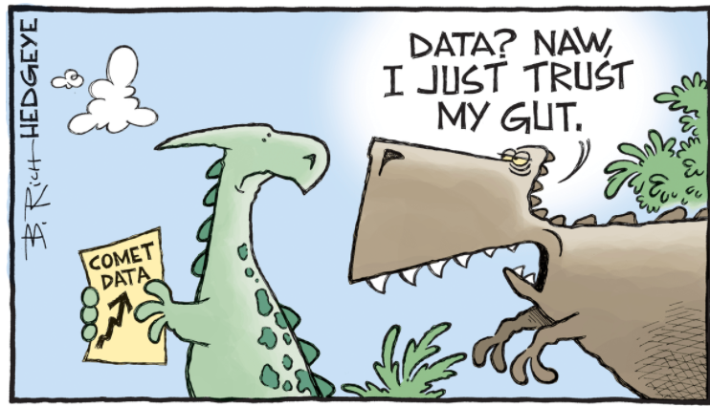
Viewpoint #5

Slide 26

When looking at Student Voice
feedback keep in mind …
Perceptions
Numbers
Comparisons

Slide 27

1. Perceptions

Slide 28
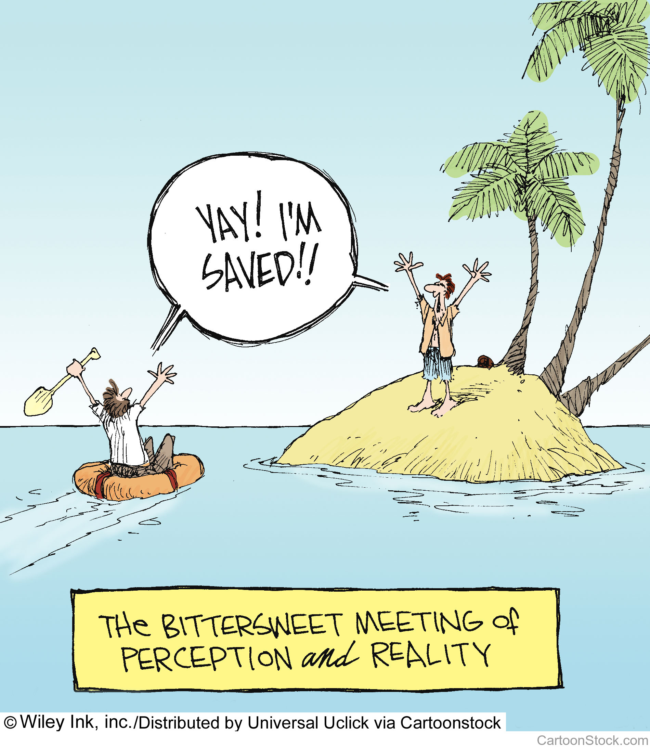

Slide 29
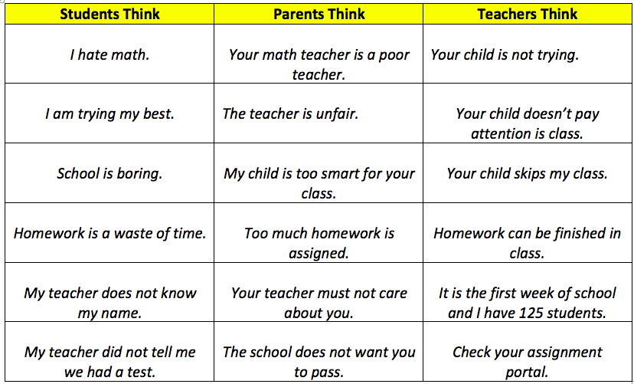
Think about it together!

Slide 30

Perceptions
Perception is reality to the beholder
Withhold personal judgement
Don’t jump to solutions
Dialogue is needed to further understand perceptions from multiple perspectives
(Listen, Learn, Lead!)

Slide 31
Reflect
What is the difference between
perception & reality?
How “valid” is student
perception data in your school?

Slide 32
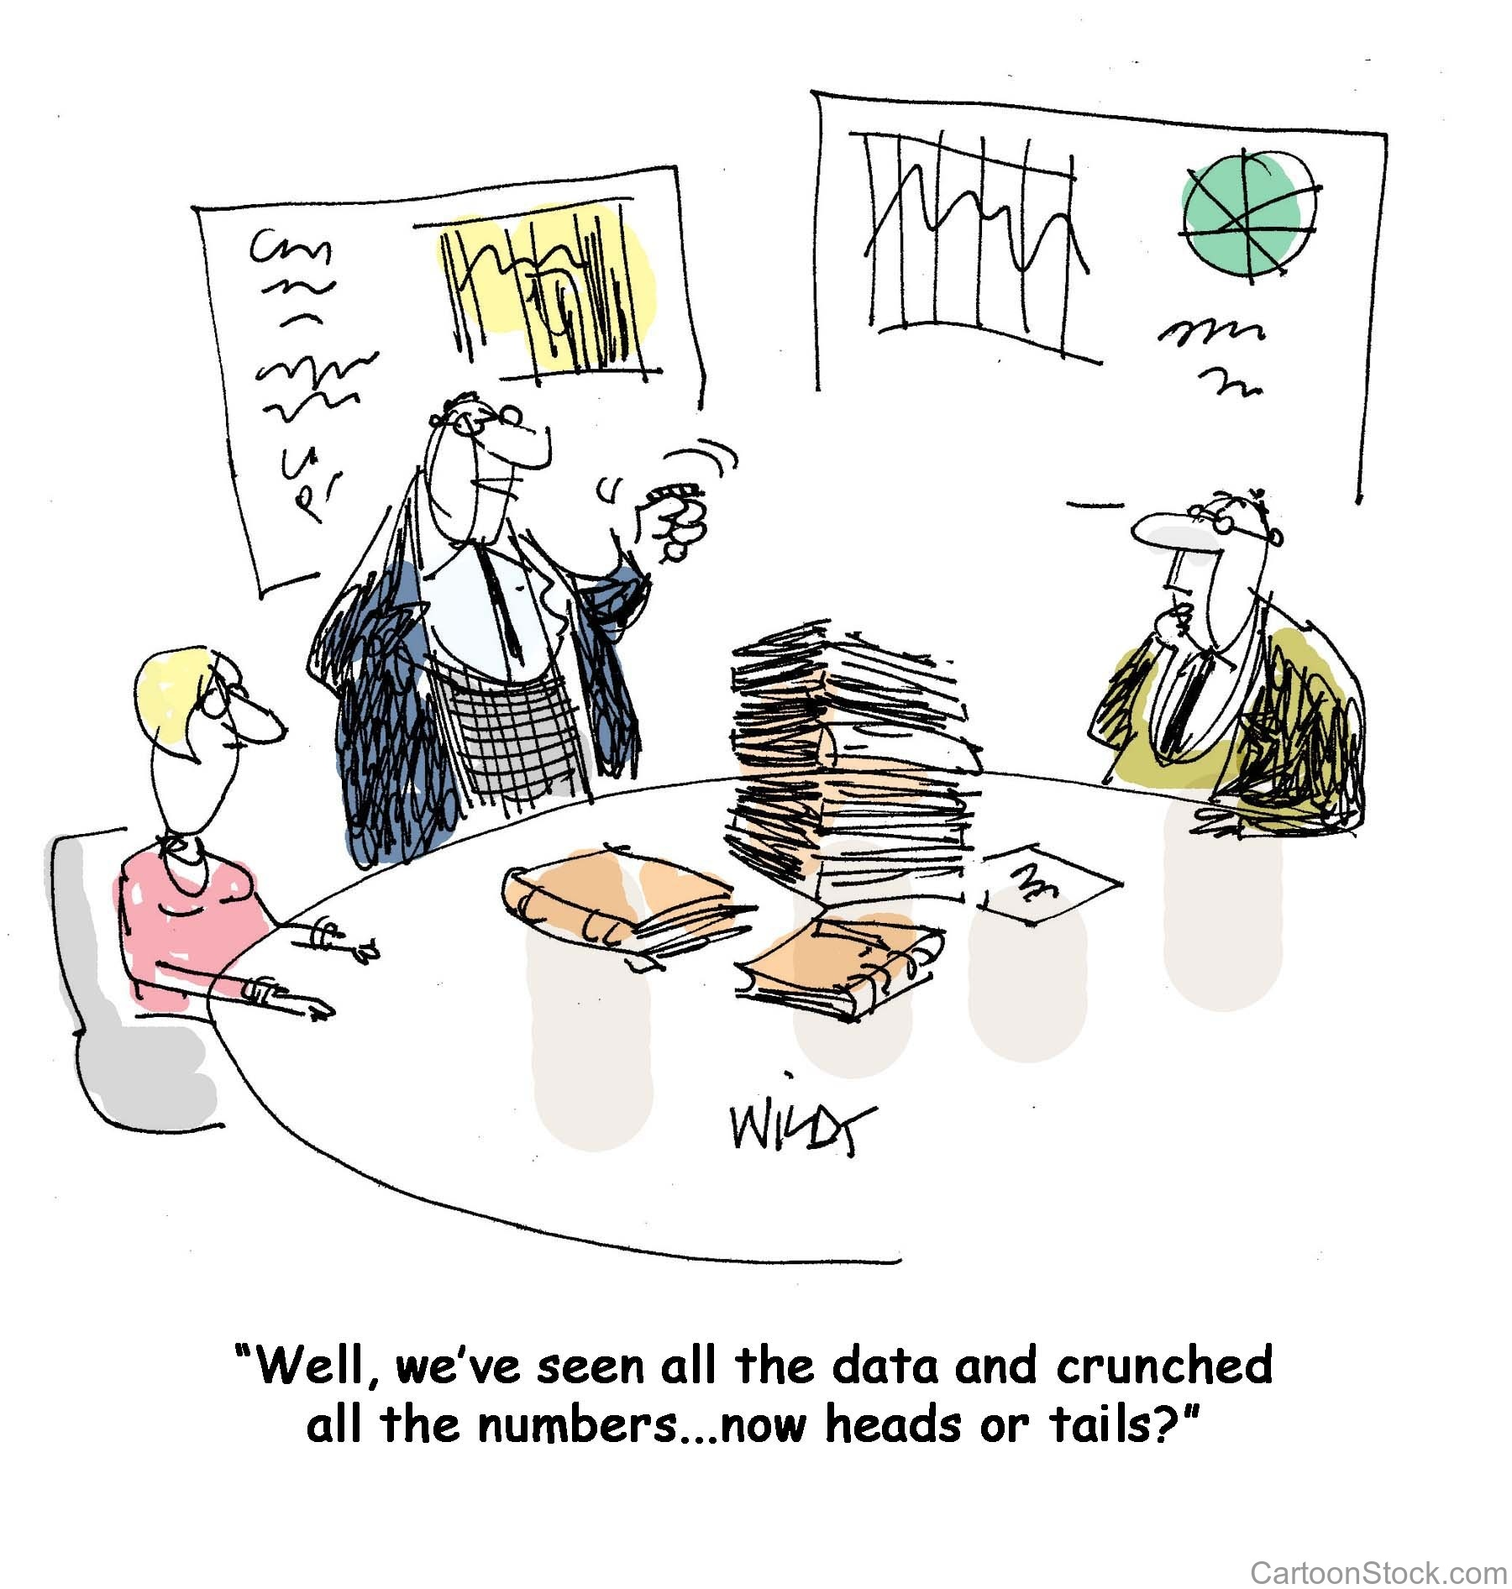
2. Numbers

Slide 33

Is this
number high
or low? Why?
250,000

Slide 34
Statistically Funny
YouTube video - https://youtu.be/TEYmmghjX6g
Vimeo video - https://vimeo.com/770006750

Slide 35
Numbers
Avoid “spinning” data
Don’t lie
Reality is not the enemy
An invitation to learn more

Slide 36
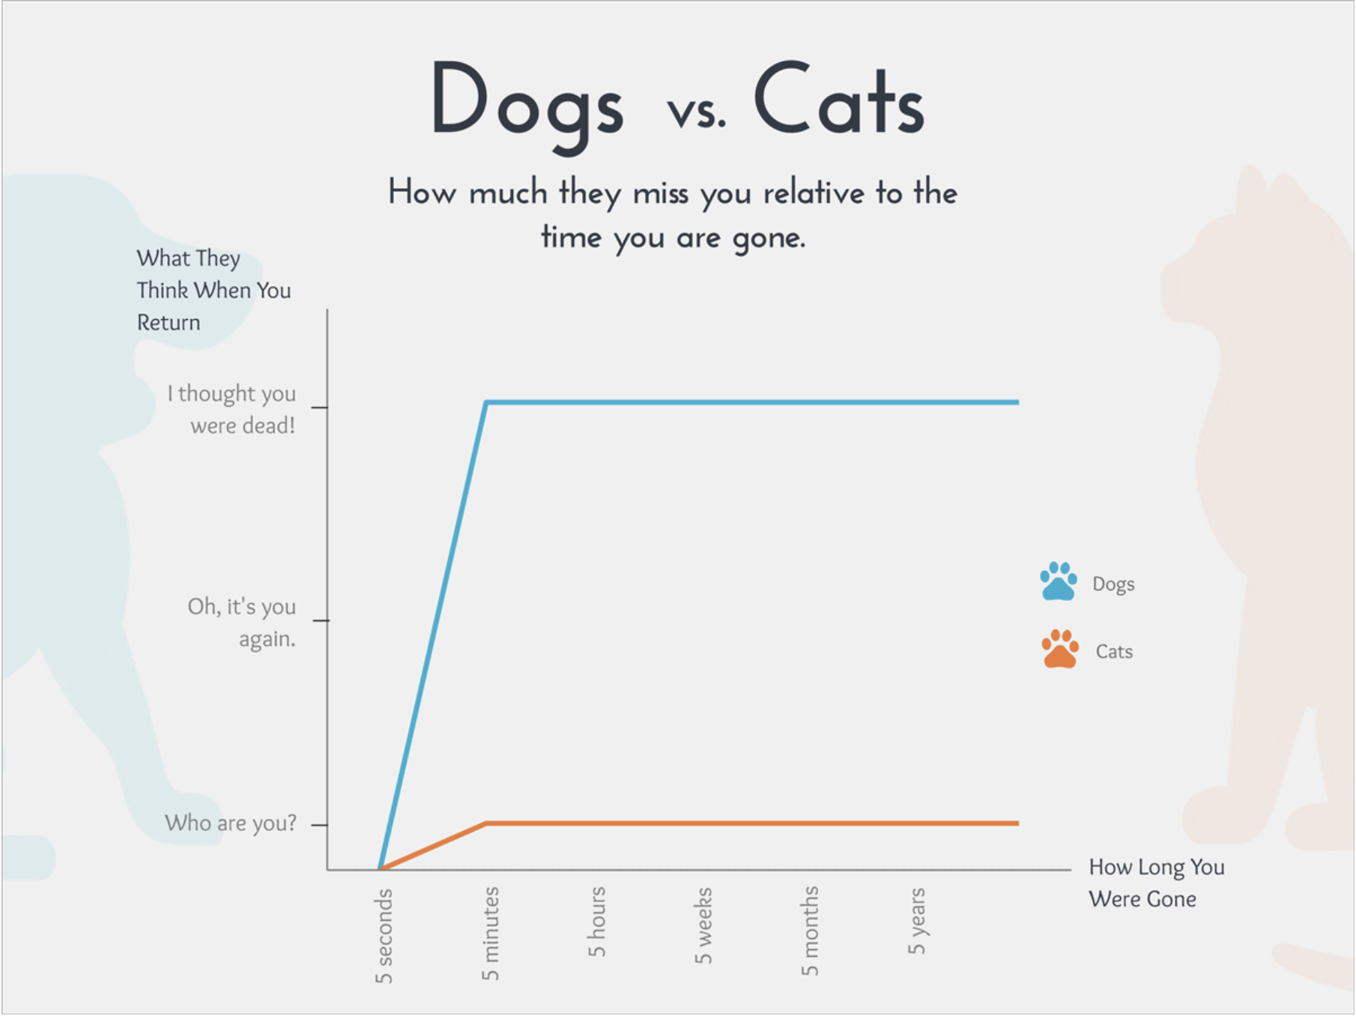
3. Comparison

Slide 37


Slide 38
Comparisons
Compare you to you!
Collect multiple data sources
Focus on growth
Strive for 100%

Slide 39
Reflect
What types of data can be compared at
your school to truly listen to, learn from, and lead with students?
What steps can be taken to create a
culture of healthy comparison at
your school?

Slide 40
Reflect
With your current data analysis, how do you:
encourage multiple perspectives
seek meaning of numbers
make comparisons to your own data trends

Slide 41

Focus Groups
Understanding what the
numbers really mean.
Deeper opportunity to
listen & learn from
students.
Resource #3a
Focus Groups K-2
Resource #3b
Focus Groups 3-12
Notes:
Russ is drawing a few new graphics I will insert where indicated on slides.

Slide 42
Focus Group
YouTube video - https://youtu.be/1jrDhlSt3xw
Vimeo video - https://vimeo.com/qisva/focusgroup

Slide 43
Focus Group Reminders
ala the Simpsons
1) Ask open-ended questions (not yes & no).
“How many want real-life problems?”
2) Be honest.
“No one from the show is here spying on you.”
3) Let the students tell you their ideas.
“You want a realistic, down to earth show.”
4) Don’t jump to conclusions
“One kid seems to love the speedo man.”
5) Refrain from assumptions.
“You kids don’t know what you want.”

Slide 44
Unpacking Themes from
Focus Groups
Be cautious of the loud voice determining the
theme of the focus groups.
    Connect focus group themes with other school
    data & evidence.
    Check/be aware of your biases.
    4. Don’t dismiss isolated comments.
    5. Don’t over-react or take things too personal.

Slide 45
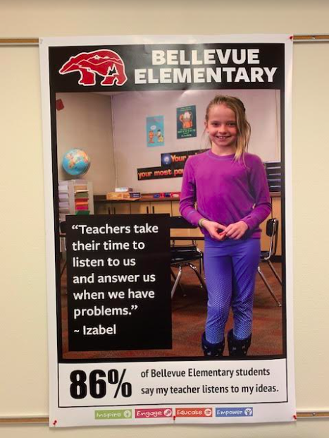
Celebrate Student Voice Data
Notes:
Celebrate wins and what school is doing well. Value student voice data

Slide 46
Quaglia Student Voice Surveys
Self-Worth
Belonging
Heroes
Sense of Accomplishment
Engagement
Fun and Excitement
Curiosity and Creativity
Spirit of Adventure
Purpose
Leadership and Responsibility
Confidence to Take Action
Notes:
We introduce the 8 conditions as to what the Quaglia Surveys are measuring and how they have been selected as they contribute to 3 key principles. Link this back to their wellbeing, learning and purpose (catholic identity) spheres. Introduce and say this is what we go deeper into in year 2, etc but will now introduce an Au school that used these surveys. Winchelsea is study tour also, which they have now heard about..,

Slide 47

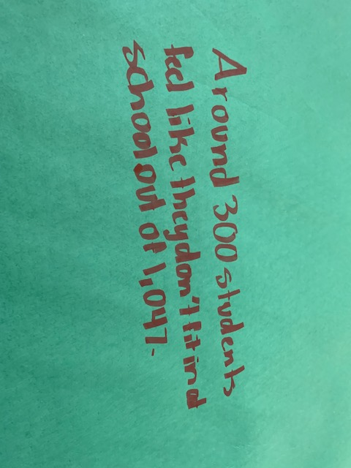
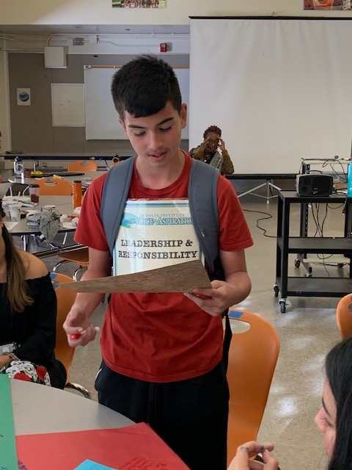
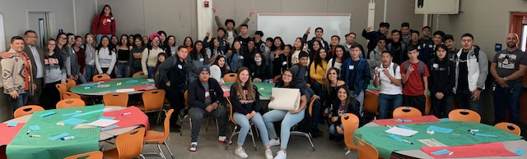
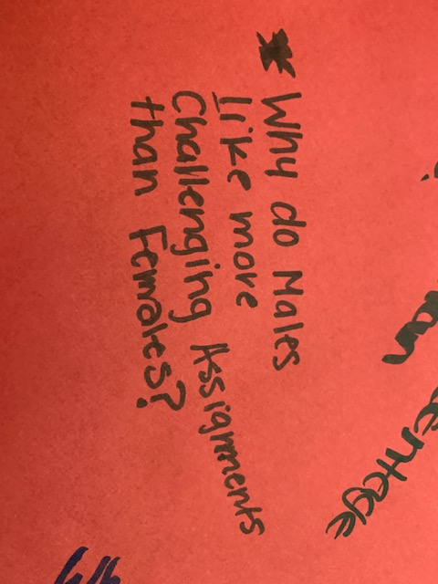
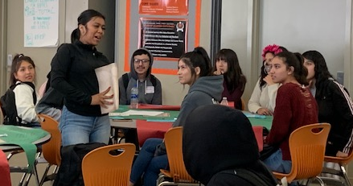
Engage Students in
Analysis & Action
Huntington Park High School

Slide 48
Why Analyse Data
With Students?
YouTube video - https://youtu.be/uJ5DBmzOP6o
Vimeo video - https://vimeo.com/qisva/whyanalysedata
Notes:
2 min 04 Opportunity for chat response. What did you hear about the benefits of unpacking and analysing data with students?

Slide 49
What pre-conditions might you need in place to have students’ voices genuinely contribute to your school vision?
Notes:
Chat opportunity. Here we would be expecting to have ideas from prior learning. Know what voice is, voice v noise, know that teachers will listen, trust and respect, aspirations to know that what they say they also are expected to act upon, together. Etc. Sue lead into next slide. Not just given student survey but now going to go deeper with listening and ask you to interpret what the whole school is saying

Slide 50
The Process. Predict First…
YouTube video - https://youtu.be/K27Wh9ZtWJk
Vimeo video - https://vimeo.com/qisva/theprocess
Notes:
1:46

Slide 51
How does asking students to predict what the whole school is saying support development of their voice skills?
Sharing thoughts and ideas in an
environment of trust and respect
Offering realistic suggestions for the good of the whole
Accepting responsibility for not only what you say but what needs to be done
Notes:
Linking back to using voice to look deeper at reality of school. Before introduce numbers, listen to what the students ‘think’ might be happening. Is this reality? Learning to use the data to challenge perceptions. Also link to good of the whole, culture of trust and respect, who is responsible for creating these conditions?

Slide 52
Skills and Capabilities
As you watch the next part of the process, consider the skills and capabilities that are being developed through this process.
Notes:
Invitation to chat from group( would expect to hear things like, collaboration, data analysis, co-operation, contributing thoughts and ideas,

Slide 53
Observe and think about why.
YouTube video - https://youtu.be/dDt_0m7wvYU
Vimeo video - https://vimeo.com/qisva/observe
Notes:
2 min

Slide 54
But First, Let’s Celebrate!
YouTube video - https://youtu.be/Y7tUygK6aXY
Vimeo video - https://vimeo.com/qisva/celebrate
Notes:
1 min

Slide 55
How did the visual prompts support a sense of accomplishment?
Notes:
Chat opportunity. Shout out about the process of students highlighting what is working well. Visual display can be shared with community.

Slide 56
What do you hear that encourages inclusivity and hearing different perspectives?
Notes:
Prompt for their thinking for next video

Slide 57
Using Our Voice… Thinking Why
YouTube video - https://youtu.be/I9Uv1XNQC_s
Vimeo video - https://vimeo.com/qisva/usingourvoice
Notes:
2.46

Slide 58
What did you hear that encourages inclusivity and hearing from different perspectives?
Notes:
Prompt for their thinking for next video

Slide 59
Shared Responsibility
YouTube video –
https://youtu.be/4Yd0lPdMH6s
Vimeo video - https://vimeo.com/qisva/sharedresponsibility
Notes:
1:15

Slide 60
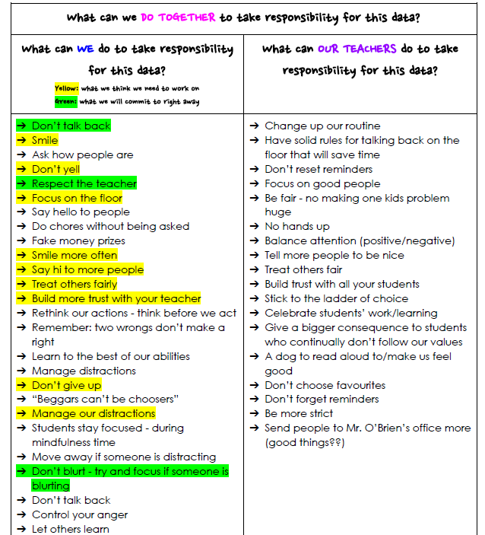

Slide 61
Reflect
In your breakout groups discuss the value of interpreting student voice data
with students.
What pre-conditions would need to be in place in your context before this process could be implemented in your school?
Notes:
Allow at least 10 minutes here as videos have shown a lot and most likely a new process for schools. Invite feedback from groups as to what was discussed. Allow another 5 minutes for this either in chat or out loud.

Slide 62
Things to think about
YouTube video –
https://youtu.be/aYRI1H1Ky3Q
Vimeo video - https://vimeo.com/qisva/thingstothinkabout
Notes:
3

Slide 63
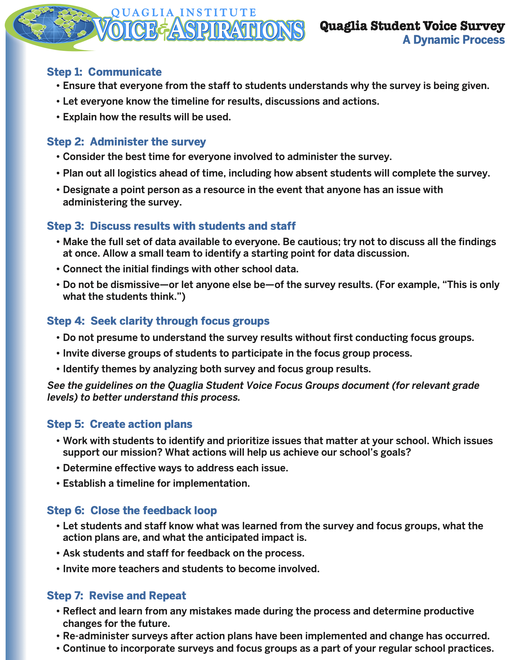

Slide 64
Reflect
What is your current culture of giving
& receiving feedback?
-teacher to student
-student to teacher
-peer to peer
What hesitations might teachers have
regarding student voice data?

Slide 65

Gathering Student
Feedback
does not mean…
Students are evaluating teachers
Students know more than the teachers
All student feedback must be acted upon
Teachers are doing something wrong
A once a year survey to “check the box” .

Slide 66
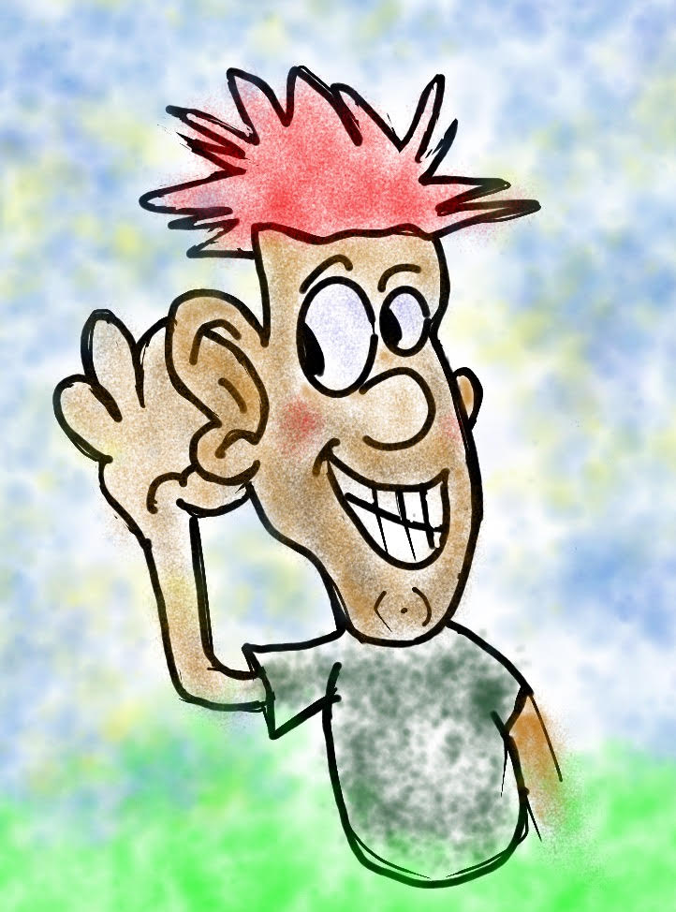
Gathering Student
Feedback
does mean…
We are ready to listen & students are
prepared to share
We believe students have something
to teach us
We are willing to learn from students
We plan to take action in partnership
with students

Slide 67

Reflect
What are you/your school missing related to Student Voice?
What or who haven’t you/your school considered when it comes to student voice?
Who do you usually pay attention to? (Loudest? Most influential? Most connected?)

Slide 68
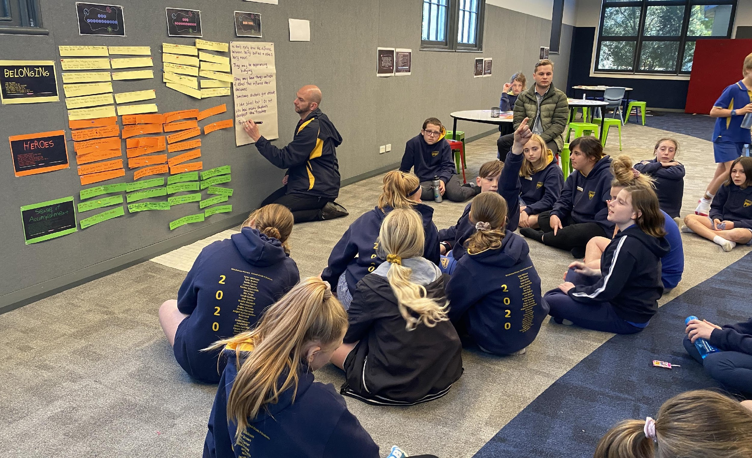
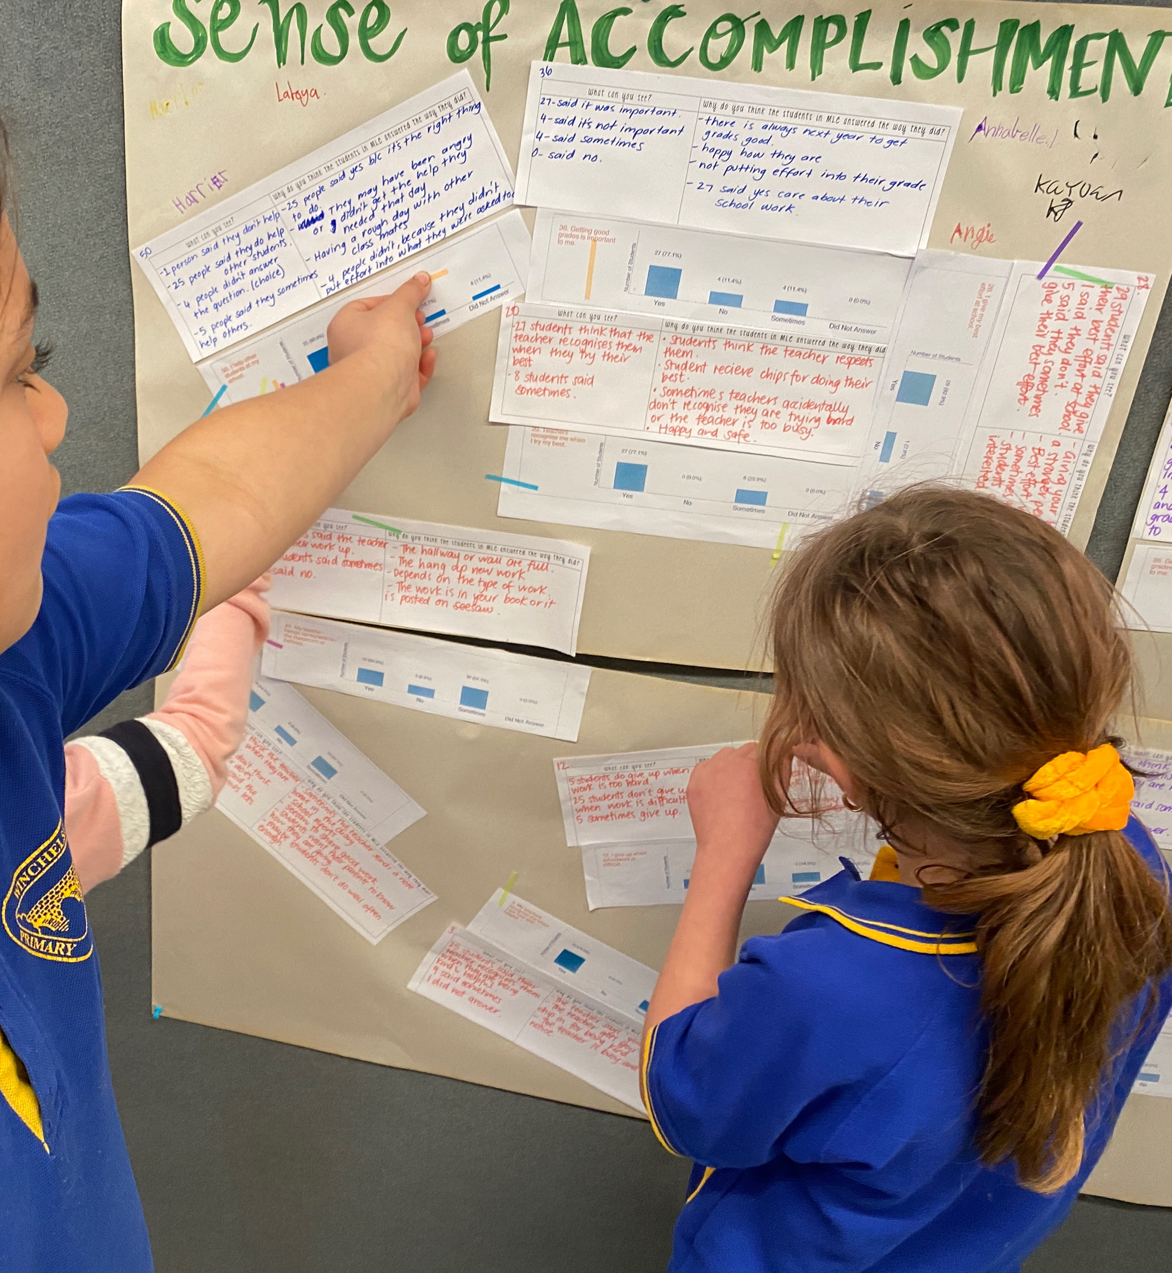
“ This is a starting point – the power in this process is to use what you’ve learned to lead with students and commit to making improvements together.”
Simone, School Leader, VIC

Slide 69
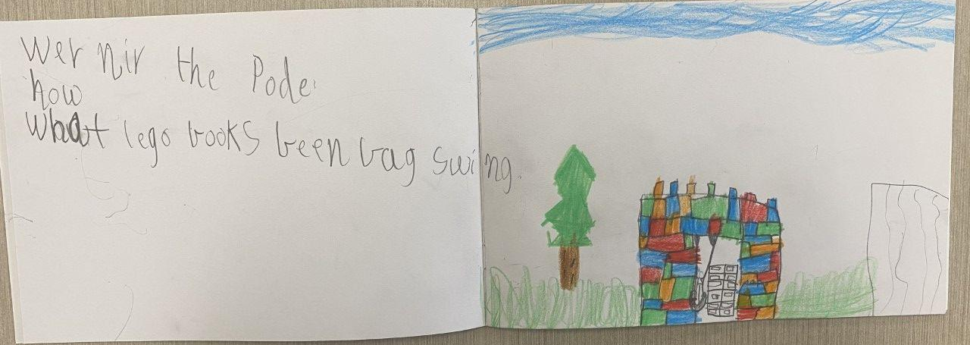
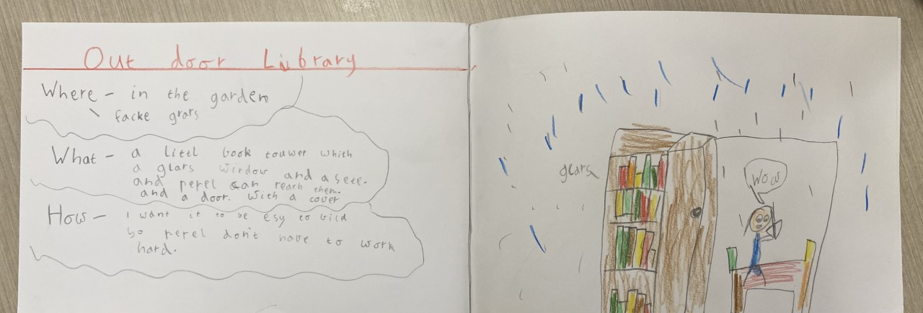
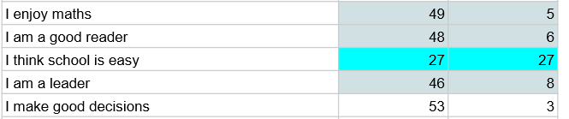
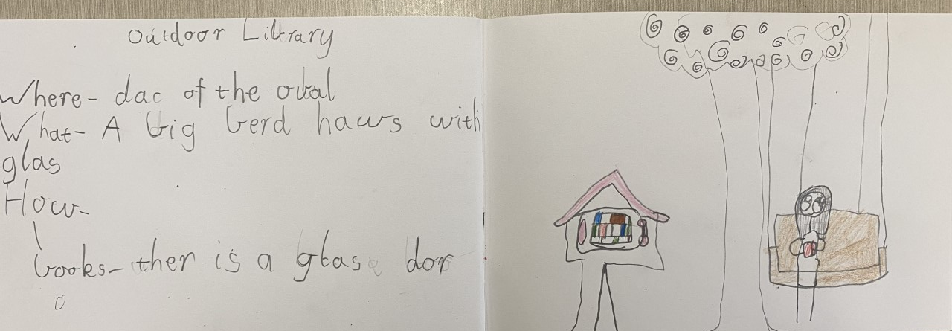
Outdoor Library
1A students identified that one challenging aspect of school is navigating the playground when their friends are absent or feel like some quiet time.
They came up with the idea of an ‘outdoor library’.
Research
Where, what and how
Design and plan
Year 1 teacher Barwon Heads Primary VIC
Notes:
Even Year 1 can do the data analysis. This is an example from a school where students and teachers identified the question I think school is easy as needing greater explanation as 50% split.

Slide 70

Teacher Reflections
“A culture shift is occurring where students are being viewed as partners, and adults are really seeing the value of collaborating with students to create and execute academic and personal excellence. Our impact is so much greater when we collaborate and partner with students, families, and the communities we serve.”

Slide 71
Teacher Reflections
“Student responses to certain questions would astonish me, like “The teacher knows my name.” Some students thought that I didn’t know their name, but when we discussed the question more deeply, their responses were really about not feeling like they were really known as an individual person. After discussing this question, we all have worked more intentionally to really get to know one another and who we are as individuals.”

Slide 72

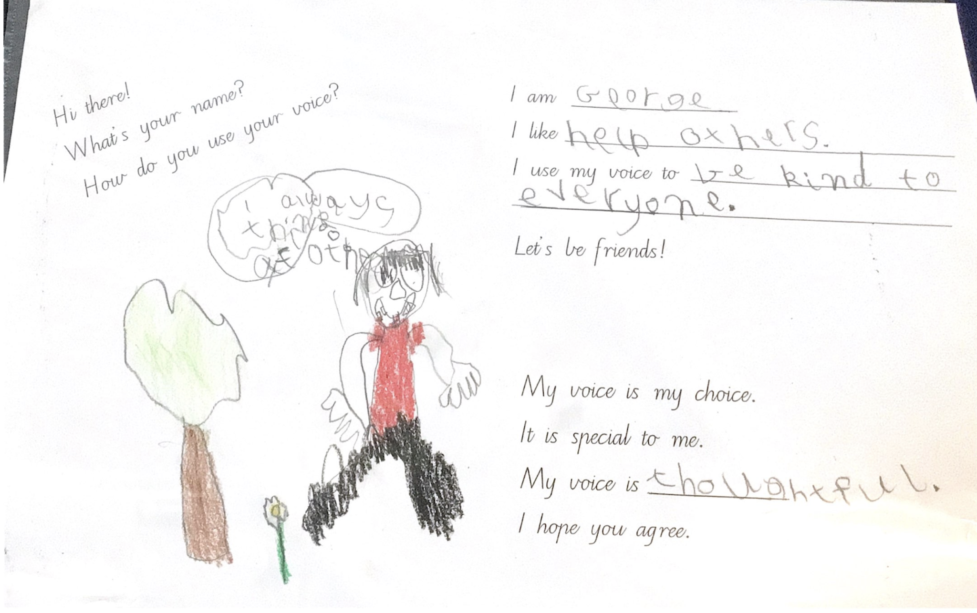
Student Voice in Action
Hampton Park Primary School, Hampton Park, Australia
Notes:
Per Sue B: I just wanted to share with you the example of student work that Charlotte has just sent me from the Year 1/2 class at Hampton Park. The whole school developed pages for their own version of the Cay and Adlee book.

Slide 73
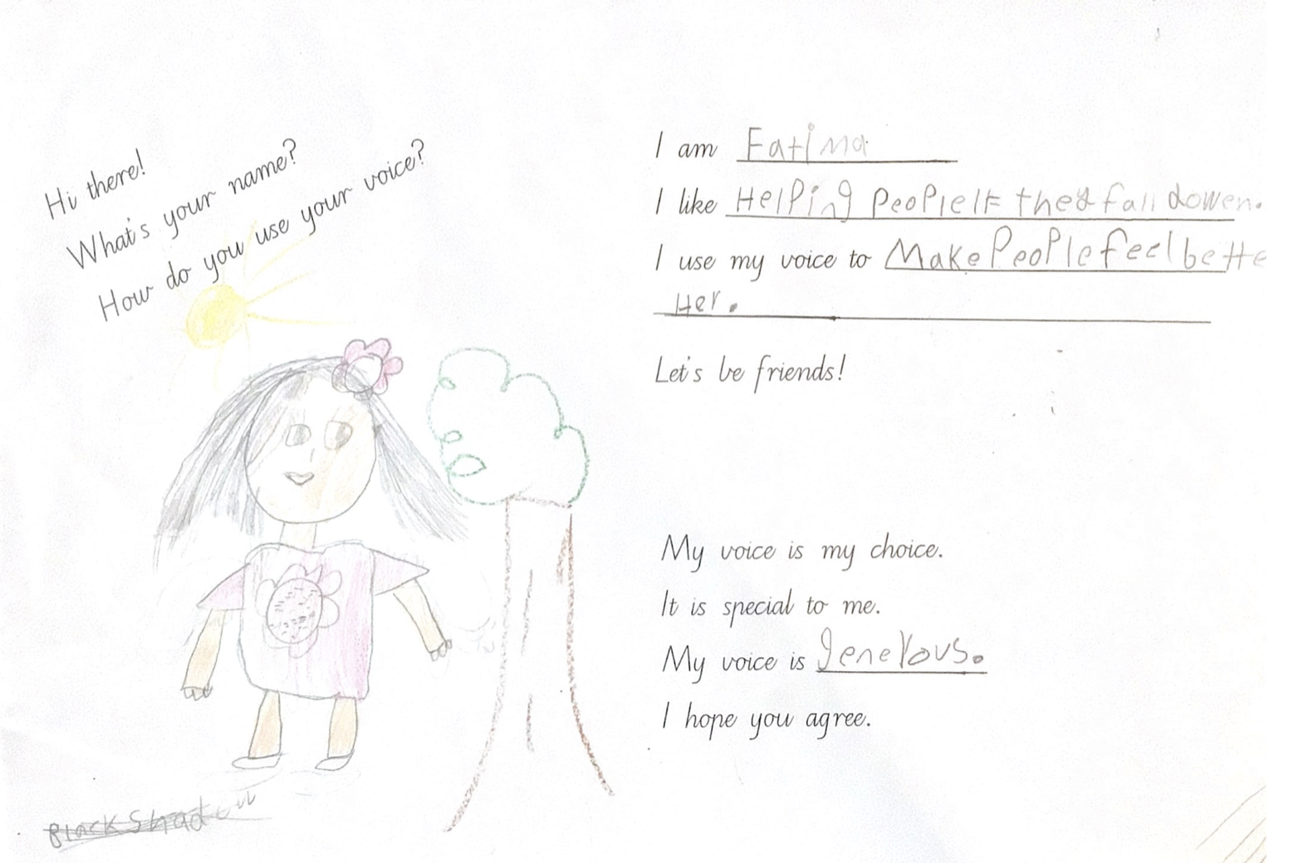
Student Voice in Action
Hampton Park Primary School, Hampton Park, Australia
Notes:
Per Sue B: I just wanted to share with you the example of student work that Charlotte has just sent me from the Year 1/2 class at Hampton Park. The whole school developed pages for their own version of the Cay and Adlee book.

Slide 74
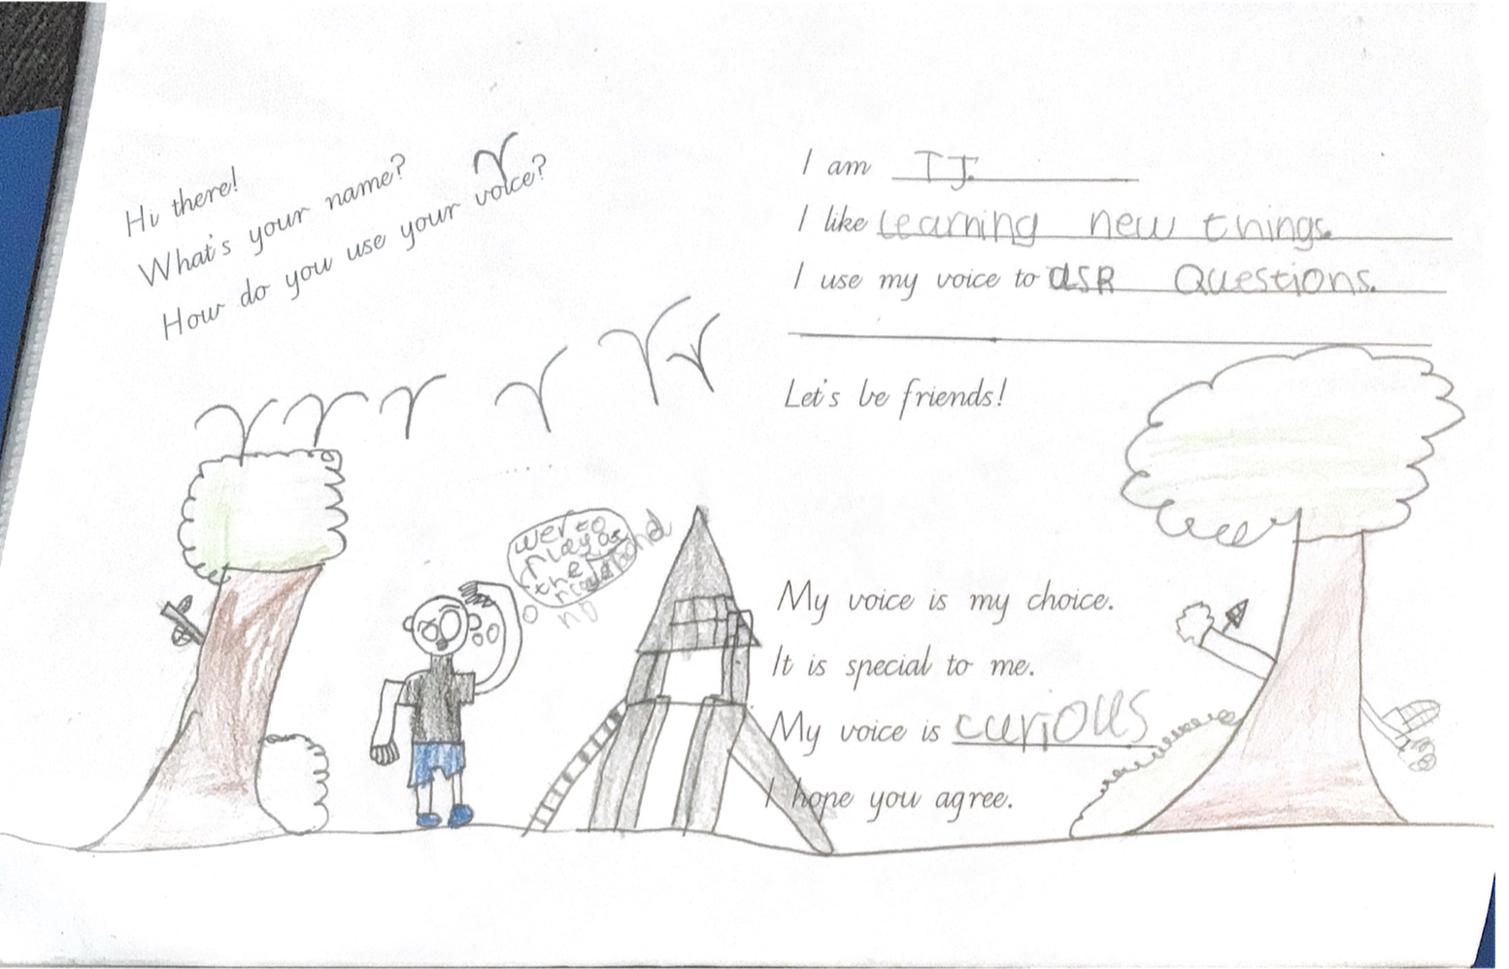
Student Voice in Action
Hampton Park Primary School, Hampton Park, Australia
Notes:
Per Sue B: I just wanted to share with you the example of student work that Charlotte has just sent me from the Year 1/2 class at Hampton Park. The whole school developed pages for their own version of the Cay and Adlee book.

Slide 75
The Power of Advertising
YouTube video –
https://youtu.be/1V2OG5Ksj_M
Vimeo video - https://vimeo.com/qisva/advertising

Slide 76
Do You Know What You’re Missing?
YouTube video - https://youtu.be/LsHdKP7HDiU
Vimeo video - https://vimeo.com/qisva/whodunnit

Slide 77


Reflect on current practices at your school that are keeping you from amplifying student voice.
CHALLENGE
Stop It!

Slide 78
What would your ‘headline’ be that summarises Voice as a way of being across the school?
CHALLENGE
Notes:
Sue can tell story of Principal that had a copy of a poster created by students that said Principal turns school upside down, teacher are learners too.

Slide 79

What is your
“Mic Drop” moment
from this Student
Voice & Aspirations learning journey?

Slide 80
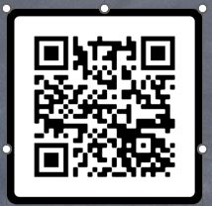

Thank you for learning with
us today!
Please reach out if we can be of support.
Sue Bryen
Bryen@Quagliainstitute.org
Dr. Kris Fox
Fox@QuagliaInstitute.org
https://forms.gle/GA5JirJvZaDLS6Qx6

