Slide 1


The Voice Process:
Listen, Learn, Lead
August 2022
Dr. Kristine Fox & Sue Bryen with special guest Dr. Lisa Lande

Slide 2
Fundamental Beliefs
Students
_________ are the potential, not the problem.
_________ have something to teach us.
Working ________ is the only way forward.
Students
together

Slide 3
Goals for Today
Learn examples of Voice in Action.
Gain a deeper understanding of the
the Student Voice Process: Listen, Learn, & Lead.
Consider how the Student Voice Process can
support the implementation of Student Voice.
Apply learning to amplify student voice in YOUR
school, particularly.

Slide 4

Quick Review

Slide 5

The 3 Components of Student Voice
Sharing thoughts & ideas in an environment
underpinned by trust and respect.
2) Offering realistic suggestions for the
good of the whole.
3) Accepting responsibility for not only what
is said but also what needs to be done.

Slide 6
ASPIRATIONS
The ability to
dream & set goals
for the future,
while being inspired
in the present
to reach those dreams.

Slide 7




high
Imagination
Aspiration
DREAMING
Hibernation
Perspiration
low
DOING
high

Slide 8

Student Voice in Action
YouTube video - https://youtu.be/EcHcXtrQxUc
Vimeo video - https://vimeo.com/qisva/studentvoiceinaction
Cherry Hill, New Jersey, USA - https://www.youtube.com/watch?v=XL-URMaOcfs

Slide 9



Welcome Dr. Lande!

Slide 10
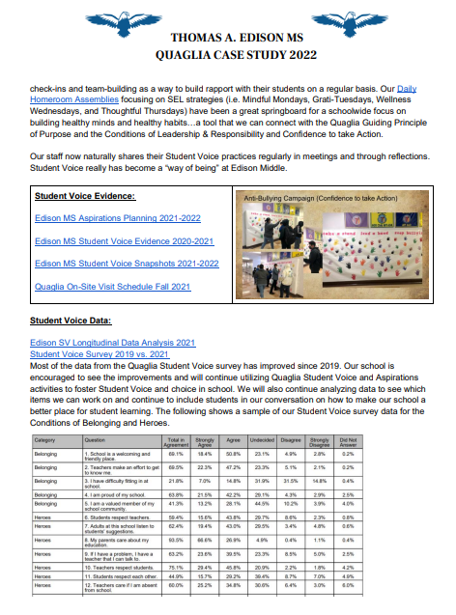

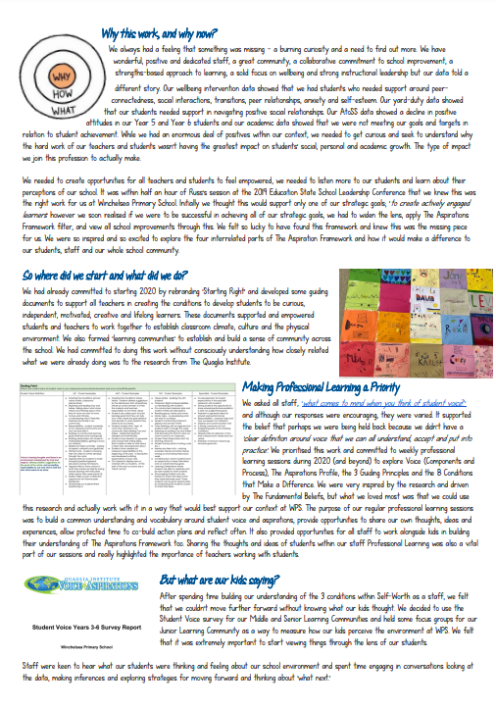
Voice in Action
Case Studies
https://quagliainstitute.org/library/case-studies

Slide 11

What connections did you make?
How does activating student voice impact on teaching and learning?

Slide 12

Quick Break!
10 minute

Slide 13

Time to journey
onward & explore
the Student Voice Process

Slide 14
Dr. Russ Quaglia
YouTube video - https://youtu.be/ufw5pWnvaWU
Vimeo video - https://vimeo.com/qisva/drq

Slide 15
LEAD
Resource #1
School Voice
Process Brief
TAKE ACTION
with others
Share
RESPONSIBILITY
LEARN
UNDERSTAND
& RESPECT
different points
of view
Build
TRUST
LISTEN
SEEK OUT
opinions from
others
School Voice Process

Slide 16

Listen

Slide 17
The Art of Listening
YouTube video - https://youtu.be/ooE9dKobjZU
Vimeo video - https://vimeo.com/qisva/artoflistening

Slide 18
Listen
Make an effort to reach out to the ones you don’t hear
Stay focused (put away your phone!)
Be genuine (at the very least be interested)
Make sure you are talking less than the
other person
Being open to new ideas is not an option

Slide 19
Reflect
Write your response in Chat:
What do you find challenging when it comes to listening to students? Teachers? Parents? Leaders?

Slide 20

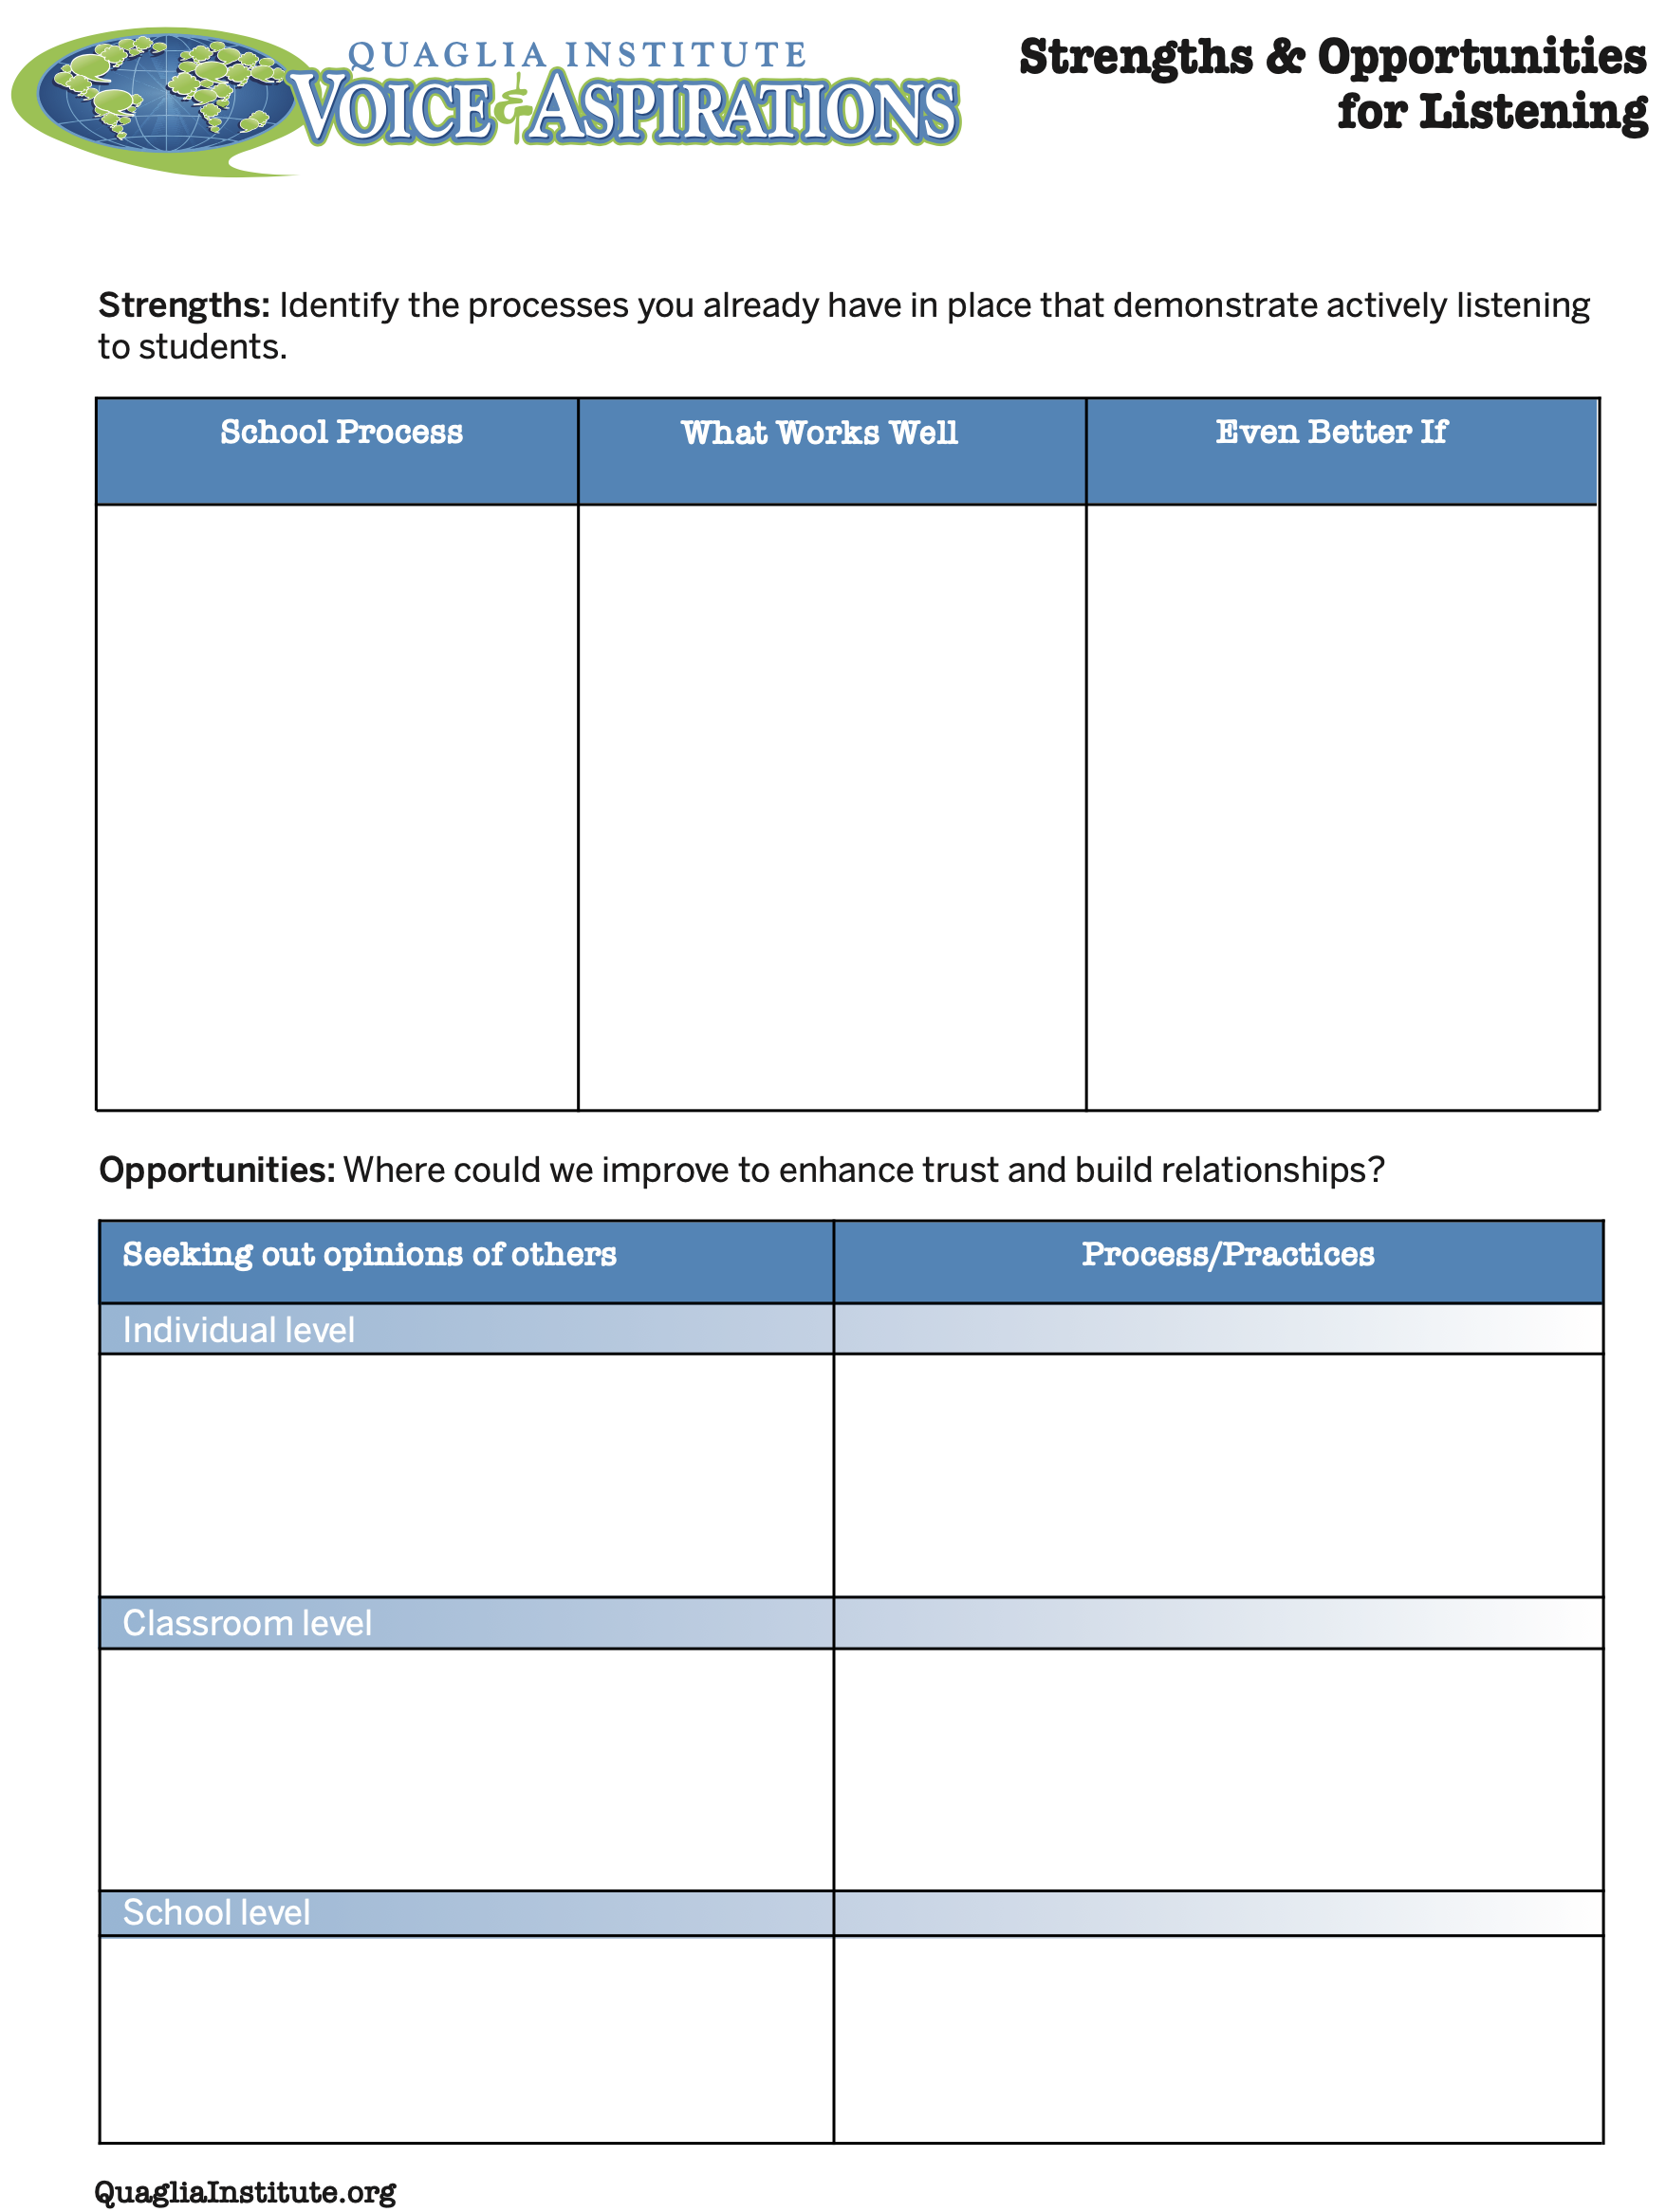
Check In
Breakout
What are your
strengths &
challenges when it
comes to
Listening to students?
How do you build trust &
positive relationships?
Resource #2
Strengths & Opportunities
for Listening

Slide 21

Learn

Slide 22
Taking Time to Learn
YouTube video - https://youtu.be/tYKcvRfxK0o
Vimeo video - https://vimeo.com/qisva/takingtimetolearn

Slide 23
Learn
Take notes
Ask questions for clarity
Do not judge
Make sure you continue to listen as you learn
Be prepared to change
Do not fear what you do not know

Slide 24

Challenge Time…

Slide 25

Challenge
Find the connection
between the 4 individual pictures.
Who can type the answer
FIRST in the Zoom chat?

Slide 26
Find The Connection
YouTube video - https://youtu.be/Yl3JrRtyGHc
Vimeo video - https://youtu.be/Yl3JrRtyGHc

Slide 27

Reflect
What actions can you take to Learn from students as a
regular practice at
your school?

Slide 28
Excerpts of videos created by NSW Public Schools
YouTube video - https://youtu.be/2oviZKloaWA
Vimeo video - https://vimeo.com/qisva/newpublicschools
http://epsvisiblelearning.weebly.com/student-voice.html and https://www.youtube.com/watch?v=L6zxU8Gv8YU
Notes:
Sue explain Multiple opportunities but requires planning, ongoing process and taking students with you

Slide 29

Lead

Slide 30
Leading Together…
YouTube video - https://youtu.be/RTvZCdUP7N4
Vimeo video - https://vimeo.com/qisva/leadingtogether

Slide 31
Reflect
What did you observe related to the term Lead in this video?

Slide 32
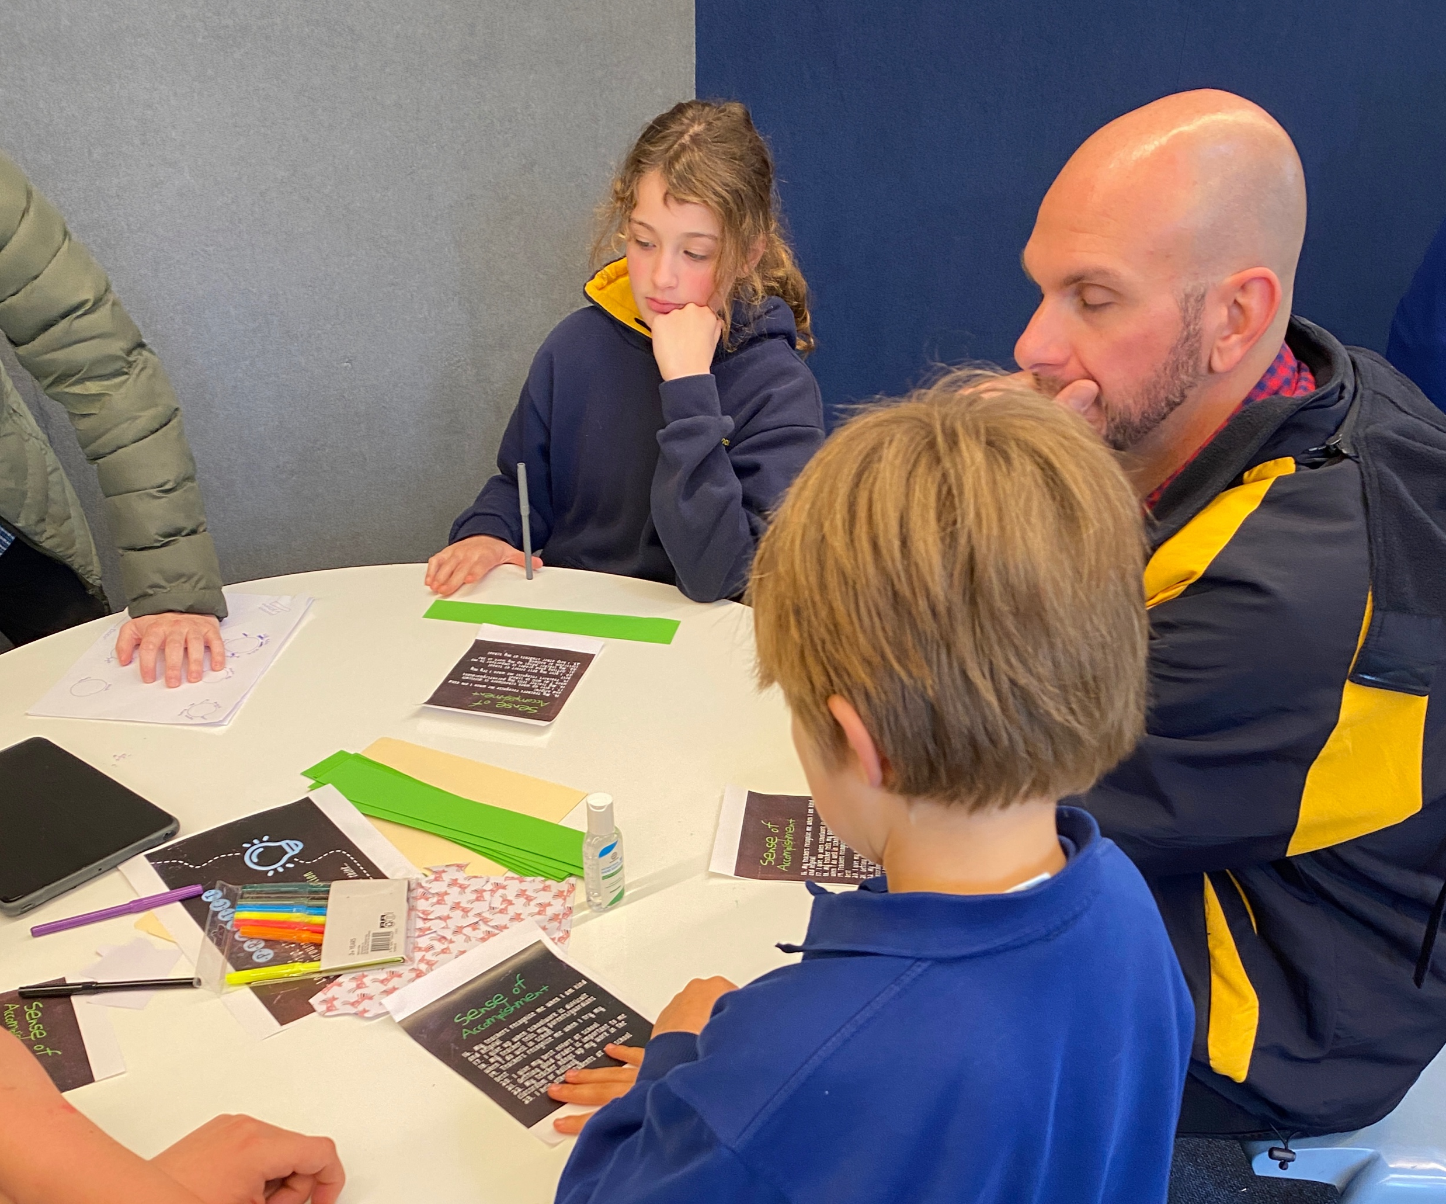
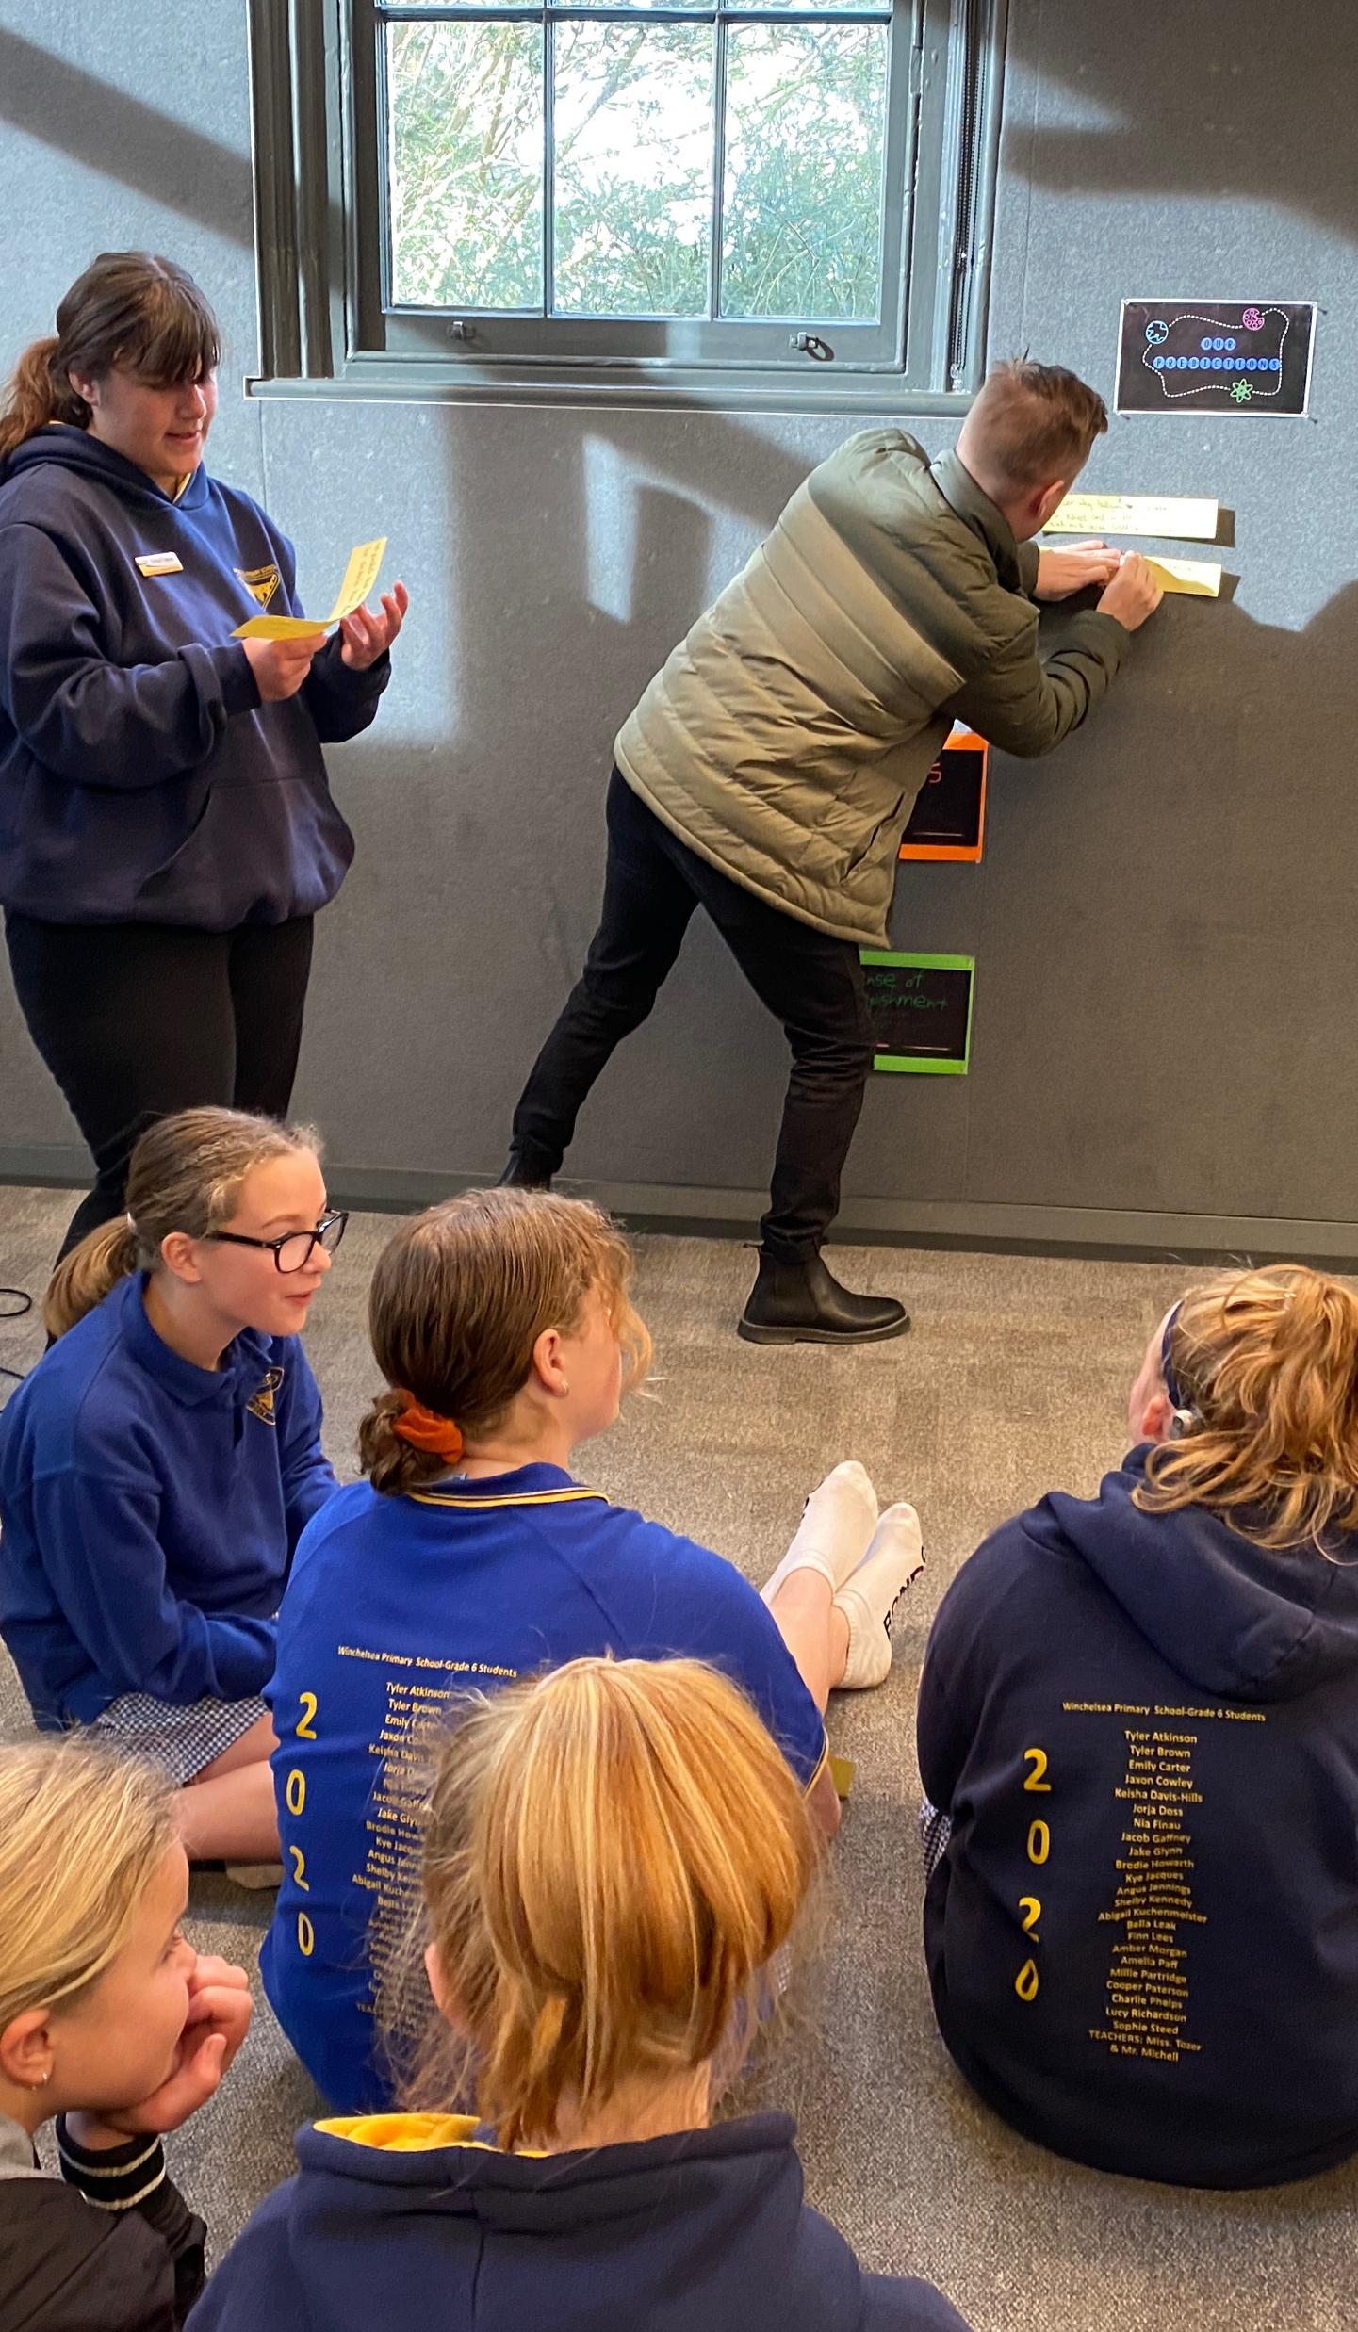
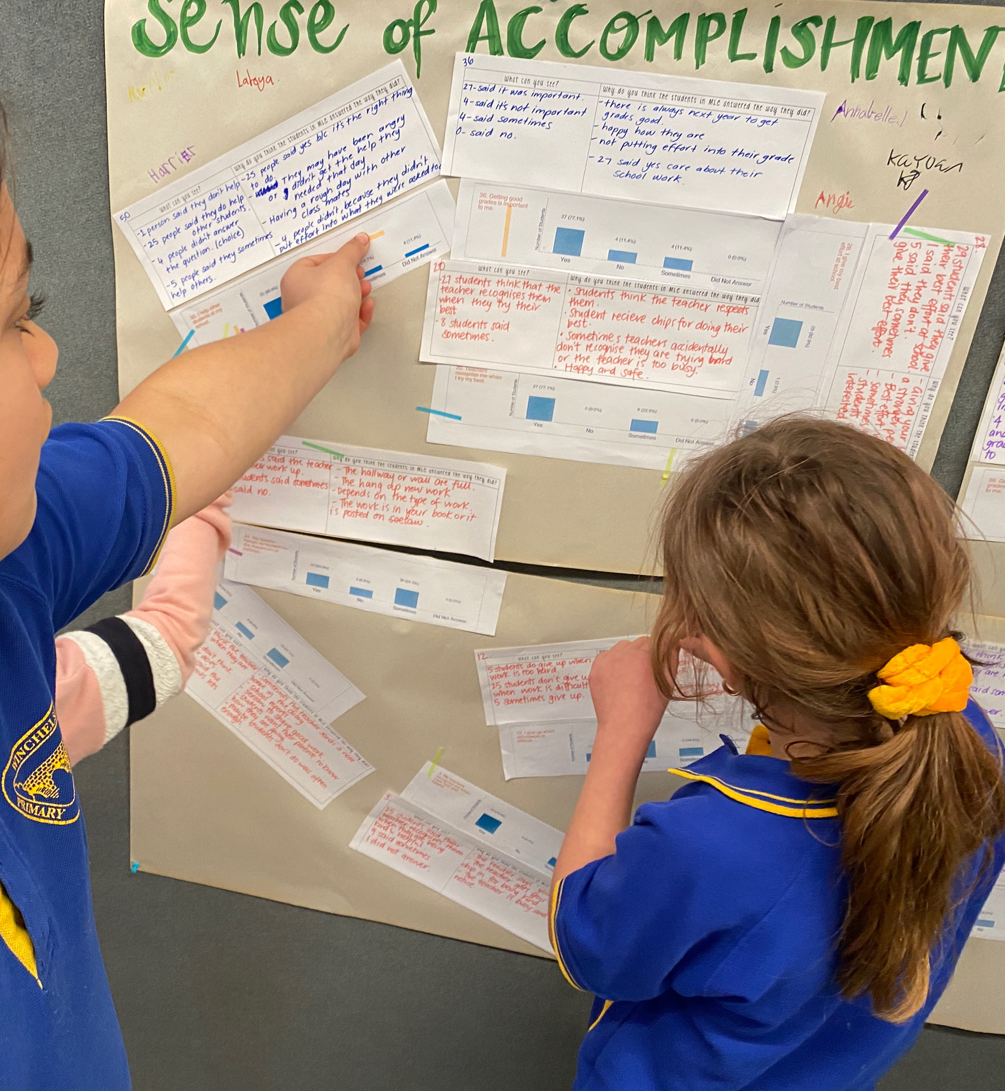
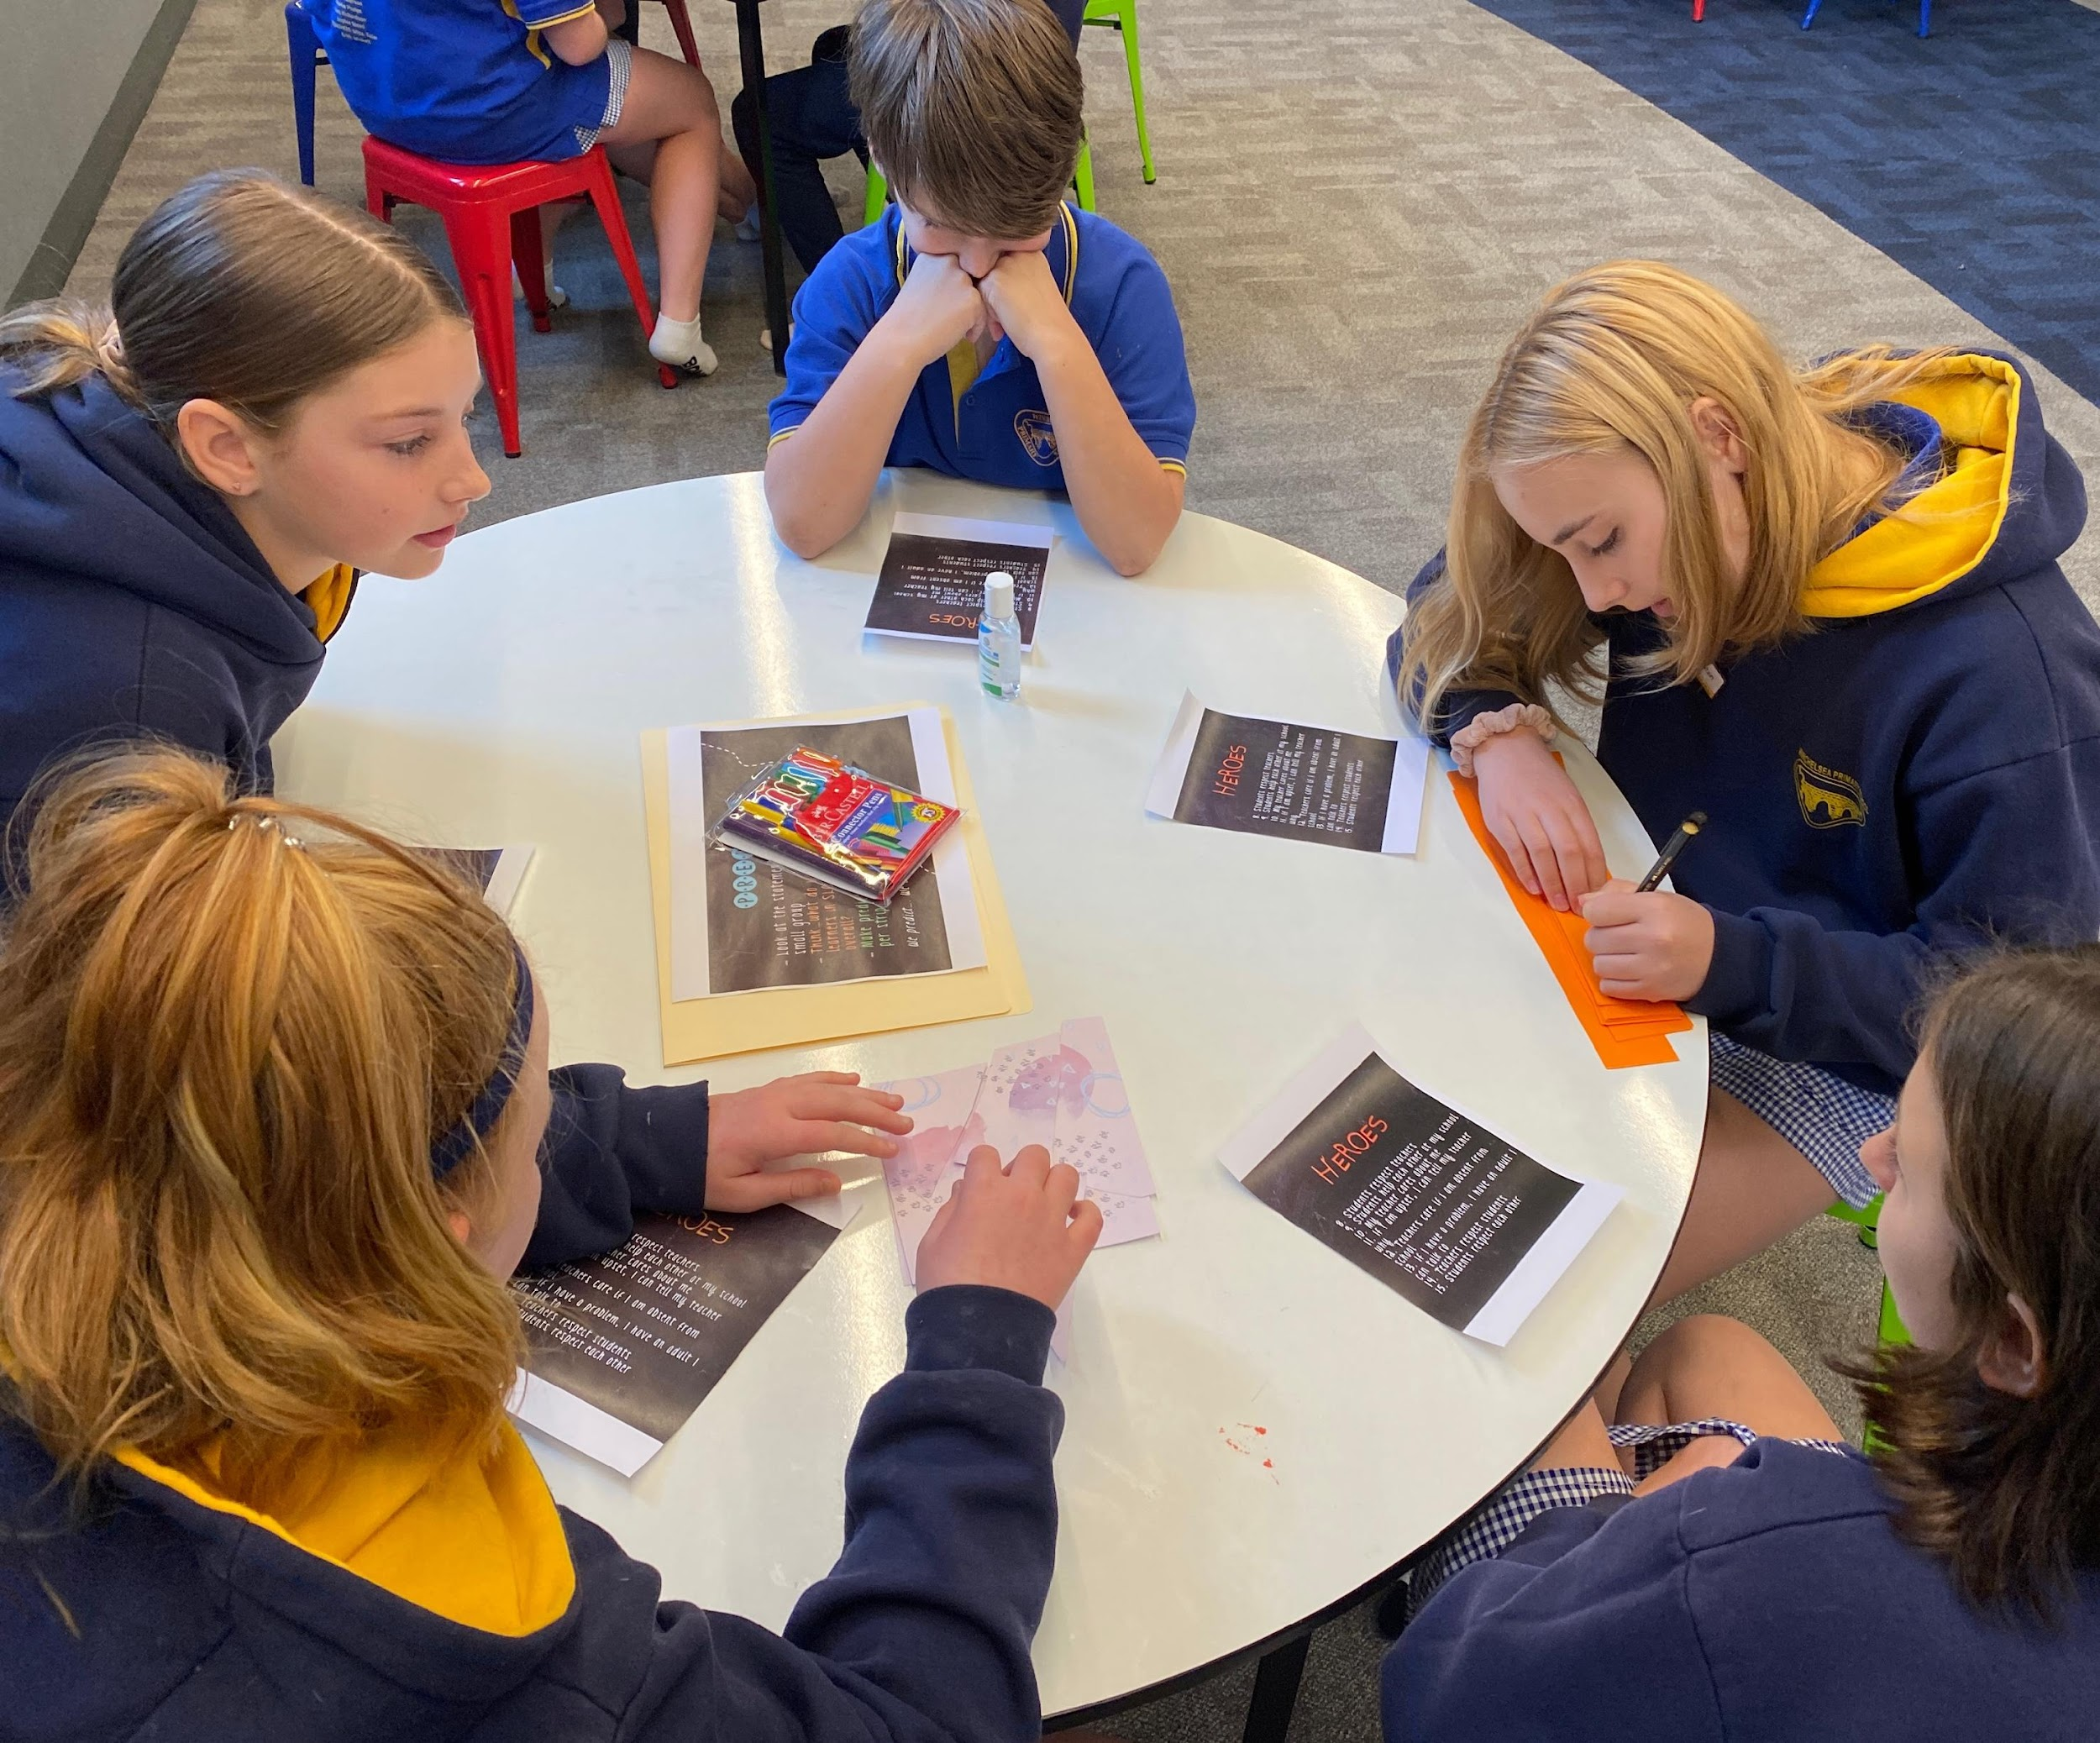
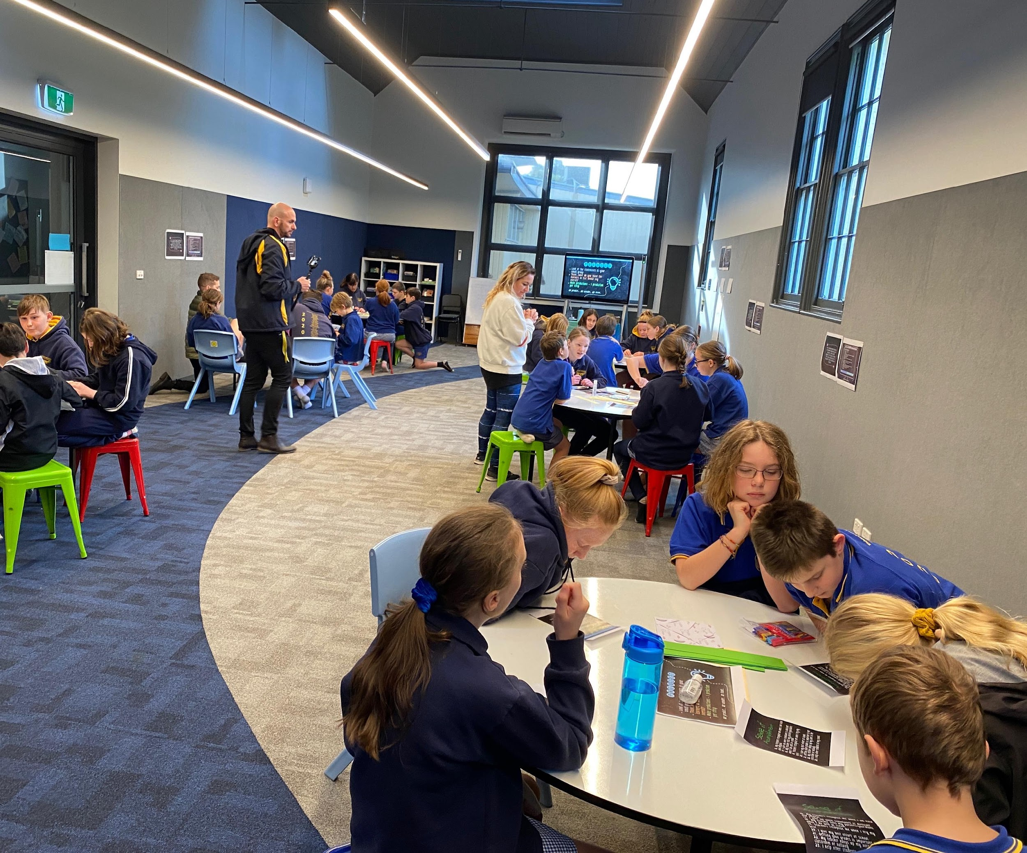
Leading Together
Pictures courtesy of Winchelsea Primary, Victoria, Australia

Slide 33
Teachers
Enabling Student Voice
Voice Amplifiers displayed
How and when do I use my voice?
Introduce voice definition
Unpack and interpret key words and create meaning.
Model and provide protocols around ‘learning talk’-
Co-create success criteria of effective learning talk
Create looks like/Sounds like with class
Noise v Voice
Voice definition displayed and referred to daily
Think- How do I show the 3 parts of voice, share my ideas, help others and do the required work?
Ask myself when I share my ideas and thoughts, Is this voice or just noise?
Create and share examples of using voice discussed and found at home
Work with others and find new ideas beyond my usual friends.
Contribute my ideas every day.
Co-create class looks like/sounds like, use as SC
Discuss voice definition at home and with peers
Students

Slide 34
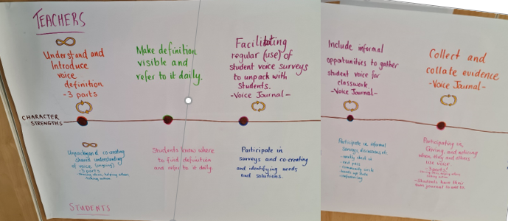
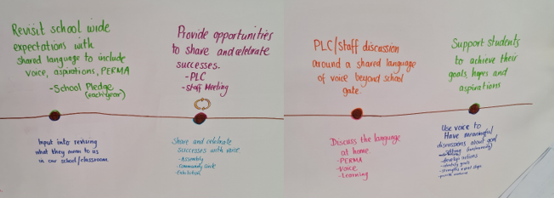



Actions necessary to reach our goals
Inquiry cycles from student data analysis
shared with colleagues

Slide 35


Slide 36

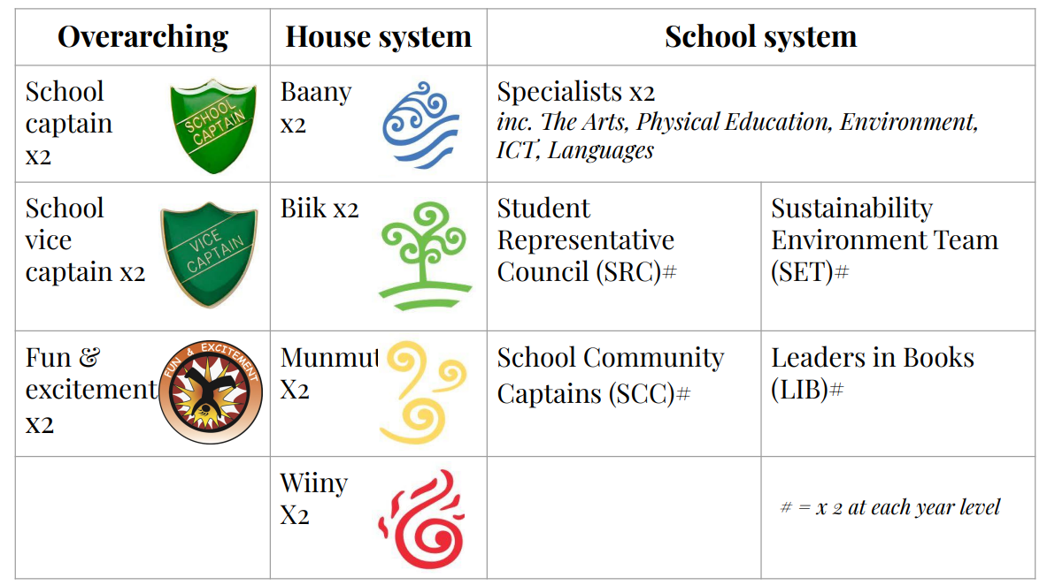

Slide 37
LEAD
Don’t let your voice be silent
Make sure ALL voices are heard
Listen, really listen
Embrace the unknown
Expect more from students
Don’t give false praise
Do something!

Slide 38
Reflect
What is one area at your
school/in your classroom in
which students can be
invited to Lead with you?

Slide 39
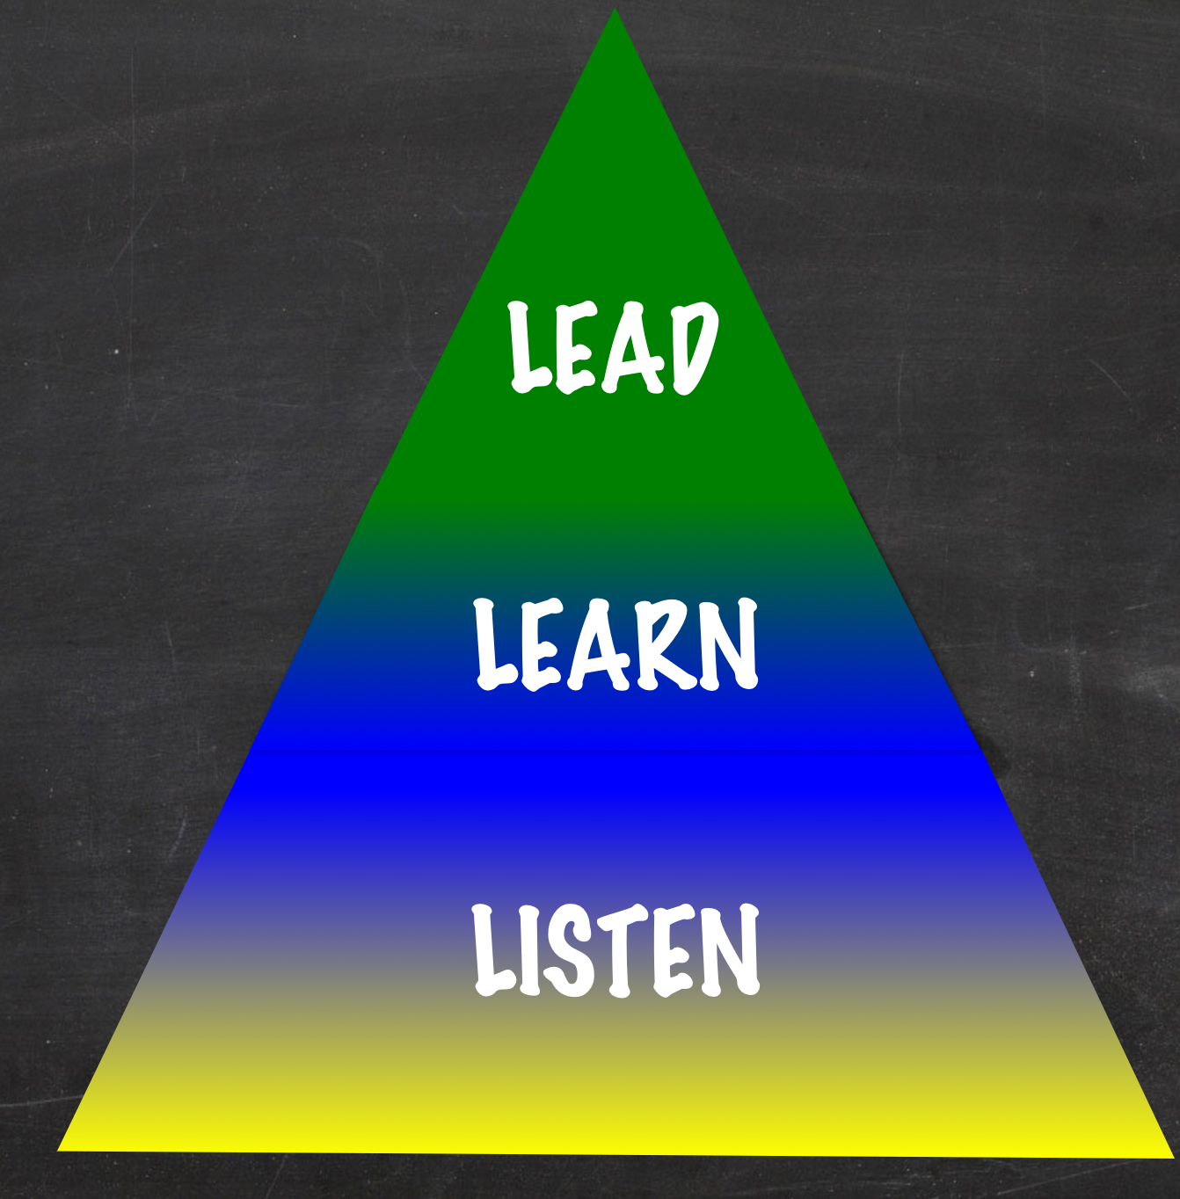
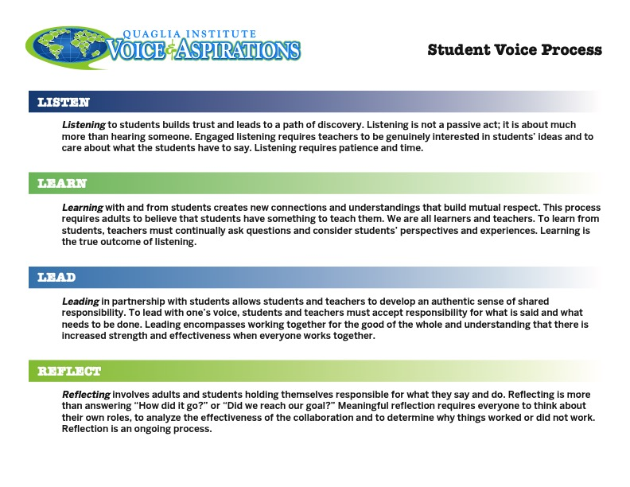
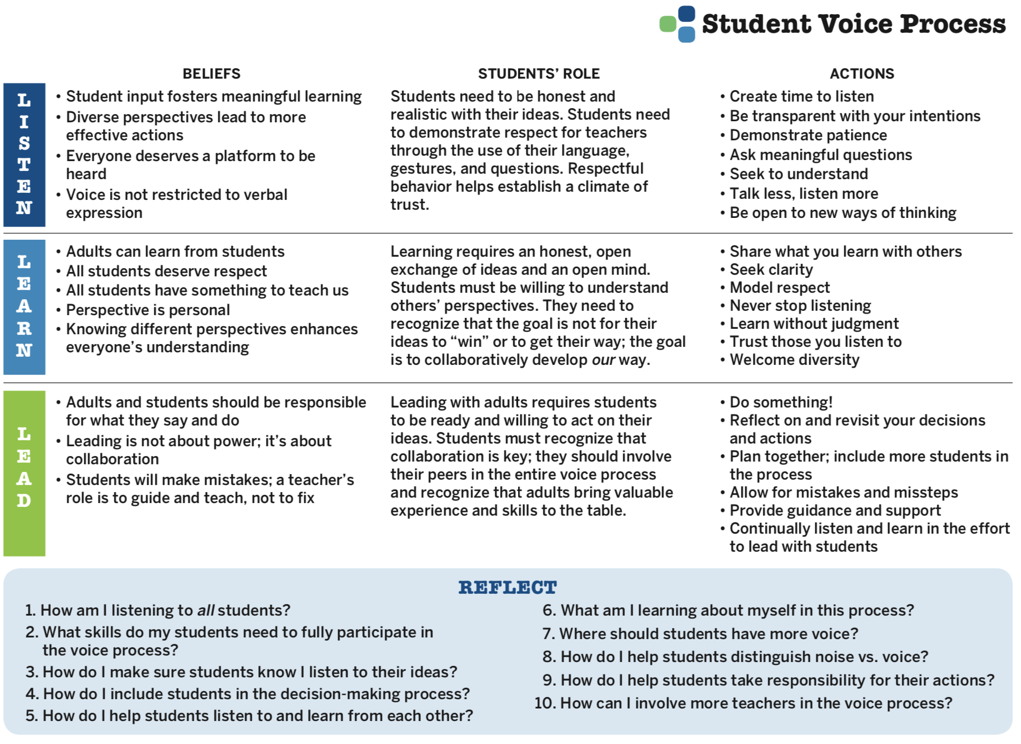

Voice Process
Resource #3
Student Voice
Process Tool

Slide 40

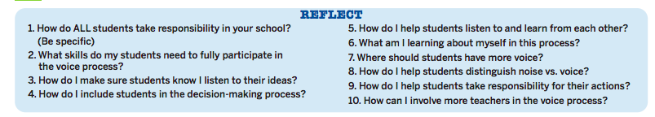
Check In
In your breakout group, check in with colleagues and discuss your responses to #1 and #2

Slide 41
Voice Process
Co-construct shared meaning &
expectations for Listen, Learn, Lead specific
to your school.

Slide 42
School Voice Model
YouTube video - https://youtu.be/Ff2UVHm9urQ
Vimeo video - https://vimeo.com/qisva/schoolvoicemodel

Slide 43
Where do we
go next?
In our next session, we will explore
Voice & Vision:
Using Data to Guide
Implementation of the
Aspirations Framework

Slide 44
RESOURCES

Slide 45
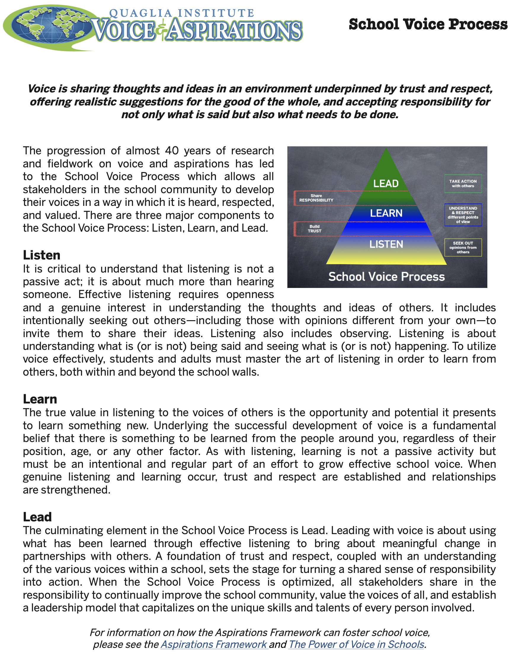
Resource #1
School Voice
Process Brief

Slide 46
Resource #3
Student Voice
Process Tool

Slide 47
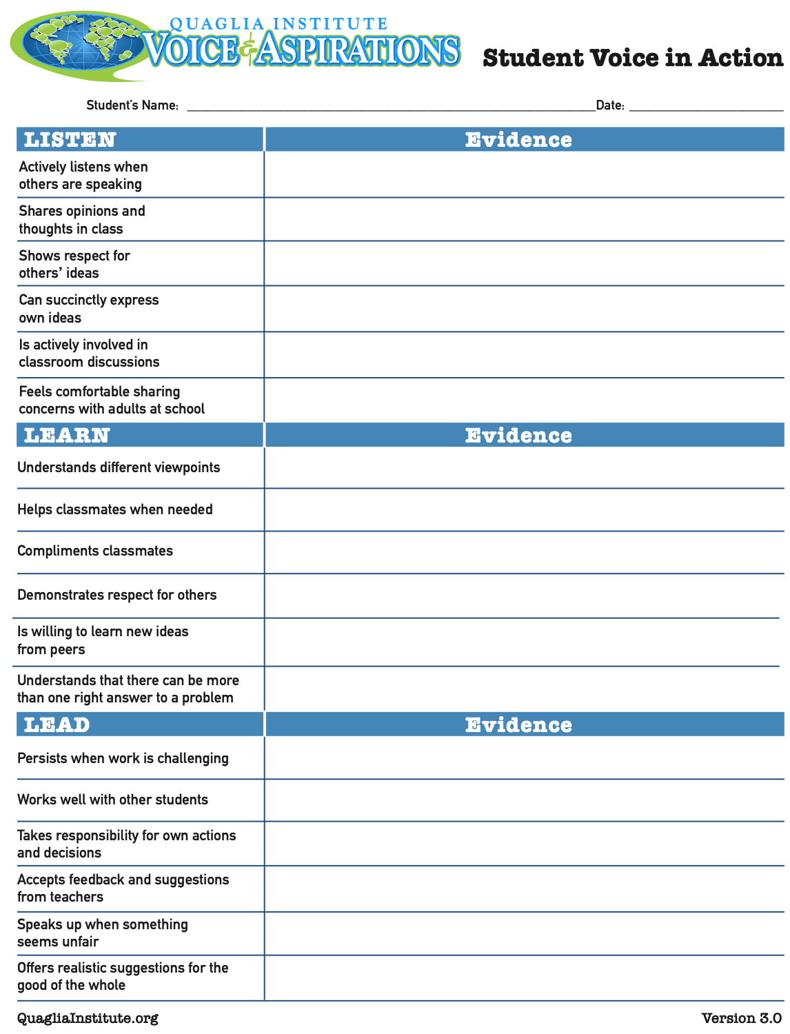
Consider asking
teachers to use this
tool in looking for
evidence of Student
Voice in action.
Resource #4
Student Voice
in Action

Slide 48

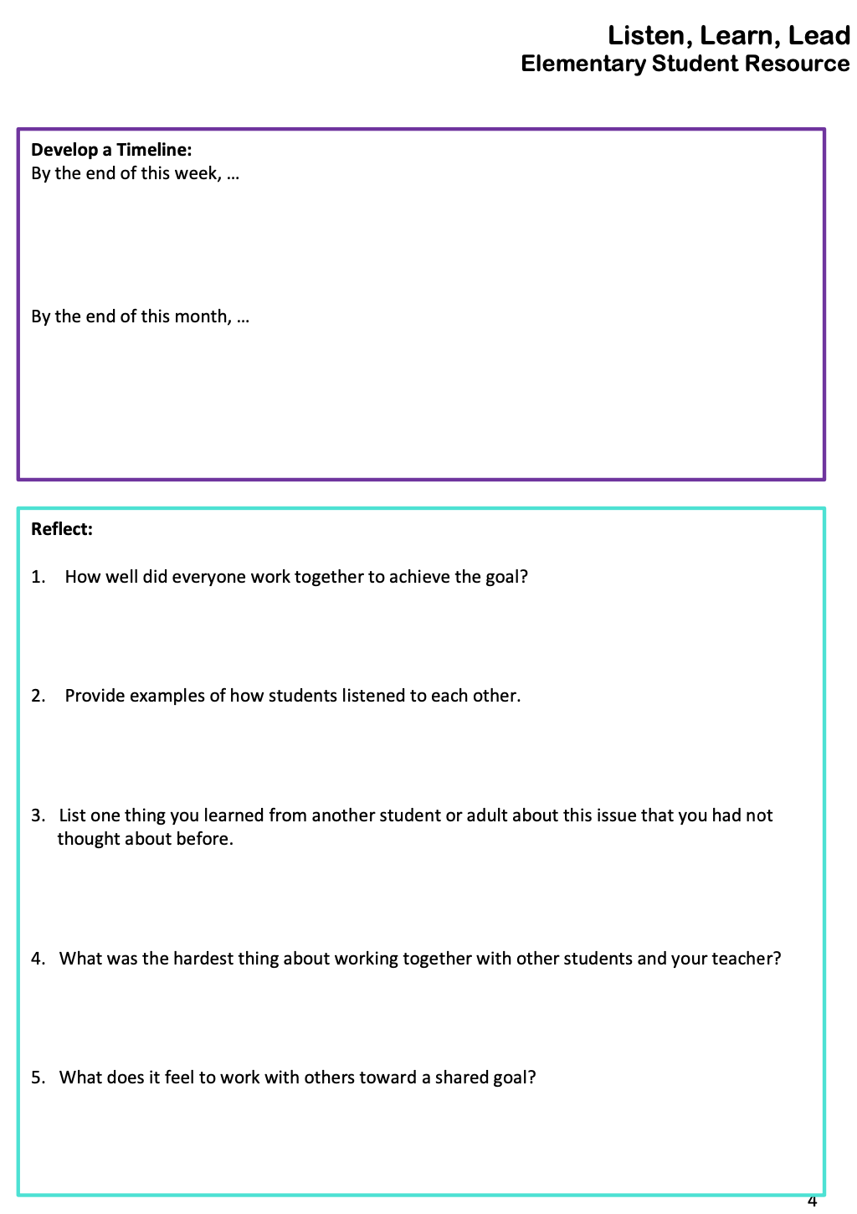

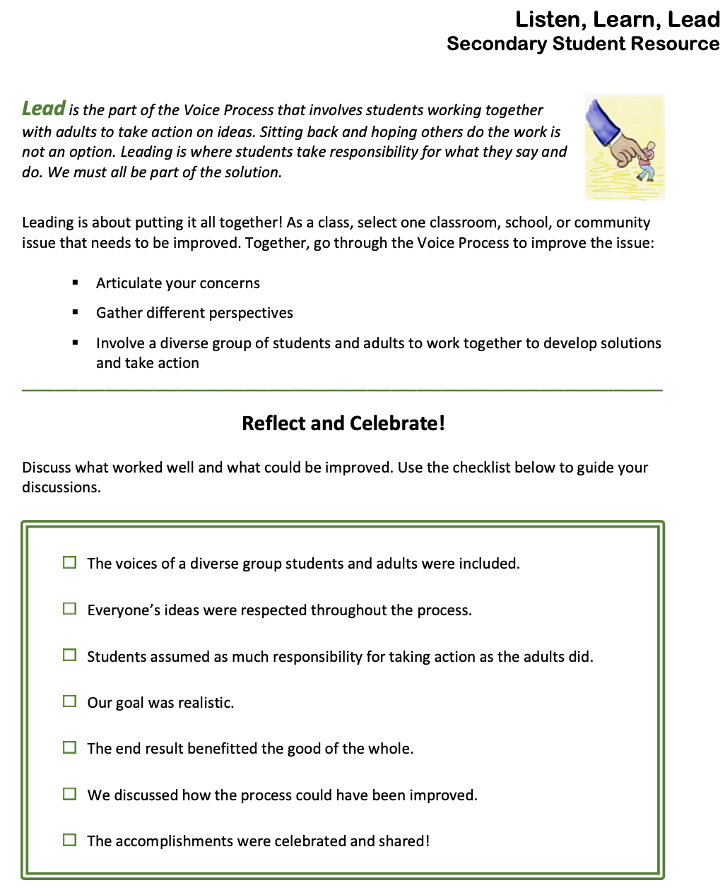
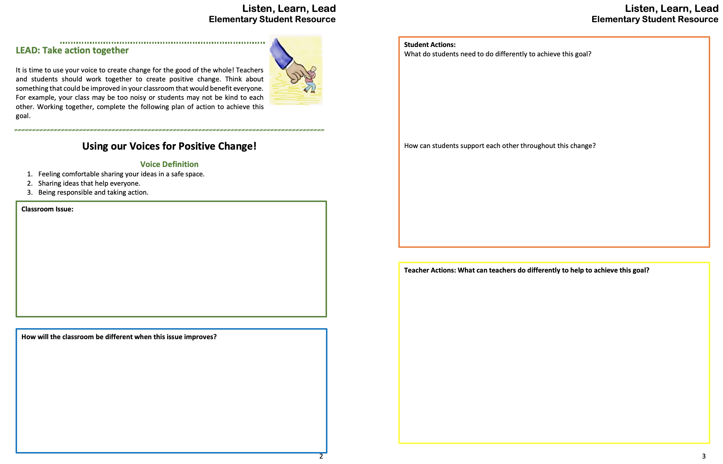
Resource #5a LLL Student Resource Elementary
Resource #5b LLL Student Resource
Secondary

Slide 49

Extended Learning
1. Review the Voice Process and consider what this means in your
context. (Resource #1)
2. Intentionally listen, lead and learn with students and staff.
3. Reflect upon you and your school’s Strengths and Opportunities for Listening. (Resource #2)
4. Complete the Student Voice Process Tool. (Resource #3)
5. Share and support teachers use Student Voice in Action.
(Resource #4)
6.Encourage staff to utilise the primary and secondary Aspirations
Student Resources. (Resource #5a and #5b)
Believe that you can make a difference in your school!

Slide 50
MANTRA
YouTube video - https://youtu.be/787lwYW0mKY
Vimeo video - https://vimeo.com/qisva/mantra

Slide 51

What is your Voice Mantra?
On a piece of paper write in LARGE letters your Voice Mantra.
Then, hold it to the camera for everyone to see!

Slide 52
Next Session:
Voice & Vision Data October 4th, 2022
Special Guest
Dr. Russ Quaglia

