Slide 1


Aspirations Profile
Dr. Kristine Fox & Sue Bryen with special guest Dr. Michael Corso
Notes:
Sue

Slide 2
Fundamental Beliefs
Students are the potential, not the problem.
Students have something to teach us.
Working together is the only way forward.
Notes:
Sue

Slide 3
Goals for Today
Realise the connections between SIF Religious
dimension sphere and Voice & Aspiration.
Explore the Aspirations Profile.
Consider how the Aspirations Profile can & should affect how we support student voice.
Apply learning to amplify student voice in
YOUR school.
Notes:
Sue

Slide 4




Welcome Dr. Corso!
Notes:
Kris

Slide 5
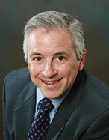
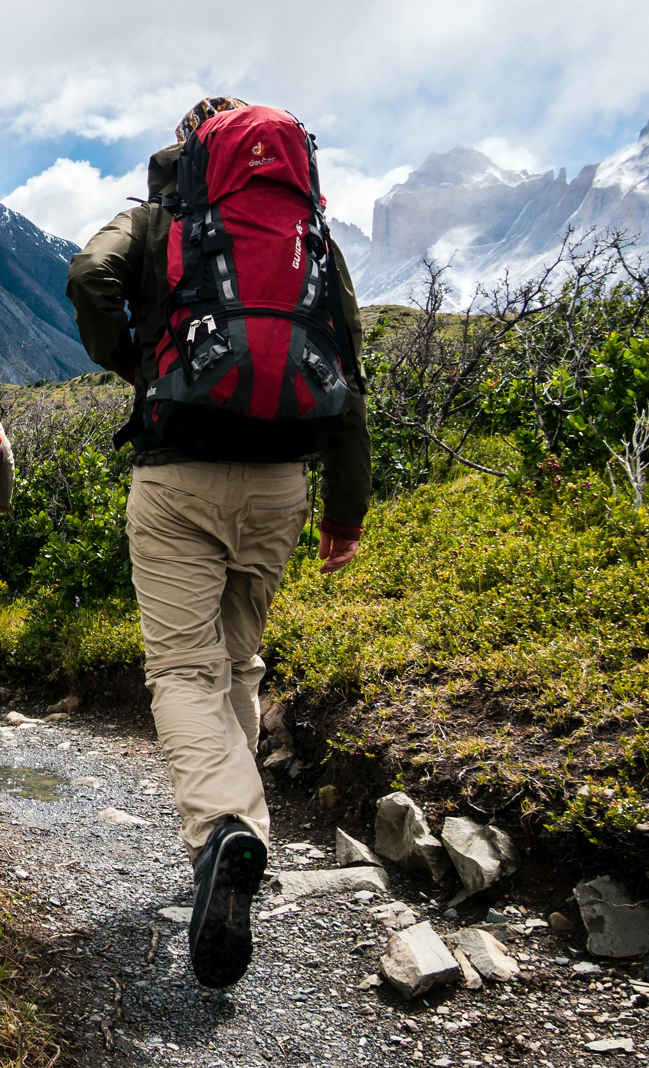
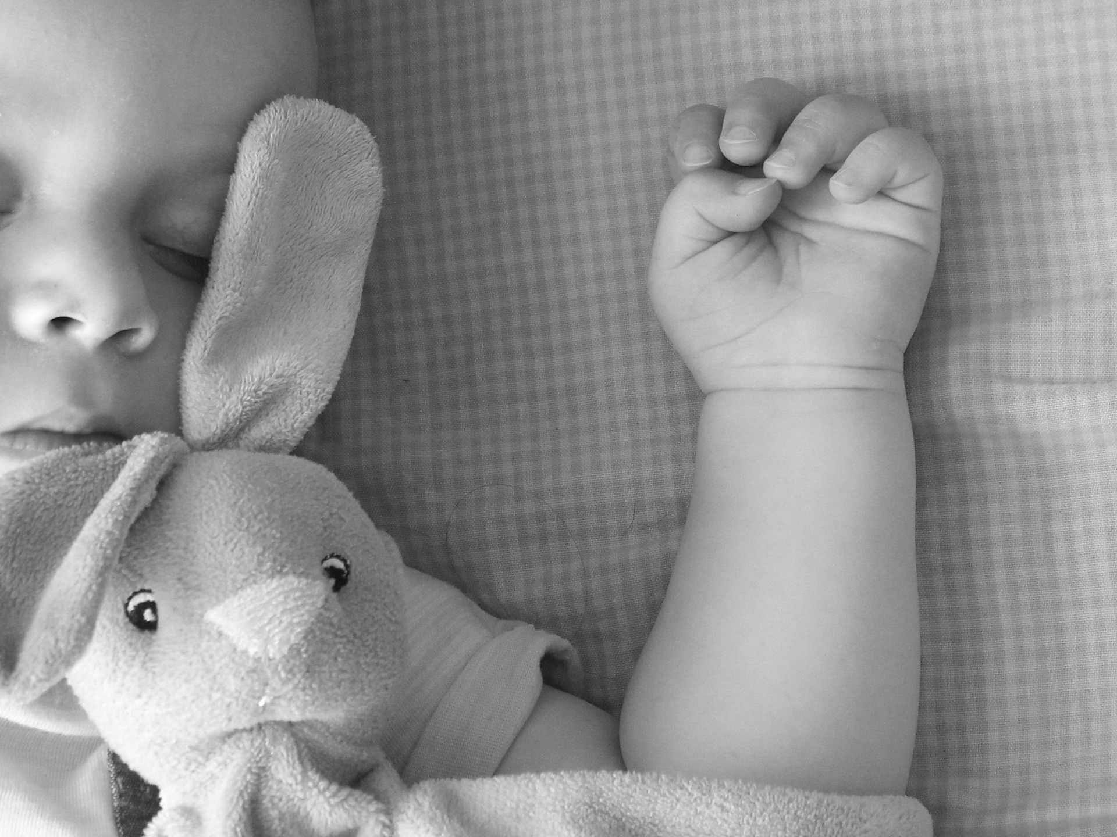
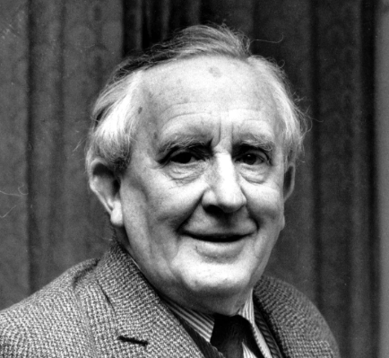



Slide 6

The 3 Components of Student Voice
Sharing thoughts & ideas in an environment
underpinned by trust and respect.
2) Offering realistic suggestions for the
good of the whole.
3) Accepting responsibility for not only what
is said but also what needs to be done.
Notes:
Mickey

Slide 7
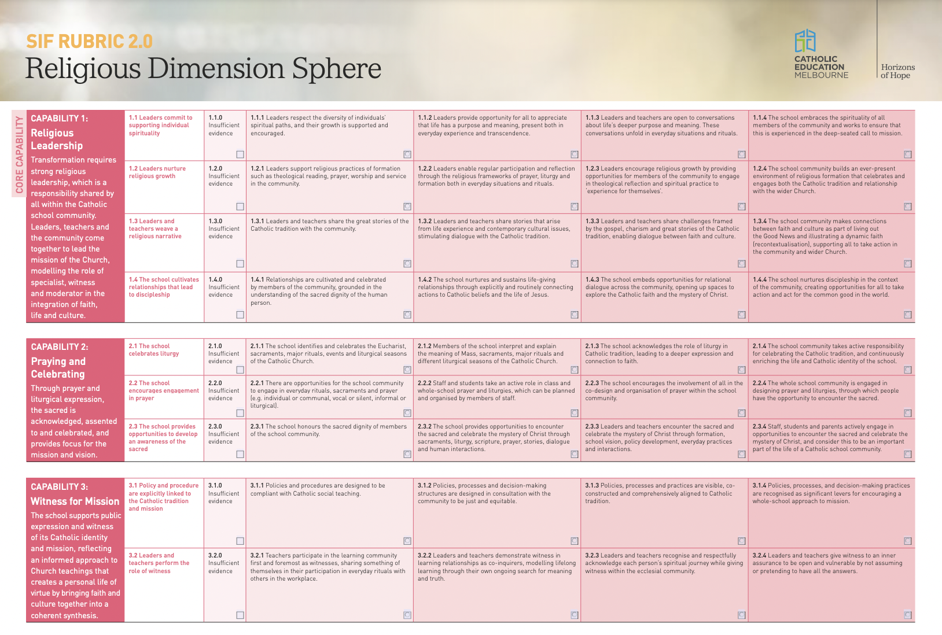
SIF Rubric 2.0 Connections
Notes:
Mickey

Slide 8
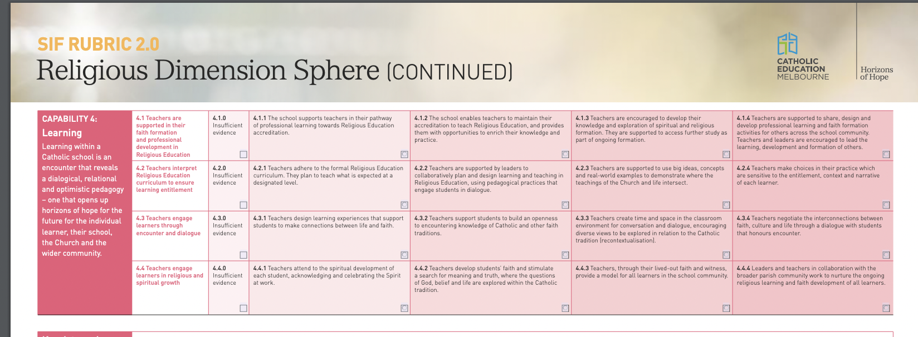
SIF Rubric 2.0 Connections
Notes:
Mickey

Slide 9
Importance of Shared Language & Common Understanding
Notes:
Kris Does everyone understand what your focus is, why you are doing it and how everything links to your strategic and annual plans?

Slide 10
Misheard Lyrics
https://vimeo.com/789015665
Notes:
Kris

Slide 11
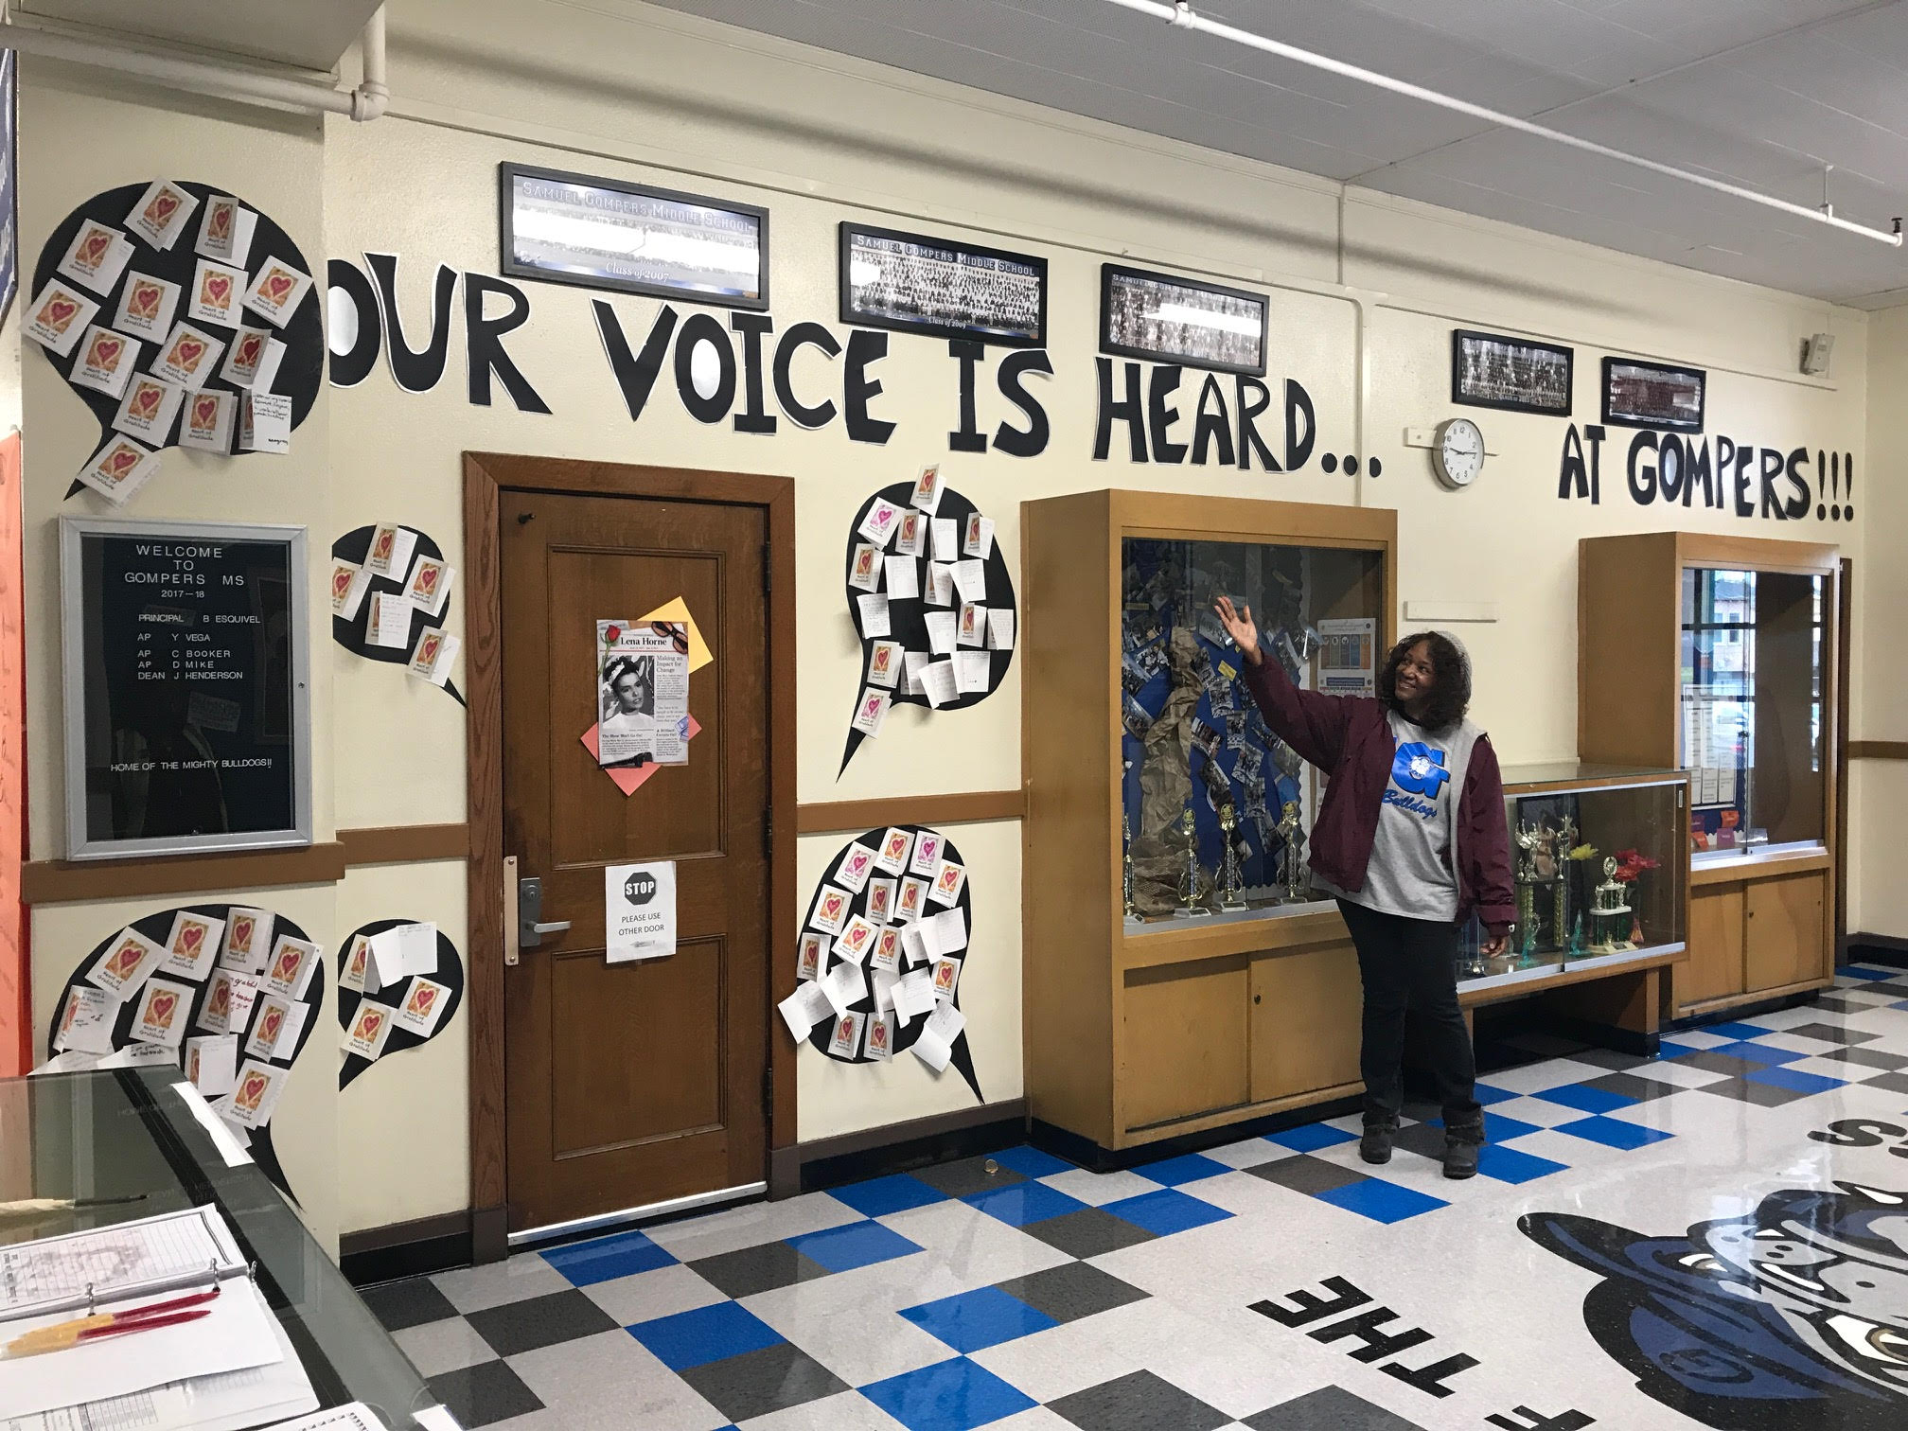
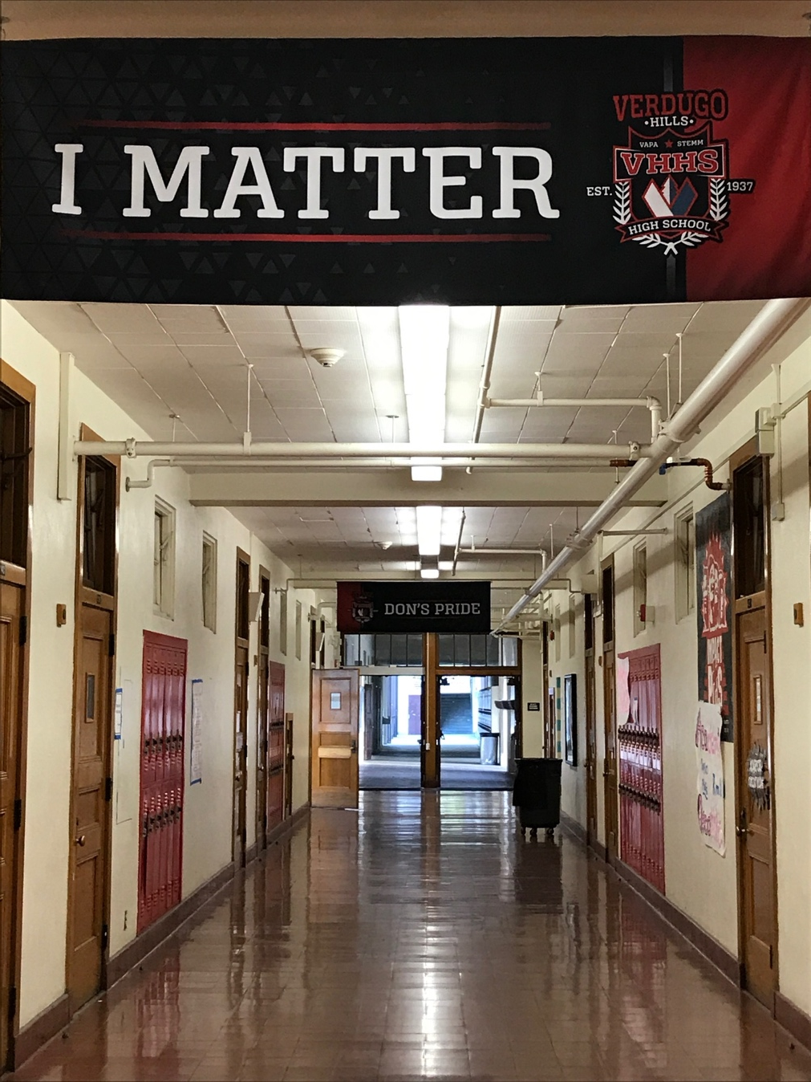
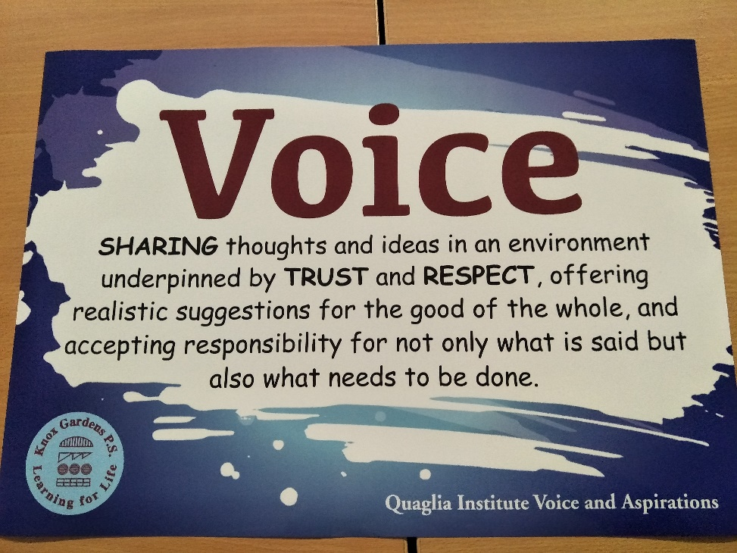
Notes:
Kris

Slide 12
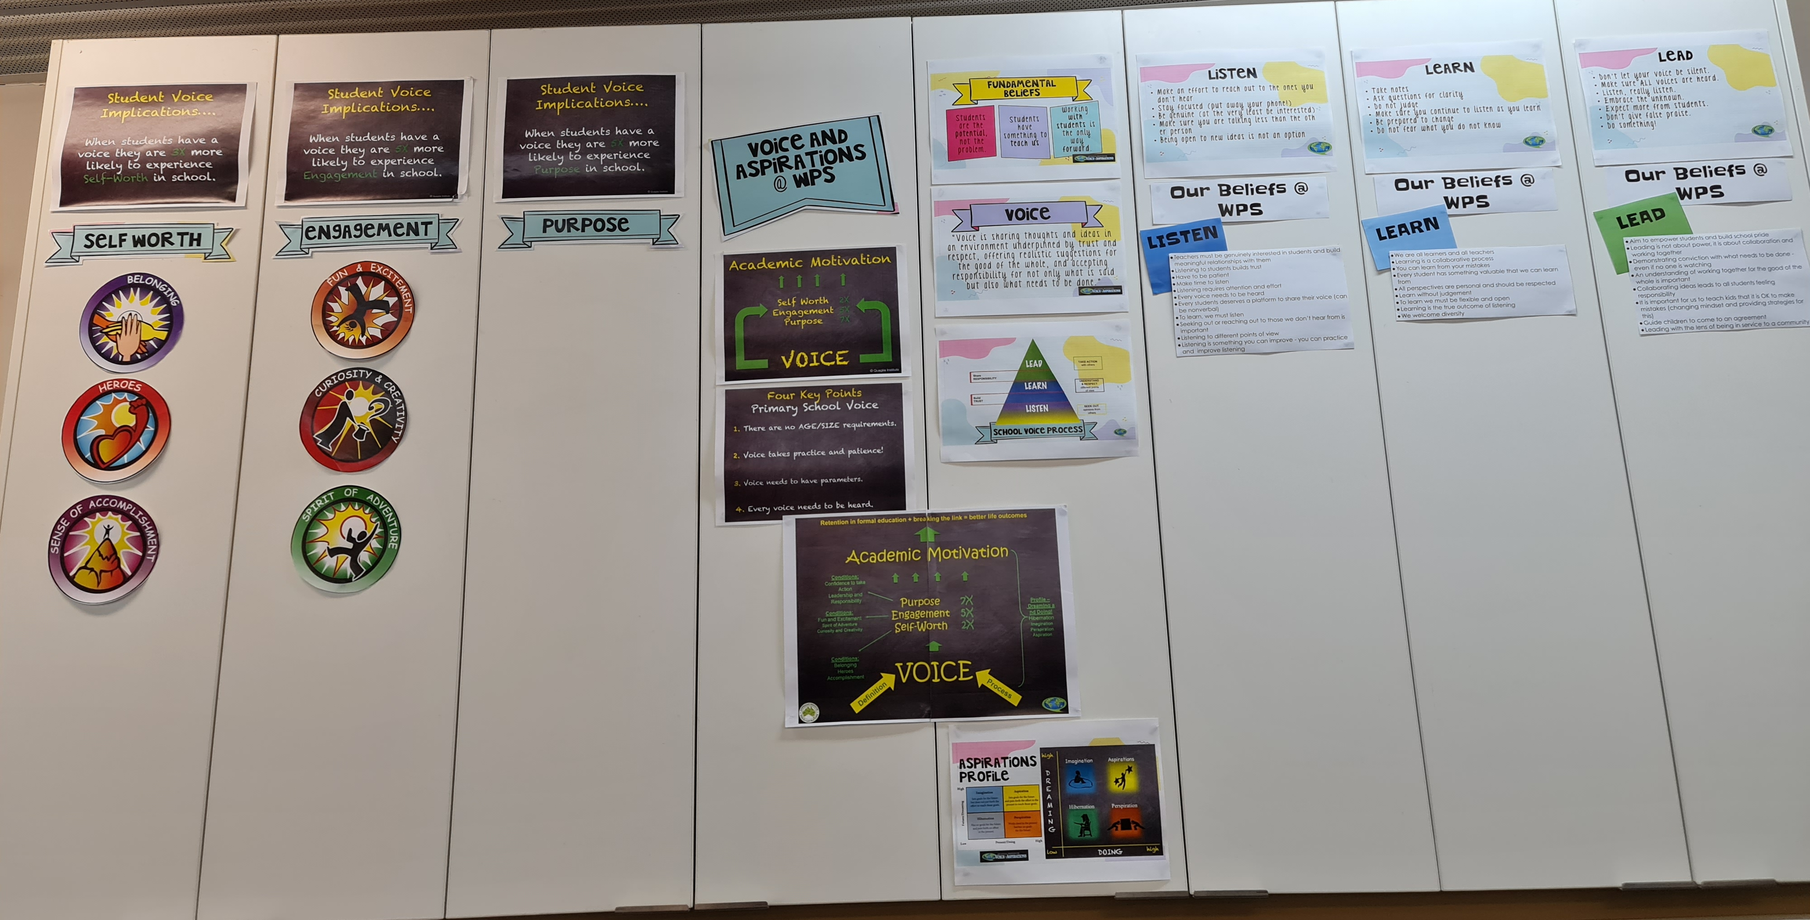
Notes:
Sue

Slide 13
Teachers
Enabling Student Voice
Voice Amplifiers displayed
How and when do I use my voice?
Introduce voice definition
Unpack and interpret key words and create meaning.
Model and provide protocols around ‘learning talk’-
Co-create success criteria of effective learning talk
Create looks like/Sounds like with class
Noise v Voice
Voice definition displayed and referred to daily
Think- How do I show the 3 parts of voice, share my ideas, help others and do the required work?
Ask myself when I share my ideas and thoughts, Is this voice or just noise?
Create and share examples of using voice discussed and found at home
Work with others and find new ideas beyond my usual friends.
Contribute my ideas every day.
Co-create class looks like/sounds like, use as SC
Discuss voice definition at home and with peers
Students
Notes:
Sue

Slide 14
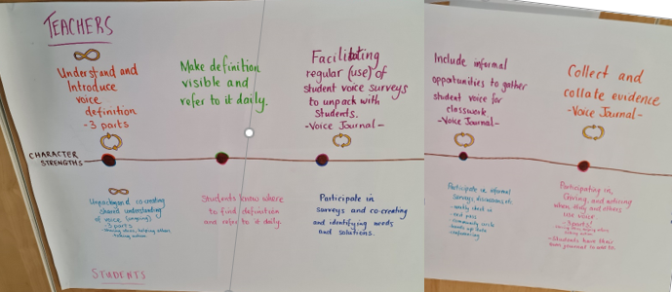
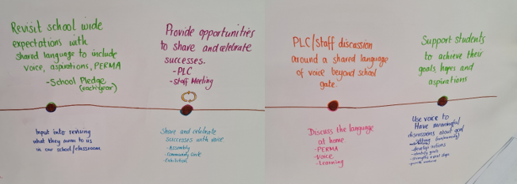



Actions necessary to reach our goals
Inquiry cycles from student data analysis
shared with colleagues
Notes:
Sue How do we make our intentions visible to staff? How will we share examples of practice?

Slide 15
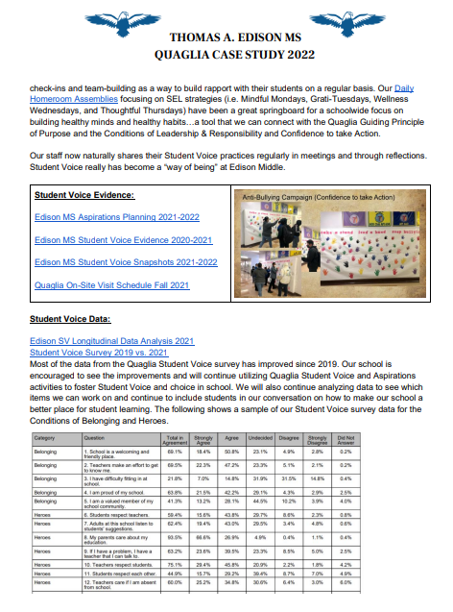
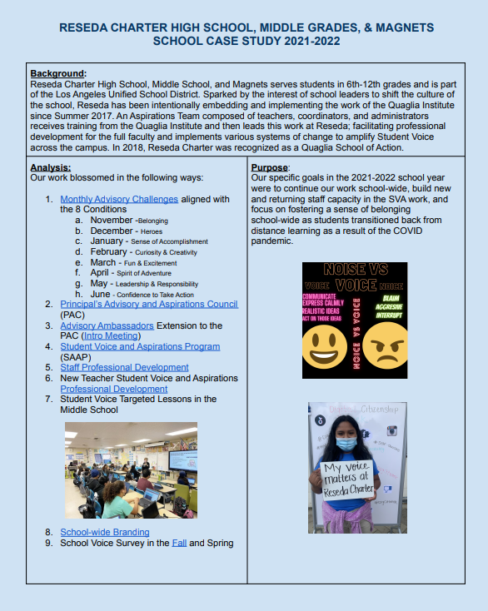
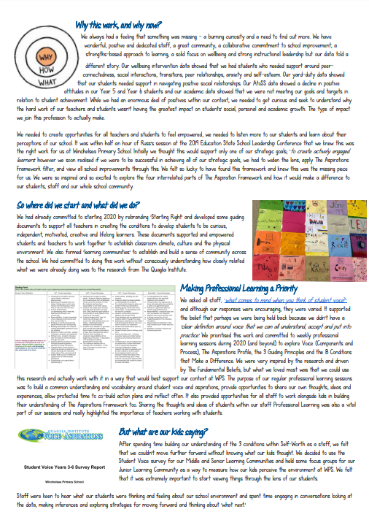
Voice in Action
Case Studies
https://quagliainstitute.org/library/case-studies
Notes:
Kris Thinking we take them to our website and show where these exist… Next time we can introduce Aspire high charts.. Maybe..

Slide 16
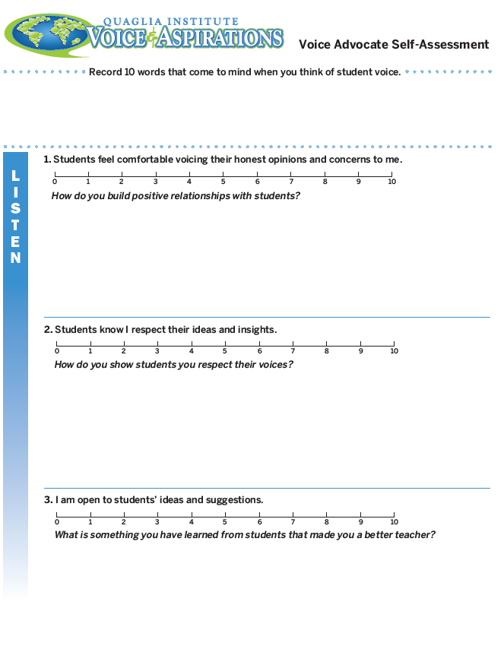
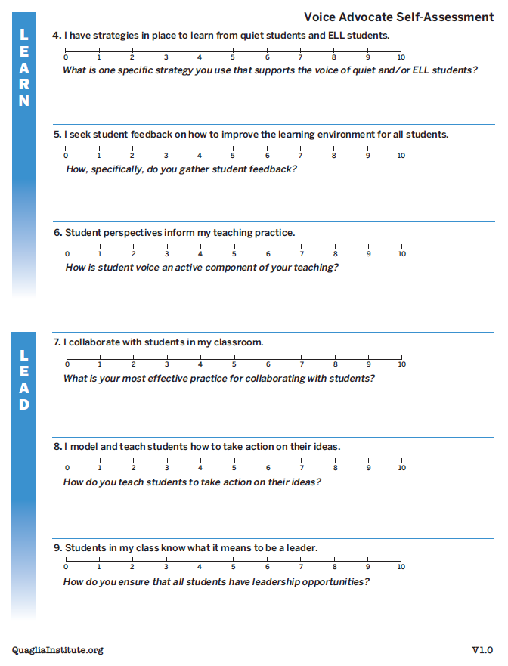
Voice Self Assessment
Complete the Voice
Self-Assessment prior to session #2
Notes:
Kris Check in to see what emerged from their homework

Slide 17

CHECK IN
In your breakout group, check in with colleagues & discuss what you learned about yourself in regard to the Voice Self-Assessment
(8 minutes)
Notes:
Kris will intro, Sue create random breakout groups 8 minutes

Slide 18
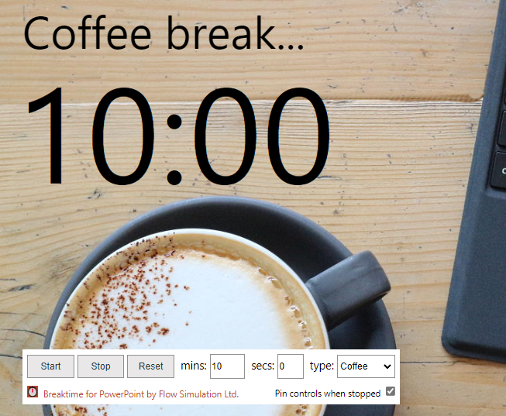
Quick Break!
10 minute

Slide 19
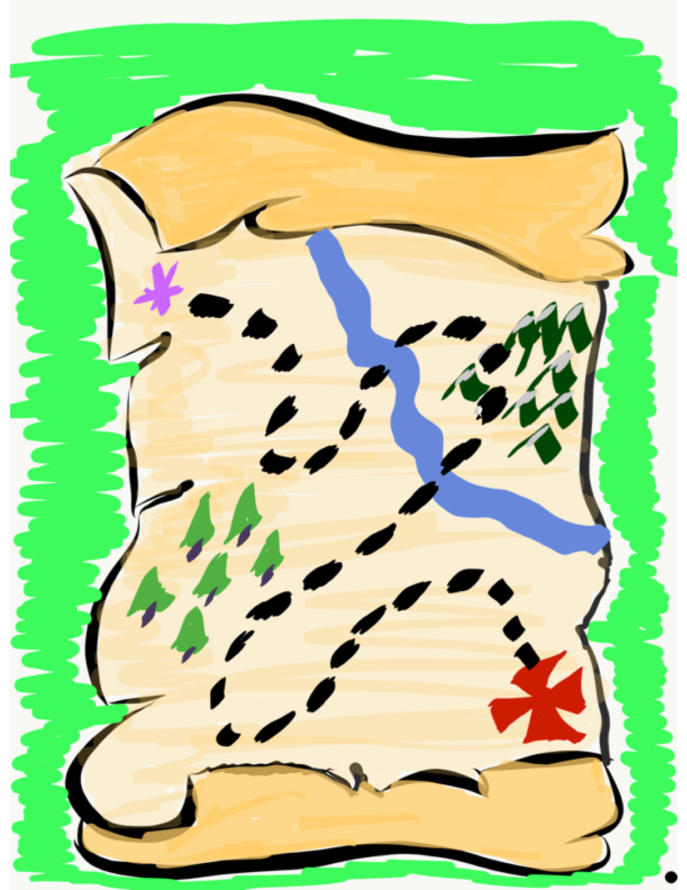
We journey
onward…
Now it is time to explore the Aspirations Profile as we
consider how to support
students in developing their voice & reaching their
fullest potential.
Notes:
kris

Slide 20
What is Student Voice?
https://vimeo.com/789017028
Notes:
Kris

Slide 21
ASPIRATIONS
The ability to
dream & set goals
for the future,
while being inspired
in the present
to reach those dreams.

Slide 22




high
Resource #2.1
Aspirations
Profile Brief
Imagination
Aspiration
DREAMING
Hibernation
Perspiration
low
DOING
high
Notes:
Kris

Slide 23
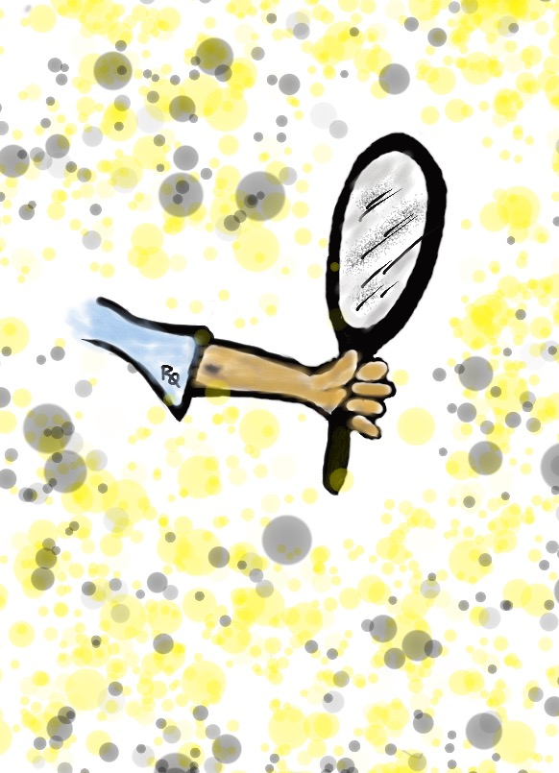
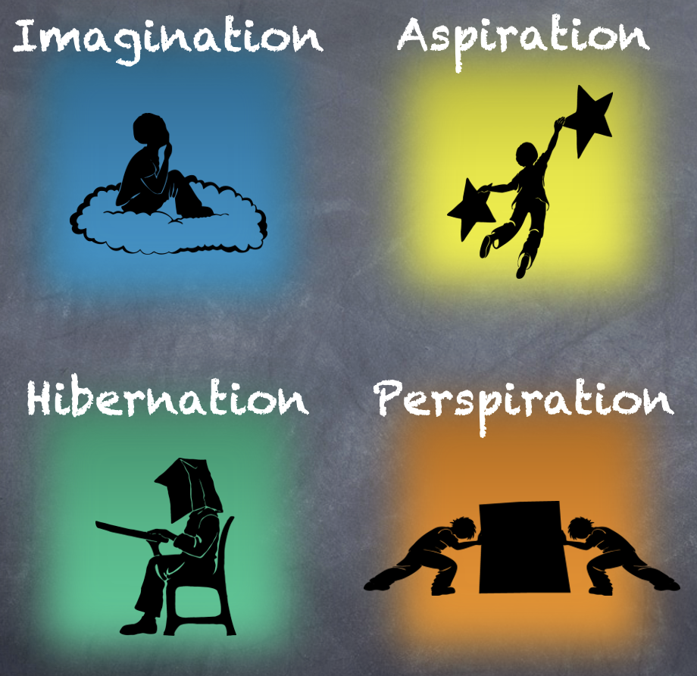
Reflect
In which quadrant did you spend most of your time as a student? Why?
Notes:
Kris

Slide 24

Time to Dig Deeper!

Slide 25
high
DREAMING
Hibernation
low
DOING
high
Notes:
Sue

Slide 26
high
DREAMING
https://vimeo.com/789017891
low
DOING
high

Slide 27
Reflect
What is one word that might describe students in hibernation?
Notes:
Sue

Slide 28

Students in Hibernation
Potential Cons:
Passive & unmotivated
Poor self-esteem &
defeatist attitude
Struggle to take
responsibility for
anything
Potential Pros:
Time to reflect
Space to recharge
They report:
Feeling isolated
Stuck
Misunderstood
Bored
They need to:
Feel valued
Be recognized for success
Have positive role models
Have a sense of purpose
Notes:
Sue

Slide 29
Reflect
Think of the word you previously shared.
Now share a word that reflects your hopes & dreams for hibernating students.
Notes:
Sue

Slide 30
high
Imagination
DREAMING
low
DOING
high
Notes:
Kris

Slide 31
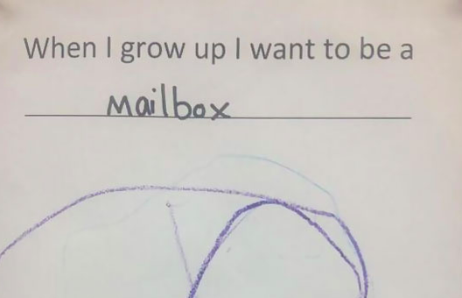
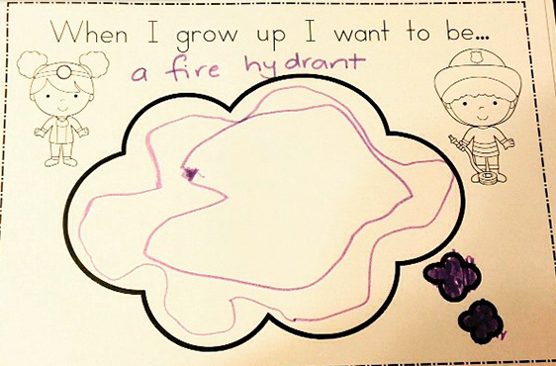
high
DREAMING
low
DOING
high
Notes:
Kris

Slide 32
Reflect
What is something you dream about doing in your professional role, but have not yet accomplished?

Slide 33

Students in Imagination
Potential Pros:
Enthusiastic
Fun to be around
Lots of creative ideas
Potential Cons:
Limited follow-through
Not well connected
to reality
Students report:
Having big dreams
Eagerness to explore
Craving creative outlets
They need to:
Develop action plans
Focus
Be realistic
Notes:
Kris

Slide 34
Reflect
How could you leverage the
3-part Voice definition to move out of Imagination?
Notes:
Kris

Slide 35
high
DREAMING
Perspiration
low
DOING
high
Notes:
Sue

Slide 36
high
DREAMING
https://vimeo.com/789017665
low
DOING
high
Notes:
Sue

Slide 37
Reflect
What is the greatest source of your own perspiration right now?
Notes:
Sue

Slide 38

Students in Perspiration
Potential Pros:
Determined
Hard Working
Driven to Succeed
Potential Cons:
Overly concerned
about grades
Single-minded,
narrow-focused
Students report:
Feeling stressed
Not sure “why” they are learning, but need
good grades
Don’t want to let
anyone down
They need to:
Have a greater purpose for learning
Balance school work with outside life
Link learning to
their passions
Notes:
Sue

Slide 39
Reflect
What can you do to perspire a little less & dream a little more?
Notes:
Sue

Slide 40
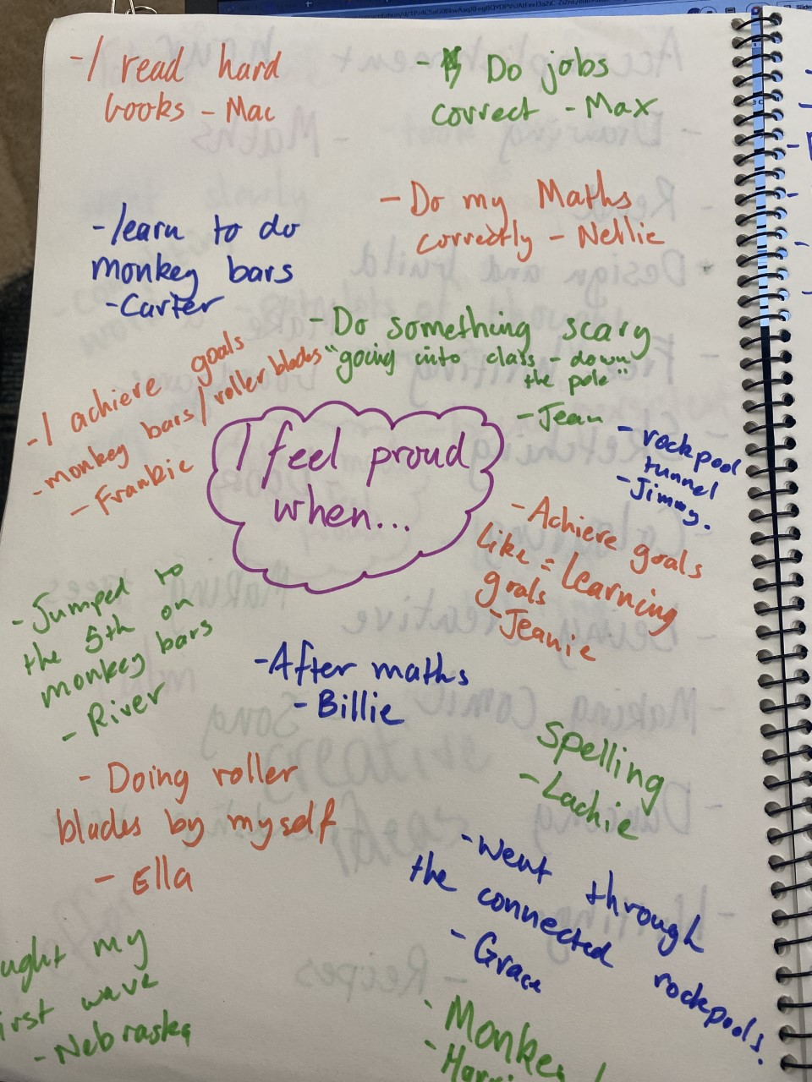
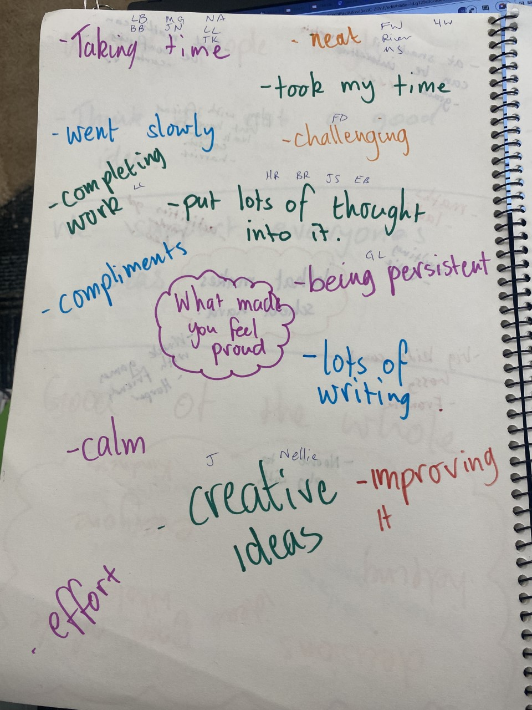
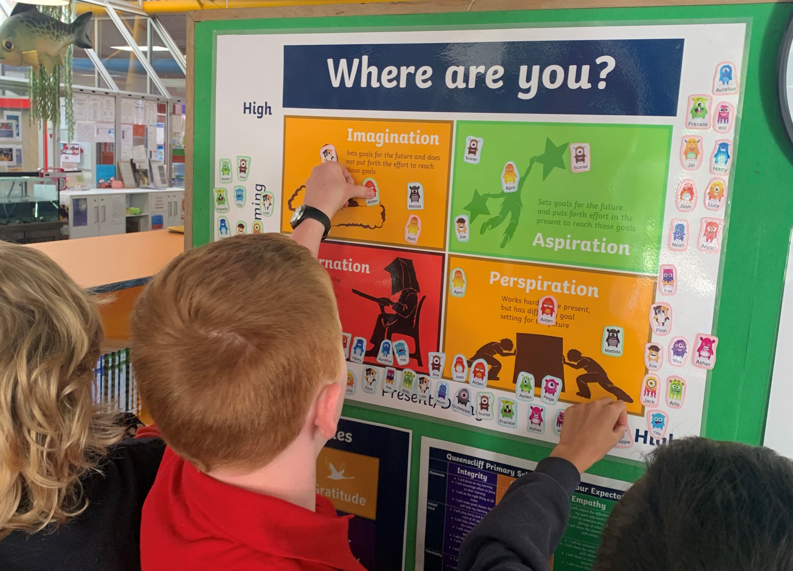
Barwon Heads, Victoria
Queenscliff Primary, Victoria
Notes:
Sue Metacognition strategies. Setting goals (2 HITS) from VIC When do you feel proud? What were yu wanting to achieve? What did you do to achieve it? (Link with PERMA Positive Ed work)
What quadrant are you in this lesson (before and afer, what did you do to move out of that quadrant?)

Slide 41

Quick Break!

Slide 42
high
Aspiration
DREAMING
low
DOING
high
Notes:
Kris

Slide 43
high
DREAMING
https://vimeo.com/789015178
low
DOING
high
Notes:
Kris

Slide 44
Reflect
What did you learn from the students about Aspirations?
Notes:
Kris

Slide 45

Students in Aspiration
Potential Pros:
Connects present
actions to future
dreams
Good idea of
potential options
Potential Cons:
Relaxation is Challenging
Under constant pressure
Self-Serving
Students report:
Never feeling
satisfied
Driven by being best
Frustration with peers
who don’t try or who
interrupt learning
They need to:
Be assured they
are on a positive track
Experience meaningful academic challenges
Breathe!

Slide 46
Reflect
From your perspective, how does the Aspirations Profile connect to Student Voice?
Notes:
Summarize in chat. Thinking time then type in chat.

Slide 47
Quadrants & PLCs
high
Imagination
Aspiration
DREAMING
Hibernation
Perspiration
low
DOING
high
Notes:
Sue PLC current practices each session. Is there a purpose? What about individual teachers?

Slide 48
Quadrants & PLCs
high
Imagination
Aspiration
Lots of planning
Little follow through
Discuss many ideas
No connection to school vision
Enthusiastic
Purposeful meetings
Changes in practice
Connection to school goals
Shared responsibility & ownership
Commitment
DREAMING
Hibernation
Perspiration
Sporadic attendance
No classroom impact
Compliance driven
No passion
Wait & see if this will last
Hard working
Meets deadlines
Overwhelmed, at risk of burnout
Team player
Dependable
low
DOING
high
Notes:
Sue

Slide 49
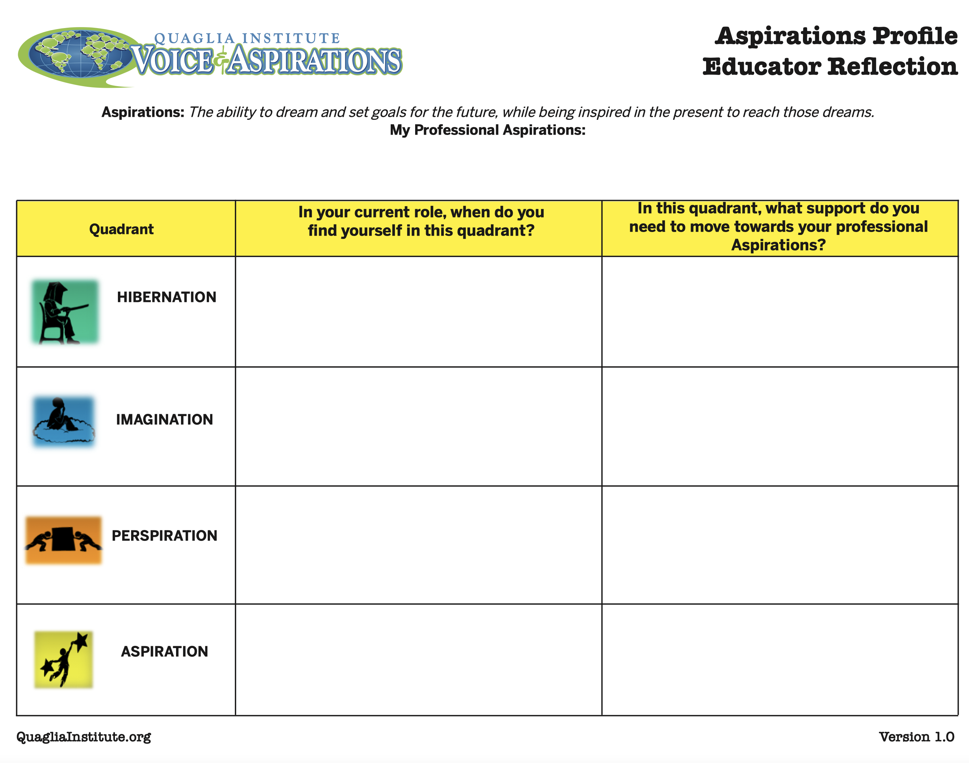
Reflect
In your breakout group, check in with colleagues & discuss 2 of the quadrant and prompts.
Resource #2.3
Aspirations
Profile Educator Reflection

Slide 50
CHECK IN
Share one take away from your
discussion during your breakout.

Slide 51
RESOURCES

Slide 52
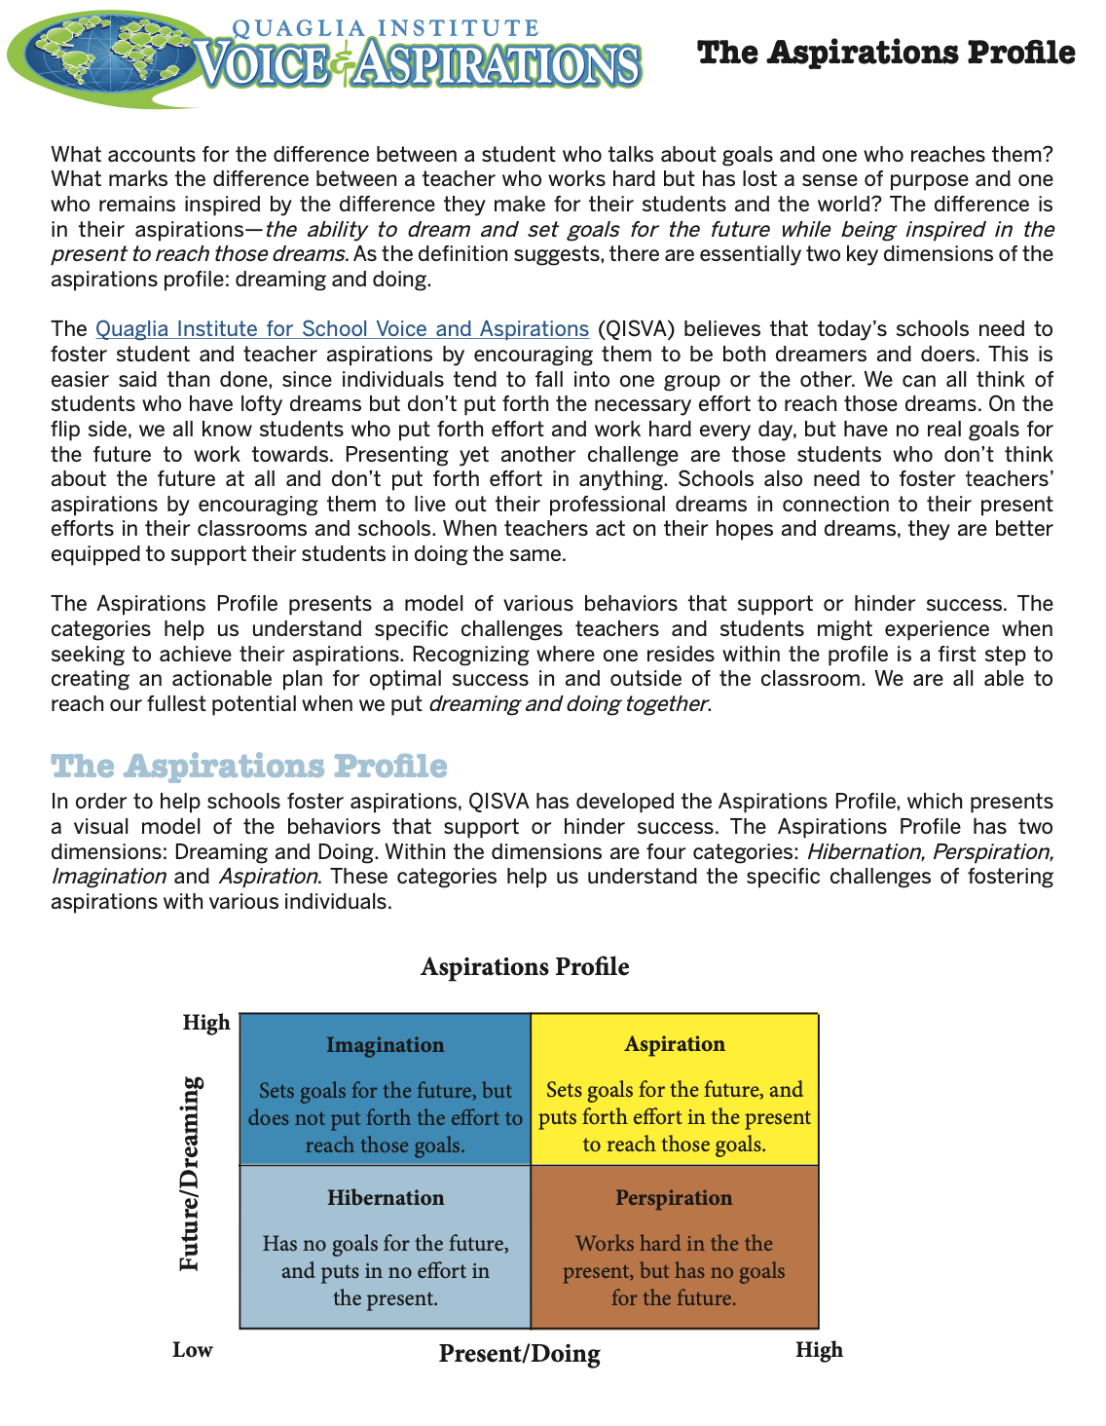
Resource #2.1
Aspirations
Profile Brief

Slide 53
Resource #2.3
Aspirations Profile
Educator Reflection

Slide 54
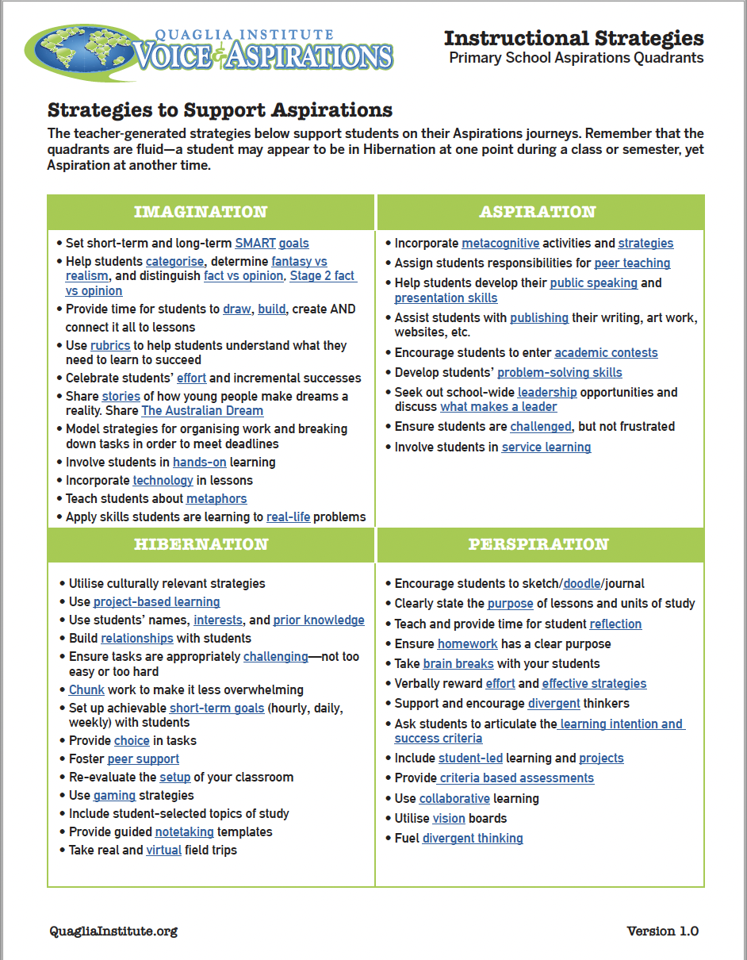
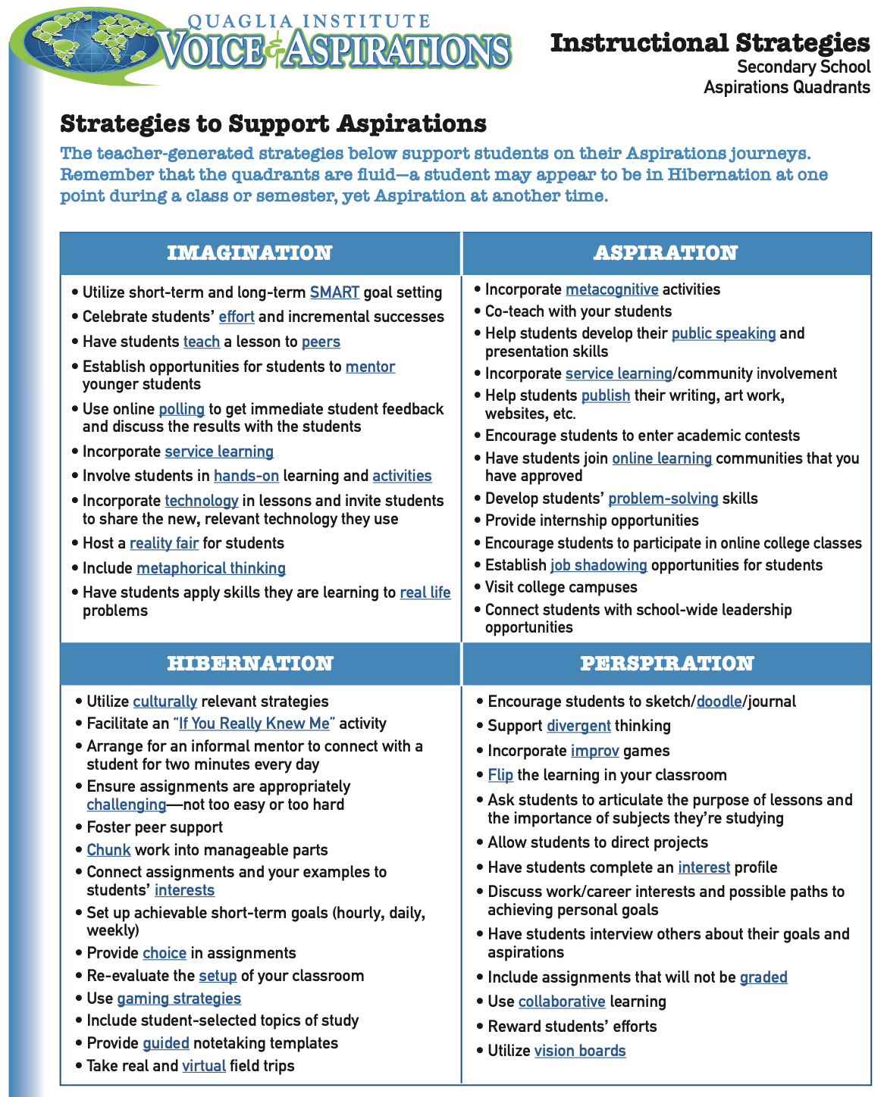
Resource #2.4a
Aspirations Instructional Strategies Primary
Resource #2.4b
Aspirations Instructional Strategies Secondary

Slide 55
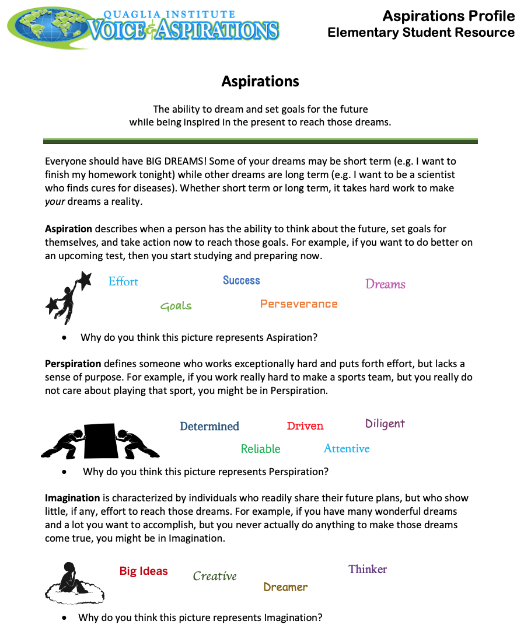
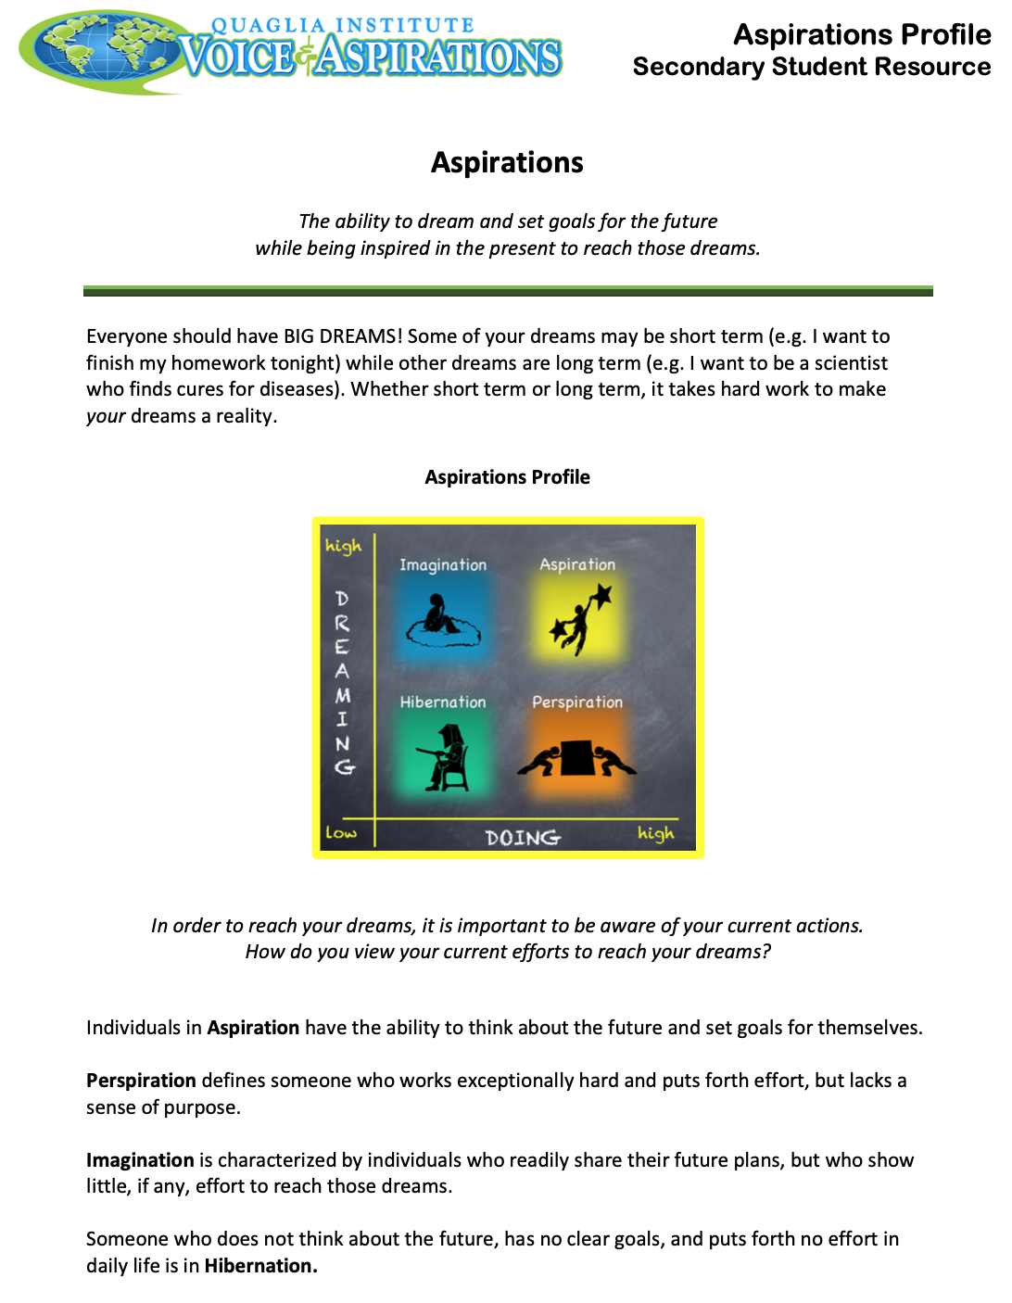
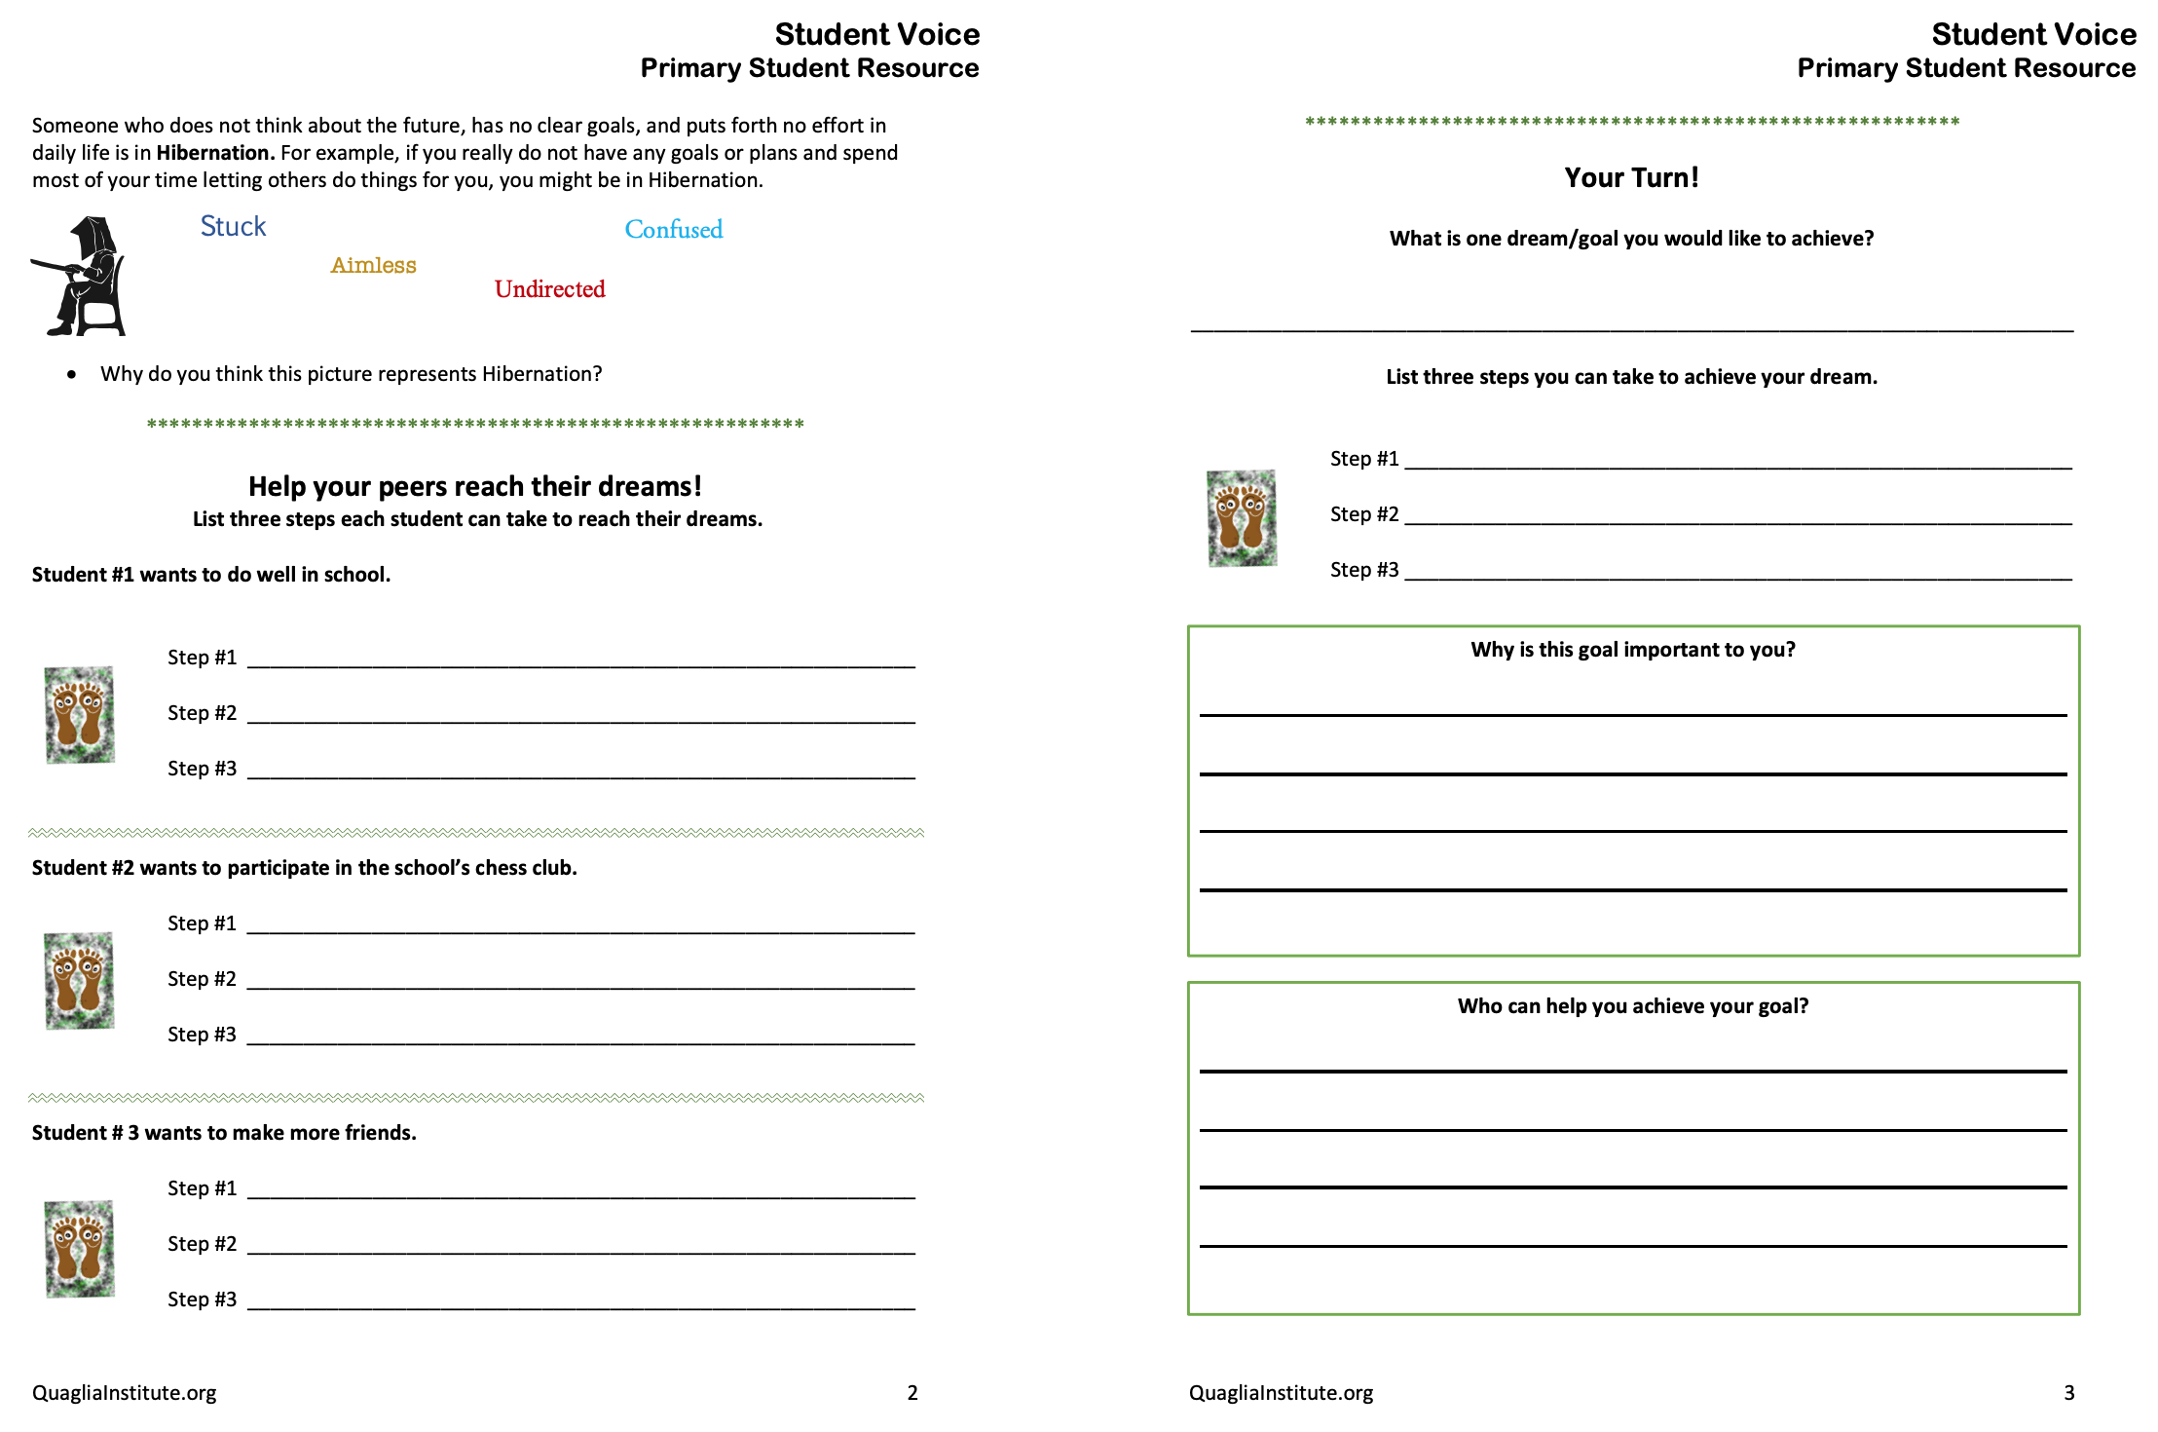
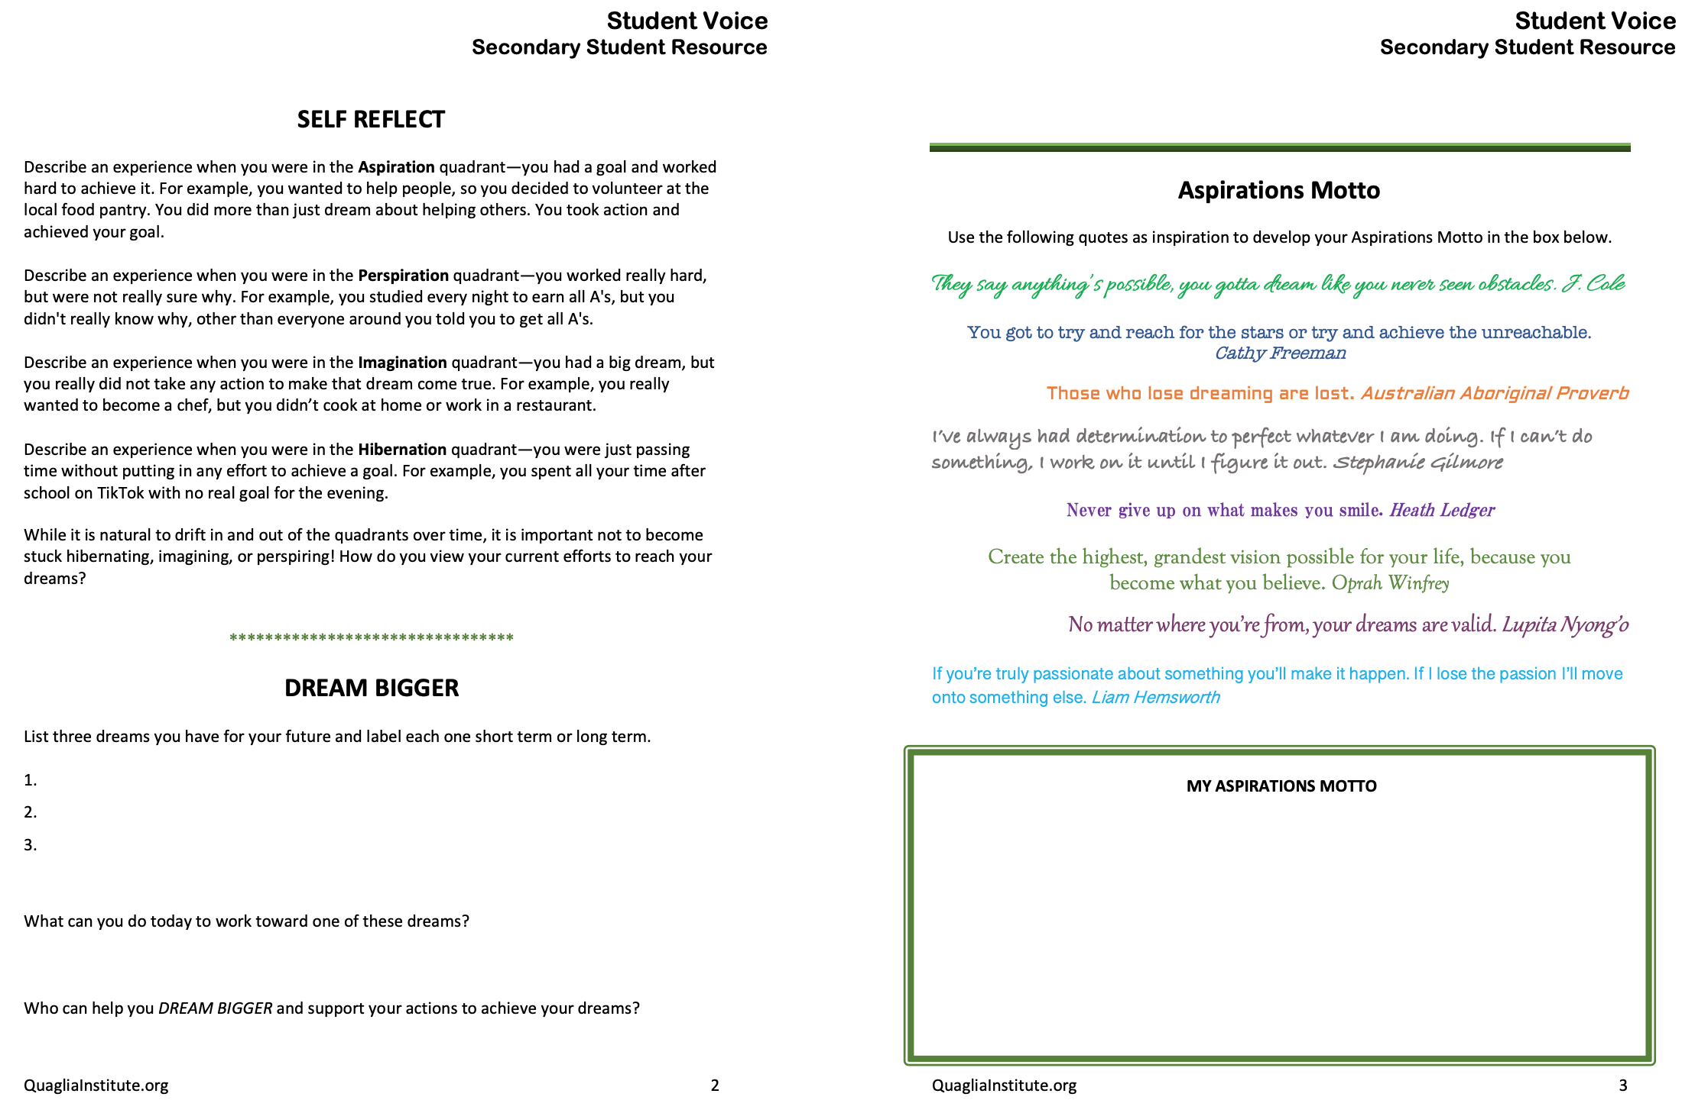
Resource #2.5a
Aspirations Student Resource Primary
Resource #2.5b
Aspirations Student
Resource Secondary

Slide 56
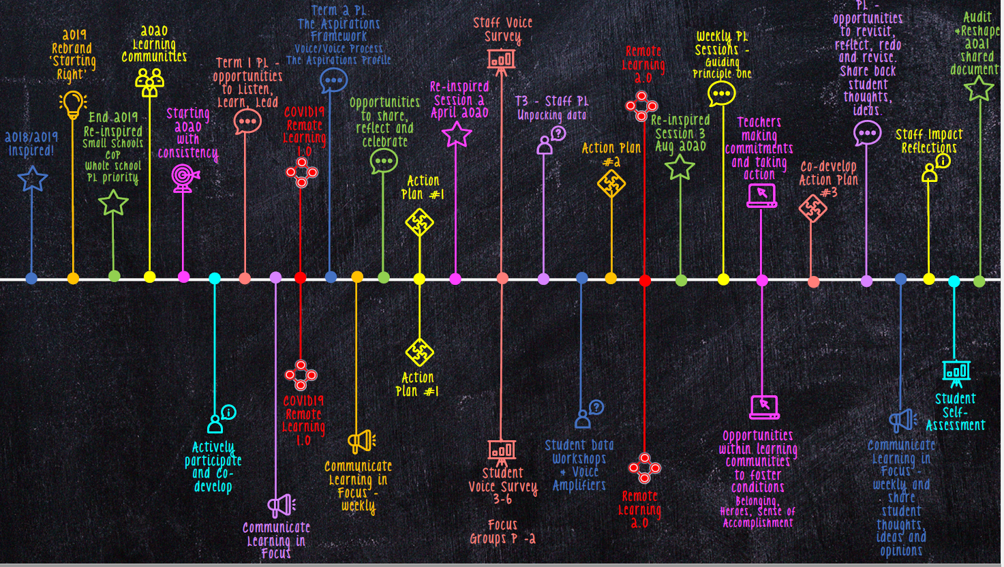

Slide 57
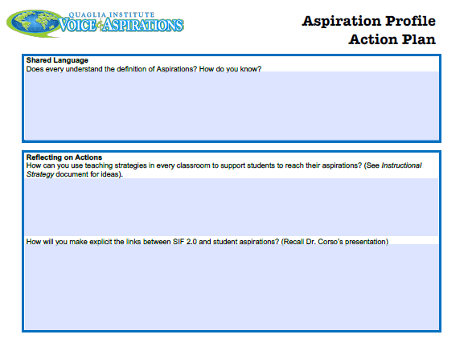
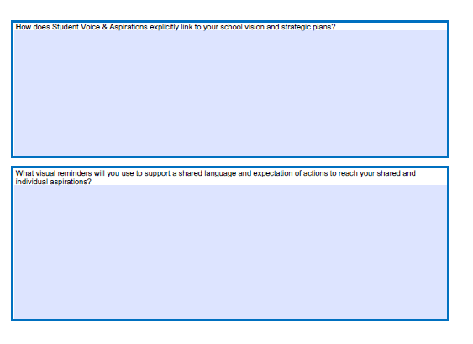
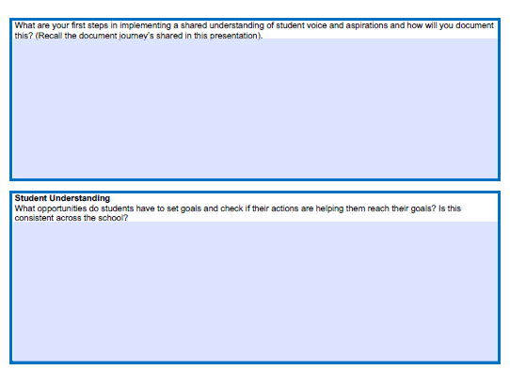
Resource #2.2
Aspirations
Action Plan

Slide 58
Extended Learning
Develop a plan to share and use the Voice definition to develop common understanding.
Review the Aspirations Profile Brief & consider what this means in your context. (Resource #1)
Complete the Aspiration Profile Educator Reflection.
(Resource #2)
Share and support teachers’ use of Aspirations Instructional
Strategies. (Resource #3a,b)
Encourage staff to utilize the primary and secondary Aspirations
Student Resources. (Resource 4a,b)
Share and encourage discussions related to the article
pre-reads for these sessions.

Slide 59
Creating Harmony
I have a voice, simple and clear
It speaks the truth, for all to hear
It gives me hope, it gives me faith
It lifts me up, it keeps me safe
I have a voice, it's mine alone
It comforts me, it is my own
Although it's small, I'm not afraid
For I am strong in its embrace
No one can say, what I have seen
Or understand where I have been
For what I found inside myself,
belongs to me and no one else
If I were blinded had no eyes to see,
still, I would hear that voice inside of me
I wish that you
I wish that you
Could hear it too
https://vimeo.com/789015178
https://www.youtube.com/watch?v=cRB4e_aEces

Slide 60
Next Session:
Listen, Learn and Lead
August 26th 2022
Special Guest
Dr. Lisa Lande

