Slide 1


Voice Matters
May 2022
Dr. Kristine Fox & Sue Bryen with special guest Dr. Russ Quaglia

Slide 2
Fundamental Beliefs
Students are the potential, not the problem.
Students have something to teach us.
Working together is the only way forward.

Slide 3
Sessions Learning Outcomes
During the 4 sessions learners will
Examine an operational definition of voice and learn why
voice matters,
Learn how to support everyone’s voice in the learning community,
Understand how to use their own voices as leaders to foster an environment underpinned by trust and respect, and
Realize the importance of voice data and demonstrate student voice connections with MACS goals & mission.
Notes:
Sue

Slide 4
Learning Outcomes Session #1
Embrace a common definition of voice,
Understand and share why voice matters,
Use voice skills and instructional strategies in the classroom, and
Lead Voice initiatives in your school.

Slide 5

SIF Rubric 2.0 Connections
Learning and Teaching:
Use of voice instructional strategies, assessments and student input to enhance teaching and learning.
Notes:
Notice how we put learning first. That is the purpose of teaching… Powerful, creates learners who know how to learn. Teaching as a result of hearing the learning and understanding shared by all students. Responsive

Slide 6

SIF Rubric 2.0 Connections
Leadership and Management:
Utilise provided voice resources to create
and reflect shared goals and vision.
(Participants will learn that respect and
collaboration are integral to the
understanding of the Voice Process).
Notes:
Leading. Understanding where we are now. Use the voices, and listen to what is working well, what needs improvement. Make clear expectations and how we can all contribute to the vision, respect for all voices, seek our different perspectives to have greater understanding of the needs. Consider context and who needs what support, both staff and students

Slide 7
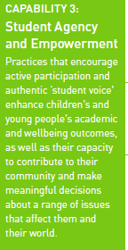
SIF Rubric 2.0 Connections
Student Wellbeing Sphere:
Activation of student voice including in
leadership and learning, to strengthen
students’ participation and engagement in school.
Notes:
Authentic, contribute empowerment. When heard and included in decisions, greater sense of wellbeing thus more able to exert effort and enthusiasm for learning.

Slide 8

Waterfall Chats
Type your response in the chat, but don’t
push send…yet!
2. Reread your response & see if there is
anything you want to edit or add.
3. When I say “waterfall”, push send!
4. Scroll up & read what others have written.
5. Type a response to what at least one
other person has written.
Notes:
Kris

Slide 9
Waterfall Chats
What comes to your mind
when you hear the term
Student Voice?

Slide 10

Quaglia Institute
Research
12 years of data
41 states
13 countries
540,223 Student Voice Surveys Grades 6-12
129,481 Student Voice Surveys Grades 3-5
240,371 iKnow My Class Surveys
37,631 Teacher Voice Surveys
26,453 Parent Voice Surveys
Notes:
Kris

Slide 11

Quaglia Institute
Research
National Reports from the last decade of data.
Notes:
Russ

Slide 12

Why Student
Voice &
Aspirations?

Slide 13
TRIUMPHS…
When you Google “Student Voice” you get over
1,010,000,000 results
Search YouTube about “Student Voice” you get over
339,000,000 results
United Nations, Rights of the Child addresses the
importance of Student Voice
Countries, States, and school districts
are making Student Voice a key initiative
Student Voice is not a passing educational whim

Slide 14
TRIBULATIONS ...
46% Students have a voice in decision making at school.
51% Teachers are willing to learn from students.
48% Students develop programs that improve the whole school.
54% Adults and students work together to make our school better.

Slide 15

Students say…
44% School is boring.
42% Teachers make school an exciting place to learn.
43% My classes help me understand what is happening in my everyday life.

Slide 16
Student Voice Implications….
When students have a voice
they are 3X more likely to
experience Self-Worth
in school.

Slide 17
Student Voice Implications….
When students have a voice they are 5X more likely to experience Engagement
in school.

Slide 18
Student Voice Implications….
When students have a voice
they are 5X more likely to experience Purpose
in school.

Slide 19

Reflect….
What does this data tell us about ourselves?

Slide 20

And so the
Journey Begins!
First, we need a clear
definition of
Student Voice
that we can all
understand, accept, &
put into practice.

Slide 21

The 3 Components of Student Voice
RESOURCE
#1
Sharing thoughts & ideas in an environment
underpinned by trust and respect.
2) Offering realistic suggestions for the
good of the whole.
3) Accepting responsibility for not only what
is said but also what needs to be done.
Notes:
Russ 10 min break at 10:30

Slide 22
Quick Break!
10 minutes

Slide 23
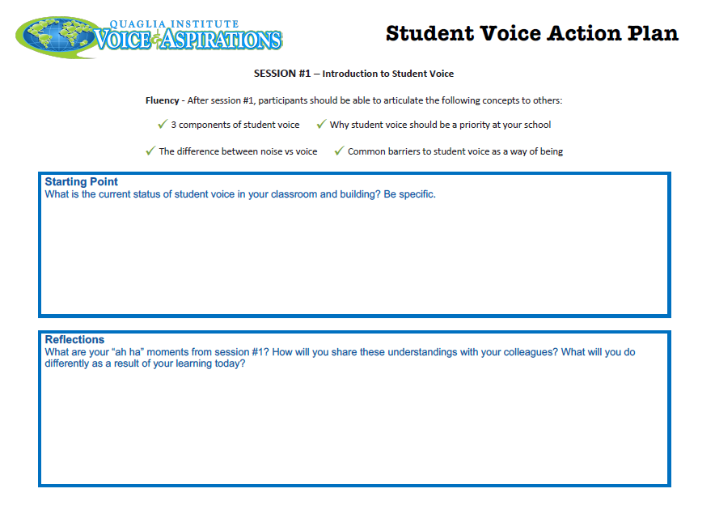
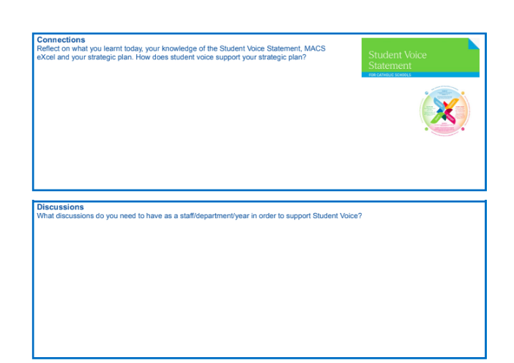
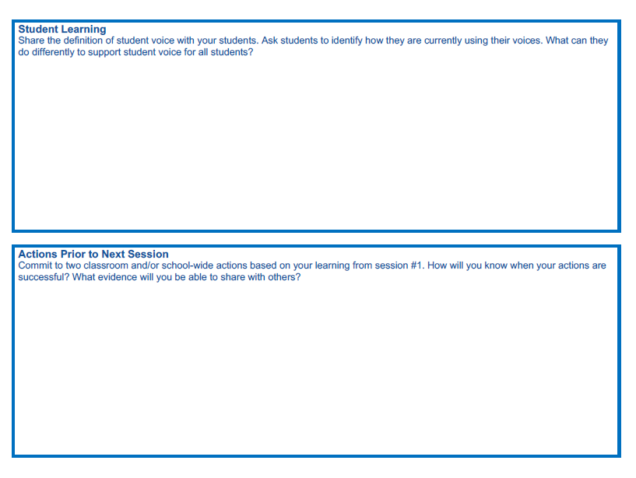
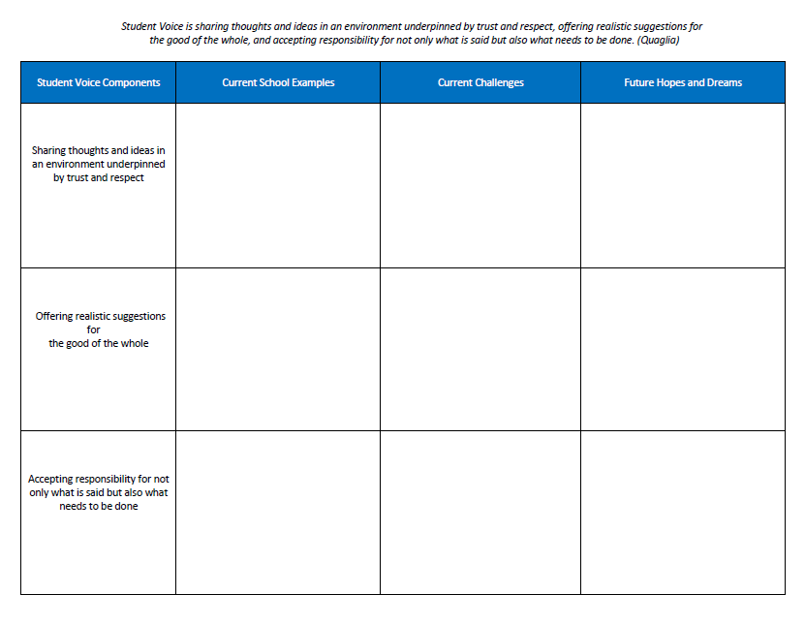
Resource
#2
Notes:
Sue. Action Plan intro. And lead to break out

Slide 24

Respond to the first prompt on your own
Notes:
3 minutes

Slide 25

CHECK IN
Check in with colleagues & share your ideas.
(8 minutes)

Slide 26
CHECK IN
Share one take away from your
discussion during your breakout.

Slide 27

Challenge Time…
Notes:
Kris

Slide 28

Challenge
Noise vs. Voice
Share words, phrases, &
examples of
Noise.

Slide 29

Noise
Voice

Slide 30
Challenge
Noise vs. Voice
Now share words, phrases, &
examples of
Voice.

Slide 31
Noise vs Voice
Student Noise
Demands/commands/chaotic
Student opinion is most important
All adult voice is negative
Everyone needs to change but me
Complaining/whining
Student Voice
Requests/inquiry/focused
Our ideas are stronger in partnership
Students are open to learn
Personal reflection
Accepting responsibility
Notes:
Kris

Slide 32
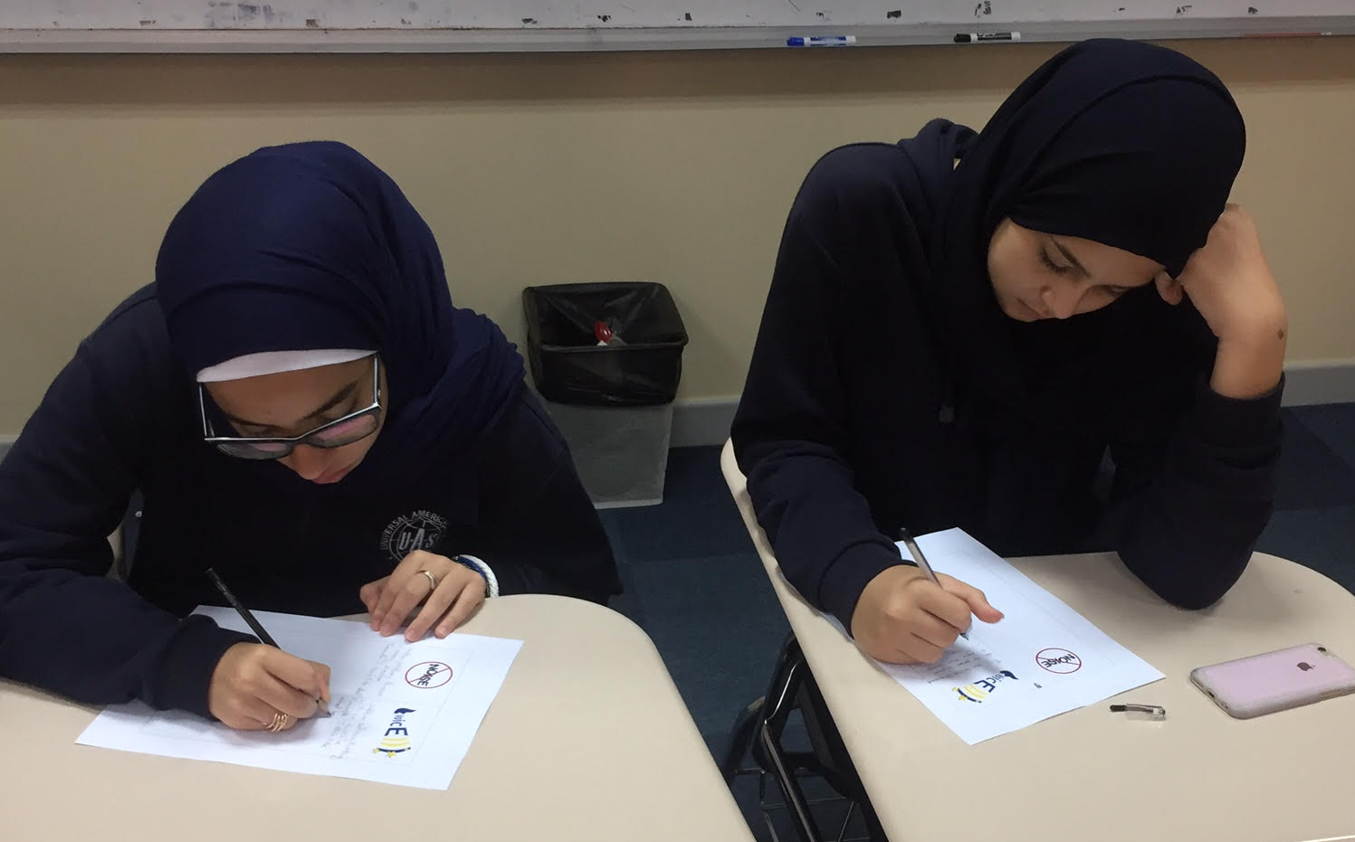
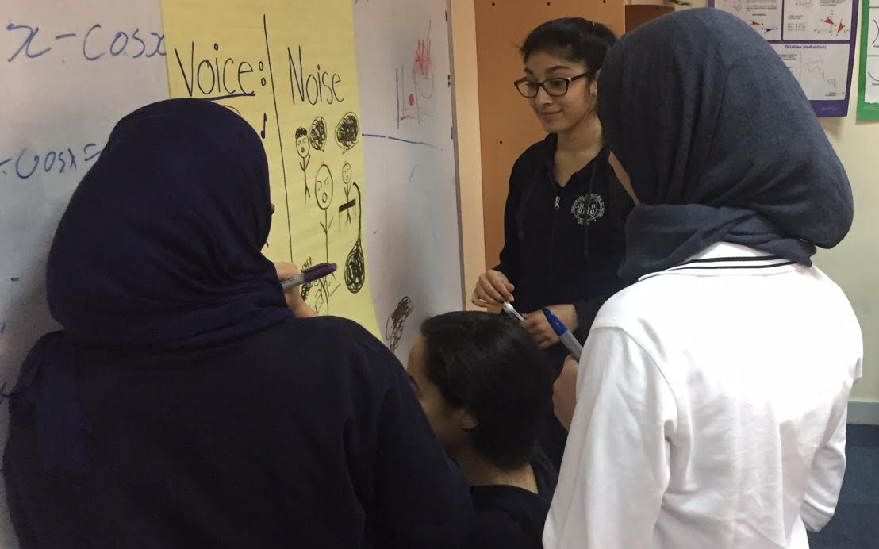
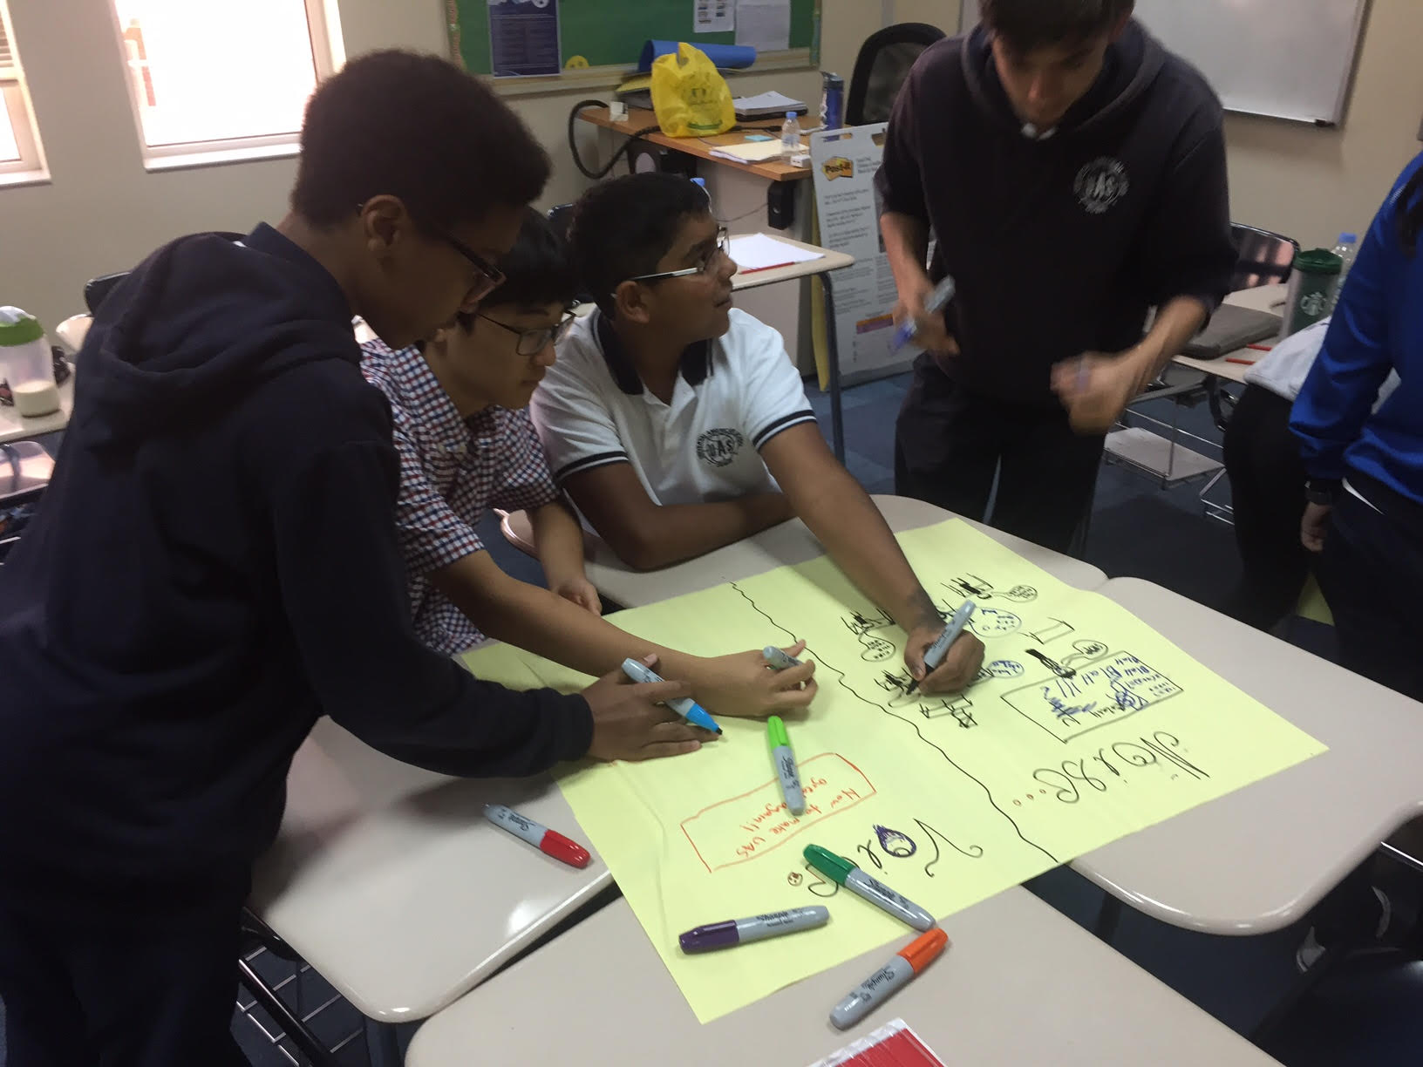
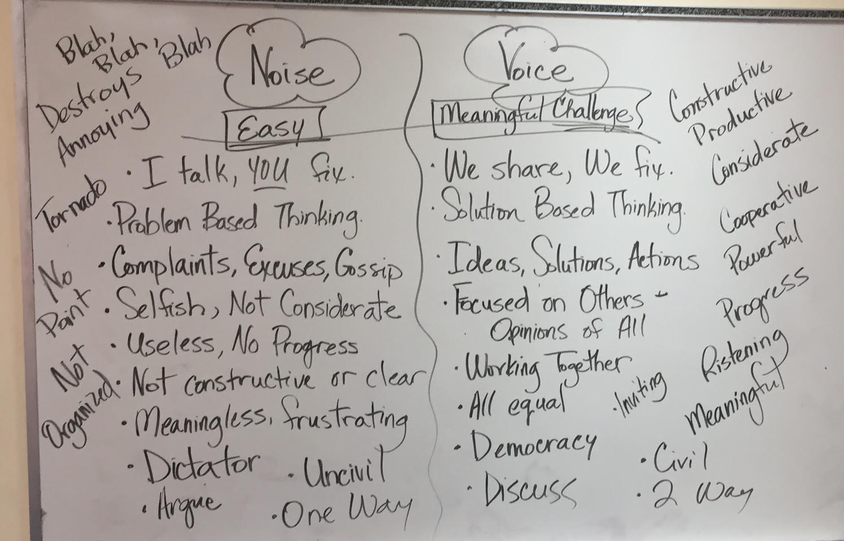

Slide 33
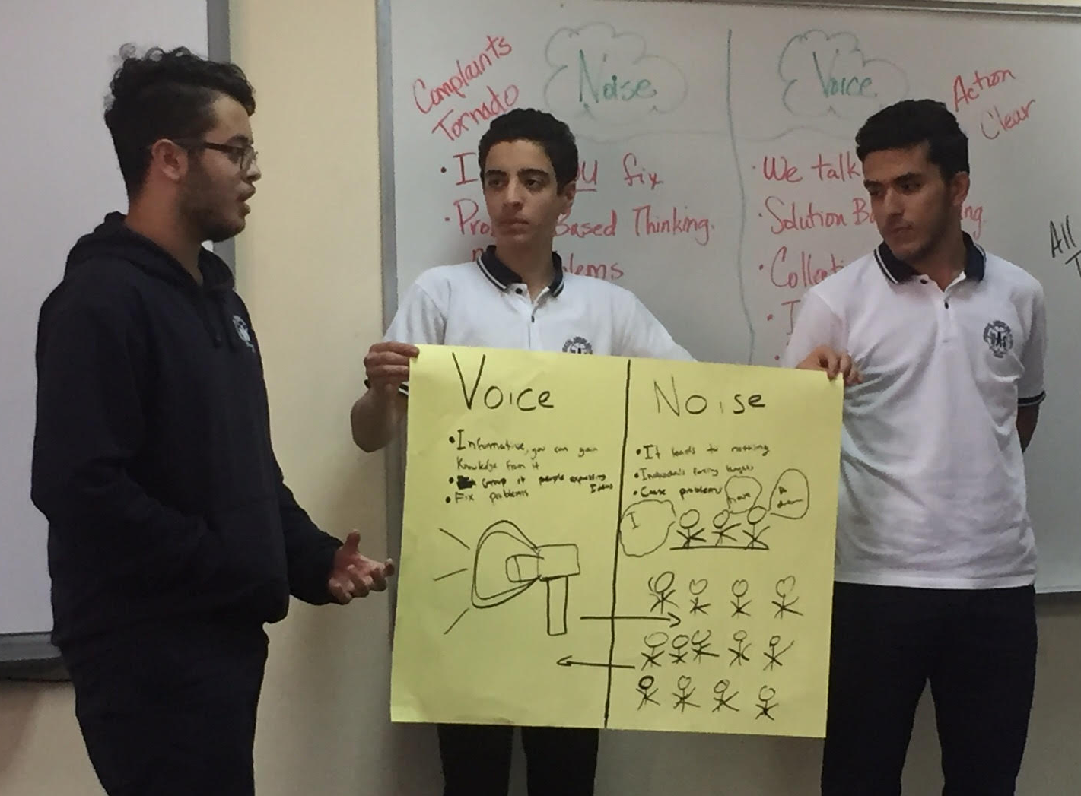
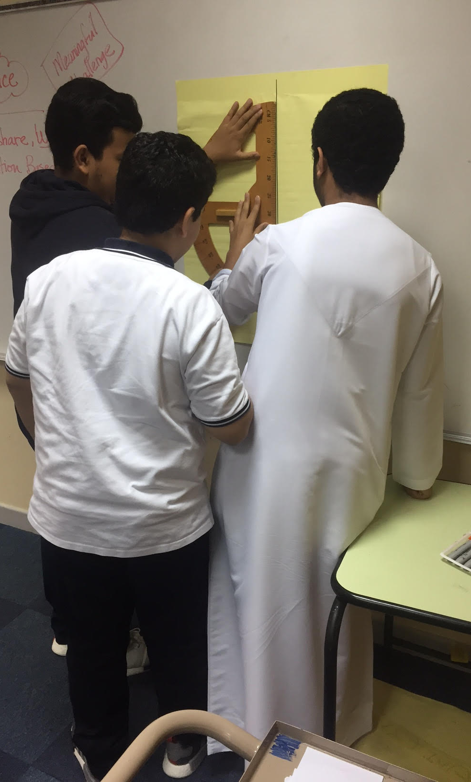
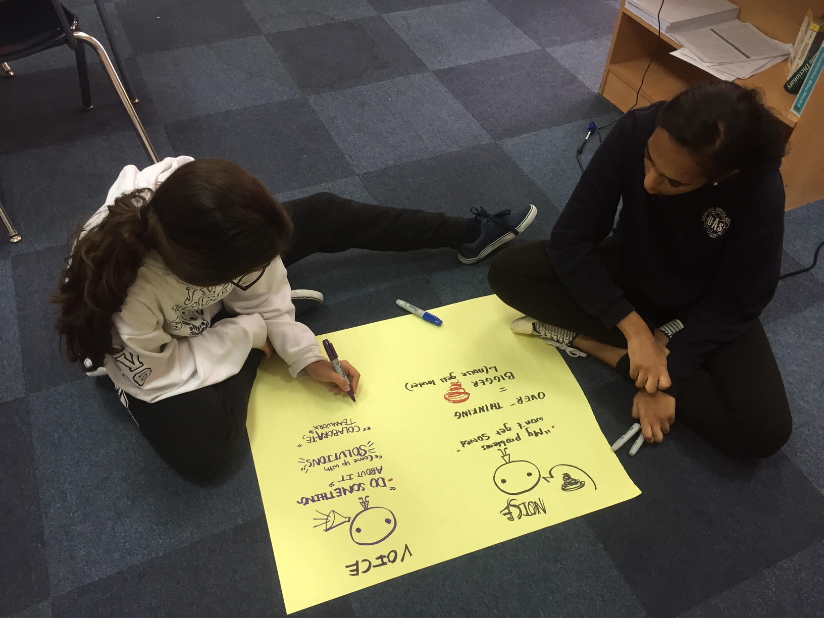

Slide 34
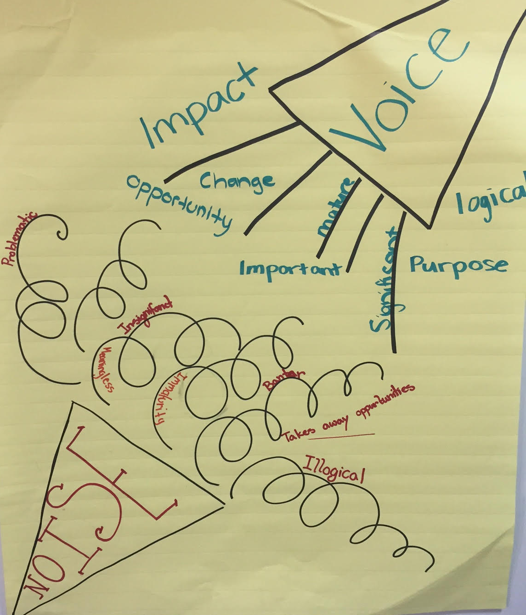
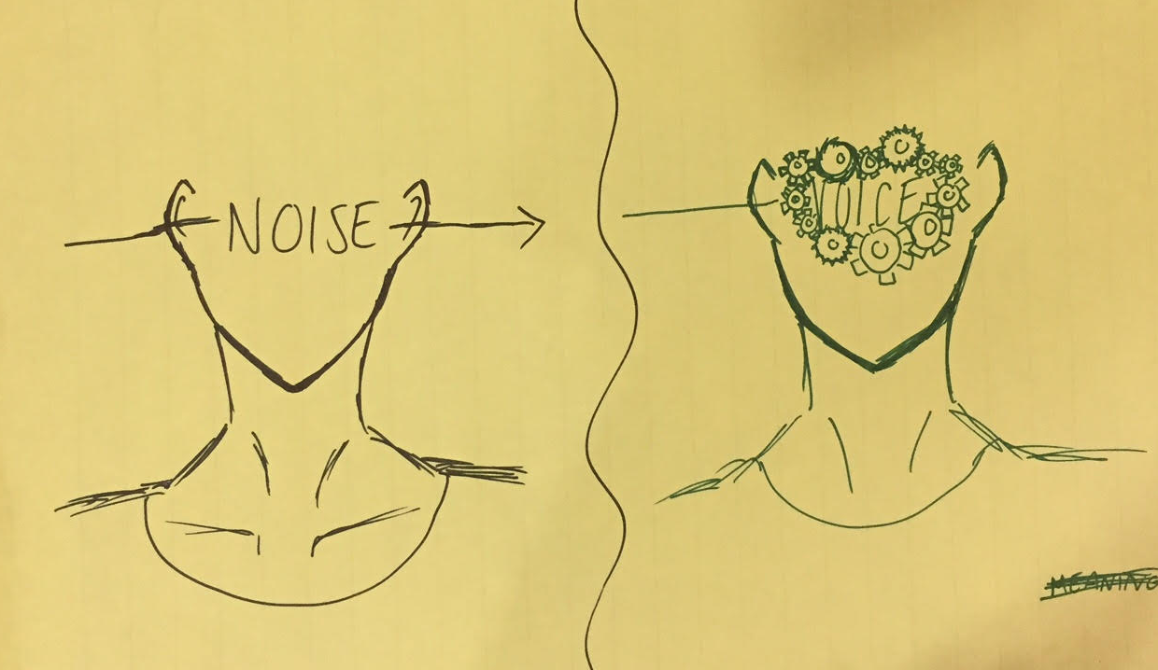
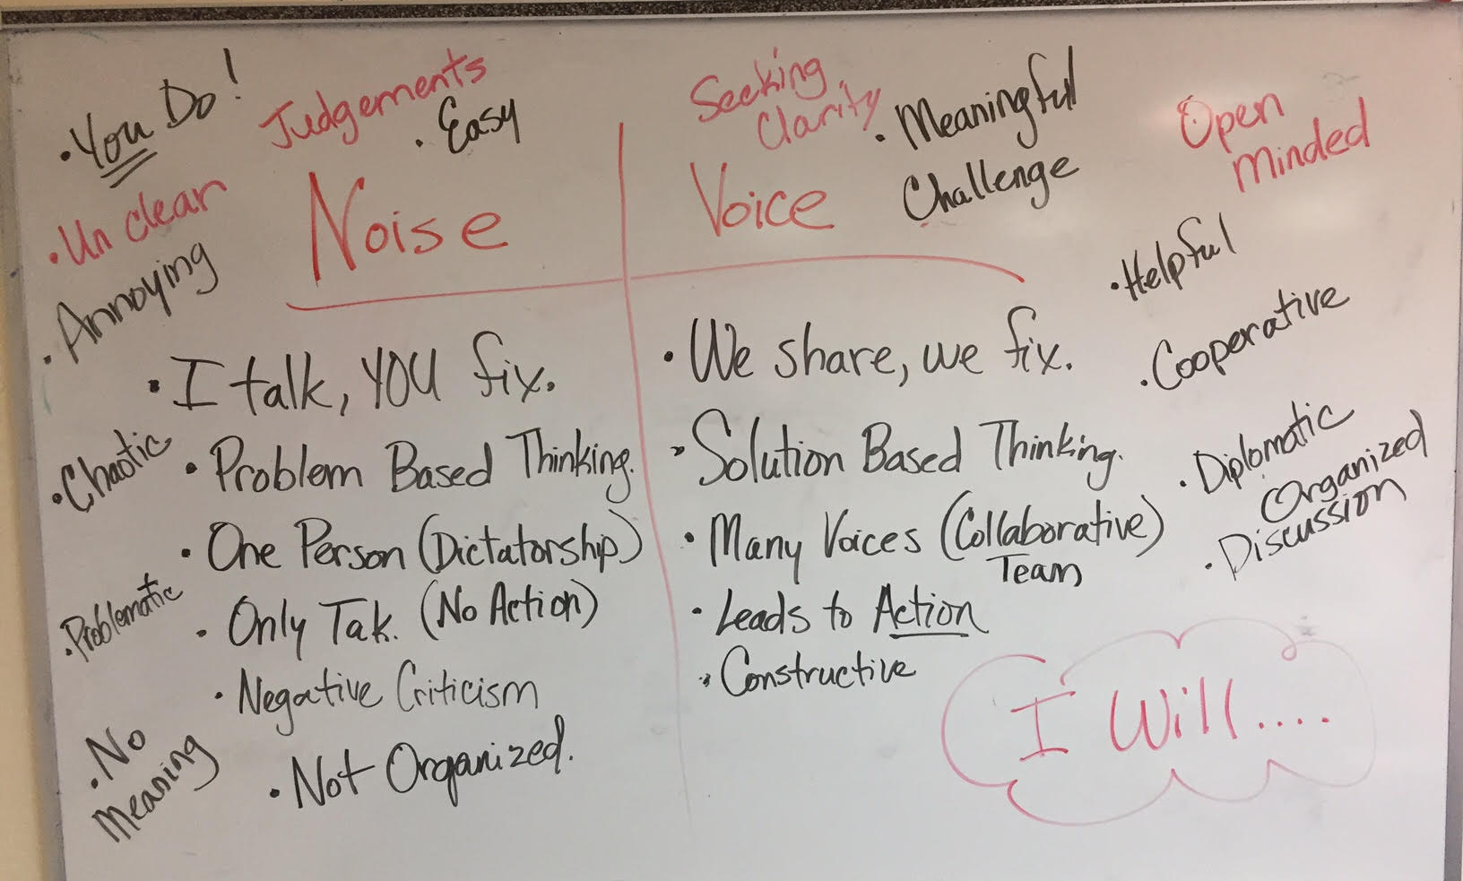

Slide 35


Slide 36
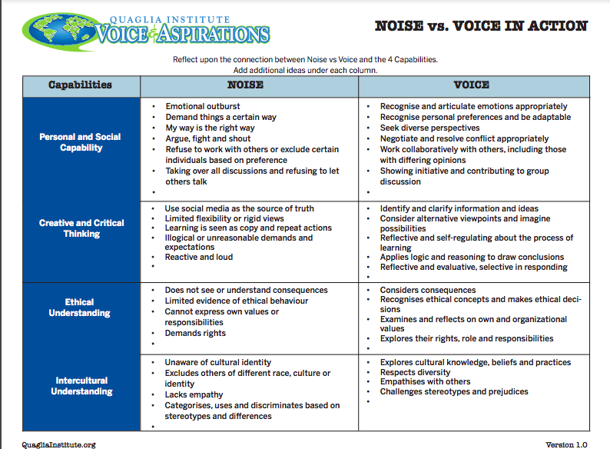
Another Lens
Resource #3
Notes:
Sue Capabilities, beyond school, developing skills. How can we support students to be authentic and respectful, think critically and understand different persepectivwes

Slide 37
REFLECT
What skills do your
students need for
their voices to be heard?
Notes:
Sue 3 minutes

Slide 38
Learning From Failure
YouTube video - https://youtu.be/B0KGarIAIGQ
Vimeo video - https://vimeo.com/qisva/learningfromfailure
Notes:
Sue introduce

Slide 39
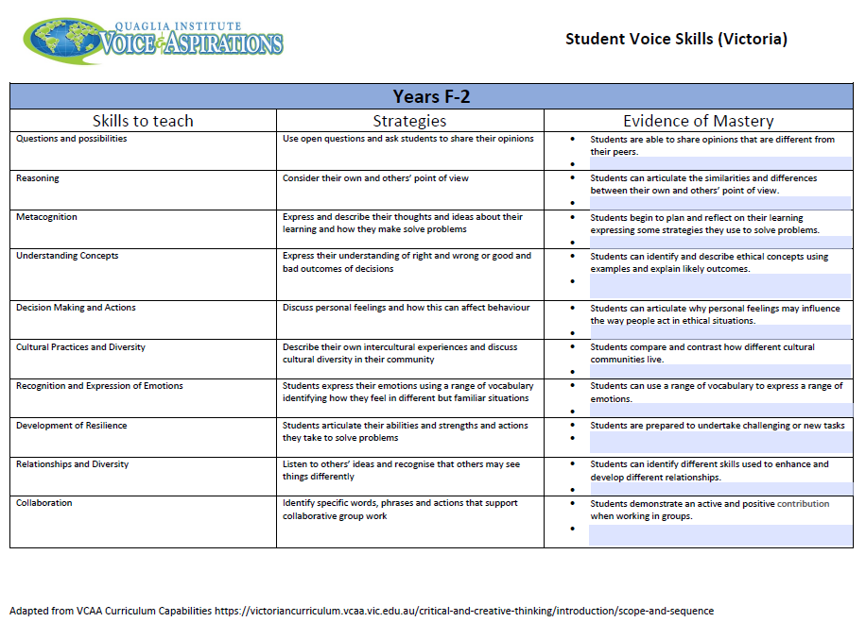
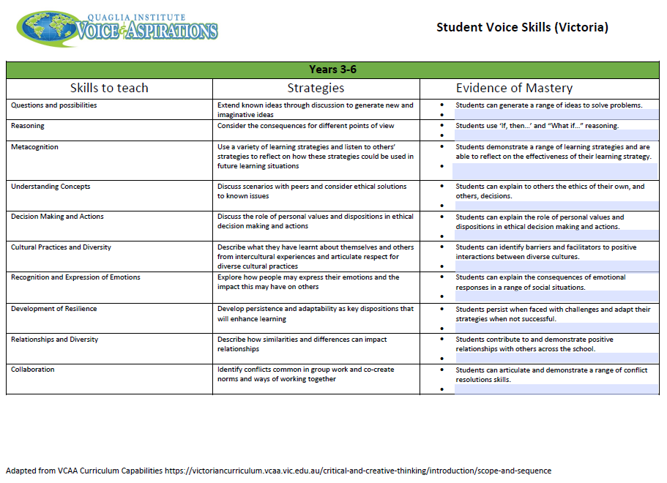
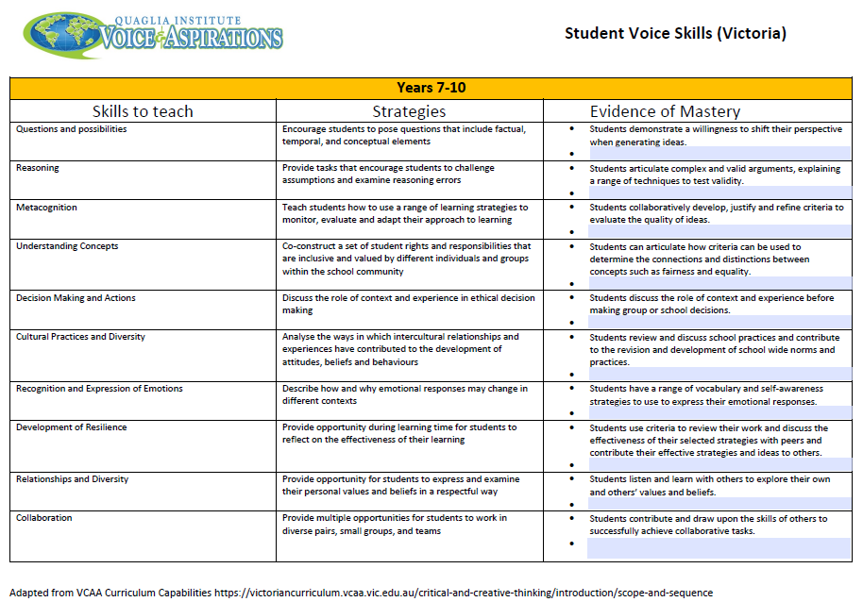
Voice Skills
Resource #4
As a teacher or leader, how can you develop or support teachers in fostering and practicing these skills with students?
Notes:
Sue. Time to look at these docs and discuss.

Slide 40
CHECK IN
In your team, check in with colleagues & share your ideas. (10 minutes)
In breakout groups, discuss the appropriate
Voice Skills page the documents. Consider
which skills are “mastered” at your year level and which are in need of more development. What ideas do your colleagues have for
developing voice skills?
Notes:
Sue, 8 min break out time to examine

Slide 41
CHECK IN
Share one
brilliant idea you heard
from a colleague.

Slide 42
Learn From Us
YouTube video - https://youtu.be/t9M8D0XiE_w
Vimeo video - https://vimeo.com/qisva/learnfromus
Notes:
Kris introduce video

Slide 43
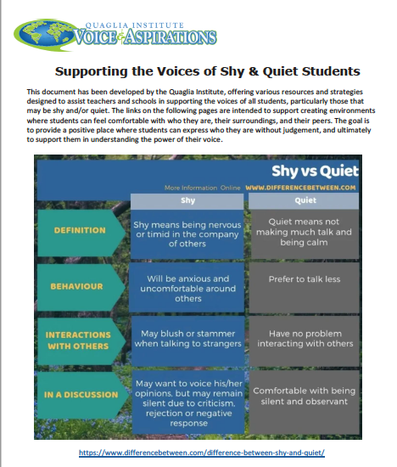
Resource #5

Slide 44
Challenge Time…

Slide 45

Greta Thunberg

Slide 46
Greta Thunberg
YouTube - https://youtu.be/0mvjn4WECdU
Vimeo - https://vimeo.com/qisva/gretathunberg

Slide 47





Slide 48

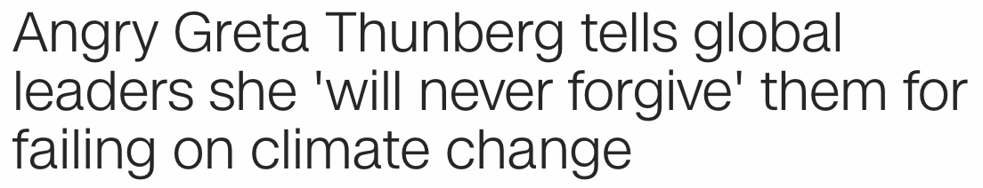
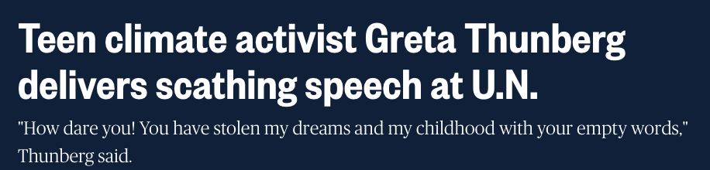
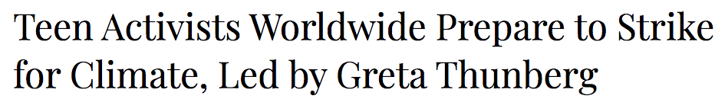
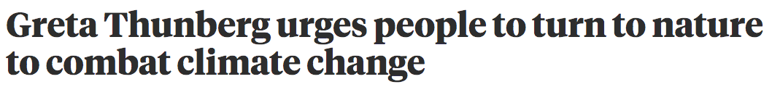

Slide 49

Think about it
In the chat, give a response to the
statement below.
Why is this a perfect example of student voice?
This is NOT a perfect example of student voice because…

Slide 50
Voice or Noise?
YouTube video - https://youtu.be/-qmN3rF7wqI
Vimeo video - https://vimeo.com/qisva/voiceornoise

Slide 51
Stretch Break
YouTube video - https://youtu.be/JghkmI506KI
Vimeo video - https://vimeo.com/qisva/stretchbreak

Slide 52


Student Voice Myths
Student voice can be finished in an activity period.

Slide 53
Student Voice Myths
Students need to be given a voice.

Slide 54
Student Voice Myths
Student voice takes too much time.

Slide 55
Student Voice Myths
Student voice is the same as choice.

Slide 56
Student Voice Myths
Student voice gives students power over teachers

Slide 57
Student Voice Myths
Student Voice is for students in secondary school

Slide 58
Student Voice Myths
Type in the chat a Student Voice Myth OR Misconception you may hear in
your school.

Slide 59
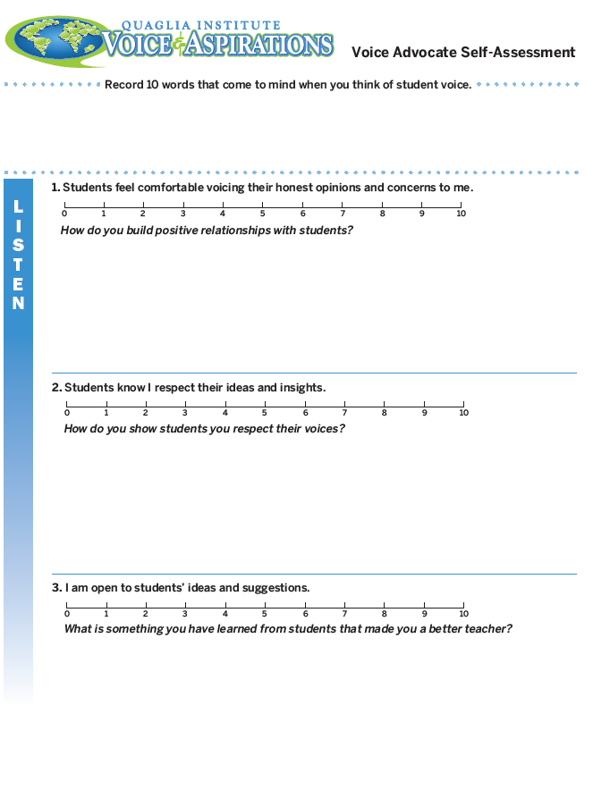
Voice Self Assessment
What is your
starting point ?
Resource #6

Slide 60

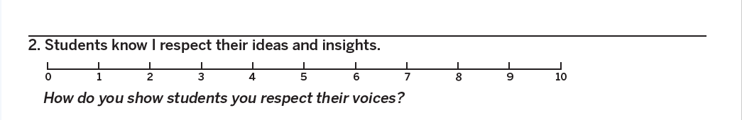
Voice Self Assessment
Notes:
6 minutes mixed break out

Slide 61
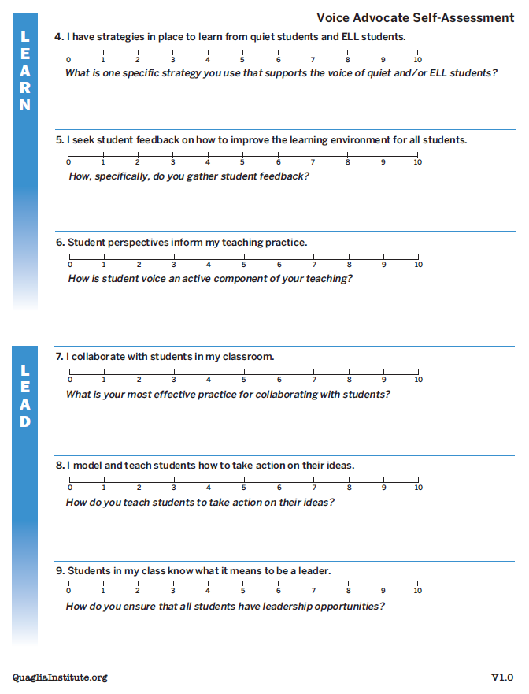
Voice Self Assessment
Resource
#6
Complete the Voice
Self-Assessment prior to session #2

Slide 62
BCE Student Voice
YouTube video - https://youtu.be/vZqc6TtLfxM
Vimeo video - https://vimeo.com/qisva/bce
Notes:
BCE Introduced by Kris

Slide 63
The 3 Components of Student Voice
Sharing thoughts & ideas in an environment
underpinned by trust and respect.
2) Offering realistic suggestions for the
good of the whole.
3) Accepting responsibility for not only what
is said but also what needs to be done.

Slide 64
Reflect and Connect
What is the vision for
student voice in your
context?

Slide 65
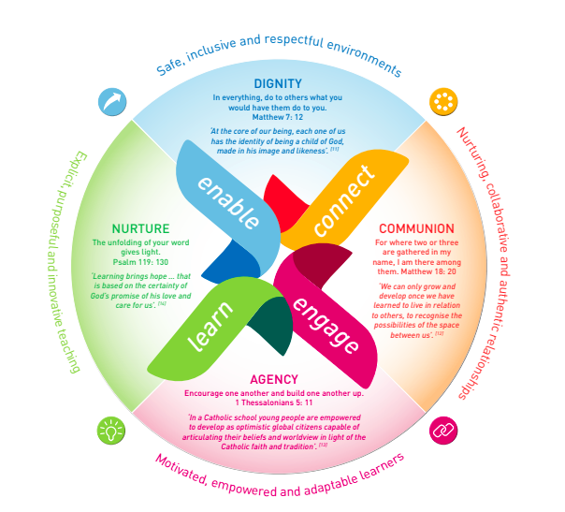

Reflect on what you learned today,
your knowledge of your Student Voice
Statement, MACS eXcel and your strategic
plan
How does your learning and student
voice support your strategic plan?

Slide 66

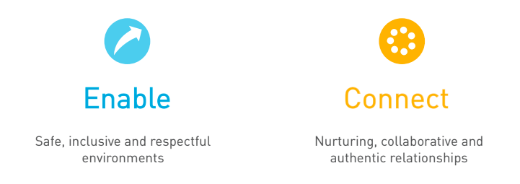
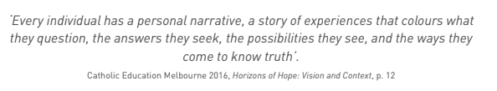
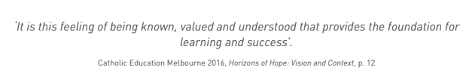
.

Slide 67
Resources

Slide 68
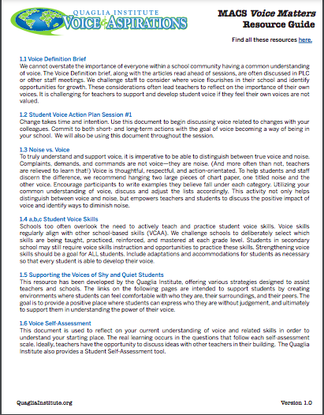

Slide 69
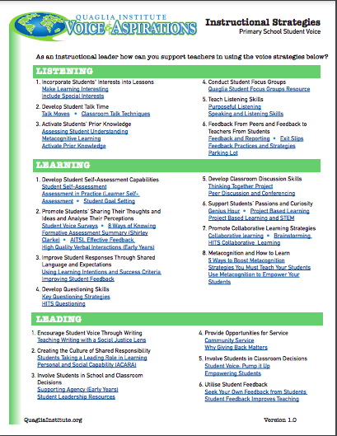
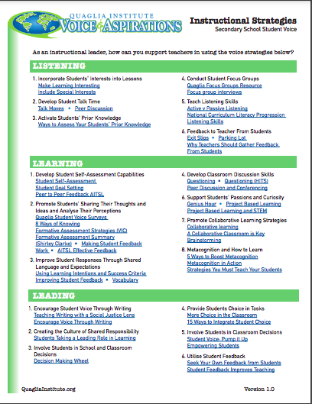
Instructional Strategies to support Voice Development
RESOURCE #6

Slide 70
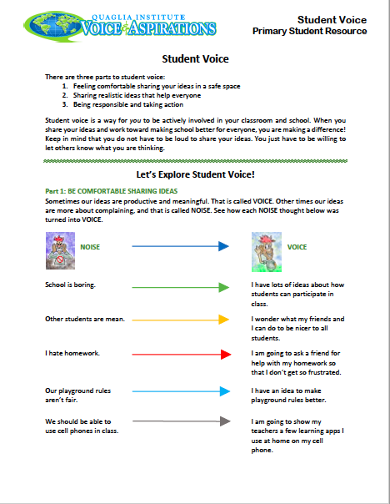
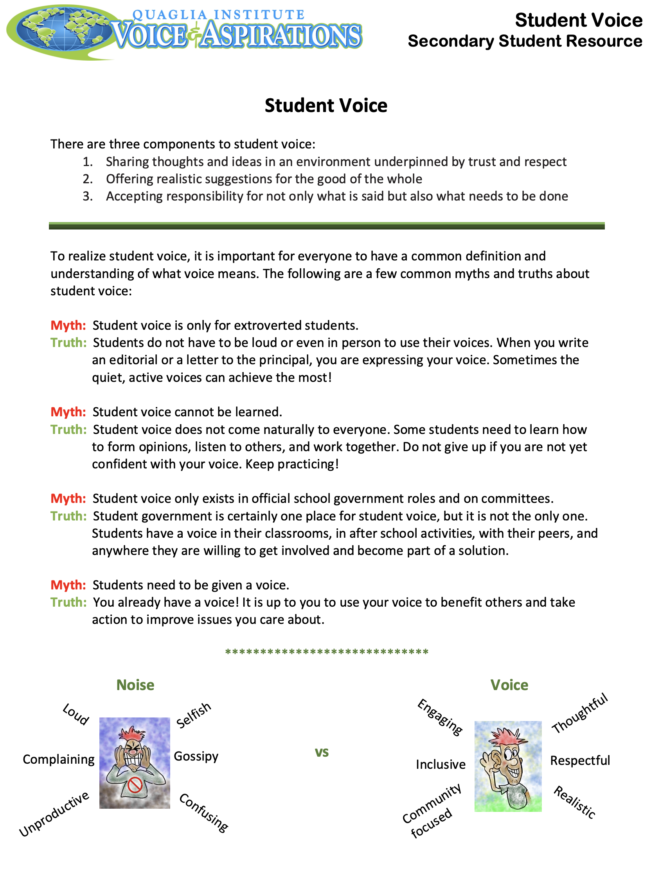
DIRECT STUDENT LEARNING
RESOURCE
#7

Slide 71
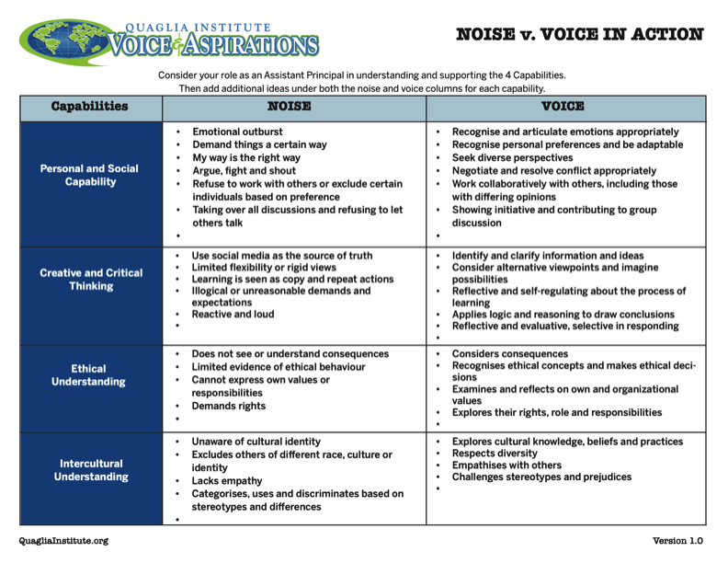
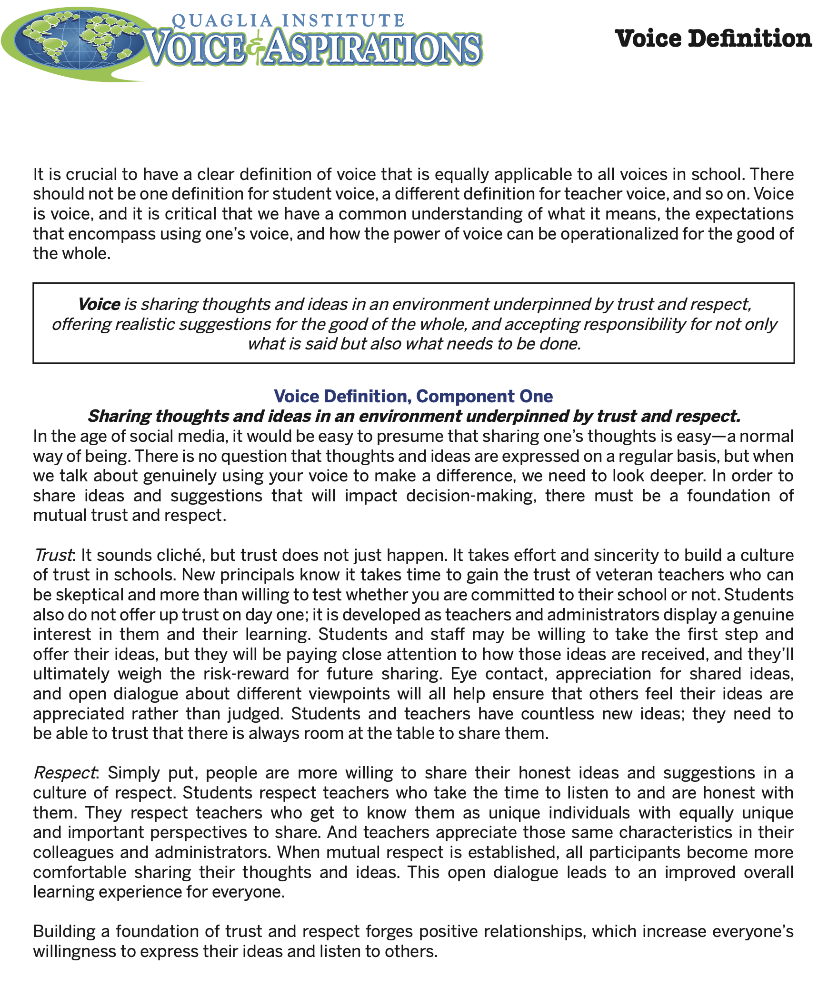
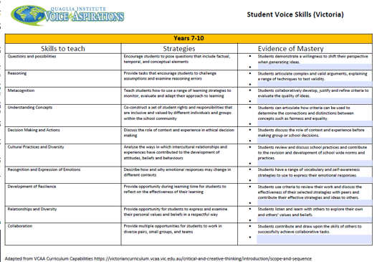
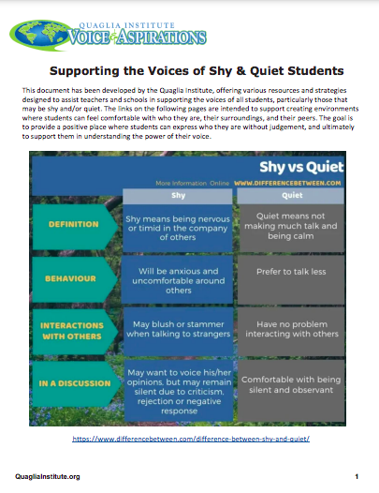
RESOURCE RECAP

Slide 72
Extended Learning
Share and discuss the Student Voice definition with staff & students. (Resource#1.1)
Complete Student Voice in Action Planning Guide (Resource #1.2)
Review the 4 Capabilities Noise vs. Voice document and add your own examples. (Resource#1.3)
Review the Voice Skills documents. How can this document be used in
your context? (Resource#1.4)
4. Complete the Voice Self-Assessment. (Resource#1.6)
Review the Instructional Strategies for primary and secondary.
(Resource #1.7)
6. ENGAGE students with voice definition using student resources (Resource #1.8)

Slide 73
Waterfall Chats
In the chat box type your biggest take away from this session.
Type your response in the chat,
but don’t push send…yet!

Slide 74

www.QuagliaInstitute.org
@QISVATweets
Dr. Russ Quaglia
Quaglia@QuagliaInstitute.org
Dr. Kristine Fox
Fox@QuagliaInstitute.org
Sue Bryen
Bryen@QuagliaInstitute.org

Slide 75
Next Session:
The Aspirations Profile
July 13 2022
Special Guest
Dr. Michael Corso

