Slide 1
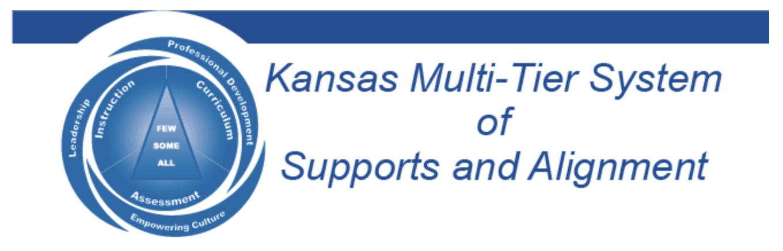

Voice & Aspirations:
Balancing Dreaming & Doing to Reach Your Fullest Potential
Dr. Russ Quaglia & Dr. Lisa Lande
@QISVAtweets @Lisa_Lande
www.quagliainstitute.org
September 11, 2024

Slide 2
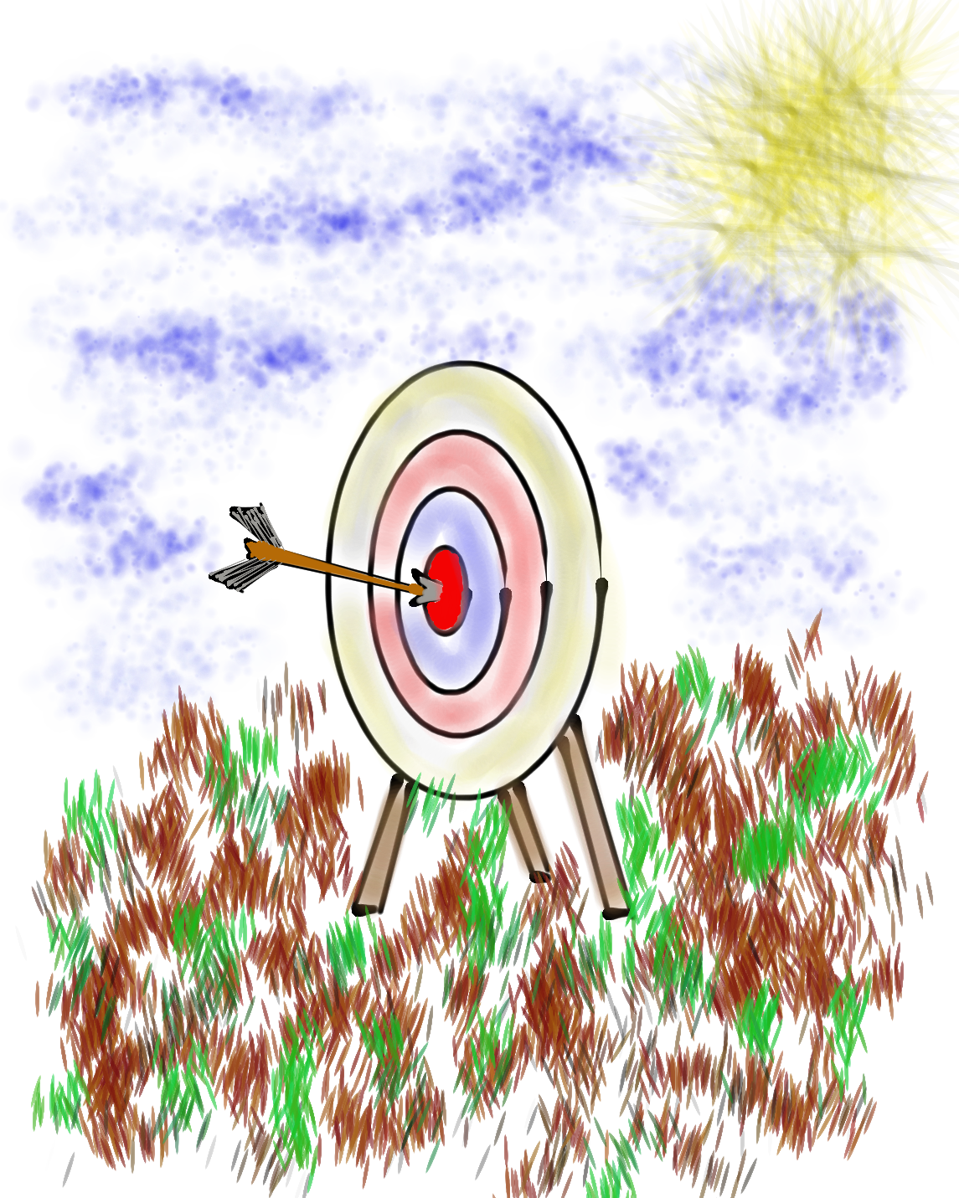
Learning Intention
We are learning about the Aspirations
Profile as a resource for supporting teachers & students in reaching their fullest potential.
Success Criteria
Explore the 4 quadrants of the Aspirations Profile:
Hibernation, Imagination, Perspiration, & Aspiration.
Consider strategies for supporting all students in
balancing dreaming & doing in their lives.
Apply the Aspirations Profile at your school
Today will be a home run for me if…

Slide 3

Challenge Time…

Slide 4

Challenge
Crossed Arms

Slide 5
ASPIRATIONS
The ability to
dream & set goals
for the future,
while being inspired
in the present
to reach those dreams.

Slide 6




high
Imagination
Aspiration
DREAMING
Hibernation
Perspiration
low
DOING
high

Slide 7
Challenge Time!
Aspirations Profile
4-Corners of Reflection

Slide 8

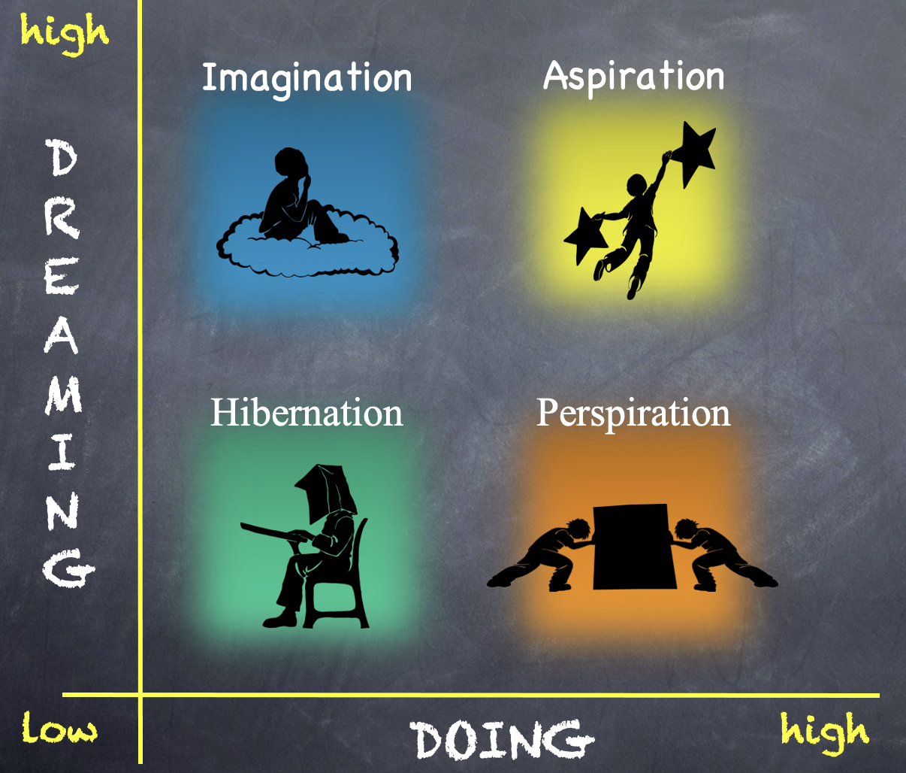
Reflect
Go to the quadrant where you spent most of your time as a student.
Break into groups of 3-4 & share why!
What would have helped you maintain a healthy balance of dreaming & doing?

Slide 9
Reflect
Rotate one corner clockwise.
What types of things do individuals in this quadrant say/do?

Slide 10
Reflect
Rotate one corner clockwise.
What questions can you ask students who are stuck in this quadrant?

Slide 11
Reflect
Rotate one corner clockwise.
What types of actions can you take to support teachers & students in this quadrant?

Slide 12

Time to Dig Deeper!

Slide 13
high
DREAMING
Hibernation
low
DOING
high

Slide 14
high
DREAMING
Vimeo
https://vimeo.com/789017891/1c391b7d0a
YouTube
https://youtu.be/qPYqaBvwhy8
low
DOING
high

Slide 15

Students in Hibernation
Potential Cons:
Passive & unmotivated
Poor self-esteem &
defeatist attitude
Struggle to take
responsibility for
anything
Potential Pros:
Time to reflect
Space to recharge
They report:
Feeling isolated
Stuck
Misunderstood
Bored
They need to:
Feel valued
Be recognized for success
Have positive role models
Have a sense of purpose

Slide 16
high
Imagination
DREAMING
low
DOING
high

Slide 17
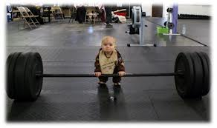
high
DREAMING
low
DOING
high

Slide 18

Students in Imagination
Potential Pros:
Enthusiastic
Fun to be around
Lots of creative ideas
Potential Cons:
Limited follow-through
Not well connected
to reality
Students report:
Having big dreams
Eagerness to explore
Craving creative outlets
They need to:
Develop action plans
Focus
Be realistic

Slide 19
high
DREAMING
Perspiration
low
DOING
high

Slide 20
high
DREAMING
Vimeo
https://vimeo.com/qisva/snowremoval
YouTube
https://youtu.be/m39gWmTaIbY
low
DOING
high

Slide 21

Students in Perspiration
Potential Pros:
Determined
Hard Working
Driven to Succeed
Potential Cons:
Overly concerned
about grades
Single-minded,
narrow-focused
Students report:
Feeling stressed
Not sure “why” they are learning, but need
good grades
Don’t want to let
anyone down
They need to:
Have a greater purpose for learning
Balance school work with outside life
Link learning to
their passions

Slide 22
high
Aspirations
DREAMING
low
DOING
high

Slide 23
high
DREAMING
Vimeo
https://vimeo.com/776344083/affe5a37da
YouTube
https://youtu.be/uLjzbSAEmJI
low
DOING
high

Slide 24

Students in Aspiration
Potential Pros:
Connects present
actions to future
dreams
Good idea of
potential options
Potential Cons:
Relaxation is Challenging
Under constant pressure
Self-Serving
Students report:
Never feeling
satisfied
Driven by being best
Frustration with peers
who don’t try or who
interrupt learning
They need to:
Be assured they
are on a positive track
Experience meaningful academic challenges
Breathe!

Slide 25
high
Imagination
Aspiration
DREAMING
Hibernation
Perspiration
low
DOING
high

Slide 26
Challenge Time…
We need 6-8 excited volunteers to come up front!
Warm Up: Establish a passing order with 1 ball.

Slide 27


Challenge
Goal: As a team,
pass 3 balls through
your established order as quickly as you can.
Rules: Maintain the
same passing order &
everyone must touch
all 3 balls.

Slide 28
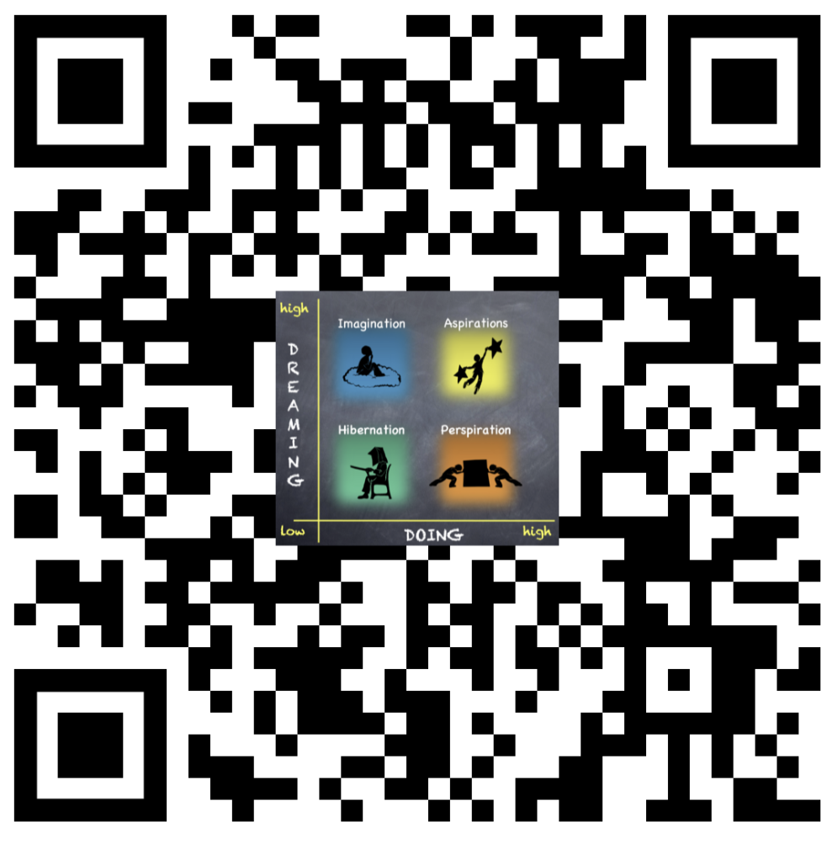
Website Just For YOU!
https://quagliainstitute.org/aspirations

Slide 29
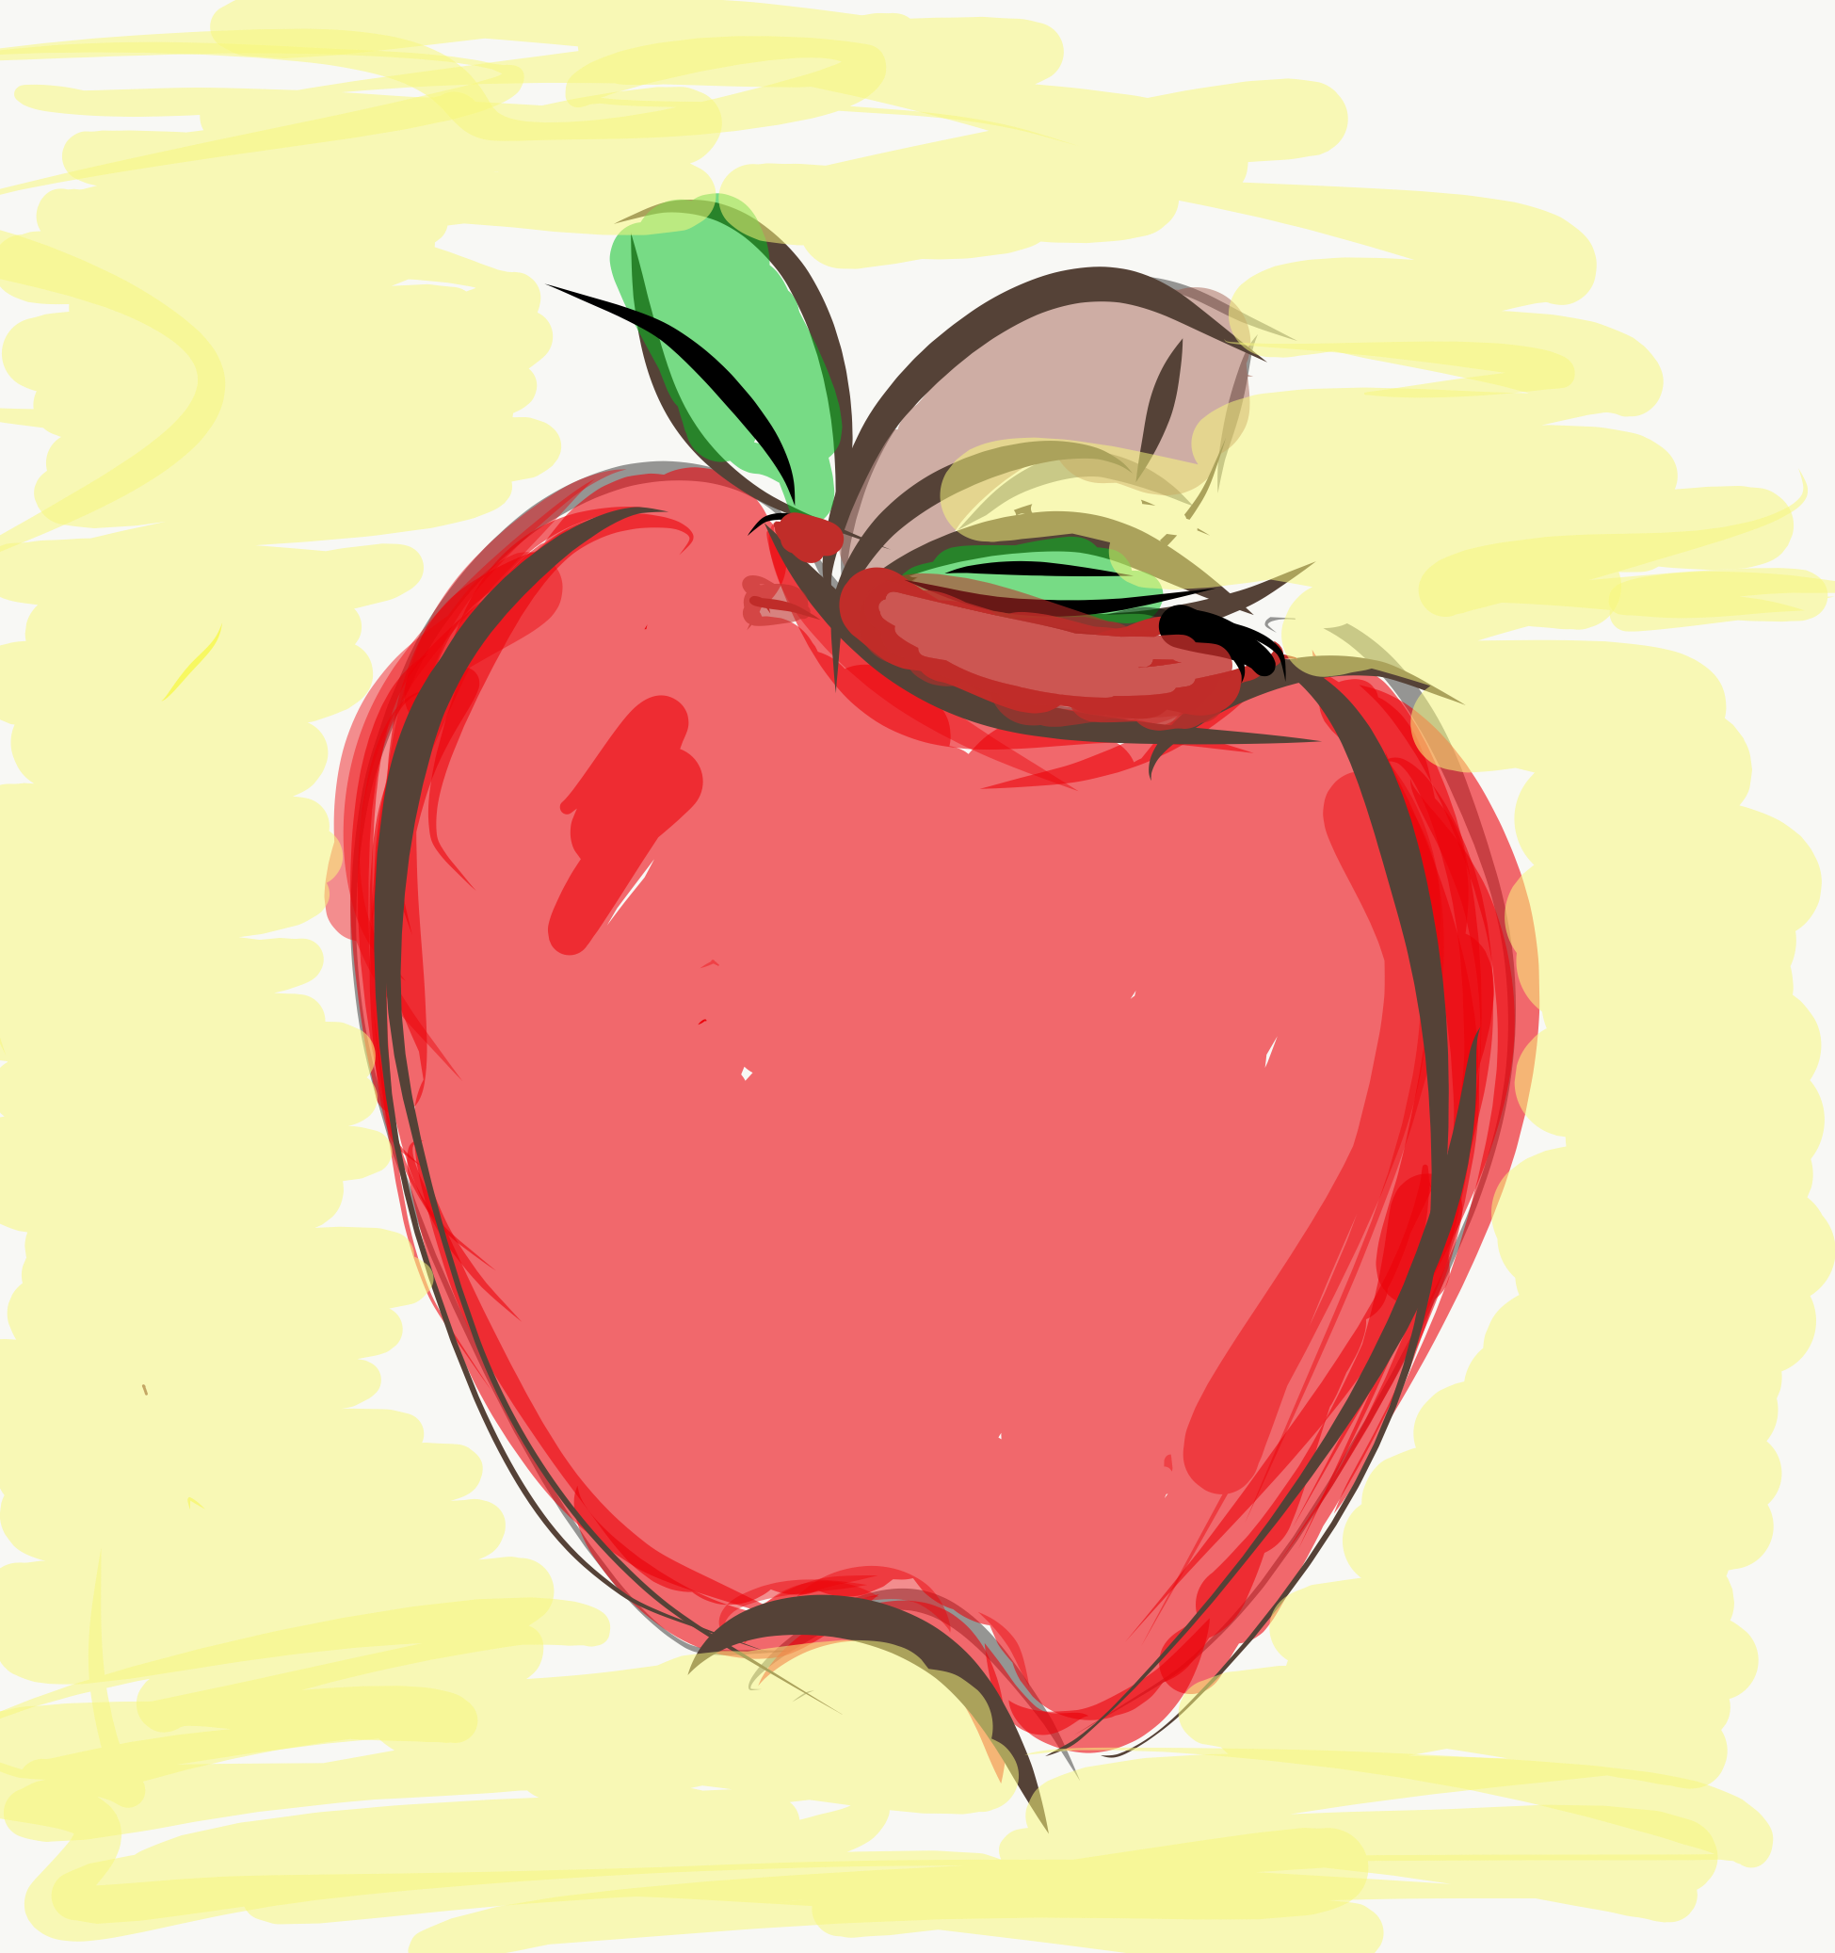
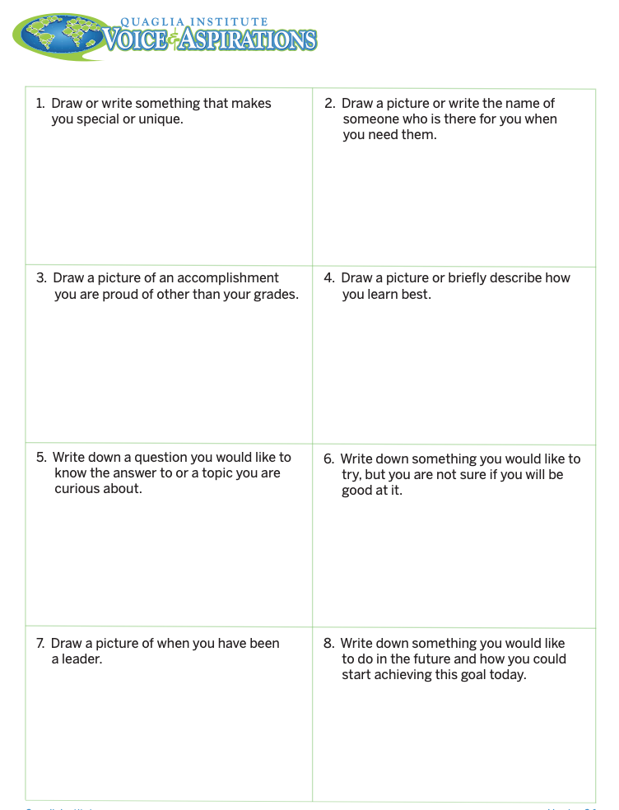
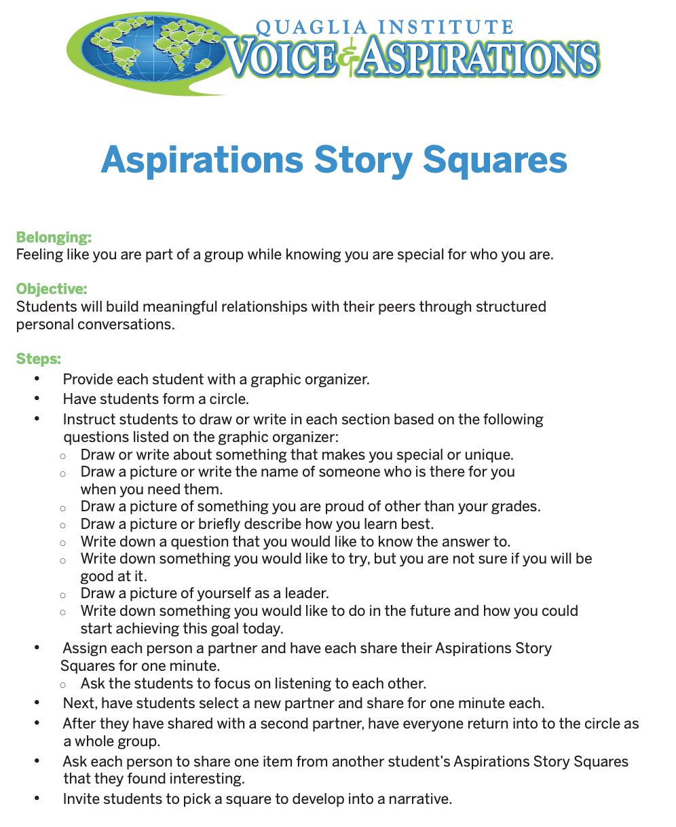
Aspirations Story
Squares Lesson Plan

Slide 30
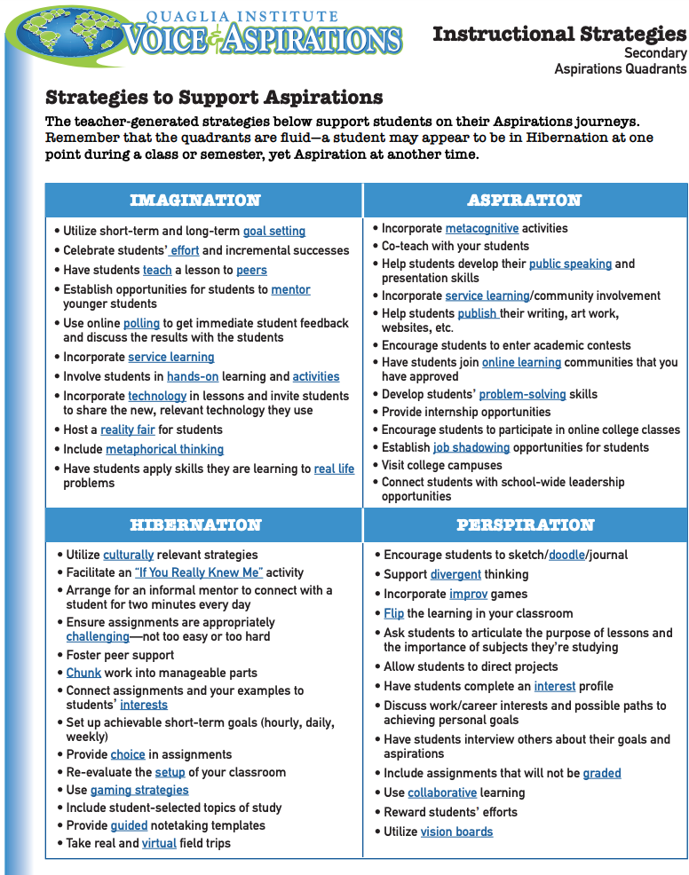
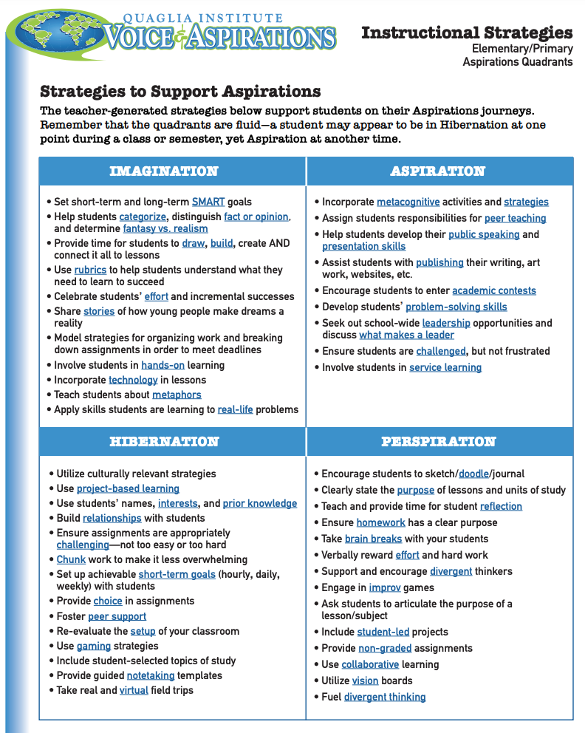
Aspirations Quadrants Instructional Strategies

Slide 31
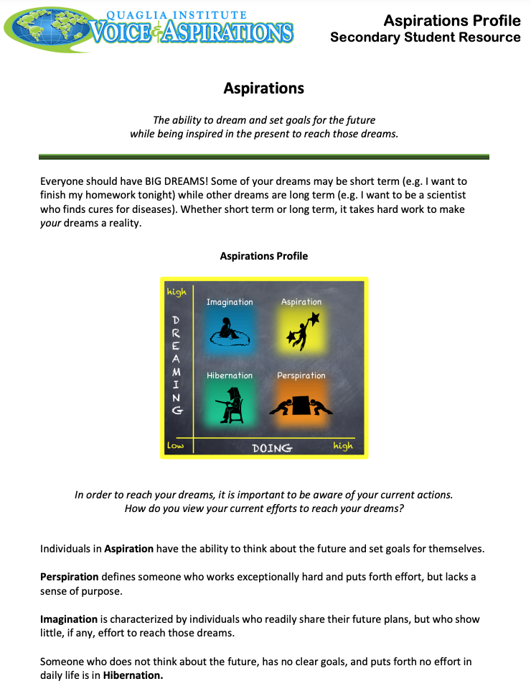
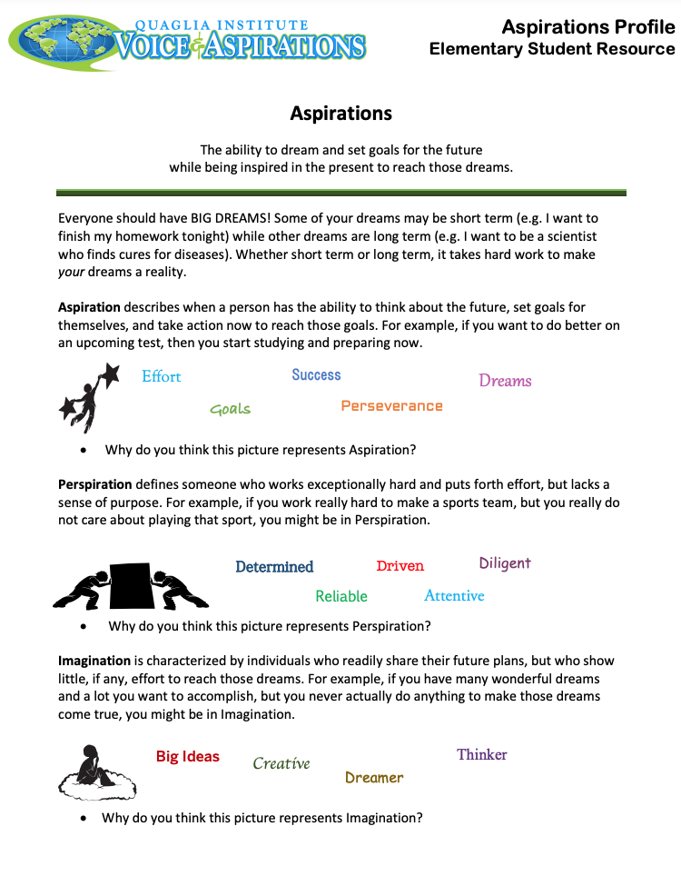
Aspirations Profile
Student Resources

Slide 32
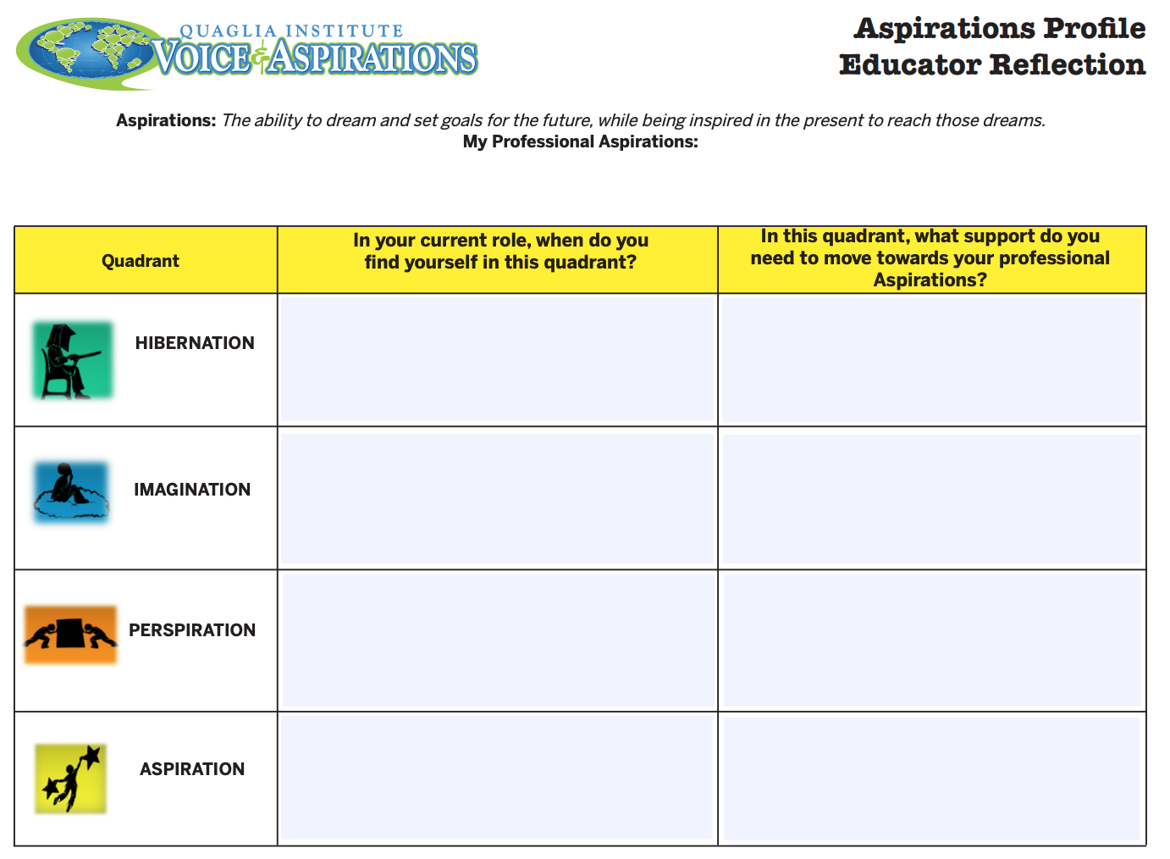
Aspirations Profile
Educator Reflection

Slide 33
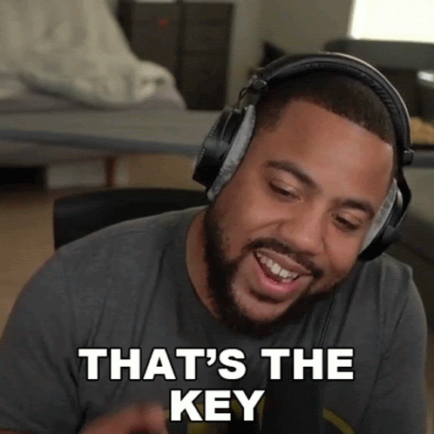
What is your key take away from today’s session?

Slide 34

What is your key take away from today’s session?

Slide 35
Voice & Aspirations:
Balancing Dreaming & Doing to Reach Your Fullest Potential
Dr. Russ Quaglia & Dr. Lisa Lande
@QISVAtweets @Lisa_Lande
www.quagliainstitute.org
September 11, 2024

