Slide 1
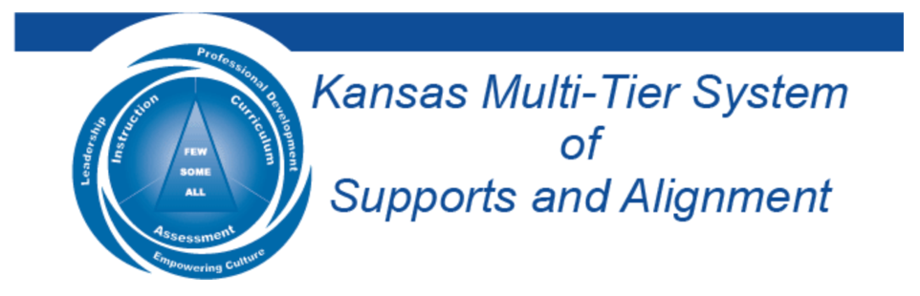

The Voice Process:
Listening To, Learning From, & Leading With Students
Dr. Russ Quaglia & Dr. Lisa Lande
@QISVAtweets @Lisa_Lande
www.quagliainstitute.org
September 11, 2024

Slide 2
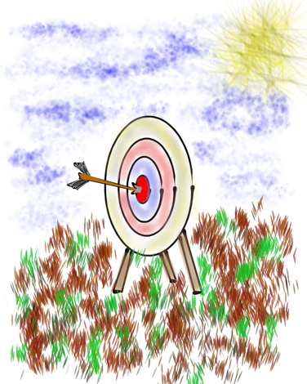

Learning Intention
We are learning to leverage the School Voice Process to amplify the voices of ALL students.
Success Criteria
Discover the components & nuances of the School Voice
Process: Listen, Learn, & Lead.
Explore strategies & resources that support teachers &
students in listening to, learning from, & leading with
one another.
Apply learning to amplify Student Voice in YOUR school.
Today will be a home run for me if…

Slide 3

Challenge Time…

Slide 4


Challenge
Perspectives
Point your index finger to the sky & above your head, move your finger in small circles clockwise.
Slowly move your hand down to your waist, continuing to move your hand in small circles.
What direction is your hand moving?

Slide 5

The 3 Components of Student Voice
Sharing thoughts & ideas in an environment underpinned by trust & respect.
Offering realistic suggestions for the
good of the whole.
Accepting responsibility for not only what is said but also what needs to be done.

Slide 6
LEAD
Voice
Process
Brief
TAKE ACTION
with others
Share
RESPONSIBILITY
LEARN
UNDERSTAND
& RESPECT
different points
of view
Build
TRUST
LISTEN
SEEK OUT
opinions from
others
School Voice Process

Slide 7
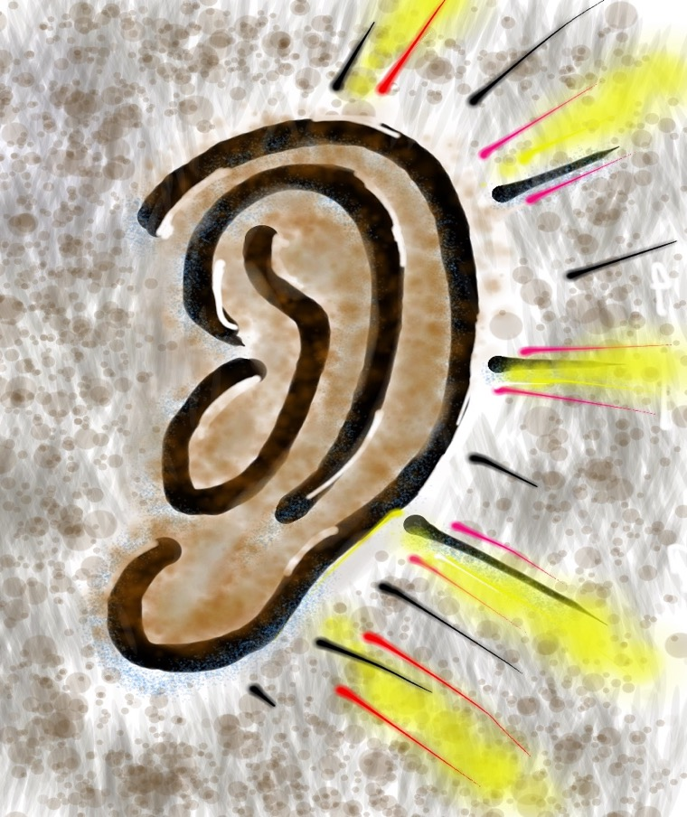
Listen

Slide 8
The Art of Listening
Vimeo:
http://vimeo.com/qisva/listening
or
YouTube:
https://youtu.be/ooE9dKobjZU
Video

Slide 9
Listen
Reach out & listen to voices
you typically don’t hear from
Stay focused (put away your phone!)
Be genuine & truly interested
Make sure you are talking less than the
other person
Being open to new ideas is not an option

Slide 10
Challenge Time…

Slide 11


Challenge
Do your best to draw the picture exactly as it is described.
You may not ask any questions.
Notes:
If delivering this activity in a virtual session, the presenter can describe a shape and have the entire virtual audience do their best to replicate the image. Then hold up the image that was described to the camera so participants can see how well they did. Then show the next slide and explain how the activity can be done with two round if delivering to an in-person audience.

Slide 12

Challenge
Drawing Dictations Lesson Plan
Round 1: Find a partner &
assign one person to be the
Describer, & one person to
be the Artist. Sit back to back. Without looking or asking
questions, describe to your
partner how to replicate
your picture.
Round 2: Switch roles (Describer & Artist) & switch cards with someone nearby.
Repeat the activity, but this time you
can ask clarifying questions. Still sit
back to back & no looking! ☺

Slide 13

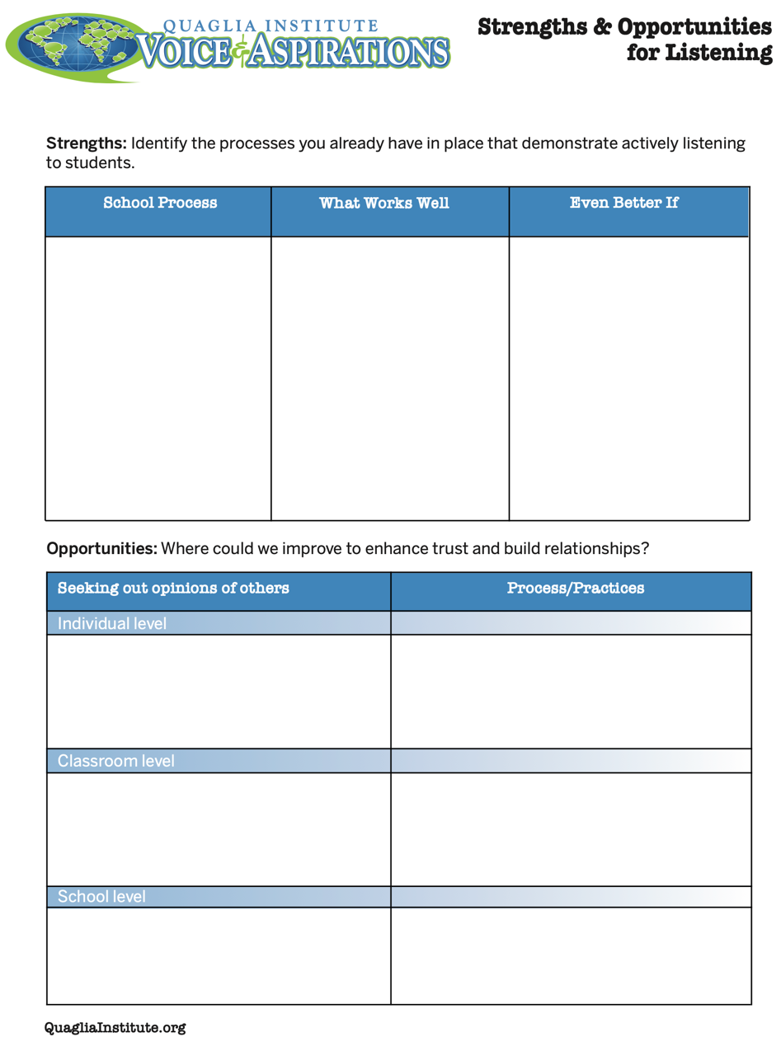
Reflect
What strengths &
challenges do you
observe when it comes
to Listening to students?
How do you/can you
really listen to students?
Strengths & Opportunities for Listening

Slide 14

Learn

Slide 15
Taking Time to Learn
Vimeo:
vimeo.com/qisva/time
or
YouTube:
https://youtu.be/tYKcvRfxK0o
Video

Slide 16
Learn
Take notes
Ask questions for clarity
Do not judge, you can learn from anyone
regardless of age, position, or any factor
Follow up & communicate what you
LEARNED from listening
Be prepared to change
Do not fear what you do not know

Slide 17
Challenge Time…

Slide 18

Challenge
Find the connection
between the 4 individual pictures.

Slide 19
Challenge
Find the connection
between the 4 individual pictures.
Be the first person to call out the correct answer!

Slide 20
Connections 1
Vimeo:
vimeo.com/qisva/connection1
or
YouTube:
https://youtu.be/Yl3JrRtyGHc
(all 9 slides)

Slide 21
Connections 2
Vimeo:
vimeo.com/qisva/connections2

Slide 22
Connections 3
Vimeo:
vimeo.com/qisva/connections3

Slide 23
Connections 4
Vimeo:
vimeo.com/qisva/connections4

Slide 24
Connections 5
Vimeo:
vimeo.com/qisva/connections5

Slide 25
Connections 6
Vimeo:
vimeo.com/qisva/connections6

Slide 26
Connections 7
Vimeo:
vimeo.com/qisva/connections7

Slide 27
Connections 8
Vimeo:
vimeo.com/qisva/connections8

Slide 28
Connections 9
Vimeo:
vimeo.com/qisva/connections9

Slide 29

Take Away Challenge
Your Connections
Pick a word that reflects your hopes & dreams for your school & create
4 images.
Share with colleagues & see if
they can guess your word.

Slide 30

Reflect
What is something you have
recently Learned from
students?
How can you facilitate Learning from students as a regular
practice at your school?

Slide 31
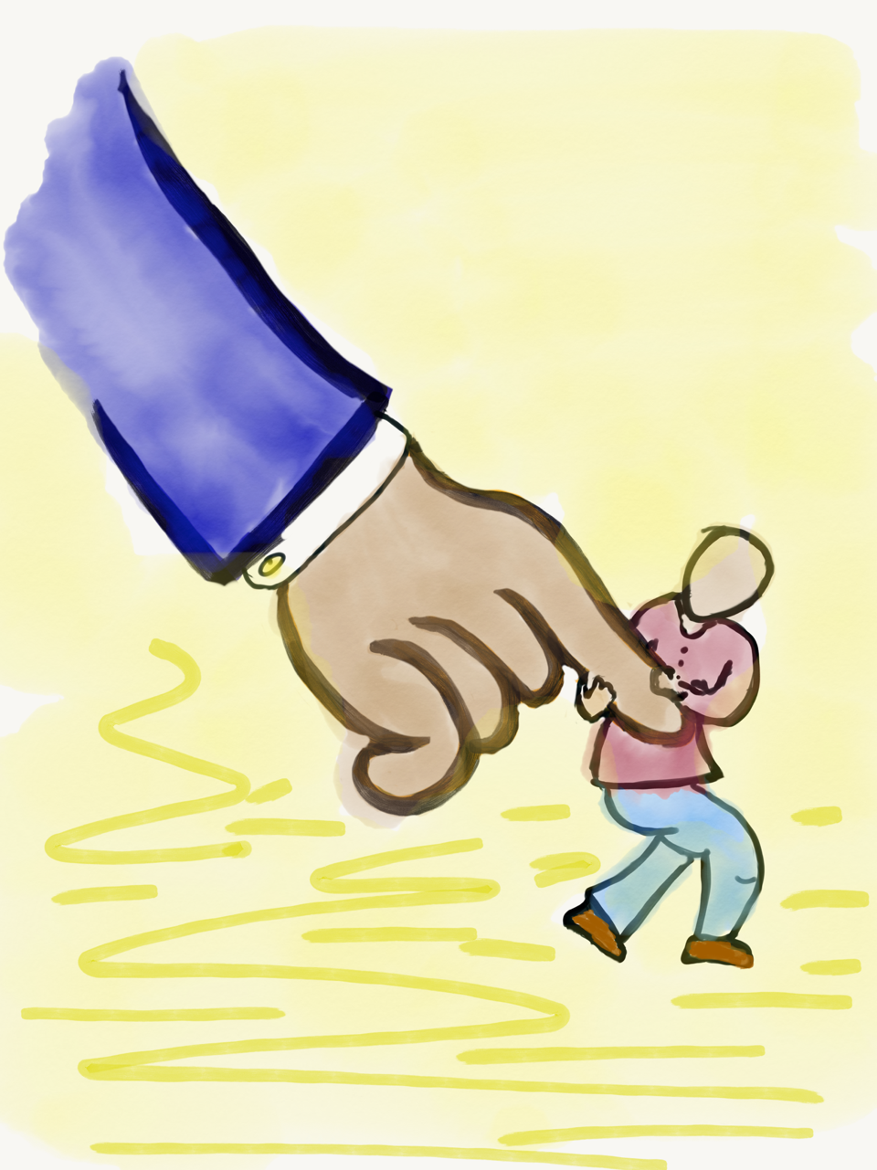
Lead

Slide 32
Leading Together…
Vimeo:
https://vimeo.com/qisva/together
or
YouTube:
https://youtu.be/RTvZCdUP7N4
Video

Slide 33

Reflect
What did you observe related to the term Lead in this video?

Slide 34
Lead
Use what you have heard & learned to drive meaningful change.
Leading is not a solo adventure; take
action with others.
Creates a shared sense of purpose.
Voice is not about getting your own way.
You can’t please everyone; but you can
demonstrate value & respect for all voices.

Slide 35
LLL in Action!
Vimeo: vimeo.com/qisva/sutter
YouTube:
https://youtu.be/_kwkyzH
Video
Sutter Middle School, Los Angeles, California

Slide 36
Co-Owning School Data
Vimeo:
https://vimeo.com/qisva/lawrence
YouTube:
https://youtu.be/iZWyKT6Gq4M
Video
Lawrence Middle School, Los Angeles, California

Slide 37
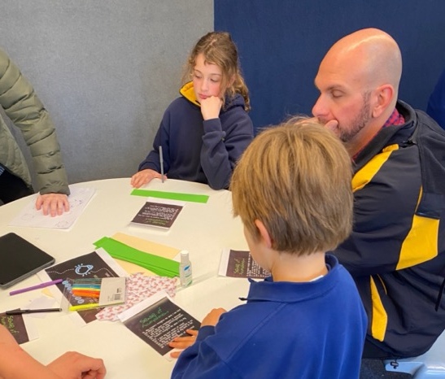
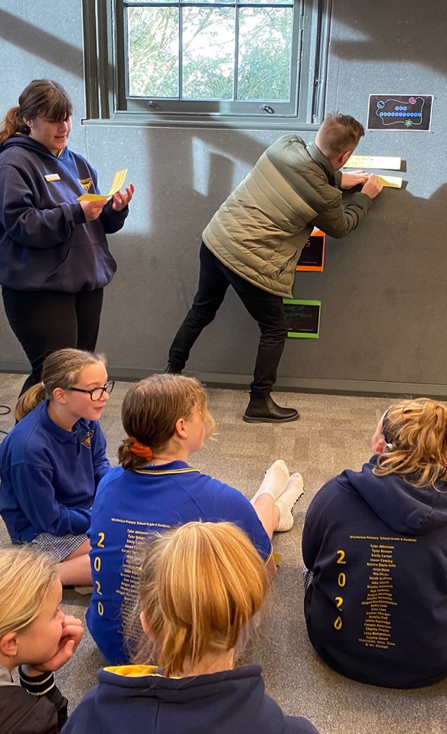
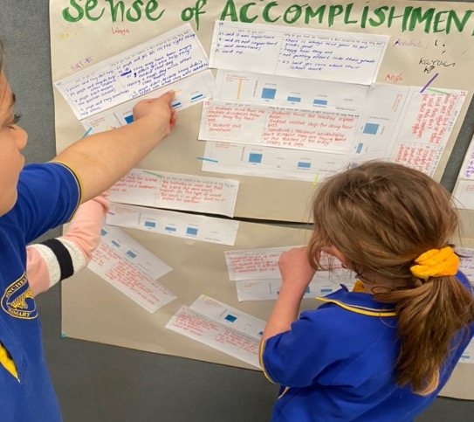
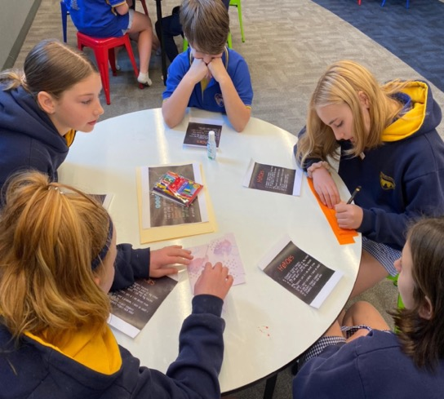
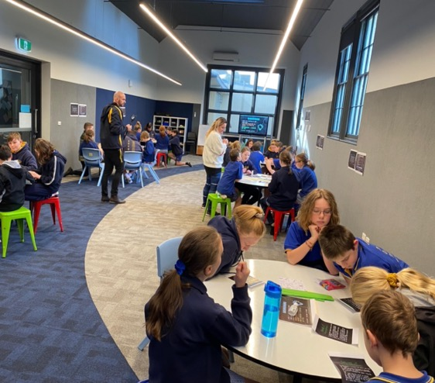
Listening, Learning, & Leading Together
Winchelsea Primary, Victoria, Australia

Slide 38
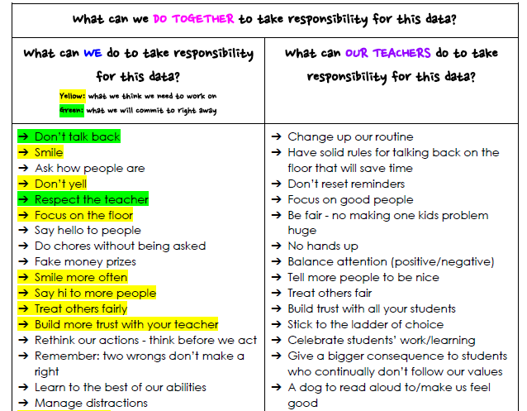
Shared Responsibility
Winchelsea Primary, Victoria, Australia

Slide 39

Reflect
What is one area at your
school in which students can be
invited to Lead with adults?
How can you increase shared
responsibility with students?

Slide 40
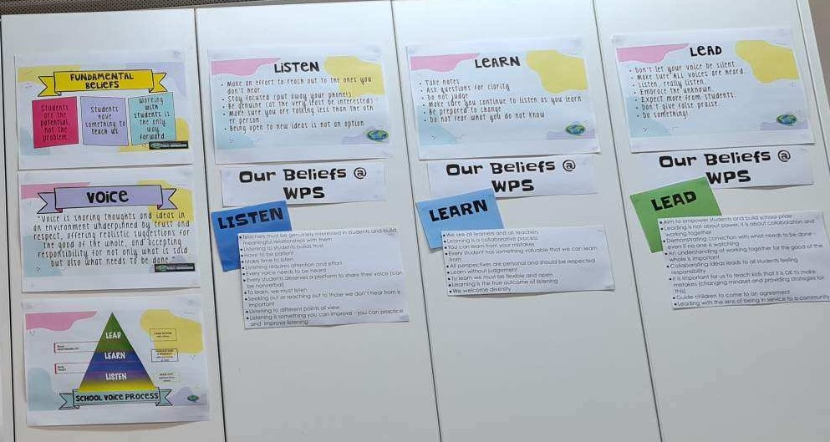
Creating Context for LLL
Winchelsea Primary, Victoria, Australia

Slide 41
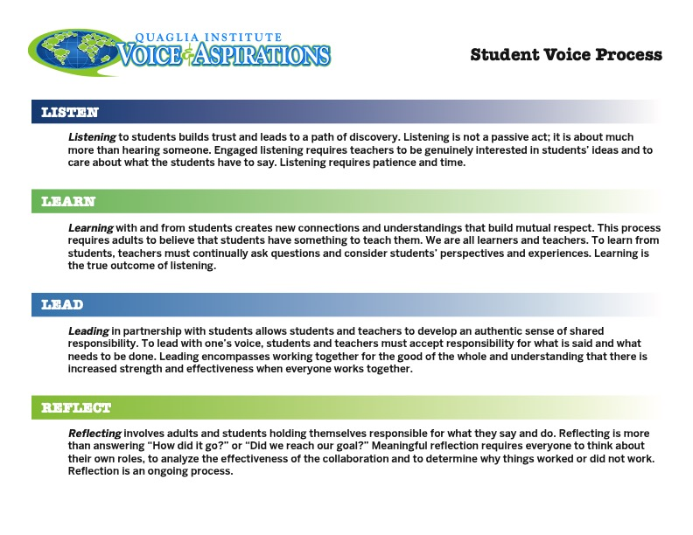
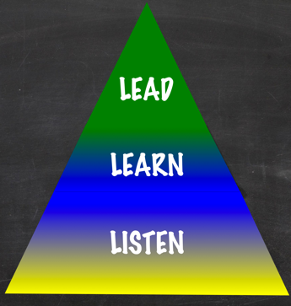
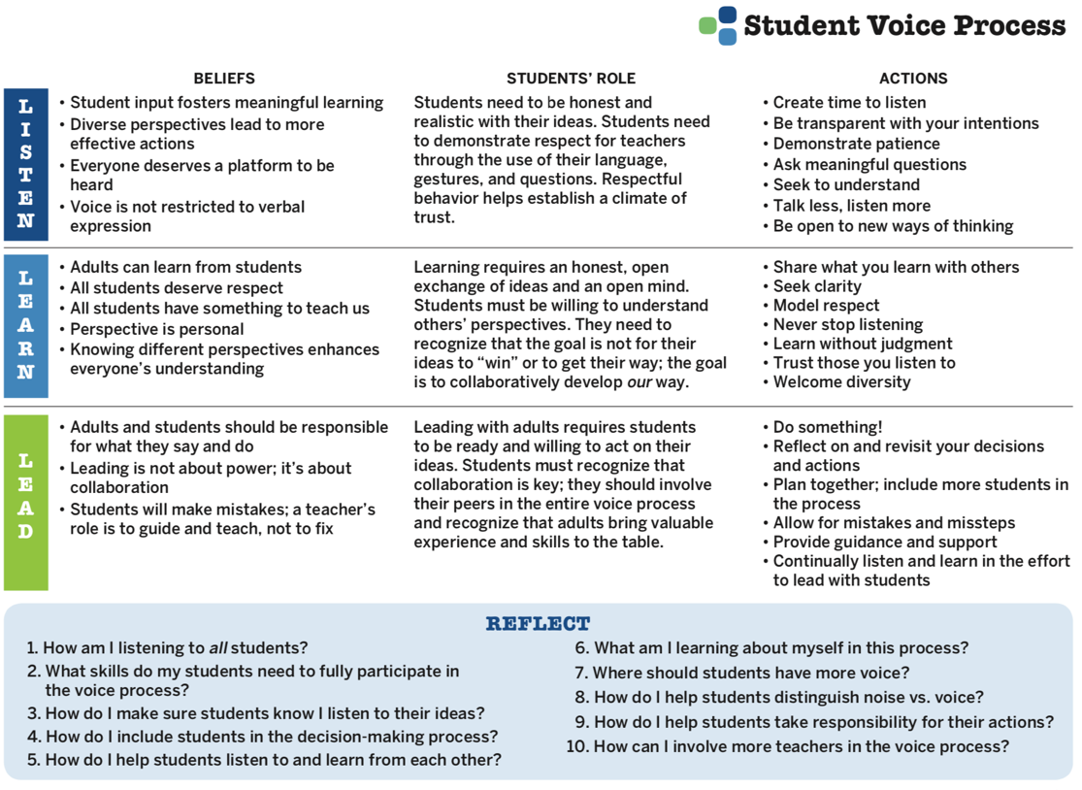

Voice Process Tool
Voice Process Tool

Slide 42
LLL Summarized
Vimeo
https://vimeo.com/1008827187/4db36a40e4
YouTube
https://youtu.be/eiYW60H8F9g
BCE, Brisbane, Australia
Video

Slide 43
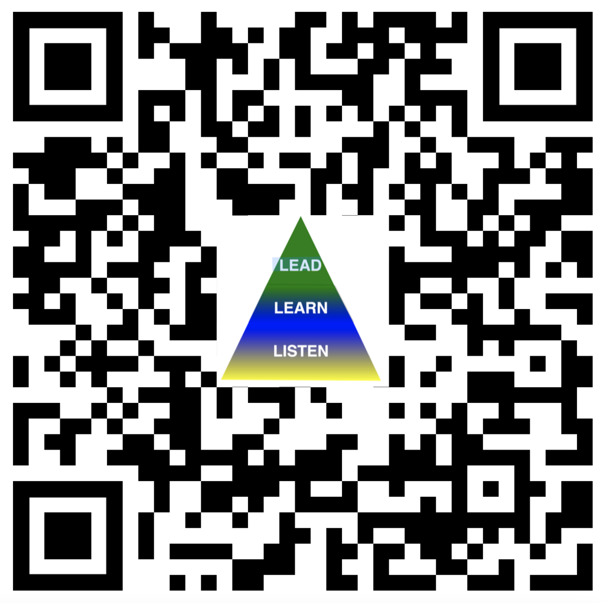
Website Just For YOU!
https://quagliainstitute.org/lll-session

Slide 44
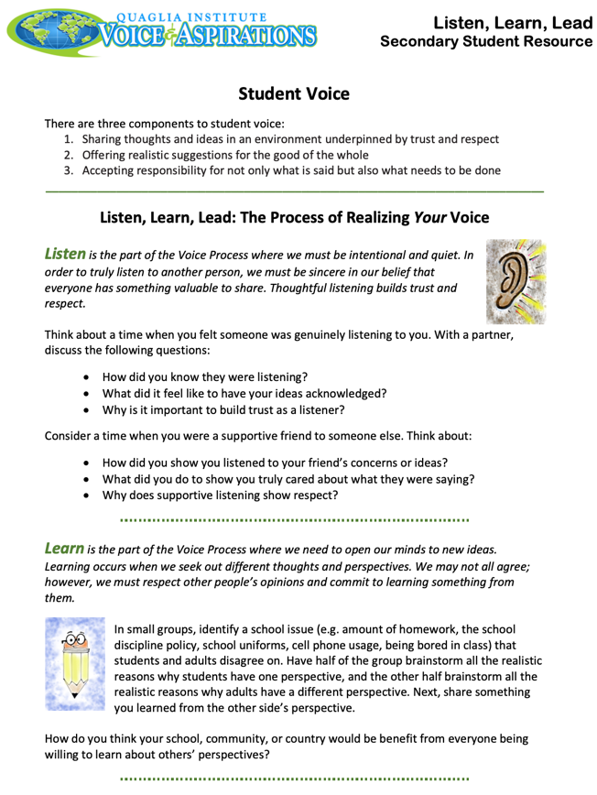

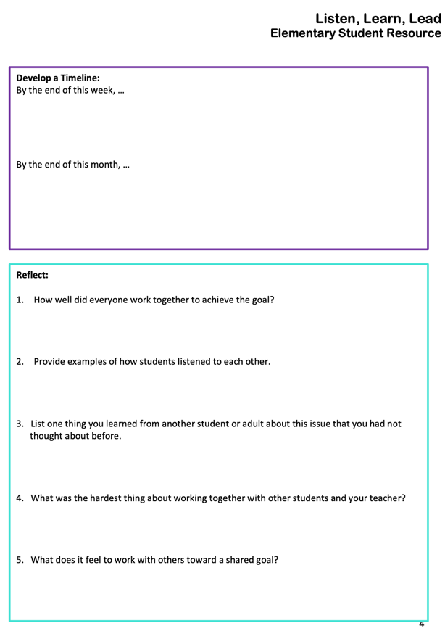
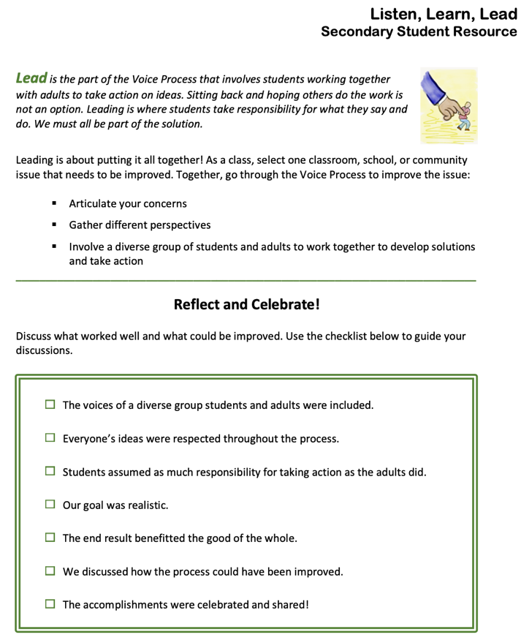
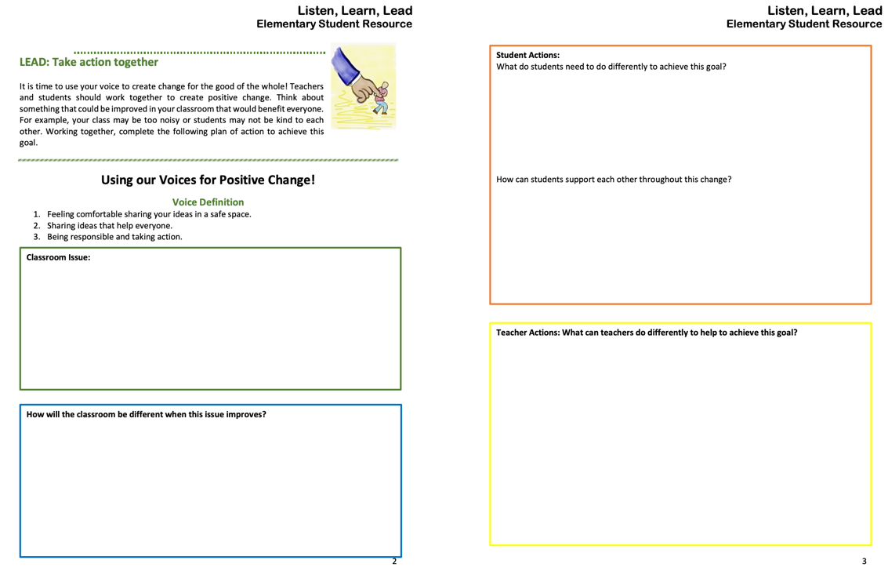
LLL Student Resource
(Elementary & Secondary)

Slide 45
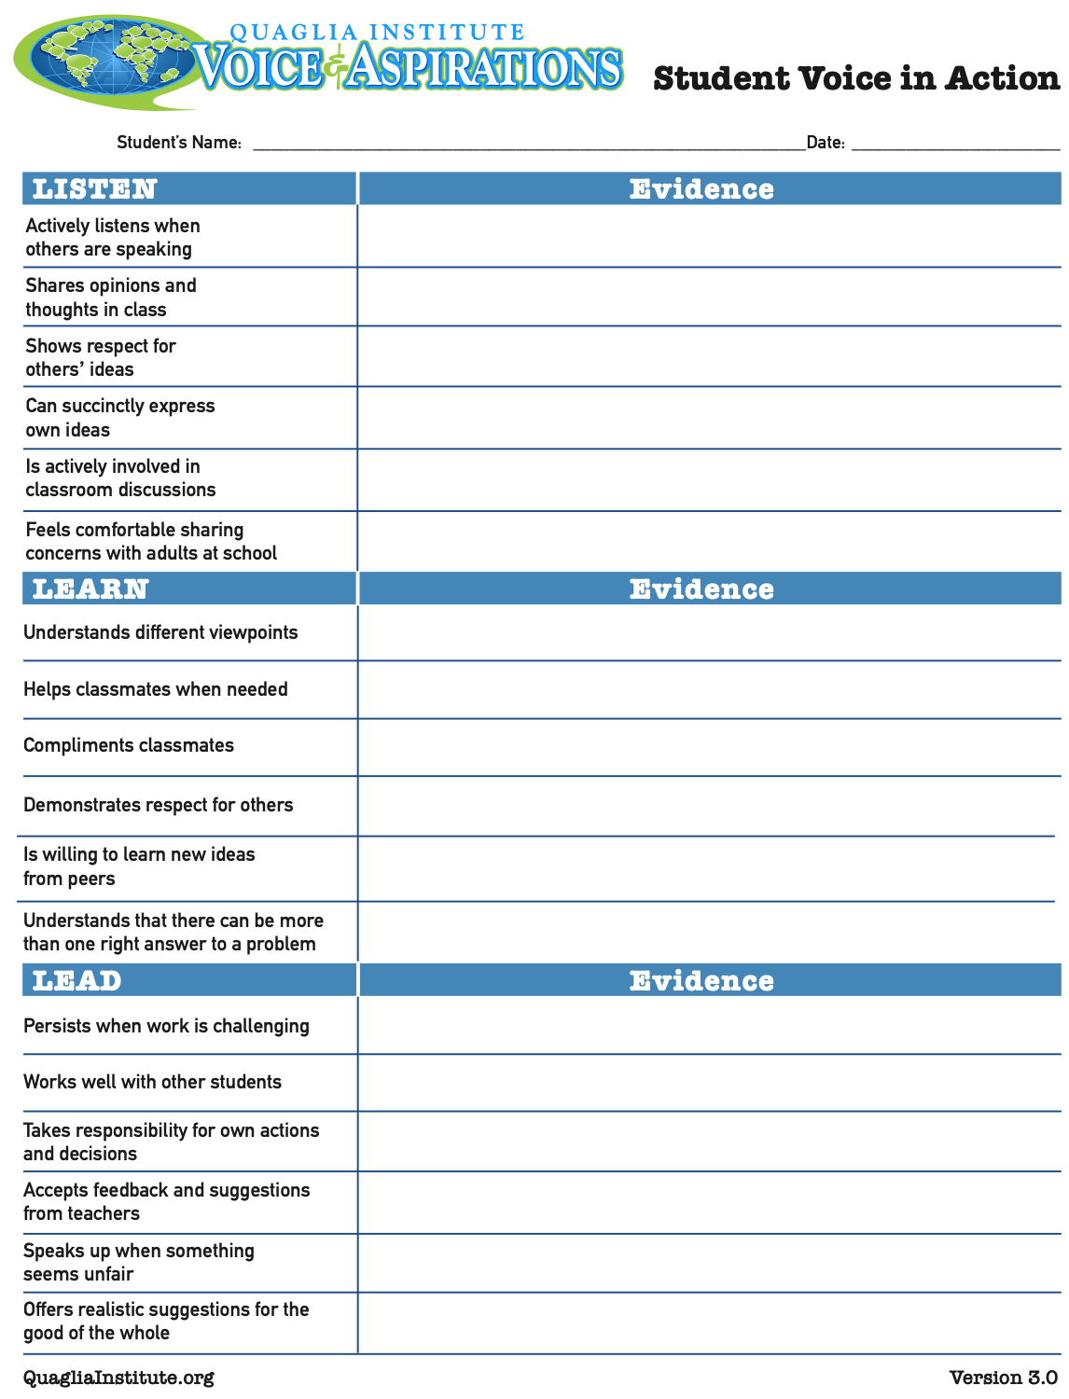
Student Voice
in Action

Slide 46

What is your “WOW” moment of
learning from today?

Slide 47

What is your “WOW” moment of
learning from
today?

Slide 48
The Voice Process:
Listening To, Learning From, & Leading With Students
Dr. Russ Quaglia & Dr. Lisa Lande
@QISVAtweets @Lisa_Lande
www.quagliainstitute.org
September 11, 2024

