Slide 1
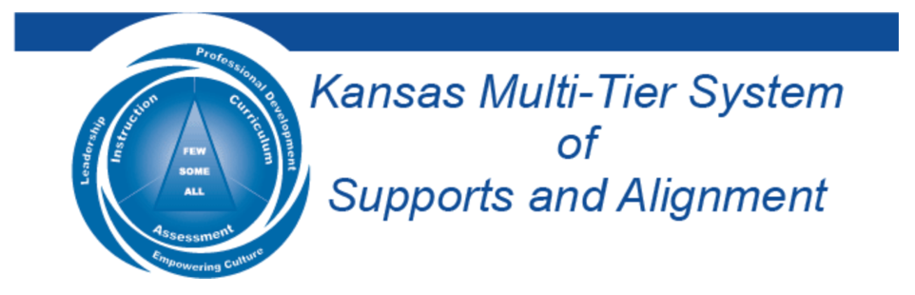

The Power of
Student Voice
Dr. Russ Quaglia & Dr. Lisa Lande
@QISVAtweets @Lisa_Lande
www.quagliainstitute.org
September 10, 2024

Slide 2

Fundamental Beliefs
Students are the potential, not the problem.
Students have something to teach us.
Working with students is the only way forward.

Slide 3


Post Card
Introductions

Slide 4

Learning Intention
We are learning about the power of amplifying voice in schools to support students in reaching their fullest potential.
Success Criteria
Embrace a common definition for student voice & understand the difference between Noise & Voice.
Consider strategies for supporting all students in
developing & using their voice to impact school
culture & the classroom learning environment.
Apply voice skills & pathways to instructional
practices at your school.
Today will be a home run for me if…

Slide 5


Making Connections
State Board Goals
Social Emotional Growth
High School Graduation
Post Secondary Success

Slide 6

Reflect
Green: What comes to mind when you hear the term
Student Voice?
Purple: Share an example
you have seen of Student
Voice in Action.

Slide 7
Speed Dating
Vimeo
https://vimeo.com/854655576
YouTube
https://youtu.be/jA9u9zaaJRs
Video

Slide 8
Academic Speed Dating

Slide 9

Challenge Time…

Slide 10

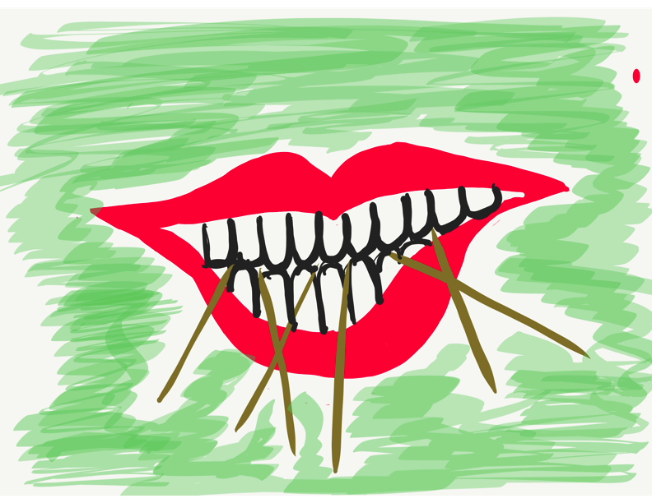
Toothpick Challenge
Using 6 toothpicks,
make 4 and only 4
equilateral triangles
(all 3 sides the same size).
You may not break the toothpicks.

Slide 11
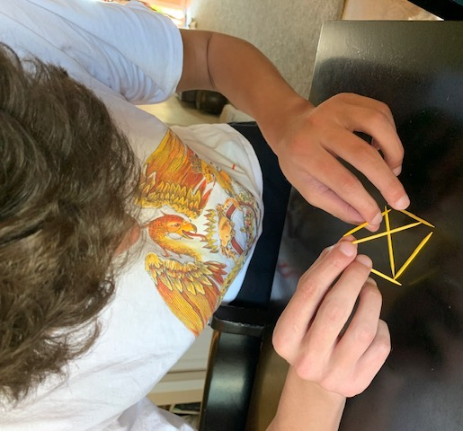
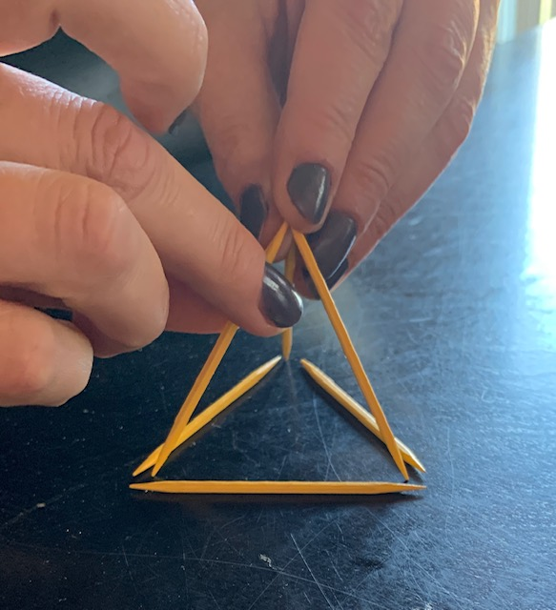
Today we invite you to do
some 3-D thinking!

Slide 12
Vimeo
https://vimeo.com/qisva/lausd
YouTube
https://www.youtube.com/watch?v=O5Tt3H73IR0
Video
Los Angeles, California, USA

Slide 13

Quaglia Institute Research
19 years of data
43 states
13 countries
1,008,091 Student Voice Surveys Grades 6-12
153,137 Student Voice Surveys Grades 3-5
641,091 iKnow My Class Surveys
59,813 Teacher Voice Surveys
29,660 Parent Voice Surveys
Notes:
Updated September 22, 2023

Slide 14
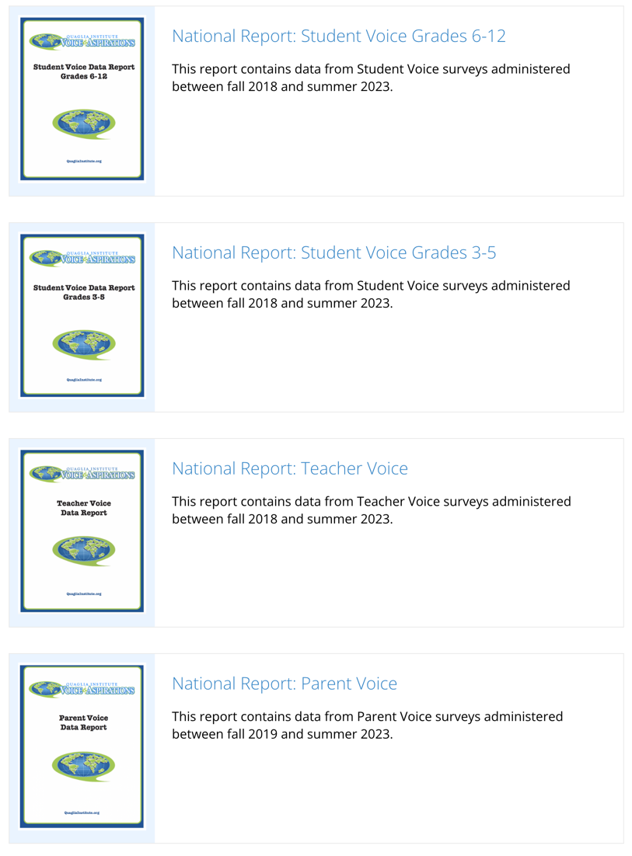
Quaglia Institute Research
QuagliaInstitute.org
National Reports
Student Voice 6-12
Student Voice 3-5
Teacher Voice
Parent Voice

Slide 15

Why Student
Voice?

Slide 16
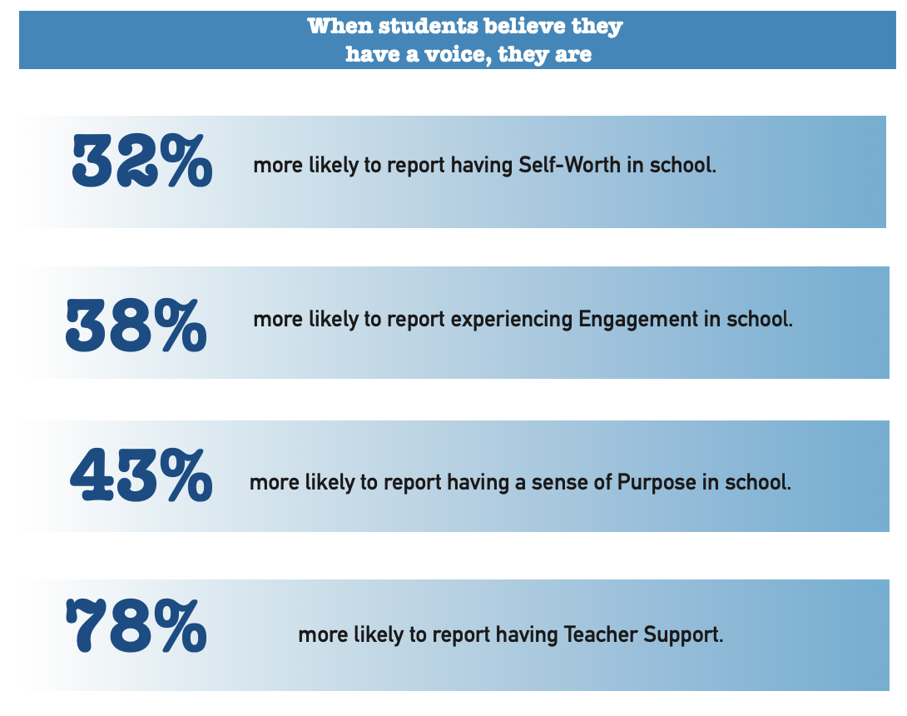

Slide 17

54% of students report that adults listen to student suggestions.

Slide 18

52% of students report using their voice to express their thoughts & ideas.

Slide 19

52% of students report having a voice in decision making at school.

Slide 20

51% of students say they work with adults to make their school better.

Slide 21

Student Voice
is not YET a
natural way of
being.
Why Not?

Slide 22

The Student Voice
Journey Begins!
First, we need a clear
definition of Student Voice
that we can all
understand, accept, &
put into practice.

Slide 23

The 3 Components of Student Voice
Sharing thoughts & ideas in an environment underpinned by trust & respect.
Offering realistic suggestions for the
good of the whole.
Accepting responsibility for not only what is said but also what needs to be done.

Slide 24

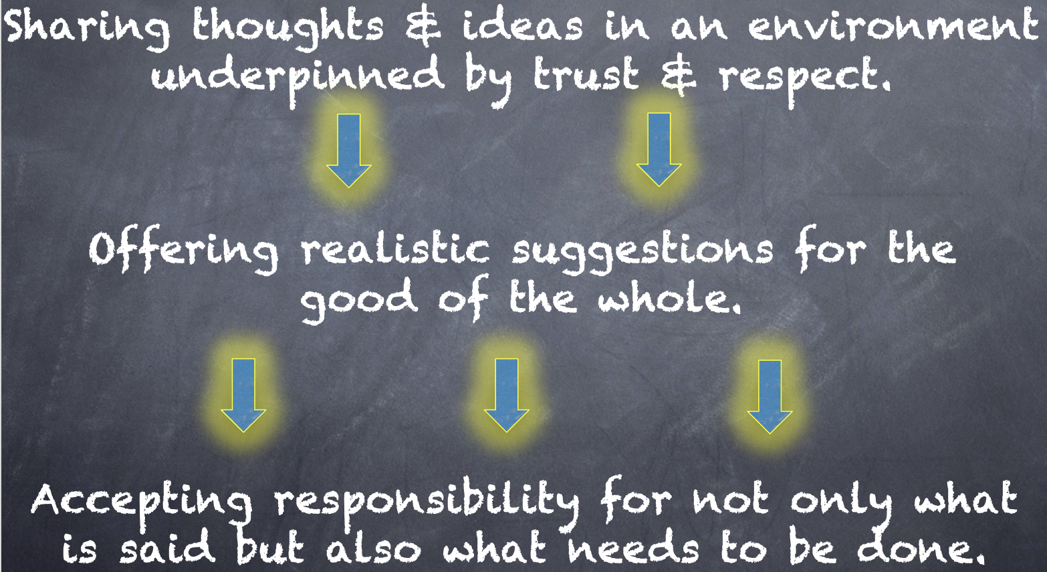
Meet With Your Feet
What resonates with you
from the Voice definition?

Slide 25

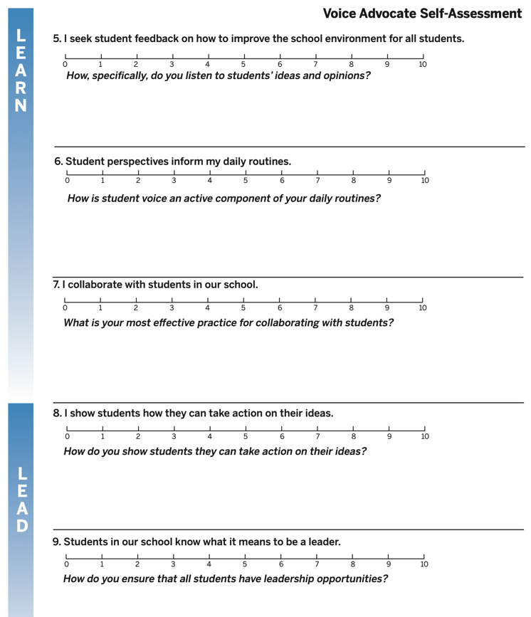
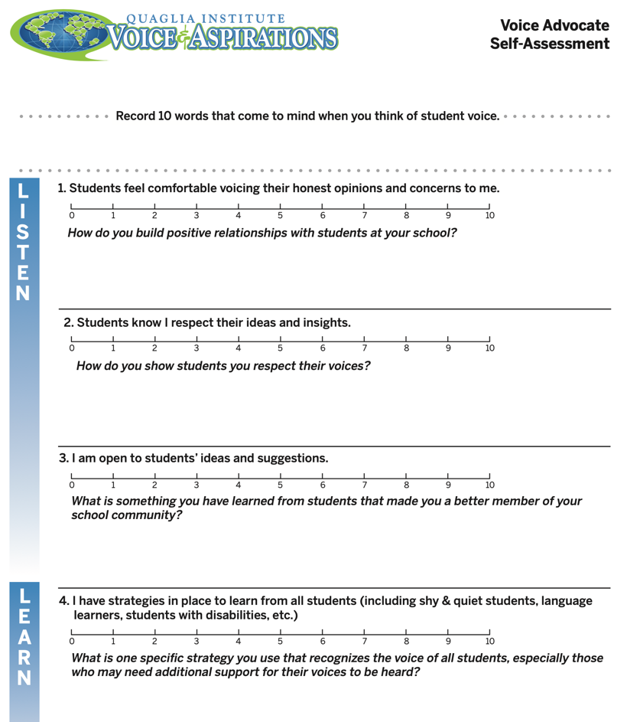
Voice Advocate
Self-Assessment
What did you learn
about yourself?

Slide 26
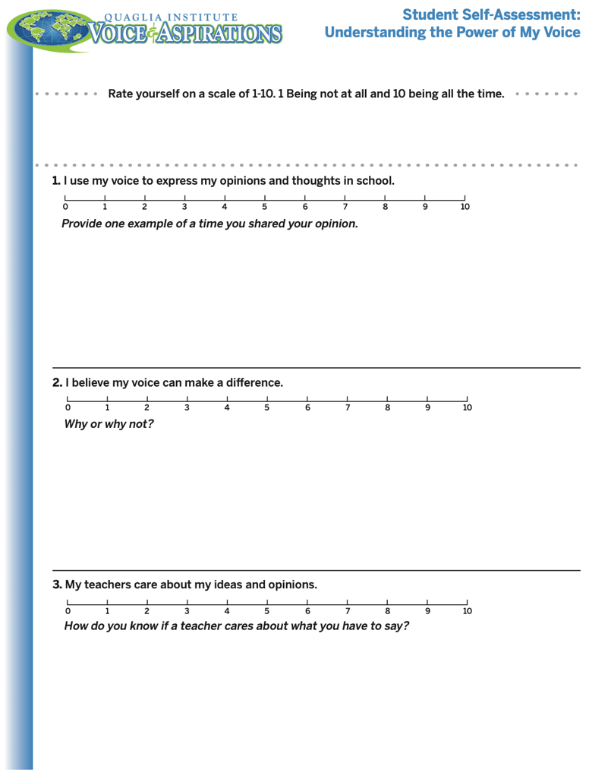
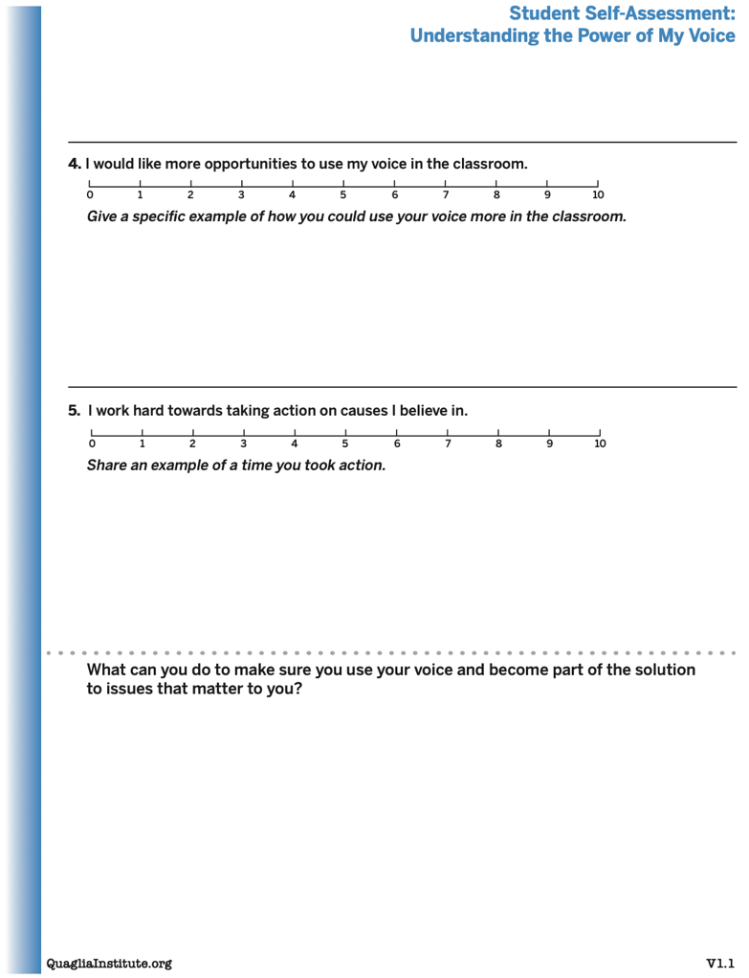
Understanding the Power of My
Voice Student Self Assessment
Consider having your students
complete this
“Understanding
the Power of
My Voice”
self-assessment.

Slide 27


Slide 28

Story Time…

Slide 30
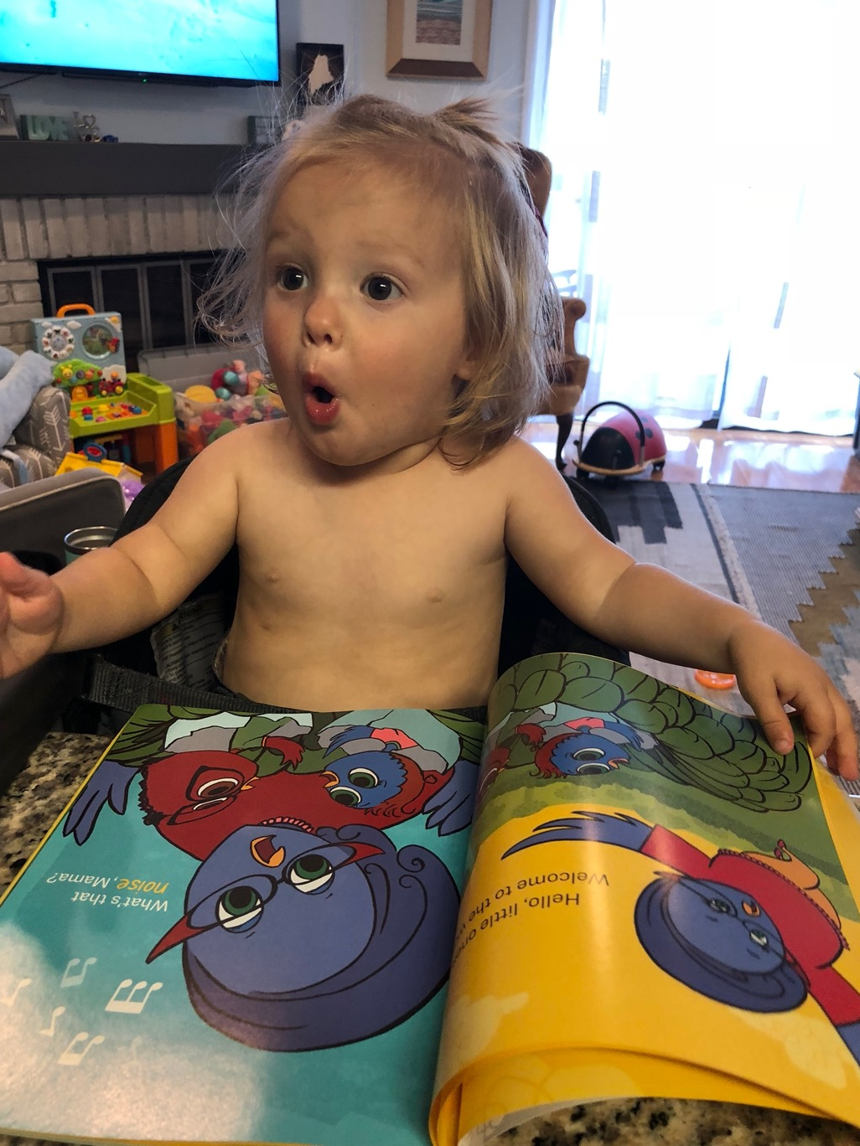
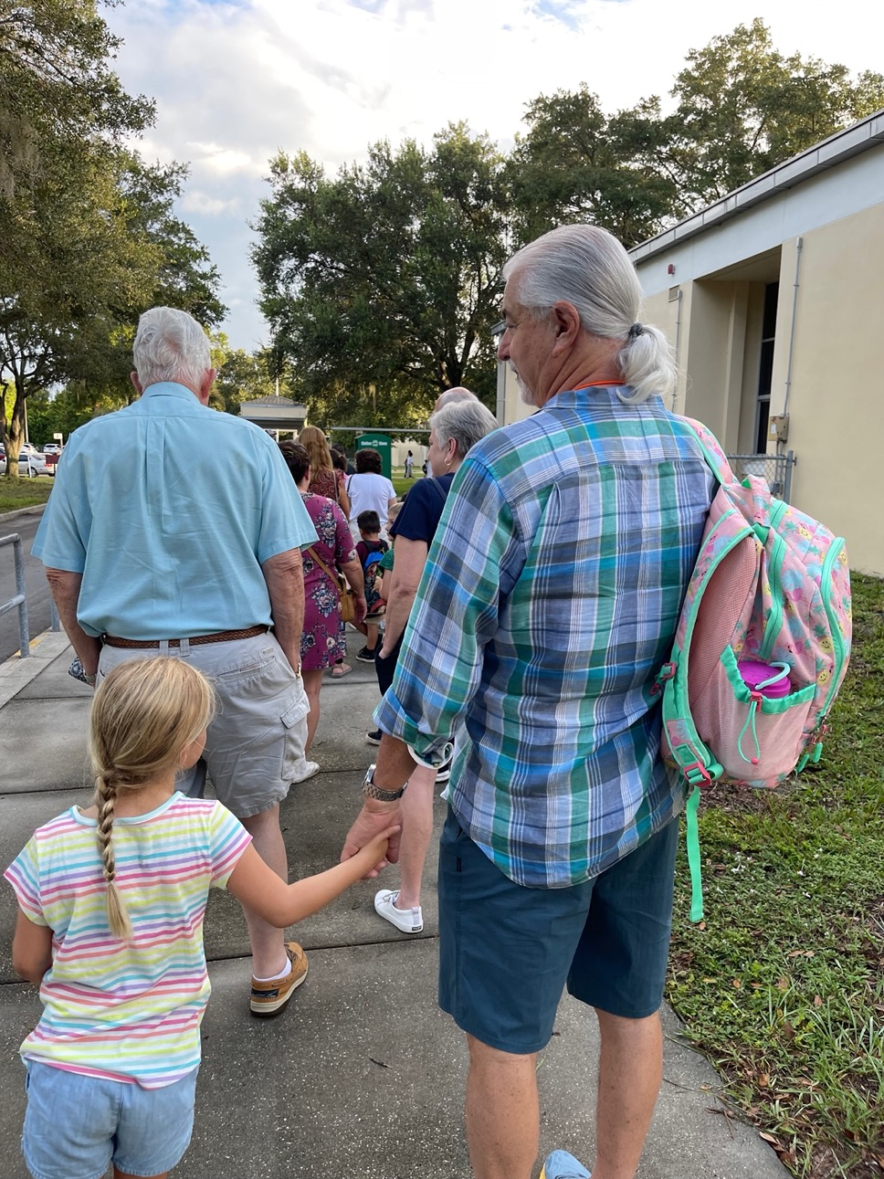

Slide 31


© Quaglia Institute

Slide 32

© Quaglia Institute

Slide 33
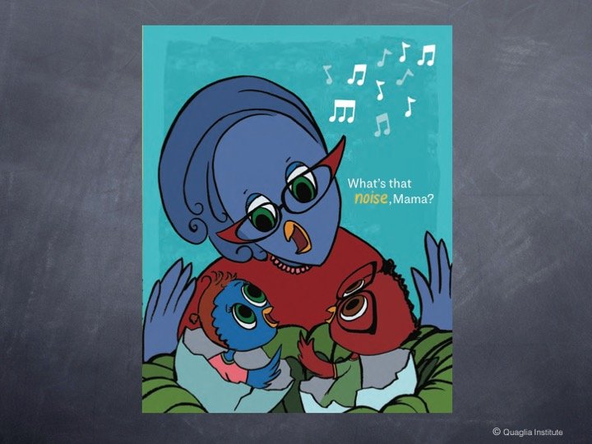
© Quaglia Institute

Slide 34
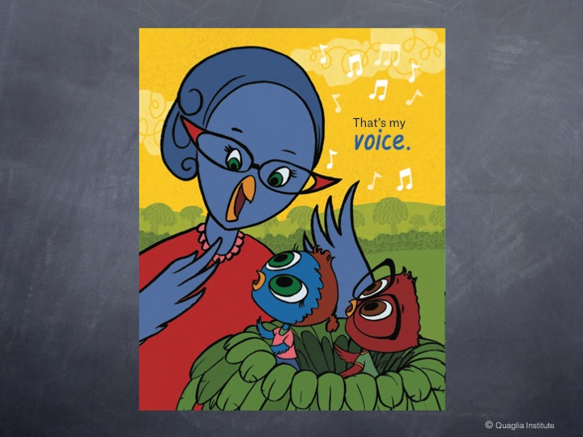
© Quaglia Institute

Slide 35
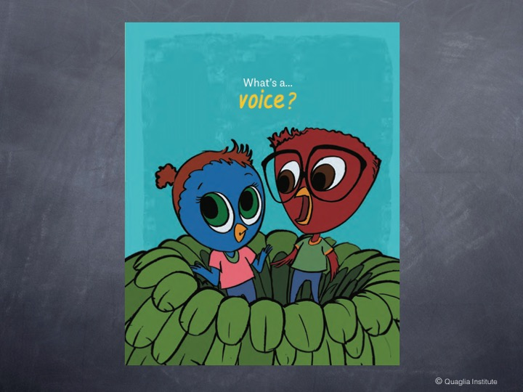
© Quaglia Institute

Slide 36
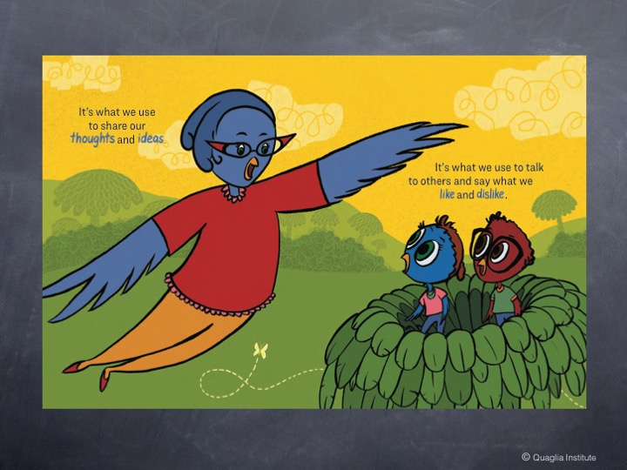
© Quaglia Institute

Slide 37

© Quaglia Institute

Slide 38

© Quaglia Institute

Slide 39

© Quaglia Institute

Slide 40
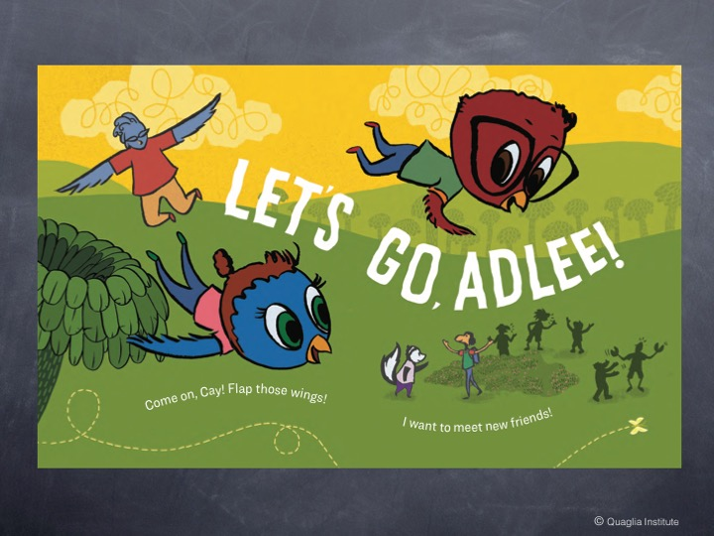
© Quaglia Institute

Slide 41

© Quaglia Institute

Slide 42
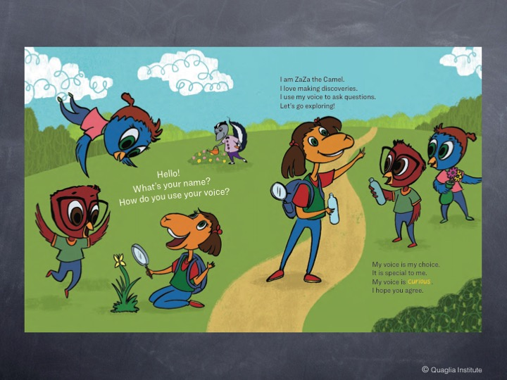
© Quaglia Institute

Slide 43
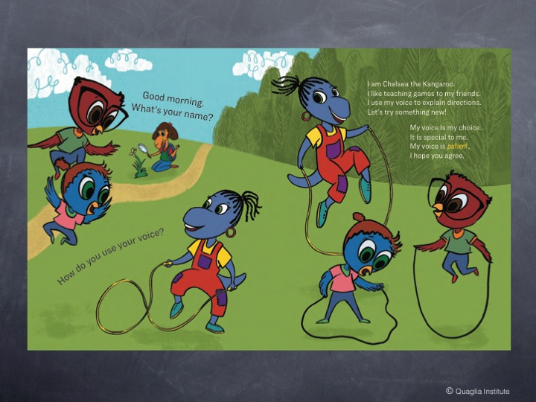
© Quaglia Institute

Slide 44
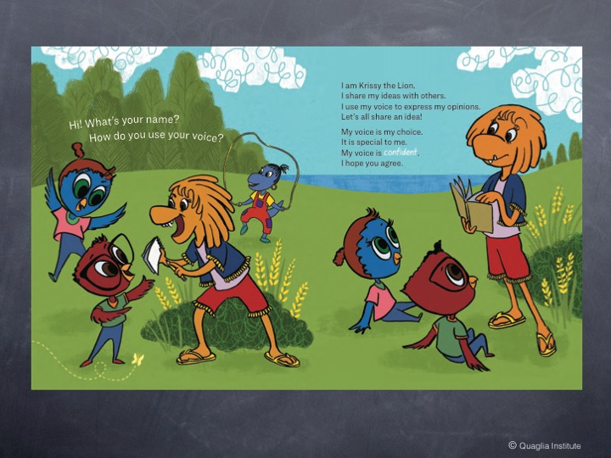
© Quaglia Institute

Slide 45
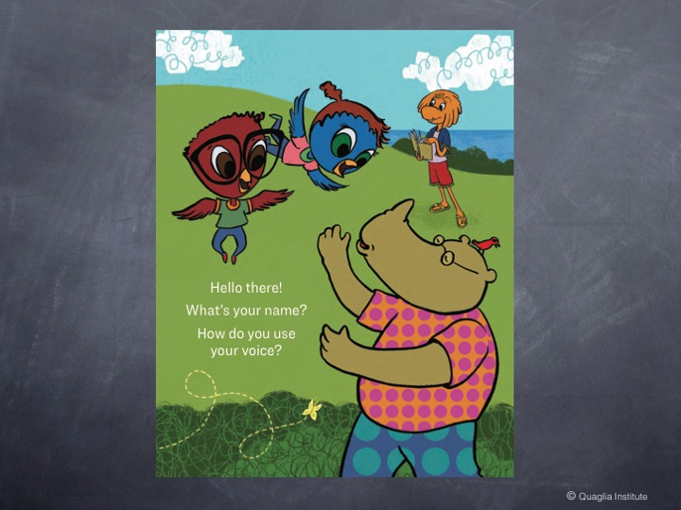
© Quaglia Institute

Slide 46

© Quaglia Institute

Slide 47
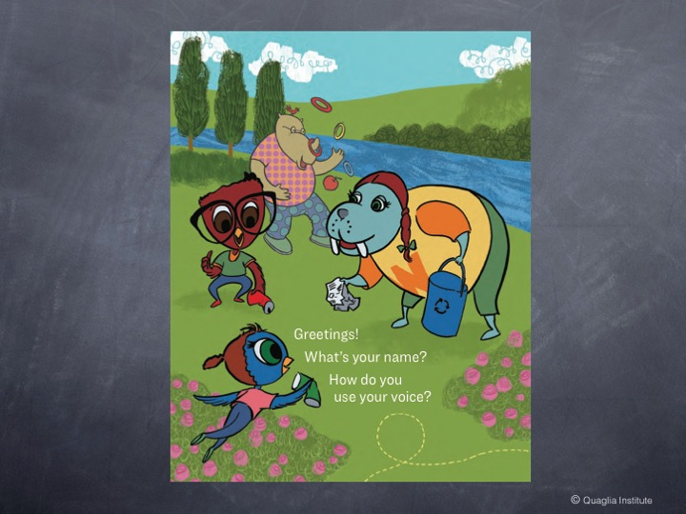
© Quaglia Institute

Slide 48

© Quaglia Institute

Slide 49
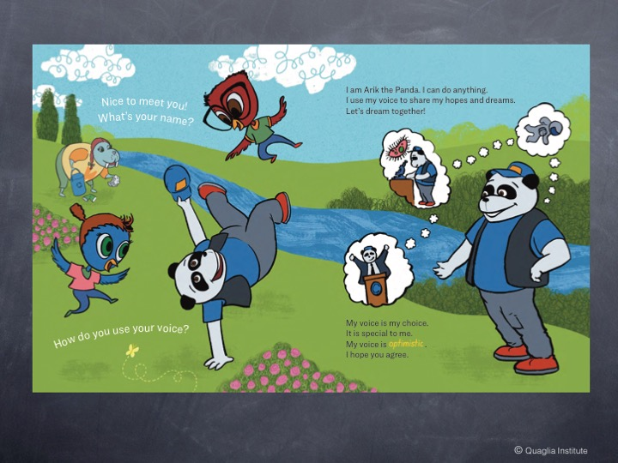
© Quaglia Institute

Slide 50
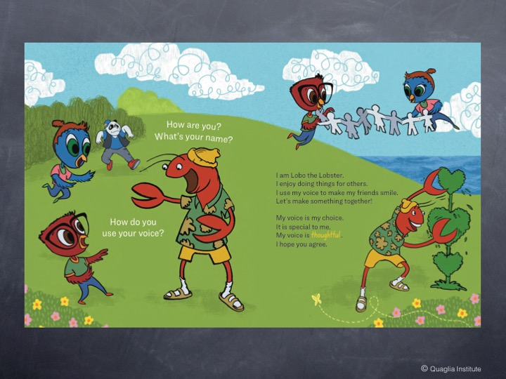
© Quaglia Institute

Slide 51
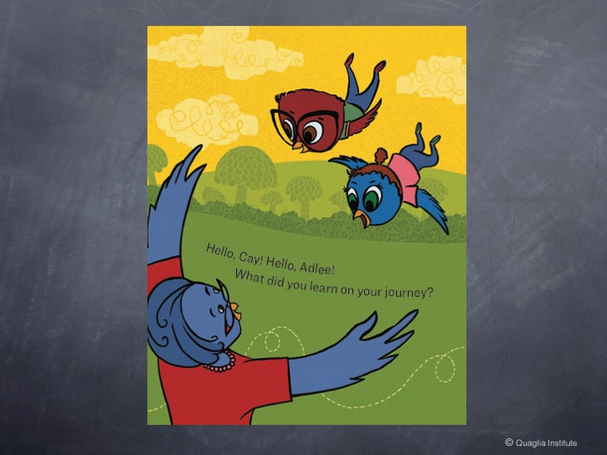
© Quaglia Institute

Slide 52
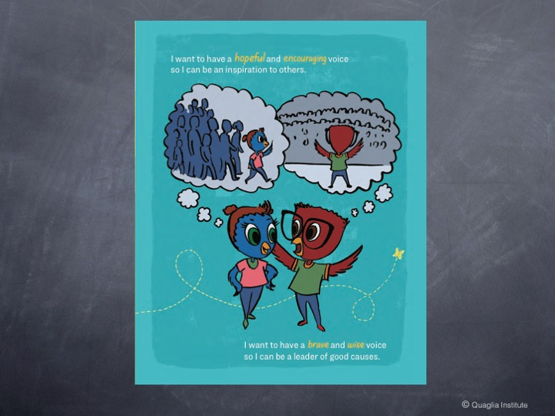
© Quaglia Institute

Slide 53
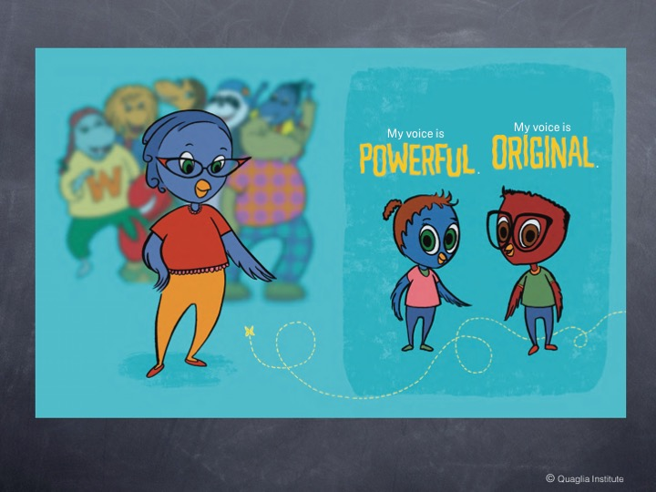
© Quaglia Institute

Slide 54

© Quaglia Institute

Slide 55


My voice is my choice.
It is special to me.
I have a _____ voice.
I hope you agree!

Slide 56

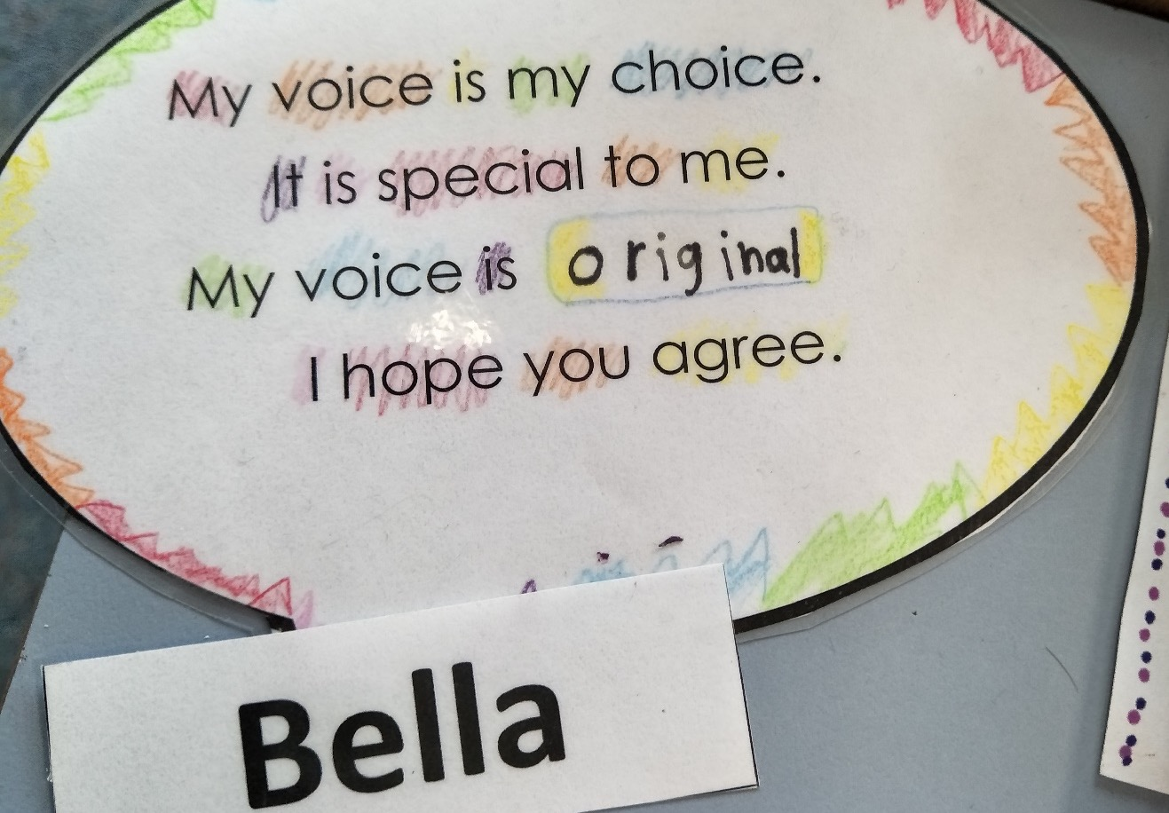
Student Voice in Action
Winchelsea Primary, Victoria, Australia

Slide 57


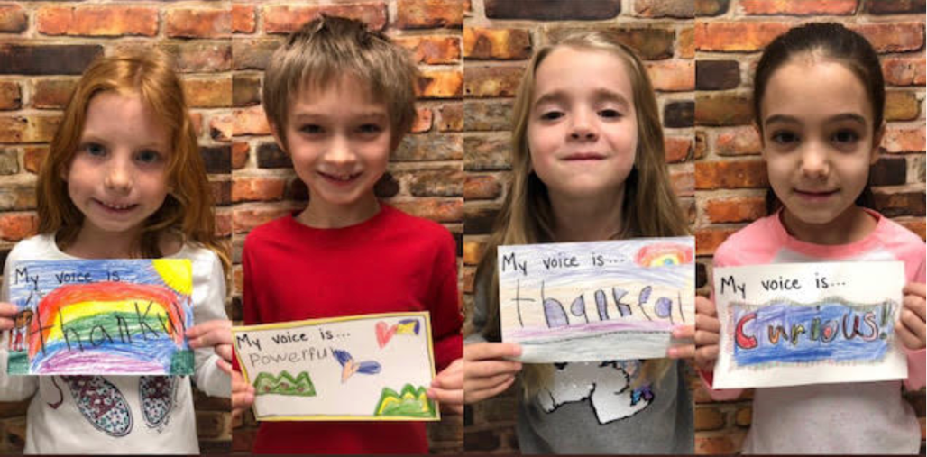
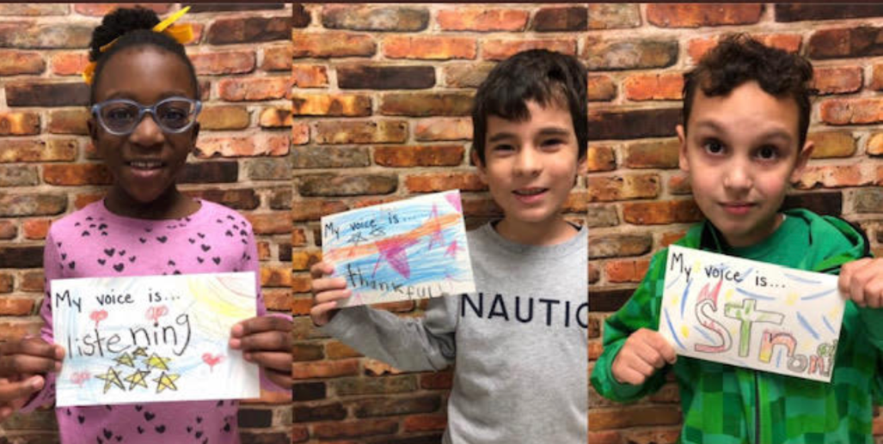
Student Voice in Action
Cobb County School District, Georgia, USA

Slide 58
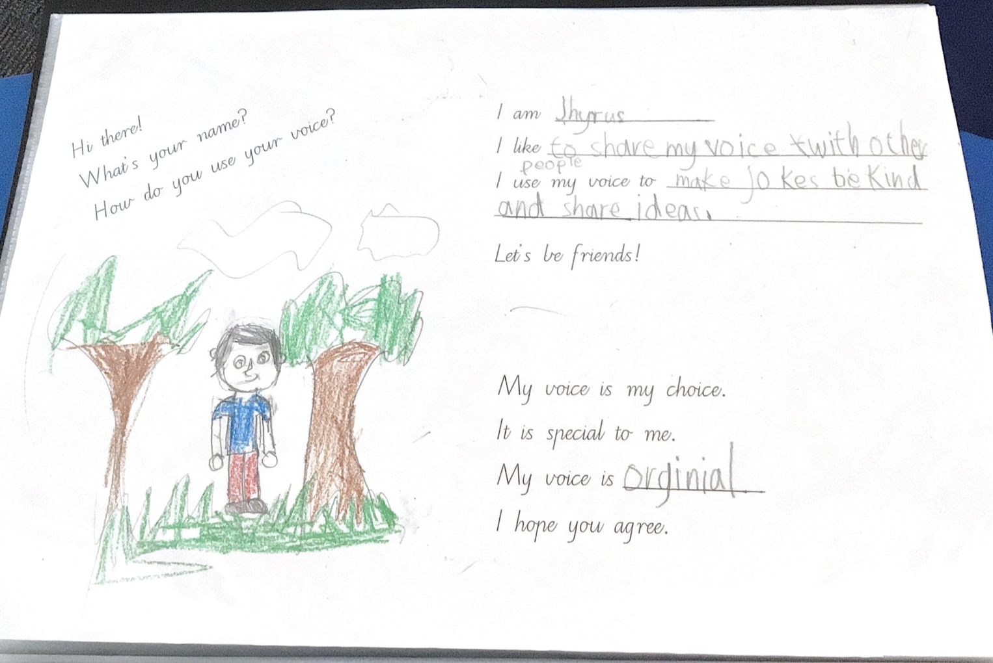
Student Voice in Action
Hampton Park Primary School, Victoria, Australia
Notes:
Per Sue B: I just wanted to share with you the example of student work that Charlotte has just sent me from the Year 1/2 class at Hampton Park. The whole school developed pages for their own version of the Cay and Adlee book.

Slide 59
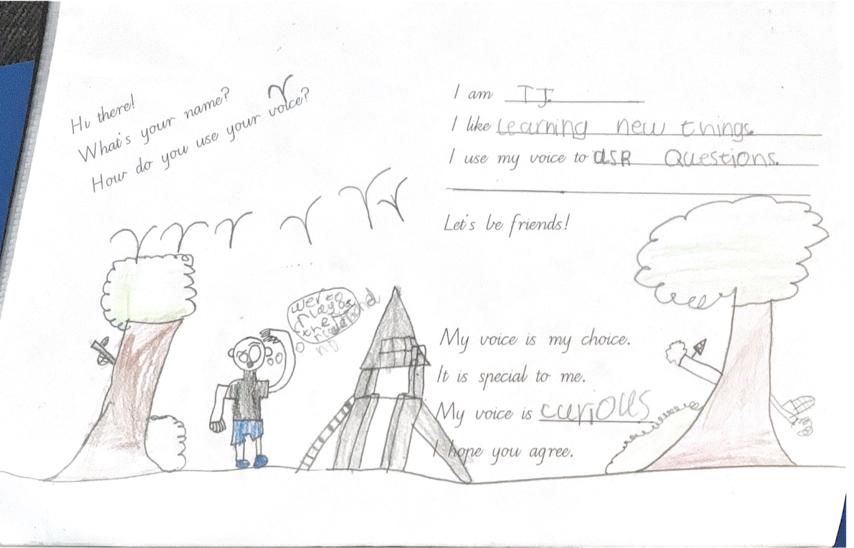
Student Voice in Action
Hampton Park Primary School, Victoria, Australia
Notes:
Year 1/2 class at Hampton Park. The whole school developed pages for their own version of the Cay and Adlee book.

Slide 60
Challenge Time…

Slide 61



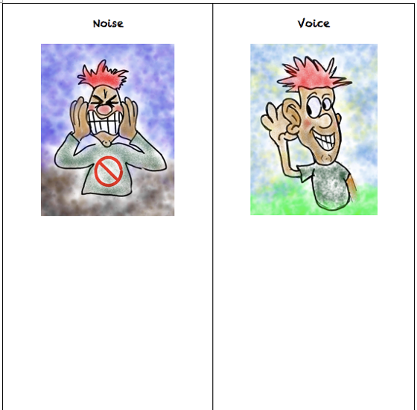
Challenge
Noise vs. Voice
Share words, phrases, &
examples of
Noise.
Now share words, phrases, &
examples of
Voice.

Slide 62


Noise vs Voice
Student Noise
Demands/commands/chaotic
Student opinion is most important
All adult voice is negative
Everyone needs to change but me
Complaining/whining
Student Voice
Requests/inquiry/focused
Our ideas are stronger in partnership
Students are open to learn
Personal reflection
Accepting responsibility

Slide 63


Students Control the Volume
Voice Inhibitors
Anger/extreme emotion
Rhetoric
Volume/Tone
Close Minded
Self-Serving
Voice Amplifiers
Authenticity/Genuineness
Knowledge
Refocus, Reanalyze, Readjust
Relentless
Being a “student”

Slide 64

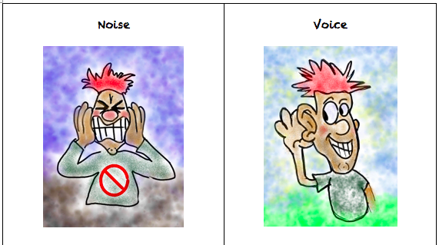
Challenge
Noise vs. Voice Art
As a table group, create a visual representation that reflects the difference between Noise v. Voice.
When finished, post your art masterpiece on the walls around the room.

Slide 65

Gallery Walk
Welcome to the Silent Gallery!
Take a wander around the room and take in the Noise v. Voice artwork created by the group.

Slide 66

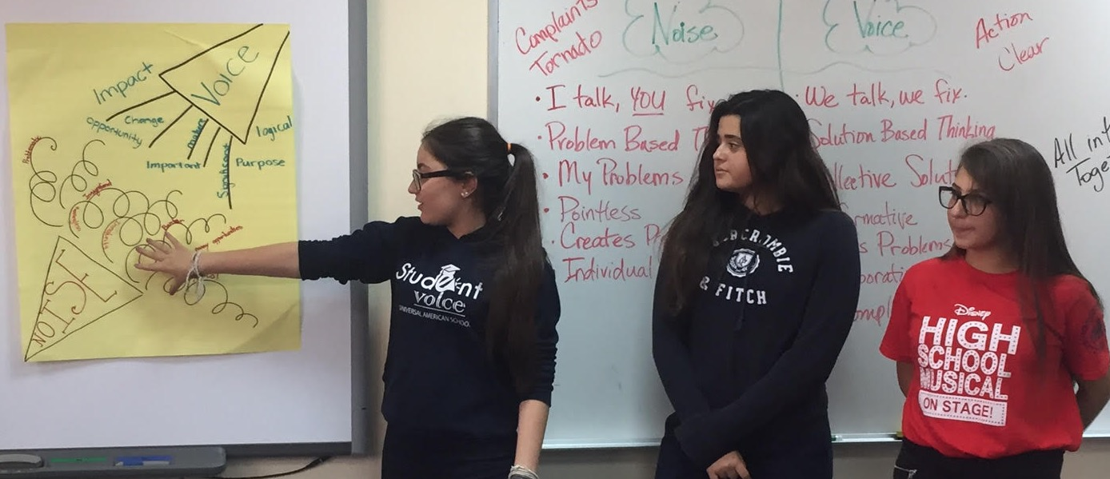
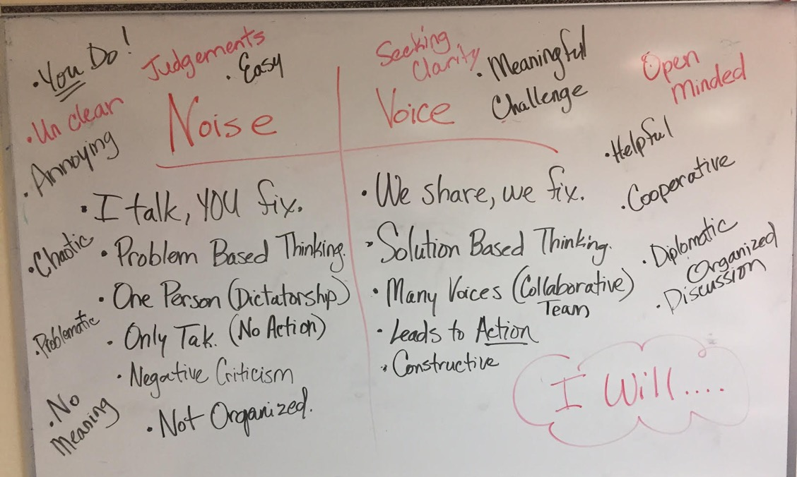
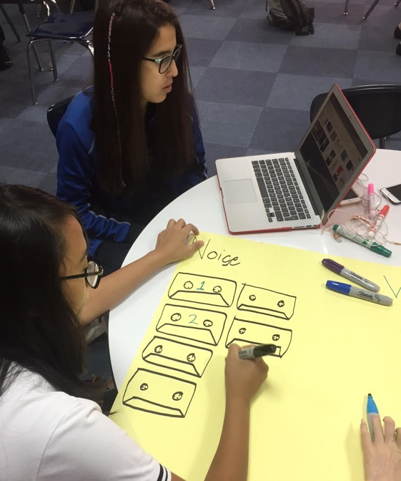
Student Voice in Action
Universal American School,
Dubai, UAE

Slide 67
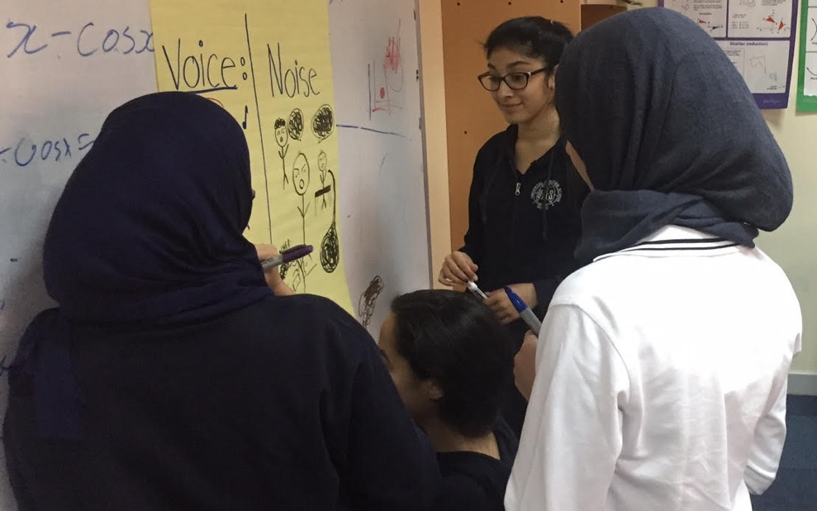
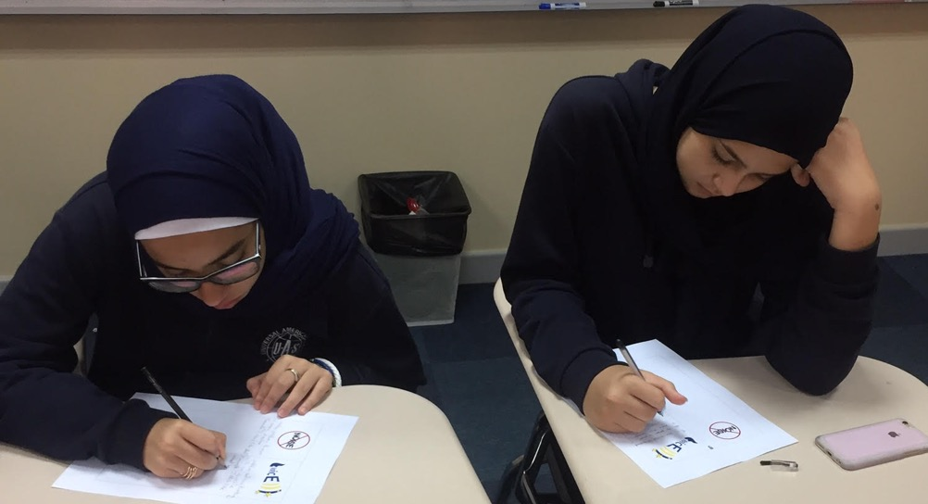
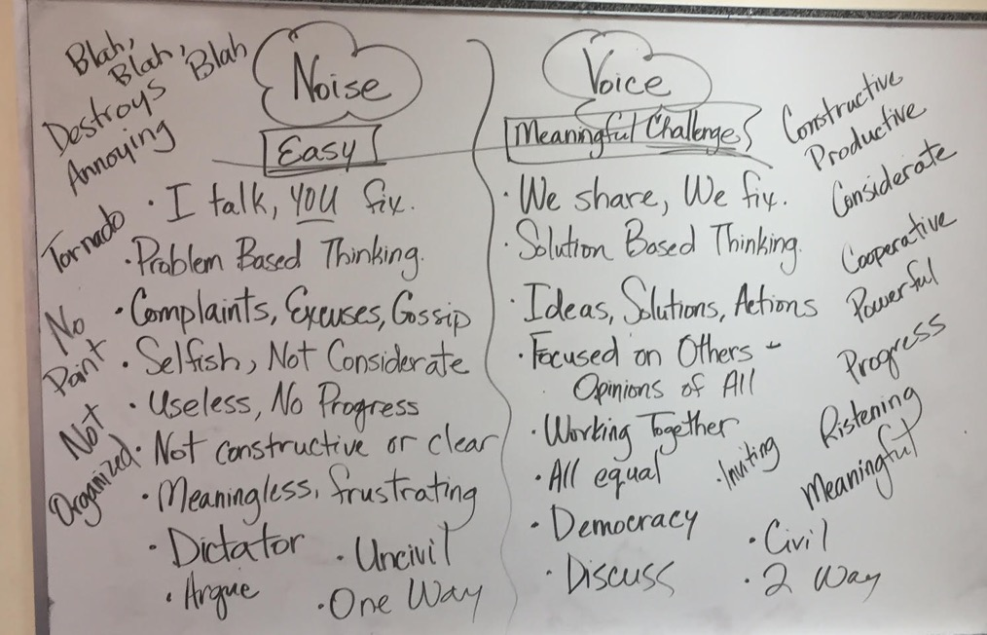
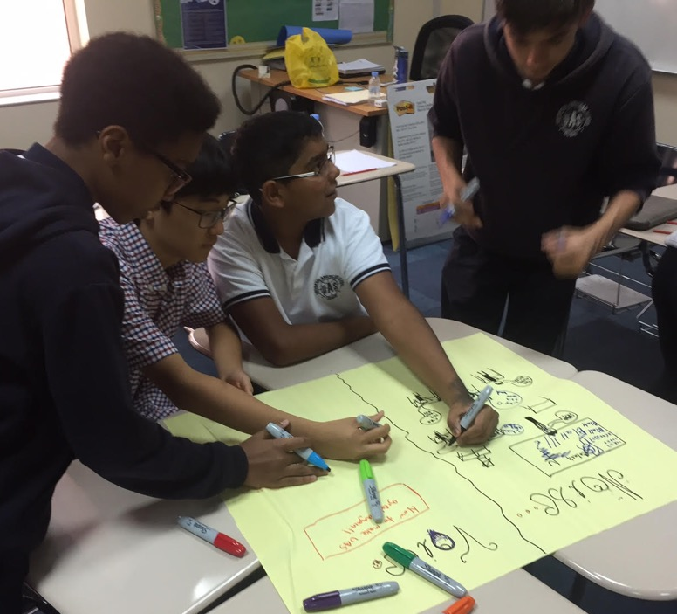
Student Voice in Action
Universal American School, Dubai, UAE

Slide 68
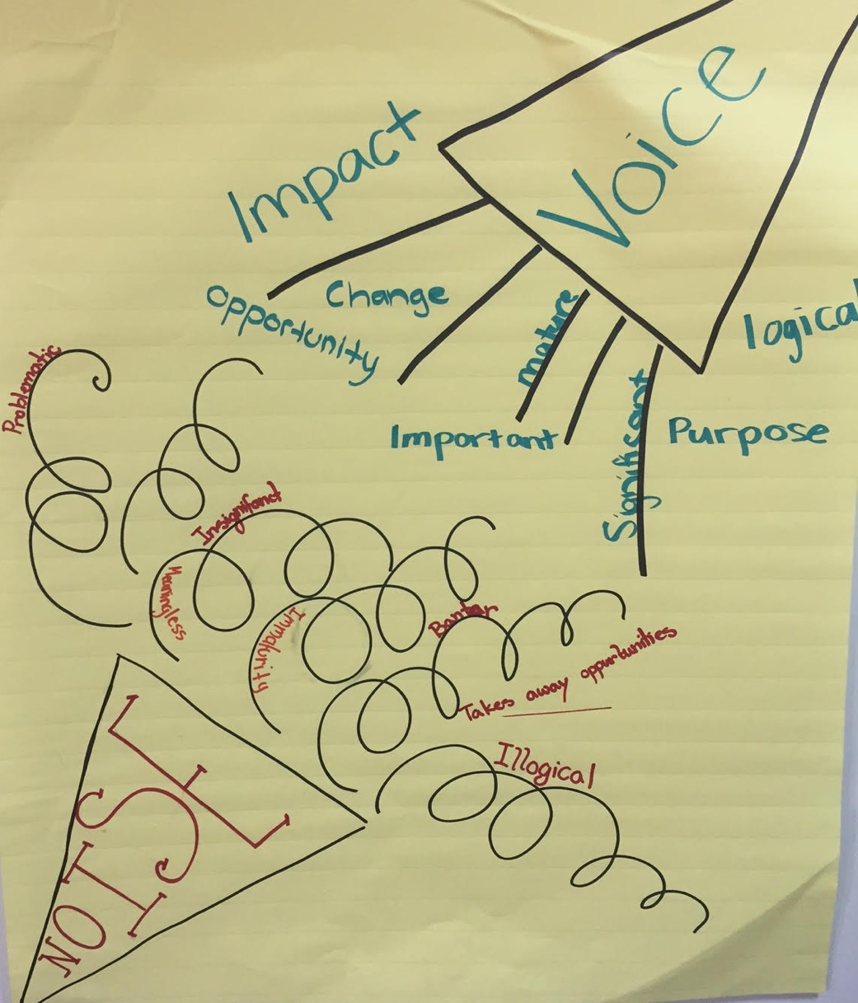
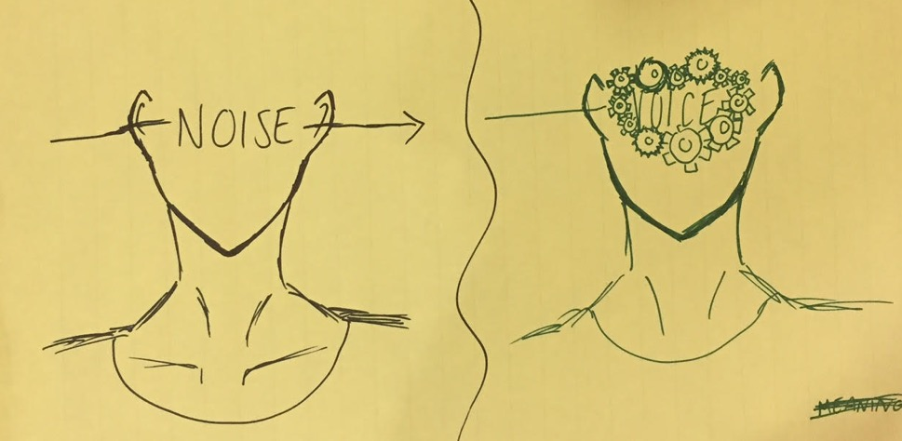
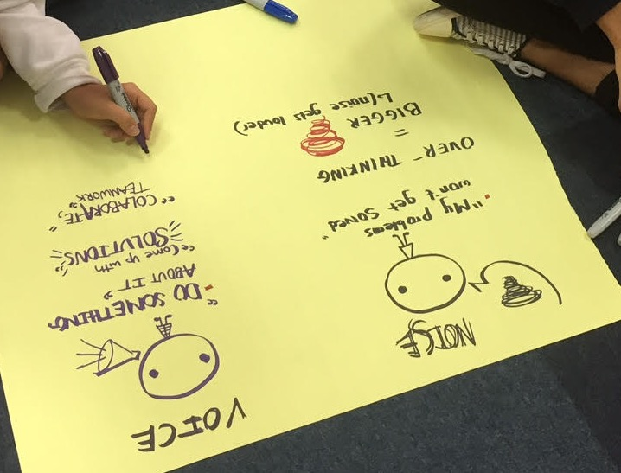
Student Voice in Action
Universal American School, Dubai, UAE

Slide 69
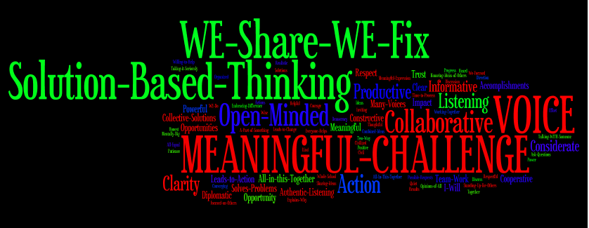
Student Voice in Action
Universal American School, Dubai, UAE

Slide 70
Student Voice in Action
Vimeo:
https://vimeo.com/1008816318/7a58ebf306
YouTube:
https://youtu.be/GLZdjHKUC6A
Video
Lawrence Middle School, Los Angeles, California, USA

Slide 71
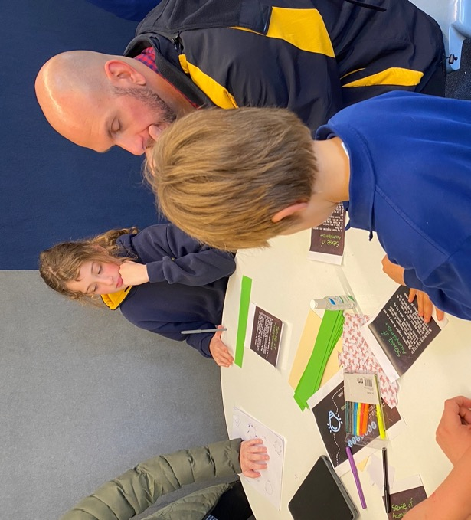
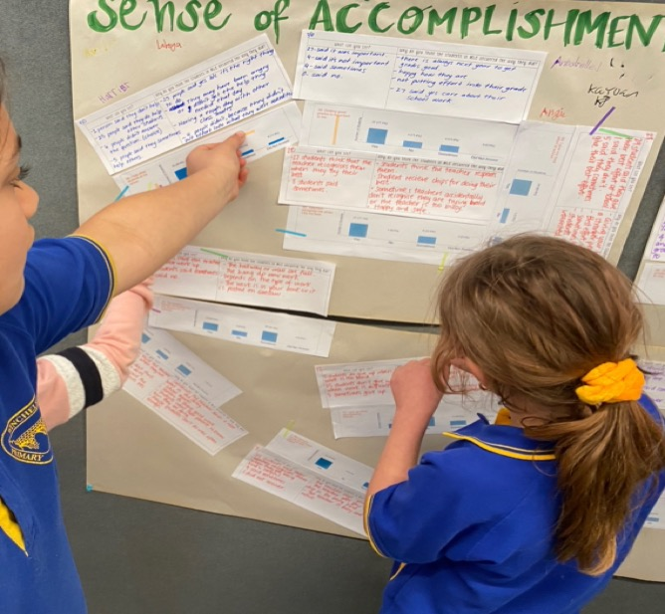
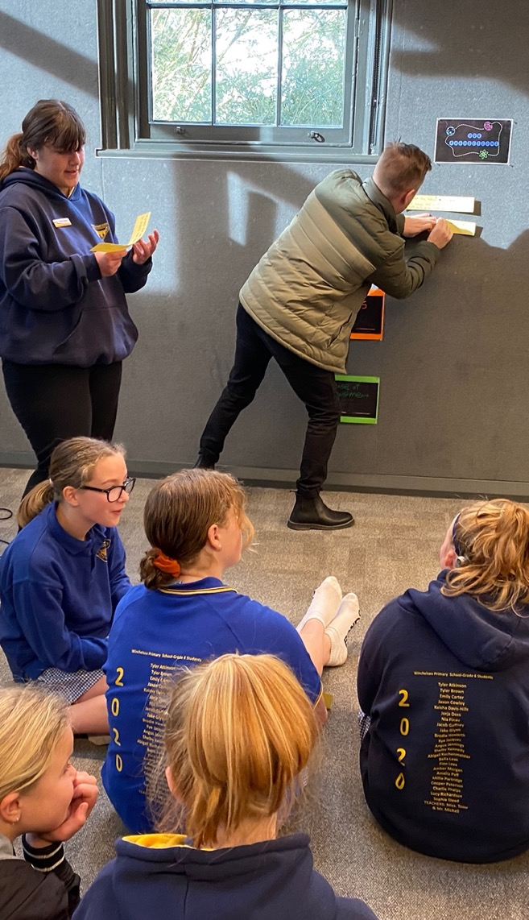
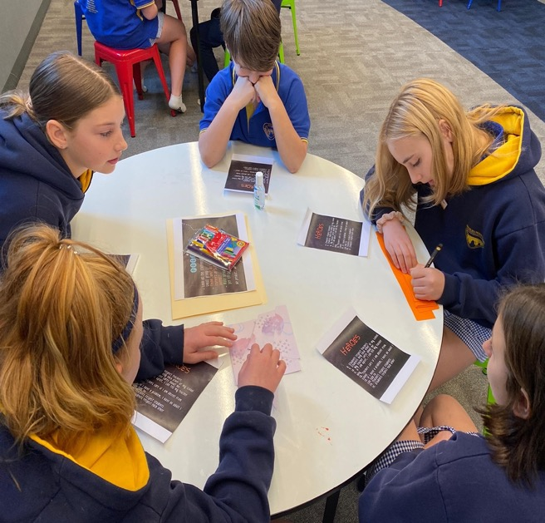

Student Voice in Action
Winchelsea Primary, Victoria, Australia

Slide 72

Student Voice in Action
Winchelsea Primary, Victoria, Australia

Slide 73


REFLECT
What skills do your students need for their voices to be heard?

Slide 74



Slide 75



Voice Instructional Strategies

Slide 76
Challenge Time…

Slide 77




Challenge Time
Pathways to Strengthen Voice

Slide 78


Teacher Peer Observation
Voice

Slide 79






Rolling Reflections
What is sticking with you from the Voice definition?
Which SV Pathways are you most interested in exploring?
What voice skills are you going to intentionally develop in students?
What key take away from this session will you share with a colleague?
What connections can you make to the Kansas State Board & Social Emotional Goals?
Wild Card! Share anything you want related to Student Voice!

Slide 80

Website Just For YOU!
https://quagliainstitute.org/power

Slide 81

What is your “Mic Drop” moment
of learning from today?

Slide 82

Mic Drop Moments
What is your mic drop moment of learning from this discussion on Student Voice?

Slide 83

Closing Thoughts
from Dr. Russ!

Slide 84
The Power of
Student Voice
Dr. Russ Quaglia & Dr. Lisa Lande
@QISVAtweets @Lisa_Lande
www.quagliainstitute.org
September 10, 2024

