Slide 1


The Power of Purpose
Dr. Russ Quaglia & Dr. Lisa Lande www.quagliainstitute.org
@QISVAtweets
September 11, 2024

Slide 2
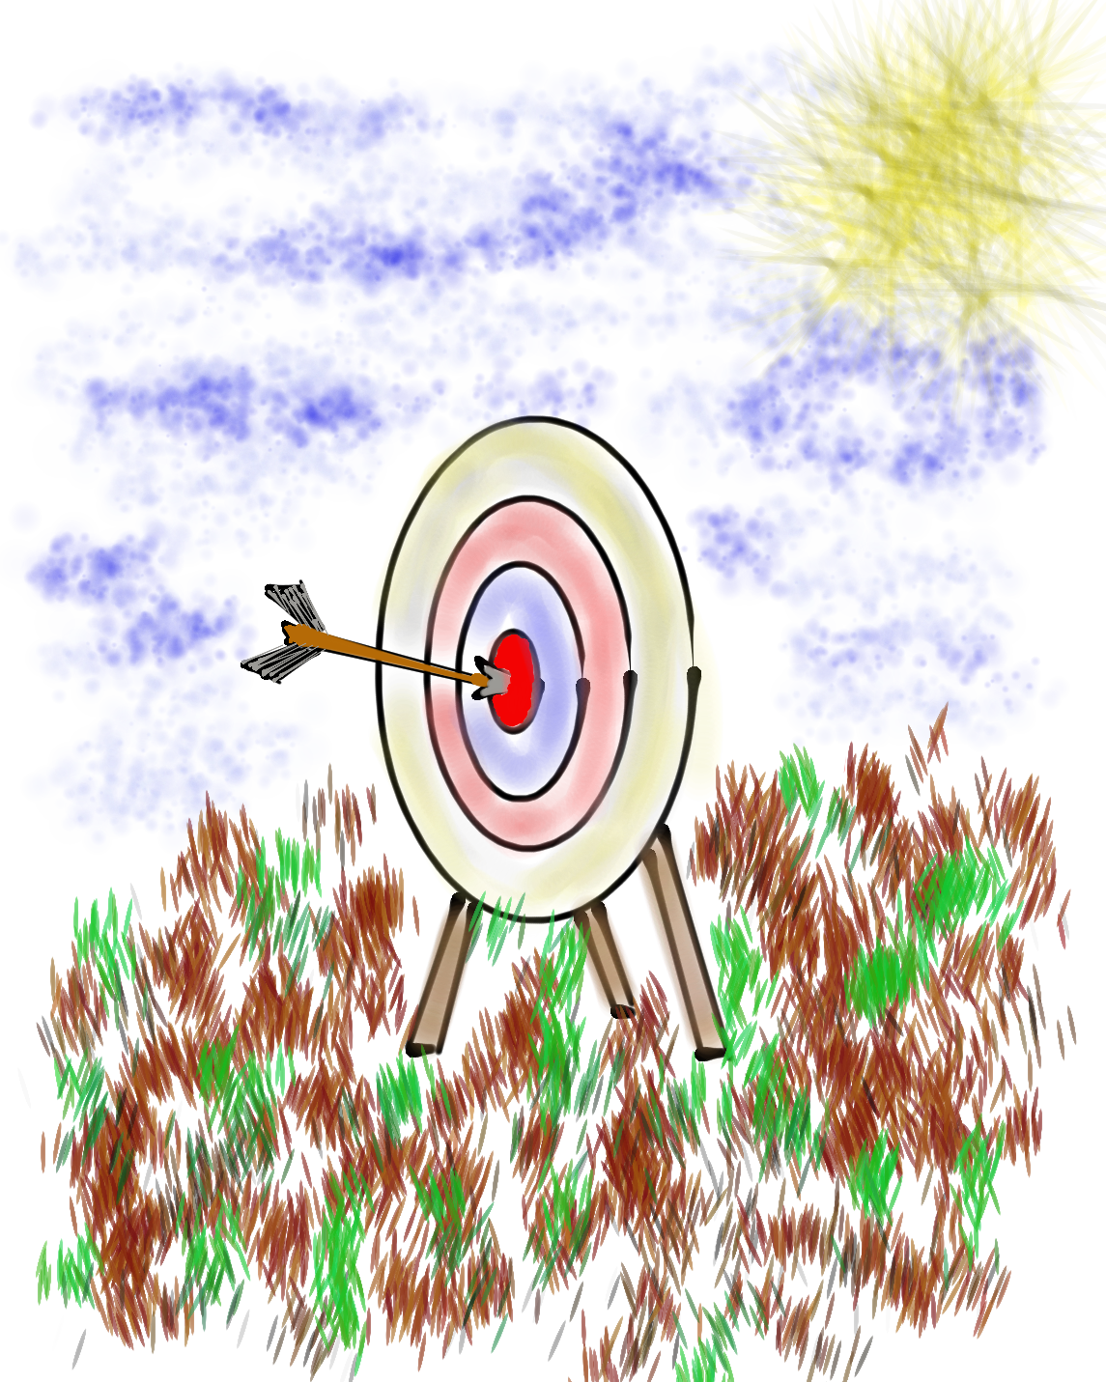
Learning Intention
We are learning about Purpose as a renewable energy source to fuel & guide educators.
Success Criteria
Consider how Purpose is the driving force that gives
meaning to educators’ actions.
Reflect on your fundamental Values, Passions, Aspirations, & Skills to help define & drive your Purpose.
Leverage your Purpose as energy to guide your career,
shape decisions, & motivate you towards personal
fulfilment & contributions to the greater good.
Today will be a home run for me if…

Slide 3







Slide 4


Slide 5
Purpose: The Renewable Energy in Education

Slide 6
Purpose Matters
Directs Energy Toward Meaningful Goals
Fosters Social Connection & Contribution
Promotes Productivity & Achievement
Helps Navigate Uncertainty & Change
Enhances Personal Well-Being

Slide 7
Four Key Elements
to Purpose
Values
Passions
Aspirations
Skills

Slide 8
Values

Slide 9
Values
The moral compass guiding our
choices & actions.
Guides Decisions
Shapes Goals
Influences Behavior

Slide 10
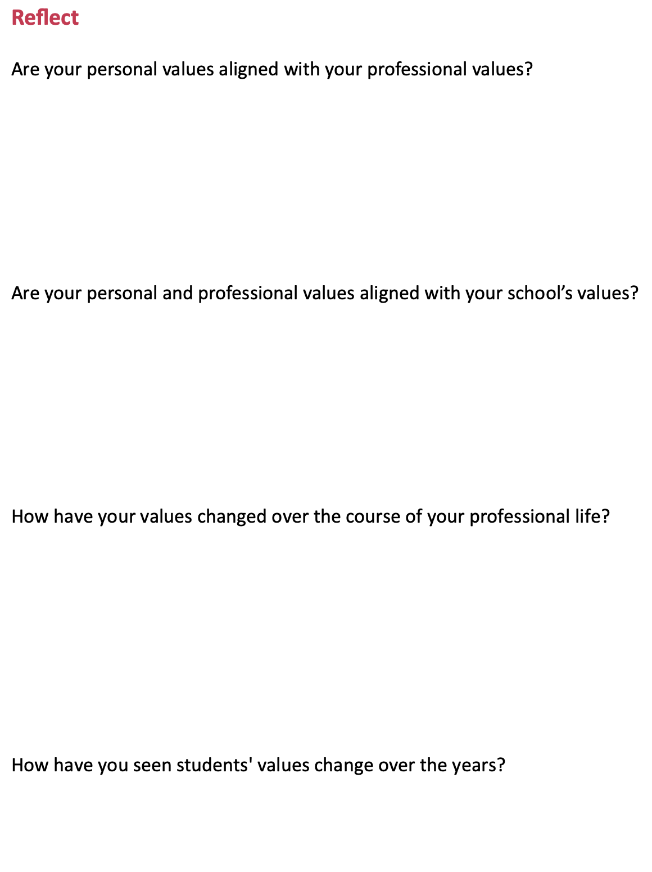
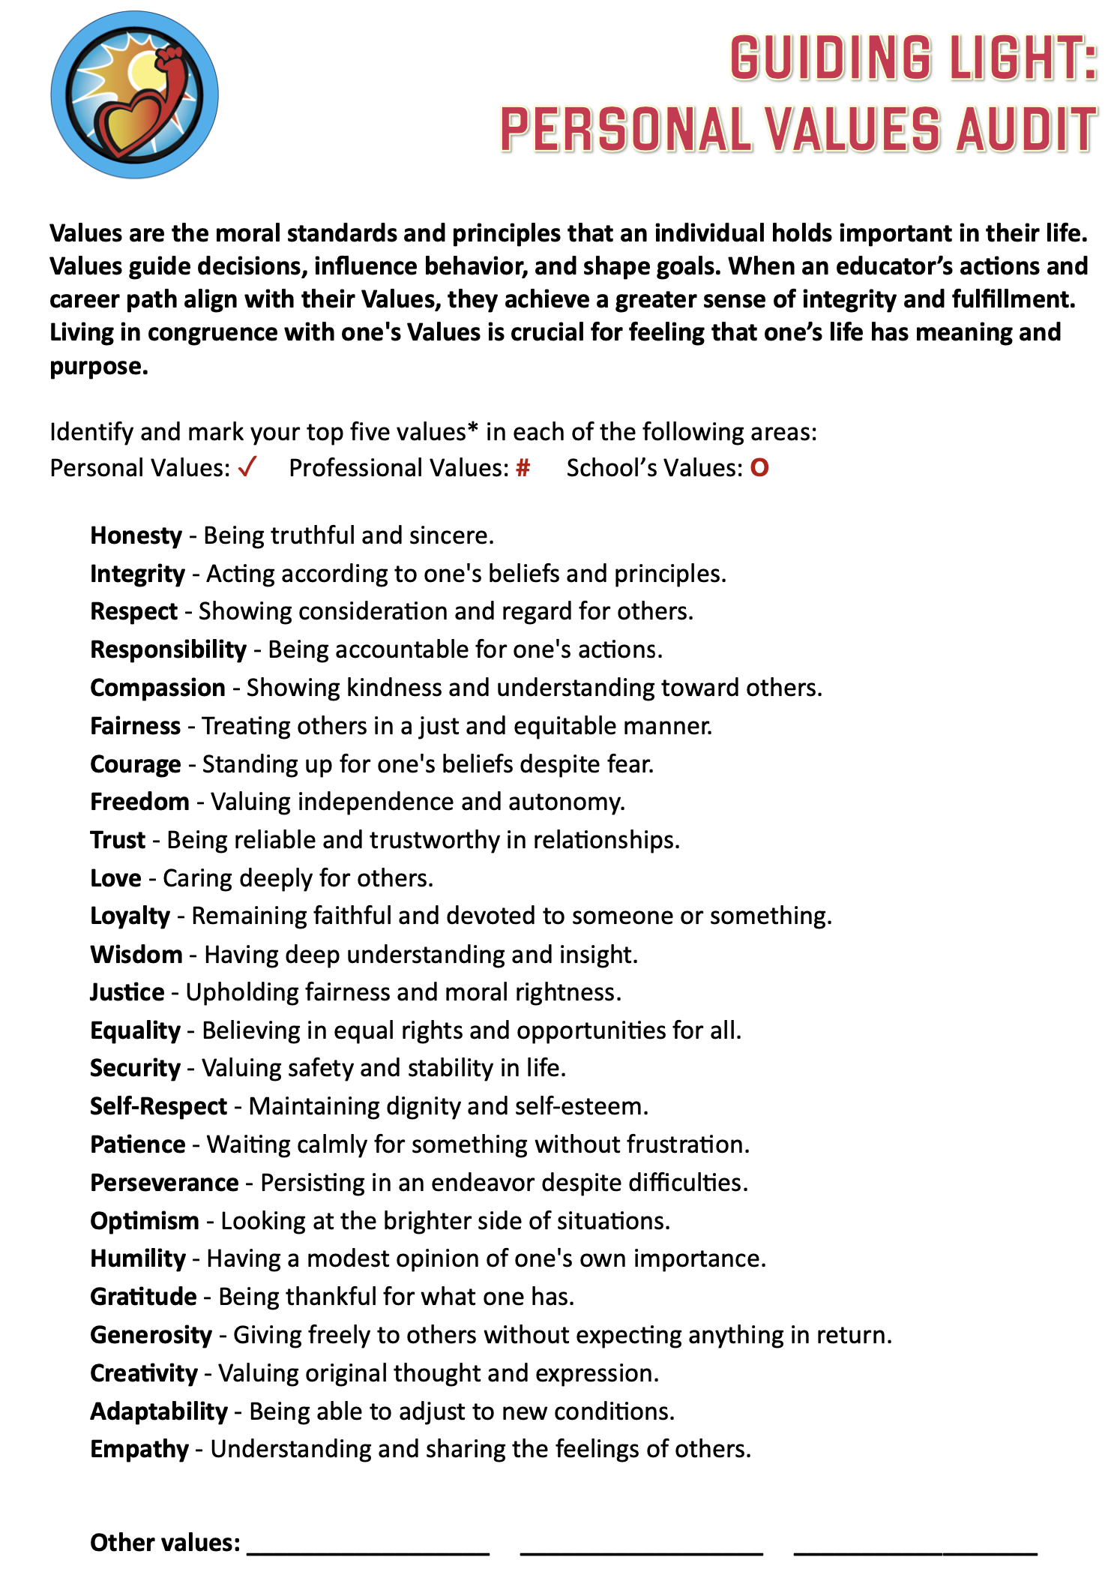

Guiding Light:
Personal Values Audit
Part 1:
Complete the
Values Audit.
Part 2:
Discuss the
reflection
questions with
a meet with
your feet partner.

Slide 11
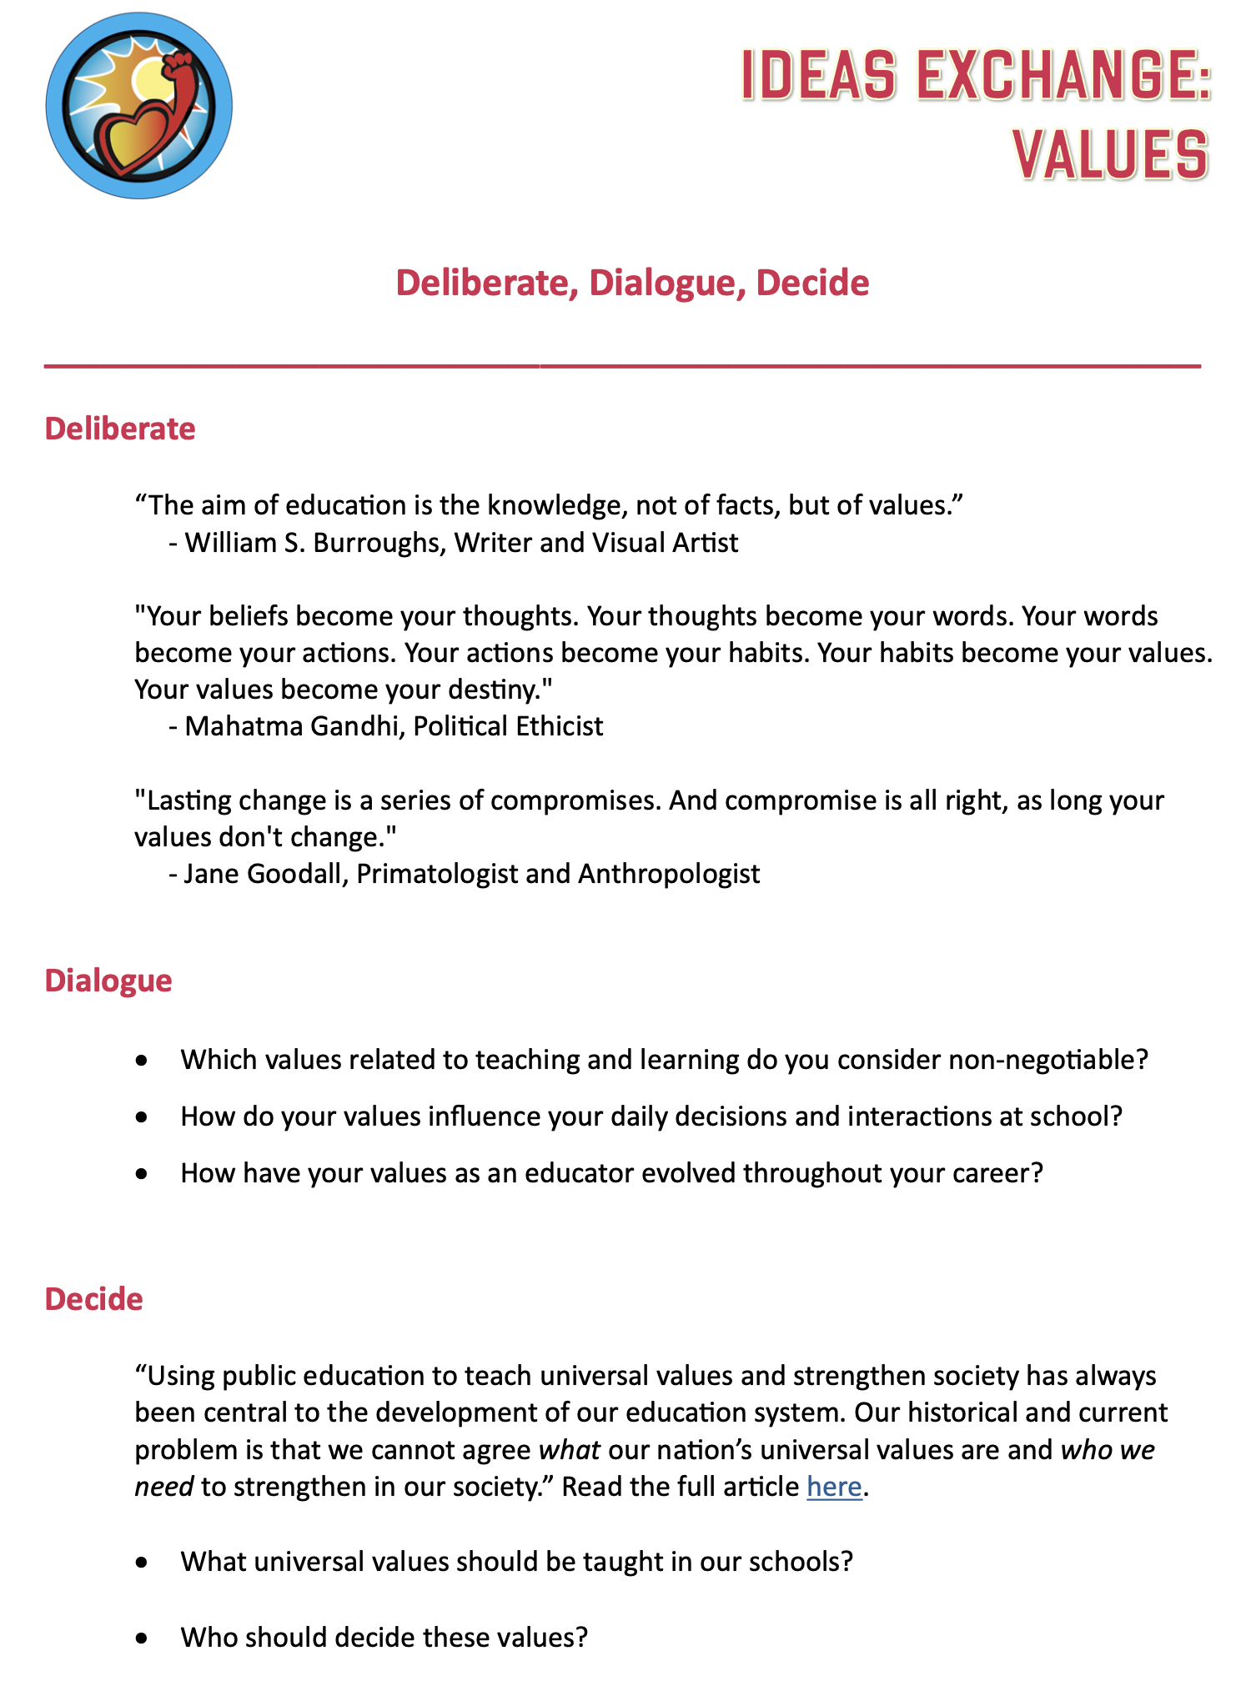
Ideas Exchange:
Values
Part 1:
Deliberate with
one partner.
Part 2:
Dialogue in groups of 4.
Part 3:
Decide is an opportunity
to extend your learning
& continue your
reflection post-session.

Slide 12
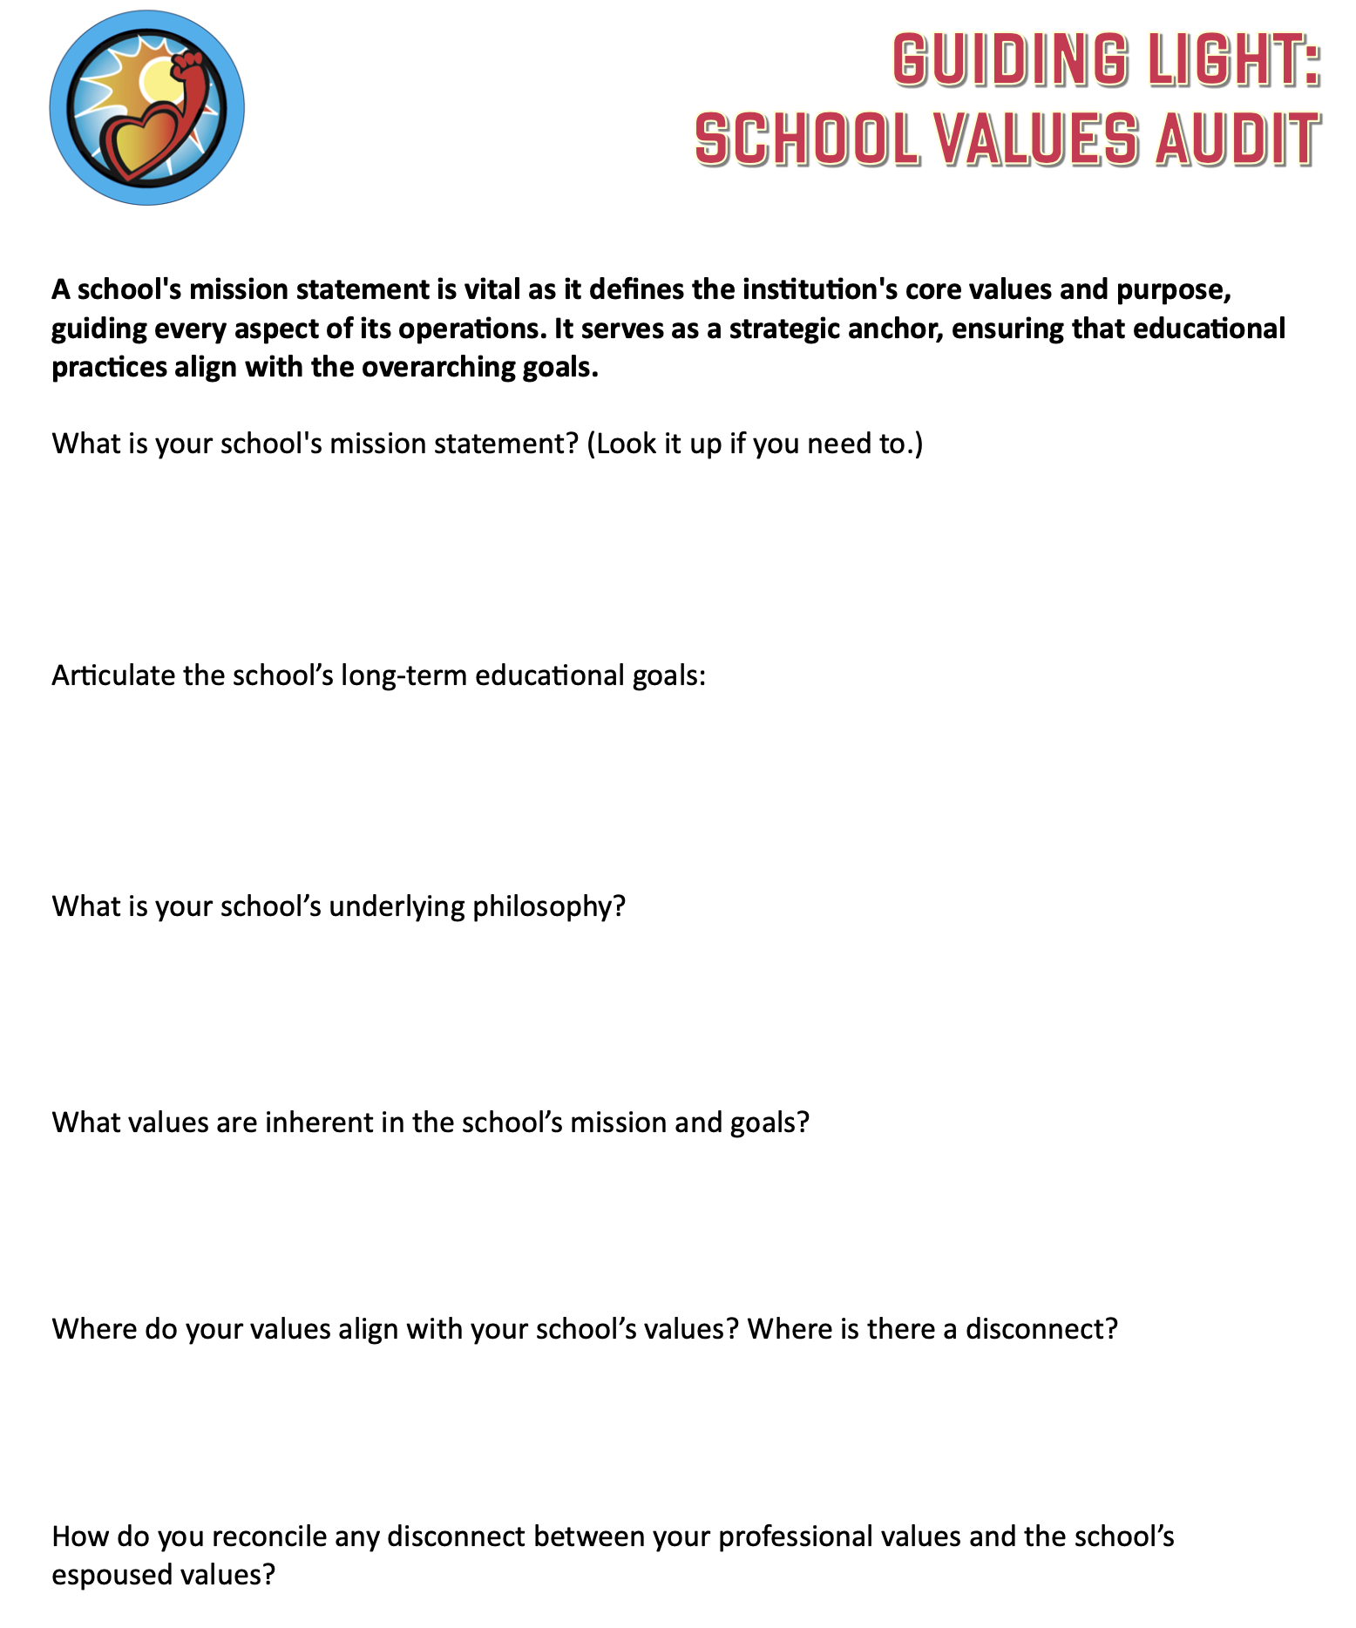
Guiding Light:
School Values Audit
Take Away
Work through the
School Audit with
the Leadership Team at your School.

Slide 13
Passions

Slide 14
Passions
The driving forces that ignite our
enthusiasm & dedication.
Fuels Motivation & Persistence
Inspires Others
Drives Innovation & Creativity

Slide 15

Reflect
What are you currently most
Passionate about?
Notes:
United in order to progress.

Slide 16
Aspirations

Slide 17
Aspirations
The art of dreaming & doing.
Provides Direction
Energizes Personal Growth & Development
Strengthens Self-Worth

Slide 18
Reflect
What is one key point of
learning you are taking from
this discussion on Aspirations?
Notes:
United in order to progress.

Slide 19
Skills

Slide 20
Skills
The tools & abilities to effectively
perform tasks.
Enables Adaptability
Raises Performance Levels
Increases Confidence

Slide 21
Reflect
What is your most valuable Skill
that helps you live your Purpose?
Notes:
United in order to progress.

Slide 22
Four Key Elements
to Purpose
Values
Passions
Aspirations
Skills

Slide 23
Four Key Elements
to Purpose
Values

Slide 24
Four Key Elements
to Purpose
Passions
Aspirations
Skills

Slide 25
Four Key Elements
to Purpose
Values
Passions
Aspirations
Skills

Slide 26
Four Key Elements
to Purpose
Passions

Slide 27
Four Key Elements
to Purpose
Values
Aspirations
Skills

Slide 28
Four Key Elements
to Purpose
Values
Passions
Aspirations
Skills

Slide 29
Four Key Elements
to Purpose
Aspirations

Slide 30
Four Key Elements
to Purpose
Values
Passions
Skills

Slide 31
Four Key Elements
to Purpose
Values
Passions
Aspirations
Skills

Slide 32
Four Key Elements
to Purpose
Skills

Slide 33
Four Key Elements
to Purpose
Values
Passions
Aspirations

Slide 34
Four Key Elements
to Purpose
Values
Passions
Aspirations
Skills

Slide 35
Reflect
What is your Key Take Away
from this session?
What is one Next Step Action you are going to take as a result of your learning today?
Notes:
United in order to progress.

Slide 36
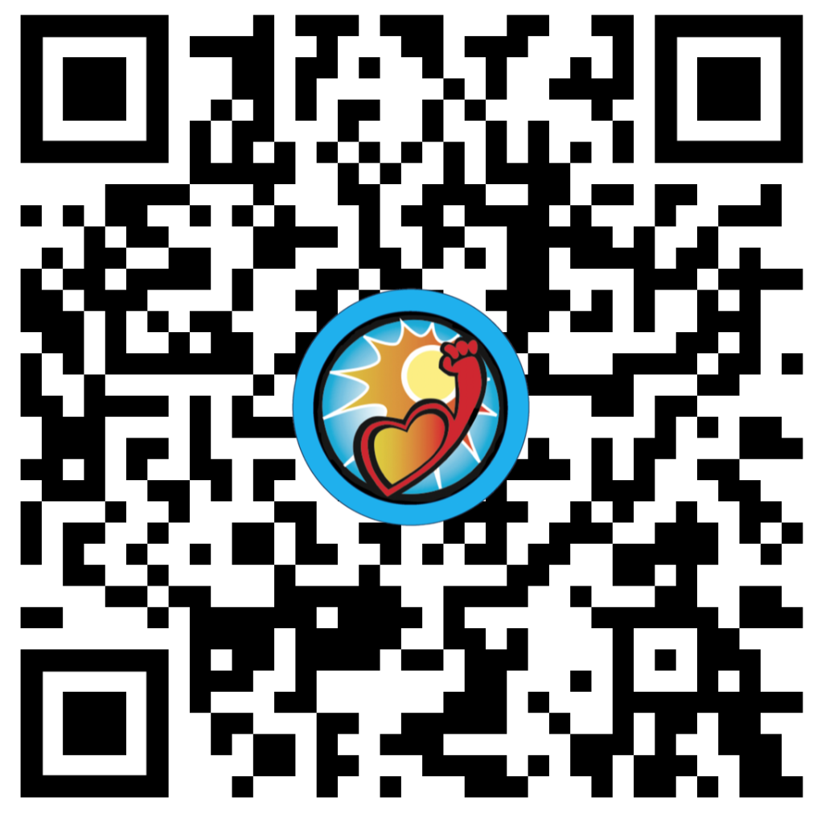
Website Just For YOU!
https://quagliainstitute.org/purpose

Slide 37
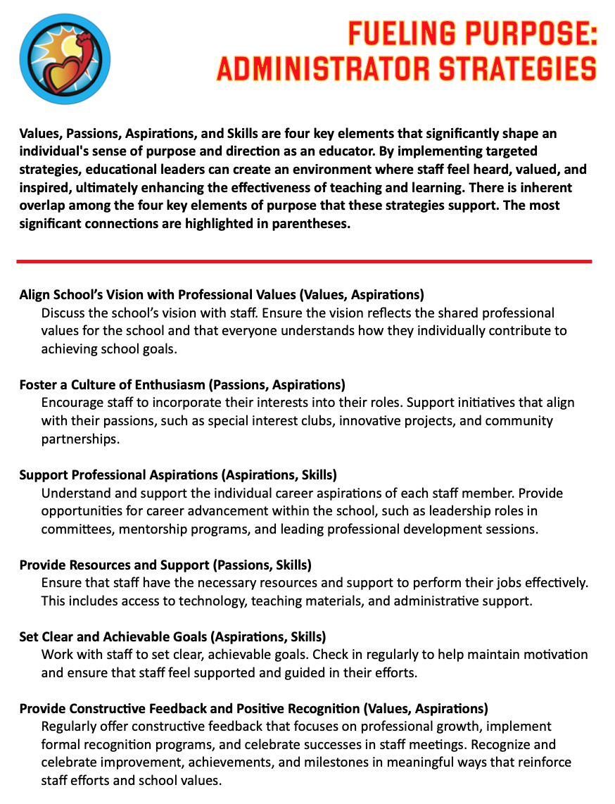
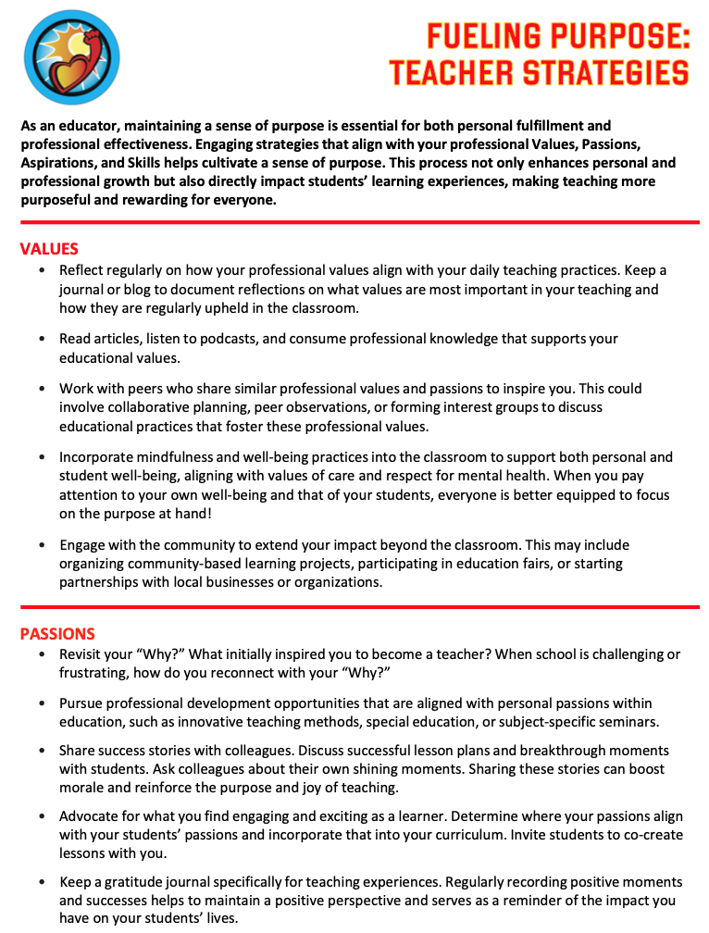
Fueling Purpose
Administrator
Strategies
Teacher
Strategies

Slide 38
Thank you for learning with us!
Reach out to us with any questions or to continue the conversation!
Dr. Russ Quaglia
Quaglia@QuagliaInstitute.org
Dr. Lisa Lande
Lande@QuagliaInstitute.org
www.quagliainstitute.org
@QISVAtweets

