Slide 1
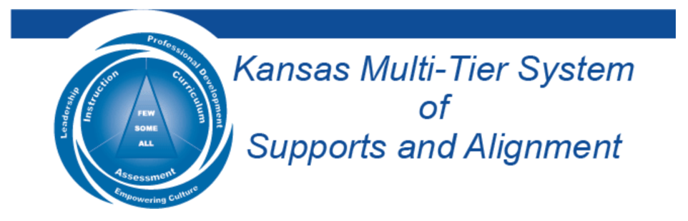

Celebrating the Power of Voice by Developing Greater Purpose & Partnerships
April 27, 2023
Dr. Russ Quaglia & Dr. Lisa Lande
@QISVAtweets @Lisa_Lande
quagliainstitute.org

Slide 2

Learning Intention
We are learning to celebrate the
power of voice by developing greater partnerships & purpose.
Success Criteria
Consider how partnerships & purpose can be
leveraged to amplify Student Voice & Aspirations.
Reflect on current practices that create
opportunities for meaningful partnerships with
students & families.
Apply learning to your school.
  This session will be a ”touchdown” for me if…

Slide 3

Quick Review

Slide 4
Fundamental Beliefs
Students are the potential, not the problem.
Students have something to teach us.
Working together is the only way forward.

Slide 5

What do you remember about the 3 Components of Student Voice
??
??
??

Slide 6
The 3 Components of Student Voice
Sharing thoughts & ideas in an environment underpinned by trust & respect.
Offering realistic suggestions for the
good of the whole.
Accepting responsibility for not only what is said but also what needs to be done.

Slide 7
ASPIRATIONS
The ability to
dream & set goals
for the future,
while being inspired
in the present
to reach those dreams.

Slide 8




high
Imagination
Aspirations
DREAMING
Hibernation
Perspiration
low
DOING
high

Slide 9
LEAD
TAKE ACTION
with others
Share
RESPONSIBILITY
LEARN
UNDERSTAND
& RESPECT
different points
of view
Build
TRUST
LISTEN
SEEK OUT
opinions from
others
Student Voice Process

Slide 10








8 Conditions
Self-Worth
Engagement
Purpose

Slide 11






Roll the Dice, Break the Ice!
Name, One Fun Fact, & Roll the Dice!
From everything we have learned so far, what has most stuck with you?
What is one thing you have learned this year from a student?
What is something you have thought about differently as a result of this learning?
What are you most proud of from your Student Voice work this year?
What is one action you have taken as a result of this learning?
Wild Card! Share anything you want related to Student Voice!

Slide 12

Time to journey
onward & explore Purpose & Partnerships!

Slide 13


Purpose 101
with Dr. Russ

Slide 14

Purpose 101

Slide 15

Purpose
“Purpose endows a person
with joy in good times &
resilience in hard times.”
Professor William Damon
(Stanford University 1990)

Slide 16

Purpose
Your life purpose consists of the
central motivating aims of your
life—the reasons you get up in the morning. Purpose can:
Guide life decisions
Influence behavior
Shape goals
Offer a sense of direction
Create meaning

Slide 17

Purpose
Is there a discrepancy
between the expectations
you put on yourself &
what really makes
you happy?

Slide 18
Purpose
Purpose is not fixed. It
can & should change as
you grow & develop.

Slide 19
Purpose
Purpose is driven by
the combination of
passion & action.

Slide 20
Purpose
Purpose is not how
well you write it…but how well you live it!

Slide 21


Reflecting on
Your Purpose?
Settle in…
Give yourself permission to reflect with an open mind & open heart…
Free write whatever comes to mind for the provided prompts…

Slide 22

Purpose
Pinwheel Discussions
Get into pinwheel groups of 6.
With your partner, discuss
reflection questions 1-2.
When the wind blows, the outside of the
pinwheel moves one person clockwise.
Discuss reflection questions 3-4.
When the wind blows, the outside of the
pinwheel moves one person clockwise.
Discuss reflection questions 5-6.

Slide 23

Brain Pops Related to Purpose

Slide 24

To fully realize our Purpose, we need
Partners!

Slide 25

Challenge Time…
We need 6-8 excited volunteers to come up front!
Warm Up: Establish a passing order with 1 ball.

Slide 26


Goal: As a team,
pass 3 balls through
your established order as quickly as you can.
Rules: Maintain the
same passing order &
everyone must touch
all 3 balls.

Slide 27

Challenge
Partnership Art
As a table group, create a play-doh masterpiece that reflects your vision for effective partnerships.

Slide 28

Gallery Walk
Take a wander around the room & check out the Partnership Masterpieces created by the group.

Slide 29

Check Up From the Neck Up
What have you learned so far today?

Slide 30

Lunch!

Slide 31

Key Components of
Healthy Partnerships
Defined Rationale
Trust
Mutually Beneficial
Clear & Consistent Communication
Planned Self-Assessment/Evaluation

Slide 32
Partnerships
With Students

Slide 33
Challenge Time…

Slide 34

A-Z Relay Challenge
List benefits & challenges of partnerships with students starting with each letter of the alphabet.
Once a letter is covered, move on to the next letter. You may not skip letters!
Share 1 benefit & 1 challenge from your list.

Slide 35

Students as Partners
Action Examples

Slide 36
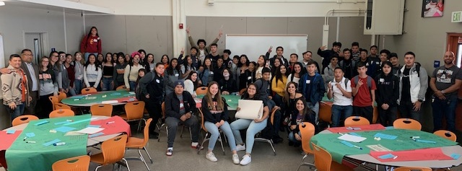
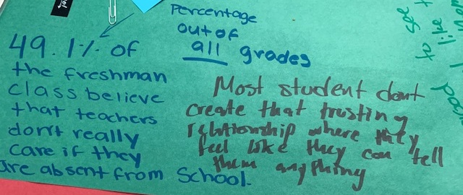
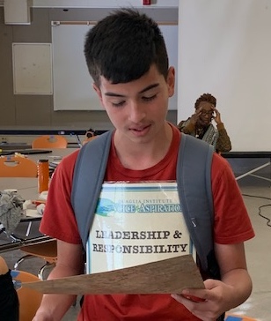
Data Analysis
Huntington Park High School
Los Angeles, California

Slide 37
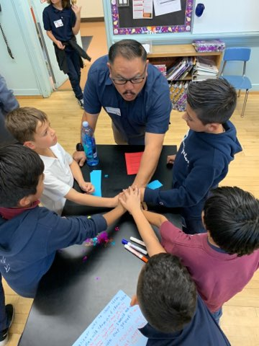
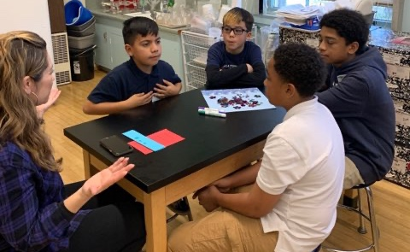
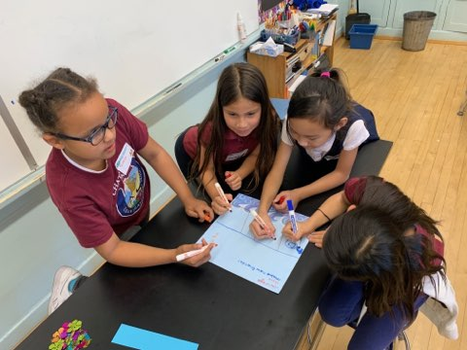
Chatsworth Park Elementary
Los Angeles, California

Slide 38
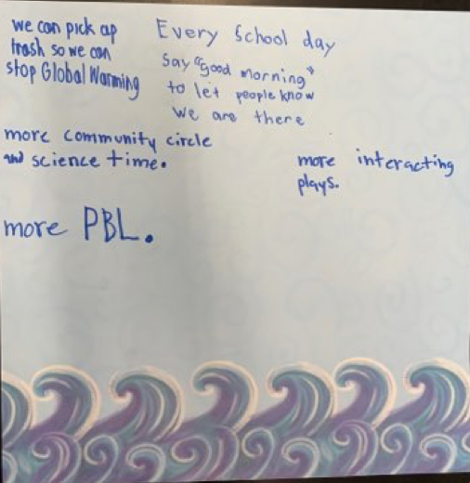
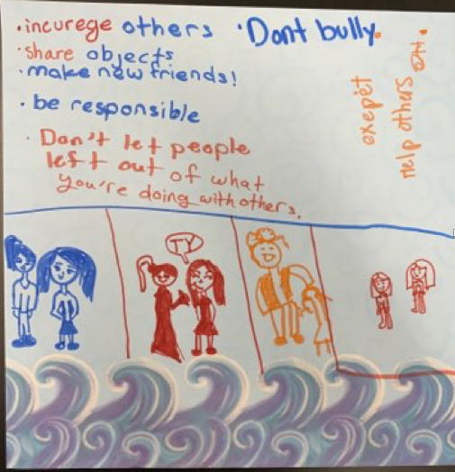
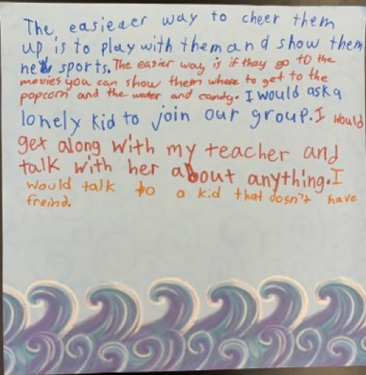
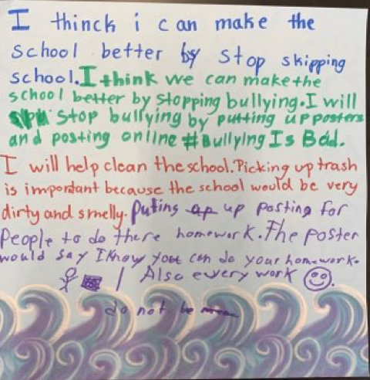
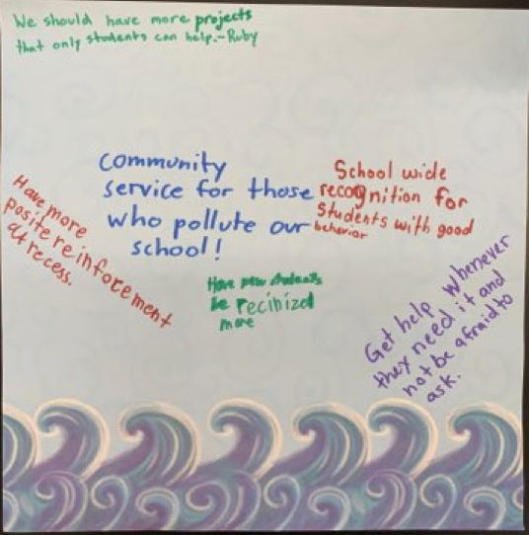

Slide 39
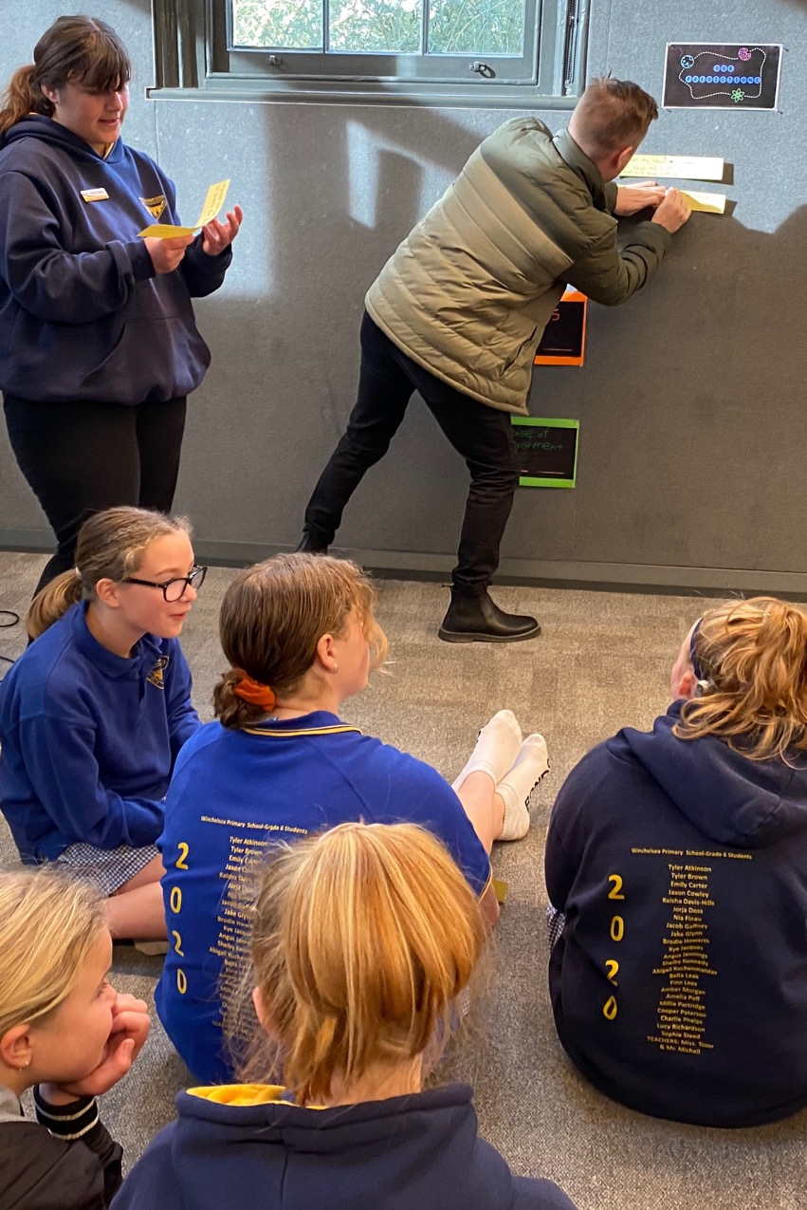
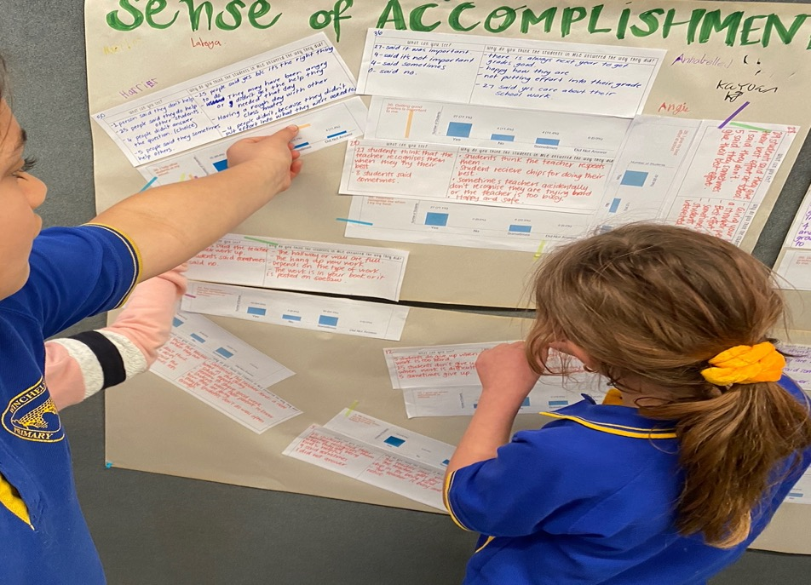
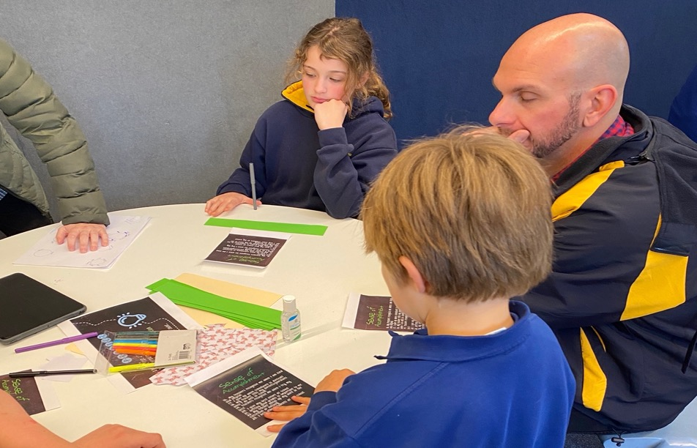
Improvement Planning
Winchelsea Primary, Victoria, Australia

Slide 40
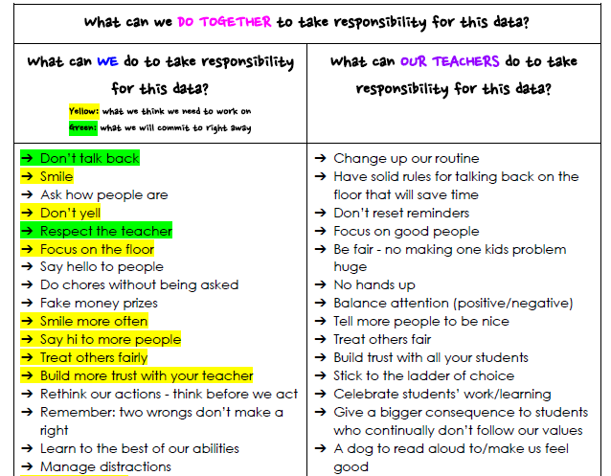
Winchelsea Primary, Victoria, Australia

Slide 41
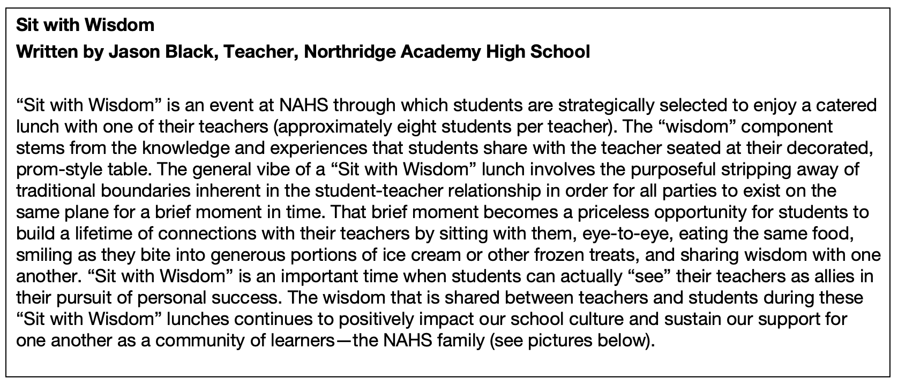
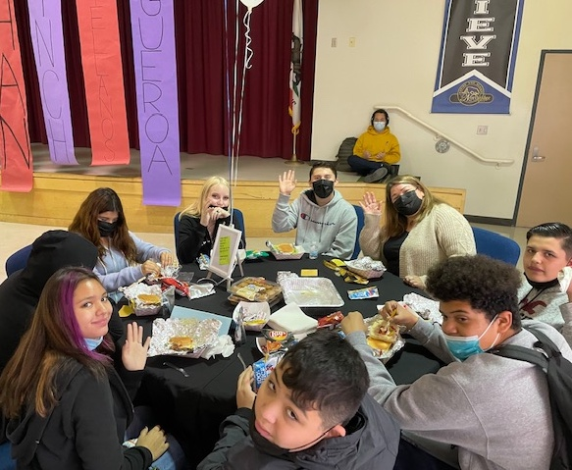
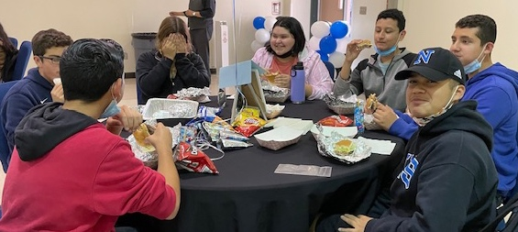
Students as Consultants
Northridge Academy High School, Los Angeles, California

Slide 42
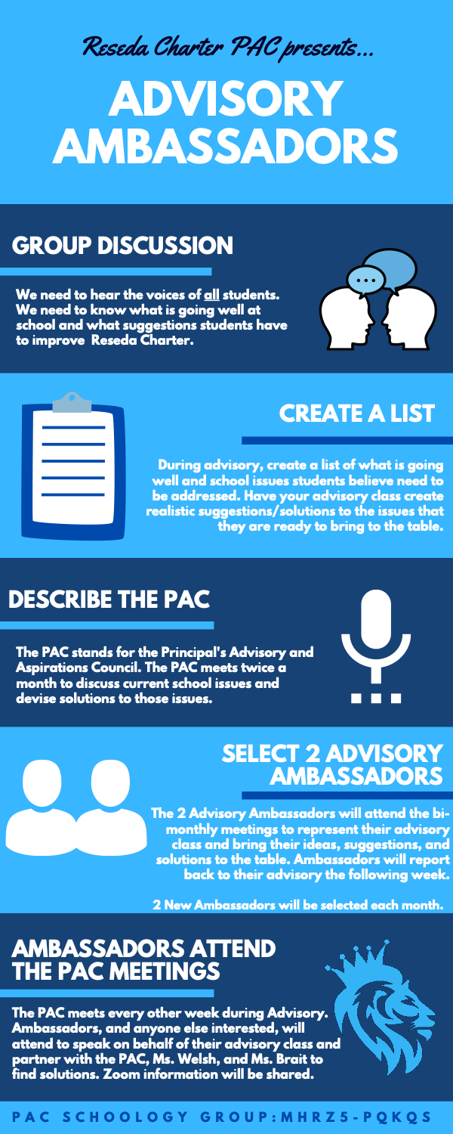
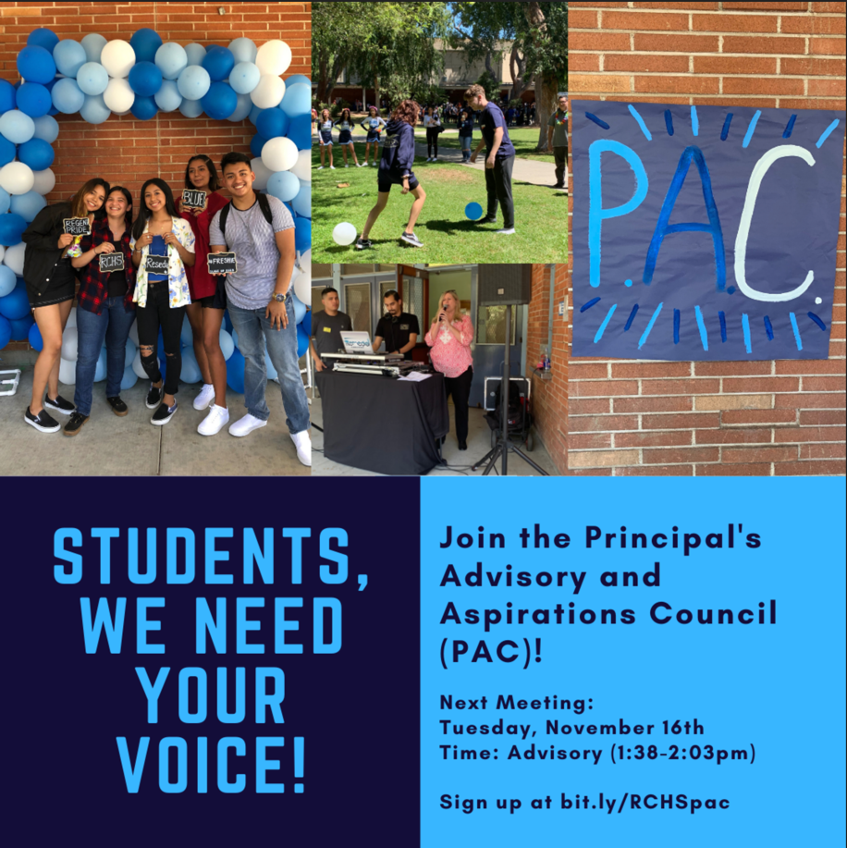
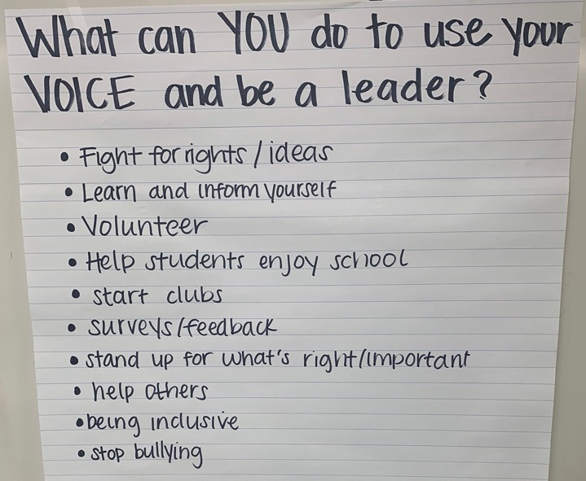
Reseda Charter,
Los Angeles, California

Slide 43
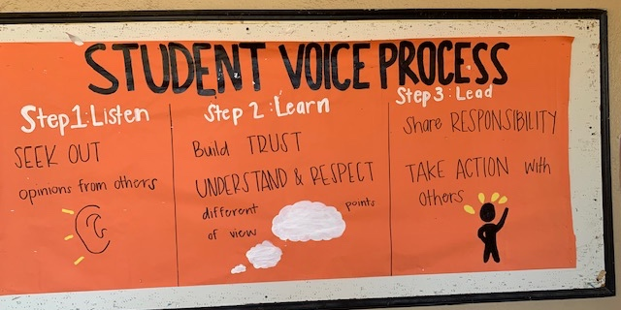
Campus Visuals
Baldwin High School, Maui, Hawaii

Slide 44
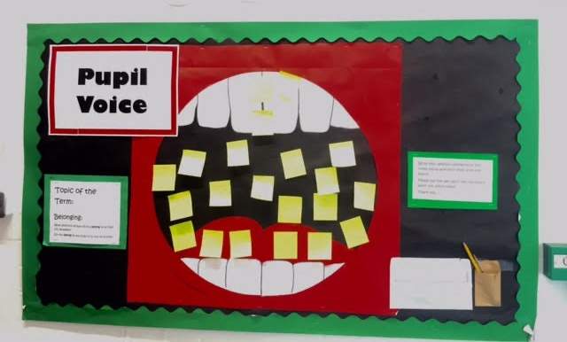
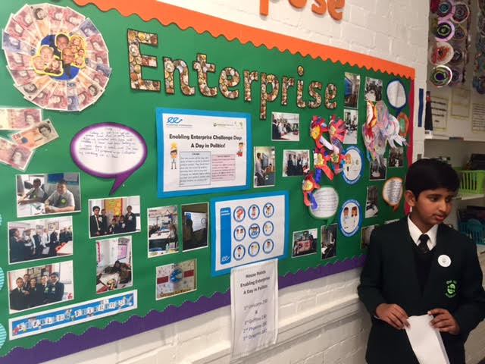
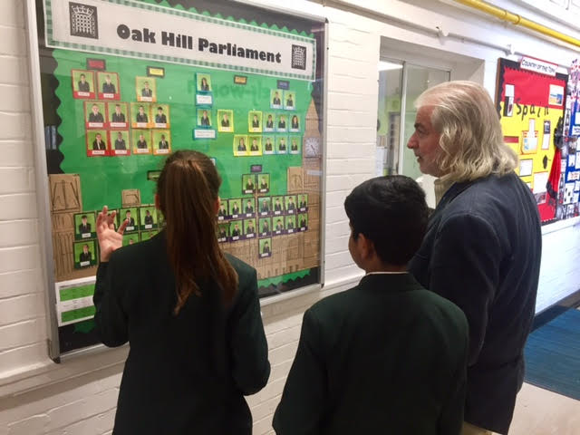
Oak Hills Primary School, Aspirations Academy Trust, Feltham, England

Slide 45
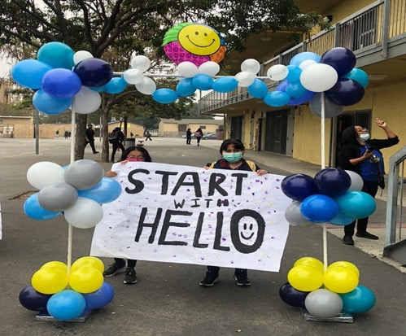

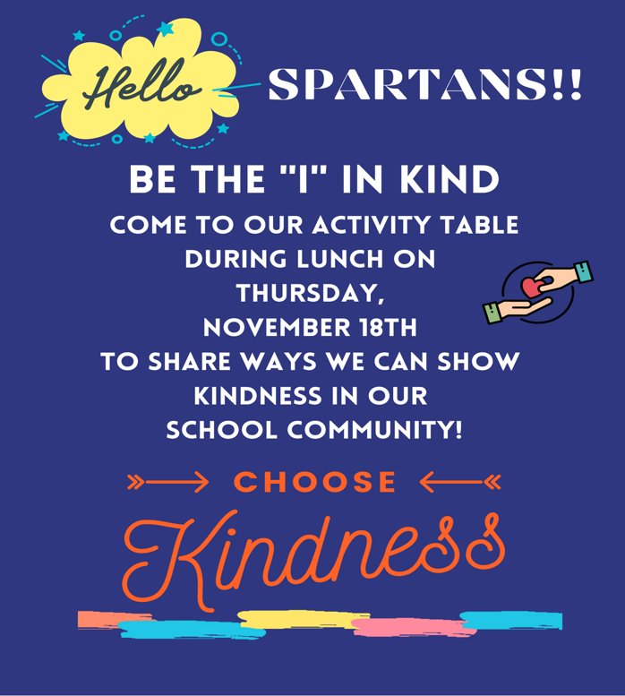
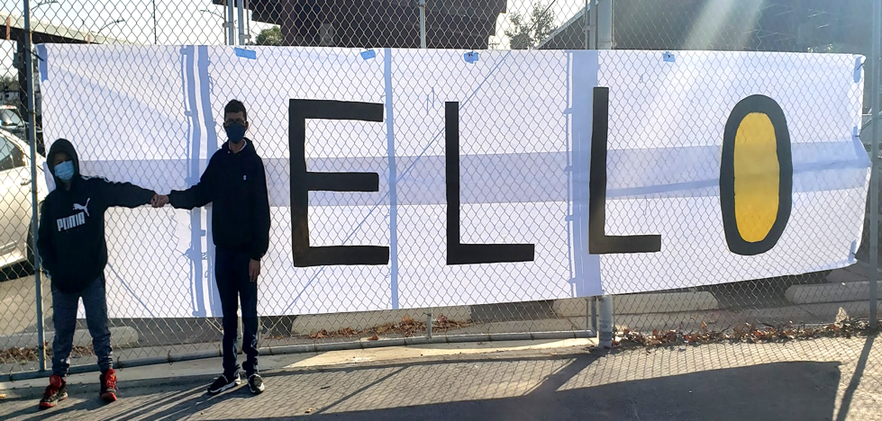
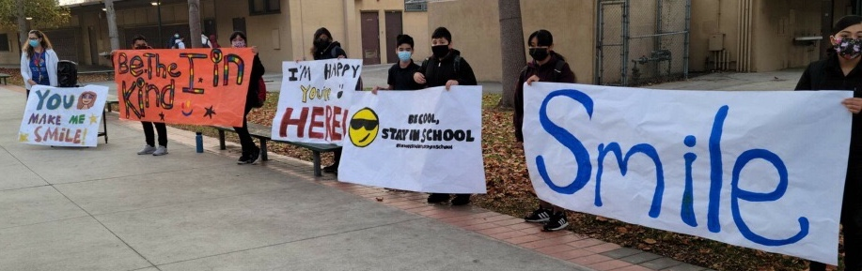
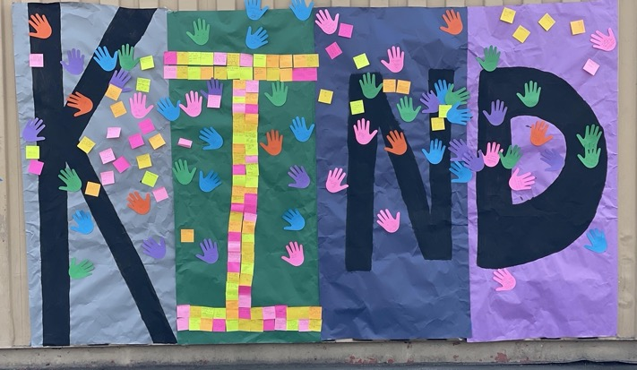
Cultivating Belonging
Gage Middle School, Los Angeles, California

Slide 46
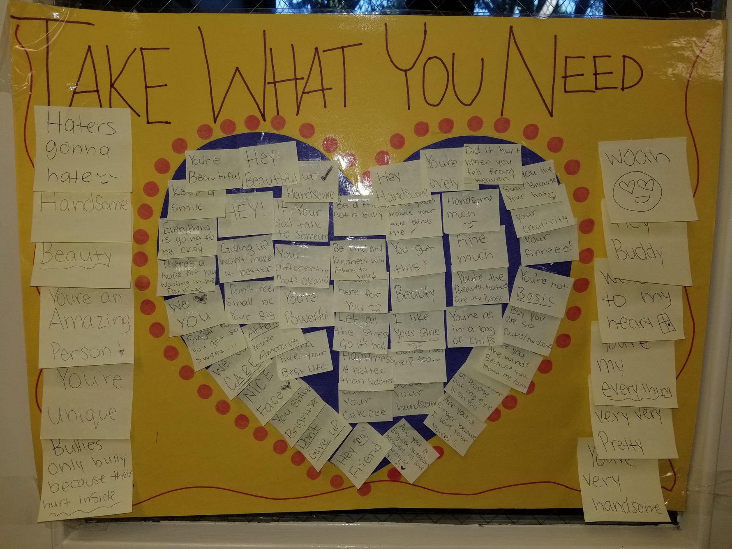
Edison Middle School, Los Angeles, California

Slide 47

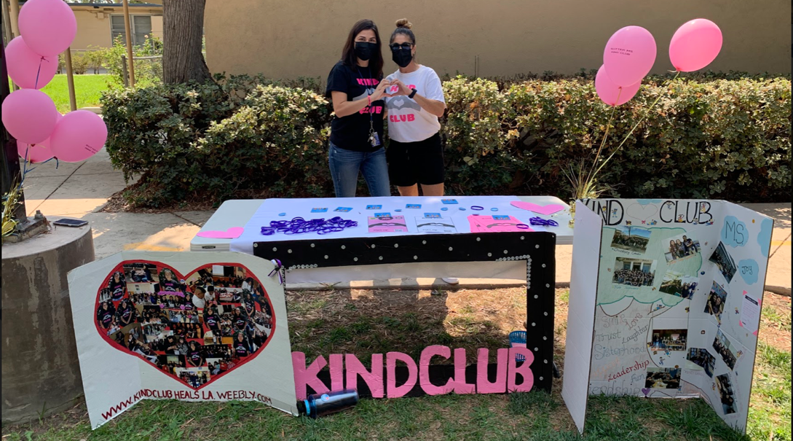
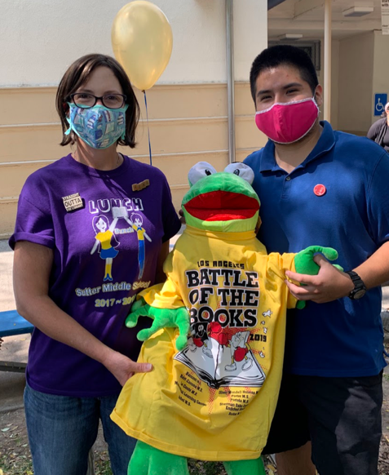
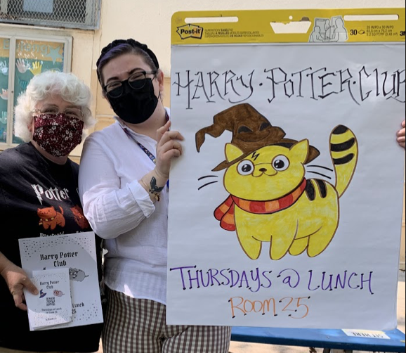
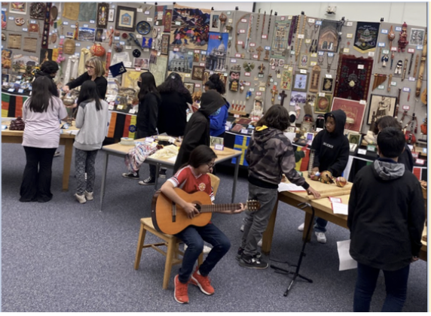
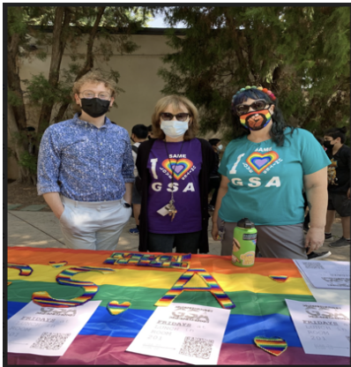
Student Clubs
Sutter Middle School, Los Angeles, California

Slide 48
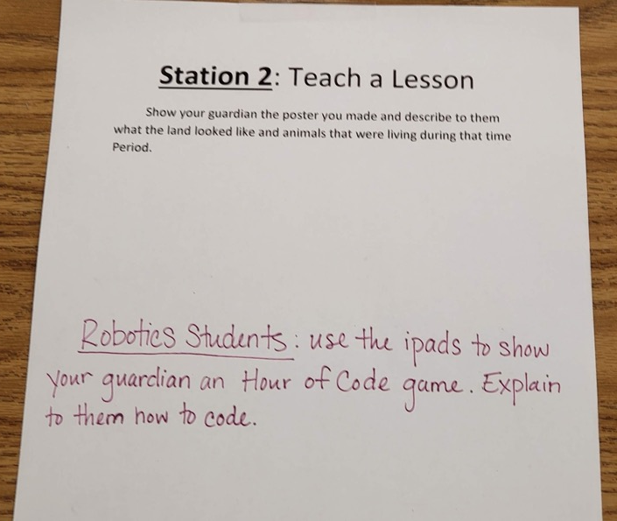
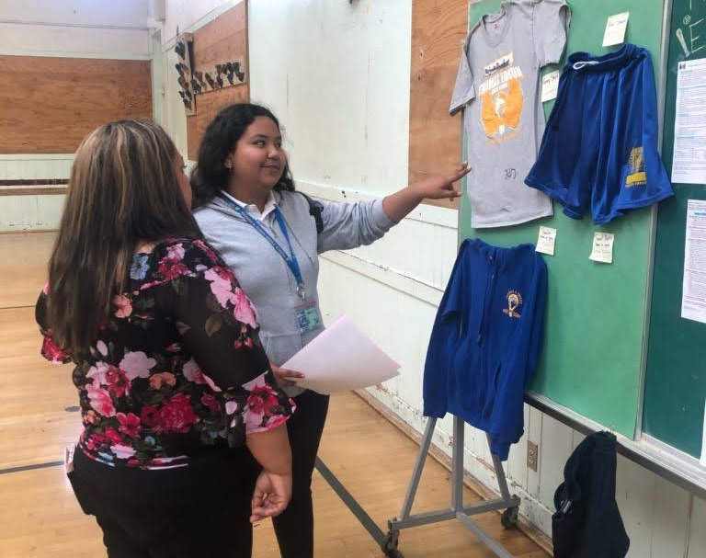
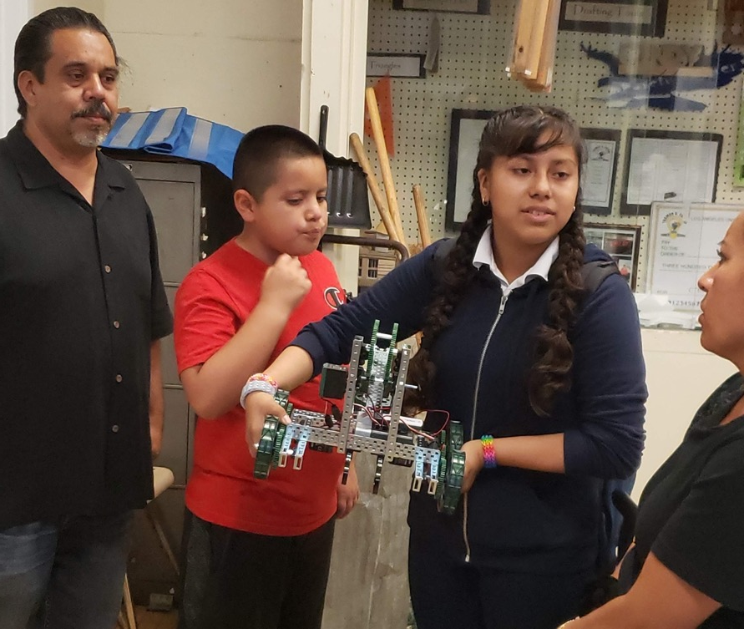
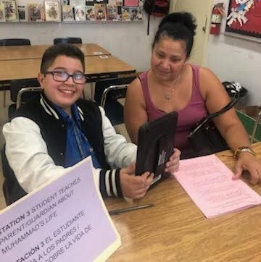
Student Led Conferences
Edison Middle School,
Los Angeles, California

Slide 49

Text Book Adoption
Sutter Middle School, Los Angeles, California

Slide 50
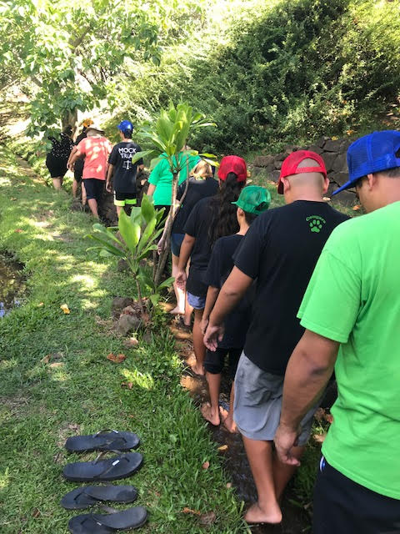
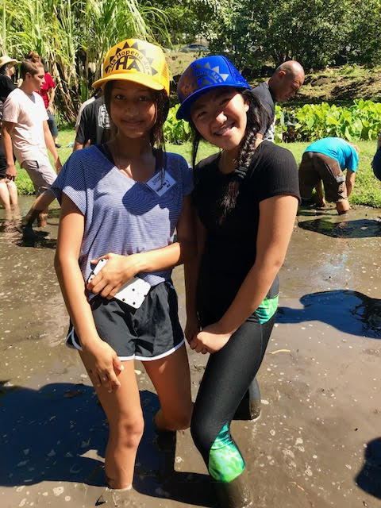
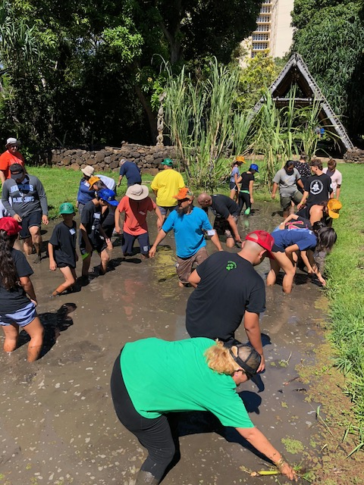
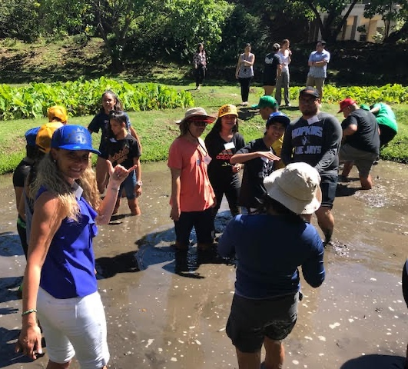
Taking Care of Campus & Community Grounds
Oahu, Hawaii

Slide 51
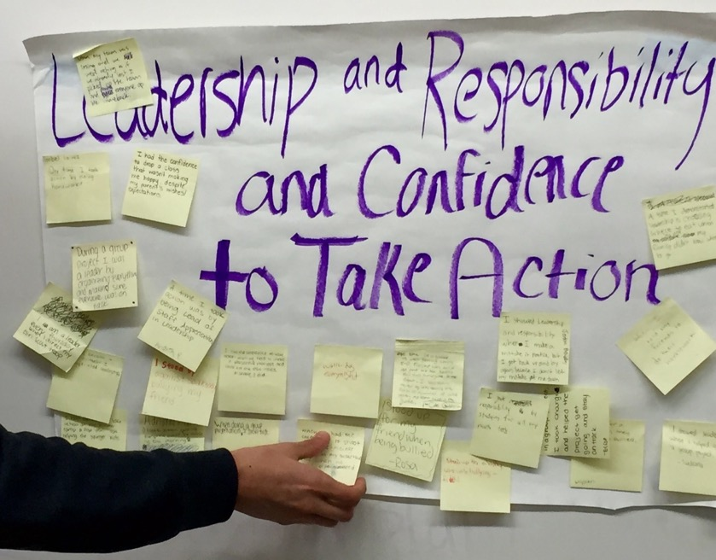
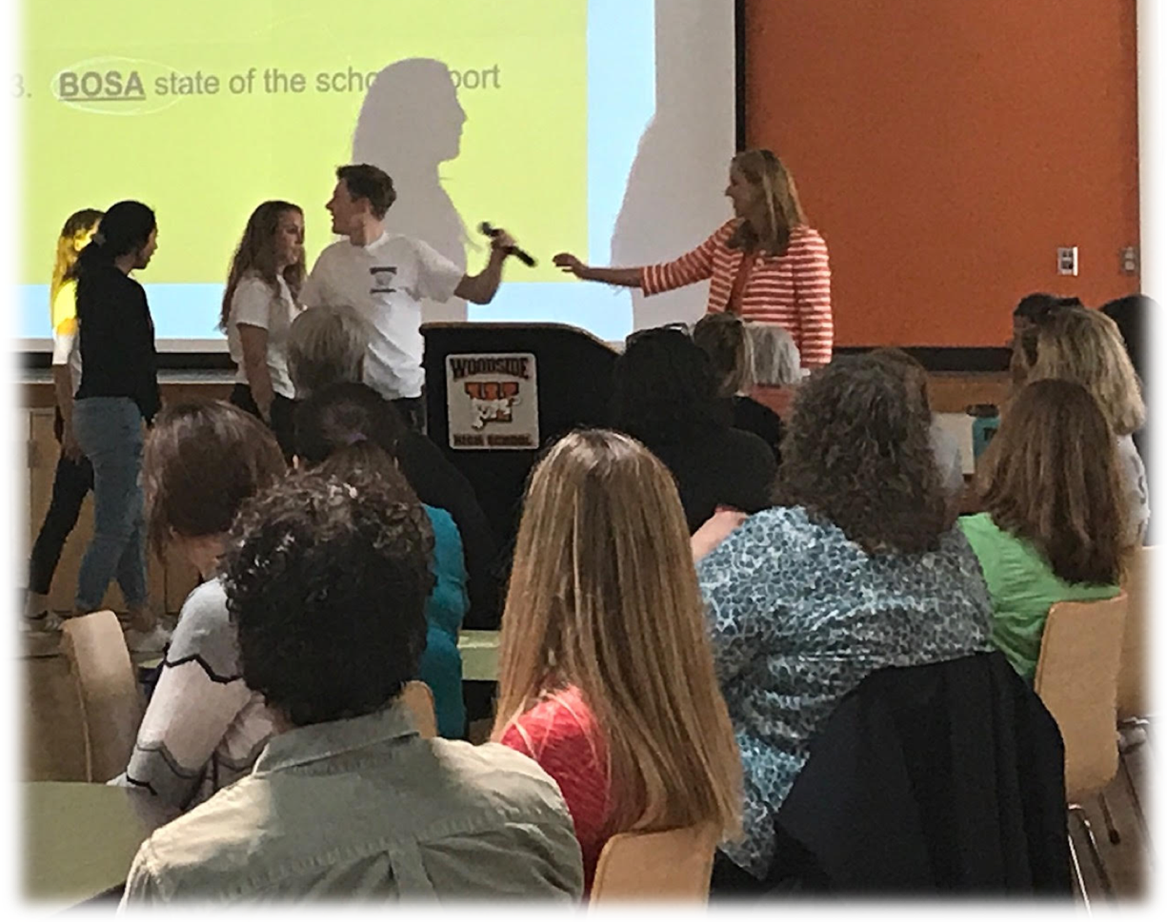
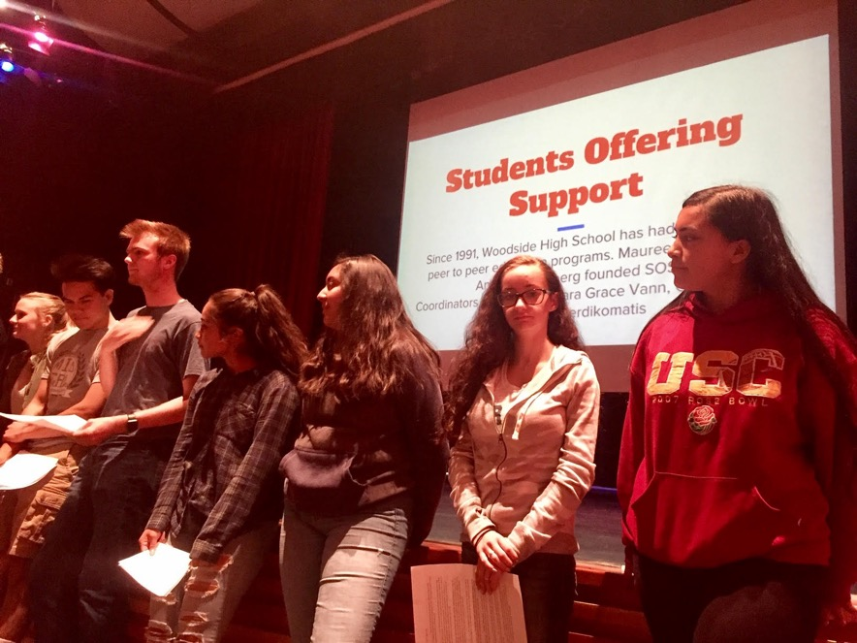
Faculty Meetings
Woodside High School, Redwood City, California

Slide 52
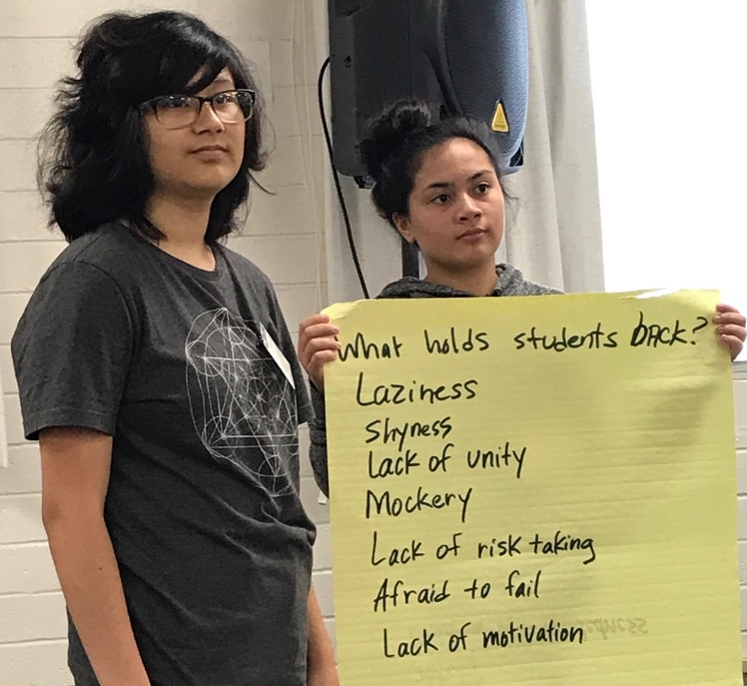
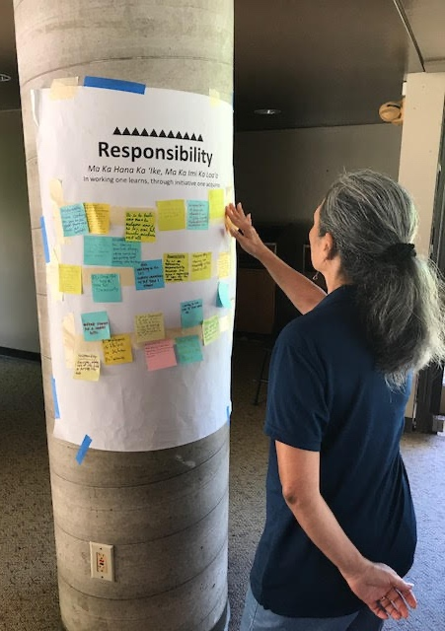



Professional Development
Oahu, Hawaii

Slide 53





Maui, Hawaii

Slide 54
Your Turn!!
What things in your classroom/school are currently controlled by adults, that students could be invited to co-own with you?

Slide 55
Partnerships
With Families

Slide 56


Reflection on
Family Partnerships
Part 1: Complete the Reflection Tool
Part 2: Find a “Meet with your Feet”
partner & discuss
what you learned.

Slide 57
Challenge Time…

Slide 58
Family Partnerships Challenge
Part 1: Read the scenario provided to your group & collectively determine your suggested course
of action. Everyone in your group needs to be
prepared to share.
Part 2: Create groups of 4 based on the number on the back of your scenario card. Share each
scenario & your suggested course of action.

Slide 59


Fostering Partnerships
with Families
Self Assess your
current status &
discuss what it would take to make
forward progress.
“Reality is not your
enemy!” –Dr. Russ

Slide 60

A Quick Recap
3-Part Definition of Voice
& Noise v. Voice
Aspirations Profile & how it
relates to Student Voice
Student Voice Process:
Listen, Learn, Lead
Voice & Vision:
Using Data to Guide Implementation
of the Aspirations Framework
Celebrating Voice by Developing Greater
Partnerships & Purpose

Slide 61


Website Just For YOU!
https://quagliainstitute.org/kansas-multi-tier-system

Slide 62
BELIEVE
https://vimeo.com/822031803/c765da120e

Slide 63

What is one word that reflects your learning about Purpose & Partnerships today?

Slide 64

Thank you for engaging in
this Learning journey with us!
Dr. Russ Quaglia & Dr. Lisa Lande
@QISVAtweets @Lisa_Lande
quagliainstitute.org

