Slide 1
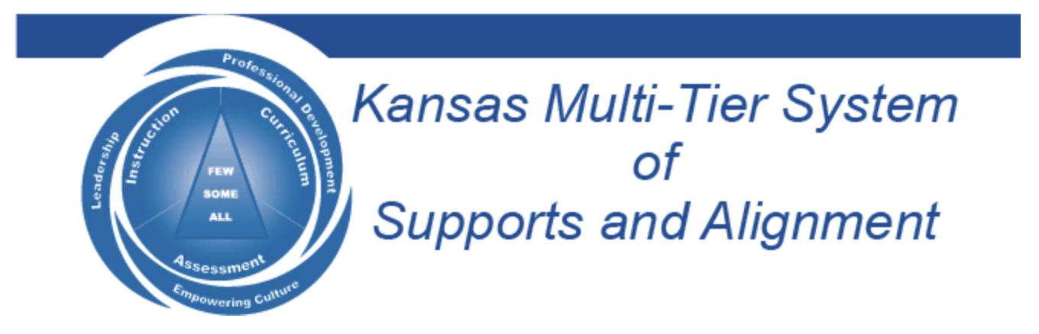

Voice & Vision:
Using Data to Guide Implementation
of the Aspirations Framework
March 1, 2023
Dr. Russ Quaglia & Dr. Lisa Lande
@QISVAtweets @Lisa_Lande
quagliainstitute.org

Slide 2

Goals for Today
Gain a deeper understanding of the
the Aspirations Framework (3 Guiding
Principles & 8 Conditions).
Consider how Student Voice Data
supports implementation of the
Aspirations Framework.
Apply learning to amplify student
voice in YOUR school.

Slide 3

Quick Review

Slide 4
Fundamental Beliefs
Students are the potential, not the problem.
Students have something to teach us.
Working together is the only way forward.

Slide 5

The 3 Components of Student Voice
Sharing thoughts & ideas in an environment underpinned by trust & respect.
Offering realistic suggestions for the
good of the whole.
Accepting responsibility for not only what is said but also what needs to be done.

Slide 6
ASPIRATIONS
The ability to
dream & set goals
for the future,
while being inspired
in the present
to reach those dreams.

Slide 7




high
Imagination
Aspirations
DREAMING
Hibernation
Perspiration
low
DOING
high

Slide 8


Reflect
What most stuck with you from your learning about the Student Voice Process?

Slide 9
LEAD
TAKE ACTION
with others
Share
RESPONSIBILITY
LEARN
UNDERSTAND
& RESPECT
different points
of view
Build
TRUST
LISTEN
SEEK OUT
opinions from
others
Student Voice Process

Slide 10

Time to journey
onward & explore the Aspirations
Framework

Slide 11

The Aspirations Framework
Aspirations
Framework
Brief
Aspirations Profile: Dreaming & Doing
3 Guiding Principles
8 Conditions
The Voices of Students, Teachers &
Leadership in deciding
concrete application

Slide 12



3 Guiding Principles
Self-Worth
3 Guiding Principles
Brief
Engagement
Purpose

Slide 13








8 Conditions
8 Conditions
Elementary &
Secondary
8 Conditions
Brief
Self-Worth
Engagement
Purpose

Slide 14

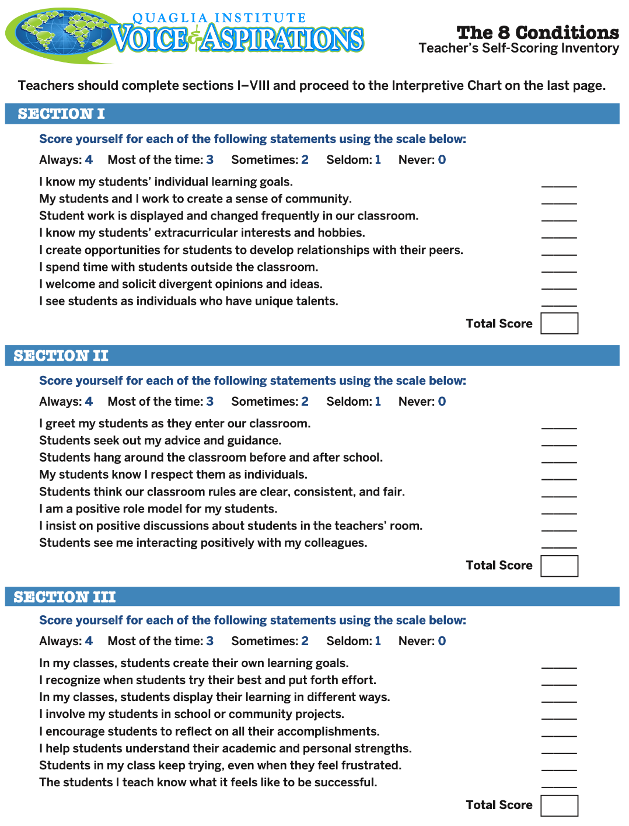
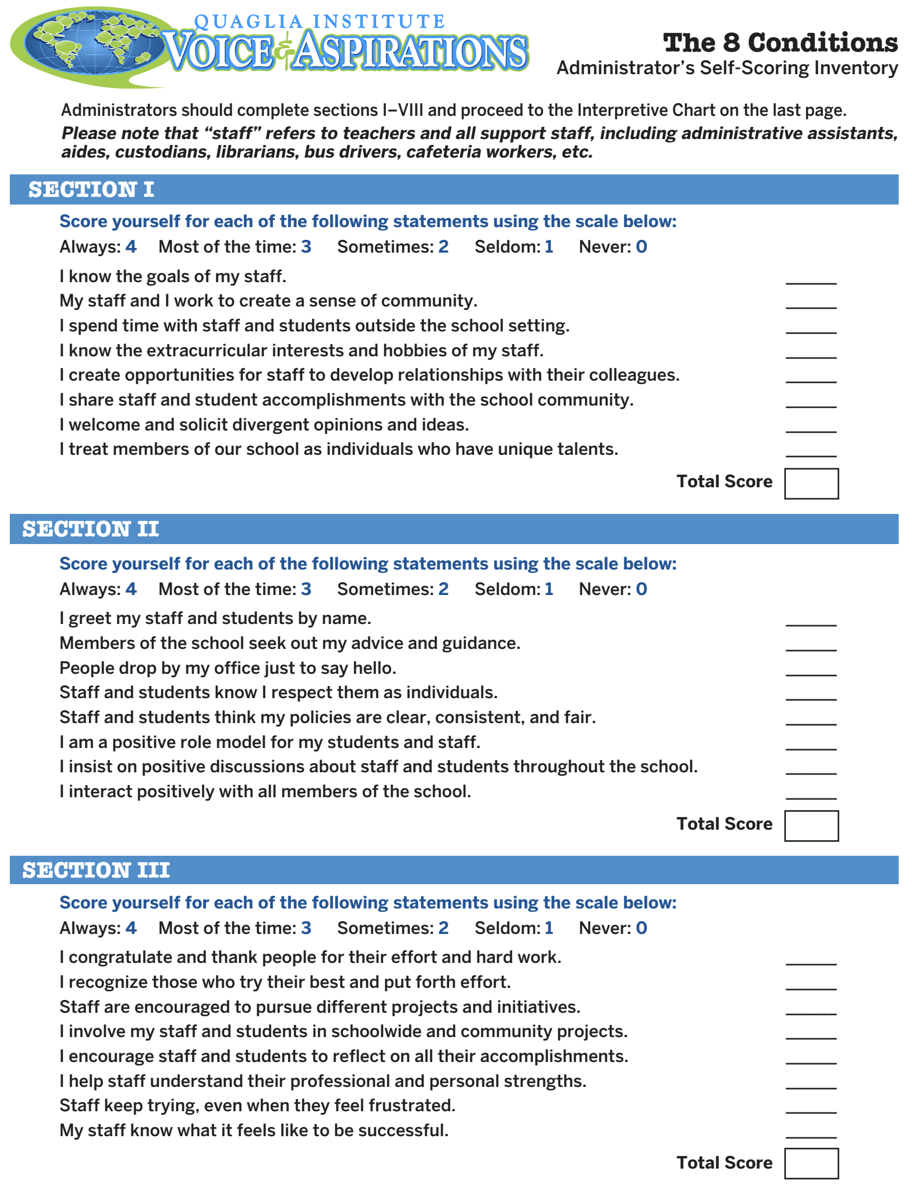
What did you learn from completing the
8 Conditions Inventory?
Teacher
8 Conditions Inventory
Administrator
8 Conditions Inventory

Slide 15
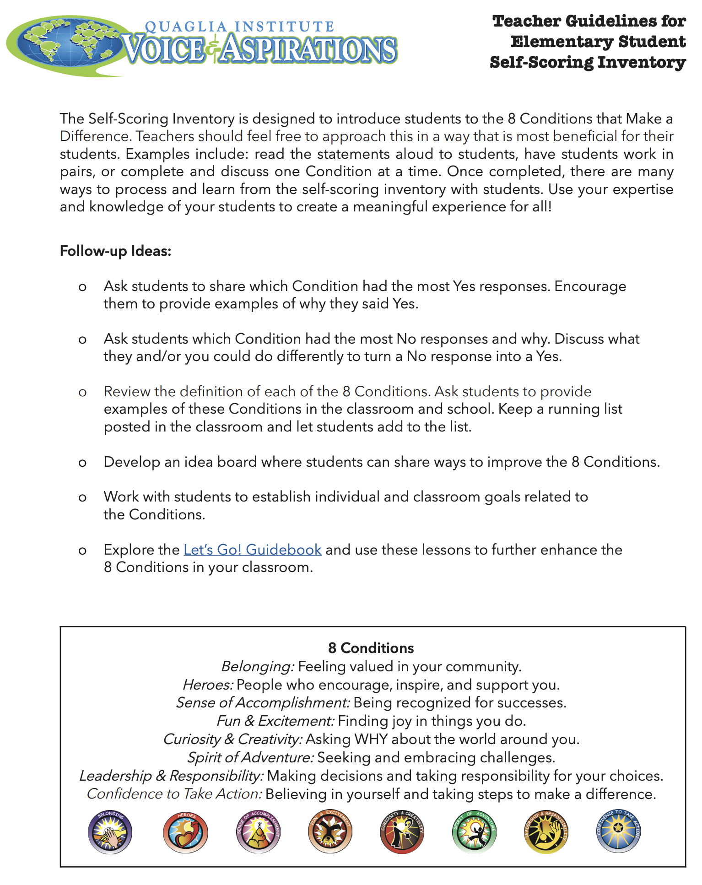
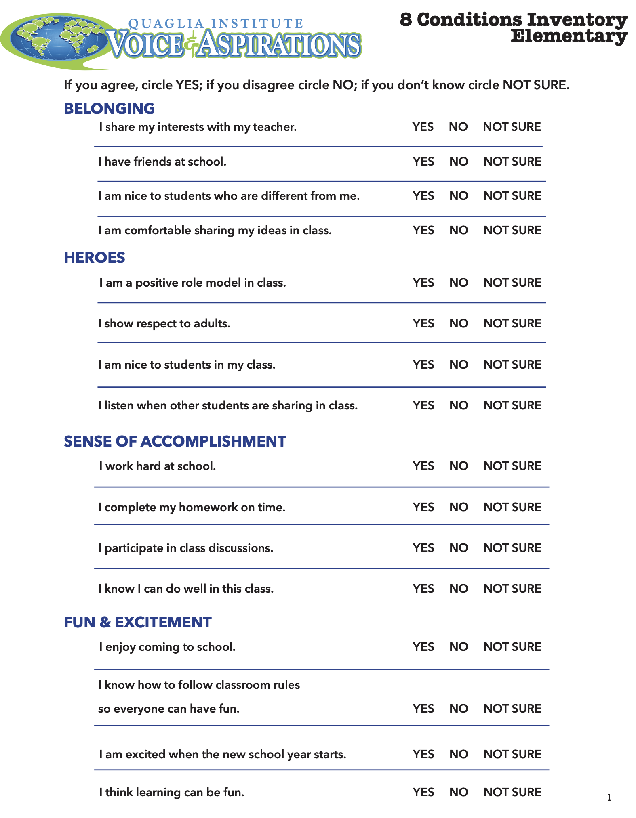
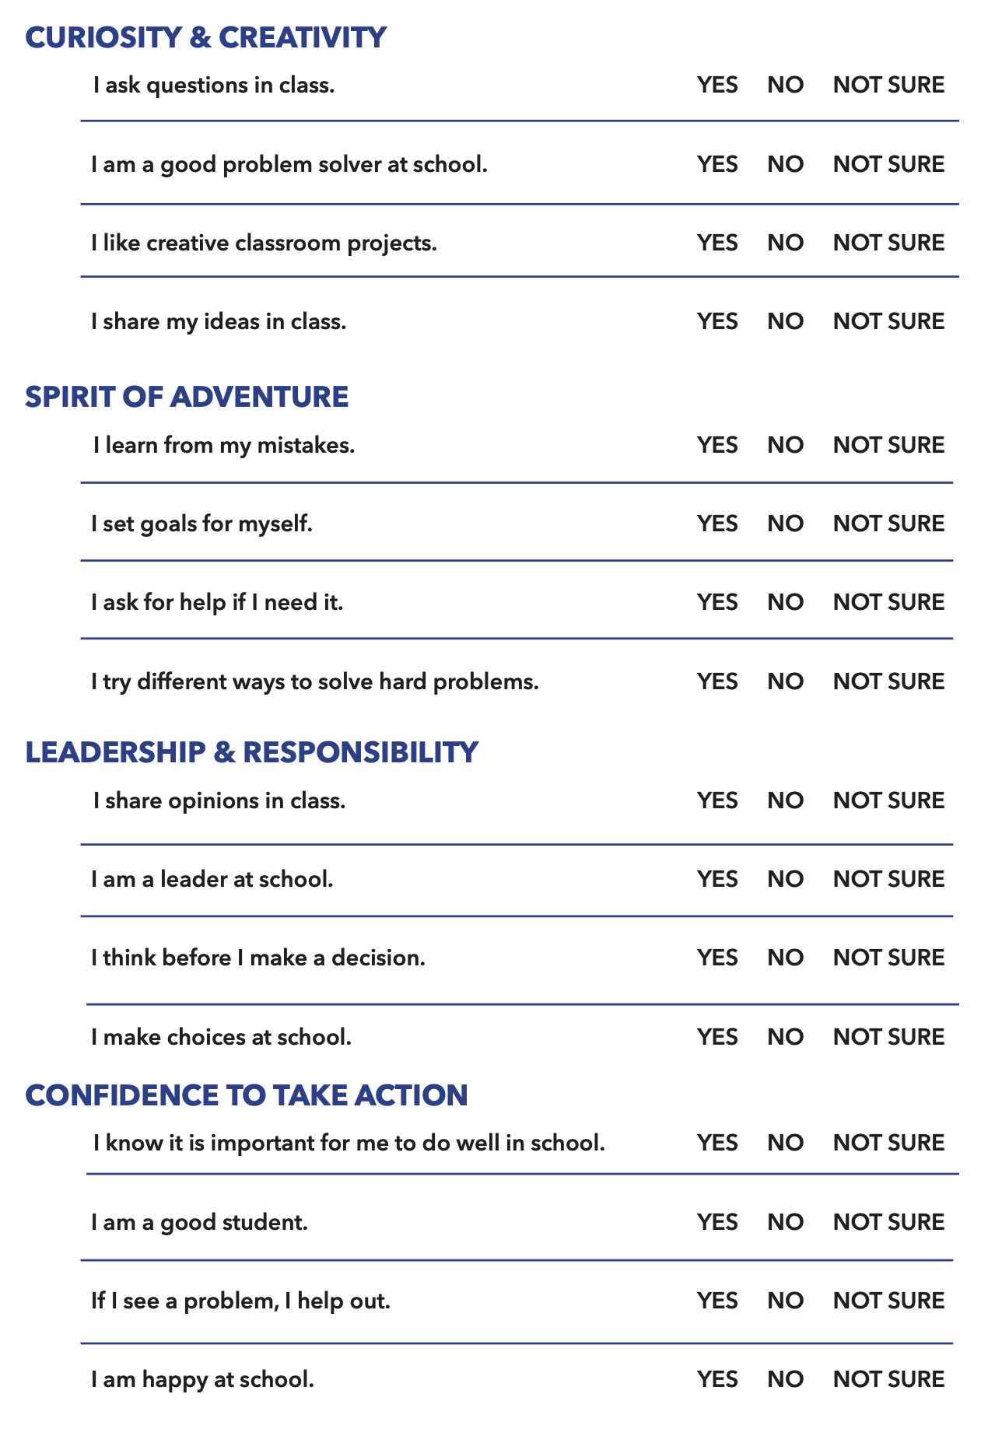
Student 8 Conditions Inventory Elementary

Slide 16
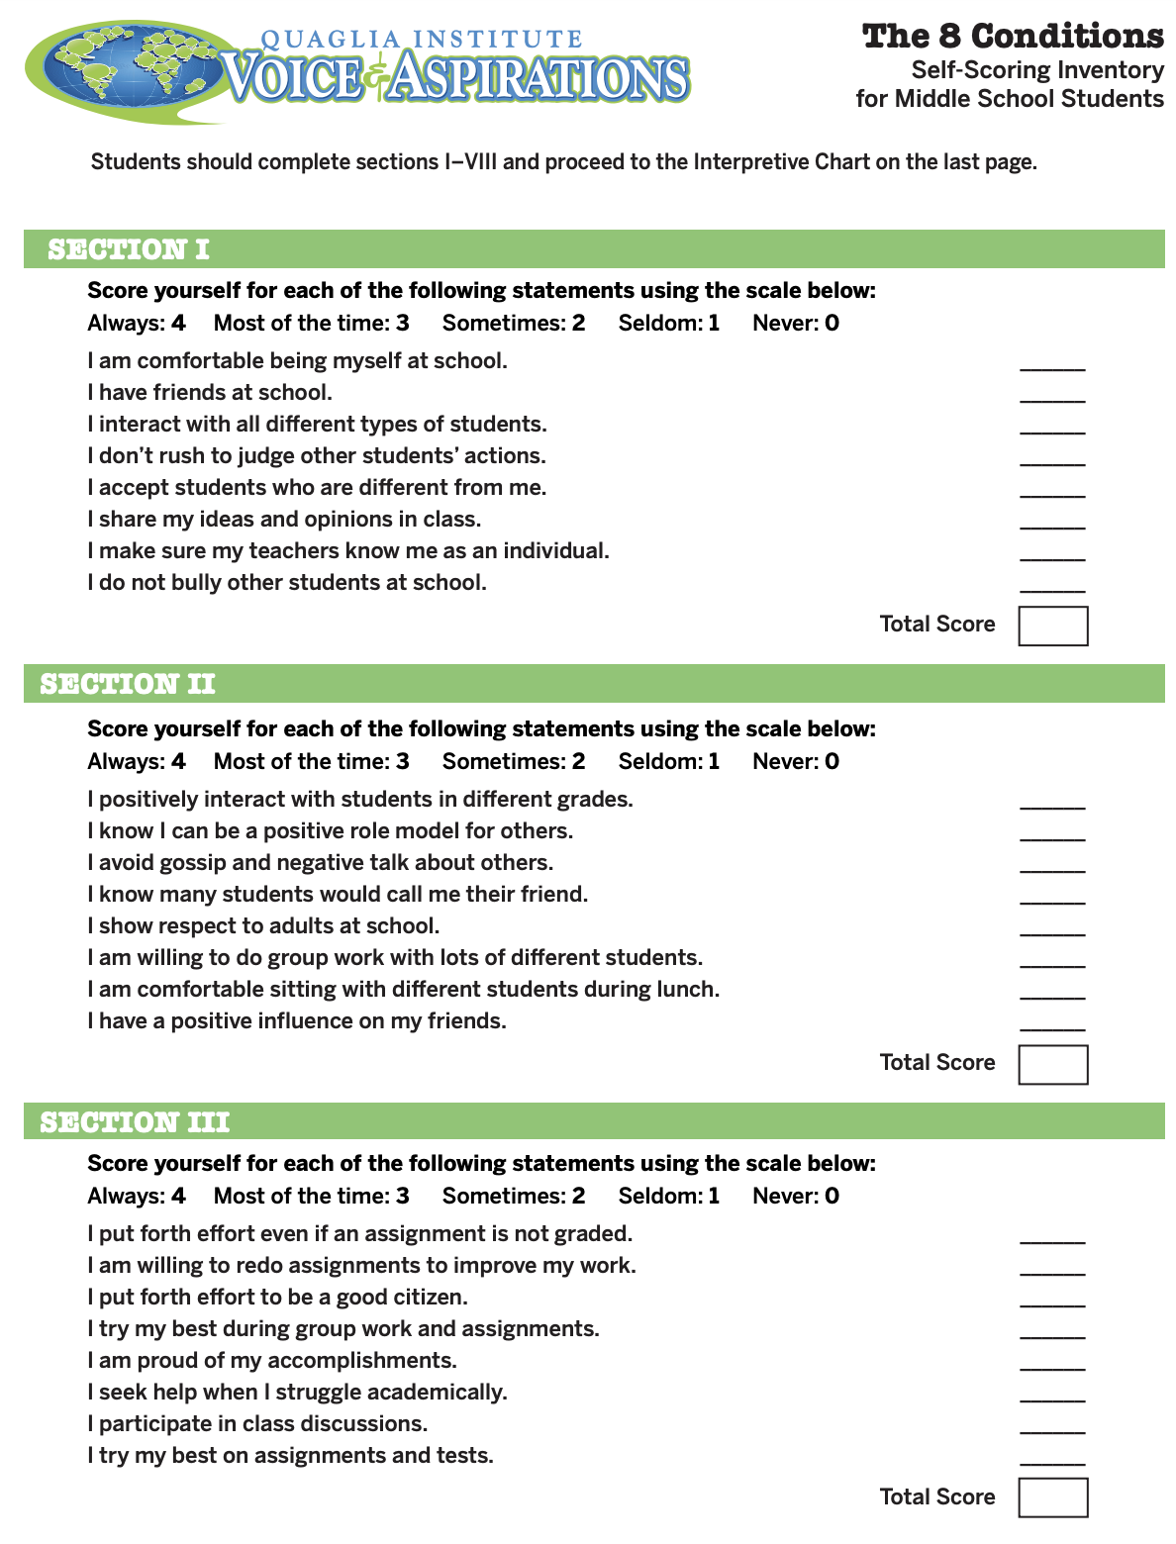
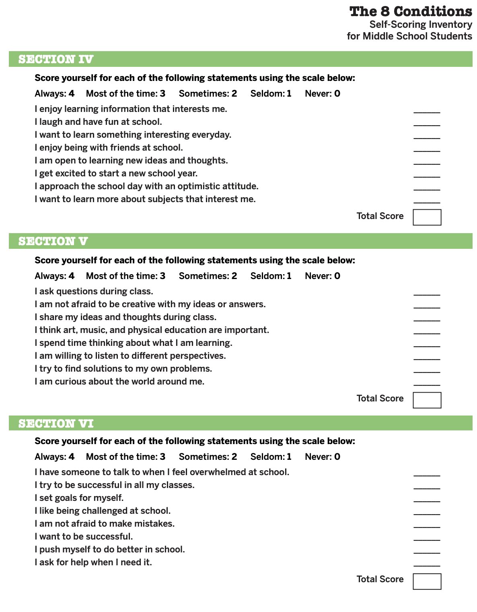
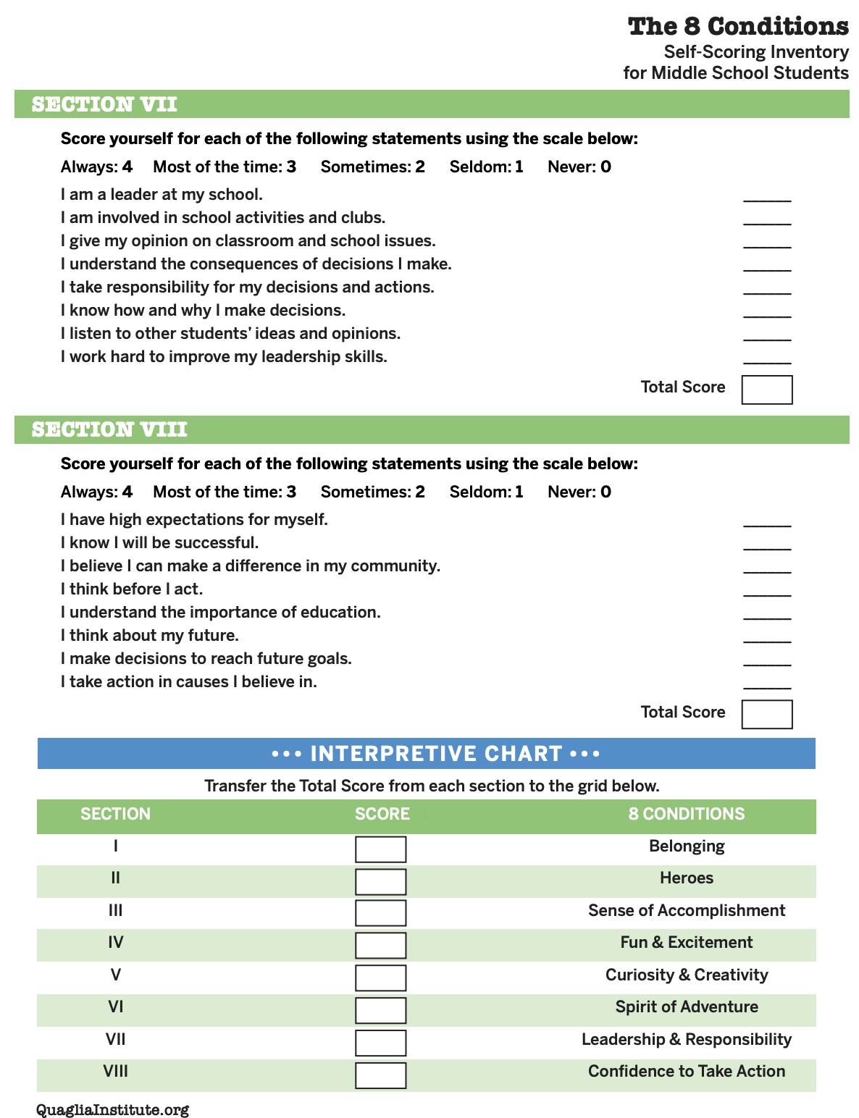
Student 8 Conditions Inventory Middle School

Slide 17
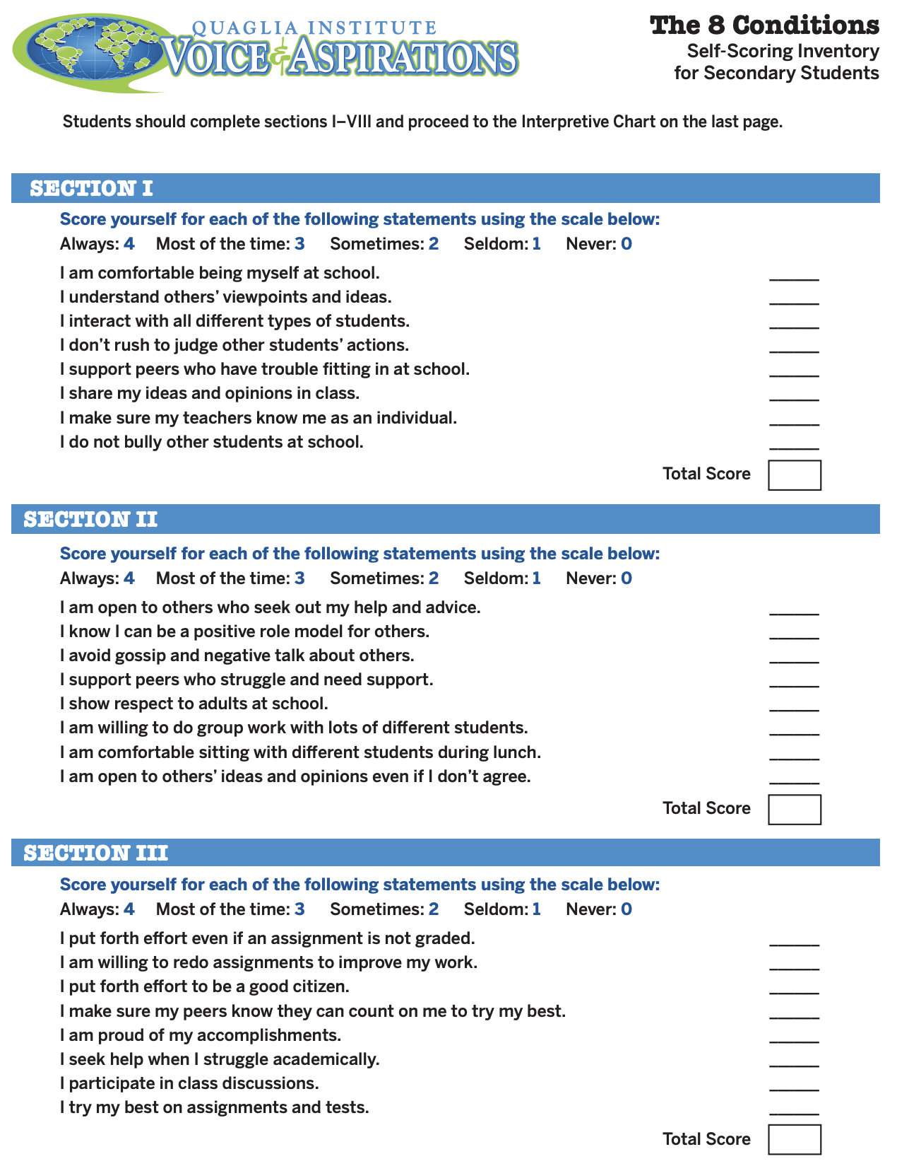
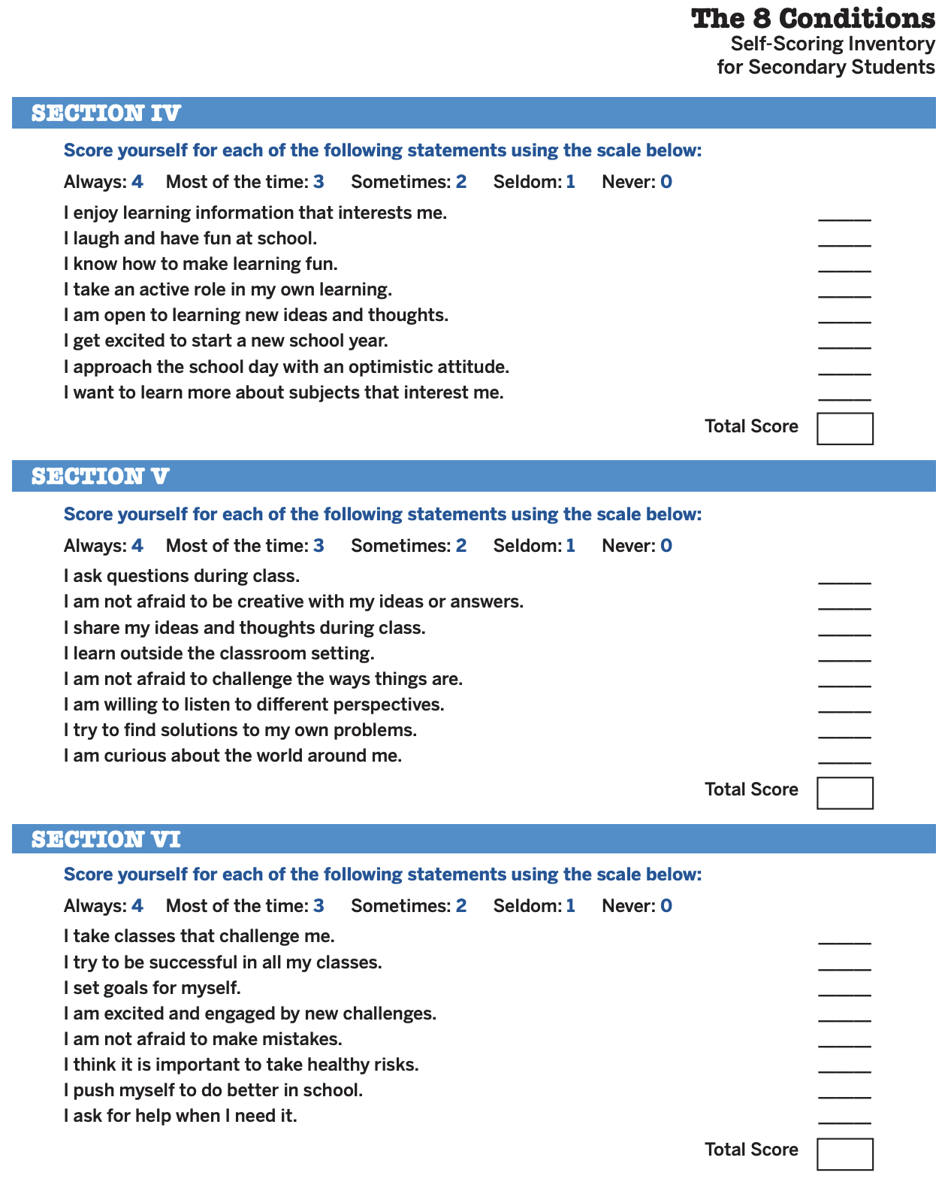
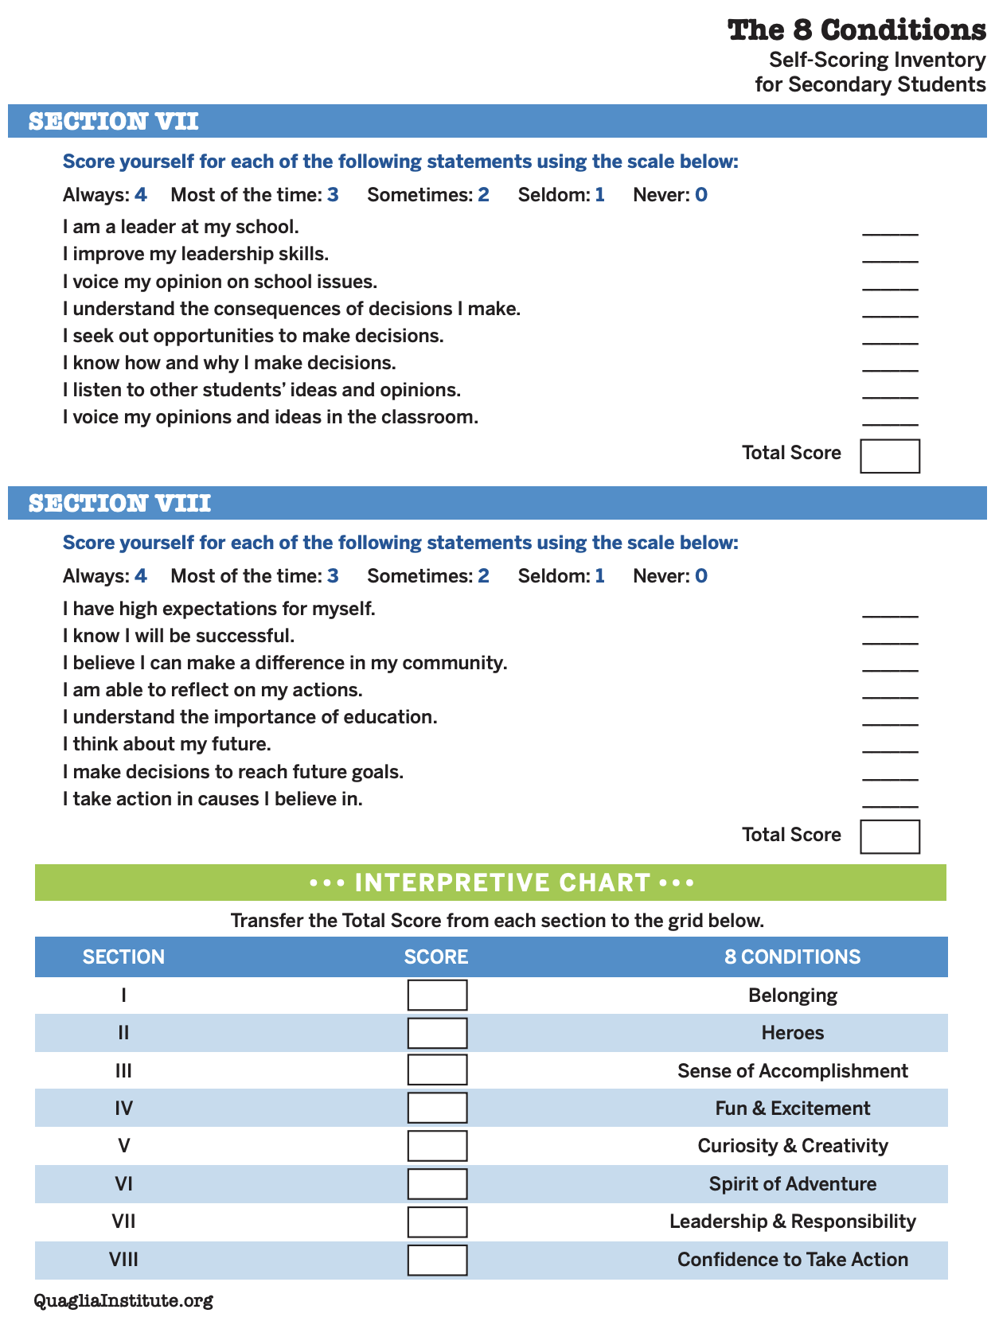
Student 8 Conditions Inventory High School

Slide 18

Challenge Time…

Slide 19
8 Conditions
Speed Hiring
8 Conditions
Speed Hiring
Congratulations! You just received funding to open up one of the following
positions at your school.
Select which position you want to add at
your school & write 1 awesome interview
question for potential candidates.

Slide 20
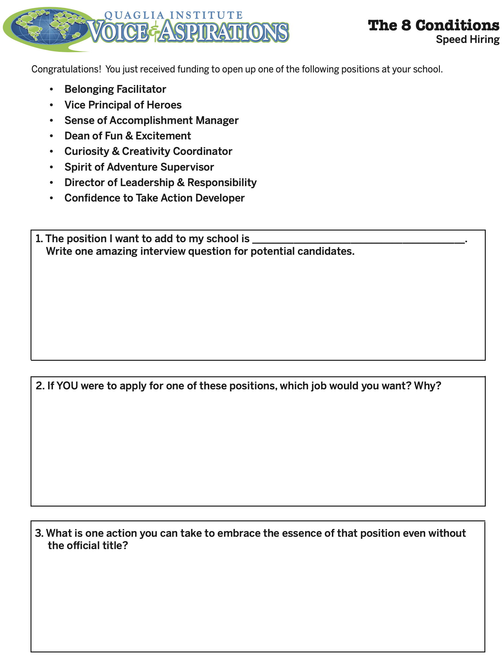
1 minute interviews using the interview question you wrote for #1.

Slide 21
Belonging Facilitator
Assistant Principal of Heroes
Sense of Accomplishment Manager
Leader of Fun & Excitement
Curiosity & Creativity Coordinator
Spirit of Adventure Supervisor
Director of Leadership & Responsibility
Confidence to Take Action Developer

Slide 22
8 Conditions
Speed Hiring
If doing this activity
in person…
First round of 1-minute interviews!
Slide the Line. 2nd round of 1-minute
interviews.
Slide the Line. Discuss Question 2 on
the handout.
Slide the Line. Discuss Question 3 on
the handout.

Slide 23
Reflect
How did this activity contribute to
your learning about the 8 Conditions?
What would be like to do an
activity like this with your students.

Slide 24
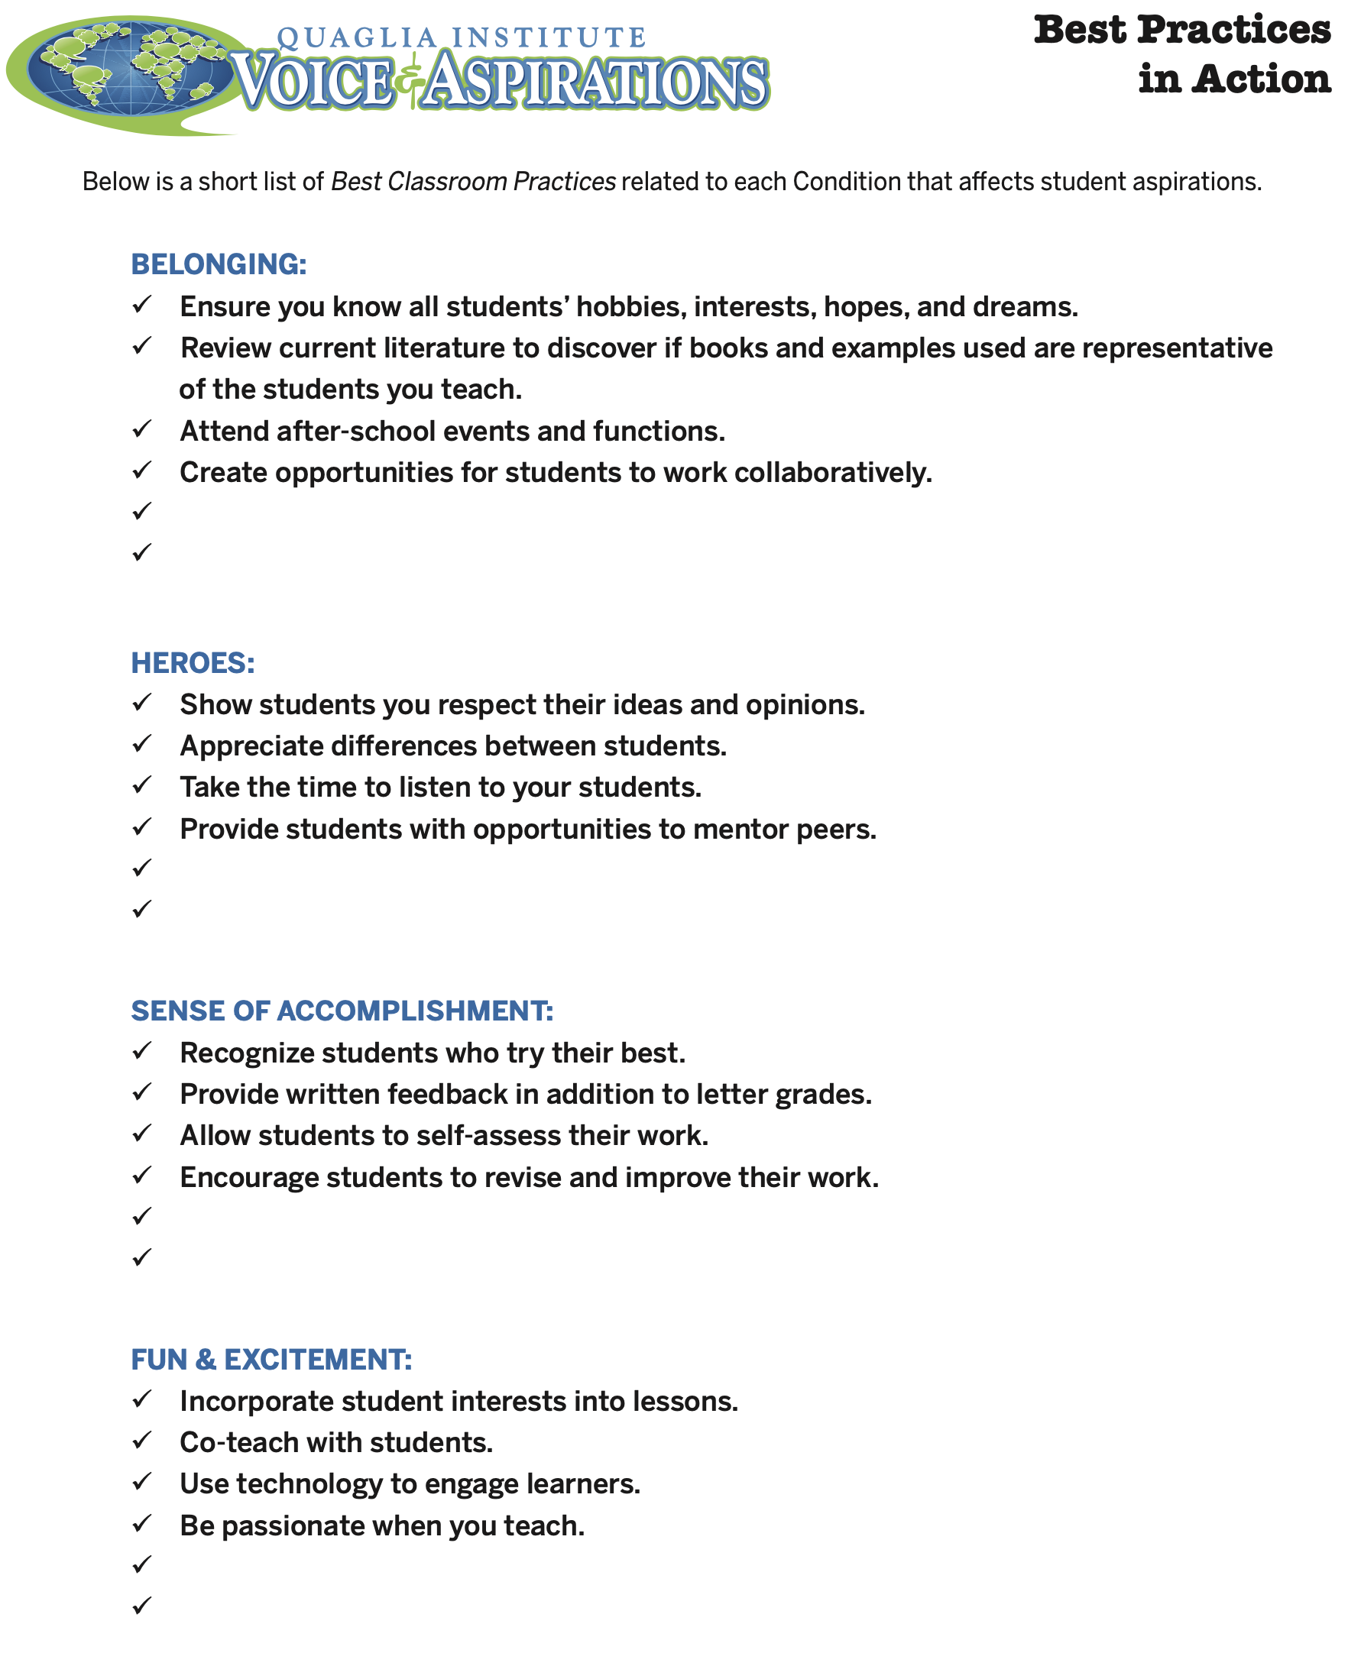
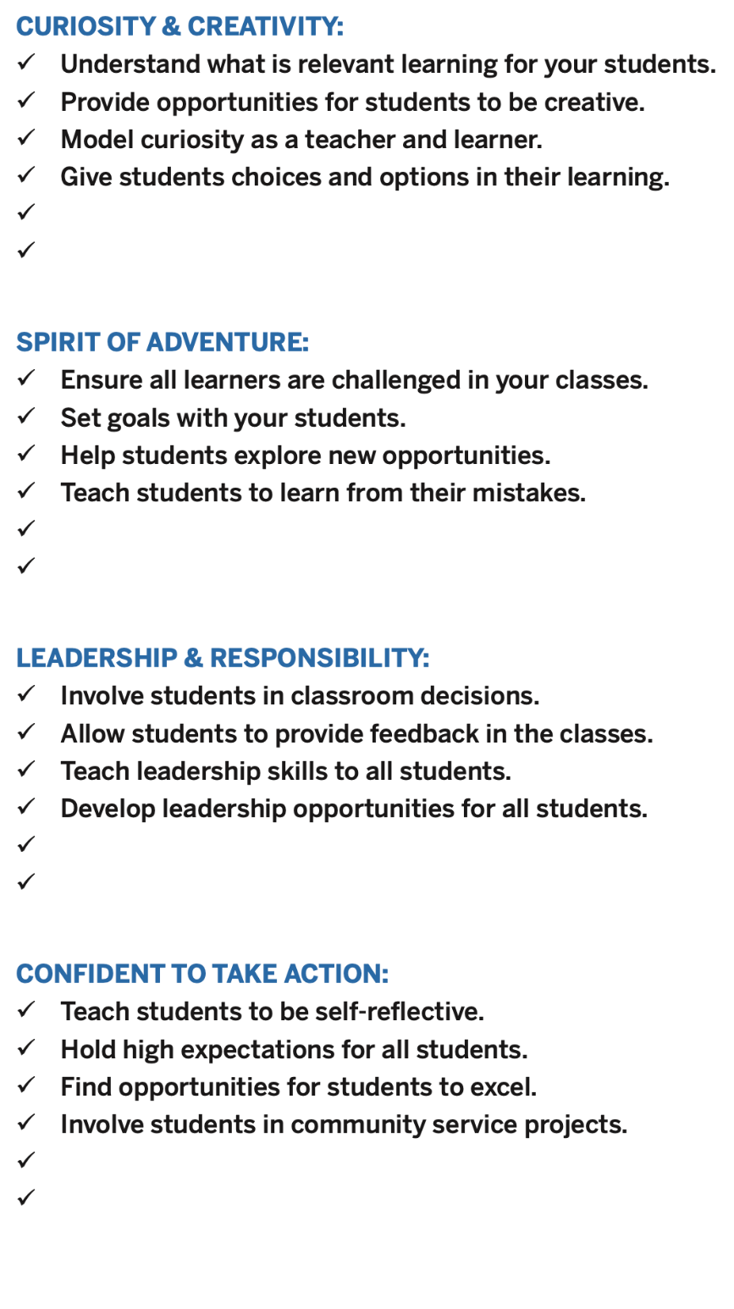
8 Conditions
Best Practices
in Action
What practices are you already doing?
Which practices are you willing to try?
Add a best practice for each of the 8 Conditions

Slide 25
The Aspirations Framework
Aspirations Profile: Dreaming & Doing
3 Guiding Principles
8 Conditions
The Voices of Students, Teachers
& Leader in deciding
concrete application

Slide 26

Student Voice Data
Love it or Leave it?
Thumbs Up
Thumbs Down
Thumbs Neutral

Slide 27
Viewpoint #1

Slide 28

Viewpoint #2

Slide 29
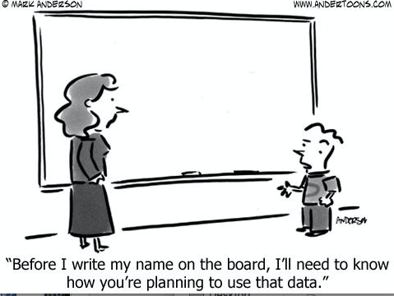
Viewpoint #3

Slide 30
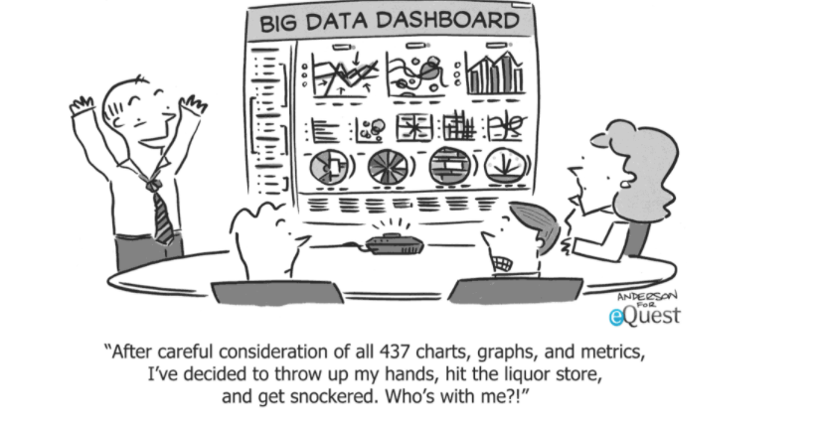
Viewpoint #4

Slide 31
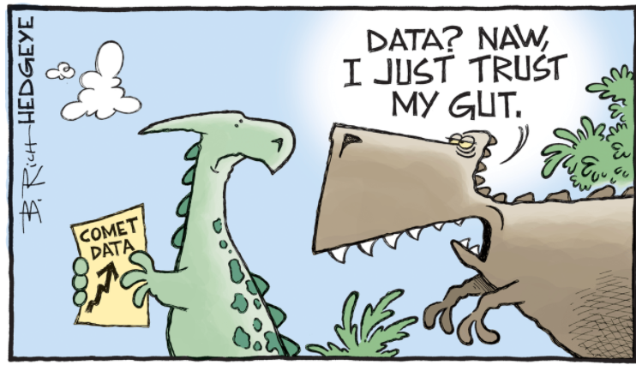
Viewpoint #5

Slide 32
Reflect
What Student Voice data does your school currently collect, & how is it used?
How are students involved in data
discussions & action planning?
What hesitations might teachers have
regarding Student Voice data?

Slide 33

Gathering Student
Feedback
does not mean…
Students are evaluating teachers
Students know more than the teachers
All student feedback must be acted upon
Teachers are doing something wrong
A once a year survey to “check the box” .

Slide 34

Gathering Student
Feedback
does mean…
We are ready to listen & students are
prepared to share
We believe students have something
to teach us
We are willing to learn from students
We plan to take action in partnership
with students

Slide 35
Quaglia Student Voice Surveys & Resources
Focus Groups
Grades PK-2
Voice Instruments
Data Analysis
Activities in
Partnership with
Students
Student Voice Survey
Grades 3-5 & 6-12
iKnow My Class Survey
Grades 3-5 & 6-12

Slide 36
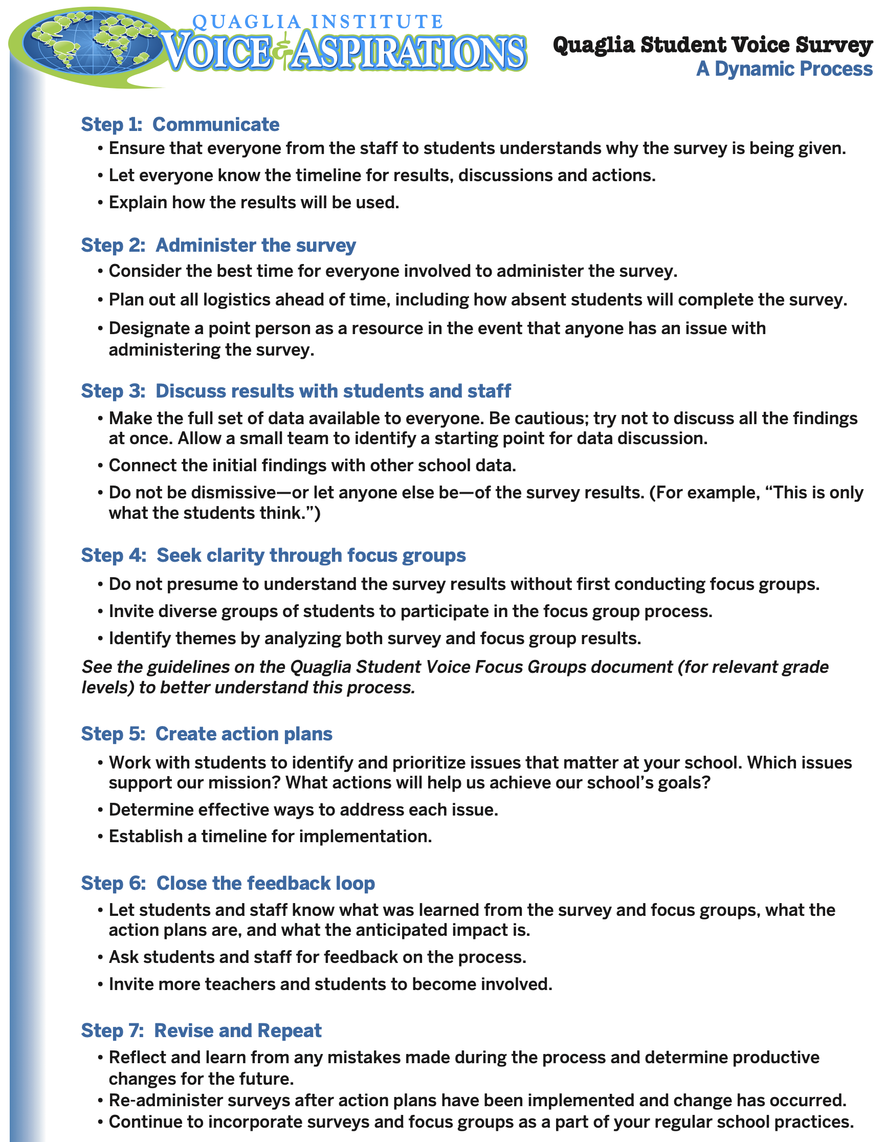
Dynamic Process

Slide 37
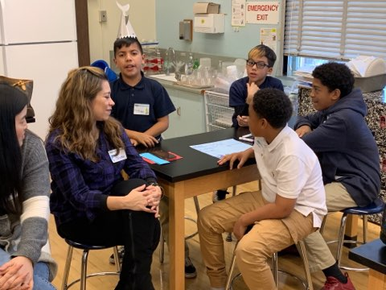
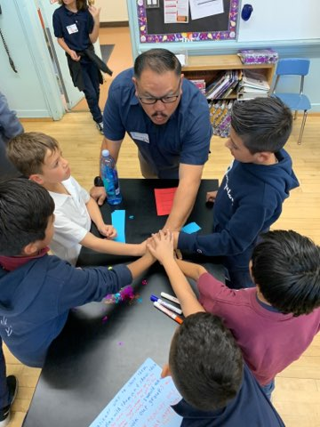
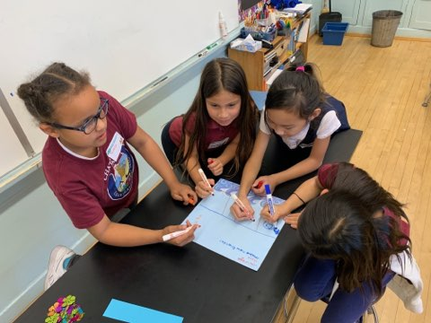
Engage Students in
Analysis & Action
Chatsworth Park Elementary School

Slide 38
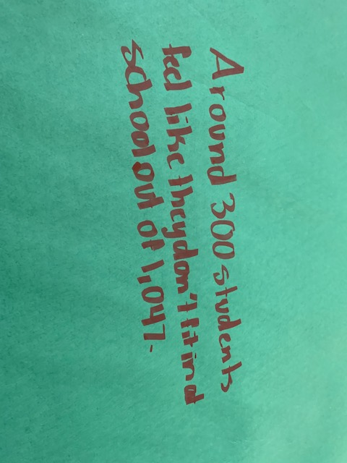
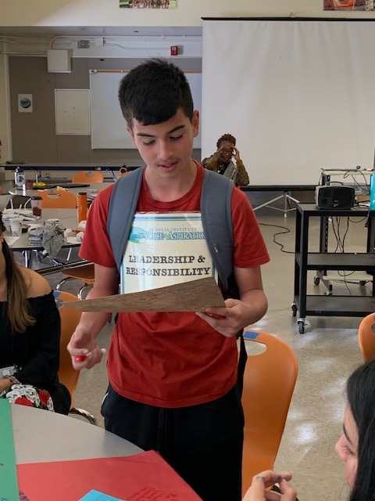
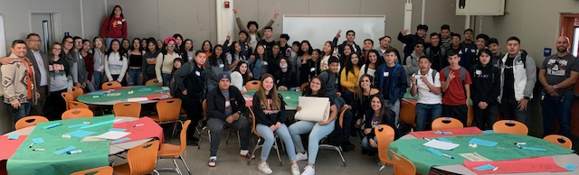
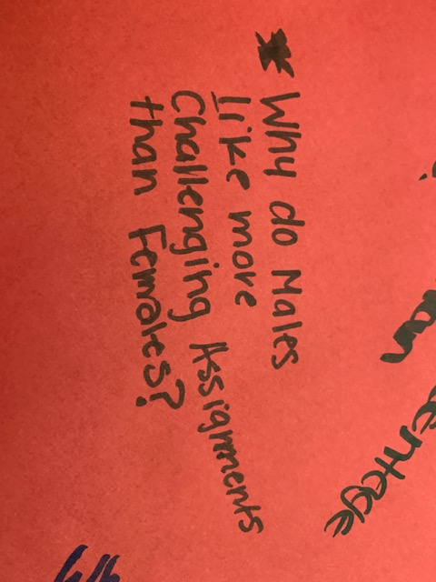
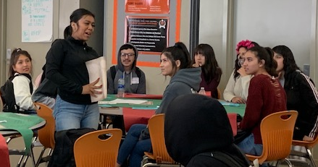
Engage Students in
Analysis & Action
Huntington Park High School

Slide 39
Student Voice Data World Café
https://vimeo.com/qisva/svinaction
Video
Lawrence Middle School

Slide 40
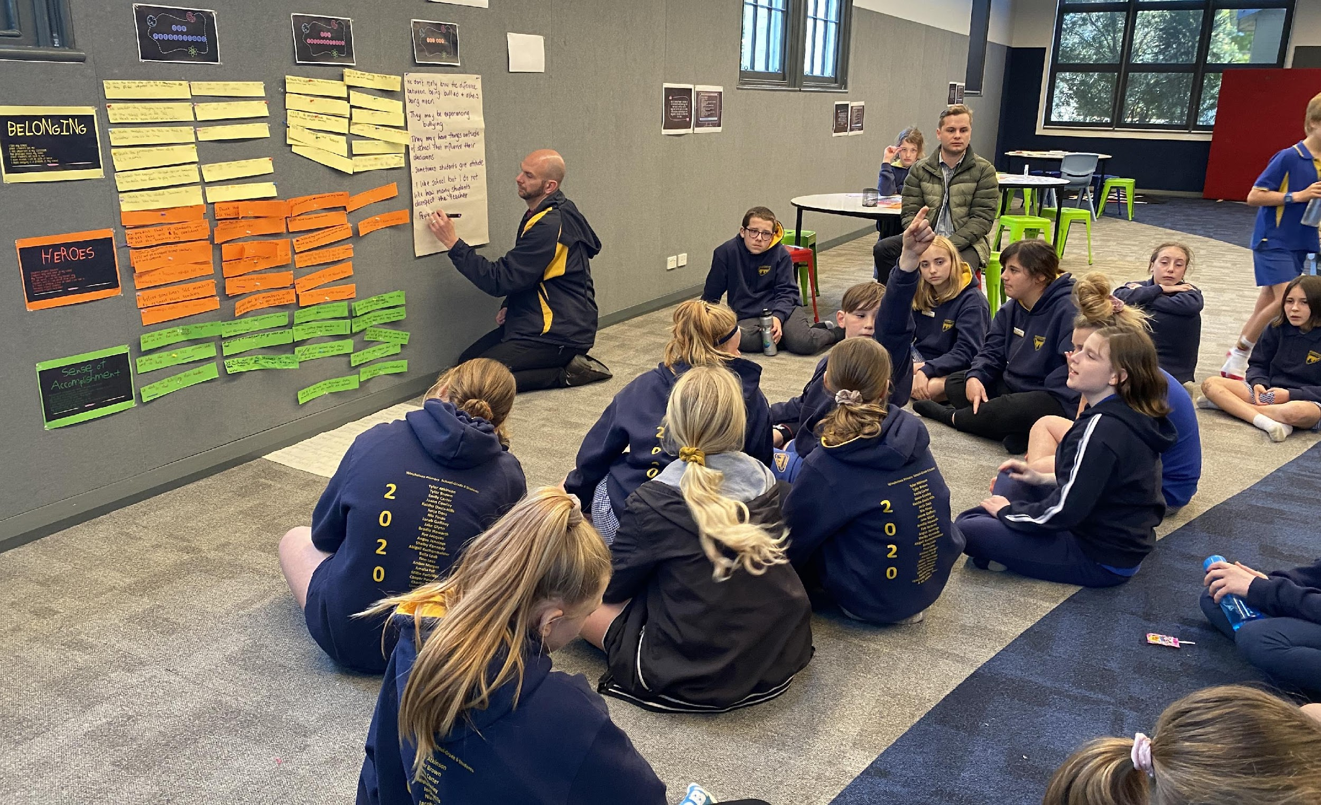
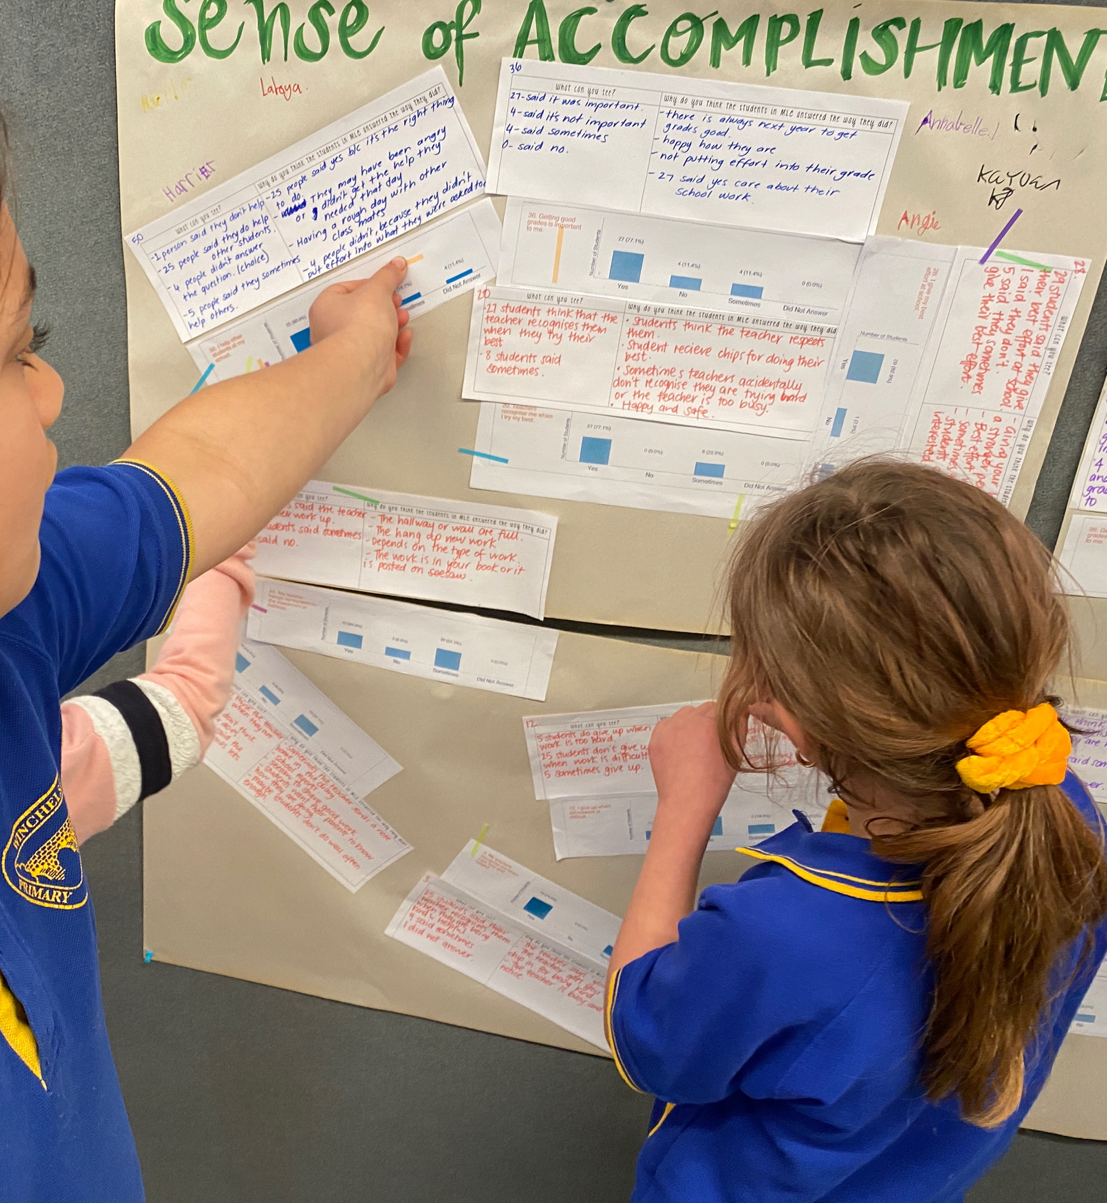
“ This is a starting point – the power in this process is to use what you’ve learned to lead with students & commit to making improvements together.”
Simone, School Leader, Australia

Slide 41

Reflect
How could Student Voice feedback contribute to your school’s
vision & goals?
How will students know they have been heard? How will staff & students USE results in partnership with one another?

Slide 42

A Quick Recap
3-Part Definition of Voice
& Noise v. Voice
Aspirations Profile & how it
relates to Student Voice
Student Voice Process:
Listen, Learn, Lead
Voice & Vision:
Using Data to Guide Implementation
of the Aspirations Framework

Slide 43
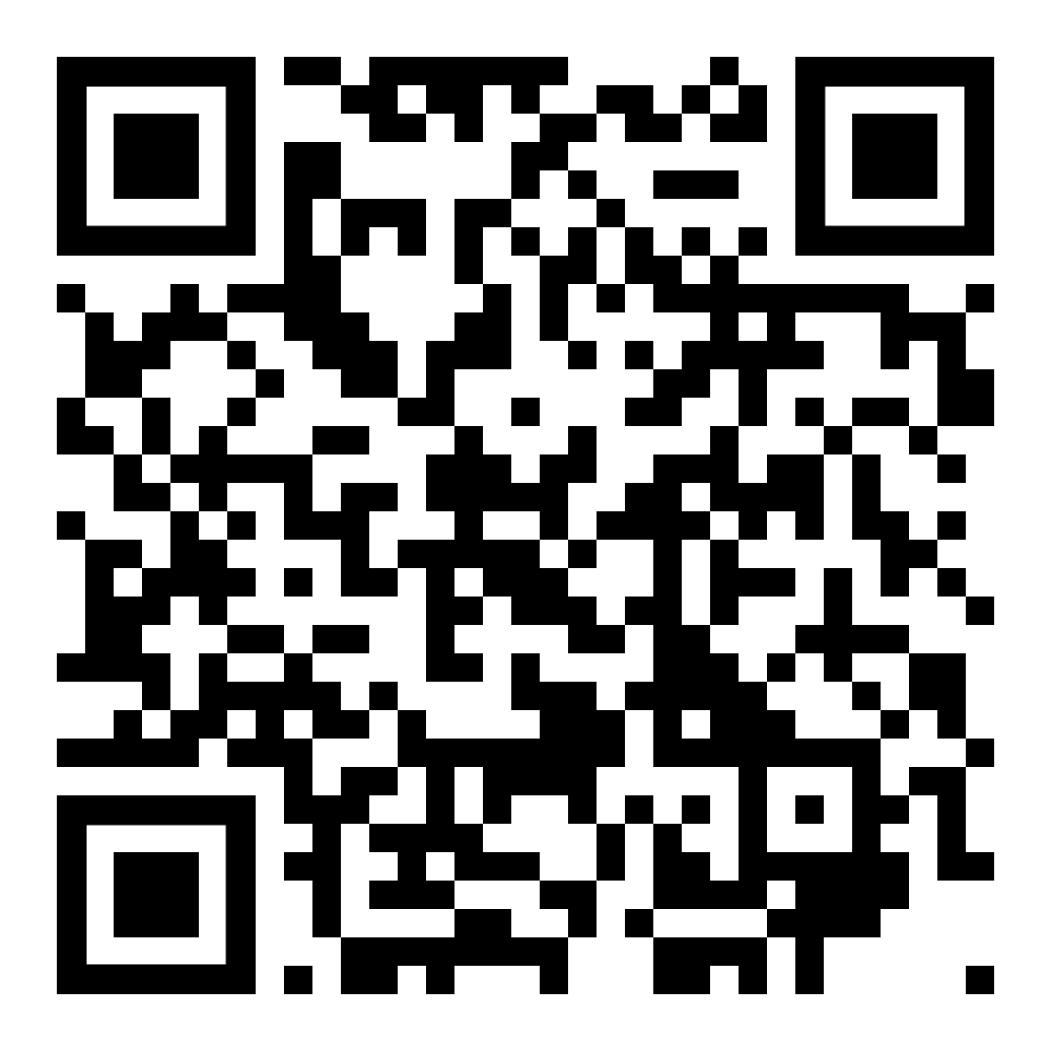

Website Just For YOU!
https://quagliainstitute.org/kansas-multi-tier-system

Slide 44
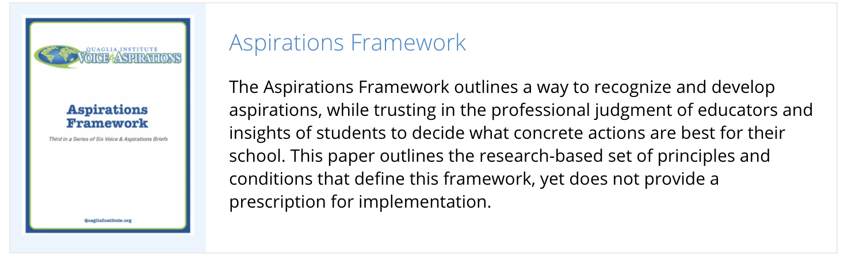
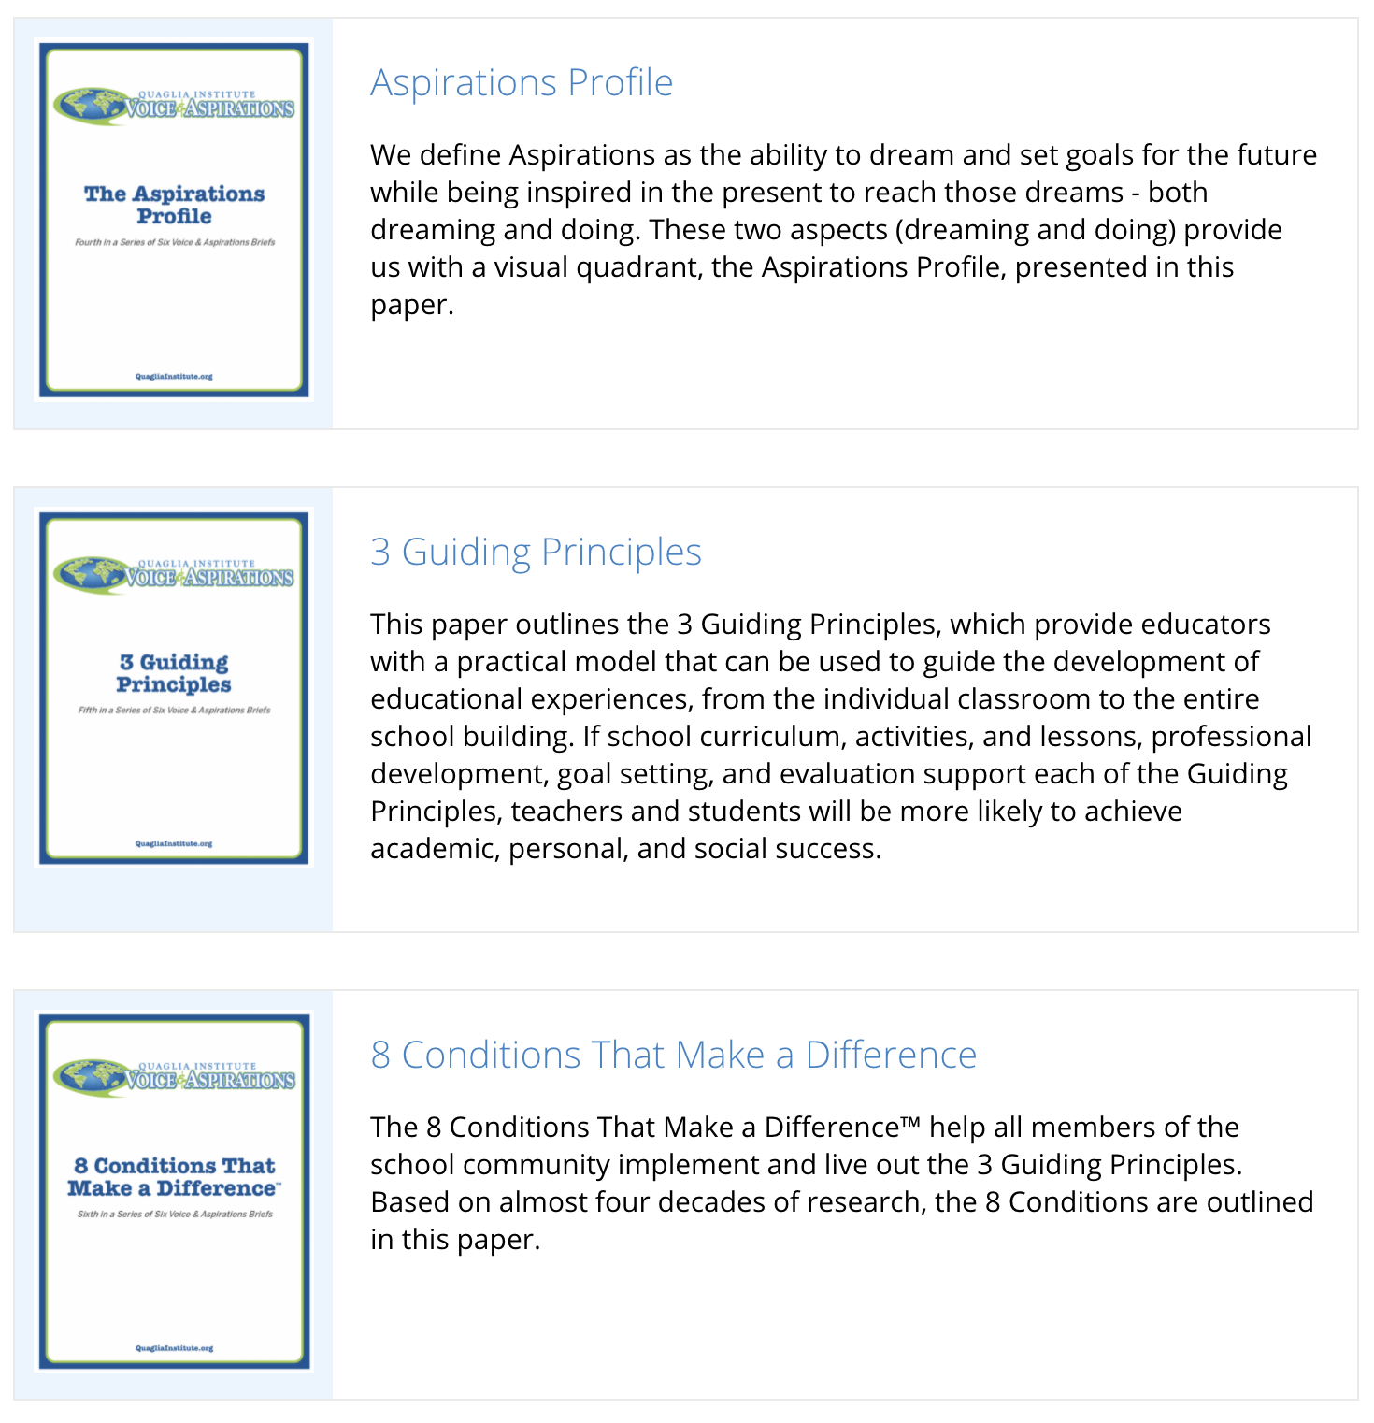
Aspirations
Framework Brief
3 Guiding
Principles Brief
8 Conditions
Brief

Slide 45


8 Conditions
Elementary & Secondary

Slide 46
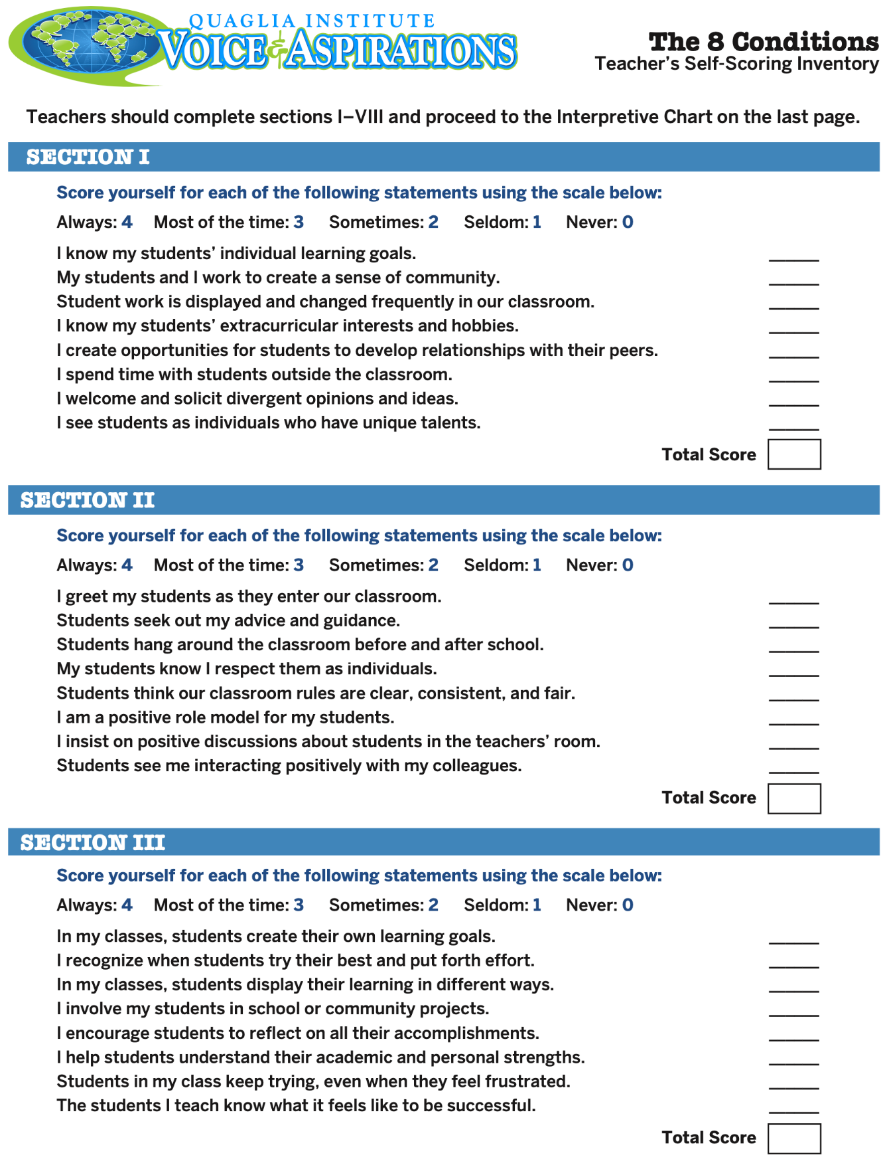
8 Conditions Inventory Resources:
Teacher, Administrator, & Students
(Elementary, Middle, & High)

Slide 47
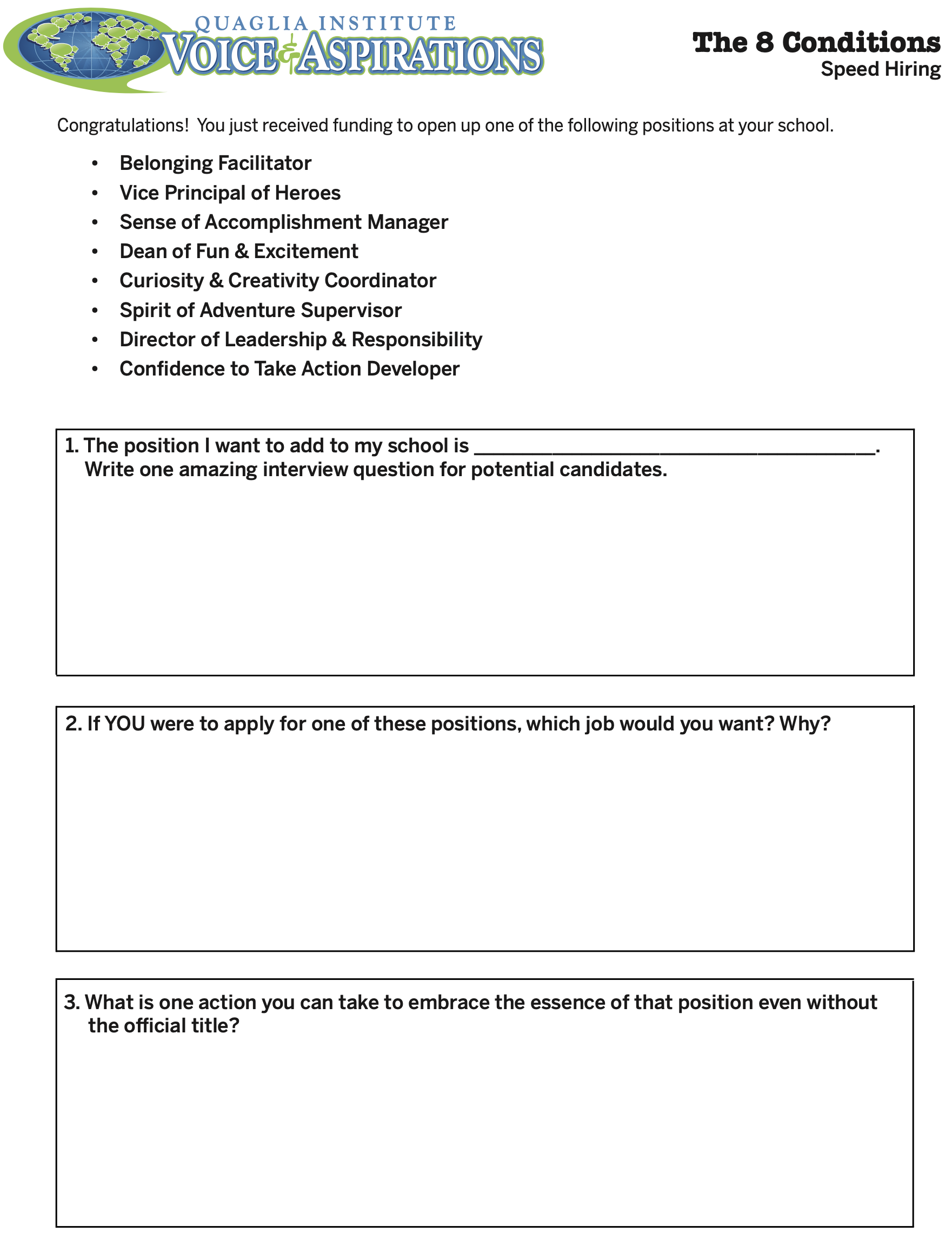
8 Conditions
Speed Hiring

Slide 48

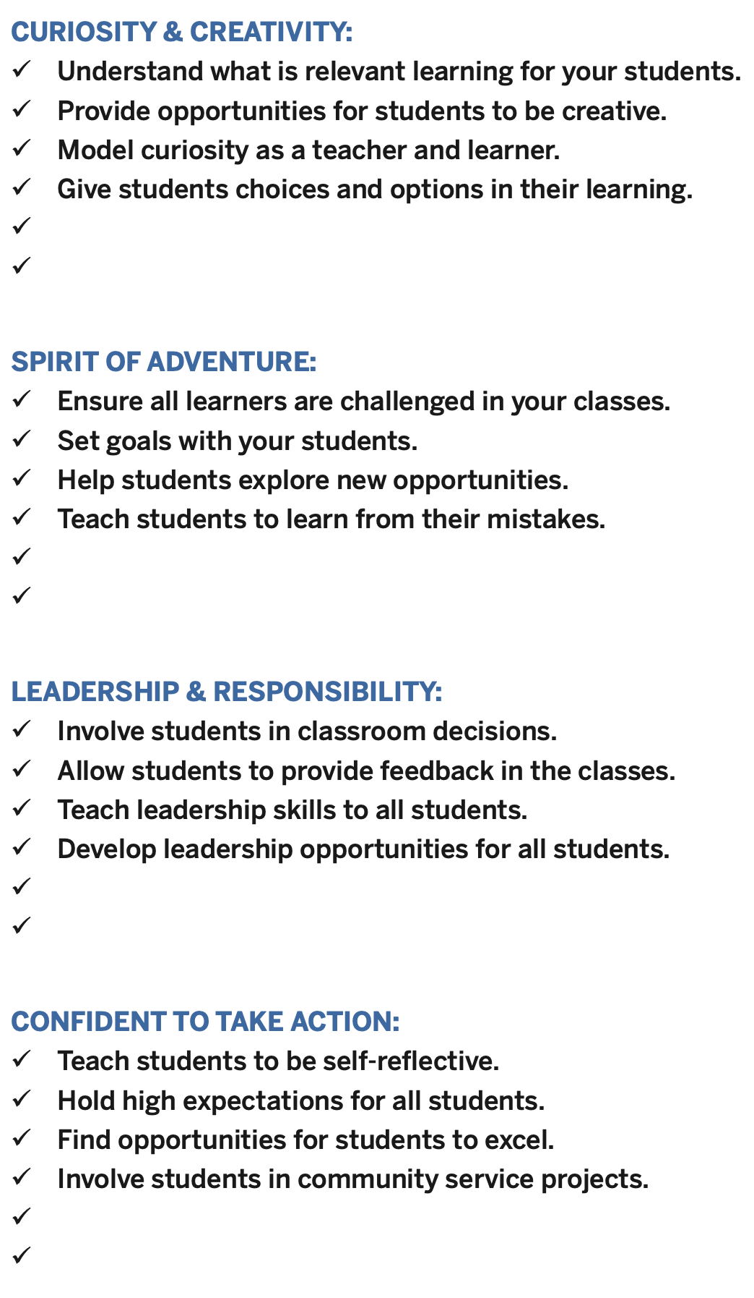
8 Conditions
Best Practices
in Action

Slide 49
Dynamic Process

Slide 50

What is your “WOW” moment of
learning from today?

Slide 51

What is your “WOW” moment of
learning from
today?

Slide 52
Next Session
Celebrating the Power of Voice by
Developing Greater
Partnerships & Purpose
April 27, 2023 in Salina
Dr. Russ Quaglia & Dr. Lisa Lande
@QISVAtweets @Lisa_Lande
quagliainstitute.org

