Slide 1
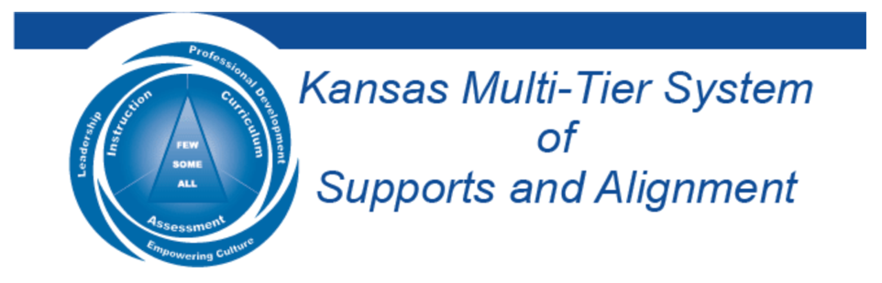

The School Voice Process:
Listen, Learn, Lead
January 18, 2023
Dr. Russ Quaglia & Dr. Lisa Lande
@QISVAtweets @Lisa_Lande
quagliainstitute.org

Slide 2
Goals for Today
Discover the components & nuances
of the School Voice Process: Listen,
Learn, Lead
Consider how the School Voice Process
can support positive school culture &
the learning environment.
Apply learning to amplify Student
Voice in YOUR school, particularly.

Slide 3
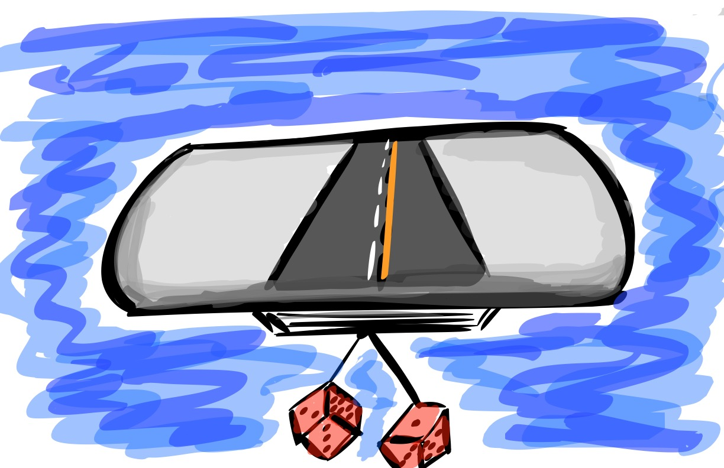
Quick Review

Slide 4

Fundamental Beliefs
Students are the potential, not the problem.
Students have something to teach us.
Working together is the only way forward.

Slide 5
The 3 Components of Student Voice
PART 1:
PART 2:
PART 3:

Slide 6

The 3 Components of Student Voice
Sharing thoughts & ideas in an environment underpinned by trust & respect.
Offering realistic suggestions for the
good of the whole.
Accepting responsibility for not only what is said but also what needs to be done.

Slide 7
ASPIRATIONS
The ability to
dream & set goals
for the future,
while being inspired
in the present
to reach those dreams.

Slide 8




high
Imagination
Aspiration
DREAMING
Hibernation
Perspiration
low
DOING
high

Slide 9

Time to journey
onward & explore
the Student Voice Process

Slide 10

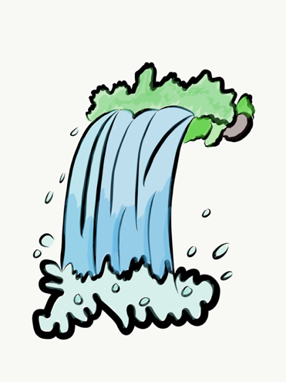
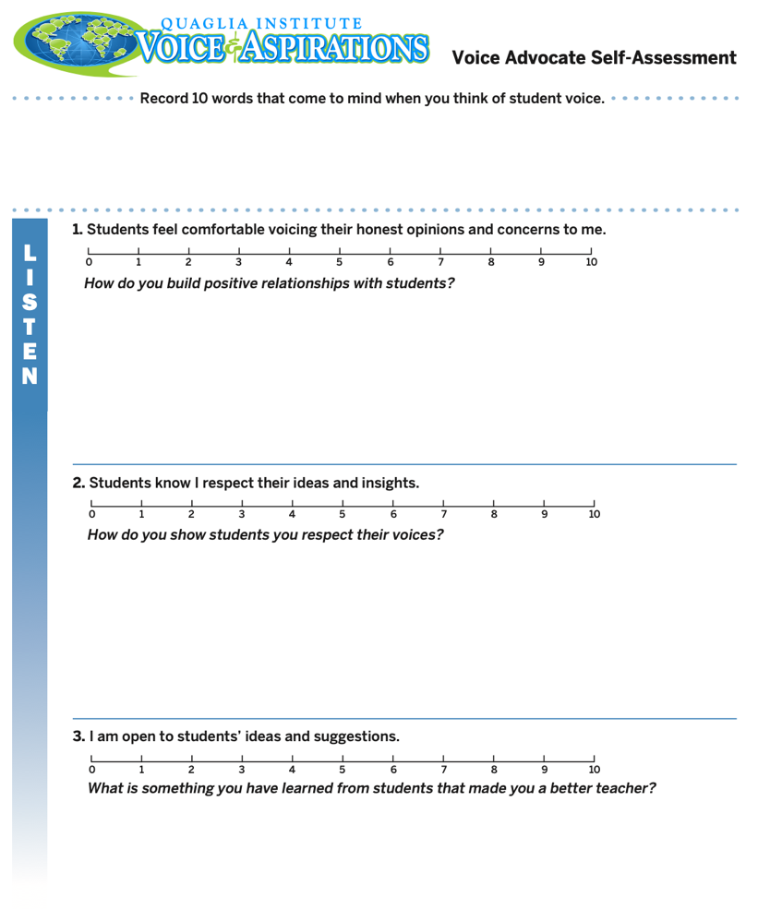
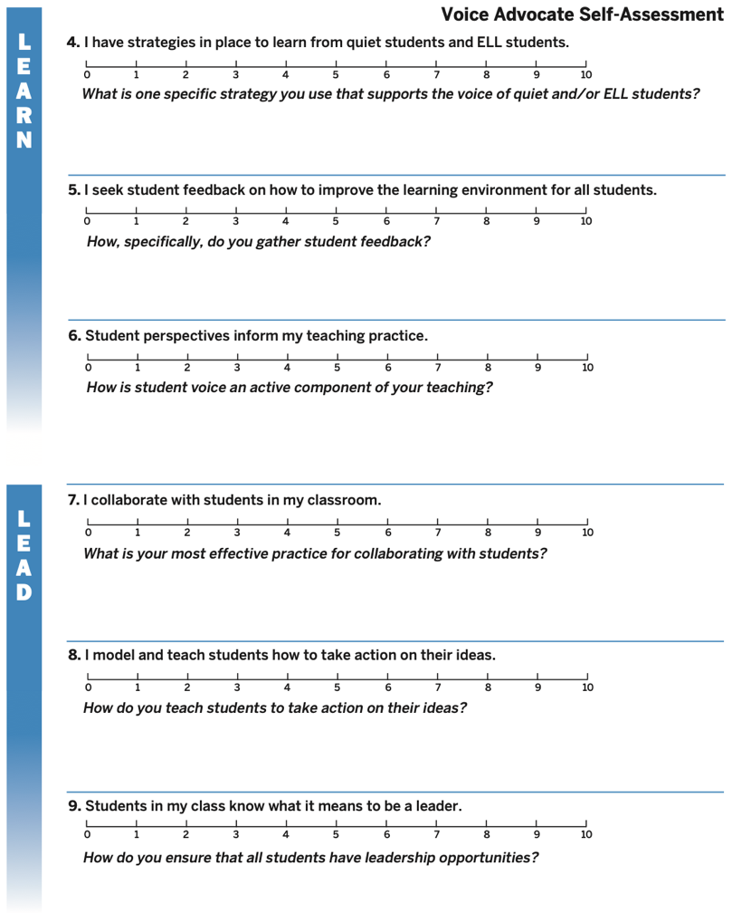
What did you learn from
the Voice Advocate
Self-Assessment?
Voice
Advocate
Self Assessment

Slide 11
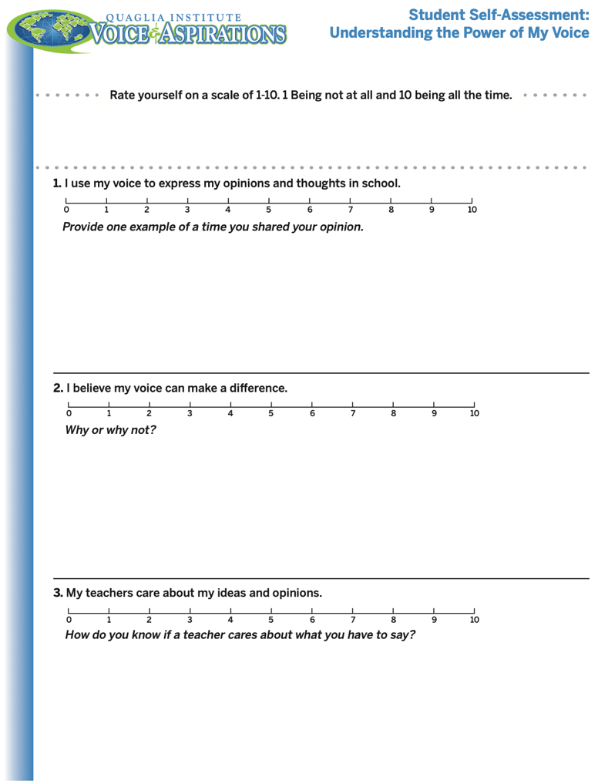
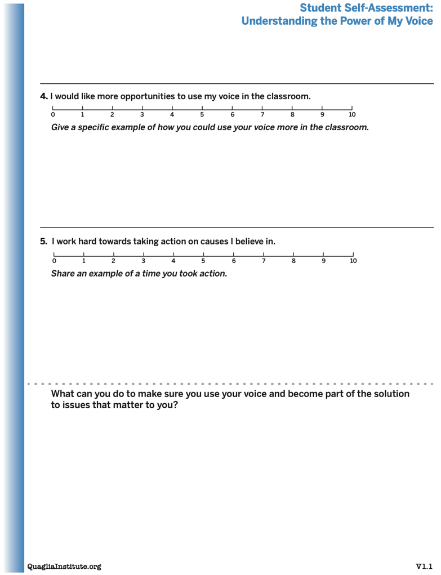
Understanding the Power of My
Voice Student Self Assessment
Student Voice
Self Assessment
Consider having your students
complete this
“Understanding
the Power of
My Voice”
self-assessment.

Slide 12
LEAD
School Voice
Process Brief
TAKE ACTION
with others
Share
RESPONSIBILITY
LEARN
UNDERSTAND
& RESPECT
different points
of view
Build
TRUST
LISTEN
SEEK OUT
opinions from
others
School Voice Process

Slide 13

Listen

Slide 14
The Art of Listening
https://vimeo.com/791196661
video

Slide 15

Challenge Time…

Slide 16


Challenge
Listen carefully and
try to accurately
draw the design
Dr. Russ will describe.
When finished, hold your picture up for everyone to see and
judge how well you listen! ☺

Slide 17


Challenge
Drawing Dictations Lesson Plan
Round 1: Find a partner &
assign one person to be the
Describer, & one person to
be the Artist. Sit back to back. Without looking or asking
questions, describe to your
partner how to replicate
your picture.
Round 2: Switch roles (Describer & Artist) & switch cards with someone nearby.
Repeat the activity, but this time you
can ask clarifying questions. Still sit
back to back & no looking! ☺

Slide 18
Listen
Make an effort to reach out to the ones
you don’t hear
Stay focused (put away your phone!)
Be genuine (at the very least be interested)
Make sure you are talking less than the
other person
Being open to new ideas is not an option

Slide 19

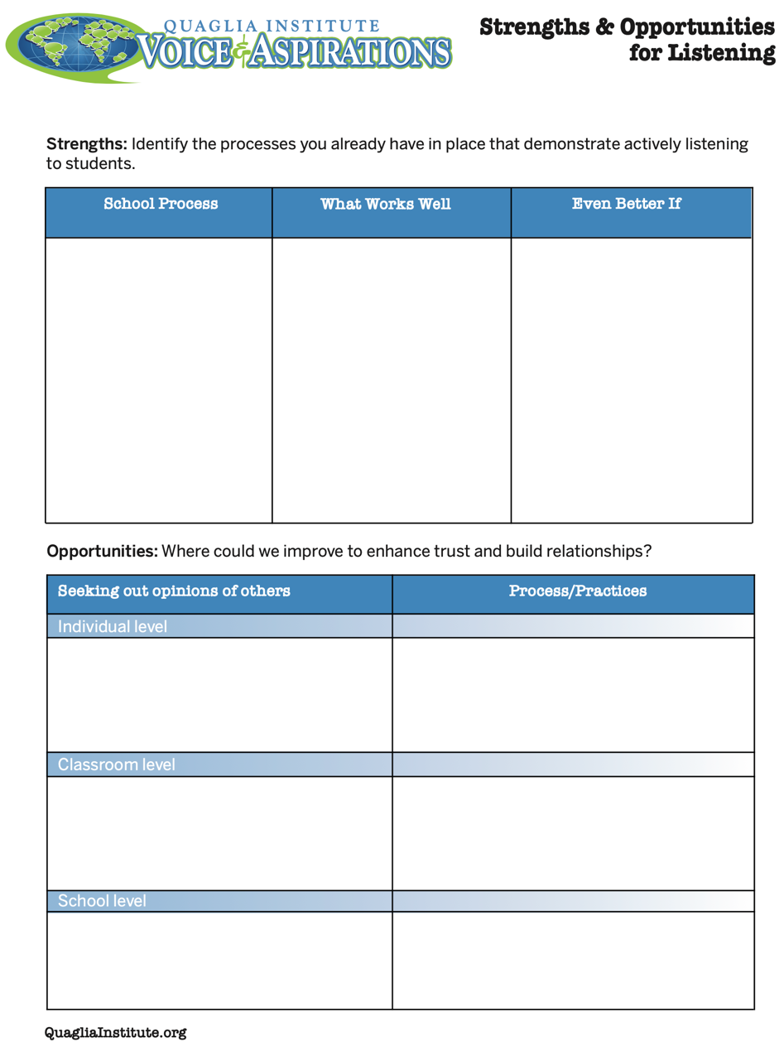
Reflect
What are your
strengths &
challenges when it
comes to
Listening to students?
How do you build trust & positive relationships?
Strengths & Opportunities
for Listening

Slide 20

Learn

Slide 21
Taking Time to Learn
https://www.vimeo.com/manage/videos/791193068/general
video

Slide 22
Challenge Time…

Slide 23

Challenge
Find the connection
between the 4 individual pictures.
Who can type the answer
FIRST in the Zoom chat?

Slide 24
Connections
https://vimeo.com/791244075/2316ae4847
video

Slide 25
Connections
https://vimeo.com/791244104/0d5c0633e8
video

Slide 26
Connections
https://vimeo.com/791244006/000860c1fb
video

Slide 27
Connections
https://vimeo.com/791243961/010d15c2a7
video

Slide 28
Connections
https://vimeo.com/791244140/4f6a685649
video

Slide 29
Connections
https://vimeo.com/791244215/361d27b9a1
video

Slide 30
Connections
https://vimeo.com/791244035/3fb0856e7a
video

Slide 31
Connections
https://vimeo.com/791244218/cb53aea45e
video

Slide 32
Connections
https://vimeo.com/791243914/7fc20b03a0
video

Slide 33
Learn
Learn from a variety of perspectives
Take notes
Ask questions for clarity
Do not judge
Make sure you continue to listen as you learn
Be prepared to change
Do not fear what you do not know

Slide 34
Excerpts of videos created by NSW Public Schools
https://vimeo.com/791196158
video
Notes:
Multiple opportunities but requires planning, ongoing process and taking students with you

Slide 35

Reflect
What actions can you take to Learn from students as a
regular practice at
your school?

Slide 36
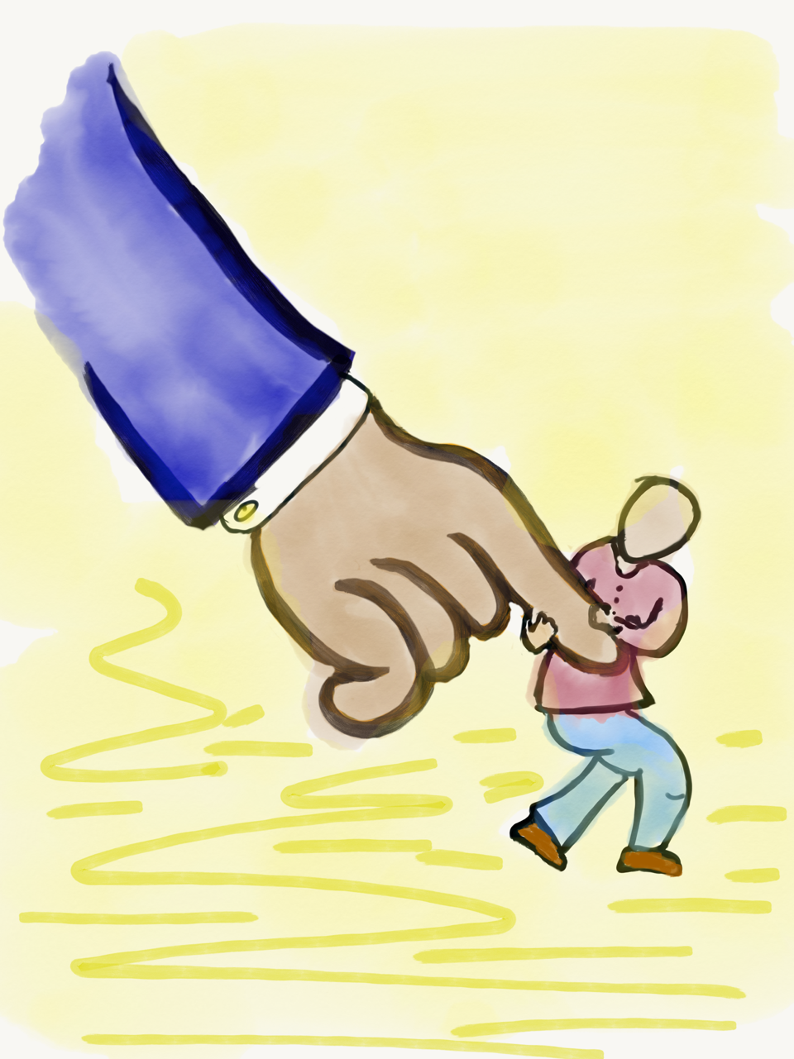
Lead

Slide 37
Leading Together…
https://vimeo.com/791195008/01d02d8710
video

Slide 38
Reflect
What did you observe related to the term Lead in this video?

Slide 39
LEAD
Don’t let your voice be silent.
Make sure ALL voices are heard.
Listen, really listen.
Embrace the unknown.
Expect more from students.
Don’t give false praise.
Do something!

Slide 40
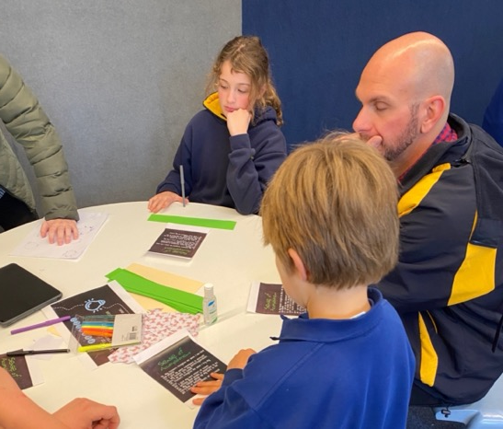
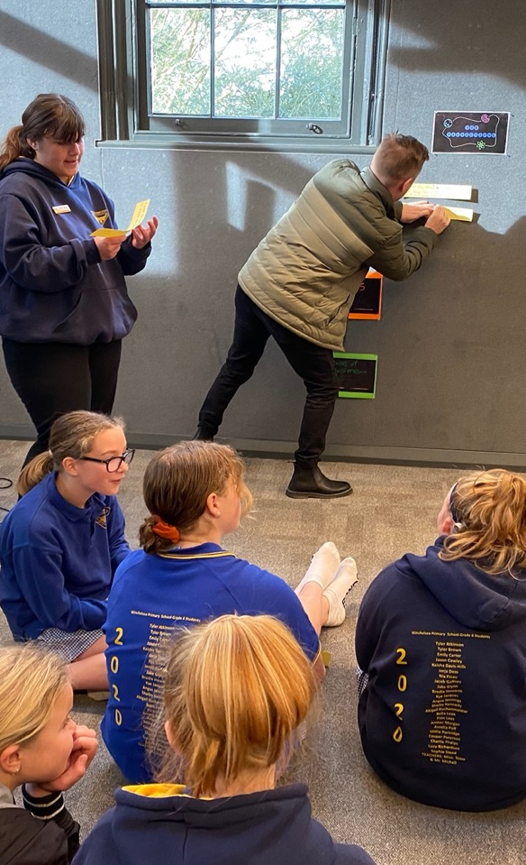
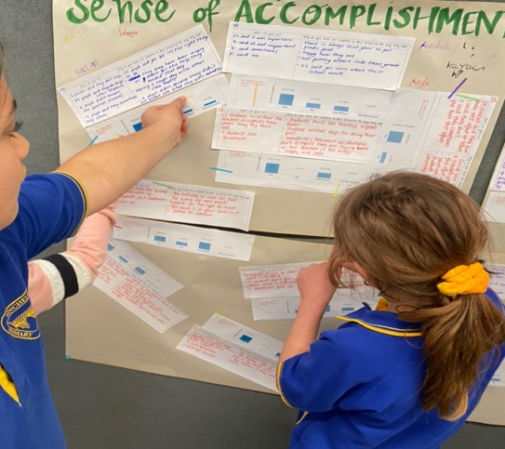
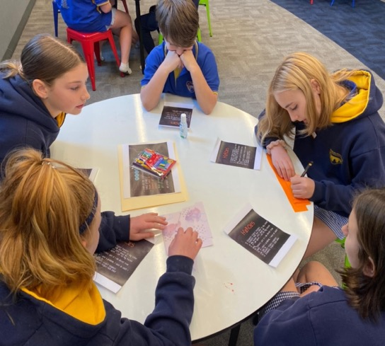
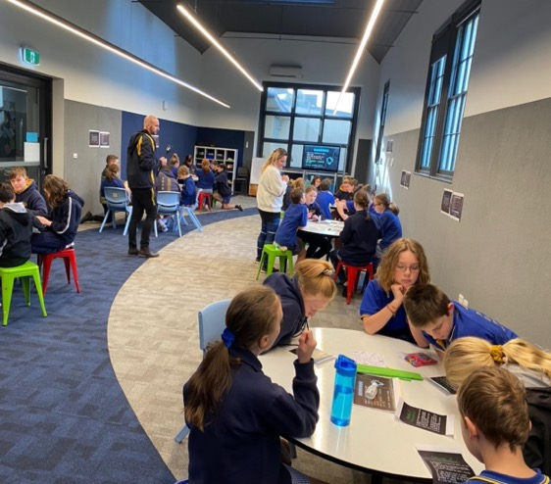
Leading Together
Pictures courtesy of Winchelsea Primary, Victoria, Australia

Slide 41
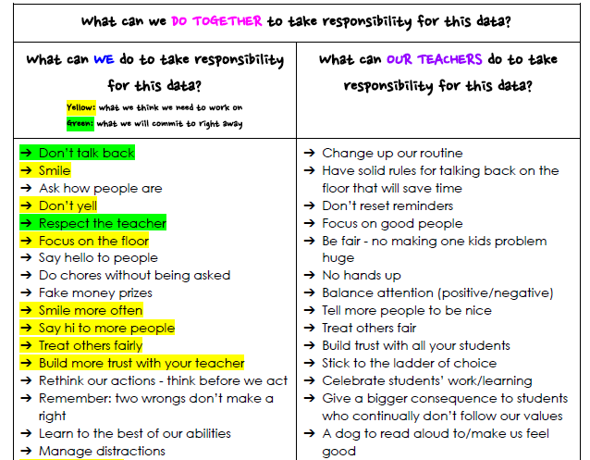
Taking Responsibility for LEAD
Document courtesy of Winchelsea Primary, Victoria, Australia

Slide 42
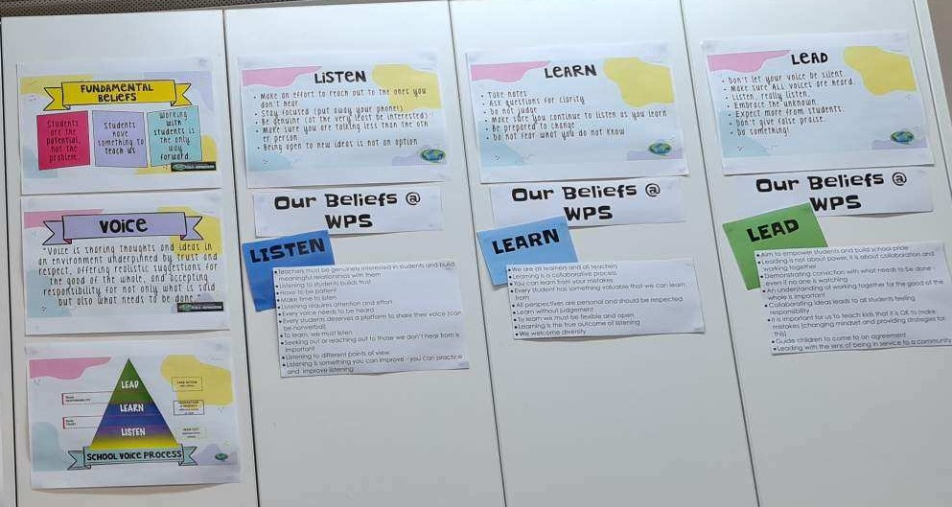
Taking Responsibility for LEAD
Picture Courtesy of Winchelsea Primary, Victoria, Australia

Slide 43


Slide 44

Reflect
What is one area at your
school/in your classroom in
which students can be
invited to Lead with you?

Slide 45
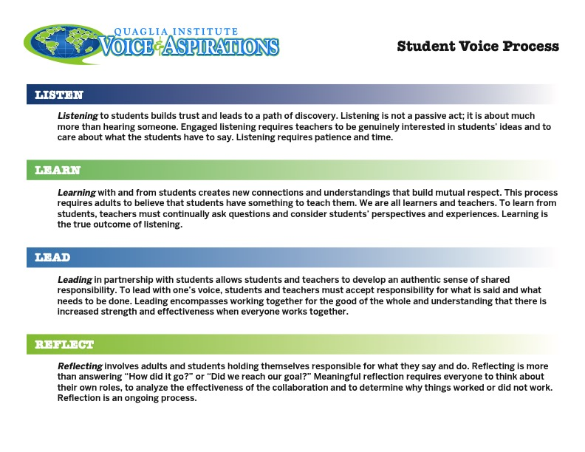
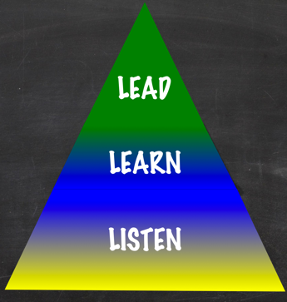
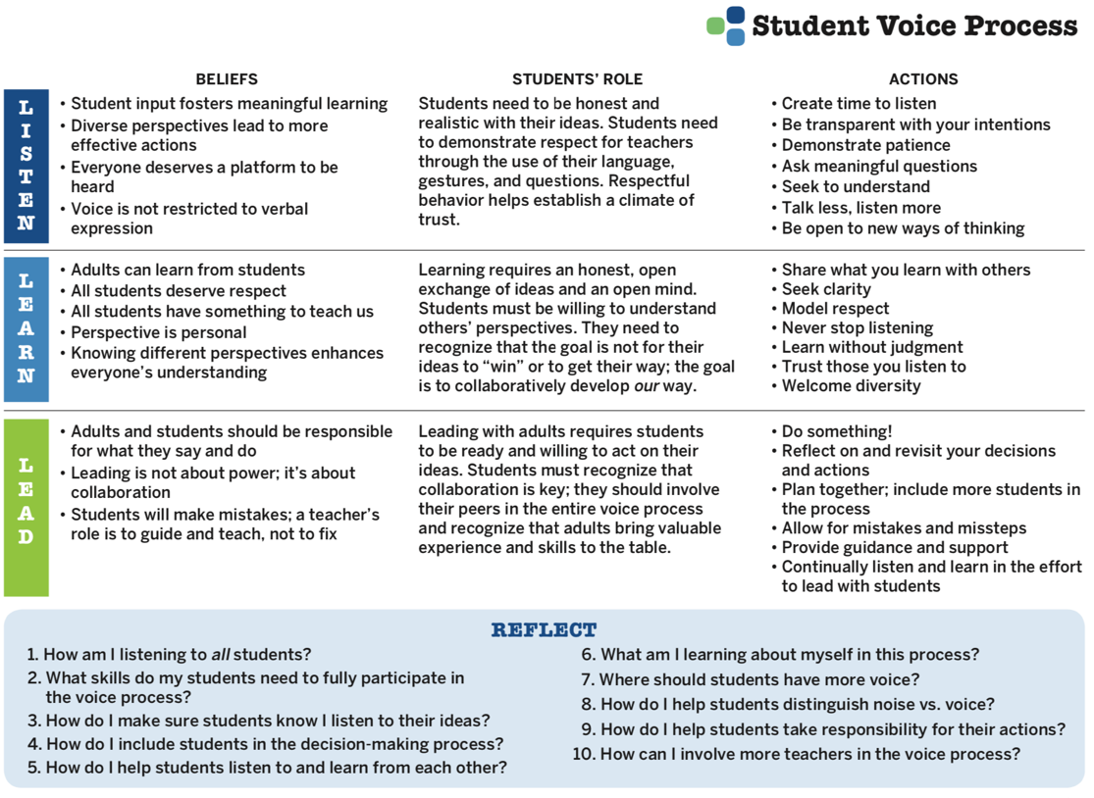

Voice Process
Student Voice
Process Tool

Slide 46


Voice Process
Explore beliefs, students’ role, & actions related to Listen, Learn, & Lead.
Discuss the reflection questions in your PLC teams.

Slide 47

Voice Process
Co-construct shared meaning &
expectations for Listen, Learn, Lead
specific to your school.

Slide 48
What is Student Voice?
https://vimeo.com/791212161/dc39d1e596
video

Slide 49

A Quick Recap
3-Part Definition of Student
Voice & Noise v. Voice
Aspirations Profile & how it
relates to Student Voice
Student Voice Process:
Listen, Learn, Lead

Slide 50

Where do we
go next?
In our next session,
we will explore
Voice & Vision:
Using Data to Guide
Implementation of the
Aspirations Framework

Slide 51
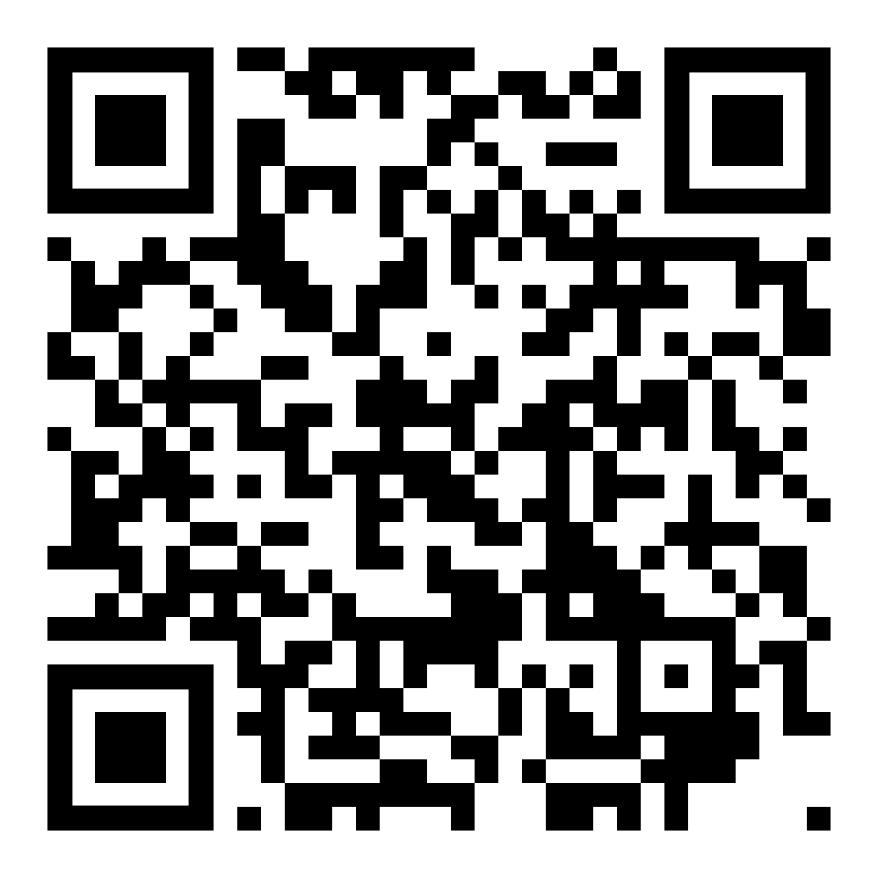

Website Just For YOU!
https://quagliainstitute.org/kansas-multi-tier-system

Slide 52


Voice Advocate
Self Assessment
Student Voice
Self Assessment

Slide 53
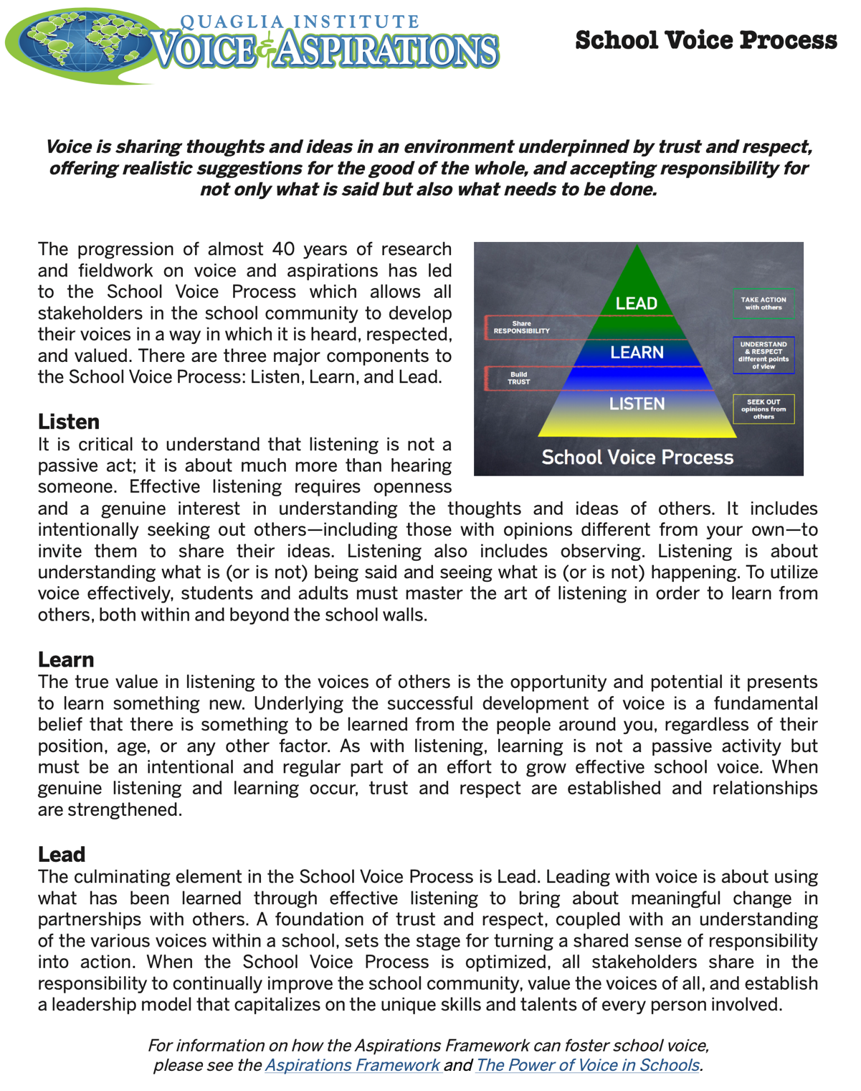
School Voice
Process Brief

Slide 54
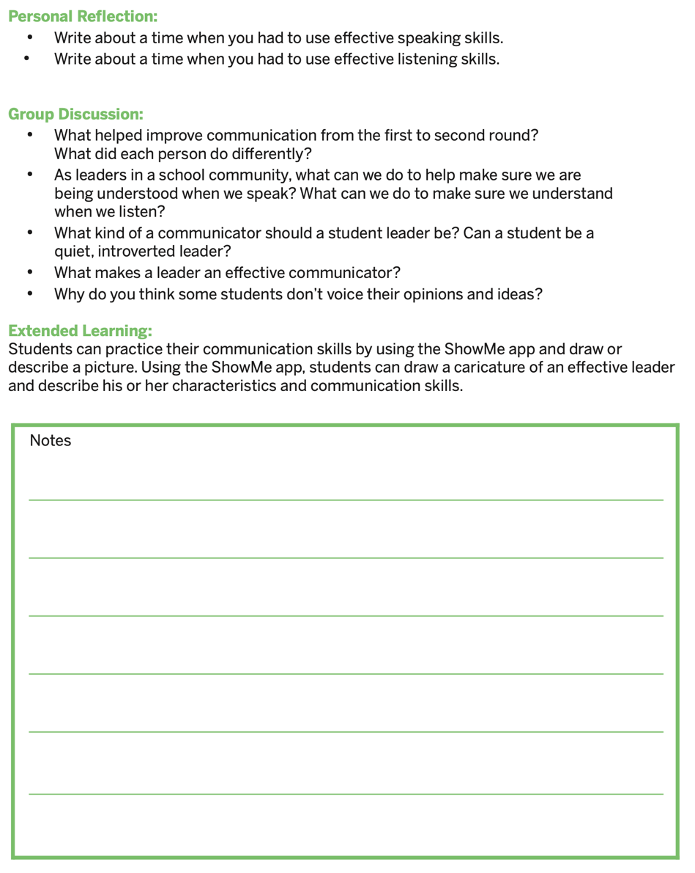
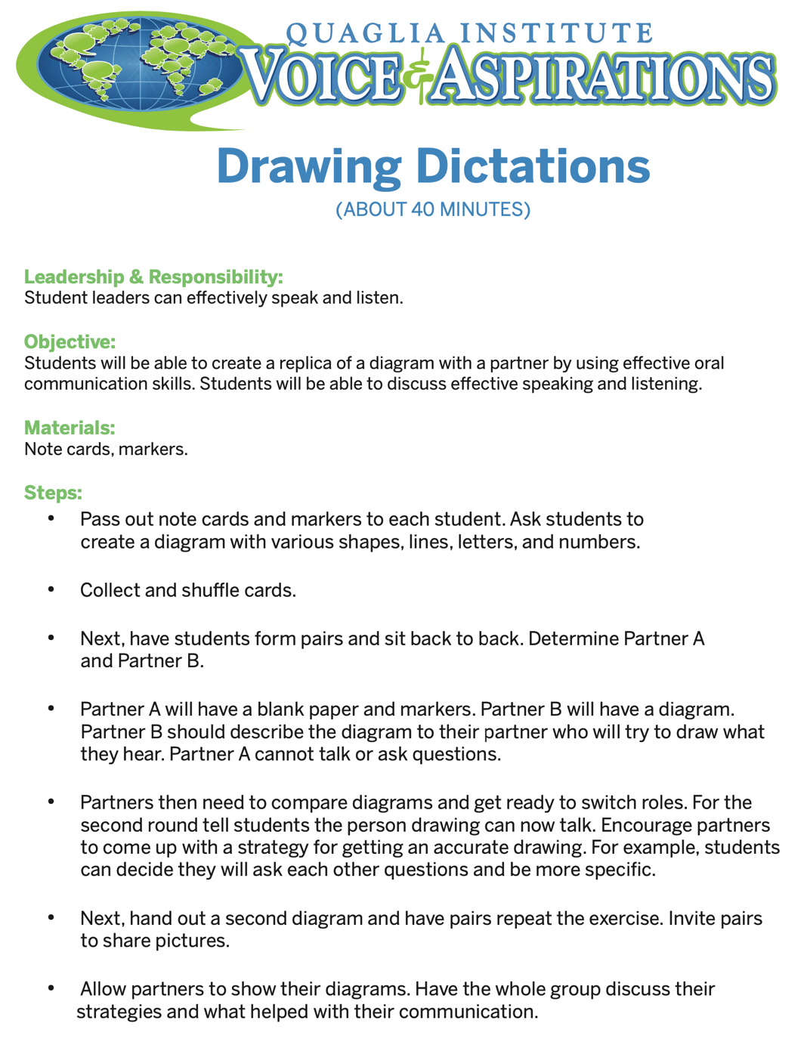
Drawing Dictations Lesson Plan

Slide 55
Student Voice
Process Tool

Slide 56
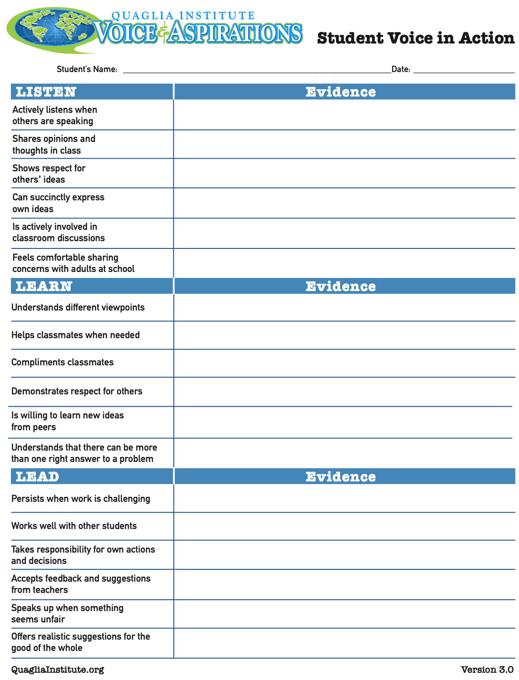
Consider asking
teachers to use this
tool in looking for
evidence of Student
Voice in action.
Student Voice
in Action

Slide 57
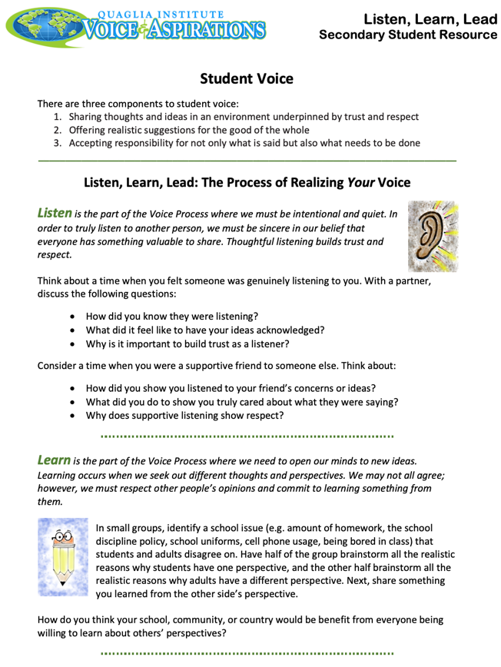
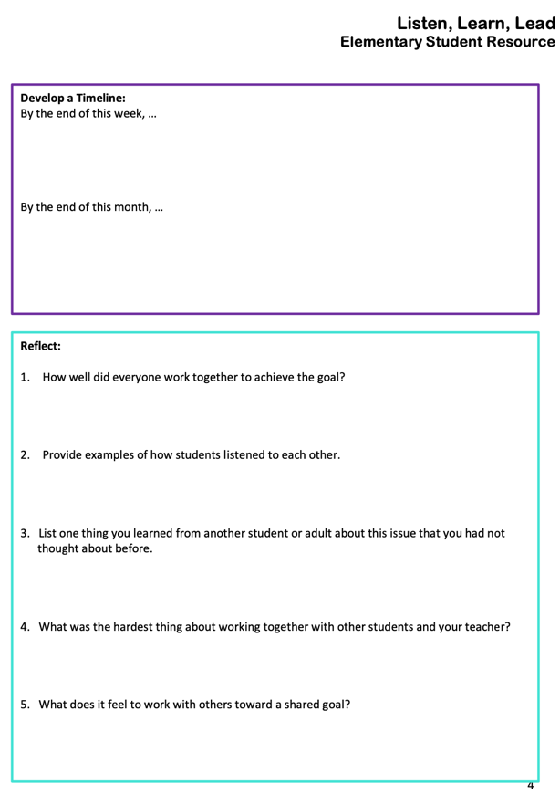

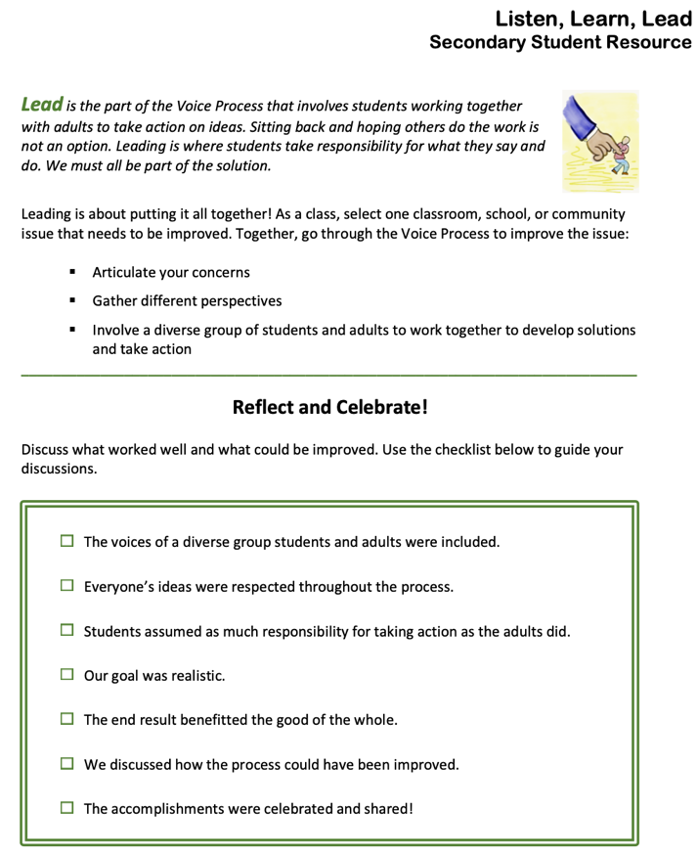
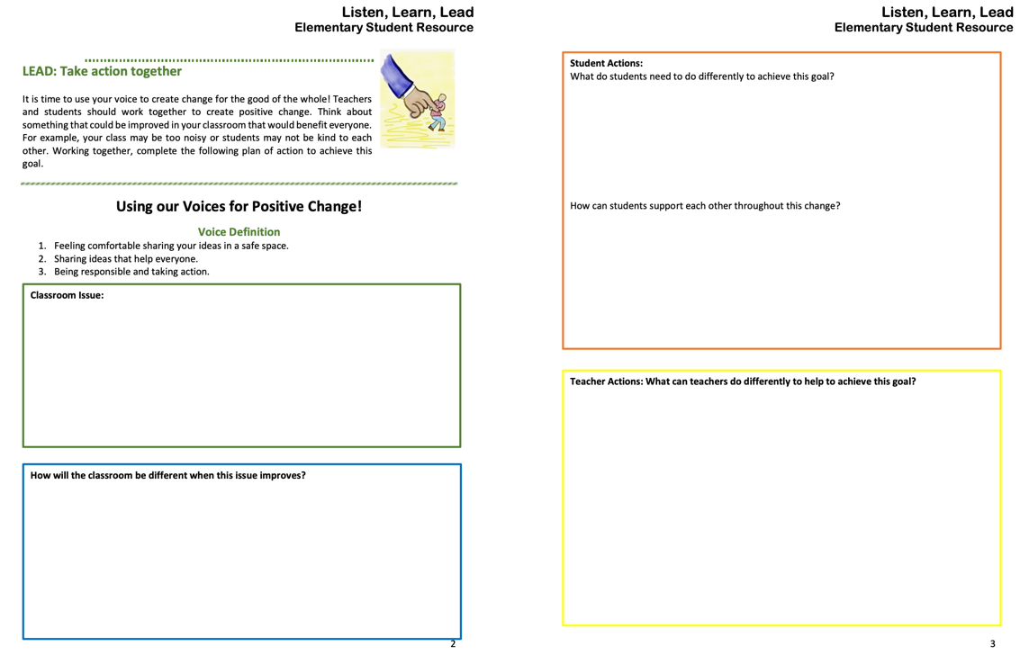
LLL Student
Resource
Elementary
LLL Student
Resource
Secondary

Slide 58
Fortune Cookie Challenge!
https://vimeo.com/791197431
video

Slide 59

Share your
fortune cookie message
related to what you
learned today.

Slide 60
Next Session
Voice & Vision:
Using Data to Guide Implementation
of the Aspirations Framework
March 1, 2023
Dr. Russ Quaglia & Dr. Lisa Lande
@QISVAtweets @Lisa_Lande
quagliainstitute.org

