Slide 1
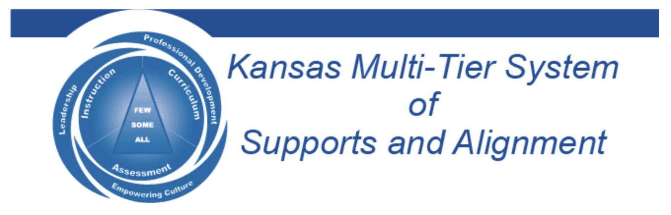

The Aspirations Profile
November 30, 2022
Dr. Russ Quaglia & Dr. Lisa Lande
@QISVAtweets @Lisa_Lande
quagliainstitute.org

Slide 2

Fundamental Beliefs
Students are the potential, not the problem.
Students have something to teach us.
Working with students is the only way forward.

Slide 3
Goals for Today
Explore the Aspirations Profile & the
relationship between dreaming & doing.
Consider how the Aspirations Profile
can & should affect how we support
Student Voice.
Apply learning to amplify Student
Voice in YOUR school.

Slide 4

Challenge Time…

Slide 5
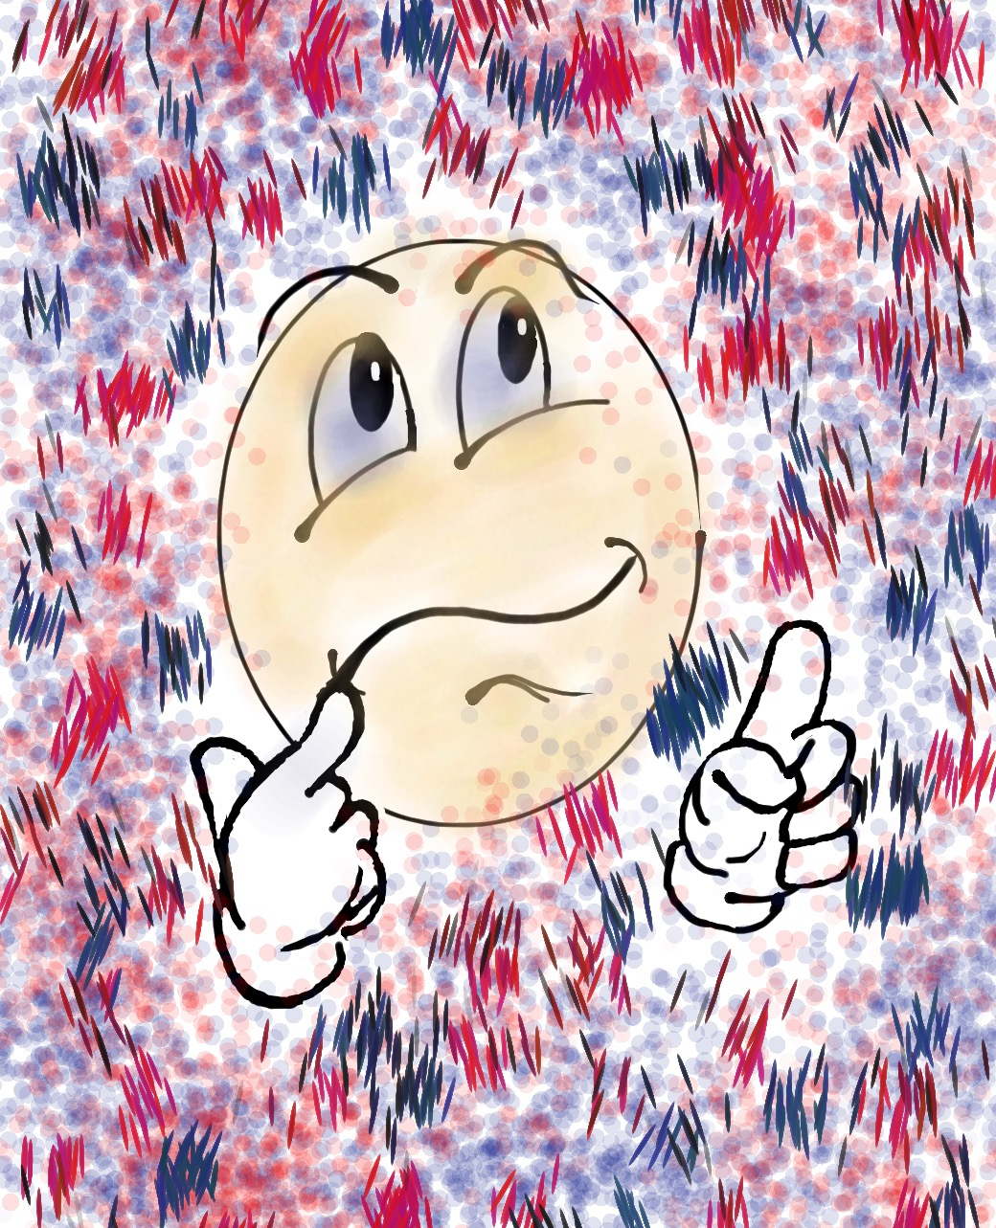
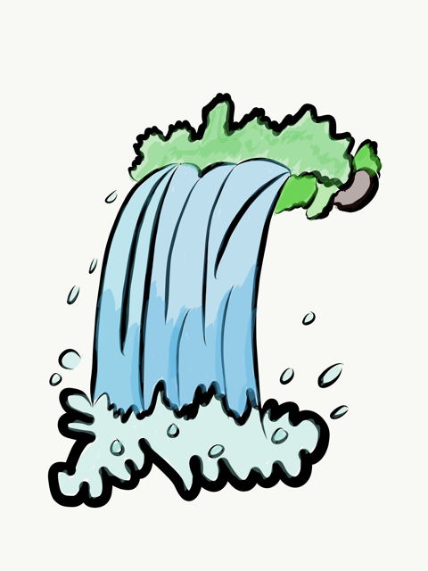
Challenge
Share anything you remember from the 3-part Voice
definition learned during
Session #1 in the chat.

Slide 6

The 3 Components of Student Voice
Sharing thoughts & ideas in an environment underpinned by trust & respect.
Offering realistic suggestions for the
good of the whole.
Accepting responsibility for not only what is said but also what needs to be done.

Slide 7
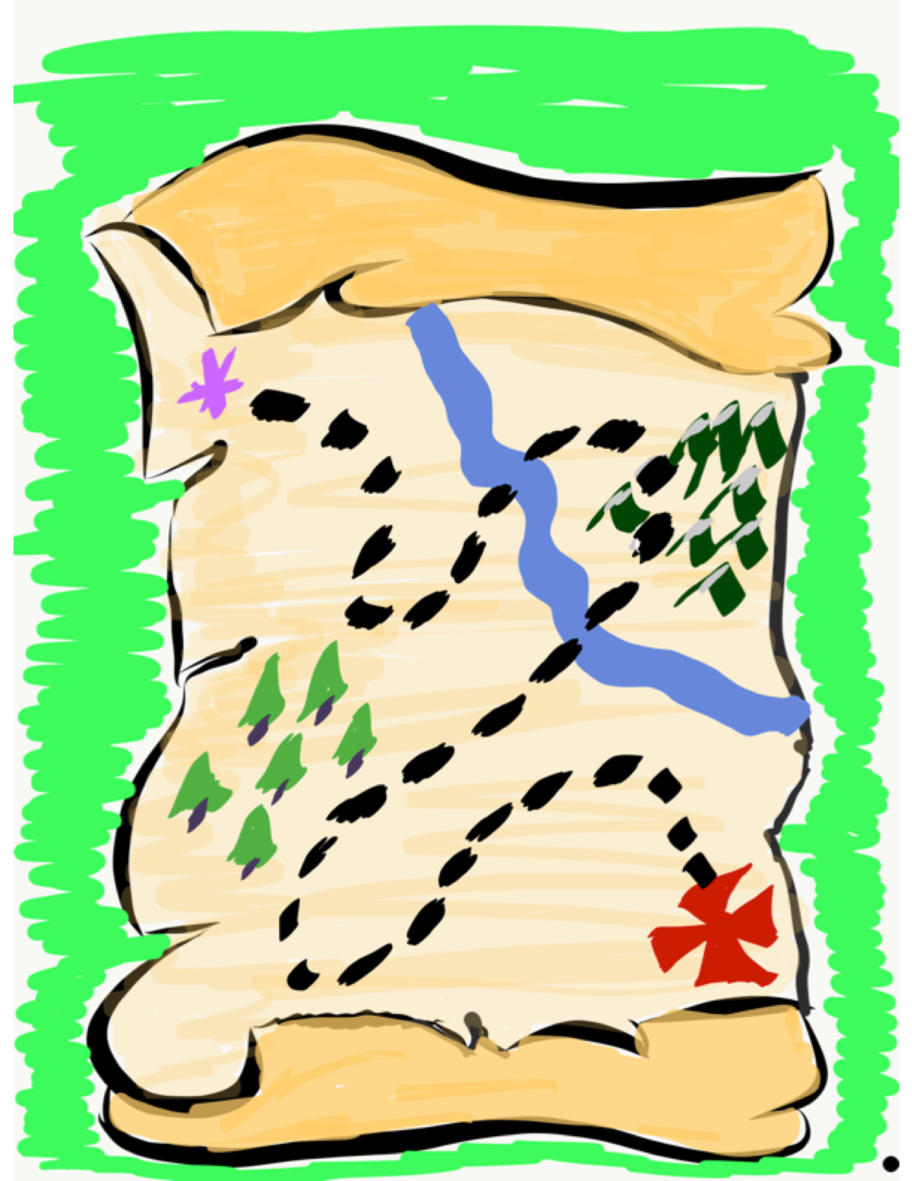
We journey
onward…
Now it is time to explore the Aspirations Profile as we
consider how to support
students in developing their voice & reaching their
fullest potential.

Slide 8
ASPIRATIONS
The ability to
dream & set goals
for the future,
while being inspired
in the present
to reach those dreams.

Slide 9




high
Imagination
Aspiration
Resource
DREAMING
Hibernation
Perspiration
low
DOING
high

Slide 10

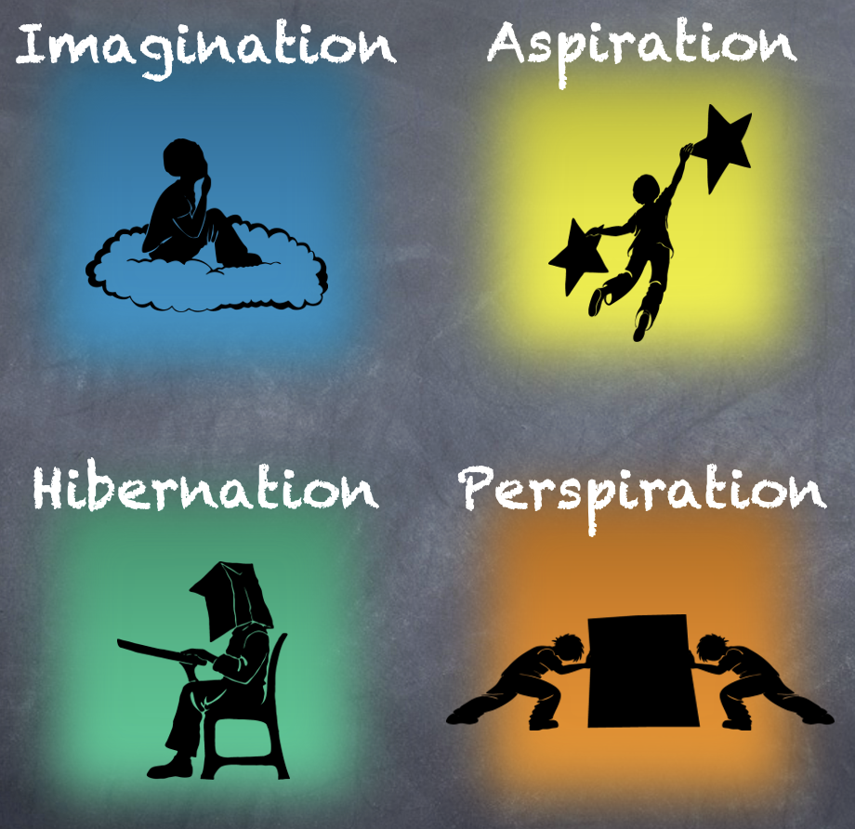
Reflect
In which quadrant did you spend most of your time as a student? Why?

Slide 11
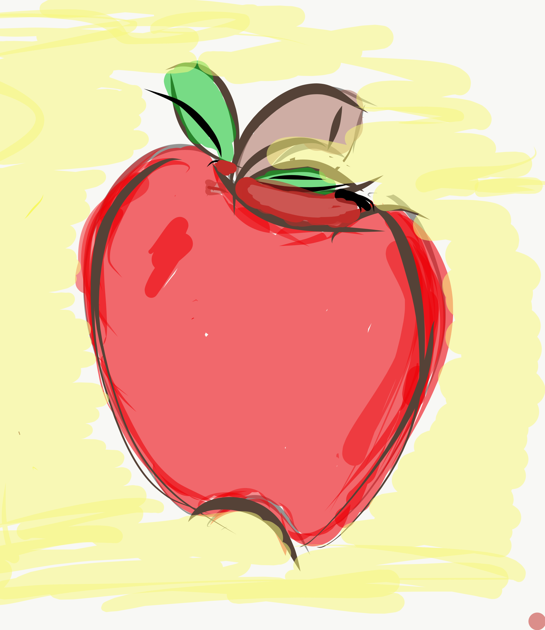
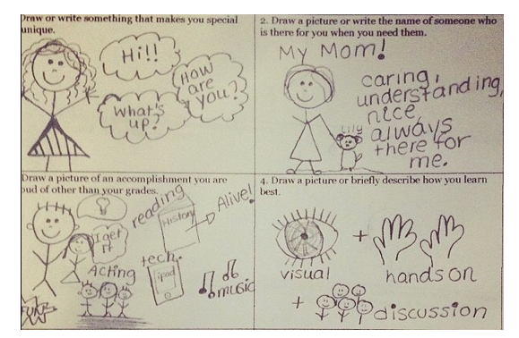
Lesson Plan
Aspirations Story Squares
Resource
Complete the Aspirations Story Squares handout.
Mingle around the room sharing different squares with your peers.

Slide 12

Time to Dig Deeper!

Slide 13
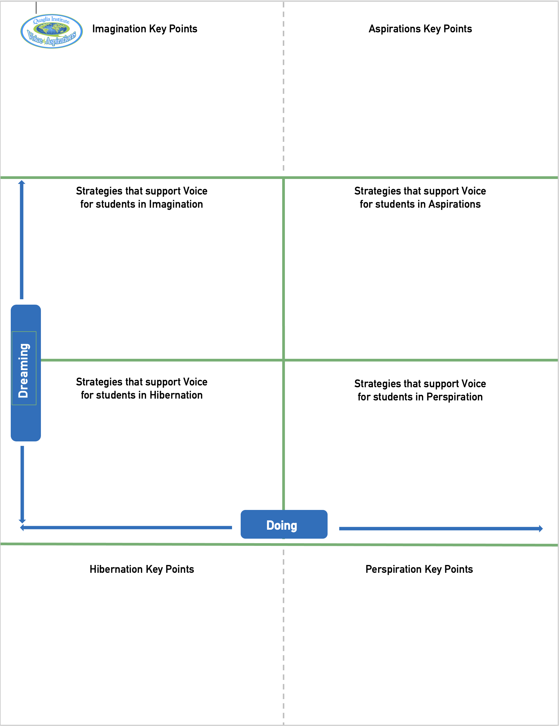
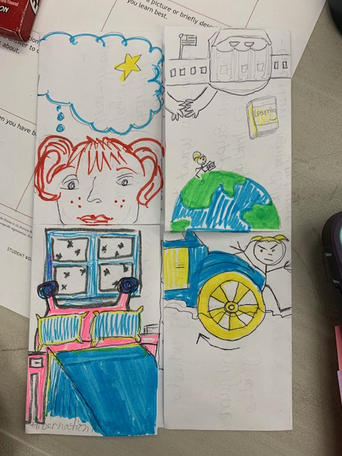
Aspirations Foldable!!
Resource
Imagination
Aspiration
Perspiration
Fold
Cut
Hibernation

Slide 14
high
DREAMING
Hibernation
low
DOING
high

Slide 15
high
DREAMING
https://vimeo.com/qisva/officespace
low
DOING
high

Slide 16
Reflect
What is one word that might describe students in hibernation?

Slide 17

Students in Hibernation
Potential Cons:
Passive & unmotivated
Poor self-esteem &
defeatist attitude
Struggle to take
responsibility for
anything
Potential Pros:
Time to reflect
Space to recharge
They report:
Feeling isolated
Stuck
Misunderstood
Bored
They need to:
Feel valued
Be recognized for success
Have positive role models
Have a sense of purpose

Slide 18
Reflect
Think of the word you previously shared.
Now share a word that reflects your hopes & dreams for hibernating students.

Slide 19
high
Imagination
DREAMING
low
DOING
high

Slide 20
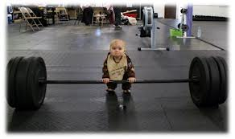
high
DREAMING
low
DOING
high

Slide 21
Reflect
What is something you dream about doing, but have not yet accomplished?

Slide 22

Students in Imagination
Potential Pros:
Enthusiastic
Fun to be around
Lots of creative ideas
Potential Cons:
Limited follow-through
Not well connected
to reality
Students report:
Having big dreams
Eagerness to explore
Craving creative outlets
They need to:
Develop action plans
Focus
Be realistic

Slide 23
Reflect
What is the first action you can take to move out of Imagination?

Slide 24
high
DREAMING
Perspiration
low
DOING
high

Slide 25
high
DREAMING
https://vimeo.com/qisva/snow
low
DOING
high

Slide 26
Reflect
What is the greatest source
of your own perspiration
right now?

Slide 27

Students in Perspiration
Potential Pros:
Determined
Hard Working
Driven to Succeed
Potential Cons:
Overly concerned
about grades
Single-minded,
narrow-focused
Students report:
Feeling stressed
Not sure “why” they are learning, but need
good grades
Don’t want to let
anyone down
They need to:
Have a greater purpose for learning
Balance school work with outside life
Link learning to
their passions

Slide 28
Reflect
What can you do to perspire a little less & dream a little more?

Slide 29
high
Aspiration
DREAMING
low
DOING
high

Slide 30
high
DREAMING
https://vimeo.com/qisva/goals
low
DOING
high

Slide 31
Reflect
What did you learn from the students about Aspirations?

Slide 32

Students in Aspiration
Potential Pros:
Connects present
actions to future
dreams
Good idea of
potential options
Potential Cons:
Relaxation is Challenging
Under constant pressure
Self-Serving
Students report:
Never feeling
satisfied
Driven by being best
Frustration with peers
who don’t try or who
interrupt learning
They need to:
Be assured they
are on a positive track
Experience meaningful academic challenges
Breathe!

Slide 33
Reflect
From your perspective, how does the Aspirations Profile connect to Student Voice.

Slide 34
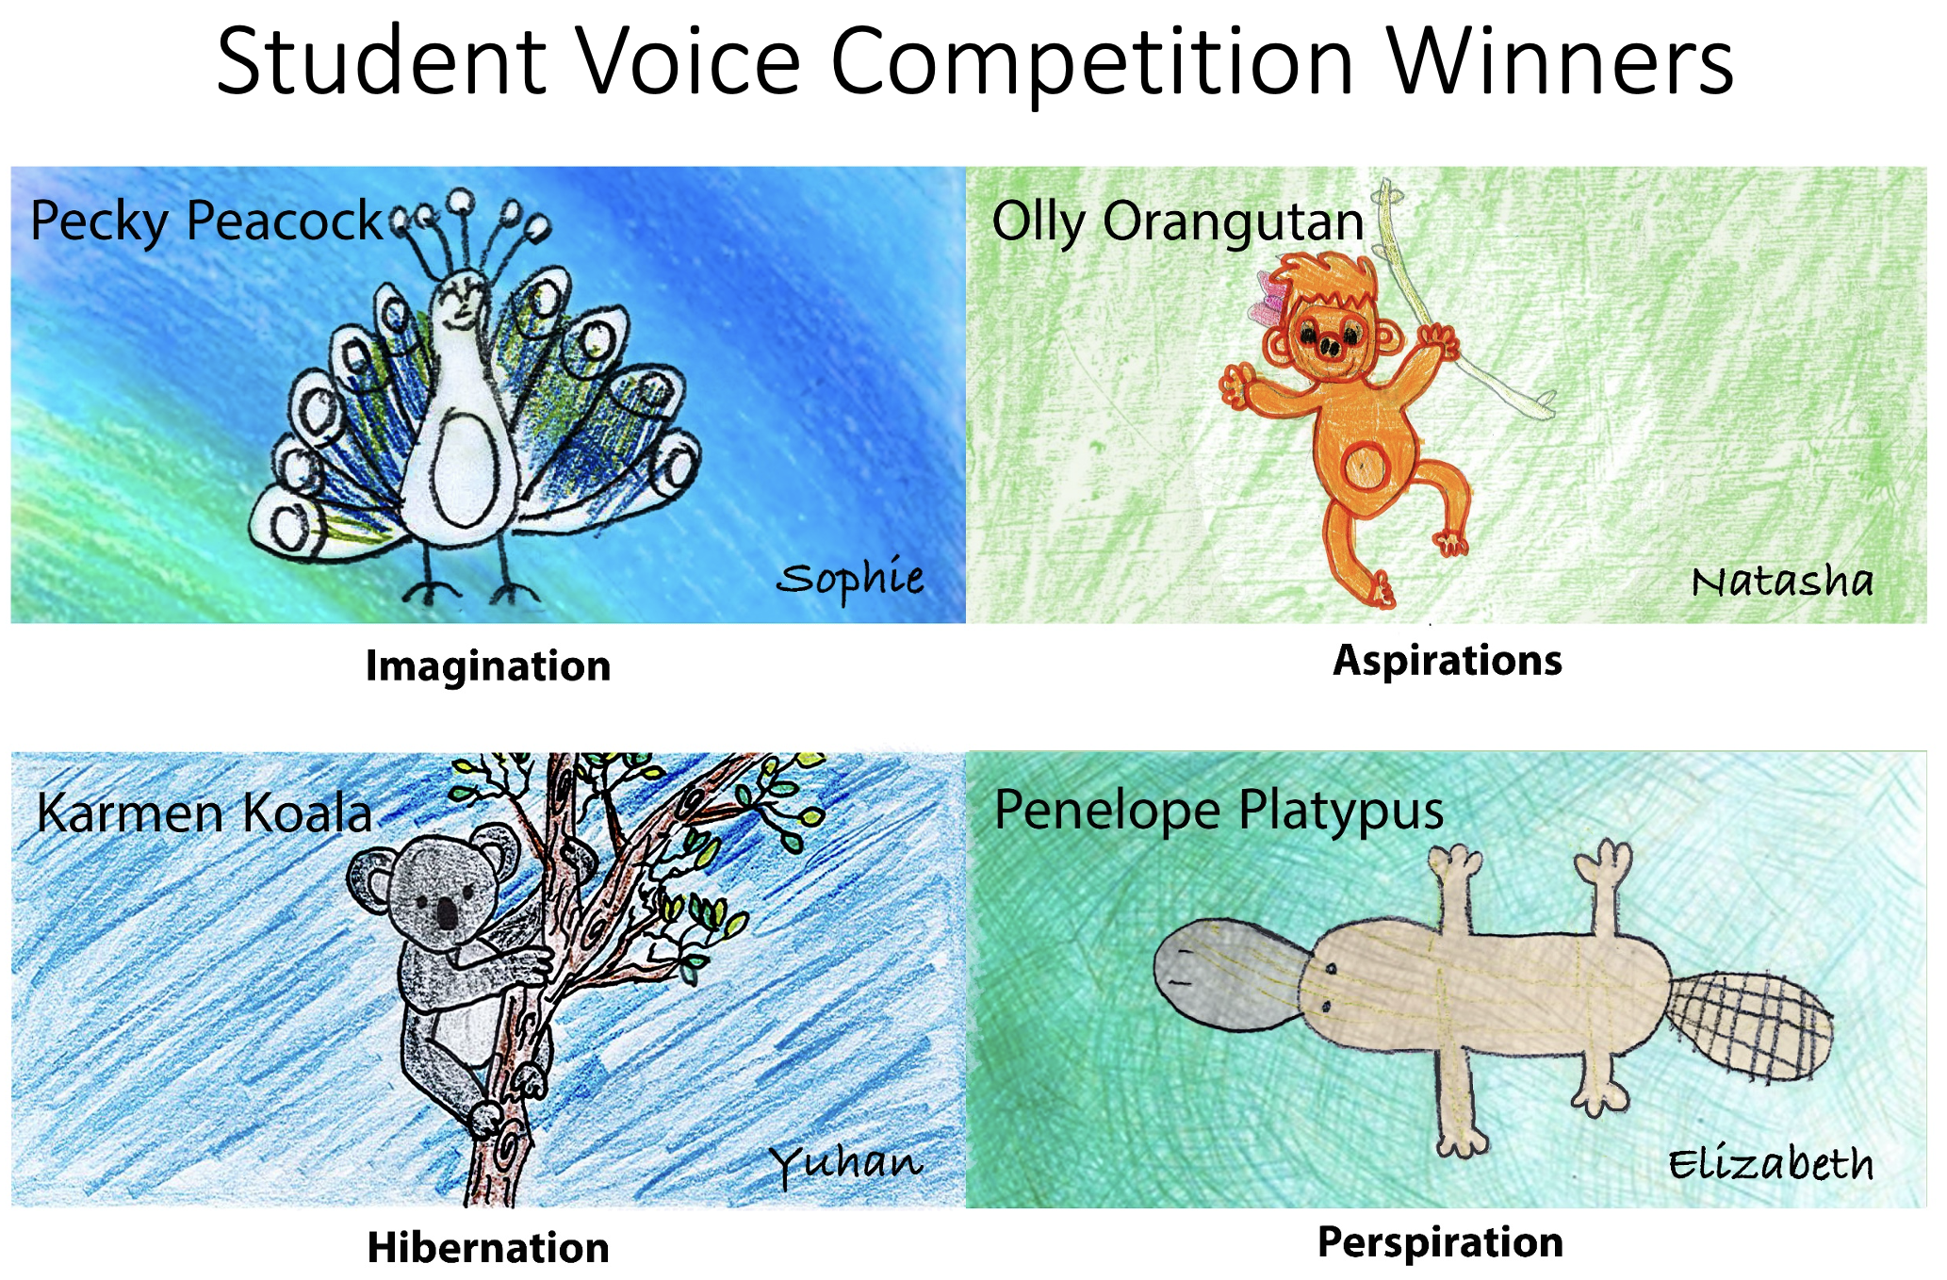
Opportunities for Students to own the Profile

Slide 35
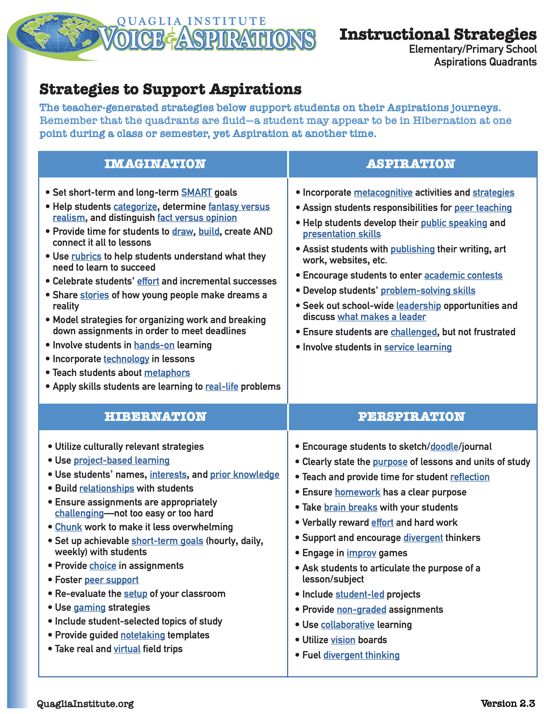
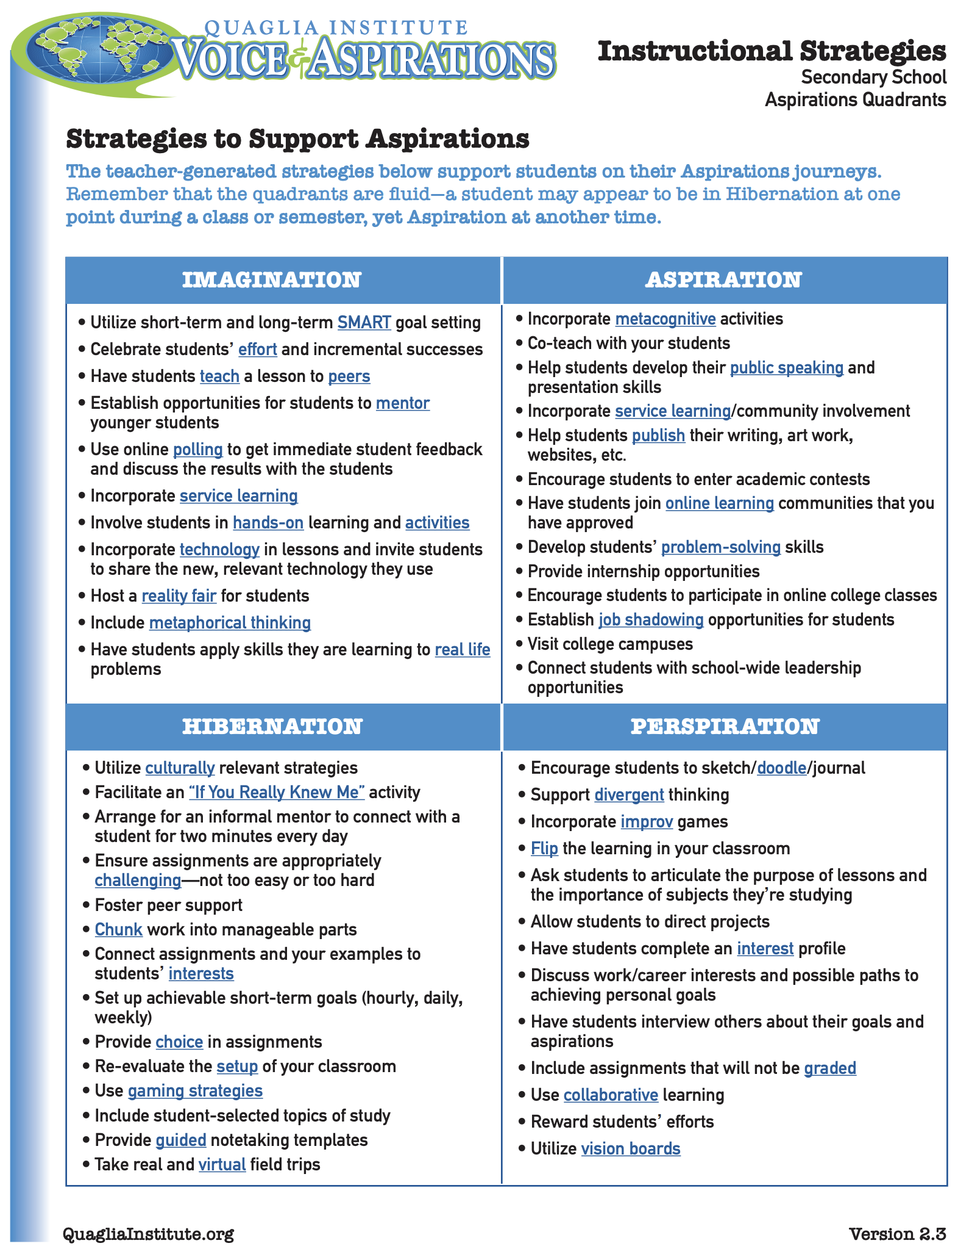
Resource

Slide 36
Quadrants & PLC’s
high
Imagination
Aspiration
Lots of planning
Little follow through
Discuss many ideas
No connection to school vision
Enthusiastic
Purposeful meetings
Changes in practice
Connection to school goals
Shared responsibility & ownership
Commitment
DREAMING
Hibernation
Perspiration
Sporadic attendance
No classroom impact
Compliance driven
No passion
Wait & see if this will last
Hard working
Meets deadlines
Overwhelmed, at risk of burnout
Team player
Dependable
low
DOING
high

Slide 37
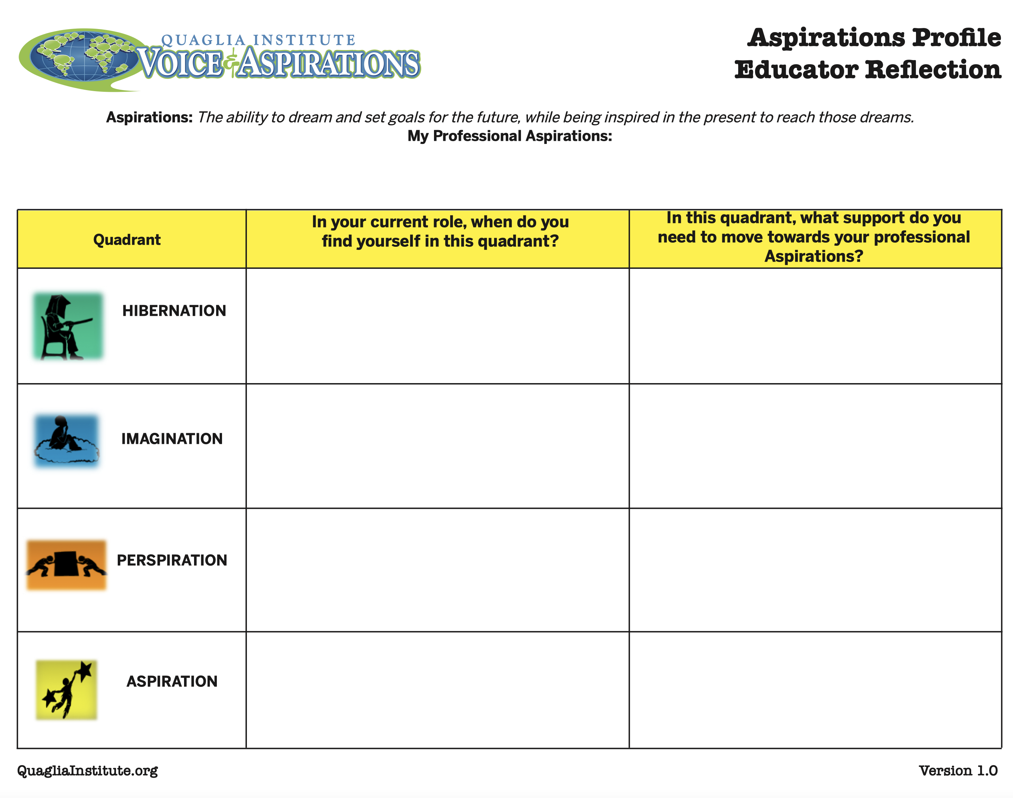
Reflect
Reflect on your professional aspirations in relation to the quadrants.
Resource

Slide 38
A Quick Recap
3-Part Definition of Student
Voice & Noise v. Voice
Aspirations Profile & how it
relates to Student Voice

Slide 39
Where do we
go next?
In our next session,
we will explore the
Student Voice Process:
Listen, Learn & Lead.

Slide 40
RESOURCES

Slide 41
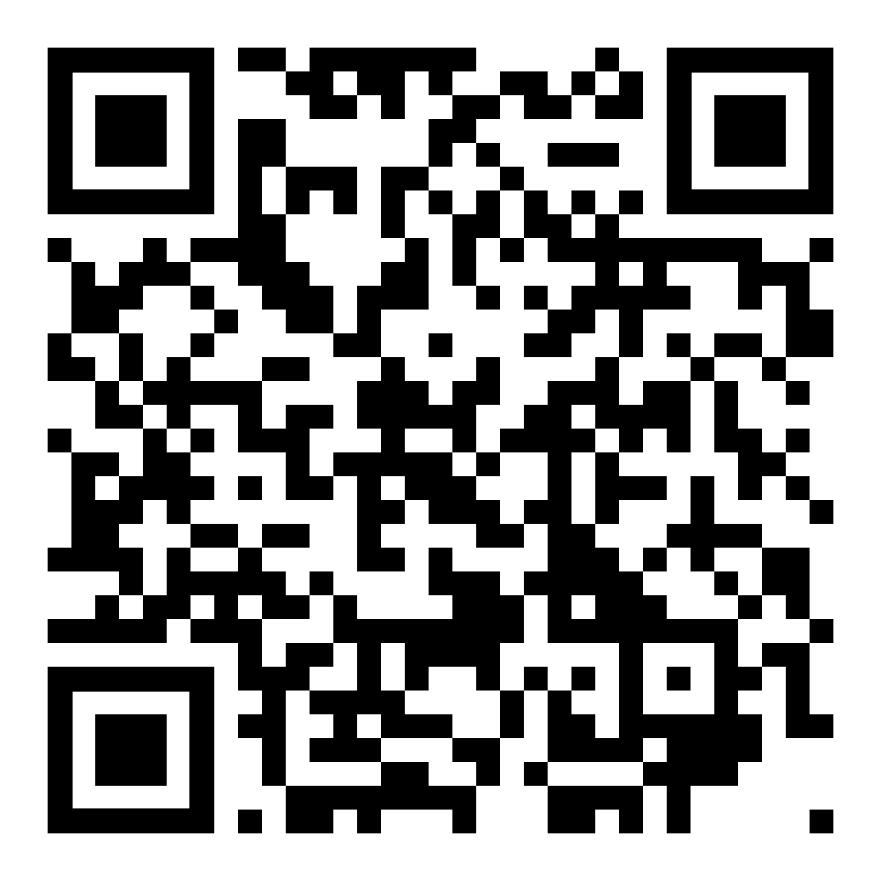

Website Just For YOU!
https://quagliainstitute.org/kansas-multi-tier-system

Slide 42
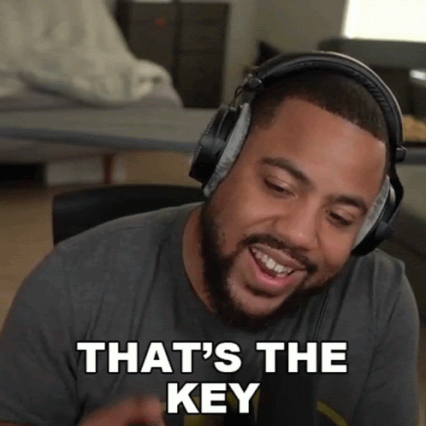
What is your key take away from today’s session?

Slide 43

What is your key take away from today’s session?

Slide 44
Next Session
Voice Process:
Listen, Learn, Lead
January 18, 2023
Dr. Russ Quaglia & Dr. Lisa Lande
@QISVAtweets @Lisa_Lande
quagliainstitute.org

