Slide 1
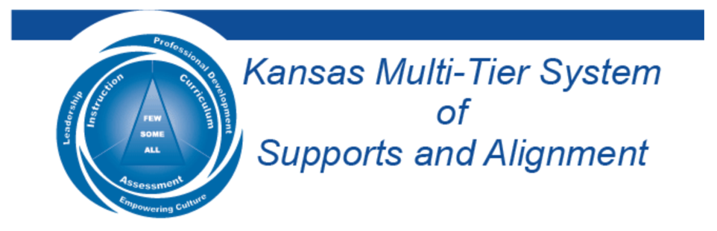

Understanding the Dynamics
of Student Voice
October 5th & 6th, 2022
Dr. Russ Quaglia & Dr. Lisa Lande
@QISVAtweets @Lisa_Lande
quagliainstitute.org

Slide 2

Fundamental Beliefs
Students are the potential, not the problem.
Students have something to teach us.
Working together is the only way forward.

Slide 3


Post Card
Introductions

Slide 4

Session Goals
Provide an introduction to Student Voice & embrace a common definition for Voice.
Consider the Power of Voice in the
teaching & learning environment.
Apply learning to amplify Student Voice
in YOUR school.

Slide 5

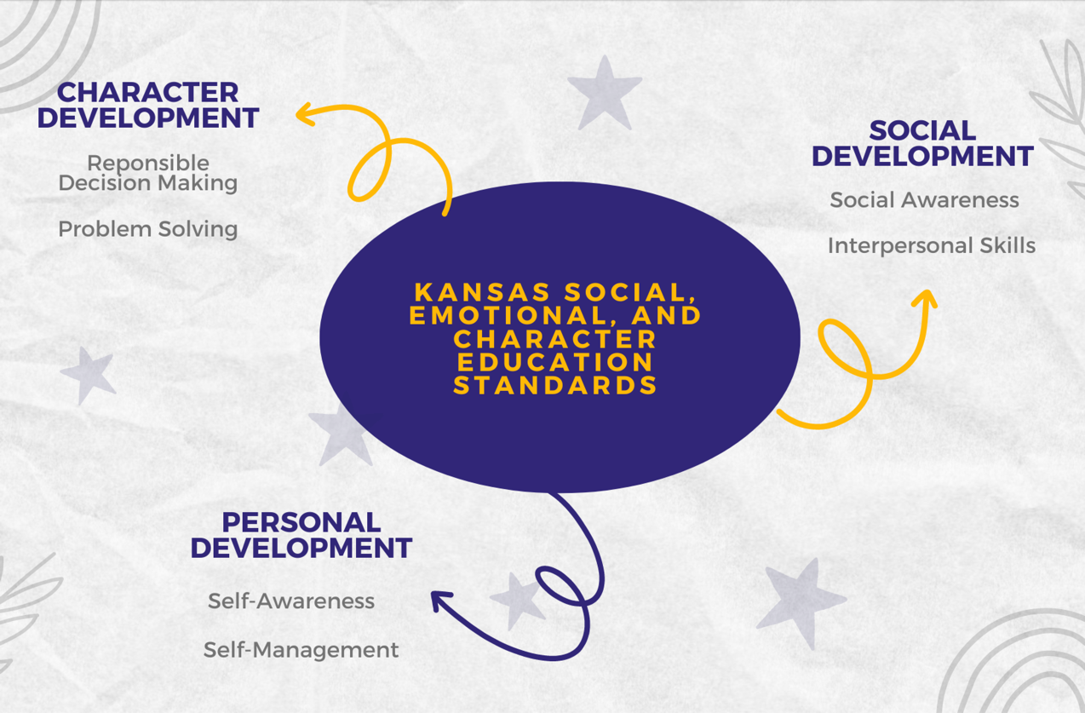
Making Connections
State Board Goals
Social Emotional Growth
High School Graduation
Post Secondary Success

Slide 6

Quaglia Institute Research
17 years of data
43 states
13 countries
980,905 Student Voice Surveys Grades 6-12
142,186 Student Voice Surveys Grades 3-5
628,975 iKnow My Class Surveys
56,353 Teacher Voice Surveys
27,115 Parent Voice Surveys
Notes:
Updated Jan 3, 2022

Slide 7
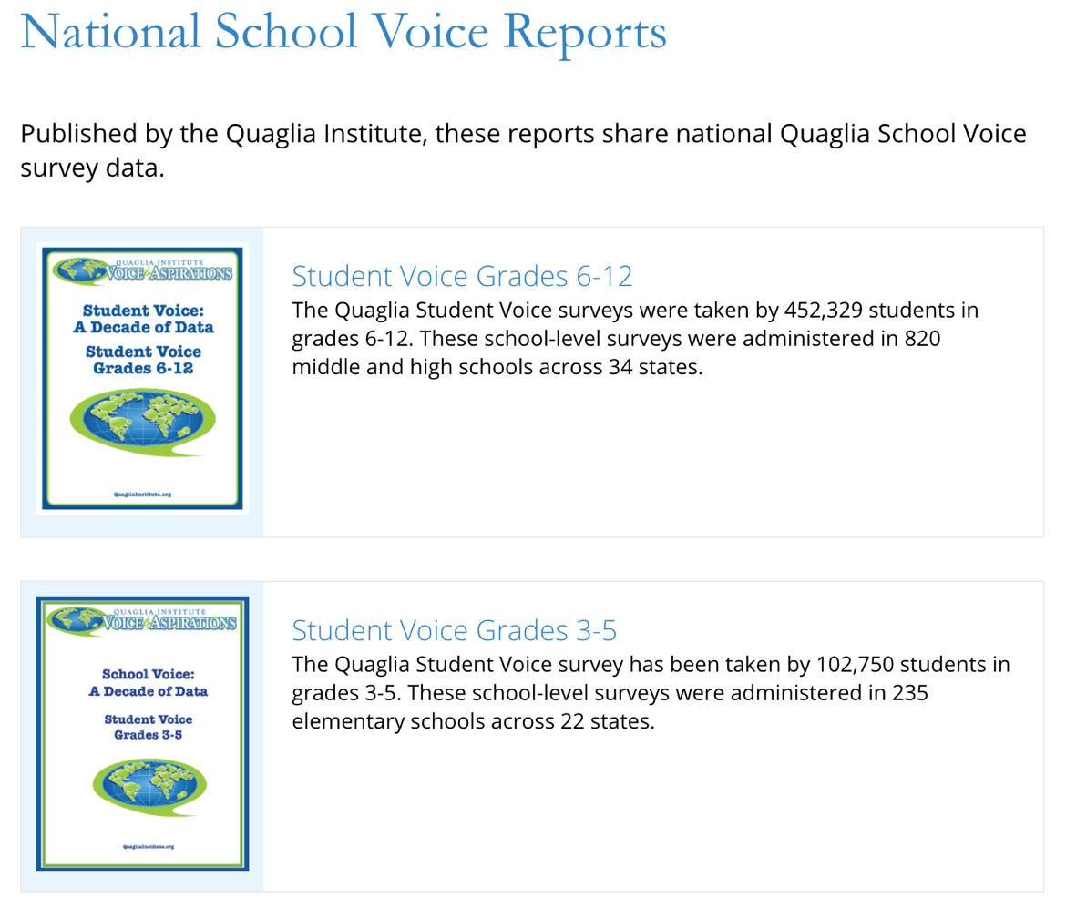
Quaglia Institute Research
QuagliaInstitute.org
National Reports from the last decade of data.

Slide 8

Challenge Time…

Slide 9

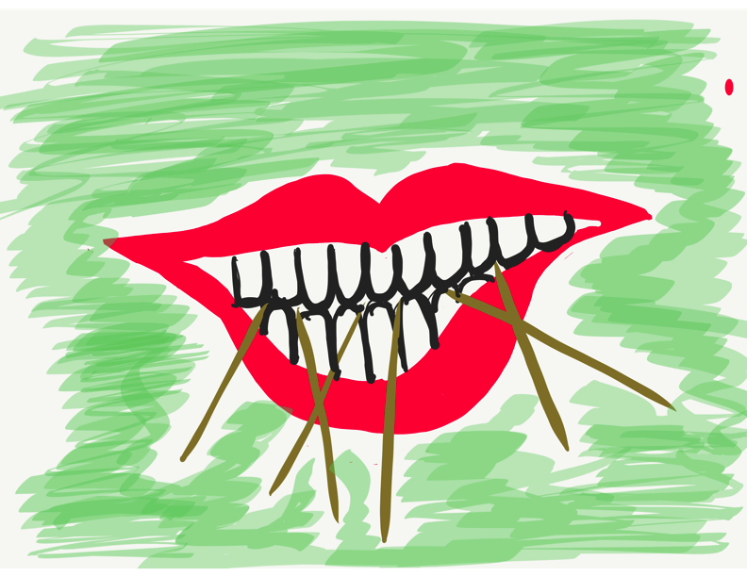
Toothpick Challenge
Using 6 toothpicks,
make 4 and only 4
equilateral triangles
(all 3 sides the same size).
You may not break the toothpicks.

Slide 10
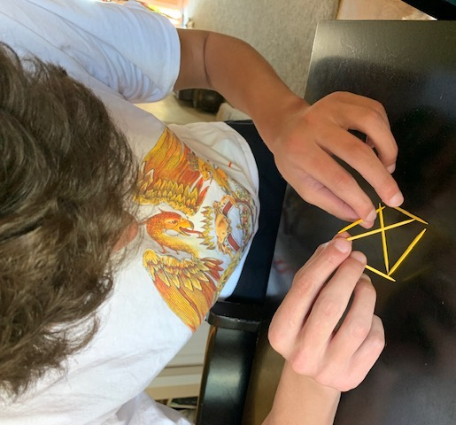
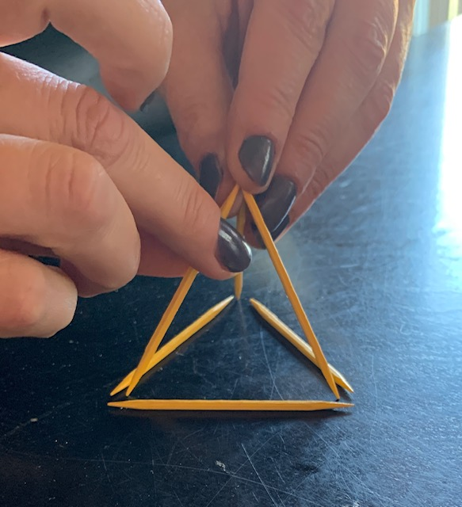
Today we invite you to do
some 3-D thinking!

Slide 11

Reflect
Pink: What comes to mind when you hear the term
Student Voice?
Purple: Share an example
you have seen of Student Voice in Action.

Slide 12
Speed Dating
https://vimeo.com/qisva/speeddating
Video

Slide 13
Academic Speed Dating

Slide 14
Student Voice
https://vimeo.com/qisva/listen
Video
https://www.youtube.com/watch?v=O5Tt3H73IR0
Los Angeles, California, USA

Slide 15

Why Student
Voice?

Slide 16
Student Voice
Implications….
When students have a voice they are 3X more likely to experience
Self-Worth in school.

Slide 17
Student Voice
Implications….
When students have a voice they are 5X more likely to experience Engagement in school.

Slide 18
Student Voice
Implications….
When students have a voice they are 5X more likely to experience Purpose in school.

Slide 19


Reflect
What is holding us back from Student Voice as a “Way of Being” in schools.

Slide 20

The Student Voice
Journey Begins!
First, we need a clear
definition of Student Voice
that we can all
understand, accept, &
put into practice.

Slide 21

The 3 Components of Student Voice
Resource
Sharing thoughts & ideas in an environment underpinned by trust & respect.
Offering realistic suggestions for the
good of the whole.
Accepting responsibility for not only what is said but also what needs to be done.

Slide 22

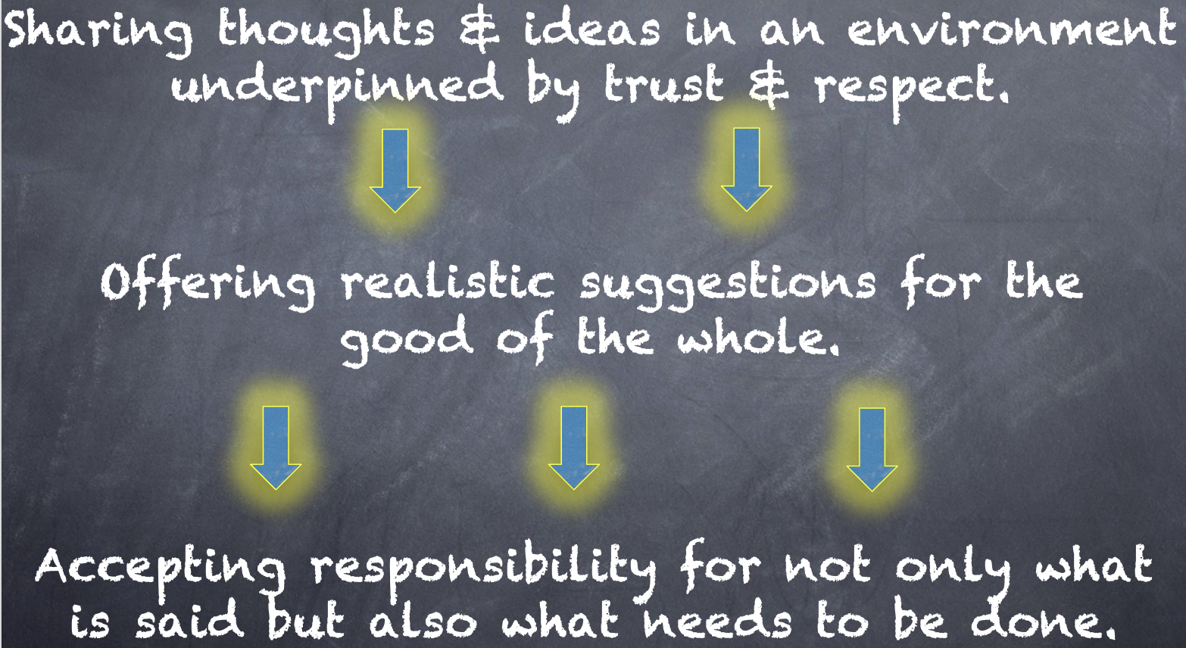
Meet With Your Feet
What resonates with you
from the Voice definition?

Slide 23
Challenge Time…

Slide 24


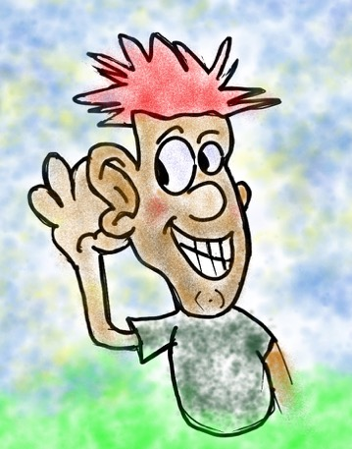
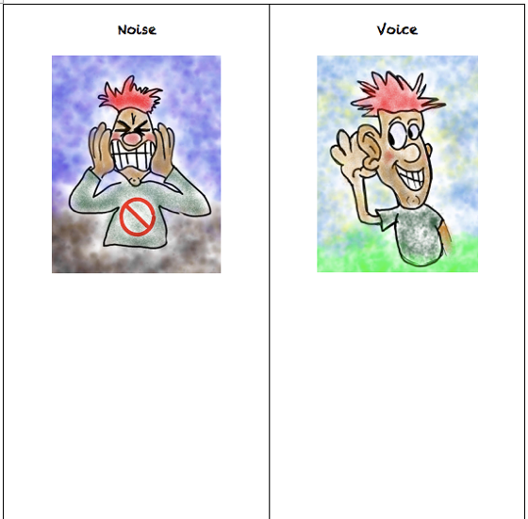
Challenge
Noise vs. Voice
Resource
Share words, phrases, &
examples of
Noise.
Now share words, phrases, &
examples of
Voice.

Slide 25


Noise vs Voice
Student Noise
Demands/commands/chaotic
Student opinion is most important
All adult voice is negative
Everyone needs to change but me
Complaining/whining
Student Voice
Requests/inquiry/focused
Our ideas are stronger in partnership
Students are open to learn
Personal reflection
Accepting responsibility

Slide 26

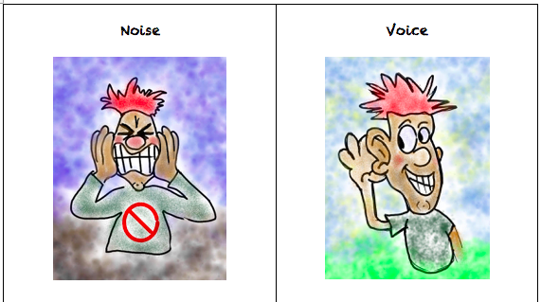
Challenge
Noise vs. Voice Art
As a table group, create a visual representation that reflects the difference between Noise v. Voice.
When finished, post your art masterpiece on the walls around the room.

Slide 27

Gallery Walk
Welcome to the Silent Gallery!
Take a wander around the room and take in the Noise v. Voice artwork created by the group.

Slide 28

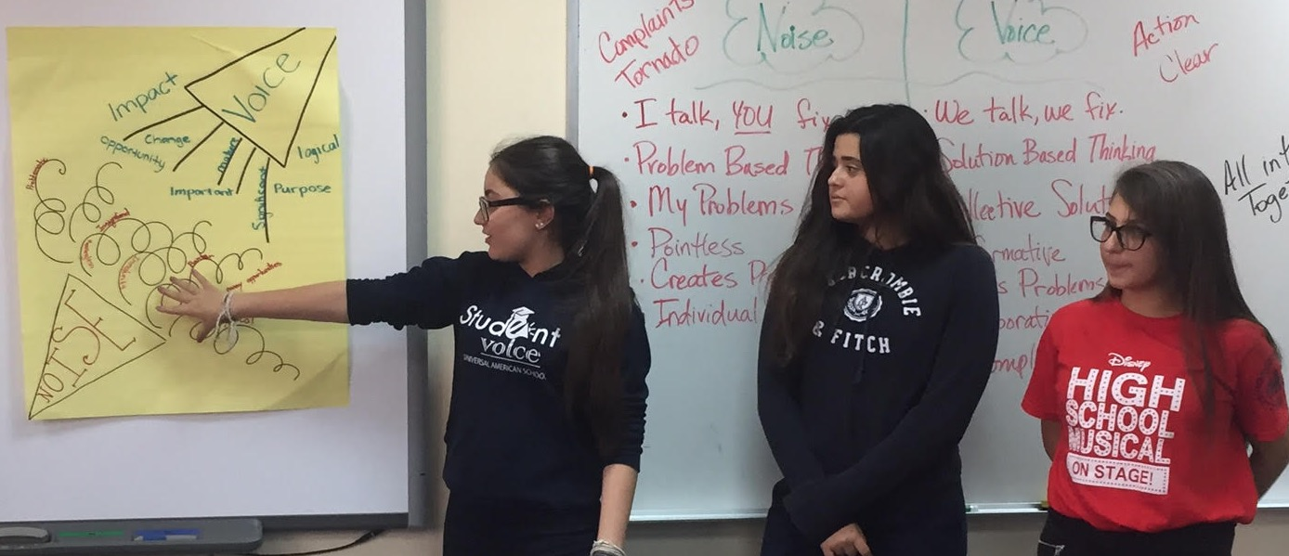
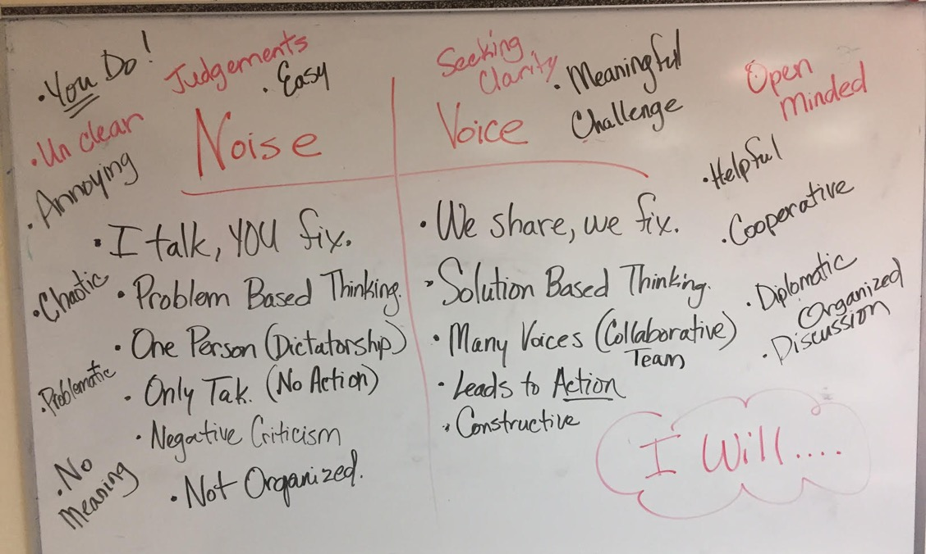
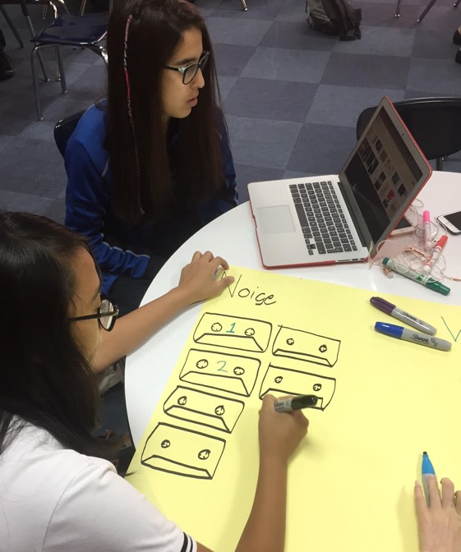
Student Voice in Action
Universal American School,
Dubai, UAE

Slide 29
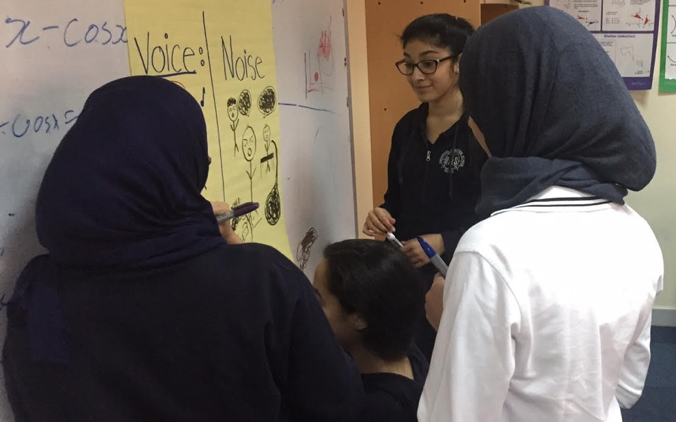
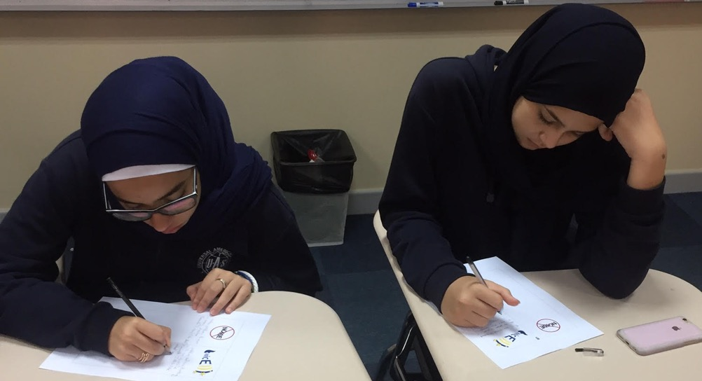
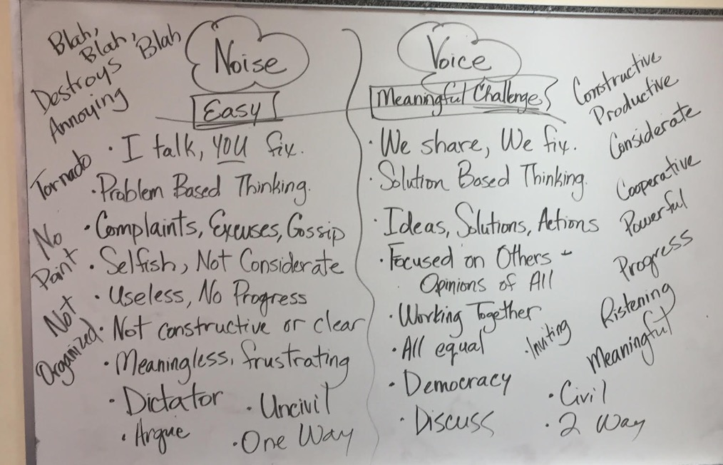
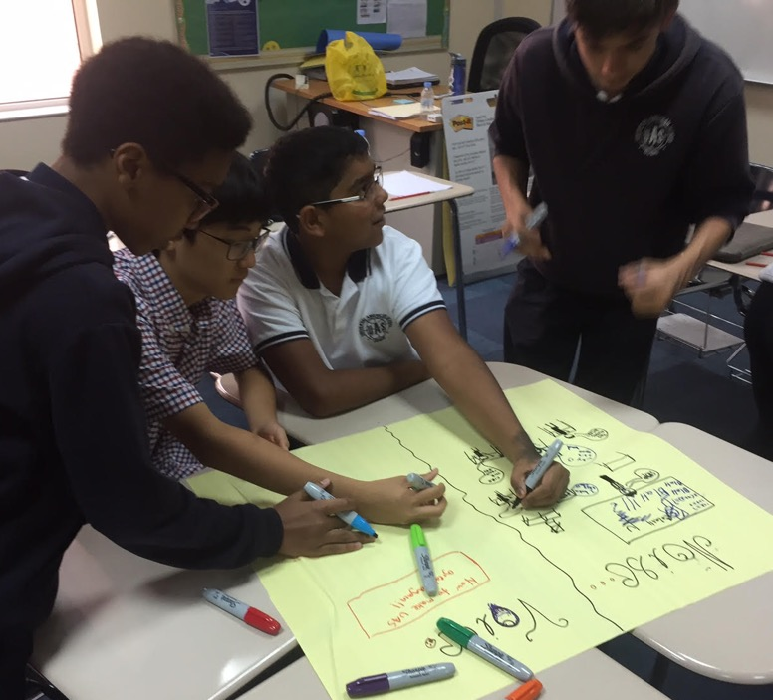
Student Voice in Action
Universal American School, Dubai, UAE

Slide 30
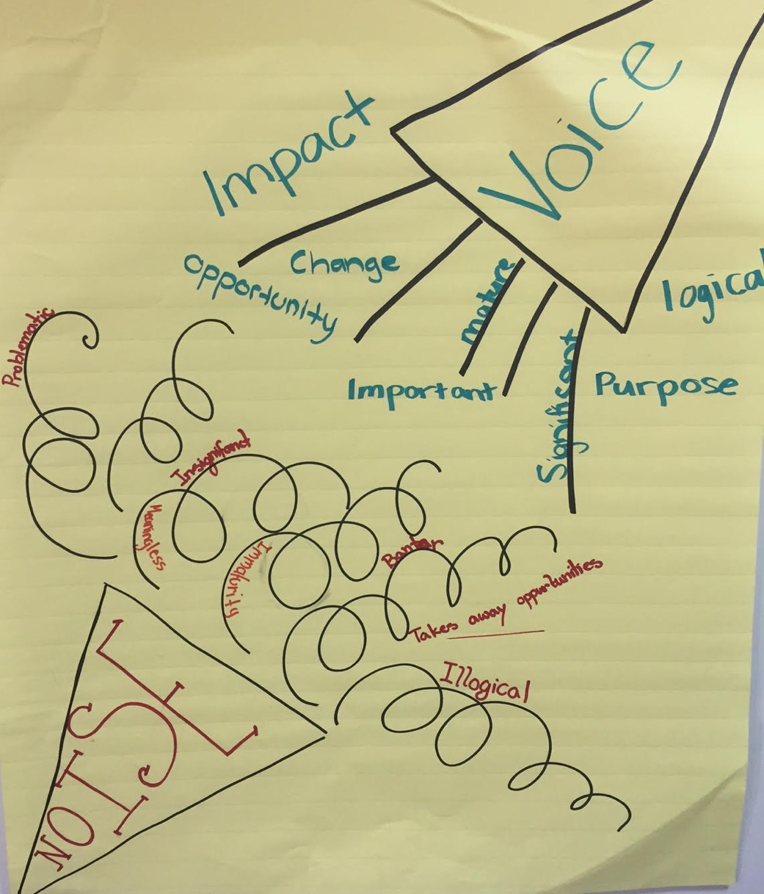
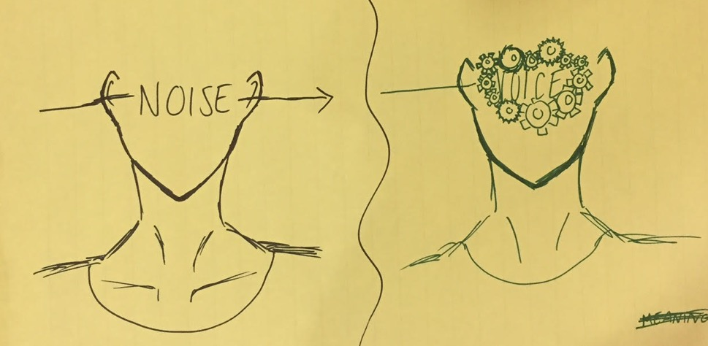
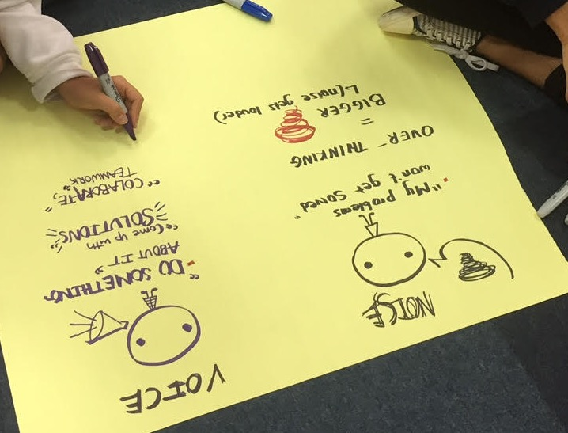
Student Voice in Action
Universal American School, Dubai, UAE

Slide 31
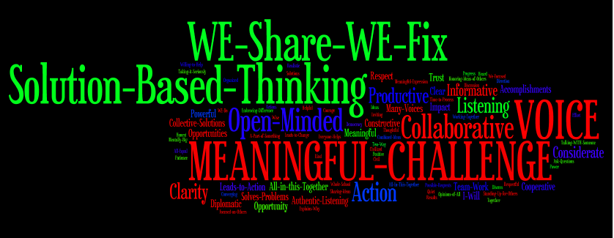
Student Voice in Action
Universal American School, Dubai, UAE

Slide 32
Student Voice Action
https://vimeo.com/qisva/svinaction
Video
Lawrence Middle School, Los Angeles, California, USA

Slide 33
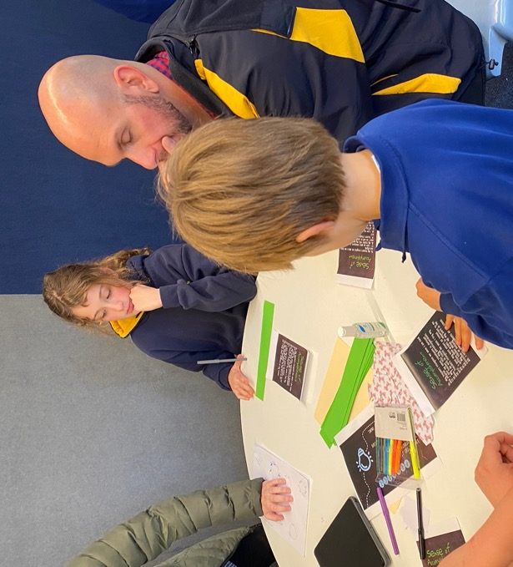
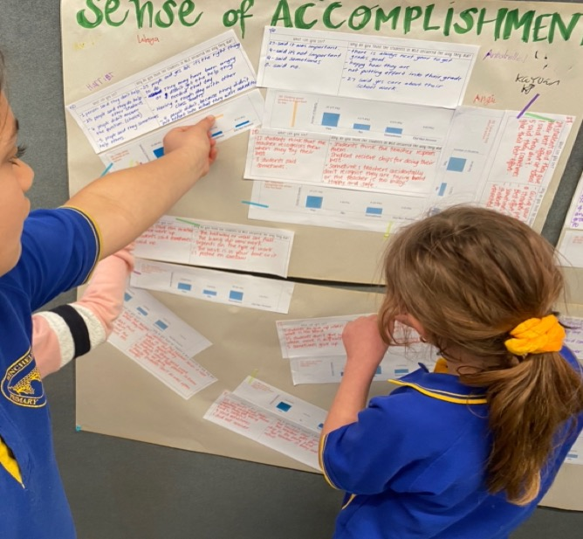
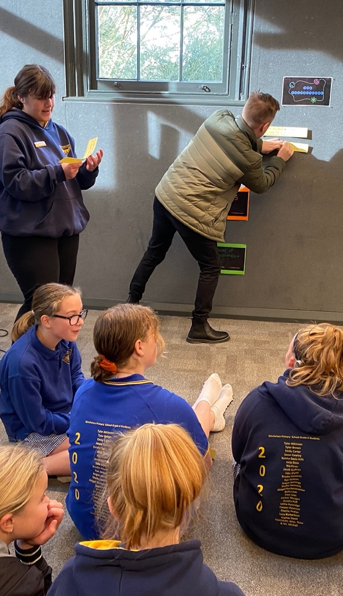
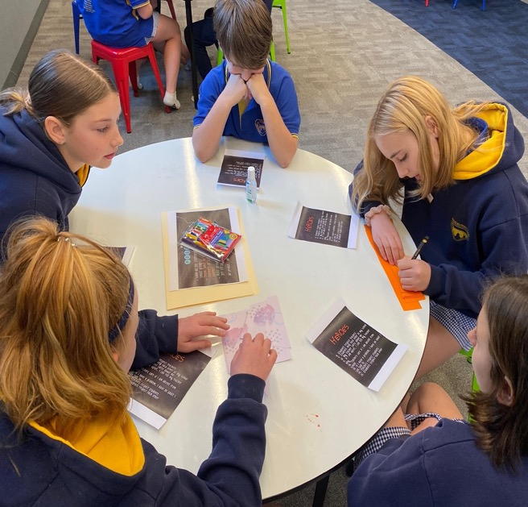
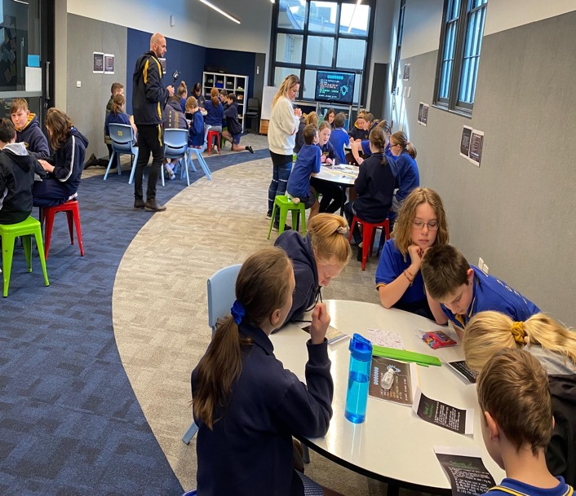
Student Voice in Action
Winchelsea Primary, Victoria, Australia

Slide 34
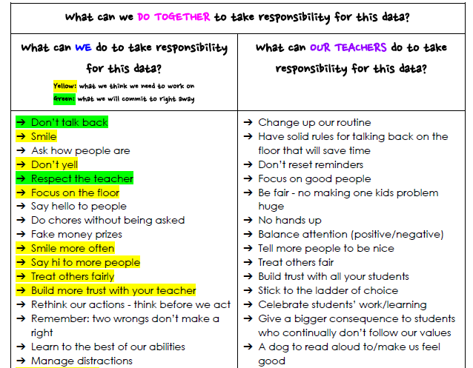
Student Voice in Action
Winchelsea Primary, Victoria, Australia

Slide 35
Challenge Time…

Slide 36

Greta Thunberg

Slide 37
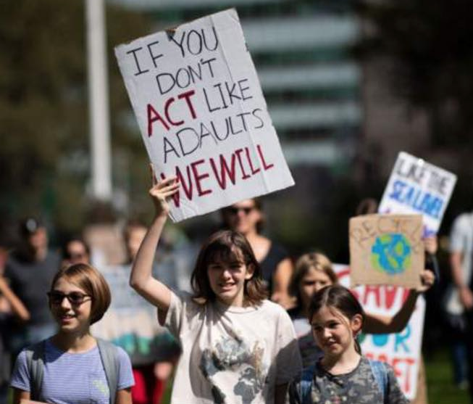


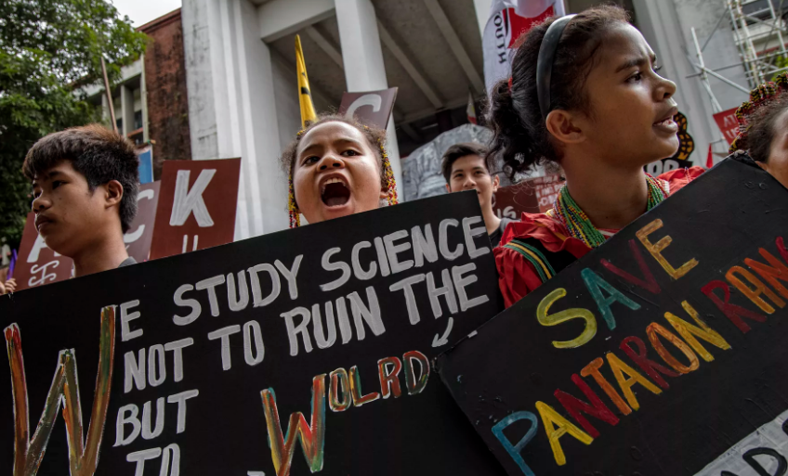

Slide 38

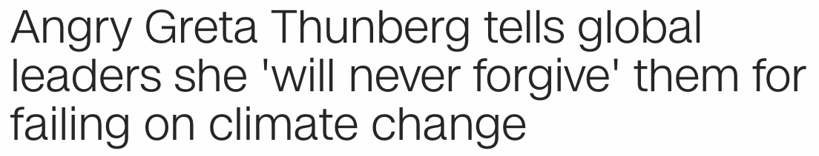
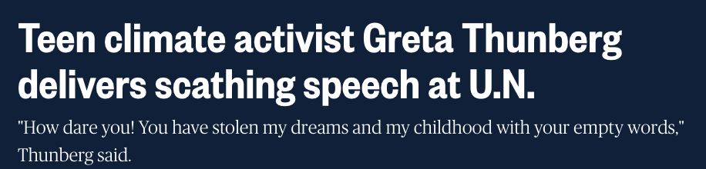
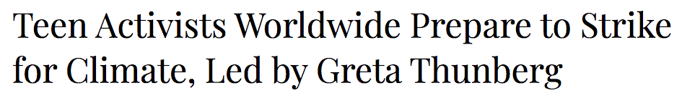
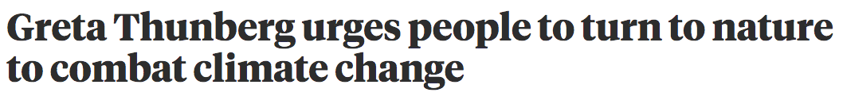

Slide 39
Greta Thunberg
https://vimeo.com/qisva/greta
Video

Slide 40
Challenge Time
Tag Team Debate
This is a PERFECT example
of Student Voice.
Resource
Provide a Pro or a
Con response to the above
statement.
Now flip & provide a response
for the opposite side of the
argument you just made.

Slide 41


Students Control the Volume
Voice Inhibitors
Anger/extreme emotion
Rhetoric
Volume/Tone
Close Minded
Self-Serving
Voice Amplifiers
Authenticity/Genuineness
Knowledge
Refocus, Reanalyze, Readjust
Relentless
Being a “student”

Slide 42

REFLECT
What skills do your students need for their voices to be heard?

Slide 43
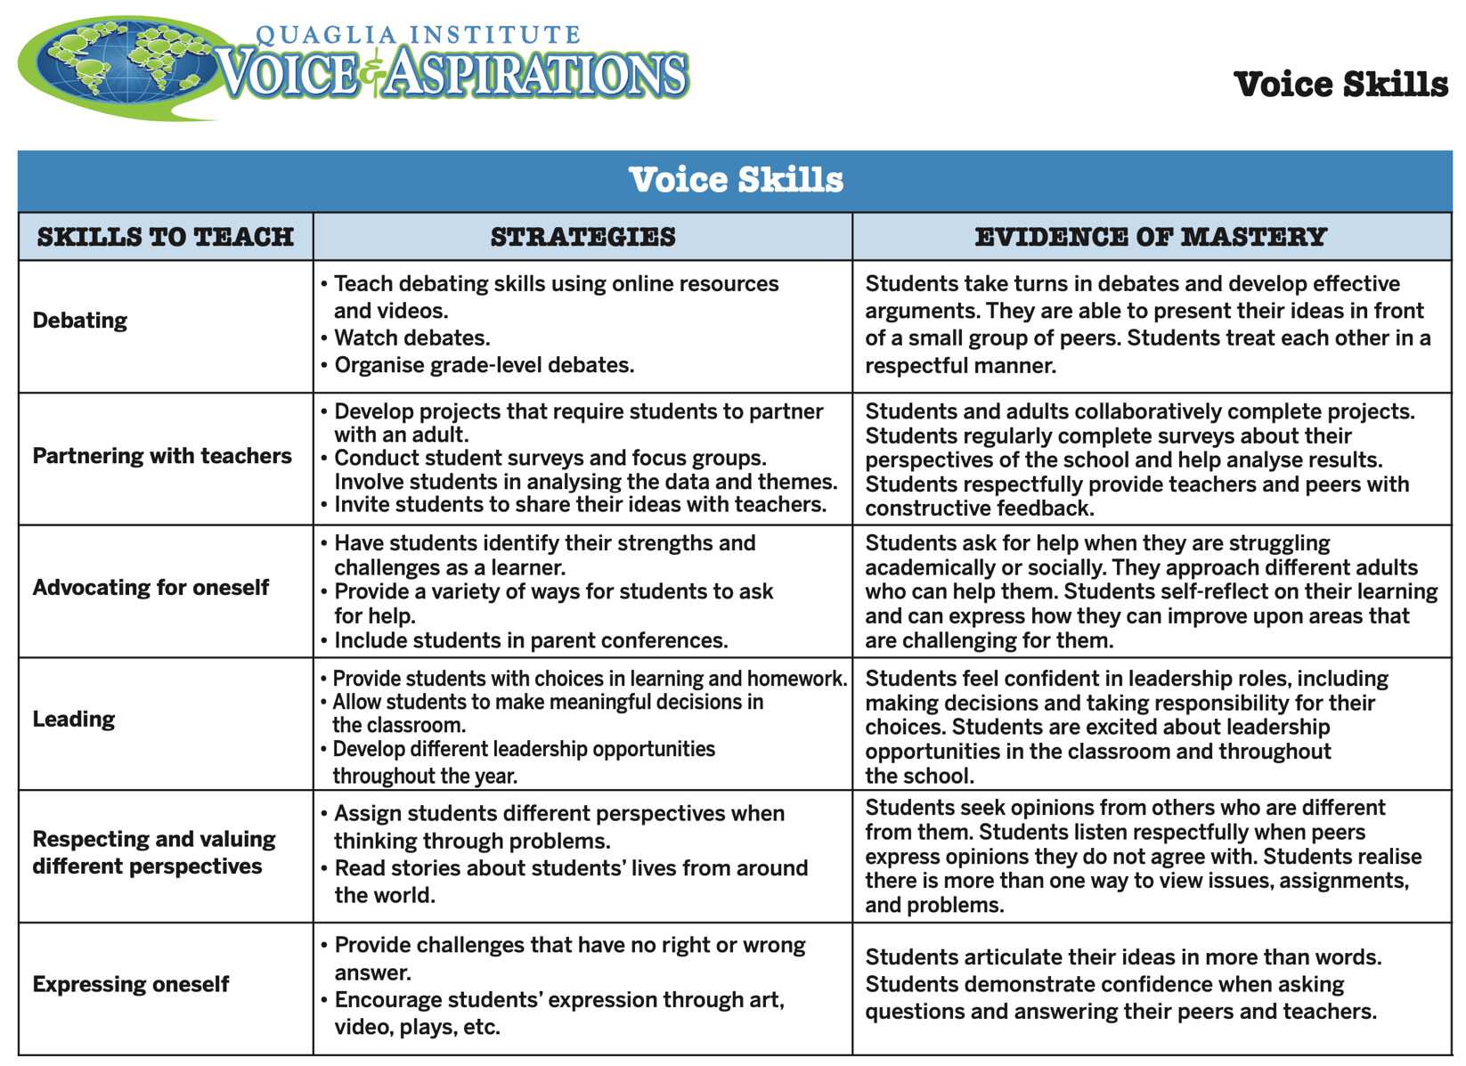
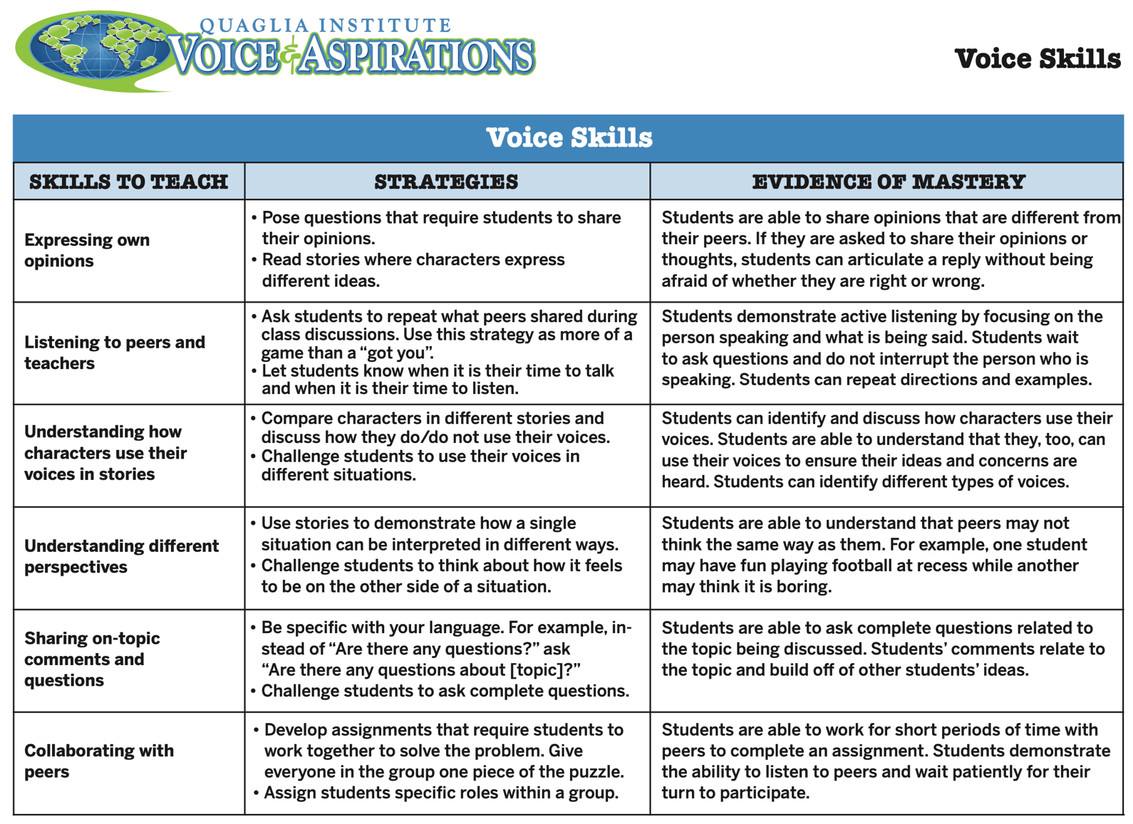
Resource

Slide 44

Morning Wrap Up

Slide 45


Slide 46

Story Time…

Slide 48
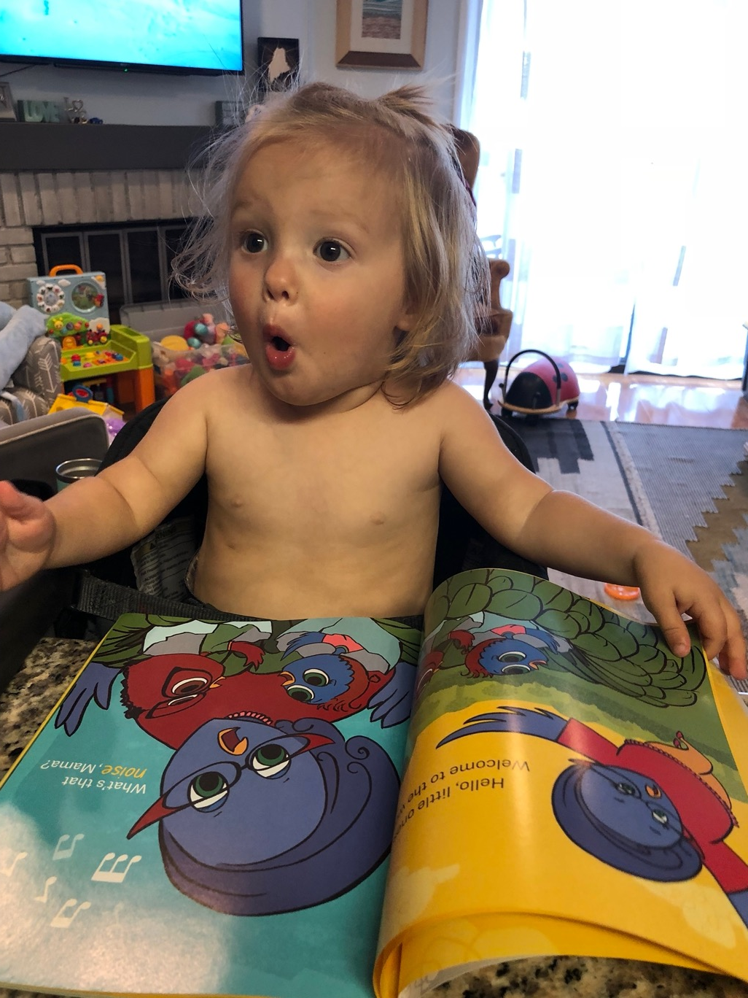
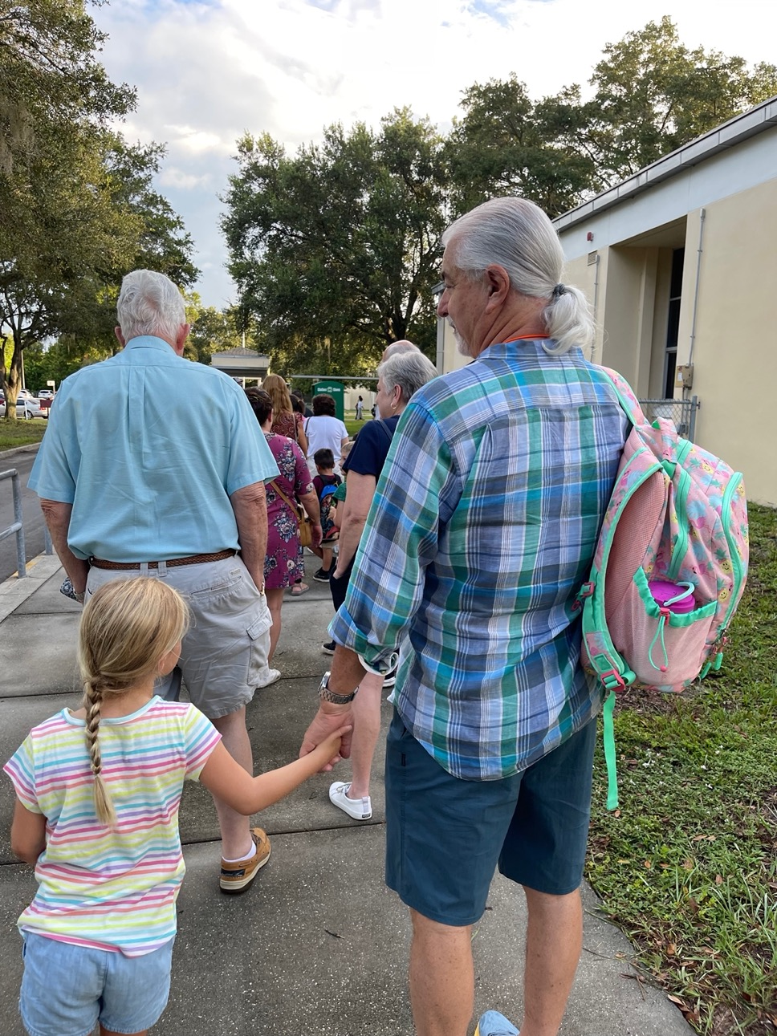

Slide 49


© Quaglia Institute

Slide 50

© Quaglia Institute

Slide 51
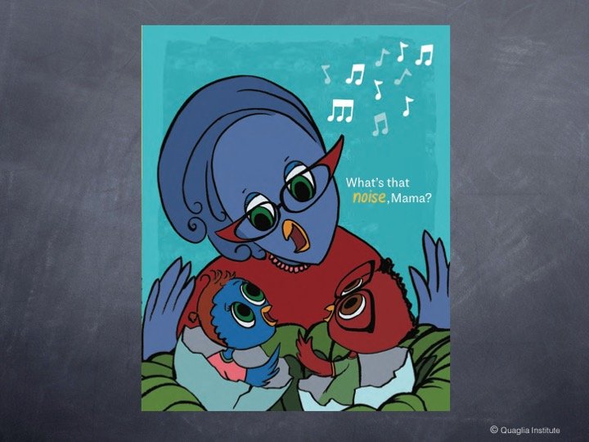
© Quaglia Institute

Slide 52
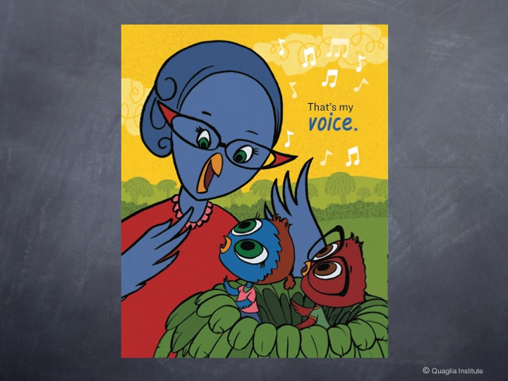
© Quaglia Institute

Slide 53
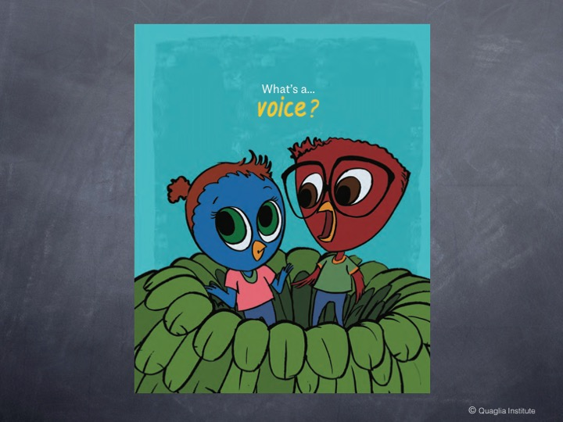
© Quaglia Institute

Slide 54

© Quaglia Institute

Slide 55

© Quaglia Institute

Slide 56

© Quaglia Institute

Slide 57

© Quaglia Institute

Slide 58
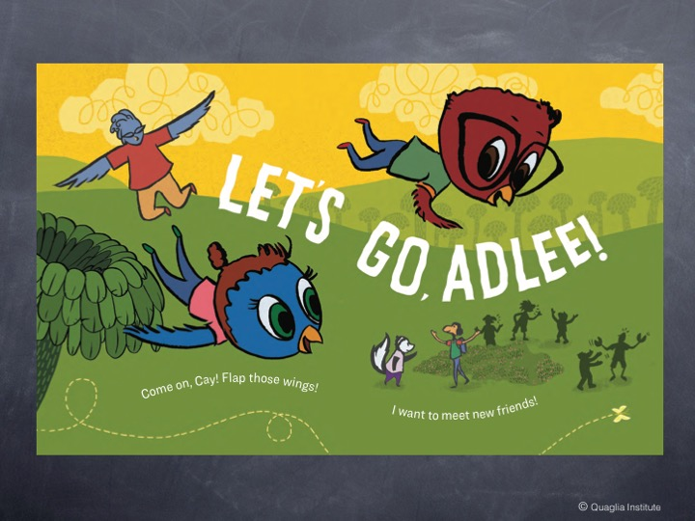
© Quaglia Institute

Slide 59

© Quaglia Institute

Slide 60
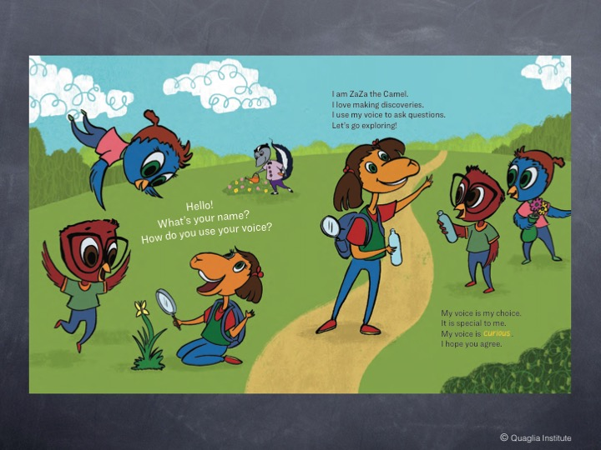
© Quaglia Institute

Slide 61
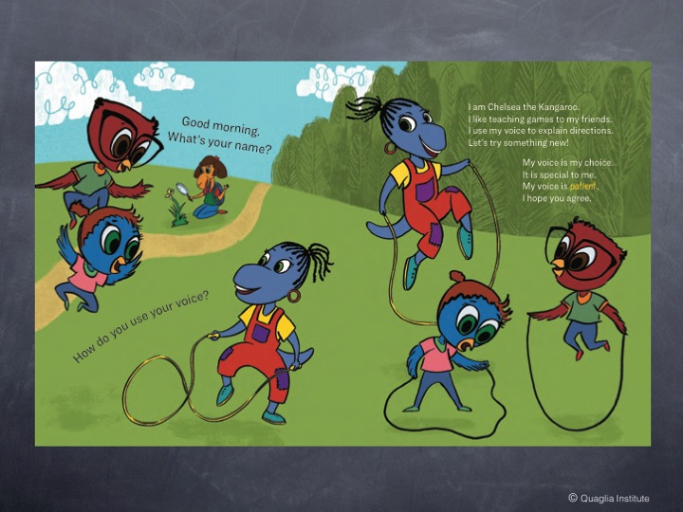
© Quaglia Institute

Slide 62
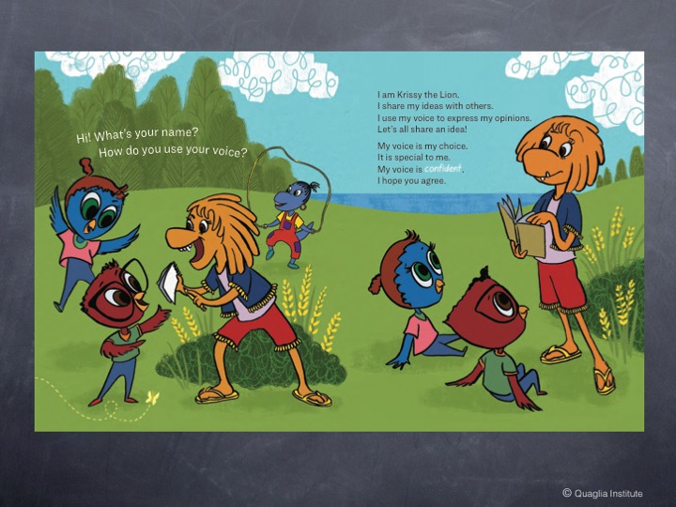
© Quaglia Institute

Slide 63

© Quaglia Institute

Slide 64
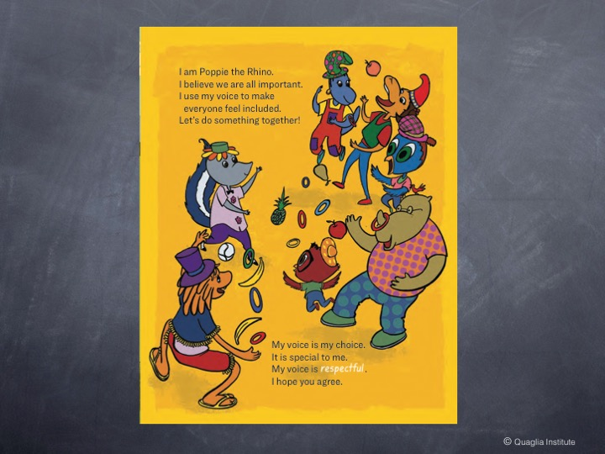
© Quaglia Institute

Slide 65

© Quaglia Institute

Slide 66

© Quaglia Institute

Slide 67
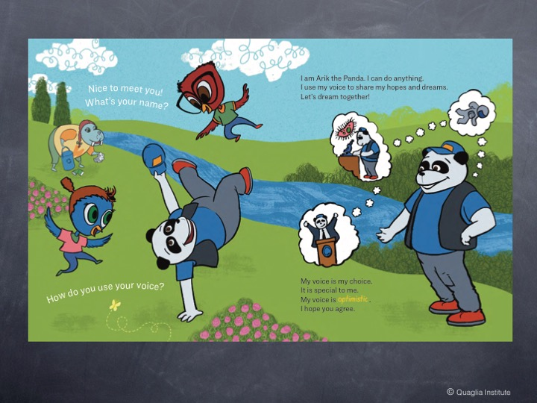
© Quaglia Institute

Slide 68
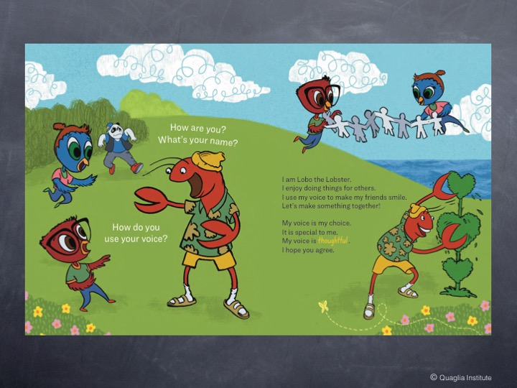
© Quaglia Institute

Slide 69
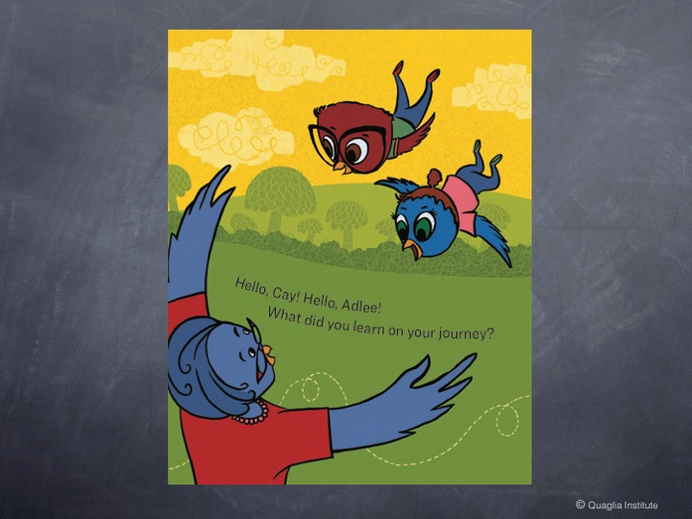
© Quaglia Institute

Slide 70
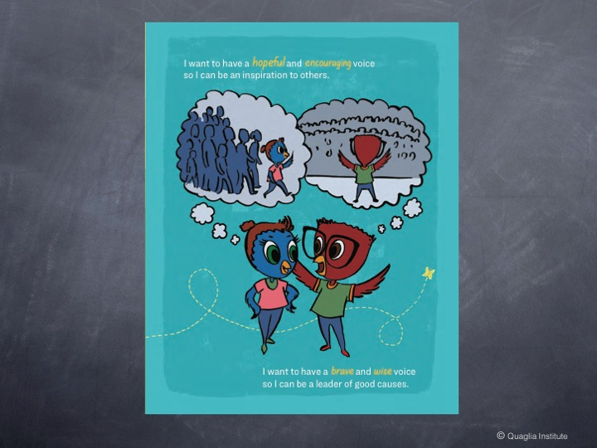
© Quaglia Institute

Slide 71
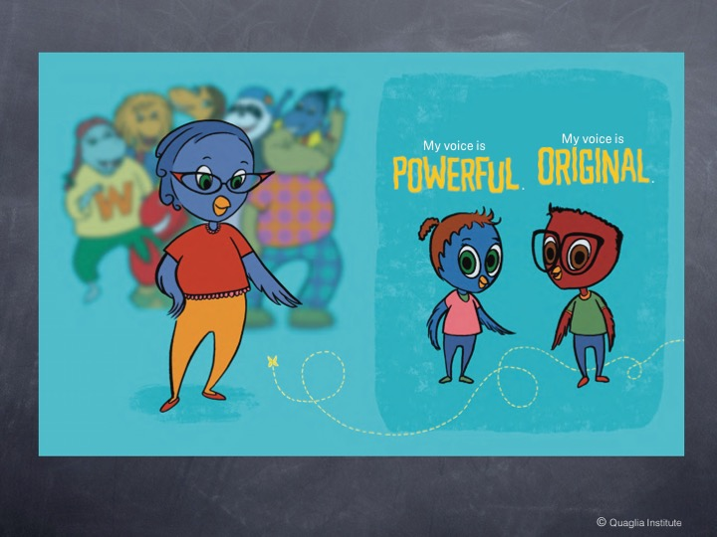
© Quaglia Institute

Slide 72

© Quaglia Institute

Slide 73


My voice is my choice.
It is special to me.
I have a _____ voice.
I hope you agree!
Resource

Slide 74


Student Voice in Action
Winchelsea Primary, Victoria, Australia

Slide 75




Student Voice in Action
Cobb County School District, Georgia, USA

Slide 76

Student Voice in Action
Hampton Park Primary School, Victoria, Australia
Notes:
Per Sue B: I just wanted to share with you the example of student work that Charlotte has just sent me from the Year 1/2 class at Hampton Park. The whole school developed pages for their own version of the Cay and Adlee book.

Slide 77

Student Voice in Action
Hampton Park Primary School, Victoria, Australia
Notes:
Year 1/2 class at Hampton Park. The whole school developed pages for their own version of the Cay and Adlee book.

Slide 78
Challenge Time…

Slide 79




Challenge Time
Pathways to Strengthen Voice
Resource

Slide 80
RESOURCES

Slide 81


Website Just For YOU!
https://quagliainstitute.org/kansas-multi-tier-system

Slide 82






Rolling Reflections
What is sticking with you from the Voice definition?
Which SV Pathways are you most interested in exploring?
What voice skills are you going to intentionally develop in students?
What key take away from this session will you share with a colleague?
What connections can you make to the Kansas State Board & Social Emotional Goals?
Wild Card! Share anything you want related to Student Voice!

Slide 83

Dr. Russ in the Hot Seat! ☺

Slide 84

What is your “Mic Drop” moment
of learning from today?

Slide 85

Mic Drop Moments
What is your mic drop moment of learning from this discussion on Student Voice?

Slide 86
Understanding the Dynamics
of Student Voice
October 5th & 6th, 2022
Dr. Russ Quaglia & Dr. Lisa Lande
@QISVAtweets @Lisa_Lande
quagliainstitute.org

