Slide 1


Self Worth:
Using Voice to Enhance
School & Classroom Culture
Session #4 March 26, 2025
Dr. Lisa Lande

Slide 2
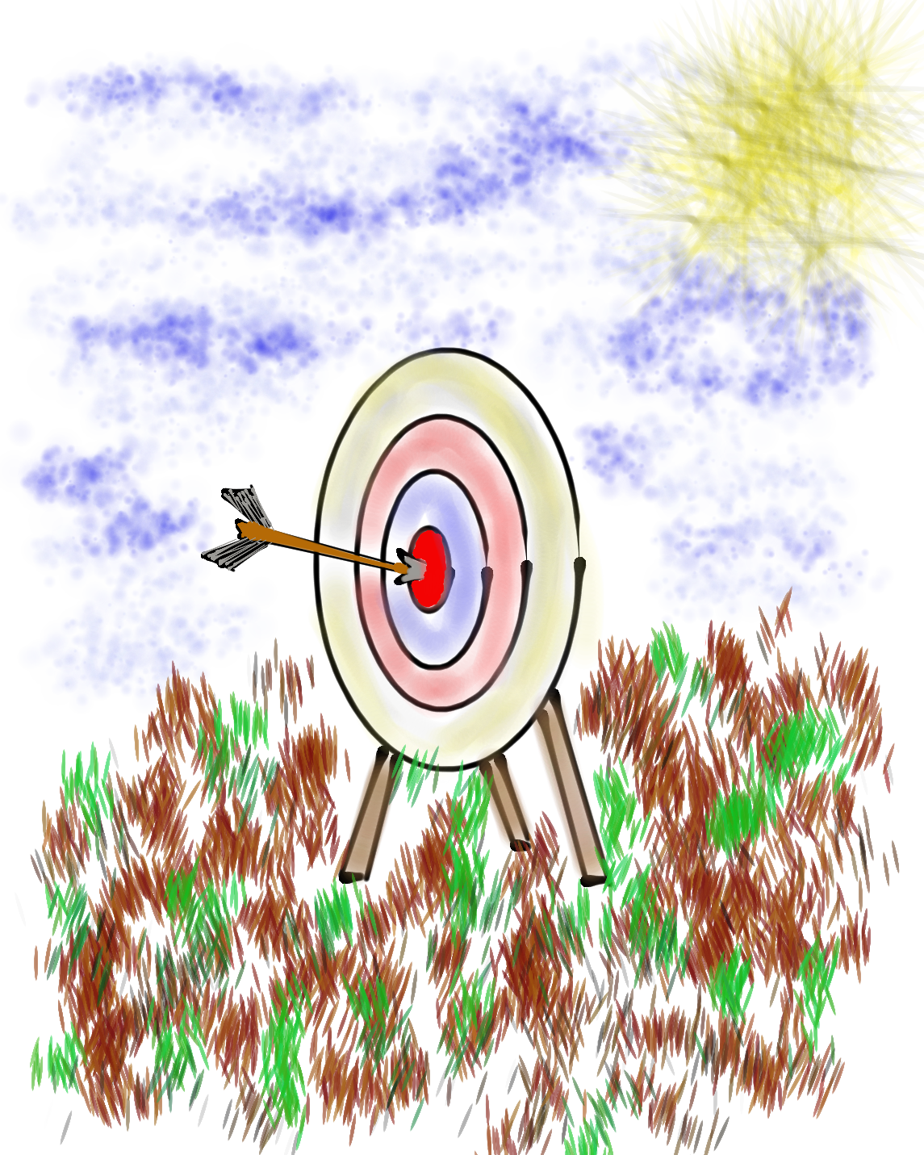
Goals for Today
Continue our journey to amplify student
voice & grow a Community Schools culture of partnership.
Explore the Aspirations Profile & consider
how this connects to Student Voice & the
Community Schools goals.
Apply learning to the Community Schools
Implementation Team efforts at Jefferson
High School, particularly in relation to BSAP.

Slide 3
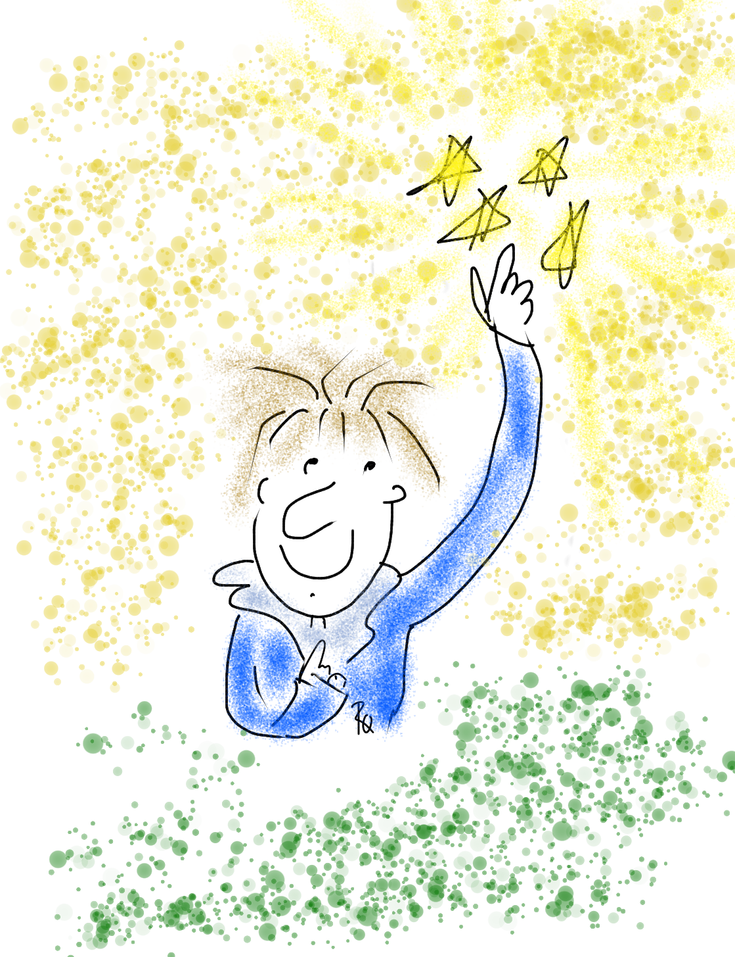
Vision & Purpose
Community Schools Vision: A family of
learning where educators, families, &
community members work together to
prepare students in achieving their
academic & career dreams.
BSAP Team Purpose: Supports the social,
emotional, & academic needs of our Black
students. It builds on the assets of the Black community & works towards preserving
its history.

Slide 4
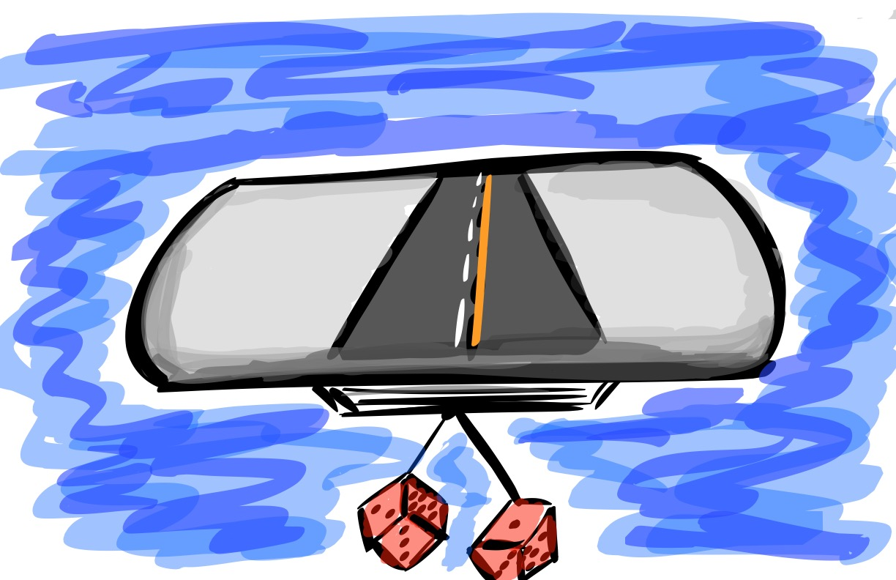
Quick Review

Slide 5

The 3 Components of Student Voice
Sharing thoughts & ideas in an environment underpinned by trust & respect.
Offering realistic suggestions for the
good of the whole.
Accepting responsibility for not only what is said but also what needs to be done.

Slide 6
LEAD
TAKE ACTION
with others
Share
RESPONSIBILITY
LEARN
UNDERSTAND
& RESPECT
different points
of view
Build
TRUST
LISTEN
SEEK OUT
opinions from
others
Voice Process

Slide 7




high
Imagination
Aspiration
DREAMING
Hibernation
Perspiration
low
DOING
high

Slide 8
Unreasonable Hospitality
Vimeo
https://vimeo.com/qisva/hospitality
YouTube
https://youtu.be/c4RIcJ9qxZ4
Video

Slide 9
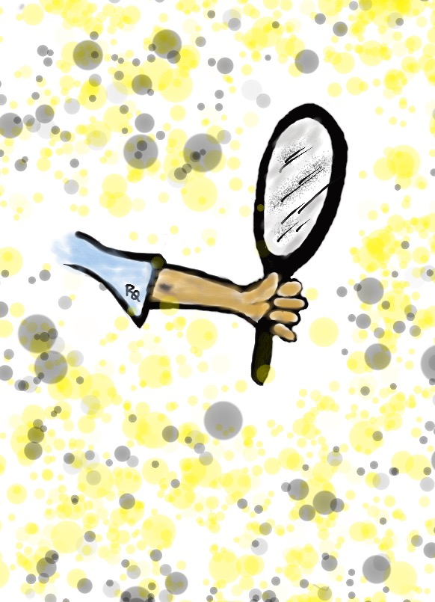
Reflect
How can you apply this concept of “Unreasonable Hospitality” to your Community Schools work?

Slide 10
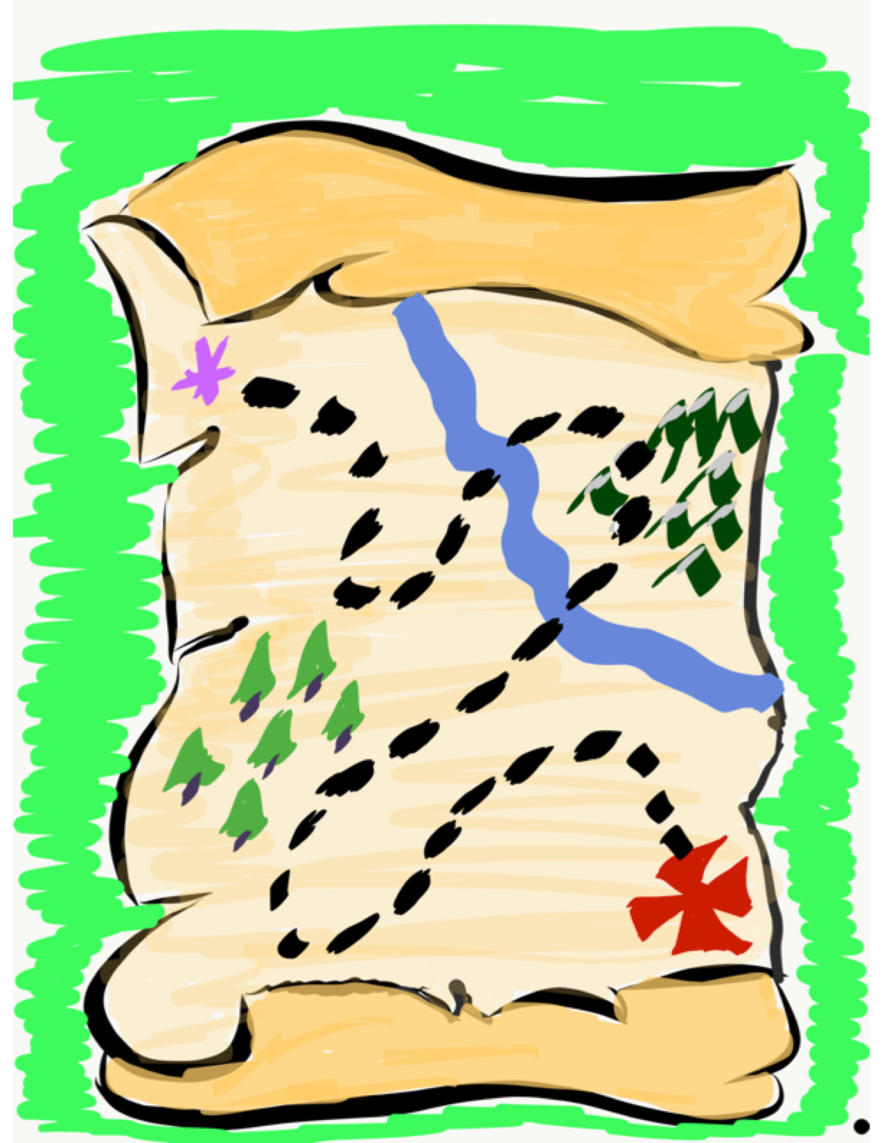
Time to journey
onward & explore
the Aspirations
Framework
& Self-Worth.

Slide 11








Aspirations Framework
Self-Worth
Engagement
Purpose

Slide 12

Self-Worth

Slide 13
Self-Worth
Self-Worth flourishes when students & staff know they are valued members of the school community, have people in their lives they can trust & learn from, believe they have the ability to achieve, & know their efforts & hard work are recognized & celebrated in a variety of ways — academically, personally, & socially.

Slide 14
Why Self-Worth?
When students believe they have a Voice they are 32% more likely to report having Self-Worth.

Slide 15
Belonging

Slide 16
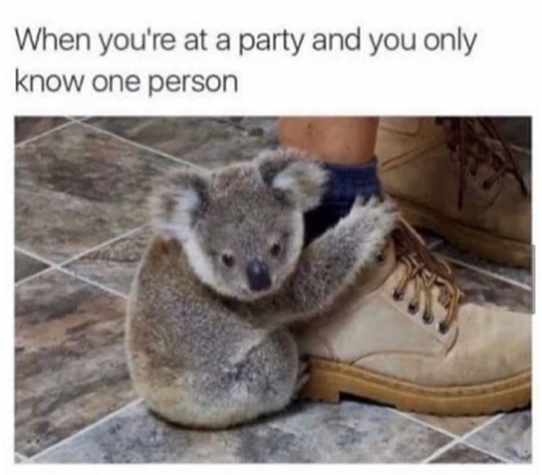

Slide 17
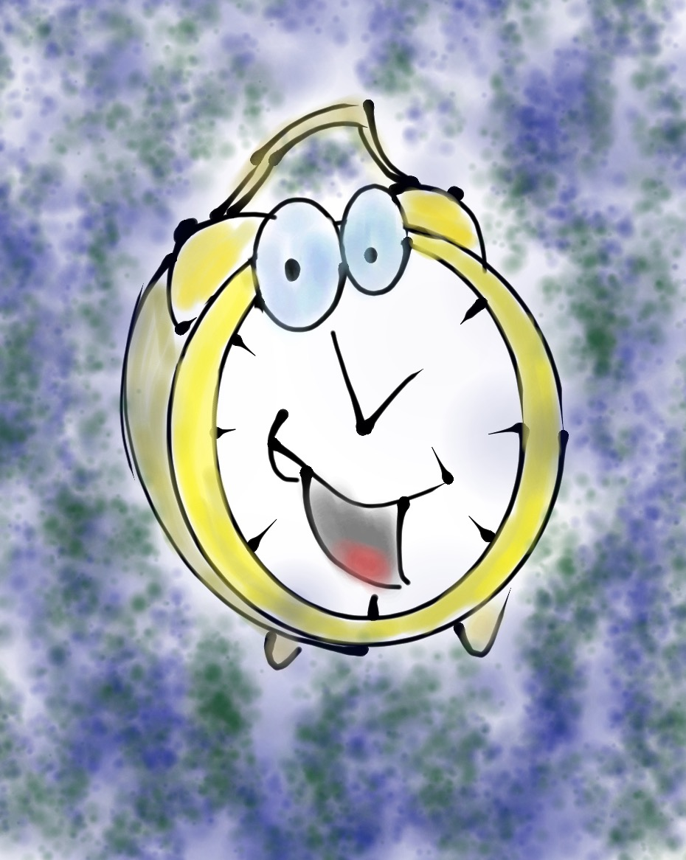
Challenge Time…

Slide 18
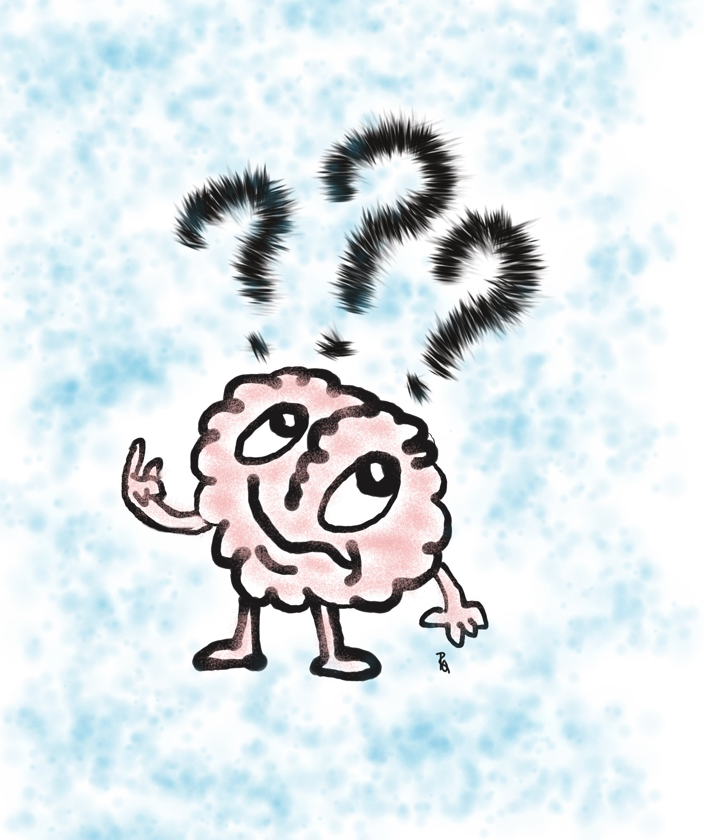
Be the first person to solve this riddle!
What is something you own, but everyone
else uses?

Slide 19
Do You Know Me?
Vimeo
https://vimeo.com/854745592
YouTube
https://youtu.be/ZQ0k2iAG1fk
Video

Slide 20

What’s in a Name
Adapted from
SRI Resource Guide p. 163-164
“My Name”
From The House on Mango Street
by Sandra Cisneros
Write the story of your name using the
provided resource.
Find a partner & share the stories of your name.
Merge with another set of partners & introduce
your last partner via their name story.

Slide 21
Key Points
Create community without losing the identity of any student.
Knowing you are a part of a group, while
being recognized & celebrated for who
you are as an individual.
Before students can feel like they belong
there needs to be trust & respect.
Belonging is about accepting, not judging.

Slide 22
Cultivating
Belonging
Be aware of the nothing, nowhere, fine rut.
Use the names of students (correctly).
Be culturally and socially sensitive.
Celebrate & recognize differences.
KNOW your students!

Slide 23
Challenge Time…

Slide 24
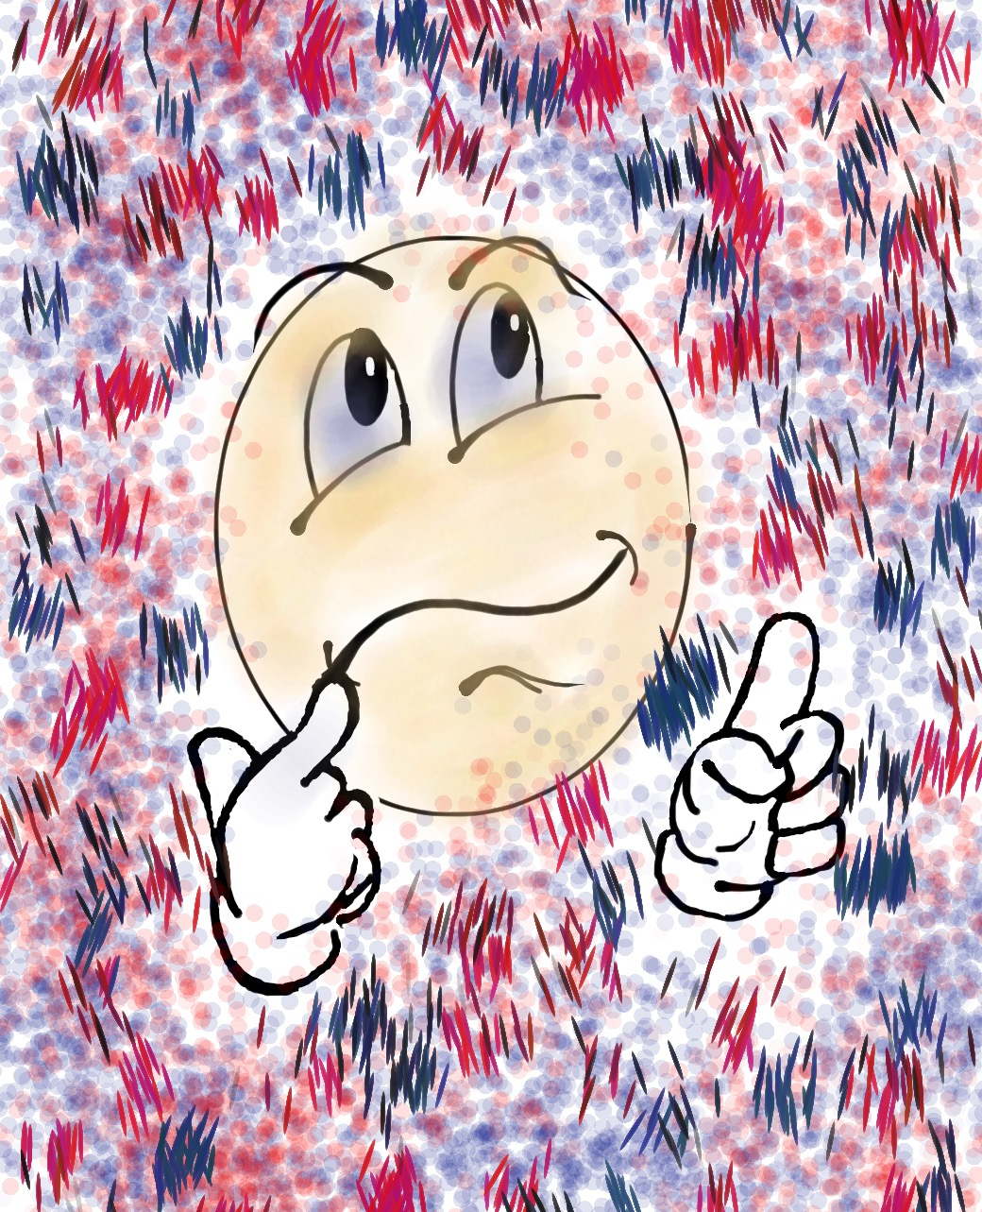

Challenge
Where do I Belong?
NO TALKING!!
NO looking at
your own dot.
Group yourselves according to the dots.

Slide 25
Challenge
Where do I Belong?
How did you FEEL
during the activity?
What did you observe
in others?
What did you learn?
How might you use this type of activity with
your colleagues &
students?

Slide 26
Odd Dot Out
Vimeo
https://vimeo.com/qisva/odddot
YouTube
https://youtu.be/x8r7BDQzaTY
Video
Notes:
This video was taken in my backyard during COVID and used for virtual professional learning sessions with teachers to demonstrate the Odd Dot Out activity and a debrief conversation with students. This group of high school students were in a COVID learning pod together—so don’t worry—I didn’t break any quarantine rules! ☺ Also, sorry for the background noise—my neighbor decided that while I was recording this video would be the perfect time to mow the law! Haha!

Slide 27
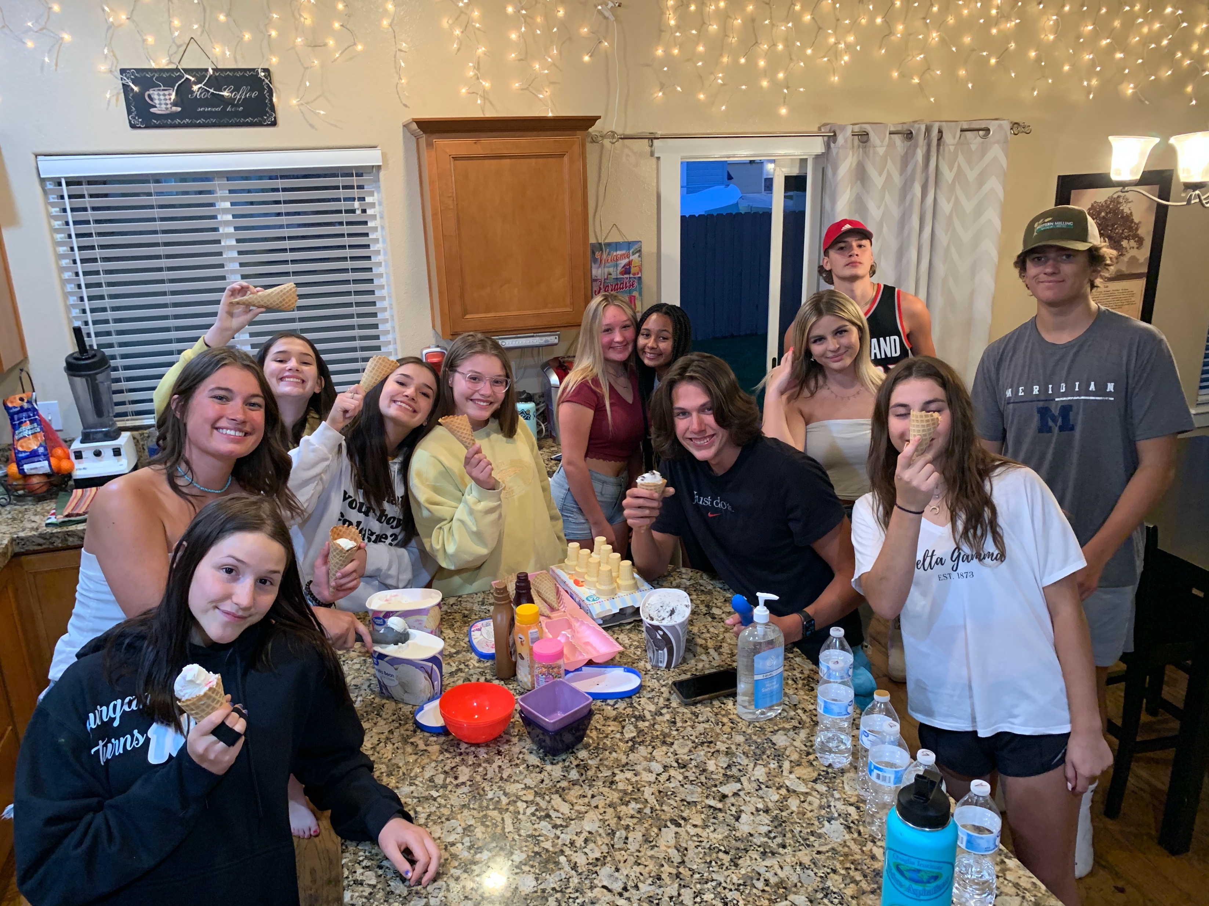
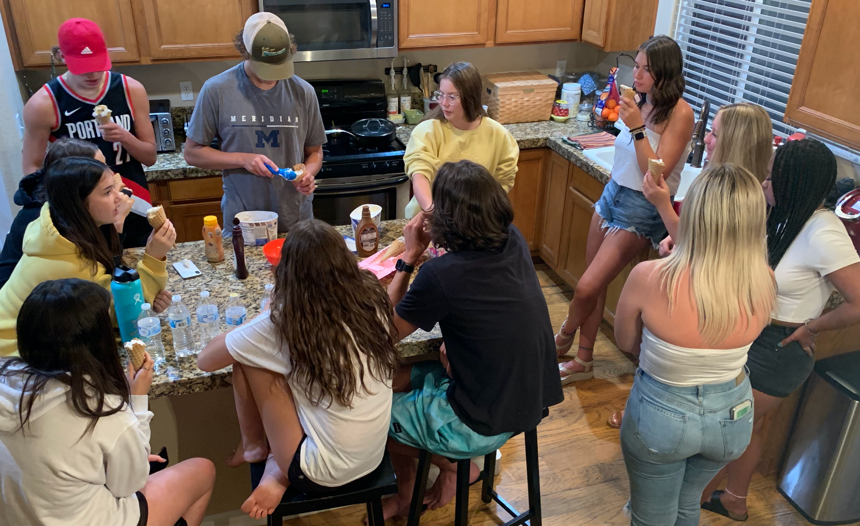
“We are all friends and it was still uncomfortable not knowing where you would fit in.”
“Imagine how it would be different if you got to have an ice cream social BEFORE playing the game!”
“I know it was just a game, but now I actually am thinking about a few people at school we could help feel like they belong.”
Notes:
After the activity I served ice cream to the students and captured a few quotes from their natural conversation (not part of my debrief) in the kitchen. It was really quite amazing to listen in on their observations and the connections they made between the “game” and real life in schools.

Slide 28
Reflect
What do you wish teachers would have known about you when you were in school? Why would it have
mattered?
How do you know when students feel part of your school community & valued for their uniqueness?

Slide 29
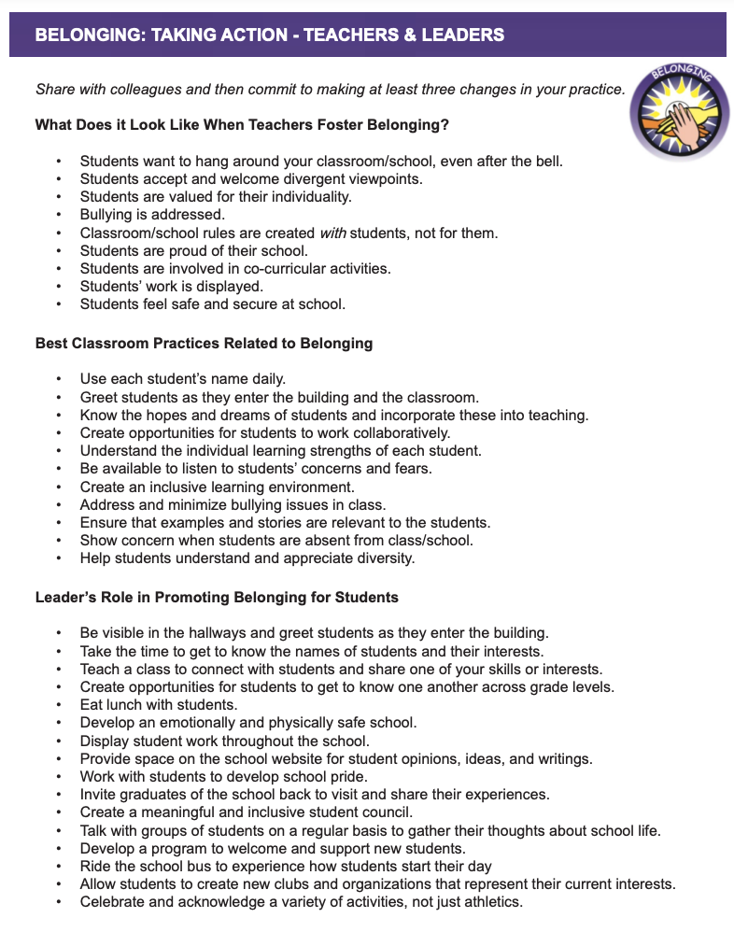
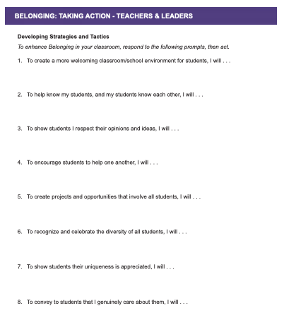

Slide 30

Taking Action
Read through the Belonging Taking Action resource.
Highlight 1-3 action statements you will intentionally try or revive.
Add one of your best Belonging strategies in the margin.
Complete 1-3 of the “I will…” statements.

Slide 31
Heroes

Slide 32
You ARE a Hero!
Vimeo
https://vimeo.com/854746766
YouTube
https://youtu.be/v4aFemrsoMw
Video

Slide 33
Key Points
Be there when things go sideways….
& when things are worth celebrating.
Must be accessible.
Relationships, relationships, relationships.
It takes respect to get respect.
You are a hero whether you know it or not.

Slide 34
Becoming a Hero
Take time to REALLY listen to your students.
Words & smiles are important.
Make sure students know they matter to YOU.
Have high expectations of success.
Simply show up.

Slide 35


Slide 36
Challenge Time…

Slide 37
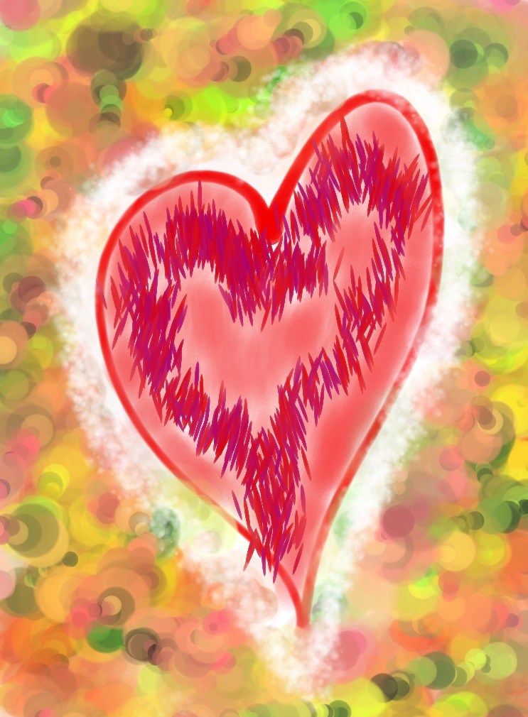
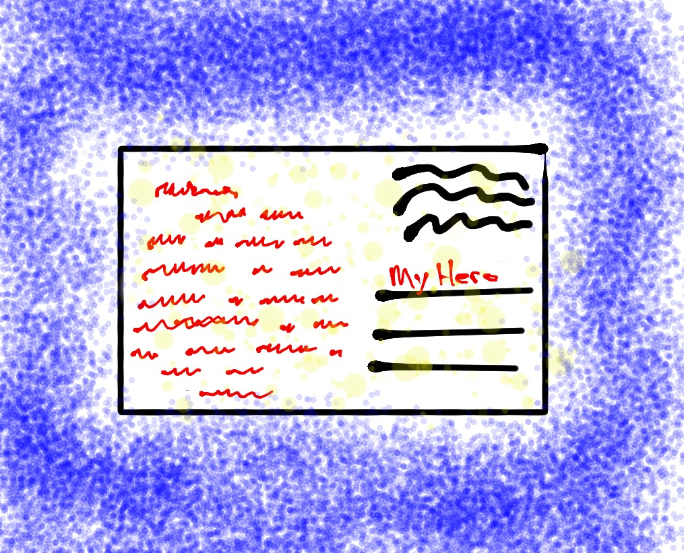
Challenge
Attitude of Gratitude
Write a note of gratitude honoring an act of heroism…
small or big!
(Don’t forget to deliver it!)

Slide 38
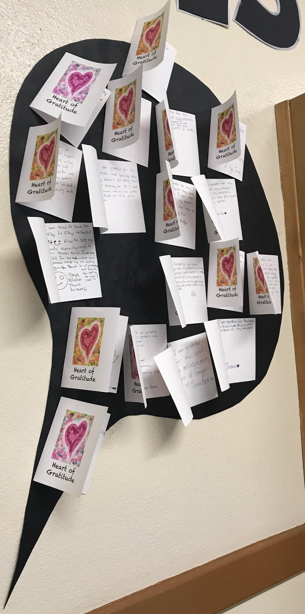
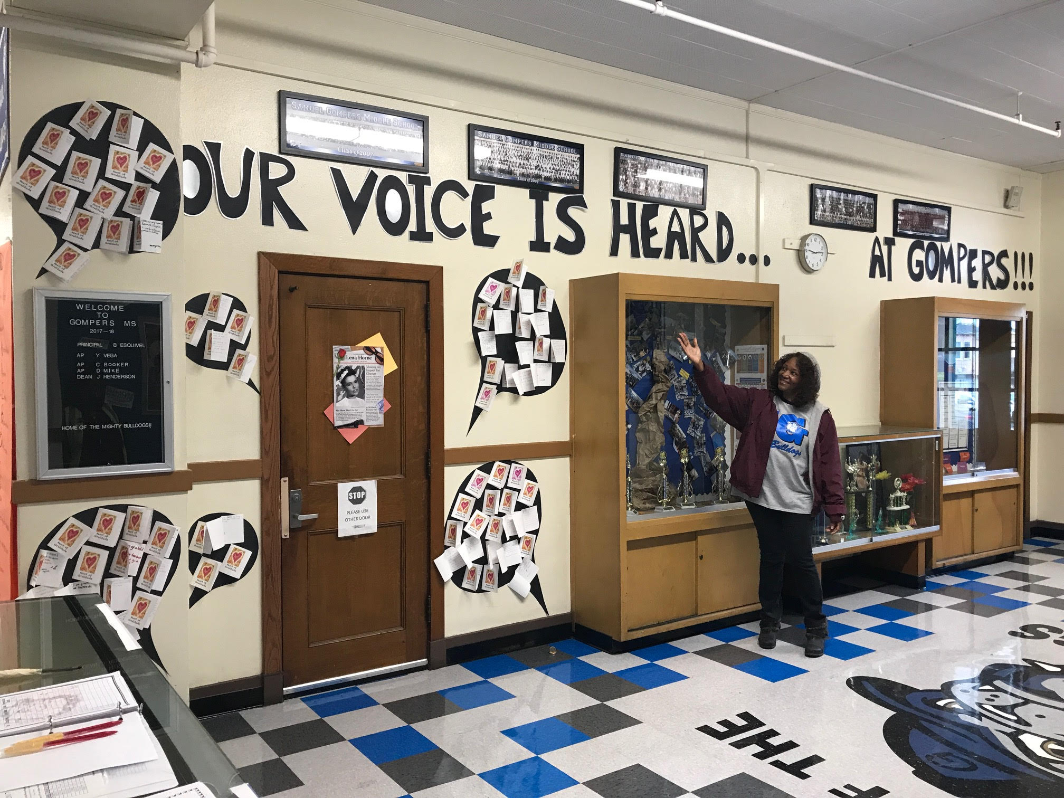
Challenge
Attitude of Gratitude

Slide 39
Reflect
Share a time you were a Hero to a student or colleague.
Share a time when a student or colleague was a Hero for you.

Slide 40
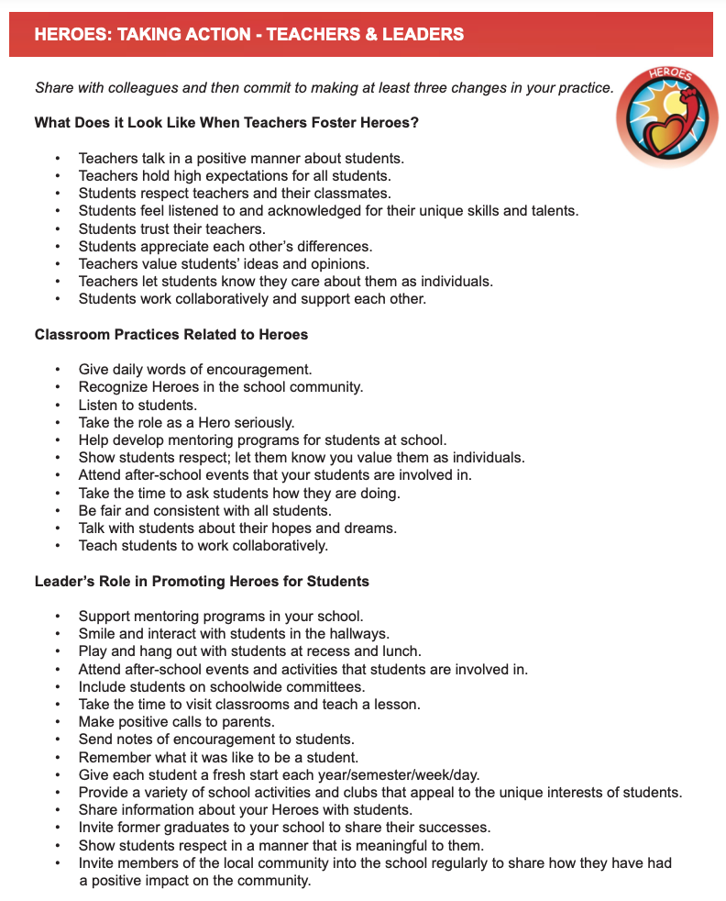
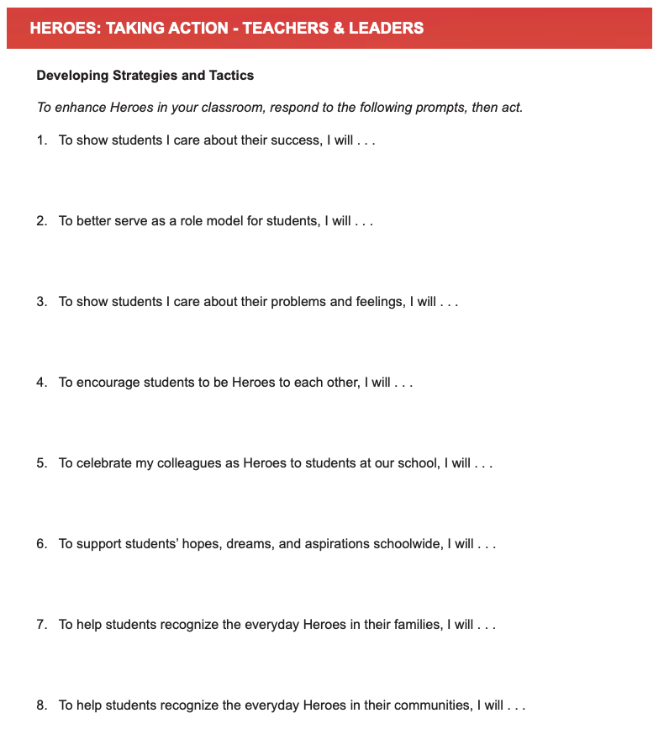

Slide 41
Taking Action
Read through the Heroes Taking Action resource.
Highlight 1-3 action statements you will intentionally try or revive.
Add one of your best Belonging strategies in the margin.
Complete 1-3 of the “I will…” statements.

Slide 42
Sense of Accomplishment

Slide 43
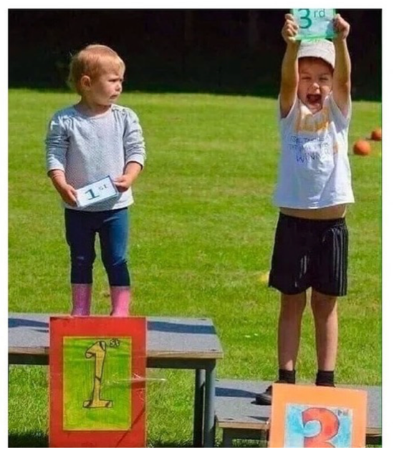

Slide 44
Effort and Perseverance
Vimeo
https://vimeo.com/854748561/53926aaf4e
YouTube
https://youtu.be/w6SgUPwJNNs
Video

Slide 45
Key Points
Move beyond academic success…
effort, perseverance & citizenship matter.
Value & recognize the learning process,
not just the final product.
Students need to establish, recognize &
celebrate their own achievements.

Slide 46
Instill a Sense of Accomplishment
Provide students opportunities to reflect
& self assess.
Students need clarity & purpose behind
learning & behavior expectations. Help
build the why & shared responsibility.
Provide a wide variety of opportunities for
students to grow & succeed.
Revise, revisit, redo!

Slide 47
Challenge Time…

Slide 48
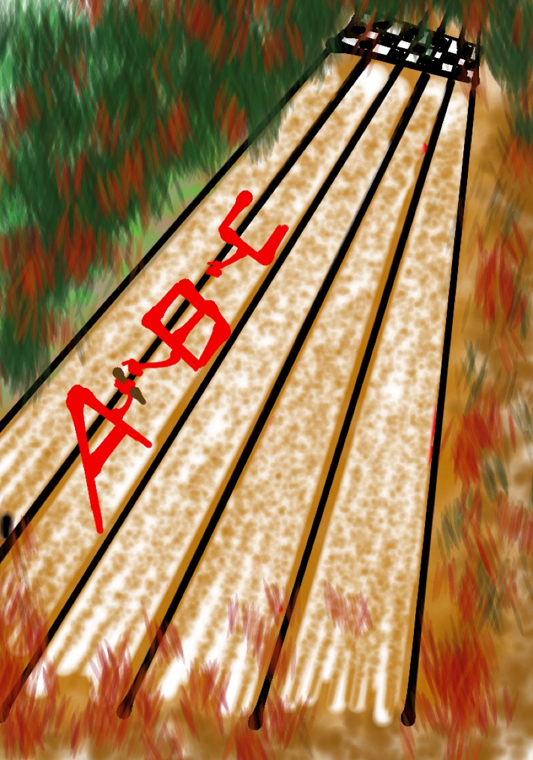
Challenge
A-Z Accomplishments Relay
List examples of different things & ways you celebrate at school starting with each letter of the alphabet.
Once a letter covered, move on to the next letter. You may not skip letters!

Slide 49

Reflect
Create a pie chart & assign percentages
to the major things your school celebrates,
with all percentages totaling to 100%.
What would you like to maintain?
What would you like to change?

Slide 50
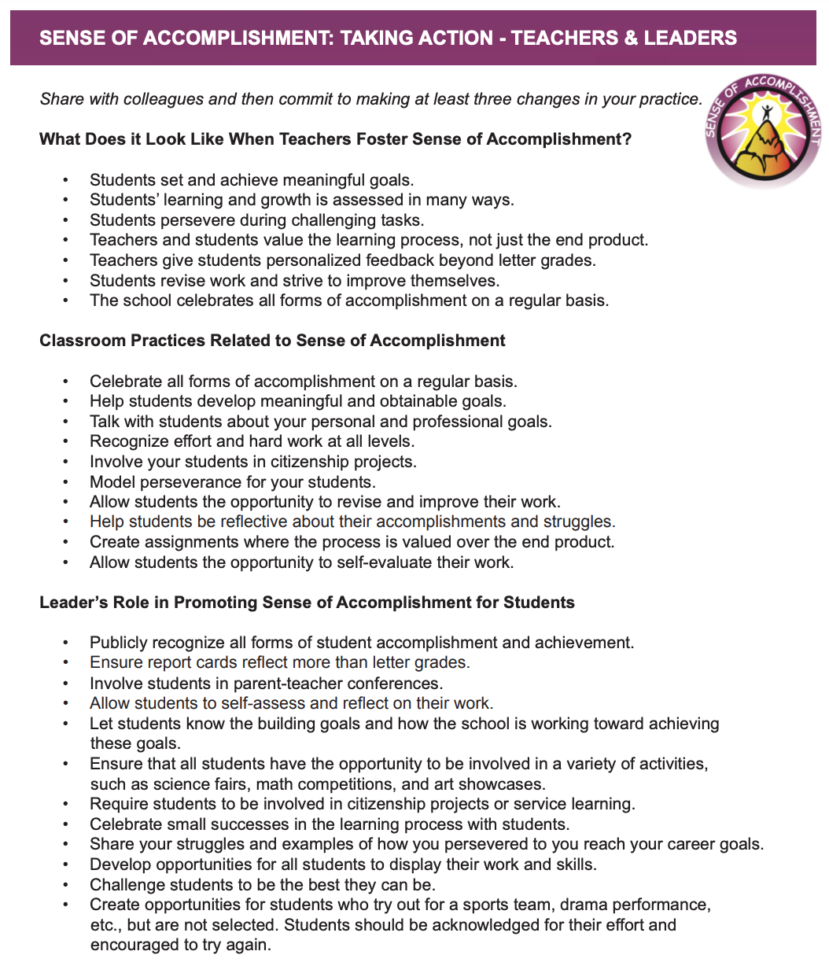
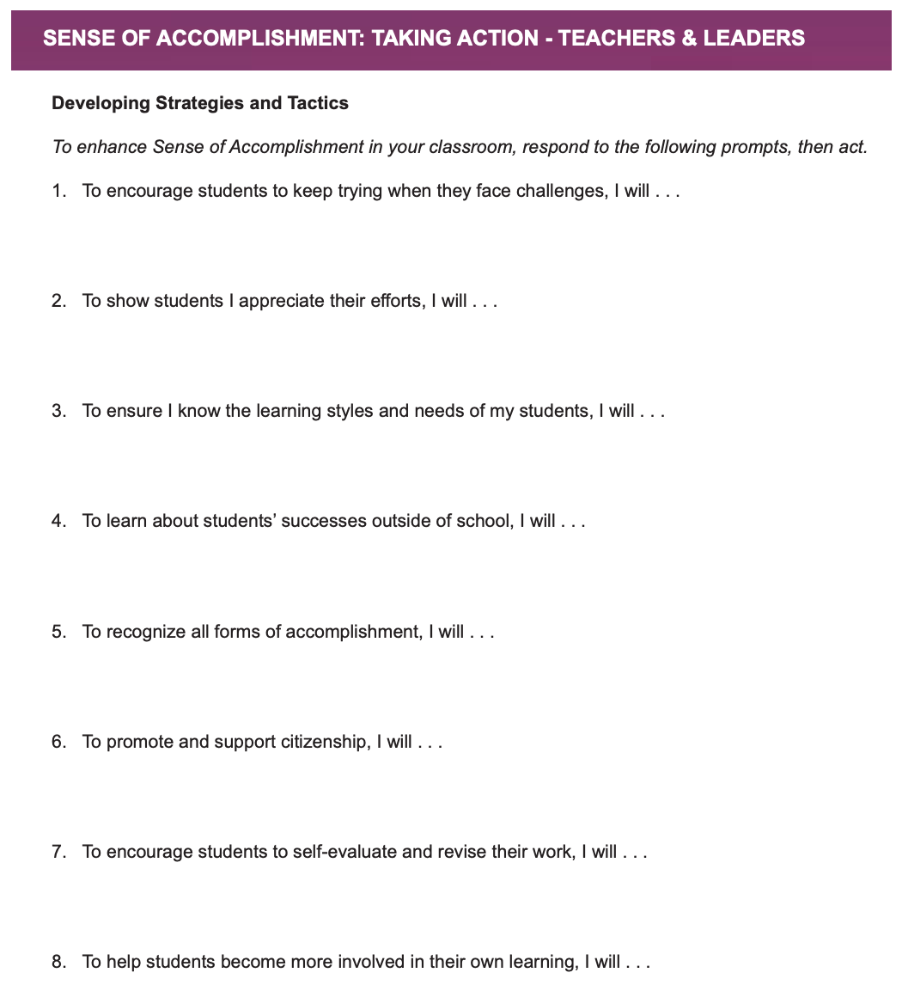

Slide 51
Taking Action
Read through the Sense of Accomplishment Taking Action resource.
Highlight 1-3 action statements you will intentionally try or revive.
Add one of your best Belonging strategies in the margin.
Complete 1-3 of the “I will…” statements.

Slide 52
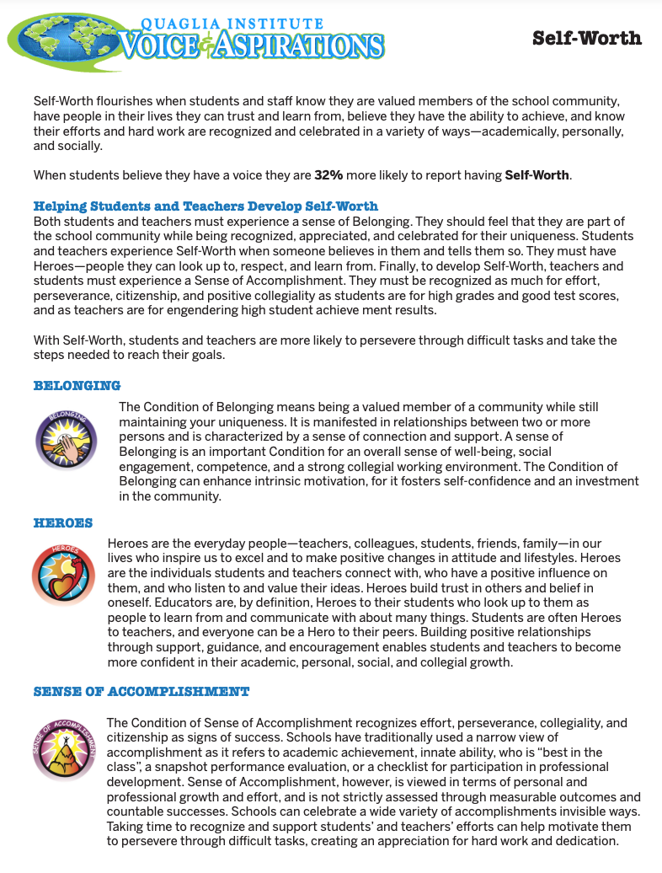
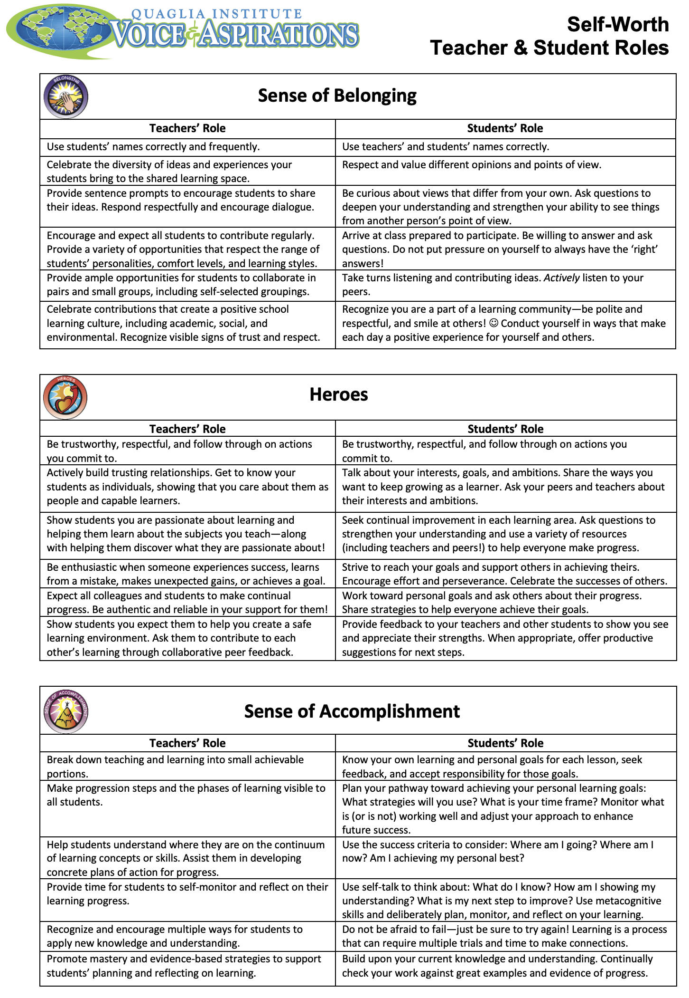
Digging Deeper into Self Worth

Slide 53
Self-Worth
Feeling like you are part of a
group, while knowing you are
valued as an individual.
Having someone in your life to
consistently support & encourage you in good times & bad.
Being recognized for different types of successes on a regular basis.

Slide 54
Challenge Time…

Slide 55

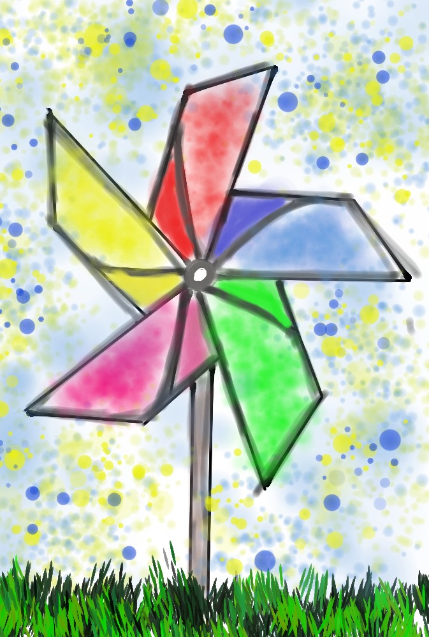
Citizens & Visitors
As a Table Team, determine your definitions for citizens & visitors.
Individually, respond to the 3 reflection questions.
In pinwheel groups of 6, discuss your responses to the reflection questions.

Slide 56
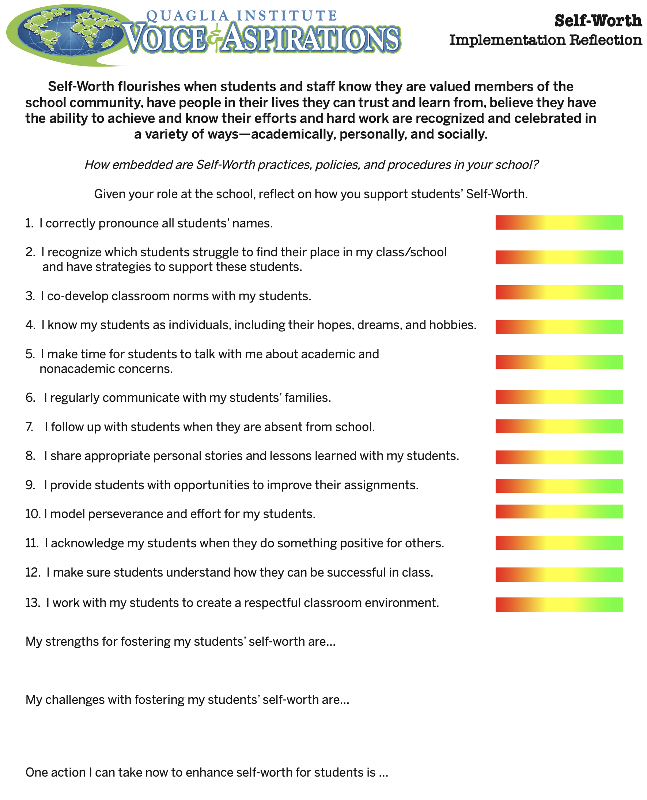
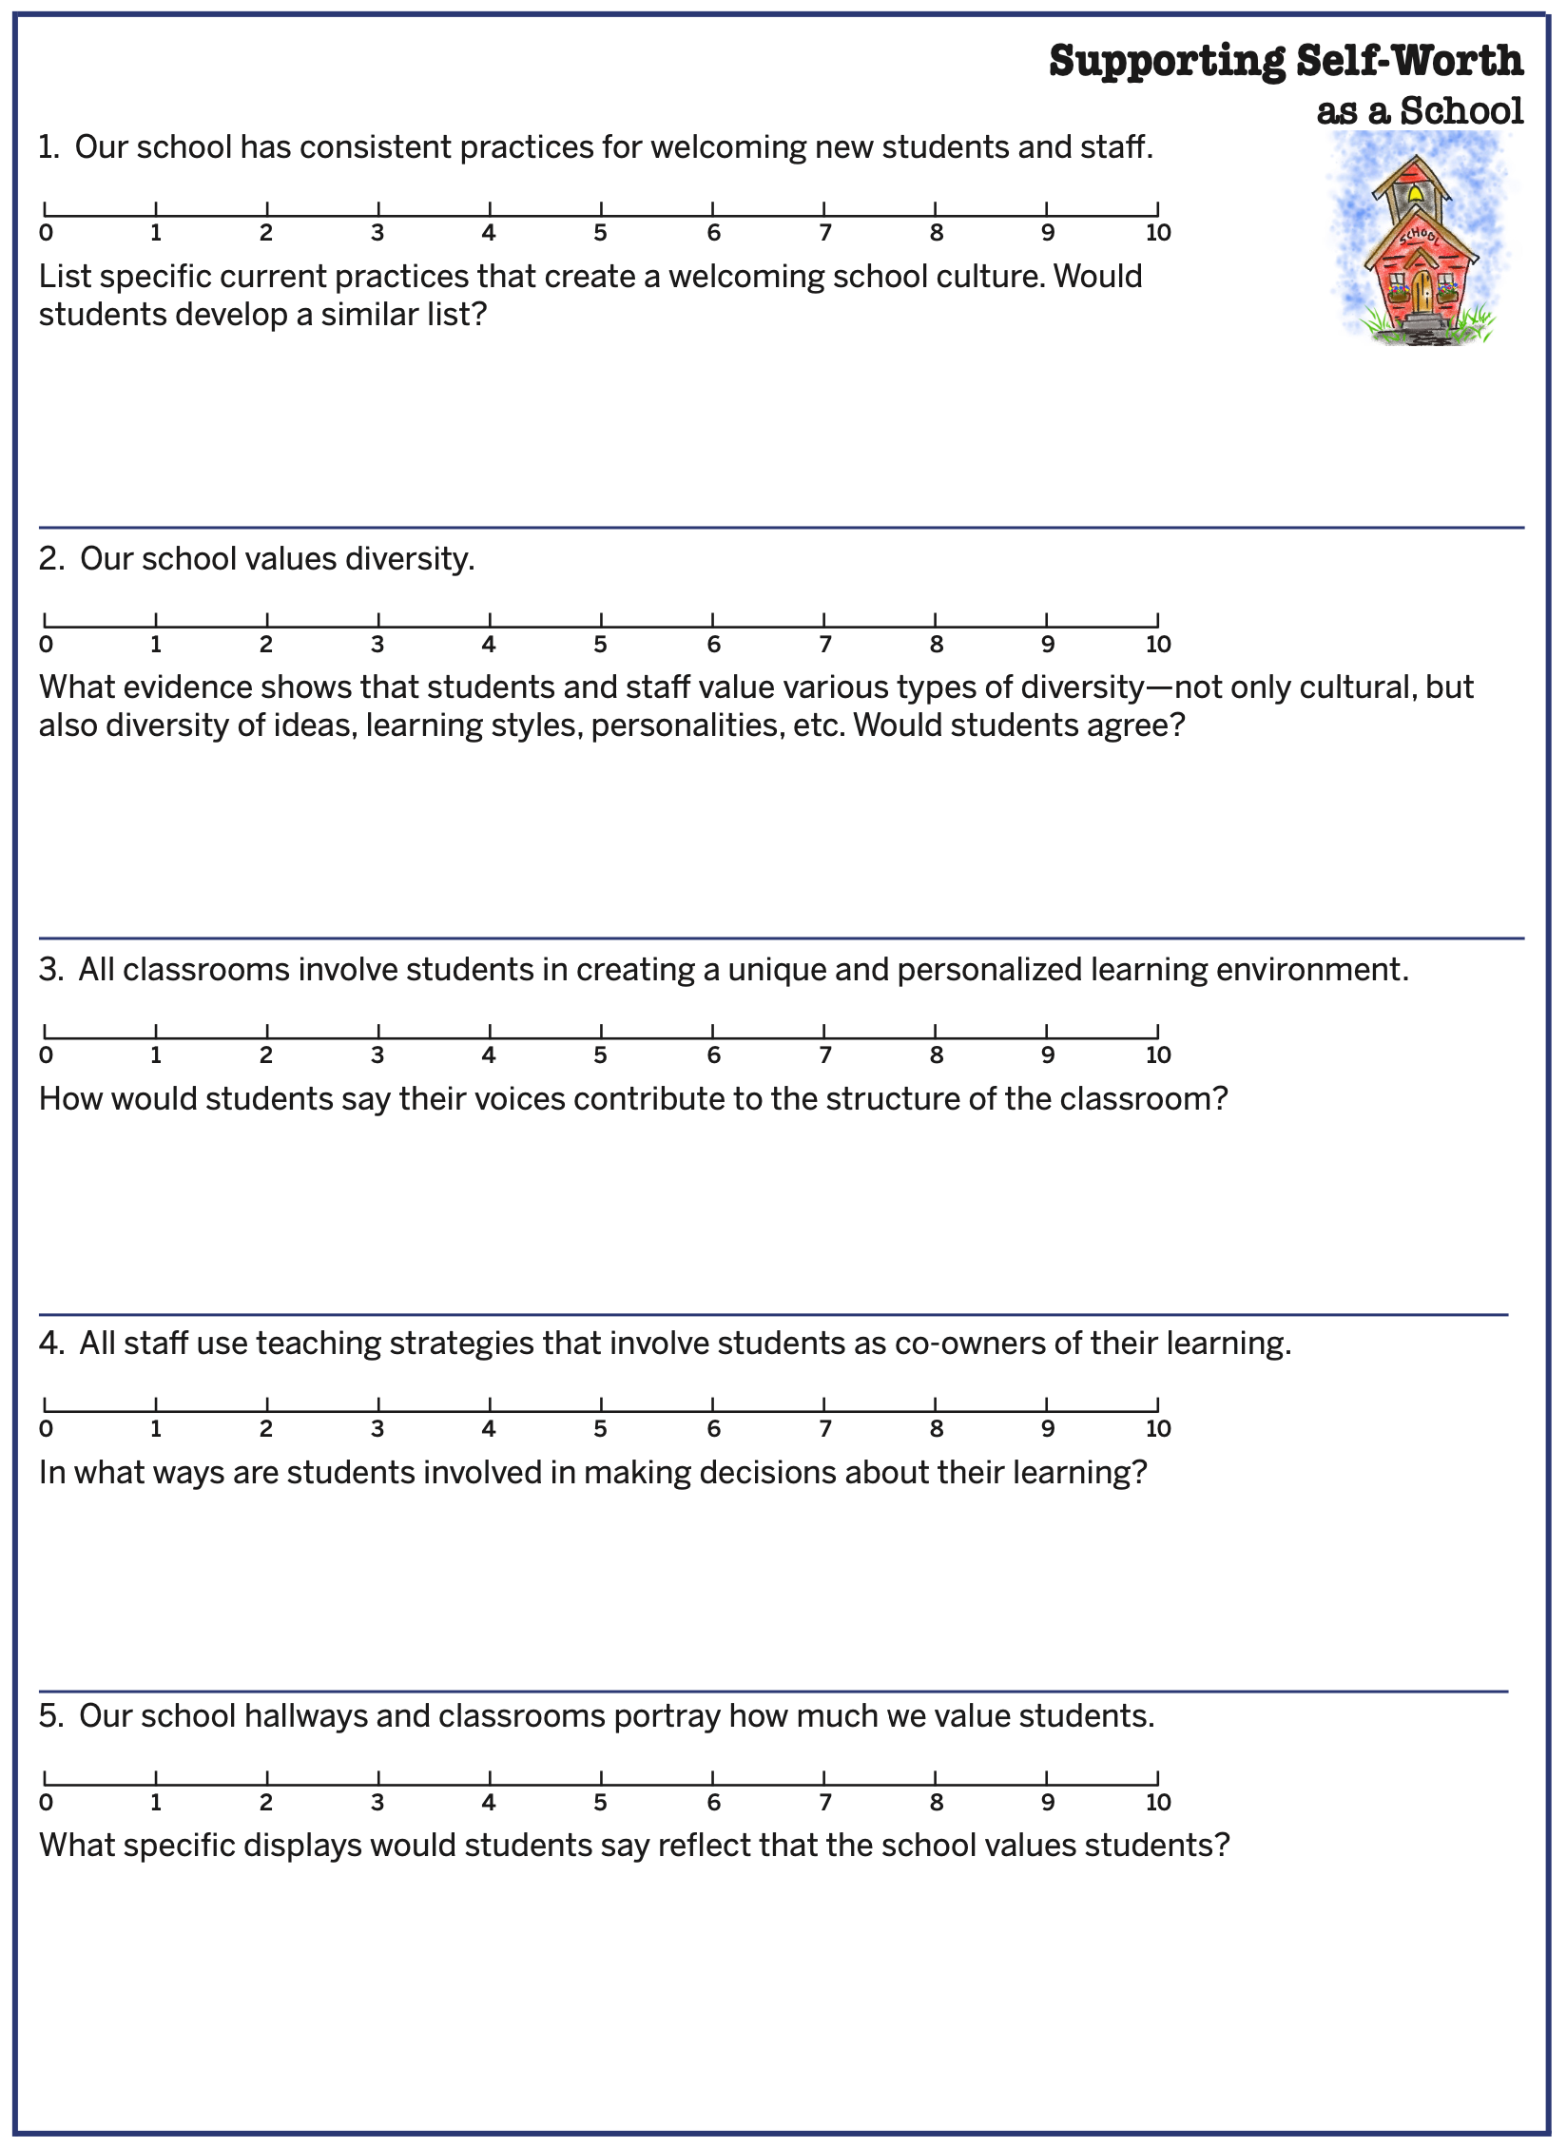
Self-Worth Implementation Self Assessment

Slide 57
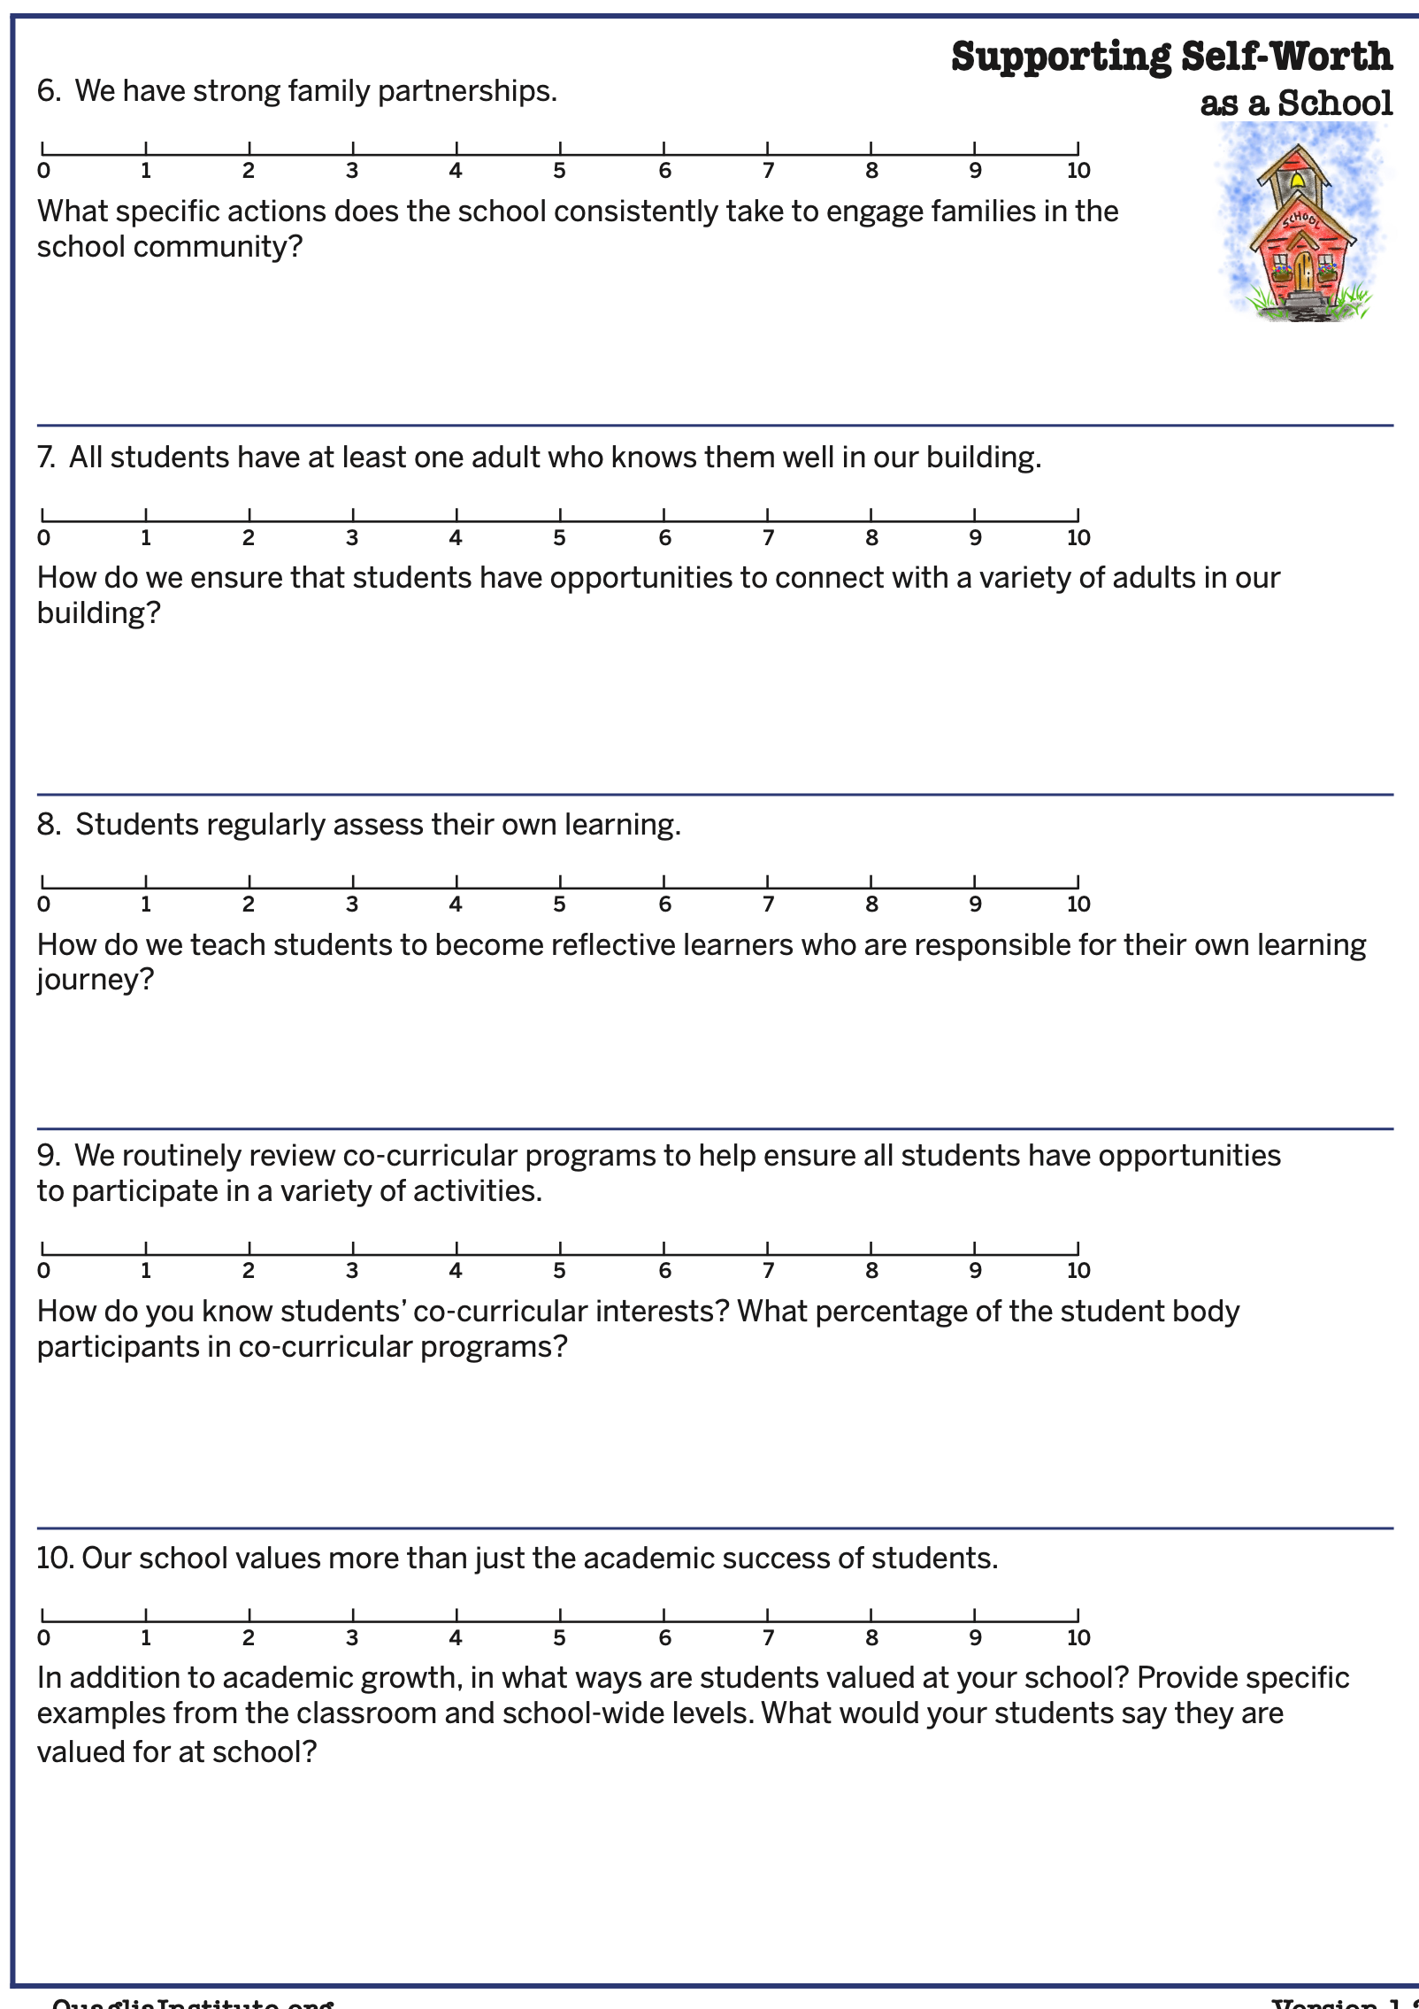
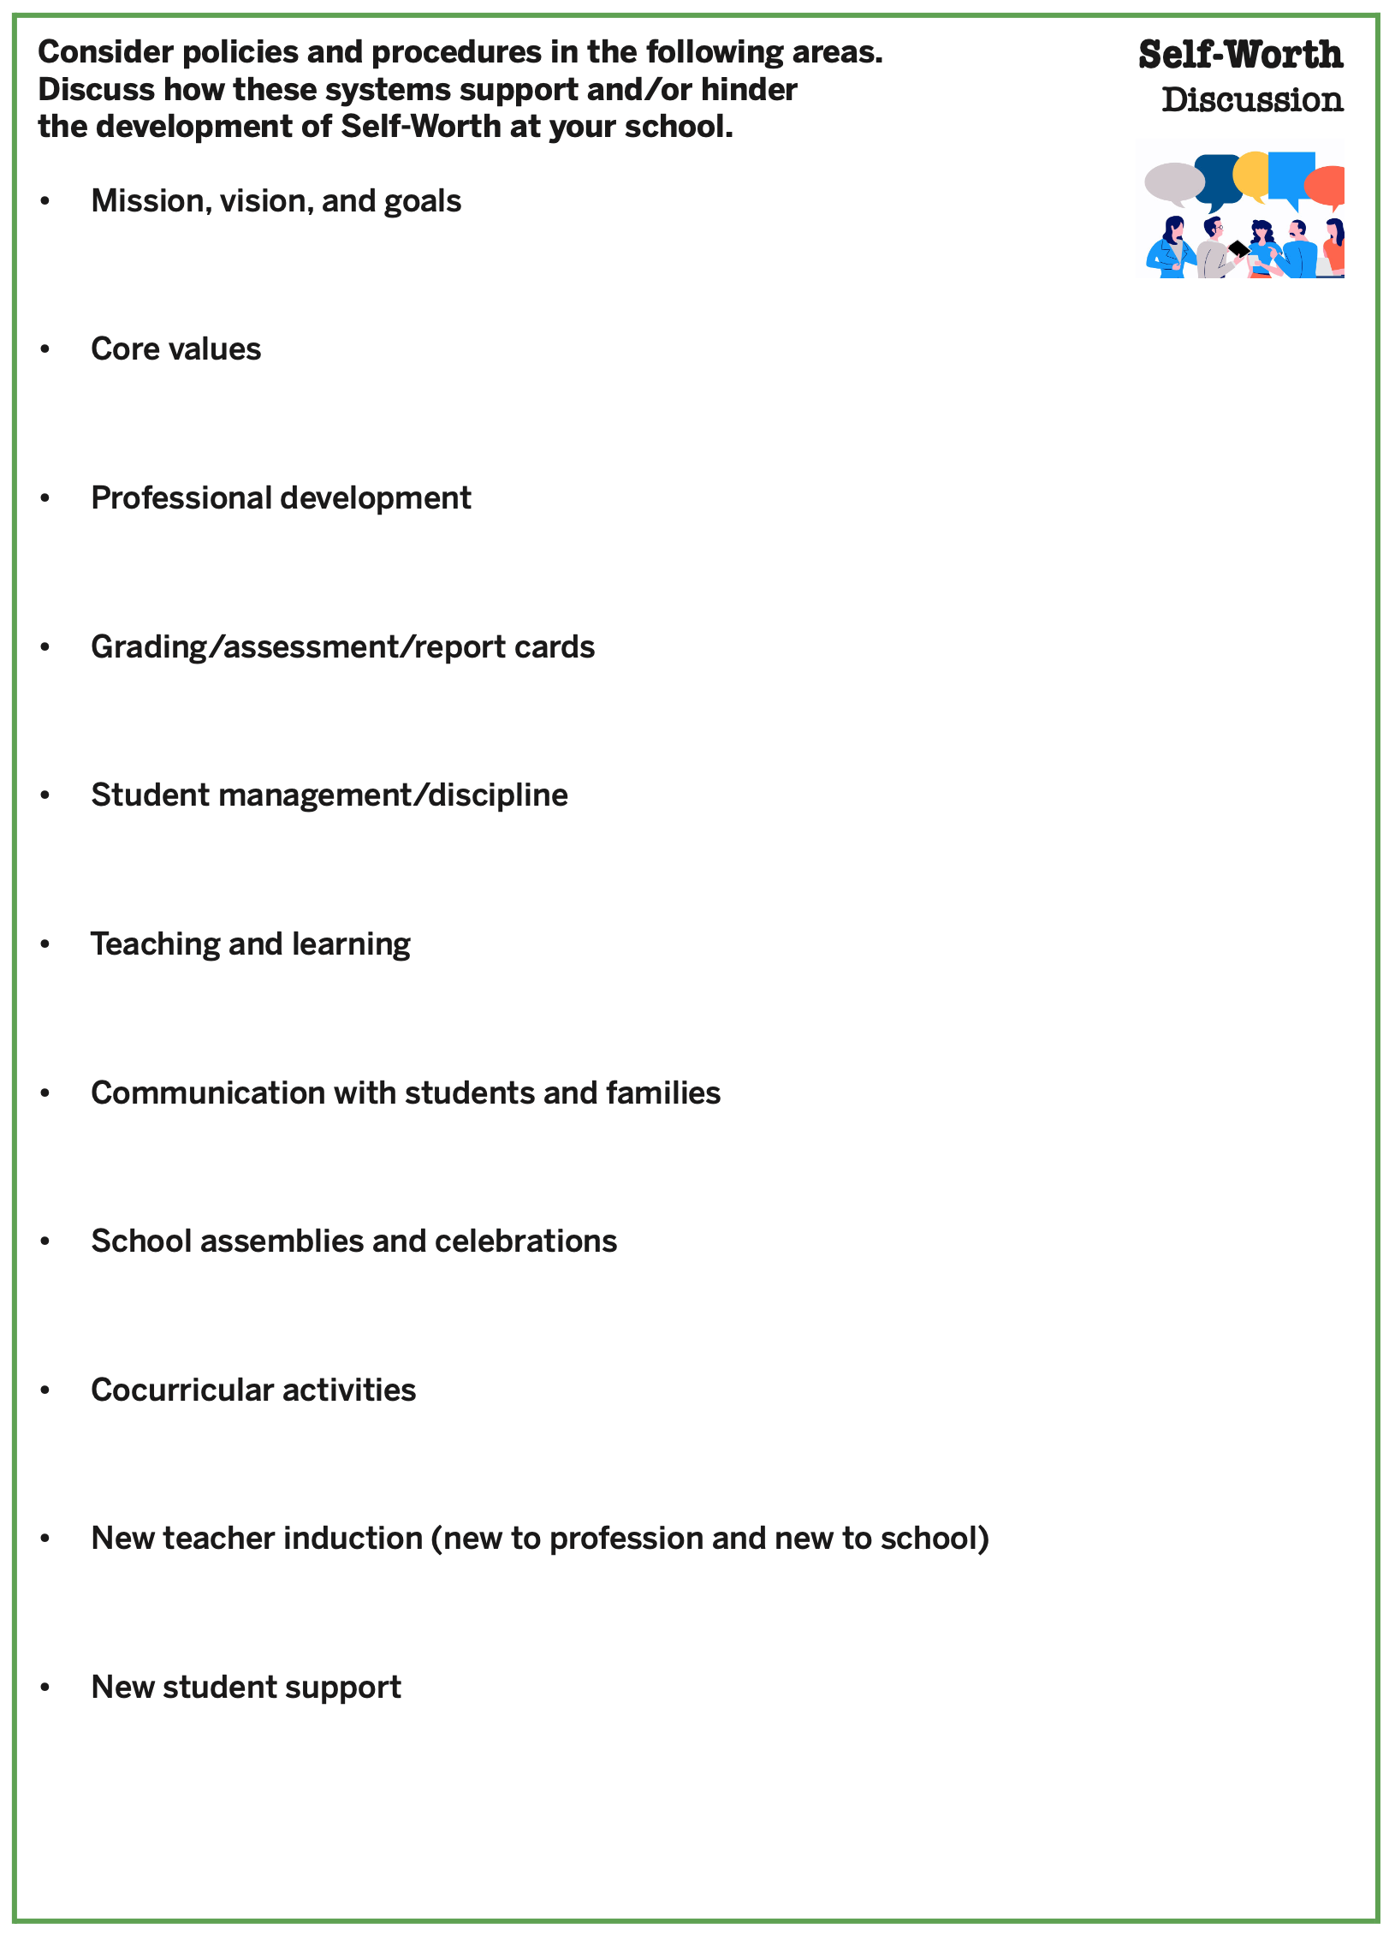
Self-Worth Implementation Self Assessment

Slide 58
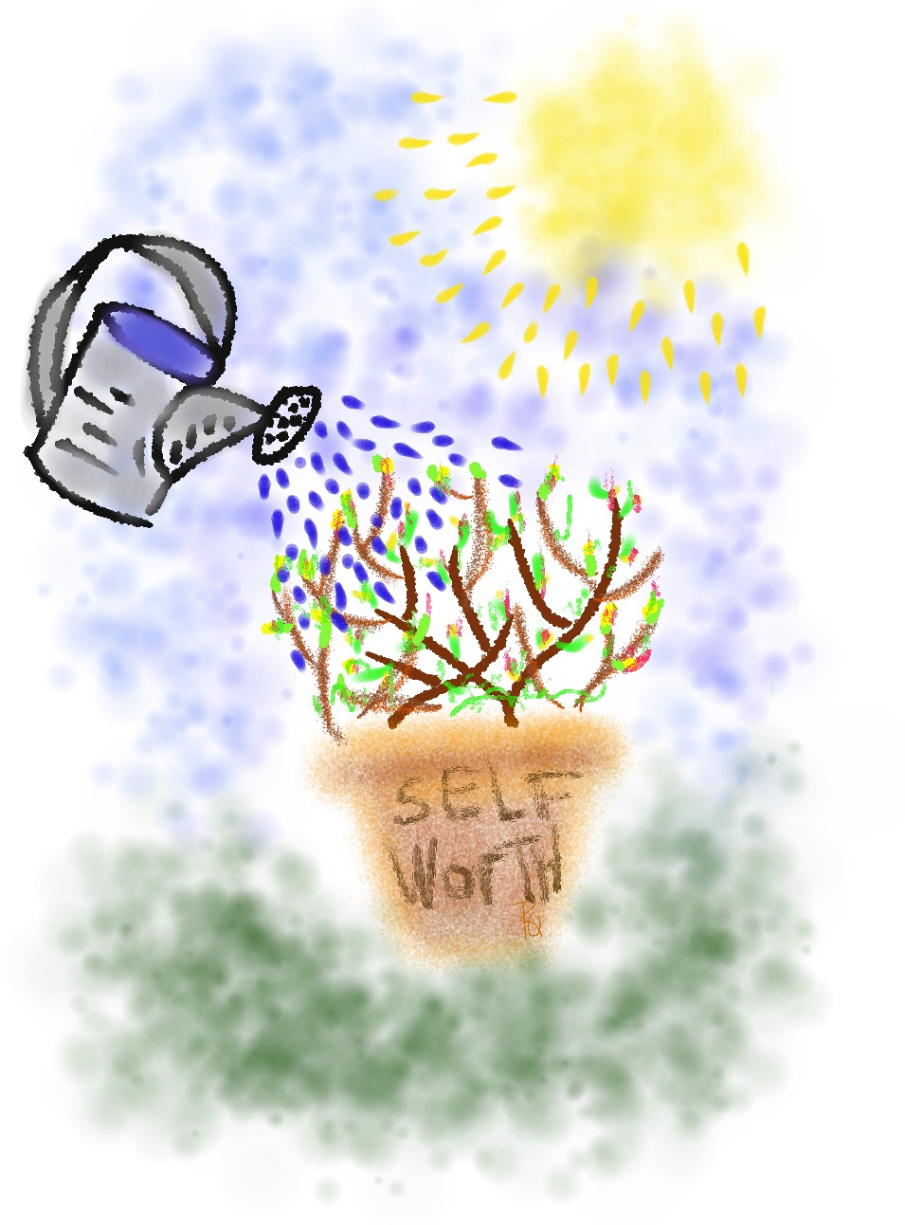
Growing Self-Worth
Individually, respond to the prompts & apply what we have learned about self-worth to your
school context.
Discuss with your Table Team.

Slide 59



Taking Action
What actions can you take as a Team to
continue forward progress cultivating
Self-Worth at your school?
How will you involve staff & students as
partners in cultivating Self-Worth?

Slide 60
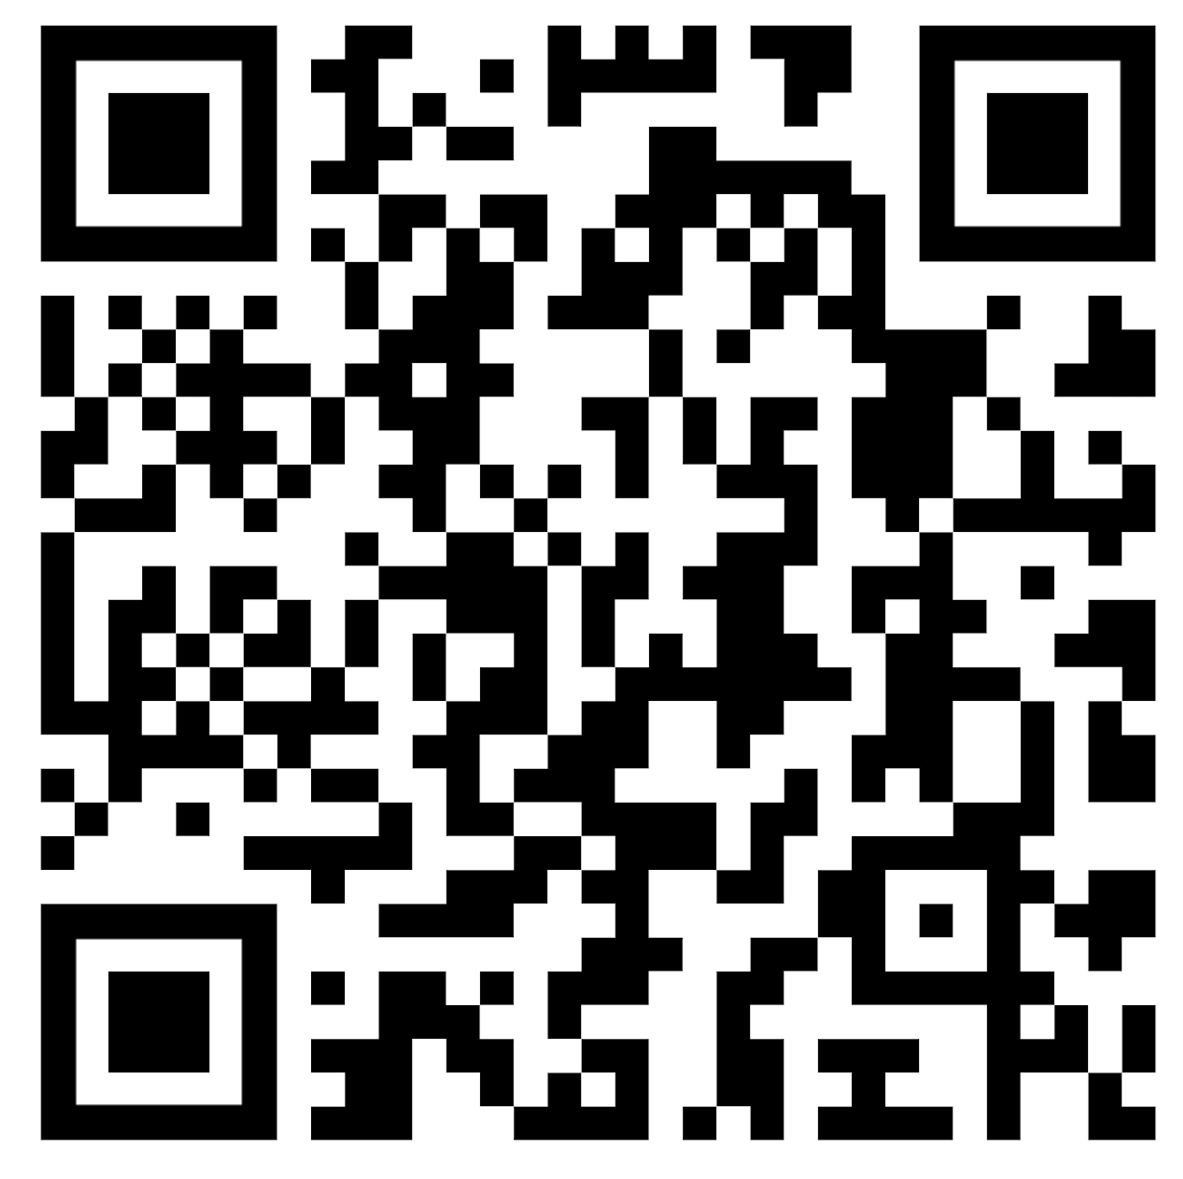
Website Just For YOU!
https://quagliainstitute.org/thomas-jefferson-senior-high

Slide 61
Thank you for the opportunity to learn together today!
Dr. Lisa Lande
lande@quagliainstitute.org
@Lisa_Lande

