Slide 1


The Aspirations Profile
Session #3 February 3, 2025
Dr. Lisa Lande

Slide 2

Choose a card that represents a future you would like to create.

Slide 3

Goals for Today
Continue our journey to amplify student
voice & grow a Community Schools culture of partnership.
Explore the Aspirations Profile & consider
how this connects to Student Voice & the
Community Schools goals.
Apply learning to the Community Schools
Implementation Team efforts at Jefferson
High School, particularly in relation to BSAP.

Slide 4
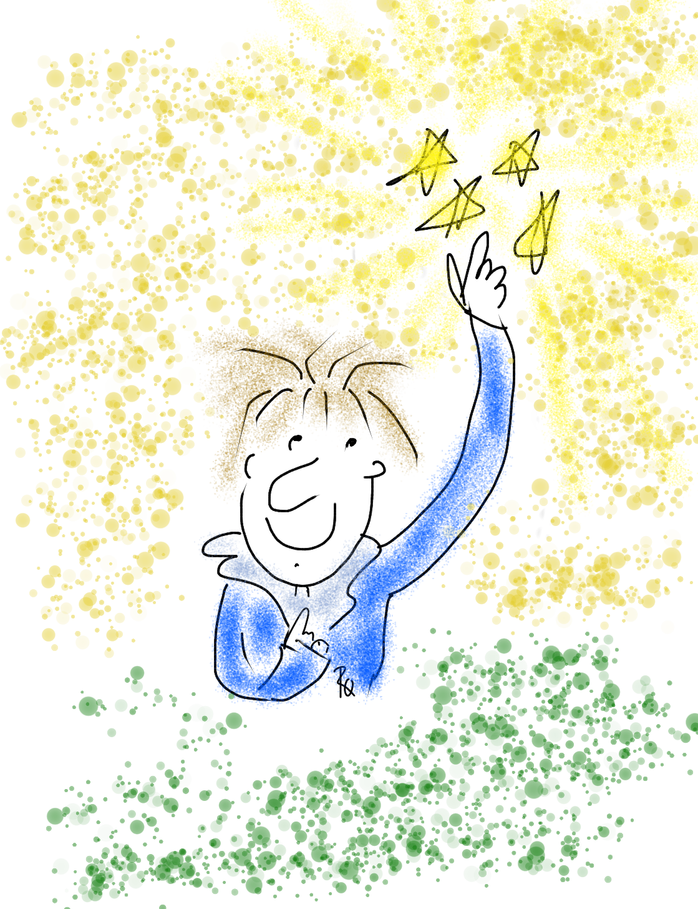
Vision & Purpose
Community Schools Vision: A family of
learning where educators, families, &
community members work together to
prepare students in achieving their
academic & career dreams.
BSAP Team Purpose: Supports the social,
emotional, & academic needs of our Black
students. It builds on the assets of the Black community & works towards preserving
its history.

Slide 5
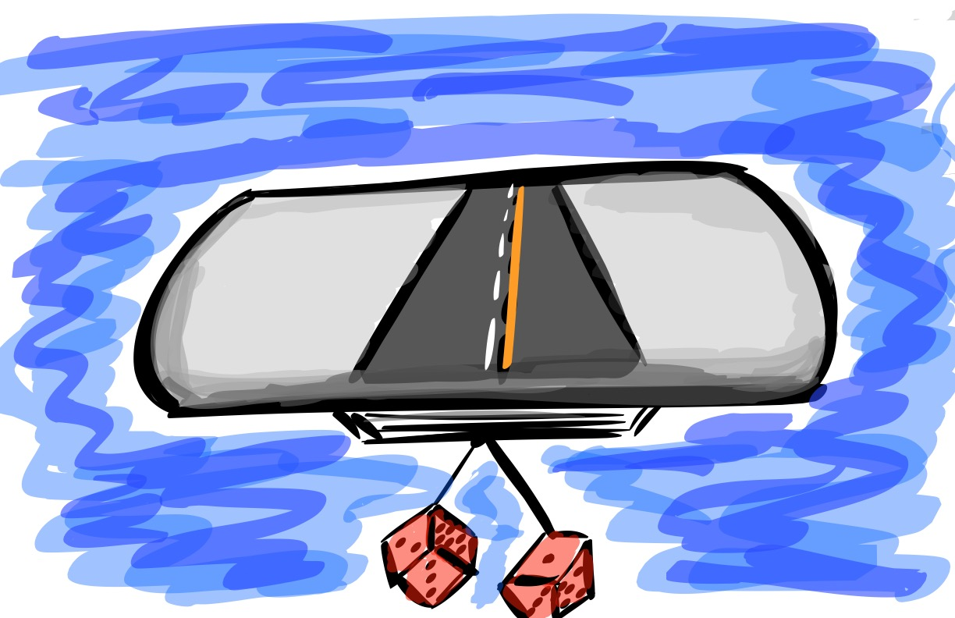
Quick Review
What do you remember from our learning together last
school year? ☺

Slide 6

The 3 Components of Student Voice
Sharing thoughts & ideas in an environment underpinned by trust & respect.
Offering realistic suggestions for the
good of the whole.
Accepting responsibility for not only what is said but also what needs to be done.

Slide 7
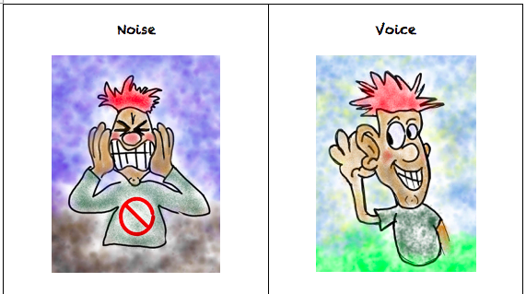

Slide 8
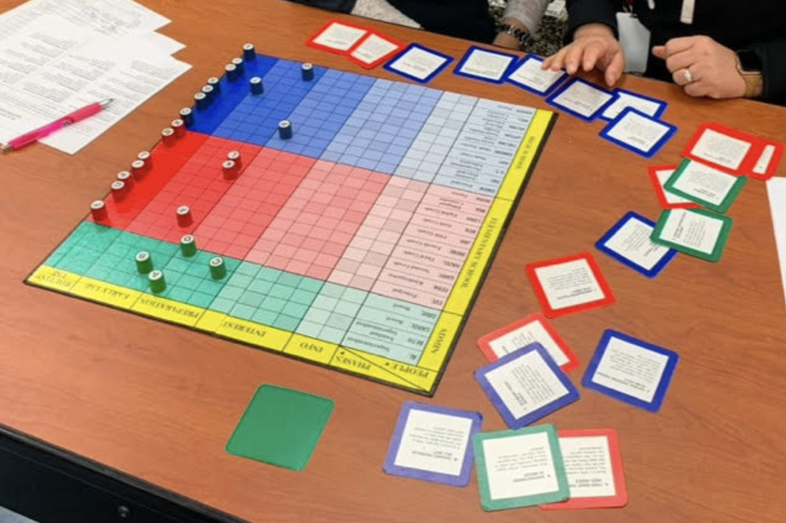
The Student Voice
Change Game

Slide 9
LEAD
TAKE ACTION
with others
Share
RESPONSIBILITY
LEARN
UNDERSTAND
& RESPECT
different points
of view
Build
TRUST
LISTEN
SEEK OUT
opinions from
others
Voice Process

Slide 10
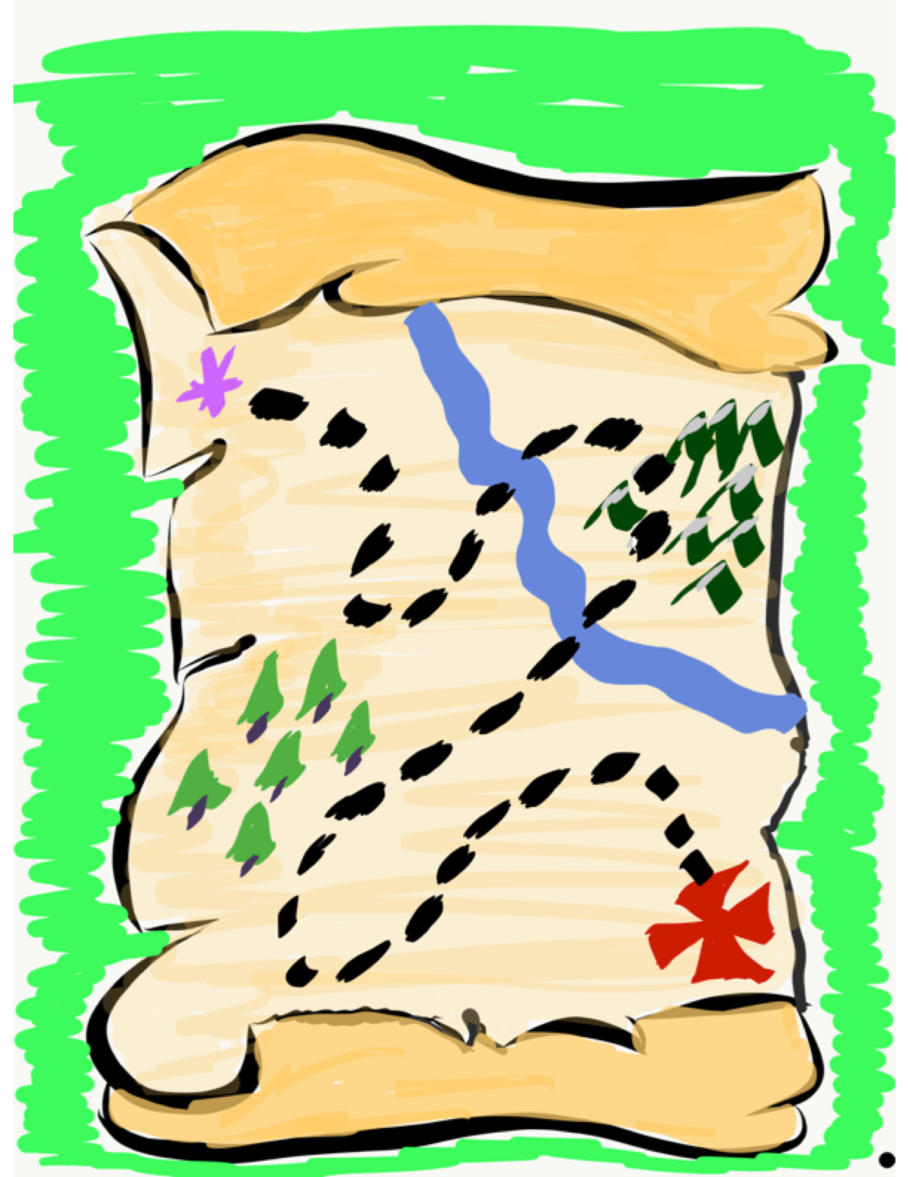
Time to journey
onward & explore
the Aspirations
Profile

Slide 11
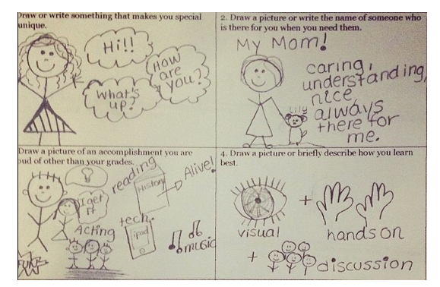
Aspirations
Story Squares
Complete 3 squares on the Aspirations Story Squares handout.
Mingle around the room sharing different squares with your peers.

Slide 12
ASPIRATIONS
The ability to
dream & set goals
for the future,
while being inspired
in the present
to reach those dreams.

Slide 13




high
Imagination
Aspiration
DREAMING
Hibernation
Perspiration
low
DOING
high

Slide 14
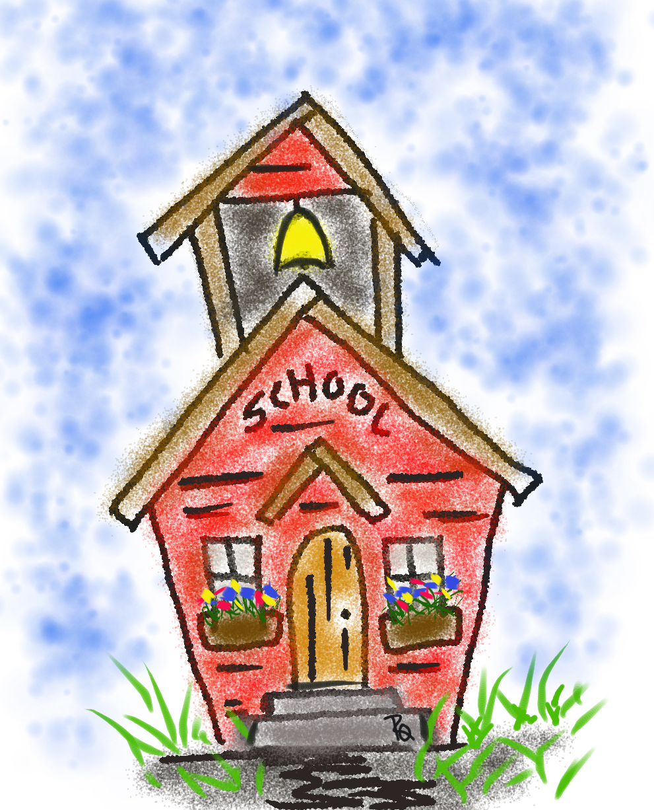
Team Time Tasks
Learn more by reading the Aspirations
Profile Brief
Complete the Aspirations Profile
Self-Assessment.
Explore the following resources on the
Jefferson Student Voice Website:
-Aspirations Profile Instructional Strategies
-Aspirations Student Resource
-Aspirations Profile Educator Reflection
-Aspirations Profile Coaching Questions

Slide 15
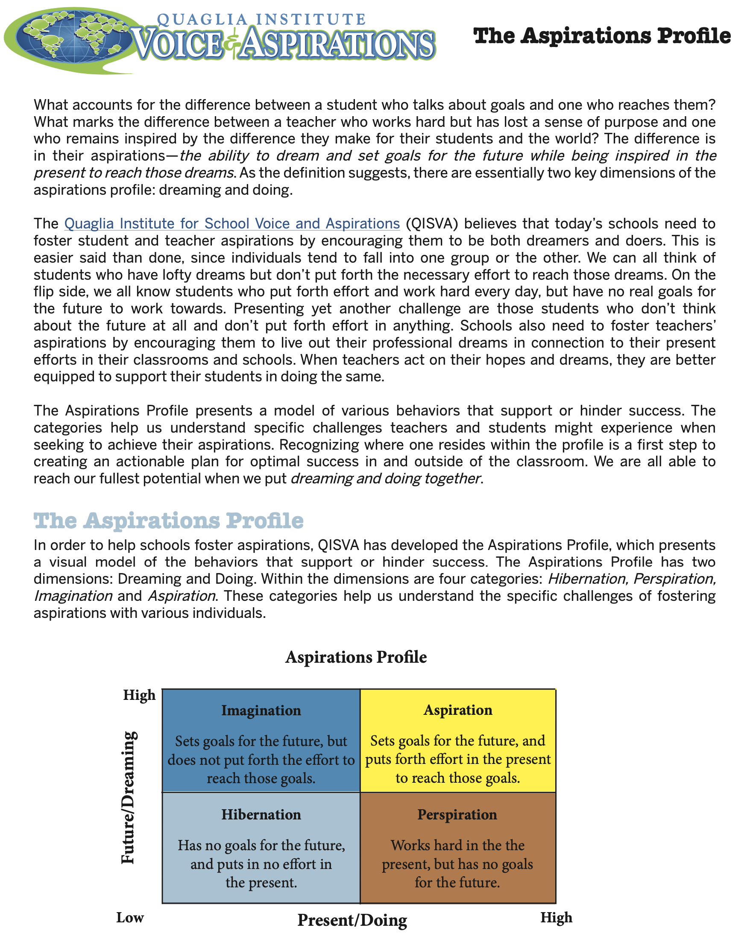

Slide 16
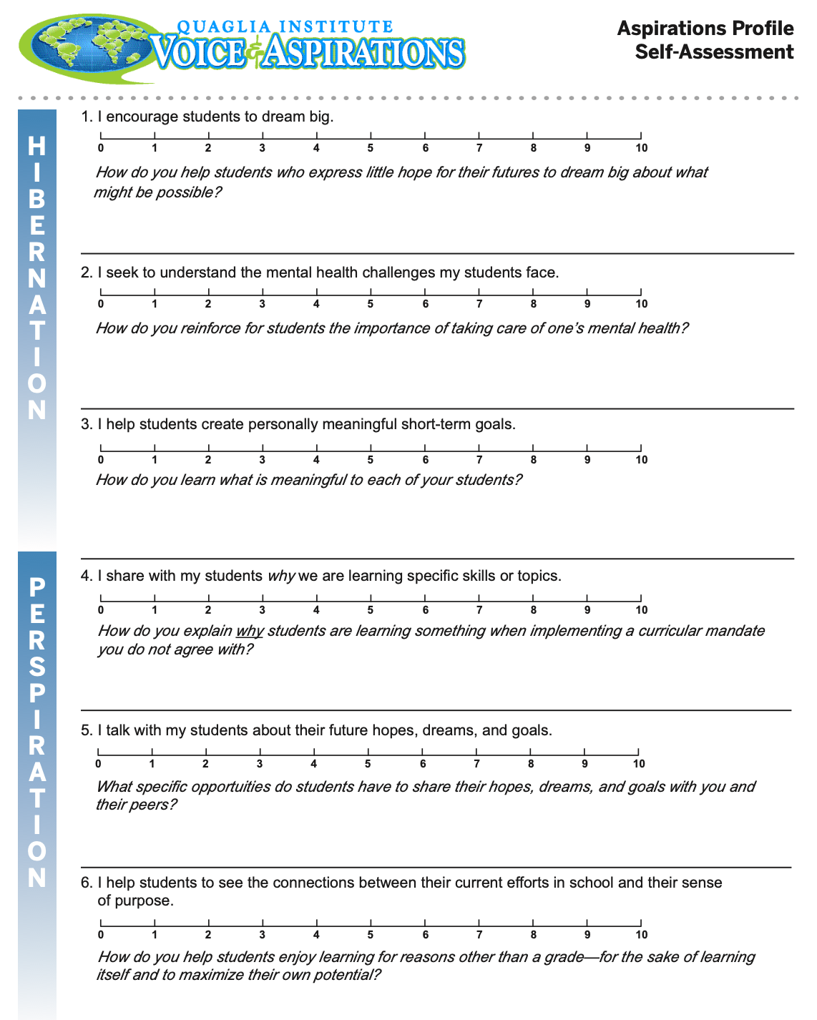
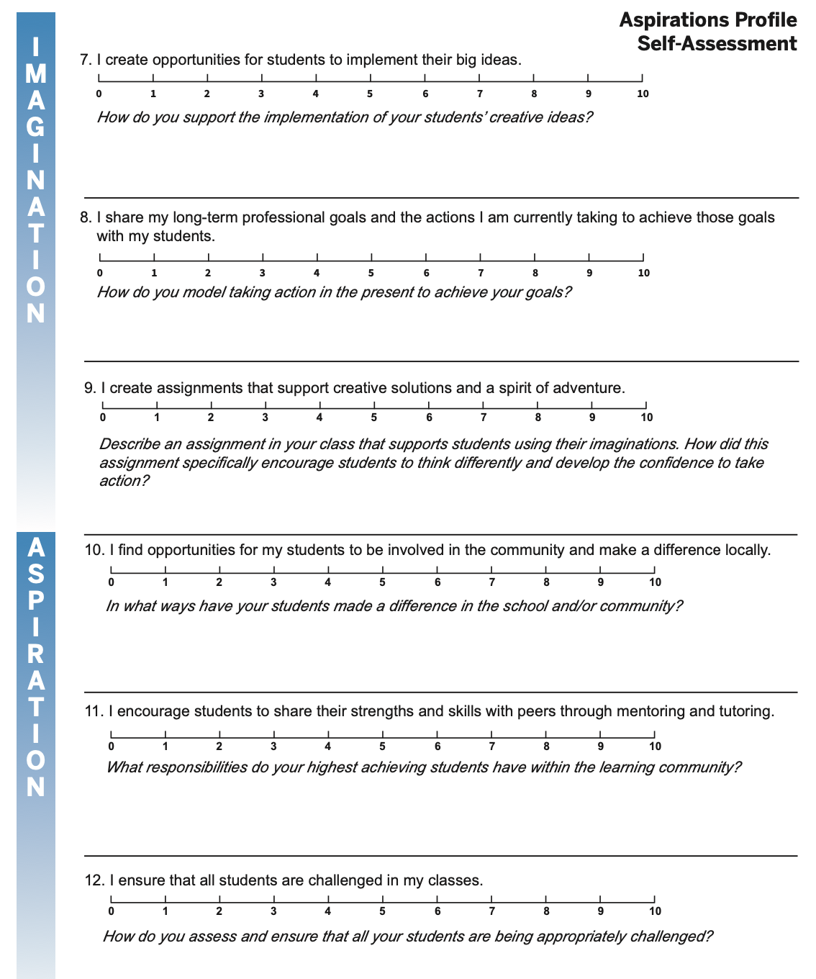

Slide 17
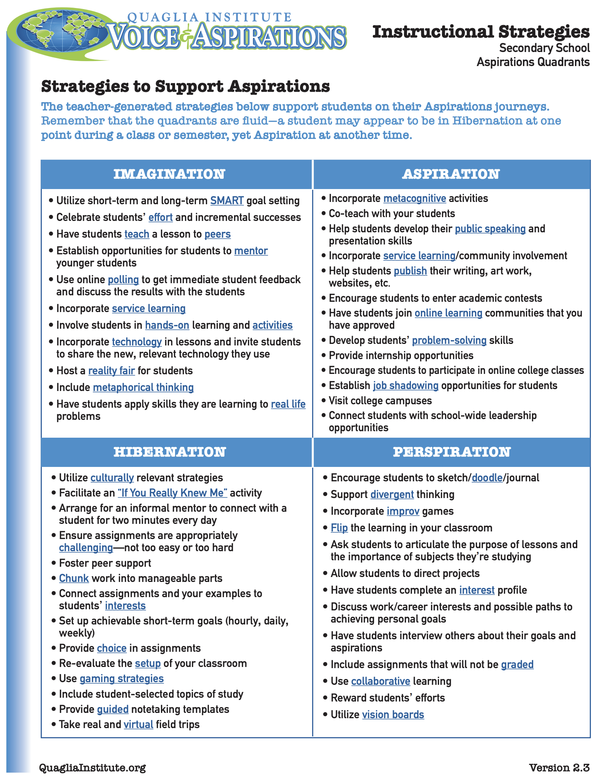

Slide 18
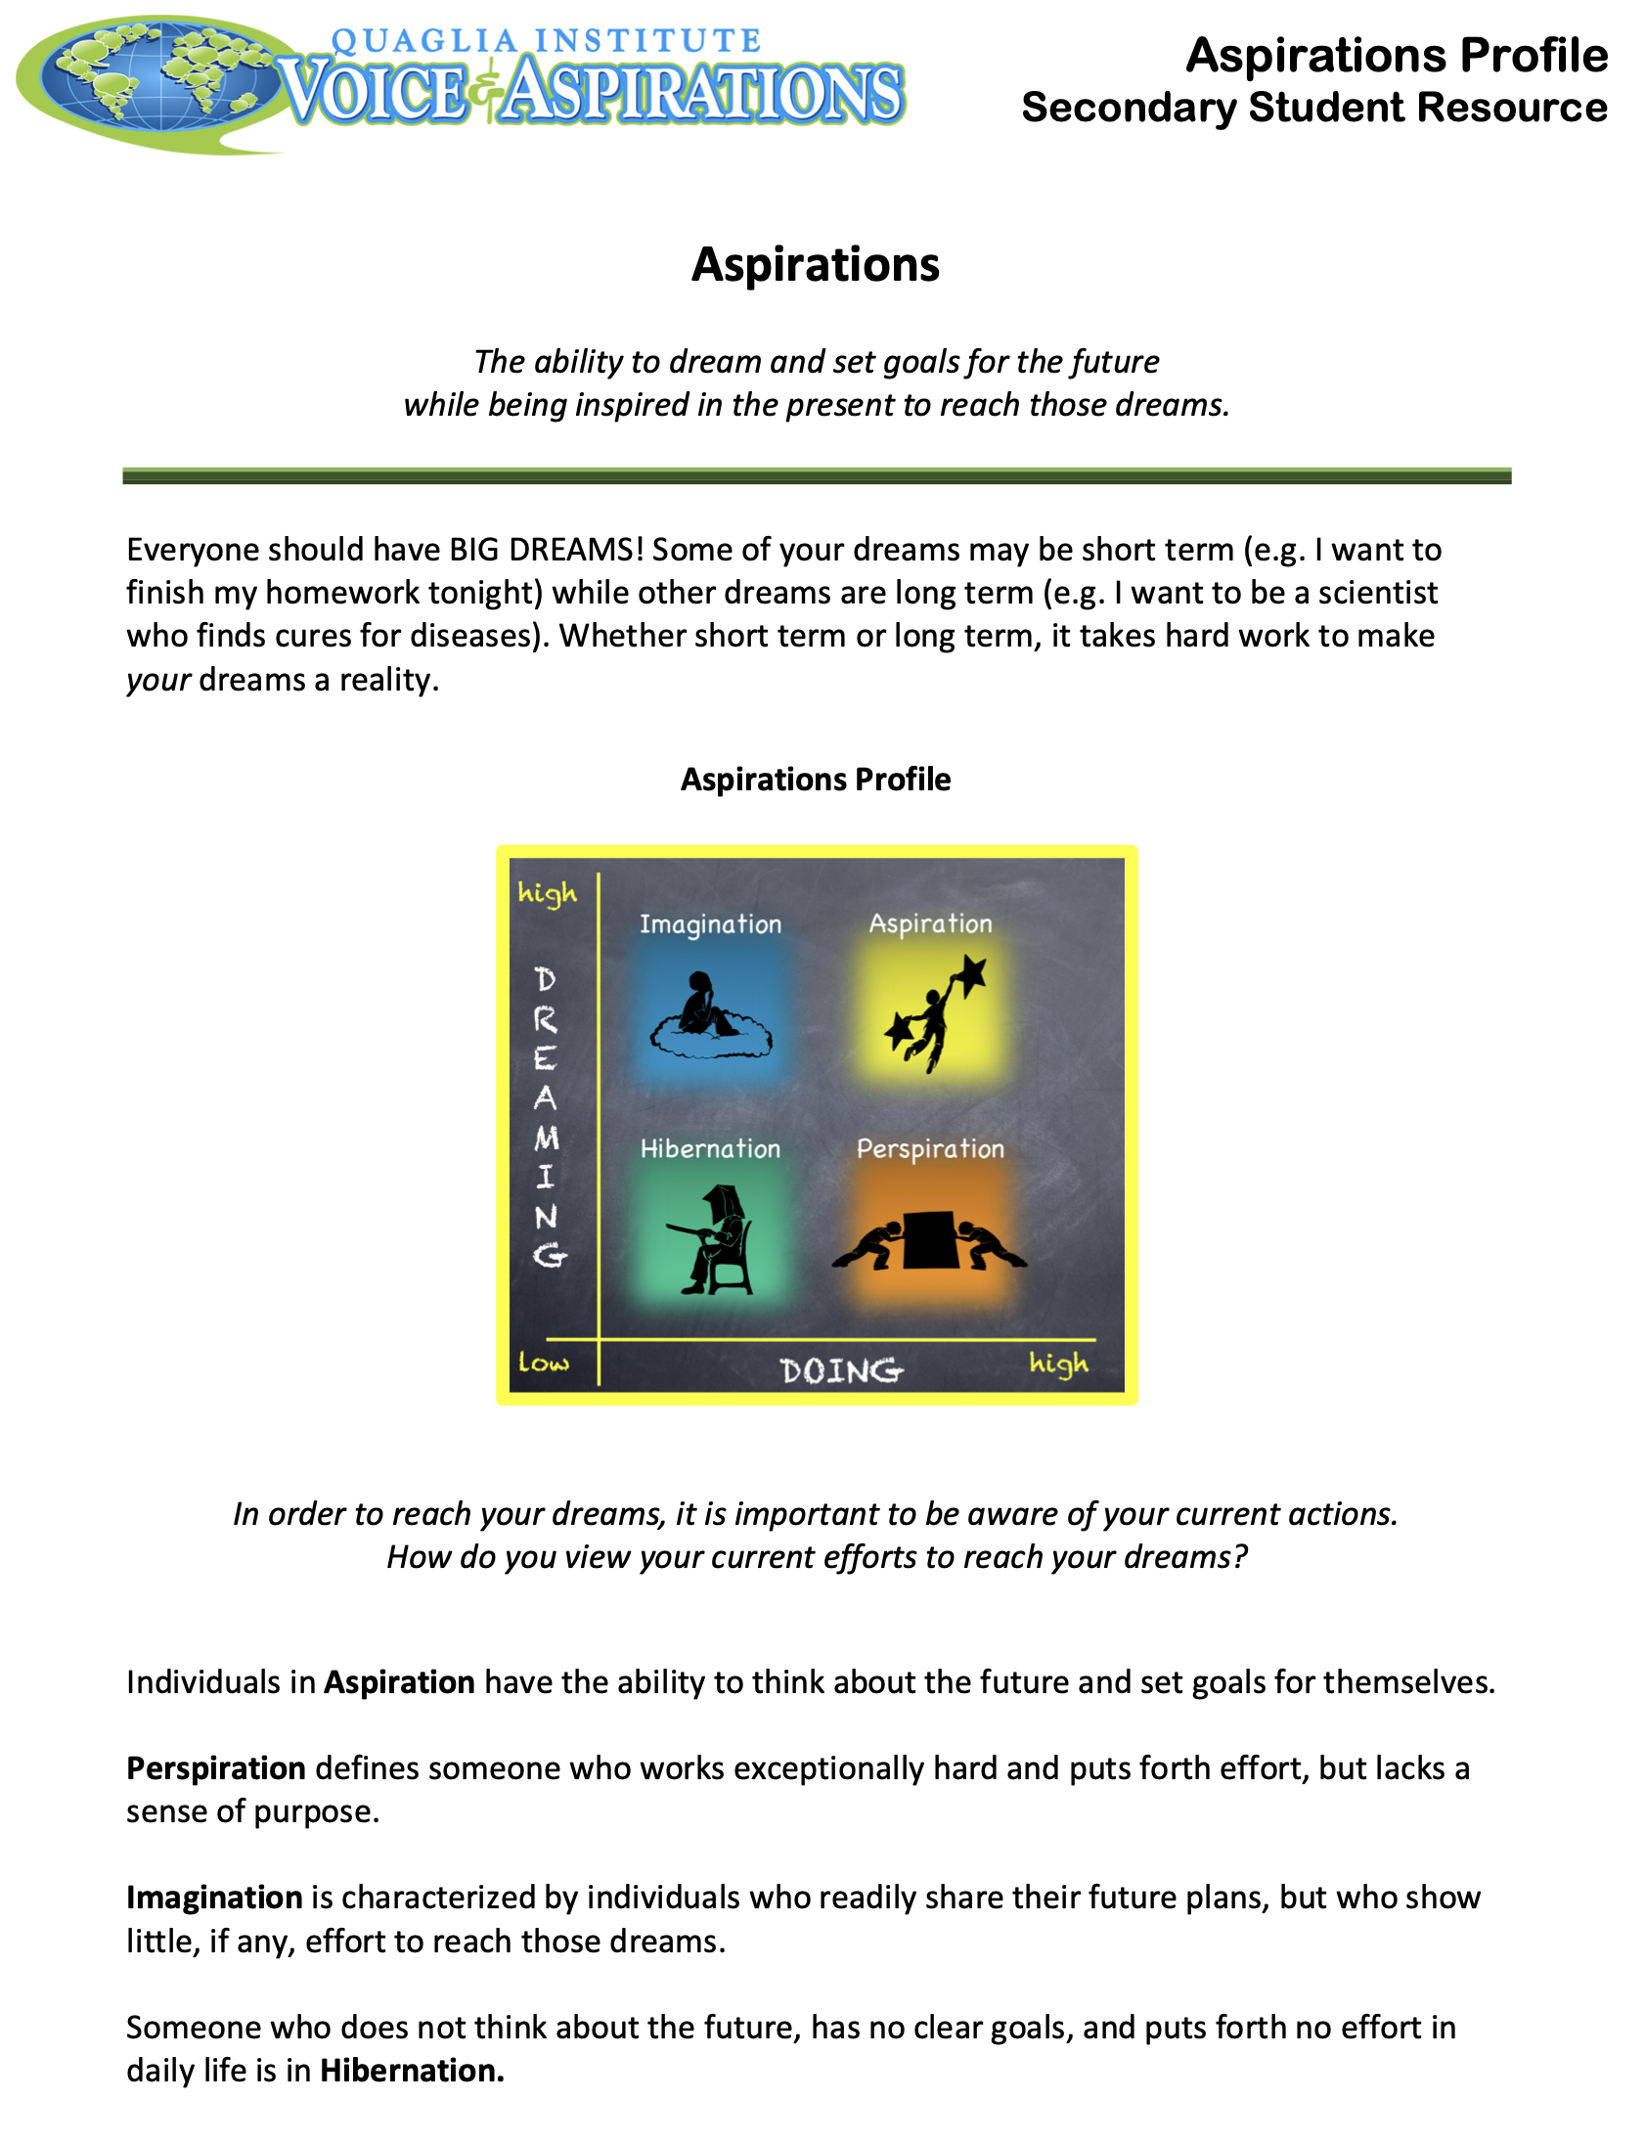
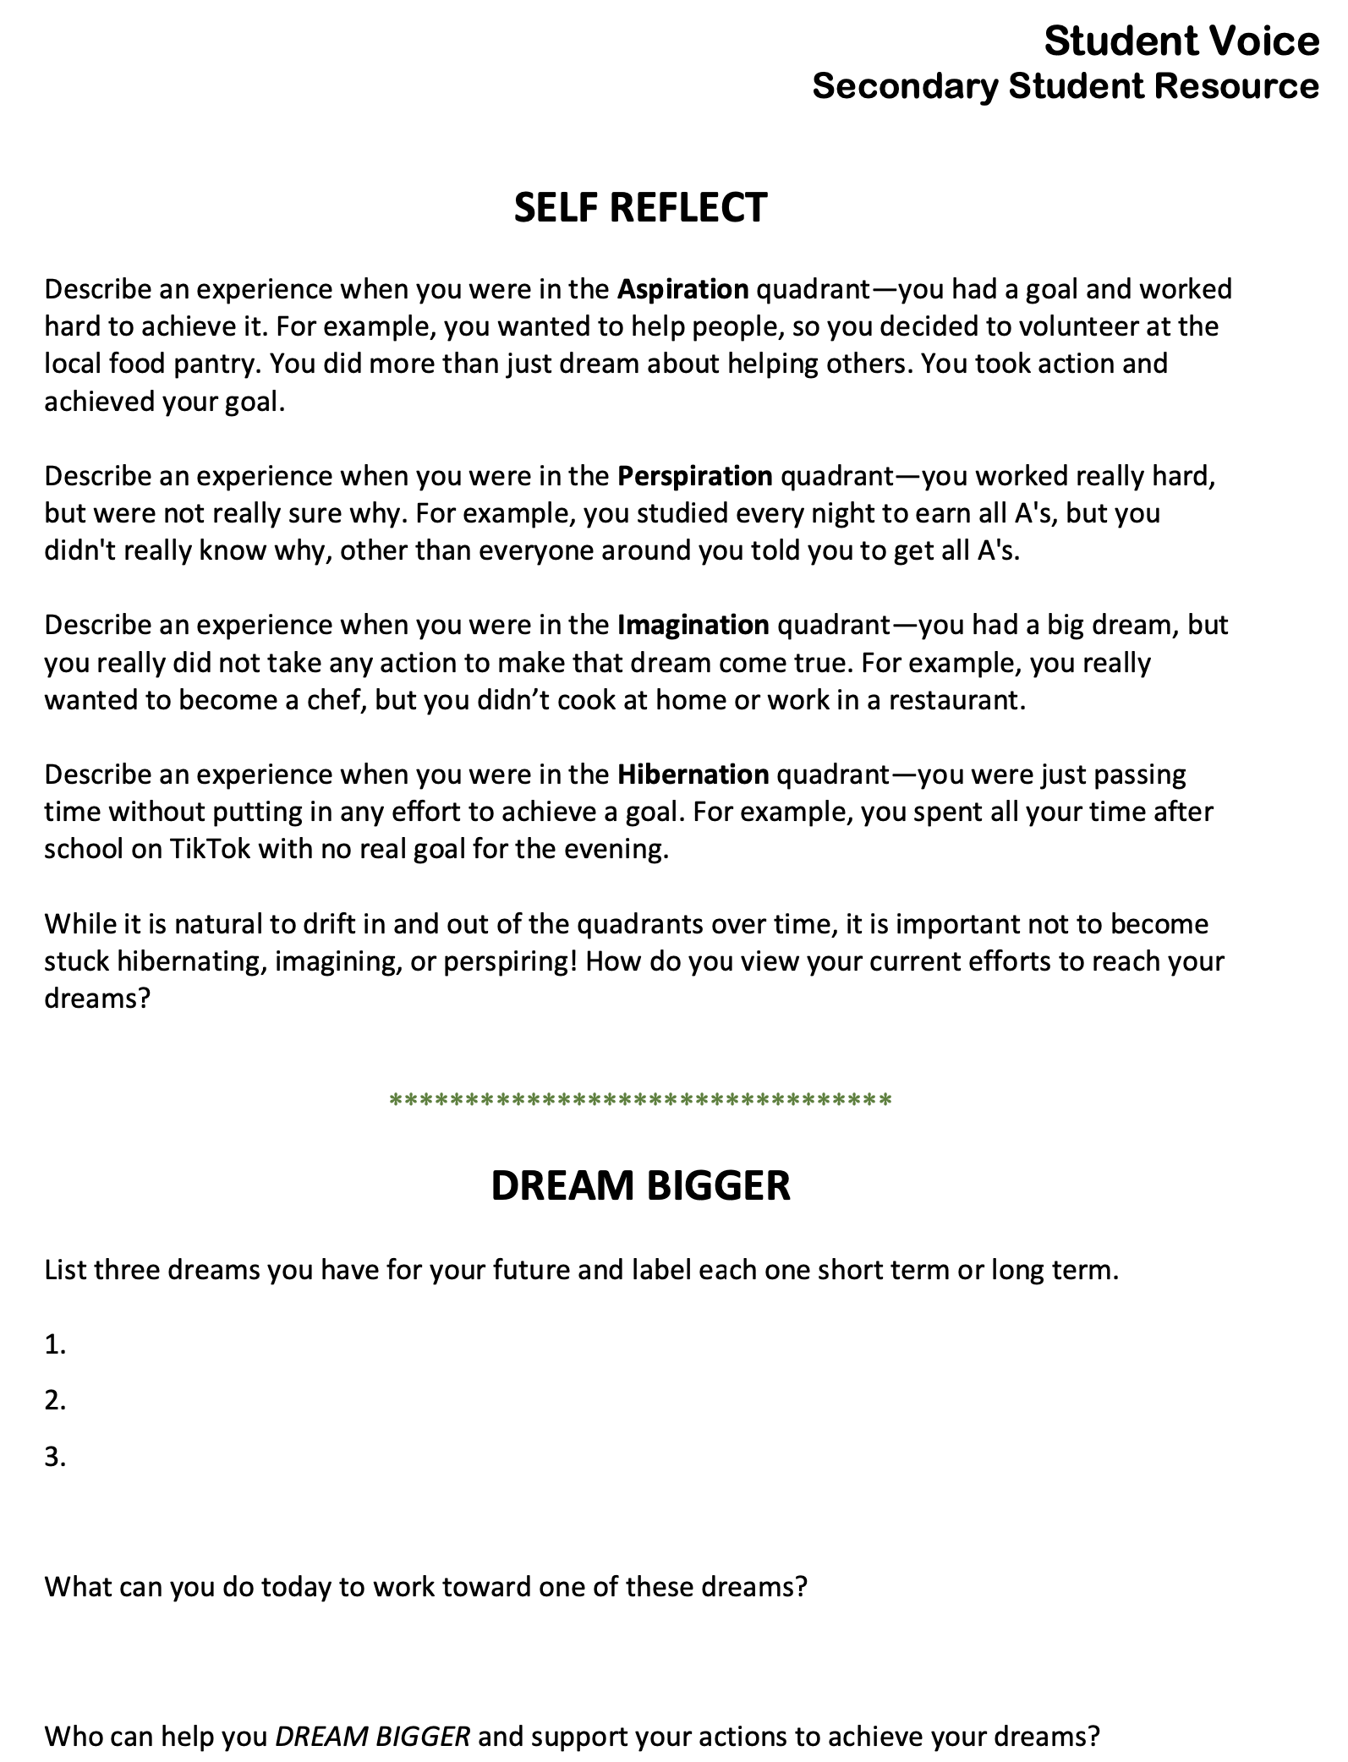
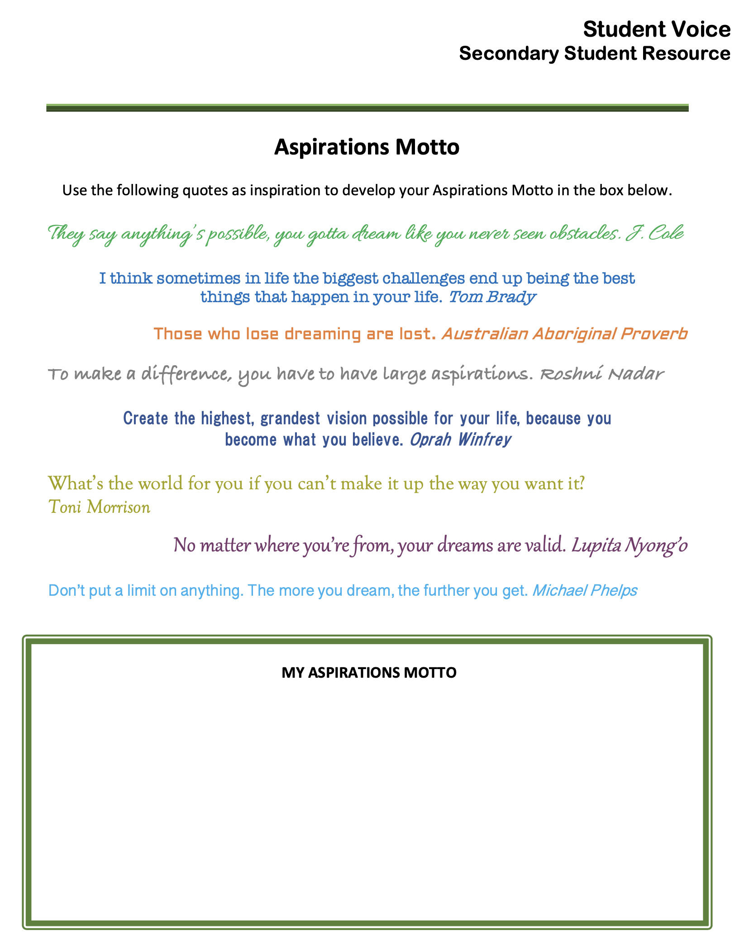

Slide 19
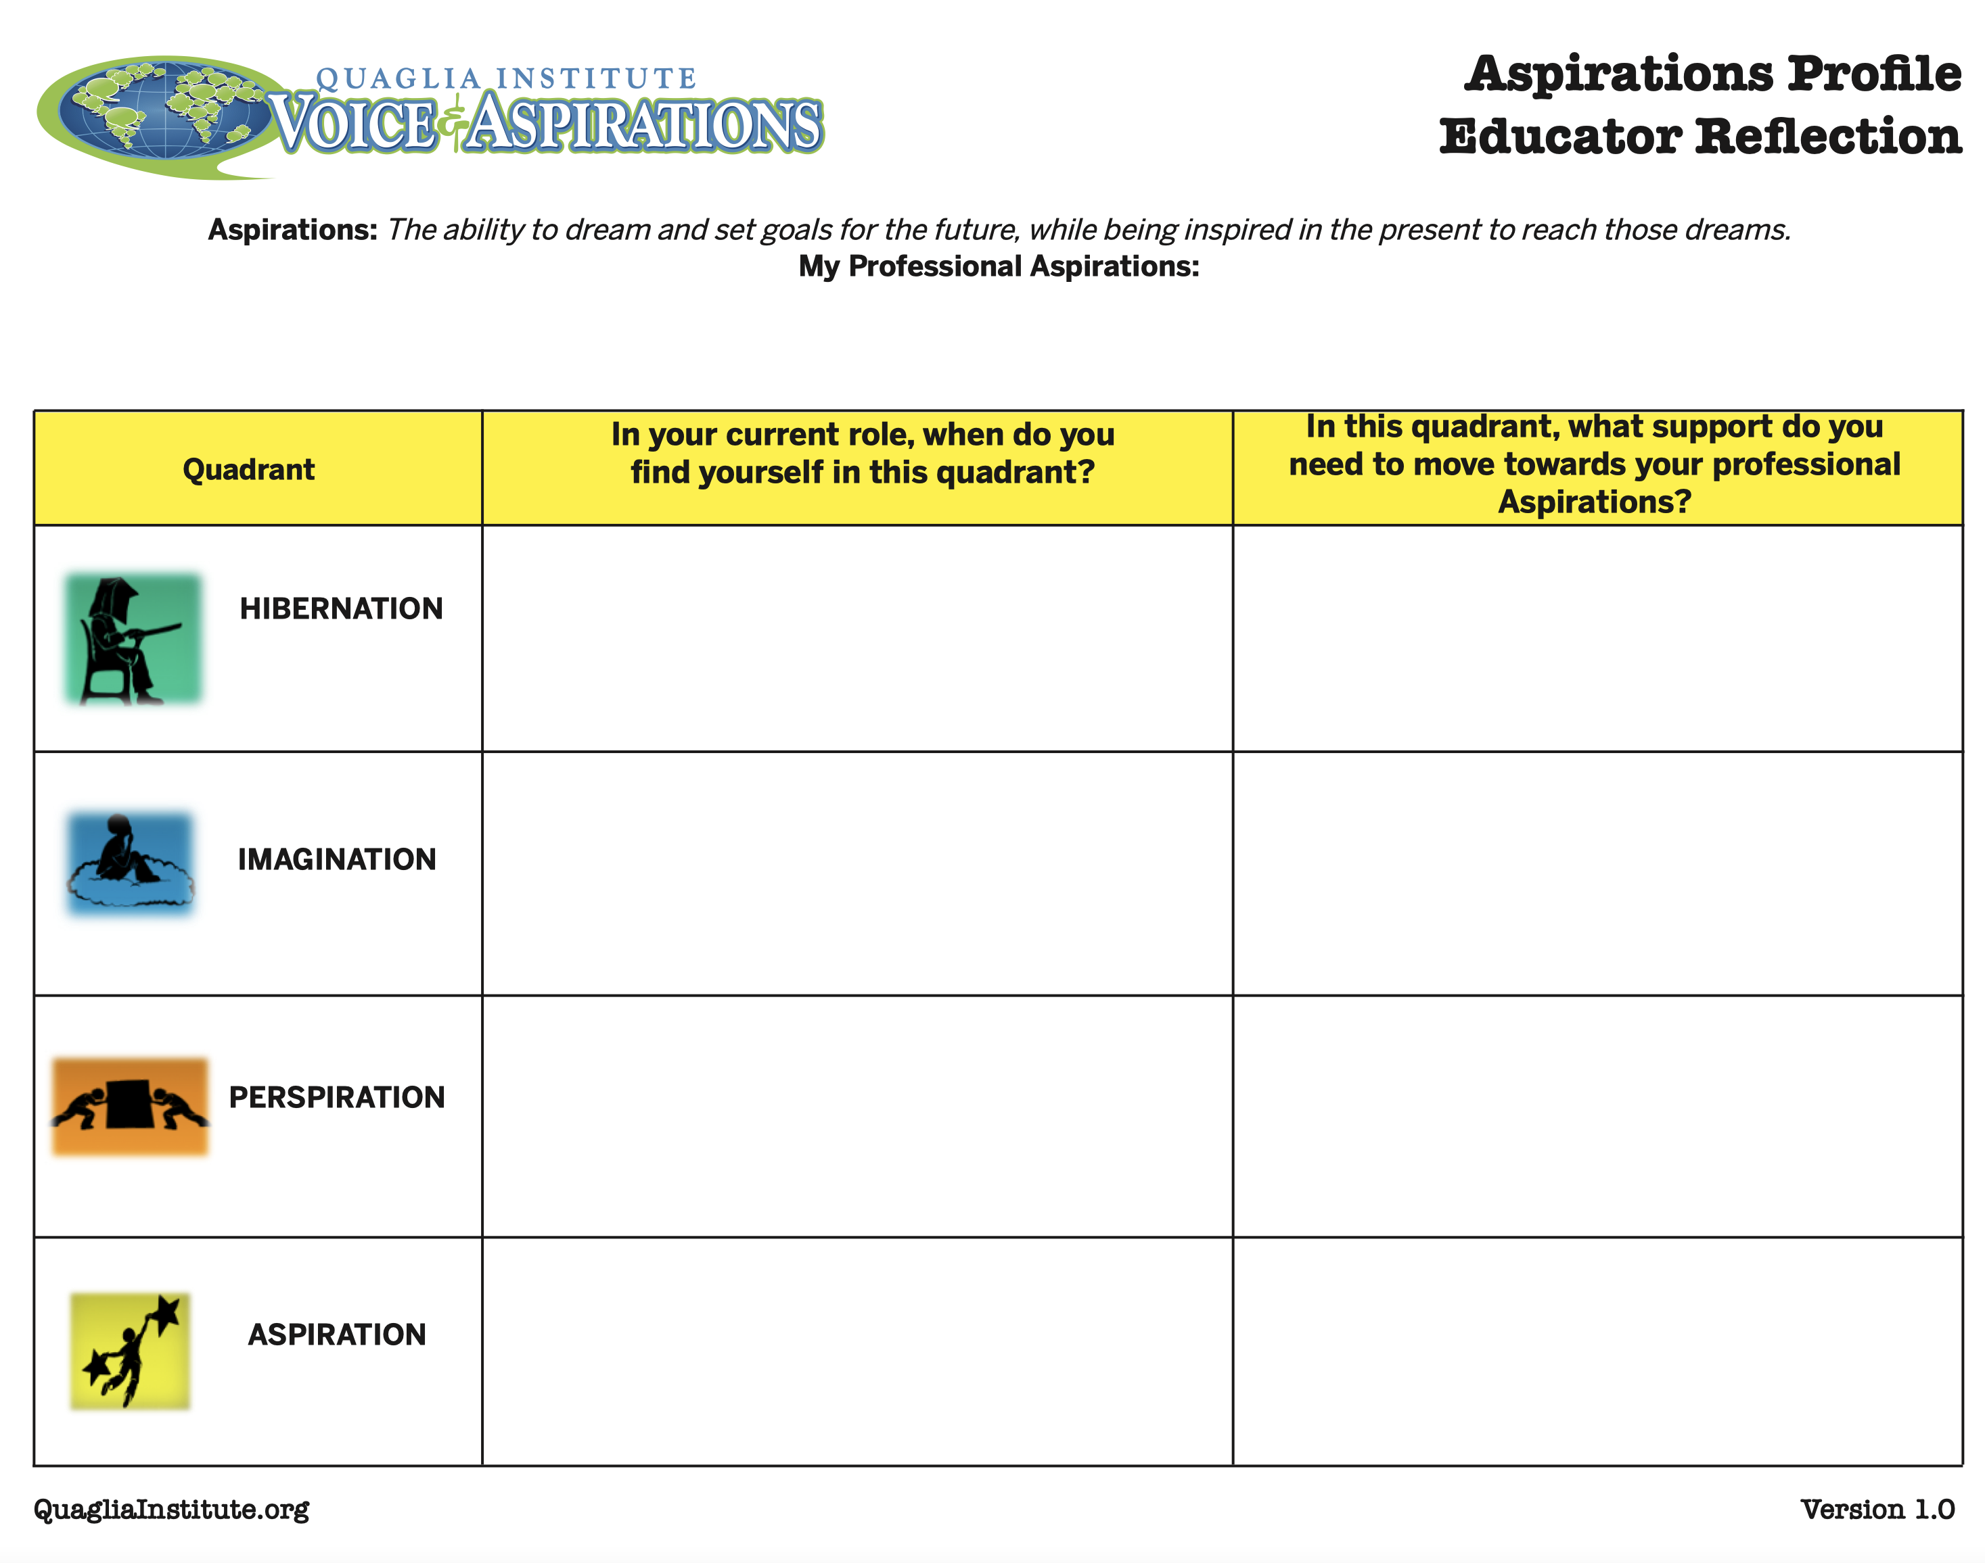

Slide 20
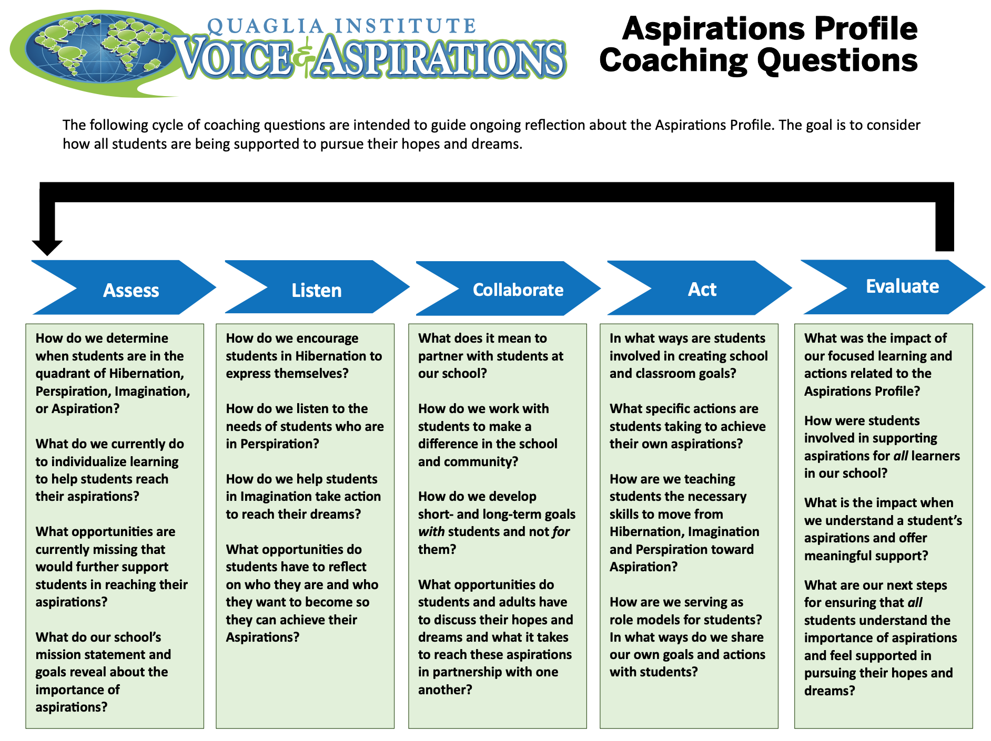

Slide 21
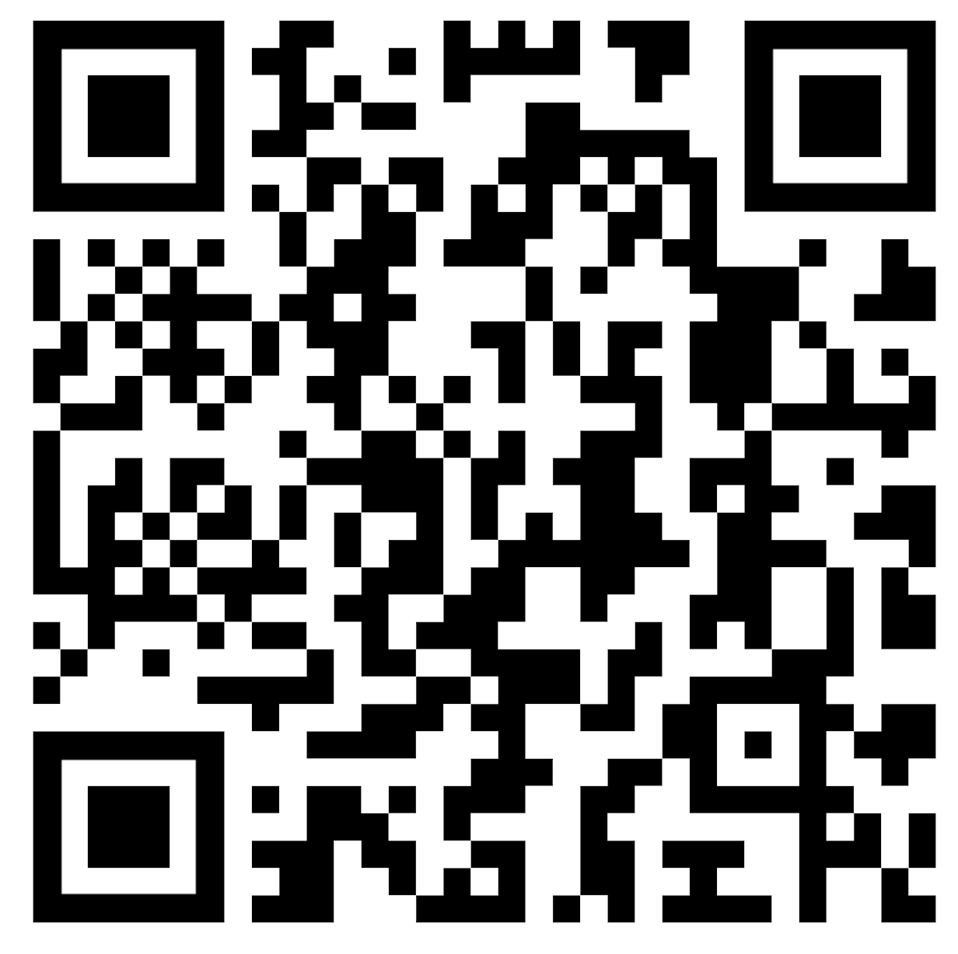
Website Just For YOU!
https://quagliainstitute.org/thomas-jefferson-senior-high

Slide 22

Challenge Time!
Aspirations Profile
4-Corners of Reflection

Slide 23
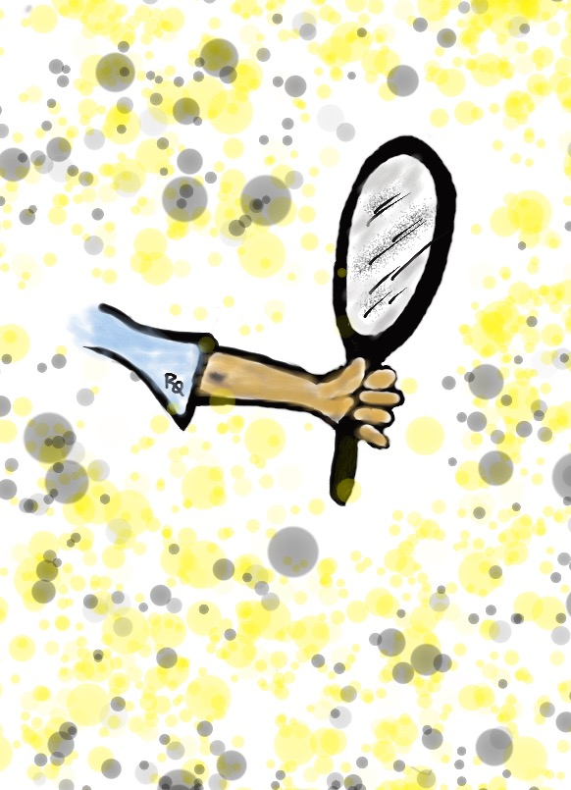
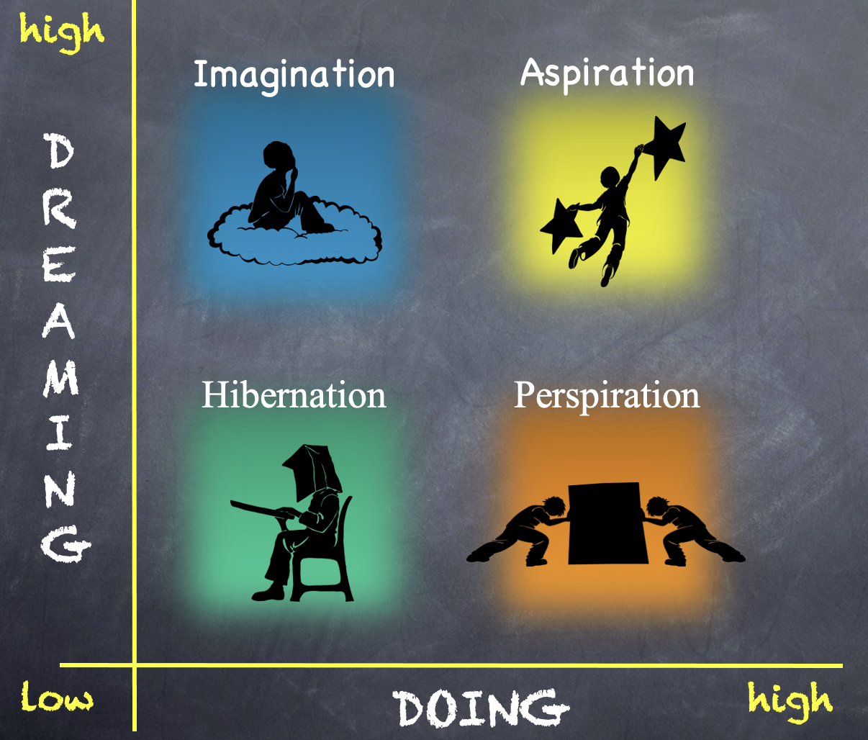
Reflect
Go to the quadrant where you spent most of your time as a student.
What would have helped you maintain a healthy balance of dreaming & doing?

Slide 24
Reflect
Rotate one corner clockwise.
What types of things do students in this quadrant say/do?

Slide 25
Reflect
Rotate one corner clockwise.
What questions can you ask students who are stuck in this quadrant?

Slide 26
Reflect
Rotate one corner clockwise.
What types of actions can you take to support students in this quadrant?

Slide 27
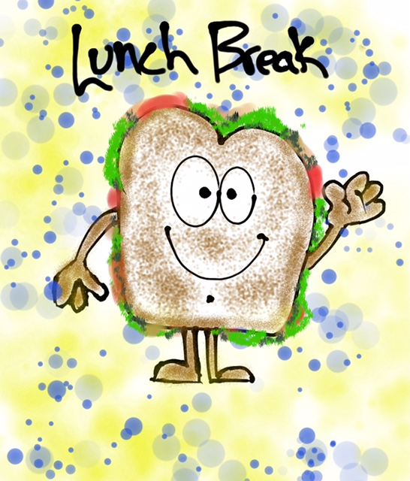

Slide 28

Time to Dig Deeper!

Slide 29
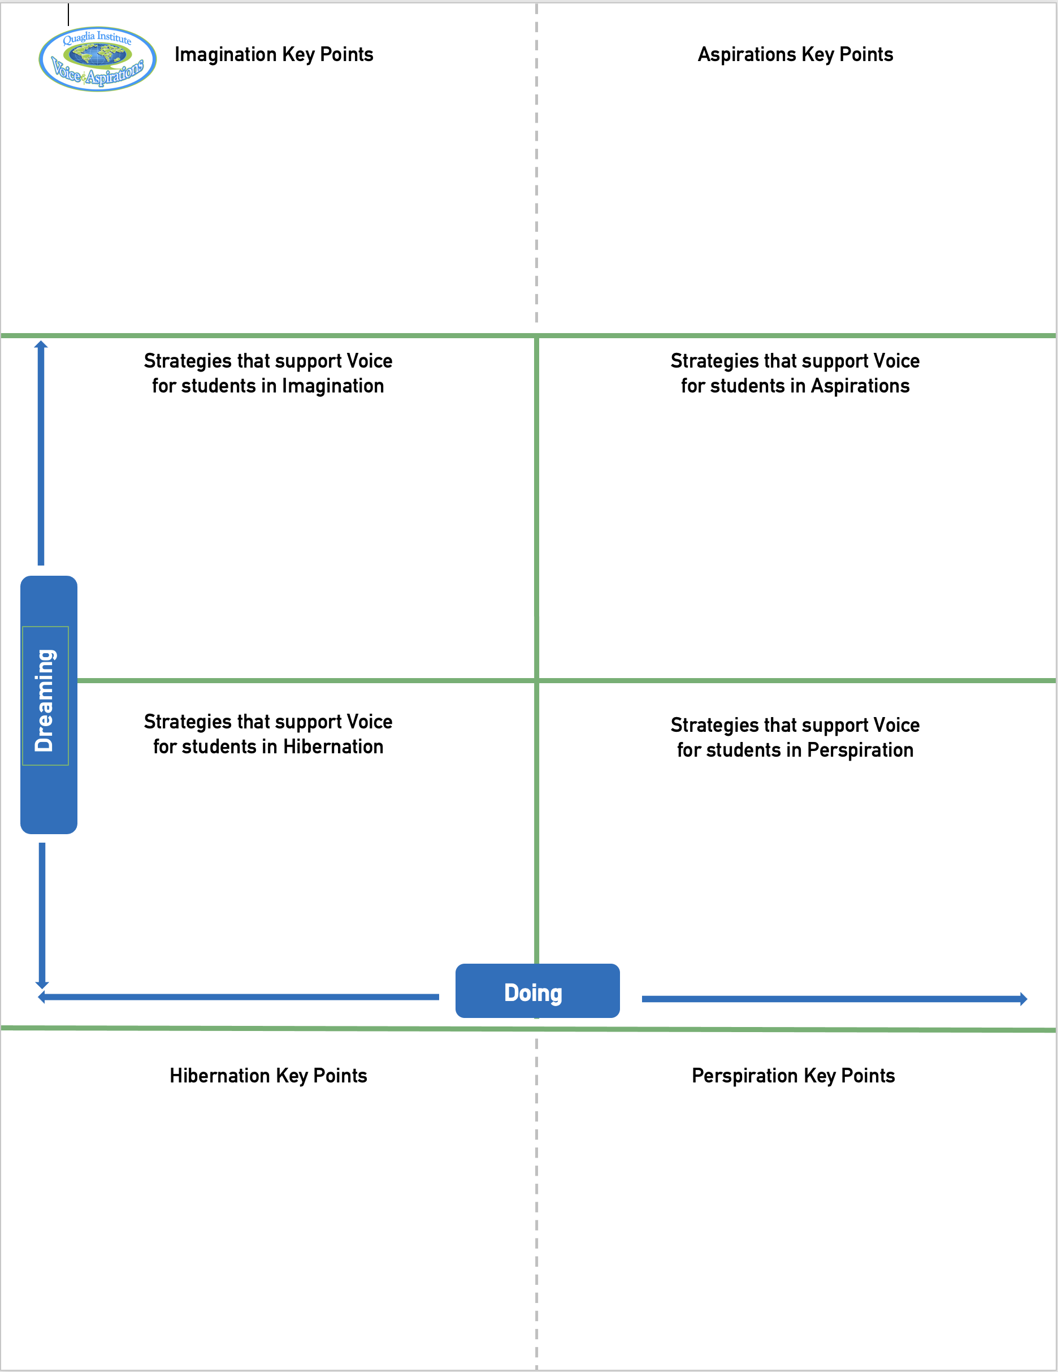
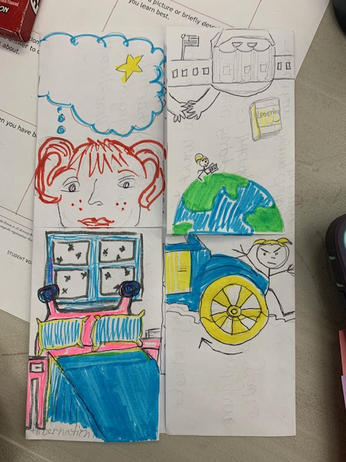
Aspirations Foldable!!
Imagination
Aspiration
Perspiration
Fold
Cut
Hibernation

Slide 30
high
DREAMING
Hibernation
low
DOING
high

Slide 31
high
DREAMING
Vimeo
https://vimeo.com/789017891/1c391b7d0a
YouTube
https://youtu.be/qPYqaBvwhy8
low
DOING
high

Slide 32
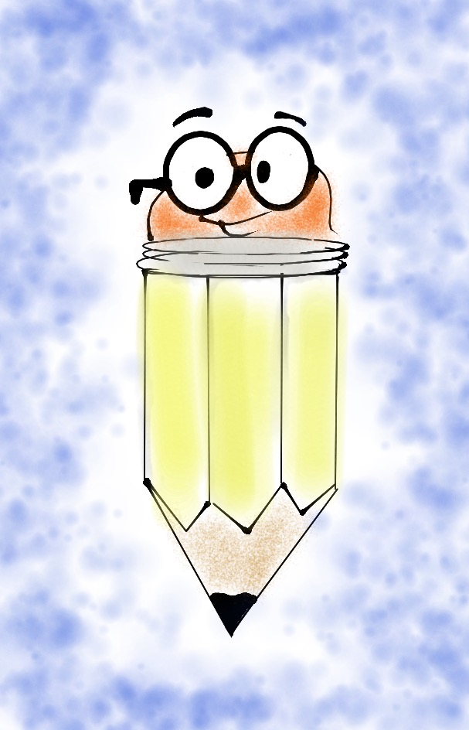
On a
Notecard…
Write one word
describing students
in Hibernation.

Slide 33

One person holds the deck of cards up to their forehead (do not look at the cards).
Team members will describe what is on the card, without using the actual words on the card.
After a card is correctly guessed, pass the deck to the left. See how quickly you can get through your team deck of cards!
Challenge Time!
Hibernation Heads Up

Slide 34

Students in Hibernation
Potential Cons:
Passive & unmotivated
Poor self-esteem &
defeatist attitude
Struggle to take
responsibility for
anything
Potential Pros:
Time to reflect
Space to recharge
They report:
Feeling isolated
Stuck
Misunderstood
Bored
They need to:
Feel valued
Be recognized for success
Have positive role models
Have a sense of purpose

Slide 35
Reflect
Think of the word you wrote on your notecard.
Now think of a word that reflects your hopes & dreams for hibernating students?

Slide 36
high
Imagination
DREAMING
low
DOING
high

Slide 37
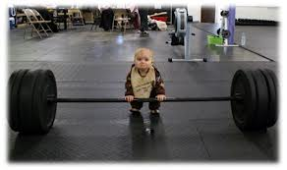
high
DREAMING
low
DOING
high

Slide 38
On a
Notecard…
Write something you
dream about doing
that you have not
yet accomplished.
And keep it
a SECRET!!

Slide 39

Read through the whole deck one time.
Read through the deck a second time and make guesses as to who each card belongs to. How well do you know your colleagues??
Challenge Time!
Imagination Guess Who??
One person takes all the notecards
& mixes them up.

Slide 40

Students in Imagination
Potential Pros:
Enthusiastic
Fun to be around
Lots of creative ideas
Potential Cons:
Limited follow-through
Not well connected
to reality
Students report:
Having big dreams
Eagerness to explore
Craving creative outlets
They need to:
Develop action plans
Focus
Be realistic

Slide 41
Reflect
Why is it challenging to make your big dream a reality?
Write on the back of the notecard what it would REALLY take to make this happen?

Slide 42
high
DREAMING
Perspiration
low
DOING
high

Slide 43
high
DREAMING
Vimeo
https://vimeo.com/qisva/snowremoval
YouTube
https://youtu.be/m39gWmTaIbY
low
DOING
high

Slide 44
On a
Notecard…
Write a rapid fire list of things that cause you to Perspire at work.

Slide 45

Students in Perspiration
Potential Pros:
Determined
Hard Working
Driven to Succeed
Potential Cons:
Overly concerned
about grades
Single-minded,
narrow-focused
Students report:
Feeling stressed
Not sure “why” they are learning, but need
good grades
Don’t want to let
anyone down
They need to:
Have a greater purpose for learning
Balance school work with outside life
Link learning to
their passions

Slide 46
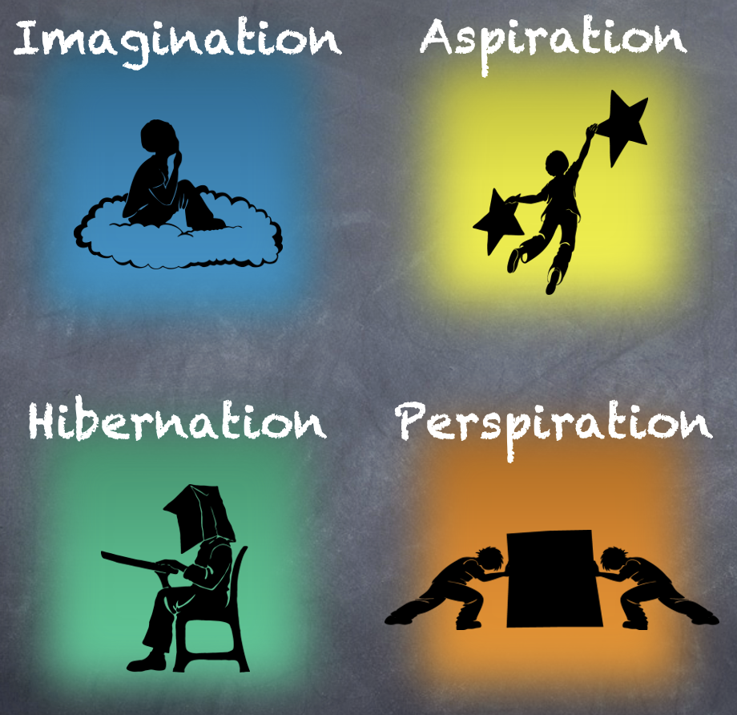
Reflect
What can you do to perspire a little less & dream a little more?

Slide 47
Challenge Time…
Warm Up: Establish a passing order with 1 ball.

Slide 48


Challenge
Perspiration Juggling
Goal: As a team,
pass 3 balls through
your established order as quickly as you can.
Rules: Maintain the
same passing order &
everyone must touch
all 3 balls.

Slide 49
Reflect
What can you do differently to perspire a little less?

Slide 50
high
Aspiration
DREAMING
low
DOING
high

Slide 51
high
DREAMING
Vimeo
https://vimeo.com/776344083/affe5a37da
YouTube
https://youtu.be/uLjzbSAEmJI
low
DOING
high

Slide 52
Reflect
What did you learn from the students about Aspirations?

Slide 53

Students in Aspiration
Potential Pros:
Connects present
actions to future
dreams
Good idea of
potential options
Potential Cons:
Relaxation is Challenging
Under constant pressure
Self-Serving
Students report:
Never feeling
satisfied
Driven by being best
Frustration with peers
who don’t try or who
interrupt learning
They need to:
Be assured they
are on a positive track
Experience meaningful academic challenges
Breathe!

Slide 54
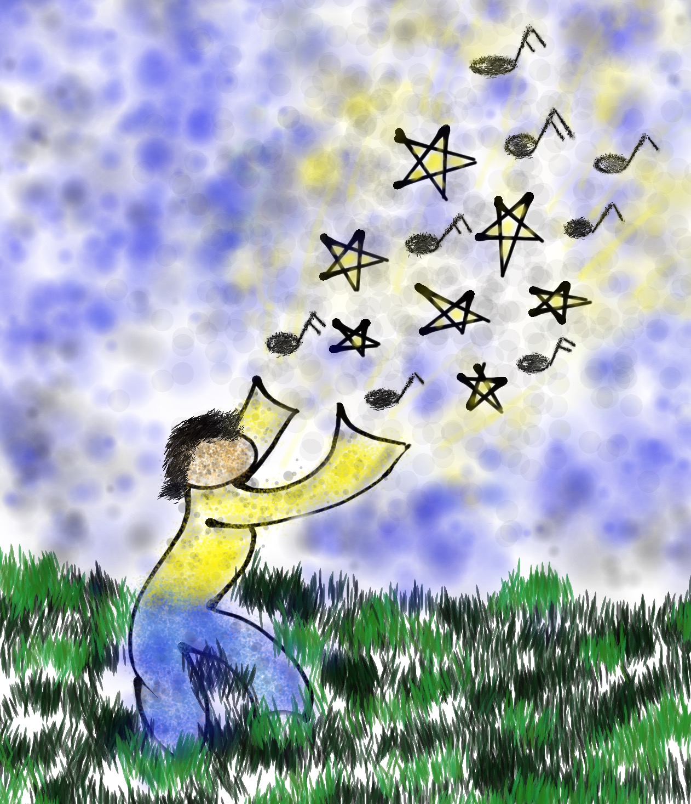
Write something you
have accomplished
that has had a
positive impact
on others.

Slide 55
Proudly use your voice to read your card & collectively celebrate your aspirational moments!
Challenge
Aspirations Accomplishments
Say It Loud…Say It Proud!
Stand in a Circle
as a table team.

Slide 56
Reflect
How does the Aspirations Profile connect to Student Voice & the Community Schools goals?

Slide 57






Rolling Reflections
What is sticking with you from the Aspirations Profile?
What is one action you can take based on what you learned today?
What was most interesting to you from the 4 Quadrants?
What key take away from this session will you share with a colleague?
What connections can you make to other goals & initiatives at Jefferson?
Wild Card! Share anything you want related to Student Voice!
Notes:
Did not have time to do this.

Slide 58
Where do we
go next?
Aspirations Framework:
Self-Worth, Engagement, Purpose
Systems Thinking for Sustainable Change

Slide 59
Student Voice at
Jefferson High School
Dr. Lisa Lande
February 3, 2025

Slide 60
Choose a card that represents a future you would like to create.

Slide 61
Reflect
Blue: What comes to mind
when you hear the term
Student Voice?
Yellow: Share an example
of a time when you knew your voice mattered at school.

Slide 62
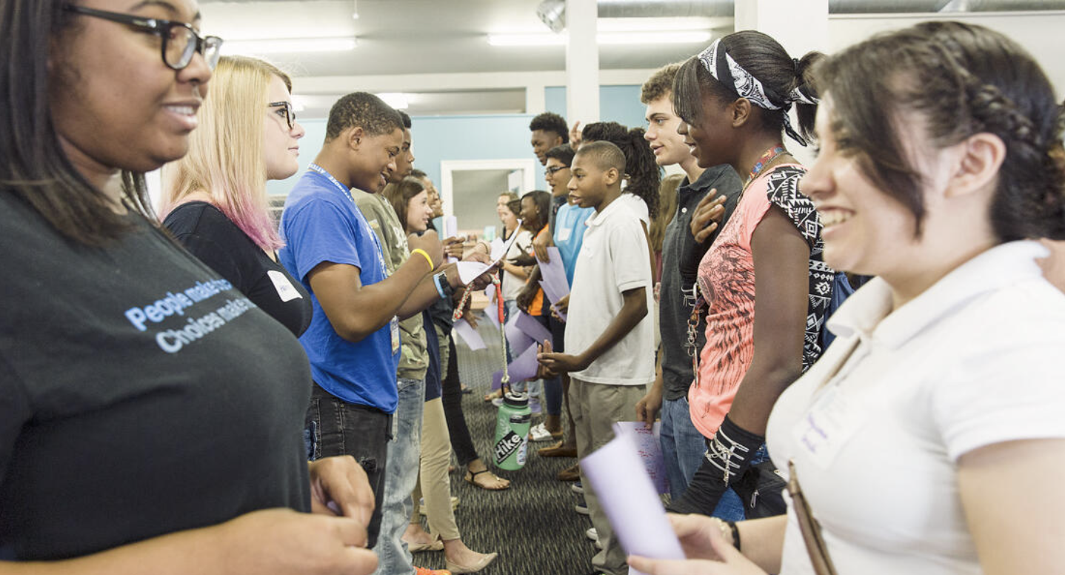
Slide the Line

Slide 63
The 3 Components of Student Voice
Sharing thoughts & ideas in an environment underpinned by trust & respect.
Offering realistic suggestions for the
good of the whole.
Accepting responsibility for not only what is said but also what needs to be done.

Slide 64

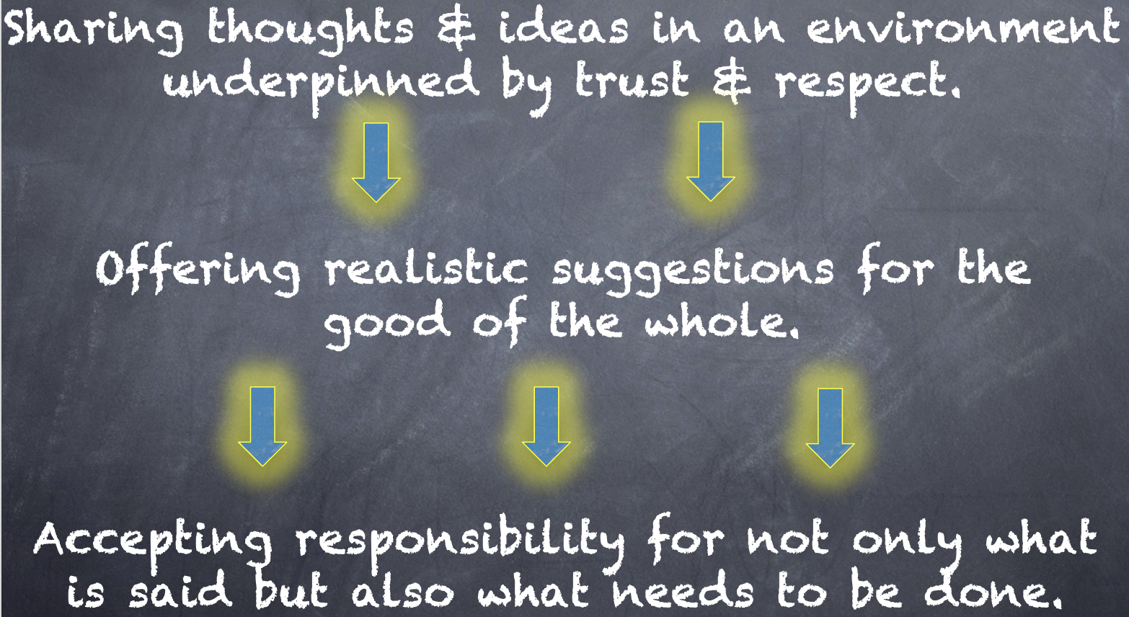
Meet With Your Feet
What do you think about this definition? Debrief all 3 parts with your partner.

Slide 65
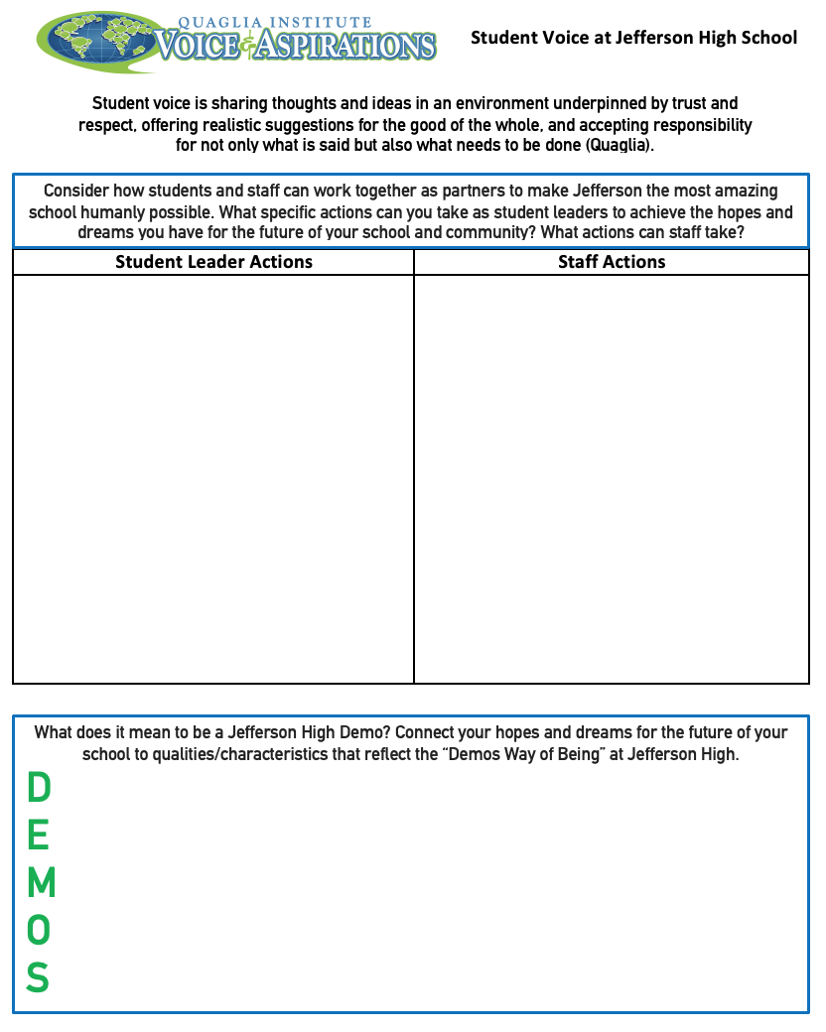

Slide 66


