Slide 1


The Dynamics of Student
Voice & Aspirations
Session #2 May 29, 2024
Dr. Lisa Lande

Slide 2


Slide 3


Slide 4
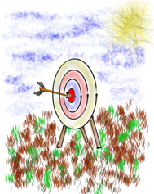
Goals for Today
Continue our journey to amplify student
voice & grow a Community Schools culture of partnership.
Explore the Voice Process & consider how
this impacts our efforts in Listening to,
Learning from, & Leading with one another (including students!).
Apply learning to the Community Schools
Implementation Team efforts at Jefferson
High School, particularly in relation to BSAP.

Slide 5
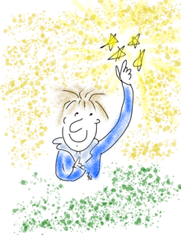
Vision & Purpose
Community Schools Vision: A family of
learning where educators, families, &
community members work together to
prepare students in achieving their
academic & career dreams.
BSAP Team Purpose: Supports the social,
emotional, & academic needs of our Black
students. It builds on the assets of the Black community & works towards preserving
its history.

Slide 6
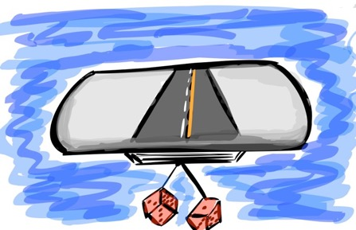
Quick Review
What do you remember from our last session? ☺

Slide 7

The 3 Components of Student Voice
Sharing thoughts & ideas in an environment underpinned by trust & respect.
Offering realistic suggestions for the
good of the whole.
Accepting responsibility for not only what is said but also what needs to be done.

Slide 8
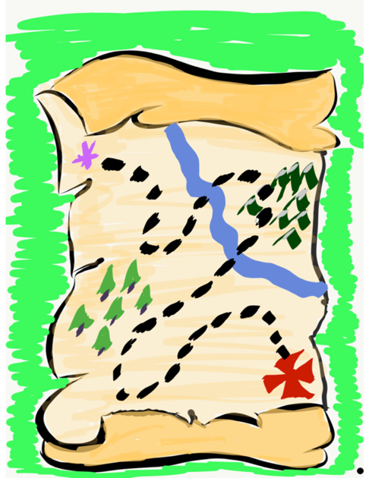
Student Voice Map
Create a map that reflects your journey with Student Voice.
-Key Understandings
-Important Experiences
-Moments of Triumph
-Epic Challenges
-Next Destination

Slide 9
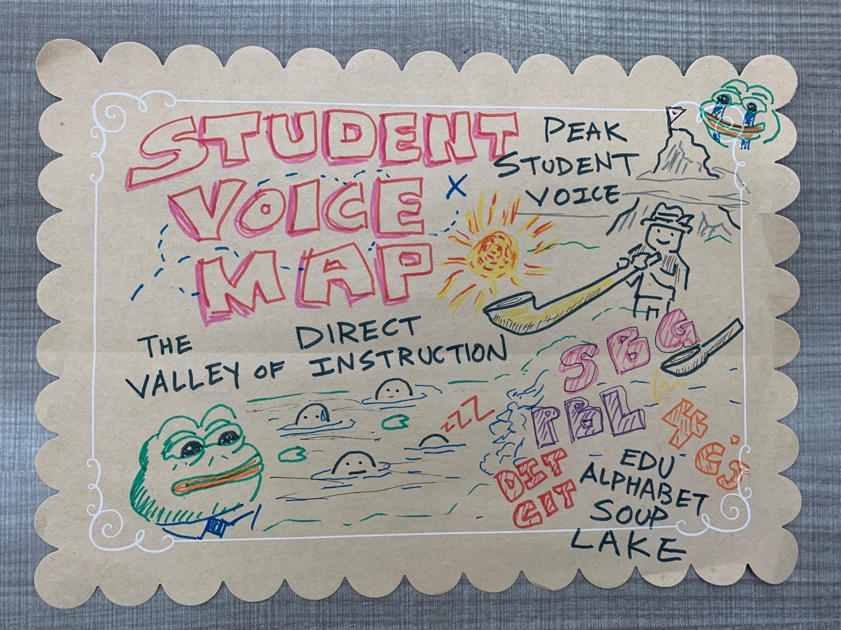
Student Voice Map

Slide 10
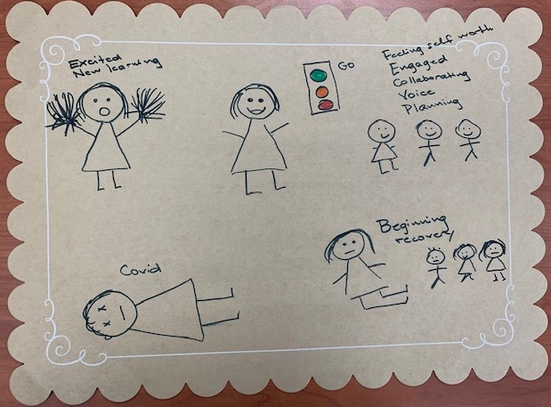
Student Voice Map

Slide 11

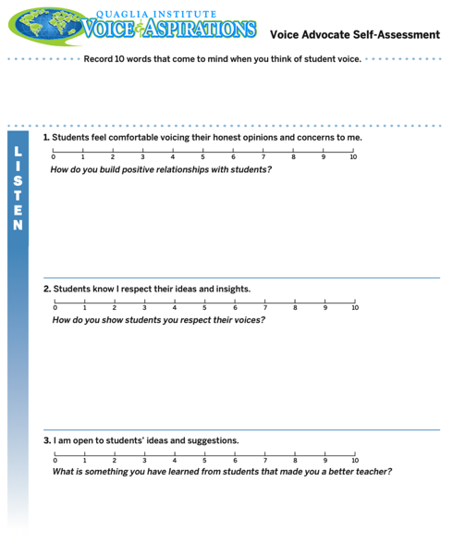
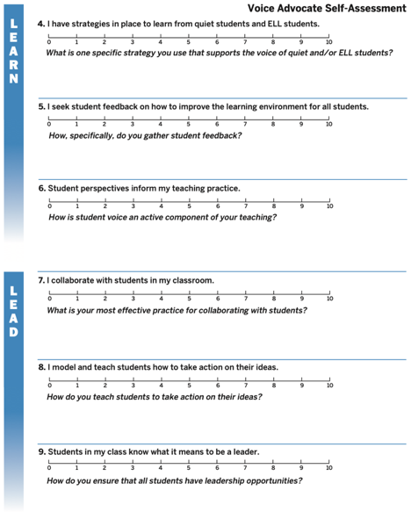
Voice Advocate
Self-Assessment
Complete the
Self-Assessment.
What did
you learn?

Slide 12
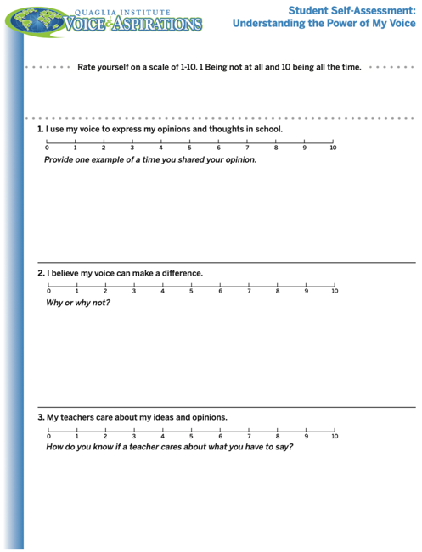
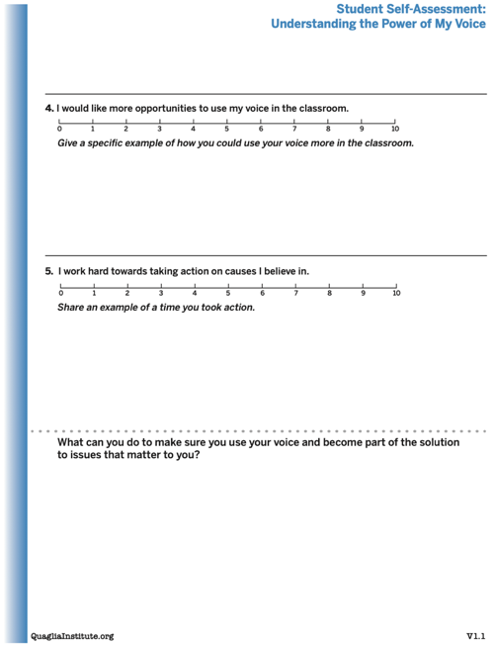
Student Voice
Self-Assessment
Consider having your students
complete this
“Understanding
the Power of
My Voice”
self-assessment.

Slide 13
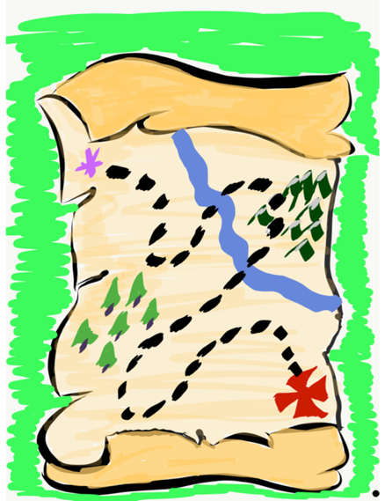
Time to journey
onward & explore
the Voice Process:
Listen, Learn,
& Lead

Slide 14
LEAD
TAKE ACTION
with others
Share
RESPONSIBILITY
LEARN
UNDERSTAND
& RESPECT
different points
of view
Build
TRUST
LISTEN
SEEK OUT
opinions from
others
Voice Process

Slide 15
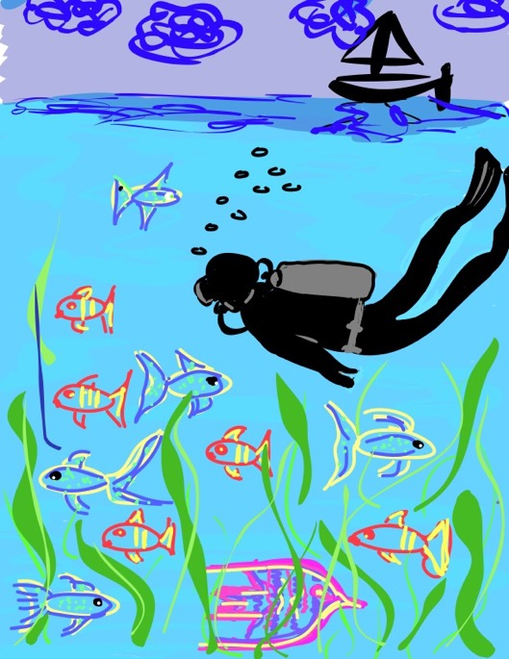
Let’s Dive Deeper…
Listen
Learn
Lead

Slide 16
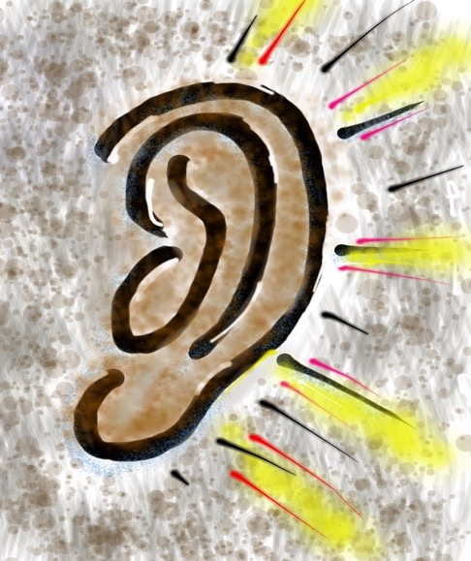
Listen

Slide 17
The Art of Listening
Vimeo:
http://vimeo.com/qisva/listening
or
YouTube:
https://youtu.be/ooE9dKobjZU
Video

Slide 18
Listen
Reach out & listen to voices
you typically don’t hear from
Stay focused (put away your phone!)
Be genuine & truly interested
Engage in 2-way conversations that are
life-giving
Be perpetually open to new ideas

Slide 19


Challenge Time!
Drawing Dictations
Round 1: Find a partner &
assign one person to be the
Describer, & one person to
be the Artist. Sit back to back. Without looking or asking
questions, describe to your
partner how to replicate
your picture.
Round 2: Switch roles
(Describer & Artist) &
repeat, but this time you
can ask clarifying questions.

Slide 20
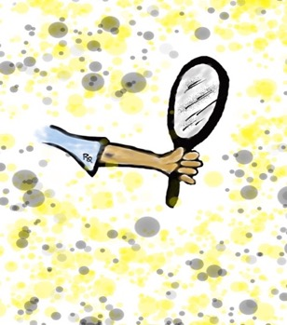
Reflect
What are the biggest challenges/barriers to effectively “listening”
to students?

Slide 21

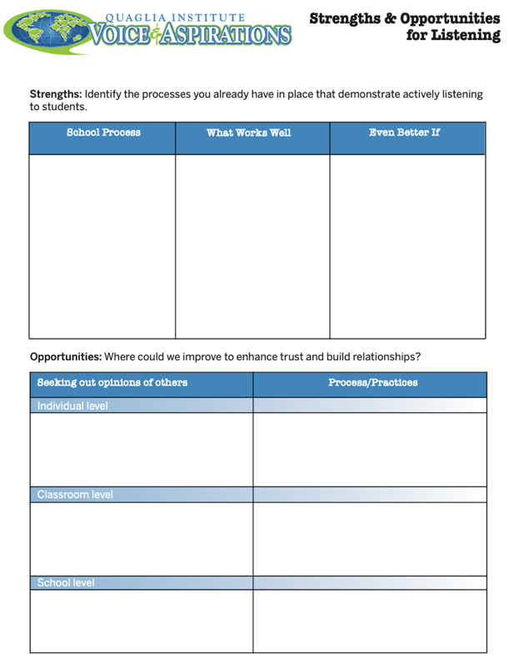
Reflect
What are your
strengths &
opportunities when it
comes to listening
to students?
How are you building
trust & positive
relationships with
ALL students?

Slide 22

Learn

Slide 23
Taking Time to Learn
Vimeo:
vimeo.com/qisva/time
or
YouTube:
https://youtu.be/tYKcvRfxK0o
Video

Slide 24
Learn
Ask questions for clarity & take notes
Move from a place of judgement to wonder
you can learn from anyone
regardless of age, position, or any factor
Follow up & communicate what you
LEARNED from listening
Be prepared to change
Do not fear what you do not know

Slide 25
Challenge Time!
Why Why Why?
With a partner, consider the
provided scenario.
Write a list of possible reasons WHY behind your scenario.
Try to get 30 reasons or MORE!

Slide 26

Reflect
Why do we jump to conclusions & solutions
so quickly?
How might the component of “learn” impact our school improvement efforts?

Slide 27
Challenge Time!
Connections
Find the connection
between the 4 individual pictures.

Slide 28
Connections 1
Vimeo:
vimeo.com/qisva/connection1
or
YouTube:
https://youtu.be/Yl3JrRtyGHc
(all 9 slides)

Slide 29
Connections 2
Vimeo:
vimeo.com/qisva/connections2

Slide 30
Connections 3
Vimeo:
vimeo.com/qisva/connections3

Slide 31
Connections 4
Vimeo:
vimeo.com/qisva/connections4

Slide 32
Connections 5
Vimeo:
vimeo.com/qisva/connections5

Slide 33
Connections 6
Vimeo:
vimeo.com/qisva/connections6

Slide 34
Connections 7
Vimeo:
vimeo.com/qisva/connections7

Slide 35
Connections 8
Vimeo:
vimeo.com/qisva/connections8

Slide 36
Connections 9
Vimeo:
vimeo.com/qisva/connections9

Slide 37

Challenge Time!
Your Connections
Pick a word that reflects your hopes & dreams for this
Community of Schools effort at Jefferson & create
4 images.
Can the group guess
your word?

Slide 38
Reflect
What voices might you still need to learn from?
What is something you have recently learned from a student?

Slide 39
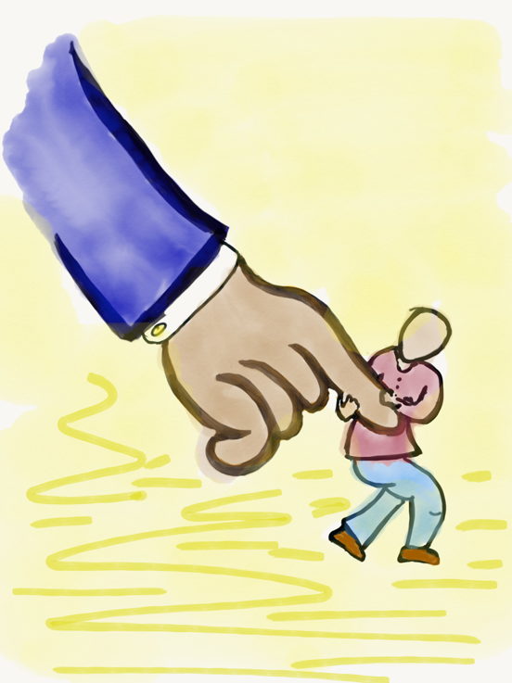
Lead

Slide 40
Leading Together…
Vimeo:
https://vimeo.com/qisva/together
or
YouTube:
https://youtu.be/RTvZCdUP7N4
Video

Slide 41

Reflect
What did you observe related to the term Lead in this video?

Slide 42
Lead
Use what you have heard & learned to drive meaningful change.
Leading is not a solo endeavor; take action in true partnership with others.
Created a shared sense of purpose.
Voice is not about getting your own way.
You can’t please everyone; but you can
demonstrate value & respect for all voices.

Slide 43

Lead
What do
you value?

Slide 44

Auction Time!!
Your team
gets $2,000!
Determine what items you want to buy at the
auction.
How much are
you willing to
spend on what?

Slide 45

Values Auction
Meaningful Collaboration
Planning Time
Professional Development
Opportunities
Small Class Size
Amazing Administration
Supportive Parents
High Student Achievement
Effective Communication

Slide 46
Reflect
What values are most important to you as a team?
How will those values guide
you in leading this work at
Jefferson?

Slide 47
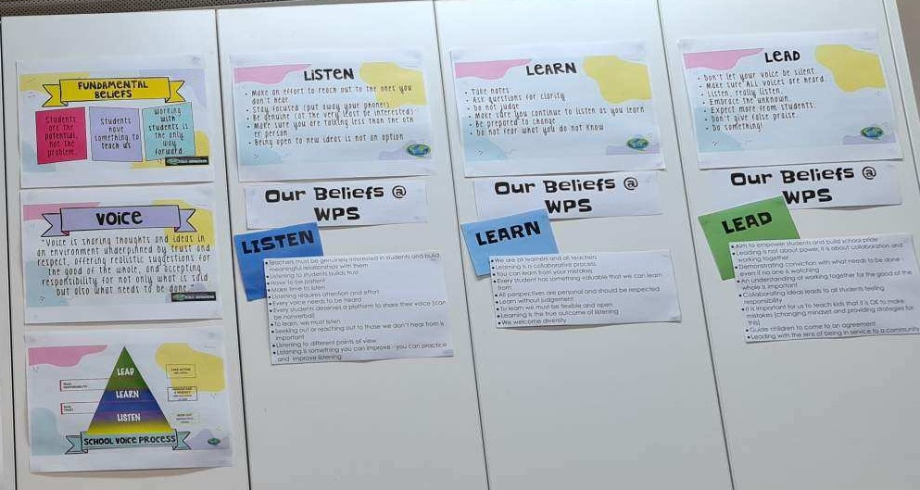
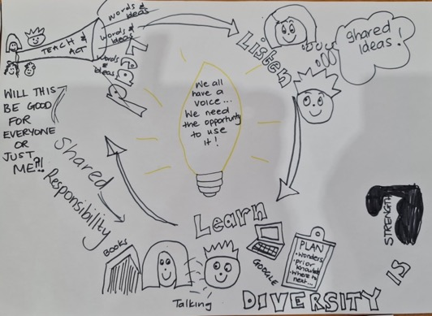
Creating Context for LLL
Winchelsea School, Victoria, Australia

Slide 48
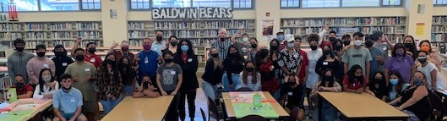
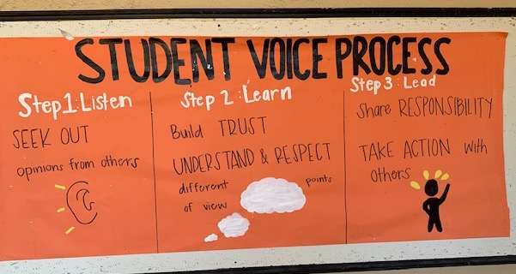
Shared Ownership with Students
Baldwin High School
Maui, Hawaii
Notes:
The top picture is a bulletin board created by students at the entrance of Baldwin High School in Maui, Hawaii that serves as a visual reminder to all students of their schoolwide commitment to live out the 3 parts of the Voice Process as part of their “way of being” at Baldwin. The bottom picture is just one example of that commitment jumping off of the bulleting board into action as randomly selected groups of students come together each year to analyze data side by side adults at the school so they listen to and learn from one another, and then create action plans for continually improving the school in partnership with one another.

Slide 49
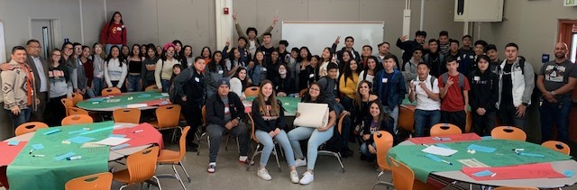
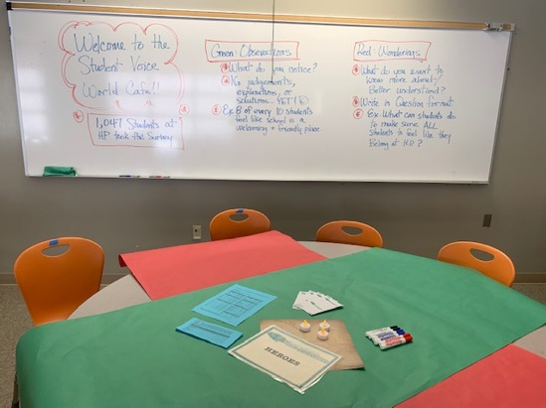
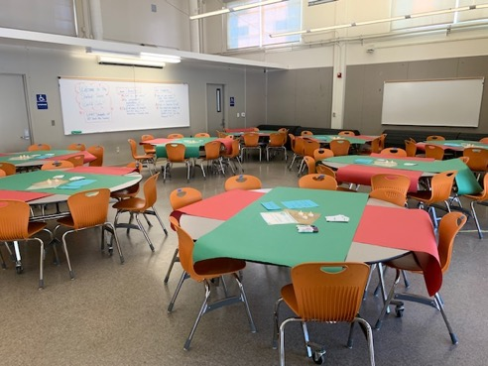
Data Analysis WITH Students
Huntington Park High School, LAUSD
Notes:
World Cafe

Slide 50
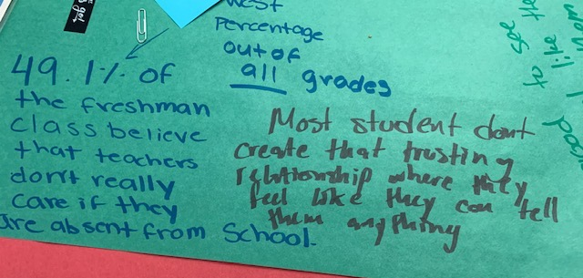
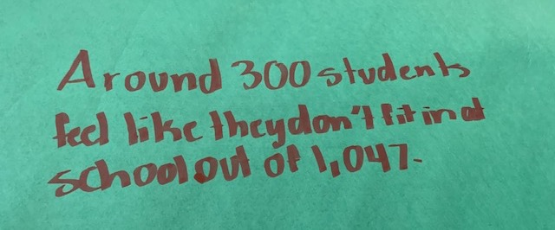
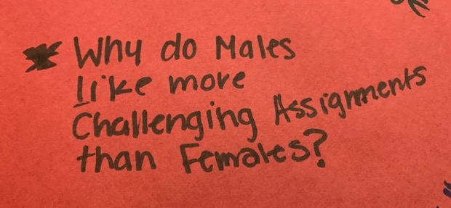
Huntington Park High School, LAUSD

Slide 51
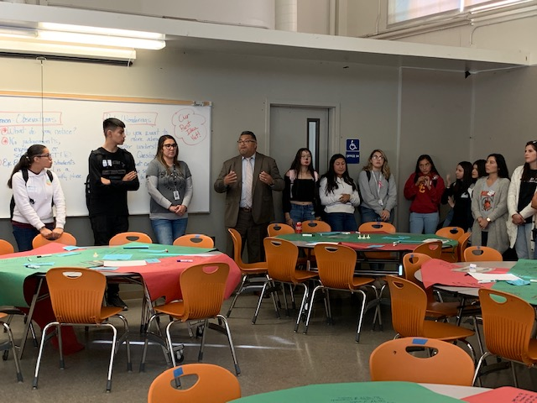
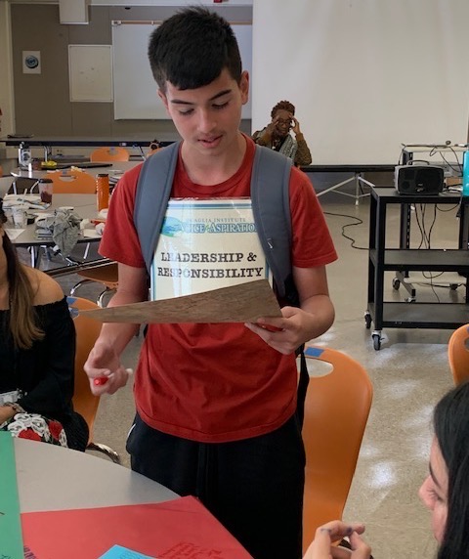
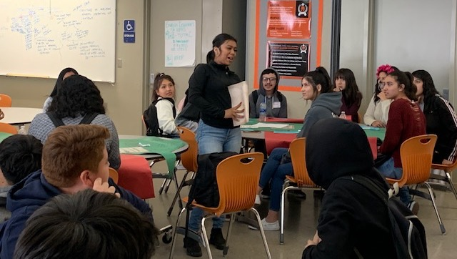
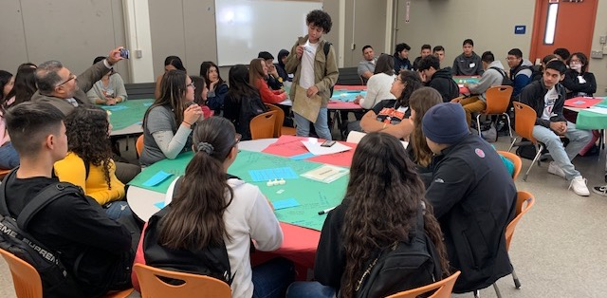
Huntington Park High School, LAUSD

Slide 52

LLL in Action!
Sutter Middle School, LAUSD

Slide 53
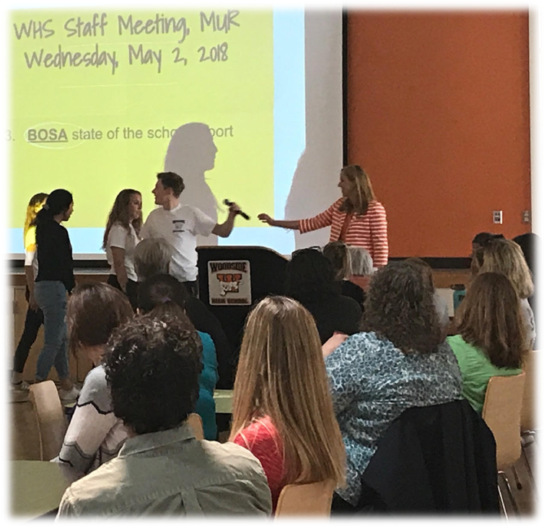
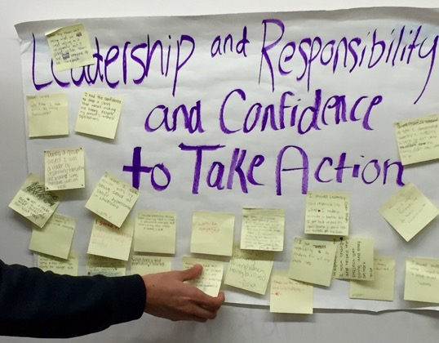
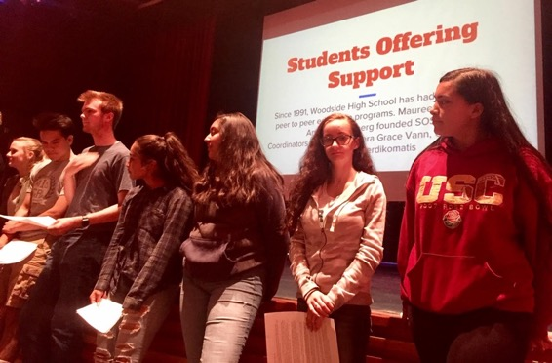
Students as Partners in Professional Learning
Woodside High School, Redwood City USD

Slide 54
Reflect
What things are currently
owned only by adults in your
school that students could be
invited to co-own with you?

Slide 55


Slide 56
LLL Summarized
Vimeo:
https://vimeo.com/qisva/louie
YouTube:
https://youtu.be/1Ebg4If1r7A
BCE, Brisane, Australia

Slide 57

Pinwheel
Discussions
Get into pinwheel groups of 6.
With your first partner, discuss your key
learnings related to “Listen.”
When the wind blows, the outside of the
pinwheel moves one person clockwise. Share your key learnings related to “Learn.”
When the wind blows, repeat & share your
key learnings related to “Lead.”

Slide 58
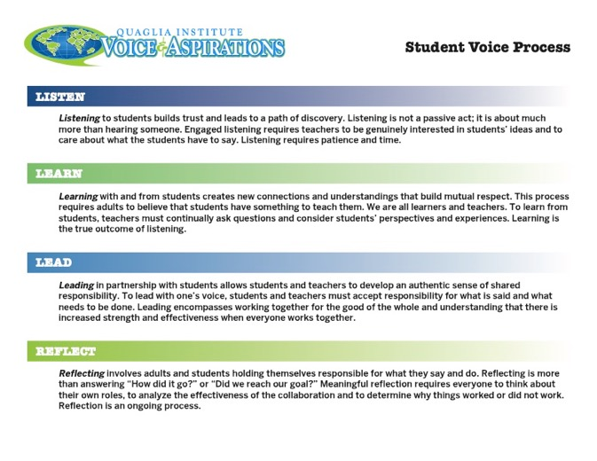
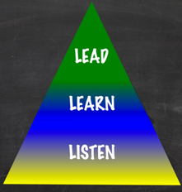
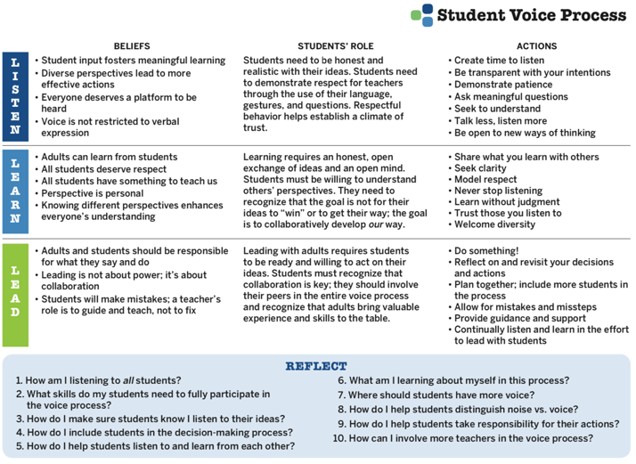
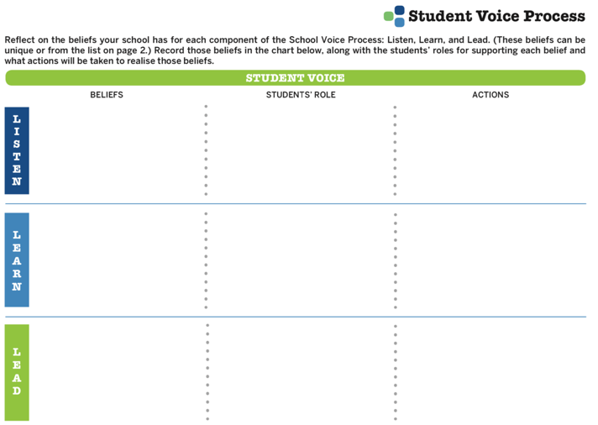
Voice Process Tool
Notes:
Given as a take away

Slide 59
Less
More
Talking
Listening
Complaints
Solutions
Isolation
Collaboration
Excuses
Action
Frustration
Celebration

Slide 60
RESOURCES

Slide 61
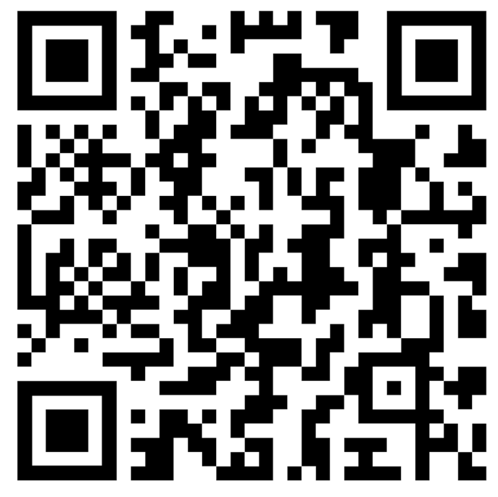
Website Just For YOU!
https://quagliainstitute.org/thomas-jefferson-senior-high

Slide 62






Rolling Reflections
What is sticking with you from the Voice definition?
What is one action you can take based on what you learned today?
What was most interesting to you from the Listen, Learn, Lead model?
What key take away from this session will you share with a colleague?
What connections can you make to other goals & initiatives at Jefferson?
Wild Card! Share anything you want related to Student Voice!
Notes:
Did not have time to do this.

Slide 63

Where do we
go next?
Aspirations Profile: Balancing
Dreaming & Doing
Aspirations Framework:
Self-Worth, Engagement, Purpose
Systems Thinking for Sustainable Change

