Slide 1


Purpose: Developing the
Leader in ALL Students
Session #6 March 6, 2026
Dr. Lisa Lande

Slide 2

Challenge Time…

Slide 3
The Life of an Emoji
Vimeo:
https://vimeo.com/1099356131/fe873ec26f
or
YouTube:
https://youtu.be/aut4gPpBkXo

Slide 4

Emoji Challenge
Crate an Emoji that represents you & your voice at Jefferson.

Slide 5

Goals for Today
Continue our journey to amplify student
voice & grow a Community Schools culture of partnership.
Explore the Guiding Principle of Purpose
& consider how this connects to Student
Voice & the Community Schools goals.
Apply learning to the Community Schools
Implementation Team efforts at Jefferson
High School, particularly in relation to BSAP.

Slide 6

Vision & Purpose
Community Schools Vision: A family of
learning where educators, families, &
community members work together to
prepare students in achieving their
academic & career dreams.
BSAP Team Purpose: Supports the social,
emotional, & academic needs of our Black
students. It builds on the assets of the Black community & works towards preserving
its history.

Slide 7
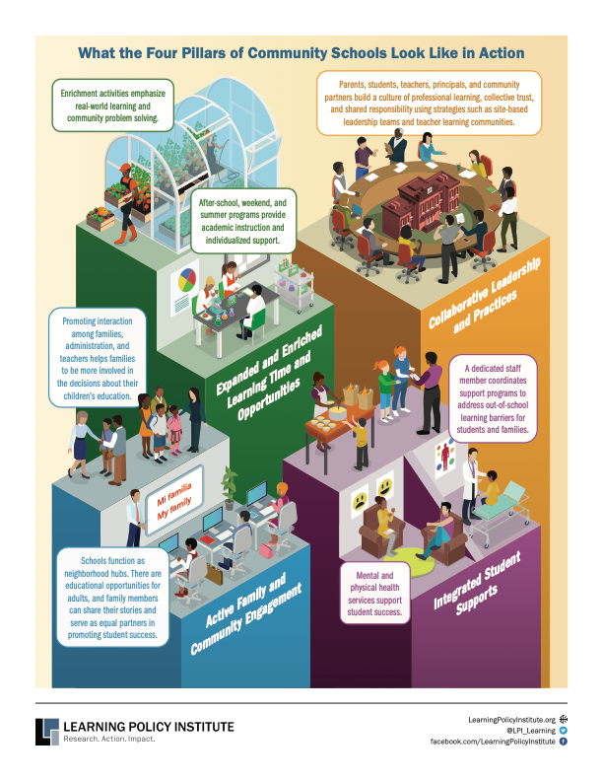

Slide 8
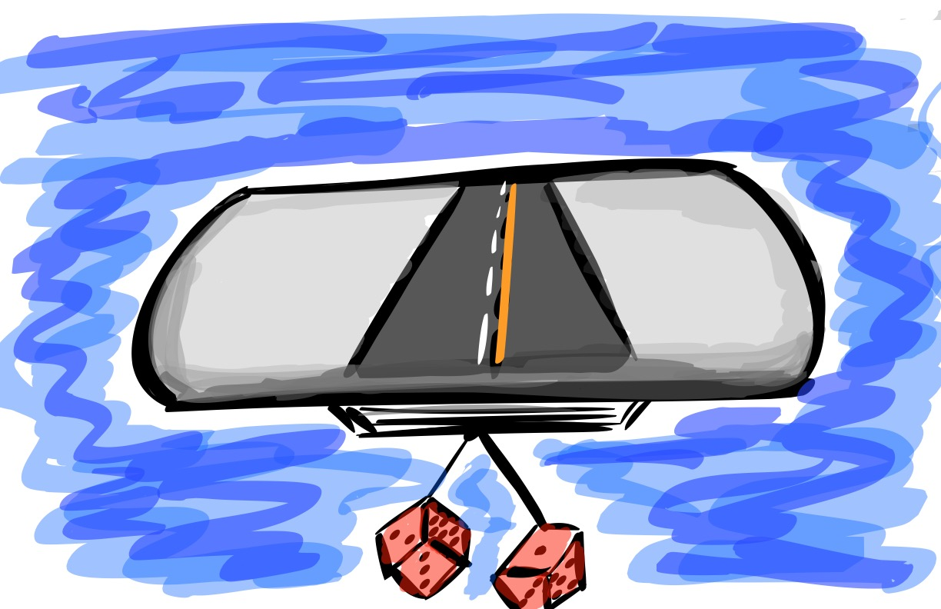

Voice & Aspirations
JENGA Review

Slide 9

The 3 Components of Student Voice
Sharing thoughts & ideas in an environment underpinned by trust & respect.
Offering realistic suggestions for the
good of the whole.
Accepting responsibility for not only what is said but also what needs to be done.

Slide 10
LEAD
TAKE ACTION
with others
Share
RESPONSIBILITY
LEARN
UNDERSTAND
& RESPECT
different points
of view
Build
TRUST
LISTEN
SEEK OUT
opinions from
others
Voice Process

Slide 11




high
Imagination
Aspiration
DREAMING
Hibernation
Perspiration
low
DOING
high

Slide 12








Aspirations Framework
Self-Worth
Engagement
Purpose

Slide 13
Challenge Time…

Slide 14

Purpose Quote Swap
Meander around the room having brief conversations about your quotes…swapping quote cards after each discussion.
When time is called, return to your table with the quote you are currently holding.

Slide 15

Voice &
Purpose
When students believe they have a voice they are 37% more likely to report having Purpose.

Slide 16
Purpose
Purpose in school
is fostered when students &
staff take responsibility for who & what they want to become, both in terms of professional careers & by being confident, responsible members of their community on a regular basis.

Slide 17
Purpose: Developing the
Leader in ALL Students

Slide 18
Challenge Time…

Slide 19
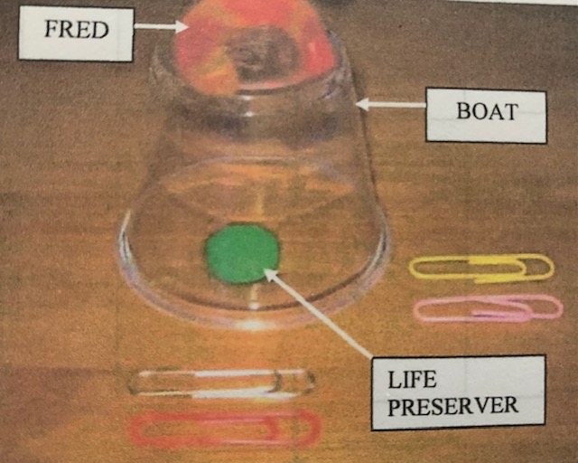
Save Fred!!
Fred, the boat, & the life preserver can be touched only with the paper clips. NO HANDS!
Save Fred & put the life preserver on him without touching the water.

Slide 20
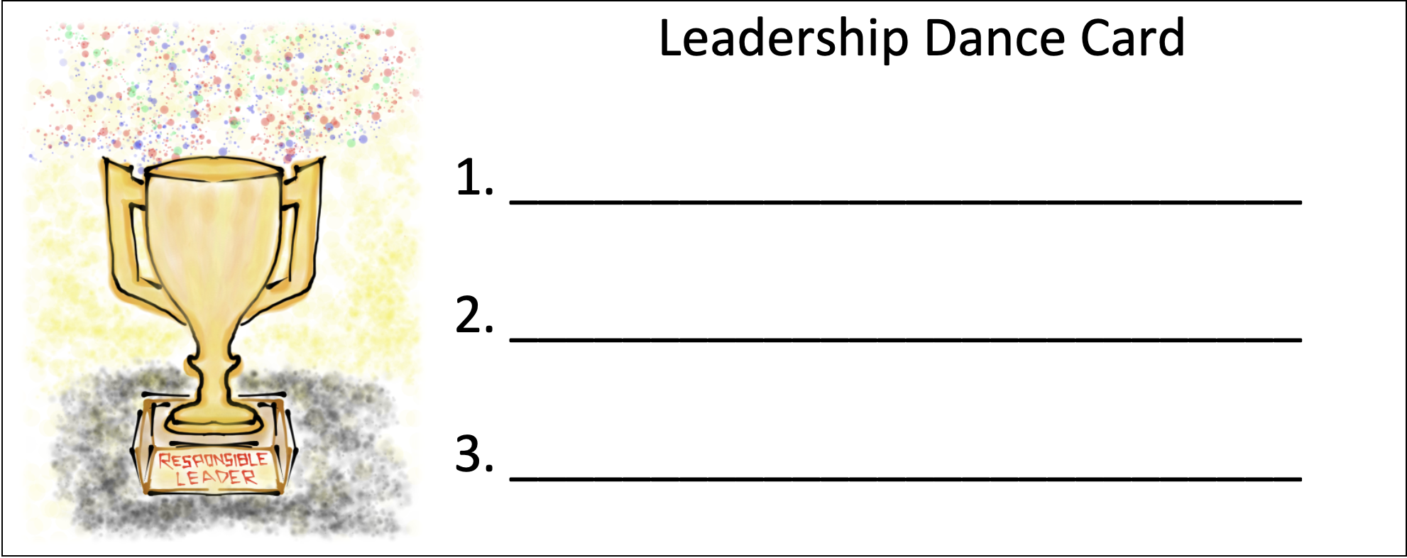
Leadership Dance Card
Find 3 people not at your table & you will both sign each others dance cards for the same number (1, 2, 0r 3).

Slide 21
Leadership & Responsibility

Slide 22
Leadership Lessons From Dancing Guy
YouTube:
https://youtu.be/FVVPi4v2D94
Vimeo:
https://vimeo.com/qisva/dancingguy
Video

Slide 23
Key Points
This condition is fostered when students are able to express their ideas, make decisions, & accept responsibility for their choices.
Leadership is not just for those with an
official title, every student is the leader of their own life & learning.
Students need genuine opportunities to be
responsible for the school community.

Slide 24
Embracing Leadership
& Responsibility
Broaden the definition of leadership.
Seek out opportunities to lead-take initiative.
Accept the consequences of your decisions.
(fail-fast)
Take time to celebrate accomplishments.
Keep learning, growing, & changing.

Slide 25

Leadership
Dance #1
Using your Leadership Dance Card, meet with partner #1 & discuss the Teacher & Student
Roles for Leadership & Responsibility.

Slide 26
Leadership
Dance #2
Using your Leadership Dance Card, meet with partner #2 & discuss the Taking Action
resource for Leadership & Responsibility.

Slide 27
Leadership
Dance #3
Using your Leadership Dance Card, meet with partner #3 & discuss any question(s) from
the Talk Story Conversation Starters resource for Leadership & Responsibility.

Slide 28

School Solutions
Lesson Plan
Supporting staff &
students in forming creative solutions to prevalent school
problems. Making
decisions & taking
responsibility for
choices that impact
the school
community.
Notes:
q

Slide 29
Confidence to Take Action

Slide 30
Key Points
Confidence to Take Action is the cumulative effect of the first seven conditions.
Exhibited by students when they have the
desire, willingness, and ability to work
hard towards achieving their goals with
a sense of passion & purpose.

Slide 31
Having Confidence
To Take Action
Support students in finding their voice &
using it in ways that match their passions.
Provide time for students to reflect &
connect their learning to their purpose.
Challenge students to dream big….
NEVER be satisfied with the status-quo.
Encourage students to embrace the legacy
they will leave at your school.

Slide 32

Confidence to
Take Action
Pinwheel Discussion #1
With your 1st pinwheel partner discuss the
Teacher & Student Roles for
Confidence to Take Action.

Slide 33
Confidence to
Take Action
Pinwheel Discussion #2
With your 2nd pinwheel partner discuss the
Taking Action Resource for Leadership
& Responsibility.

Slide 34
Confidence to
Take Action
Pinwheel Discussion #3
With your 3rd pinwheel partner discuss any
question(s) from the Talk Story Conversation Starters resource for Leadership
& Responsibility.

Slide 35
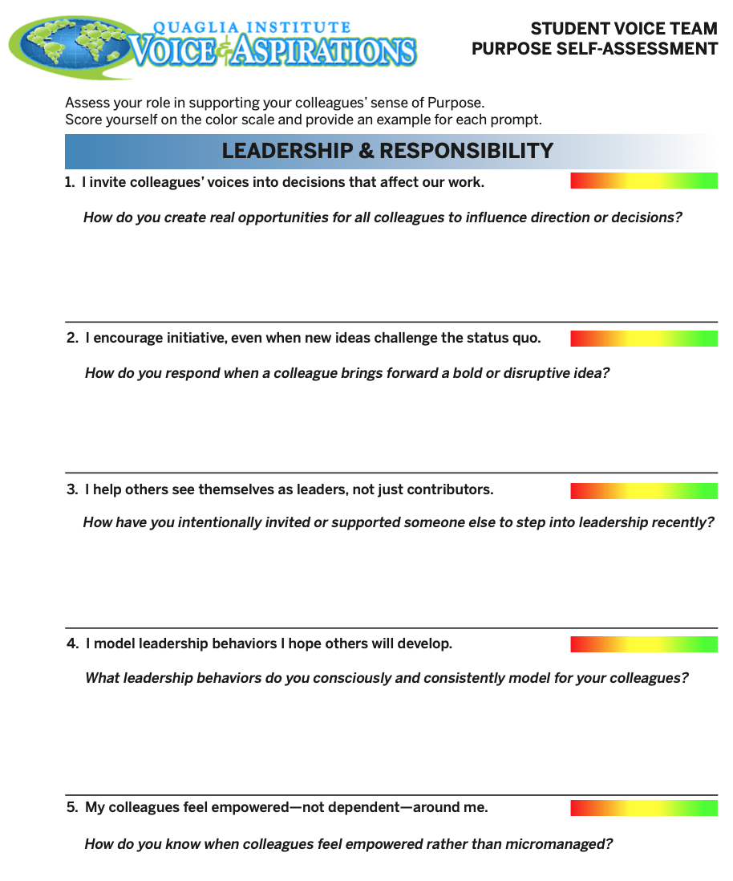
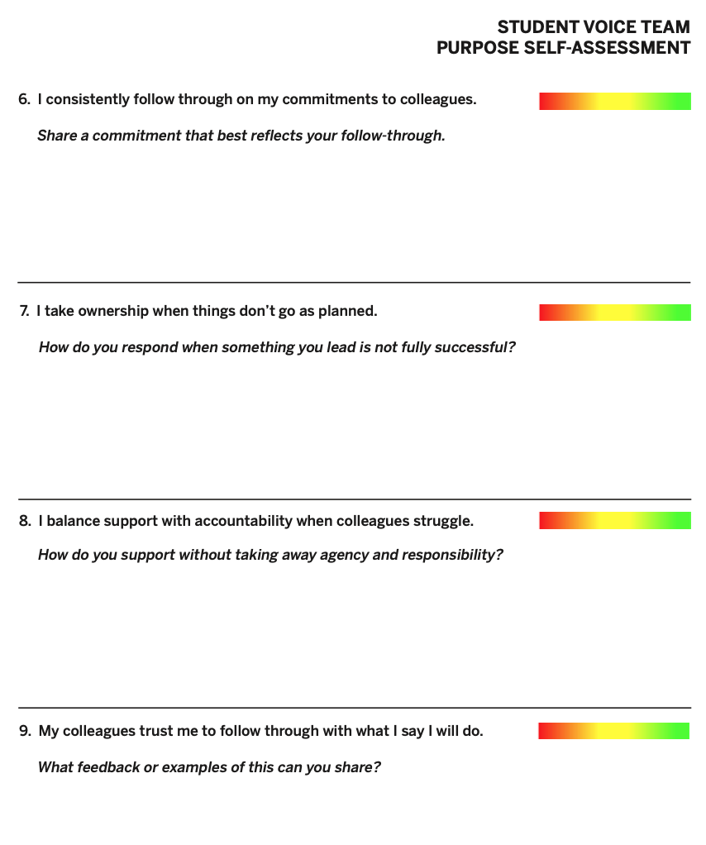
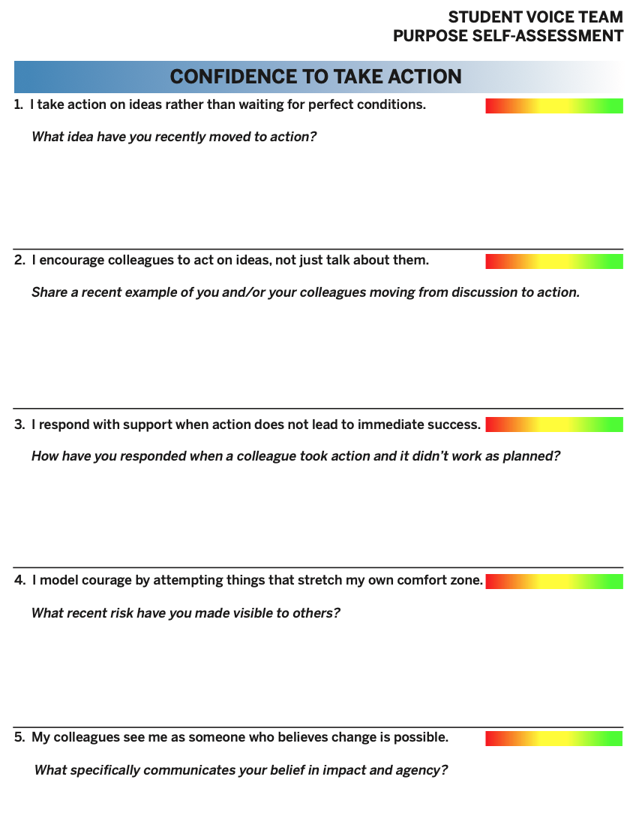
Purpose Self-Assessment: Student Voice Teams

Slide 36
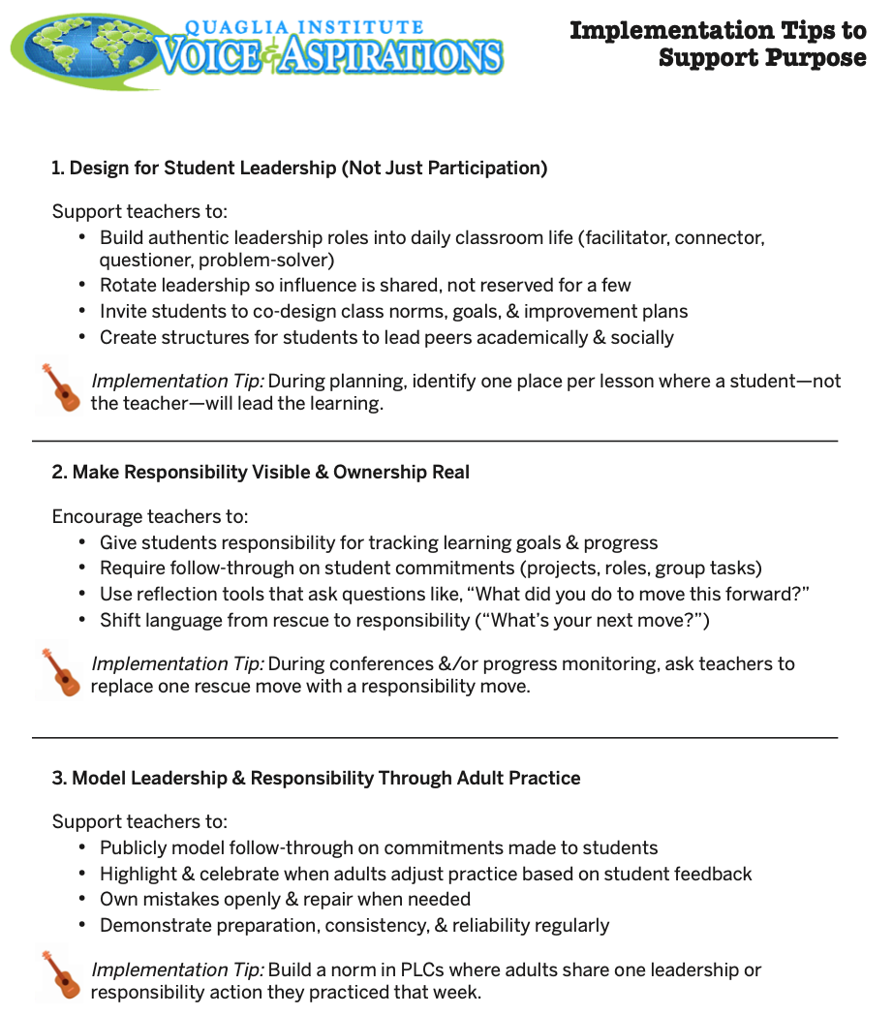
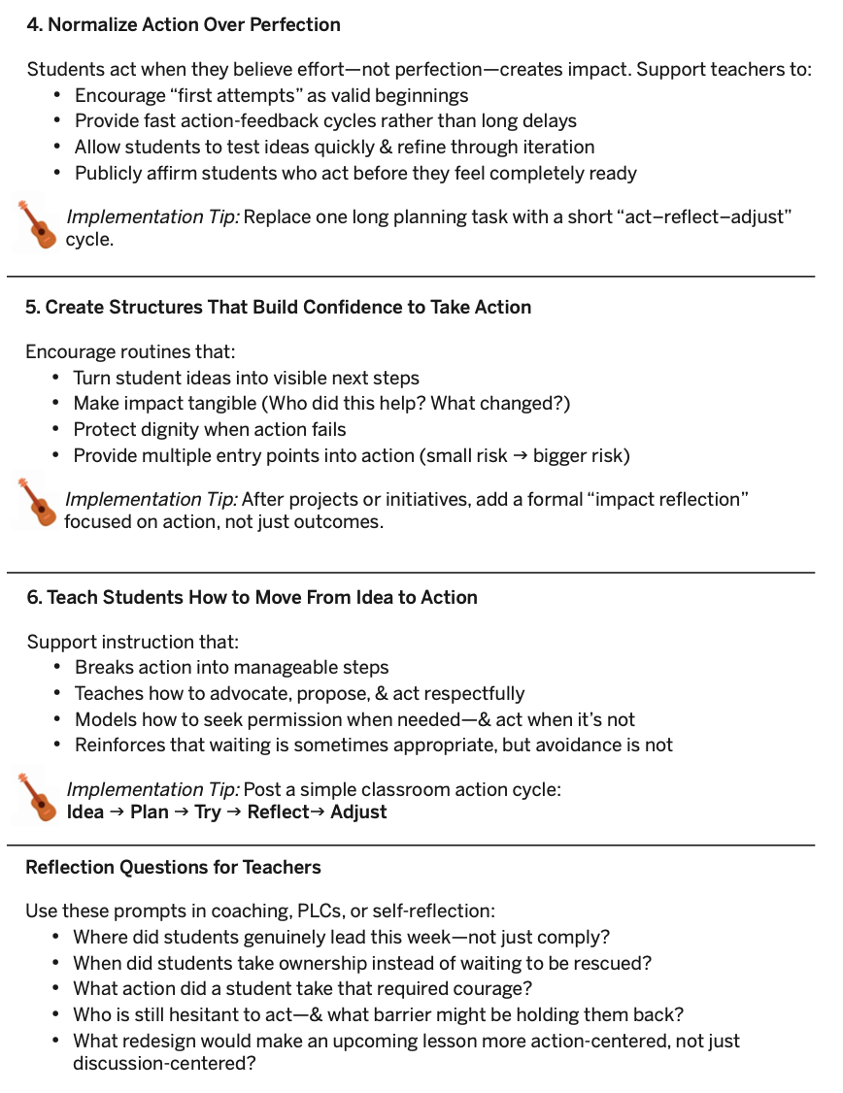

Slide 37
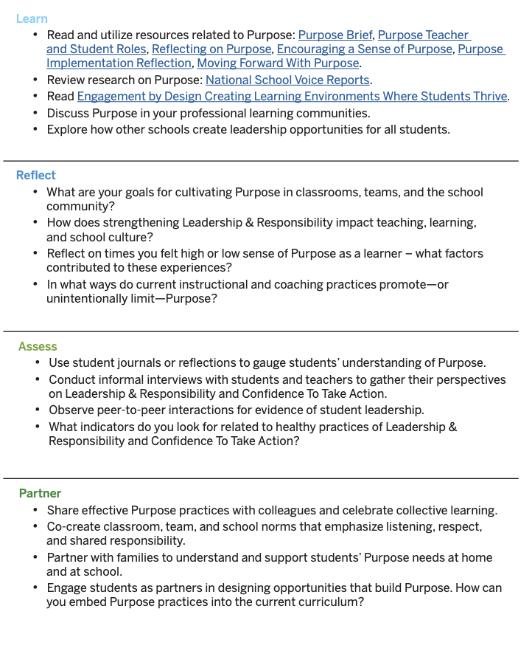
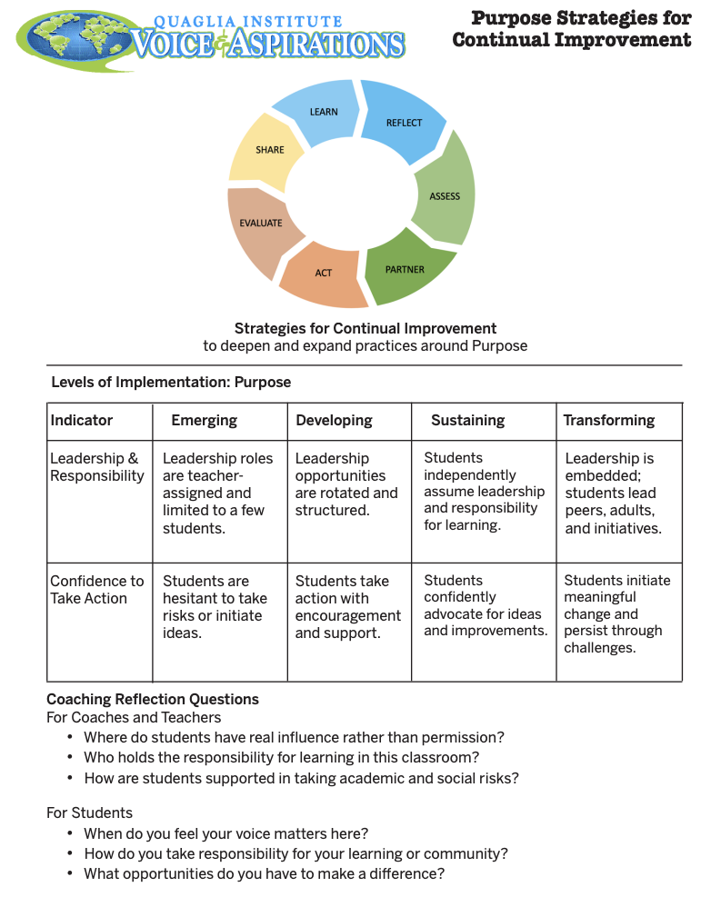
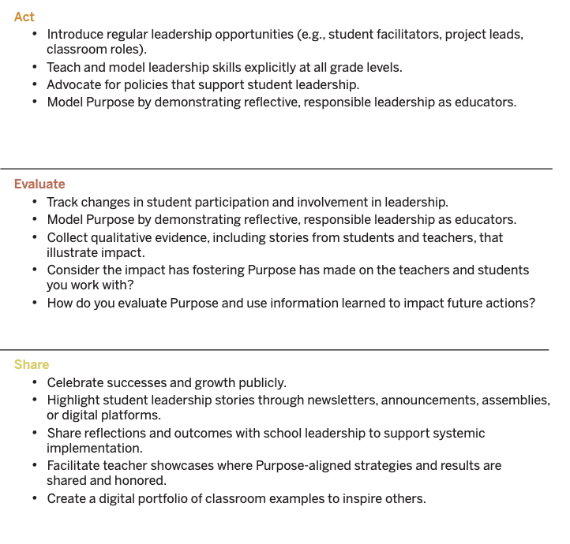

Slide 38
Challenge Time…

Slide 39
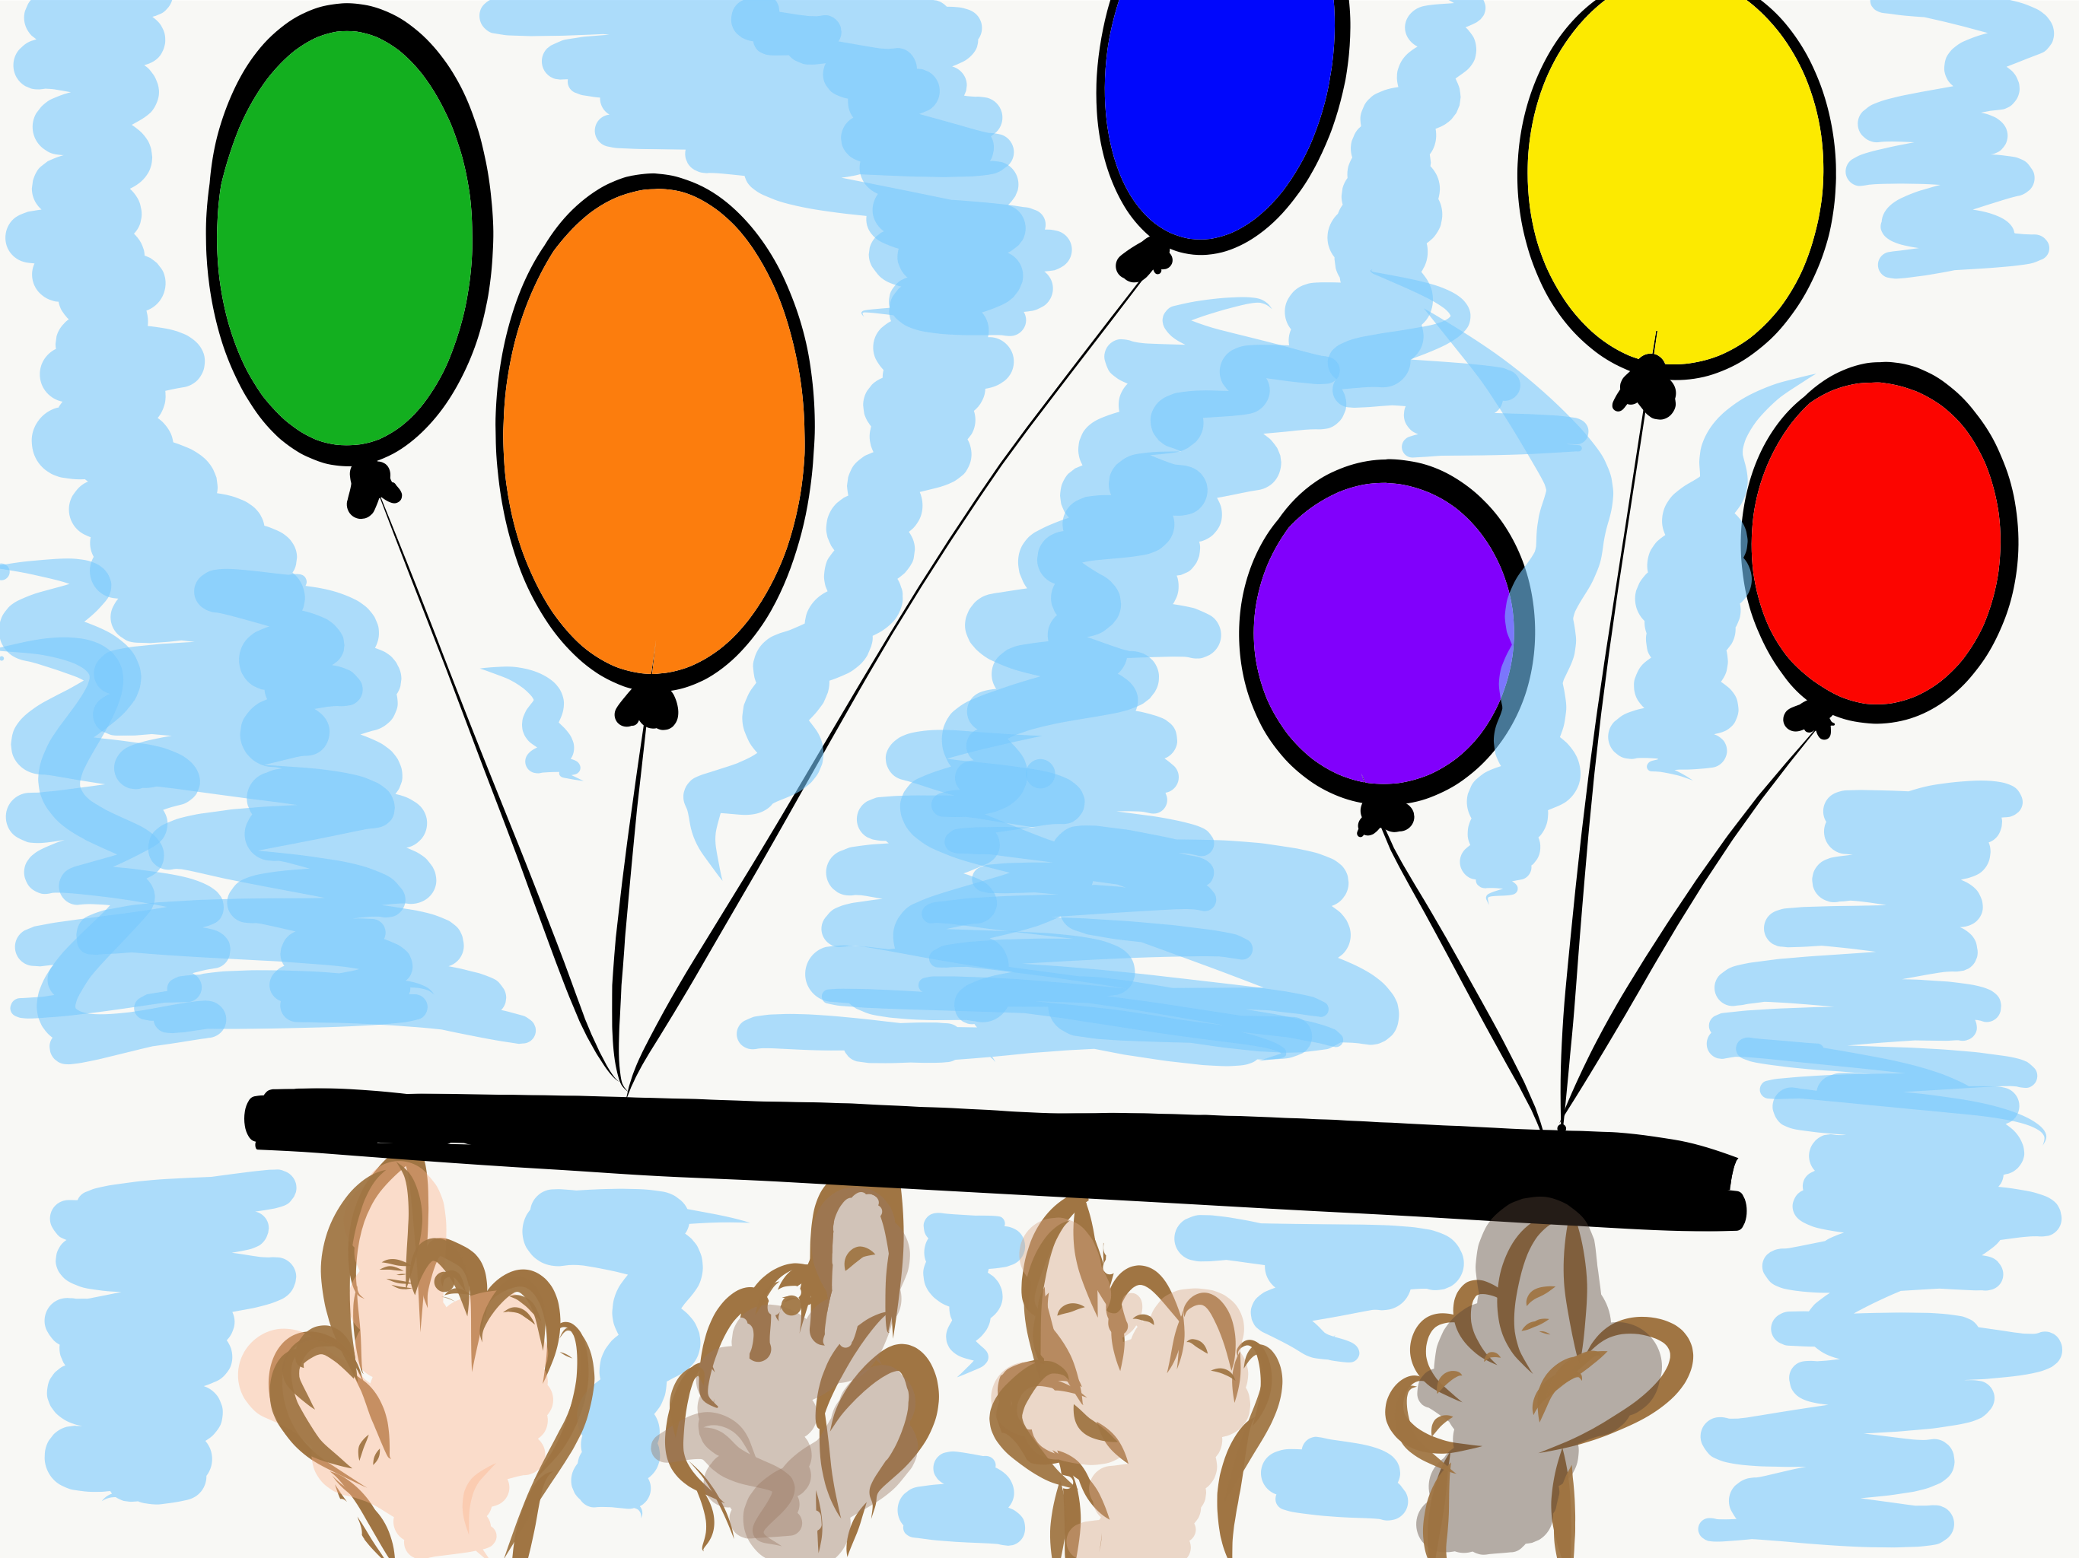
Lower the Stick
Each team member places their index finger under the stick at chest level. Lower the stick to the ground as a team. If anyoneʻs finger comes off the stick you must start over.
HONOR SYSTEM!

Slide 40

Teacher Leaders
Embrace….
The Power of Balance

Slide 41

We need to balance...
Teacher
Responsibility
Student
Responsibility

Slide 42
We need to balance...
Listening
Speaking

Slide 43
We need to balance...
Innovation
Compliance

Slide 44
We need to balance...
Needs Fixed
Going Right

Slide 45
We need to balance...
Dreaming
Doing

Slide 46
We need to balance...
Mind
Heart

Slide 47
We need to balance...
Important
Urgent

Slide 48
What would you add?

Slide 49

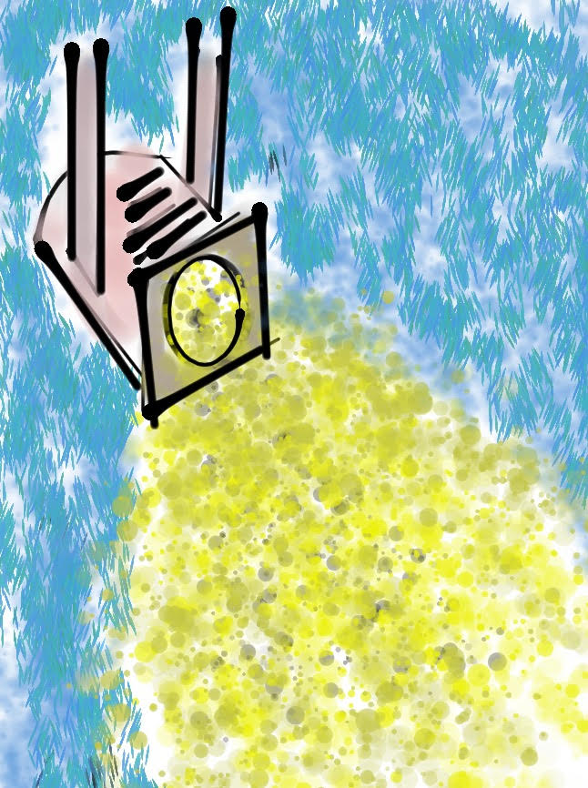
A Balanced
Conversation
Identify 3 Bright Spots in your district, school or classroom.
Determine how you will share these Bright Spots with others both within & outside of your
school.

Slide 50
Challenge Time…

Slide 51
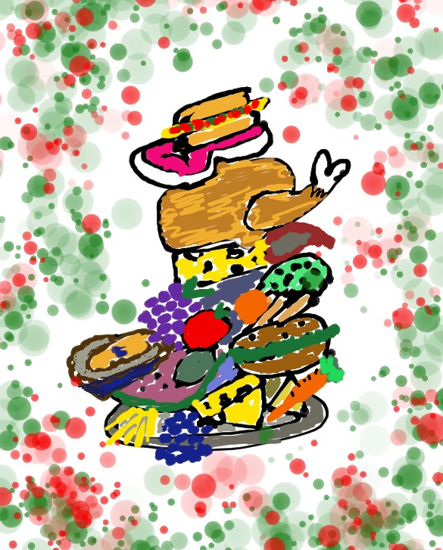
What
Fills
Your Plate?

Slide 52

What
Fills
Your Heart?

Slide 53
Be sure to balance...

Slide 54
Purpose Resources
Purpose Brief
Purpose: Teacher & Student Roles
Purpose Talk Story Conversation Starters
Implementation Tips to Support Purpose
Purpose Strategies for Continual Improvement
Taking Action Resources: Leadership &
Responsibility, Confidence to Take Action
Purpose Implementation Self-Reflection
Purpose Peer Observation
Purpose Scenarios
Student Dream On Guidebook
Leadership & Responsibility and Confidence
to Take Action Activities (Lesson Plans)

Slide 55

Dr. Lisa Lande
Lande@QuagliaInstitute.org
208-484-6187
@Lisa_Lande

