Slide 1


Engagement: Creating
Learning Environments
Where Students Thrive
Session #5 February 9, 2026
Dr. Lisa Lande

Slide 2


Slide 3
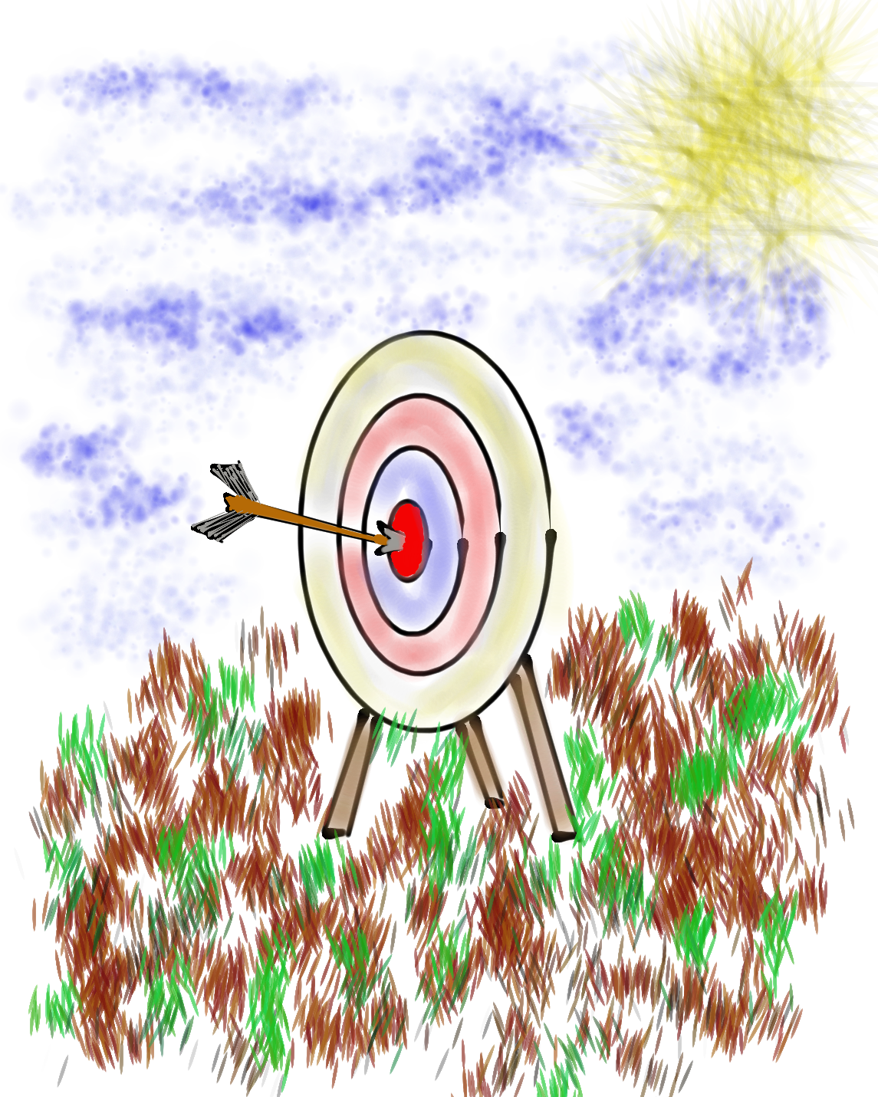
Goals for Today
Continue our journey to amplify student
voice & grow a Community Schools culture of partnership.
Explore the Guiding Principle of Engagement & consider how this connects to Student
Voice & the Community Schools goals.
Apply learning to the Community Schools
Implementation Team efforts at Jefferson
High School, particularly in relation to BSAP.

Slide 4

Vision & Purpose
Community Schools Vision: A family of
learning where educators, families, &
community members work together to
prepare students in achieving their
academic & career dreams.
BSAP Team Purpose: Supports the social,
emotional, & academic needs of our Black
students. It builds on the assets of the Black community & works towards preserving
its history.

Slide 5


Slide 6

Challenge Time…

Slide 7

Square Pieces
Goal: Each team member is to form a square (flat on the table or ground) with the pieces of paper.
Process:
-Form a group of 5, make a
circle & distribute 3 pieces
to each person.
-A participant wanting to
exchange a piece can place it in the center of the circle.
-A piece placed in the center
may be take by another
participant in exchange for
one of their pieces.
Rules:
-No Talking
-No folding the pieces
-No overlapping pieces
-All pieces must be used (each square is 3 pieces)
-Exchange 1 piece
at a time

Slide 8

Reflect
What made the task challenging?
What was required to solve the task?
How does this exercise reflect systems thinking in relation to schools?
Notes:
.

Slide 9
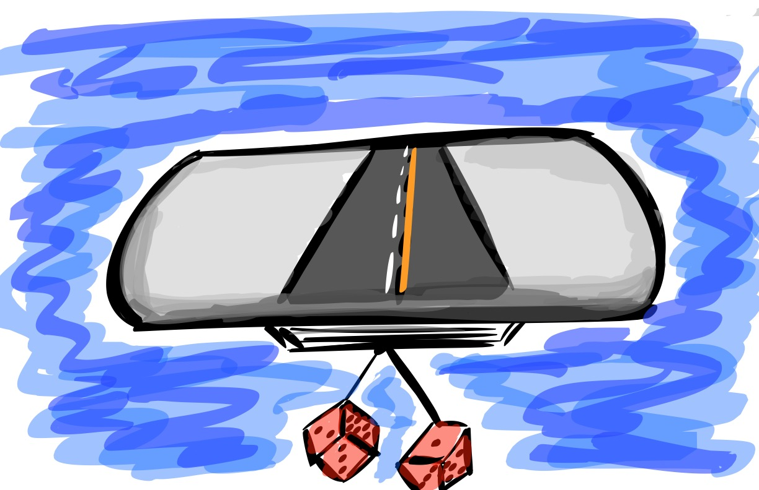
Quick Review

Slide 10

The 3 Components of Student Voice
Sharing thoughts & ideas in an environment underpinned by trust & respect.
Offering realistic suggestions for the
good of the whole.
Accepting responsibility for not only what is said but also what needs to be done.

Slide 11
LEAD
TAKE ACTION
with others
Share
RESPONSIBILITY
LEARN
UNDERSTAND
& RESPECT
different points
of view
Build
TRUST
LISTEN
SEEK OUT
opinions from
others
Voice Process

Slide 12




high
Imagination
Aspiration
DREAMING
Hibernation
Perspiration
low
DOING
high

Slide 13








Aspirations Framework
Self-Worth
Engagement
Purpose

Slide 14
Optimal Engagement?
YouTube:
https://youtu.be/E6H063AuUZ4
Vimeo:
https://vimeo.com/991665358
Video

Slide 15

Share about a
time you were
SUPER ENGAGED in a school
learning
experience?

Slide 16

Engagement
Engagement takes root when schools ensure that students & staff are deeply involved in the learning process, showing enthusiasm & a desire to learn new things, as well as a willingness to take positive, healthy steps toward the future.

Slide 17
Voice &
Engagement
When students believe they have a voice they are 38% more likely to report experiencing engagement in school.

Slide 18
Engagement

Slide 19
Fun & Excitement

Slide 20
A Fun & Exciting Classroom??
YouTube:
https://youtu.be/5ITa-dKVlxU
Vimeo:
https://vimeo.com/qisva/engagingclassroom
Video

Slide 21
Key Points
Losing track of time & space.
If you are bored, you can bet your
life the students will be as well.
Instilling passion & intellectual
excitement for content being taught.
YOU can make DIRT exciting! ☺

Slide 22
Creating
Fun & Excitement
Let your passion & excitement show!
Do things that “surprise” your colleagues & students…let them know you are alive!
Learn from your students & colleagues, continually adding to your teacher
toolkit of teaching strategies.

Slide 23
Challenge Time…

Slide 24


Slide 25
Reflect
What was challenging for you about the game?
What made it difficult to “spot” things?
What things might be challenging to “spot” in
your school system?
What lessons can you apply to your work as a
Community Schools Team? (ie look beyond the
biggest/loudest voices, be aware that some voices are
consistently overlooked, recognize natural bias, etc.)
Notes:
.

Slide 26

Reflect
What was “fun & exciting” about Spot It?
Aside from just having fun, what did you LEARN
from the experience?
What is something from this experience you might apply to your own efforts to make school “fun & exciting”?
Notes:
.

Slide 27
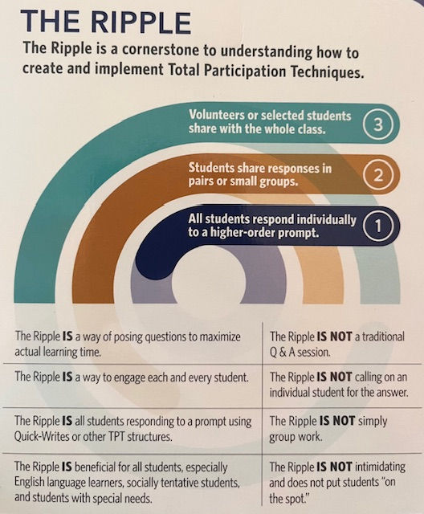

The Ripple Protocol
Adapted from
Total Participation Techniques
Himmele & Himmele

Slide 28

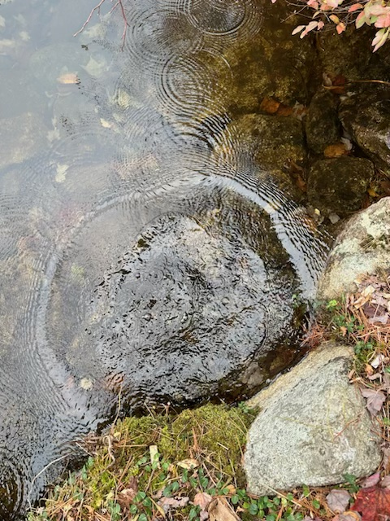
Ripple
Protocol
Individual. Explore the Fun &
Excitement Resources. Write down 2-3 things you find interesting
from your exploration.
2. Pairs. Find a partner & share
what you wrote about Fun &
Excitement.
3. Whole Group. Share out something you heard from your partner with the whole group!

Slide 29
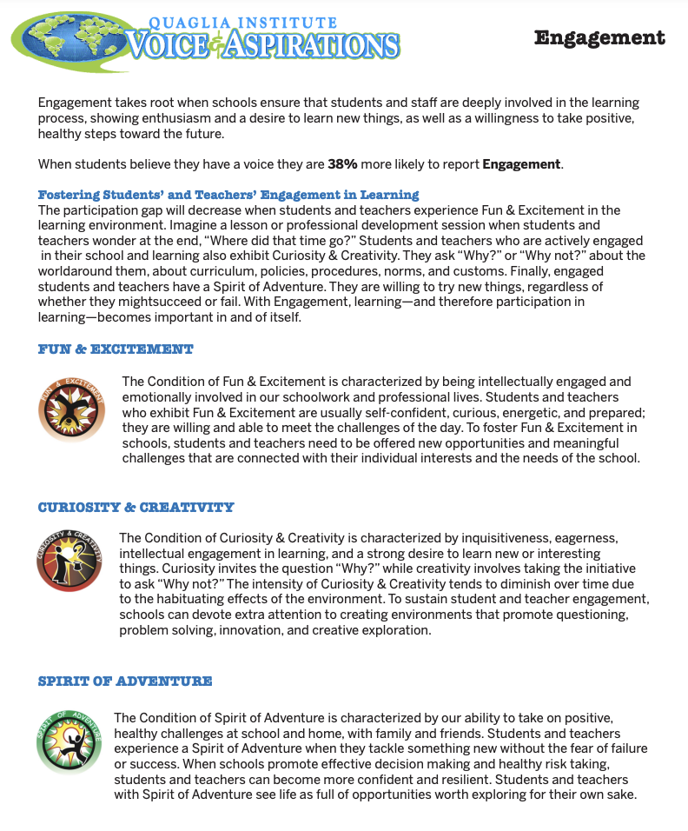
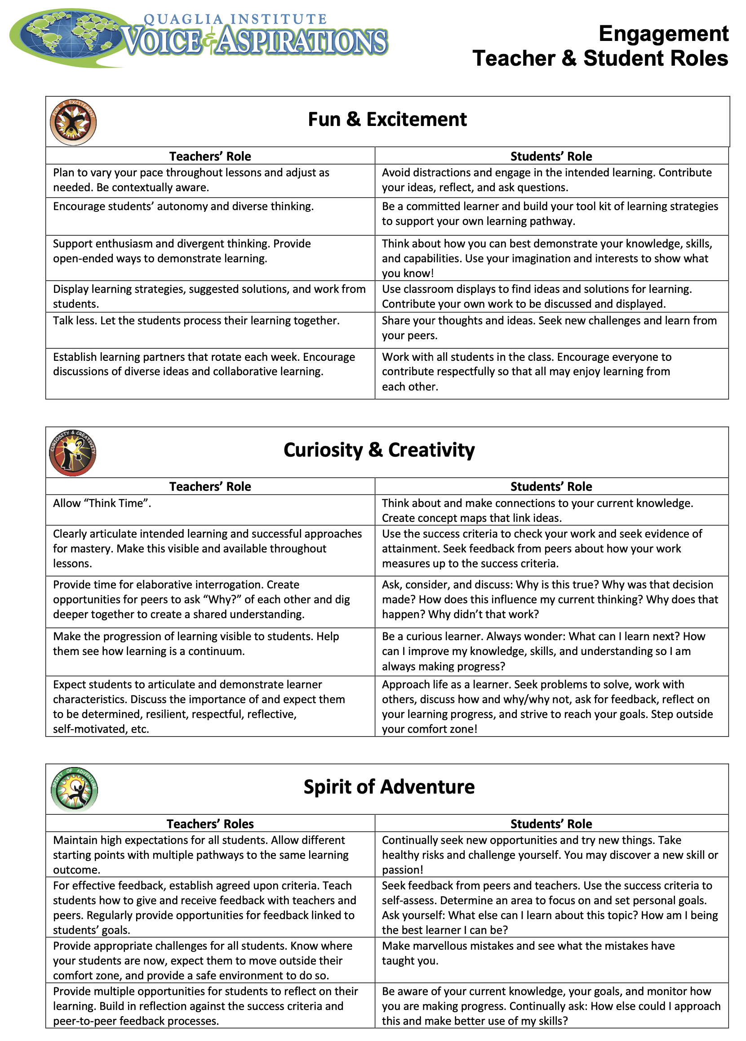
Digging Deeper into Engagement

Slide 30
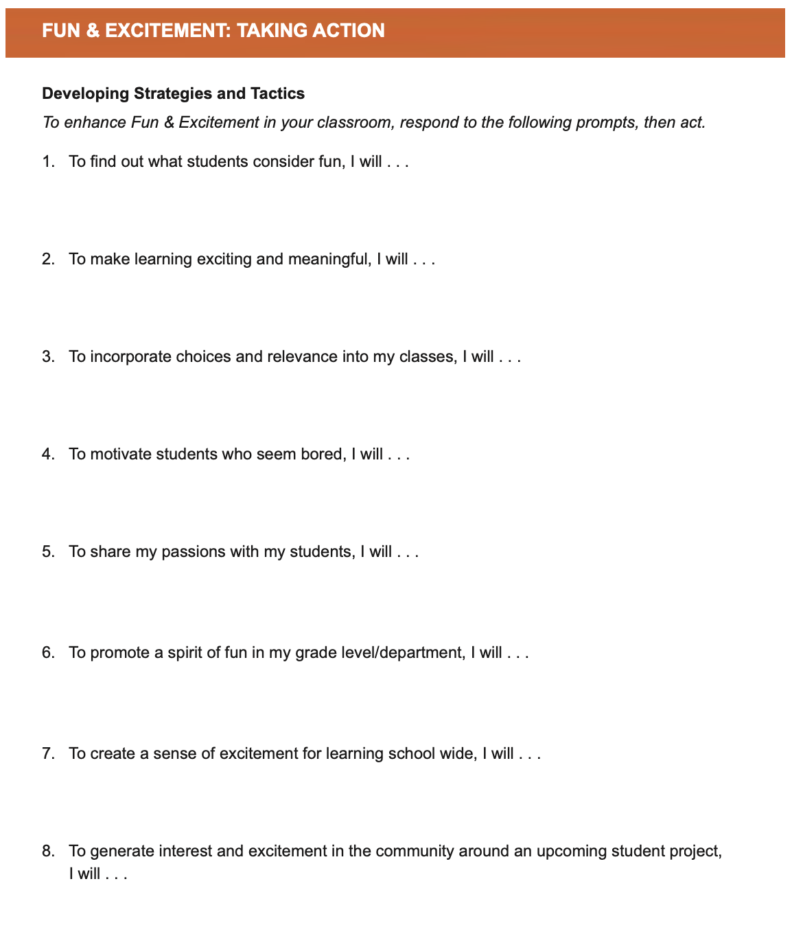
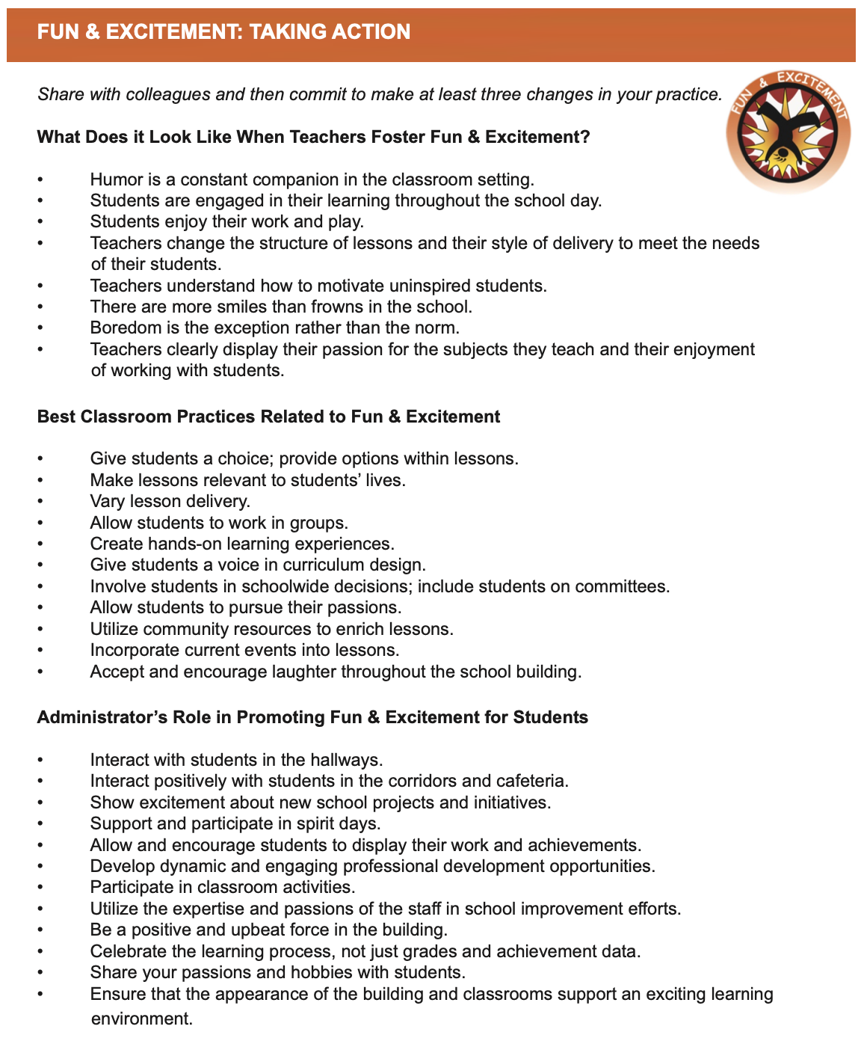
Taking
Action

Slide 31

Taking Action
Read through the Fun & Excitement Taking Action resource.
Highlight action statements you already use & identify others you will try.
Complete one of the “I will…” statements.

Slide 32
Curiosity & Creativity

Slide 33
Creativity in the Future
YouTube:
https://youtu.be/g1RnveGk8YM
Vimeo:
https://vimeo.com/qisva/creativityfuture
Video

Slide 34
Key Points
Curious students will ask “Why?”
Creative students will ask “Why not?”

Slide 35
Fostering
Curiosity & Creativity
Know your students hopes, dreams, &
interests.
Share things with your students that you
are curious about.
Let students design lessons.
Teach students to pose questions &
encourage critical thinking.

Slide 36
Challenge Time…

Slide 37


Challenge
Cultivating Creativity
Write down the
first word
that comes to mind
for each of the
prompts.

Slide 38
Challenge
Cultivating Creativity
This time, write
down your most
creative thought for
each of the
prompts!

Slide 39
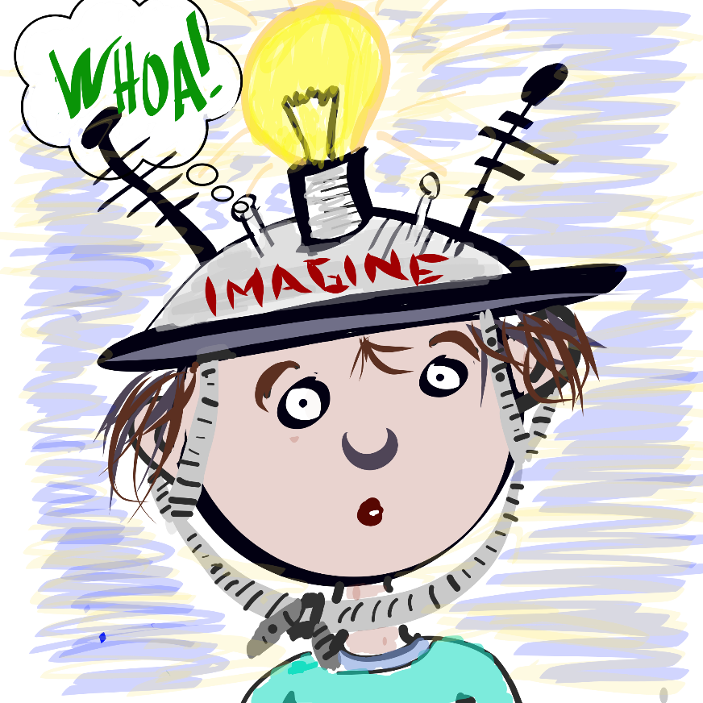
Provide students with an opportunity to explore something they are curious about. See the Genius Hour Lesson Plan for suggestions on how to structure this activity for students.
Challenge
Genius Hour

Slide 40

Reflect
If you were given a “Genius Hour” what would you choose to explore?
What subject were you most curious about in school? Why?

Slide 41

Microlabs Protocol
Meeting Goals p. 52-56
Microlab: A short, active experience
Create groups of 3 & letter off A-C.
(Read directions on p. 53.)
Question #1: What is one thing you found
interesting from your exploration of the
Curiosity & Creativity resources?
Question #2: What are some of the challenges
you experience trying to instill Curiosity &
Creativity in students?
Question #3: What is one thing you do in your role that reflects Curiosity & Creativity?

Slide 42
Digging Deeper into Engagement

Slide 43


Taking
Action

Slide 44
Taking Action
Read through the Curiosity & Creativity Taking Action resource.
Highlight action statements you already use & identify others you will try.
Complete one of the
“I will…” statements.

Slide 45
Spirit of Adventure

Slide 46
Spirit of Adventure!!
YouTube:
https://youtu.be/DYMYtL_ISH4
Vimeo:
https://vimeo.com/qisva/spiritofadventure
Video

Slide 47
Key Points
It is more than being willing to try
something new, it is being excited about
the opportunity to experience & learn
new things!
Make it safe for teachers & students to fail & succeed.

Slide 48
Encouraging
Spirit of Adventure
Share with colleagues & students your
accomplishments & disappointments.
Share things you are & are not very
adventurous about.
Have a “Failfest” every now & again.

Slide 49
Challenge Time…

Slide 50
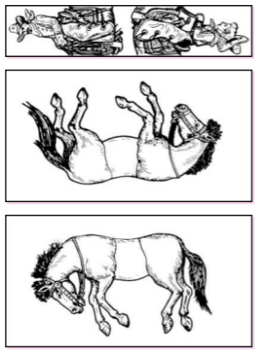
Solve the Puzzle
Arrange the 2 horses & the jockey sheets
so that the 2 jockeys
are mounted on the 2
horses (in the correct
manner that jockeys
ride horses!)
All 3 sheets should
be face up, do not
bend, fold, cut, or
tear the sheets.

Slide 51

Solve the Puzzle

Slide 52
Explorations:
The Adventure of Learning
YouTube:
https://youtu.be/eCuuoX9UjwI
Vimeo:
https://vimeo.com/qisva/explorations
Video

Slide 53
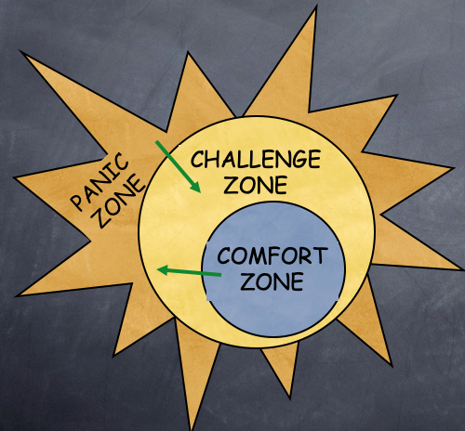
Challenge
In the Zone
Comfort: Things are easy for you,
your heart rate is even & breathing is easy.
Challenge: Things are more difficult but not unworkable. Your heart rate picks up, & you may take a deep breath.
Panic: Things seem impossible and completely over your head. Your breathing is short & your heart pounds.

Slide 54



Challenge
Share something that is in your Comfort, Challenge, or Panic Zone.
Example:
Public Speaking
In the Zone
CHALLENGE ZONE
PANIC ZONE
COMFORT ZONE

Slide 55


Reflect
Share an ”epic fail” moment & what you learned from the experience.
How do you help cultivate a Spirit of Adventure in learning for your students?

Slide 56
Questions
& Assumptions
Meeting Goals p. 39-41 (modified)
On one sticky note, write a question & on another sticky note, write an assumption you have related to the Spirit of Adventure information you explored.
Get up & meander around the room, meeting with various partners to discuss your questions, & assumptions.
Identify commonalities & differences in your questions & assumptions.

Slide 57
Digging Deeper into Engagement

Slide 58
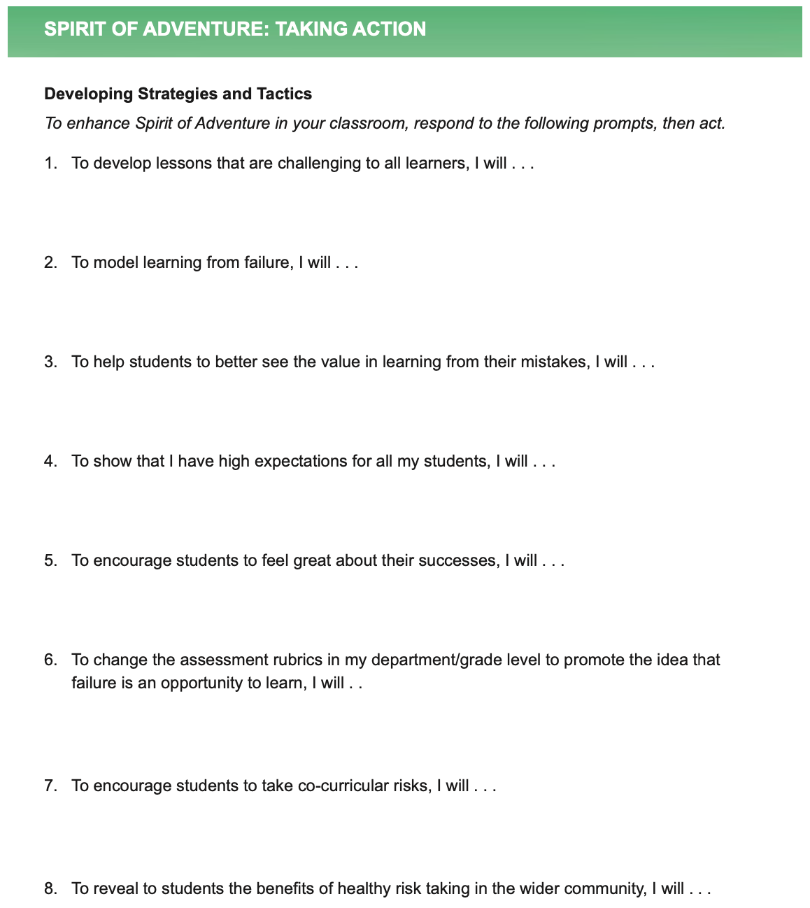
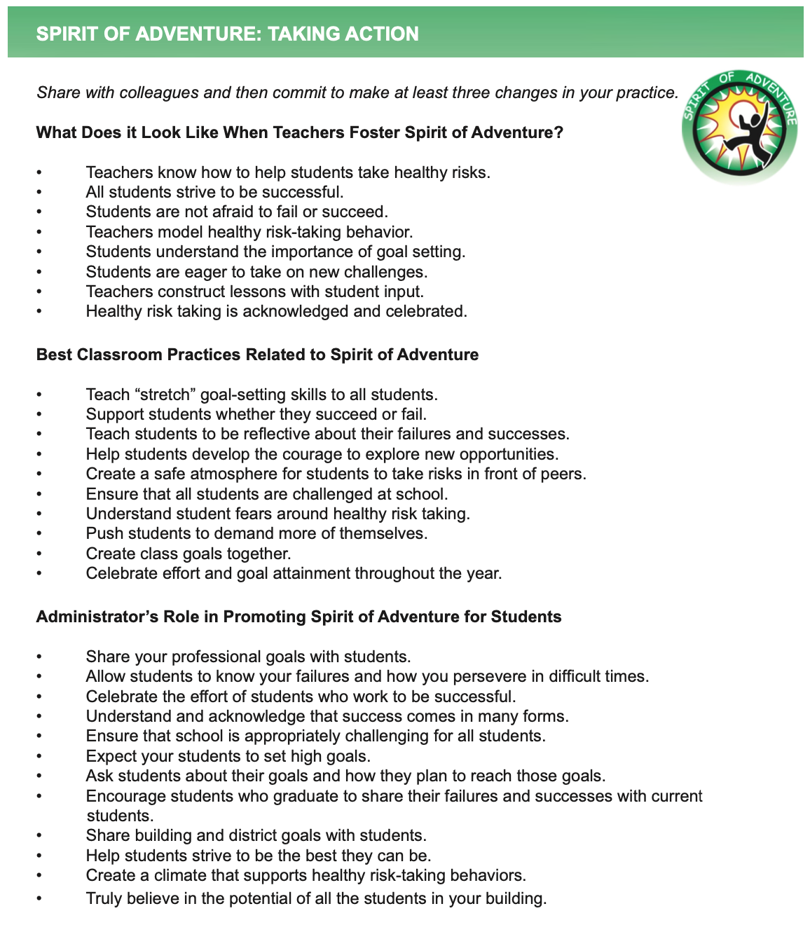
Taking
Action

Slide 59
Taking Action
Read through the Spirit of Adventure Taking Action resource.
Highlight action statements you already use & identify others you will try.
Complete one of the
“I will…” statements.

Slide 60
Challenge Time…

Slide 61



Slide 62
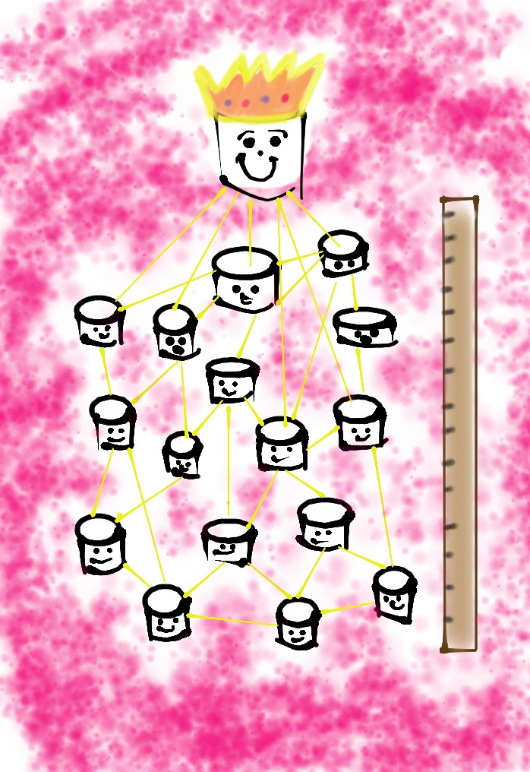
Marshmallow Challenge
*18 minutes
*NO Technology
Devices Allowed
*Build the tallest
free-standing structure
*Use as much or as little of the
supplies
*The entire, whole marshmallow must be on top

Slide 63
Vimeo:
https://vimeo.com/qisva/tedmarshmallow
or
YouTube:
https://youtu.be/jt5Lsp0BW4w
Video

Slide 64
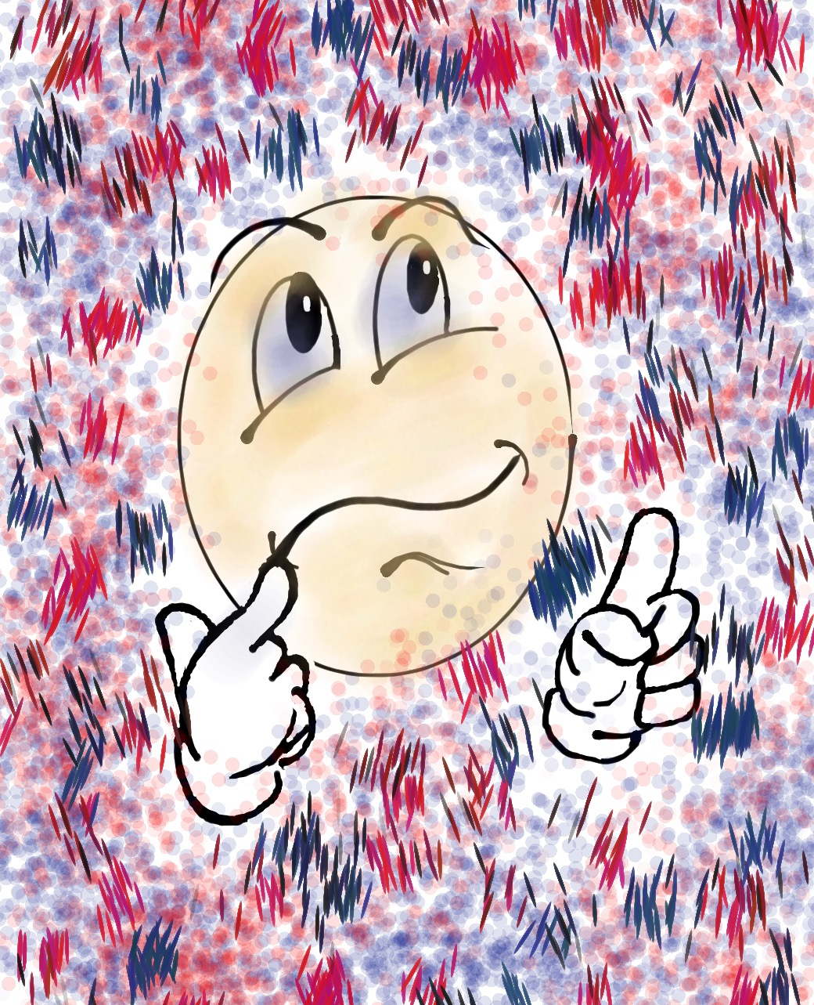
Check Up From the Neck Up
*When were you MOST engaged?
*When were you LEAST engaged?
*What could YOU do in the future to be MORE engaged?

Slide 65

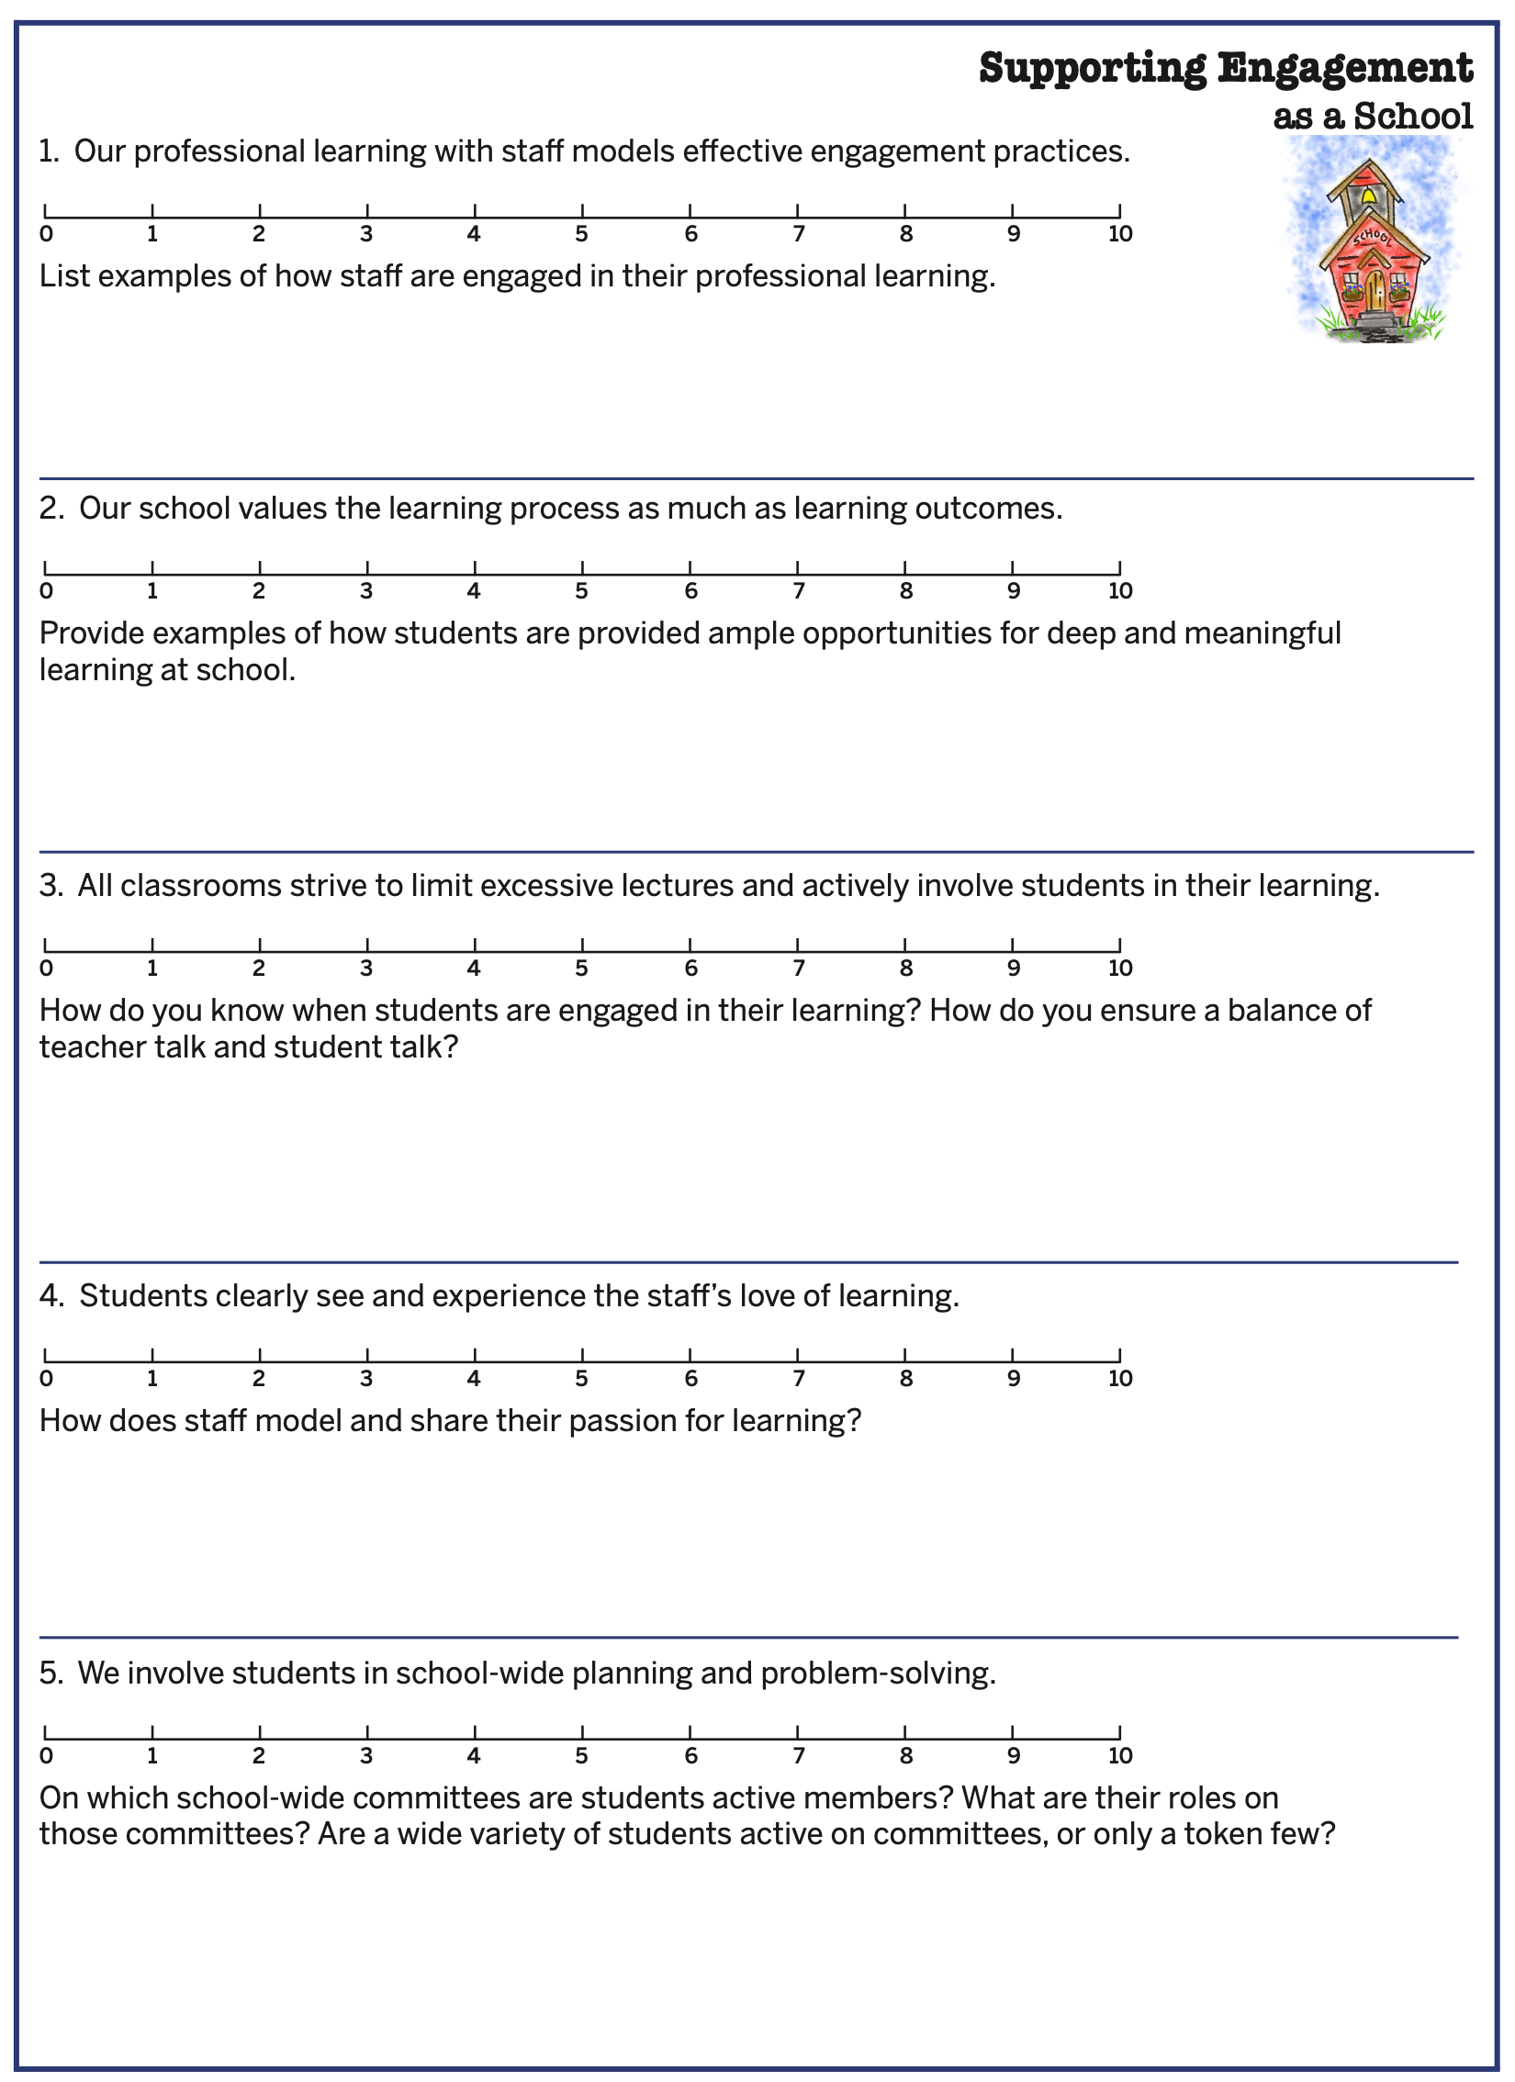
Engagement Implementation Self Assessment

Slide 66
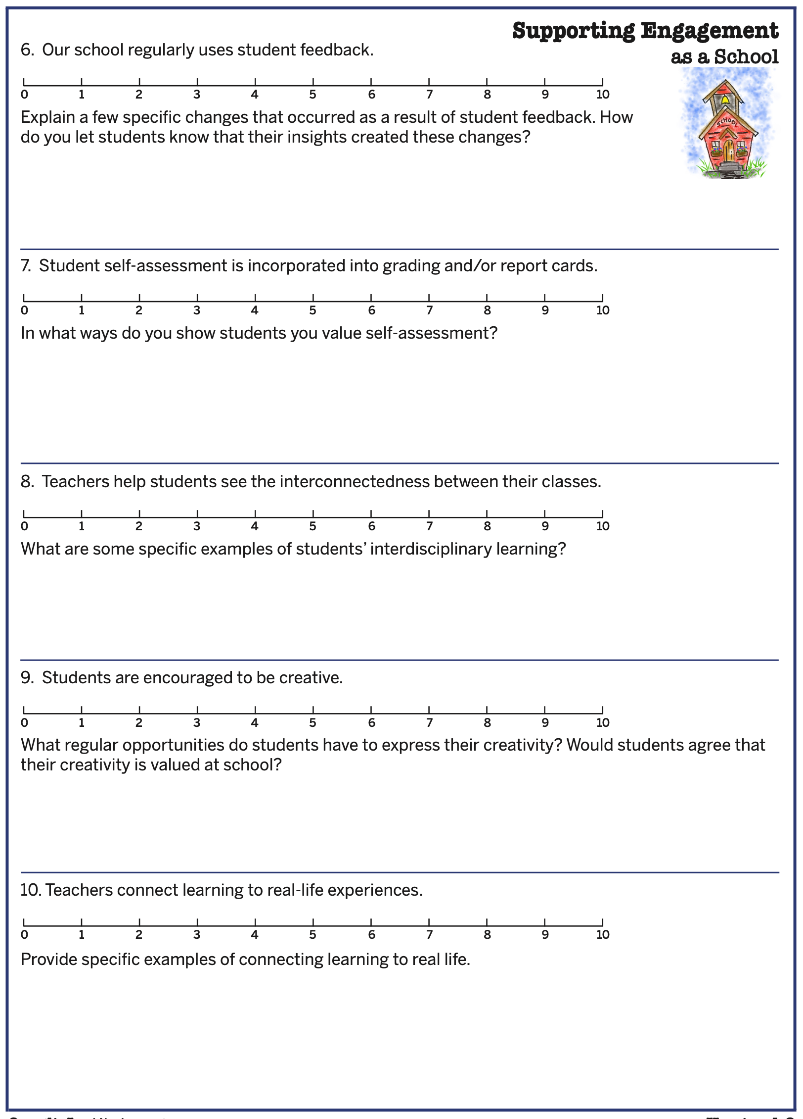
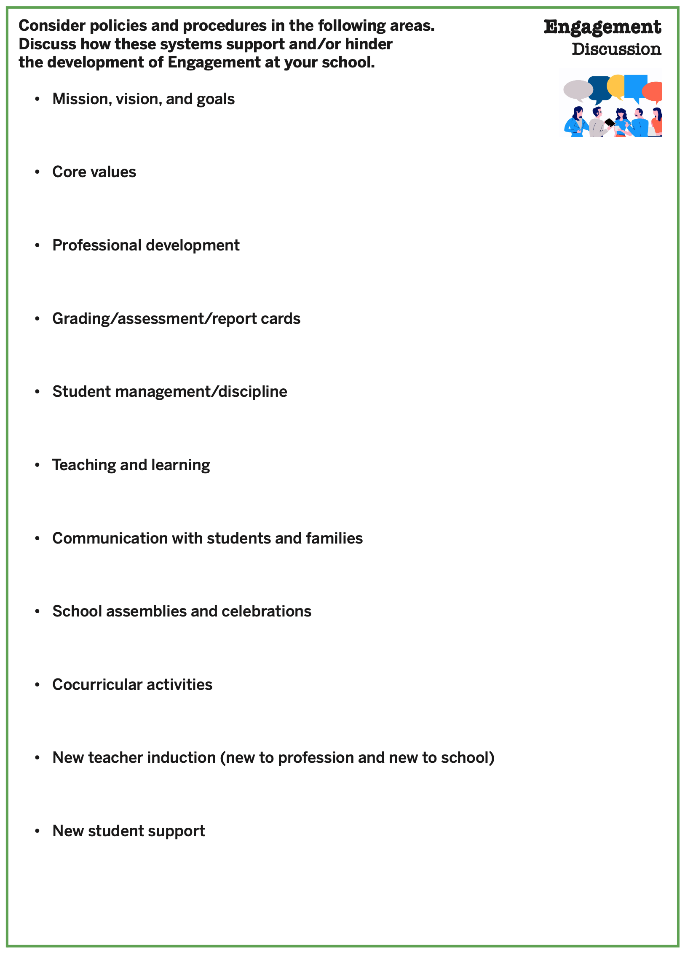
Engagement Implementation Self Assessment

Slide 67
Whatʻs Possible?
Vimeo:
https://vimeo.com/854401116/06a359ba71
YouTube:
https://www.youtube.com/watch?v=ioxxd7C6hrg
Video

Slide 68

Engagement by Design
YouTube:
https://youtu.be/YR2fnjLipOg
Vimeo:
https://vimeo.com/qisva/engagementbydesign

Slide 69
Engagement Resources
Engagement Brief
Engagement: Teacher & Student Roles
Engagement Implementation Reflection
Fun & Excitement, Curiosity & Creativity,
Spirit of Adventure Taking Action Resources
Engagement Instructional Strategies
Teacher Peer Observation Guide Engagement
Student Dream On Guidebook
Fun & Excitement, Curiosity & Creativity,
Spirit of Adventure Activities (Lesson Plans)

Slide 70

What action are you willing to take to increase student engagement at Jefferson?

Slide 71
What action are you willing to take to increase student engagement at Jefferson?

Slide 72

Dr. Lisa Lande
Lande@QuagliaInstitute.org
208-484-6187
@Lisa_Lande

