Slide 1


The Dynamics of Student
Voice & Aspirations
Session #1 April 9, 2024
Dr. Lisa Lande

Slide 2
Fundamental Beliefs
Students are the potential, not the problem.
Students have something to teach us.
Working together is the only way forward.

Slide 3

Goals for Today
Understand & embrace a common definition for Student Voice.
Consider how Voice impacts the school
improvement process.
Apply learning to the Community Schools
Implementation Team efforts at Jefferson
High School, particularly in relation to BSAP.

Slide 4

Vision & Purpose
Community Schools Vision: A family of
learning where educators, families, &
community members work together to
prepare students in achieving their
academic & career dreams.
BSAP Team Purpose: Supports the social,
emotional, & academic needs of our Black
students. It builds on the assets of the Black community & works towards preserving
its history.

Slide 5

Postcard
Introductions
Name & Role at Jefferson
Your postcard connection
Something you want me to know about this
Team or Jefferson High in general
Your hopes & dreams for this Team

Slide 6

Reflect
Pink: What comes to mind when
you hear the term Student Voice?
Purple: Share an example
of how the voices of students
representing various
sub-populations are valued
& heard at Jefferson.

Slide 7
Speed Dating
Vimeo
https://vimeo.com/854655576
YouTube
https://youtu.be/jA9u9zaaJRs
Video

Slide 8
Academic Speed Dating

Slide 9

Challenge Time…

Slide 10


Toothpick Challenge
Using 6 toothpicks,
make 4 and only 4
equilateral triangles
(all 3 sides the same size).
You may not break the toothpicks.

Slide 11
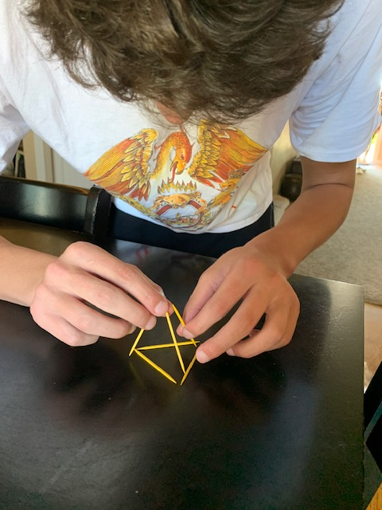
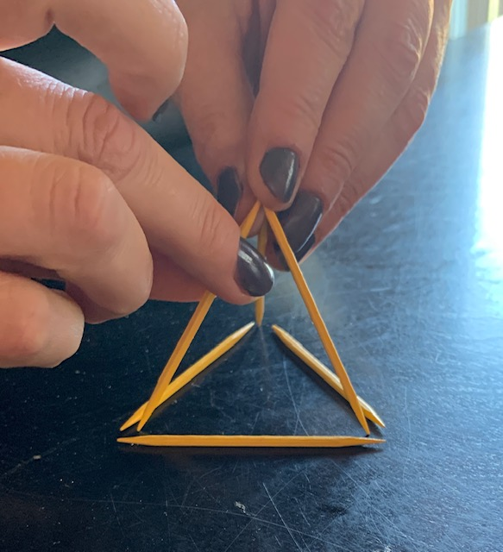
Today we invite you to do
some 3-D thinking!

Slide 12

Quaglia Institute Research
19 years of data
43 states
13 countries
1,008,091 Student Voice Surveys Grades 6-12
153,137 Student Voice Surveys Grades 3-5
641,091 iKnow My Class Surveys
59,813 Teacher Voice Surveys
29,660 Parent Voice Surveys
Notes:
Updated September 22, 2023

Slide 13
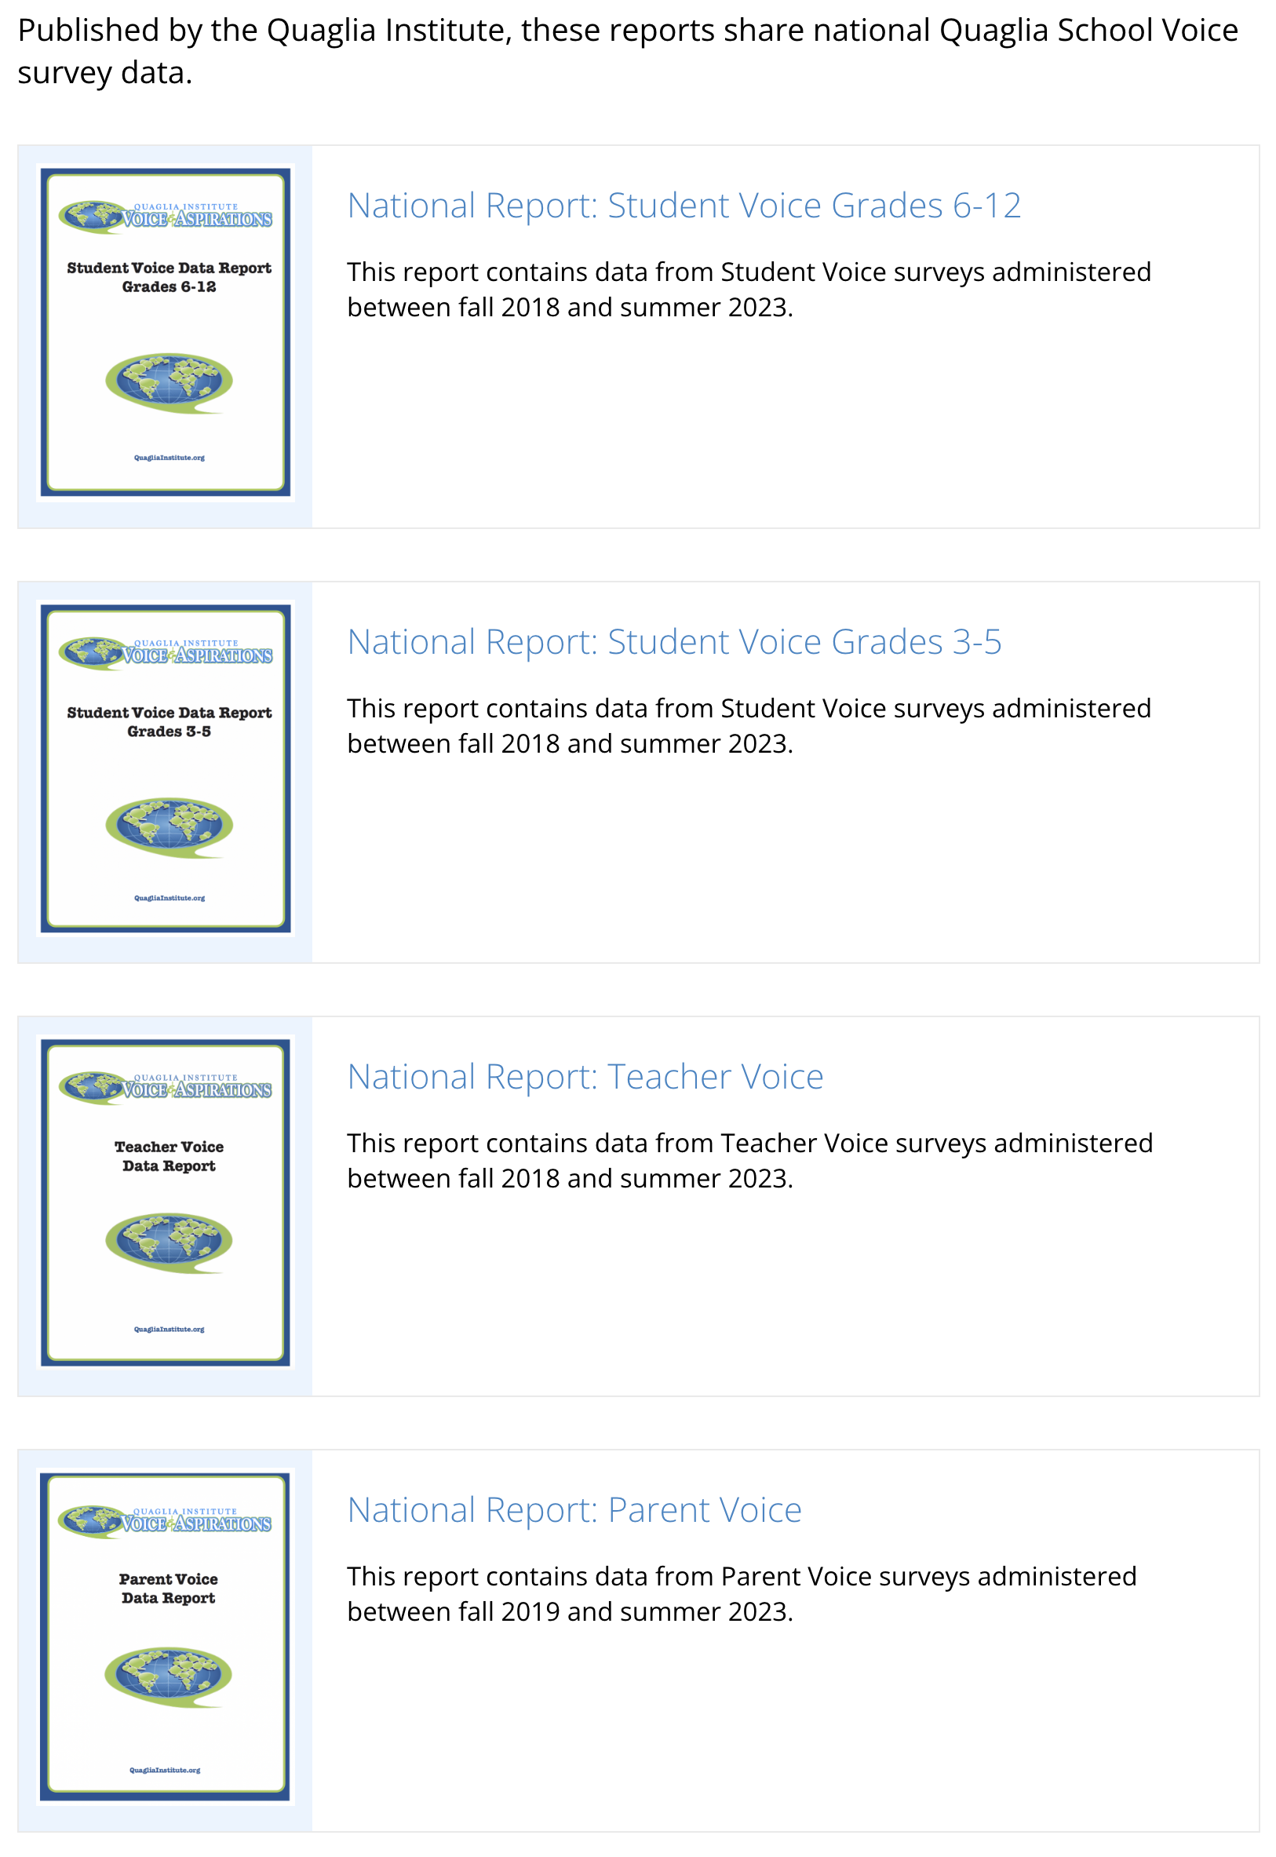
Quaglia Institute Research
QuagliaInstitute.org
National Reports
Student Voice 6-12
Student Voice 3-5
Teacher Voice
Parent Voice

Slide 14

Why Student
Voice &
Aspirations?

Slide 15
TRIUMPHS…
When you Google “Student Voice” you get over
1,620,000,000 results
Search YouTube about “Student Voice” you get over
289,000,000 results
United Nations, Rights of the Child addresses the
importance of Student Voice
Countries, States, & school districts
are making Student Voice a key initiative
Student Voice is not a passing educational whim.

Slide 16
TRIBULATIONS…
52% Adults and students work together to make our school better.
52% Students have a voice in decision making at school.
54% Adults at this school listen to studentsʻ suggestions
57% I use my voice to express my thoughts and ideas.

Slide 17

Students say…
49% Teachers care if I am absent from school.
42% I am a valued member of my school community.
41% My classes help me understand what is happening in my everyday life.
38% Teachers have fun at school.

Slide 18
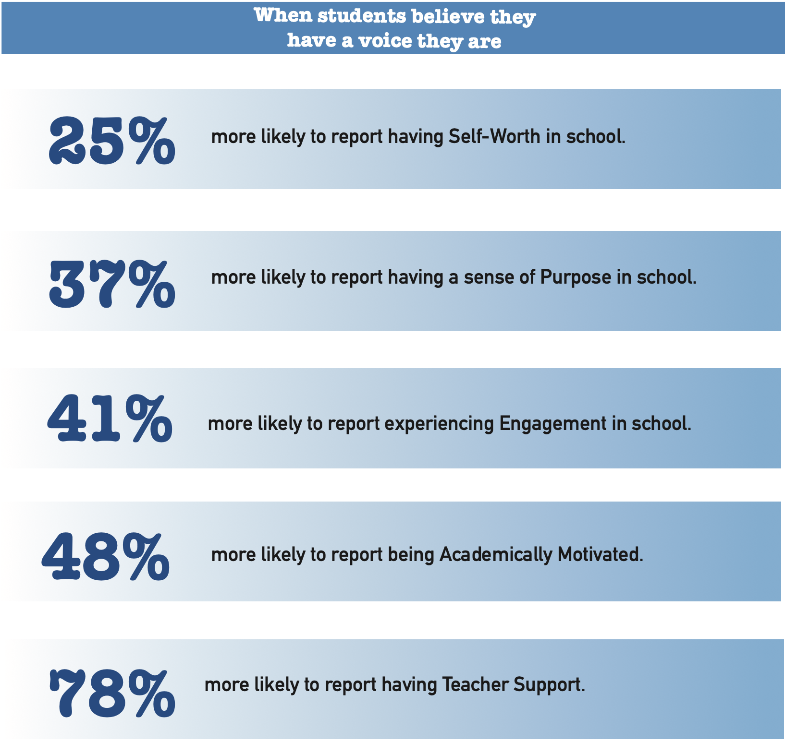

Slide 19
Student Voice in
Los Angeles Unified School District
YouTube
https://www.youtube.com/watch?v=O5Tt3H73IR0
Video

Slide 20

And so the
journey begins!
First, we need a clear
definition of student voice
that we can all
understand, accept, &
put into practice.

Slide 21

The 3 Components of Student Voice
Sharing thoughts & ideas in an environment underpinned by trust & respect.
Offering realistic suggestions for the
good of the whole.
Accepting responsibility for not only what is said but also what needs to be done.

Slide 22
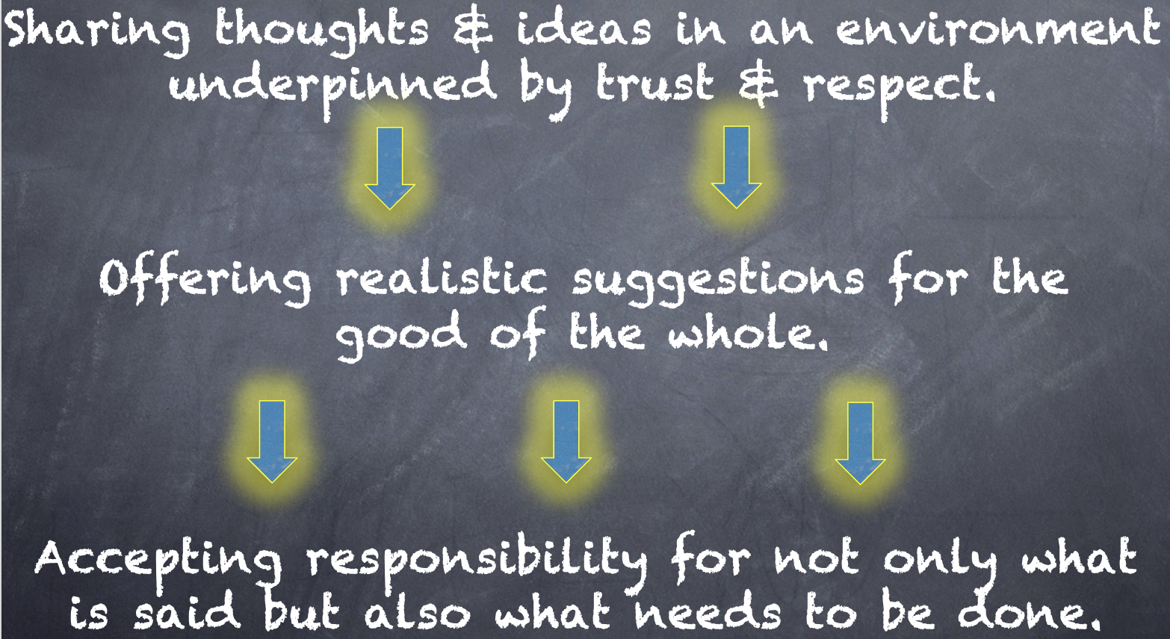
Reflect
What resonates with you from the Voice definition? How does this connect with your work as the Community Schools Implementation Team?

Slide 23

Every voice is unique & represents individual experiences & ideas.
One voice is not better/more important than another.
Equity recognizes that each person
has different circumstances & allocates the exact resources & opportunities needed to reach an equal outcome…every
voice matters!
Voice & Equity

Slide 24
Challenge Time…

Slide 25
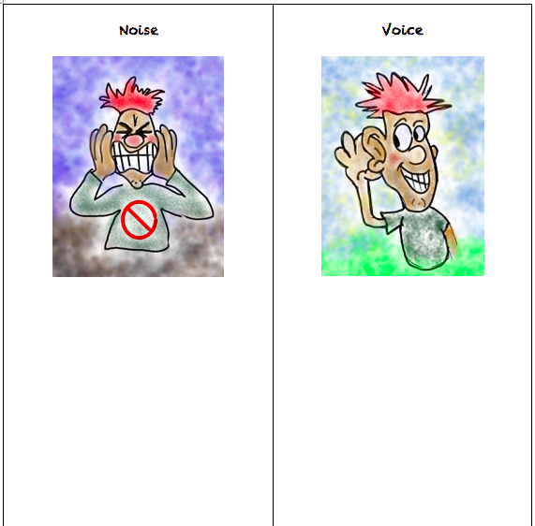


CHALLENGE
Noise vs. Voice
Share words, phrases, &
examples of
Noise.
Now share words, phrases, &
examples of
Voice.

Slide 26
Noise vs Voice
Student Noise
Demands/commands/chaotic
Student opinion is most important
All adult voice is negative
Everyone needs to change but me
Complaining/whining
Student Voice
Requests/inquiry/focused
Our ideas are stronger in partnership
Students are open to learn
Personal reflection
Accepting responsibility

Slide 27
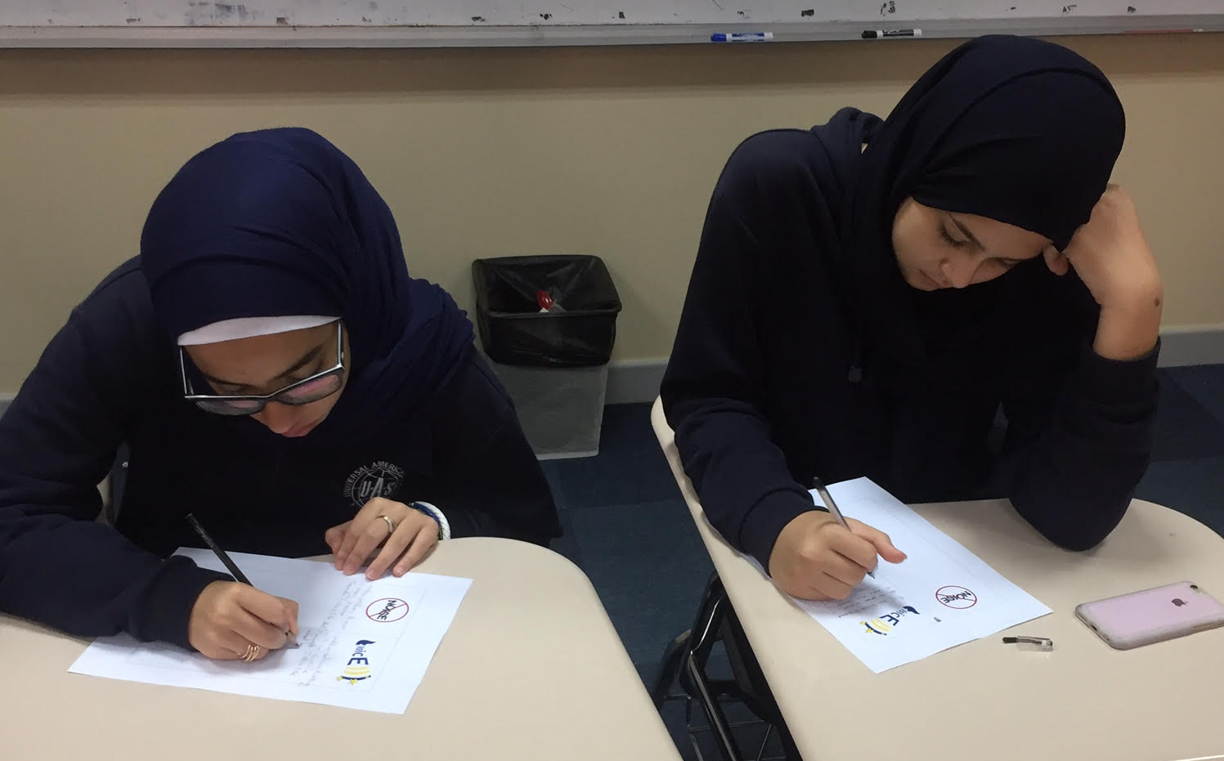
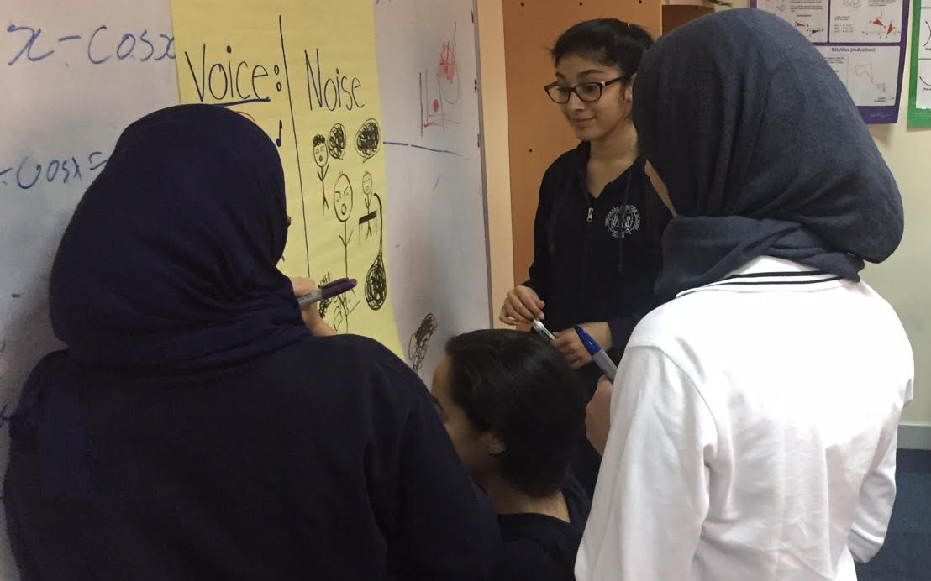
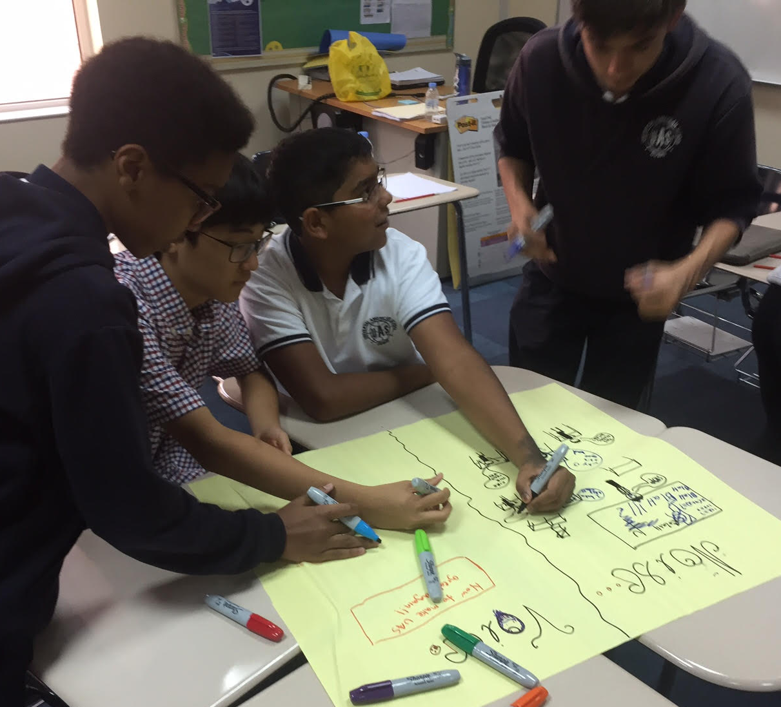
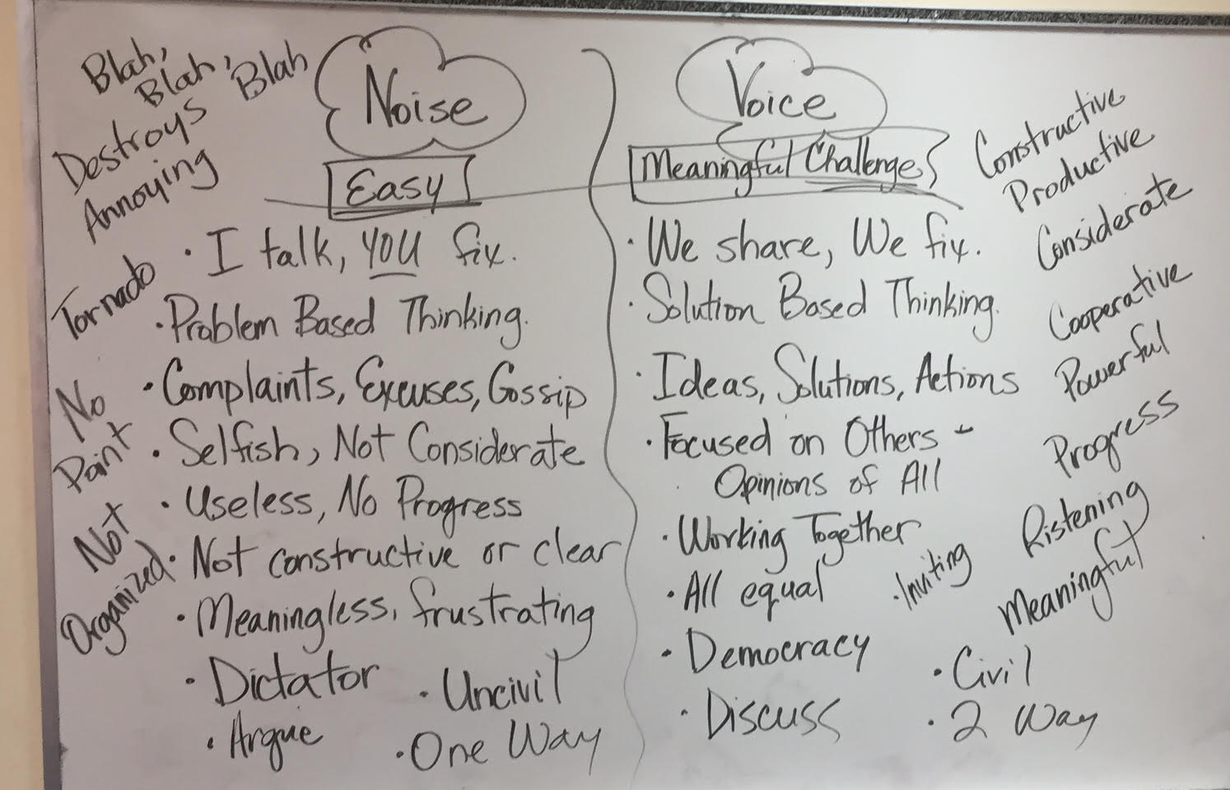

Slide 28
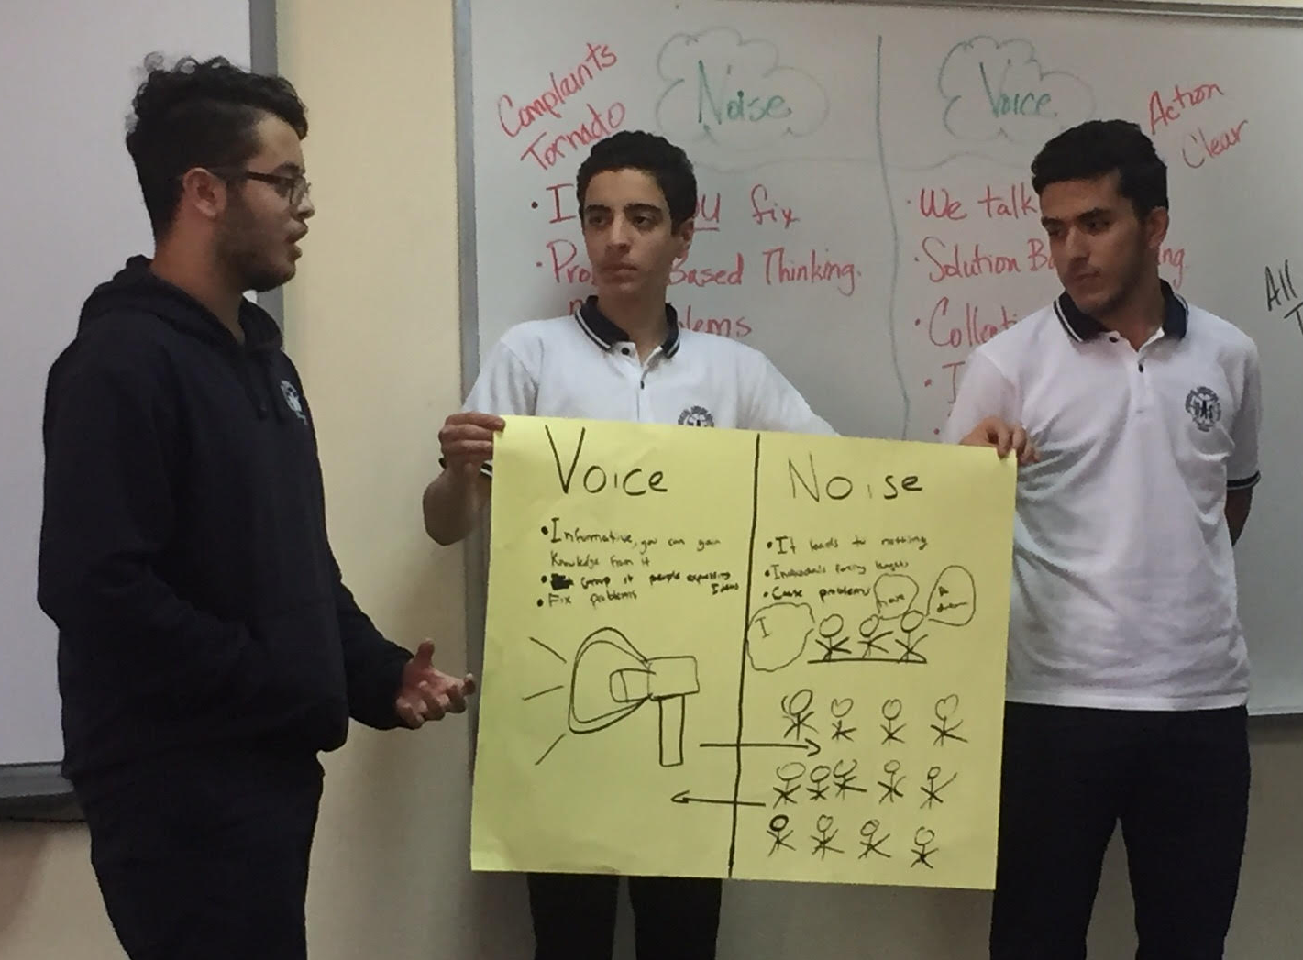
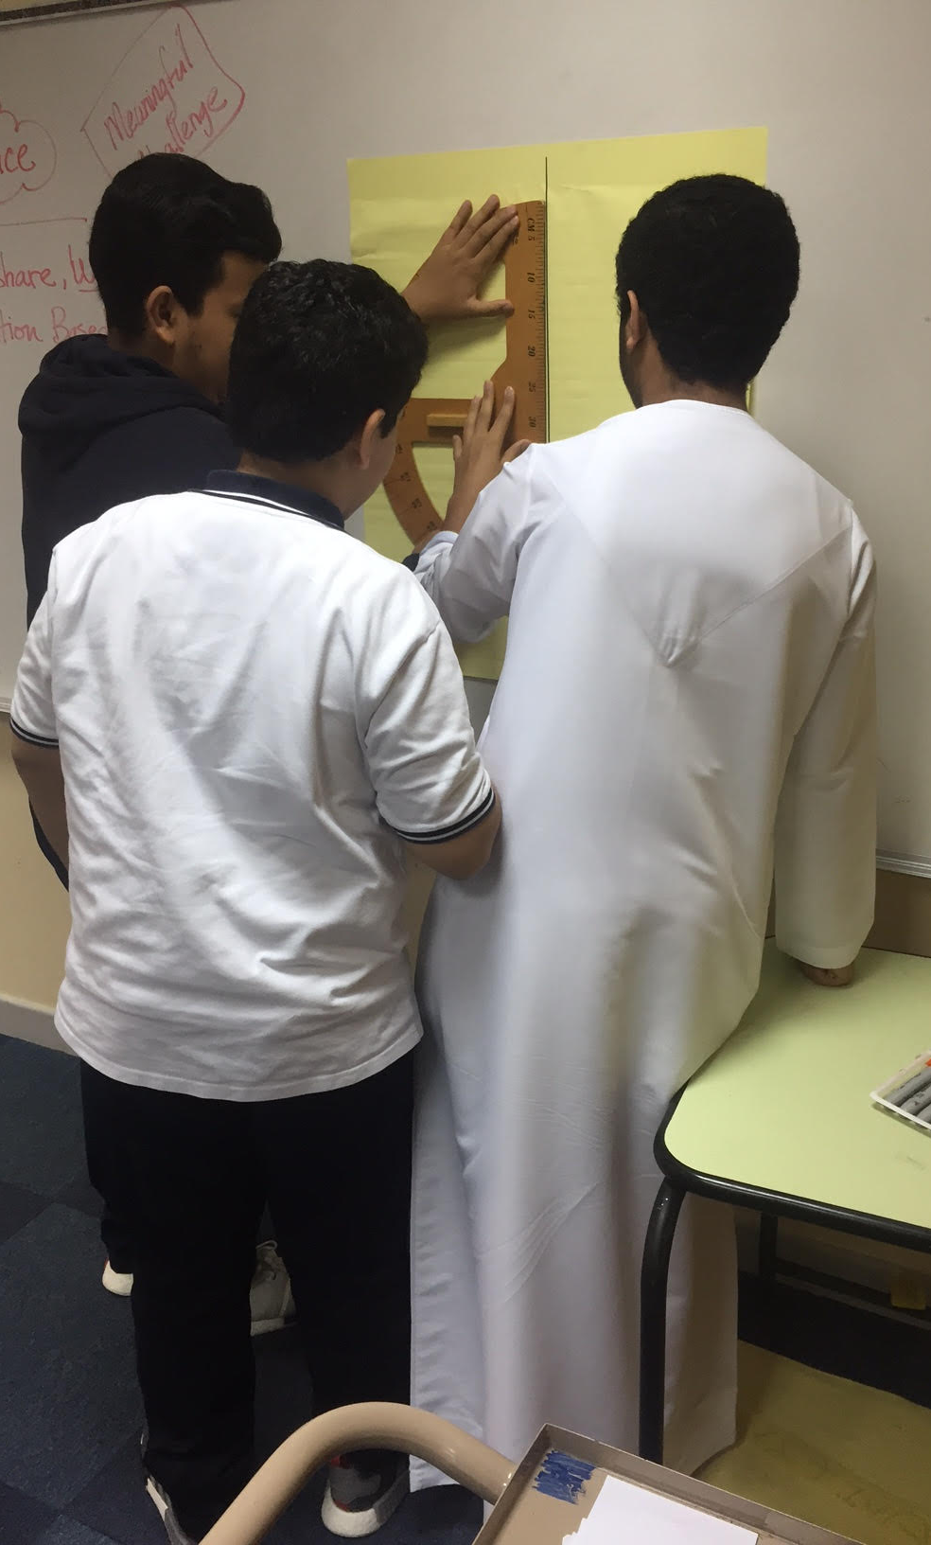
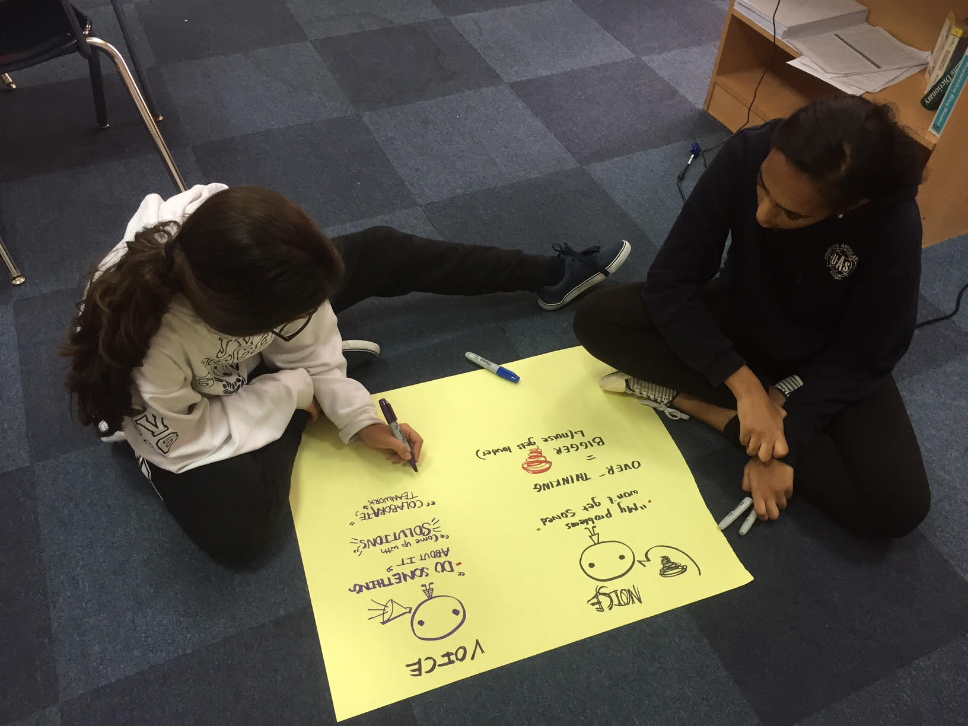

Slide 29
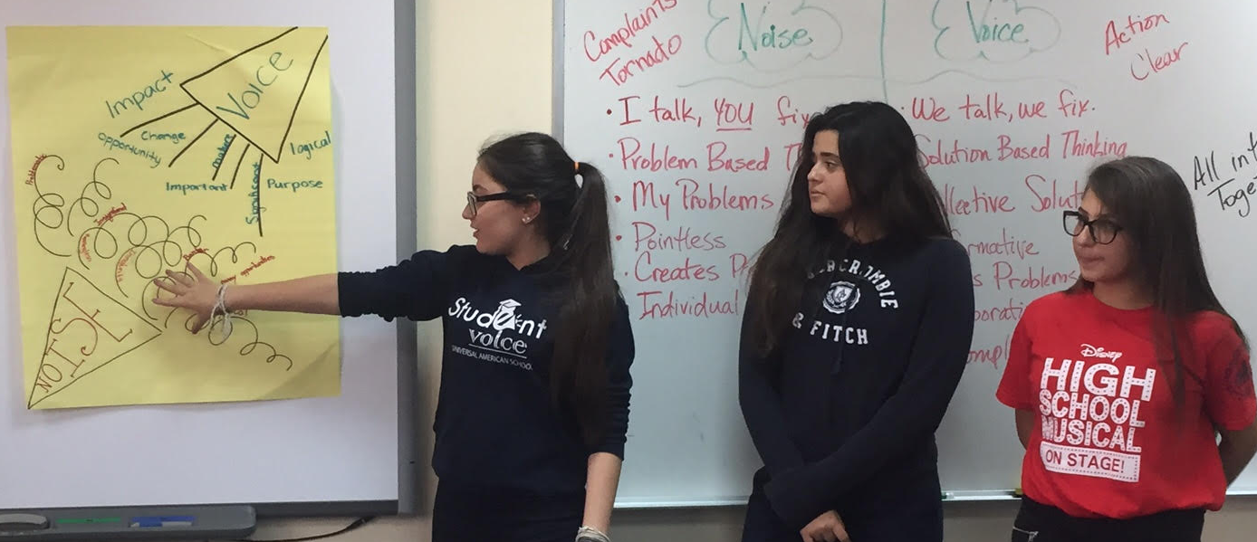
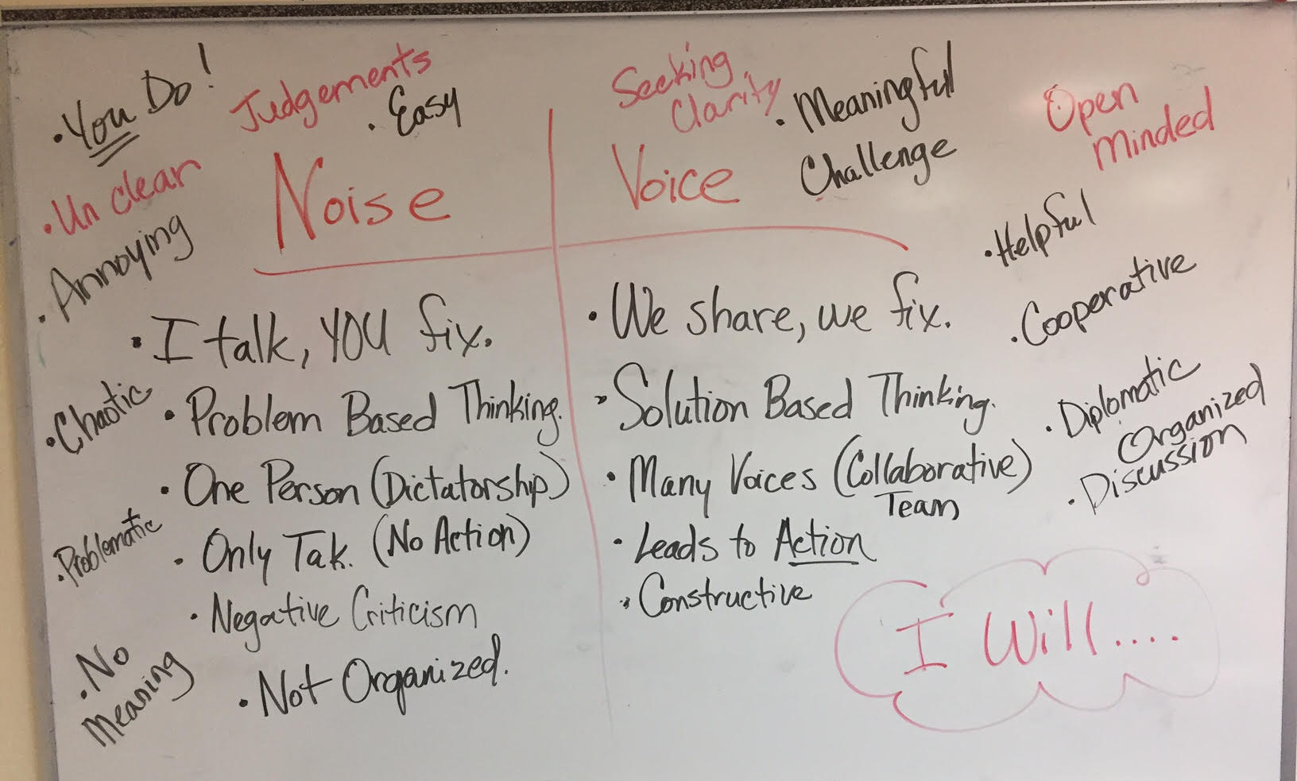
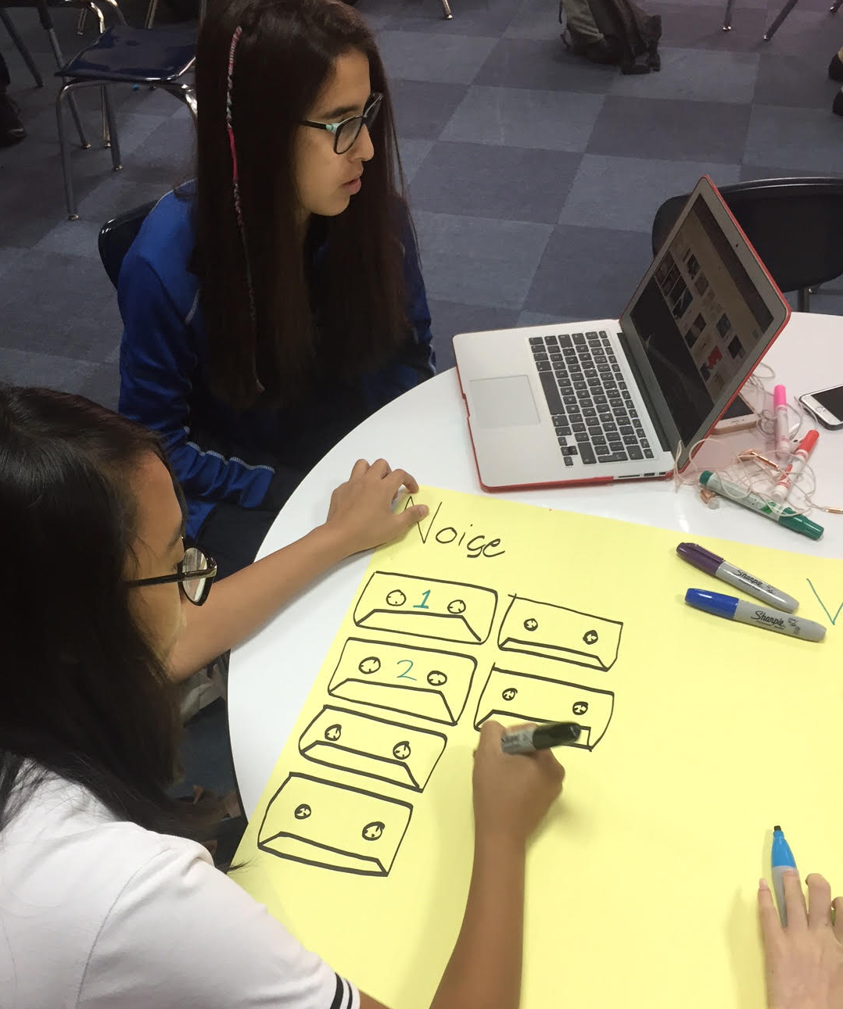

Slide 30
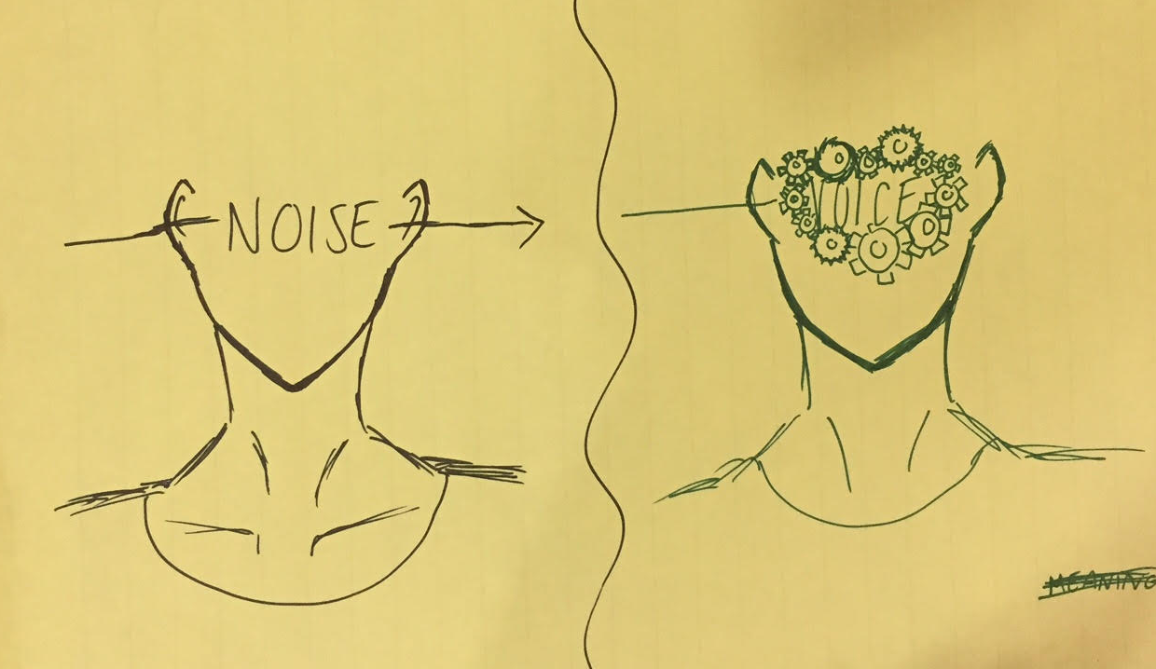
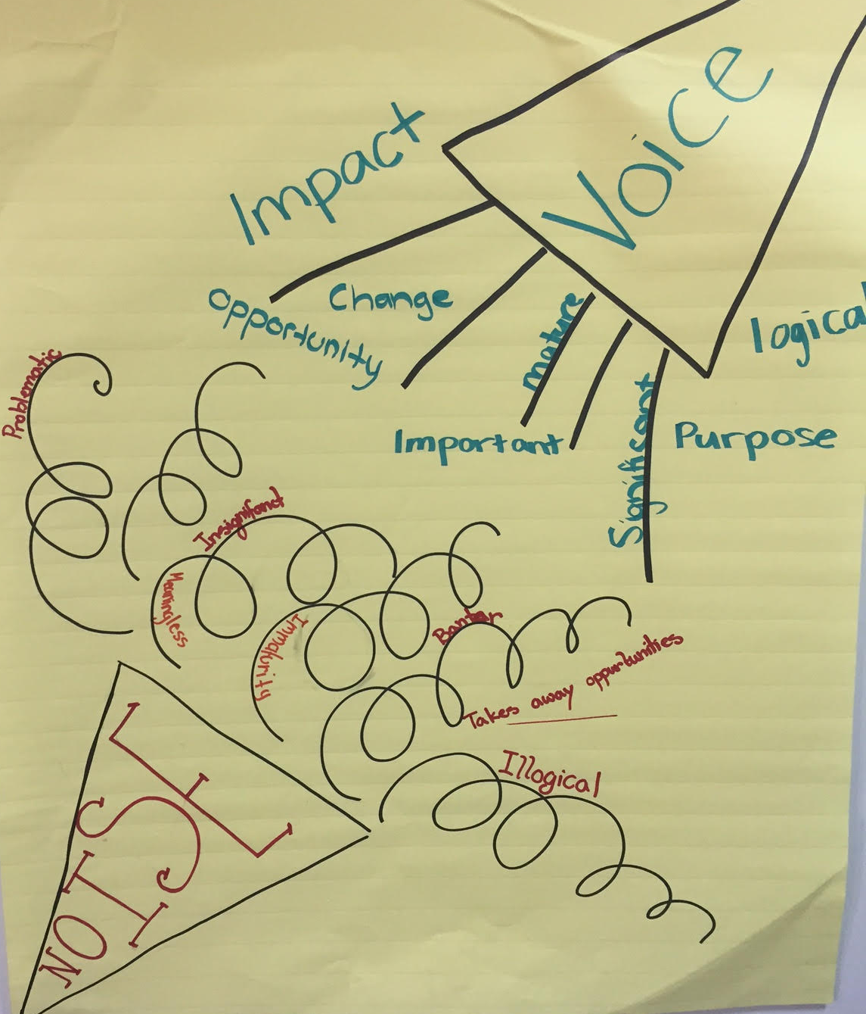

Slide 31
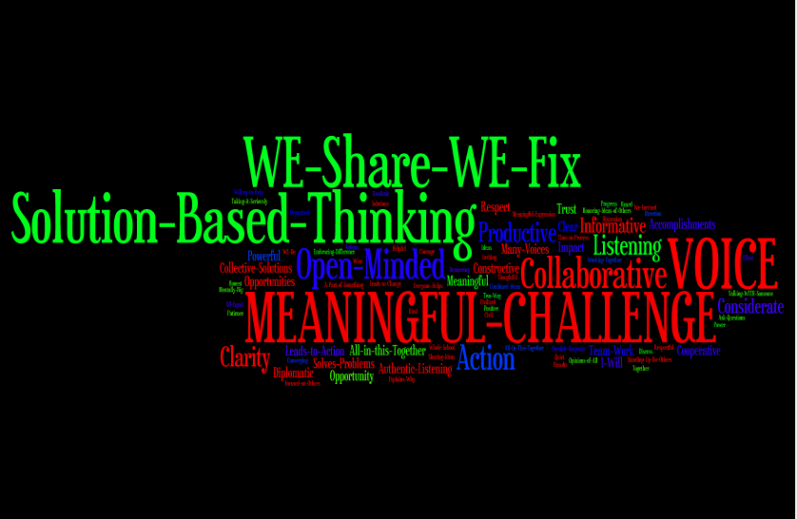

Slide 32
Students Control the Volume
Voice Inhibitors
Anger/extreme emotion
Rhetoric
Volume/Tone
Close Minded
Self-Serving
Voice Amplifiers
Authenticity/Genuineness
Knowledge
Refocus, Reanalyze, Readjust
Relentless
Being a “student”

Slide 33
Reflect
What skills do your students need for their voices to be heard?

Slide 34
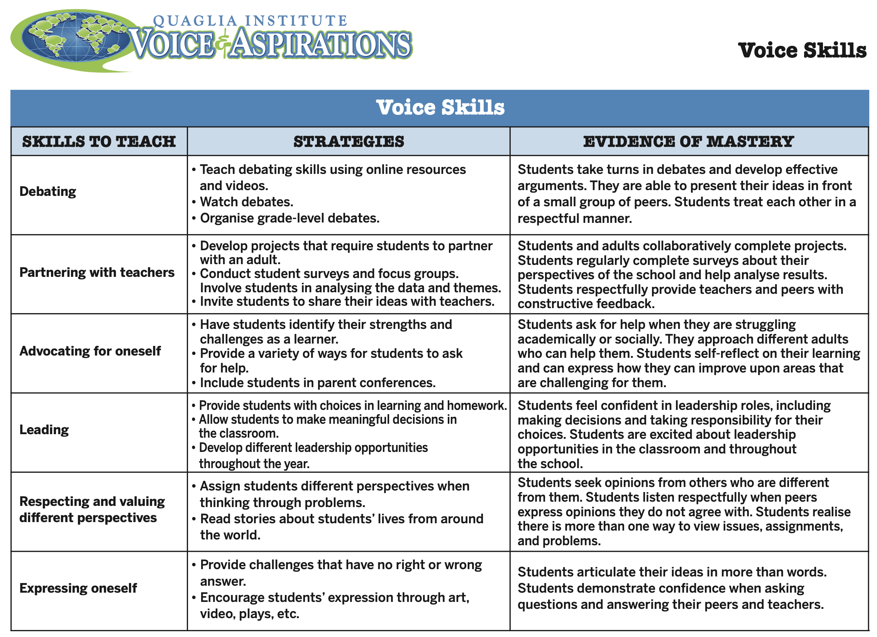

Slide 35
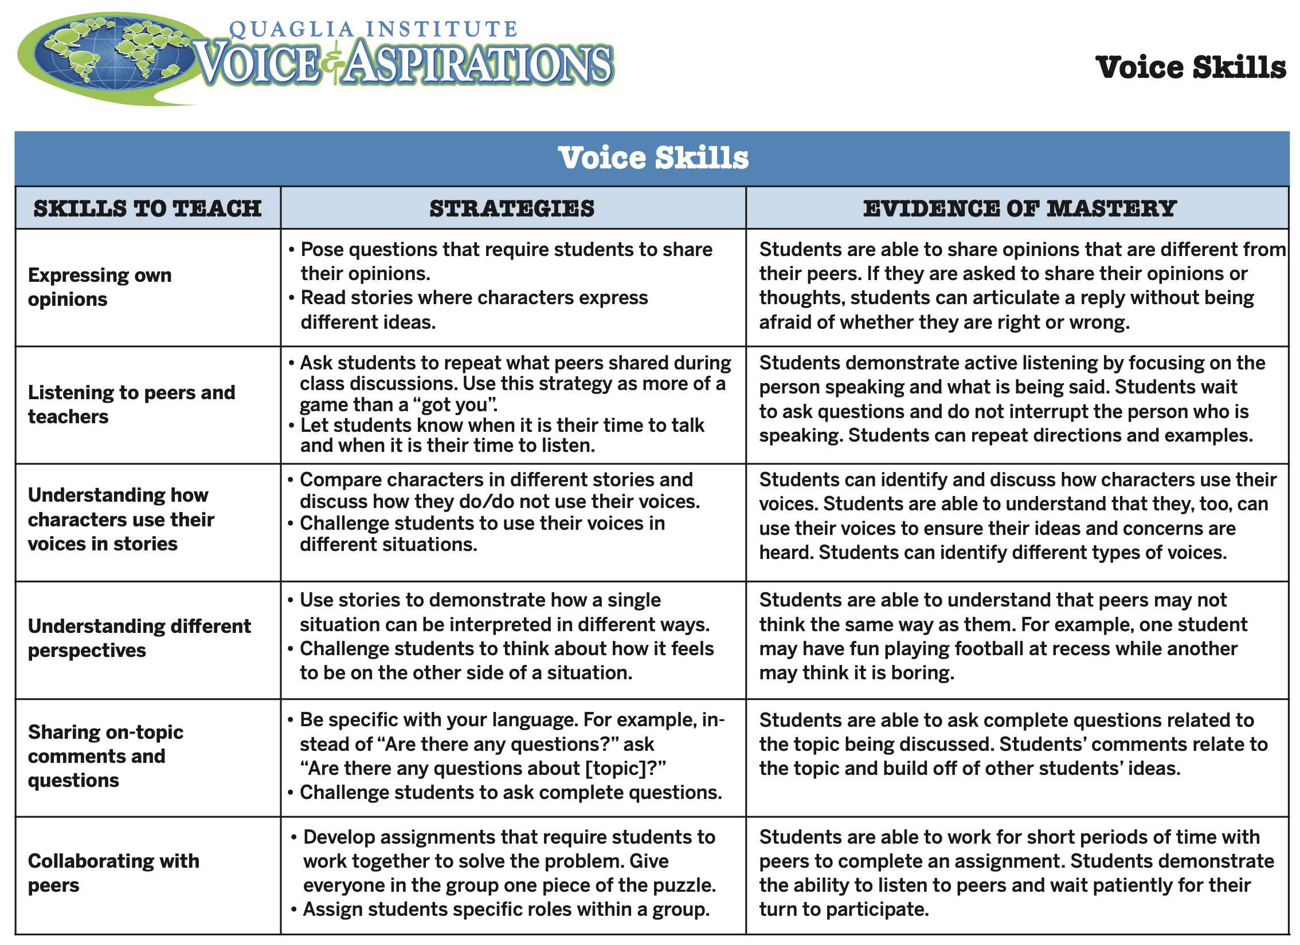

Slide 36



Slide 37

Voice Implementation

Slide 38

Lunch!

Slide 39
Voice Implementation

Slide 40
Where do we
go next?
Aspirations Profile: Balancing
Dreaming & Doing
Student Voice Process: Listen,
Learn, Lead
Aspirations Framework:
Self-Worth, Engagement, Purpose
Systems Thinking for Sustainable Change

Slide 41
RESOURCES

Slide 42
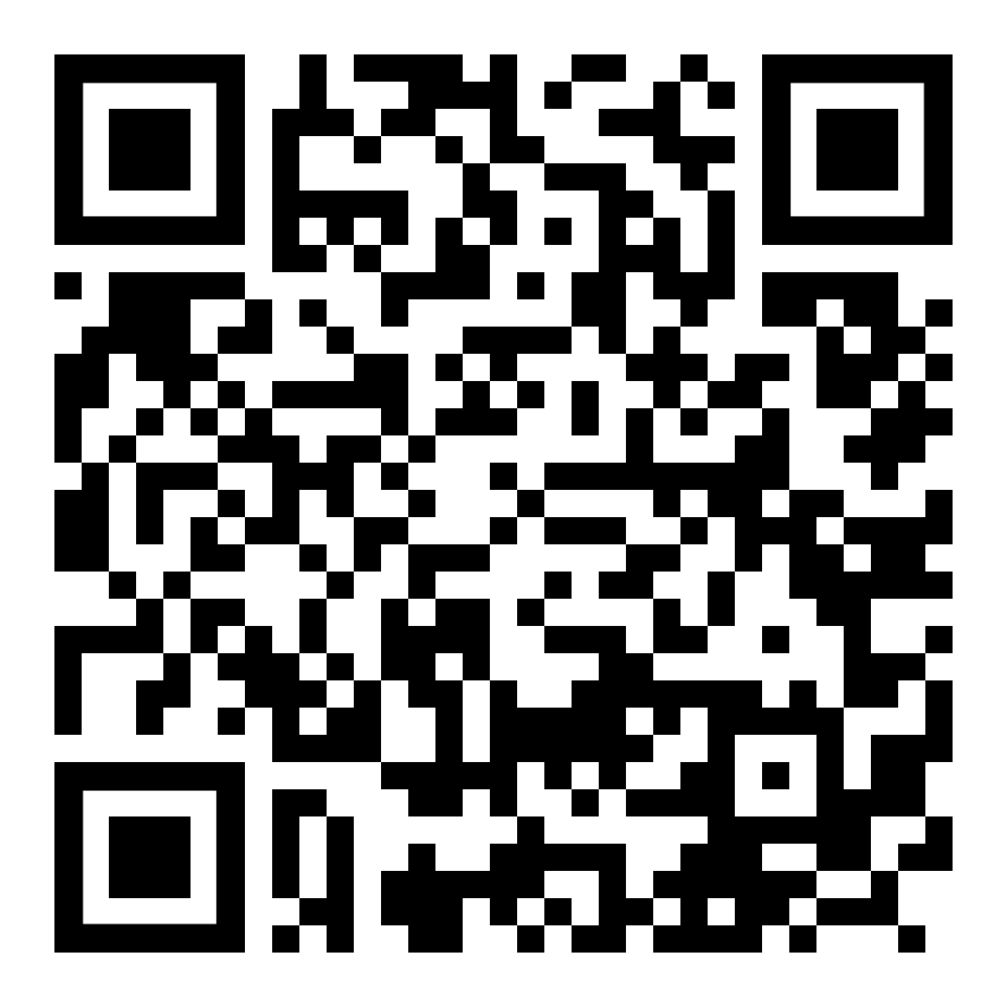
Website Just For YOU!
https://quagliainstitute.org/qisva-lausd-schools-of-action

Slide 43

What is your key take away from today’s session you can share with colleagues &/or students?

Slide 44

What is your key take away from today’s session you can share with colleagues &/or students?

Slide 45
Thank you for the opportunity to learn together today!
Dr. Lisa Lande
lande@quagliainstitute.org
@Lisa_Lande

