Slide 1
STUDENT VOICE
HAIKU ELEMENTARY SCHOOL
“The Little School with a Big Heart”
2024-2025

Slide 2
Conditions of Student Voice
K
1
2
3
4
5
While Haiku is working to implement all 8 Conditions as part of our way of being, grade level teams identified which of the 8 Conditions they wanted to specifically focus on this school year.
KINDERGARTEN
FIRST GRADE
Fun & Excitement
Fun & Excitement
SECOND GRADE
THIRD GRADE
Curiosity & Creativity
Sense of Accomplishment
FOURTH GRADE
FIFTH GRADE
My Voice, Belonging, Heroes, Spirit of Adventure, Sense of Accomplishment
Voice & Choice, Creating a Community of Ownership

Slide 3
Our Findings After Implementing Student Voice
In our first year of full schoolwide implementation,
we improved on 31 of the 50 Student Voice Survey statements.
The following are some of our top areas of growth.
Students respect teachers. 29.7% to 43.9% (14.2% growth)
My teacher tealls my parents when I do well in school. 54.3% to 64.4% (10.1% growth)
Students help make classroom rules. 50% to 59.5% (9.5% growth)
The things I learn in school are important to me. 64.2% to 73.2% (9% growth)
It is important to follow rules. 85.8% to 94.6% (8.8% growth)
I like what I learn at school. 51.5% to 59.7% (8.2% growth)
I give my best effort at school. 77.9% to 85.2% (7.3% growth)
I am a good decision maker. 41.5% to 29.3% (7.7% growth)
I work hard in school. 73.2% to 80.9% (7.5% growth)

Slide 4
Kindergarten
FUN & EXCITEMENT
What do we mean by Fun & Excitement?
Enjoying what you are doing, whether at home, school, or play!
Jokes are fun!
Friends and Math are fun!
School is fun! Kindergarten students made a book to showcase everything they enjoy at school!

Slide 5
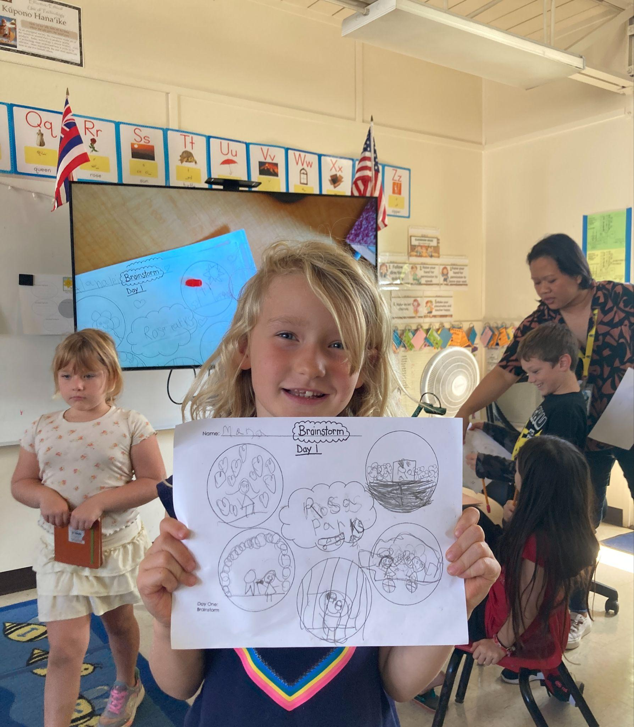
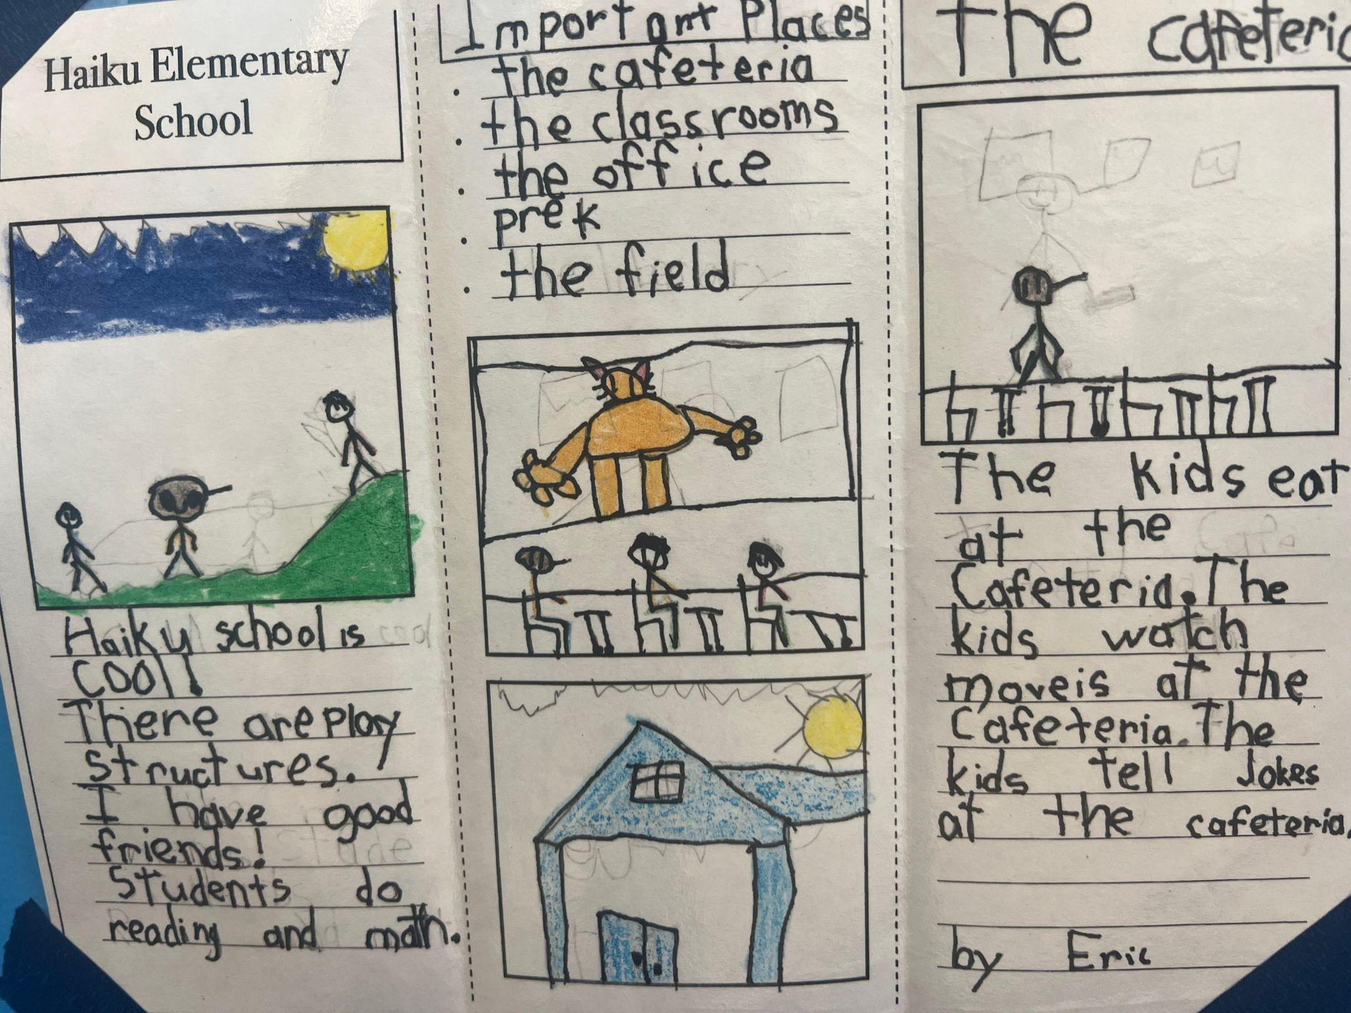
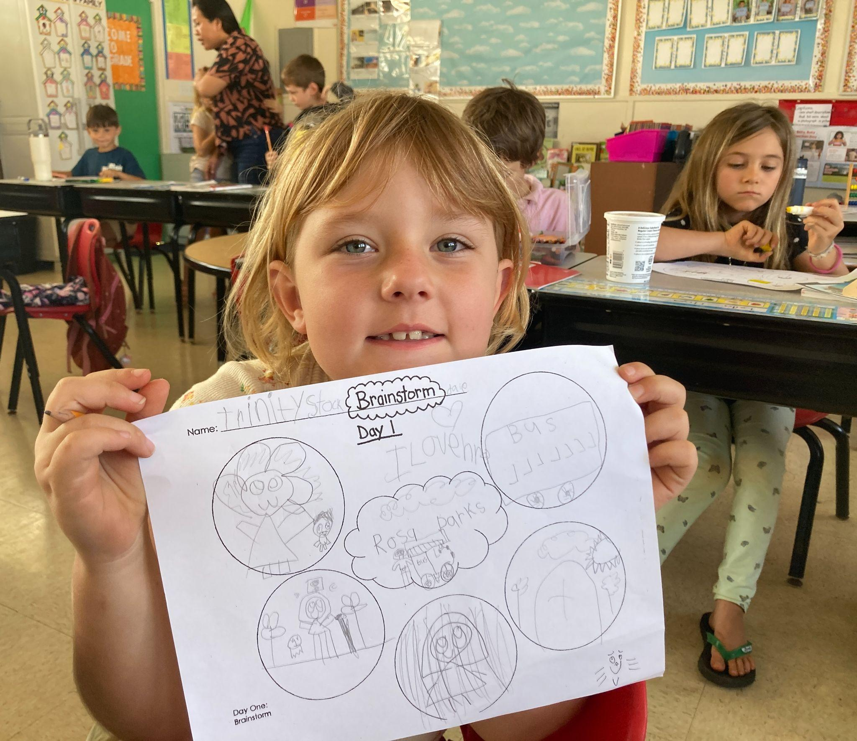
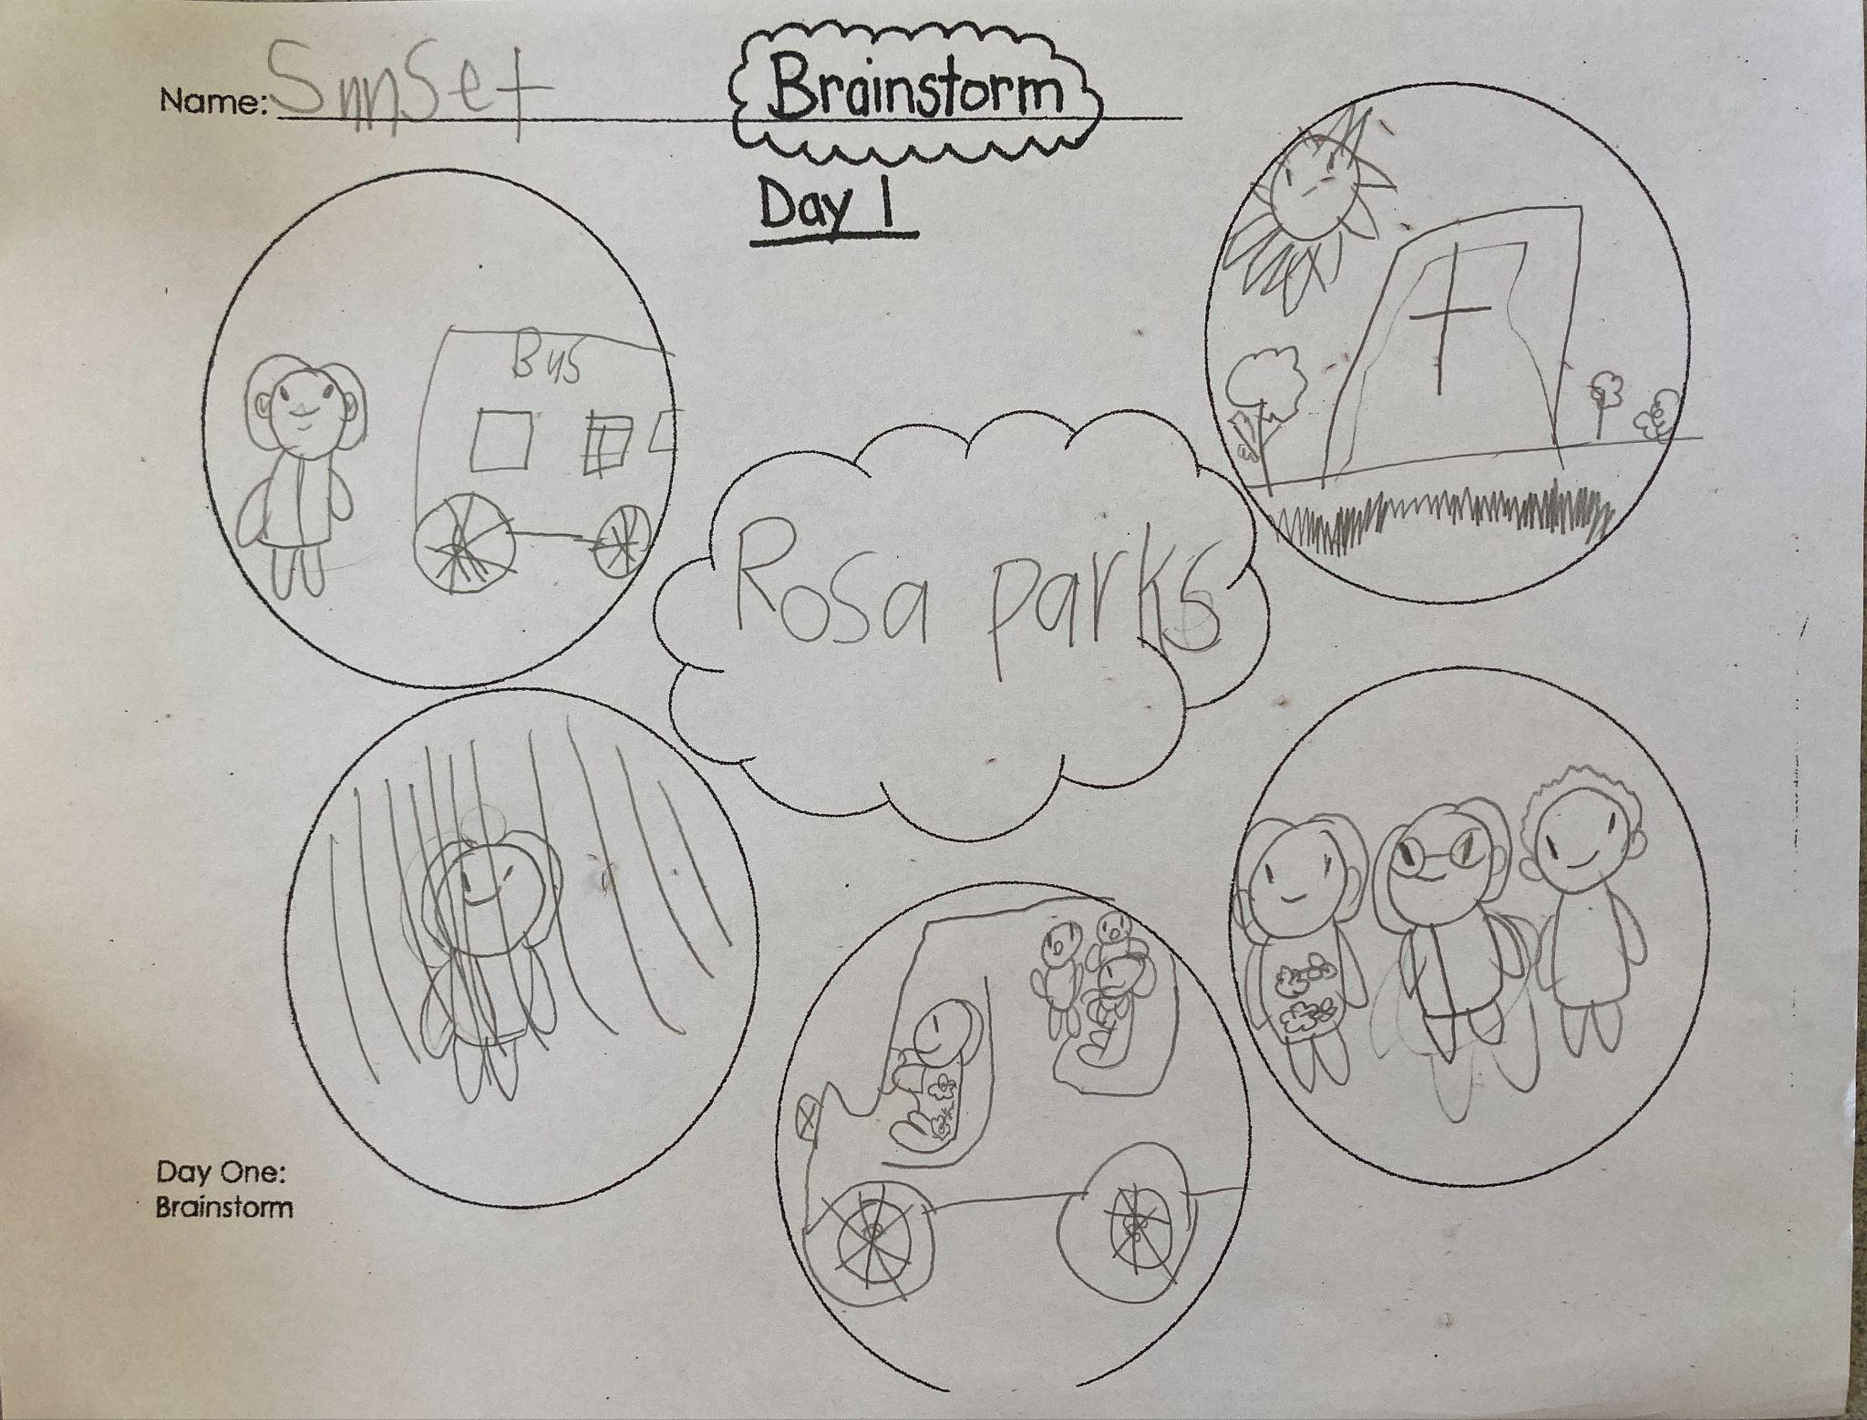
1st grade
FUN & EXCITEMENT
As part of their PBL Communities Project, students created Haiku School welcome brochures on what is fun and exciting at Haiku School, along with important places on our campus.
First Grade created Class Cheers to make ECRI more fun while learning about the condition FUN & EXCITEMENT.
Student groups made posters of what is fun in school
First graders finding joy in the things they do at school.

Slide 6
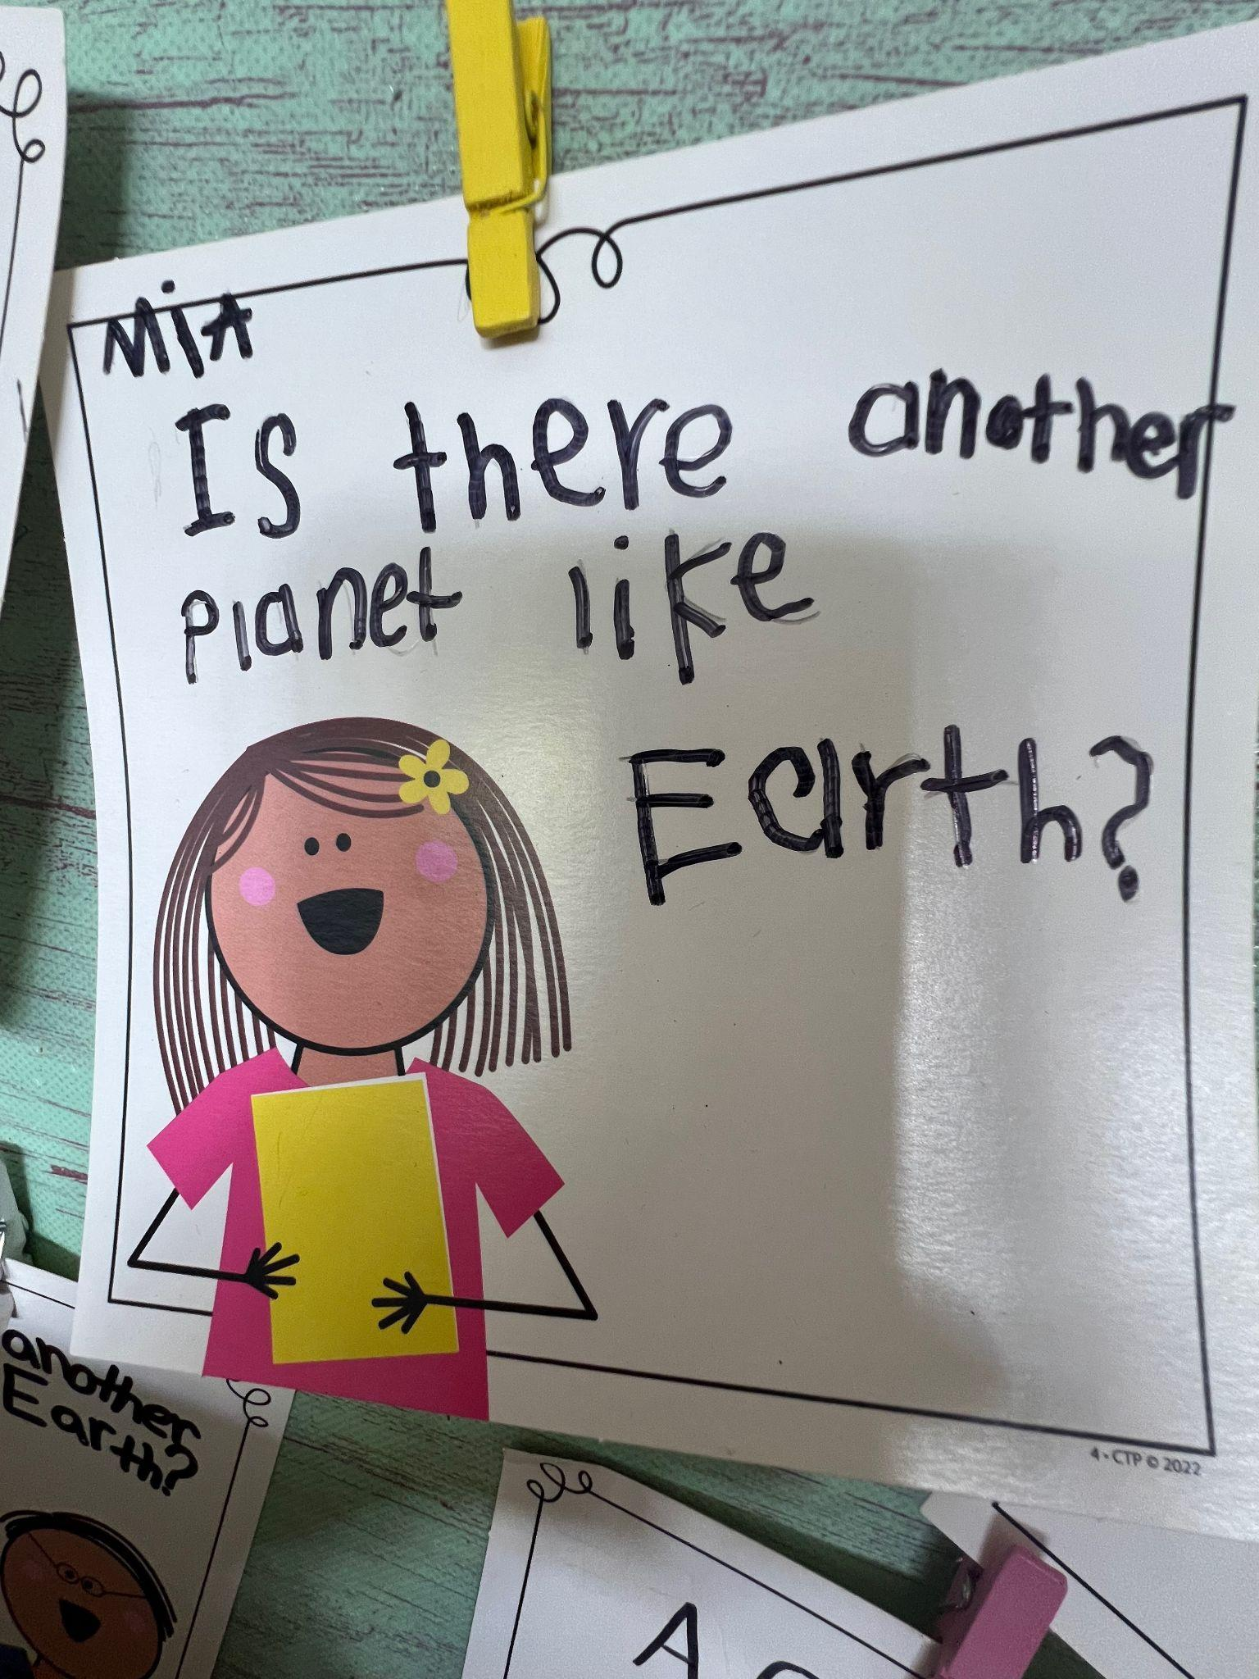
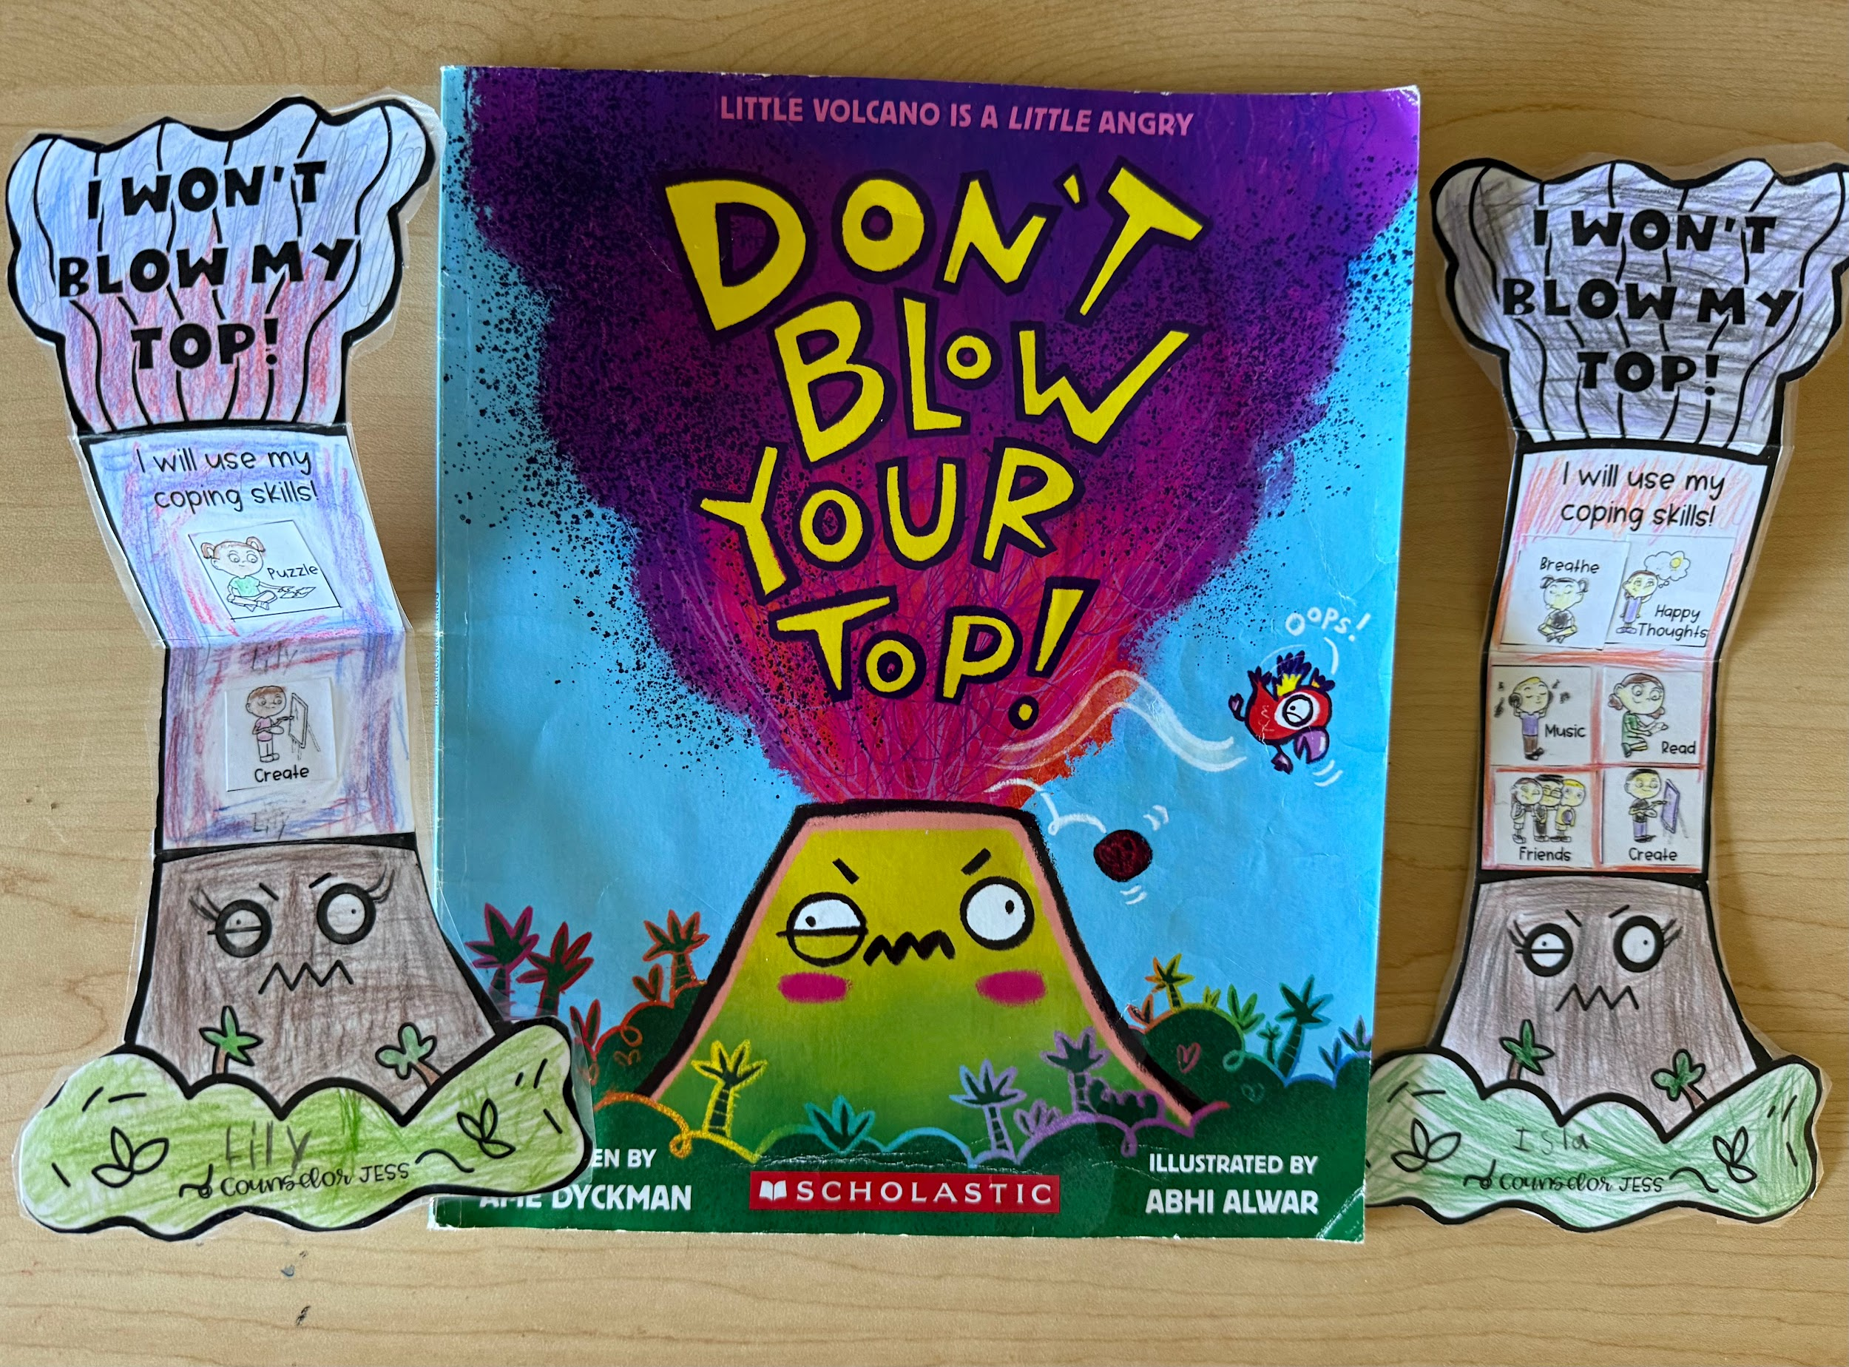
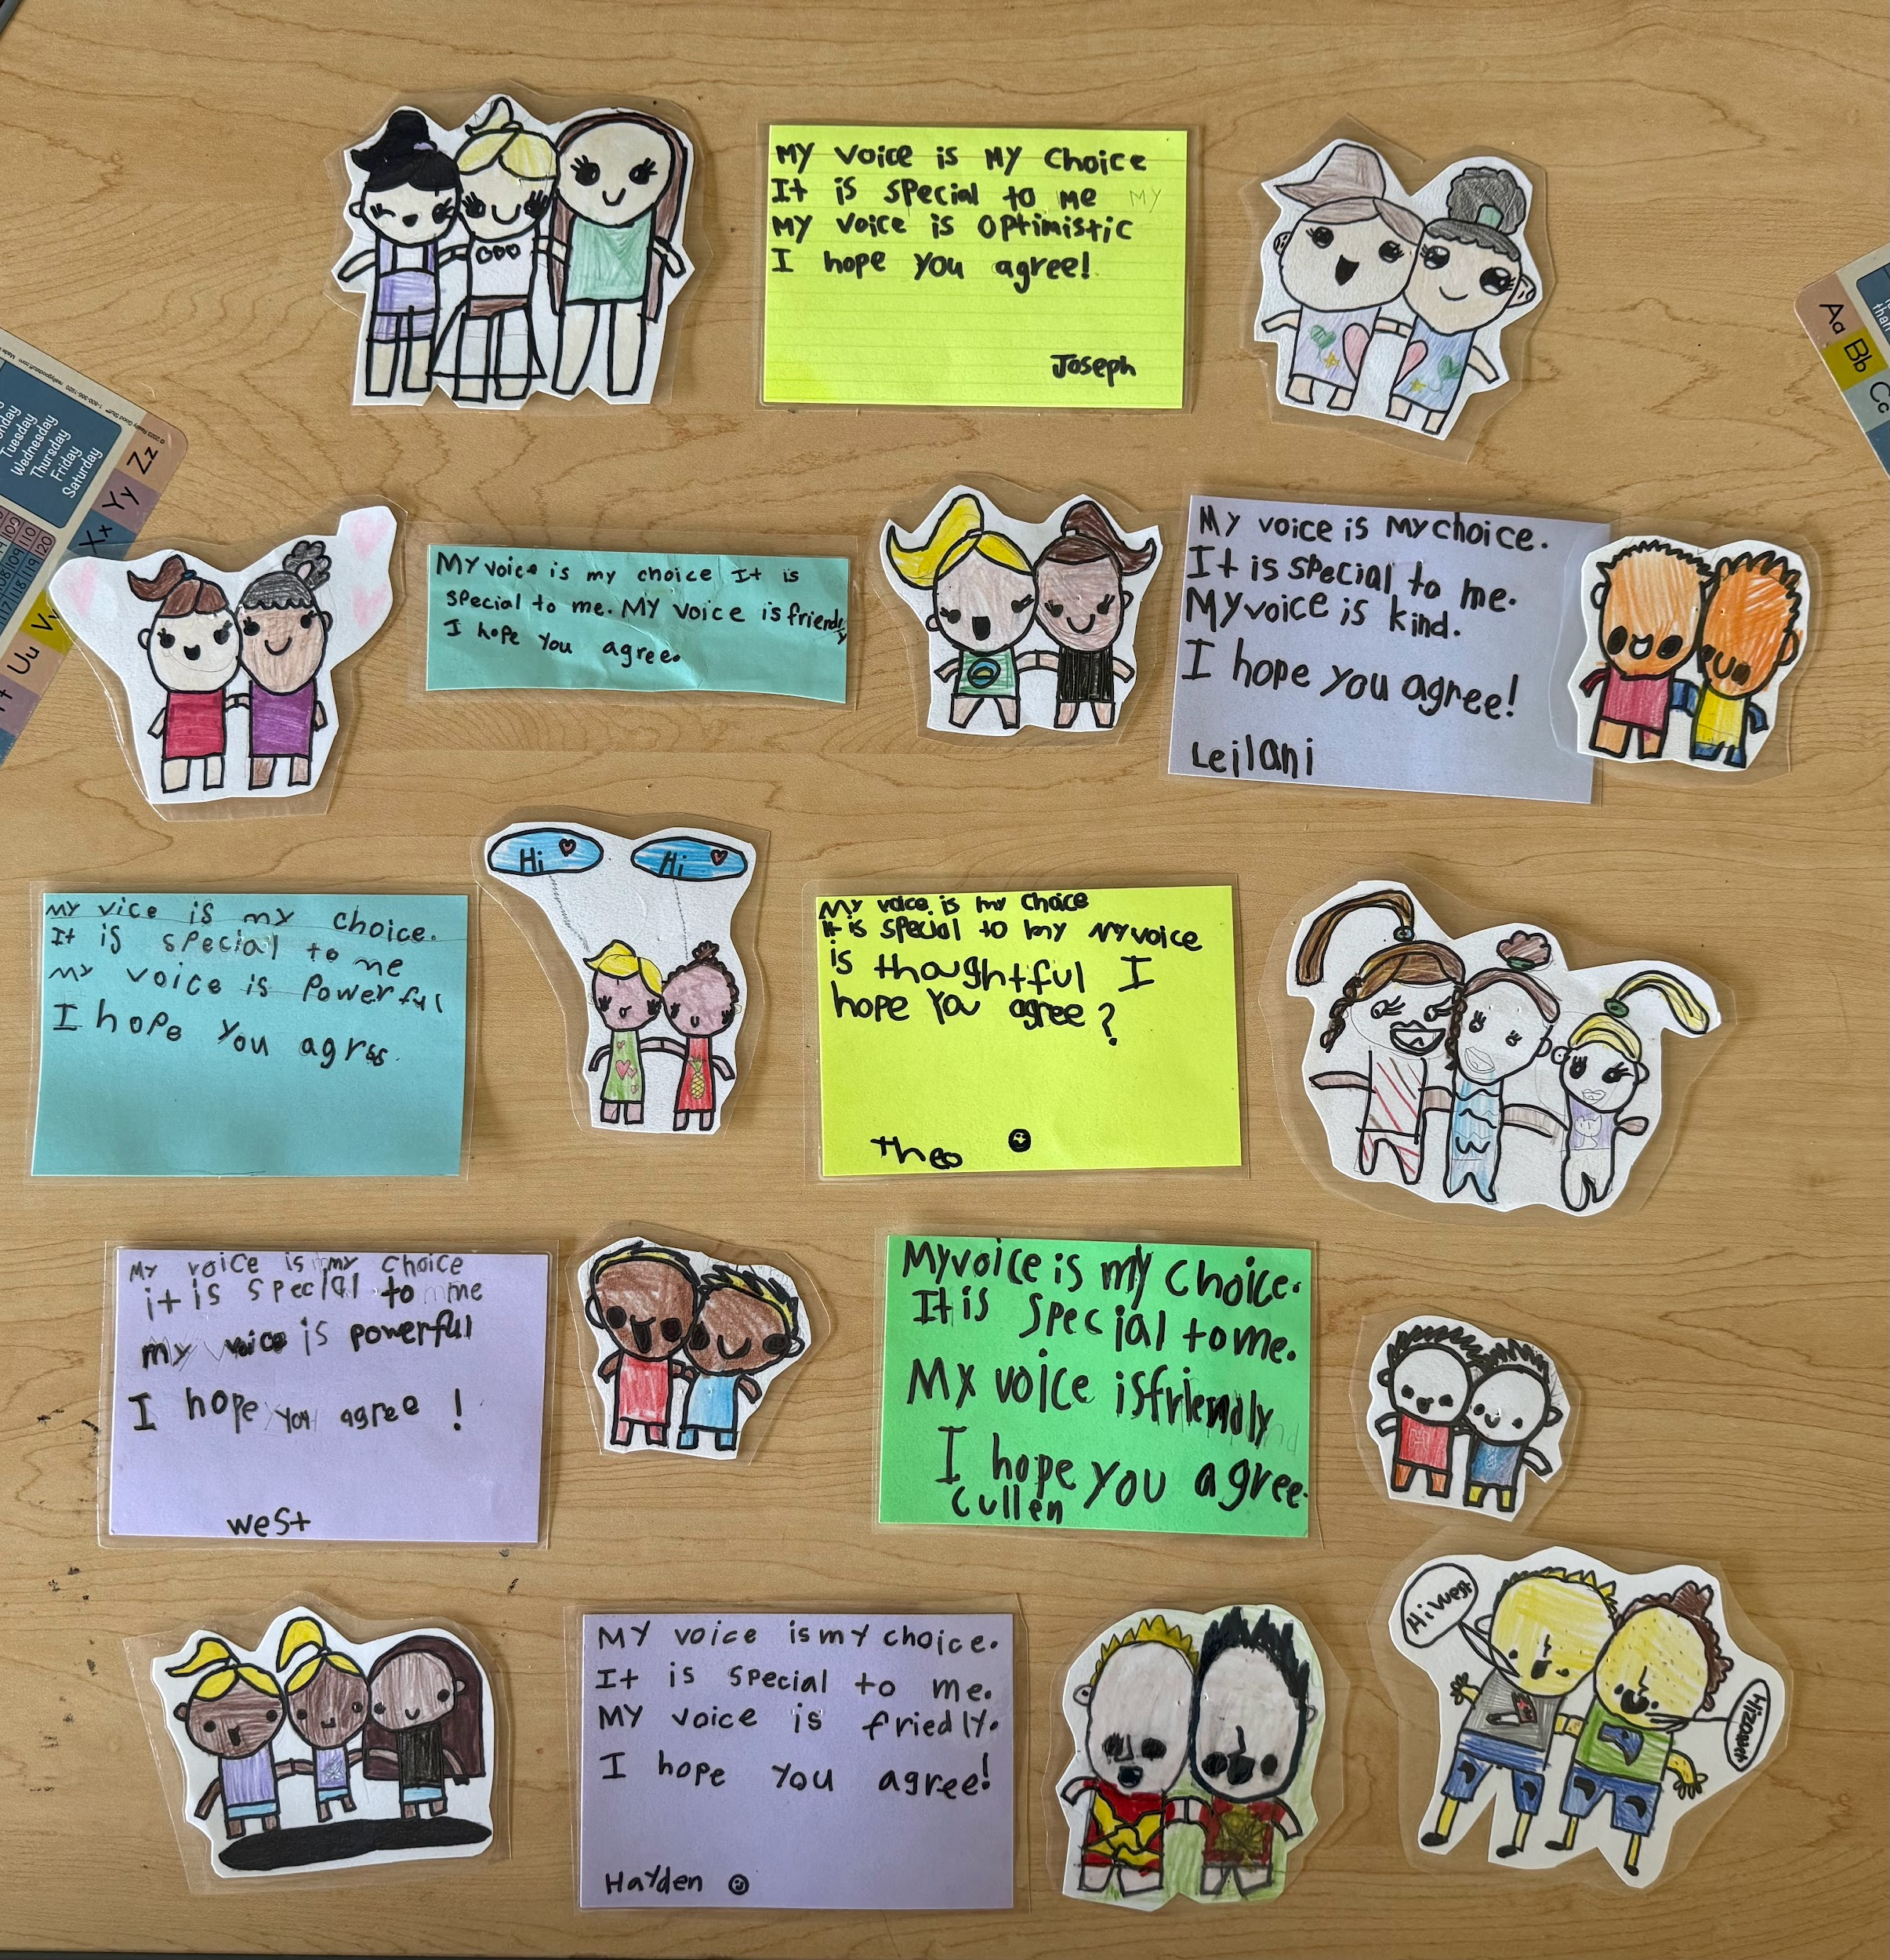
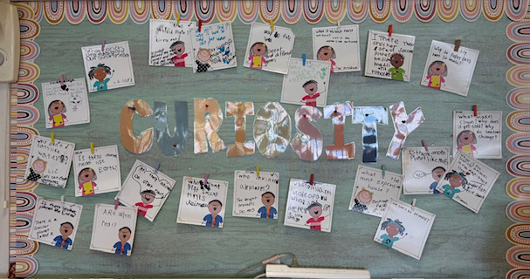
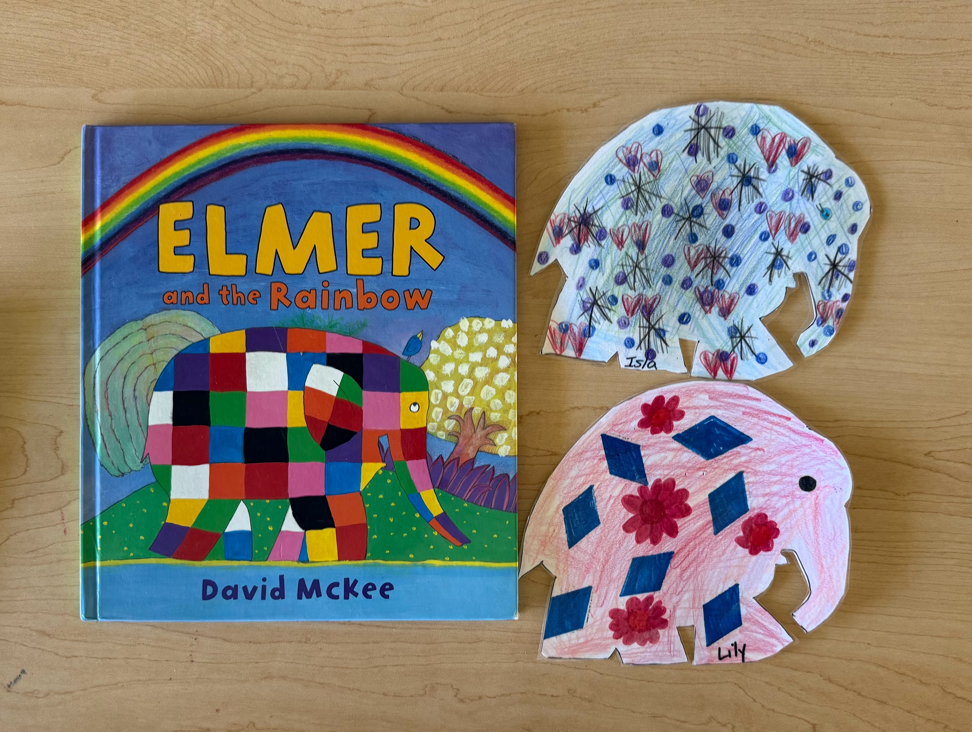
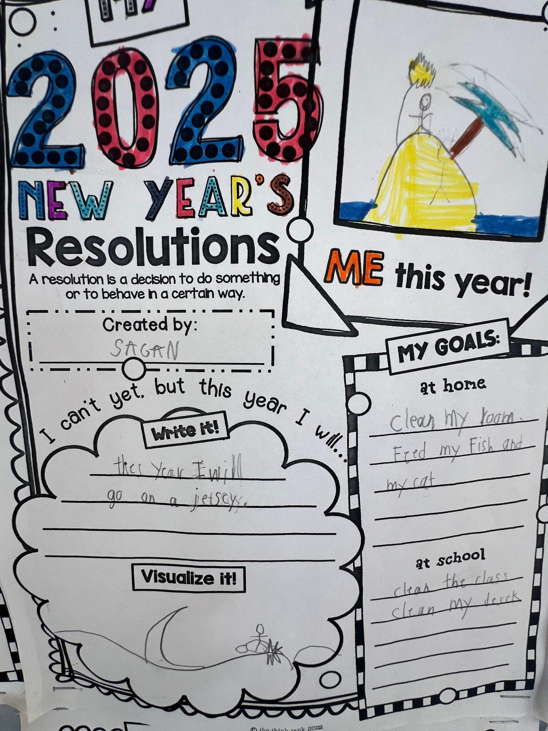
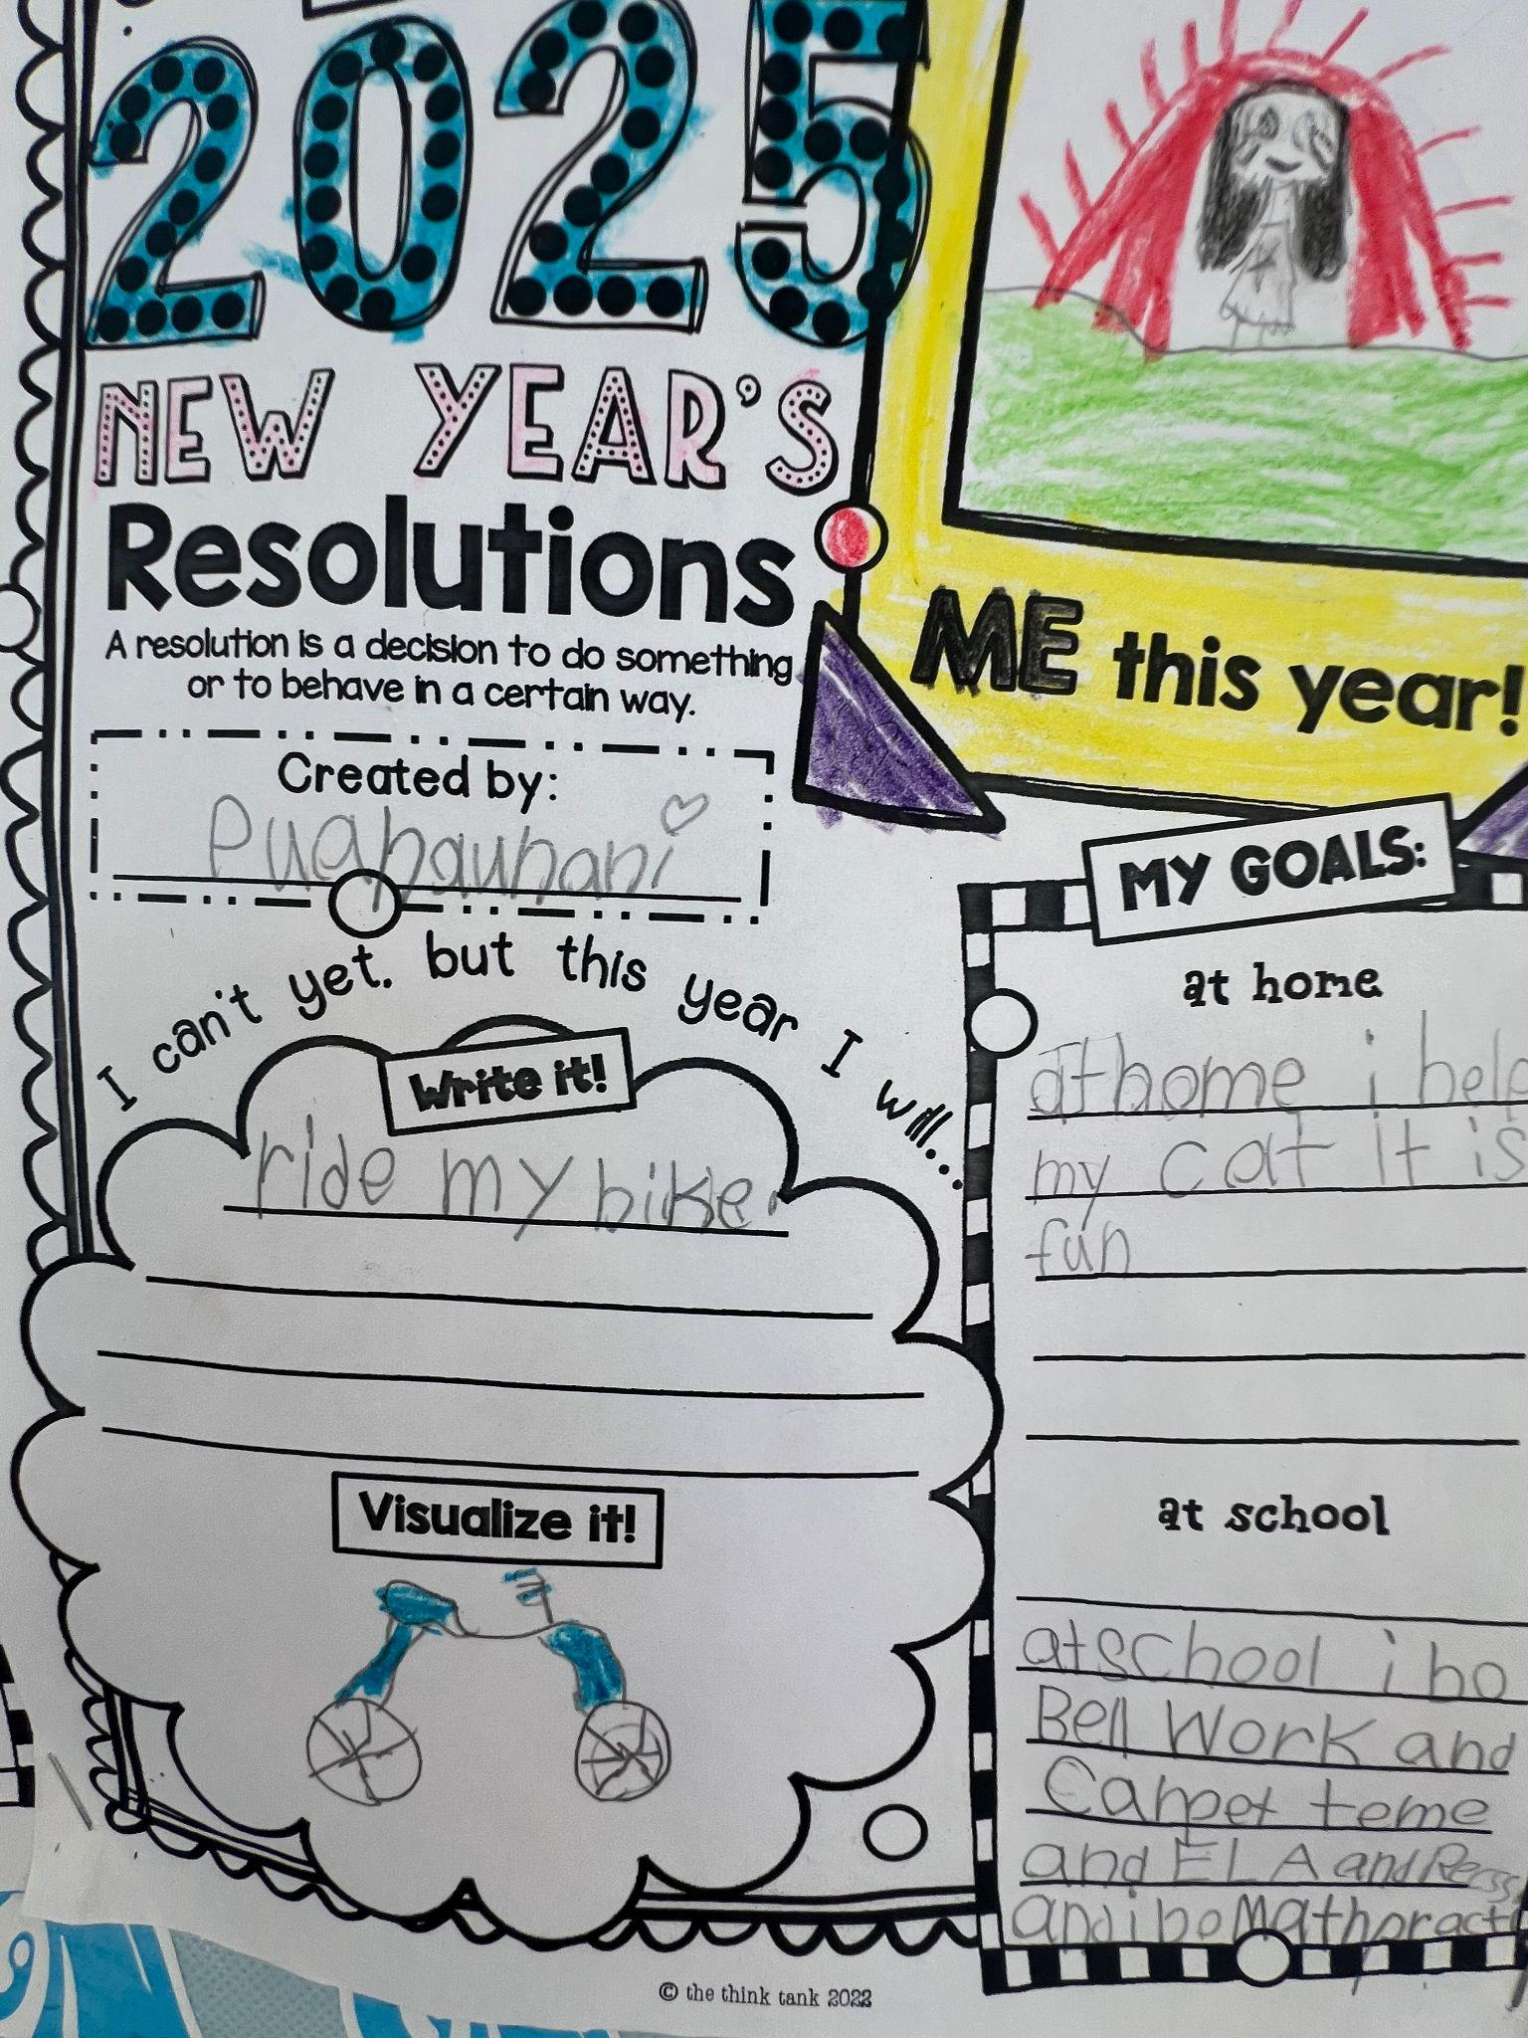
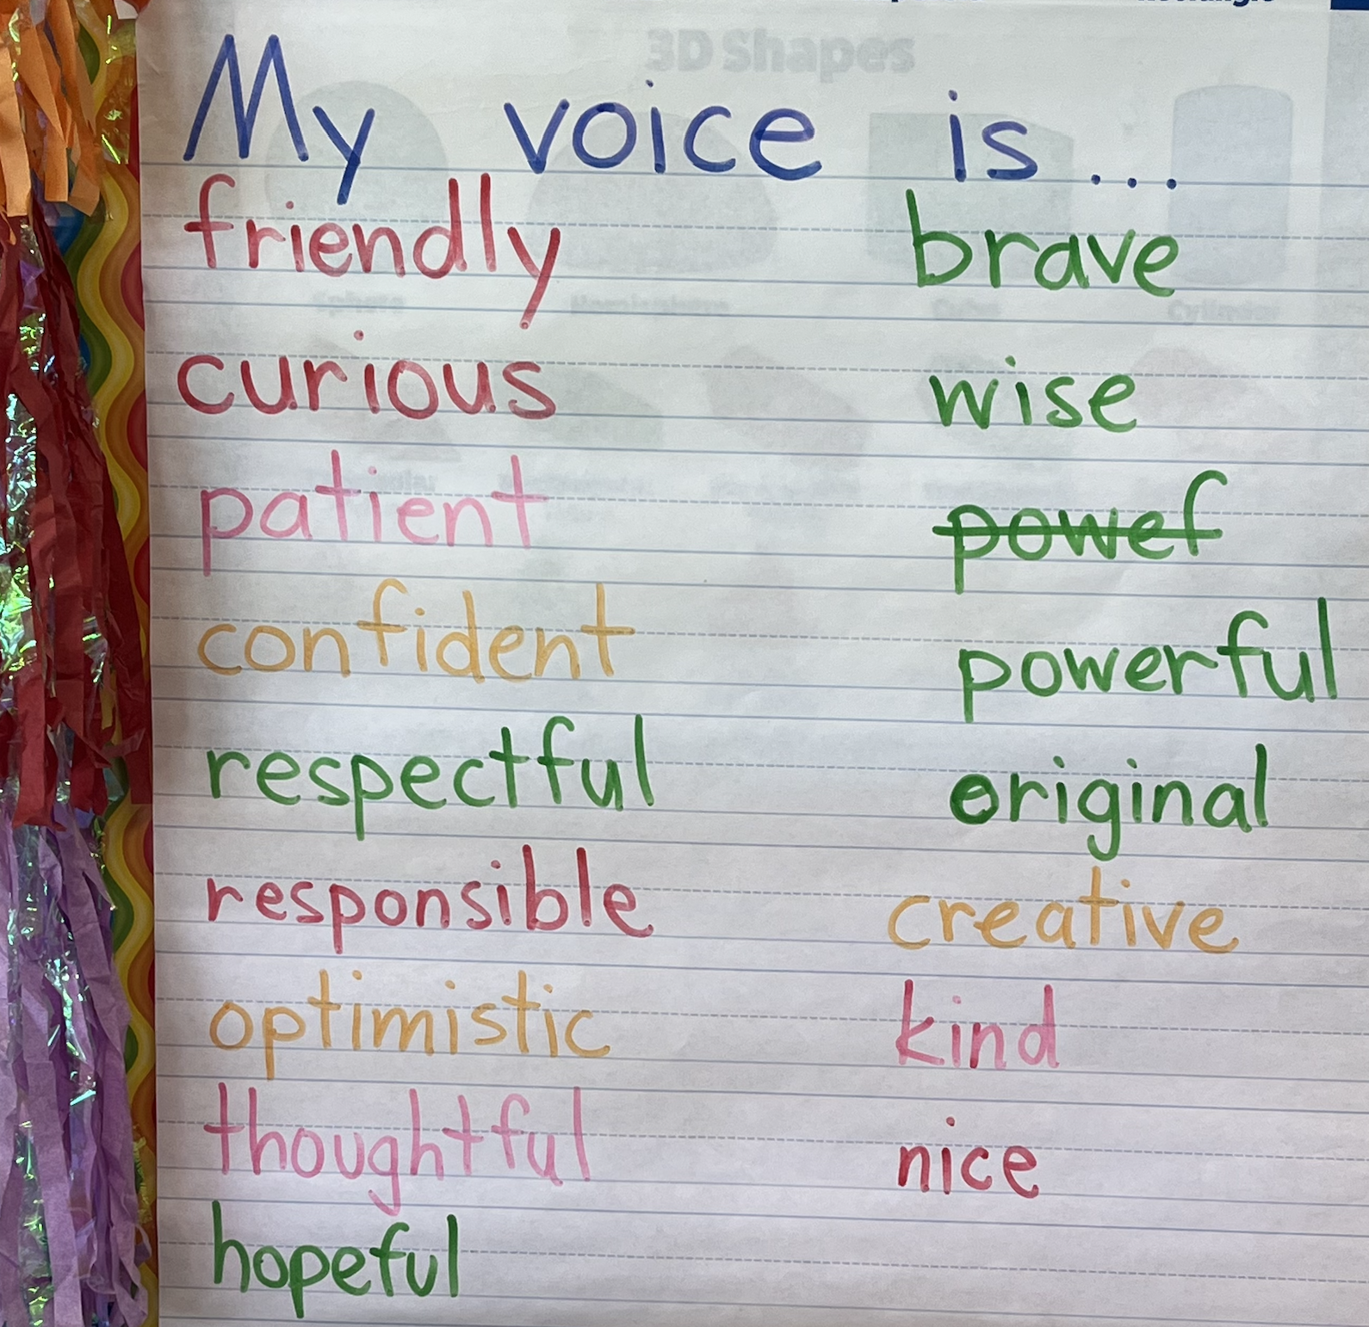
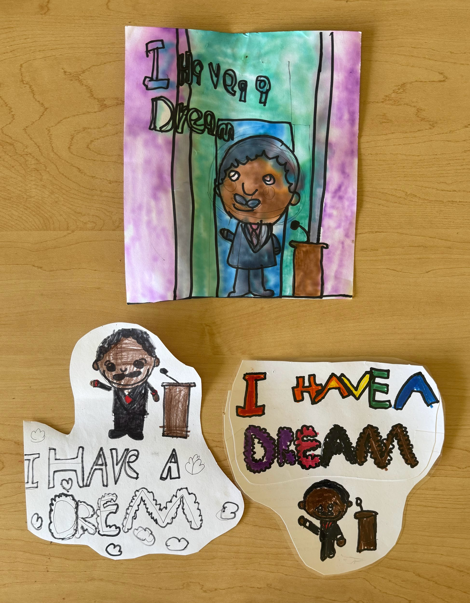
2nd grade
CURIOSITY & CREATIVITY
Anyone can be a Hero
Elmer’s story helps us connect Belonging
My voice is my choice, it is special to me
Spirit of Adventure
MLK Jr. is our Hero
Our curious second graders exploring their voices & all 8 Conditions.

Slide 7
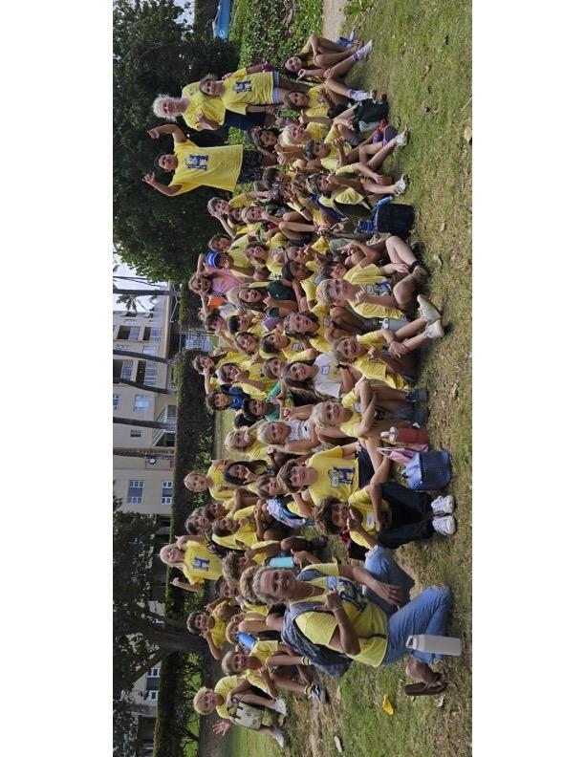
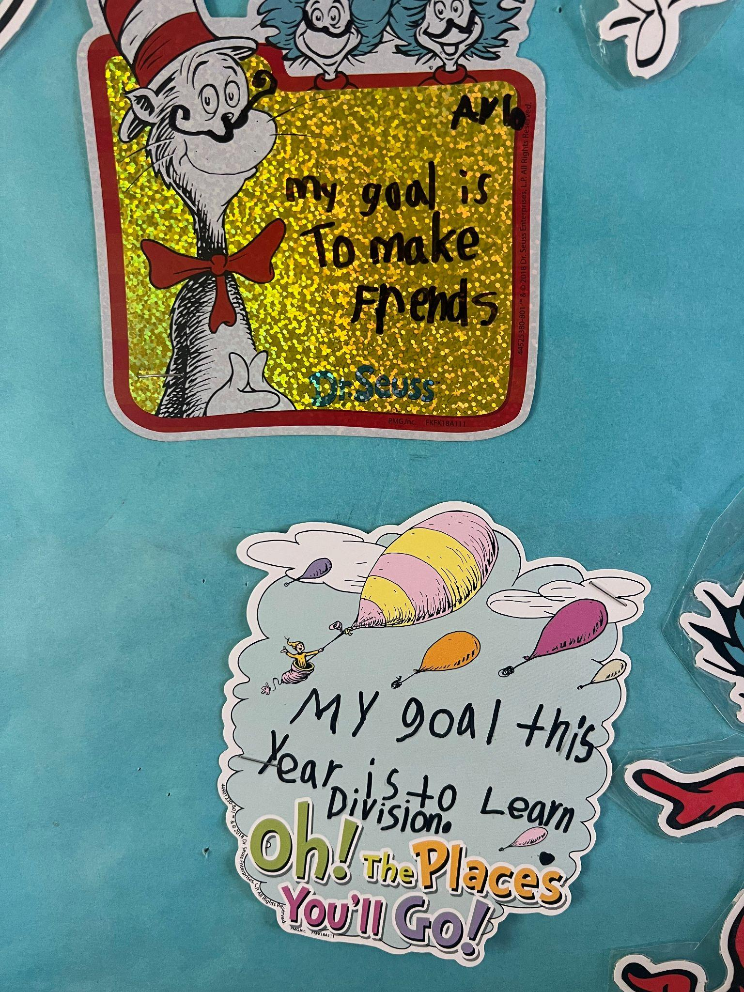
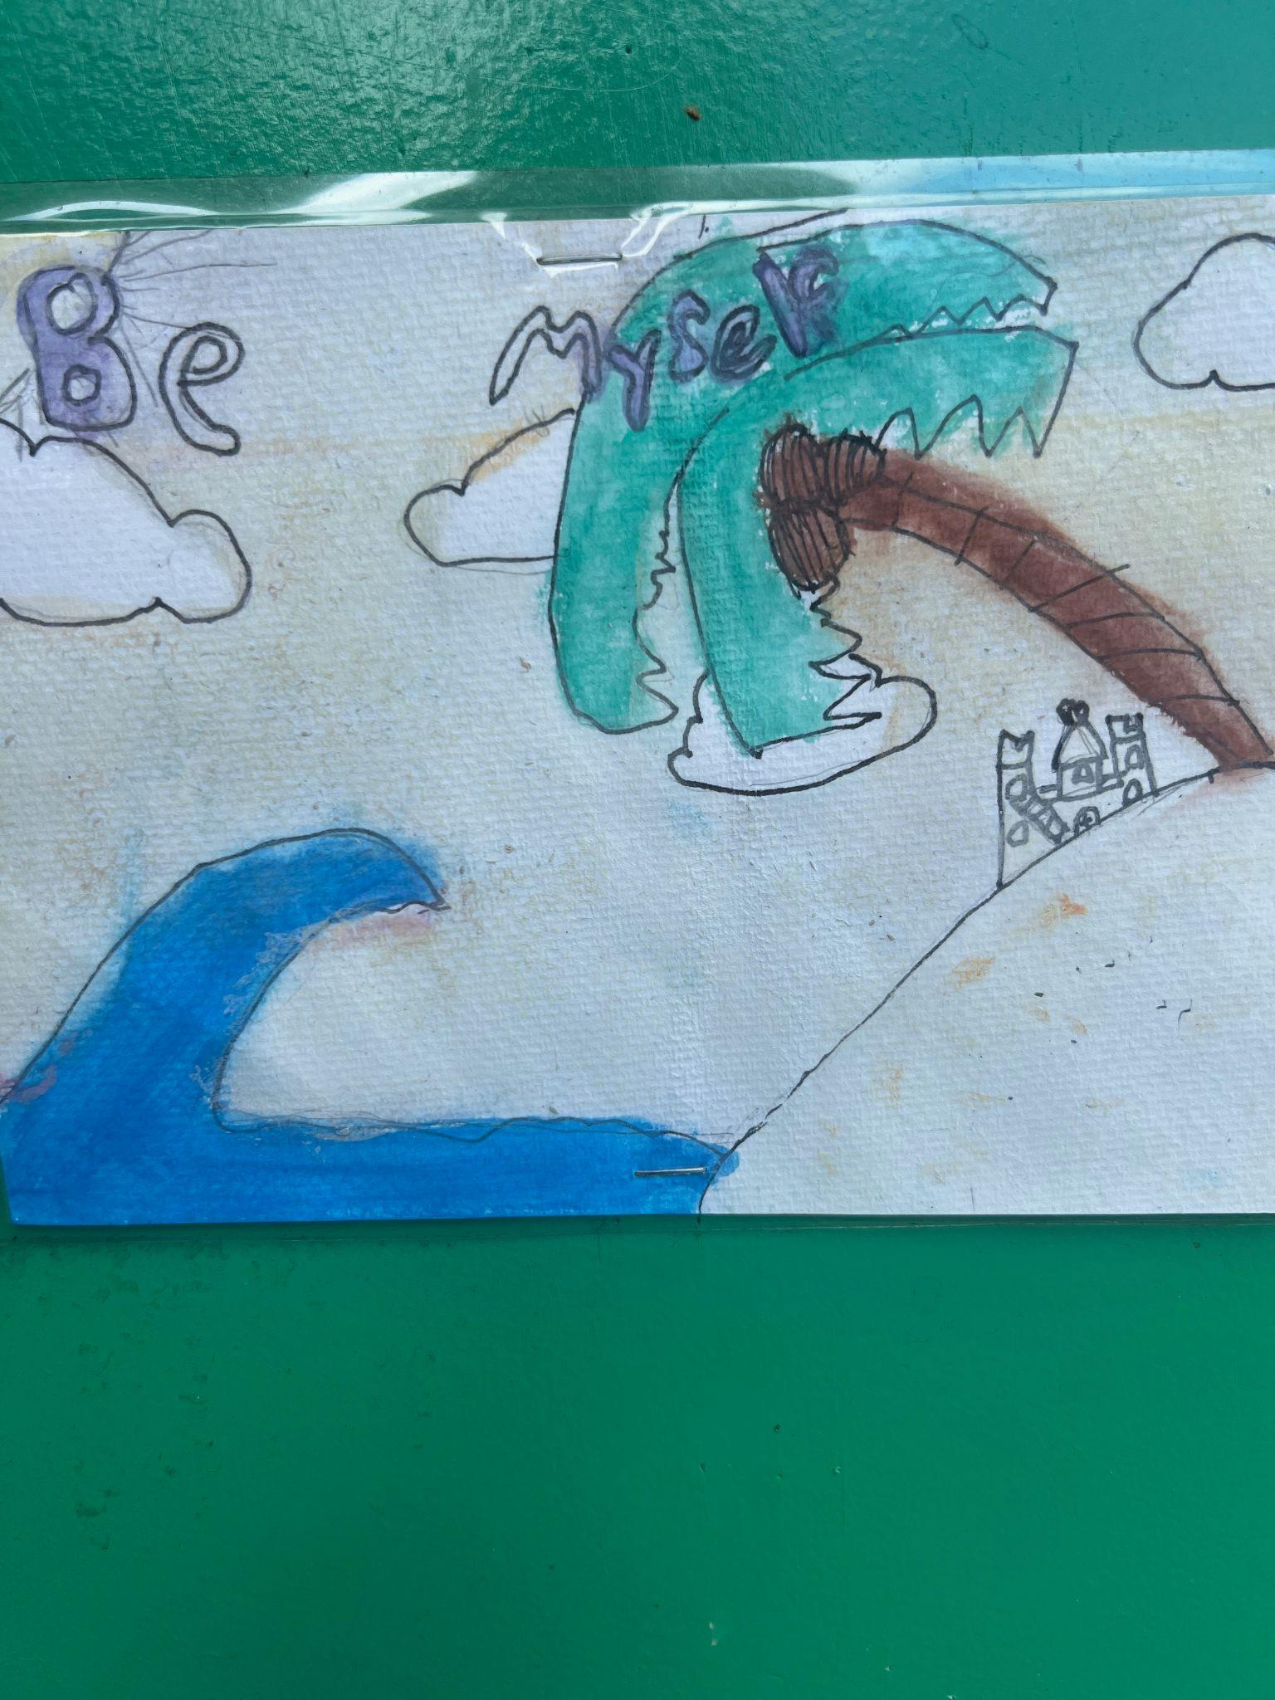
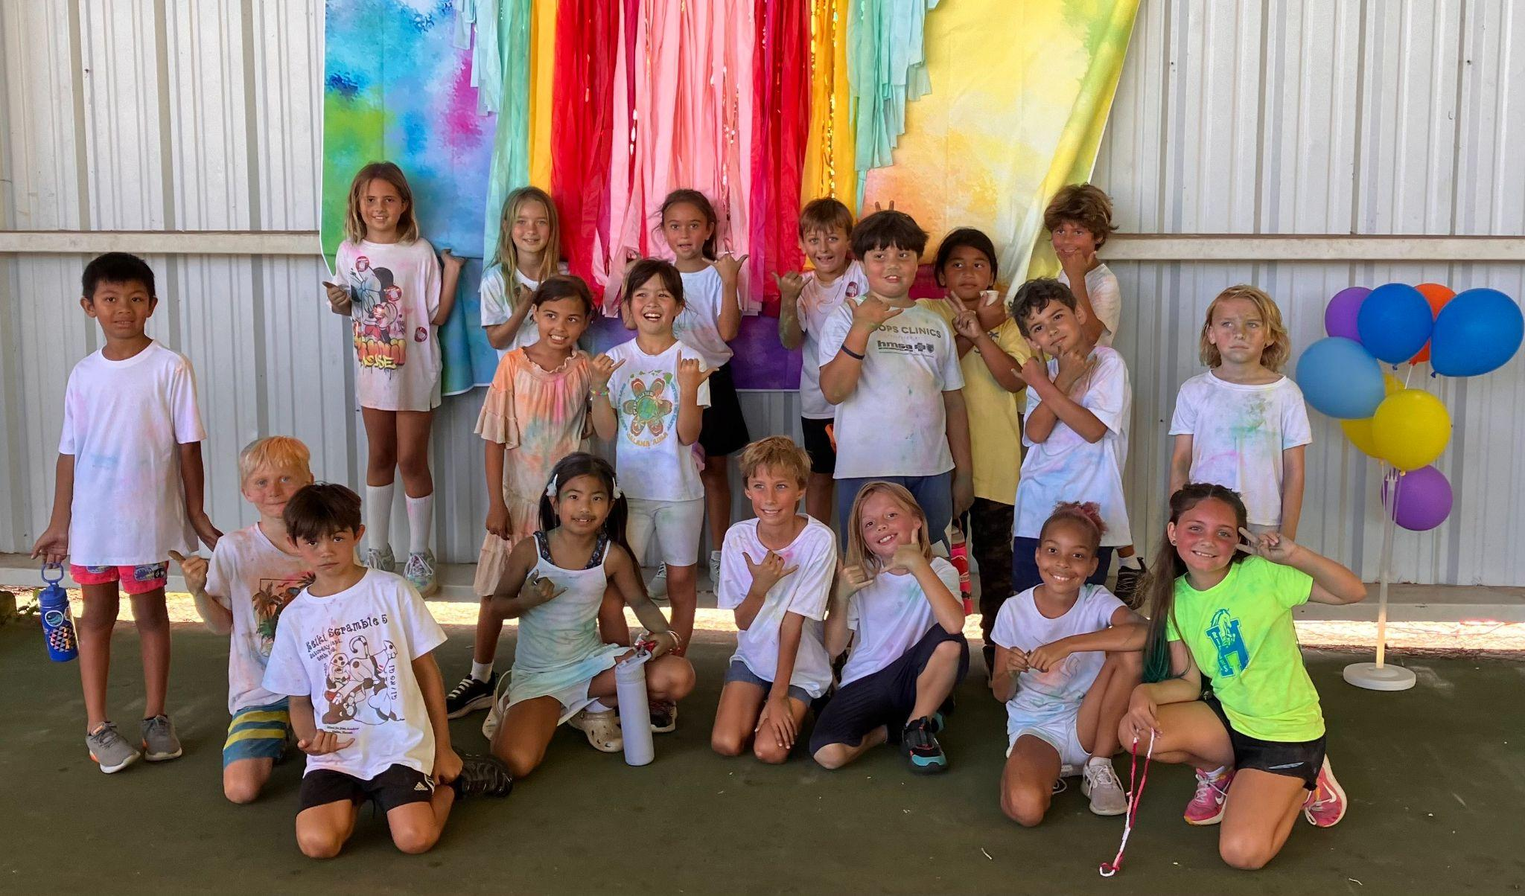
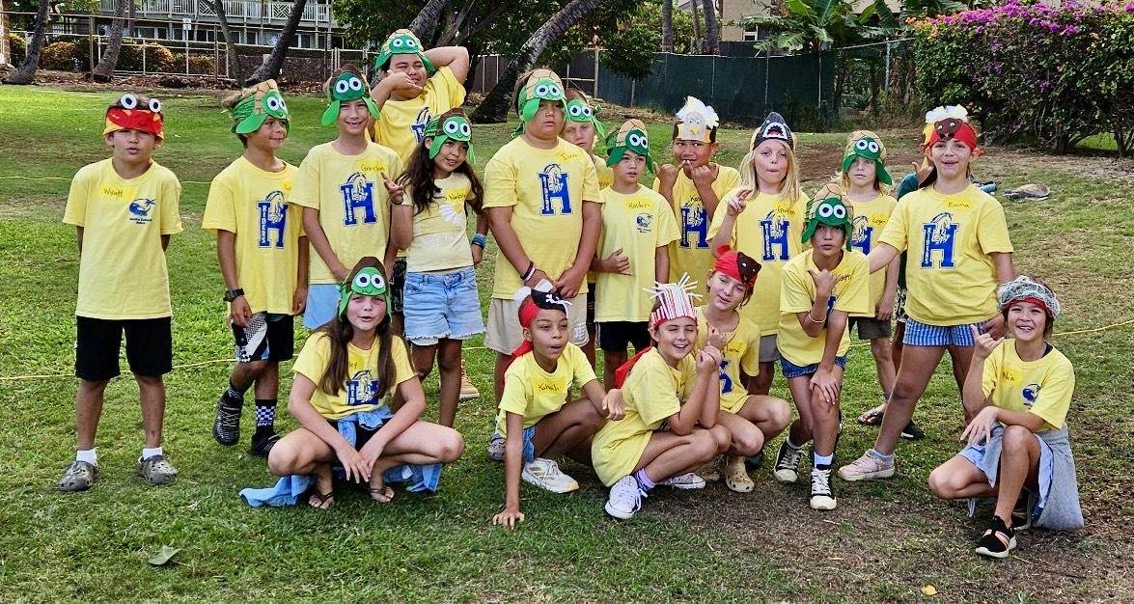
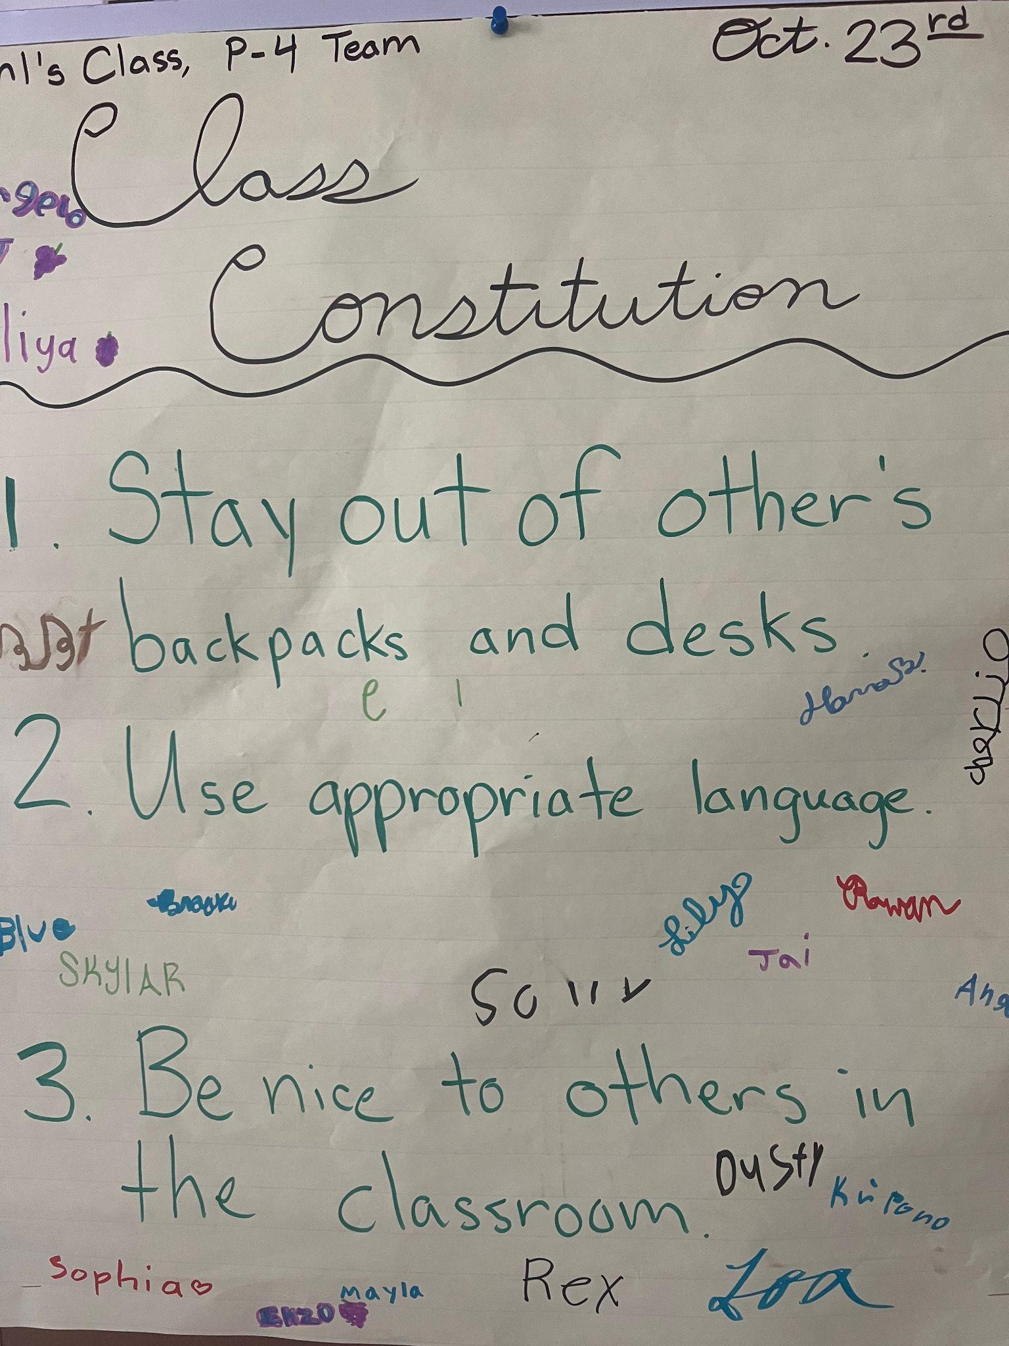
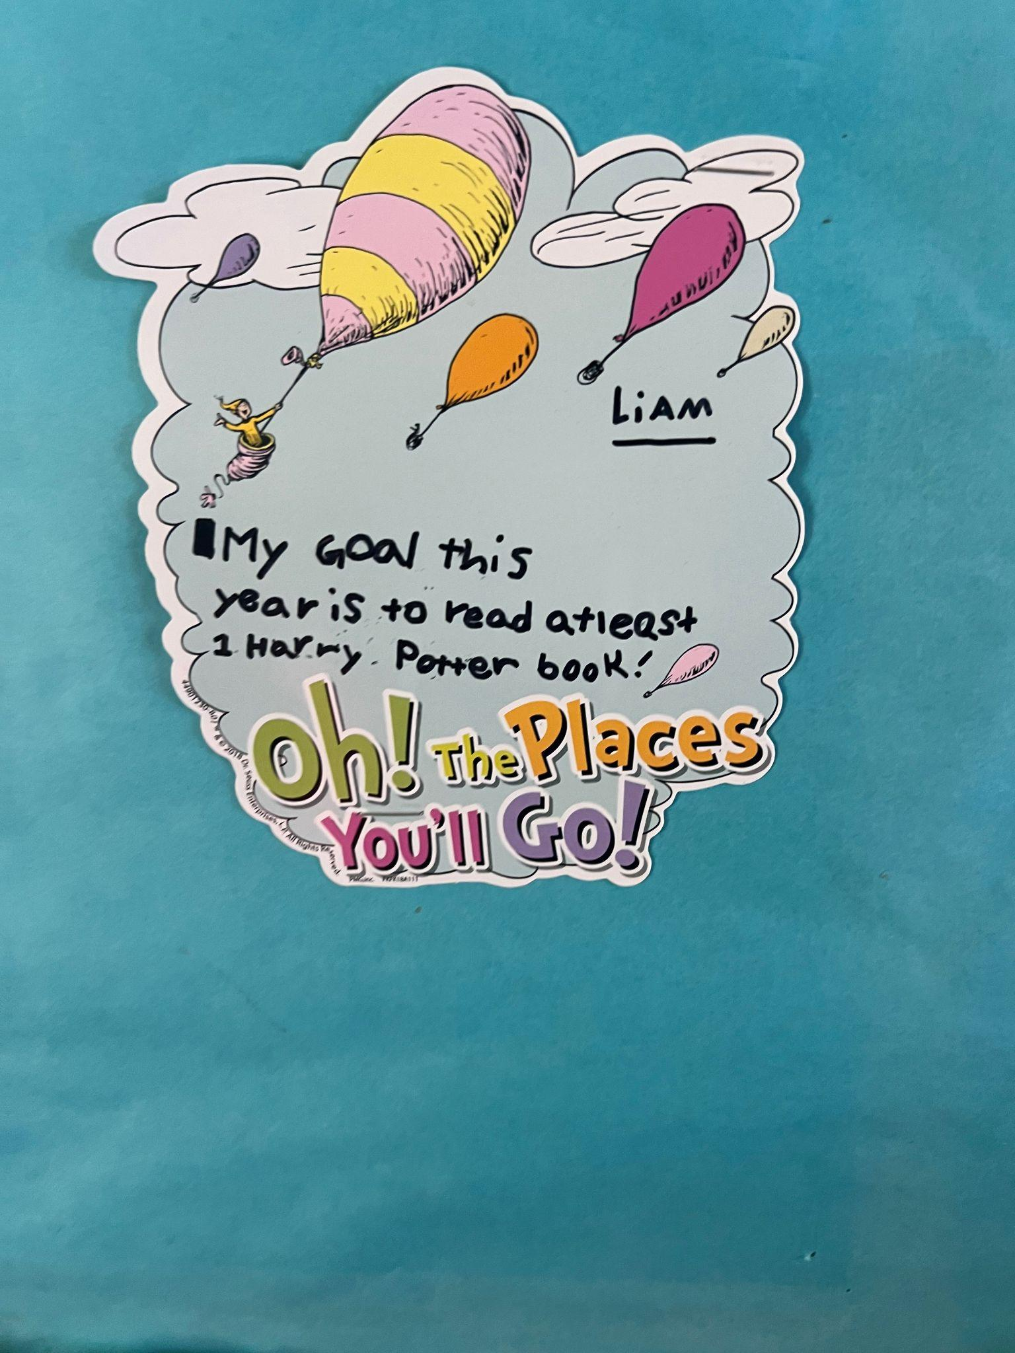
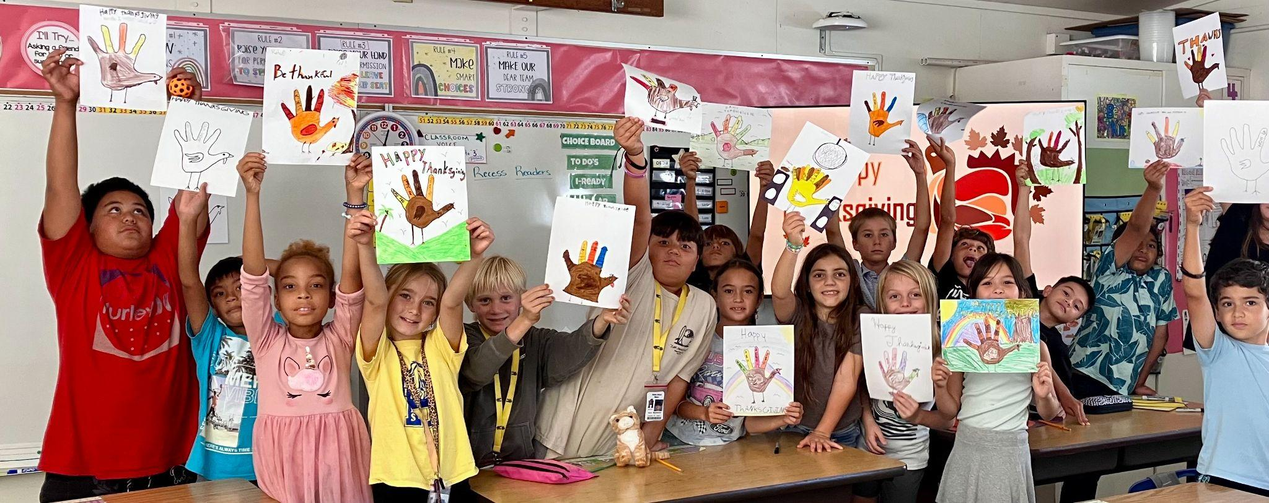
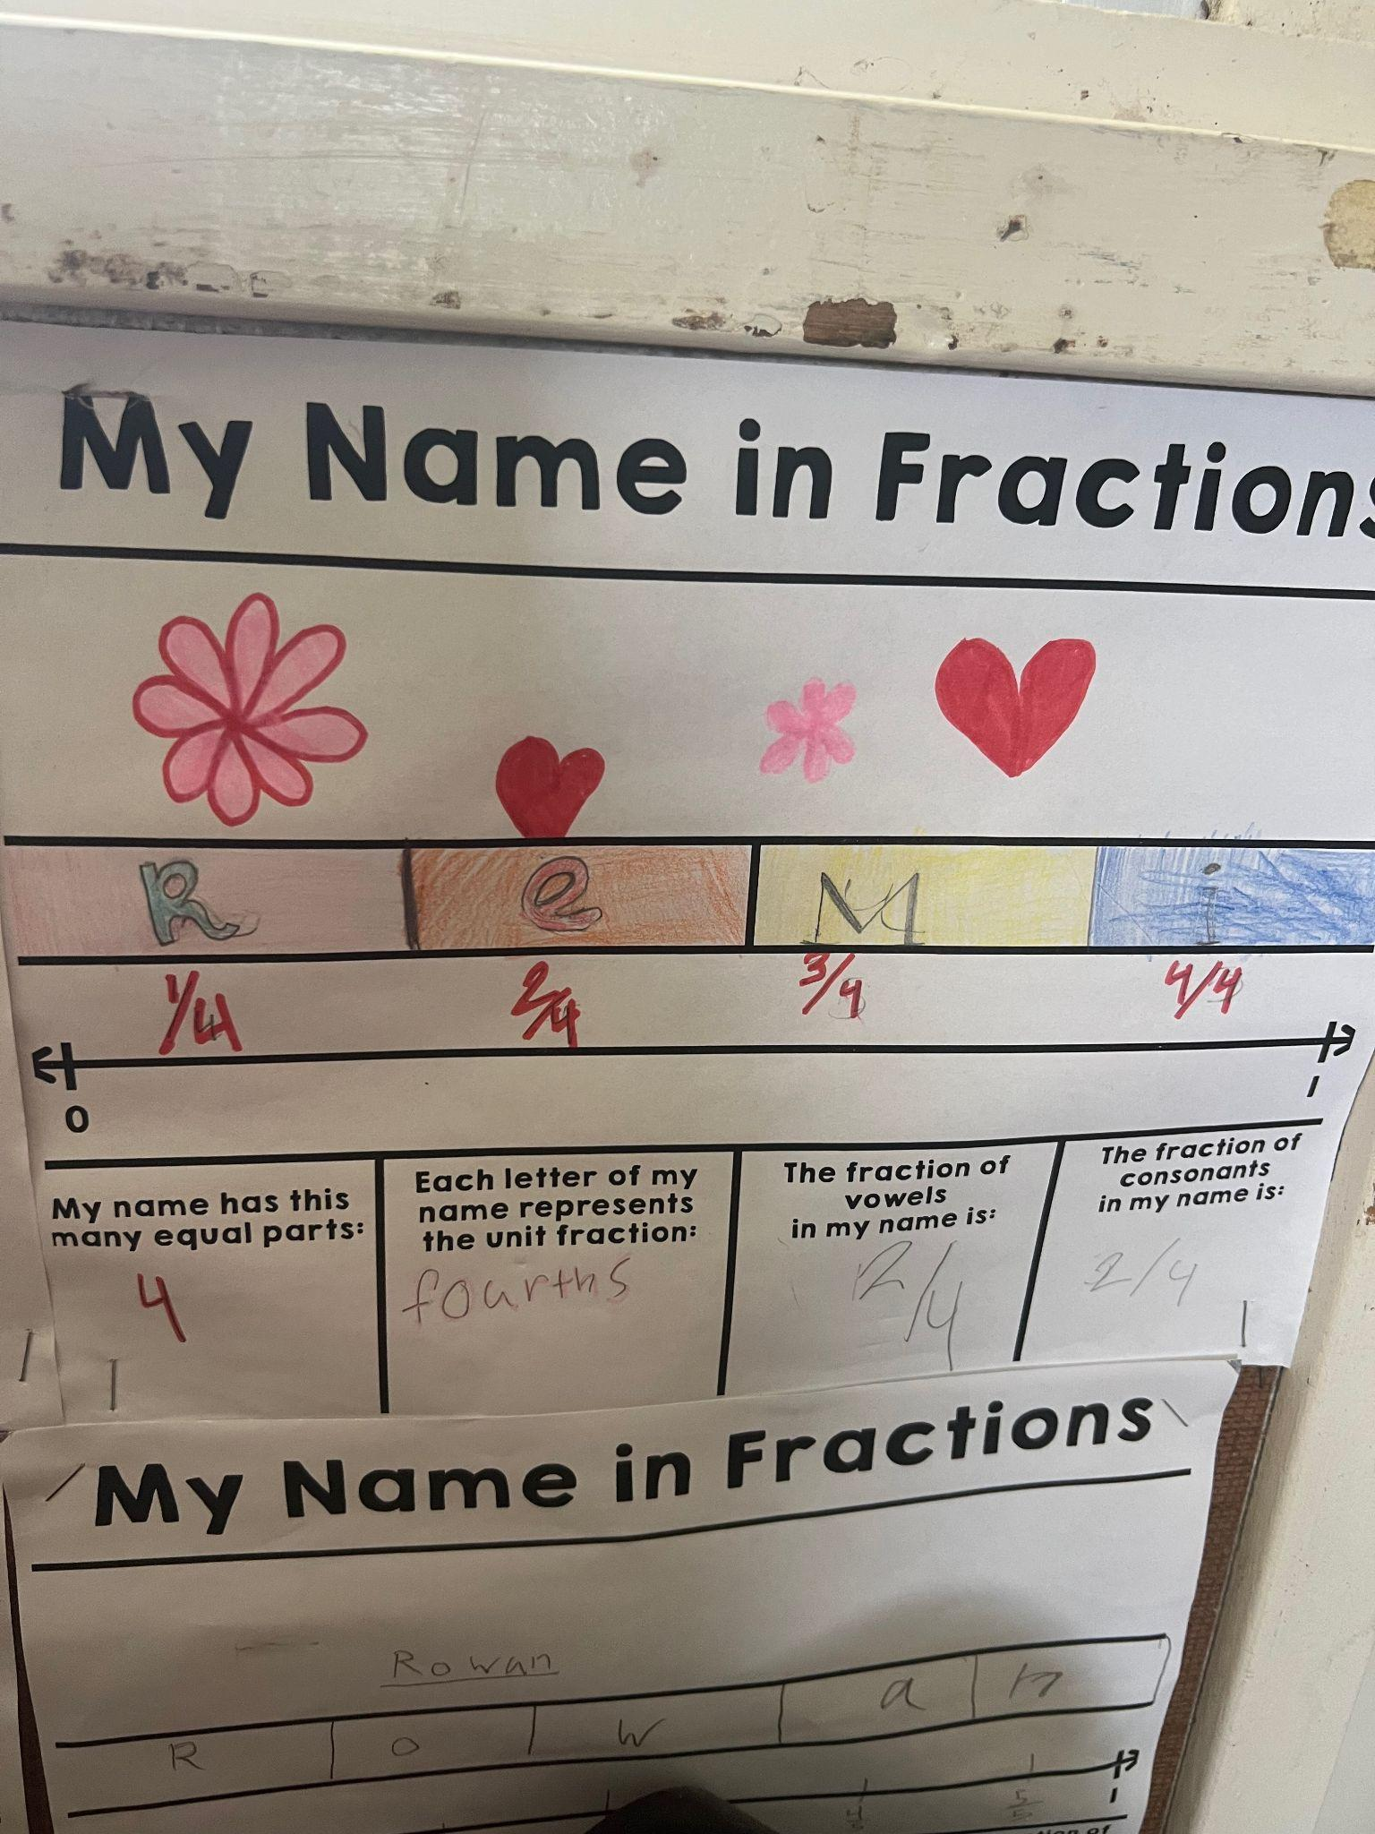
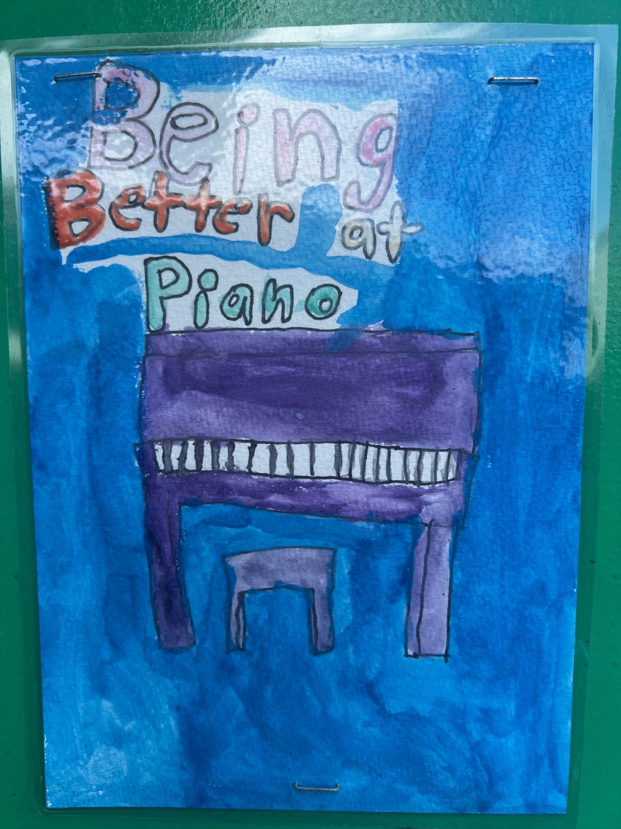
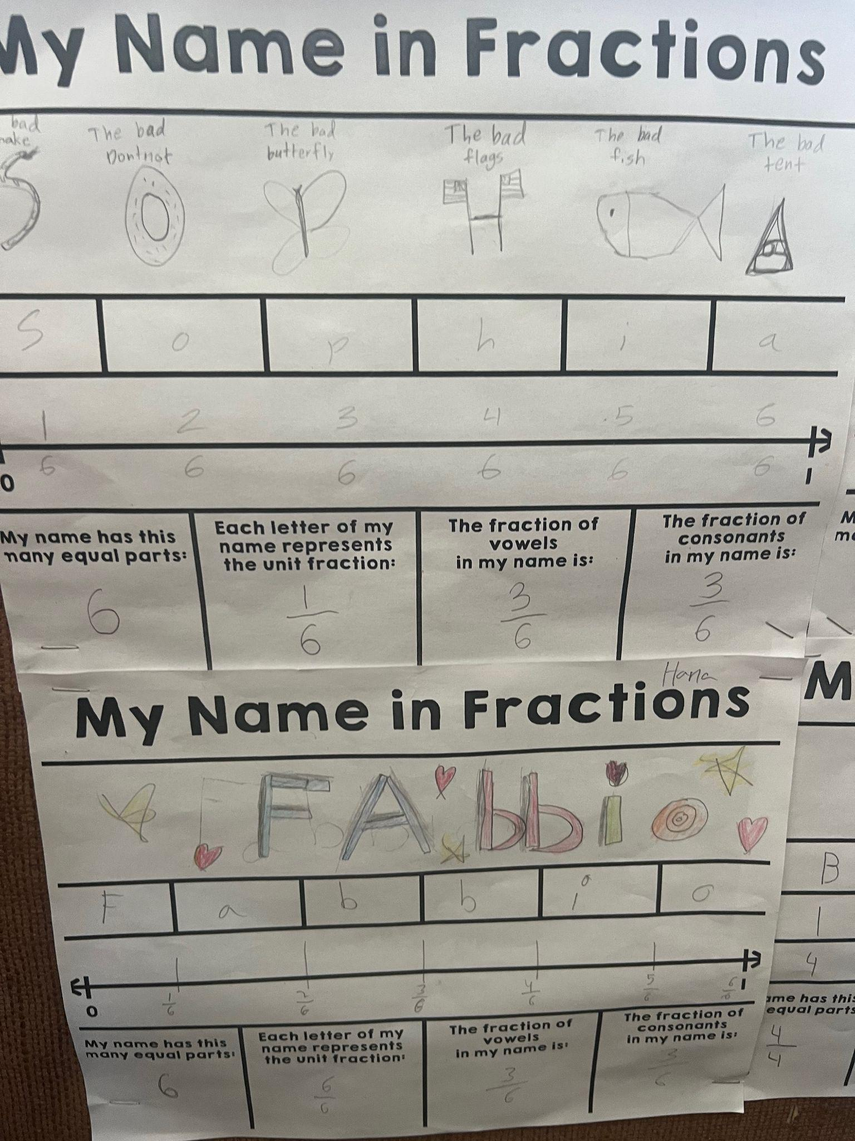
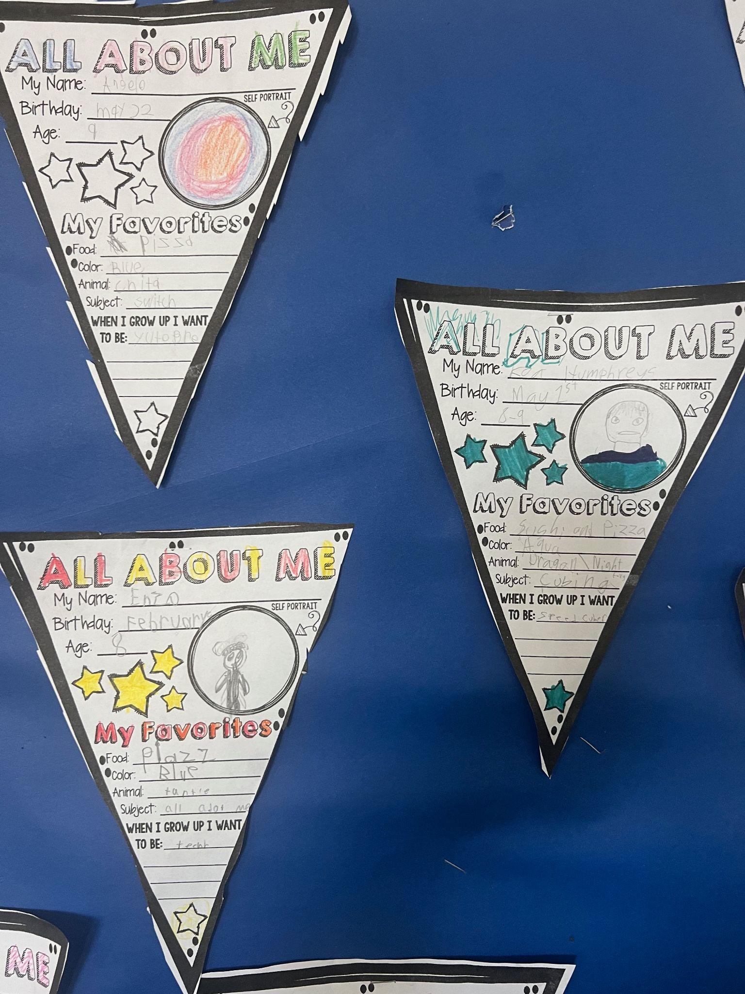
3rd grade
SENSE OF ACCOMPLISHMENT
Third graders growing their sense of belonging,
setting goals, and celebrating their accomplishments!

Slide 8
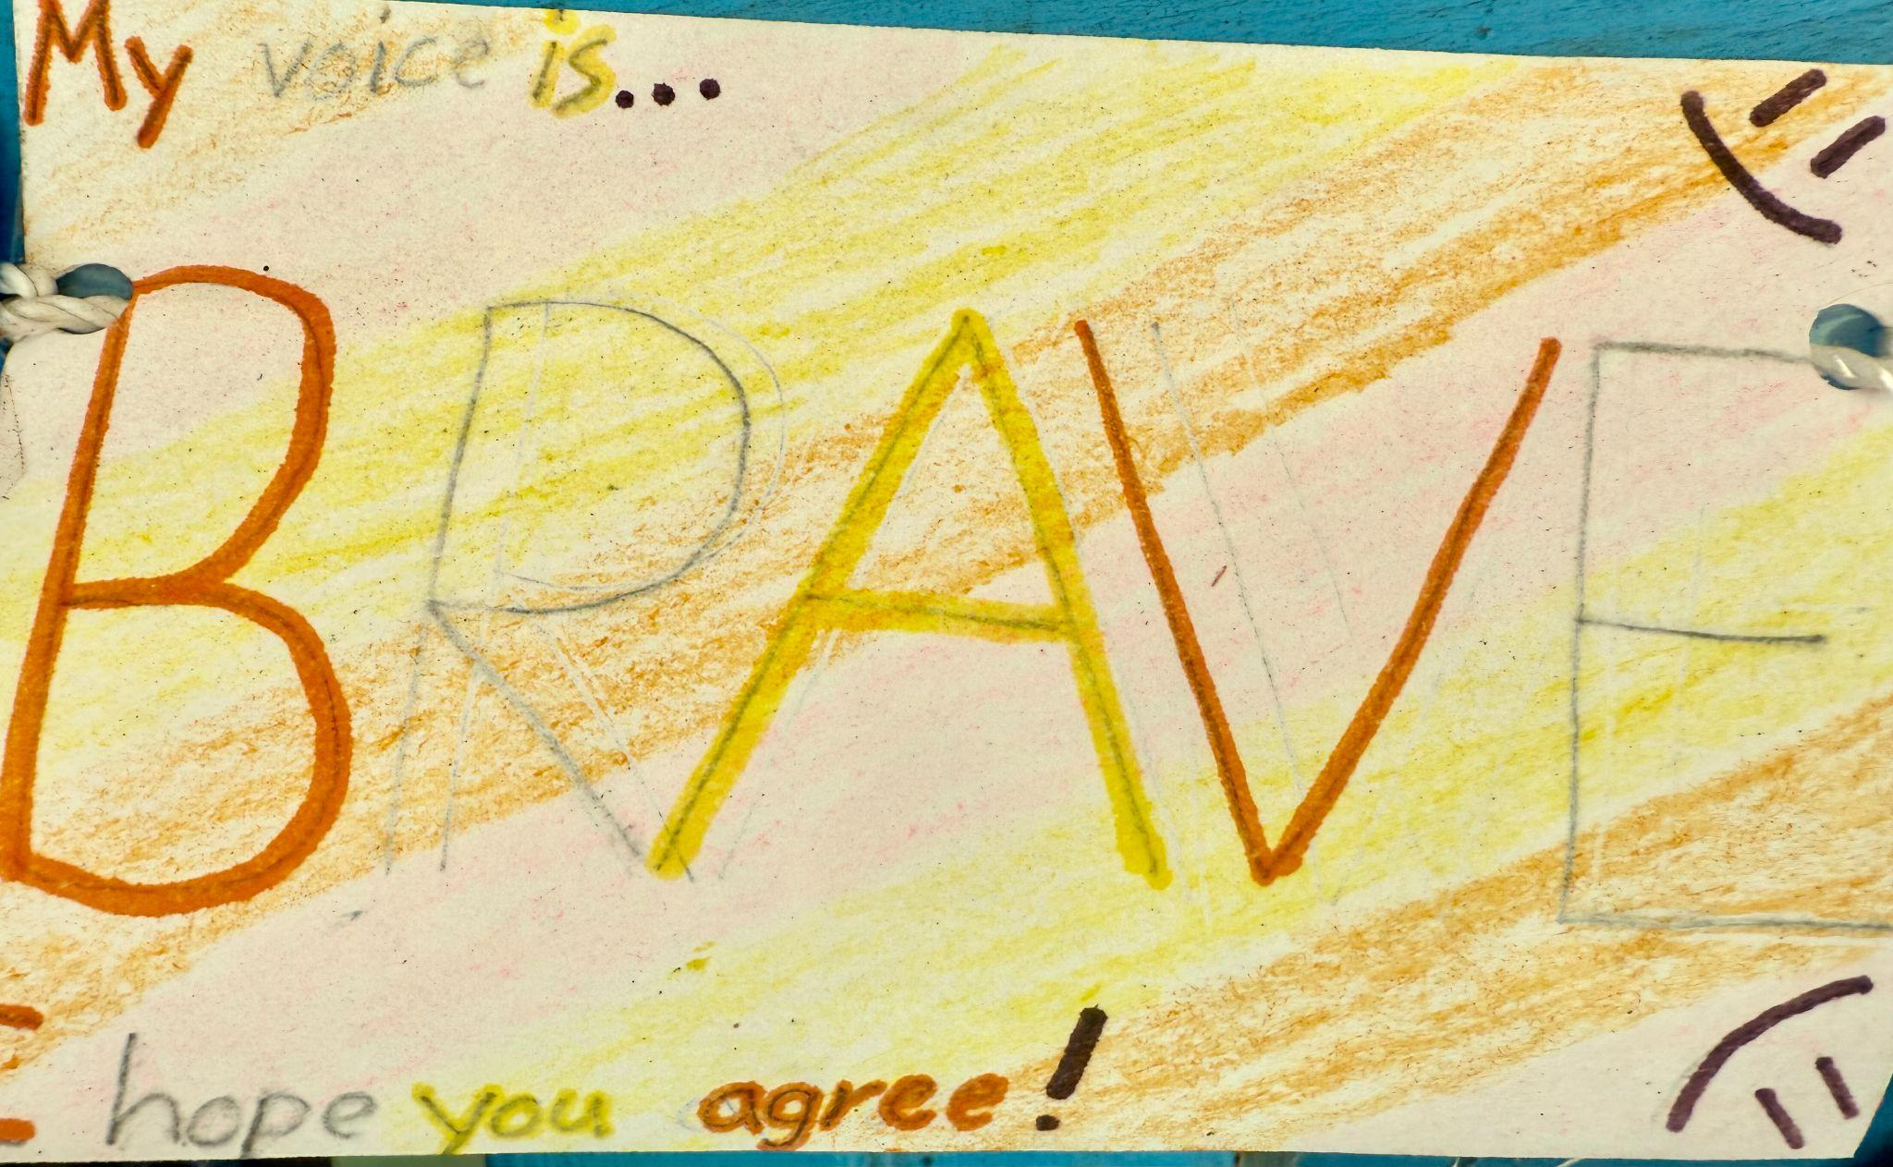
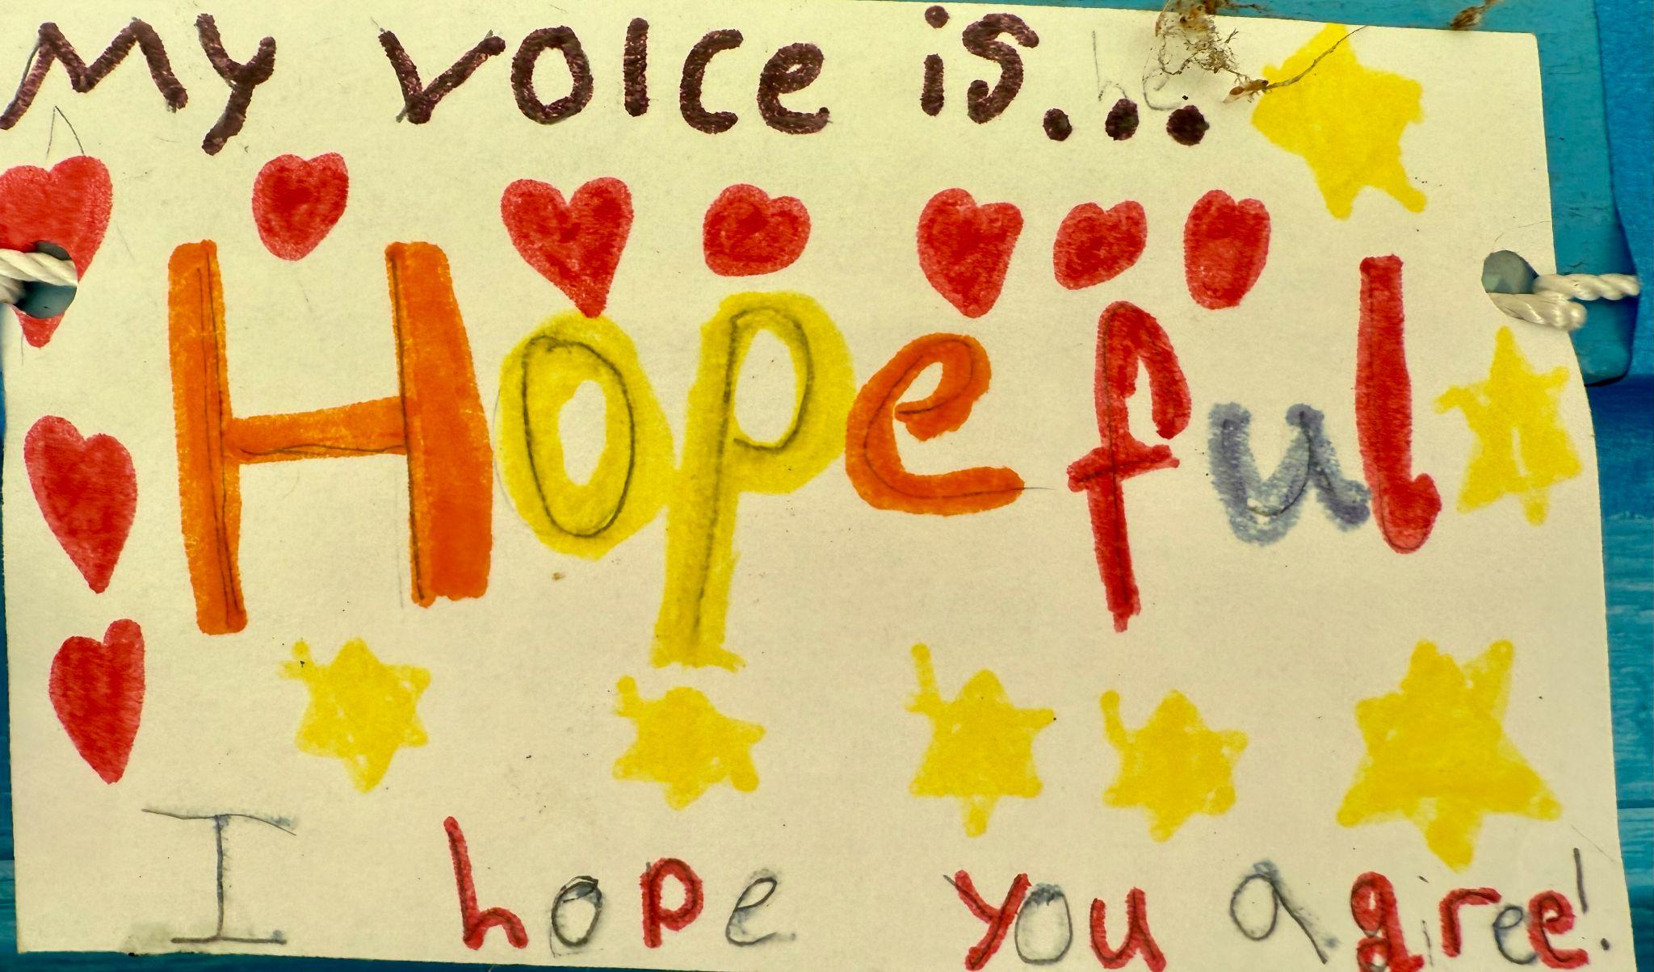
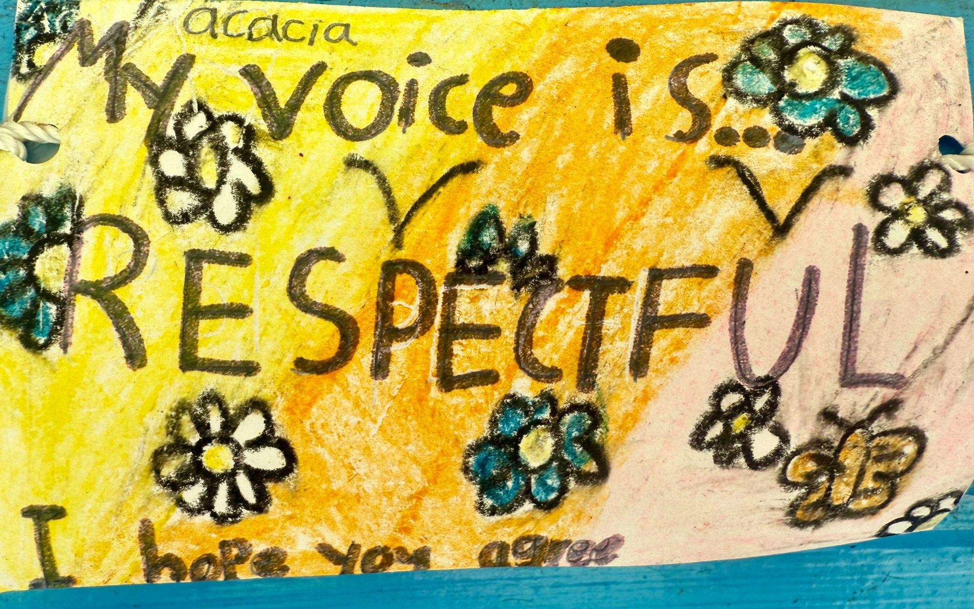
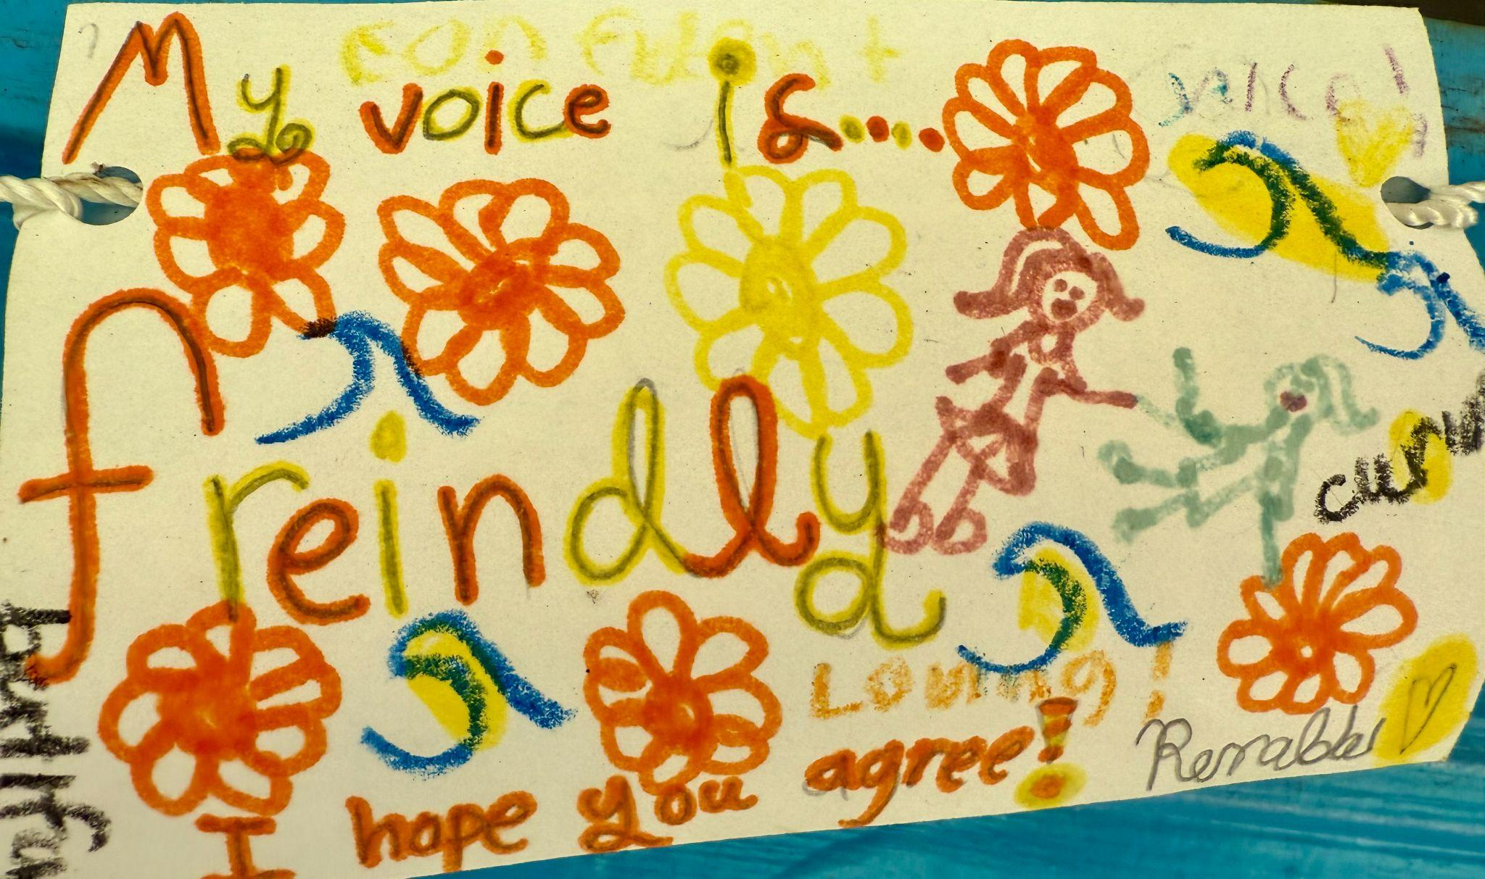
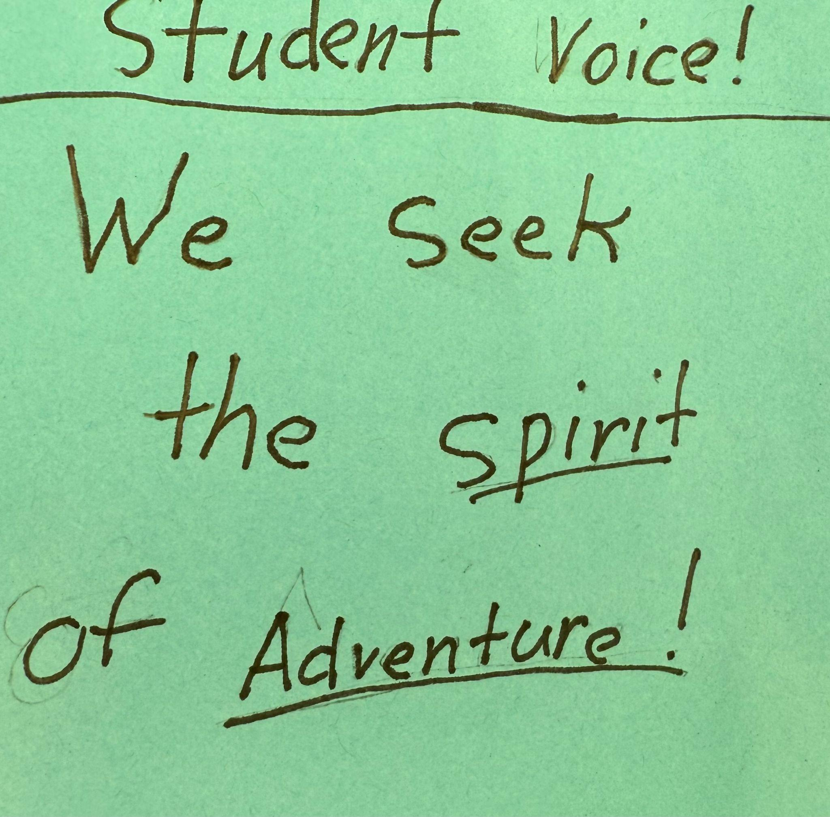
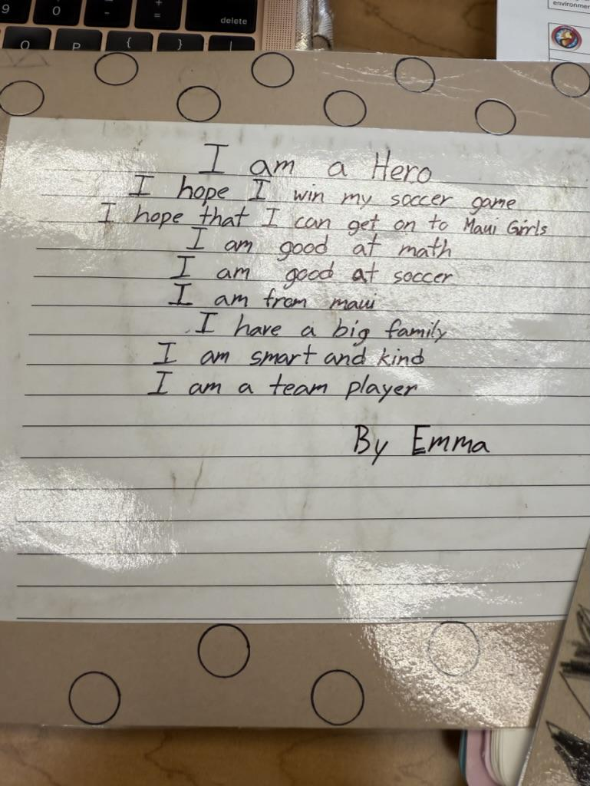
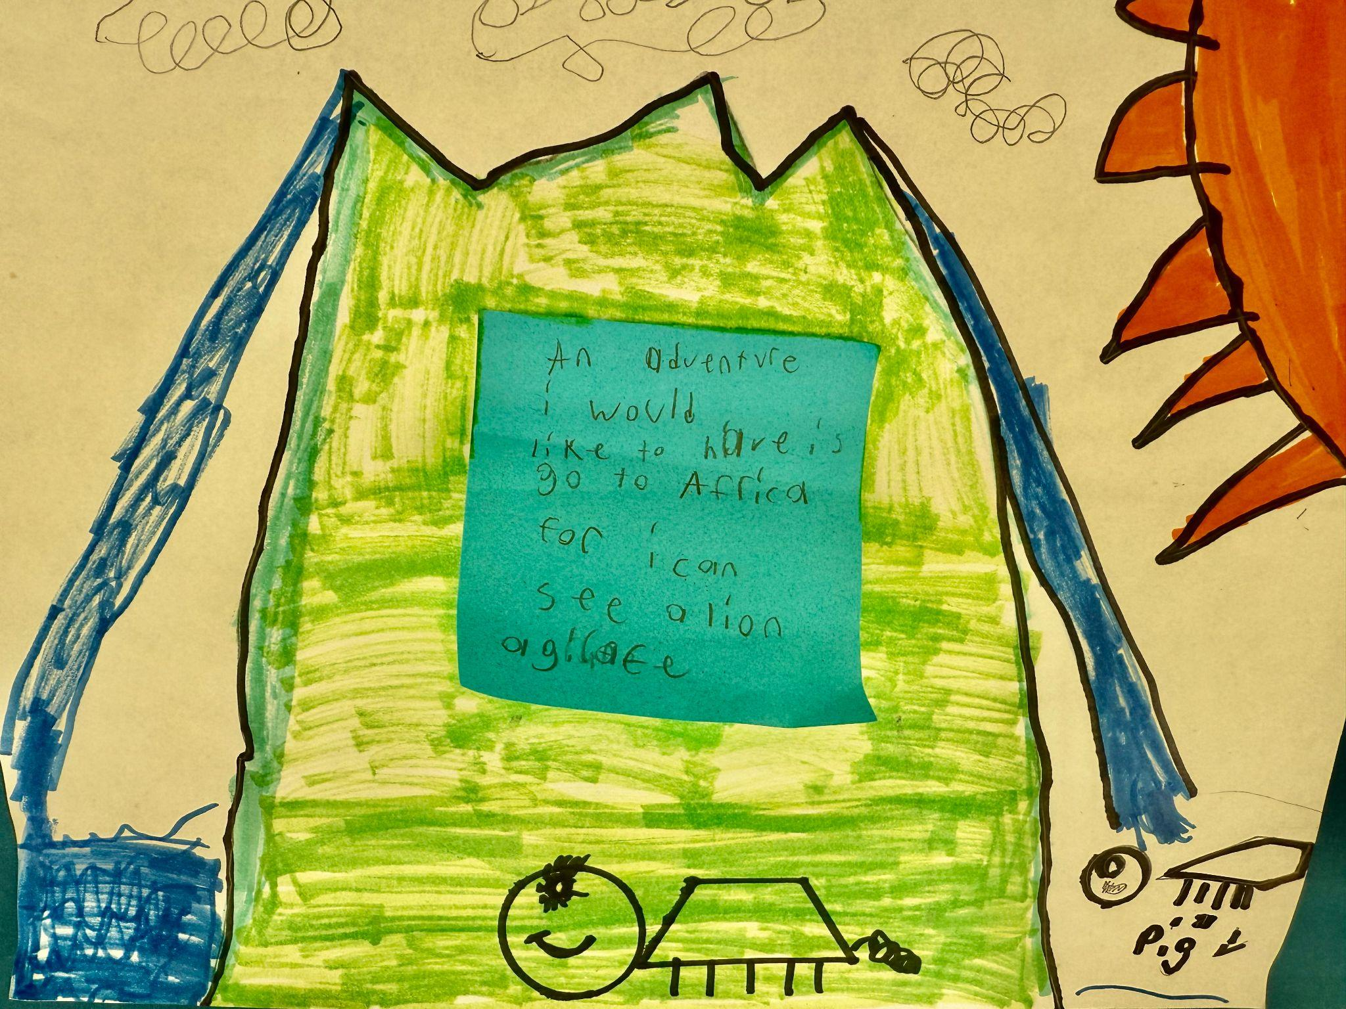
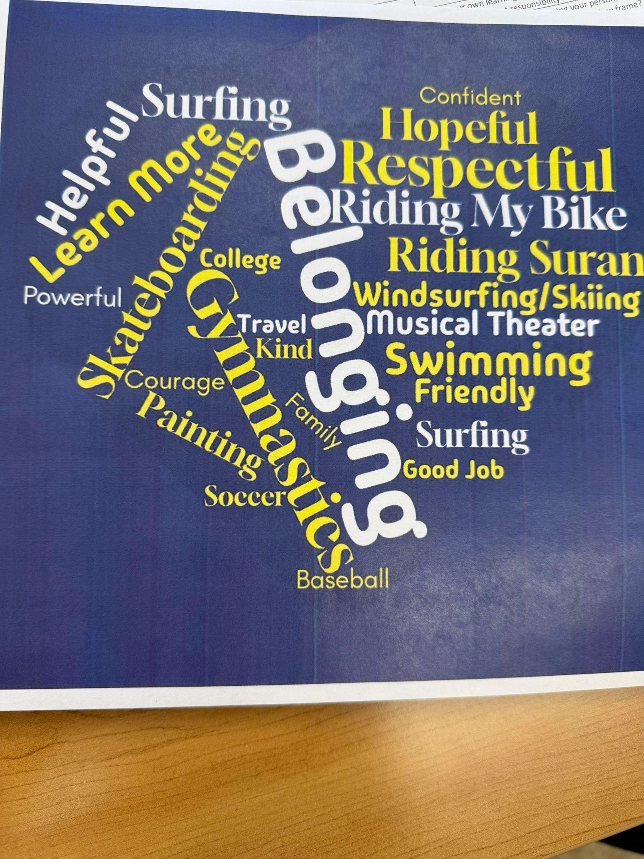
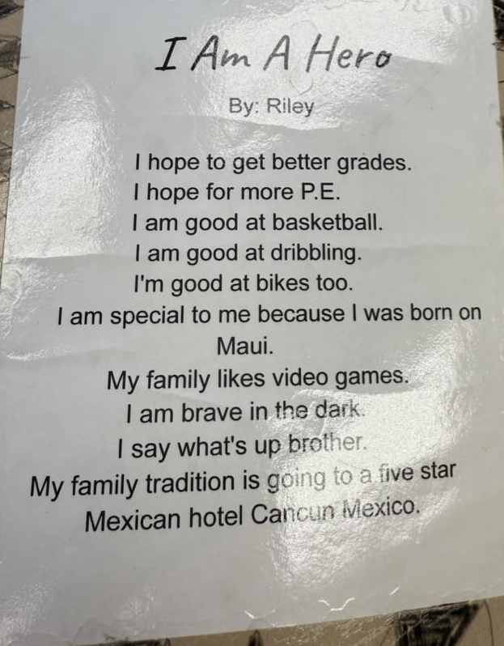
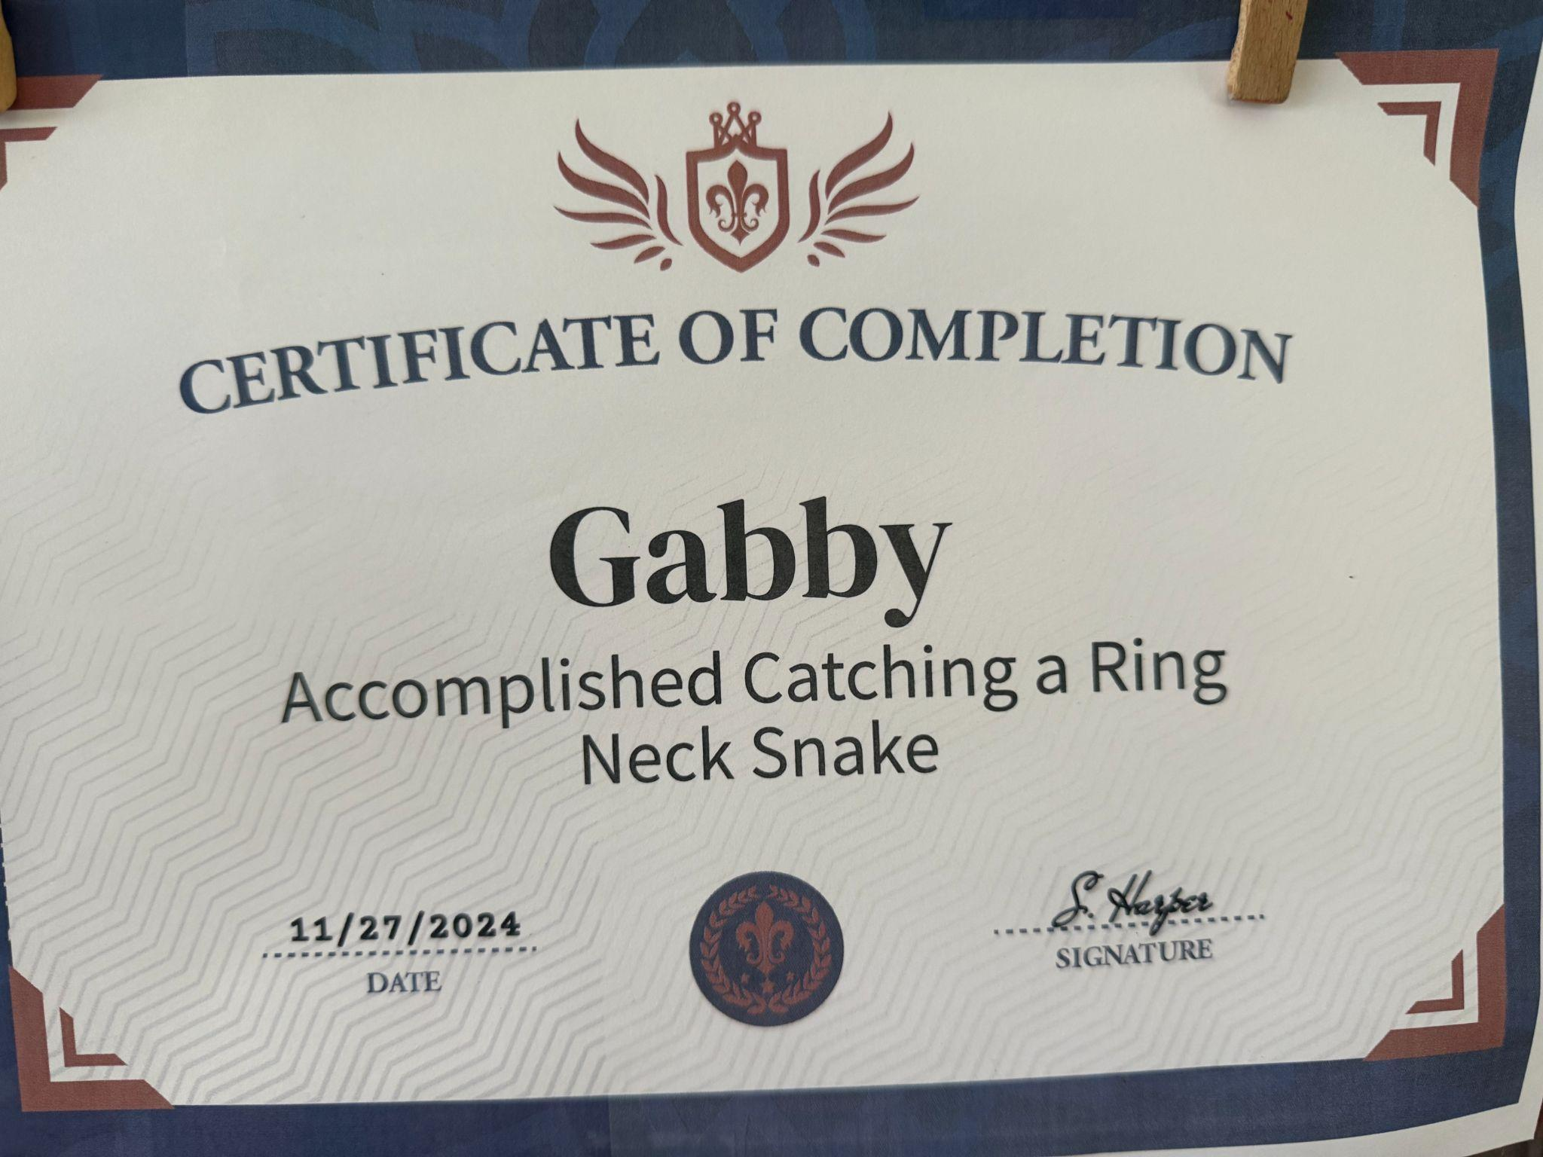
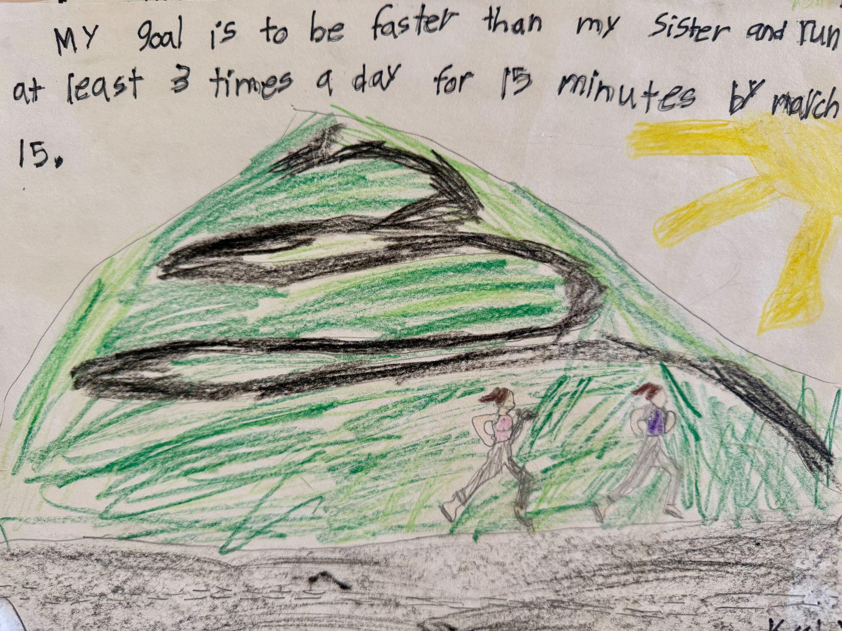
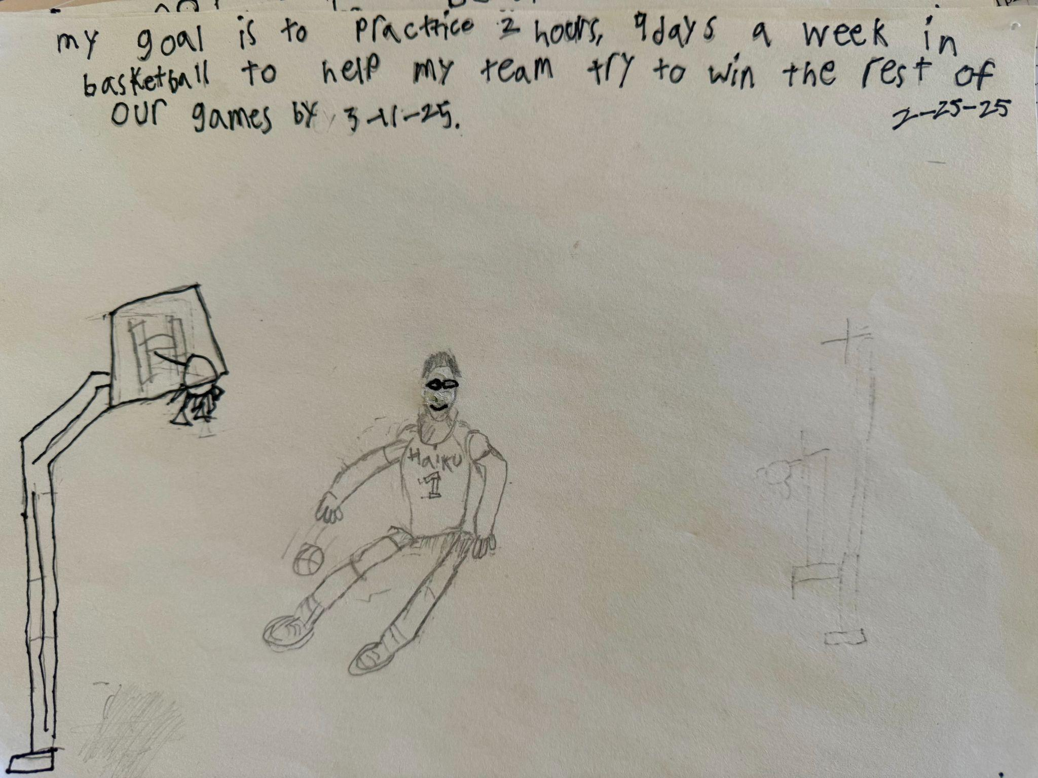
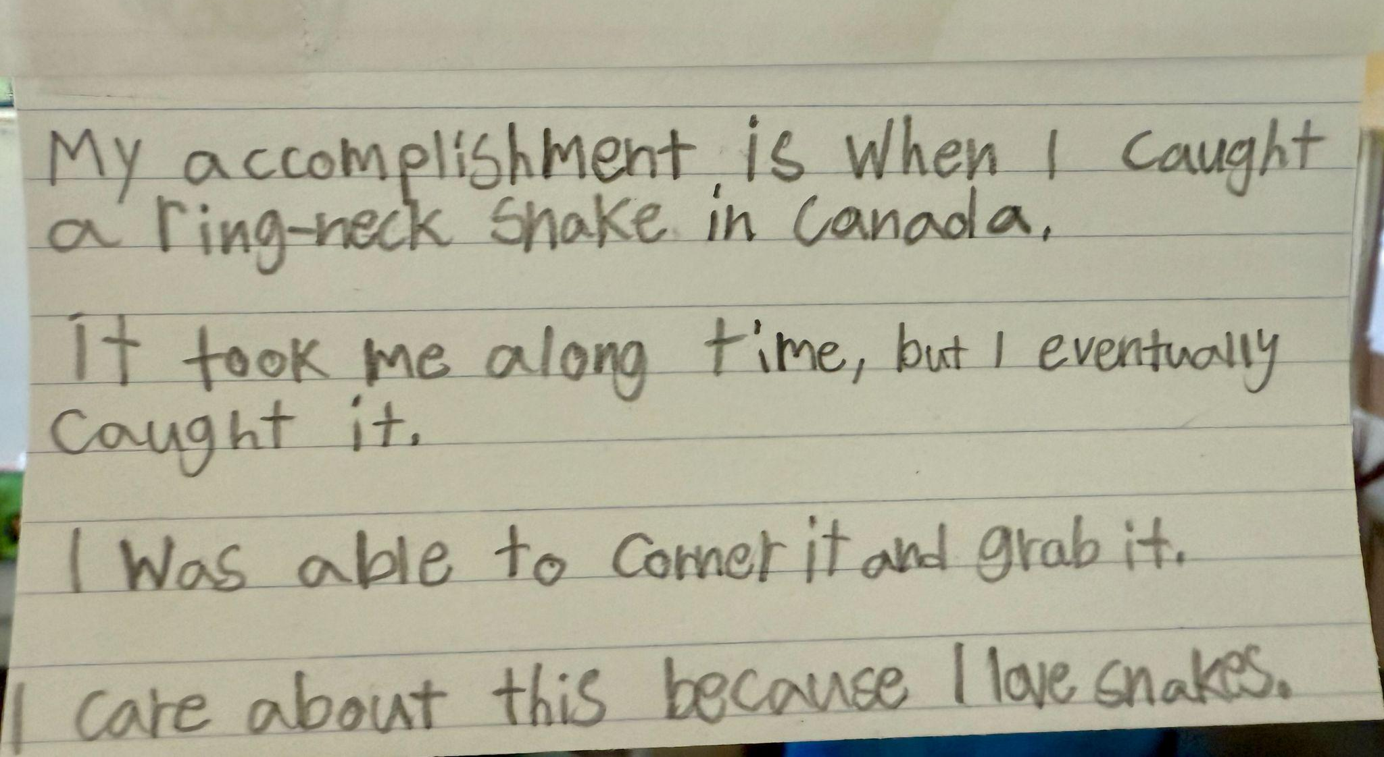
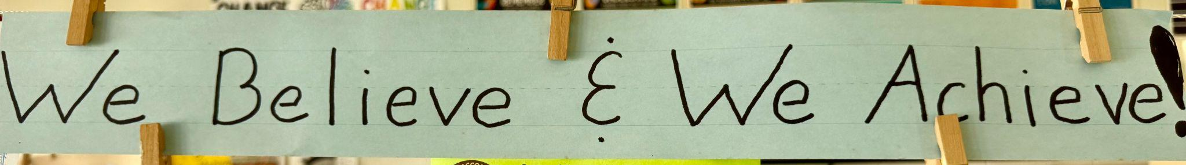
4th grade
MY VOICE IS MY CHOICE
Spirit of Adventure
Belonging
Heroes
Fourth-grade students and teachers have enjoyed embracing Student Voice. We use it daily to support our school community (classroom, playground, and cafeteria). Our 8 Conditions That Make a Difference lessons are great kickstarts/reminders to ways of thinking and living here at school, at home, and for our future. These lessons always incorporate class discussions that lead to fun activities. We have created banners, posters, collages, poems, and reflections.
Sense of Accomplishment
Fourth graders are taking responsibility for their voices and their choices.

Slide 9
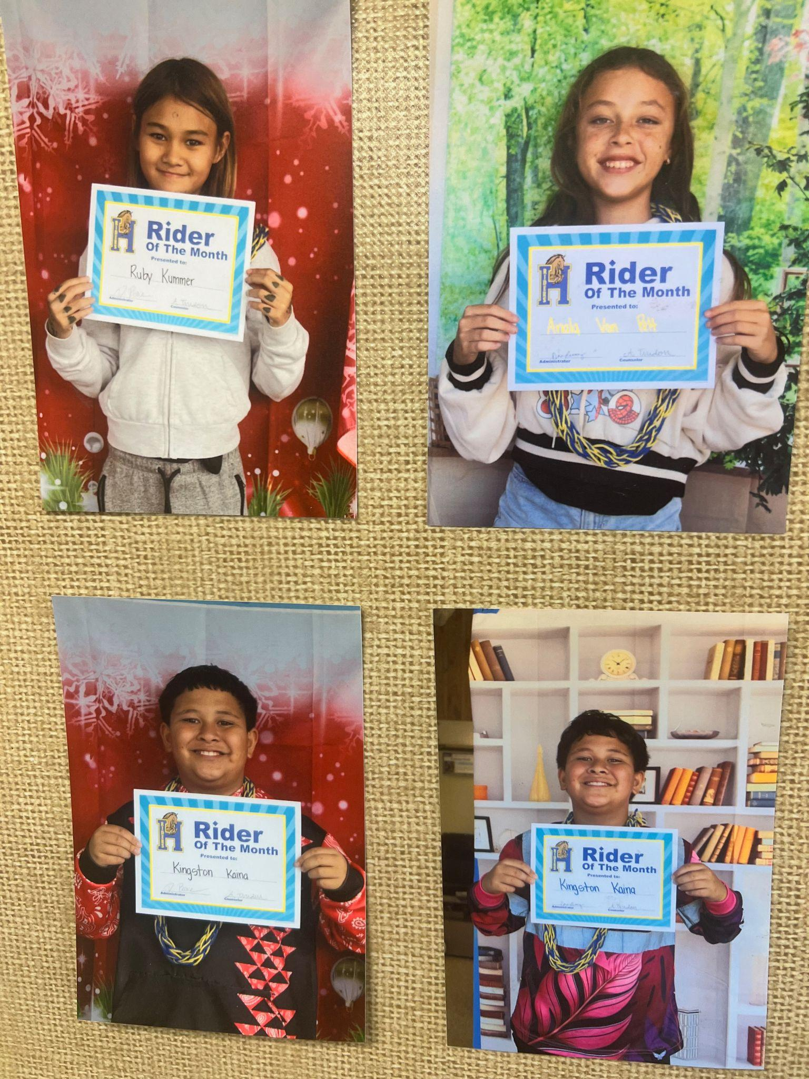
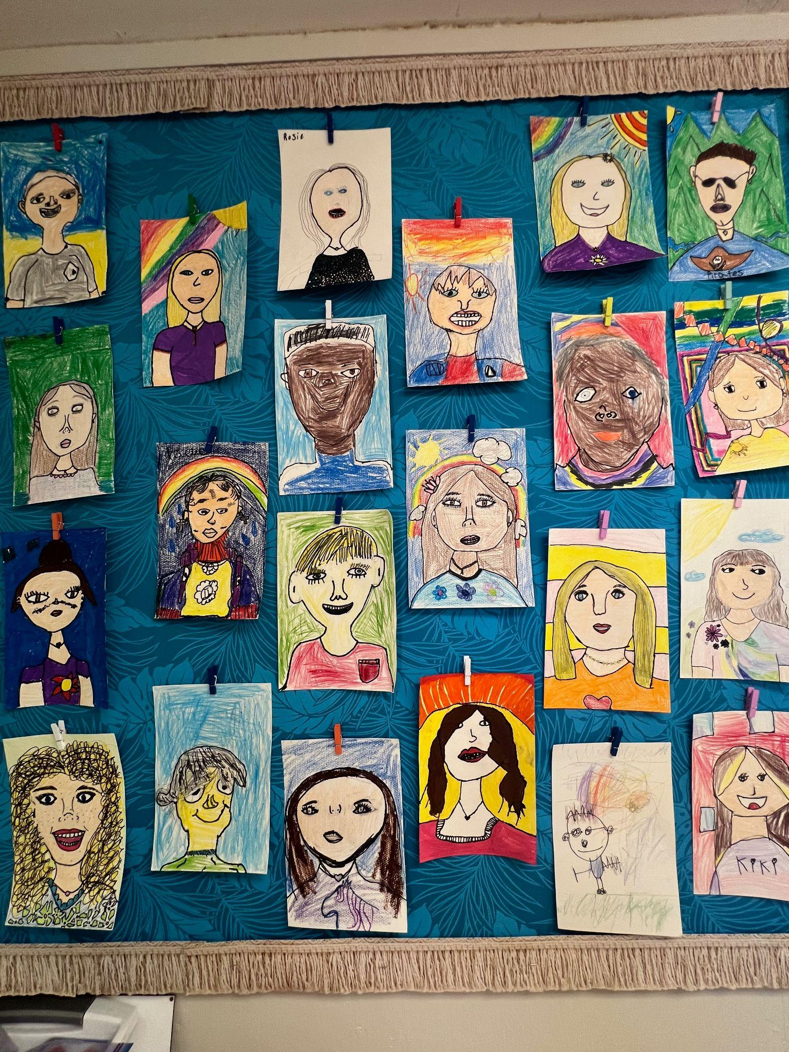
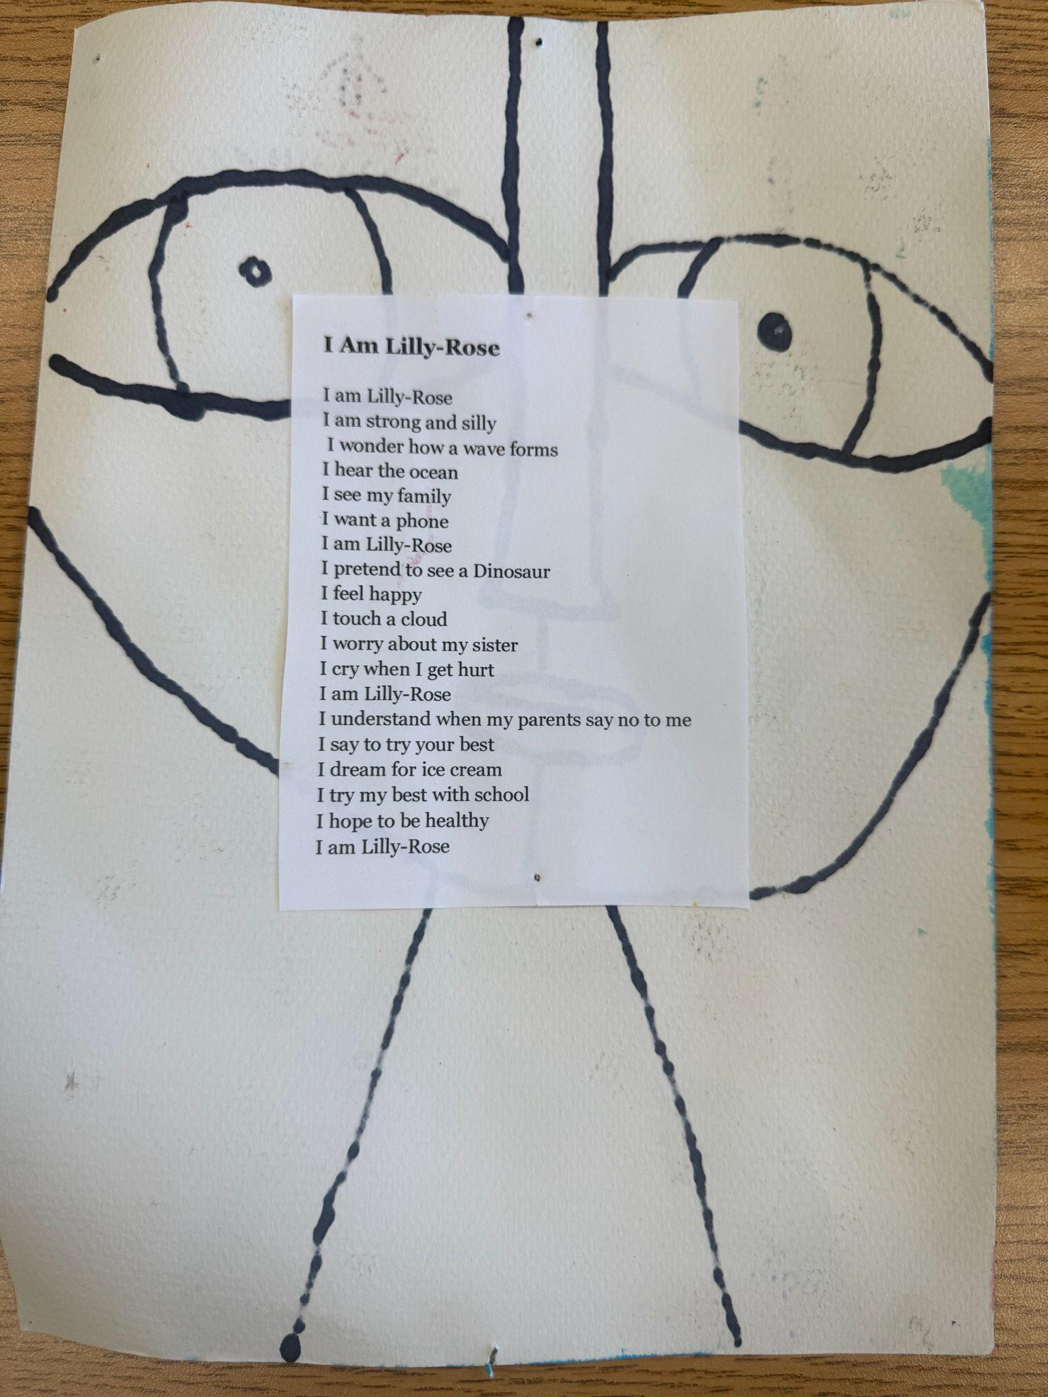
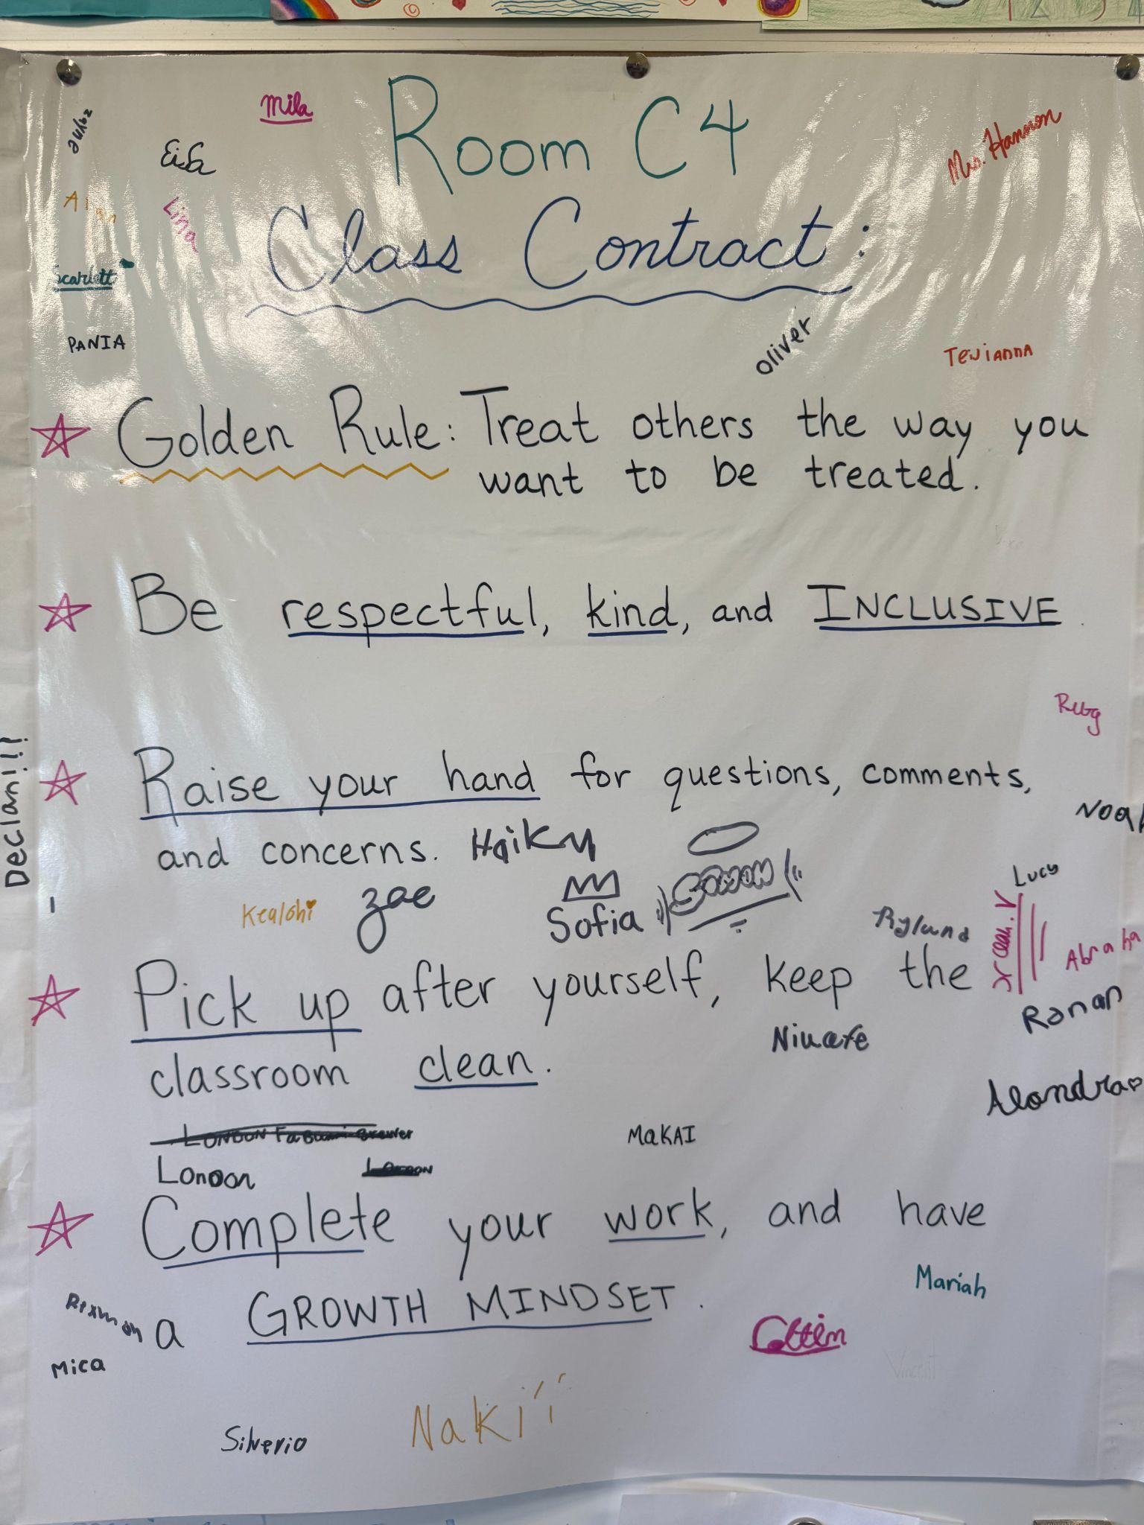
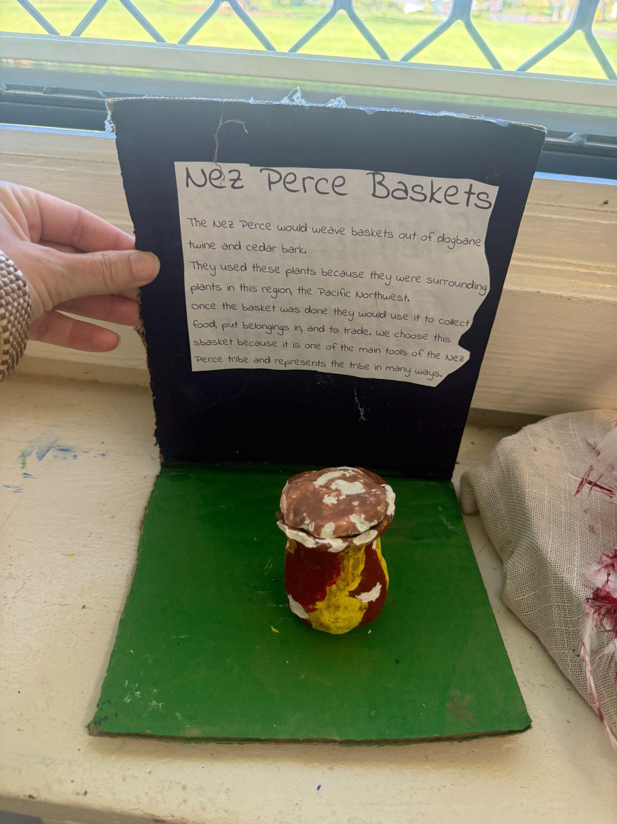
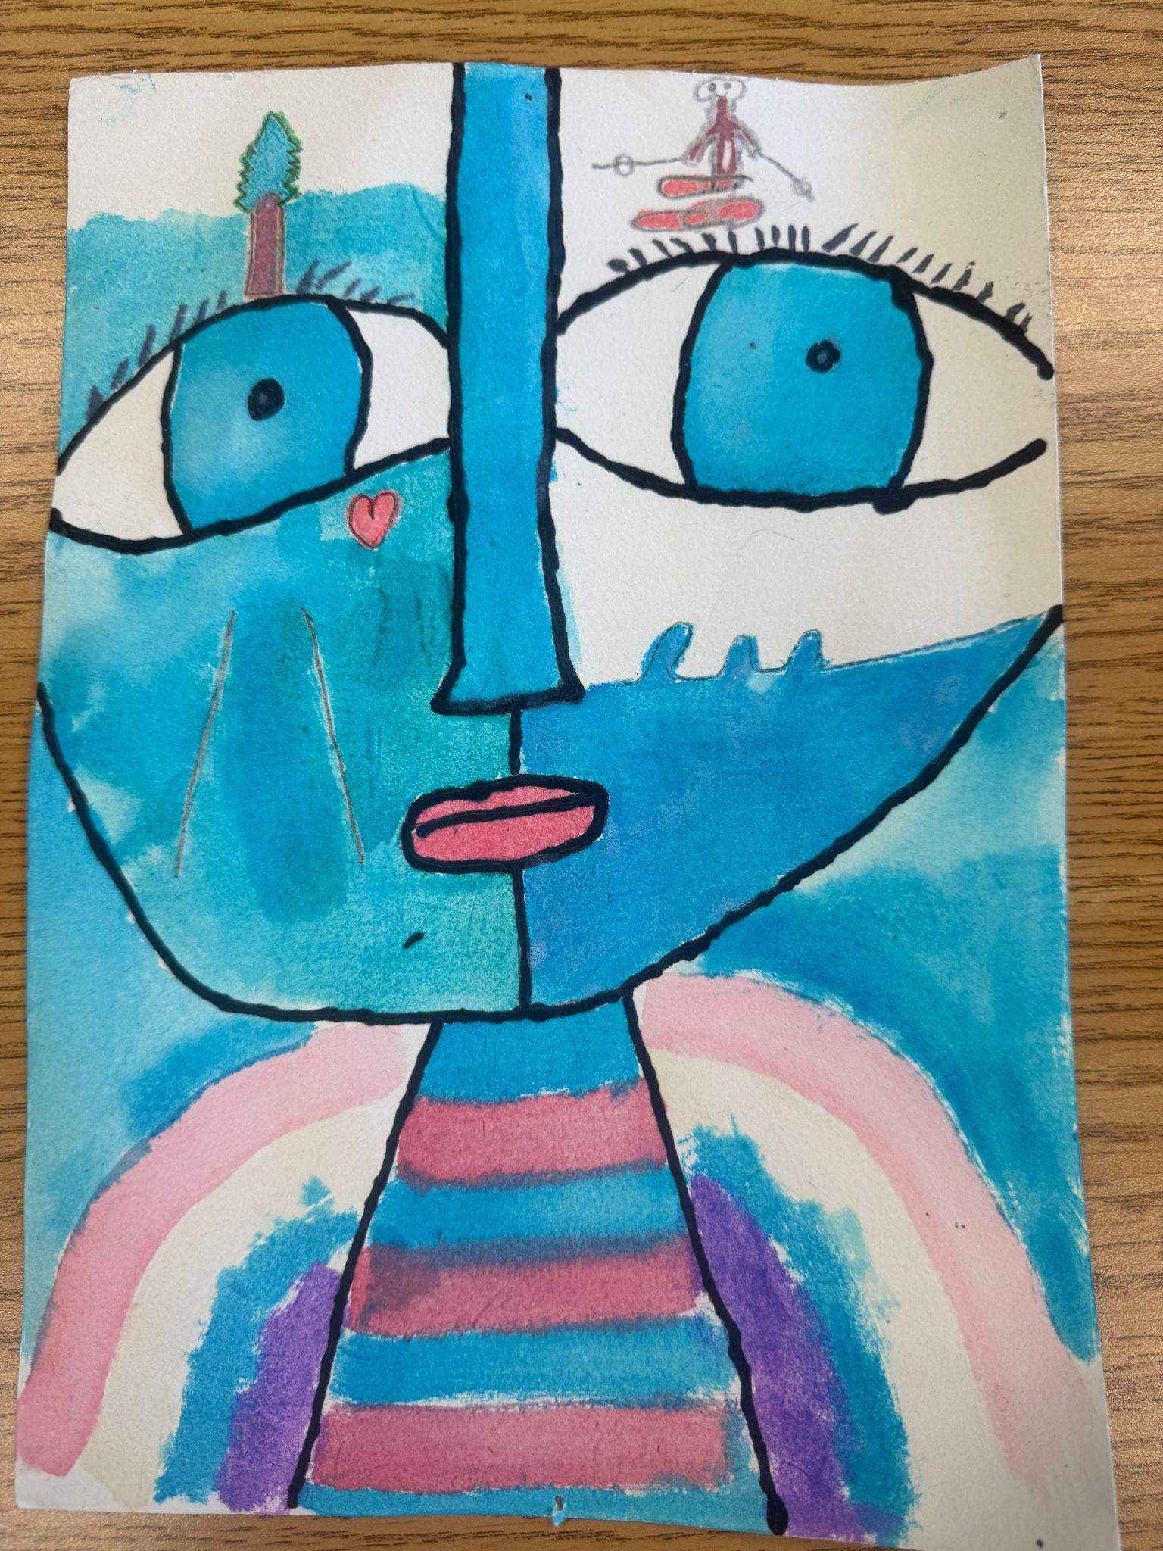
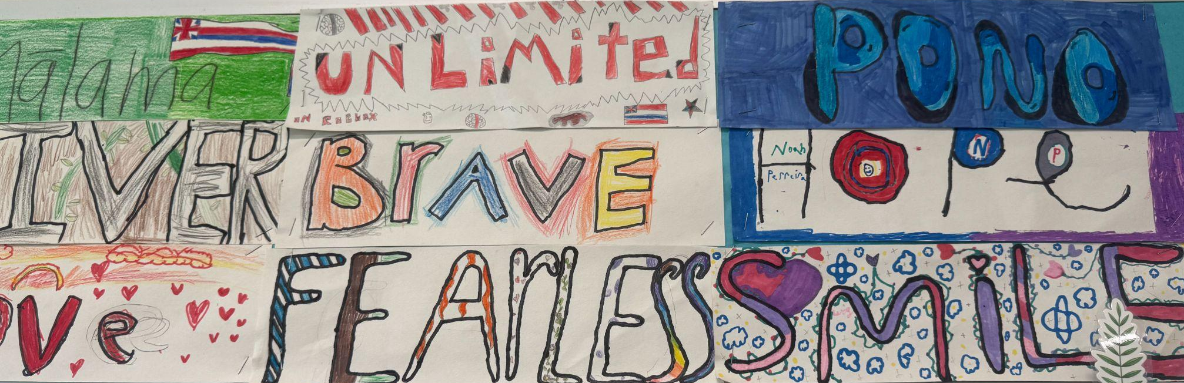
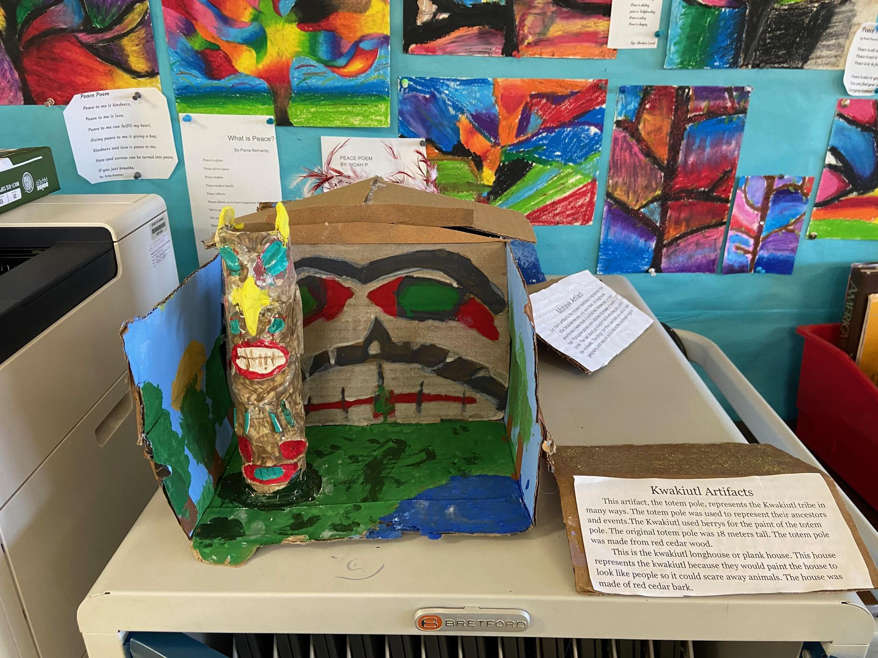
5th grade
Voice & Choice: Creating a Community of Ownership
My Voice Poems
Project Choices
Hero Quotes
Class Created
Contract
Students chose a word for the year and thought about why this word will help them stay positive, focused or motivated. They decorated these words we displayed the at the front of the room all year. We started with the difference between noise and voice and did activities and role playing with these concepts. The kids used their voice to come up with our class rules, and each voted on and signed our contract. This led to the students using their voice to write persuasive letters to the principal with ideas for how the school can improve. Some ideas were to add more after school clubs (this happened), after school homework club (i.e. tutoring), Student recess monitors (kokua club), and more. The students had a meeting with the principal where they read their letter and discussed feasibility and details with him. It was a very valuable experience for the students. Then we moved into the sense of belonging where we did the Odd Dot Out activity which opened up rich conversations about cliques, exclusion/inclusion and how we can make sure our peers feel like they belong. We then explored our heroes and each student wrote a thank you card to an adult hero, thanking them for their guidance, support, and encouragement. For Sense of Accomplishment, the students researched different quotes that evoked perseverance and then created a cover for their portfolios with their quote of choice and some art. They see this quote every time they insert work into their portfolio throughout the year. Students enjoyed expressing themselves with poetry. We started with “I Am” poems and abstract self portraits. Then Peace Poems and art entered into the International Peace Poem contest. Students are recognized for receiving Rider of the Month with their picture being displayed all year long. They have engaged with their PBL units where curiosity and creativity have been key areas of focus.
Voice Banners
Self Portraits

Slide 10

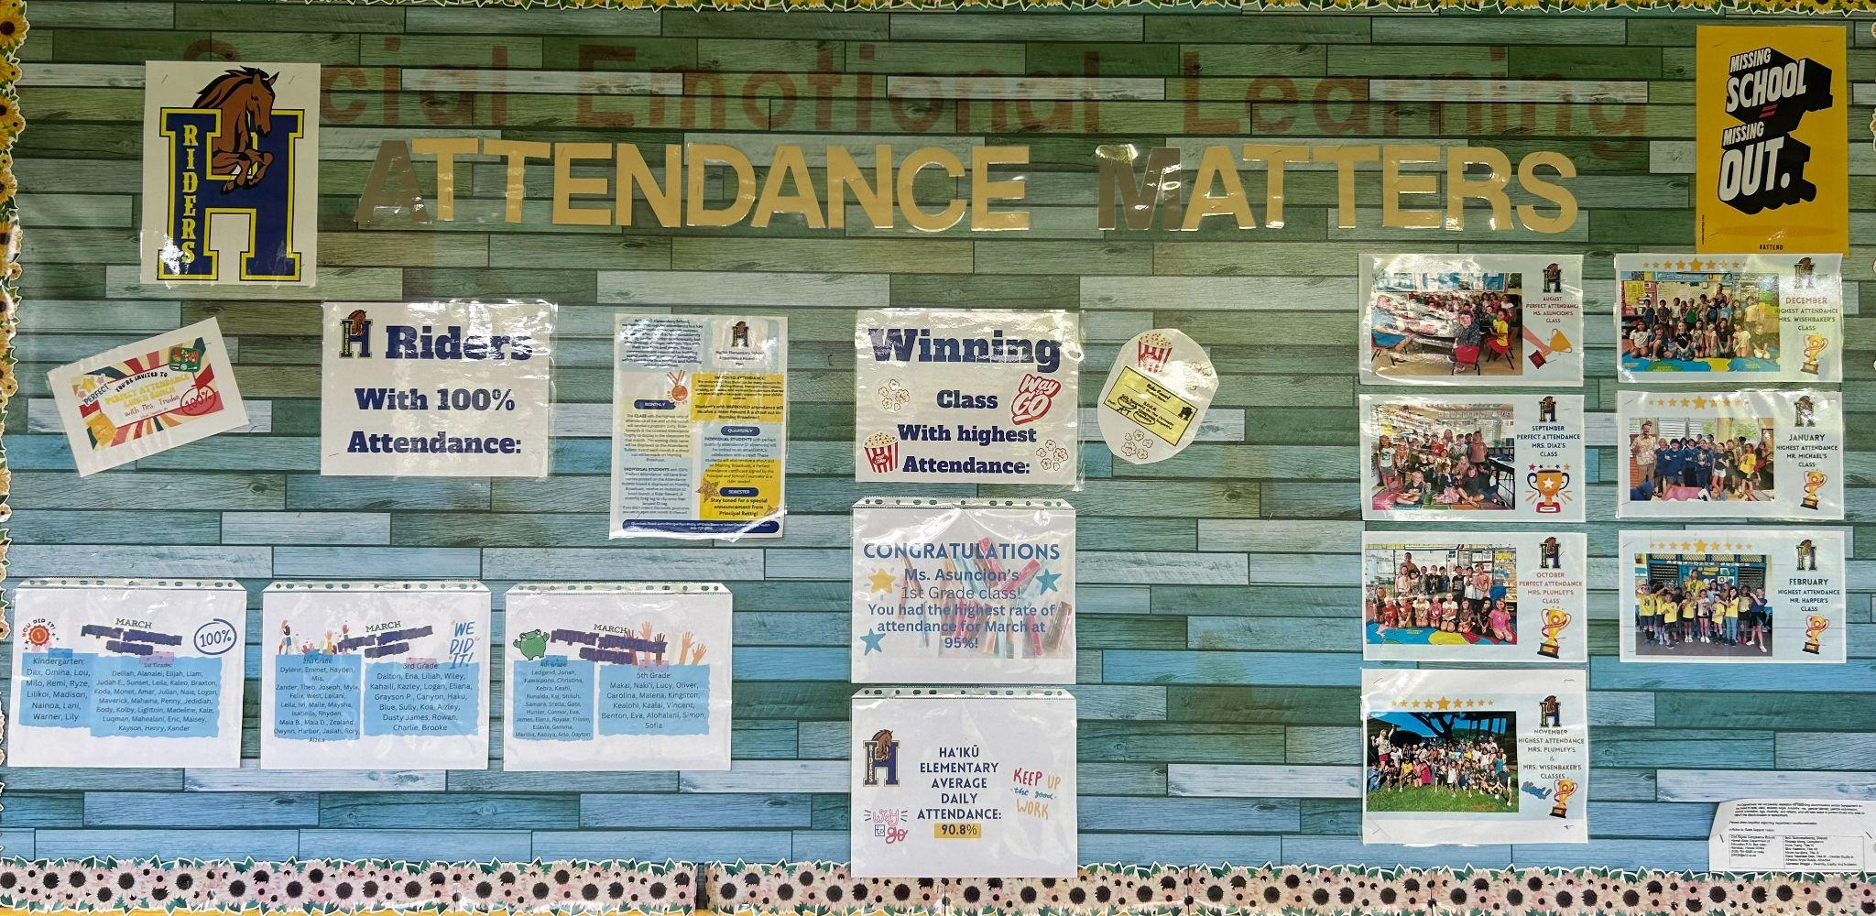
Haiku School Counseling Program
"The mission of Ha’iku Elementary School’s counseling program is to provide a comprehensive counseling program that supports the whole child. The School Counselor will focus on the needs, interests, and issues related to social-emotional, academic, and college/career development of all students through a multi-tiered system of support. School Counselors will advocate, collaborate and facilitate actions that promote a positive school climate, provide an opportunity for all students to access their education and achieve personal and academic success to meet the challenges of a rapidly changing world."
Sense of Accomplishment:
3 Components of Voice
Used in small group & individual sessions:
Being recognized for many different types of success, including hard work, being a good person, and attendance.
Sharing thoughts & ideas in an environment underpinned by trust & respect.
Offering realistic suggestions for the good of the whole.
Accepting responsibility for not only what is said but also for what needs to be done.
Attendance Wall
Attendance Slides
Link here: Attendance Slides

Slide 11
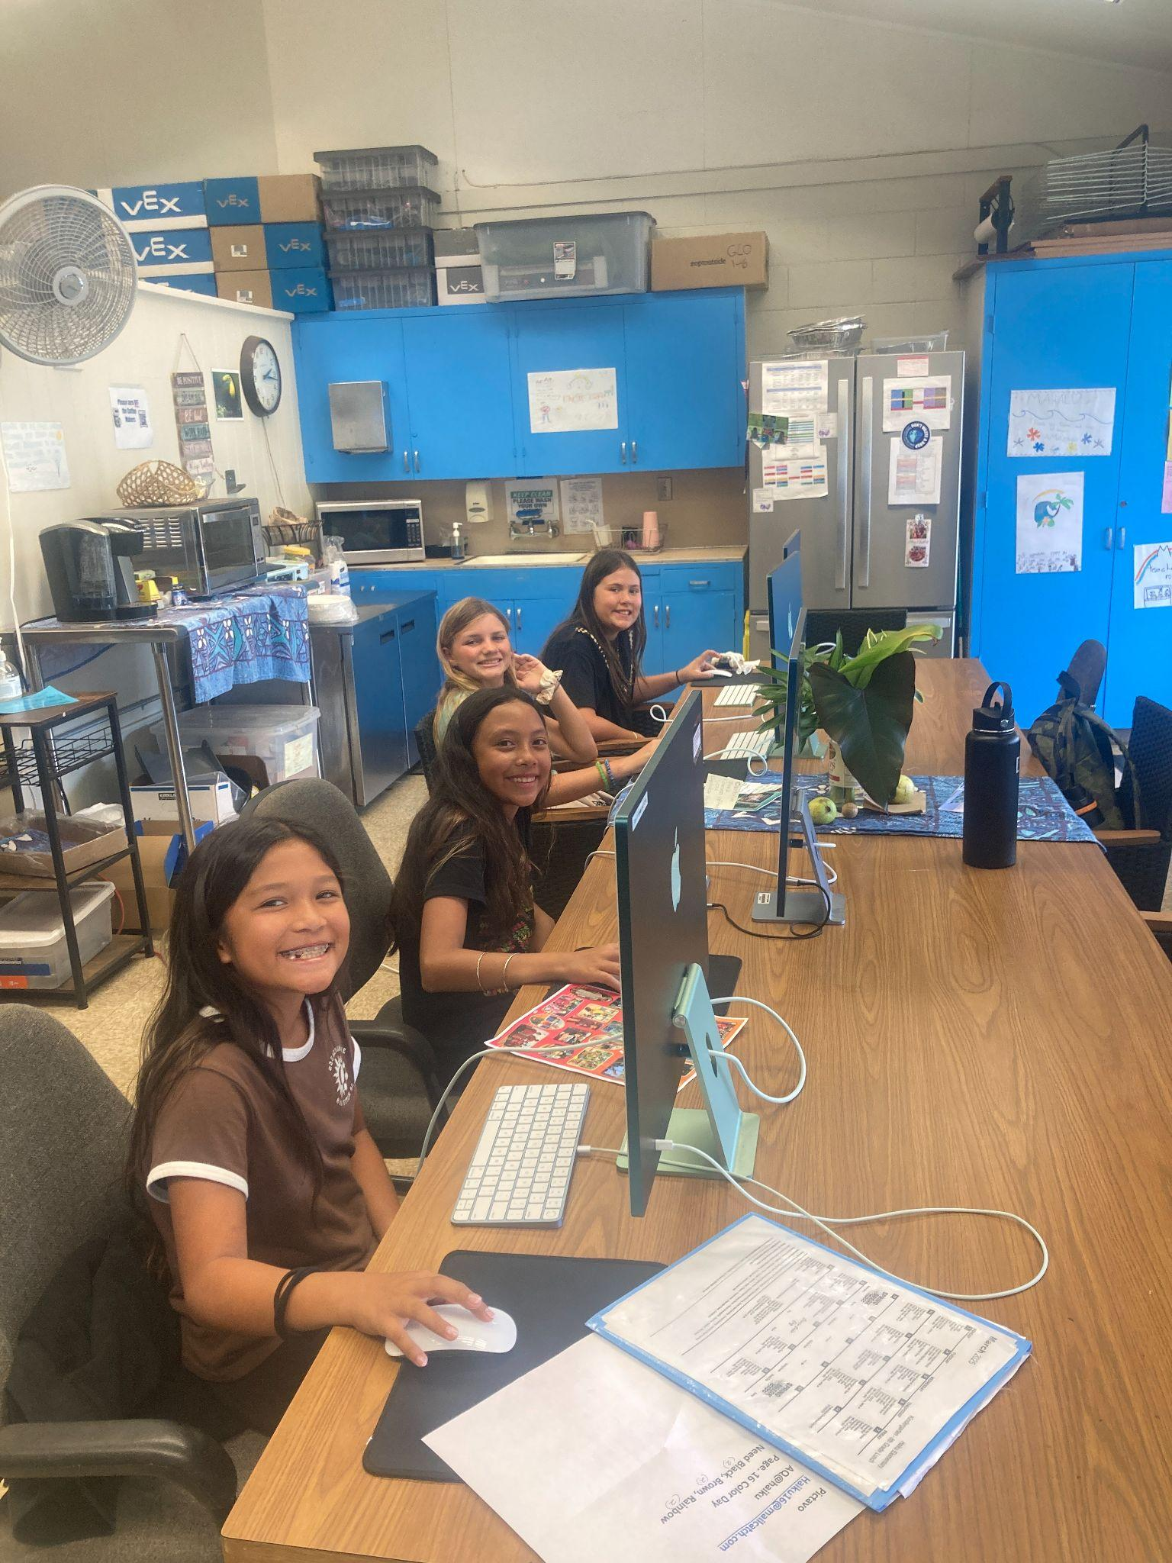
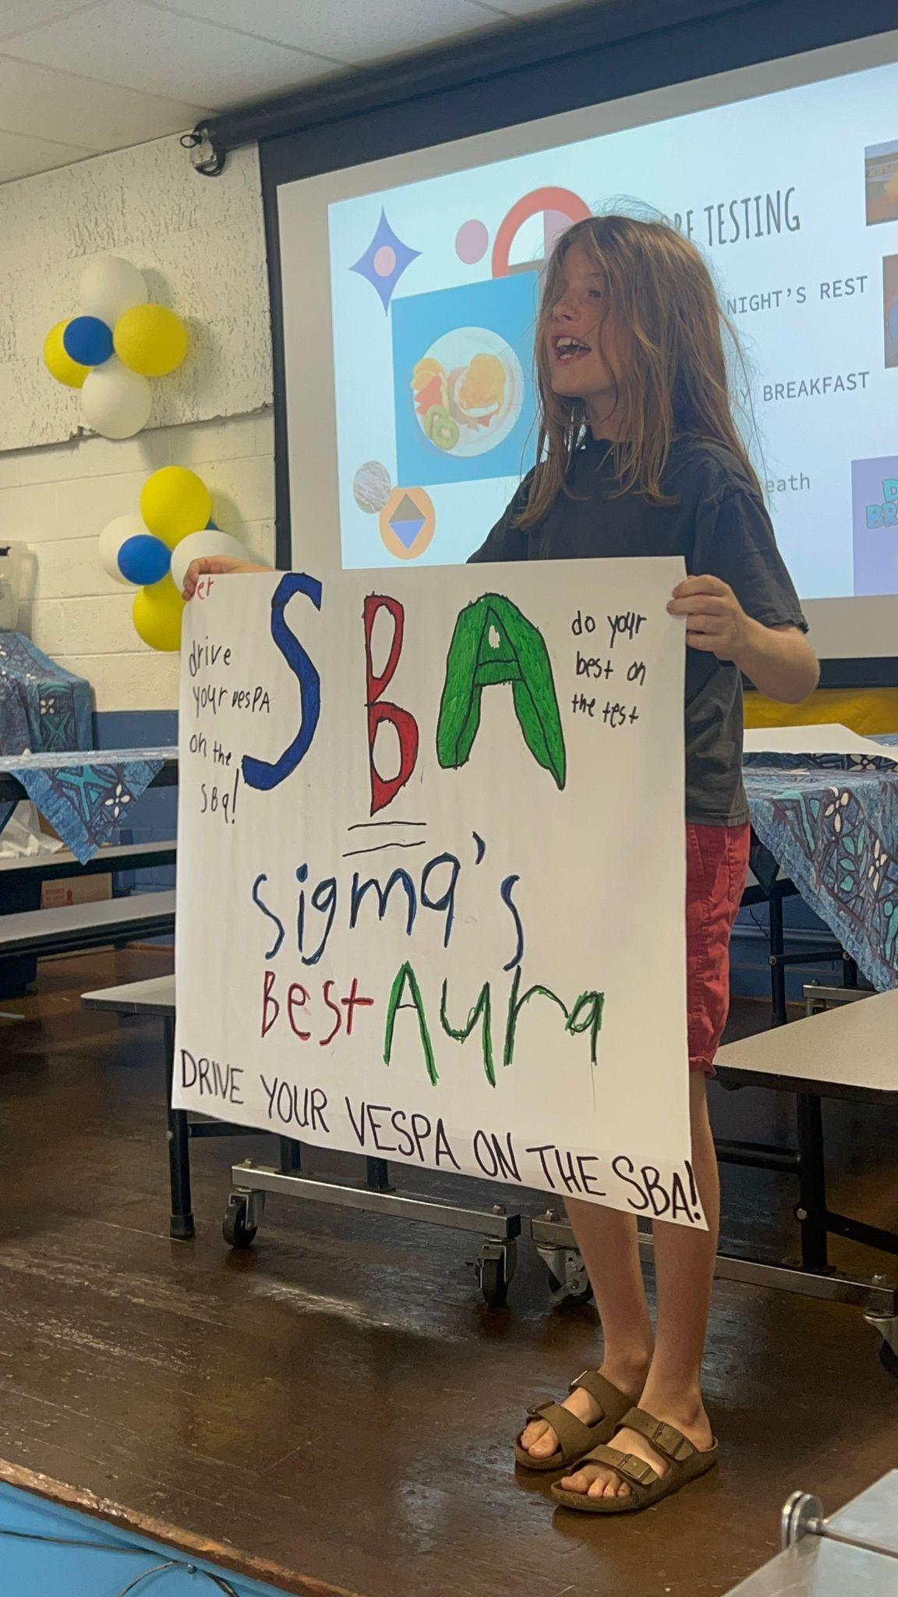



Student Voice Seen & Heard Around HAIKU SCHOOL
All teachers were invited to share additional examples of Haiku students living the 8 Conditions. The following slides reflect those contributions.
SENSE OF ACCOMPLISHMENT
Yearbook Club students working
hard to complete our school
Yearbook before the deadline
Confidence to Take Action
Girl Scout Cookie season sales at Haiku Marketplace & Talent Show
Voice & Choice In PBL
Annual second grade Food Drive to give back to our community

Slide 12



Belonging and
Fun & Excitement
KOKUA CLUB
ANIMANGA CLUB
Students keep our campus clean and take responsibility for trash pick up at recess
Students sign up quarterly to take part in Ms. Frost’s creative writing club
GIRL SCOUTS
RUN CLUB
We have 70 Girl Scouts in our Troop, most who attend our school
Students in Grades K-3 take part in Track

Slide 13

Belonging, Fun & Excitement, and Sense of Accomplishment
Fourth and fifth graders had an amazing basketball season!

Slide 14








LUNCH TALENT SHOWS! Students Are excited and eager to perform
Encouraging a
Sense of Purpose:
Leadership & Responsibility and Confidence to
Take Action
Whether students have a joke to share, show off their Talent, students exemplify how to keep lunch calm, entertaining, and enjoyable for all.
Lunch duty can often be challenging for administrators. This year we turned lunch into a fun place to be and provided students with the opportunity to try new things, overcome fears, turn into a hero, and practice their talents. This has created a positive buzz during lunch time. Students are often found rehearsing around campus, asking each day if we are sharing ‘Talents’ or ‘Jokes’ today at lunch. All students feel included, are given opportunities to shine and support one another.

Slide 15
SENSE OF ACCOMPLISHMENT & HEROES
Animanga.mov
Through Animanga Club, students learn about the creative writing process through reading, writing, drawing, anime, and more!
Students in Grades 1 through 5 sign up and get their creative juices flowing. Run by our first grade teacher, Ms. Frost!
Fostering Students' Engagement in Learning:
Fun & Excitement, Curiosity & Creativity, and Spirit of Adventure

Slide 16









Belonging at EOEL Preschool
Deputy Lieutenant Governor, Sylvia Luke stopped by to read to our EOEL Preschoolers, along with Senator Lynn Decoite yesterday. Students shared their butterfly songs with her after she read The Very Hungry Caterpillar. These new little members of our school community have been a great addition to our campus. Their Sense of Belonging is just beginning.

Slide 17
Our Future Plans for Student Voice
Continue working on our GROW AREAS:
Sense of Accomplishment
My teacher hangs up my work in the hallway or classroom.
Heroes
Teachers care if I am absent.
Students respect teachers.
Students help each other at my school.
Students respect each other.
Belonging
Bullying is a problem at my school.
Other students are kind to me.
I feel important in my classroom.

Slide 18
RESOURCES & IMPLEMENTATION
Our Student Voice Cohort met Quarterly to map out implementation, pacing, and planning.
Each Student Voice Cohort teacher member guided their team:
K/1 - Kornienko 2/3 - Plumley 4/5 - Harper
Weekly PLCs were provided for teachers to explore resources, & plan
their grade level lessons. Resources include SEL incorporated stories.
Wednesday school-wide Student Voice lesson block.
Student Voice successes, ideas, share -outs, and check-ins
presented to staff at Wednesday meetings monthly.
School-wide monthly pacing
Haiku Student Voice Implementation

Slide 19
Thanks for Exploring Our Student Voice Journey
Do you have any questions?
daria.boone@k12.hi.us
haikuschoolriders.org

