Slide 1




Curiosity & Creativity
Spirit of Adventure

Slide 2
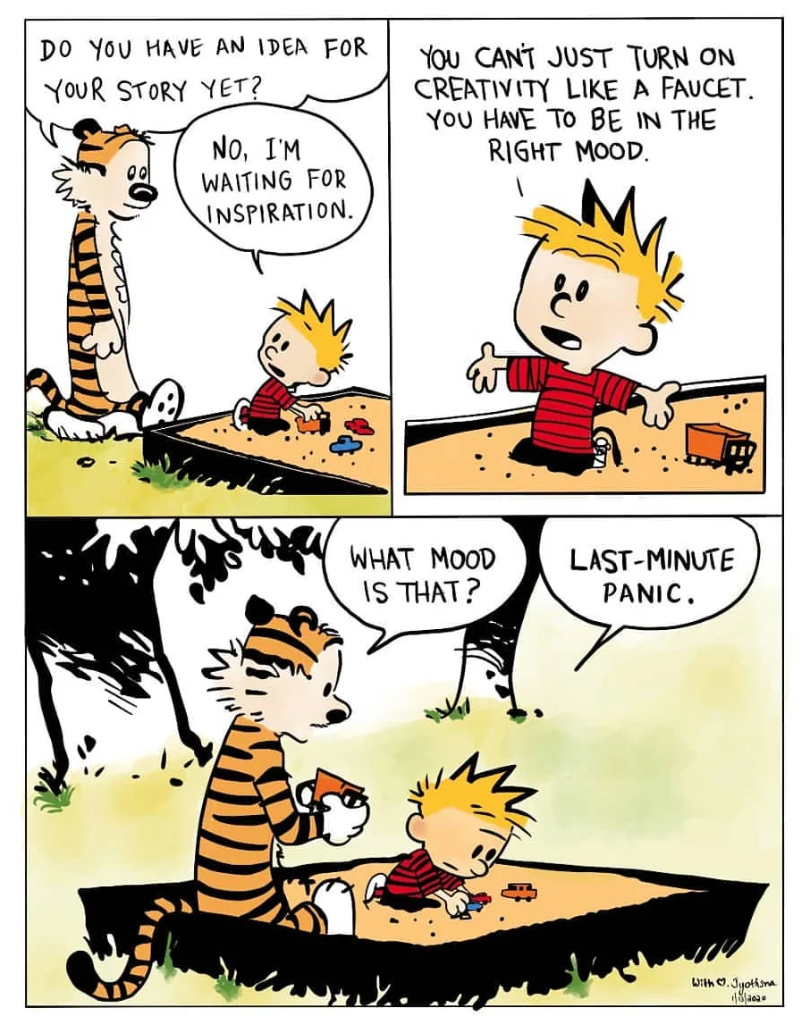
Curiosity & Creativity

Slide 3
Curiosity & Creativity
Being inquisitive, eager, & intellectually engaged while having a strong desire to
learn new or interesting things.

Slide 4
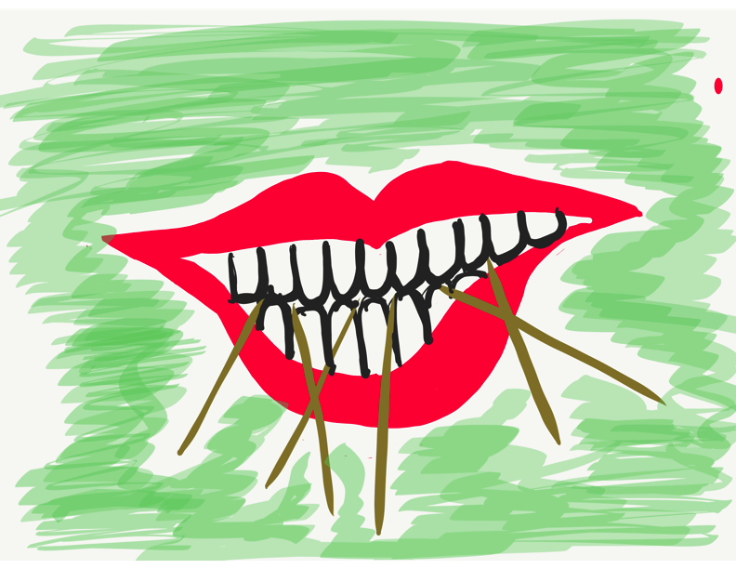
Toothpick Challenge
Using 6 toothpicks,
make 4 & only 4 equilateral triangles
(all 3 sides the same size).
You may not break or the toothpicks.

Slide 5
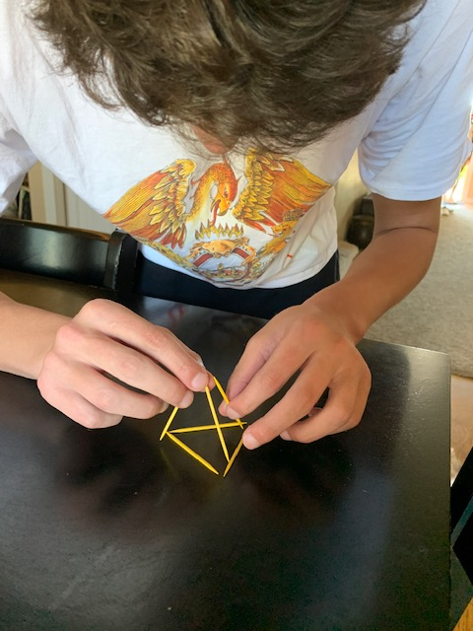
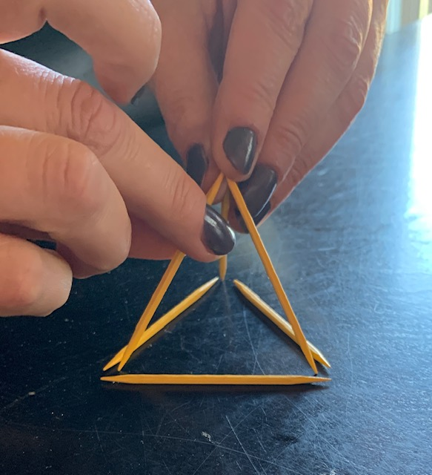
Toothpick Challenge

Slide 6
Curiosity & Creativity
Why is it so challenging for many
people to
”think outside of the box?”
What school, community or world
problem do you think could be solved with people thinking more creativity?

Slide 7

Where Does Your Curiosity Lead?
Vimeo:
https://vimeo.com/1179957559/4f8ae33618
YouTube:
https://youtu.be/5w_hAzwvm7E
Video

Slide 8
Creativity Challenge
In groups of 3, you will have 2 minutes per slide to develop a creative description of these everyday items.

Slide 9
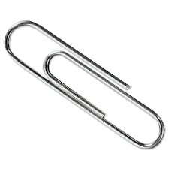
Creativity Challenge
Example
This might look like a paperclip, but it is an alien
communication device. When it is stretched out aliens can communicate with home, when it looks like a paperclip it is in sleep mode.

Slide 10
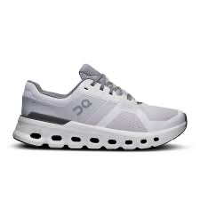
Creativity Challenge
What is this & how can it be used?

Slide 11
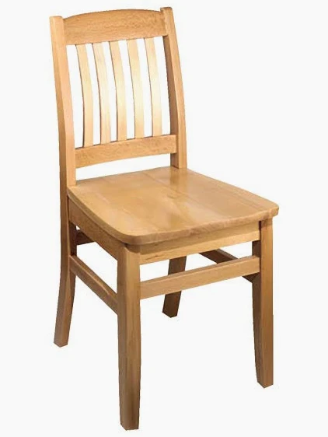
Creativity Challenge
What is this & how can it be used?

Slide 12

Creativity Challenge
What is this & how can it be used?

Slide 13

Creativity Challenge
What is this & how can it be used?

Slide 14
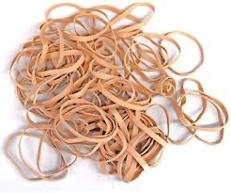
Creativity Challenge
What is this & how can it be used?

Slide 15
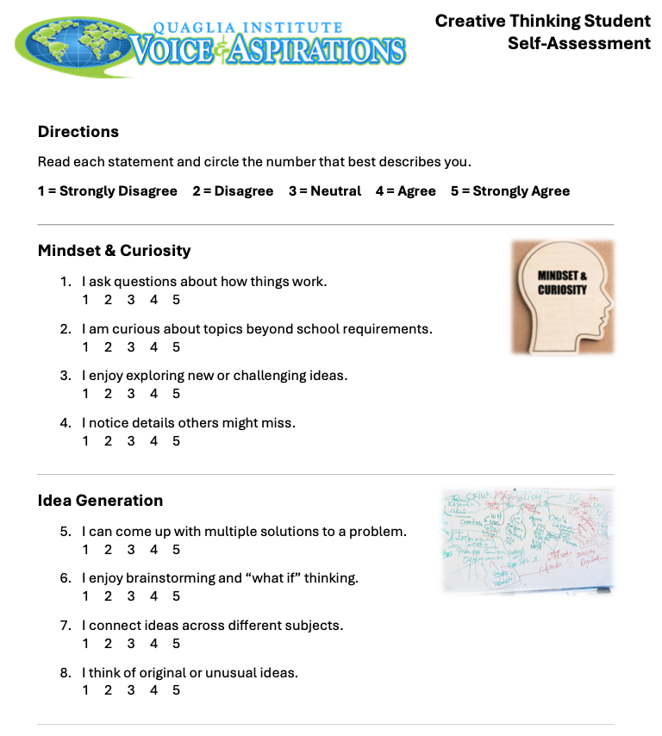
Creativity Self-Assessment
Check your level
of creativity.
What can you do to
be more creative?

Slide 16

Spirit of
Adventure
Being excited to try new things even when you aren’t sure you will be good at them. Taking positive, healthy challenges to tackle something new.

Slide 17

Team Ball Challenge
We need 6-8 volunteers.
Warm Up: Toss the ball around the group to establish a passing order. Everyone in the group must touch
the ball once.

Slide 18
Team Ball Challenge
Goal: As a team, pass 3 balls through your established passing order as quickly as you can.
Rules: Maintain the same passing order & everyone
must touch all 3 balls.
Time begins when the first ball is tossed & ends when all 3 balls are back to the starting person.

Slide 19
Team Ball Challenge
Any ideas from the audience or team members on
how you could improve your time & do it faster?
Take Two! Good luck beating your first time!

Slide 20
Team Ball Challenge
Any ideas from the audience or team members on
how you could improve your time & do it faster?
Remember…the only rules are to maintain the same
passing order & everyone must touch all 3 balls.
Last chance! Try to make this your fastest time yet!

Slide 21
Reflect & Discuss
When did it click that you could do
something different to improve your time?
Spirit of Adventure is about taking on healthy
challenges & not just doing what is easy,
quick or obvious.

Slide 22
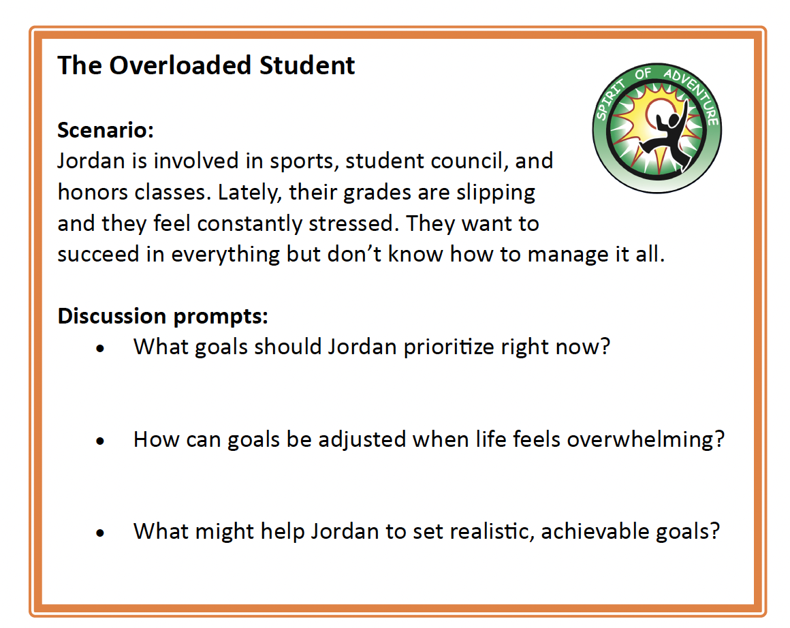
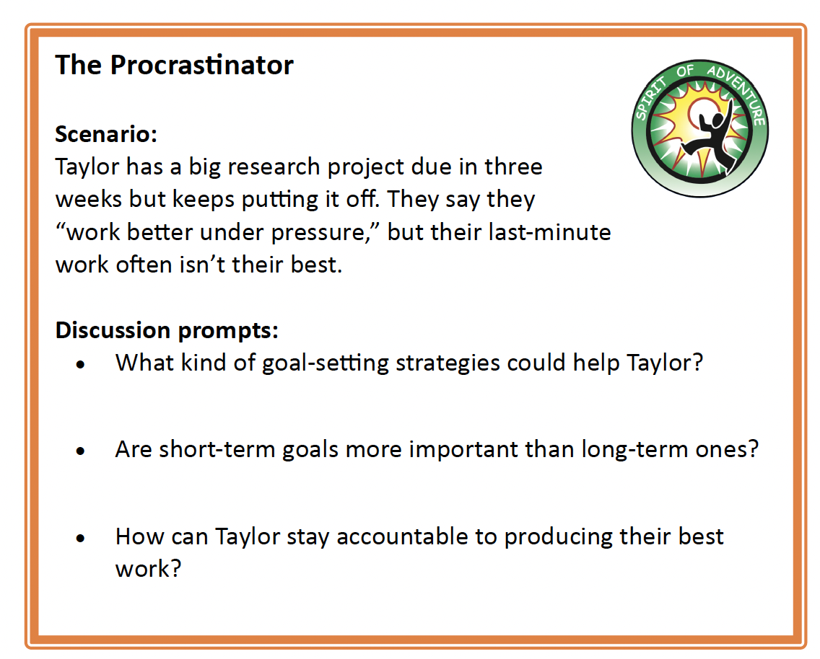
Spirit of Adventure
Scenarios
In small groups discuss the provided scenarios

Slide 23
Goal Setting
Goal setting is fundamental to Spirit of
Adventure. Goal setting helps us take
positive risks & create a roadmap for
success.

Slide 24
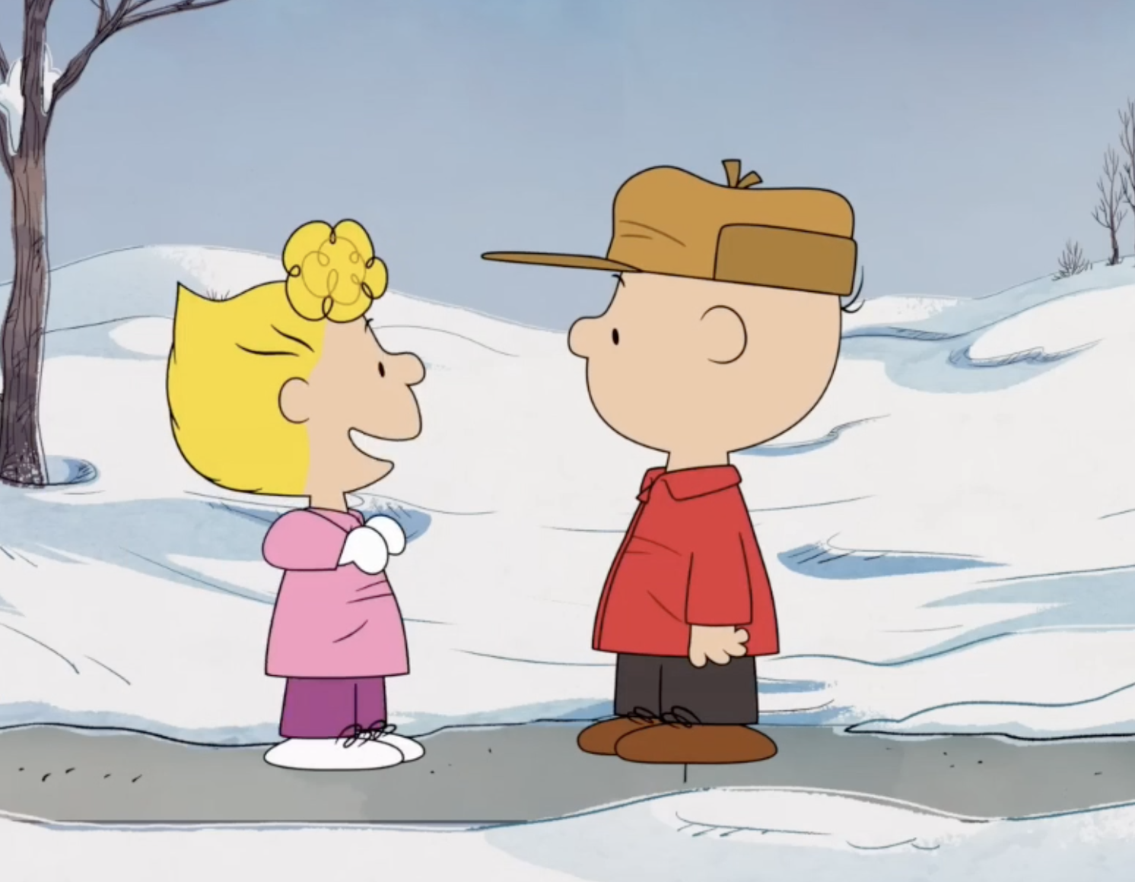
Spirit of Adventure: Goal Setting
Vimeo:
https://vimeo.com/1179957255/c03311e8bb
YouTube:
https://youtu.be/KZ6TMgHe4m0
Video

Slide 25

Goal Setting Recipe
In small groups create a recipe for successful goal setting.
What are the ingredients?
How long will it take?
What is the name of your recipe?

Slide 26
Spirit of Adventure
What healthy/positive risk are you willing
to take at school this month?
Risk isn’t about being reckless—it’s about being
willing to try, make mistakes along the way, & persevere
to move forward. That’s where growth happens.
What are the ideal outcomes of the healthy/positive risk you are willing to take? What will you do if you
aren’t immediately successful?

Slide 27
Curiosity & Creativity
Spirit of Adventure

